Slide 1
BULGARIA
PowerPoint made by : Pantelis Kolias

Slide 2
T O P I C S T O B E D I S C U S S E D

Slide 3
T O P I C S T O B E D I S C U S S E D
01
GENERAL FACTS
GEOGRAPHY & SIZE
POLITICAL SYSTEM
PLACE ON THE MAP
HISTORY
ECONOMY

Slide 4
T O P I C S T O B E D I S C U S S E D
01
GENERAL FACTS
02
BULGARIA & THE EU
GEOGRAPHY & SIZE
POLITICAL SYSTEM
PLACE ON THE MAP
HISTORY
ECONOMY
WHEN & WHY
CHANGES & REFORMS
ACCOMPLISHMENTS
POLITICAL PARTIES

Slide 5
T O P I C S T O B E D I S C U S S E D
01
GENERAL FACTS
02
BULGARIA & THE EU
03
CRISIS
GEOGRAPHY & SIZE
POLITICAL SYSTEM
PLACE ON THE MAP
HISTORY
ECONOMY
WHEN & WHY
CHANGES & REFORMS
ACCOMPLISHMENTS
POLITICAL PARTIES
RULE OF LAW & CORRUPTION
RUSSIAN & UKRAINE WAR
VETO TO AND FROM

Slide 6
T O P I C S T O B E D I S C U S S E D
01
GENERAL FACTS
02
BULGARIA & THE EU
03
CRISIS
04
EUROSCEPTICISM
GEOGRAPHY & SIZE
POLITICAL SYSTEM
PLACE ON THE MAP
HISTORY
ECONOMY
WHEN & WHY
CHANGES & REFORMS
ACCOMPLISHMENTS
POLITICAL PARTIES
RULE OF LAW AND CORRUPTION
RUSSIAN & UKRAINE WAR
VETO TO AND FROM
POLITICAL PARTIES
PEOPLE
FUTURE OF BULGARIA

Slide 7
Capital
Geographical Area
Population
National Day
Official Language
Capital
Geographical Area
Population
National Day
Official Language
Sofia
110.994 km²
6.4 Million
3rd of March
Bulgarian
Size
Ranking
EU Population
Political System
SMALL MEMBER STATE
15TH amongst EU
1.4 %
Parliamentary Democracy

Slide 9
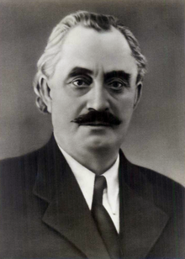
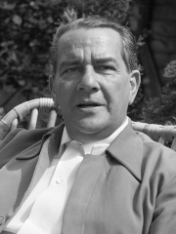
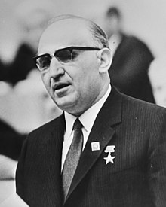
F
HISTORY
1396-1878 : Part of the Ottoman Empire
- 1875 – 1876 : Uprising & National Awakening
- 1877-1878 : Russo – Turkish War
- 1878 : Saint Stefano Treaty & Treaty of Berlin
1908 : Independence
4 BIG WARS
1912 – 1914 : First & Second Balkan War
1st - Balkan Union vs Ottoman Empire
2nd - Bulgaria vs Allies & Romania
1914 – 1918 & 1939 – 1945 : WW1 & WW2
1st - Sided with the Central Powers
2nd - Sided with Germany despite the efforts of keeping its neutrality
F
STALINIZATION
- 1943 : From Bulgarian Empire to People’s Republic of Bulgaria
- 1946 – 1949 : Georgi Dimitrov
- 1950 – 1956 : Valko Velyov Chervenkov
F
DESTALINIZATION
- 1954 – 1989 : Todor Zhivkov - Leader of the People’s Republic of Bulgaria
- 1955 Joined the Warsaw Pact
- Overthrow of the Regime led to the Bulgarian Republic of today

Slide 10
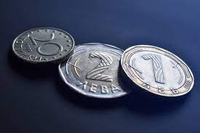
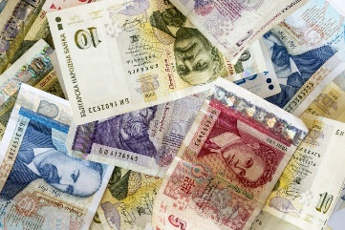
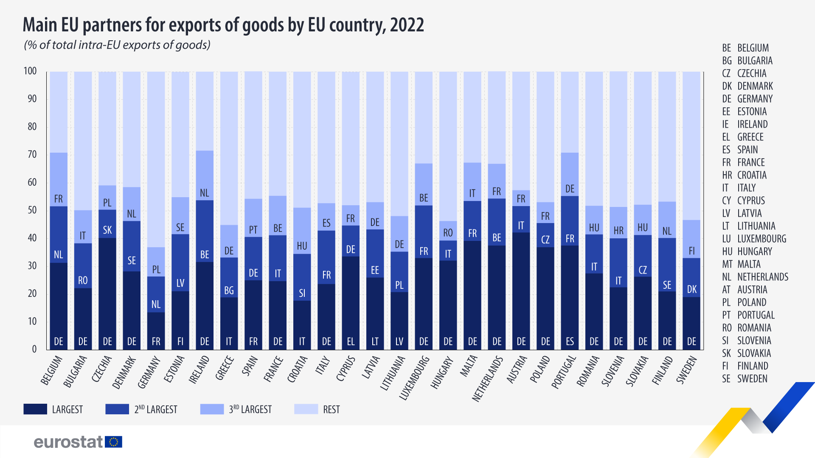
ECONOMY
Top 3 Partner in Exports within EU – 50% in 2022
EU COMMISION STATISTICS 2023
BULGARIA EU
GDP GROWTH 2.0% 3%
INFLATION 8.8% 4.3%
UNEMPLOYMENT 3.9% 6.5%
National Currency - Bulgarian Lev
GPT per Capita – 56% ( Lowest in the EU)
National Debt – 22.9 Million ( 2nd lowest in the EU )

Slide 11
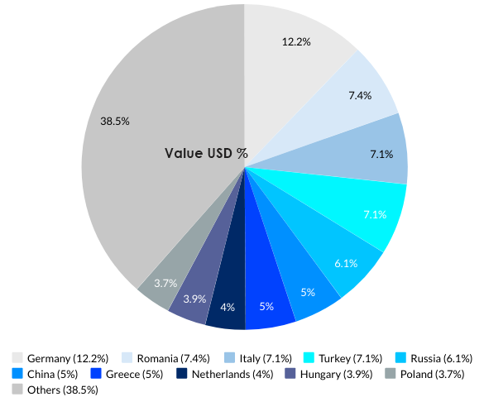
INPORTS - EXPORTS
GERMANY LEADS BOTH IN EXPORTS AND IMPORTS
TOP 5 : ROMANIA , RUSSIA , ITALY , TURKEY , GERMANY
RUSSIA 5TH IN EXPORTS AND 2ND IN IMPORTS
EU COUNTRIES - IMPORTS 61% / EXPORTS 66%

Slide 12
BULGARIA & THE EU

Slide 13
WHEN & WHY
ECONOMIC IMPROVEMENT
- Access to the Single market
- Big opportunities to investments
Formal application for membership on 14th December 1995
Joined the EU on 1st of January 2007
WHY?
EUROPEAN IDENTITY
- Socialist - > European
SAFETY & SECURITY
- Russia
RULE OF LAW & DEMOCRACY CONSOLIDATION
- EU = ‘Watch – Guard’
- Anti – Corruption Support

Slide 14
CHANGES AND REFORMS
In order to join, Bulgaria had to adapt to the Eu requirements :
STREGHTEN THE RULE OF LAW
RESPECT OF HUMAN RIGHTS
REFORMS IN THE ROLE OF MARKET ECONOMY
ENSURE DEMOCRATIC INSTITUTION
AUTHORITY TREATMENT
DOMESTIC VIOLENCE
DICRIMINATION
JUIDICIAL SYSTEM
FIGHT AGAINST CORRUPTION
LIBERALIZATION OF ECONOMY
POLITICAL STABILITY

Slide 15
ACCOMPLISHMENTS
Joined NATO in 2004
Joined EU in 2007
?
Eurozone and Schengen Treaty

Slide 16
POLITICAL PARTIES
Movements For Rights And Freedoms ( DPS )
- Liberal Party , Ahmed Dogan
- Interest of Turkish and Romani minorities
Bulgarian Socialist Party For Bulgaria ( BSPzB)
- Centre – Left / Social Democratic Party , Korneliya Ninova
There is Such People ( ITN )
- Populist / Anti – Corruption Party , Slavi Trifonov
- Similarities to GERB
Citizens For European Development of Bulgaria ( GERB )
-Conservative Party , Boyko Borisov
Union Of Democratic Forces ( SDS )
- Conservative / Christian Democratic Party , Rumen Hristov
- Political Coalition with GERB
Democratic Bulgaria ( DB )
- Liberal Party , Hristo Ivanov & Atanas Atanasov & Vladislav Panev
- Coalition of 3 parties : Democrats For A Strong Bulgaria , Yes Bulgaria and Green Movement
We Continue The Change ( PP )
- Centrist / Anti – Corruption Party , Kiril Petkov & Aser Vasilev
- Political Coalition with DB
Revival
- Far Right Party , Kostadin Kostadinov
- Split from the Bulgarian National Movement ( VMRO )
GENERAL FACTS
National Assembly consists of 240 Legislators
4% Threshold
17 members in the European Parliament

Slide 17
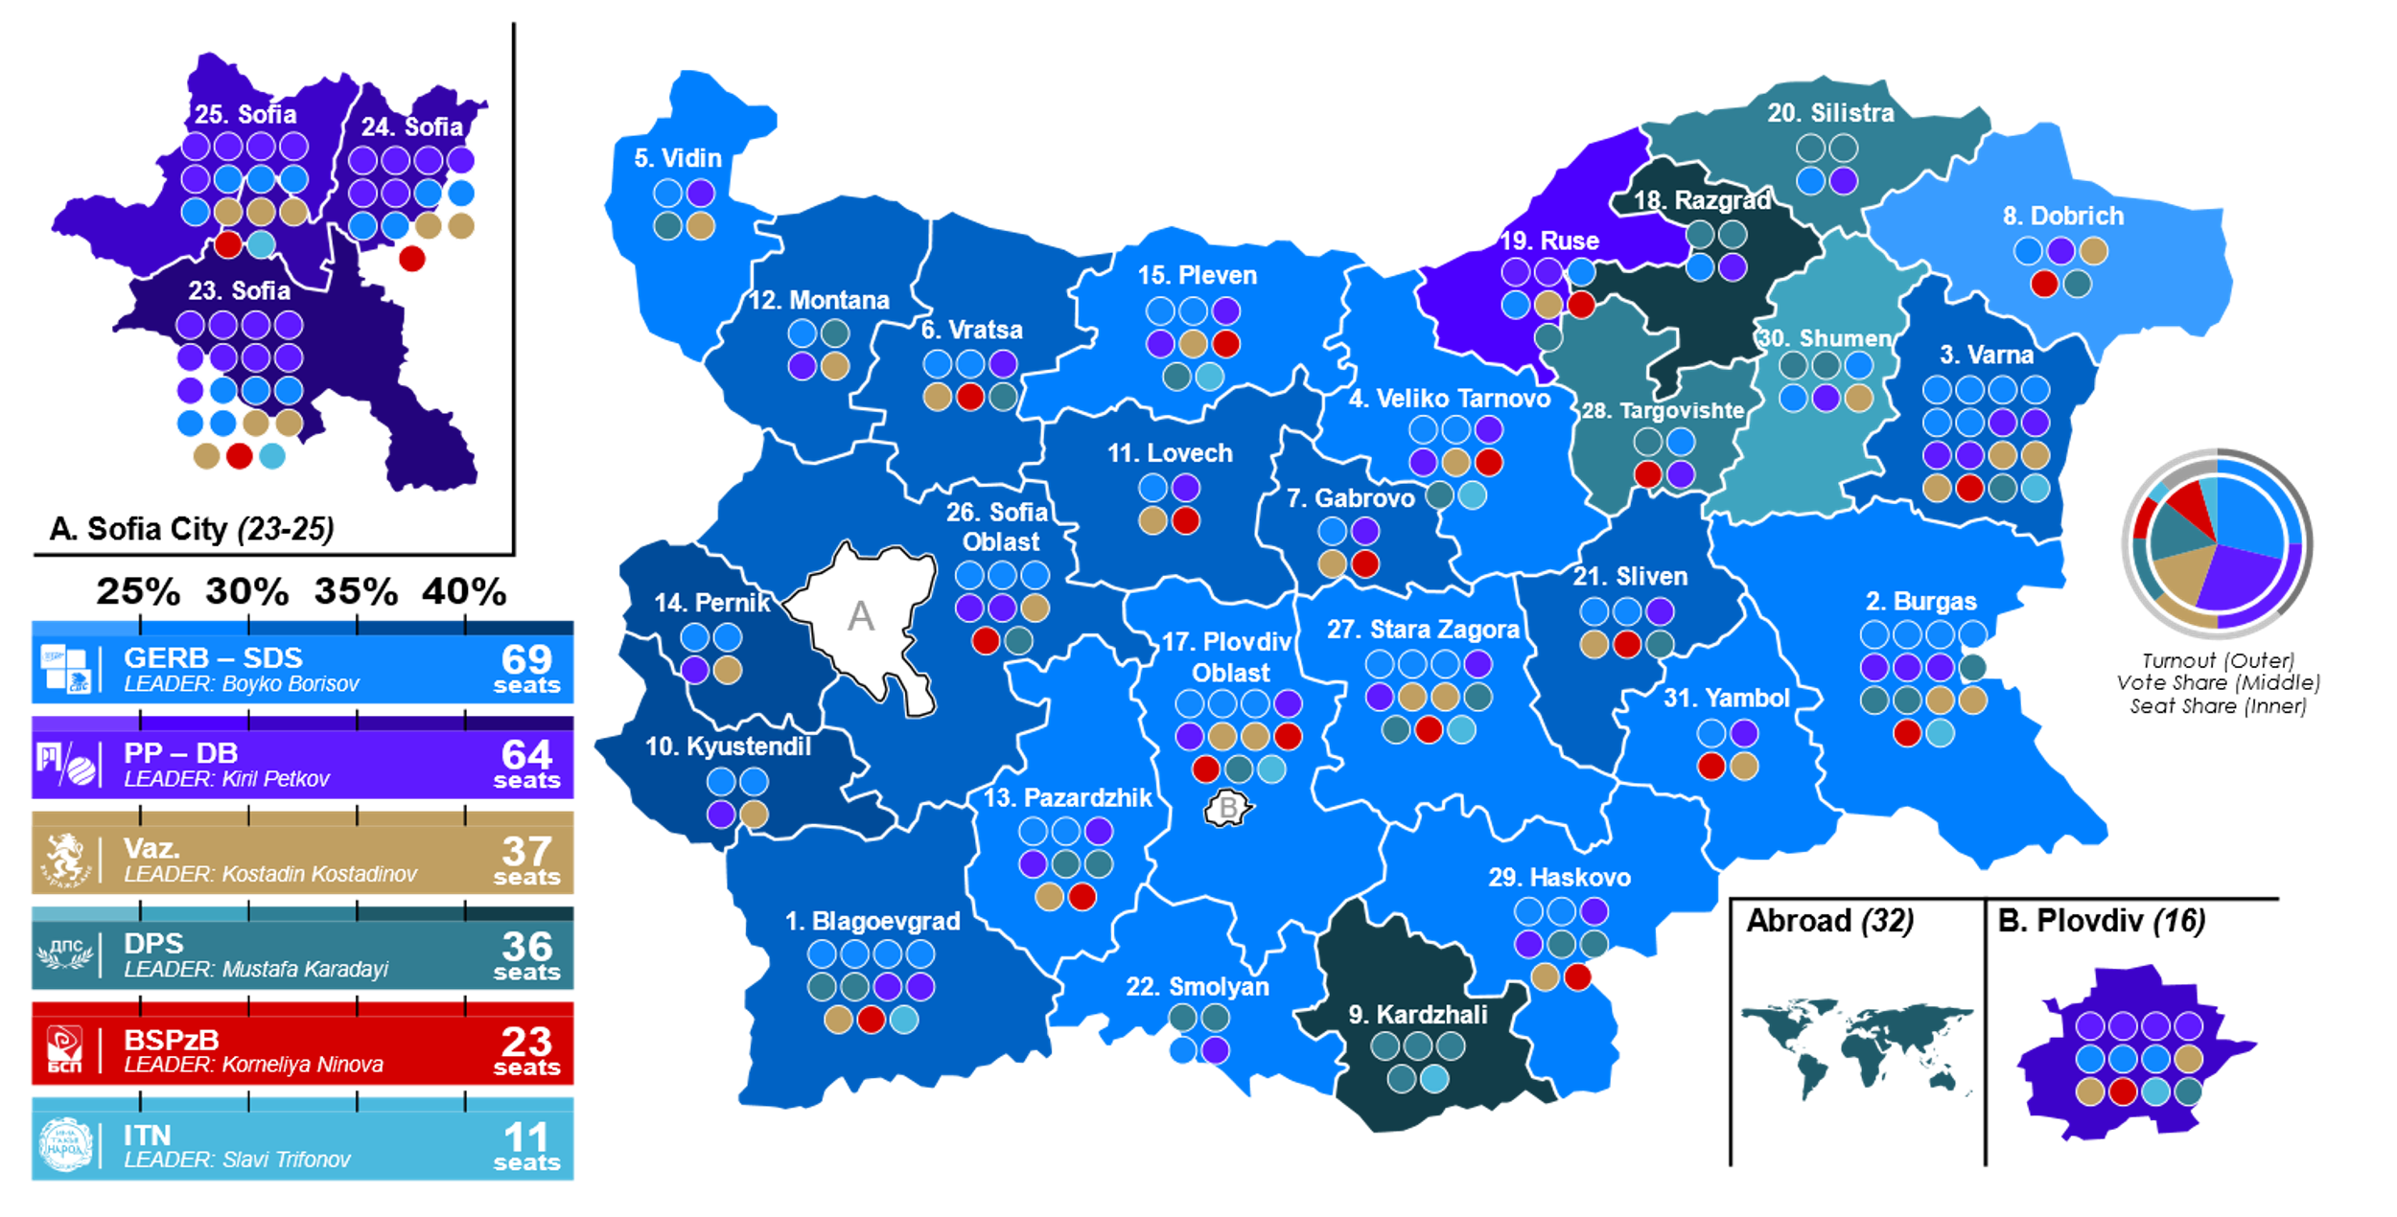
APRIL 2023 BULGARIAN ELECTIONS

Slide 18
EU PARLIAMENT ELECTIONS 2019 –17 SEATS
EPP = European People’s Party Group
- Centre - Right
S&D = Progressive Alliance of Socialists and Democrats
- Centre – Left
ALDE = Group Of Alliance Of Liberals And Democrats Of Europe
- Centre
ERC = European Conservatives & Reformists
- Right
GERB + SDS + DSB
BSP
DPS
VMRO
EPP
S&D
ALDE
ERC

Slide 19
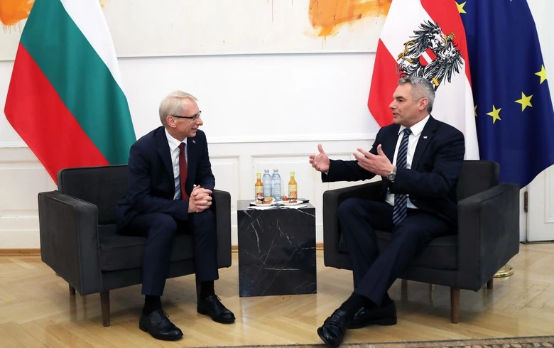
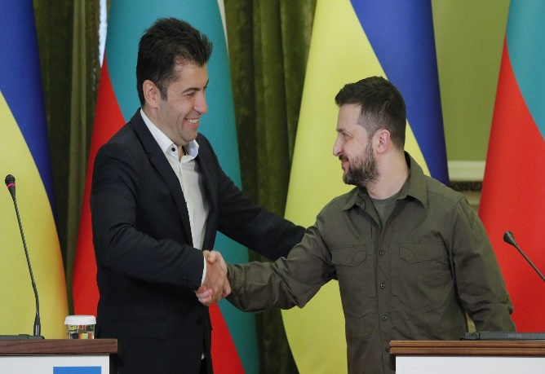
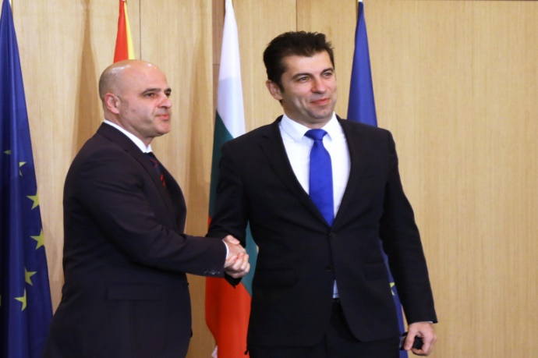
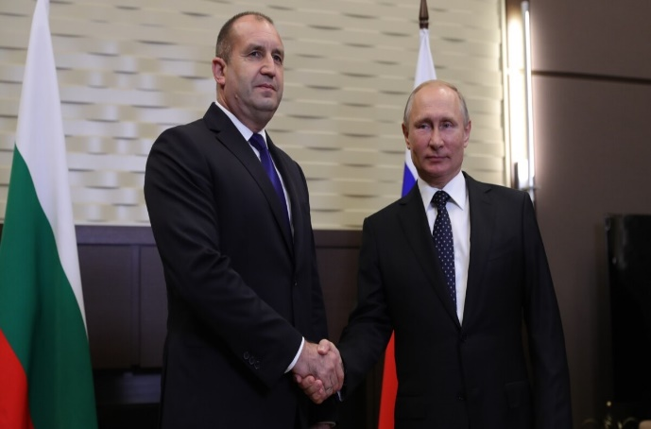
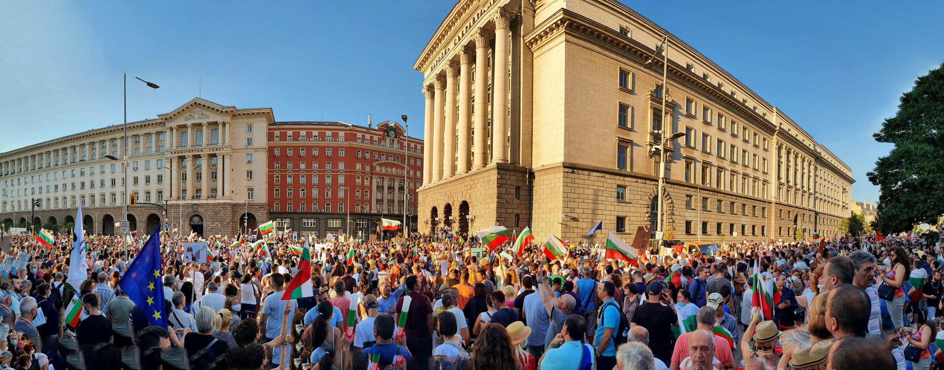
VETO TO AND VETO FROM
RUSSIAN – UKRAINE WAR
RULE OF LAW CRISIS

Slide 20
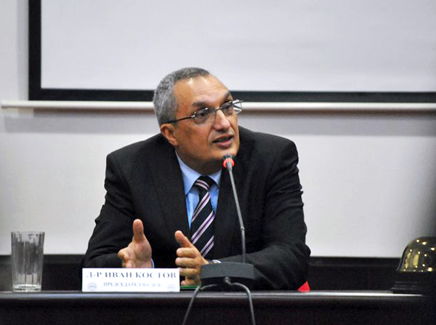
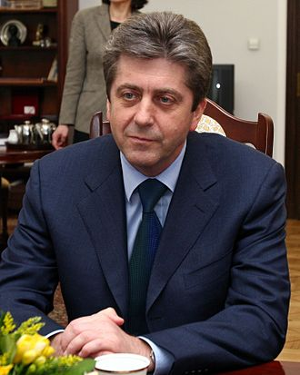
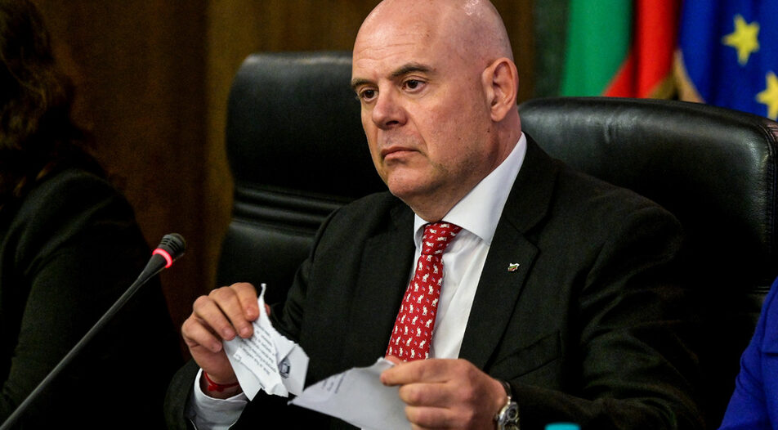
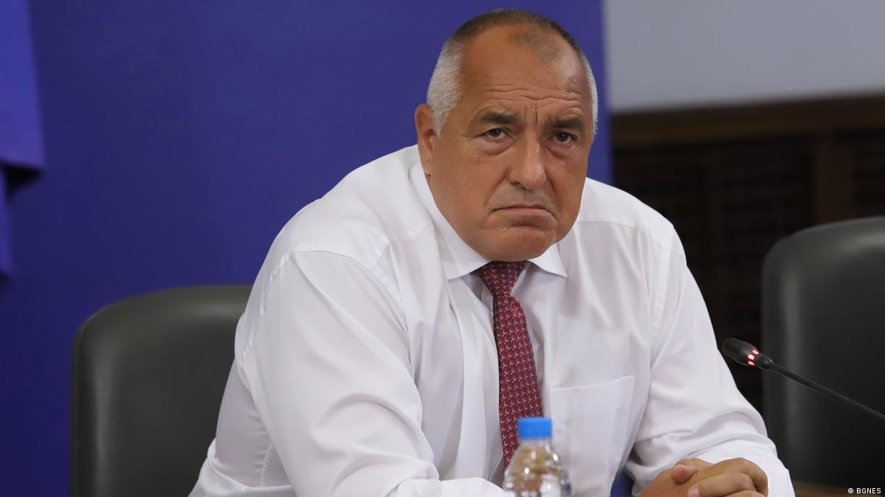
RULE OF LAW CRISIS
IVAN KOSTOV
Prime Minister from 1997 - 2001
IVAN GESHEV
Chief Public Prosecutor from 2019 - 2023
GEORGI PARNANOV
President from 2002 - 2012
BOYKO BORISHOV
Prime Minister from 2009 - 2021

Slide 21
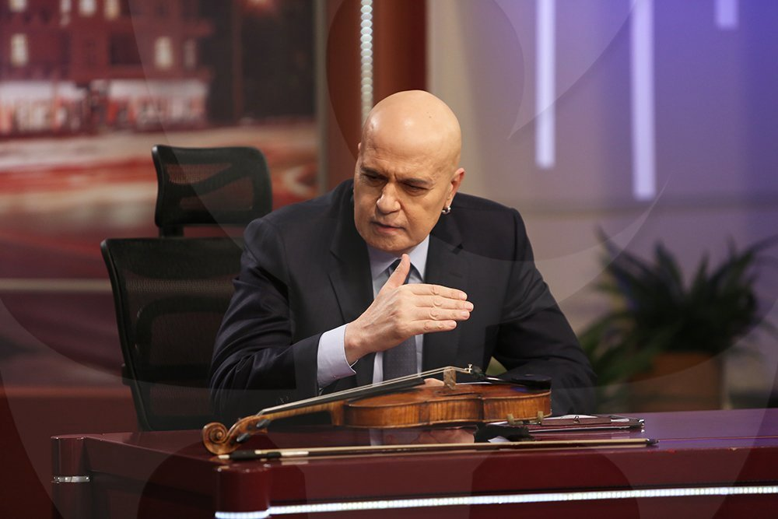
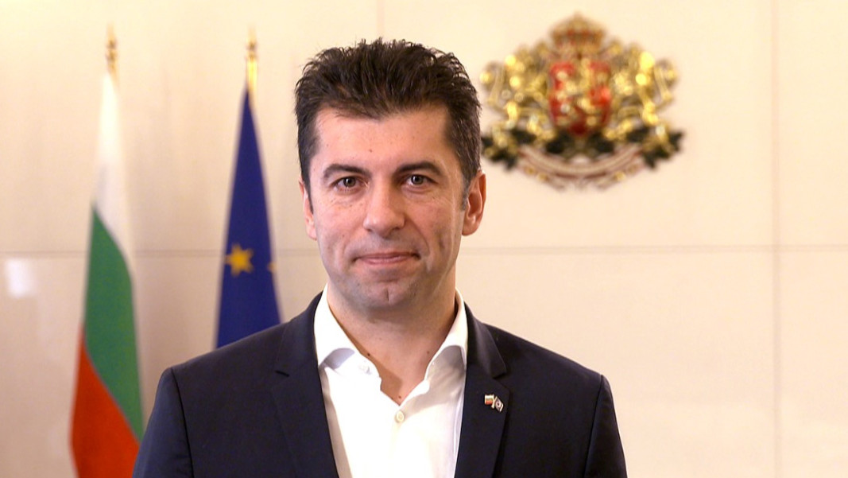
2021
APRIL 2021
GERB – 26% ( 75 SEATS)
COALITION REFUSAL FROM THE ANTI - CORRUPTION PARTIES
JULY 2021
ITN - 1st WITH 23.78% ( 65 SEATS )
COALITION REFUSAL FROM ITN
PROPOSAL FOR MINORITY GOVERNMENT
NOVEMBER 2021
PP – 1st WITH 25.32% ( 67 SEATS )
4 PARTY COALITION
ITN WITHRAWAL DUE TO DISAGREEMENTS ON SPENDING AND NORTH MACEDONIA EU ACCESSION

Slide 22
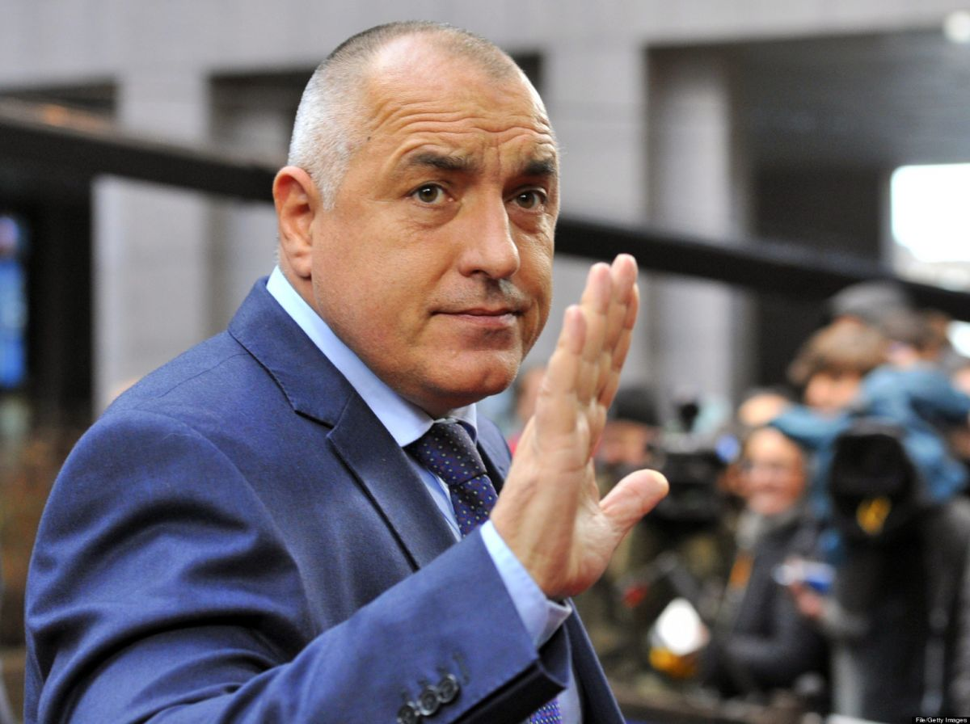
2022
2023
APRIL 2023
GERB - 25.39% ( 69 SEATS)
COALITION NEGOTIATIONS THAT LED TO A ‘ GRAND COALITION’
OCTOBER 2022
GERB – 24.48% ( 67 SEATS)
COALITION REFUSAL FROM THE ANTI - CORRUPTION PARTIES
GRAND COALITION PROPOSAL
GERB + PP / DB COALITION
132 SEAT MAJORITY
ROTATING PRIME MINISTER

Slide 23
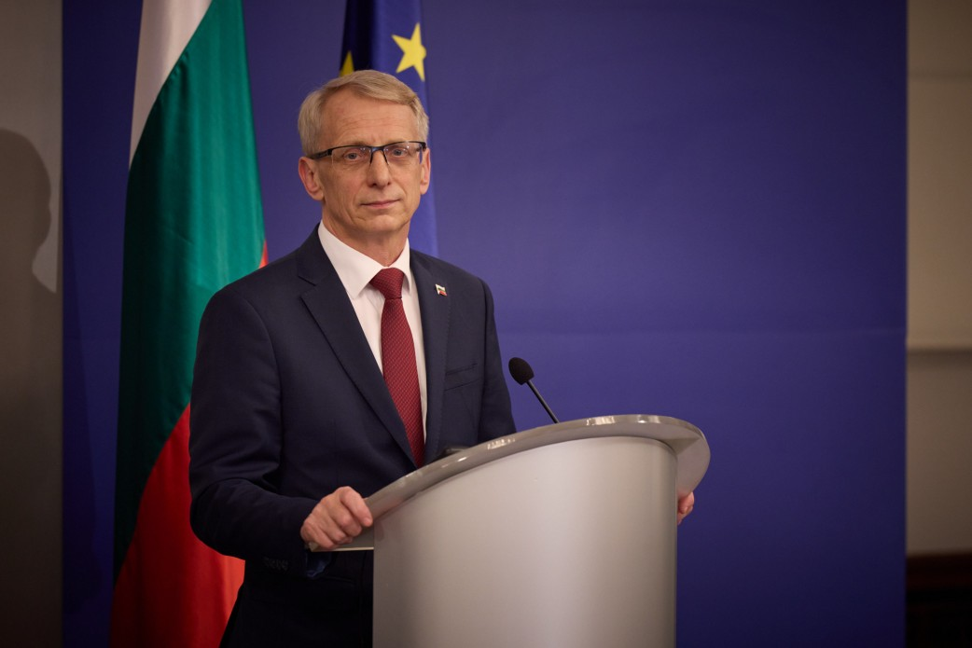
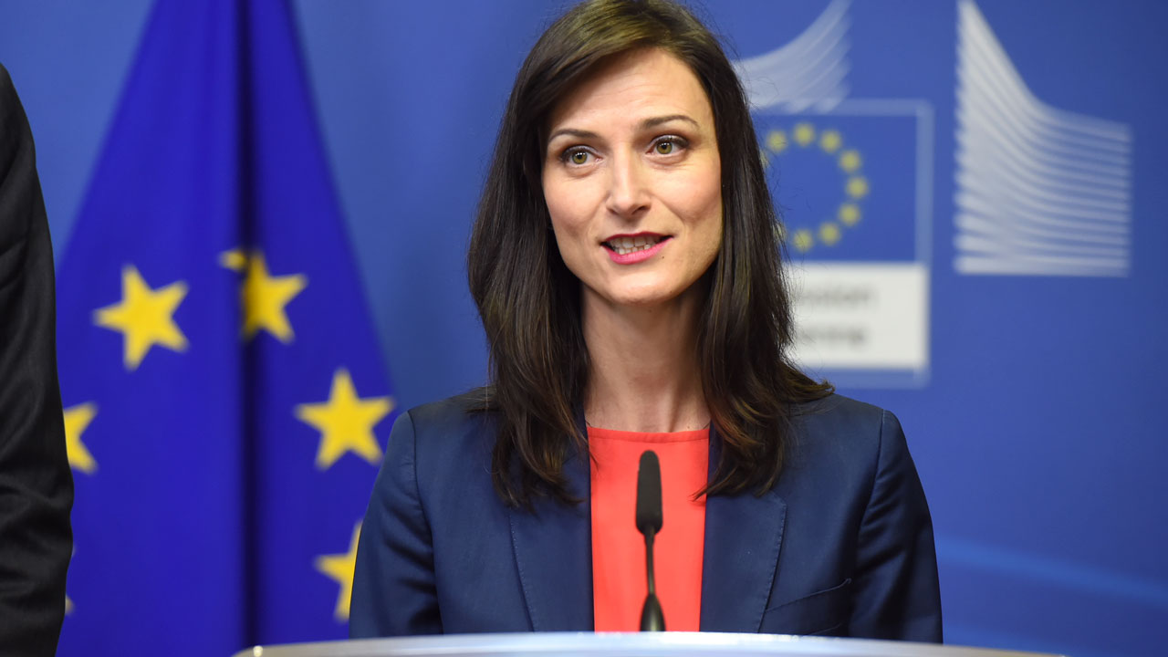
6TH JUNE 2023
A Government was approved by the Parliament
- > Coalition of GERB – SDS & PP / DB
ROTATING PRIME MINISTERS :
PP – DB’S Nikolay Denkov
GERB’S Mariya Gabriel
Priorities ?

Slide 24
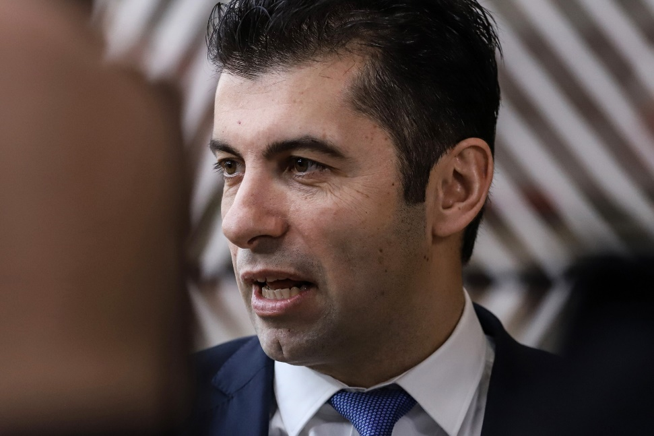
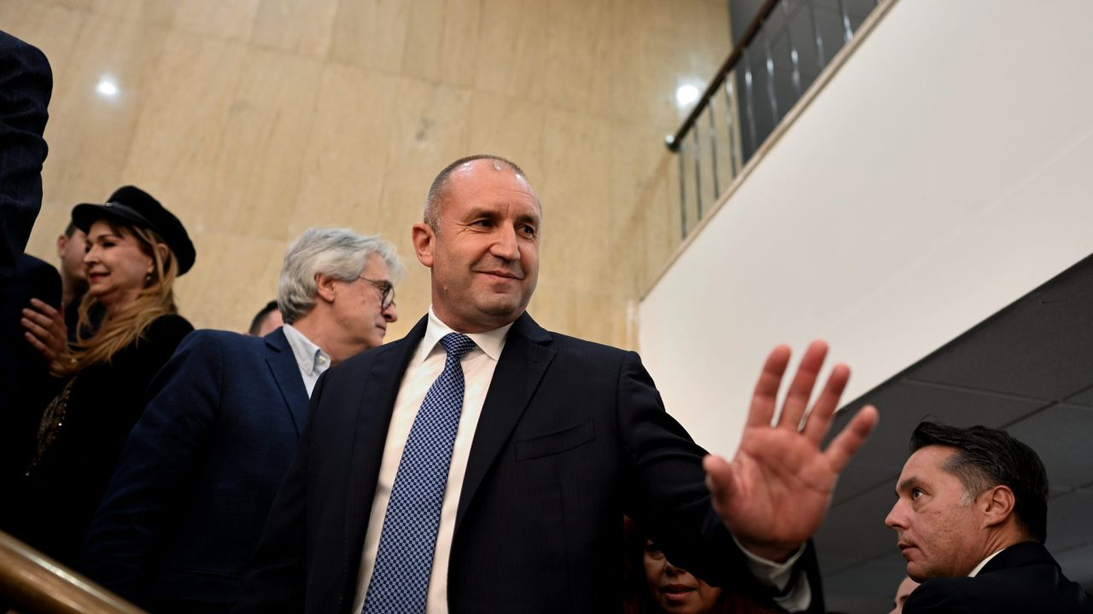
RUSSIAN – UKRAINE WAR
TAKE BACK CONTROL!
LATE MAY 2023
LEAKED CONVERSATION BETWEEN THE ANTI – CORRUPTION LEADERS
- Taking back control of the Security Services from President Radev, that still had ties with Kremlin (despite joining the EU and the NATO )
- Critical comments about GERB leaders
Most of Bulgaria’s political Parties are pro – western but….
Rumen Radev , the President of Bulgaria, is pro - Russian
Denied the Eu efforts of providing aid and arming Ukraine
Secret , ‘Indirect’ Bulgarian arms exports
NEARLY LED TO THE COLLAPSE OF THE COALITION

Slide 25
IMPOSING ECONOMIC SACTIONS AGAINST RUSSIA
2022 80% 2023 72%
2022 44% 2023 46%
EU - 27
BULGARIA

Slide 26
VETO TO NORTH MACEDONIA
Bulgaria supported North – Macedonia ever since its independence
Providing military aid and artillery and support to its EU path
BEST FRIENDS?
2019 Bulgaria Blocks North – Macedonia’s EU Accession
- Ethnic Macedonians - > Subgroup of the Bulgarian Nation
- Macedonian Language - > Not Separate but part of the Bulgarian Dialect
French proposal
Lift VETO ⬄ North Macedonia accepts Bulgarian’s Historical disputes
24th JUNE 2022
Bulgaria allows North Macedonia Pre-Negotiation Eu Accession Process but still doesn’t raise
the Veto unless the constitution includes also the Bulgarian minorities

Slide 27
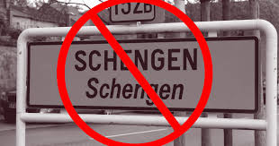
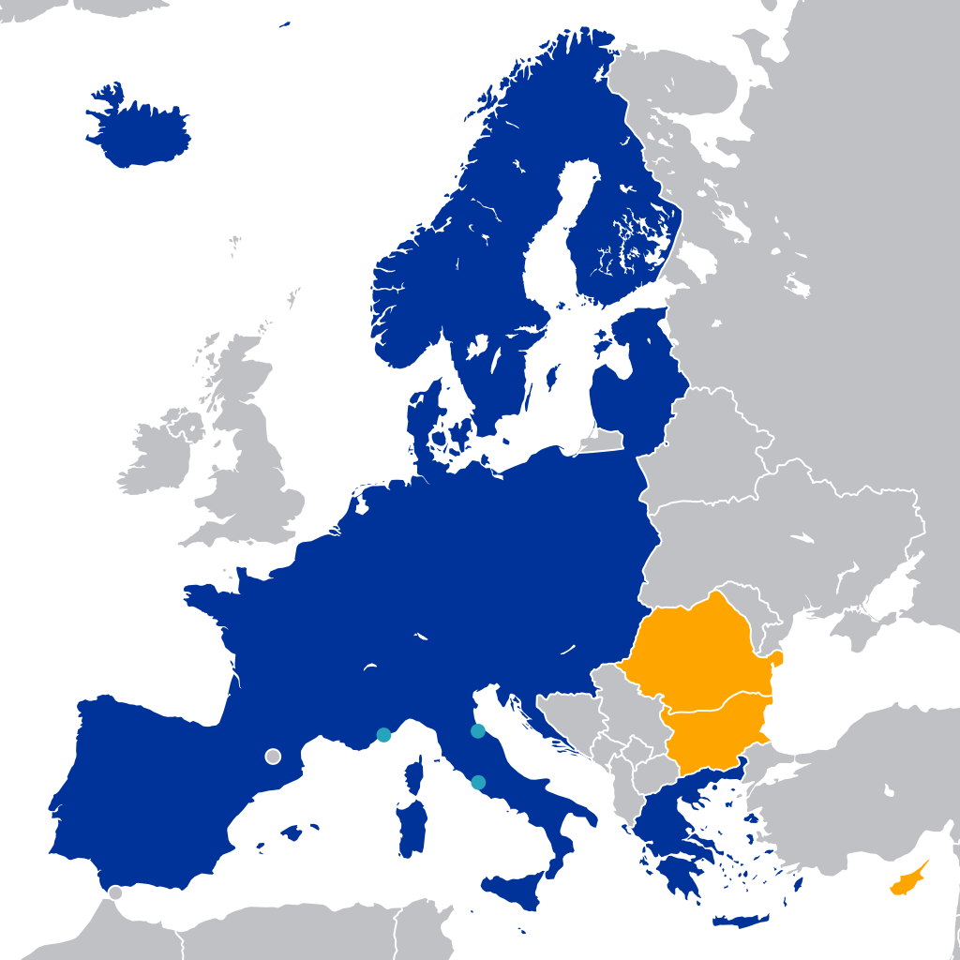
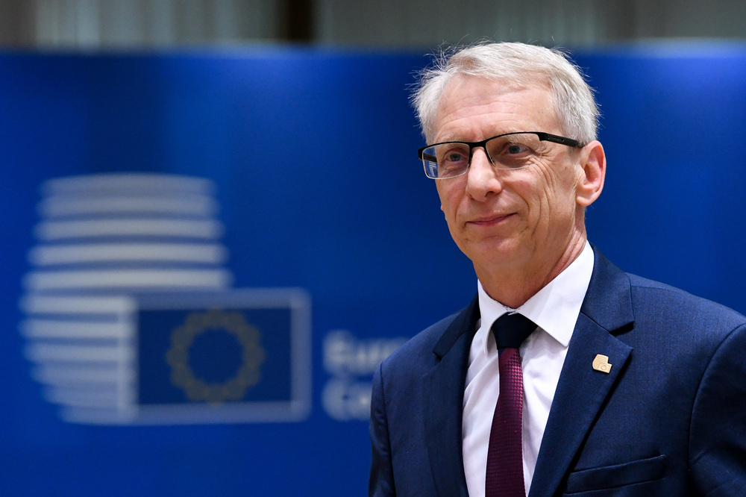
VETO FROM AUSTRIA
December 15th, 2023 - > Netherlands lift their Veto
December 8th, 2020 - > Vote between Schengen area members for Bulgaria / Romania / Croatia
December 28th, 2023 - > Austria agreement with Bulgaria
to ‘Partially’ join by March 2024
Netherlands & Austria Block Bulgaria - > Concerns about the ⇑ number of
Refugees via the Balkan Route
After 12 Years without much progress on Schengen, today we congratulate ourselves on this indisputable success of Bulgaria!
Partially = By Air & Sea
RO
BU

Slide 28
EUROSCEPTISICM

Slide 29
EUROSCEPTIC POLITICAL PARTIES
Hard Euroscepticism
Soft Euroscepticism

Slide 30
EUROBAROMETER STATISTICS - APRIL 2023

Slide 31
FUTURE

