Slide 1
BELGIUM
EU member

Slide 2
Structure
Fun Facts
About Belgium
History and security
Economy
Political system
Euroscepticism and public opinion
Impact of Covid-19
Current world crisis

Slide 3
Fun Facts
Record of days without government
Huge number of different kind of beers
Biggest tram network
Super bright road network
Birth place of fried potatoes

Slide 4
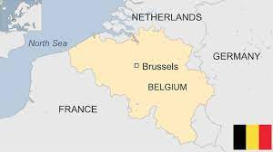
About Belgium
Capital: Brussels
Founder member of the EU (1958), part of Euro (1999) and Schengen Area(1995)
11,8 million people/2,63% of the EU population
3 different national languages
It is placed between Germany
and France (role in war)

Slide 5
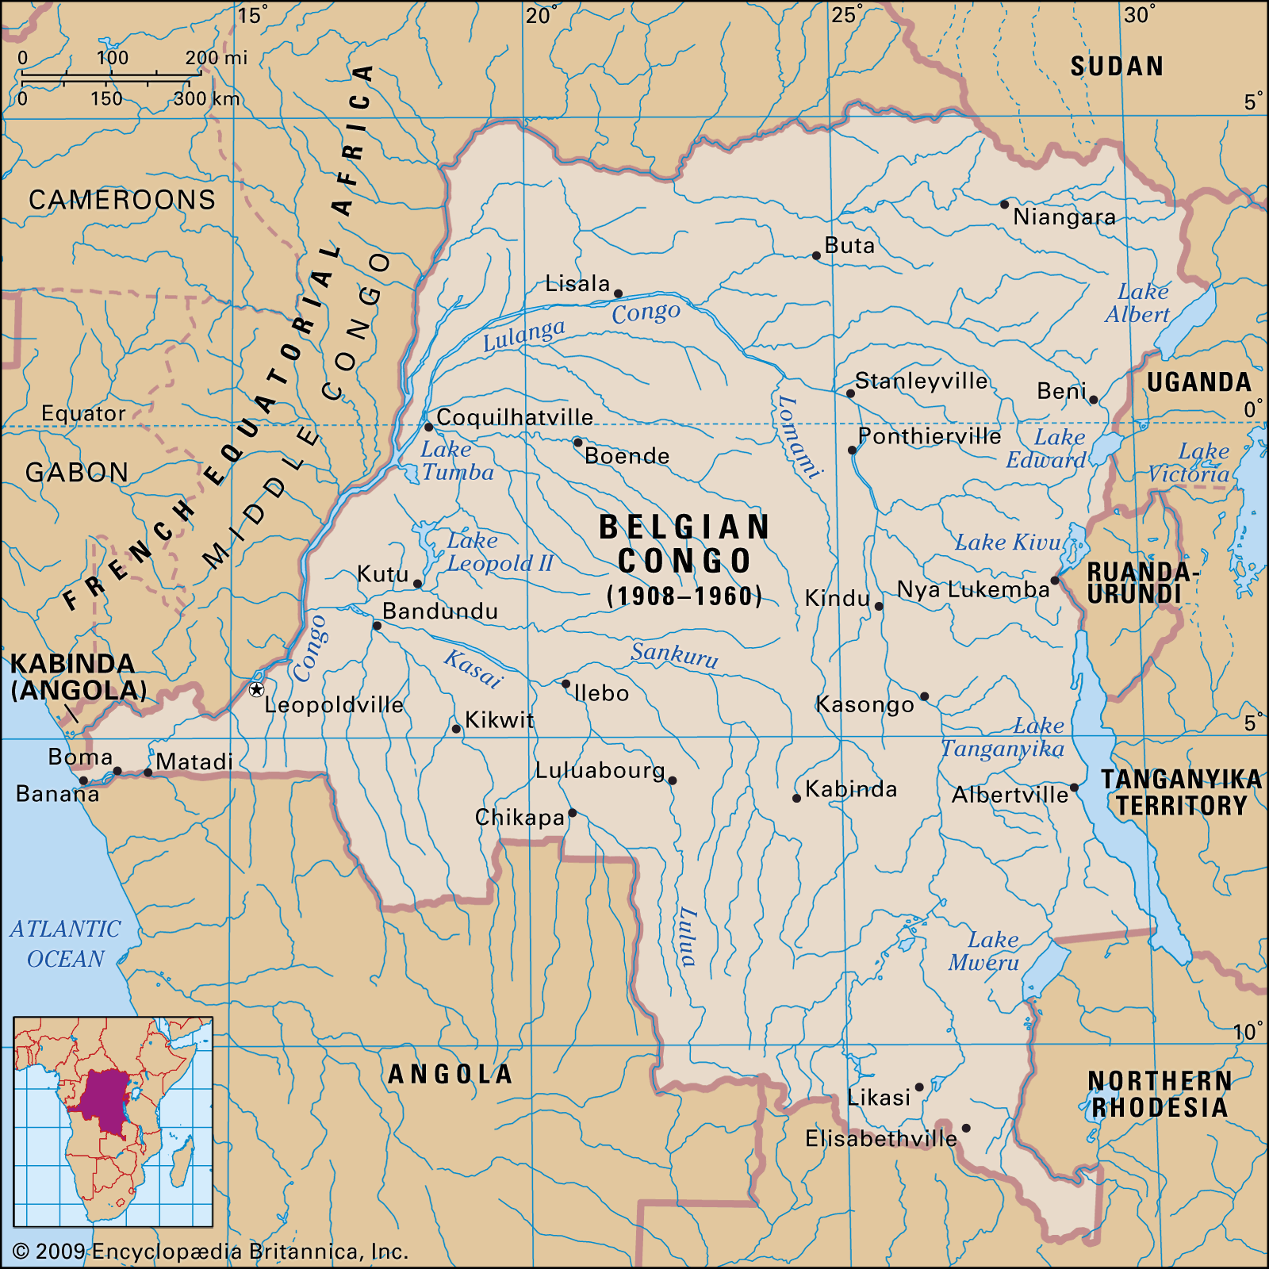
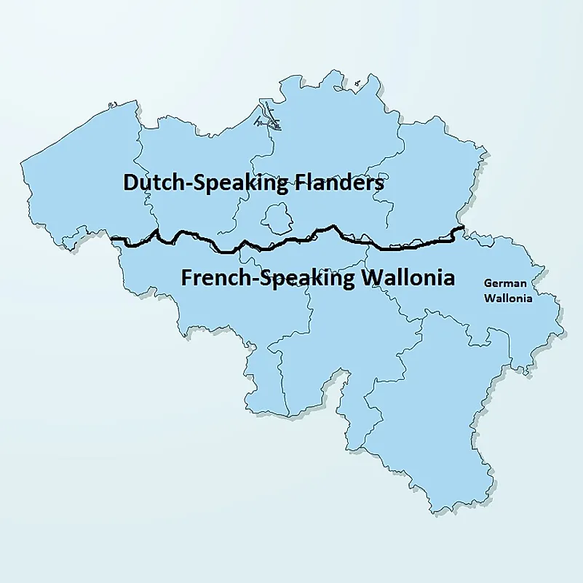
History
Independence from Netherlands in 1830
German occupation (1914-1918/ 1940-1944)
Part of Benelux
1960 independence of Congo
Wallonia and Flanders
Now centre of the EU (parliament)
Co founder of the NATO, very strong
Allies

Slide 6
Economy
High income economy and public debt, strong welfare system
Above EU Average( top 11 richest countries→ 6th)
National debt→ is ranked 6th over 100% GDP, its mostly internal debt
65% of trade in EU is Belgian exports. 80% is with fellow EU members
Imports: 509.018 billion $
(Netherlands 16%, Germany 13%, France 10%, USA 8%, Ireland 5%, China 5%)
Exports: 515.625 billion $
(Germany 17%, France 14%, The Netherlands 13%, UK 8%, USA 6%, Italy5%)
Unemployment 6.42%

Slide 7
Economy

Slide 8
Political system
Belgium is a federal constitutional monarchy-parliamentary democracy
The king is the head of state(current king Philippe) and the prime minister(current Alexander de Croo) is the head of government
Decision-making powers are divided between 3 levels of government:
the federal government
3 language-based communities (Flemish, French and German-speaking) and
3 regions (Flanders, Brussels Capital and Wallonia)
The industrial revolution(in Belgium) happened first in Flanders

Slide 9
Last elections:2019 The far-right Vlaams Belang scored a huge win in Belgium's northern region of Flanders, where the right-wing New Flemish Alliance again had the highest vote share. The Greens triumphed in Brussels and the southern part of the country.

Slide 10
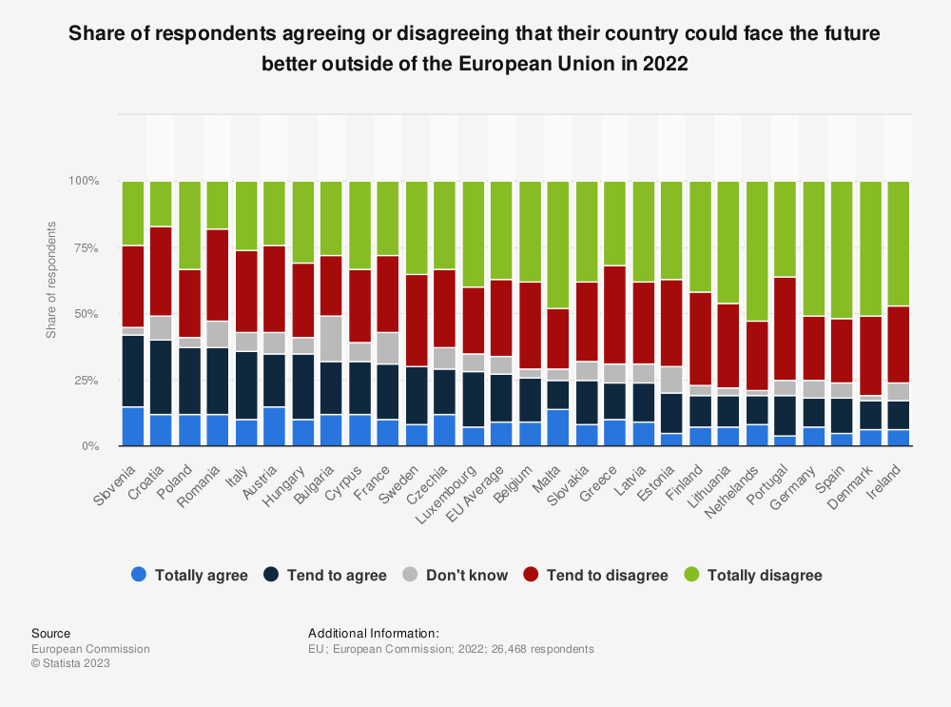
Euroscepticism

Slide 11
National Political Parties
Identity and democracy Group: VLAAMS BELANG
European conservatives and reformists Group: NVA Belgium
(October 2023)
European United Left Nordic Green left: Workers party of Belgium

Slide 12
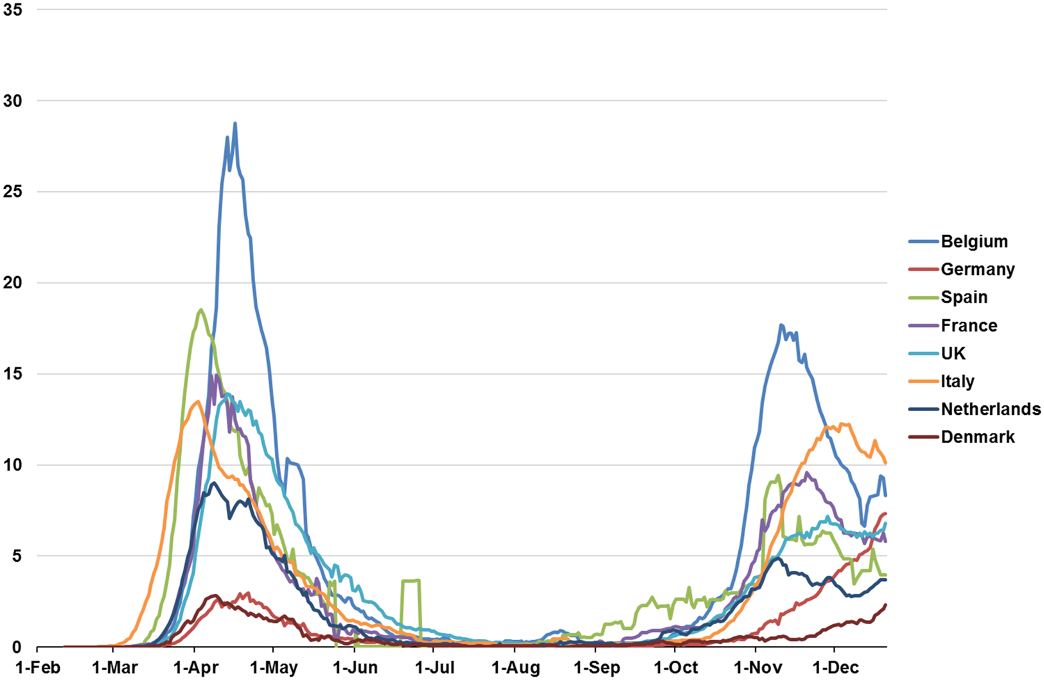
Impact of covid-19
Belgium was hit a lot by the virus. It is called the ‘champion of coronavirus’
COVID-19 struck Belgium not as hard as Spain and Italy, but, in many respects, a lot harder than its neighbors France, Germany, and the Netherlands

Slide 13
Current crisis Russia-Ukraine war
Belgium support for Ukraine: has given up to 400 million$ for Humanitarian Aid, military support and rebuilding process
The diamond sanctions: Belgium is well-known for its diamond trade. Before the war, 25% of the diamonds came from Russia through Antwerp. After the beginning of the war, the imports from Russian diamonds had sharply decrease, the Belgium government has started the process of banning Russian diamonds

Slide 14
Sources
https://european-union.europa.eu/principles-countries-history/country-profiles/belgium_en
https://www.cia.gov/the-world-factbook/countries/belgium/#economy
https://www.euractiv.com/section/politics/news/diamonds-are-not-forever-as-belgium-ready-to-ban-russian-stones/
https://www.politico.eu/europe-poll-of-polls/
https://www.bbc.com/news/world-europe-17205436
https://www.taylorfrancis.com/chapters/oa-edit/10.4324/9781003251217-5/belgium-response-covid-19-peter-bursens-patricia-popelier-petra-meier
https://diplomatie.belgium.be/en/policy/policy-areas/highlighted/belgian-support-ukraine-overview
https://en.wikipedia.org/wiki/Communities,_regions,_and_language_areas_of_Belgium
https://kanguro.com.pl/en/differences-between-flanders-and-wallonia/

Slide 15
Images
https://www.google.com/url?sa=i&url=https%3A%2F%2Fwww.bbc.com%2Fnews%2Fworld-europe-17205436&psig=AOvVaw0NX7p51ZfeHCDVKZoAgyjx&ust=1698659422746000&source=images&cd=vfe&opi=89978449&ved=0CAUQjB1qFwoTCJjo4c39moIDFQAAAAAdAAAAABAE (Pic1)
https://www.google.com/url?sa=i&url=https%3A%2F%2Fwww.britannica.com%2Fplace%2FBelgian-Congo&psig=AOvVaw3zNGR3G6ope2svZ1ZvfTt3&ust=1698659463317000&source=images&cd=vfe&opi=89978449&ved=0CAUQjB1qFwoTCMD_i-H9moIDFQAAAAAdAAAAABAE (Pic2)
https://www.google.com/url?sa=i&url=https%3A%2F%2Fwww.worldatlas.com%2Farticles%2Fwhat-are-flanders-and-wallonia.html&psig=AOvVaw25ZAOWfD-j7oFZv5ZnedMy&ust=1698659503446000&source=images&cd=vfe&opi=89978449&ved=0CAUQjB1qFwoTCIDpmPT9moIDFQAAAAAdAAAAABAE (pic3)
https://www.google.com/url?sa=i&url=https%3A%2F%2Fwww.thenewfederalist.eu%2Fprojection-for-2019-european-elections-projection&psig=AOvVaw0Pgb7aNvuYbz10Ut_MPY1D&ust=1698659558408000&source=images&cd=vfe&opi=89978449&ved=0CAUQjB1qFwoTCMjpv47-moIDFQAAAAAdAAAAABAK (pic4)
https://www.google.com/url?sa=i&url=https%3A%2F%2Fwww.statista.com%2Fstatistics%2F1360467%2Feuroscepticism-europeans-future-leave-eu%2F&psig=AOvVaw1ufP_cMEa4nDUYt4_MGwLs&ust=1698659630212000&source=images&cd=vfe&opi=89978449&ved=0CAUQjB1qFwoTCMj-z7D-moIDFQAAAAAdAAAAABAE (pic5)
https://www.google.com/url?sa=i&url=https%3A%2F%2Fwww.cambridge.org%2Fcore%2Fjournals%2Fhealth-economics-policy-and-law%2Farticle%2Fbelgiums-response-to-the-covid19-pandemic%2FB80558ADF3FBB8E5D9E3A42A878B4359&psig=AOvVaw1leCJCB6IdmVVIFCW_yhZe&ust=1698658829792000&source=images&cd=vfe&opi=89978449&ved=0CAUQjB1qFwoTCPD_-7L7moIDFQAAAAAdAAAAABAE (pic6)

