Slide 1
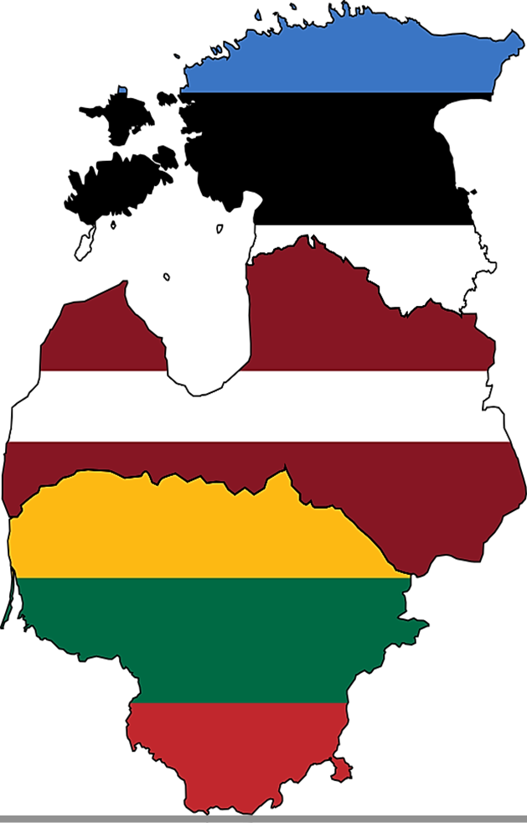
EU policies of the Baltic States in light of the fall-out of the Russian invasion in Ukraine
Eleni potamiti

Slide 2
Points of discussion
I. Historical and geopolitical context of the current crisis
II. The Annexation of Crimea and Donbas, as a turning point for the West
III. The War in Ukraine, and the Baltics’ response to it

Slide 3
I. The Baltic Nations in a nutshell
Small- but ethnically diverse- populations
Estonia: 1.202.762 (Estonian 68,7%- Russian 20,1%-…)
Latvia: 1.821.750 residents (Latvian 62,7%- Russian 24,5%-…)
Lithuania: 2.655.755 (Lithuanian 84,6%- Polish 6,5%- Russian 5%-…)
GDP per capita (current prices): Estonia 28.631 $
Latvia 26.950 $
Lithuania 31.120 $
(imf.org)

Slide 4
I. Their Baltic Nations in a nutshell
They gained their independence from the Soviet Union, in 1991
They joined the EU with the Fifth Enlargement, in 2004
Their narrative? Security

Slide 5
The Baltic States share over 1.370 km of borders with Russia “Fun Fact”: Latvia and Estonia didn’t have ratified borders with Russia before their accession to the EU

Slide 6
I. Tensions between the Baltic States and Russia
EU and NATO memberships were accepted with discontent in Moscow: loss of territory that was perceived to be under the Russian sphere of influence
The three countries were extremely pro-active in offering assistance to the European trajectory of another 6 former Soviet Republics: Armenia, Azerbaijan, Belarus, Georgia, Moldova, and Ukraine
Important initiative in that direction: the Eastern Partnership Policy
(2009)

Slide 7
I. The Baltic “battlefield”
The westward orientation of the Baltics and their initiatives, coupled with the clear anti-Russian sentiment of the majority of the political elites, expressed in a number of occasions, put fuel to the fire
Political Warfare
“The use of all means available by a nation, short of war, to achieve its national objectives, at the expense of other countries”

Slide 8
I. The Baltic “front”- Estonia
In April 2007, Estonia fell under a serious cyberattack
It lasted 22 days and brought down critical sectors of the banking system and government platforms.
Cyber Defense Unit
ec.europa.eu (2016)

Slide 9
I. The Baltic “front”- Latvia
Russia tailored a policy targeting the Russian/ Russian speaking population in the Baltic States- Russian Compatriot Policy
It took advantage of social media and formal media platforms to spread propaganda, in order to strengthen ties of the local Russian population with the “motherland”
This scheme appeared to be effective in Latvia, where the Russian population reaches 24,5%

Slide 10
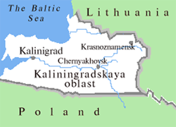
I. The Baltic “front”- Lithuania
Kaliningrad Oblast
Anti- Access/ Area Denial territories

Slide 11
II. The Annexation of Crimea and the beginning of the current crisis
The Baltic States/ EEP policy almost came to bare fruits with Ukraine, in 2013
Yanukovich withdrew from the deal one week before the Association Agreement Summit, in Vilnius
Pro-EU protesters flooded the streets, pro- Russian citizens retaliated and the unrest soon reached the East of the country
Invasion and Annexation of Crimea and Donbas (February, 2014)
Russia claimed they need to protect “Russians abroad”….

Slide 12
II. The Annexation of Crimea and the beginning of the current crisis

Slide 13
II. The Annexation of Crimea and the beginning of the current crisis

Slide 14
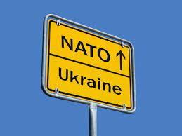
II. Response to the aggression
The annexation awakened the fear of the Baltic States of Russian aggression- the security question was resumed
“First Ukraine, then the Baltics”
EU “soft” security was not enough
They turned to NATO:
The alliance established Centers of
Excellence in all three capitals and
reinforced its presence in the region

Slide 15
II. Response to the aggression
The Baltics are among the most outspoken supporters of Ukraine.
They were in favor of all the sanctions the EU enforced, despite the impact they had on their economy
Estonia and Lithuania co-signed with the UK and Denmark a non-paper addressed to the High Commissioner, requesting the EU to take action against disinformation. This led to East StratCom Task Force, under the European External Action Service

Slide 16
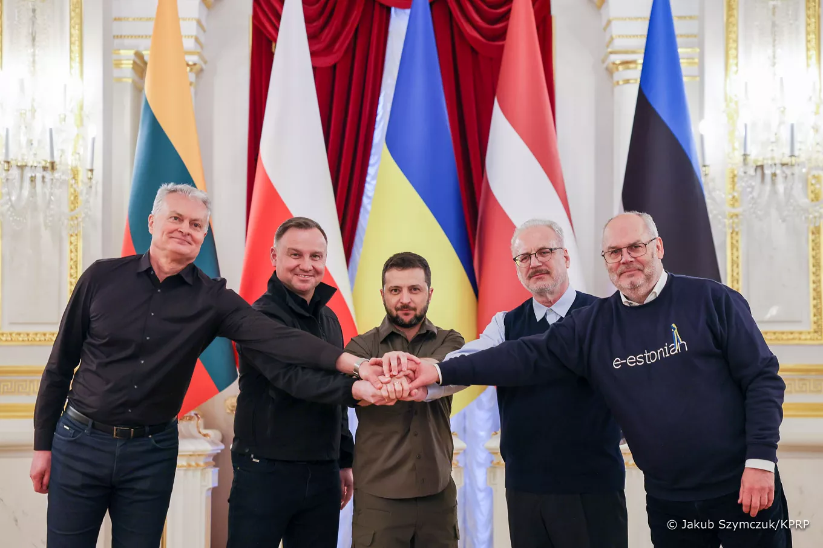
III. Russian invasion in Ukraine
“Specially military operation” launched Feb. 24th, 2022
The Baltics and Poland were to the first to show moral support to Ukraine

Slide 17
III. Russian invasion in Ukraine
The EU imposed new sanctions. The Baltics were again in favor
Russia as trade partner, at the beginning of 2022:
Estonia: 6,4% of exports- 5th largest partner
11,6% of imports- mainly natural gas
Latvia: 9,4% of exports- 5th largest partner
11,5% of imports- raw materials, natural gas
(31% of natural gas in 2022)
Lithuania: 10,8% of exports- largest trading partner
12,1% of imports- 2nd largest partner
(40% of natural gas and 83% of oil and refined oil)
Inflation soared in all three countries: Estonia 19,45%, Latvia 17,3%, Lithuania 19,7% (World Bank,2022)

Slide 18
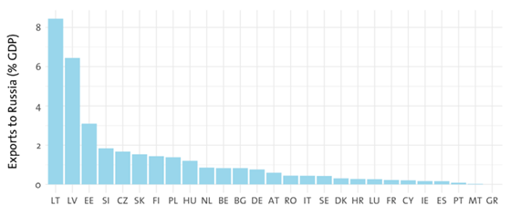
III. Russian invasion in Ukraine
Exports to Russia, expressed as a percentage of GDP, 2020

Slide 19
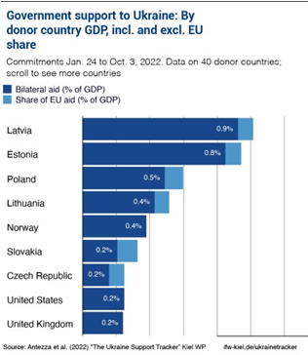
III. Russian invasion in Ukraine
Military aid to Ukraine: the Baltics ranked in the top 4, as a percentage of their GDP spent on military aid, in 2022
(Hartwell et al, 2023)

Slide 20
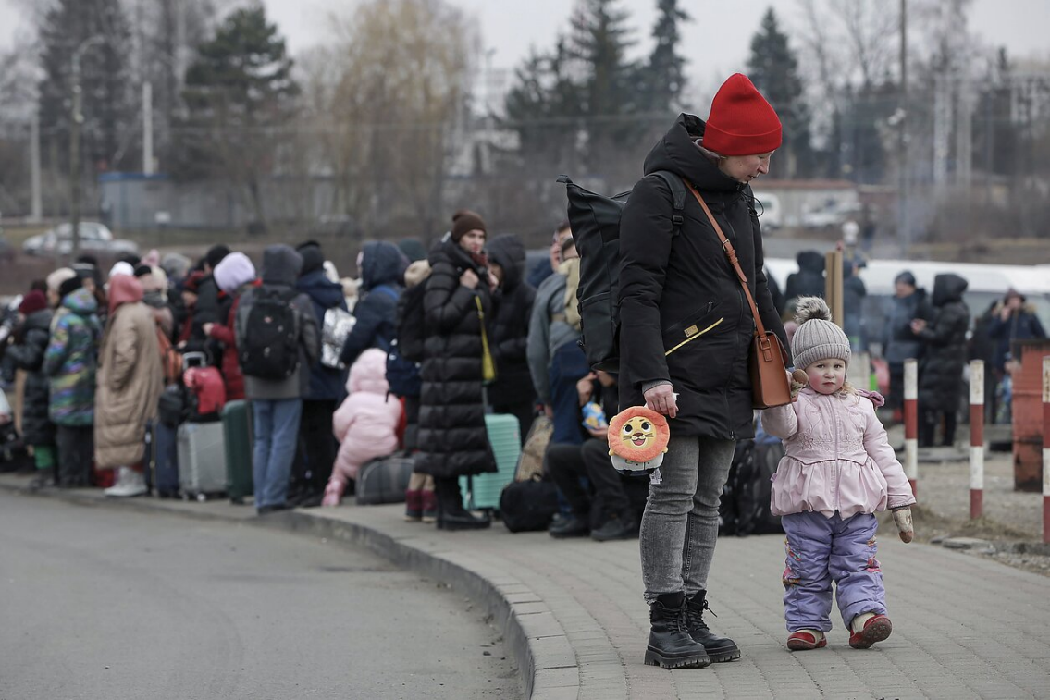
III. Russian invasion in Ukraine
The response to the Ukrainian refugee crisis
Estonia accepted the most refugees per thousand residents
67.243 people (5,049% of total residents)
Latvia accepted 35.332 (1,883% of total residents)
Lithuania accepted 74.611 (2,659% of total residents)

Slide 21
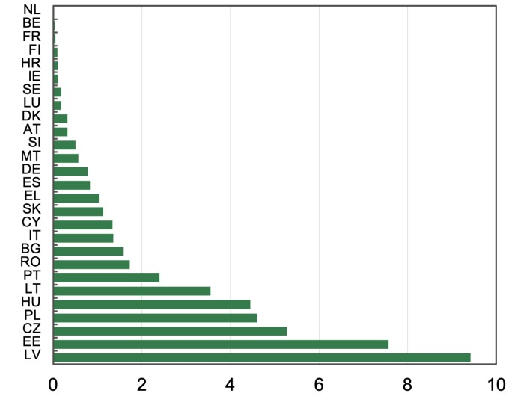
III. Russian invasion in Ukraine
Expected spending on hosting migrants in the EU in the first year of their stay, estimates by various expert organizations, % of GDP
(Estimates by the European Investment Bank; Source: Pogarska et al, 2023)

Slide 22
III. Russian invasion in Ukraine
The effects of the war in politics
Estonia: The ruling party claimed the national vote, in March 2023, prioritizing national security
Latvia: The Russian minority party, which won the election in 2018, was left out of Parliament in the 2022 elections
Lithuania: The strong stance adopted by the government against Russia, gained it a momentum of protecting national dignity and identity- no radical changes are expected at the 2024 presidential elections

Slide 23
III. Russian invasion in Ukraine
The Ukraine war is still a top priority in the agendas of the Baltic States. They continuously toughen up their stance against Russia, as the end of the conflict is not near
Working in unison, they advocate for more measures to be taken against Russia, in regional and international fora
On a national scale, all of them fight against disinformation of Russian media outlets, and work on the social and political cohesion of their societies, including drafting laws to strip more people of their citizenship if deemed necessary (Lithuania), or move for a complete ban of the use of the Russian language in schools (Latvia)

Slide 24
In way of conclusion
National security probably was the main reason the Baltic States pursued accession to the EU and NATO.
The ongoing war in Europe’s backyard, initiated by an aggressor, of whom the Baltic States have warned their European counterparts, led the Baltics to rely more on NATO for military support and the EU for diplomatic and financial synergies

Slide 25
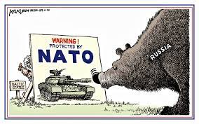
Thank you for your attention

Slide 26
References
https://www.imf.org/external/datamapper/NGDPDPC@WEO/UVK/EURO/EU
https://ec.europa.eu/regional_policy/en/projects/estonia/estonia-leads-the-way-with-advanced-e-services-for-citizens
https://data.worldbank.org/indicator/FP.CPI.TOTL.ZG
Hartwell L, Rakstyte A., Ryng, J., & Selga E.K. (2022). “Winter is coming: The Baltics and the Russia- Ukraine war. Ideas and Policy recommendations”, LSE Ideas [online] Available at: https://www.lse.ac.uk/ideas/Assets/Documents/reports/2022-12-05-BalticRussia-FINALweb.pdf [retrieved 25/11/2023]
Pogarska et al (2023). How Ukrainian migrants affect the economies of European countries [online] Avalailable at: https://cepr.org/voxeu/columns/how-ukrainian-migrants-affect-economies-european-countries [retrieved 24/12/2023]
Redeker N. (2022). “Same shock, different effects. EU member states’ exposure to the economic consequences of Putin’s war. Policy Brief”. Hertie School- Jacques Delors Centre [online] Available at: https://www.delorscentre.eu/fileadmin/2_Research/1_About_our_research/2_Research_centres/6_Jacques_Delors_Centre/Publications/20220307_Economic_Consequences_Ukraine_Redeker.pdf [retrieved 3/12/2023

