Slide 1
Memory Hierarchy: search for data at the highest level: Hit or Miss and search in the lower level

Slide 2
Actual Connection

Slide 3
Rough Approximation for Access Time vs Volume

Slide 4
L1 cache: for instructions- access no delay L2 cache: for data- access with 1-2 cycles delay

Slide 6
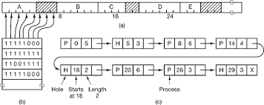
Segment: a set of data (or code) that belong to the logical entity, e.g. data of a process, code of a program.
Page: a set of contiguous data (words in memory) that are a power of 2, e.g. 128 contiguous words, 512 (2⁹ ) contiguous words , 4096 (2¹² )contiguous words.
^{Memory Management (Mem Mgt)}
^{1) Bitmap}

Slide 7
Linked List: each record contains the beginning and ending address of either an unused space or used by a segment. Four examples with unused spaces (holes) and spaces used by segments

Slide 8
Algorithms for “Where to write a new Segment” (Mem MGT with Segments)
Searching an unused space (hole) to store a new segment
First fit: the first unused space (hole) that can contain the segment.
Best fit: the smallest unused space (hole) that can contain the segment.
Worst fit: the largest hole that can contain the segment.
Buddy’s Algorithm: we keep lists for holes. Each list has the holes with the same “hole size” as powers of 2. Each time that we have a segment S of size |S|, 2^{k-1} <|S|≤ 2^{k} , we write the S into the first hole in the list of size 2^{k} and the rest of the space we split into powers of 2 and add to the other lists.
Example: |S|=491, write in a hole of the list 512 (2⁹ ) and create new holes in the lists with sizes 16, 4 and 1.
Fastest, best space management, needs the logistics overhead (lists).
External Fragmentation: the set of spaces between contiguous segments that are small and cannot be used by the newly created segments.

Slide 9
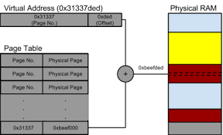
Virtual Memory: a mapping function of Virtual Addresses onto Real Addresses.
Implemented by a memory called Look Up Table (LUT)
Use of Pages: to reduce the size of the LUT
Handled by the Memory Management Unit (MMU)

Slide 11
Memory access
Use Associative Memory (Translation Lookaside Buffer) to speed-up the search.
If we find the page (data) in memory: hit
If we do not find it: miss, we have a page fault and it has to fetch it from the HD
For large memories: multilevel page tables
Internal Fragmentation: the unused space of a file within its pages.

Slide 12
Multi-level Page Table

Slide 13
Segments needed to distinguish logic entities: data, code, etc. Segmentation with Paging: Virtual Address Translation

Slide 14
Content Addressable Memory (CAM)

Slide 15
Interleaved Memory

Slide 16
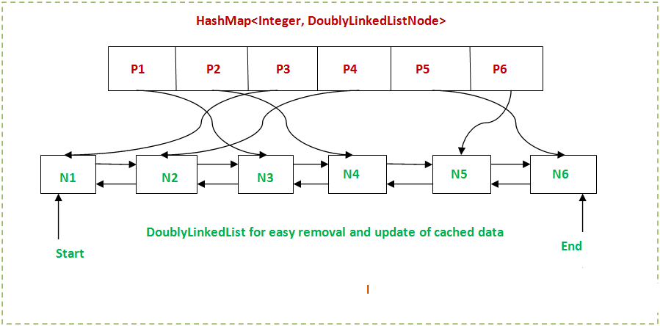
Page Replacement Algorithms
Least Recently Used (LRU): A linked-list of pages. The page that is used takes the “head” of the list. We store back (or overwrite) the “tail” page.

Slide 17
Working Set (with clock) WSClock
The set of pages that a process is currently using is its working set
make sure that it is in memory before letting the process run
Load the working set before the process runs:
prepaging ( vs paging on demand )
WSClock: circular list of page frames
pages are added, they go into the list to form a ring.
Entries of a page record: a) Time of last use b) R –referenced-bit c) M –modified-bit. A pointer (hand of the cclock) shows the last reference page.
at each page fault the page pointed to by the hand is examined first. If the R bit is set to 1, the page has been used during the current tick. Set R=0 and hand=hand->next.
If the age is greater than τ and the page is clean, it is not in the working set: overwritten.
If M=1: schedule the page’s HD transfer and search for another clean page.
Efficient almost as LRU, easiest, cheapest to implement.

Slide 22
Example of computing the page size
Needs a lot of parameters, here we consider only:
average process size: s bytes
page size be p bytes
each page entry (LUT) requires e bytes
approximate number of pages per process is then s/ p,
occupying (se / p) bytes of page table space.
last page’s internal fragmentation is p/2
overhead = (se / p) + p/2
First derivative with respect to p and equating it to zero
$p= (2se)$^{1/2}

