Slide 1
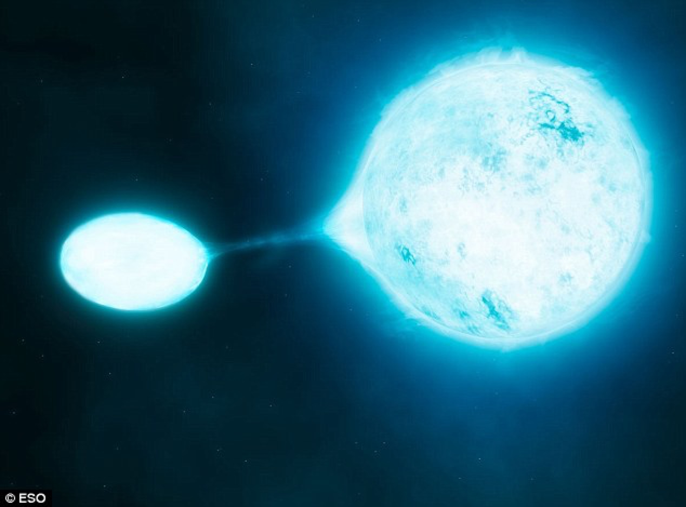

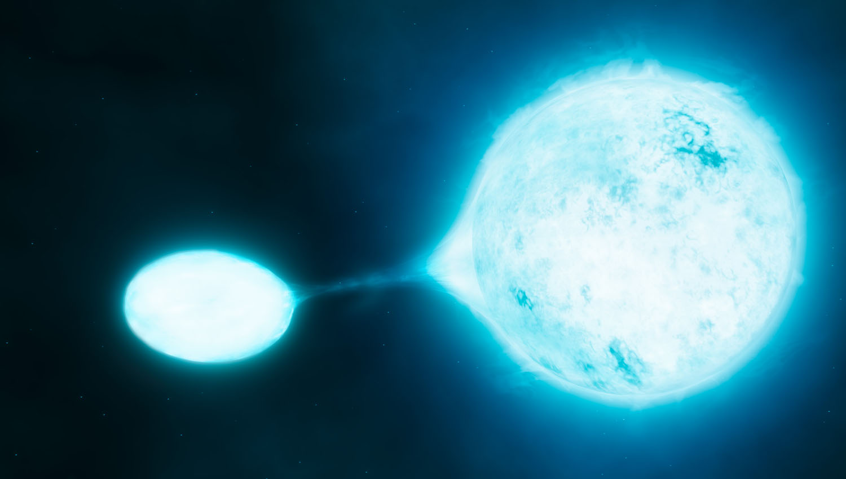
Stars and compact objects in binary systems
Manos Zapartas
Stellar Structure and Nucleosynthesis
Notes:
compact: NS/BHs
first massive stellar binaires

Slide 2
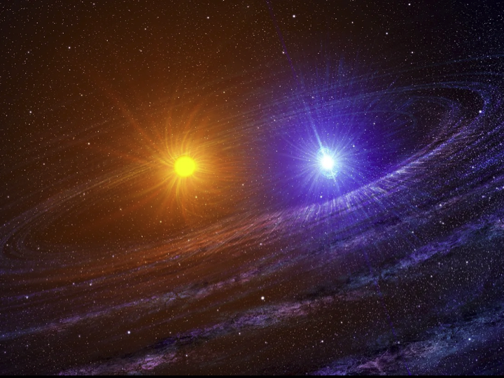

Slide 3
Observations of stellar binaries
Visual / astrometric
(resolved so probably wide binaries)
Spectroscopic binaries (SB1 or SB2)
Eclipsing binaries

Slide 4
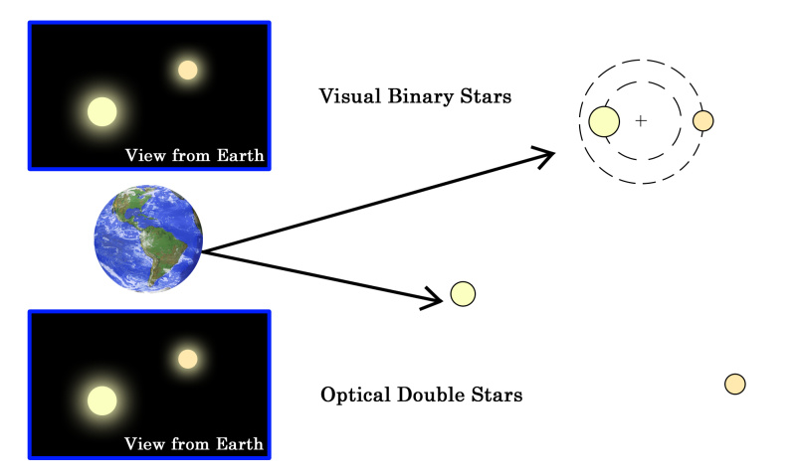
Visual binaries
Image from: Liberal dictionaries
Notes:
Gravitationally bound
Spatially resolved, close-by

Slide 5
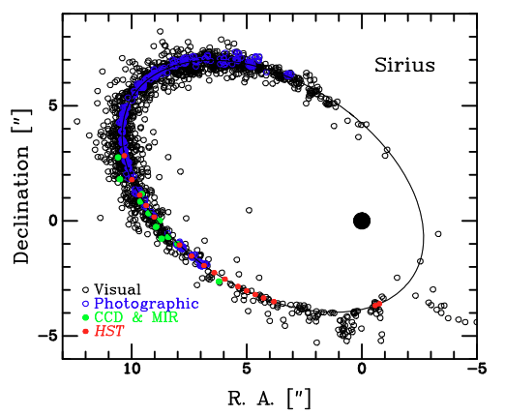
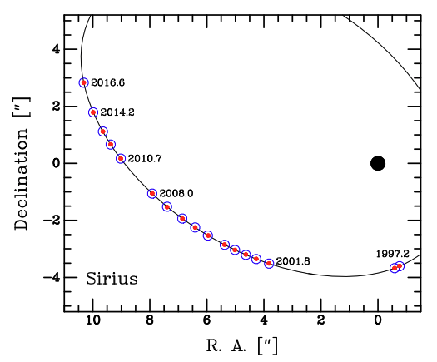
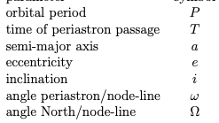
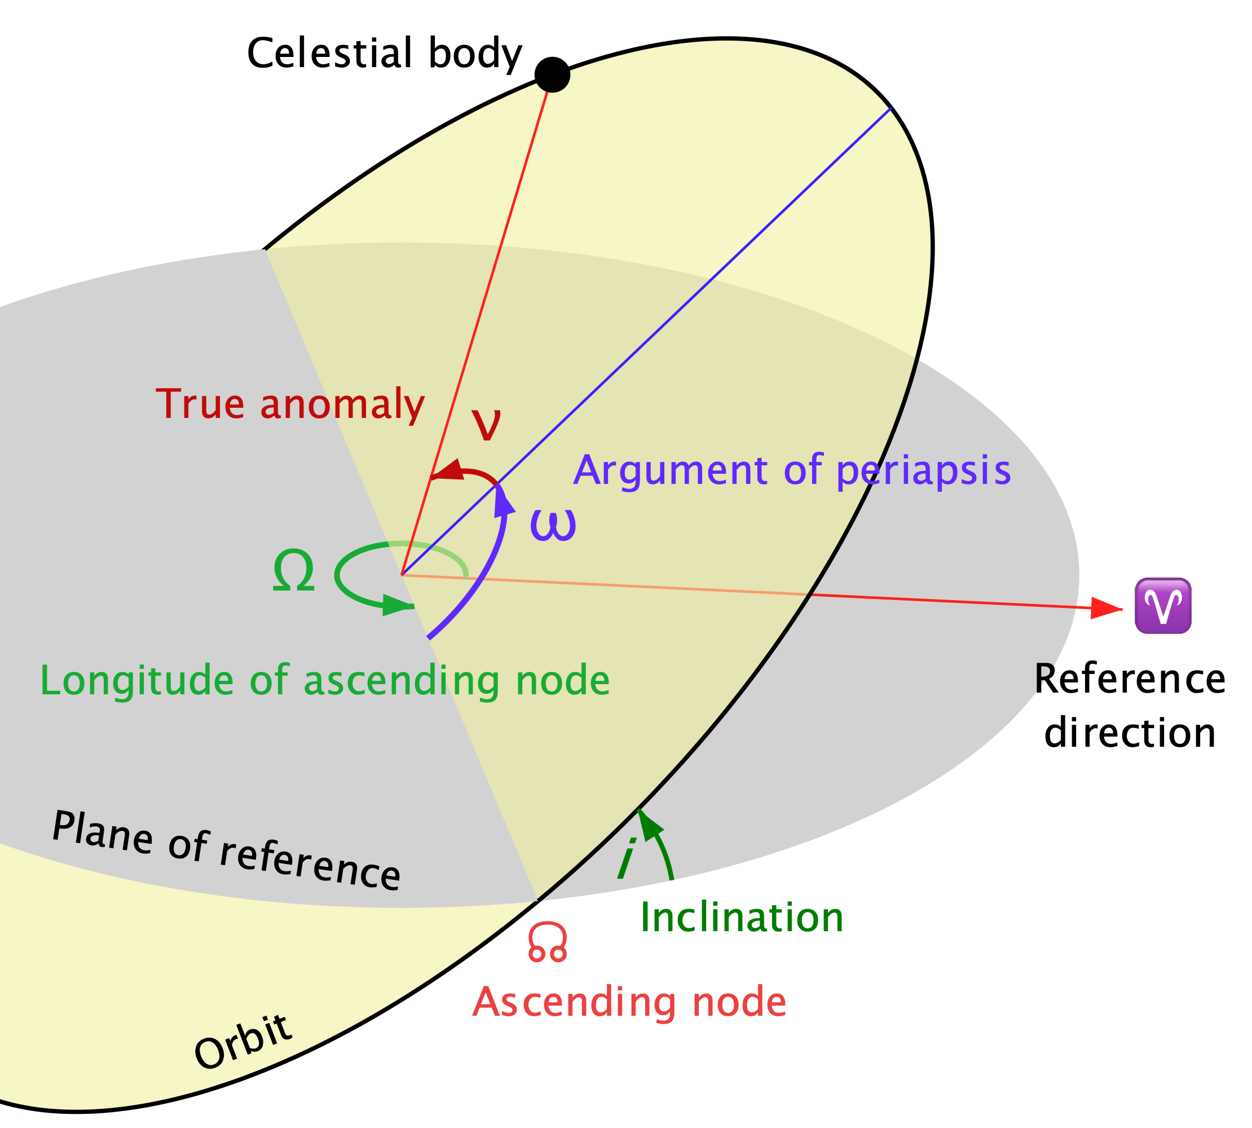



Visual binaries
Both stars and their orbit visible
  e.g. Sirius A/B
Whole orbit fitting:
Derivation of sum of masses
  for known distance from parallax
  from 3rd Kepler law
If also motion around the baricenter:
  individual M₁, M₂
Bond+2017
Notes:
https://ui.adsabs.harvard.edu/abs/2017ApJ...840...70B/abstract

Slide 6


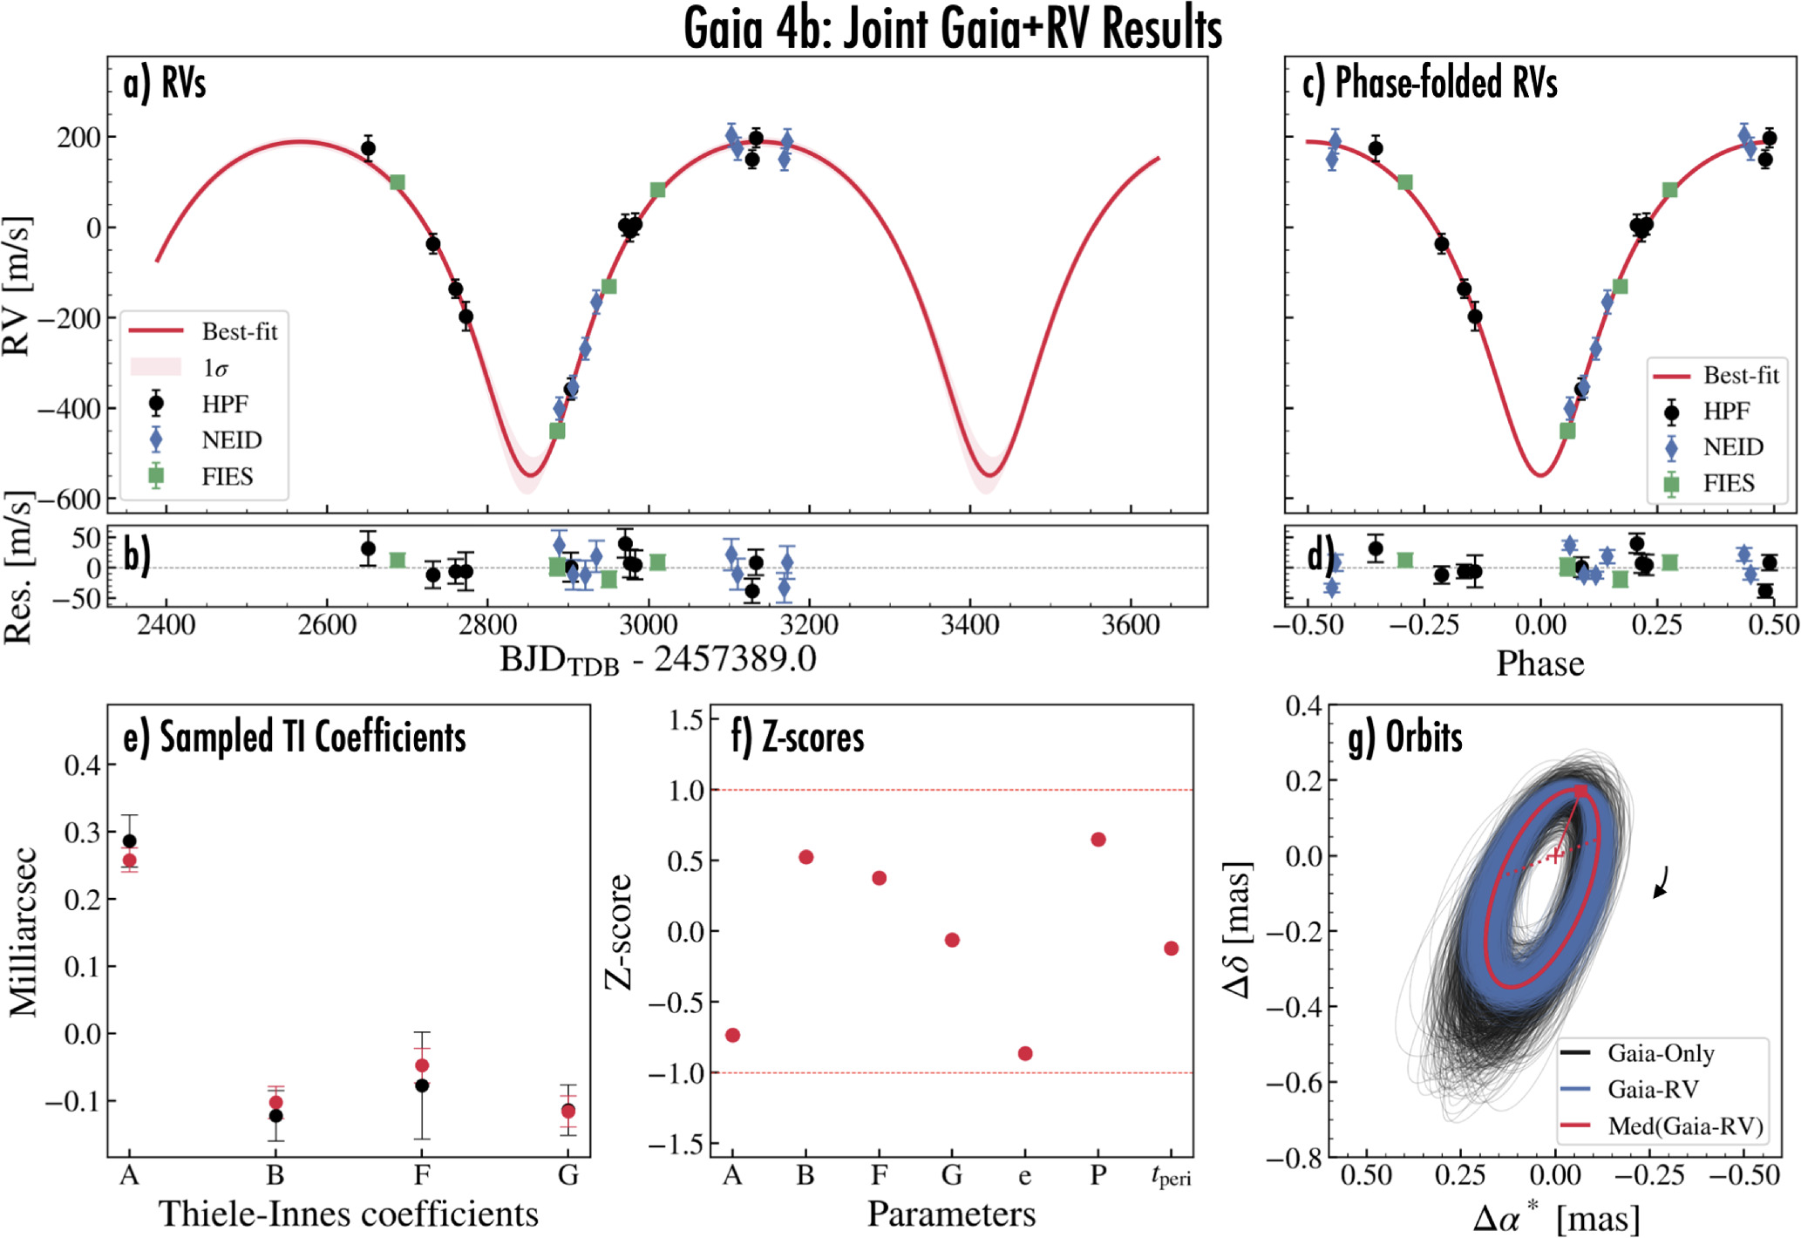
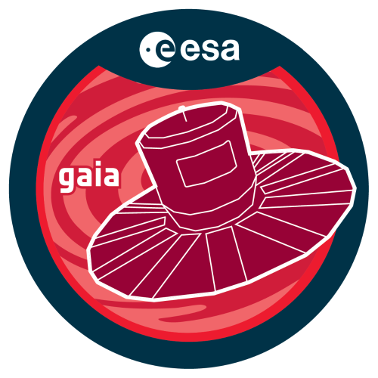
Astrometric binaries
The “wobble” motion of only one star detected
  faint, “dark” (i.e. compact object) or planet companion
α₁
from center of mass
Stefánsson+2025
Notes:
Not 2 stars
https://iopscience.iop.org/article/10.3847/1538-3881/ada9e1

Slide 7
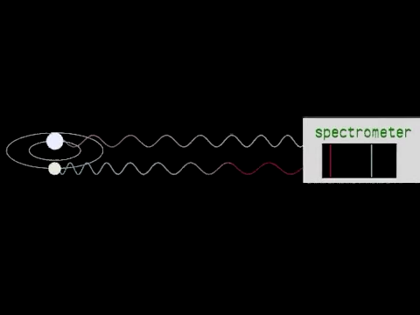
Spectroscopic binaries
Video from: Animations for Physics and Astronomy
Notes:
Not resolved!
Doppler effect
SB1 or SB2 if both spectra are visible
inclination. Face on, edge on
Mass ratio for SB2
Period

Slide 8
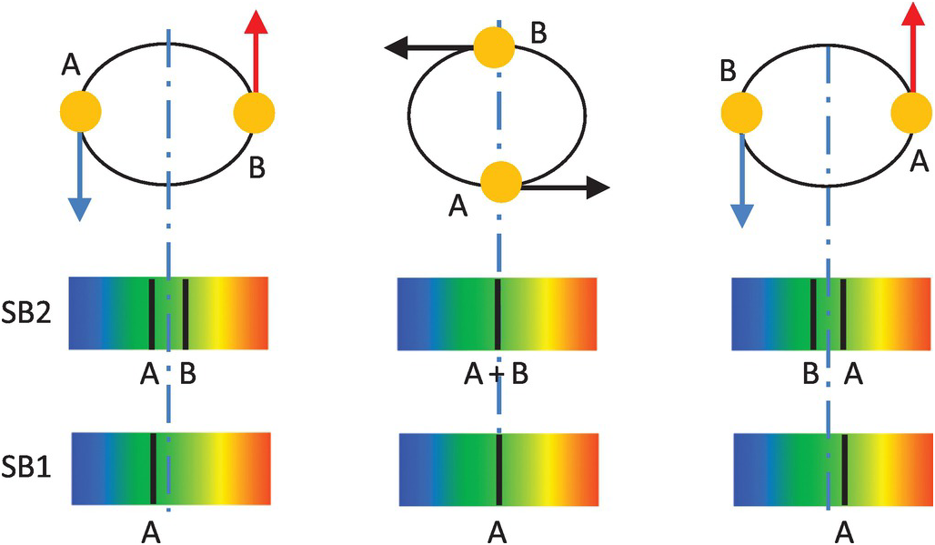
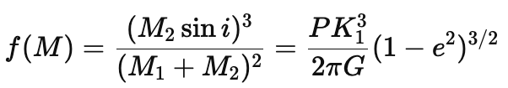

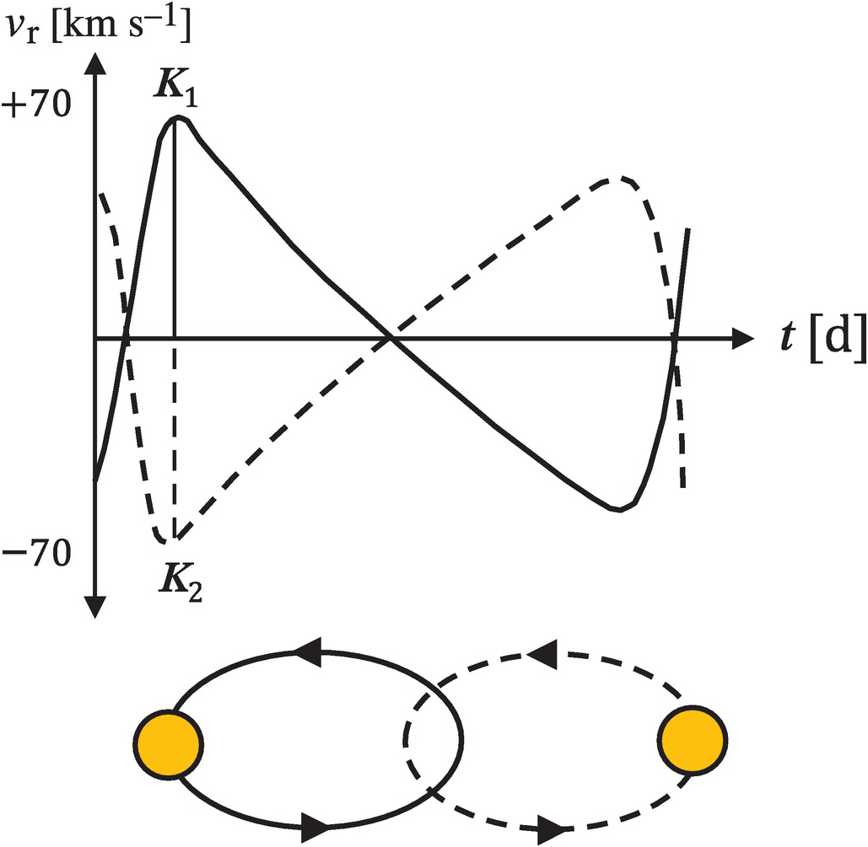
Single spectroscopic binaries (SB1)
Companion not visible (faint, compact object, planet)
Mass function:
As M₁ > 0:
we get the absolute minimum mass for M₂ (the not visible star), setting sin(i) = 1
If we assume M₁ = known, we have an even stronger constraint on M₂
Eq. (4.10) in Pettini
Notes:
https://people.ast.cam.ac.uk/~pettini/Stellar%20Structure%20Evolution/Lecture04.pdf

Slide 9
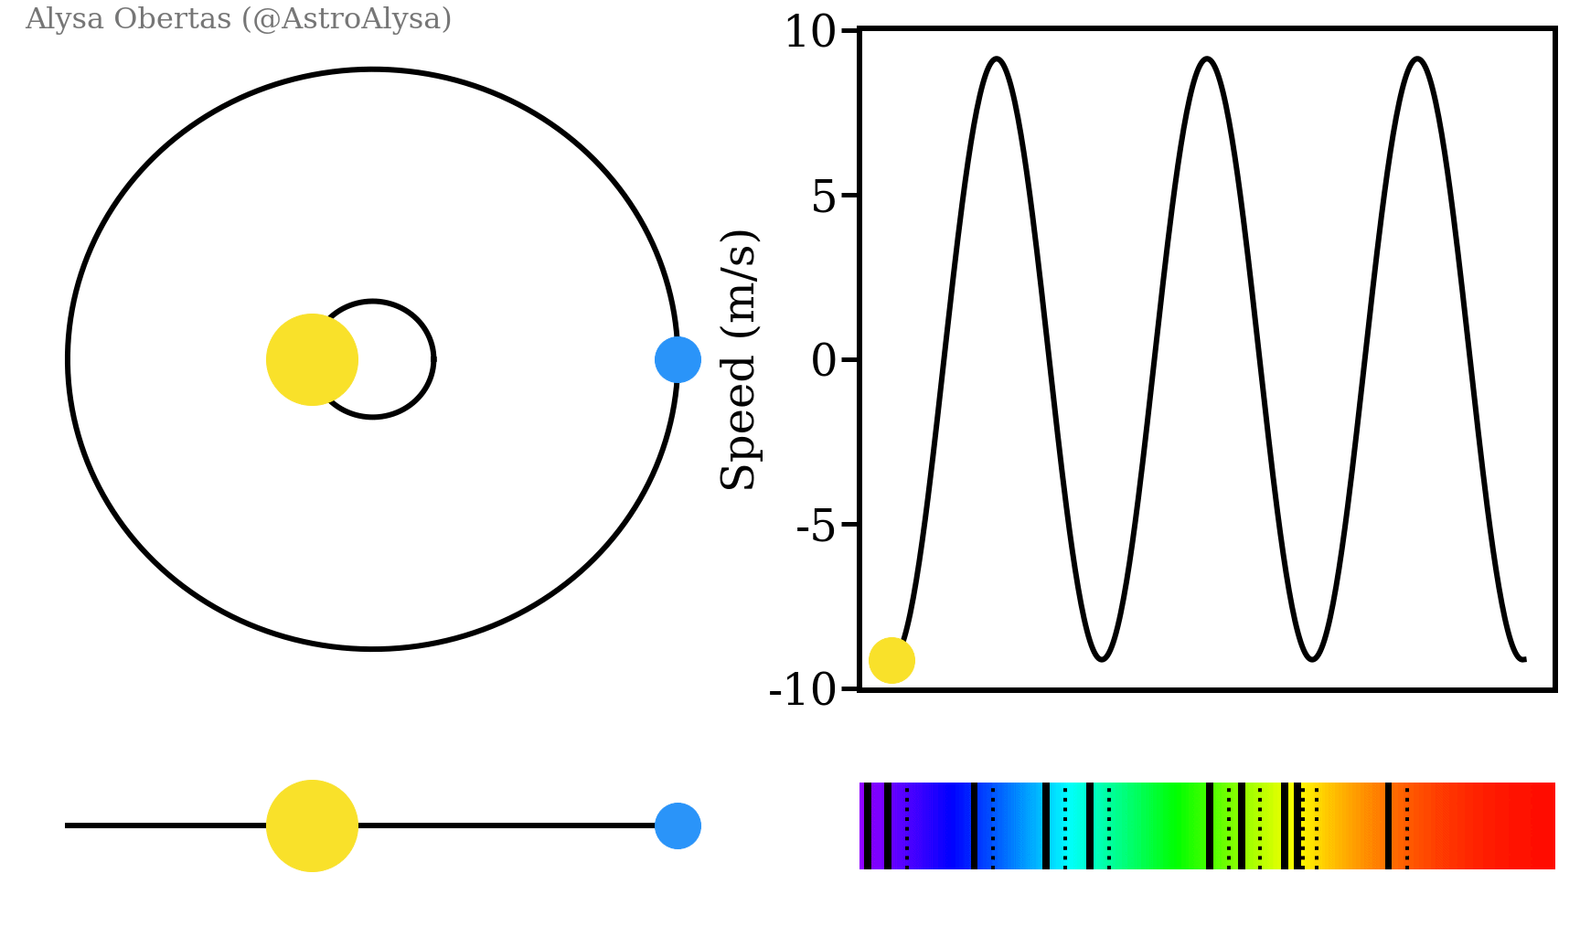

Slide 10
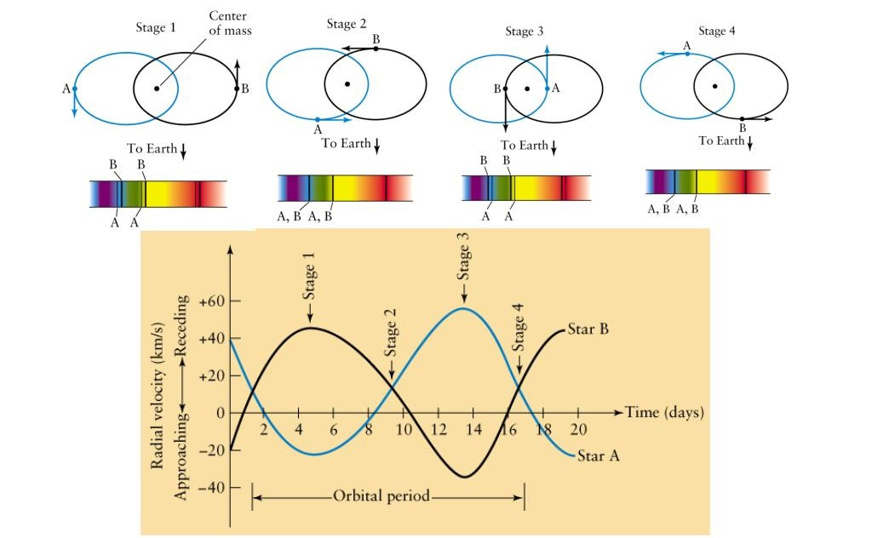
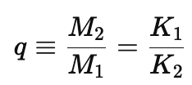
Double spectroscopic binaries (SB2)
Stars comparable luminosity
(so both spectra and lines are visible)
Mass ratio:
As well as the mass function
(i.e. minimum mass) of each star
K₁
K₂
Notes:
The ratio of the velocity semi-amplitudes (K1 and K2 ) provides the mass ratio (q) directly, independent of the orbital inclination (i)

Slide 11
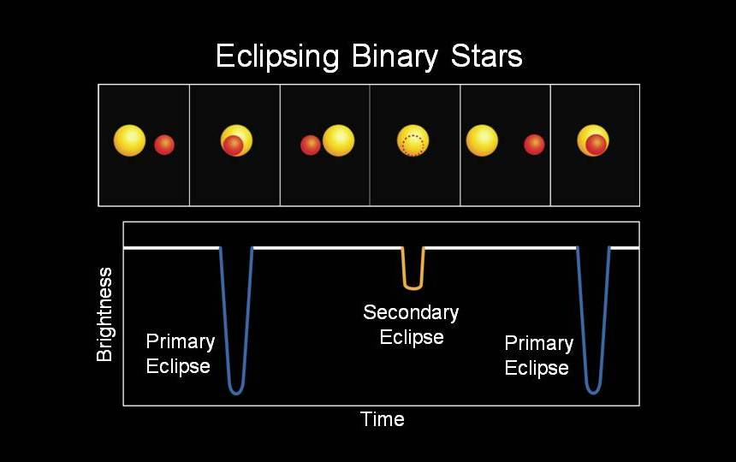
Source - Wikimedia, NASA
Notes:
Edge-on
Radius of the stars
More than one method

Slide 12
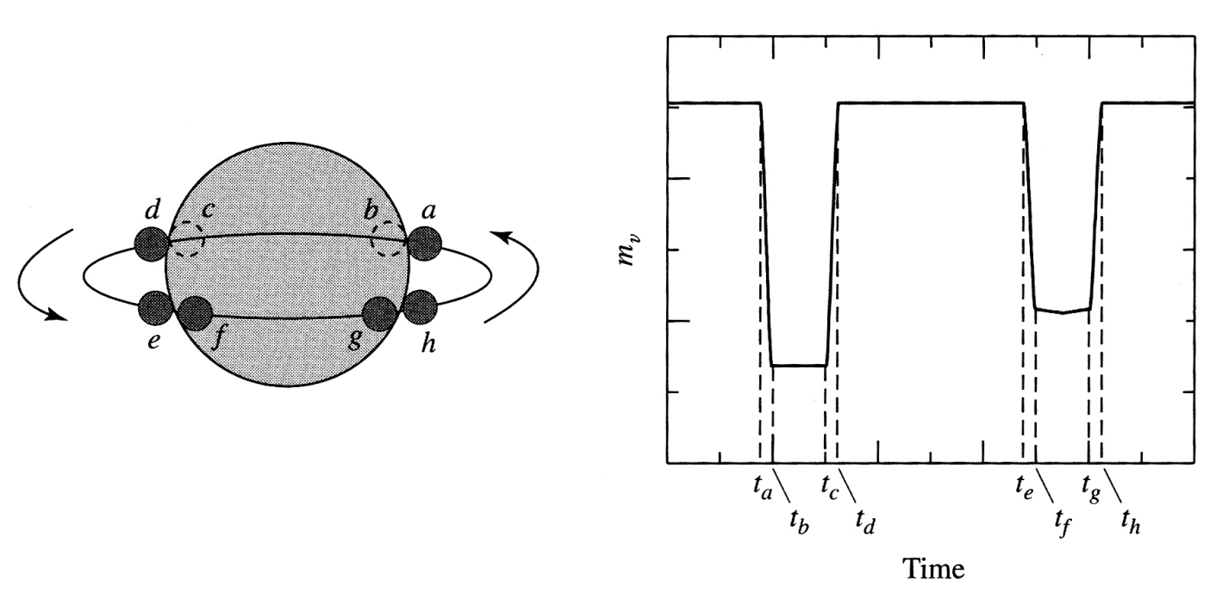
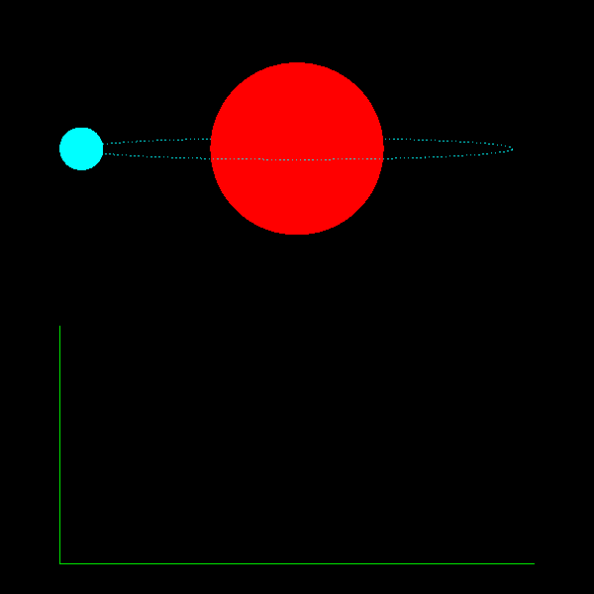

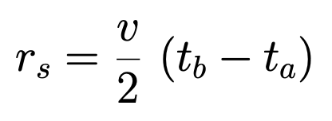

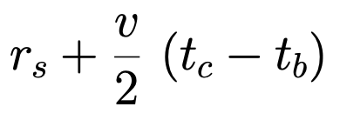

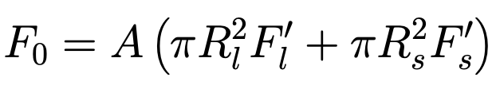
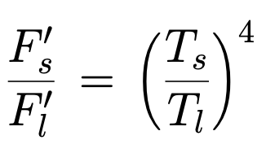
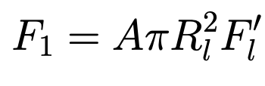
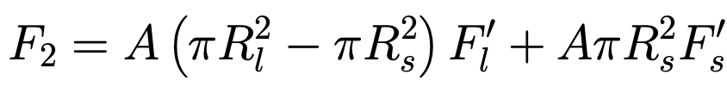
In these systems, the orbital plane is inclined such that it lies nearly along the observer's line of sight (i ~ 90°). Consequently, the stars periodically pass in front of each other, causing dips in the system's total brightness.
Inclination ~ 90º
The Geometry of Eclipses
The light curve encodes detailed geometric information:
Primary Eclipse: The deeper dip, occurring when the hotter star is occulted by the cooler star.
Secondary Eclipse: The shallower dip, occurring when withthe cooler star is occulted by the hotter star.
Eclipse Duration: Relates to the sum of the radii (R1 + R2) relative to the orbit.
Ingress/Egress Time: Relates to the difference in radii, helping to resolve the individual sizes of the stars.
Radii of the two stars:
from (small star)
(large star)
Temperature ratio
from flux drop
Eq. (4.14- 4.15) in Pettini
Eq. (4.16- 4.19) in Pettini
Notes:
Edge-on (i ~ 90°)
Radius of the stars
More than one method
Ingress occurs as the small star begins to move behind the larger central star. It ends when it is completely covered by the central star, at which time the period of totality begins. Egress begins when the small star begins to reappear from behind the central star and ends when it is once again completely revealed.
Source:Live from RXTE! Project

Slide 13
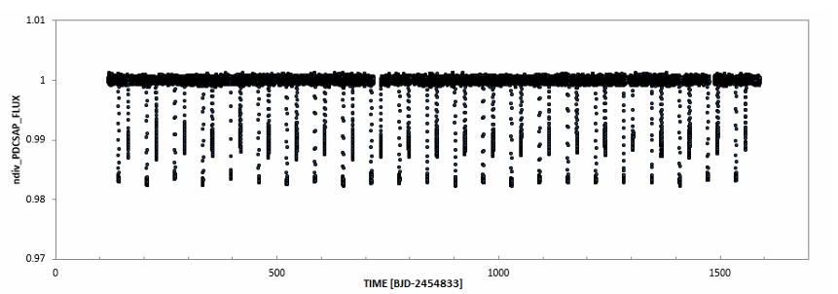
Eclipsing Binaries
Image: K. Gazeas & G. Dellis
Notes:
Observational data from the Kepler space telescope for the red giant KIC 8430105.
Primary and Secondary Eclipses can be seen

Slide 14
# Exercise 1: Derive a) 3rd Kepler’s Law for 2-body problem b) mass function for SB1 stars
a)
b)
Eq. (4.10) in Pettini

Slide 15
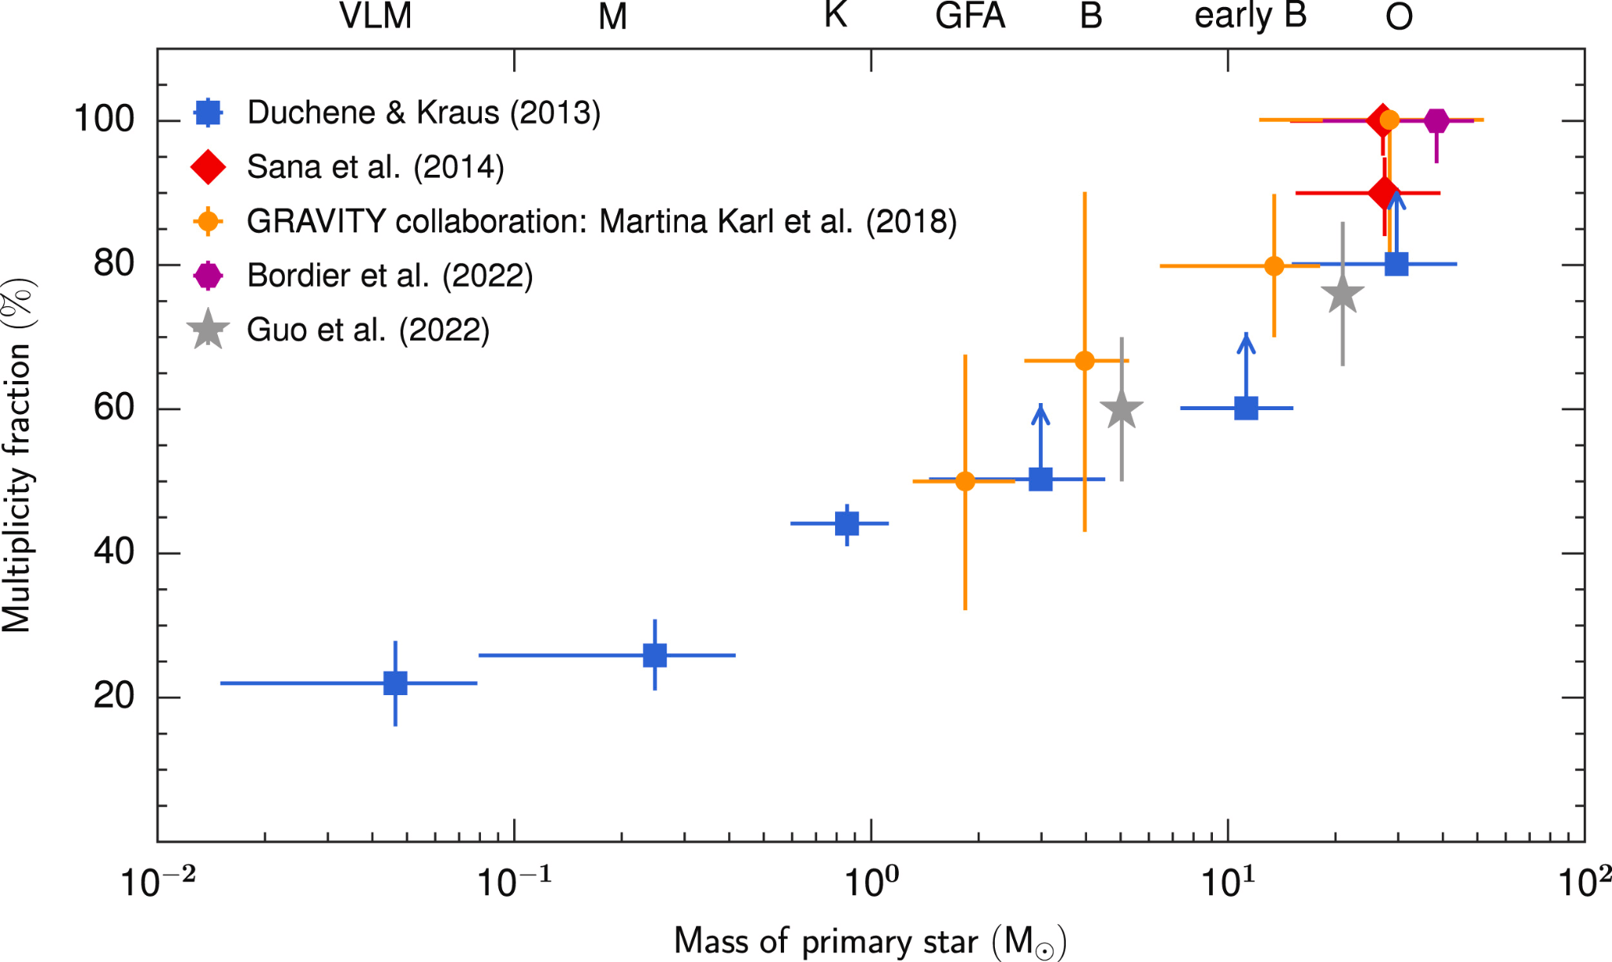
Binarity dominates in high mass stars
Duchene & Kraus 2013

Slide 16
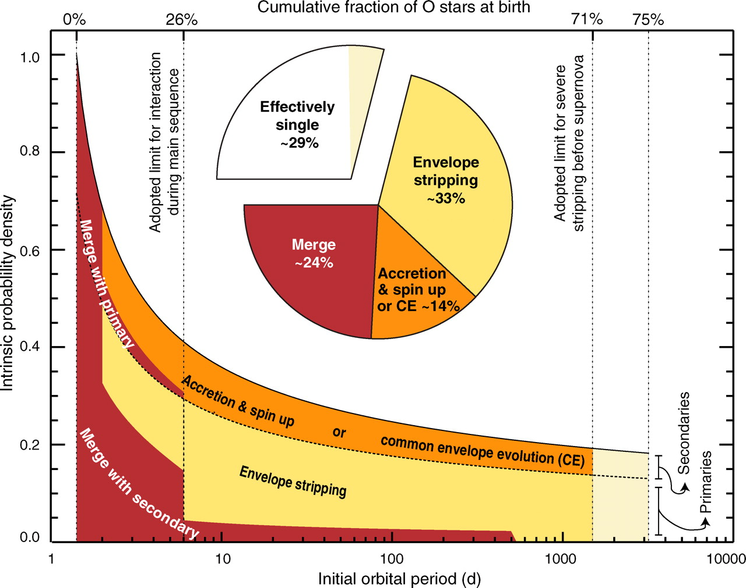
Sana et al. 2012
Notes:
Spectroscopic survey of massive star (O-type stars)
~70% are close enough to interact (exchange mass) with their companion
~50% for solar-like mass stars
Multi-epoch to get the period
Easier for closer binaries
Short period == Short separation (3rd Kepler’s law)

Slide 17
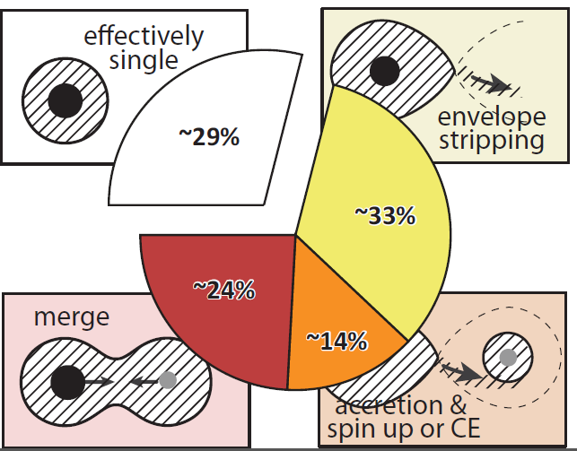
70% of O-type stars are expected to interact with a close binary companion!
Kobulnicky+Fryer 2007; Eggleton+Tokovinin2008; Chini +2012; Kiminki+Kobulnicky 2012; Sana+2012; Dunstall +2015; Moe+DiStefano 2017; Almeida+al. 2017
Adapted figure from Sana+2012, courtesy of S.E. de Mink
Notes:
Not an exception

Slide 18
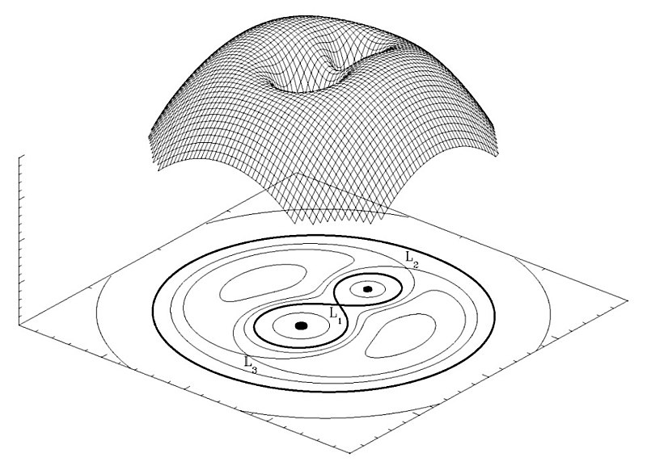
Roche potential
Source - Marc van der Sluys (2006)
Notes:
Equipotential lines
Corotating frame with the orbit. Non-inertial reference frame, centrifugal forces
Point mass approximation
Circular orbit (tides)
Langragian

Slide 19
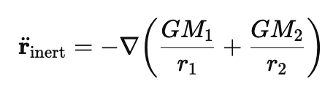
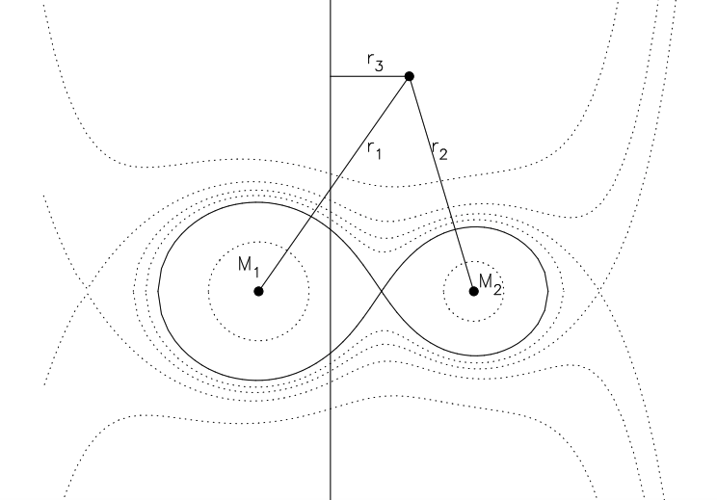


Roche potential=
test particle around the binary system
Circular orbit
co-rotating frame of reference
Non-moving test particle
Coriolis
centrifugal
Euler

Slide 20
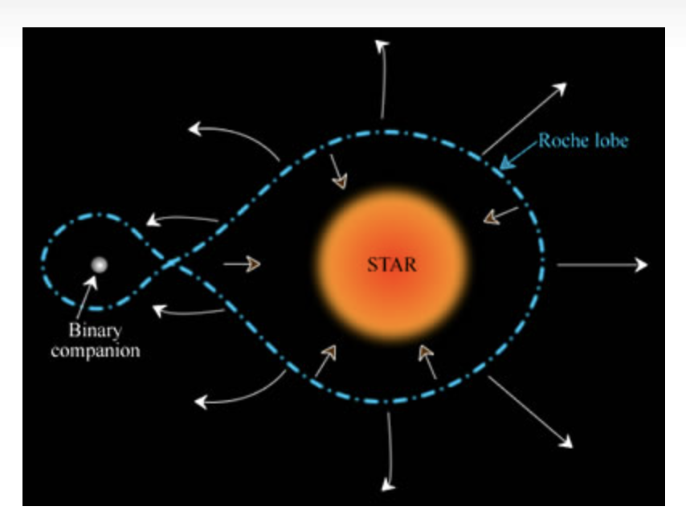
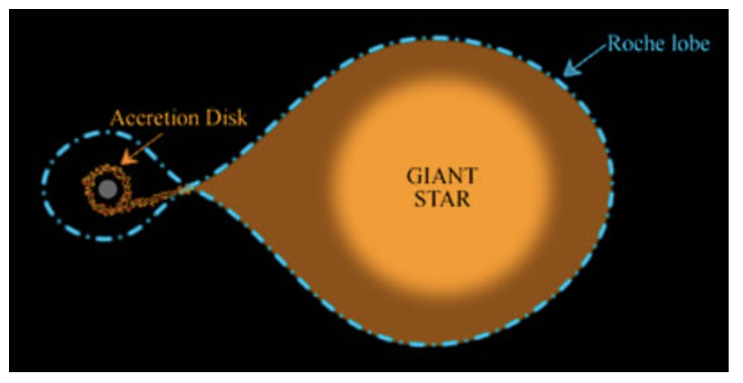
Roche lobe
Notes:
Not able to do 3D binary. Not even 3D star.
Notion of Roche lobe
Equation
which expands first

Slide 21

Roche lobe
for
Eggleton 1983
Notes:
Not able to do 3D binary. Not even 3D star.
Notion of Roche lobe
Equation
Which of the two stars is the most massive?
Which star do we expect to lose its mass first, fill its RL?

Slide 22
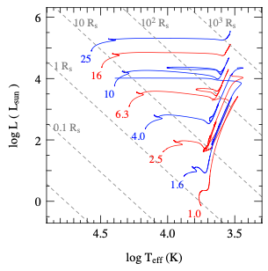
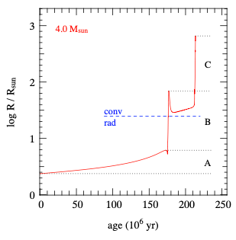
Stars tend to expand during their evolution (and so they fill their Roche lobe)

Slide 23
Stars tend to expand during their evolution (and so they fill their Roche lobe)
After core-He exhaustion:
Red Supergiant
Shell H burning
or
Core He burning
Core H burning:
(Main-sequence)

Slide 24


Slide 25
Mass transfer
Notes:
The initially more massive star is expected to fill its Roche lobe first!

Slide 26
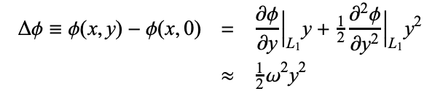




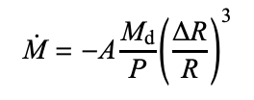


Mass loss rate calculation in stable MT
$$\dot{M}=ρL1 vL1 S$$
S
y
eq. (7.1-7.6) Pols notes
Star stays within its Roche lobe. $R≈RL$
Notes:
Sensitivity of MT rate to DR/R
MT rate high enough for low DR/R
Star stays within its Roche lobe. R~RL

Slide 27
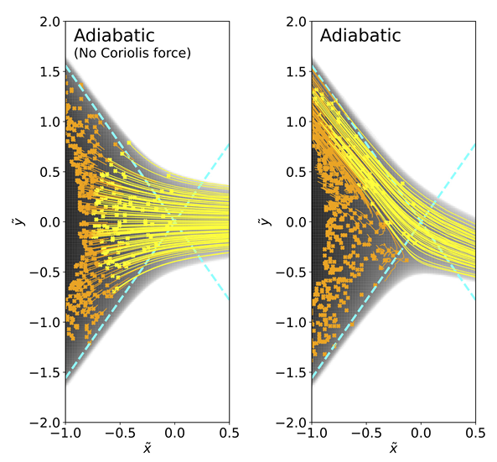
Hydro simulations of mass transfer rate
e.g. taking into account the Coriolis force
Quite close to the analytical forms
Ryu et al. 2025

Slide 28

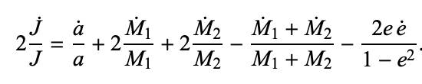
Orbital evolution during stable MT
# Exercise 2
Derive orbital angular momentum for
2-body problem (at least for circular orbit)
eq. (7.7) Pols notes
eq. (7.8) Pols notes
Notes:
Orbital angular momentum (spin orbital momentum is negligible usually) . Around the center of mass.
# Why J not dependent on omega?
Logarithmic Differentiation
adot: change of orbit, conservation of angular momentum

Slide 29

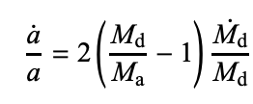
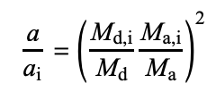
Orbital evolution during stable MT
eq. (7.7) Pols notes
eq. (7.8) Pols notes
Conservative MT:
section 7.2.1 Pols notes
Notes:
donor accretor definition
Ma+Md dot. Jdot

Slide 30







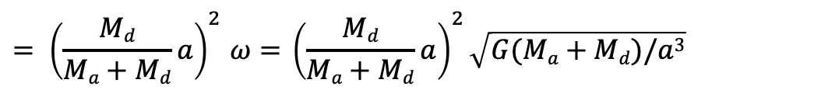
Orbital evolution during stable MT
section 7.2.2 Pols notes
Non-conservative MT:
e.g. Isotropic re-emission
$${= \left(\frac{Md}{Ma+Md}a\right)}^{2}ω={ \left(\frac{Md}{Ma+Md}a\right)}^{2}\sqrt{G(Ma+Md)/a3}$$
so
# Exercise 3
derive γ for isotropic re-emission
derive γ for “fast wind / Jeans mode” (mass lost with the orbital angular momentum of the donor)
Notes:
mass transfer efficiency. Uncertain in binary evolution.
This lost mass carries away some angular momentum. Mechanism of ejection
Fast mode, Jeans mode
Circum binary disk (disk)
Draining angular momentum: shrinks the orbit

Slide 31
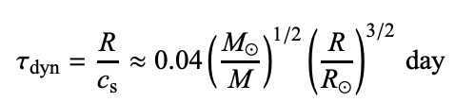


Stellar timescales
Three timescales:
eq. (6.3-6.5) Pols notes
Notes:
Time to adjust to change from equilibrium (Tassos lecture).
Else Time to evolve

Slide 32




Timescales of MT
Three timescales:
eq. (6.3-6.5) Pols notes
vs
which for conservative
mass transfer:
eq. (7.22) Pols notes
Notes:
How the radius, the structure of the star readjusts going away from equilibrium.

Slide 33
Change of Roche lobe for conservative mass transfer
eq. (6.3-6.5) Pols notes
eq. (7.22) Pols notes
Notes:
How the radius, the structure of the star readjusts going away from equilibrium.

Slide 34
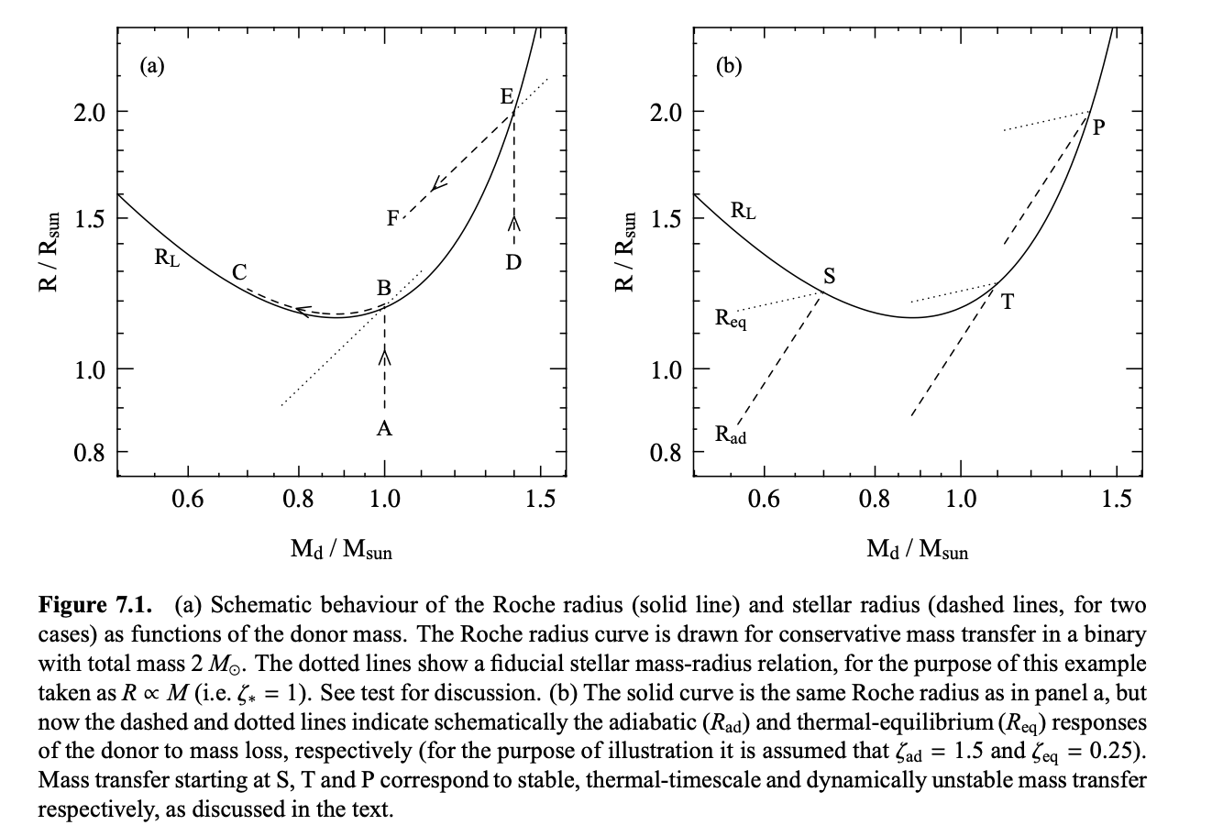
Stability of MT: stellar radius vs RL radius
dynamically unstable MT
ζ_{L}>ζ_{ad} and ζ_{eq}
extreme mass ratio
or convective envelope of the donor
stable MT at
nuclear timescale
ζ_{L}<ζ_{ad} and ζ_{eq}
stable MT at
thermal timescale
ζ_{eq} <ζ_{L}<ζ_{ad}
Notes:
Up (expansion) and then left (decrease in mass of the donor)
Radiative stars: Loses mass, tries to shrink
For convetive envelopes, ζad is negative. Loses mass tries to expand, occupy the same volume

Slide 35
Common envelope evolution
Succesful envelope ejection:
short orbit binary
Merging of the two stars in one
Notes:
Oveflowing of mass onto the companion star: Formation of a commone envelope around both “stars” (or cores)
Spiral in due to gravitational drag
Shrikage of orbit. Energy from the orbit heats up the envelope and can lead to its ejection
Two outcomes
Very close orbit
Merging: unknow process, mixing, rotation, re-adjustment

Slide 36
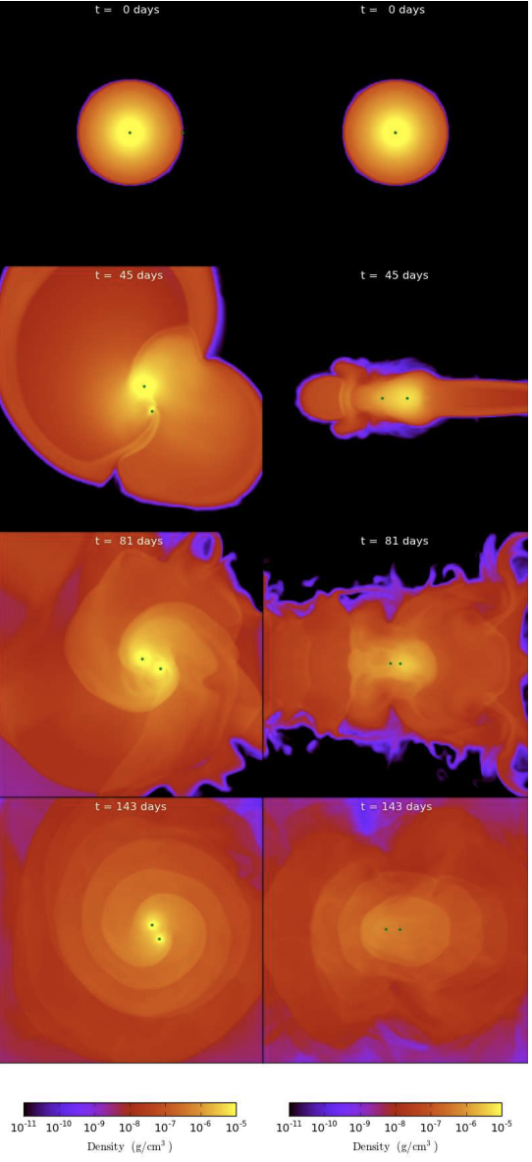
Common envelope evolution
Looking the binary face-on (from above the orbit)
Looking the binary edge-on (from the orbital plane)
Figure from Ivanova et al (2013)
Notes:
Very fast dynamical process. Expensive 3D simulations

Slide 37





Common envelope evolution
Succesful envelope ejection:
short orbit binary
Merging of the two stars in one
vs
eq. (10.17) Pols notes
eq. (10.18, 10.19) Pols notes
or better:
Notes:
energy budge:
alpha-lambda prescription:
uncertain parameter

Slide 38
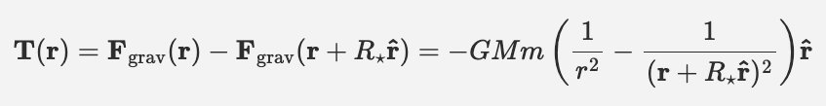

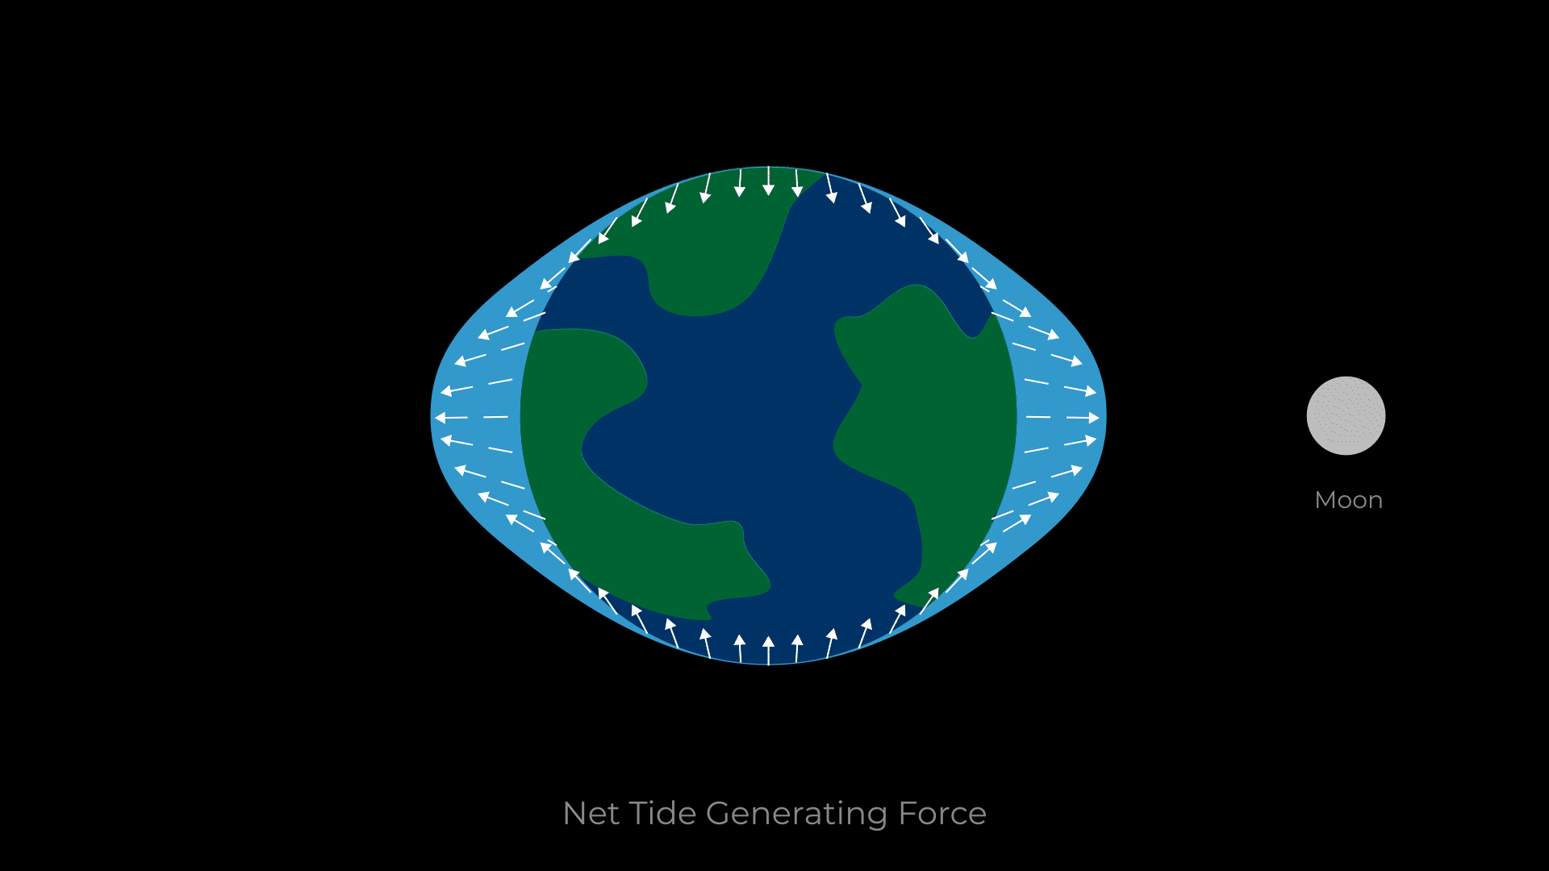

Tidal forces
(no point mass stars)
Difference in gravitational pull across star m
cases of tidal disruption
(important for SMBHs)
eq. (2) Renzo notes
or equivalently
eq. (3) Renzo notes
check Renzo notes here: https://www.as.arizona.edu/~mrenzo/courses/545/notes-lecture-tides.html

Slide 39

Tidal forces
(no point mass stars)
Difference in gravitational pull across star m
Tidal forces drop faster than just gravity force. → important usually for tight binary orbits
We do not have in stars
cases of tidal disruption
(important for SMBHs)
eq. (2) Renzo notes
or equivalently
eq. (3) Renzo notes

Slide 40

Tidal evolution
Tidal deformation, tidal bulges!
  Spin rotation and orbit coupled. Exchange of angular momentum, although total conserved.
  Excess kinetic energy in form of waves, dissipated inside the star
Earth spins down!
Orbit re-adjusts

Slide 41

Tidal evolution
Tides tend to do the following at the :
  Synchronize spins with the orbit (P_{spins} = P_{orbit})
    and corotate
  Circularize the orbit (e=0)
v
Extreme case: tidal locking!
“The buldge is steady and looks always at the companion!”
Notes:
reason for Moons synchronization with orbit
earth’s day longer, +1min / 3.3 Myrs

Slide 42



Tidal evolution
(no point mass stars)
eq. (3) Renzo notes
Highly dependent on (R/r) ratio!
So important for:
  tight orbits
  extended stars
Synchonization occurs faster than circularization
mianly Hut 1982, Zahn 1977

Slide 43




Mass transfer and tidal spin up!
Stars in binaries tend to rotate fast!
  Chemical homogeneous evolution
  Highly rotating cores when reach collapse
    (else winds tend to spin down the surface)
    Computational Assignment 2!
De Mink et al. 2008
Creidts: Maeder+Meynet

Slide 44
Mass transfer
Notes:
Progenitors are massive stars
key property. Found in binary interactions

Slide 45
mass stripping
Mass transfer
Notes:
Progenitors are massive stars
key property. Found in binary interactions

Slide 46

Stripped star
Notes:
Donor usually stripped up to the (He-rich) core

Slide 47
Different evolution of a stripped star
After core-He exhaustion:
Red Supergiant
Shell H burning
or
Core He burning
Core H burning:
(Main-sequence)

Slide 48

HRD of a stripped star
Figure from Götberg et al (2017)
Notes:
not RSG Goes to the blue (hot).
He core burning there (10% of its MS)
Ionizing radiation
# SN Type?

Slide 49
mass gaining
Mass transfer
Notes:
gain mass and angular momentum. Mixing?

Slide 50

mass gaining
Merging
Credits: (ESO) / L. Calçada
Notes:
merging of the two stars
Merging: unknow process, mixing, rotation, re-adjustment. Magnetic
Many sinlge stars that we see may be binary mergers.

Slide 51

Hydrodynamical simulations of merging
Schneider et al. 2019
Looking the binary face-on (from above the orbit)
Looking the binary edge-on (from inside the orbital plane)
Notes:
Schneider et al. long term

Slide 52

Questions?
Notes:
Great.
Interestingly, many open questions
cc: which make NS/BH, which explode?
Ia; main mechanism (sd vs dd)
- zoo of observed classification (superluminous, associated with GRBs, sub-luminous, ) -> which progenitors

