Slide 1
Kostis Palamas
1859-1943

Slide 2
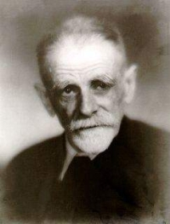
Palamas
A central figure of the Greek literary generation of the 1880s and one of the cofounders of the so-called New Athenian School (or Palamian School, or Second Athenian School) along with Georgios Drosinis and Ioannis Polemis.
He wrote the words to the Olympic Hymn (first performed at the 1896 Summer Olympics, the first modern Olympic Games).

Slide 3
Palamas
Born in Patras and educated in Mesolonghi.
He was enrolled at the School of Law, Economics and Political Sciences of the University of Athens, but he soon abandoned his studies.
He held an administrative post at the University of Athens between 1897 and 1926. Worked as a journalist.
Nominated for the Nobel Prize.
He died on 27 February 1943, during the Axis occupation of Greece in World War II.
His funeral at the First Cemetery of Athens on the next day became a major symbolic event of the Greek resistance against the occupation.\
The old administration building of the University of Athens, in central Athens, where his office was located, is now dedicated to him as the "Kostis Palamas Building“.

Slide 4
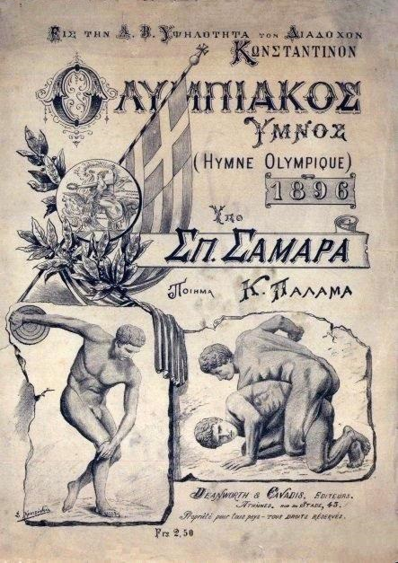
Olympic Hymn
Αρχαίο Πνεύμα αθάνατο, αγνέ πατέρα
του ωραίου, του μεγάλου και του αληθινού,
Κατέβα, φανερώσου κι άστραψε εδώ πέρα
στη δόξα της δικής σου γης και τ' ουρανού.
Στο δρόμο και στο πάλεμα και στο λιθάρι
Στων ευγενών αγώνων λάμψε την ορμή
Και με το αμάραντο στεφάνωσε κλωνάρι
και σιδερένιο πλάσε και άξιο το κορμί.
Κάμποι, βουνά και θάλασσες φέγγουνε μαζί σου
σαν ένας λευκοπόρφυρος μέγας ναός.
Και τρέχει στο ναό εδώ προσκυνητής σου
Αρχαίο Πνεύμα αθάνατο, κάθε λαός.

Slide 5
Olympic Hymn
O Ancient Spirit immortal, pure father
of the beautiful, the great and the true,
Descend, appear, and sparkle over here
to the glory of thine own earth and heaven.
At running and at wrestling and at throwing,
shine in the momentum of noble contests,
and crown with the unfading branch,
and make the body worthy and ironlike.
Plains, mountains and seas shine with thee
like a great white-purple temple.
And thy pilgrim is running to this here temple,
O Ancient Spirit immortal, of every people.

