Slide 1
Ancient Greek (Intermediate Level)
ATHENS MA IN ANCIENT PHILOSOPHY
NATIONAL AND KAPODISTRIAN UNIVERSITY OF ATHENS / Department of History and Philosophy of Science
In collaboration with:
•UNIVERSITY OF PATRAS / Department of Philosophy
•UNIVERSITY OF CRETE / Department of Philosophy and Social Studies

Slide 2
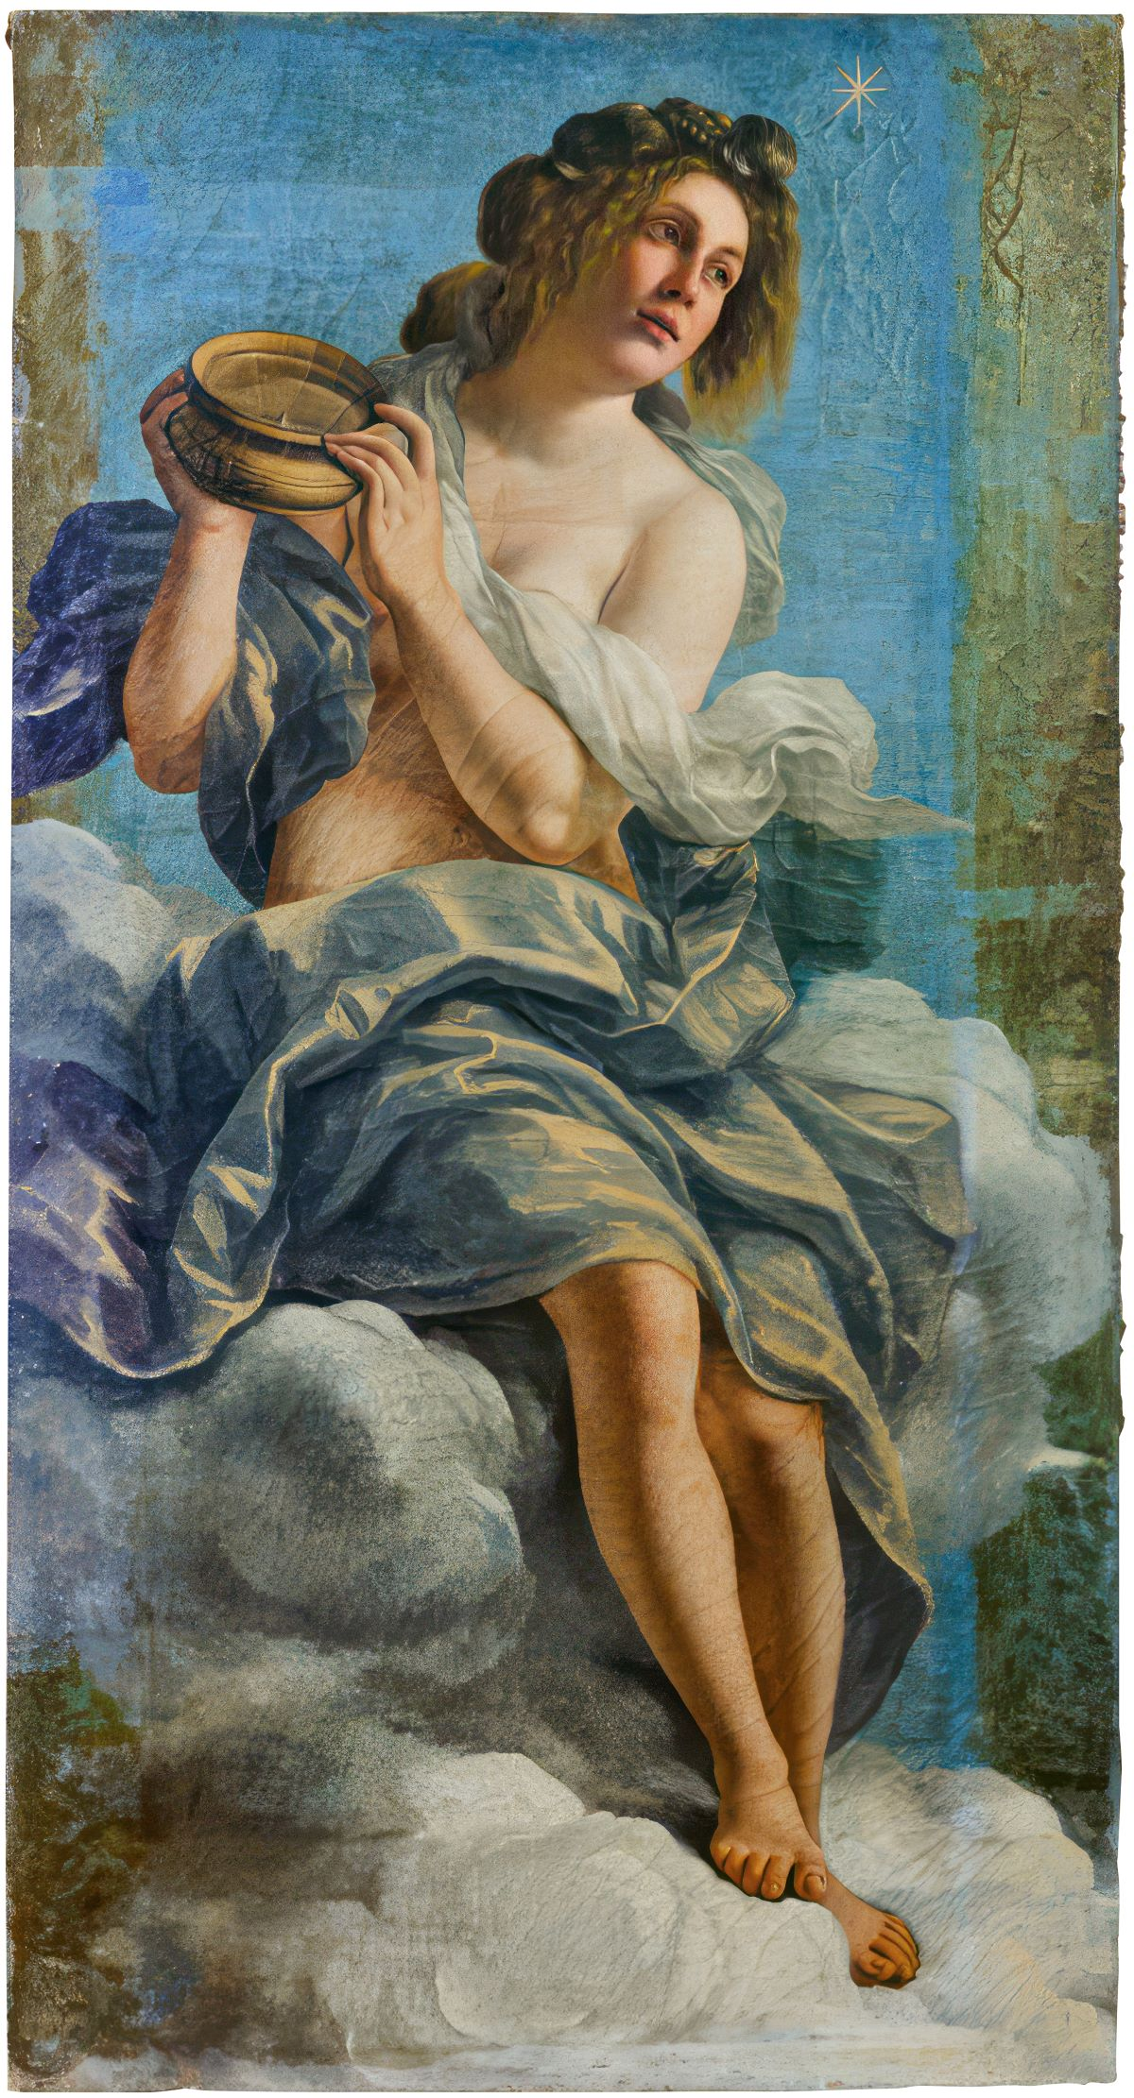
WEEK 8
Participles and Infinitives

Slide 3
Participles and Infinitives
Verb Forms:
Greek verb forms are either finite (indicatives, subjunctives, optatives, imperatives) or non-finite (infinitives, participles, and verbal adjectives in -τός or -τέος). Finite verbs have a personal ending and express person, number and mood; nonfinite verbs do not have a personal ending and do not express person or mood.
Categories Pertaining to All Verb Forms: Tense-Aspect and Voice
All Greek verb forms, i.e. both finite and non-finite forms (except verbal adjectives in -τός or -τέος), are marked for the categories of tense-aspect and voice.

Slide 4
Participles and Infinitives
Tense-aspect: Greek verb forms fall into four overarching systems, depending on which stem of the verb is used; these four systems differ primarily in their expression of aspect, although in the case of the future stems tense is the more important variable:
– the present-stem system, covering the present indicative (or primary present indicative), the imperfect (or secondary present indicative), the present subjunctive, the present optative, the present imperative, the present infinitive, and the present participle;
– the aorist-stem system, covering the aorist indicative, the aorist subjunctive, the aorist optative, the aorist imperative, the aorist infinitive, and the aorist participle;
– the future-stem system, covering the future indicative, the future optative, the future infinitive, and the future participle;
– and the perfect-stem system, covering the perfect indicative (or primary perfect indicative), the pluperfect (or secondary perfect indicative), the perfect subjunctive, the perfect optative, the perfect imperative, the perfect infinitive, and the perfect participle.
Within these systems, tense is expressed by the indicatives, and by all forms of the future-stem system. Aspect is expressed by all forms except future-stem forms.

Slide 5
Participles and Infinitives
Voice: all Greek verb forms also express voice. A basic two-way distinction between different kinds of forms may be made:
– active forms;
– and middle-passive forms.
Note: In the aorist-stem system and in the future-stem system, further sub-divisions usually exist between different kinds of middle-passive forms, most often between middle forms and passive forms.

Slide 6
Participles and Infinitives
Non-finite verb forms are marked for the following categories:
– Infinitives only express tense-aspect and voice.
– Participles express tense-aspect and voice, and, like adjectives, are also marked for the categories of case, number and gender.
– Verbal adjectives are only marked for the categories of case, number and
gender.
Some examples of non-finite verb forms and the categories they express:
παιδευθῆναι: aor. pass. inf. to be/have been educated – an infinitive, part of the aorist-stem system; expresses aspect and passive voice;
παιδεύουσαι: nom. pl. fem., pres. act. ppl.: educating – a participle, part of the present-stem system; expresses nominative case, plural number, feminine gender, as well as aspect and active voice;

Slide 7
Participles and Infinitives
Infinitives:
Formation of the Infinitive:
The tenses occurring in the infinitive are the present, future, aorist, perfect, and future perfect. The middle and passive differ from one another, in form, only in the future and aorist.
The endings are in the active -εν and -ναι; in the middle and passive -σθαι.
The ending -εν contracts with a preceding -ε to -ειν (λῡε-εν, λύειν). The perfect active and aorist passive add -ανι, but the perfect changes α of the stem to ε (λελυκα, λελυκέ-ναι), and the aorist lengthens the tense suffix as in the indicative (λυθε, λυθῆ-ναι). The aorist active (λῦσαι) is irregular in form.
The accent of verbs is recessive, but all infinitives in -ναι (as λελυκέναι, λυθῆναι), the aorist active infinitive (λῦσαι, βουλεῦσαι), and the perfect middle and passive infinitive (λελύσθαι) accent the penult.

Slide 8
Participles and Infinitives
Infinitives:
Formation of the Infinitive:
The endings of active infinitives are as follows:
– Thematic: -εν; this contracts with the preceding thematic vowel ε to form -ειν, e.g. παιδεύειν; this may then further contract with the final vowel of a verb stem: e.g. τιμᾶν (<*τιμά-ε-εν), δηλοῦν (<*δηλό-ε-εν).
– Athematic: -ναι (e.g. pres. δεικνύναι, διδόναι, εἶναι, aor. pass. παιδευθῆναι) or -εναι (e.g. pres. ἰέναι, aor. δοῦναι (<*δόεναι), pf. πεπαιδευκέναι).
The ending in the sigmatic aorist is -(σ)αι: e.g. παιδεῦσαι, γράψαι, ἀγγεῖλαι (<*-ελ-σαι).
The ending of all middle-passive infinitives is -σθαι: e.g. pres. παιδεύεσθαι, δείκνυσθαι, aor. παιδεύσασθαι, pf. πεπαιδεῦσθαι.

Slide 9
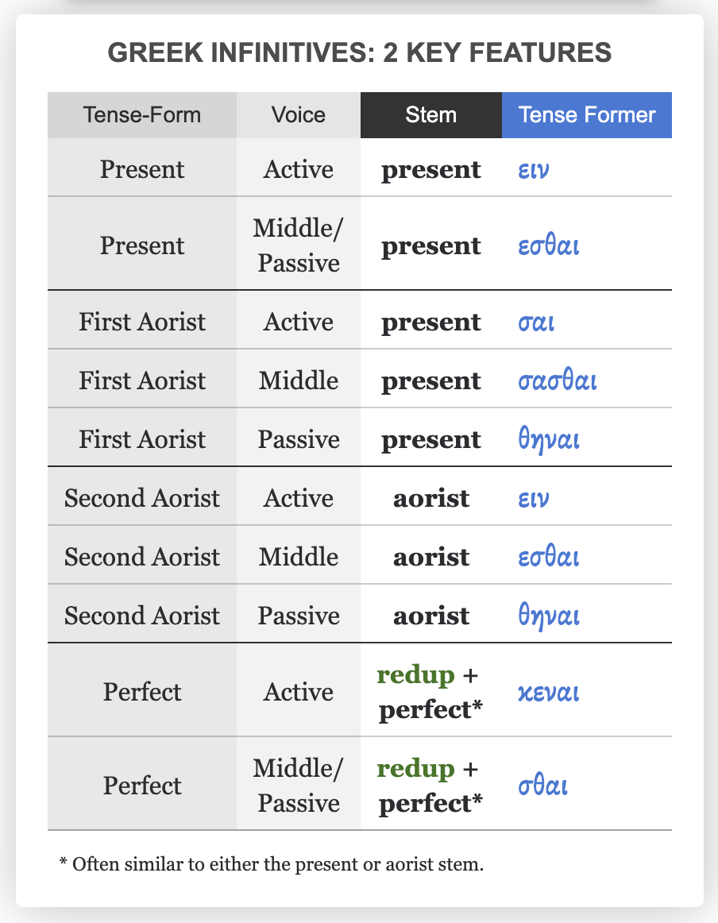

Slide 10
Participles and Infinitives
Infinitive of λύω
Present Active λύειν
Present Middle and Passive λύε-σθαι
Future Active λύσειν
Future Middle λύσε-σθαι
Future Passive λυθήσε-σθαι
Aorist Active λῦσαι
Aorist Middle λύσα-σθαι
Aorist Passive λυθῆ-ναι
Perfect Active λελυκέ-ναι
Perfect Middle and Passive λελύ-σθαι
Future Perfect Middle and Passive λελύσε-σθαι

Slide 11
Participles and Infinitives
Present Active Infinitive of τῑμάω (τῑμάειν) τῑμᾶν
Middle and Passive Infinitive of τῑμάω (τῑμάεσθαι) τῑμᾶσθαι
Present Active Infinitive of ποιέω (ποιέειν) ποιεῖν
Present Middle and Passive Infinitive of ποιέω (ποιέεσθαι) ποιεῖσθαι
Present Active Infinitive of δηλόω (δηλόειν) δηλοῦν
Present Middle and Passive Infinitive of δηλόω (δηλόεσθαι) δηλοῦσθαι

Slide 12
Participles and Infinitives
Infinitives:
Basic Properties
Infinitives are verbal nouns:
– they are like nouns in that they may fulfil syntactic roles which are typically fulfilled by noun phrases (subject, object, complement, and in that they may be modified by the article);
they can perform the functions of a noun (S, DO, Obj of the Prep).
– they are like verbs in that they are marked for tense-aspect and voice; may be construed with an object, complement, etc.; modified by adverbs; etc.
You can frequently translate a Greek infinitive like an English one: “to _____” (like to eat).

Slide 13
Participles and Infinitives
Infinitives:
Infinitive as Subject and Object
If the object of the infinitive is expressed, this will also be accusative
if the verb is normally found with an accusative object:
μαθητὰς τὴν ἀλήθειαν μανθάνειν ἀγαθόν έστι
it is a good thing that students should learn the truth.

Slide 14
Participles and Infinitives
Infinitives:
Since the INF is not technically a finite verb, it doesn’t have a S(ubject). The conceptual S of an INF, if it is overt, is going to be in the ACCUSATIVE case (not the NOM case!). It is often omitted if it is the same as the subject or object of the main verb.
Luke 2:27 (NA28)
καὶ ἐν τῷ εἰσαγαγεῖν τοὺς γονεῖς τὸ παιδίον Ἰησοῦν
… and when the parents brought in the child Jesus…

Slide 15
Participles and Infinitives
Infinitives:
Infinitive as Subject and Object
The infinitive can be used as a noun. It can be the subject of a verb:
μανθάνειν ἀγαθὸν ἐστἰ to learn is good or it is good to learn.
It can be the object of a verb:
μανθάνειν οὐκ ἐθέλω I do not want to learn.
As the subject of a verb, an infinitive can have an object:
τὀ τὴν ἀλήθειαν μανθάνειν ἀγαθόν έστι
to learn the truth is a good thing.
If the subject of the infinitive is expressed, it is in the accusative:
τὸ μαθητὰς μανθάνειν ἀγαθὀν ἐστί students to learn is a good thing

Slide 16
Participles and Infinitives
Exercise 1: Translate and find the Subject of these infinitives:
(οἱ ἄνθρωποι) κελεύουσι αὐτοὺς ἀπελθεῖν
βούλεται ἀπελθεῖν
Vocabulary:
ἀπέρχομαι = go, leave
κελεύω = command
βούλομαι = want

Slide 17
Participles and Infinitives
(The men command them to go away). Here, αὐτοὺς (them) is the subject of ἀπελθεῖν (to go away), while οἱ ἄνθρωποι (the men) is the subject of the main verb κελεύουσι (command).
(He wants to go away). The subject of ἀπελθεῖν (to go away) is understood to be the same as the subject of the main verb βούλεται (wants).

Slide 18
Participles and Infinitives
Infinitives:
With the article:
Used as nouns: e.g. τὸ βάλλειν ἐστιν ἀγαθόν.
An infinitive can function as the subject of a sentence, acting as a noun, especially with impersonal verbs like δεῖ, δοκεῖ (it is necessary, it seems) or with έστί. In these cases, it is typically placed at the beginning of the sentence, sometimes with a neuter article (e.g., τὸ ζῆν).
BUT ALSO: Δεῖ σε ἀπελθεῖν: with impersonal verbs: An infinitive can be the subject of an impersonal verb, such as dei (it is necessary) or dokei (it seems).
Example: Δεῖ σε ἀπελθεῖν (It is necessary for you to go away). Here, ἀπελθεῖν is the subject of the impersonal verb Δεῖ
With prepositions: Prepositions can be combined with an infinitive to create complex meanings.
διά + infinitive: Expresses cause.
ὥστε + infinitive: Indicates result.
πρίν + infinitive: Can express "before" or "until".

Slide 19
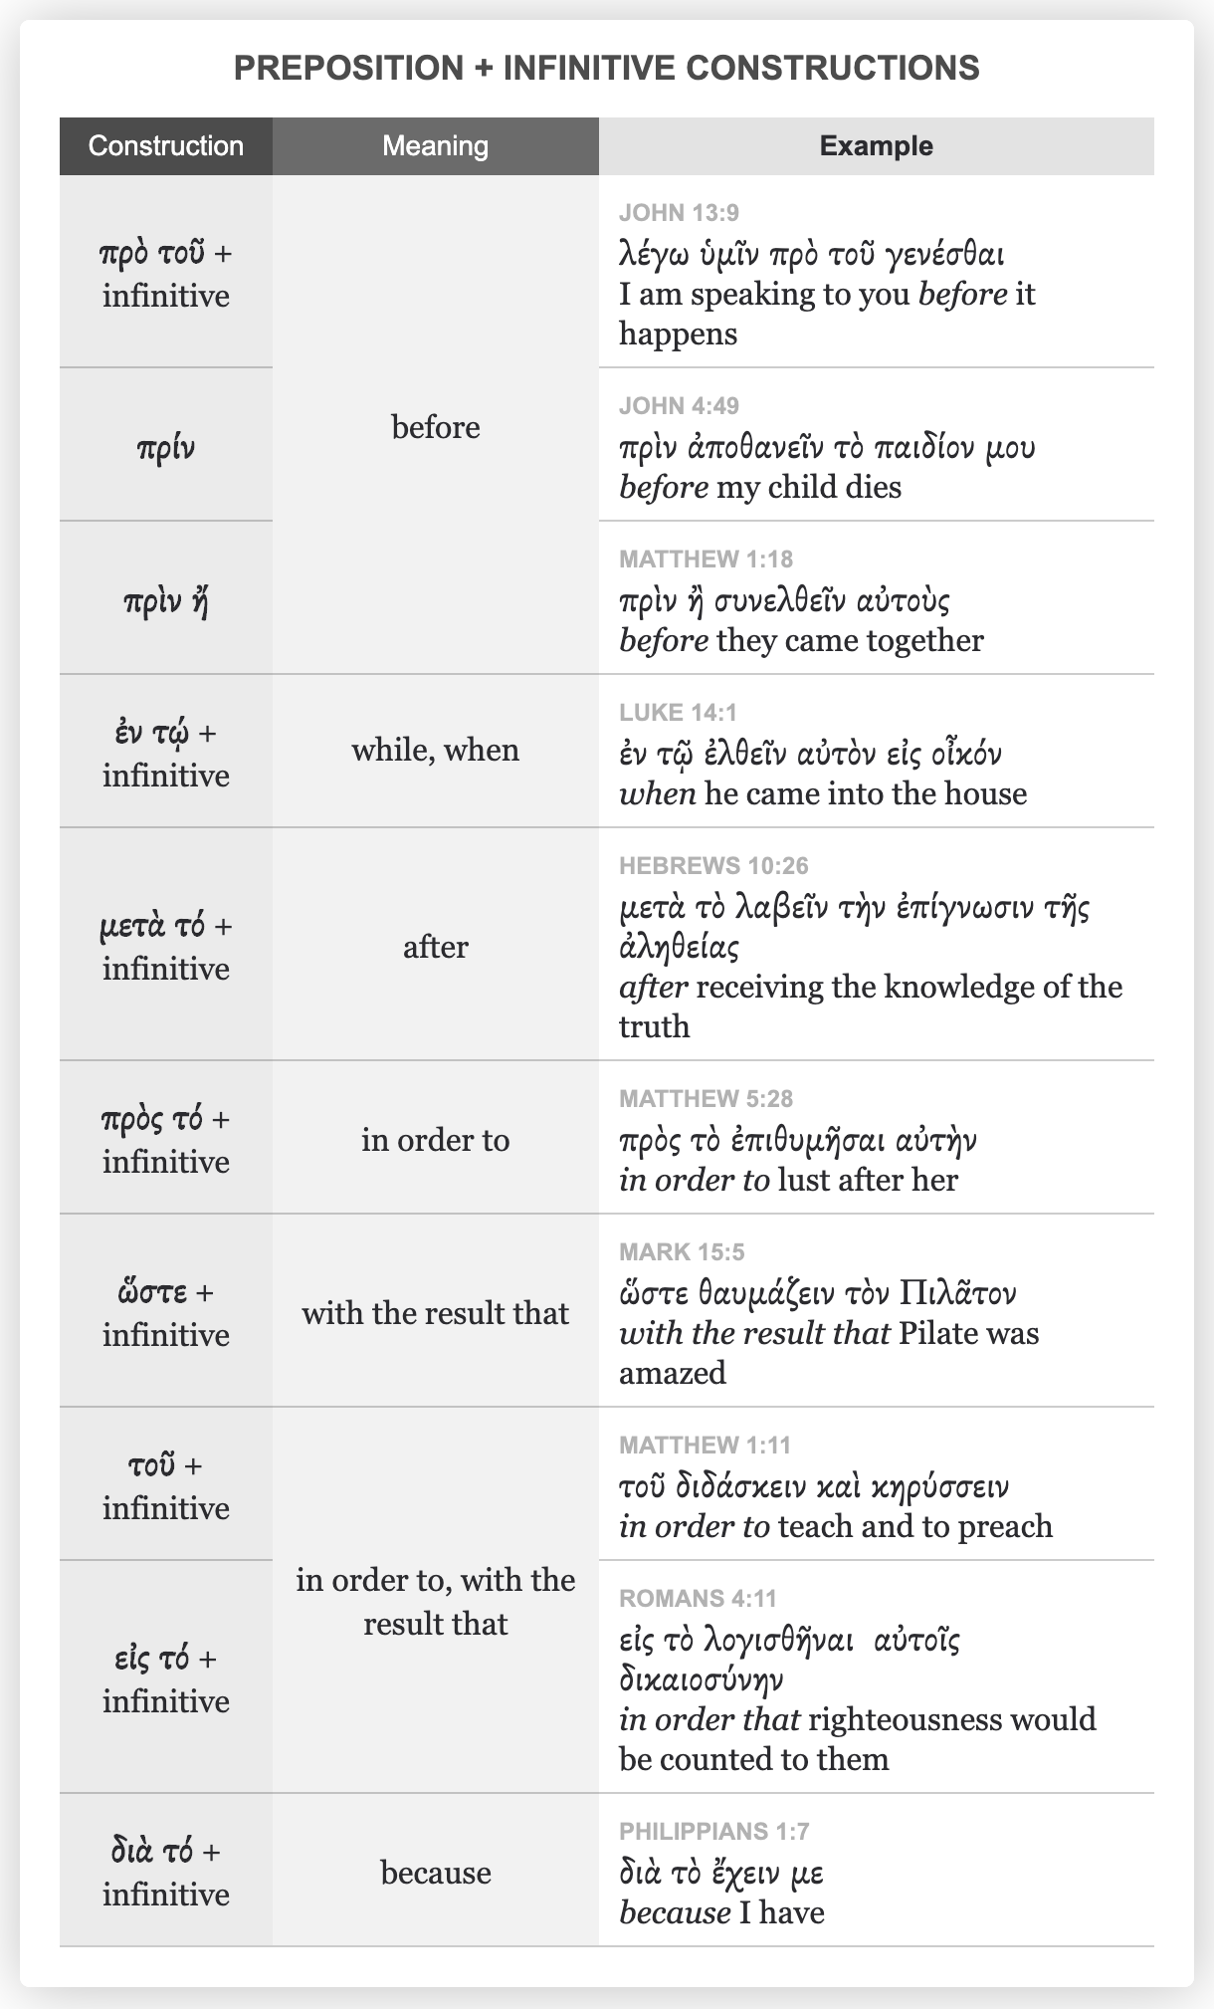

Slide 20
Participles and Infinitives
Infinitives:
Without the Article: Dynamic and Declarative Infinitive
The use of the infinitive without the article can be broadly divided into two categories:
– the dynamic infinitive: to complement verbs meaning ‘must’, ‘can’, ‘be able’, etc. (modal verbs); ‘want’, ‘desire’, ‘dare’, ‘try’, etc. (desiderative/volitional verbs); ‘be good at’, ‘teach how to’, ‘learn how to’, etc. (practical knowledge verbs); ‘command’, ‘suggest’, ‘compel’, etc. (manipulative verbs); ‘begin’, ‘stop’, etc. (phase verbs); and certain adjectives and nouns with similar meanings. It can be the object of these verbs.
– the declarative infinitive: to complement certain verbs of speech and verbs of belief and opinion, introducing a form of indirect statement.

Slide 21
Participles and Infinitives
Infinitives:
Without the Article: Dynamic and Declarative Infinitive
As complements, the dynamic and declarative infinitive are different in nature:
– The dynamic infinitive expresses an action, the realization of which is enabled, attempted, desired, forced, necessitated, asked for, etc. The action may or may not be realized.
– The declarative infinitive expresses the content of someone’s speech or belief about an action. This content (so-called ‘propositional’ content) may or may not be true.

Slide 22
Participles and Infinitives
Infinitives: Similarity
Without the Article: Dynamic and Declarative Infinitive
The dynamic infinitive and the declarative infinitive have in common that they do not in themselves specify whether the action is or is not realized or whether the propositional content is or is not true.

Slide 23
Participles and Infinitives
Infinitives: Differences
Without the Article: Dynamic and Declarative Infinitive
– The negative with dynamic infinitives is μή, with declarative infinitives nearly always οὐ;
– The dynamic infinitive is never modified by ἄν, whereas the declarative infinitive may be modified by ἄν;

Slide 24
Participles and Infinitives
Infinitives:
Without the Article: Dynamic and Declarative Infinitive
Examples:
(1) ἡ δὲ Παρύσατις . . . ἐκέλευσε . . . τὴν . . . Ῥωξάνην ζῶσαν κατατεμεῖν· καὶ ἐγένετο. (Ctes. fr. 15.56 Lenfant)
Parysatis ordered Roxane to be cut up alive. And so it happened. κατατεμεῖν, complementing κελεύω ‘command’, is a dynamic infinitive. Parysatis asks for a gruesome execution. The narrator then continues to say that this execution was actually carried out.
(2) φημὶ τοίνυν ἐγώ (καὶ . . . μηδεὶς φθόνῳ τὸ μέλλον ἀκούσῃ, ἀλλ᾽ ἂν ἀληθὲς ᾖ σκοπείτω), . . . κάλλιον Κόνωνα τὰ τείχη στῆσαι Θεμιστοκλέους. (Dem. 20.74)
Now I maintain (and let no one take offence at what is coming, but consider whether it is true) that Conon has put up the walls in a more laudable manner than Themistocles. στῆσαι, complementing φημί ‘say’, is a declarative infinitive. Demosthenes puts forward his opinion and asks his audience to consider whether that opinion is true or false.

Slide 25
Participles and Infinitives
Infinitives:
Without the Article: Dynamic and Declarative Infinitive
Exercise 2: Do we have a dynamic or a declarative infinitive?
1. ἔδοξε δὲ καὶ τοῖς τῶν Ἀθηναίων στρατηγοῖς . . . πλεῖν . . . ταῦτα δὲ βουλομένους ποιεῖν ἄνεμος καὶ χειμὼν διεκώλυσεν αὐτοὺς. (Xen. Hell. 1.6.35)
The generals of the Athenians also decided to sail. But although they wanted to do this, the wintry, stormy weather prevented them.
2. οὔ φημι ποιεῖν αὐτοὺς ἃ βούλονται· ἀλλάμ ’ ἔλεγχε. (Pl. Grg. 467b)
I claim that they are not doing what they want: refute me if you can.

Slide 26
Participles and Infinitives
1. ἔδοξε δὲ καὶ τοῖς τῶν Ἀθηναίων στρατηγοῖς . . . πλεῖν . . . ταῦτα δὲ βουλομένους ποιεῖν ἄνεμος καὶ χειμὼν διεκώλυσεν αὐτοὺς. (Xen. Hell. 1.6.35)
The generals of the Athenians also decided to sail. But although they wanted to do this, the wintry, stormy weather prevented them. ποιεῖν is a dynamic infinitive, complementing βουλομένους, a verb of wanting (so too πλεῖν, after a verb of deciding, impers. ἔδοξε). The Athenian generals want to go ahead with the expedition; the narrator goes on to say that the expedition is in fact not realized.
2. οὔ φημι ποιεῖν αὐτοὺς ἃ βούλονται· ἀλλάμ ’ ἔλεγχε. (Pl. Grg. 467b)
I claim that they are not doing what they want: refute me if you can. ποιεῖν is a declarative infinitive, complementing a verb of speech/opinion (φημί). Socrates puts forward his own opinion and challenges his addressee to prove that opinion false.

Slide 27
Participles and Infinitives
Infinitives:
With the Article; Other Uses
A neuter article (in any case, always singular) may be added to an infinitive to turn it into (the head of) a noun phrase. The infinitive itself never declines: τὸ παιδεύειν, τοῦ παιδεύειν, etc.

Slide 28
Participles and Infinitives
The Other Uses of the Infinitive:
The infinitive is occasionally used independently in commands (the imperatival infinitive):
σὺ δέ μοι ἐπὶ τὴν Ἑλλάδα στρατεύεσθαι. (Hdt. 3.134.5)
You must undertake an expedition against Greece
The infinitive is infrequently used in exclamations:
τῆς μωρίας, | τὸν Δία νομίζειν ὄντα τηλικουτονί. (Ar. Nub. 818–19)
What madness! To believe in Zeus, at your age!

Slide 29
Participles and Infinitives
The Other Uses of the Infinitive:
Finally, the infinitive is used in some idiomatic expressions, for instance:
ὡς (ἔπος) εἰπεῖν so to say, if I may use this expression, as it were, practically (often with forms of πᾶς, ‘practically everyone’, οὐδείς, ‘practically no one’)
(ὡς) συνελόντι εἰπεῖν in short, to be brief, to cut to the chase, if I may be brief
τὸ σύμπαν εἰπεῖν in short, in any case
ὀλίγου δεῖν almost, practically
ἐμοὶ δοκεῖν it seems to me
ὡς εἰκάσαι it seems/appears, so far as one might guess
ἑκὼν εἶναι voluntarily, willingly, intentionally
τὸ νῦν εἶναι for the time being
In each of these expressions, the infinitive is used absolutely, i.e. not dependent on
a verb, adjective, etc.:

Slide 30
Participles and Infinitives
https://wordwall.net/resource/29782343

Slide 31
Participles and Infinitives
Exercise 3: Find the use of these infinitives:
1) δεῖ γενέσθαι, It is necessary [for these things] to take place
2) ἐπετράπη τῷ Παυλῷ μένειν καθ' ἑαυτὸν, Paul was permitted to stay by himself
3) ἐδεῖτο τοῦ Κλεάρχου μὴ ποιεῖν ταῦτα, he besought Clearchus not to do this
4) βούλομαί σε εἰς τὰς Ἀθήνας ἰέναι, I want (for) you to go to Athens
5) τὸ παρανομεῖν εἰς κήρυκα καὶ πρέσβεις ἀσεβὲς ἐστί, To transgress the laws (= the act of transgressing the laws) against a herald and against ambassadors is impious

Slide 32
Participles and Infinitives
δεῖ γενέσθαι: S of the impersonal verb
ἐπετράπη … μένειν: object of the verb
ἐδεῖτο … μὴ ποιεῖν: object of the verb
βούλομαί … ἰέναι: object of the verb
τὸ παρανομεῖν … ἐστί: subject of the verb

Slide 33
Participles and Infinitives
Participles:
Basic Properties; Main Uses:
Participles are verbal adjectives:
– they are like adjectives in that they are marked for case, number and gender, and follow the rules of agreement;
– they are like verbs in that they are marked for tense-aspect and voice, and may be construed with an object, complement, etc.; modified by adverbs; etc.

Slide 34
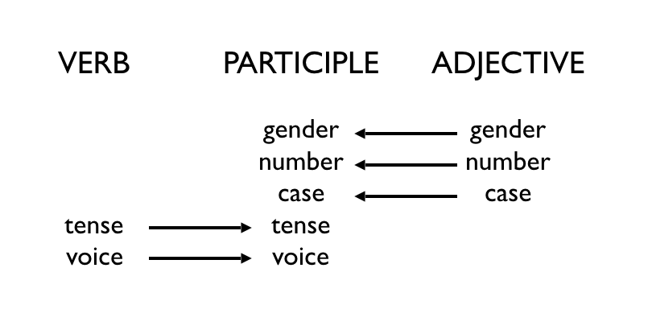

Slide 35
Participles and Infinitives
Participles:
Participles use the same TENSE STEM that a given VERB uses in the INDICATIVE mood.
Greek participles exist in the ACTIVE, MIDDLE, and PASSIVE voices. To mark these voices:
Participles add VOICE MARKERS to the tense stem.
Finally, Greek participles must be able to reflect the GENDER, NUMBER, and CASE of their ANTECEDENT, i.e., the noun to which the participle refers or modifies. To match the antecedent:
Participles add ADJECTIVE endings.

Slide 36
Participles and Infinitives
Participles:
Formation of the Participles:
The endings of participles are those of adjectives of the first and third declensions.

Slide 37
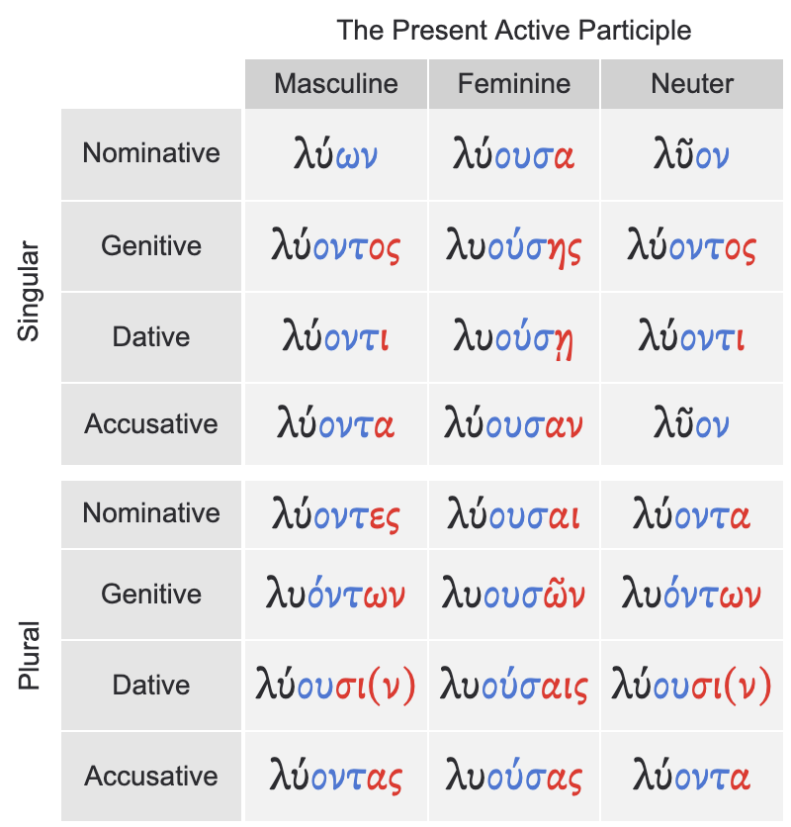

Slide 38
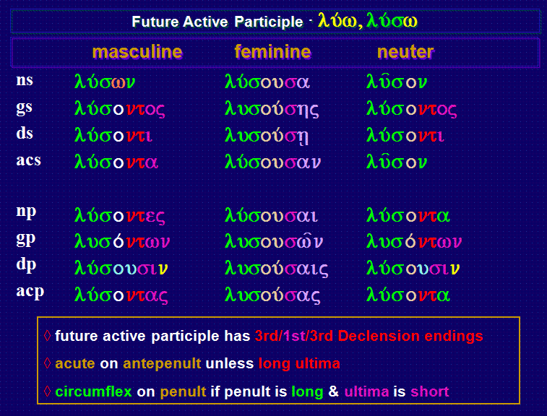

Slide 39
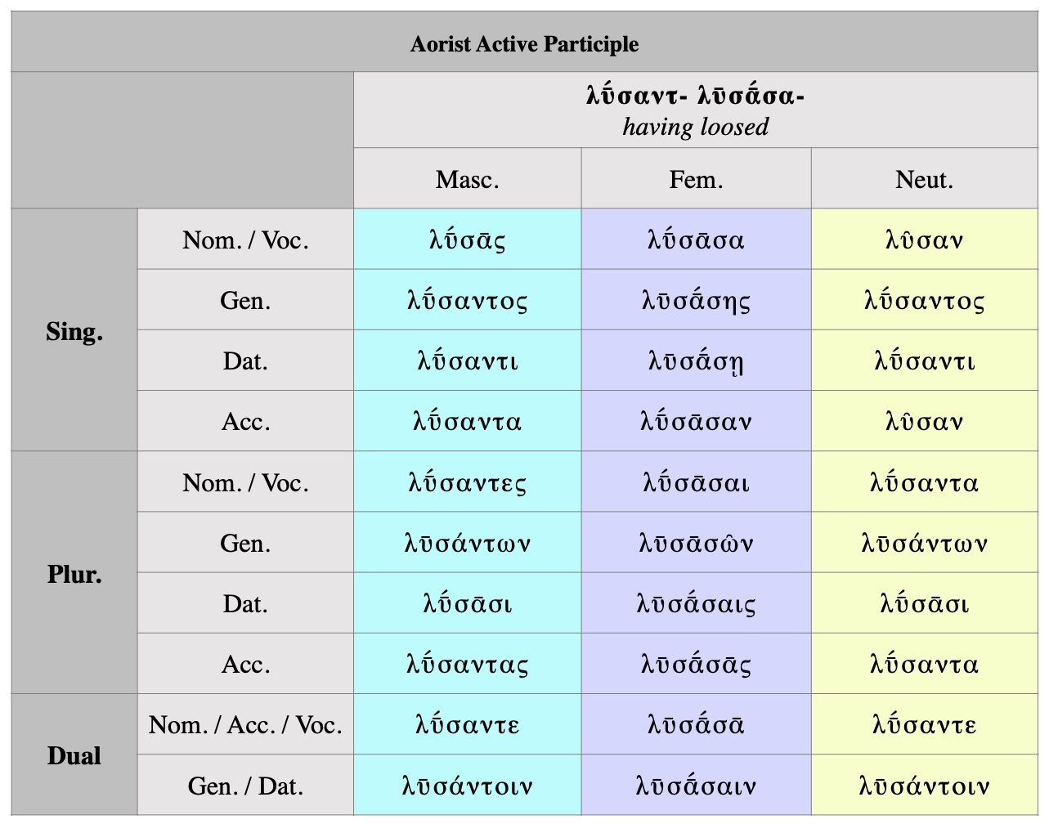

Slide 40
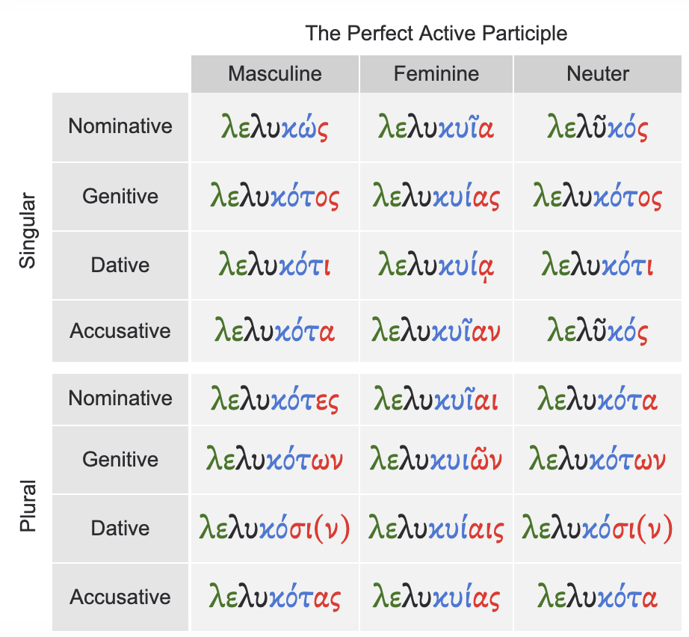

Slide 41
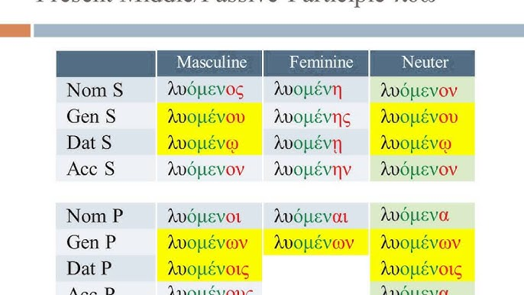

Slide 42
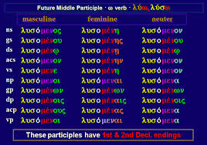

Slide 43
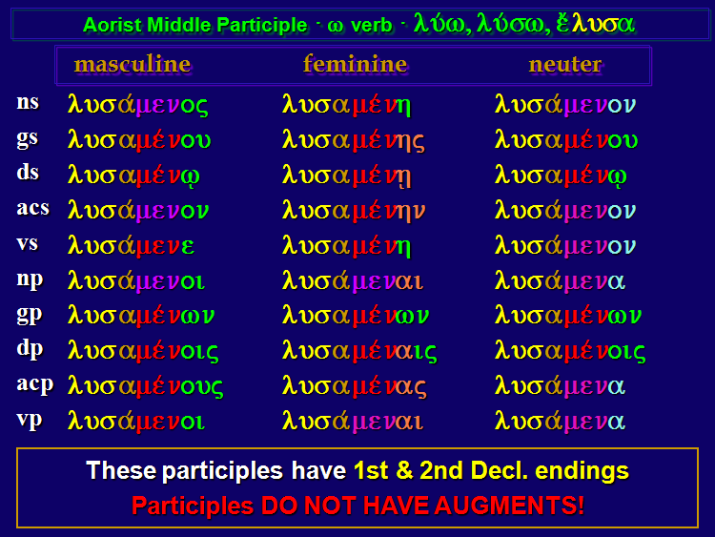

Slide 44
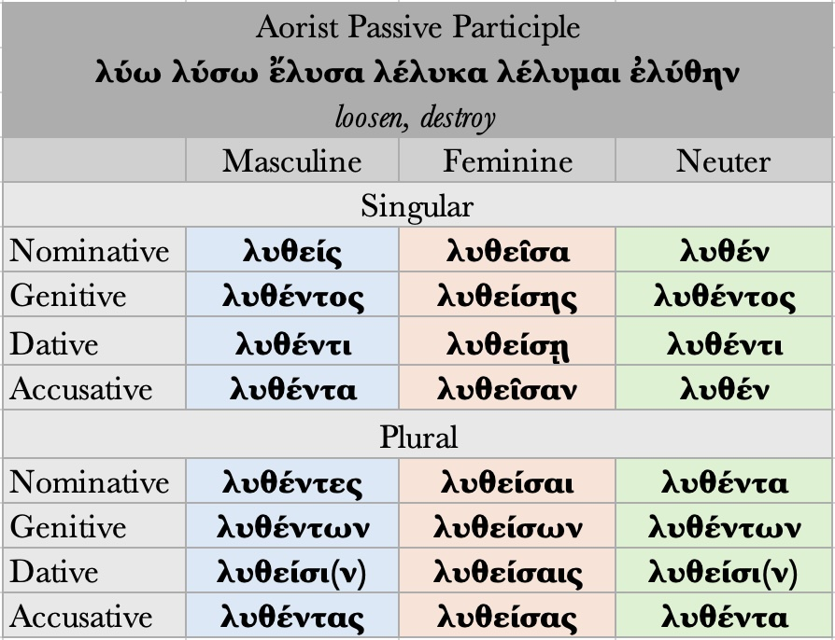

Slide 45
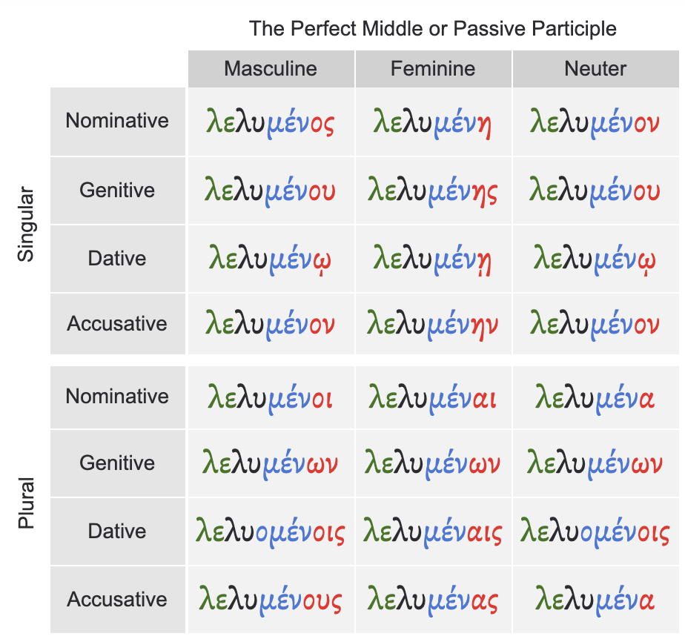

Slide 46
Participles and Infinitives
Participles:
Active Participles
The pattern for ALL PARTICIPLES in the ACTIVE voice is:
tense stem + ντ + 3-1-3 adjective endings
A σ is added before the 1st declension endings for the FEMININE
1st declension endings for the FEMININE use ᾰ in the nom. and acc. sing.
The persistent accent is on the LAST VOWEL SOUND of the TENSE STEM.

Slide 47
Participles and Infinitives
Participles:
Present Active Participle: Thematic Verbs
Present active participles are built upon the PRESENT TENSE STEM. For –ω verbs, the thematic vowel ο is added before the ντ marker, producing the following pattern:
present stem + οντ + 3-1-3 adjective endings
Predictable sound changes yield the following endings for the NOMINATIVE SINGULAR of THEMATIC PRESENT ACTIVE participles:
Masculine: (-οντς→-ονς→) –ων
Feminine: (-οντσα→-ονσα→) –ουσα
Neuter: (-οντ→) –ον
On their own, these endings form one of the most common and useful participles:
Being: Present Active Participle of εἰμί be (ὤν, οὖσα, ὄν)

Slide 48
Participles and Infinitives
Participles:
Present Active Participle: Thematic Verbs
To form the present active participle of –ω verbs, simply add the inflected forms of ων, ουσα, ον as an ending.
Loosening: Present Active Participle of λύω loosen: λύων λύουσα λῦον
M F N
Nominative λύων λύουσα λῦον
Genitive λύοντος λυούσης λύοντος
Dative λύοντι λυούσῃ λύοντι
Accusative λύοντα λύουσαν λῦον
Plural:
M F N
Nominative λύοντες λύουσαι λύοντα
Genitive λυόντων λυουσῶν λυόντων
Dative λύουσι λυούσαις λύουσι
Accusative λύοντας λυούσας λύοντα

Slide 49
Participles and Infinitives
Participles:
Present Active Participle: Contract Verbs
Contract verbs follow the normal rules of contraction when forming thematic present active participles.
Grabbing: Present Active Participle of αἱρέω grab
Masculine:
Nominative (αἱρέων→) αἱρῶν
Genitive (αἱρέοντος→) αἱροῦντος
κτλ
Feminine:
Nominative (αἱρέουσα→) αἱροῦσα
Genitive (αἱρεούσης→) αἱρούσης
κτλ
Neuter:
Nominative (αἱρέον→) αἱροῦν
Genitive (αἱρέοντος→) αἱροῦντος

Slide 50
Participles and Infinitives
Asking: Present Active Participle of ἐρωτάω ask
Masculine:
Nominative (ἐρωτάων→) ἐρωτῶν
Genitive (ἐρωτάοντος→) ἐρωτῶντος
κτλ
Feminine:
Nominative (ἐρωτάουσα→) ἐρωτῶσα
Genitive (ἐρωταούσης→) ἐρωτώσης
κτλ
Neuter:
Nominative (ἐρωτάον→) ἐρωτῶν
Genitive (ἐρωτάοντος→) ἐρωτῶντος
κτλ
Showing: Present Active Participle of δηλόω show
Masculine:
Nominative (δηλόων→) δηλῶν
Genitive (δηλόοντος→) δηλοῦντος
κτλ
Feminine:
Nominative (δηλόουσα→) δηλοῦσα
Genitive (δηλοούσης→) δηλούσης
κτλ
Neuter:
Nominative (δηλόον→) δηλοῦν
Genitive (δηλόοντος→) δηλοῦντος
κτλ

Slide 51
Participles and Infinitives
Participles:
Present Active Participle: Athematic Verbs
For athematic (-μι) verbs, no thematic vowel is added before the ντ marker. The result is the following pattern:
present stem + ντ + 3-1-3 adjective endings
Predictable sound changes yield the following endings for the NOMINATIVE SINGULAR of ATHEMATIC PRESENT ACTIVE participles:
Masculine: (-ντς→-νς→) –ς
Feminine: (-ντσα→-νσα→) –σα
Neuter: (-ντ→) –ν
In other words, for athematic verbs, add ς, σα, ν as an ending.

Slide 52
Participles and Infinitives
Showing: Present Active Participle of δείκνυμι show
Singular:
M F N
Nominative δεικνύς δεικνῦσα δεικνύν
Genitive δεικνύντος δεικνύσης δεικνύντος
Dative δεικνύντι δεικνύσῃ δεικνύντι
Accusative δεικνύντα δεικνῦσαν δεικνύν
Plural:
M F N
Nominative δεικνύντες δεικνῦσαι δεικνύντα
Genitive δεικνύντων δεικνυσῶν δεικνύντων
Dative δεικνῦσι δεικνύσαις δεικνῦσι
Accusative δεικνύντας δεικνύσας δεικνύντα
Note that when υ is lengthened due to compensatory lengthening, the result is long υ.

Slide 53
Participles and Infinitives
Giving: Present Active Participle of δίδωμι give
M F N
Nominative διδούς διδοῦσα διδόν
Genitive διδόντος διδούσης διδόντος
κτλ
Note that the stem of this participle is διδόντ. When ο is lengthened due to compensatory lengthening, the result is ου.
Placing, making: Present Active Participle of τίθημι place, make
M F N
Nominative τιθείς τιθεῖσα τιθέν
Genitive τιθέντος τιθείσης τιθέντος
κτλ
Note that the stem of this participle is τιθέντ. When ε is lengthened due to compensatory lengthening, the result is ει.

Slide 54
Participles and Infinitives
Standing: Present Active Participle of ἵστημι stand
M F N
Nominative ἱστάς ἱστᾶσα ἱστάν
Genitive ἱστάντος ἱστάσης ἱστάντος
κτλ
Note that the stem of this participle is ἱστάντ. When α is lengthened due to compensatory lengthening, the result is long α.
Throwing: Present Active Participle of ἵημι throw
M F N
Nominative ἱείς ἱεῖσα ἱέν
Genitive ἱέντος ἱείσης ἱέντος
κτλ
Note that the stem of this participle is ἱέντ. When ε is lengthened due to compensatory lengthening, the result is ει.

Slide 55
Participles and Infinitives
Participles:
Future Active Participle
Recall that ALL verbs are THEMATIC (-ω) verbs in the FUTURE tense. So to form the future active participle:
Add ων, ουσα, ον to the future stem (= verb stem + σ)
About to loosen: Future Active Participle of λύω loosen
M F N
Nominative λύσων λύσουσα λῦσον
Genitive λύσοντος λυσούσης λύσοντος

Slide 56
Participles and Infinitives
Participles:
Future Active Participle
About to show: Future Active Participle of δείκνυμι show
M F N
Nominative δείξων δείξουσα δεῖξον
Genitive δείξοντος δειξούσης δείξοντος

Slide 57
Participles and Infinitives
Participles:
First Aorist Active Participle
The pattern to form the FIRST AORIST ACTIVE participle is:
verb stem + σα + ντ + 3-1-3 adjective endings
Predictable sound changes yield the following endings for the nominative singular of first aorist active participles:
Masculine: (-σαντς→-σανς→) –σας
Feminine: (-σαντσα→-σανσα→) –σασα
Neuter: (-σαντ→) –σαν

Slide 58
Participles and Infinitives
In other words, to form the first aorist active participle, add the inflected athematic endings of ς, σα, ν to the aorist stem (i.e. verb stem + σα). As with present active participles:
A σ is added before the 1st declension endings for the FEMININE
1st declension endings for the FEMININE are ᾰ in the nom. and acc. sing.
The persistent accent is on the LAST VOWEL SOUND of the VERB STEM.
Finally, remember that only past tense INDICATIVE verbs receive an AUGMENT. Participles, like infinitives, receive no augment.
Having loosened: First Aorist Active Participle of λύω loosen
M F N
Nominative λύσας λύσασα λῦσαν
Genitive λύσαντος λυσάσης λύσαντος
κτλ

Slide 59
Participles and Infinitives
Participles:
Second Aorist Active Participle: Thematic
The pattern to form the SECOND AORIST ACTIVE participle is:
verb stem + ντ + 3-1-3 adjective endings
If the SECOND AORIST is THEMATIC, sound changes yield endings identical with the nominative singular of thematic present active participles:
Masculine: (-οντς→-ονς→) –ων
Feminine: (-οντσα→-ονσα→) –ουσα
Neuter: (-οντ→) –ον

Slide 60
Participles and Infinitives
Participles:
There are two differences between the ACTIVE THEMATIC participles of the PRESENT and the SECOND AORIST:
Stem
The PRESENT uses the PRESENT TENSE stem
The SECOND AORIST uses the VERB stem
Accent
The PRESENT accents the LAST VOWEL SOUND of the TENSE STEM
The SECOND AORIST accents the THEMATIC VOWEL sound
In other words, to form the second aorist active thematic participle, add –ών –οῦσα –όν to the verb stem.
Having taken: Second Aorist Active Participle of λαμβάνω take
M F N
Nominative λαβών λαβοῦσα λαβόν
Genitive λαβόντος λαβούσης λαβόντος
κτλ

Slide 61
Participles and Infinitives
Participles:
Second Aorist Active Participle: Athematic
Athematic (-μι) second aorist verbs have no thematic vowel before the ντ marker. The result is the following pattern:
verb stem + ντ + 3-1-3 adjective endings
As with present active athematic participles, predictable sound changes yield the following endings for the nominative singular of athematic present active participles:
Masculine: (-ντς→-νς→) –ς
Feminine: (-ντσα→-νσα→) –σα
Neuter: (-ντ→) –ν

Slide 62
Participles and Infinitives
Participles:
In other words, for athematic verbs, simply add ς, σα, ν as an ending to the verb stem. Note that for δίδωμι, τίθημι, ἵστημι, and ἵημι, the AORIST ACTIVE participle is identical with the PRESENT ACTIVE participle except for the REDUPLICATION in the present:
διδούς/δούς
τιθείς/θείς
ἱστάς/στάς
ἱείς/εἵς
Having given: Aorist Active Participle of δίδωμι give
M F N
Nominative δούς δοῦσα δόν
Genitive δόντος δούσης δόντος
Κτλ
Having placed, made: Aorist Active Participle of τίθημι place, make
M F N
Nominative θείς θεῖσα θέν
Genitive θέντος θείσης θέντος
κτλ

Slide 63
Participles and Infinitives
Participles:
Participles: Middle Voice
Middle Participles
The pattern for ALL PARTICIPLES in the MIDDLE voice is:
tense stem + μεν + 2-1-2 adjective endings
In other words, to form the PRESENT, FUTURE, or AORIST middle participle:
simply add –μενος –μένη –μενον to the appropriate tense stem
thematic (-ω) verbs add an –ο before these endings: –όμενος –ομένη –όμενον
The ACCENT for all middle participles:
recedes to the ANTEPENULT when possible

Slide 64
Participles and Infinitives
Participles:
Present Middle Thematic Participles
λύω
λυόμενος λυομένη λυόμενον
Future Middle Participles
λύω
λυσόμενος λυσομένη λυσόμενον

Slide 65
Participles and Infinitives
Participles:
Middle Participles: Athematic Verbs
δείκνυμι
Present: δεικνύμενος -η -ον
δίδωμι
Present: διδόμενος -η –ον
Aorist: δόμενος -η –ον
τίθημι
Present: τιθέμενος -η -ον
Aorist: θέμενος -η –ον
ἵστημι
Present: ἱστάμενος -η -ον
Aorist: none
ἵημι
Present: ἱέμενος -η -ον
Aorist: ἕμενος -η –ον

Slide 66
Participles and Infinitives
Participles:
Middle Participles: First Aorist
λύω
λυσάμενος λυσαμένη λυσάμενον
Middle Participles: Second Aorist Thematic
λαμβάνω
λαβόμενος λαβομένη λαβόμενον

Slide 67
Participles and Infinitives
Participles:
Aorist Passive Participle
Recall that the marker –θη– means an AORIST is PASSIVE or INTRANSITIVE. In the participle, the –η– shortens to –ε-. As a result, the pattern for the AORIST PASSIVE PARTICIPLE is:
verb stem + θε + ντ + 3-1-3 adjective endings
Sound changes yield the following endings for the NOMINATIVE SINGULAR of AORIST PASSIVE participles:
Masculine: (-θεντς→-θενς→) –θείς
Feminine: (-θεντσα→-θενσα→) –θεῖσα
Neuter: (-θεντ→) –θέν
As with present and aorist active participles:
A σ is added before the 1st declension endings for the FEMININE
1st declension endings for the FEMININE are ᾰ in the nom. and acc. sing.
Note, though, that the persistent ACCENT remains on the –ε– sound. In other words, to form the aorist passive participle, add –θείς –θεῖσα –θέν to the verb stem.

Slide 68
Participles and Infinitives
Participles:
Having been loosened: Aorist Passive Participle of λύω loosen
M F N
Nominative λυθείς λυθεῖσα λυθέν
Genitive λυθέντος λυθείσης λυθέντος
κτλ

Slide 69
Participles and Infinitives
Summary of Participles:
The following charts summarizes the participle forms, and the translation of the active and passive forms. The translation of the middle form varies according to the particular verb and its context.
λύω, λύσω, ἔλυσα loosen, destroy
Active Middle (Passive) Passive
Present
λύων loosening λυόμενος
Future
λύσων about to loosen λυσόμενος
Aorist
λύσας having loosened λυσάμενος λυθείς having been loosened

Slide 70
Participles and Infinitives
Exercise 4: For each of the participial forms, identify the tense, voice, gender, number, and case. Note that there may be more than one possibility for each category.
ὄντα
λεγόντων
διδόμενον
βαίνουσαι
οἰκοῦντας
ἀγαπῶντος
ἱστάμενος
βουλεύσοντας
θεμένη

Slide 71
Participles and Infinitives
Participles:
Now that we have learned how to form participles, let’s see how they are used in Greek. Recall that participles are VERBAL ADJECTIVES.
VERBAL: participles have tense and voice, and can take objects or introduce clauses or phrases
ADJECTIVAL: participles match their antecedent (usually a noun or pronoun) in gender, number, and case

Slide 72
Participles and Infinitives
Participles:
They can be used adjectivally to describe a noun, or adverbially to provide circumstantial information like time, manner, or cause for the main verb of a sentence. Key features to identify are their tense (present, aorist, perfect, future), voice (active, middle, passive), and agreement with nouns in gender, number, and case.

Slide 73
Participles and Infinitives
Participles:
The uses of participles may be grouped under three headings:
– Supplementary (also predicative participle): the participle is used as an obligatory constituent (argument of a verb) with verbs:
ὅλην ἀδικῶν φανήσεται τὴν πόλιν. (Dem. 24.29)
He will prove to be doing wrong to the city as a whole. ὅλην ἀδικῶν . . . Τὴν πόλιν is a complement of φανήσεται.
It agrees with the object or the subject of some verbs.

Slide 74
Participles and Infinitives
Predicative participles:
Common with verbs (agrees with the subject):
a) that express existence in some particular way. Τυγχάνω = am by chance, happen to be, λανθάνω = am secretly or without the knowledge οf, φθάνω = am first, get the start in, = διάγω, διατελῶ, διαγίγνομαι, = am continuously, keep on
φαίνομαι (also δῆλός or φανερός εἰμι) = am plainly,
Παρὼν ἐτύγχανε. He happened to be there. Xen. Anabasis 1.1.2
b. With verbs meaning begin, cease, endure, grow weary, and the like.
Oὔποτε ἐπαυόμην ἡμᾶς οἰκτῑ́ρων.
I never ceased pitying ourselves. Xen. Anabasis 3.1.19
c. With οἴχομαι (am gone) a predicate participle may specify the manner of going, and so contain the main thought.
Εἰς τὸ πρόσθεν οἱχονται διώκοντες.
They have gone forward in pursuit. Xen. Anabasis 1.10.5
Predicative participles:
Common with verbs (agrees with the object):
a) With some verbs meaning perceive (with the senses or with the mind), remember, knοw, and the like.
Εἶδε Κλέαρχον διελαύνοντα.
He saw Klearchos riding through. Xen. Anabasis 1.5.12
b) With verbs meaning show, make knοwn, and the like.
Κῦρον ἐπιστρατεύοντα πρῶτος ἤγγειλα.
I was the fιrst to report that Cyrus was marching against him. Xen. Anabasis 2.3.19

Slide 75
Participles and Infinitives
Participles:
The uses of participles may be grouped under three headings:
– Circumstantial (no articles precedes)/adverbial: the participle is added as an optional constituent to clauses to express a circumstance, cause, condition, motivation, purpose, etc. It either agrees with a constituent of the clause (connected use) or is added with its own subject in the genitive (genitive absolute). It is an an adverbial satellite of a verbal predicate.
The participle introduces the circumstances under which an action occurred. It is often translated into English with a dependent clause:
αὐτοὶ δ’ οὐ δύνανται . . . ἡσυχίαν ἄγειν οὐδενὸς αὐτοὺς ἀδικοῦντος. (Dem. 8.67)
They themselves cannot keep quiet, even though no one is wronging them. οὐδενὸς αὐτοὺς ἀδικοῦντος is an optional constituent added in the genitive absolute construction, expressing a concession (‘even though’).

Slide 76
Participles and Infinitives
Participles:
The uses of participles may be grouped under three headings:
– Attributive/substantival (article precedes): the participle is used, normally with the article, in noun phrases, as modifier of a noun (attributive use) or head (substantival use). It is practically an adjective:
. . . βοηθεῖν ταῖς ἀδικουμέναις πόλεσι. (Xen. Hell. 6.3.18)
. . . to help the cities that were being wronged. Attributive: modifier with ταῖς πόλεσι.

Slide 77
Participles and Infinitives
Participles:
Tenses of Participles:
The TENSE of the CIRCUMSTANTIAL participle indicates a temporal relationship with the main verb:
The PRESENT participle:
refers to action happening at the SAME TIME as the main verb
The FUTURE active participle:
refers to action AFTER the main verb
The AORIST participle:
often refers to action PRIOR to another verb

Slide 78
Participles and Infinitives
Participles:
Negatives
The negative for a participle is normally οὐ:
οὐ τρέχοντες ἐλαμβάνομεν τοὺς ἵππους.
Although we were not running, we caught the horses.
For GENERIC ATTRIBUTIVE participles, however, the negative is μή:
λαμβάνομεν τοὺς μὴ τρέχοντας ἵππους.
We catch horses that do not run.
For CIRCUMSTANTIAL participles expressing a NEGATIVE CONDITION, the negative is μή:
λαμβάνομεν τοὺς ἵππους μὴ τρέχοντας.
We catch horses, if they are not running.

Slide 79
Participles and Infinitives
Participles:
Placement of Participles:
Both circumstantial participles and supplementary participles occur in predicative position relative to any (head) noun with which they agree; attributive participles naturally occur in attributive position:
ὁρῶντες . . . τοὺς ἑαυτῶν ἱππέας φεύγοντας (Xen. An. 4.3.23)
seeing that their own cavalry was fleeing . . . Supplementary participle, predicative position
τοὺς δούλους παρέλυσεν | τοὺς φεύγοντας. (Ar. Pax 742–3)
He cut loose the slaves who run away. Attributive participle, attributive position.

Slide 80
Participles and Infinitives
Participles:
Tense/Aspect and ‘Mood’ of Participles:
Each of the tense-aspect stems has its own participle: the difference between the stems is aspectual (except for the future stem). In the case of the participle, these aspectual differences lead to a relative-tense interpretation in a large majority of cases:
– The present participle typically expresses an action simultaneous with that of the matrix verb:
ταῦτα γράφων ἔννομα . . . ἔγραψα. (Dem. 7.25)
In writing those things I wrote things that were lawful.
– The aorist participle usually expresses an action anterior to that of the matrix verb:
κἀν δέλτου πτυχαῖς | γράψας ἔπεμψα πρὸς δάμαρτα τὴν ἐμήν. (Eur. IA 98–9)
After writing (a message) on a folded tablet, I sent it to my wife.

Slide 81
Participles and Infinitives
Participles:
Tense/Aspect and ‘Mood’ of Participles:
– The perfect participle typically refers to a state (or lasting effects), simultaneous with the matrix verb, resulting from a previously completed action:
ὑπανέγνω τὸ ψήφισμα ὃ γεγραφὼς αὐτὸς ἦν. (Aeschin. 2.109)
He read aloud the motion of which he himself was the author. Being the author of something is the state that results from writing it.
– The future participle always has a relative-tense interpretation, referring to an action posterior to that of the matrix verb:
οὐδέπω . . . δῆλος ἦν . . . ἐκεῖνος τοιαῦτα γράψων. (Dem. 19.236)
It was not yet clear that that man was going to draft such proposals.
For the use of the future participle to express purpose

Slide 82
Participles and Infinitives
Participles:
Tense/Aspect and ‘Mood’ of Participles:
ἄν with Participles
The participle (in any of its uses) may be joined with ἄν, and then has the force either of a potential optative or a counterfactual indicative:
καὶ ὁρῶν τὸ παρατείχισμα τῶν Συρακοσίων . . . ῥᾳδίως ἂν . . . ληφθέν . . . (Thuc. 7.42.4)
And seeing that the fortification of the Syracusans might easily be taken . . . ἂν ληφθέν is supplementary with ὁρῶν, and represents ληφθείη ἄν (potential opt. + ἄν). For more on supplementary participles + ἄν.
Ποτείδαιαν . . . ἑλὼν καὶ δυνηθεὶς ἂν αὐτὸς ἔχειν, εἴπερ ἐβουλήθη, παρέδωκεν. (Dem. 23.107)
Having taken Potidaea, and even though he would have been able to keep it by himself, had he wanted to, he gave it up. δυνηθεὶς ἄν is circumstantial, and represents ἐδυνήθη ἄν (counterfactual ind. + ἄν).

Slide 83
Participles and Infinitives
Exercise 5: Identify the participles in the sentences that follow and provide the following information for each:
Tense
Voice
Gender
Number
Case
Function (Attributive, Circumstantial, Supplementary)

Slide 84
Participles and Infinitives
1) οἱ φεύγοντες ἄνδρες, The men who flee…
2) τρέχοντες λαμβάνομεν τοὺς ἵππους, When we are running, we catch the horses
3) λαμβάνομεν τρέχοντας τοὺς ἵππους, We catch the horses, while they are running
4) ἐτύγχανον λέγων, I was just saying
5) ἤκουσά ποτε αὐτοῦ περὶ φίλων διαλεγομένου,I once heard him talking about friends

Slide 85
Participles and Infinitives
1) attributive (an article precedes, it is an ‘adjective’, modifies the men)
2) circumstantial (no article, shows the circumstances under which an action is happening: HOW? E.g., Running, manner or time while we are running), ANTECEDENT: ἡμεῖς (Subject of λαμβάνομεν)
3) circumstantial (no article). ANTECEDENT: τοὺς ἵππους (ACCUSATIVE CASE = object of the verb).
4) supplementary/predicative (τυγχάνω = meaning I exist). It agrees with the subject of the verb: who ἐτύγχανον? = I / who λέγων? = Ι
5) supplementary/predicative (ἤκουσά = perceive by hearing, agrees with the object, who ἤκουσά = I, who διαλεγομένου = αὐτοῦ)

Slide 86
Philosophical Vocabulary
Λ
λέξις: in general, speech. In philosophy, lexis is sometimes diction as opposed to content: kata de tén lexin asapheian poiei to hé toi ho logos proskeimenon kai thélukon arthron téi arsenikéi suntetagmenon — as regards diction, some unclarity is caused by the ‘hé’ adjoining ‘ho logos’, i.e. the feminine article joined with the masculine (Simplicius, Physics 233.3); cf. Aspasius on EN. 122.27.
λογιστικός: usually applied to matters of calculation, numbers and arithmetic; hoi te phusei logistikoi eis panta ta mathémata hos epos eipein oxeis phuontai — natural calculators are naturally quick at practically speaking all studies (Pl. Rep. 526b). But also more generally ‘rational’: hé men oun aisthétiké phantasia kai en tois allois zoiois huparkhei, hé de bouleutiké‘ en tois logistikois — perceptual imagination is found also in other animals, but deliberative imagination only in those that are rational (Ar. De An. 434a 6).

Slide 87
Philosophical Vocabulary
λύπη, λυπεῖσθαι, λυπηρός: opposite of hédoné, hédesthai, hédus. lupé is any emotionally unfavourable reaction, and includes dislike, distress, grief and pain, but is not to be identified with any of these, and especially not with pain, though this is often given as the single translation. Andronicus, in his book Peri Pathén — ‘On Emotions’ — lists 25 varieties of lupé, including metameleia, regret, and oiktos,pity. Similarly the lupéros, as the opposite of the hédus, is the unpleasant, not specifically the painful, though pain is one among many unpleasant things. hotan tis sterétheis lupéthéi dia tén khreian — when someone deprived is distressed through his need (Pl. Philebus 52b).
λύσις: in general, and always in Plato, freeing or liberation: lusis kai khérismos psukhés apo sématos — freeing and separation of soul from body (Pl. Phaedo 67d).

Slide 88
Philosophical Vocabulary
Μ
μανία: mania: usually, madness in an ordinary medical sense. But, most noticably in the Phaedrus, it is used by Plato of what he considers to be irrational but in some way inspired.
μέσοτης: intermediacy, an abstract noun derived from mesos, used especially in Aristotle’s doctrine of the mean: estin ara hé areté hexis proairetiké en mesotéti ousa téi pros hémas — so excellence is a disposition to choose in a mean relative to us (Ar. EN. 1 107 b 36); Peri men oun phobous kai tharré andreia mesotés — so bravery is a mean state concerning fear and confidence (Ar. E.N. 1107a 34).

Slide 89
Philosophical Vocabulary
μεταβολή: change: ton politeién genesis kai metabolé —- the coming into being ofand change in constitutions (Pl. Laws 676C). In Aristotle and, under his influence, in much later philosophy, metabolé became “ the most general word for change of all kinds, the principal distinction being between substantial change, such as genesis, coming to be, and phthora, ceasing to be, on the one hand, and various types of kiné‘sis on the other:
μέτρον: measure: phési gar pou ‘panton khrématon metron’ anthropon einai ‘tén men onton hos estin ton de mé onton hos ouk estin’- for [Protagoras] says that man is ‘the measure ofall things, of things that are that they are and of things that are not that they are not’ (Pl. Theaet. 152a); to meson ta auta metra ton eskhatén —- the middle point which is the same distance from the extremes (Pl. Tim. 62d); metra oinéra kai sitéra — measures of wine and grain (Ar. E.N. 1135a 1).

Slide 90
Philosophical Vocabulary
μίμησις: imitation, representation: hé mimésis poiésis tis estin, eidélc‘m mentoi phamen, all’ouk autén hekaston — imitation is a kind of creation, but we say that it is of images and not of the things themselves (Pl. Soph. 265a). In Book 3 of the Republic Plato limits mimésis in dramatic poetry to speaking in the person of a character, in contrast to haplé diégésis, simple narration, of the words of the poet, including indirect speech, but that restriction is not found later in the Republic or elsewhere. In Poetics 1447 a-b Aristotle includes all that we should call the fine arts under mimésis, including epic, tragedy, comedy, wind and string instruments, colours and shapes (i.e. painting and sculpture): tautas men oun lego tas diaphoras ton tekhnon en hois poiountai tén mimésin - these I say are the differences in the arts in which there is representation (Ar. Poetics 1147b 28).

Slide 91
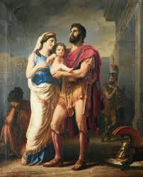
Thank you!
Have a nice evening.

