Slide 1
Ancient Greek (Intermediate Level)
ATHENS MA IN ANCIENT PHILOSOPHY
NATIONAL AND KAPODISTRIAN UNIVERSITY OF ATHENS / Department of History and Philosophy of Science
In collaboration with:
•UNIVERSITY OF PATRAS / Department of Philosophy
•UNIVERSITY OF CRETE / Department of Philosophy and Social Studies

Slide 2
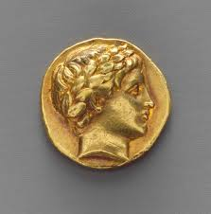
WEEK 7
Contract verbs and Verbs in –μι

Slide 3
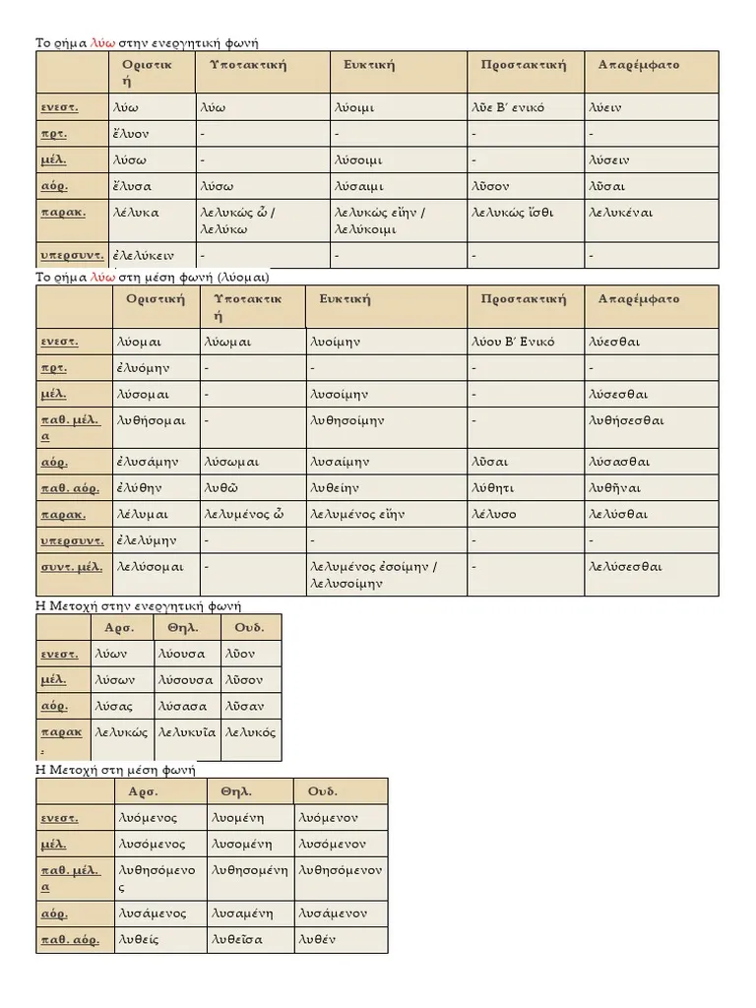
Contract Verbs

Slide 4
Contract Verbs
Present stems ending in ι, υ, a diphthong or a consonant, e.g. χρίω anoint, λύω loosen, release, παιδεύω educate, λέγω say, speak. The thematic vowel and endings follow on the stem.
Present stems ending in other vowels (typically ε, α, ο), e.g. ποιέ-ω make, do, τιμά-ω honour, δηλό-ω make clear. The thematic vowel and endings contract with the final vowel of the stem: ποιῶ, τιμῶ, δηλῶ. These are called contract(ed) verbs.

Slide 5
Contract Verbs
The rules of vowel contraction operate in verbs when the VERB STEM ends in one of three short vowels: –α, –ε or –ο. In these cases, the final vowel of the stem contracts with the THEMATIC VOWEL of –ω verbs.
There are three types of contract verbs: έω, άω, and όω. To inform readers that a verb is a CONTRACT VERB, its FIRST PRINCIPAL PART is always listed in its uncontracted form in a lexicon. For example:
αἱρέω grab
ἐρωτάω ask
δηλόω show

Slide 6
Contract Verbs
In –έω:
The most common type of contract verbs are those whose verb stems end in –ε. For these verbs, when –ε contracts with a long vowel or diphthong, the long sound simply absorbs the –ε.
ε + ω = ω
ε + ει = ει
ε + ο = ου
ε + ε = ει
ε + ου = ου

Slide 7
Contract Verbs
Verbs in –έω with a disyllabic first-person singular offer a slight variation from all other –έω verbs. They DO NOT contract the –ε with either ο or ω. They DO contract –ε with ε and ει. There are only two common disyllabic –έω verbs in Greek: δέω “need, want, lack” and πλέω “sail.”
(πλέω →) πλέω I sail
(πλέομεν →) πλέομεν we sail
(πλέεις →) πλεῖς you sail
(πλέετε →) πλεῖτε y’all sail
(πλέει →) πλεῖ (s)he, it sails
(πλέουσι →) πλέουσι they sail
Present infinitive active: (πλέειν →) πλεῖν

Slide 8
Contract Verbs
The FUTURE TENSE of most έω verbs is formed regularly, with one slight change. When the tense marker σ is added to a verb stem ending in ε, the ε lengthens to η. Most (not all!) έω verbs form their future active by adding –σω to the lengthened vowel, resulting in the ending –ήσω. The future tense then conjugates regularly, using –ω personal and infinitive endings.
Note the PRINCIPAL PARTS of the following έω verbs.
ἀδικέω -ήσω commit injustice
αἱρέω -ήσω grab
ἀναιρέω -ήσω raise up
ἀφαιρέω -ήσω take from, take away
αἰτέω -ήσω beg, ask
βοηθέω -ήσω help
δέω, δεήσω lack, miss, be in need of (+ gen.)
Note that the –ε of δέω remains when forming its future tense!
δοκέω, δόξω think, suppose; seem
Note the future tense for this verb!
ζητέω -ήσω seek
κατηγορέω -ήσω accuse

Slide 9
Contract Verbs
Exercise 1: Form the future tense of the following verbs: κατοικῶ, κινῶ, κρατῶ, μισῶ, οἰκῶ, οἰκοδομῶ, ποιῶ, πολεμῶ, φοβῶ, φρονῶ.

Slide 10
Contract Verbs
κατοικέω -ήσω inhabit, settle
κινέω -ήσω move
κρατέω -ήσω rule over
μισέω -ήσω hate
οἰκέω -ήσω dwell
οἰκοδομέω -ήσω build
ποιέω -ήσω do, make
πολεμέω -ήσω make war
φοβέω -ήσω frighten
φρονέω -ήσω think

Slide 11
Contract Verbs
In –άω:
Present Active Indicative
The next most common type of contraction in verbs involves –α. These verbs contract with thematic vowels in a similar fashion to έω verbs, though with some differences:
α + ω = ω
α + ει = ᾳ
α + ο = ω
α + ε = ᾱ
α + ου = ω

Slide 12
Contract Verbs
The Present Indicative Active of ἐρωτάω
(ἐρωτάω →) ἐρωτῶ I ask
(ἐρωτάομεν →) ἐρωτῶμεν we ask
(ἐρωτάεις →) ἐρωτᾷς you ask
(ἐρωτάετε →) ἐρωτᾶτε you all ask
(ἐρωτάει →) ἐρωτᾷ (s)he, it asks
(ἐρωτάουσι →) ἐρωτῶσι they ask
Present infinitive active: (ἐρωτάειν →) ἐρωτᾶν

Slide 13
Contract Verbs
Future Active Indicative
The FUTURE TENSE of most άω verbs is formed regularly, with one slight change. When the tense marker σ is added to a verb stem ending in –α, the α lengthens to η. Like έω verbs, most (not all!) άω verbs form their future active by adding –σω to the lengthened vowel, resulting in the ending –ήσω. Classical Greek, however, lengthens α to long α (not η) if the lengthened α is directly preceded by an ε, ι, or ρ. The future tense then conjugates regularly, using –ω personal and infinitive endings.
ἀγαπάω -ήσω love
δράω, δράσω do
ἐάω, ἐάσω allow
ἐρωτάω -ήσω ask
ζάω, ζήσω live
νικάω -ήσω conquer, defeat
ὁρμάω -ήσω hurry
πειράω, πειράσω try, attempt

Slide 14
Contract Verbs
In –όω:
Present Active Indicative
The least common type of contraction in verbs involves –ο, where the contractions are:
ο + ω = ω
ο + ει = οι
ο + ο = ου
ο + ε = ου
ο + ου = ου

Slide 15
Contract Verbs
The Present Indicative Active of δηλόω
(δηλόω →) δηλῶ I show
(δηλόομεν →) δηλοῦμεν we show
(δηλόεις →) δηλοῖς you show
(δηλόετε →) δηλοῦτε you all show
(δηλόει →) δηλοῖ (s)he, it shows
(δηλόουσι →) δηλοῦσι they show
Present infinitive active: (δηλόειν →) δηλοῦν
Note that for the present infinitive, the anticipated form, δηλοῖν, is not the actual form. As with the άω verbs, Greek speakers appear to have dropped the ι of the –ειν ending before the contraction, resulting in δηλοῦν.

Slide 16
Contract Verbs
Future Active Indicative
The FUTURE TENSE of most όω verbs is formed regularly, with one slight change. When the tense marker σ is added to a verb stem ending in o, the o lengthens to ω. As a result, most όω verbs form their future active by adding –σω to the lengthened vowel, resulting in the ending –ώσω. The future tense then conjugates regularly, using –ω personal and infinitive endings.
Note the PRINCIPAL PARTS of the following όω verbs.
ἀξιόω -ώσω consider worthy, valuable
δηλόω -ώσω show
φανερόω -ώσω reveal

Slide 17
Contract Verbs
Exercise 2: For each inflected verb form, provide the person and number. If it is an infinitive, simply identify it as such. Then provide the future form of the verb in the same person and number (or future infinitive). For example: λαλεῖτε = (answer) 2nd pers., plural/ you all babble/ λαλήσετε. κρατεῖν = (answer) infinitive/ to rule over/ κρατήσειν.
ζῶμεν, μισεῖς, τιμᾶτε, κινεῖν, ἀγαπῶσιν, οἰκῶ, ὁμολογοῦσι, δηλοῦν, τολμᾷ

Slide 18
Contract Verbs
OPTATIVE
1) α + οι = ῳ
2) ε + οι = οι
3) ο + οι = οι

Slide 19
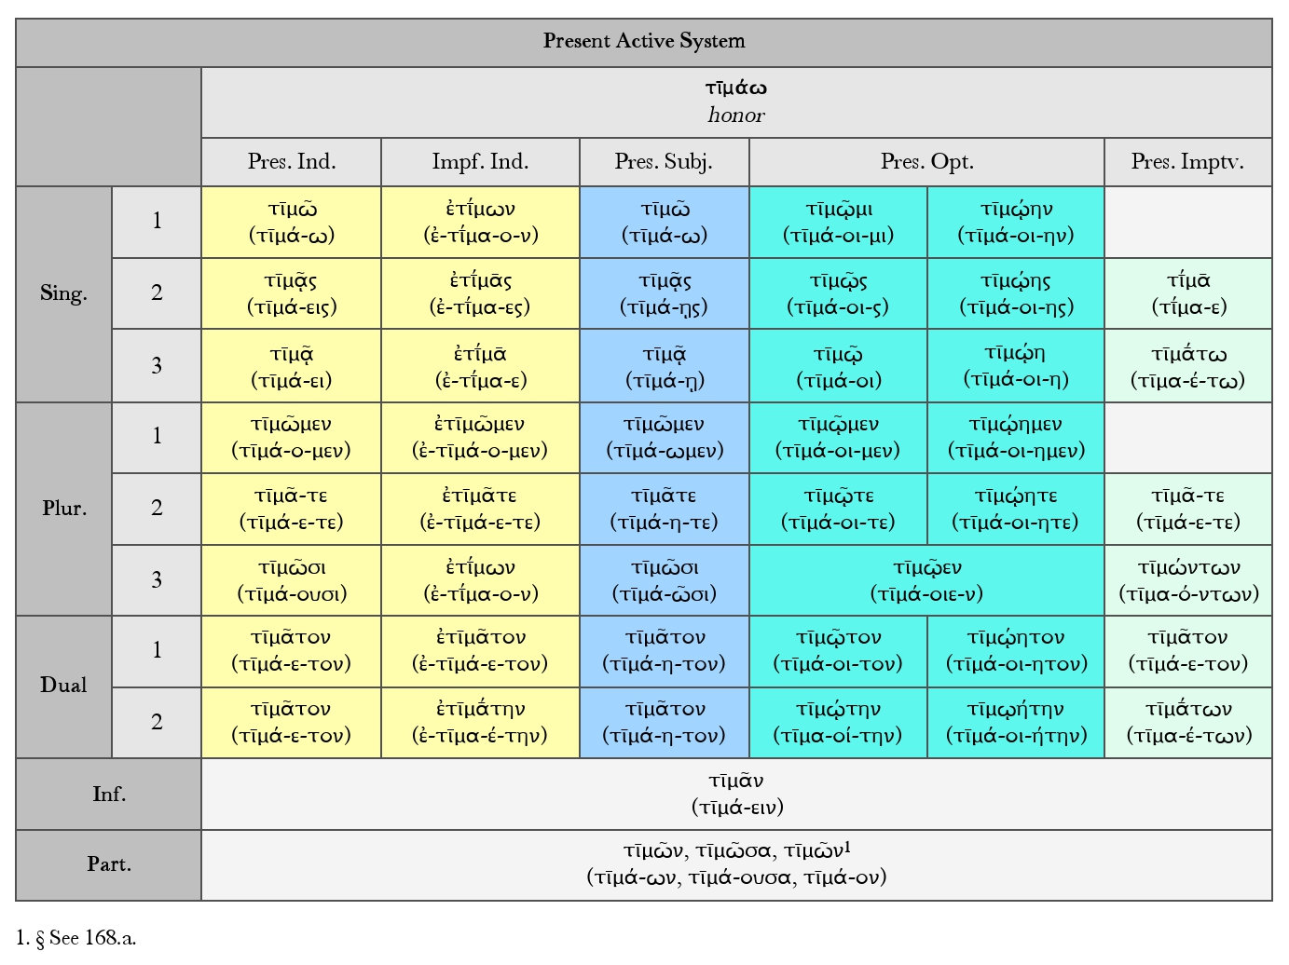
Contract Verbs

Slide 20
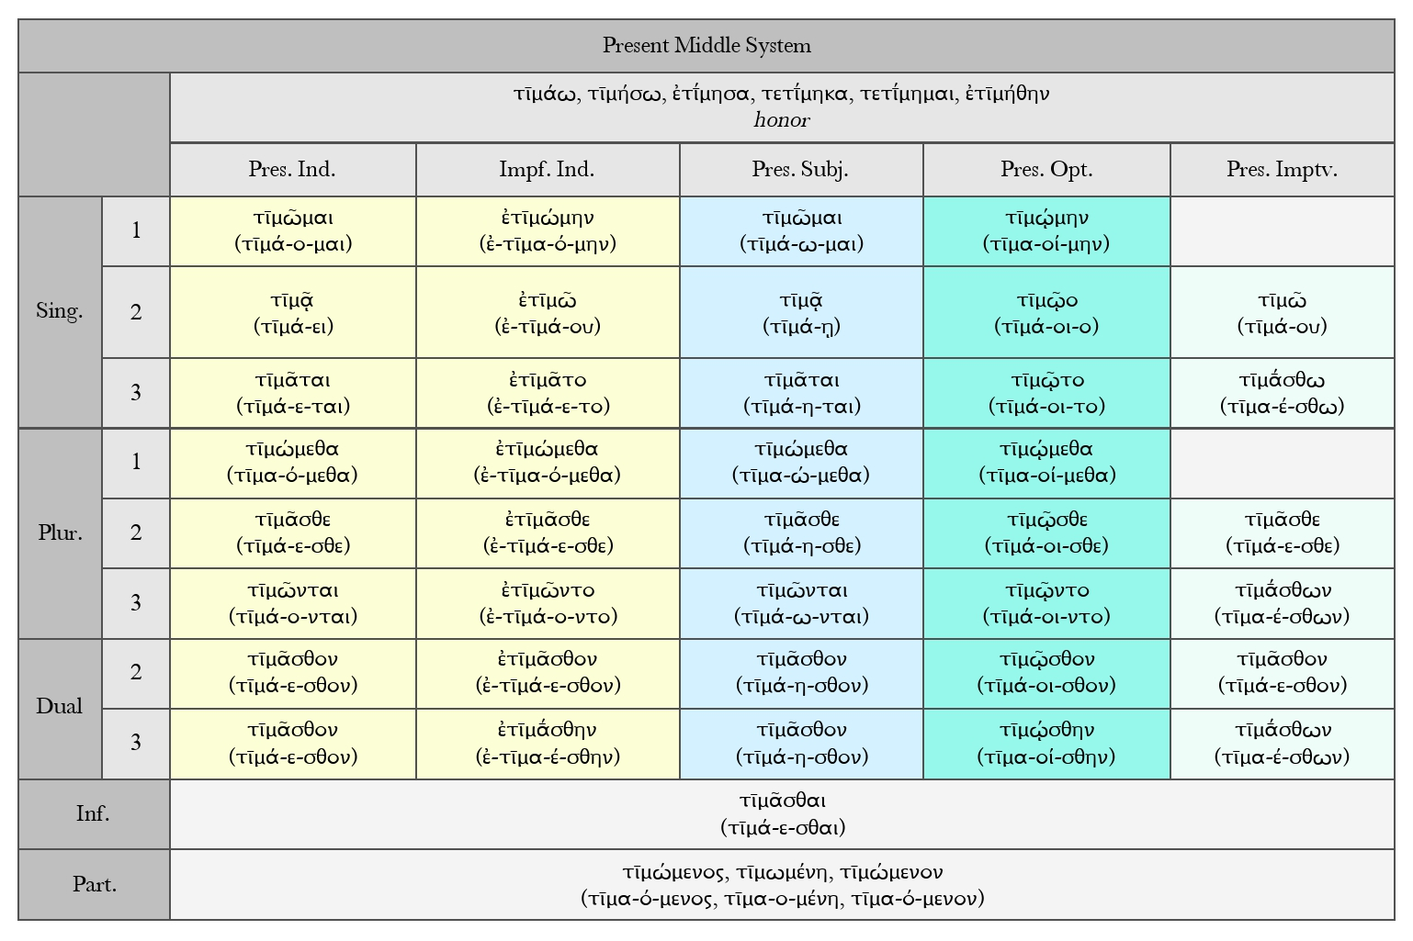
Contract Verbs

Slide 21
Contract Verbs
Notes:
1) The present indicative and subjunctive are identical.
2) The neuter present participle looks like the masculine one.
3) The -1- of the optative is subscript.
4 ) The present infinitive is easily confused with an accusative of the first declension, especially because the iota is elided.

Slide 22
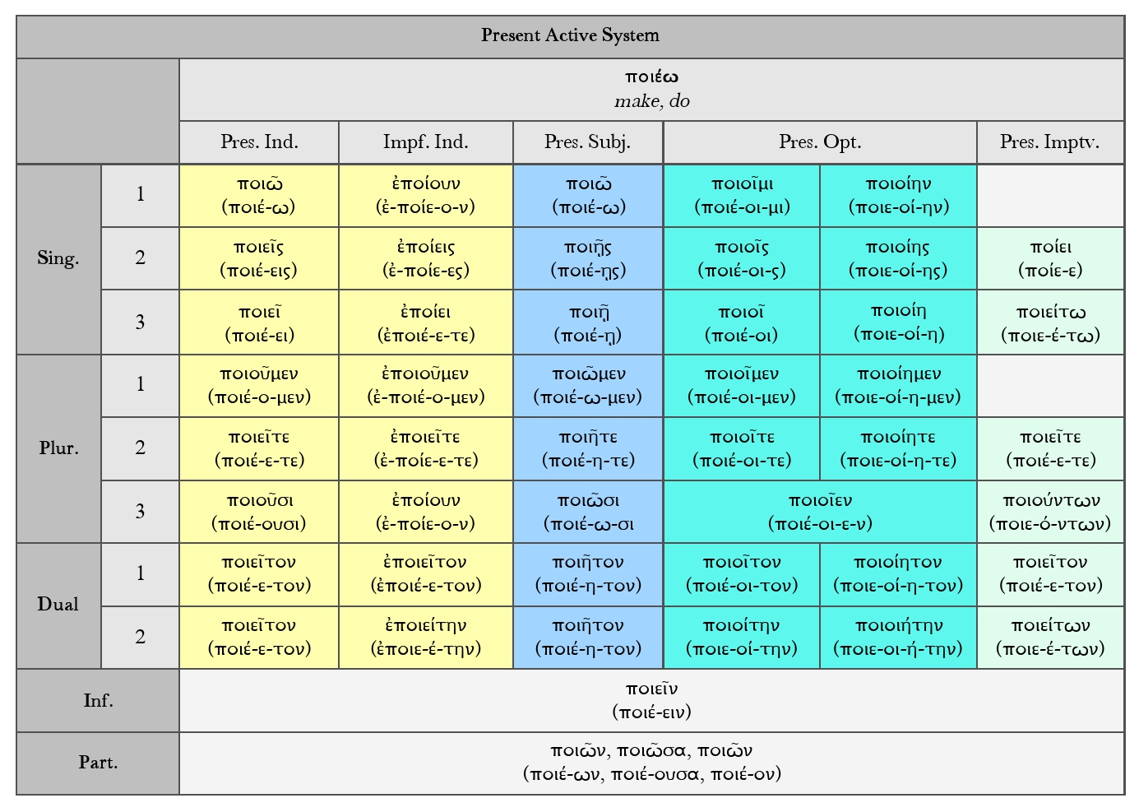
Contract Verbs

Slide 23
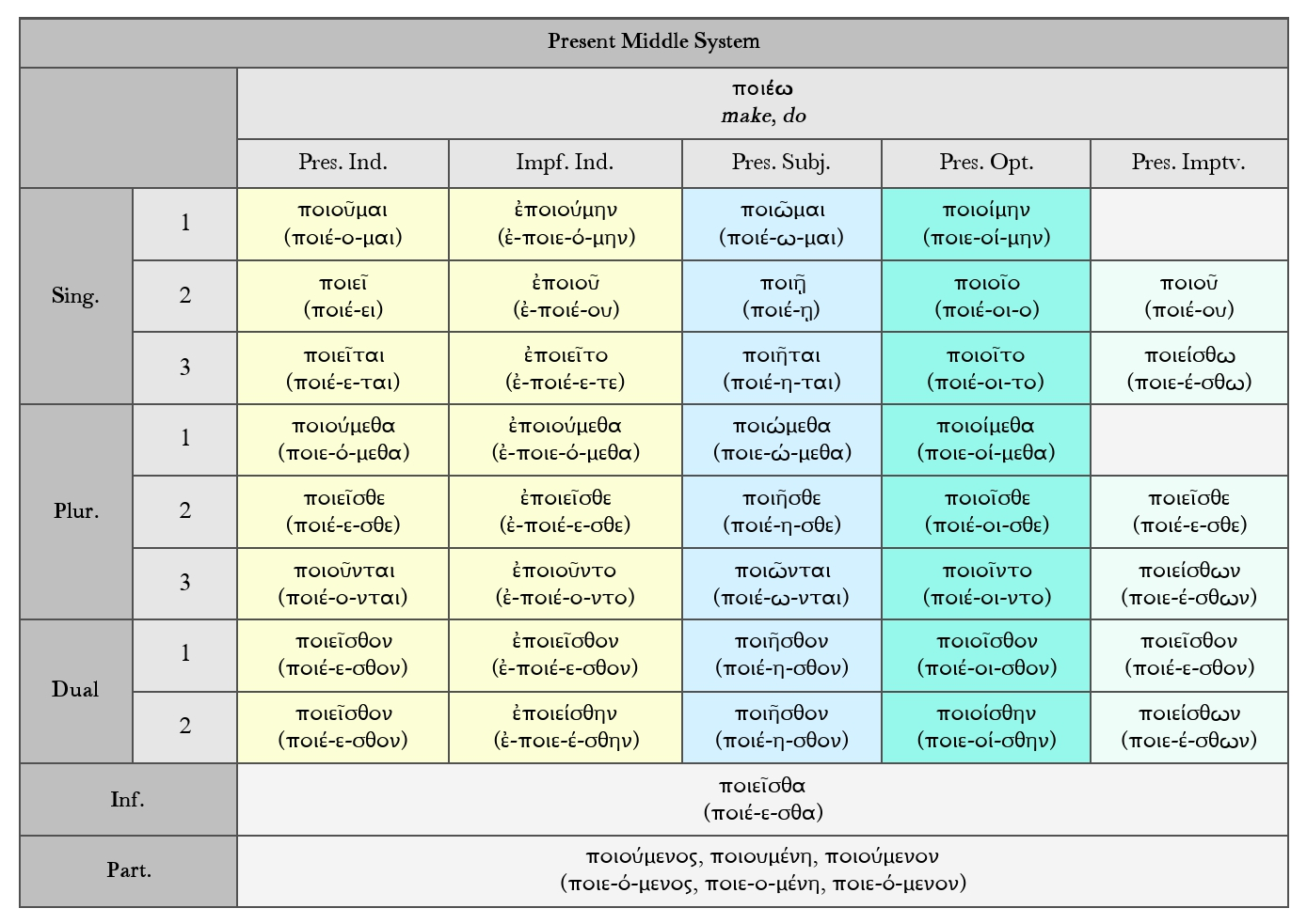
Contract Verbs

Slide 24
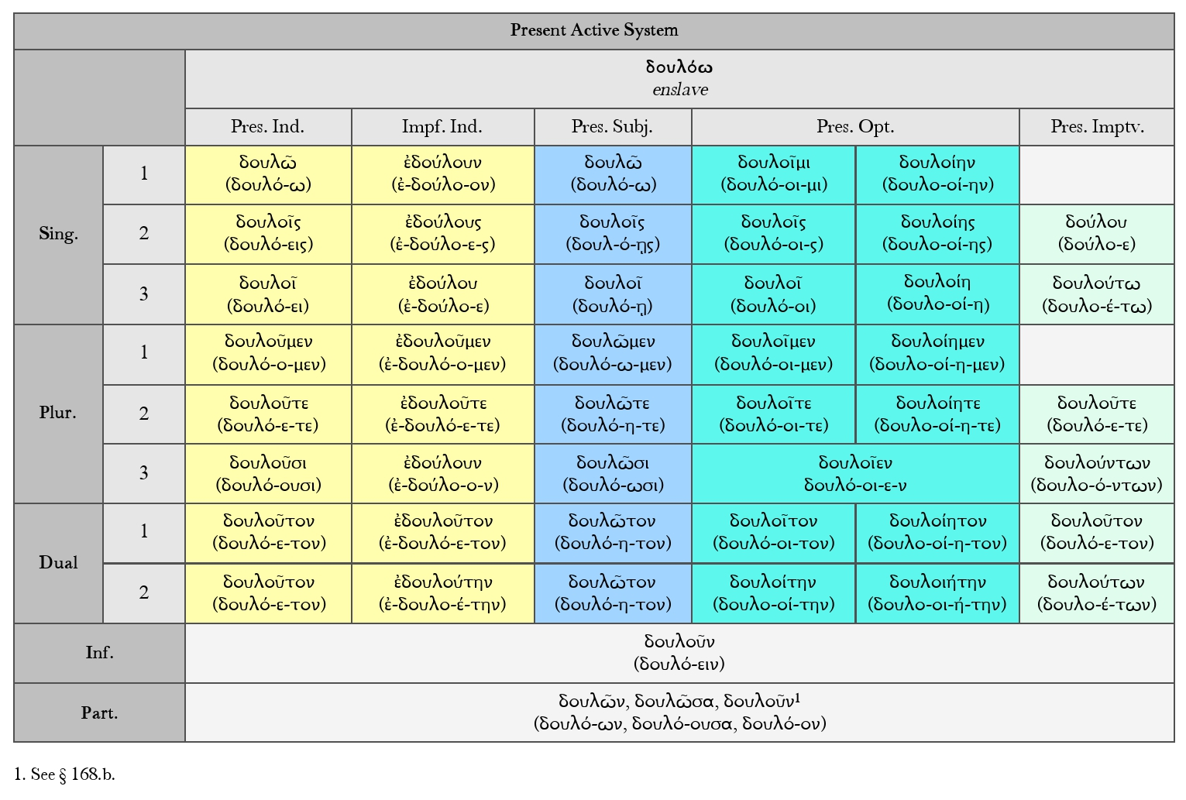
Contract Verbs

Slide 25
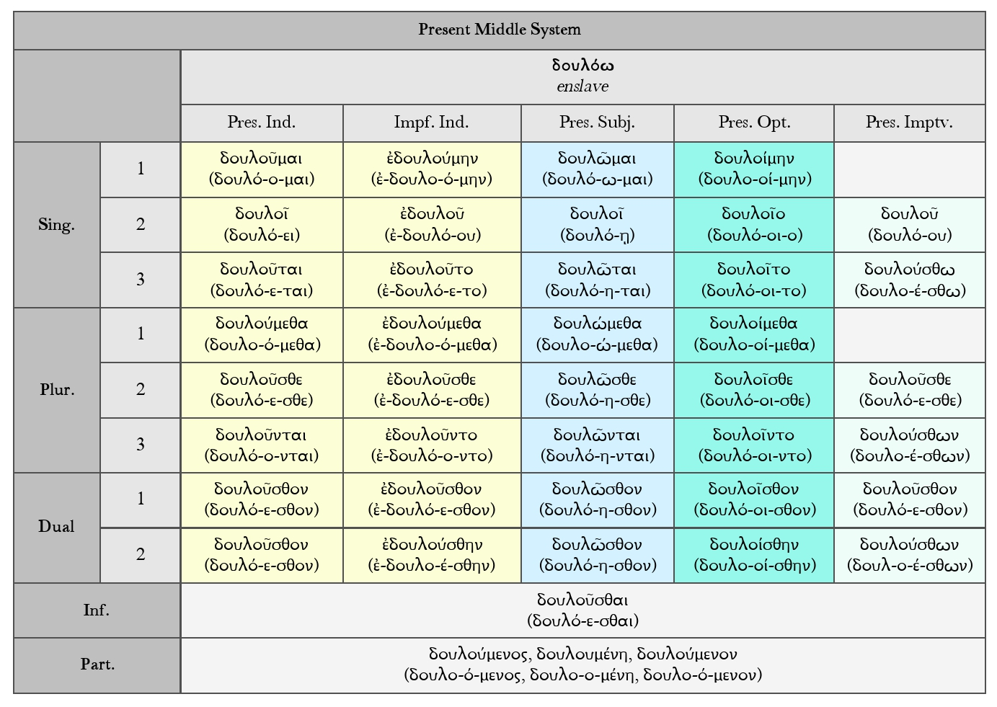
Contract Verbs

Slide 26
Verbs in –μι
Forms built on the present stem follow either a thematic or an athematic conjugation.
– The thematic conjugation, comprising all verbs in -ω, is much more common.
With these verbs, a thematic vowel (ε/ο) stands between the present stem and the endings: e.g. 1 pl. act. ind. παιδεύ-ο-μεν, 2 pl. παιδεύ-ε-τε.
– The athematic conjugation comprises all verbs ending in -μι. The endings follow immediately on the present stem: e.g. 1 pl. act. ind. δείκνυ-μεν, 2 pl. δείκνυ-τε.

Slide 27
Verbs in –μι
Apart from the thematic vowel, there are two important points of distinction between thematic and athematic presents:
– Endings: the endings of thematic and athematic presents differ:
in the present indicative singular: thematic (including thematic vowels) -ω, -εις, -ει, athematic -μι, -ς, -σῐ(ν);
in the present third person plural: thematic (including thematic vowel) -ουσι(ν) (<*-ονσῐ(ν), →11.27), athematic -ᾱσῐ(ν);
in the imperfect third person plural: thematic -ν, athematic: -σαν; and in the active infinitive: thematic (including thematic vowel) -ειν, athematic -ναι.
Contrast e.g. 2 sg. pres. act. ind. παιδεύεις (thematic) with δείκνυς (athematic); pres. act. inf. παιδεύειν (thematic) with δεικνύναι (athematic).

Slide 28
Verbs in –μι
– Variation of vowel length in the stem: athematic presents use a stem with a long vowel in the singular of the present active indicative, the singular of the imperfect active, and in the subjunctive, but a stem with a short vowel elsewhere.
Contrast e.g. 1 sg./pl. act. ind. λύω/λύομεν (thematic) with δείκνῡμι/δείκνῠμεν (athematic).

Slide 29
Verbs in –μι
Present Tense Endings
Add to the correct tense stem.
Primary Active (use for the present tense): -μι, -ς, -σι (ν), -μεν, -τε, -ᾱσι (ν)

Slide 30
Verbs in –μι
The three classes:
I) Reduplicated stem + mi (δίδωμι, τίθημι, ἵστημι)
The present or imperfect tense of these verbs can be identified by ​​​iota reduplication. This means that the stem consonant is reduplicated and the letter iota is further added: δίδωμι, τίθημι, ἳστημι, ἀφίημι. In the case of some forms, it is not obvious what is the reduplicating consonant. We must remember that the original stem is not always identical with its present tense form.
II) Stem + mi (εἰμί, φημί)
III) Stem + numi (δείκνυμι etc.)

Slide 31
Verbs in –μι
Present Tense Stems
Use the long vowel grade stem for the singular (I, you, he, she, it) and the short vowel grade for the plural (we, you, they). Note that the stems differ even within the same tense, mood, and voice.
long vowel grade stem
(use for the singular)
διδω-
τιθη-
short vowel grade stem
(use for the plural)
διδο-
τιθε-

Slide 32
Verbs in –μι
Types of -μι Verb; Present Stem Formation
Verbs in -νυμι
A number of athematic present stems are formed with the nasal infix -νυ-. Most of these verbs have a verb stem ending in a velar stop, or in the case of verbs in -ννυμι, a verb stem originally ending in σ (there are some others). E.g.: verb (present stem) verb stem compare verb stems ending in a velar stop:
δείκνυμι show δεικ- aor. ἔδειξα
ζεύγνυμι yoke ζευγ-/ζῠγ- aor. ἔζευξα
μείγνυμι mix μειγ-/μῐγ- aor. ἔμειξα
πήγνυμι affix, fasten πηγ-/πᾰγ- aor. ἔπηξα
ῥήγνυμι (cause to) break ῥηγ-/ῥωγ-/ῥᾰγ- aor. ἔρρηξα
verb stems originally ending in σ:
κεράννυμι mix (<*κεράσ-νυ-μι) κερᾰ(σ)-/κρᾱ- aor. ἐκέρασ(σ)α
κρεμάννυμι hang up (<*κρεμάσ-νυ-μι) κρεμᾰ(σ)- aor. ἐκρέμασ(σ)α
σβέννυμι quench, put out (<*σβέσ-νυ-μι) σβη-/σβε(σ)- aor. pass. ἐσβέσθην
χώννυμι heap up (<*χώσ-νυ-μι) χω(σ)-/χο- aor. pass. ἐχώσθην

Slide 33
Verbs in –μι
Reduplicated Verbs
A few important athematic present stems are formed by reduplication:
verb (present stem) verb stem compare
ἵ-στημι make stand, set up (<*σί-στᾱμι) στη-/στᾰ- aor. ἔστησα
δί-δωμι give δω-/δο- aor. ἔδωκα
τί-θημι put, place θη-/θε- aor. ἔθηκα
ἵ-ημι send, let go (<*yί-yημι) ἡ-/ἑ- aor. ἧκα
More complex is the formation of πίμπλημι, πίμπρημι, and ὀνίνημι, which have a nasal infix in
addition to reduplication. They are all conjugated in the present like ἵστημι:
verb (present stem) verb stem compare
πί-μ-πλημι fill πλη-/πλᾰ- aor. ἔπλησα
πί-μ-πρημι burn πρη-/πρᾰ- aor. ἔπρησα
ὀ-νί-νημι help, benefit

Slide 34
Verbs in –μι
Root Presents
Finally, there are several athematic root presents (or ‘primitive verbs’), whose present stem is an unelaborated verbal root:
verb (present stem) verb stem
εἰμί be ἐσ- (εἰμί = ἐμί <*ἐσμί)
εἶμι go εἰ-/ι-
φημί say, claim φη-/φᾰ-
ἠμί say, speak ἠ
Endings
Present-stem forms of –μι verbs are built as follows.

Slide 35
Verbs in –μι
Present indicative: formed with primary endings. E.g. 1 sg. act. δείκνῡ-μι, τίθη-μι, 2 sg. act. δείκνῡ-ς, τίθη-ς; 1 sg. mp. δείκνῠ-μαι, τίθε-μαι. Note that the σ of the 2 sg. mp. does not disappear: δείκνῠ-σαι, τίθε-σαι. The root presents have several irregular forms.
Imperfect: formed with the augment, and with secondary endings. E.g. 1 sg. act. ἐ-δείκνῡ-ν, 2 sg. act. ἐ-δείκνῡ-ς; 1 sg. mp. ἐ-δεικνύ-μην. Note that the σ of the 2 sg. mp. does not disappear: ἐ-δείκνῠ-σο. Some singular active forms are thematic. The root presents have several irregular forms.

Slide 36
Verbs in –μι
Imperative: the 2 sg. act. is usually formed without ending (some are thematic), but the root presents have ἴσθι, ἴθι, φάθι. Other imperatives: e.g. 2 pl. act. δείκνῠ-τε, 2 sg. mp. δείκνῠ-σο.
Subjunctive: formed with the long thematic vowel of the subjunctive and primary endings. In reduplicated -μι presents and in κάθημαι, the long thematic vowel contracts with the preceding (long) vowel: e.g. 1 sg. act. διδῶ (<*-ώ-ω), 2 sg. act. διδῷς (<*-ώ-ῃς), 1 sg. mp. διδῶμαι (<*-ώ-ω-μαι), 2 sg. act. ἱῇς (<*ἱή-ῃς), 2 pl. mp. ἱστῆσθε (<*ἱστή-η-σθε).

Slide 37
Verbs in –μι
Optative: the optatives of -νυμι verbs, κάθημαι and κεῖμαι are thematic.
Others are formed with the optative suffix -ιη- in the singular, with optative suffix -ι- in the plural and all middle-passive forms, and with secondary endings. The iota forms a diphthong with the preceding short stem vowel. E.g. 1 sg. act. διδοίη-ν, 1 pl. act. διδοῖ-μεν, 1 sg. mp. διδοί-μην; 1 sg. act. τιθείη-ν, 1 pl. act. τιθεῖ-μεν, 1 sg. mp. τιθεί-μην.

Slide 38
Verbs in –μι
Active infinitive: formed with -ναι. E.g. act. δεικνύ-ναι. But the inf. of εἶμι go ends in -εναι: ἰ-έναι.
Middle-passive infinitive: formed with -σθαι. E.g. δείκνῠ-σθαι, κεῖ-σθαι
Active participle: formed with -ντ-; for the declension. E.g. gen. sg. masc. δεικνύ-ντ-ος, nom. sg. fem. δεικνῦσα (<*-ύντyα).
Middle-passive participle: formed with -μεν-; for the declension. E.g. nom. sg. masc. δεικνύ-μεν-ος, nom. sg. fem. δεικνῠ-μέν-η.

Slide 39
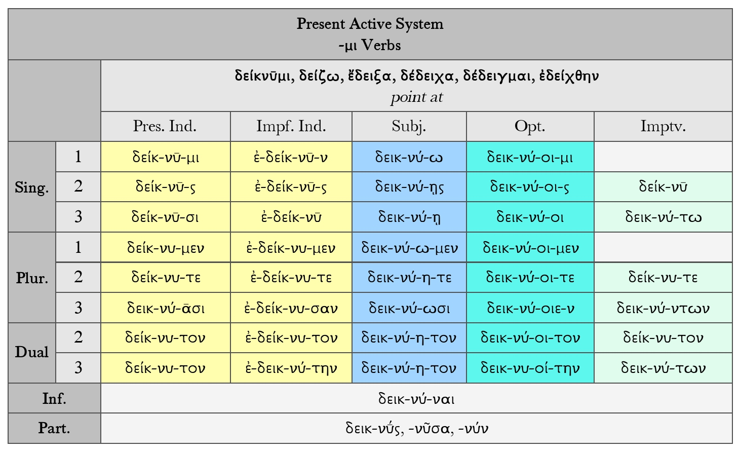

Slide 40
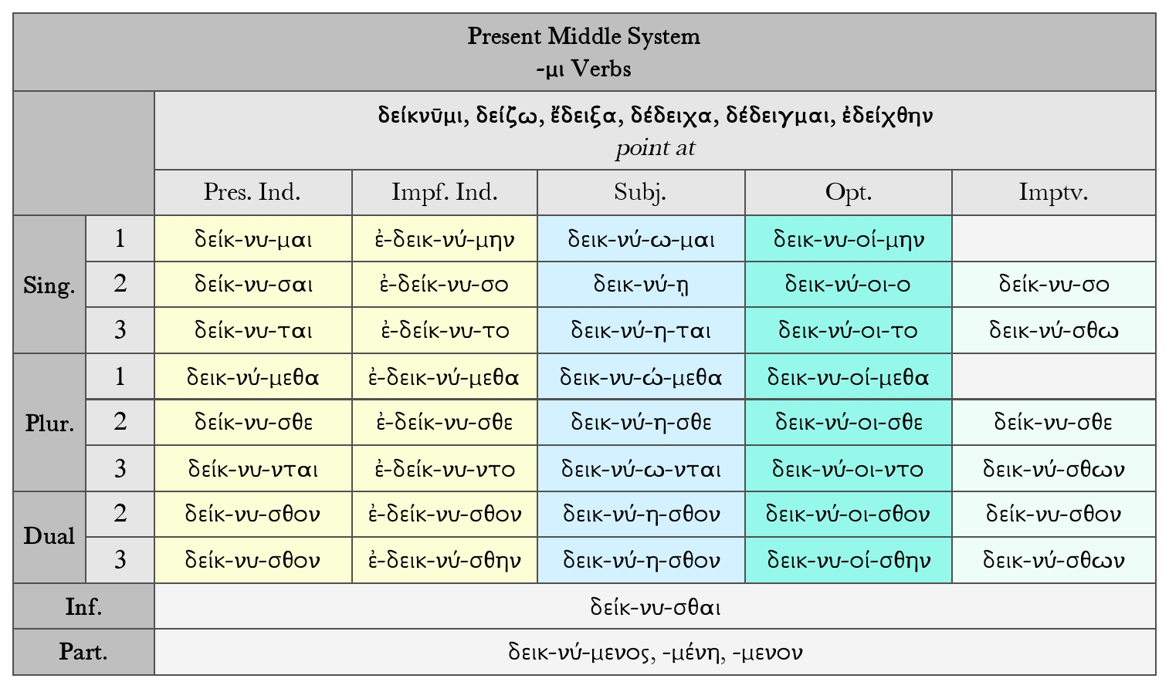

Slide 41
Verbs in –μι
Verbs of the root class with present stem in –α or –η follow ἵστημι. They are like δείκνῡμι except as follows.
1. ά-ᾱσι contracts to -ᾶσ
2. The subjunctive contracts -άω- and -άη- to -ῶ- and -ῆ-
3. The optative mode suffix is -ιη-, or in the plural and dual more often -ι- (-ιε- in the 3rd plural), added directly to the stem. The accent never stands before the mode-suffix. (Cp. the passive aorist optative).

Slide 42
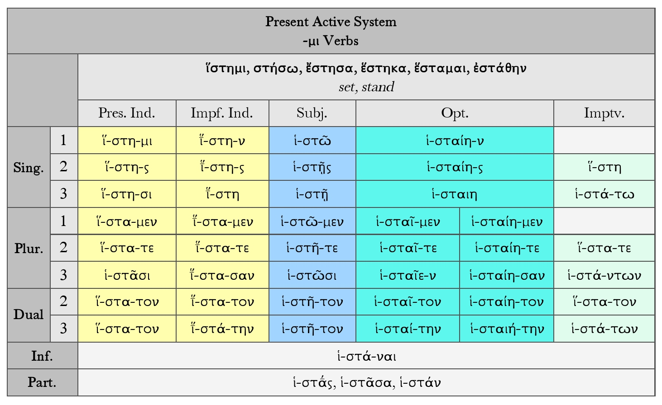

Slide 43
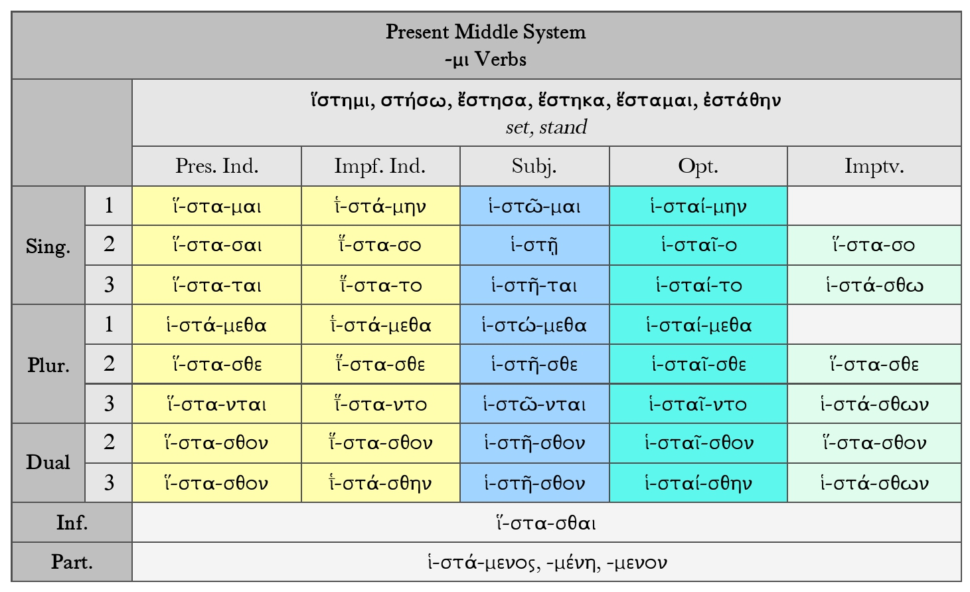

Slide 44
Verbs in –μι
Exercise 3: Decline the following verbs: κεράννῡμι (mix, present indicative, MV), κρεμάννῡμι (hang, optative, AV), πετάννῡμι (imperfect indicative, AV).

Slide 45
Verbs in –μι
Exercise 4: Translate the sentences below, which have been adapted from Euripides’ Medea (Μήδεια). Nominative case endings are bolded, dative endings are highlighted, and accusative endings are underlined.
1. τὸ ὄχημα ῞Ηλιος δίδωσιν αὐτῇ.
2. τὸν κόσμον ῞Ηλιος δίδωσιν αὐτῇ.
3. Φοῖβος αὐτῇ φάρμακα δίδωσιν.
4. τῇ νύμφῃ διδόᾱσιν δῶρα.

Slide 46
Verbs in –μι
Case Ending Function
Nominative: -α, -η, -ος: subject of the verb
Dative: -ῃ, -ι, -ῳ: indirect object of the verb
Accusative: -α, -ην, -ν, -ο, -ον: object of the verb

Slide 47
Verbs in –μι
Vocabulary:
δίδωμι give; αὐτή αὐτῇ αὐτήν she, her, hers; δῶρον, δώρῳ, δῶρον gift; Ηλιος, Ἡλίῳ, ῞Ηλιον Helios; κόσμος, κόσμῳ, κόσμον ornament, dress; νύμφη, νύμφῃ, νύμφην bride; ὄχημα, ὀχήματι, ὄχημα carriage, chariot

Slide 48
Verbs in –μι
Three very common verbs—δίδωμι (give), τίθημι (put), ῑ̔́ημι (send)—are nearly like ἵστημι, but agree in certain differences from ἵστημι in the present and root-aorist systems, as also in forming a peculiar κα- aorist.

Slide 49
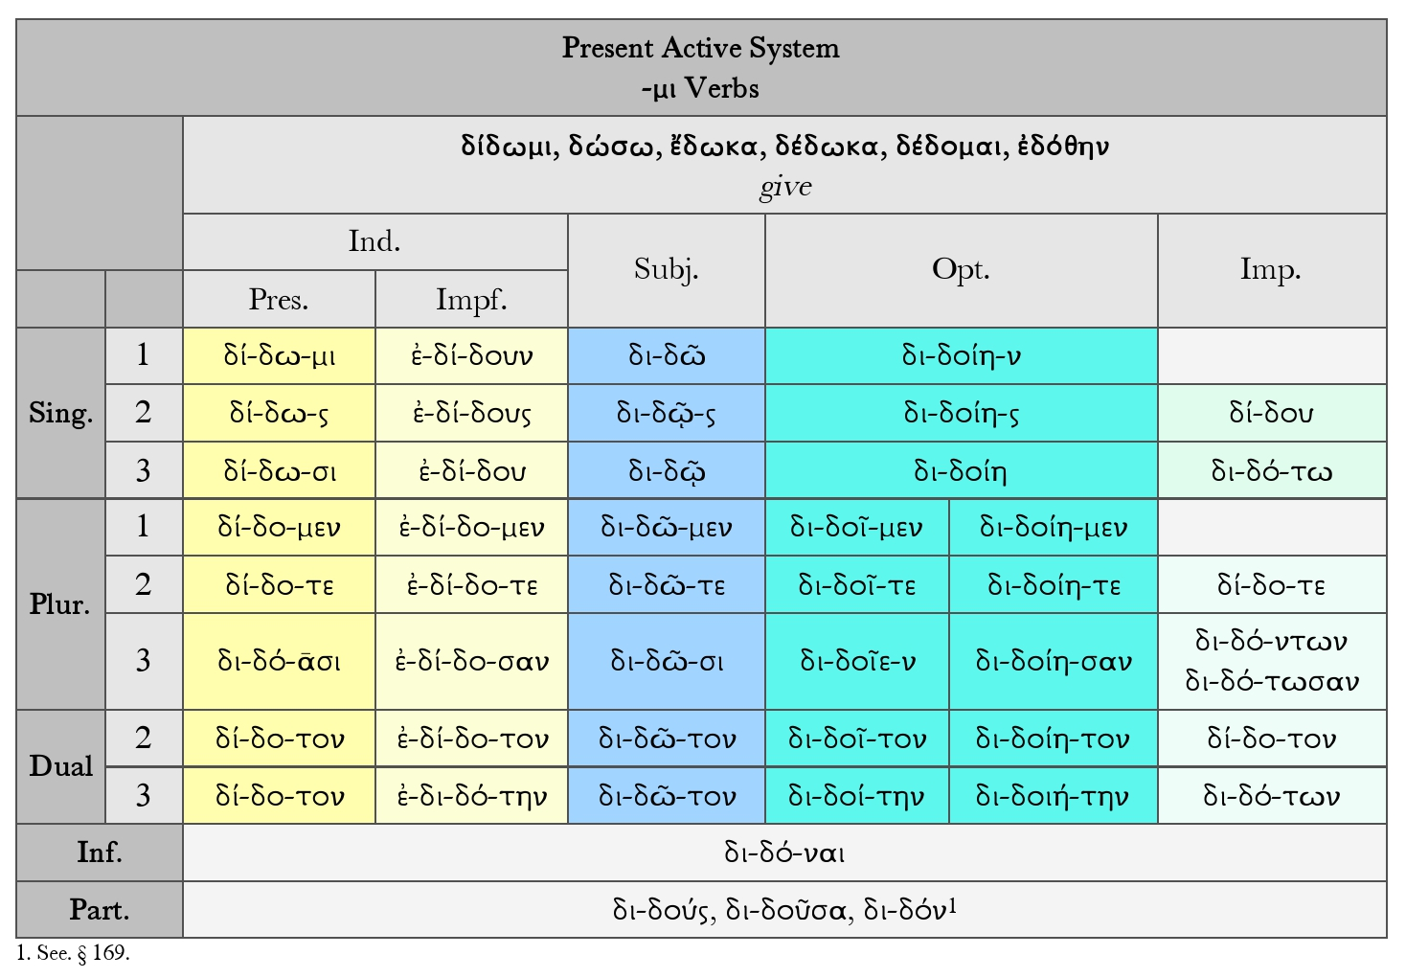
Verbs in –μι

Slide 50
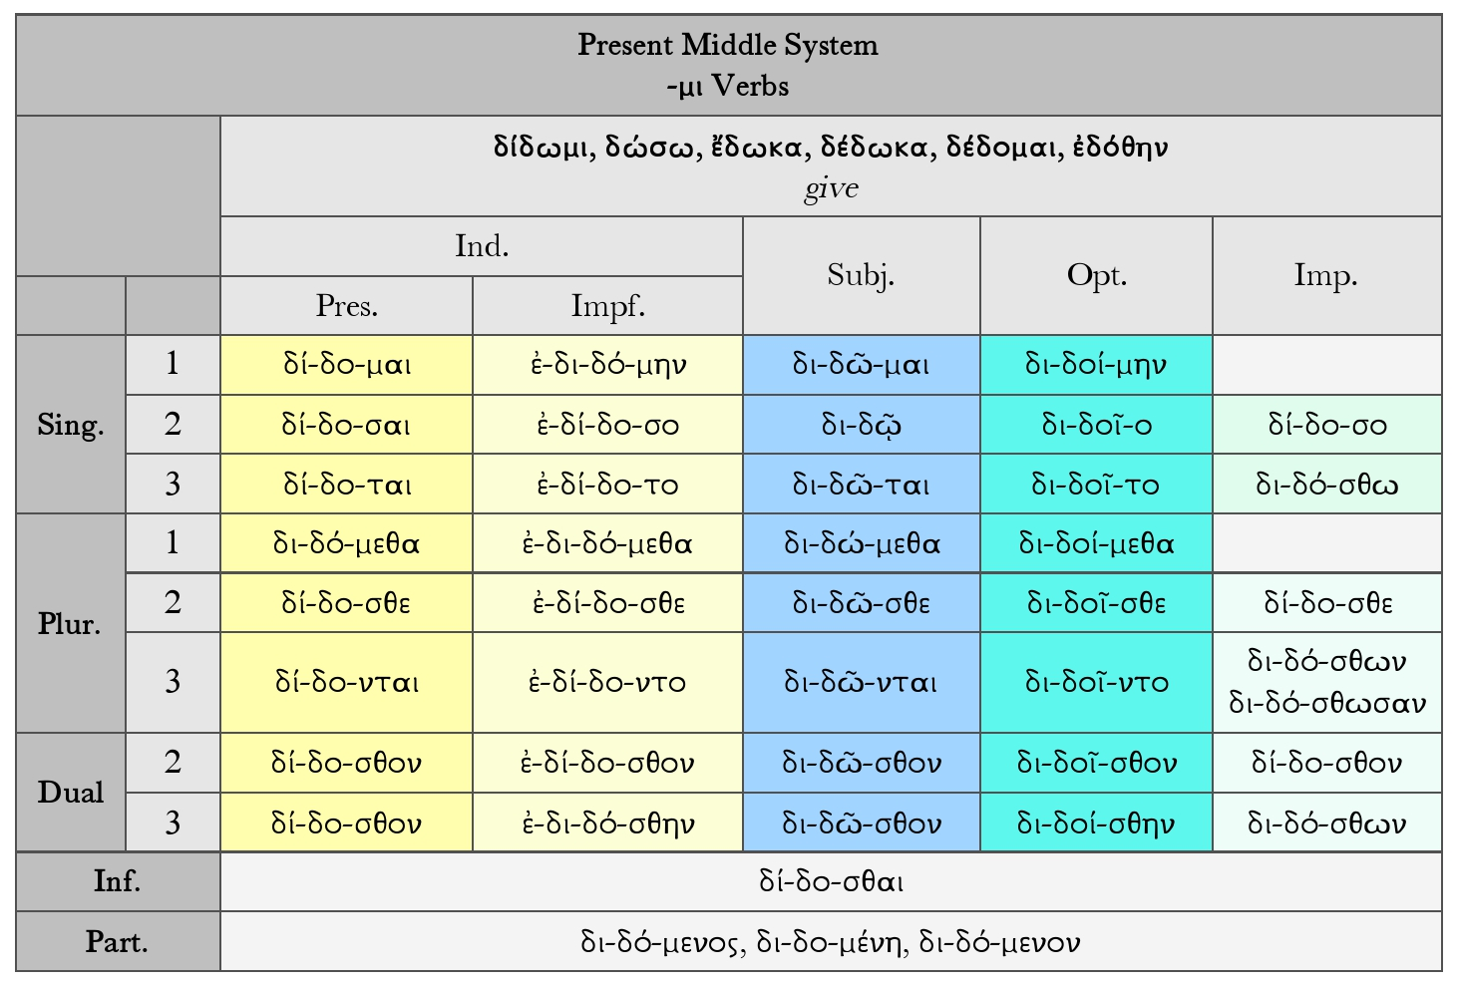
Verbs in –μι

Slide 51
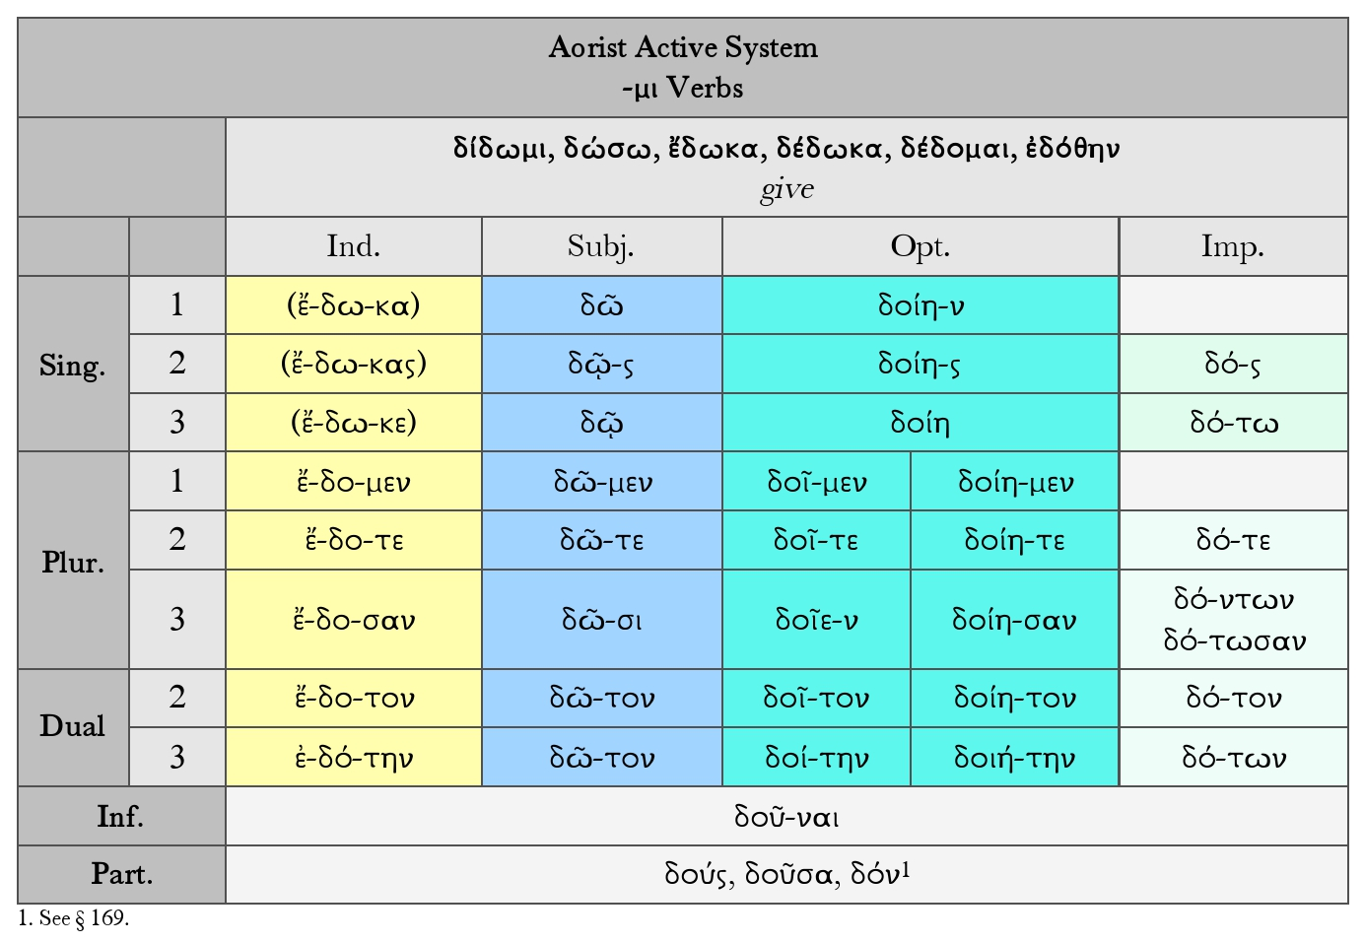
Verbs in –μι

Slide 52
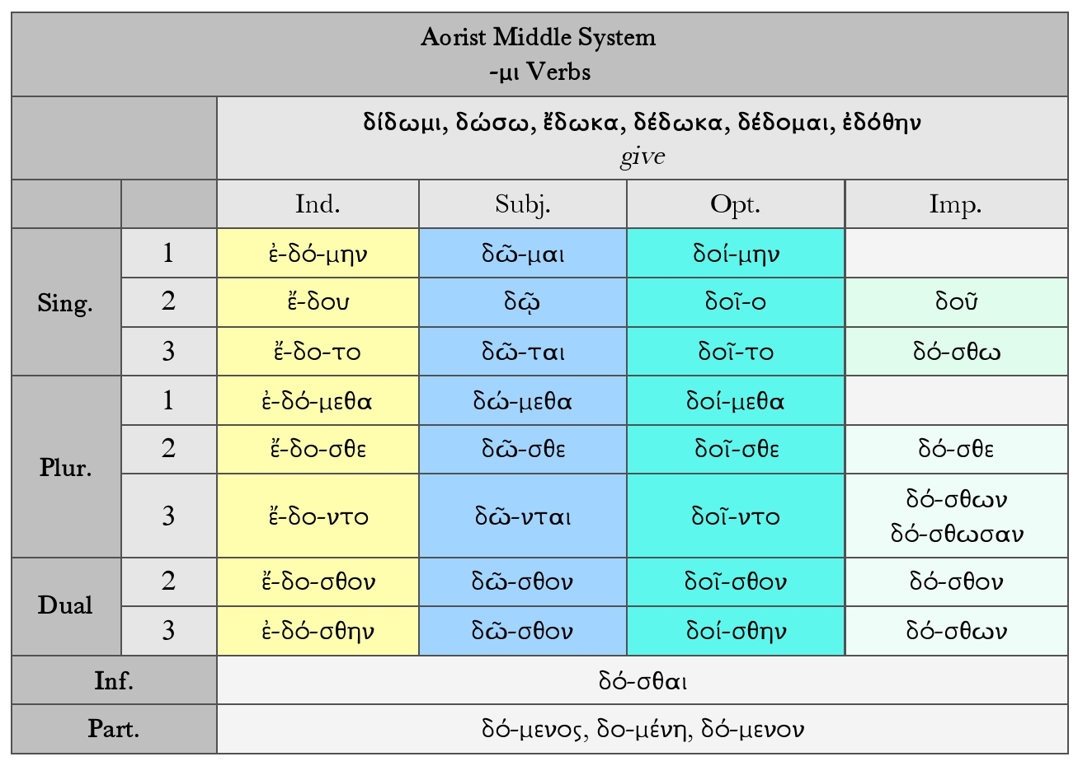
Verbs in –μι

Slide 53
Verbs in –μι

Slide 54
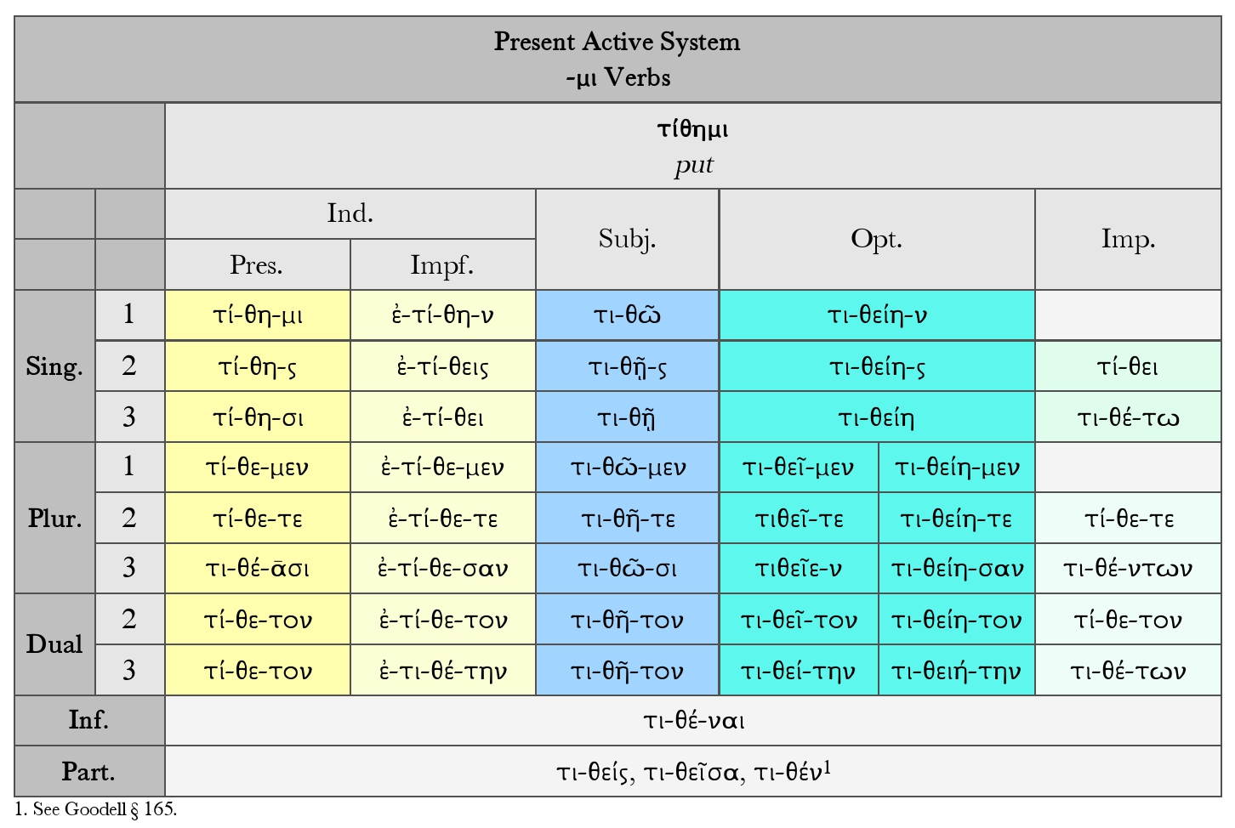
Verbs in –μι

Slide 55
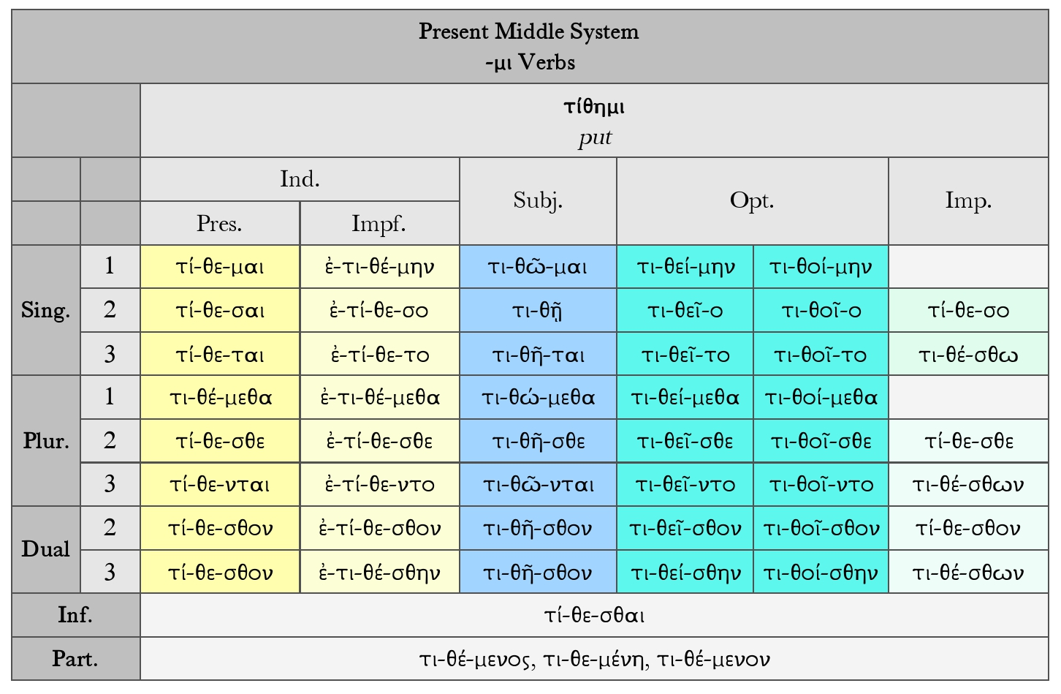
Verbs in –μι

Slide 56
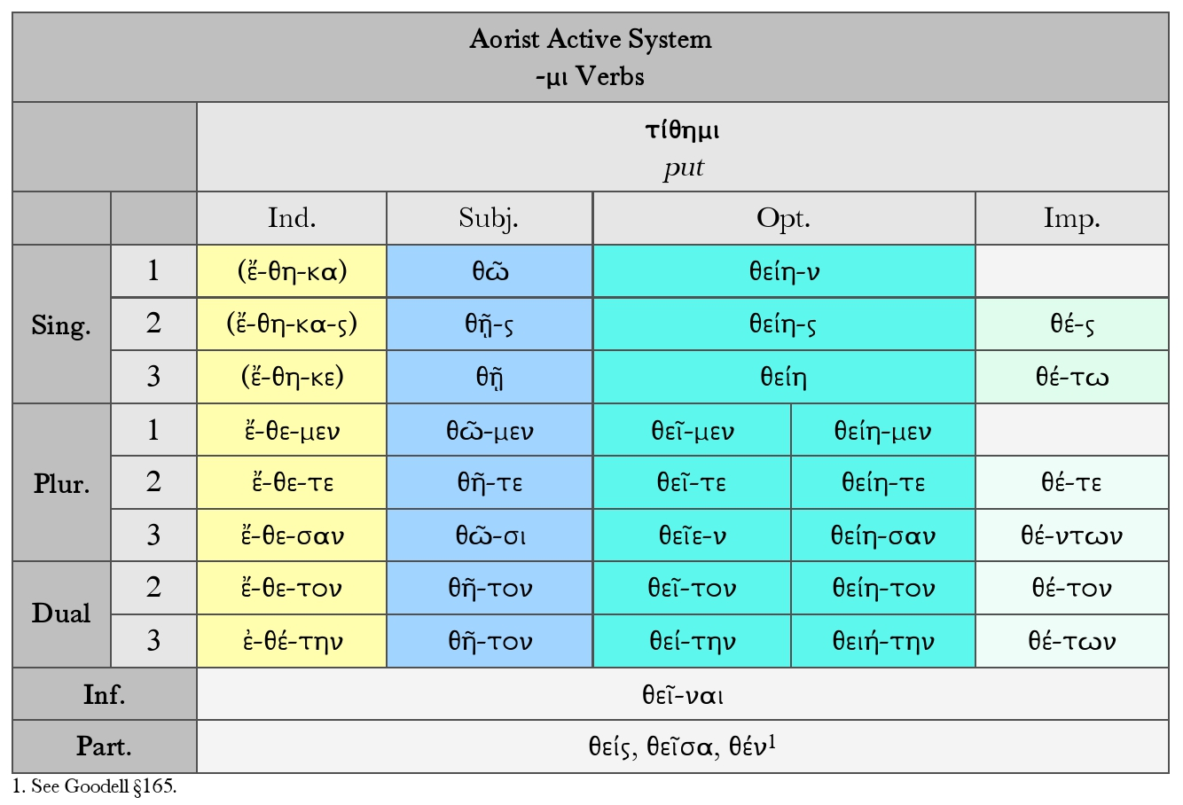
Verbs in –μι

Slide 57
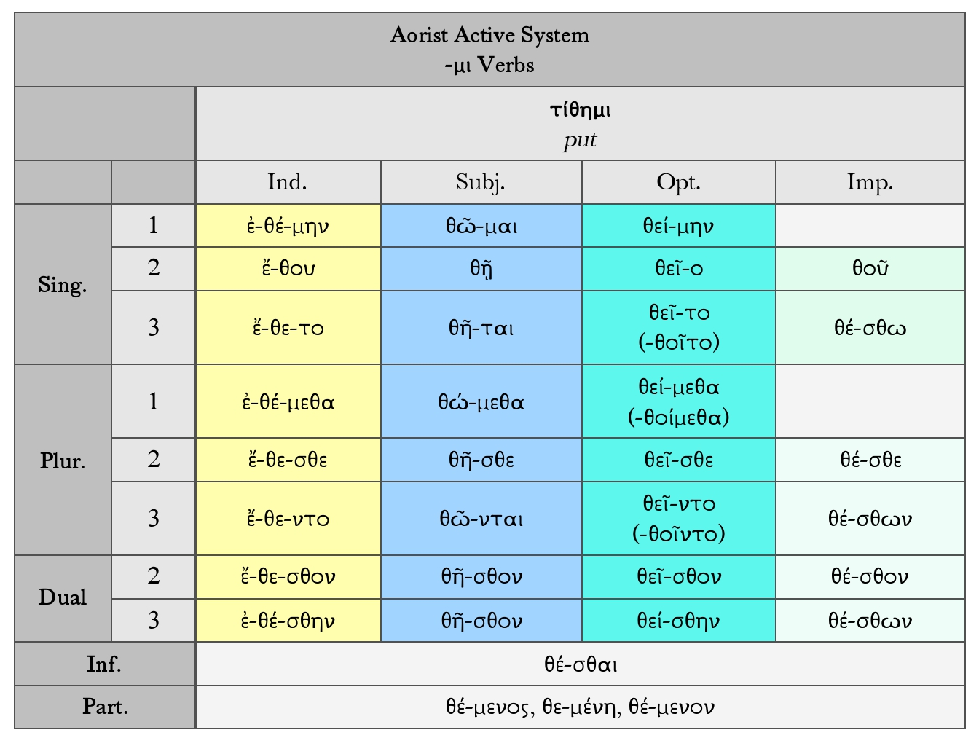
Verbs in –μι

Slide 58
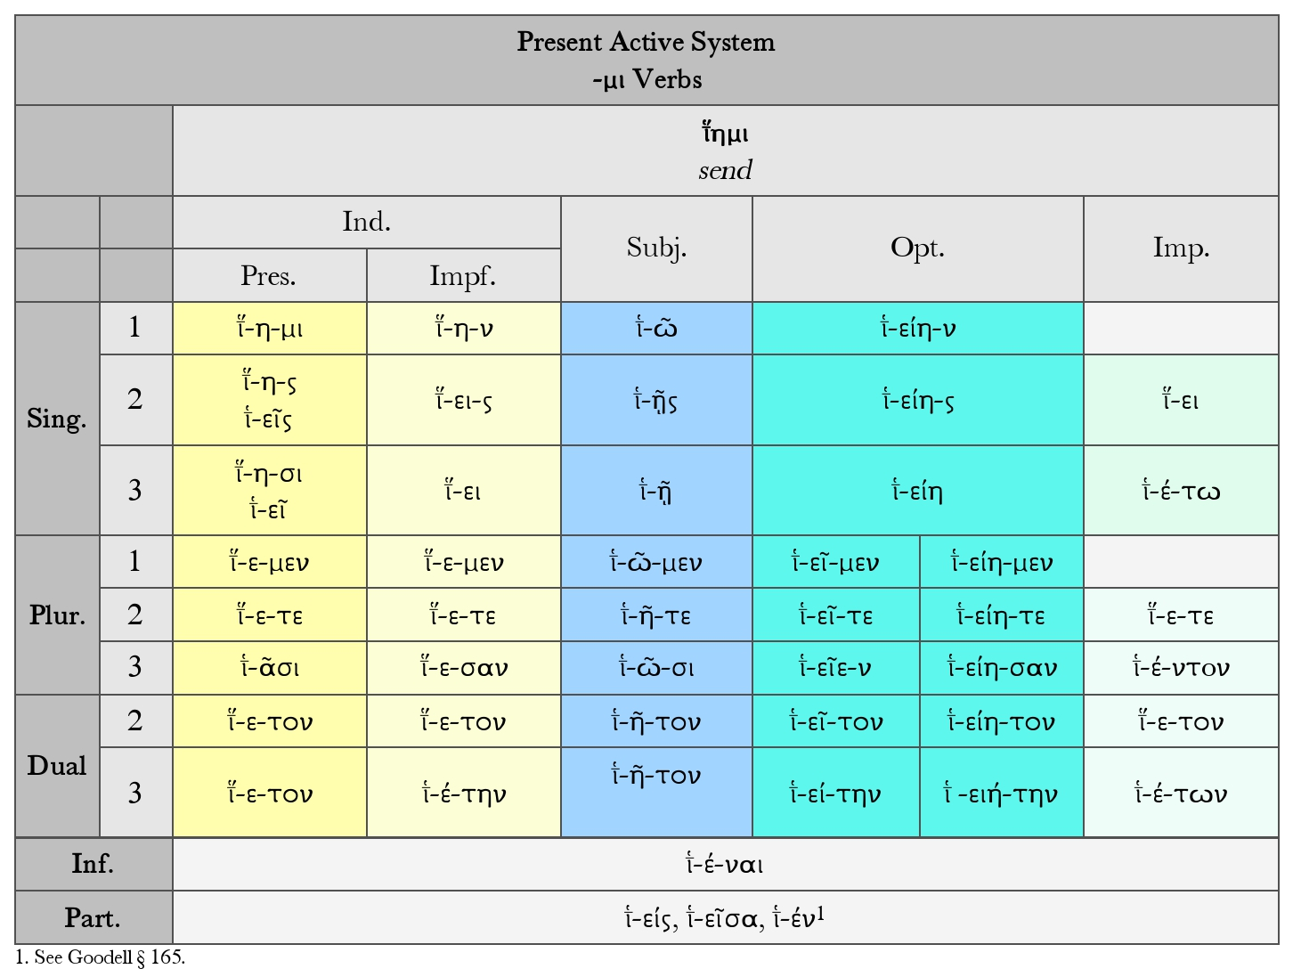
Verbs in –μι

Slide 59
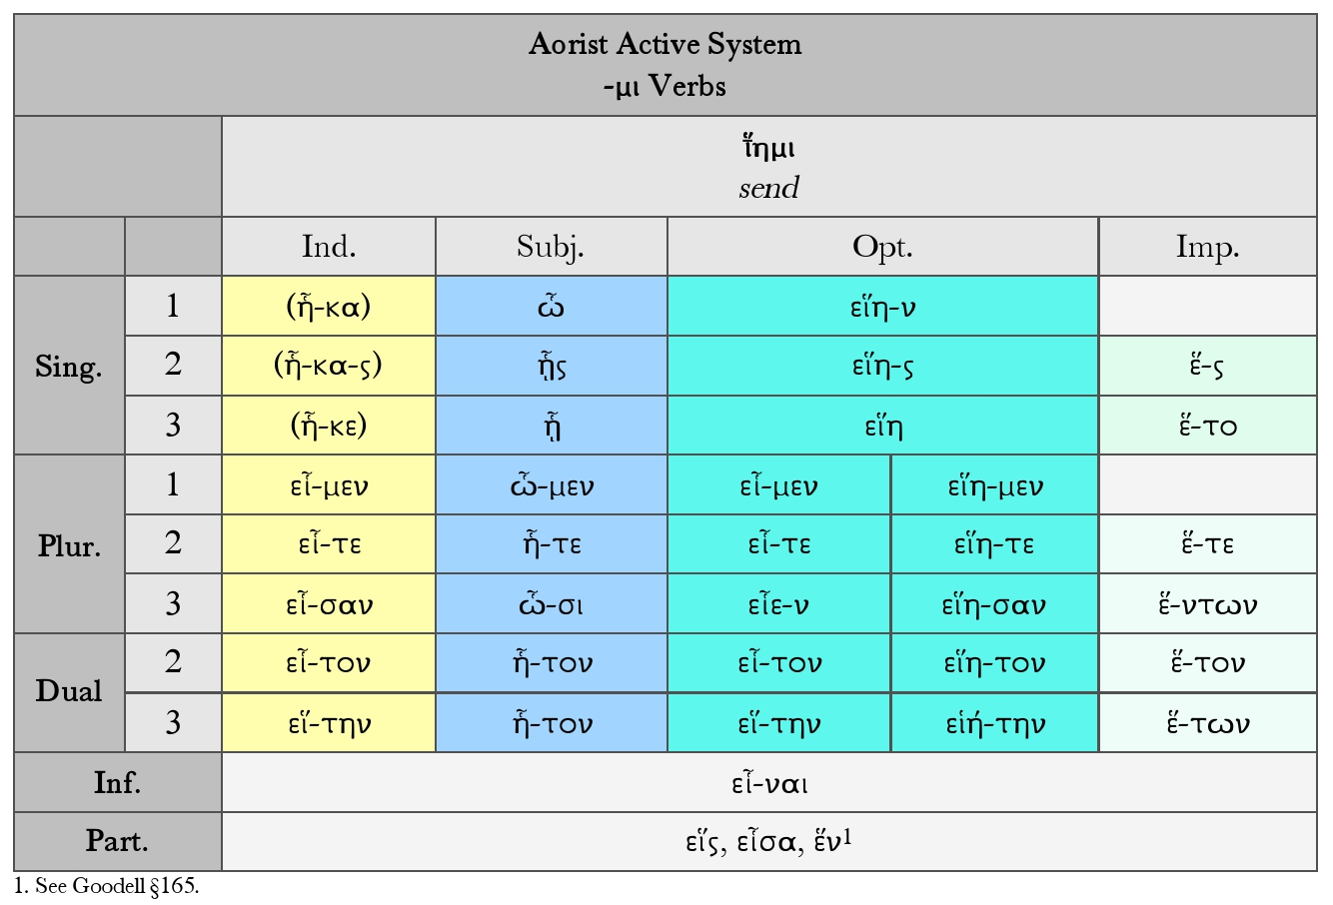
Verbs in –μι

Slide 60
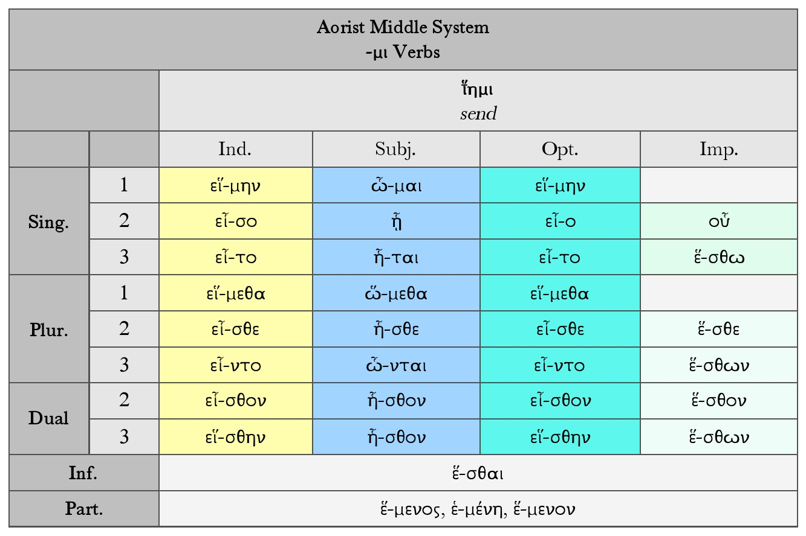
Verbs in –μι

Slide 61
Verbs in –μι
Irregular verbs in –μι: φημί, εἰμί, and εἶμι.
Certain important verbs follow the analogy of regular verbs in -μι in the present and second aorist systems, but are more or less irregular in formation. Some of them lack the second aorist system entirely. In their other systems, so far as these occur, they follow verbs in ω.

Slide 62
Verbs in –μι
Present Active Indicative of φημί (φα), SAY
First Person Singular φημί
Second Person Singular φῄς or φής
Third Person Singular φησί
Second Person Dual φατόν
Third Person Dual φατόν
First Person Plural φαμέν
Second Person Plural φατέ
Third Person Plural φᾱσί

Slide 63
Verbs in –μι
Imperfect Active Indicative of φημί (φα), SAY
First Person Singular ἔφην
Second Person Singular ἔφησθα or ἔφης
Third Person Singular ἔφη
Second Person Dual ἔφατον
Third Person Dual ἐφάτην
First Person Plural ἔφαμεν
Second Person Plural ἔφατε
Third Person Plural ἔφασαν

Slide 64
Verbs in –μι
Present Active Subjunctive of φημί (φα), SAY
First Person Singular φῶ
Second Person Singular φῇς
Third Person Singular φῇ
Second Person Dual φῆτον
Third Person Dual φῆτον
First Person Plural φῶμεν
Second Person Plural φῆτε
Third Person Plural φῶσι
Present Active Optative of φημί (φα), SAY
First Person Singular φαίην
Second Person Singular φαίης
Third Person Singular φαίη
Second Person Dual φαῖτον or φαίητον
Third Person Dual φαίτην or φαιήτην
First Person Plural φαῖμεν or φαίημεν
Second Person Plural φαῖτε or φαίητε
Third Person Plural φαῖεν or φαίησαν

Slide 65
Verbs in –μι
Present Active Indicative of εἰμί (ἐσ), BE
First Person Singular εἰμί
Second Person Singular εἶ
Third Person Singular ἐστί
Second Person Dual ἐστόν
Third Person Dual ἐστόν
First Person Plural ἐσμέν
Second Person Plural ἐστέ
Third Person Plural εἰσί
Imperfect Active Indicative of εἰμί (ἐσ), BE
First Person Singular ἦ or ἦν
Second Person Singular ἦσθα
Third Person Singular ἦν
Second Person Dual ἦστον or ἦτον
Third Person Dual ἤστην or ἤτην
First Person Plural ἦμεν
Second Person Plural ἦστε or ἦτε
Third Person Plural ἦσαν

Slide 66
Verbs in –μι
Present Active Subjunctive of εἰμί (ἐσ), BE
First Person Singular ὦ
Second Person Singular ᾖς
Third Person Singular ᾖ
Second Person Dual ἦτον
Third Person Dual ἦτον
First Person Plural ὦμεν
Second Person Plural ἦτε
Third Person Plural ὦσι
Present Active Optative of εἰμί (ἐσ), BE
First Person Singular εἴην
Second Person Singular εἴης
Third Person Singular εἴη
Second Person Dual εἶτον or εἴητον
Third Person Dual εἴτην or εἰήτην
First Person Plural εἶμεν or εἴημεν
Second Person Plural εἶτε or εἴητε
Third Person Plural εἶεν or εἴησαν

Slide 67
Verbs in –μι
Present Active Indicative of εἶμι (ἰ), GO
First Person Singular εἶμι
Second Person Singular εἶ
Third Person Singular εἶσι
Second Person Dual ἴτον
Third Person Dual ἴτον
First Person Plural ἴμεν
Second Person Plural ἴτε
Third Person Plural ἴᾱσι
Present Active Indicative of εἶμι (ἰ), GO
First Person Singular ᾖα or ᾔειν
Second Person Singular ᾔεις or ᾔεισθα
Third Person Singular ᾔει ir ᾔειν
Second Person Dual ᾖτον
Third Person Dual ᾔτην
First Person Plural ᾖμεν
Second Person Plural ᾖτε
Third Person Plural ᾖσαν or ᾔεσαν

Slide 68
Verbs in –μι
Present Active Subjunctive of εἶμι (ἰ), GO
First Person Singular ἴω
Second Person Singular ἴῃς
Third Person Singular ἴῃ
Second Person Dual ἴητον
Third Person Dual ἴητον
First Person Plural ἴωμεν
Second Person Plural ἴητε
Third Person Plural ἴωσι
Present Active Optative of εἶμι (ἰ), GO
First Person Singular ἴοιμι or ἰοίην
Second Person Singular ἴοις
Third Person Singular ἴοι
Second Person Dual ἴοιτον
Third Person Dual ἰοίτην
First Person Plural ἴοιμεν
Second Person Plural ἴοιτε
Third Person Plural ἴοιεν

Slide 69
Philosophical Vocabulary
K (K/X)
κακία: the contrary of areté. It is frequently translated ‘Vice’, as areté is translated ‘virtue’, but ‘defect’, ‘fault’ or ‘badness’ is preferable. Often, but not always, with reference to human character: areté men ara, hos eoiken, hugieia te tis an eié kai kallos kai euexia psukhés, kakia de nosos te kai aiskhos kai astheneia — so, as it seems, excellence is some health and beauty and well-being of the soul, but badness is disease and ugliness and weakness (Pl. Rep. 444d).
κακός: has much the same spread of uses as the English ‘bad’. (1) Of moral badness: kakos men gar hekon oudeis — nobody is intentionally bad (Pl. Tim. 86d). (2) Of inefficiency: kakou mageirou — a bad cook (P1. Phaedrus ‘265e); Aristotle notes the difference between calling somebody simply bad and calling him had of a kind: kakon iatron kai kakOn hupokritén, hon haplos ouk an eipoien kakon — a bad doctor and a bad actor, whom one would not call bad without qualification (Ar. E.N. 1148b 8).

Slide 70
Philosophical Vocabulary
καλοκαγαθία: and kaloskagathos seem to be as near as Greek can get to gentlemanliness and gentleman, in the old sense of someone of gentle birth and breeding.
καλός: has a width of use which makes it difficult to find any single translation. Thus Diotima in the Symposium of Plato speaks of a person being led apo ton kalon sématén epi ta kala epitédeumata, kai apo ton epite‘duematén epi ta kala mathémata — from bodies to occupations to studies all of which are called kala (Pl. Symp. 2110); guné kalé kai eueidés — a beautiful and good-looking woman (Pl. Crito 44a); to kalon telos tés aretés — the noble is the goal of excellence (Ar. E.N. 1115b 12). Thus kalos seems to cover the aesthetic and at least some morality, and not only these.

Slide 71
Philosophical Vocabulary
κάθαρσις: a term important in philosophy only as occurring in Aristotle’s definition of tragedy: estin oun tragéidia mimésis praxeés spoudaias kai teleias megethos ekhousés, hé‘dusmenéi logoi di’eleou kai phobou perainousa tén ton toioutén pathématénkatharsin — so tragedy is a representation of some important action that is complete and sizeable, in pleasing language by pity and fear accomplishing purgation of such passions (Ar. Poetics 1449b 24).
xαρά: pleasure, enjoyment, joy — the noun from khairein. In Epicurus it is an active rather than katastématiké, calm, pleasure: hé de khara kai hé euphrosuné kata kinésin energeiai blepontai — but joy and exultation are considered as active pleasures involving change (Vita Epicuri 136).

Slide 72
Exercise 5: Find the contract verbs and the verbs in –μι (Plato, Apology 29e-30c):
καὶ ἐάν τις ὑμῶν ἀμφισβητήσῃ καὶ φῇ ἐπιμελεῖσθαι, οὐκ εὐθὺς ἀφήσω αὐτὸν οὐδ᾽ ἄπειμι, ἀλλ᾽ ἐρήσομαι αὐτὸν καὶ ἐξετάσω καὶ ἐλέγξω, καὶ ἐάν μοι μὴ δοκῇ κεκτῆσθαι ἀρετήν, [30a] φάναι δέ, ὀνειδιῶ ὅτι τὰ πλείστου ἄξια περὶ ἐλαχίστου ποιεῖται, τὰ δὲ φαυλότερα περὶ πλείονος. ταῦτα καὶ νεωτέρῳ καὶ πρεσβυτέρῳ ὅτῳ ἂν ἐντυγχάνω ποιήσω, καὶ ξένῳ καὶ ἀστῷ, μᾶλλον δὲ τοῖς ἀστοῖς, ὅσῳ μου ἐγγυτέρω ἐστὲ γένει. ταῦτα γὰρ κελεύει ὁ θεός, εὖ ἴστε, καὶ ἐγὼ οἴομαι οὐδέν πω ὑμῖν μεῖζον ἀγαθὸν γενέσθαι ἐν τῇ πόλει ἢ τὴν ἐμὴν τῷ θεῷ ὑπηρεσίαν.
And if the person with whom I am arguing says: “Yes, but I do care;” I do not depart or let him go at once; I interrogate and examine and cross-examine him, and if I think that he has no virtue [aretē], but only says that he has, [30a] I reproach him with undervaluing the greater, and overvaluing the less. And this I should say to everyone whom I meet, young and old, citizen and alien [xenos], but especially to the citizens, inasmuch as they are my brethren. For this is the command of the god, as I would have you know; and I believe that to this day no greater good [agathos] has ever happened in the state than my service to the god.

Slide 73
Exercise 5: Find the contract verbs and the verbs in –μι (Plato, Apology 29e-30c):
οὐδὲν γὰρ ἄλλο πράττων ἐγὼ περιέρχομαι ἢ πείθων ὑμῶν καὶ νεωτέρους καὶ πρεσβυτέρους μήτε σωμάτων [30b] ἐπιμελεῖσθαι μήτε χρημάτων πρότερον μηδὲ οὕτω σφόδρα ὡς τῆς ψυχῆς ὅπως ὡς ἀρίστη ἔσται, λέγων ὅτι “Οὐκ ἐκ χρημάτων ἀρετὴ γίγνεται, ἀλλ᾽ ἐξ ἀρετῆς χρήματα καὶ τὰ ἄλλα ἀγαθὰ τοῖς ἀνθρώποις ἅπαντα καὶ ἰδίᾳ καὶ δημοσίᾳ.” εἰ μὲν οὖν ταῦτα λέγων διαφθείρω τοὺς νέους, ταῦτ᾽ ἂν εἴη βλαβερά· εἰ δέ τίς μέ φησιν ἄλλα λέγειν ἢ ταῦτα, οὐδὲν λέγει. πρὸς ταῦτα,» φαίην ἄν, «ὦ ἄνδρες Ἀθηναῖοι, ἢ πείθεσθε Ἀνύτῳ ἢ μή, καὶ ἢ ἀφίετέ με ἢ μή, ὡς ἐμοῦ οὐκ [30c] ἂν ποιήσαντος ἄλλα, οὐδ᾽ εἰ μέλλω πολλάκις τεθνάναι».
For I do nothing but go about persuading you all, old and young alike, [30b] not to take thought for your persons and your properties, but first and chiefly to care about the greatest improvement of the soul [psūkhē]. I tell you that virtue [aretē] is not given by money, but that from virtue [aretē] come money and every other good [agathon] of man, public [= in the dēmos] as well as private. This is my teaching, and if this is the doctrine which corrupts the youth, my influence is ruinous indeed. But if anyone says that this is not my teaching, he is speaking an untruth. Wherefore, O men of Athens, I say to you, do as Anytus bids or not as Anytus bids, and either acquit me or not; [30c] but whatever you do, know that I shall never alter my ways, not even if I have to die many times.

Slide 74
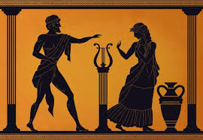
Have a nice evening!
ΕΥΧΑΡΙΣΤΩ!

