Slide 1
Ancient Greek (Intermediate Level)
ATHENS MA IN ANCIENT PHILOSOPHY
NATIONAL AND KAPODISTRIAN UNIVERSITY OF ATHENS / Department of History and Philosophy of Science
In collaboration with:
•UNIVERSITY OF PATRAS / Department of Philosophy
•UNIVERSITY OF CRETE / Department of Philosophy and Social Studies

Slide 2
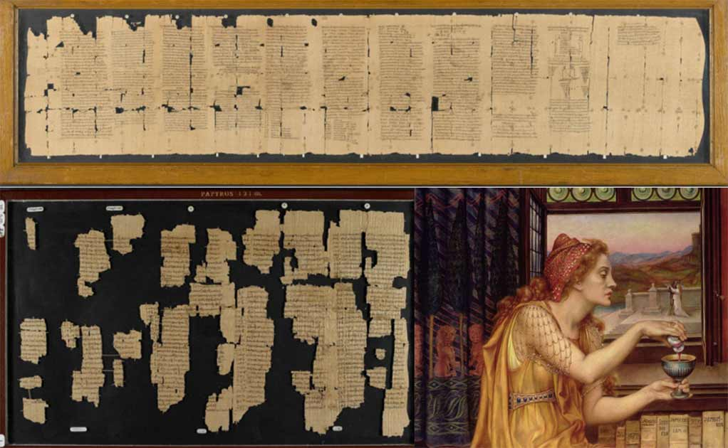
Week 6
Textual Criticism and Editorial Techniques

Slide 3
What is an apparatus criticus? = Critical edition of a Greek text
What is an apparatus criticus?
Critical apparatus is a standard feature of scholarly editions in which variant readings and other philological comments are presented to readers as a compressed list immediately following the text, organized by line numbers therein.

Slide 4
What is an apparatus criticus? = Critical edition of a Greek text
Ancient Greek philosophical texts were handed down through the Middle Ages to the modern world. Various historical and cultural phenomena affected the transmission of these texts.
The business of textual criticism is in a sense to reverse this process, to follow back the threads of transmission and try to restore the texts as closely as possible to the form which they originally had.
Errors occur in copying, and the comparison of different manuscripts brings variant readings to light.

Slide 5
What is an apparatus criticus? = Critical edition of a Greek text
When a variant is noticed, it might be introduced into the new copy by correction, or it might be noted in the margin or between the lines, preceded by some such expression as ἐν ἄλλωι (κεῖται), ἐν ἄλλοις γρ. (γράφεται), al. (= alibi or aliter), vel. When a copy furnished with this kind of primitive critical apparatus served in its turn as an exemplar to another scribe, he might do any of four things. He might preserve both the variant in the text (t) and the marginal variant (v) in their places; he might retain (t) and omit (v); he might adopt (v) in place of (t), without mention of (t); or he might put (v) in the text and (t) in the margin.

Slide 6
What is an apparatus criticus? = Critical edition of a Greek text
This confluence of readings from more than one exemplar is known as contamination. When it is not present, the relationship of copies to exemplars can be represented by diverging lines. For example the diagram expresses the fact that Band C were copied from A, and D and E from B.
But if the scribe of E mingled readings from Band C, this calls for converging lines.
Α
Β
C
D
E

Slide 7
What is an apparatus criticus? = Critical edition of a Greek text
But of all the manuscripts that existed, only a small fraction have survived, and often they all belong to the same small corner of the whole diagram that we have imagined. If they happen to come from an area where the lines are all diverging, we shall have what is called a closed recension, that is, it will be possible to construct a self-contained diagram (known as a stemma) which represents the historical relationship of the manuscripts accurately enough for useful conclusions to be drawn about the antiquity of individual readings.
If the extant manuscripts do not come from such a straightforward area of the tradition, they may still appear to, if not enough of them are extant to reveal the complexity of their true relationships; or it may be apparent that no stemma can do justice to the situation, and we shall realize that we are faced with an open recension.

Slide 8
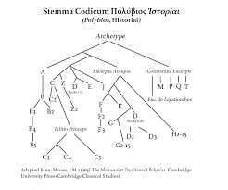
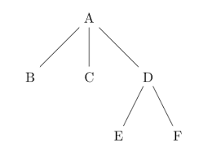
What is an apparatus criticus? = Critical edition of a Greek text

Slide 9
What is an apparatus criticus? = Critical edition of a Greek text
What is a critical edition?
Printing arrives in 1450. The first printed editions of ancient texts arrive then.
Though text-critical techniques involving emending texts and reporting variants have existed since antiquity, the critical edition in its contemporary garb springs from philological interests among renaissance Humanists to reconstruct the Greek and Latin secular classics and the Greek New Testament. Textual critics distinguish between the author’s original text (the ‘autograph’) — a somewhat fictive object in not a few cases — and the manuscript to which all subsequent manuscript witnesses of the text can be genealogically traced (the ‘archetype’).
Assuming that the archetype is, in the words of Paul Maas, ‘closer to the original than the text of any witness’, textual critics attempt to recover the autograph as far as possible by reconstructing the archetype. Like the autograph, the archetype no longer exists. Its existence, however, is hypothetical rather than fictive. Textual critics insist that the recovery of the archetype should proceed from understanding the genealogical relations that link the extant manuscripts to the archetype, and by setting down criteria that allowed editors to mechanically determine which readings go back to the archetype, nineteenth-century editors claimed they could scientifically reconstruct the archetype — and by extension, the autograph — of any text.

Slide 10
Why do we need an apparatus criticus? = History of ancient Greek scholarship
Ancient books:
In archaic Greece literature preceded literacy. From the seventh century onwards, there was a need for authors to put their works in writing, even if only one copy was made for the purpose of reference (e.g. Heraclitus deposited his famous treatise in a temple and perhaps for this reason it survived to be read by Aristotle).
According to a tradition frequently repeated in antiquity the first written text of the epics was prepared at Athens in the middle of the sixth century by order of Pisistratus.
Books remained something of a rarity until well into the fifth century.

Slide 11
Why do we need an apparatus criticus? = History of ancient Greek scholarship
Ancient books:
The first works to reach even a modest public were either the writings of the Ionian philosophers and historians or those of the sophists.
There must also have been a certain demand for copies of the poetic texts that formed the basis of school education.
It is until the middle of the fifth century or a little later that a book trade can be said to have existed in Greece: references to a part of the Athenian market where books can be bought (Eupolis fr. 327 K.-A.), and Socrates is represented by Plato as saying in his Apology (26D) that anyone can buy Anaxagoras' works for a drachma in the orchestra.

Slide 12
Why do we need an apparatus criticus? = History of ancient Greek scholarship
Ancient books:
The appearance of the books that were produced in classical Greece: based primarily on Hellenistic material, but it may be inferred with some plausibility that they are true also for the classical period.
Physical differences between modern and ancient books.

Slide 13
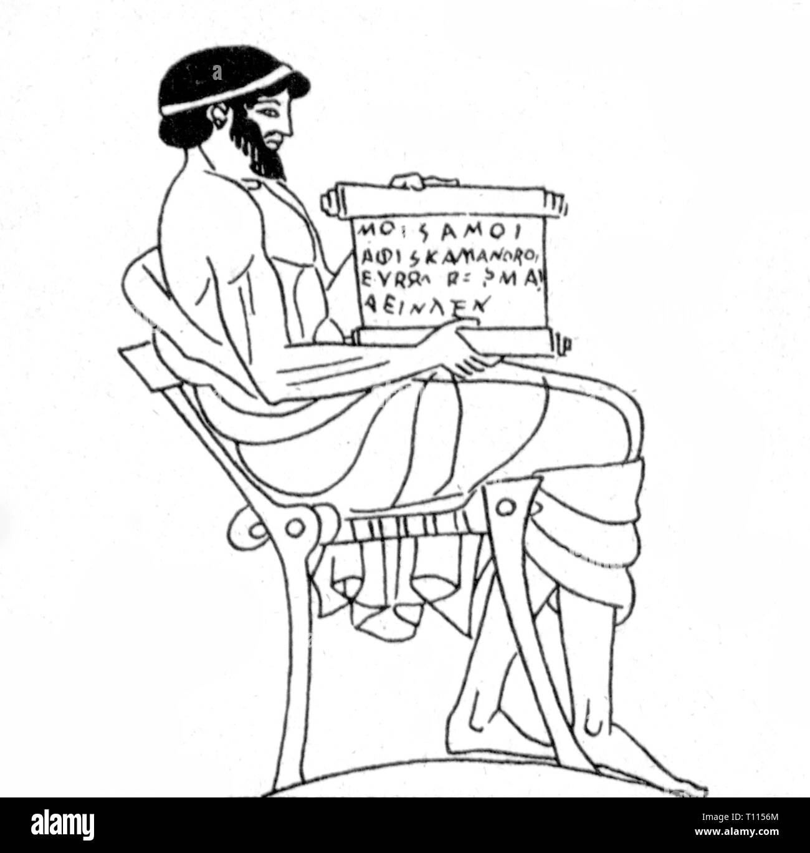
Why do we need an apparatus criticus? = History of ancient Greek scholarship
Ancient books:
The form of the book was a roll, on one side of which the text was written in a series of columns. The reader would unroll it gradually, using one hand to hold the part that he had already seen, which was rolled up; but the result of this process was to reverse the coil, so that the whole book had to be unrolled again before the next reader could use it.
Inconvenient. The material of which it was composed was by no means strong = easily damaged.

Slide 14
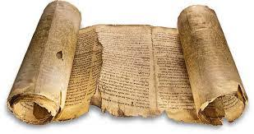
Why do we need an apparatus criticus? = History of ancient Greek scholarship
Ancient books:
The standard writing material was papyrus. It was prepared by cutting thin strips from the fibrous pith of a reed that grew freely in the Nile delta; in the first century A.D. there were also minor centres of production in Syria and near Babylon.
Two layers of these strips, one laid at right angles over the other, were pressed together to form sheets (Pliny, N.H. 13.680). The sheets could then be glued together in a long row to make a roll.
Leather: rarely used until the Hellenistic period.

Slide 15

Why do we need an apparatus criticus? = History of ancient Greek scholarship
Ancient books:
In the Hellenistic period, according to Varro can be (cf. Pliny, NH 13.70), the Egyptian government placed an embargo on the export of papyrus, which seems to have stimulated the search for an acceptable alternative.
At Pergamum a process was devised for treating animal skins to give a better writing surface than leather, the result being what is now called parchment (otherwise known as vellum); the word owes part of its etymology to the name Pergamum, and the derivation can be seen more clearly from the Italian form pergamena or the Greek form περγαμηνή.
Temporary embargo. it is not until the early centuries of the Christian era that parchment comes into common use for books; an early example is the fragment of Euripides’ Cretans (P. Berol. 13 217).

Slide 16
Why do we need an apparatus criticus? = History of ancient Greek scholarship
Ancient Books:
Papyri: usually written on one side only. Rarely written on both sides.
Punctuation was usually rudimentary at best.
Texts were written without word-division, and it was not until the middle ages that a real effort was made to alter this convention in Greek or Latin texts.
The system of accentuation was not invented until the Hellenistic period, and for a long time after its invention it was not universally used; here again it is not until the early middle ages that the writing of accents becomes normal practice.
In dramatic texts throughout antiquity changes of speaker were not indicated with the precision now thought necessary.
In the pre-Hellenistic period is that lyric verse was written as if it were prose.

Slide 17
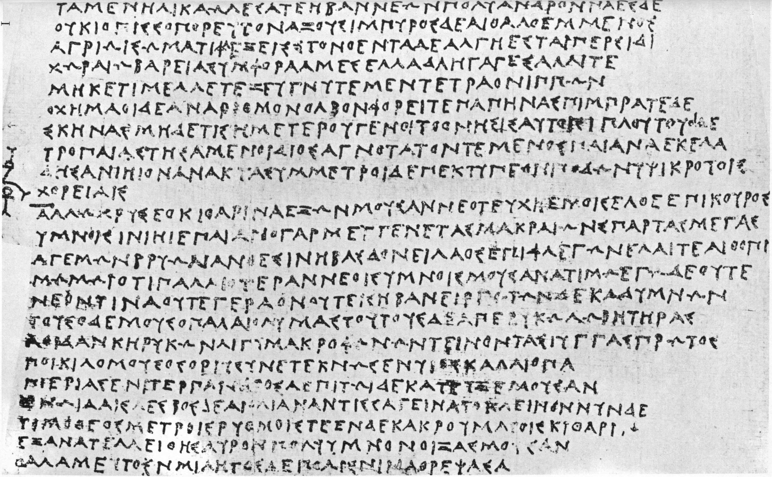
Why do we need an apparatus criticus? = History of ancient Greek scholarship

Slide 18
Why do we need an apparatus criticus? = History of ancient Greek scholarship
Ancient books:
Difficult for the reader to consult (risk of damaging the book).
Difficult to understand well and create a copy.
Result:
Corruption of the texts. The most serious corruptions in classical texts go back to this period and were already widely current in the books that eventually entered the library of the Museum at Alexandria.

Slide 19
Why do we need an apparatus criticus? = History of ancient Greek scholarship
The Library of the Museum and Hellenistic Scholarship:
Early libraries:
The increase of the book trade made it possible for private individuals to form libraries. Even if the tradition that sixth-century tyrants such as Pisistratus and Polycrates of Samos possessed large collections of books is discounted (Athenaeus 1.3A), it is clear that by the end of the fifth century private libraries existed; Aristophanes pokes fun at Euripides for drawing heavily on literary sources in composing his tragedies (Frogs 943), and his own work, being full of parody and allusion, must have depended to some extent on a personal book collection.
Official copies of plays performed at the leading festivals such as the Dionysia were kept at the theatre or in the public record office.

Slide 20
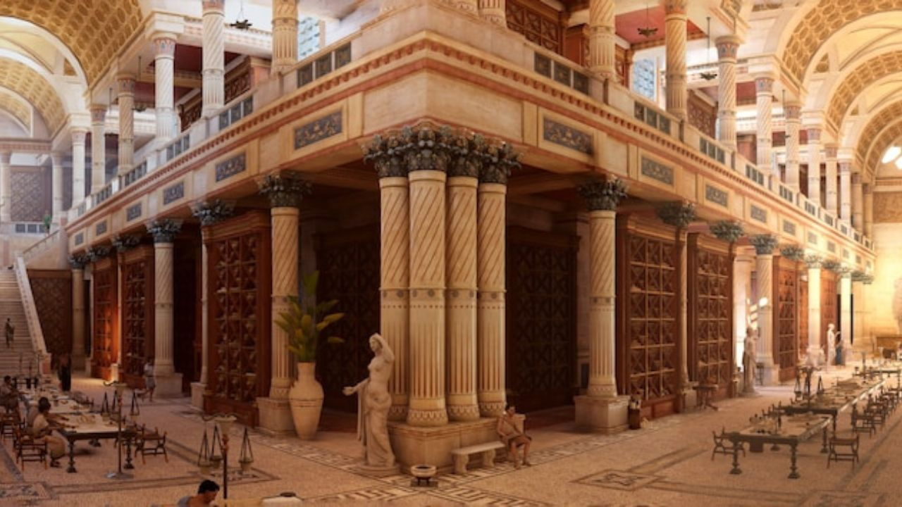
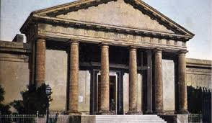
Why do we need an apparatus criticus? = History of ancient Greek scholarship
Museum of Alexandria
Library of Alexandria

Slide 21
Why do we need an apparatus criticus? = History of ancient Greek scholarship
The Library of the Museum and Hellenistic Scholarship:
Early libraries:
Institutions with libraries were founded. It is not surprising to find Strabo reporting (13.1.54) that Aristotle built up a large collection of books, no doubt representing the wide diversity of interests in the Lyceum. This collection and that of the Academy were taken as a pattern soon afterwards by the king of Egypt when establishing the famous library at Alexandria (Diog. Laert. 4.1, 5.51).
The main interests of the Lyceum were scientific and philosophical, but literary studies were not neglected. Aristotle himself wrote on problems of interpretation in Homer besides his well-known Poetics and Rhetoric and in connection with the latter there is some evidence that he and his successors were interested in the study of Demosthenes' speeches.

Slide 22
Why do we need an apparatus criticus? = History of ancient Greek scholarship
The Library of the Museum and Hellenistic Scholarship:
Museum in Alexandria. This was formally, as the name implies, a temple in honour of the Muses presided over by a priest. It was in fact the centre of a literary and scientific community.
The Museum was maintained at the expense of the king, and the members of it had study rooms and a hall in which they dined together. They also received a stipend from the royal purse.
The community was probably set up by Ptolemy Philadelphus c. 280 B.C., and it soon won a reputation, perhaps arousing jealousy through the lavishness of its arrangements, for we find the satirist Timon of Phlius writing of it c. 230 B.C. ‘‘in populous Egypt they fatten up many bookish pedants who quarrel unceasingly in the Muses' bird-cage’’ (Athenaeus I.22D).

Slide 23
Why do we need an apparatus criticus? = History of ancient Greek scholarship
The Library of the Museum and Hellenistic Scholarship:
Library: Some steps had been taken already in the previous reign by the first Ptolemy to set up a library, by inviting Demetrius of Phalerum, the eminent pupil of Theophrastus, to come to Alexandria for the purpose c. 295 B.C.
The library grew rapidly. The number of volumes is variously estimated by the ancient sources (e.g., in the third century the library contained 200,000 or 490,000 volumes).
Great efforts were made to form a complete collection of Greek literature.
The Alexandrians did what was necessary to prepare a standard text of all authors commonly read by the educated public.

Slide 24
Why do we need an apparatus criticus? = History of ancient Greek scholarship
Library:
Problems:
Texts copied by hand are quickly liable to corruption; to make an accurate copy of even a short text is a much harder task than is realized by those who have not had to do it. In addition to this pre-Hellenistic books gave no help to the reader in any difficulty. Consequently, there must have been numerous passages where the author's meaning could no longer be discerned, and many others in which various copies of texts reaching the Museum showed serious discrepancies.
Solutions:
The librarians’ effort to put the text in order led a great advance in learning and scholarly methods. It is no coincidence that five of the first six librarians (Zenodotus, Apollonius Rhodius, Eratosthenes, Aristophanes, and Aristarchus) were among the most famous literary men of their day, and it is in no small measure due to the success of their methods that classical Greek texts have come down to us in a state that is reasonably free from corruption.

Slide 25
Why do we need an apparatus criticus? = History of ancient Greek scholarship
Library:
Solutions:
1) standardization of texts, 2) aids to the reader: The first step was to ensure that fifth-century books coming from Attica, some of which must have been written in the old alphabet, were all transliterated into the normal Greek spelling of the Ionic alphabet. An improvement in the method of punctuation and the invention of the system of accentuation, both commonly ascribed to Aristophanes of Byzantium. In a text lacking word-division the addition of a few accents gave the reader a substantial help, and it is rather strange that they did not immediately come to be regarded as indispensable to a written text. They were not regularly added until the beginning of the tenth century.

Slide 26
Why do we need an apparatus criticus? = History of ancient Greek scholarship
Library:
Solutions: advances in scholarly method made by members of the Museum.
The need to establish the text of Homer and the other classical authors inspired scholars to define and apply the principles of literary scholarship more systematically than had been attempted before. Discussion of difficult passages led not merely to the production of a reliable text of the authors in question, but to commentaries in which the problems were discussed and interpretations offered. A mass of critical literature was produced for the first time. Invention of many critical signs.

Slide 27
Why do we need an apparatus criticus? = History of ancient Greek scholarship
Library:
Solutions:
Scholars capable of treating a text so drastically, especially in their willingness to condemn lines as spurious for inadequate reasons, might have done great damage to the text. But fortunately for subsequent generations of readers the Alexandrians avoided the temptation to incorporate all their proposed alterations into the text itself and were content to note proposals in their commentaries.

Slide 28
Why do we need an apparatus criticus? = History of ancient Greek scholarship
Other Hellenistic Work:
Library of Pergamum:
The scheme is primarily associated with the name of king Eumenes II (197-159 B.C.).
The librarians clearly undertook bibliographical studies on a large scale, and literary men found it useful to consult their work along with that of the Alexandrians.
The Pergamene scholars are not credited with editions of the classical authors and appear to have confined themselves to short monographs on specific points, sometimes directly in controversy with the Alexandrians.
Stoic influence: the application of allegorical explanations.

Slide 29
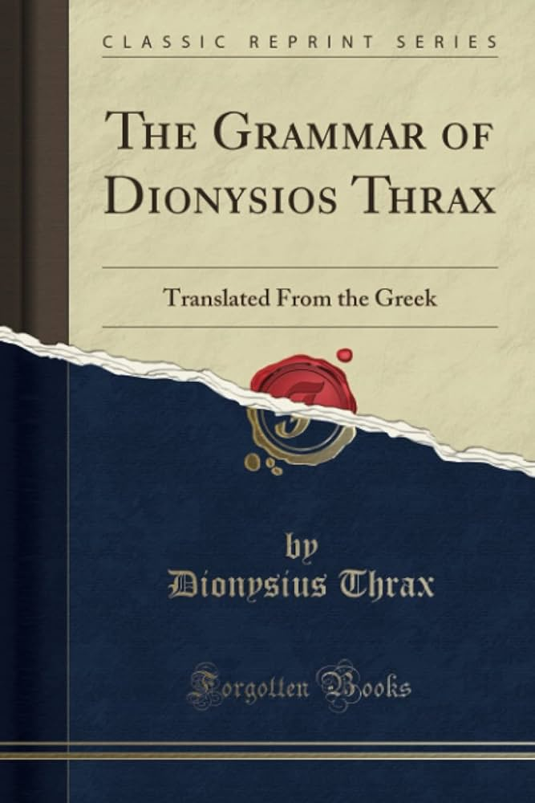
Why do we need an apparatus criticus? = History of ancient Greek scholarship
Other Hellenistic Work:
The First Grammar: the first formal Greek grammar was by Dionysius Thrax (c. 170-c. 90 B.C.);
He appears to have been just old enough to have been a pupil of Aristarchus, but is not to be counted as an Alexandrian in the full sense, since his teaching was done largely in Rhodes.

Slide 30
Why do we need an apparatus criticus? = History of ancient Greek scholarship
Scholarship under the Roman Empire:
In the early centuries of the Roman Empire, despite the existence of institutions of higher education such as the schools of philosophy and oratory at Athens, Rhodes, and elsewhere, there were few outstanding achievements in literature or scholarship.
The Museum at Alexandria still existed; although the end of independent government in Egypt brought to a close the royal patronage of scholarship. But notable works of scholarship do not seem to have been produced.
Only the library continued to render service as a leading collection of material for the scholarly public;
The tradition that Caesar was accidentally responsible for its destruction during his visit to Egypt (48-47 B.C.) has been widely accepted, but the sources are not entirely in agreement as to the extent of the damage, and it seems likely that no more than a section of the library was burnt, or that the deficiencies were made good by Antony, who was said to have transferred the Pergamene library to Alexandria (Plutarch, Antony 58); total destruction is also difficult to reconcile with the evidence that Strabo apparently did his geographical research in Alexandria.

Slide 31
Why do we need an apparatus criticus? = History of ancient Greek scholarship
Scholarship under the Roman Empire:
In the Augustan age Aristonicus did further selection of the Homeric commentaries, and Tryphon studied and classified figures of speech (the treatise which now passes under his name has been revised by later redactors).
During the reign of Tiberius there are again signs of some activity. Theon commented on various poetic texts, especially Hellenistic, such as Theocritus, Apollonius Rhodius, and Callimachus. Heliodorus wrote a commentary on the metres of Aristophanes, parts of which are found in the extant scholia.
But as far as we can see none of these works was outstanding as an advance in scholarly method or critical principles.

Slide 32
Why do we need an apparatus criticus? = History of ancient Greek scholarship
Scholarship under the Roman Empire:
Much the same is true of the second and third centuries, except that the grammarians Apollonius Dyscolus and his son Herodian were important in their own field, and some of their works survive independently of the scholia.
Apollonius was the first grammarian to write on syntax in something approaching the modern sense of the term; the name Dyscolus is said to have been given to him owing to the difficulty of his subject-matter.
Decline of scholarship and criticism.
Nostalgic admiration for the achievements of the classical period.

Slide 33
Why do we need an apparatus criticus? = History of ancient Greek scholarship
Scholarship under the Roman Empire:
Second century A.D.: By this time the Greek language had undergone considerable changes, as can be seen from a comparison of the classical language with that of the New Testament or the letters and documents among the papyri.
A desire to write in classical style at once created a need for manuals of instruction, and the energy of men with literary tastes was diverted to the writing of these textbooks. Dictionaries composed by Aelius Dionysius and Pausanias under Hadrian (117-38) have survived in fragments; we have also complete works by Pollux and Phrynichus dating from the reigns of Marcus Aurelius (161-80) and Commodus (180-92).
These books all gave guidance to the would-be writer of classical Attic prose; in general they listed words or constructions current in everyday use which a writer might be tempted to employ, and then added the correct classical idiom.

Slide 34
Why do we need an apparatus criticus? = History of ancient Greek scholarship
Scholarship under the Roman Empire:
The practice of Atticism lasted a very long time; it was the governing principle for all writers who aimed at a good style not merely under the Roman empire but right to the end of the Byzantine period.
The Byzantines may as a rule have been less successful in their imitation of ancient models than the writers of the Second Sophistic age such as Lucian and Aristides, but there is no doubt that their aims were identical, since lexica of Attic diction were composed by later scholars, for example Photius in the ninth century and Thomas Magister in the fourteenth.
Problem: The requirement to use only Attic diction of the best period ensured that in schools the classics of Athenian literature continued to be read as part of the regular curriculum, and this in turn meant that new copies of the text of major works were being steadily produced in sufficient numbers to guarantee the survival of most of them; only Menander was an exception.
Even when the Eastern empire was at its lowest ebb the tradition of reading classical literature in the schools was never quite obliterated.

Slide 35
Why do we need an apparatus criticus? = History of ancient Greek scholarship
Scholarship under the Roman Empire:
Problem: Close linguistic study of Attic texts led to other results. The occurrence of non-Attic words in a text supposed to come from the classical period might rouse suspicions as to its authenticity.
But the minute linguistic observations of the schools were not entirely beneficial.
They had the effect of instilling the forms and inflections of the Attic dialect so deeply that, when an educated man was transcribing a text, he tended to replace forms drawn from other dialects by the Attic forms which he knew so well. This is clear in works which contain Doric dialect, such as the lyrics of tragedy or Theocritus' Idylls in many parts of the text original Doric forms have been eliminated by successive generations of copyists.

Slide 36
Why do we need an apparatus criticus? = History of ancient Greek scholarship
The Christian Church and Classical Studies:
The effects of the growth of the Christian Church: In earlier antiquity religious toleration had been the rule rather than the exception but the animosity with which Christians and pagans regarded each other brought about a substantial and permanent change.
Many influential clergy disliked equally the unbelievers and the classical Greek literature which they studied with enthusiasm, and so the members of Christian communities were advised not to read such books.
One of the major reasons for the loss of classical texts is that most Christians were not interested in reading them, and hence not enough new copies of the texts were made to ensure their survival in an age of war and destruction.

Slide 37
Why do we need an apparatus criticus? = History of ancient Greek scholarship
The Christian Church and Classical Studies:
Studied at schools. The major classical texts, which had a firm position in the curriculum, were read by believer and unbeliever alike; but the survival of other texts was immediately put in danger when the new religion became universal, since the mass of the public, after the completion of their education, had no further interest in reading pagan books.
Allegorical interpretation might be used to make certain passages inoffensive to Christian taste.
Make Christianism appealing to educated Pagans: show that some of the important concepts of the new faith could be discussed in terms borrowed from the classical philosophers, especially the Stoics and Plato. The fusion of Greek and Christian thought in Justin and Clement exemplifies this attitude.

Slide 38
Why do we need an apparatus criticus? = History of ancient Greek scholarship
The Christian Church and Classical Studies:
The attitude of the church remained substantially unaltered throughout the Byzantine age. Classical authors maintained their place in the schools.
Eminent members of the higher clergy figure among the most competent students of classical Greek at all times.

Slide 39
Why do we need an apparatus criticus? = History of ancient Greek scholarship
The Early Byzantine Period:
Τhe Eastern part of the empire was more flourishing than ever before.
Schools can be traced at Alexandria, Antioch, Athens, Beirut, Constantinople, and Gaza; they were in effect the universities of the ancient world.
The need for such institutions was created by a vast increase in the Roman civil service in the fourth century. The government required administrators of liberal education and good prose style, as the emperor Constantius stated explicitly in 360 in an edict preserved in the Theodosian code (14.1.1).
The study of classical poetry and oratory continued in the schools as before; special attention was given to cultivating Attic prose style, and for this purpose a number of rhetorical tricks of style had to be mastered.

Slide 40
Why do we need an apparatus criticus? = History of ancient Greek scholarship
The Early Byzantine Period:
One by one the schools declined or closed, until by the middle of the sixth century only Constantinople and Alexandria remained: Justinian himself had closed the philosophical school at Athens in 529, and the other cities had been much reduced by war or natural disasters.
The emphasis on rhetoric and Atticism did not encourage much scholarship in the modern sense of the term. One achievement, however, which may belong to this period, is the conversion of ancient commentaries into the form of scholia, now placed in the margins of a text instead of occupying a separate book.
The progressive narrowing of the range of literature normally read. After the third century it becomes more and more uncommon to find any educated man showing knowledge of the texts that have not come down to the modern world.

Slide 41
Why do we need an apparatus criticus? = History of ancient Greek scholarship
Greek Texts in the Orient:
History of transmission: the significance of translations of Greek texts into Oriental languages.
At some point during late antiquity Greek texts began to be translated into Syriac, activity being centred in the towns of Nisibis and Edessa.
Probably the first text to be translated was the New Testament, followed shortly by a range of patristic works. The earliest manuscripts of these versions go back to the fourth and fifth centuries, and it is well known that they are of value to theologians.
It comes as a surprise, however, to find that other forms of Greek literature were translated. The schools of Nisibis and Edessa are known to have prepared versions of Aristotle, and a section of Theophrastus’ Meteorology survives in Syriac alone.

Slide 42
Why do we need an apparatus criticus? = History of ancient Greek scholarship
Greek Texts in the Orient:
Arabic versions of classical texts are perhaps more numerous than their Syriac counterparts and certainly better known.
The stimulus to make these translations seems to have come purely from a desire to use the best handbooks of science and philosophy available, and it is unlikely that a translation of the Bible preceded that of classical texts. As a rule the translations were made from an existing Syriac version, and so allowance must be made for two stages at which the inaccuracy of a translator could mar the expression of the original.
For the most part, however, it was science and philosophy that interested the Arabs. Plato, Aristotle, and Theophrastus were much studied.
Also: Translation into Armenian probably began for the purposes of the Church as it did in Syria. Bible. Plato.

Slide 43
Why do we need an apparatus criticus? = History of ancient Greek scholarship
The Renaissance of the Ninth Century:
The first real achievements of Byzantine scholarship belong to the middle of the ninth century.
The assistant emperor Bardas revived the imperial university, which had disappeared in the turmoil of the preceding centuries, by founding a school in the capital c. 860 under the direction of Leo, a philosopher and mathematician of distinction; other professors appointed at the same time were Theodore the geometrician, Theodegius the astronomer, and Cometas the literary scholar.
The revival of learning coincided with, and was perhaps assisted by, certain changes in the appearance and production of manuscripts.

Slide 44
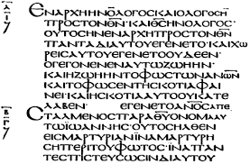
Why do we need an apparatus criticus? = History of ancient Greek scholarship
The Renaissance of the Ninth Century:
Books had normally been written in the script known as uncial or biblical majuscule, which had reached its fully developed form as early as the fourth century, and had changed surprisingly little in the course of centuries: serious disadvantage that it was slow to write and so large that the quantity of text on each page was strictly limited.

Slide 45
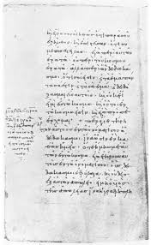
Why do we need an apparatus criticus? = History of ancient Greek scholarship
The Renaissance of the Ninth Century:
The papyrus plantations were either exhausted or used mainly by the Arabs after their conquest of Egypt in 641, the demand for parchment must have increased sharply;
To meet this difficulty, it appears that the expedient was devised of adapting for use in books the script that had been current for some time in official circles for letters, documents, accounts, and the like; the modern technical term for the revised script is minuscule. It occupied far less space on the page and could be written at high speed by a practised scribe.

Slide 46
Why do we need an apparatus criticus? = History of ancient Greek scholarship
The Renaissance of the Ninth Century:
Gradually the uncial hand was abandoned, and by the end of the tenth century it was no longer used except for a few special liturgical books.
The new script facilitated the copying of texts by making more economical use of parchment, and not long afterwards the situation was improved by another invention.
In 751 the Arabs had taken some Chinese prisoners of war at Samarkand and learnt from them the process of paper-making. Soon Arab production in the East and in Spain reached substantial proportions, and in due course it was exported to Byzantium. Hostilities between the two empires may have had an unfavourable effect on the trade, but there is no doubt that paper came to be widely used in Byzantium, and it seems to have been used in the imperial archives from the middle of the eleventh century.

Slide 47
Why do we need an apparatus criticus? = History of ancient Greek scholarship
The Renaissance of the Ninth Century:
The transliteration of old uncial books into the new script was energetically undertaken by the scholars of the ninth century. It is largely owing to their activity that Greek literature can still be read, for the text of almost all authors depends ultimately on one or more books written in minuscule script at this date or shortly after, from which all later copies are derived.
In the process of transliteration mistakes were sometimes made, especially by misreading letters that were similar in the uncial script and therefore easily confused.
At many points in Greek texts there are errors common to all the extant manuscripts which appear to derive from the same source, and this source is usually taken to be a ninth-century copy.

Slide 48
Why do we need an apparatus criticus? = History of ancient Greek scholarship
The Renaissance of the Ninth Century:
The Bardas school was founded under favourable conditions, and was probably the centre of a lively group of scholars concerned to recover and disseminate classical texts of many different kinds. Yet it does not seem to have had the influence that might have been expected, for there is very little reference to it at later dates. Its professors are completely overshadowed by their contemporary Photius (c. 8io-c. 893).
Twice he held the patriarchal throne of Constantinople (858-67, 877-86).
Before going on the long and dangerous journey Photius wrote, as an offering and consolation to his brother Tarasius, a summary of books that he had read over a long period of time, omitting some standard texts that Tarasius might have been expected to know. The resulting work, known as the Bibliotheca (this title is not due to its author), is a fascinating production, in which Photius shows himself the inventor of the book-review. Lexicon.

Slide 49
Why do we need an apparatus criticus? = History of ancient Greek scholarship
The Renaissance of the Ninth Century:
From this time onwards, as a result of the activity in Photius' salon and in various schools, there is a practically continuous tradition of classical studies in Byzantium. Literary texts were copied regularly and more technical works, especially mathematical and medical, were much studied, not least because they were still in general the best textbooks available.
The first major result of these new stimuli to scholarship can be seen in Arethas (c. 860-c. 935), who became archbishop of Caesarea in Cappadocia; again it is a churchman who shows great interest in learning.
Whereas Photius' own books do not survive, or at least have not been identified, several volumes from the library of Arethas still exist, and copies derived from other lost volumes are known, so that a good picture of his collection can be obtained.
Arethas commissioned books from professional scribes, in the main monks of monasteries which accepted regular orders on a commercial basis, and he then wrote a large amount of commentary in the margins in his own hand.

Slide 50
Why do we need an apparatus criticus? = History of ancient Greek scholarship
The Later Byzantine Period:
With the death of Arethas some time in the thirties of the tenth century a new period begins, in which eminent scholars and bibliophiles are much more difficult to identify (e.g., Constantine VII Porphyrogenitus (913-59) John Tzetzes (969-76)
Copies. New manuscripts.

Slide 51
Why do we need an apparatus criticus? = History of ancient Greek scholarship
The Later Byzantine Period:
Classical learning and education continued in the eleventh century much as before. The major change of this epoch consisted of a reorganization of the imperial university; whether this was provoked by a decline in the institution in the form that Bardas had given it is unknown, but the new arrangement included the setting up of a faculty of law and another of philosophy. The changes were made under the aegis of the emperor Constantine IX Monomachus, perhaps in 1047.
The philosophical school, which also gave instruction in grammar, rhetoric and literary subjects, was under the direction of Michael Psellus (1018-78).
A renewed interest in Plato and to a lesser extent Aristotle.

Slide 52
Why do we need an apparatus criticus? = History of ancient Greek scholarship
The Later Byzantine Period:
A further revival of philosophy, this time with Aristotle as the main author for study, can perhaps be traced to the early twelfth century. Anna Comnena was connected with two scholars who wrote commentaries on Aristotle, Eustratius of Nicaea and Michael of Ephesus.
The most interesting fact about this activity is that their treatises are devoted not only to the Politics and Ethics but also to the zoological works; these latter texts had not yet been supplied with commentaries, despite the enormous amount of study of Aristotle that had taken place in the ancient world and early Byzantine period. It rather looks as if Anna may have noticed this gap and decided to commission the necessary commentaries. She may also be ultimately responsible for the composition of two commentaries on the Rhetoric.

Slide 53
Why do we need an apparatus criticus? = History of ancient Greek scholarship
The Later Byzantine Period:
Other important figures: Eustathius od Thessalonica (c. 11T5-C. 1195), John Tzetzes (c. 1110-80), Michael Choniates.
Problems:
The capture and sack of Constantinople by the Fourth Crusade in 1204. Great damage was done, and there is little doubt that libraries suffered. In 1204 the rare texts were destroyed.
1453: the city fell into the hands of the Turks little remained to be discovered by the collectors.
Numerous Italian visitors and book collectors who went to Greece and brought back manuscripts.

Slide 54
How to make an apparatus criticus? = Editing a text
Since no autograph manuscripts of the Greek philosophers survive, we are dependent for our knowledge of what they wrote on manuscripts (and sometimes printed editions) which lie at an unknown number of removes from the originals.
These manuscripts vary in their trustworthiness as witnesses to the original texts; all of them have suffered to some degree in the process of transmission, whether from physical damage, from the fallibility of scribes, or from the effects of deliberate interpolation.

Slide 55
How to make an apparatus criticus? = Editing a text
Any attempt to restore the original text will obviously involve the use of a difficult and complex process, and this process falls into two stages (recensio and emendatio):
The first stage is recension (recensio). The object of recension is to reconstruct from the evidence of the surviving manuscripts the earliest recoverable form of the text that lies behind them.
When the most primitive state of the text that is recoverable from the manuscripts has been reconstructed, the second main stage of the critical process begins. The transmitted text must be examined and the critic must decide whether it is authentic or not (examinatio); if not, his duty is to emend it (emendatio), if this can be done with a reasonable degree of certainty, or to isolate the corruption.

Slide 56
How to make an apparatus criticus? = Editing a text
Recensio:
Unless the manuscript tradition depends on a single witness, it is necessary (1) to establish the relationships of the surviving manuscripts to each other, (2) to eliminate from consideration those which are derived exclusively from other existing manuscripts and therefore have no independent value (eliminatio codicum descriptorum), and (3) to use the established relationship of those which remain (ideally expressed in the form of a stemma codicum or family tree) to reconstruct the lost manuscript or manuscripts from which the surviving witnesses descend.

Slide 57
How to read an apparatus criticus? = Practical Instructions
The Apparatus Criticus: Abbreviations and Conventions:
Latin Meaning
a(nte) c(orrectionem) before correction (by a scribe or reader)
add(idit) added
addub(itavit) wondered about (a conjecture)
agn(ovit) recognised, realised
al(ii/ias/ibi/iter) others / elsewhere / elsewhere / otherwise
alii alia (coniecerunt) (too many) others (to name) have made other (unstated) conjectures
alt(er) second (latter of two)
an or perhaps (used to introduce an editor’s tentative suggestion)
ap(ud) in (of one author being cited by another)
cens(uit) adjudged
cet(eri) others (usually of the remaining mss)

Slide 58
How to read an apparatus criticus? = Practical Instructions
cf. (=confer) compare
cod(ices) manuscripts
coll(ato etc.) comparing (a passage)
comm(entarius etc.) commentary
coni(ecit)/conj./cj. conjectured
cont(inuavit) continued (esp. the attribution of dialogue)
corr(ectio/exit) correction / corrected
damn(avit) deleted as spurious
deest/desunt is/are missing (from one or more mss)
def(endit) defended (the transmitted text from emendation / deletion)
del(evit) deleted (as spurious)
det(eriores) worse manuscripts
dist(inxit) punctuated / separated by punctuation
dub(itanter) doubtfully (of non-committal conjectures)
ed(itiones/itores) editions / editors; edd. vett. = editores veteres; edd. pr. = editores priores
emend(avit) emended
exc(idit) fell out (from the manuscript(s))
exp(unxit) expunged / deleted
expl(evit) filled (a lacuna)

Slide 59
How to read an apparatus criticus? = Practical Instructions
fin(is) end
fors(itan) / fort(e/asse) perhaps
fr(agmentum) fragment
gl(oss(em)a) gloss
γρ(άφεται) it is written (used of glosses)
h(ic) l(ocus) this passage / place (in the text)
h(aec/ic) v(ox/ersus) this word/line
i(n) m(argine) in the margin
i(n) r(asura) in an erasure
i(n) t(extu) in the text (as opposed to the margin)
ibid(em) in the same place
id(em) the same (person)
incip(it) ‘it begins’: the opening header of a work / ms
incl(usit) enclosed (usually within brackets)
indic(avit) marked
inf(ra) below
init(ium) beginning
ins(eruit) inserted
lac(una) a gap in text (caused in the manuscript transmission)
lect(io) a reading (i.e. something found in a manuscript)
l(inea/ae) pl. ll. line(s) (of text)
loc(us) place/passage (of text)
l(oco) c(itato) in the passage cited
malim I (the editor) would prefer (this tentative suggestion I don’t print)
m(anus) hand (of scribe or reader)

Slide 60
How to read an apparatus criticus? = Practical Instructions
m(anus) r(ecentior) a more recent hand (of scribe or reader)
ms(s) (codex) manu scriptus = manuscript(s)
mut(avit) changed
om(isit) omitted
op(ere) cit(ato) in the work cited
p(agina) pl. pp. page(s) (of printed books)
Π / P papyrus fragment (much more common in Greek texts)
p(ost) c(orrectionem) after correction (by a scribe or reader)
pap(irus) papyrus fragment
pler(ique) most (manuscripts / editors / scholars)
pos(uit) placed (in the text)
possis (e.g.) you could (read) (for example)
pr(imus etc.) first
praef(atio) preface
prob(ante/avit) approving/ed (a conjecture)
q(uod) s(equitur) (and the text) which follows
ras(ura) erasure
rec(entior/es) more recent (esp. of manuscripts)
rel(iqui) the remaining (manuscripts)
s(aeculum) century
Σ scholion (much commoner in Greek texts)

Slide 61
How to read an apparatus criticus? = Practical Instructions
s(upra) l(ineam) written above the (usual) line
s(upra)s(criptum) /sscr. written above a word/line
s(ub) v(oce) under the word entry (in a dictionary vel sim.)
s(i) v(era) l(ectio) if (this) is the true reading
saep(e) often
sc(ilicet) namely
schol(ium/ion) scholion
scr(ipsi/t) wrote (often of an emendation)
secl(usit) bracketed off (usually as text out of place)
sim(ilia) similar (things)
spat(ium) space / gap (in manuscript)
stat(uit) marked (especially of lacunae)
sup(ra) above
suppl(evit) supplied (to fill a lacuna)
susp(icatus/a est) suspected
tempt(avit) tried / attempted (often of a conjecture)
test(e/ibus) on the testimony of (an author / scholar)
tit(ulus) title
tr(ansposuit) transposed (i.e. moved some text to a diferent place)
trib(uit) attributed (to another speaker / author)
ult(imus etc.) last
unc(is) incl(usit) enclosed in brackets (as spurious or out of place)
ut vid(etur) as it seems (expressing uncertainty)
vulg(o) commonly, i.e. the lectio vulgata / textus receptus of an edition
v(ide) or vid(e) see
v(ersus) pl. vv. verses (of poetry)
v(aria) l(ectio) variant reading
vac(uus) empty (of space left in manuscript)

Slide 62
How to read an apparatus criticus? = Practical Instructions
For most editions of Greek and Roman texts:
[ ] words deleted by the editor
[[ ]] words deleted by the scribe
< > words added by the editor
† (†) the transmitted text which cannot be right nor confidently corrected
For papyri and epigraphic texts:
[ ] words lost in damage: anything within them is conjectural
ạ ṿ ọ etc. the letter read is doubtful, as not enough ink/stone survives for certainty.

Slide 63
How to read an apparatus criticus? = Practical Instructions
The Leiden Conventions are a system of markers ("sigla") used in modern editions of epigraphic or papyrological texts.
In 1931, classical scholars met at the University of Leiden to arrive at a shared system of markers. Previously, scholars who published texts from inscriptions, papyri, or manuscripts used divergent conventions to indicate the condition of the text and editorial corrections or restorations. The new system, the Leiden Conventions, was published in U. Wilcken, "Das Leydener Klammersystem", Archiv für Papyrusforschung 10 (1932), pp. 211–212.
https://papyri.info/docs/leiden_plus

Slide 64
How to read an apparatus criticus? = Practical Instructions
Hesiod, Theogony 176-200
This text has been transmitted in a fairly large number of manuscripts. West has complete collations of thirty at his disposal, and partial collations of several more.
Many of them are of no individual importance, but in what follows I report their readings in full in order to give an idea of the extent and character of manuscript variation in a tradition of this kind.
No stemma can be constructed, but the majority of manuscripts fall into clearly defined groups. The hyparchetype a is represented by four descendants, OVWX. None of them is older than the 14th century, but agreements with an 11 th-century fragment and with the perhaps pre-Eustathian allegorical commentary of Johannes Diaconus Galenus suggest that a may represent a kind of Byzantine vulgate. Not dissimilar is r, a lost copy represented by seven extant manuscripts and their apographa; three of the seven come from an intermediate copy u which deserts r a little later in the poem. After leaving r, u will follow k, which may have been a recension of the Palaeologan era drawing on several sources. In lines 176-200, k is represented only by one extant manuscript, k of similar character to k is the hyparchetype b, represented by five manuscripts. one of these, L, is 14th-century, the others depend on a 15th-century model m.
S, the oldest manuscript available here (1280), is of Planudean origin, and characterized by emendation as well as by eclecticism. The same applies to Triclinius' autograph copy Tr, made a little before 1320. The remaining manuscripts mostly belong to the undistinguished family c, which has its heyday in the 15th century but has a precursor in Q about 1300.

Slide 66
How to read an apparatus criticus? = Practical Instructions
ἦλθε δὲ νύκτ᾽ ἐπάγων μέγας Οὐρανός, ἀμφὶ δὲ Γαίῃ
ἱμείρων φιλότητος ἐπέσχετο καί ῥ᾽ ἐτανύσθη
πάντη· ὃ δ᾽ ἐκ λοχέοιο πάις ὠρέξατο χειρὶ
σκαιῇ, δεξιτερῇ δὲ πελώριον ἔλλαβεν ἅρπην
μακρὴν καρχαρόδοντα, φίλου δ᾽ ἀπὸ μήδεα 180
Πατρὸς ἐσσυμένως ἤμησε, πάλιν δ᾽ ἔρριψε φέρεσθαι
ἐξοπίσω· τὰ μὲν οὔ τι ἐτώσια ἔκφυγε χειρός·
ὅσσαι γὰρ ῥαθάμιγγες ἀπέσσυθεν αἱματόεσσαι,
πάσας δέξατο Γαῖα· περιπλομένων δ᾽ ἐνιαυτῶν
γείνατ᾽ Ἐρινῦς τε κρατερὰς μεγάλους τε Γίγαντας, 185
τεύχεσι λαμπομένους, δολίχ᾽ ἔγχεα χερσὶν ἔχοντας,
Νύμφας θ᾽ ἃς Μελίας καλέουσ᾽ ἐπ᾽ ἀπείρονα γαῖαν.
And Heaven came, bringing on night and longing for love, and he lay about Earth spreading himself full upon her. Then the son from his ambush stretched forth his left hand and in his right took the great long sickle [180] with jagged teeth, and swiftly lopped off his own father's members and cast them away to fall behind him. And not vainly did they fall from his hand; for all the bloody drops that gushed forth Earth received, and as the seasons moved round [185] she bore the strong Erinyes and the great Giants with gleaming armour, holding long spears in their hands and the Nymphs whom they call Meliae all over the boundless earth.

Slide 67
How to read an apparatus criticus? = Practical Instructions
μήδεα δ᾽ ὡς τὸ πρῶτον ἀποτμήξας ἀδάμαντι
κάββαλ᾽ ἀπ᾽ ἠπείροιο πολυκλύστῳ ἐνὶ πόντῳ,
ὣς φέρετ᾽ ἂμ πέλαγος πουλὺν χρόνον, ἀμφὶ δὲ λευκὸς 190
ἀφρὸς ἀπ᾽ ἀθανάτου χροὸς ὤρνυτο· τῷ δ᾽ ἔνι κούρη
ἐθρέφθη· πρῶτον δὲ Κυθήροισιν ζαθέοισιν
ἔπλητ᾽, ἔνθεν ἔπειτα περίρρυτον ἵκετο Κύπρον.
ἐκ δ᾽ ἔβη αἰδοίη καλὴ θεός, ἀμφὶ δὲ ποίη
ποσσὶν ὕπο ῥαδινοῖσιν ἀέξετο· τὴν δ᾽ Ἀφροδίτην 195
ἀφρογενέα τε θεὰν καὶ ἐυστέφανον Κυθέρειαν
κικλῄσκουσι θεοί τε καὶ ἀνέρες, οὕνεκ᾽ ἐν ἀφρῷ
θρέφθη· ἀτὰρ Κυθέρειαν, ὅτι προσέκυρσε Κυθήροις·
Κυπρογενέα δ᾽, ὅτι γέντο πολυκλύστῳ ἐνὶ Κύπρῳ·
ἠδὲ φιλομμηδέα, ὅτι μηδέων ἐξεφαάνθη. 200
And so soon as he had cut off the members with flint and cast them from the land into the surging sea, [190] they were swept away over the main a long time: and a white foam spread around them from the immortal flesh, and in it there grew a maiden. First she drew near holy Cythera, and from there, afterwards, she came to sea-girt Cyprus, and came forth an awful and lovely goddess, and grass [195] grew up about her beneath her shapely feet. Her gods and men call Aphrodite, and the foam-born goddess and rich-crowned Cytherea, because she grew amid the foam, and Cytherea because she reached Cythera, and Cyprogenes because she was born in billowy Cyprus, [200] and Philommedes because she sprang from the members.

Slide 68
How to read an apparatus criticus? = Practical Instructions
176 γαίην Vat. 1948
An accusative would be possible, but the correct form would γαῖαν, and a single member of the c family is most unlikely to preserve a true reading by itself.
177 (i) ἱμείρω Arundel 522 : ἱμέρων u (εἰ superscr. U²). The variants are restricted to the r family, and seem to be independent of each other. Neither has an obvious explanation; possibly the scribe who wrote ἱμείρω, seeing the words 'longing for sex', at once thought of his own longing.
ii) ἐτανύσθη : ἐπανίσθη Vat. 1948
The scribe was unfamiliar with the poetic word ἐπάν- may be an echo of ἐπ-έσχετο or an anticipation of παντῆι, or, if the exemplar was written in two columns, it may come from πάντα at the end of 175, which would have appeared immediately above. –ίσθη represents the substitution of a phonetically equivalent but commoner ending, as if from a verb in -ίζω.

Slide 69
How to read an apparatus criticus? = Practical Instructions
178 (i) λοχέοιο KLSTr Par. 2772 Laur. 31,32, yp. Z2 schol. Et. Gen.: λοχεοῖο Mosq. 469 (χε in rase ?), Aristonicus: λεχέοιο Q : λόχοιο OV r Par. 2833 Vrat. Rehd. 35, γρ. L¹: λοχοῖο W: λούχοιο X² ex λόχοιο: λοχίοιο Mosq. 470 Phillipps 11723 Senensis I,IX,3, λοχόιο Par. 2834: λοχιοῖο Vat. 1948: λόκχοιο Paley: -τε λόχοιο Heyne : λεχρίοιο Ahrens
Scholia on this line and on Iliad 23,160 discuss the accentuation of λοχεος. In both, λοχεός is commended but it is admitted that manuscripts give λοχέοιο. Aristonicus is named as the authority for the correct form. It is clear, then, that λοχεοιο was the ancient reading, and although it is not found elsewhere, it is credible as a by-form of λόχος, however we accent it.

Slide 70
How to read an apparatus criticus? = Practical Instructions
Those manuscripts which have preserved it mostly give the accentuation which the scholia describe as current. In a, r, and m it was displaced by the ordinary form λόχοιο, to the detriment of the metre. But the copyist of one of the m manuscripts, Mosq. 469, had the scholium before him and was able to restore λοχεοῖο (with Aristonicus' accentuation). The scholium may also be responsible for the accentuations λοχοῖο in W and λοχιοῖο in Vat. 1948. λοχίοιο in four other c manuscripts may represent either a misreading of λοχέοιο or a metrical emendation of λόχοιο. λούχοιο (X²) is certainly the latter, inspired by epic forms such as πουλύς for πολύς. Q’s λεχέοιο springs from confusion with λέχος, which the context put into the scribe's mind.

Slide 71
How to read an apparatus criticus? = Practical Instructions
It should not be taken as support for Ahrens's conjecture, which was based on suspicion of the form λοχεος, and on Antimachus’ use of the adverb λέχρις, in connexion with the castration of Uranos. The other conjectures also aim at being rid of λοχεος but retain the word meaning hiding-place, which Hesiod used in 174 and is likely enough to have used again. Heyne's introduction of τε links the clause with the following one more closely than is usual in epic narrative. Paley assumes an original λόχοιο with the first syllable scanned long as with βρόχος, in Theogn. 1099, ὄφις, in Homer and Hipponax, etc. λοχεοιο would then be an early emendation of what seemed unmetrical. This is certainly an easier change than that presupposed by Ahrens, but still harder to believe than that λοχεοιο is original.

Slide 72
Editions
https://wiki.digitalclassicist.org/Digital_Critical_Editions_of_Texts_in_Greek_and_Latin
https://docs.google.com/spreadsheets/d/e/2PACX-1vRkUFBfVVqv5Tr2aZS4apFNpTJ-ys6VqeQxgsAI1v7cH5putIgchYWJAVGHuu0lWGmdD2DU7Vb1o7XH/pubhtml?gid=2058581320

Slide 73
Editions
Oxford Classical Texts.
Bibliotheca Teubneriana, or Bibliotheca Scriptorum Graecorum e Romanorum Teubneriana, also known as Teubner editions.
Les Belles Lettres (Collection Budé).
Die fragmente der Vorsokratiker (hereafter Diels-Kranz).

Slide 74
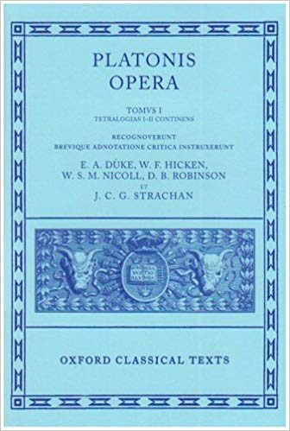
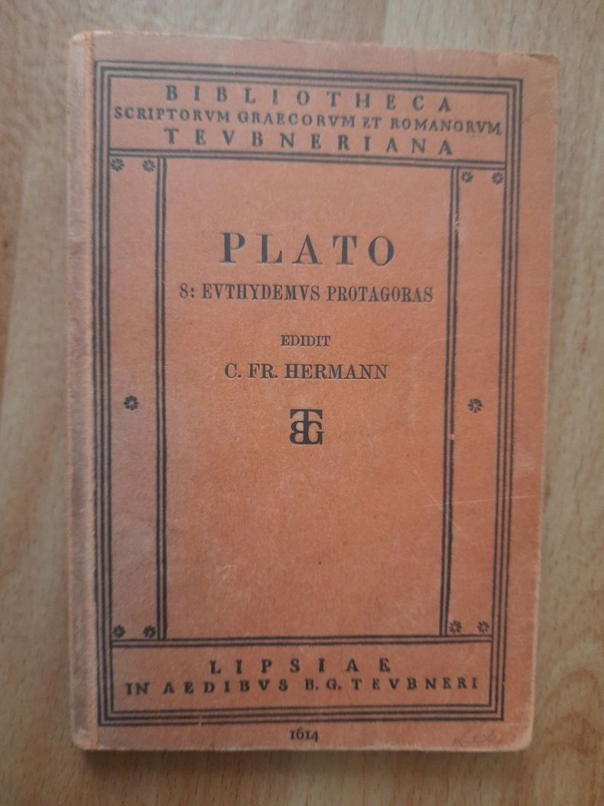
Editions
Oxford Classical Texts
Teubner

Slide 75


Editions
Les Belles Lettres
D-K

Slide 76
Bibliography
P. Maas, Textual Criticism, trans. B. Flower, Oxford, Oxford University Press, 1958.
L. D. Reynolds, Nigel Guy Wilson, Scribes and Scholars: A Guide to the Transmission of Greek and Latin Literature, Oxford, Oxford University Press, 1991.
M. L. West, Textual Criticism and Editorial Technique, Berlin, Walter De Gruyter, 1973.

Slide 77
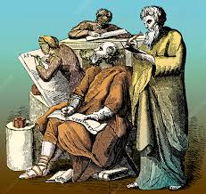
Thank you!
Have a nice day!

