Slide 1
Ancient Greek (Intermediate Level)
NATIONAL AND KAPODISTRIAN UNIVERSITY OF ATHENS / Department of History and Philosophy of Science
In collaboration with:
•UNIVERSITY OF PATRAS / Department of Philosophy
•UNIVERSITY OF CRETE / Department of Philosophy and Social Studies

Slide 2
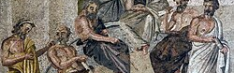
WEEK 5
Verbal Adjectives ending in -τος, -τη, -τον,Verbal Adjectives ending in -τέος, -τέα, τέον, and Relative pronouns

Slide 3
Verbal Adjectives ending in -τος, -τη, -ton AND -ΤΕΟΣ, -ΤΕΑ, -ΤΕΟΝ
Greek verb forms are either finite (indicatives, subjunctives, optatives, imperatives) or non-finite (infinitives, participles, and verbal adjectives in -τός or -τέος). Finite verbs have a personal ending and express person, number and mood; nonfinite verbs do not have a personal ending and do not express person or mood.
Verbal adjectives are only marked for the categories of case, number and gender. Their endings express case, number and gender.
Types of Verbal Adjectives
Greek has two types of verbal adjectives (adjectives formed from verb stems):
– adjectives in -τέος, -τέα, -τέον;
– adjectives in -τός, -τή, -τόν (the accent varies: sometimes, in compounds, -τος, -τη, -τον).
Verbal adjectives (in -τέος, -τέᾱ, -τέον, and in -τός, -τή, -τόν) have endings of the first and second declensions.
They are formed by adding τός and τέος to the verb stem, which generally has the same form as in the first aorist passive (with the change of φ and χ to π and κ before τ).
Thus, ποιέω, do, ἐποήθην, ποιητέος; πορεύομαι, advance, ἐπορεύθην, πορευτέος; πέμπω, send, ἐπέμφθην, πεμπτέος; θαυμάζω, wonder at, ἐθαυμάσθην, θαυμαστός; πείθω, persuade, mid. obey, ἐπείσθην, πειστέος; διώκω, pursue, ἐδιώχθην, διωκτέος.

Slide 4
Verbal Adjectives ending in -τος, -τη, -τον AND -ΤΕΟΣ, -ΤΕΑ, -ΤΕΟΝ
Verbal Adjectives in -τος, -τη, -τoν:
-τός, -τή, -τόν: these forms of verbal adjectives are expressing a passive state or passive possibility.
The formation is directly analogous to that of adjectives in -τέος, with the suffix added directly to the verb stem:
παιδευτός teachable (παιδεύω educate, verb stem παιδευ-)
φευκτός avoidable (φεύγω flee, verb stem φευγ-/φῠγ-)
ποιητός done, made (ποιέω do, make, verb stem ποιη-/ποιε-)

Slide 5
Verbal Adjectives ending in -τος, -τη, -ton AND –ΤΕΟΣ, -ΤΕΑ, - ΤΕΟΝ
Verbal Adjectives in -τέος, -τέα, τέον:
-τέος, -τέᾱ, -τέον: these forms of verbal adjectives expressing passive necessity.
The suffix is added directly to the verb stem:
παιδευτέος to be educated (παιδεύω educate, verb stem παιδευ-)
γραπτέος to be written (γράφω write, verb stem γραφ-; for πτ (assimilation)
φυλακτέος to be guarded (φυλάττω guard, verb stem φυλακ-)
κομιστέος to be brought (κομίζω bring, verb stem κομιδ-)

Slide 6
Verbal Adjectives ending in -τος, -τη, -ton AND –ΤΕΟΣ, -ΤΕΑ, - ΤΕΟΝ
Verbal Adjectives in -τέος, -τέα, τέον:
With verb stems that have ablaut variants, the full e-grade is typically used; with verb stems alternating between a long and a short final stem vowel, the long vowel is used:
φευκτέος to be fled (φεύγω flee, verb stem φευγ-/φῠγ-)
λειπτέος to be left (λείπω leave, verb stem λειπ-/λοιπ-/λῐπ-)
ποιητέος to be done, made (ποιέω do, make, verb stem ποιη-/ποιε-)
τιμητέος to be honoured (τιμάω honour, verb stem τιμη-/τιμᾰ-)

Slide 7
Verbal Adjectives ending in -τος, -τη, -ton AND –ΤΕΟΣ, -ΤΕΑ, - ΤΕΟΝ
Verbal Adjectives in -τέος, -τέα, τέον:
As Predicative Complement
Verbal adjectives in -τέος, -τέα, -τέον (also called gerundives) express a passive necessity: the word or phrase with which the adjective agrees is to undergo a certain action, e.g. παιδευτέος (ἐστί) (he is) to be educated, τὰ πρακτέα the things which must be done (substantivized).
Such adjectives are used as predicative complement with the linking verb εἰμί be (though the linking verb is in fact often omitted:
(1) ἐὰν δέ τις κατάτι κακὸς γίγνηται, κολαστέος ἐστί. (Pl. Grg. 527b)
If someone becomes bad in some respect, he ought to be punished. (κολάζω)
(2) οὐκοῦν αὗται (ἁρμονίαι), ἦν δ’ ἐγώ, ἀφαιρετέαι; (Pl. Resp. 398e)
‘Aren’t these modes of music,’ I said, ‘to be done away with?’ (ἀφαιρέω)
If expressed, the agent appears in the dative:
(3) ταῦτα μὲν οὖν, ὦ ἄνδρες δικασταί, τούτοις ποιητέα ἦν. (Andoc. 1.136)
These are the things, men of the jury, that had to be done by these men. (ποιέω)
(4) νουθετητέος δέ μοι | Φοῖβος. (Eur. Ion 436–7)
I must rebuke Phoebus. (νουθετέω)

Slide 8
Verbal Adjectives ending in -τος, -τη, -ton AND –ΤΕΟΣ, -ΤΕΑ, - ΤΕΟΝ
Adjectives in -τός, -τή, -τόν:
The adjectives in -τός, -τή, -τόν either express a passive state (like a perfect passive participle) or express passive possibility:
κρυπτός hidden (passive state; κρύπτω)
πόλις ἀφύλακτος an unguarded city (passive state; φυλάττω)
πιστός reliable (= ‘who can/may be trusted’, passive possibility; πείθομαι)
ποταμὸς διαβατός a fordable river (passive possibility; διαβαίνω)
(12) δίδαξον, εἰ διδακτόν, ἐξ ὅτου φοβῇ. (Soph. Trach. 671)
Explain to me, if it may be explained, the cause of your fear.

Slide 9
Verbal Adjectives ending in -τος, -τη, -ton AND –ΤΕΟΣ, -ΤΕΑ, - ΤΕΟΝ
Adjectives in -τός, -τή, -τόν:
Note 1: ‘Passive possibility’ should here be taken to include a range of nuances, such as ‘permission’, ‘right’, ‘appropriateness’, etc.
Several adjectives have both meanings, e.g.:
ἄγνωστος unknown; unknowable (γιγνώσκω)
ἀόρατος unseen; invisible (ὁράω)
Note 2: A few of these adjectives have both passive and active meaning:
δυνατός which can/may be done (passive); capable, powerful (active) (δύναμαι)
ἄπρακτος intractable, unprofitable, not to be done (passive); unsuccessful (active) (πράττω)

Slide 10
Verbal Adjectives ending in -τος, -τη, -ton AND –ΤΕΟΣ, -ΤΕΑ, - ΤΕΟΝ
Verbal Adjectives in -τέος, -τέα, τέον:
Impersonal Use
The neuter singular form in -τέον (rarely the plural -τέα) may be used impersonally to indicate that an action ought to be performed. The dative is used to express the agent, if present. This construction is used:
– with verbs that do not take an object/complement (these cannot otherwise be used in the passive):
(5) εἰσιτέον εἴσω δ’ ἐστίν. (Men. Cith. 63)
I should go inside (lit. ‘there is to be gone inside’). εἴσειμι cannot normally be used in the passive.
(6) ἐν ἀσπίσιν σοι πρῶτα κινδυνευτέον. (Eur. Supp. 572)
First, you must run a risk behind your shields (lit. ‘there is to be run a risk by you’). (κινδυνεύω)

Slide 11
Verbal Adjectives ending in -τος, -τη, -ton AND –ΤΕΟΣ, -ΤΕΑ, - ΤΕΟΝ
Verbal Adjectives in -τέος, -τέα, τέον:
– with verbs that take an object or complement; in this case such objects or complements are expressed in the case-form required by the verb:
(7) πᾶσαν κολακείαν . . . φευκτέον. (Pl. Grg. 527c)
Every kind of flattery must be avoided. φεύγω takes a direct object in the accusative.
(8) ἀκροατέον ὑμῖν ἐν μέρει τῶν κρειττόνων. (Ar. Av. 1228)
It’s now your turn to obey your superiors. ἀκροάομαι takes a complement in the genitive.
(9) τί ταῦτ᾽ ἀλύω; πειστέον πατρὸς λόγοις. (Eur. Hipp. 1182)
Why should I be distraught at this? The words of a father must be obeyed.
πείθομαι takes a complement in the dative

Slide 12
Verbal Adjectives ending in -τος, -τη, -ton AND –ΤΕΟΣ, -ΤΕΑ, - ΤΕΟΝ
Verbal Adjectives in -τέος, -τέα, τέον:
Note 1: Such expressions may be seen as roughly equivalent to δεῖ/χρή + inf.; for (7), for instance, cf. δεῖ φεύγειν πᾶσαν κολακείαν. This similarity was clearly felt by Attic authors, who sometimes express the agent with an accusative (the case to complement δεῖ/χρή) rather than a dative:
(10) οὐ μὴν δουλευτέον τοὺς νοῦν ἔχοντας τοῖς οὕτω κακῶς φρονοῦσιν. (Isoc. 9.7)
Men of intelligence should not serve as slaves to those who are perverted in this way.
Note 2: With verbs which have a different meaning in the active and middle-passive (e.g. πείθω persuade, convince and πείθομαι obey, believe), the impersonal verbal adjective in -τέον is ambiguous, and may correspond to either meaning. The construction or context makes clear which meaning is intended. For example, with (9), compare:
(11) τοὺς φύλακας ἐκεῖνο ἀναγκαστέον ποιεῖν καὶ πειστέον. (Pl. Resp. 421b)
The guardians must be forced and persuaded to do this. πειστέον corresponds to active
πείθω, which takes a direct object in the accusative

Slide 13
Verbal Adjectives ending in -τος, -τη, -ton AND –ΤΕΟΣ, -ΤΕΑ, - ΤΕΟΝ
Exercise 1: Read aloud and translate:
1) ἄλλαι νῆες μεταπεμπτέαι εἰσίν
2) ταῦτα ἡμῖν ποιητέον ἐστίν
3) ὦ ἄνδρες στρατιῶται, τὴν πορείᾱν πεζῇ ποιητέον· οὐ γάρ ἐστι πλοῖα
4) τοῦτο γὰρ δὴ ἐγὼ παντάπασιν οὐ διδακτὸν ᾤμην εἶναι
Vocabulary: μετάπεμπτος, ον (cf. μεταπέμπομαι) = sent for, ναῦς (ἡ) = ship, πλοῖον (το) = ship, στρατιώτης (ὁ) = soldier, πορεία (ἡ) = mode of walking or mode of running, journey, course, πεζῇ = on foot, by land, παντάπασιν (adv.) altogether οἴεσθαι to think (Mid. with Aor. Pass.; ᾤμην = ᾠόμην, Past Imperf.)

Slide 14
Verbal Adjectives ending in -τος, -τη, -ton AND –ΤΕΟΣ, -ΤΕΑ, - ΤΕΟΝ
Exercise II: Form the verbal adjectives in –τος, -το, -τον:
κρύπτω, παιδεύω, ὁράω, μέμφομαι, λύω

Slide 15
Verbal Adjectives ending in -τος, -τη, -ton AND –ΤΕΟΣ, -ΤΕΑ, - ΤΕΟΝ
stem κρυφ > κρυφ-τός > κρυπτός [φ changes to π before τ]
st. παιδευ < παιδευ-τός
st. ορα < ορα-τός
st. μεμφ < μεμπ-τός [φ changes to π before τ]
st. λύ < λυτός

Slide 16
RELATIVE PRONOUNS
Relative Pronouns "Who", "Which", "What", "That"
"Who","which", "what" and "that" are often used at the beginning of descriptive clauses.. These pronouns are sometimes called "the relative pronouns" because they relate a subordinate clause to a noun or pronoun in the main clause of a sentence.
Examples.
We are listening to a philosopher who walks about in the lectures.
(the "who" clause refers to "a philosopher")
The deeds which they do are eviL
(the "which" clause refers to "the deeds")
We know what we are talking about
(the "what" clause refers to things which we know)
The people that live in Athens are called Athenians.
(the "that" clause refers to the people).

Slide 17
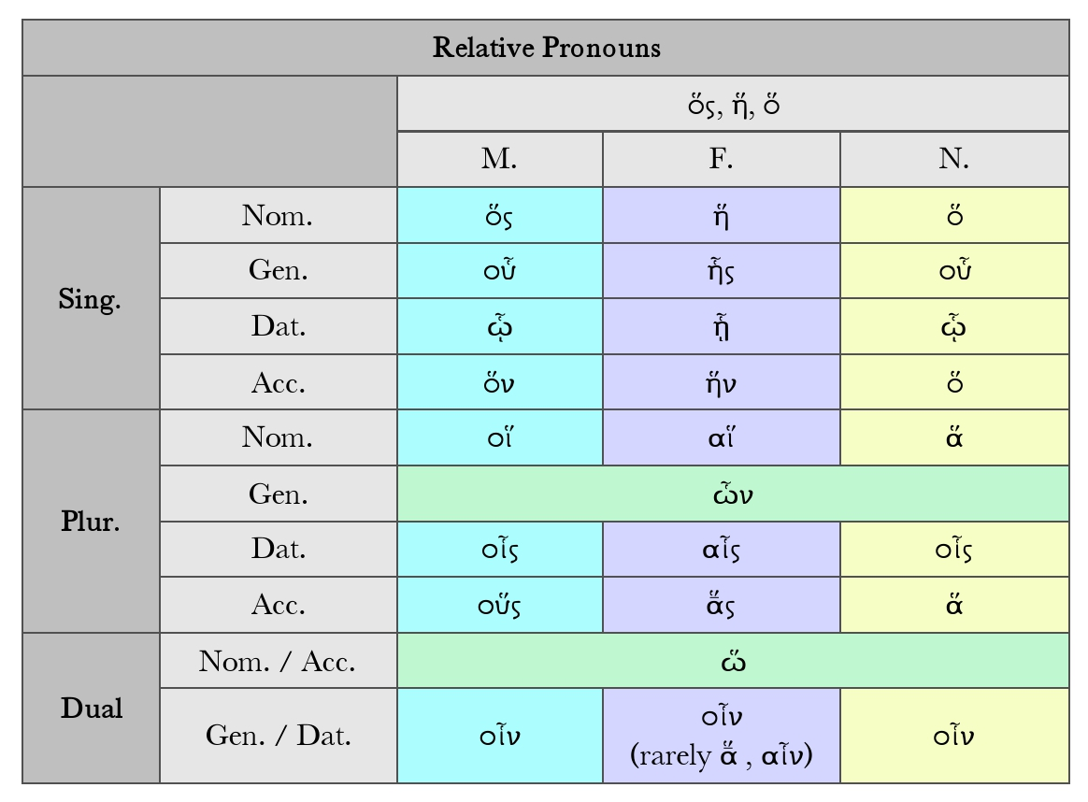
RELATIVE PRONOUNS

Slide 18
RELATIVE PRONOUNS
Examples:
ὁρῶ τὸν ἄνθρωπον ὅς λέγει = I see the man who is talking.
ὁρῶ τὸν ἄνθρωπον ὅν βούλομαι εὑρίσκειν = I see the man (that) I want to find.
ὁρῶ τὸν ἄνθρωπον οὗ τὴν βίβλον ἔχω = I see the man whose book I have.
ὁρῶ τὸν ἄνθρωπον ὧι λέγειν βούλομαι = I see the man to whom I want to speak.
The noun in the main clause (τὸν ἄνθρωπον in these examples) is called the antecedent (that which goes before). A relative pronoun agrees with its antecedent in gender and number (masculine singular in these examples) but its case is decided by the meaning of clause in which it stands.

Slide 19
RELATIVE PRONOUNS
Masculine Indefinite Relative Pronoun
Nominative Singular ὄστις
Genitive Singular οὗτινος, ὅτου
Dative Singular ᾧτινι, ὅτῳ
Accusative Singular ὅντινα
Nominative Plural οἵτινες
Genitive Plural ὧντινων, ὄτων
Dative Plural οἷστισι, ὅτοις
Accusative Plural οὕστινας
Feminine Indefinite Relative Pronoun
Nominative Singular ἤτις
Genitive Singular ἧστινος
Dative Singular ᾗτινι
Accusative Singular ἥντινα
Nominative Plural αἵτινες
Genitive Plural ὧντινων
Dative Plural αἷστισι
Accusative Plural ἅστινας

Slide 20
RELATIVE PRONOUNS
Neuter Indefinite Relative Pronoun
Nominative Singular ὅτι
Genitive Singular οὗτινος, ὅτου
Dative Singular ᾧτινι, ὅτῳ
Accusative Singular ὅ τι
Nominative Plural ἅτινα, ἅττα
Genitive Plural ὧντινων, ὄτων
Dative Plural οἷστισι, ὅτοις
Accusative Plural ἅτινα, ἅττα
This is also a relative pronoun in Greek, but it is less definite than ὅς or ὅσπερ and refers to a general category, rather than to a precise individual. It is often the equivalent of whoever or whatever.

Slide 21
RELATIVE PRONOUNS
The enclitic particle -περ added to a relative pronoun makes more distinct the reference to the antecedent, which is thereby emphasized.
ὅπερ which very thing, the very thing which
ὥσπερ just as
θέλω ἅπερ σύ
I wish the very things that you do.
Eur. Ipheginia in Tauris, 991

Slide 22
RELATIVE PRONOUNS
The Relative Pronoun ὅς connects its clause with some noun or pronoun, and has its own construction in the subordinate clause. (So of its compounds ὅσπερ, ὅστις, etc.)
a. The connecting force of ὅς may be no stronger than that of a demonstrative. The ὅς clause is then really independent.
When clearly subordinate, the ὅς clause often precedes the leading clause, or may be included within it.
The Relative Pronouns take their gender, number, and person from the antecedent; but sense may prevail over form, and when the relative is the subject a predicate noun sometimes prevails over the antecedent.
b. The Relative is often attracted from its proper case to the case of the antecedent, especially from the accusative to the genitive or dative.
Ἄνδρες ἄξιοι τῆς ἐλευθερίᾱς ἧς κέκτησθε
men worthy of the freedom which you possess
Xen. Anabasis 1.7.3

Slide 23
RELATIVE PRONOUNS
Plato, Meno 76c-76d
Σωκράτης
βούλει οὖν σοι κατὰ Γοργίαν ἀποκρίνωμαι, ᾗ ἂν σὺ μάλιστα ἀκολουθήσαις;
Μένων
βούλομαι· πῶς γὰρ οὔ;
Σωκράτης
οὐκοῦν λέγετε ἀπορροάς τινας τῶν ὄντων κατὰ Ἐμπεδοκλέα;
Μένων
σφόδρα γε.
Σωκράτης
καὶ πόρους εἰς οὓς καὶ δι᾽ ὧν αἱ ἀπορροαὶ πορεύονται;
Μένων
πάνυ γε.
Σωκράτης
καὶ τῶν ἀπορροῶν τὰς μὲν ἁρμόττειν ἐνίοις τῶν [76d] πόρων, τὰς δὲ ἐλάττους ἢ μείζους εἶναι;

Slide 24
RELATIVE PRONOUNS
Μένων
ἔστι ταῦτα.
Σωκράτης
οὐκοῦν καὶ ὄψιν καλεῖς τι;
Μένων
ἔγωγε.
Σωκράτης
ἐκ τούτων δὴ ‘σύνες ὅ τοι λέγω,’ ἔφη Πίνδαρος. ἔστιν γὰρ χρόα ἀπορροὴ σχημάτων ὄψει σύμμετρος καὶ αἰσθητός.
Notes: βούλει …. ἀποκρίνωμαι: an exampIe of parataxis i.e. cIauses not subordinated one to the other: βούλει and ἀποκρίνωμαι are 2 main verbs side by side, not joined by ‘‘and’’ or "but". The sense, do you want? am I to reply? (subjunctive) is like the English would you like me to reply?
ᾗ: by which, i.e. in the way in which. μάλιστα: especially (here meaning most readily). ἀκολουθήσαις is 2nd person singular of ἀκολουθήσαιμι, the optative of ἠκουλούθησα, the aorist of ἀκολουθέω: I follow. ἂν ἀκολουθήσαις; you would follow.
πῶς γὰρ οὔ: for how not?: of course.

Slide 25
RELATIVE PRONOUNS
Notes: οὔκουν , Ion. οὔκων , Adv., (οὐκ, οὖν): in replies, where the speaker seizes an opening offered by the previous speaker = well
λέγω (here) with accusative: I speak of
ἡ ἀπορροή, τῆς ἀπορροῆ: the effluence.
τὰ ὄντα (the things that are) means whatever exists. The:genitive here expresses separation- τῶν ὄντων from things, i.e. from whatever exists.
Empedocles thought that the objects we perceive give off effluences (ἀπορροαί) and that perception happens when these effluences fit apertures in our organs of sensation.
σφόδρα γε: very much indeed.
ὁ πόρος, τοῦ πόρου: ford, way through, here aperture, pore. εἰς οὓς καὶ δι᾽ ὧν: into which and through which. πορεύομαι I make my way
πάνυ γε: most certainly

Slide 26
RELATIVE PRONOUNS
Notes: τὰς μὲν …. τὰς δὲ: some ... others ... (feminine accusative plural to qualify ἀπορροάς, understood from τῶν ἀπορροῶν)
ἁρμόττω: (with dative) I fit. ἔνιοι, αι, α: some
Understand φατέ before ἀρμόττειν. (φατὲ) τὰς μὲν τῶν ἀπορροῶν ἁρμόττειν ἐνίοις τῶν [76d] πόρων; (do you affirm) some of the effluences to fit some of the pores?
τὰς δὲ: but others; ἐλάττους: (standing for ἐλάττονας): too small
μείζους (standing for μείζονας): too big
ἡ ὄψις, -εως: sight
σύνες: is 2nd person singular imperative of συνῆκα, the aorist of συνίημι = I understand and means understand!
ὅ : what, τοι is a form of σοι
σύνες ὅ τοι λέγω: is a quotation from the poet Pindar which may have been a catch phrase. Plato uses it playfully also at Phaedrus 236d. It is the beginning of a hyporchema (a song to be accompanied by dancing) in honour of Hiero of Syracuse (fragment 94 in the Oxford Classical Text of Pindar, eel. Bowra). At Aristophanes, Birds 945, a poor poet, guying Pindar, says σύνες ὅ τοι λέγω (understand what I am saying to you! = get my meaning!} when trying to cadge a tunic.

Slide 27
RELATIVE PRONOUNS
σύμμετρος, σύμμετρον: feminine as masculine) (with dative): commensurate with.
καὶ: and therefore
αἰσθητός, -ον: (feminine as masculine here, but sometimes αἰσθητή): perceptible.
χρώς, χρωτός: noun sg masc acc epic ionic = of the human body, skin or flesh
σχῆμα, σχήματος (τὸ): form, shape, figure
Empedocles taught that material objects are known to us by means of effluences or films given off by them and suited in various ways to our sense-organs.

Slide 28
RELATIVE PRONOUNS
Socrates
Then would you like me to answer you in the manner of Gorgias,1 which you would find easiest to follow?
Meno
I should like that, of course.
Socrates
Do not both of you say there are certain effluences of existent things, as Empedocles held?
Meno
Certainly.
Socrates
And passages into which and through which the effluences pass?
Meno
To be sure.
Socrates
And some of the effluences fit into various passages,
[76d] while some are too small or too large?
Meno
That is so.
Socrates
And further, there is what you call sight?
Meno
Yes.
Socrates
So now “conceive my meaning,” as Pindar1 says: color is an effluence of figures, commensurate with sight and sensible.

Slide 29
PHILOSOPHICAL VOCABULARY
G (Γ)
γένεσις, γίγνεσθαι: genesis, gignesthai. (1) Birth, being born: prin kai genesthai hémas - before we were even born (Pl. Phaedo 88a). (2) Becoming, to become. Aristotle distinguishes absolute becoming (coming to be) from becoming somehow: phamen gar ton manthanonta gignesthai men epistémona, gignesthai d’haplos ou — for we say that he who learns becomes learned, but not that he comes to be absolutely (Ar. De Gen. et Cor. 318a 35).
γιγνώσκειν: gignéskein: to know, to recognise; gnésis: knowledge; gnéstos: knowable. tous men gar duo misthous gignéské — I recognise two of the rewards (Pl. Rep. 347a); gnéthi sauton — know yourself (Pl. Prot. 343b). In Plato, frequently contrasted with doxa and its cognates: estai gnéston kai doxaston to auto, é adunaton? — will the same thing be the object of knowledge and belief, or is that impossible? (Pl. Rep. 478a).

Slide 30
PHILOSOPHICAL VOCABULARY
H (Ἁ/Ἡ/Ἑ/Ὁ/Χ/Ὑ)
ἁμαρτάνειν: hamartanein: in Homer, usually physically to miss one’s mark, with a spear, etc.; from that it acquired a more general sense of making a mistake. This use is common in philosophy, and in it oudeis hekén hamartanei — nobody makes mistakes intentionally — is, as Socrates claimed, a truism not a paradox: kata ton akribé logon oudeis ton de‘miourgon hamartanei — strictly speaking, a craftsman does not make mistakes (Pl. Rep. 340e); eu isthi hoti akontes hamartanomen — be sure that it is an unintentional mistake (Pl. Rep. 336e).
ἡδονή: pleasure, enjoyment, the opposite of lupé, dislike, distress. It often refers to pleasant feelings, since, as Aristotle says, eiléphasi tén tou onomatos kléronomian hai somatikai hédonai — the bodily pleasures have taken over the inheritance of the name (Ar. E.N.1153b 33).
ἕκων: hekén, hekousion, hekousiés. (1) Intending, intended, intentionally: epi tois hekousioisv epainén kai psogon gignomenon — praise and blame are given to intended actions (E.N. 1109b 30). The common translation ‘voluntary’ is best avoided. The contrary of hekon is ἄκων.

Slide 31
PHILOSOPHICAL VOCABULARY
ὕδωρ: hudér: water. One of the four elements, earth, water, air and fire, recognised by most philosophers after Empedocles as constituting the sublunary region. All liquids were philosophically regarded as water, though most were recognised to be impure. Of the four bodies exhibiting some combination of hot or cold, wet or dry, water is the wet and cold: to d’hudérpsukhron kai hugron -— water is cold and wet (Ar. De Gen. et Cor. 330b 4). Earth and water are the lower pair, air and fire the higher pair of the four elements: pur men gar kai aér tou pros ton horon pheromenou, gé de kai hudér tou pres to meson — fire and air belong to the pair that tends to the boundary [of the universe], earth and water to that which tends to the middle (Ar. De Gen. et Cor. 33Gb 32).
ὕλη: Originally wood, timber. ton tektonén diaponémata parekhetai - what wood supplies towards the constructions of builders (Pl. Critias 114a). In Aristotelian and neoplatonic physics, the matter that together with the form constitutes a substantial reality and which has the capacity to receive form.

Slide 32
PHILOSOPHICAL VOCABULARY: Ἀριστοτέλης, Περὶ Γενέσεως Καὶ Φθορᾶς
Ἐπεὶ δὲ τέτταρα τὰ στοιχεῖα, τῶν δὲ τεττάρων ἓξ αἱ συζεύξεις, τὰ δ' ἐναντία οὐ πέφυκε συνδυάζεσθαι (θερμὸν γὰρ καὶ ψυχρὸν εἶναι τὸ αὐτὸ καὶ πάλιν ξηρὸν καὶ ὑγρὸν ἀδύνατον), φανερὸν ὅτι τέτταρες ἔσονται αἱ τῶν στοιχείων συζεύξεις, θερμοῦ καὶ ξηροῦ, καὶ θερμοῦ καὶ ὑγροῦ, καὶ [330b] πάλιν ψυχροῦ καὶ ὑγροῦ, καὶ ψυχροῦ καὶ ξηροῦ. Καὶ ἠκολούθηκε κατὰ λόγον τοῖς ἁπλοῖς φαινομένοις σώμασι, πυρὶ καὶ ἀέρι καὶ ὕδατι καὶ γῇ· τὸ μὲν γὰρ πῦρ θερμὸν καὶ ξηρόν, ὁ δ' ἀὴρ θερμὸν καὶ ὑγρόν (οἷον ἀτμὶς γὰρ ὁ ἀήρ), τὸ δ' ὕδωρ ψυχρὸν καὶ ὑγρόν, ἡ δὲ γῆ ψυχρὸν καὶ ξηρόν, ὥστ' εὐλόγως διανέμεσθαι τὰς διαφορὰς τοῖς πρώτοις σώμασι, καὶ τὸ πλῆθος αὐτῶν εἶναι κατὰ λόγον. Ἅπαντες γὰρ οἱ τὰ ἁπλᾶ σώματα στοιχεῖα ποιοῦντες οἱ μὲν ἕν, οἱ δὲ δύο, οἱ δὲ τρία, οἱ δὲ τέτταρα ποιοῦσιν. Ὅσοι μὲν οὖν ἓν μόνον λέγουσιν, εἶτα πυκνώσει καὶ μανώσει τἆλλα γεννῶσι, τούτοις συμβαίνει δύο ποιεῖν τὰς ἀρχάς, τό τε μανὸν καὶ τὸ πυκνὸν ἢ τὸ θερμὸν καὶ τὸ ψυχρόν· ταῦτα γὰρ τὰ δημιουργοῦντα, τὸ δ' ἓν ὑπόκειται καθάπερ ὕλη.
The elementary qualities are four, and any four terms can be combined in six couples. Contraries, however, refuse to be coupled: for it is impossible for the same thing to be hot and cold, or moist and dry. Hence it is evident that the 'couplings' of the elementary qualities will be four: hot with dry and moist with hot, and again cold with dry and cold with moist. And these four couples have attached themselves to the apparently 'simple' bodies (Fire, Air, Water, and Earth) in a manner consonant with theory. For Fire is hot and dry, whereas Air is hot and moist (Air being a sort of aqueous vapour); and Water is cold and moist, while Earth is cold and dry. Thus the differences are reasonably distributed among the primary bodies, and the number of the latter is consonant with theory. For all who make the simple bodies 'elements' postulate either one, or two, or three, or four. Now (i) those who assert there is one only, and the generate everything else by condensation and rarefaction, are in effect making their 'originative sources' two, viz. the rare and the dense, or rather the hot and the cold: for it is these which are the moulding forces, while the 'one' underlies them as a 'matter'.

Slide 33
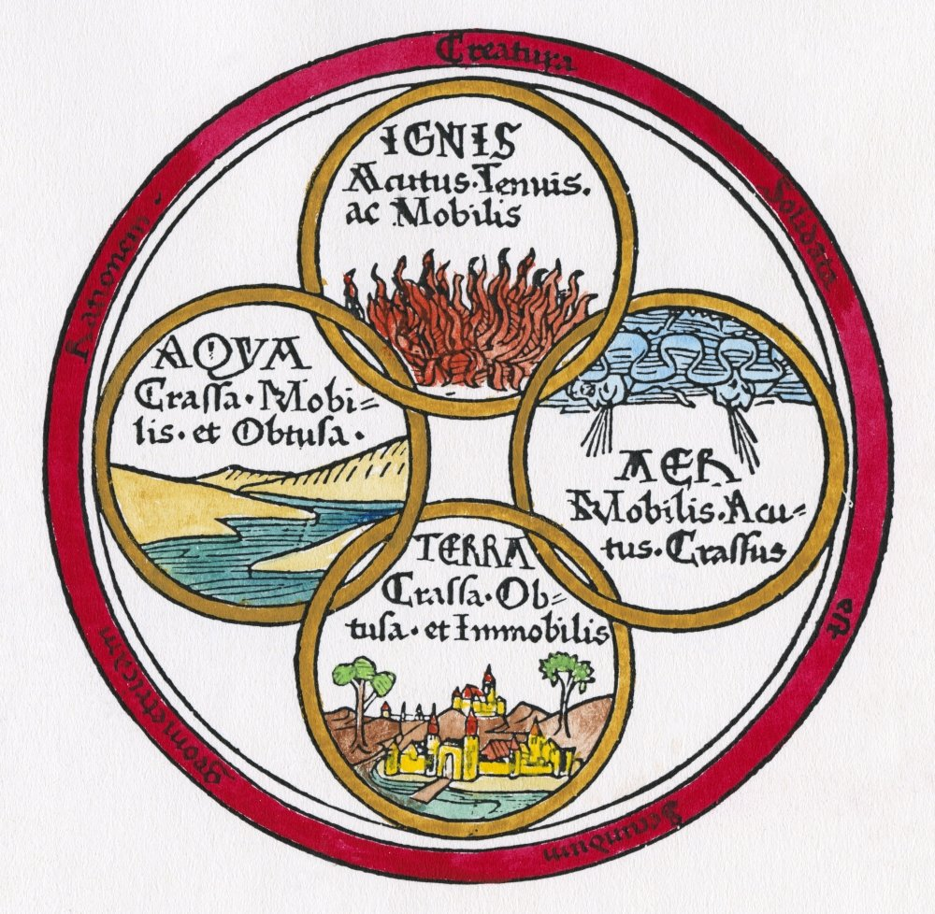
Thanks!
ΕΥΧΑΡΙΣΤΩ!

