Slide 1
Ancient Greek (Intermediate Level)
NATIONAL AND KAPODISTRIAN UNIVERSITY OF ATHENS / Department of History and Philosophy of Science
In collaboration with:
•UNIVERSITY OF PATRAS / Department of Philosophy
•UNIVERSITY OF CRETE / Department of Philosophy and Social Studies

Slide 2
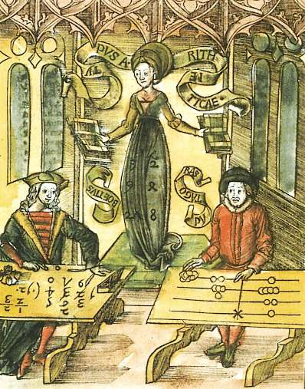
WEEK 4
Numbers and Degrees of Comparison

Slide 3
numerals
Cardinal numbers: e.g., one, two, three.
Ordinal Adjectives: e.g., first, second, third.

Slide 4
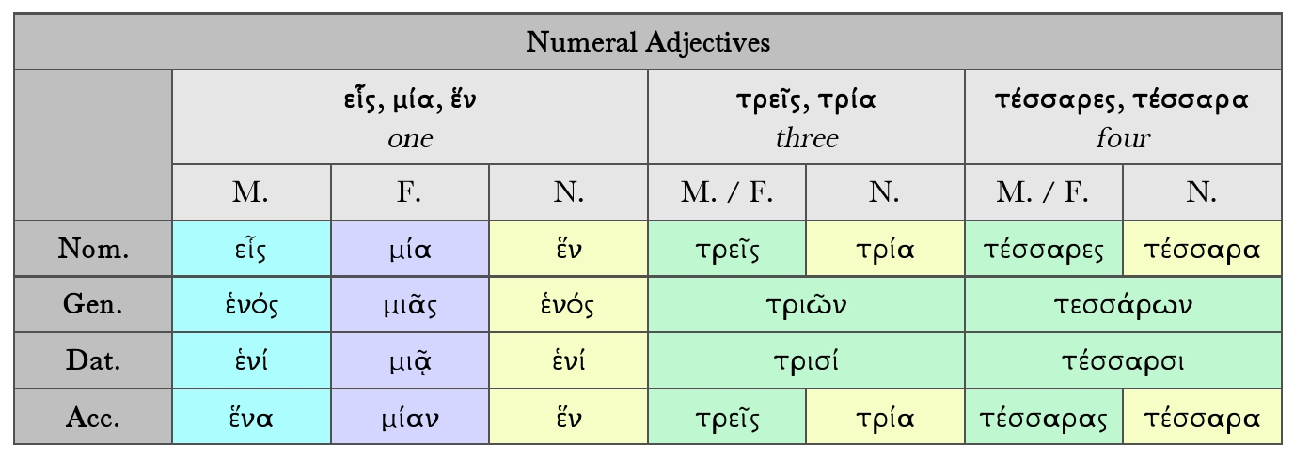
Numerals

Slide 5
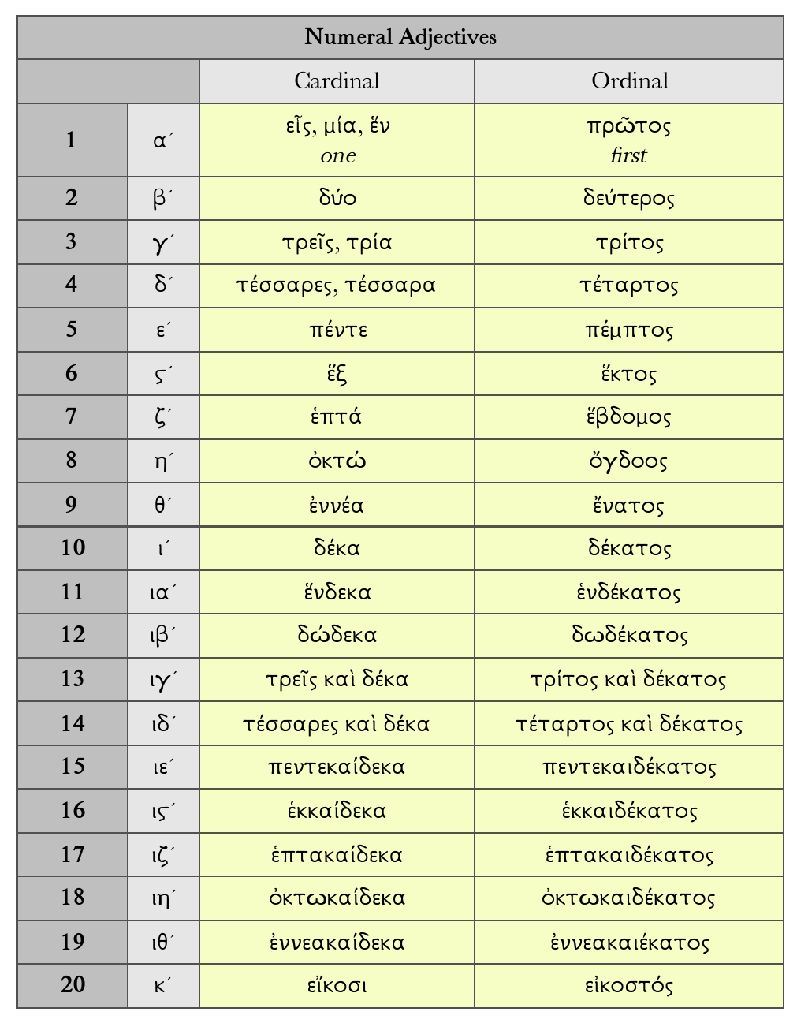
NUMERALS

Slide 6
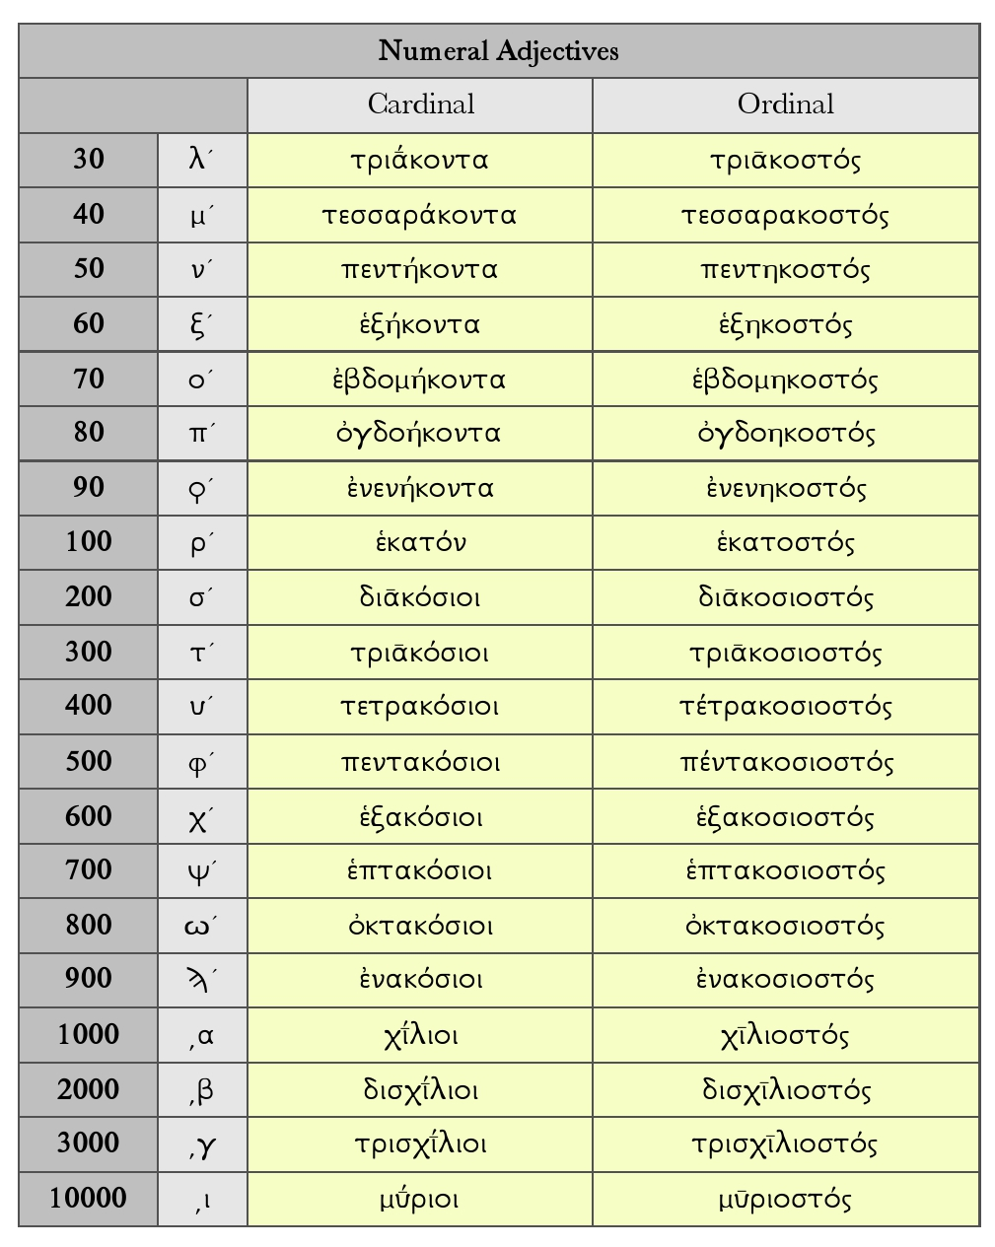
NUMERALS

Slide 7
NUMERALS
The cardinal numbers 5-29
five: πέντε fourteen: τέτταρες καὶ δέκα
six: ἕξ fifteen: πεντεκαίδεκα
seven: ἑπτά sixteen: ἑκκαίδεκα
eight: ὀκτώ seventeen: ἑπτακαίδεκα
nine: ἐννέα eighteen: ὀκτωκαίδεκα
ten: δέκα nineteen: ἐννεακαίδεκα
eleven: ἕνδεκα twenty: εἴκοσι
twelve: δώδεκα twenty one: εἷς καὶ εἴκοσι
thirteen: τρεῖς καὶ δέκα twenty two: δύο καὶ εἴκοσι κτλ
thirty: τριάκοντα seventy: ἑβδομήκοντα
forty: τετταράκοντα eighty: ὀγδοήκοντα
fifty: πεντήκοντα ninety: ἐνενήκοντα
sixty: ἑξήκοντα one hundred: ἑκατόν

Slide 8
NUMERALS
greek usually expresses written compound numbers above 20 (21, 22…) in one of two ways:
placing the smaller number first, followed by καί and the larger number
εἷς καὶ εἴκοσι
placing the larger number first, followed by the smaller number. in this order, καί is optional.
εἴκοσι καὶ εἷς
εἴκοσι εἷς

Slide 9
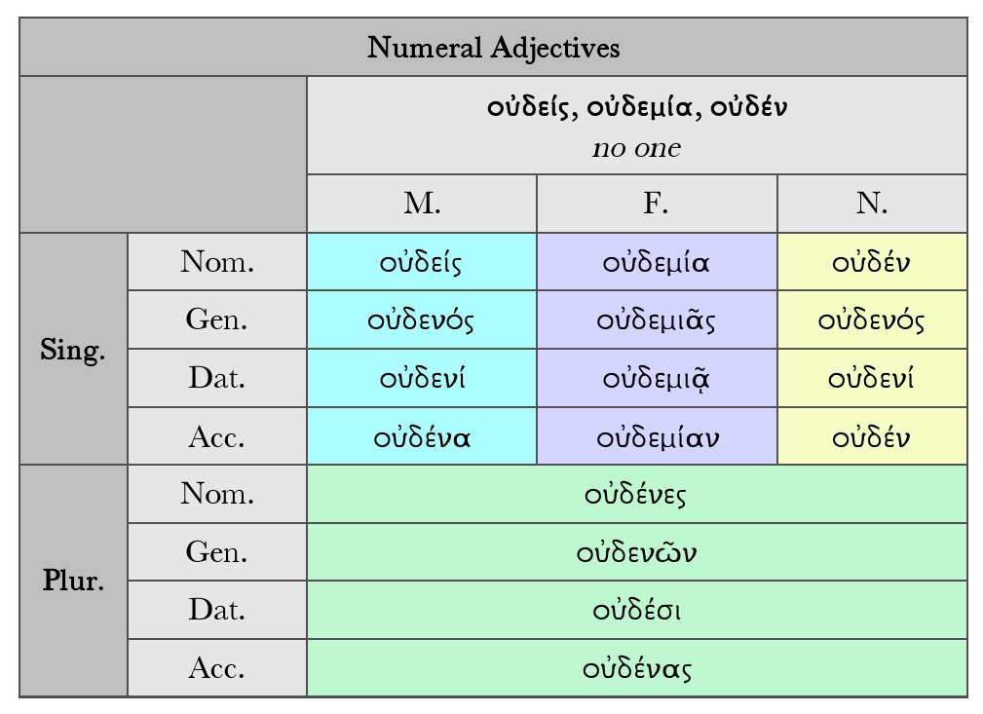
NUMERALS

Slide 10
NUMERALS
The declension of the first four cardinal numbers is as follows:
εἷς one δύο two τρεῖς three τέτταρες four
masc. fem. neut. m./f./n. m./f. n. m./f. n.
nom. εἷς μία ἕν δύο τρεῖς τρία τέτταρες τέτταρα
gen. ἑνός μιᾶς ἑνός δυοῖν τριῶν τριῶν τεττάρων τεττάρων
dat. ἑνί μιᾷ ἑνί δυοῖν τρισί(ν) τρισί(ν) τέτταρσι(ν) τέτταρσι(ν)
acc. ἕνα μίαν ἕν δύο τρεῖς τρία τέτταρας τέτταρα

Slide 11
NUMERALS
Like εἷς is declined:
– οὐδείς, gen. οὐδενός; fem. οὐδεμία, -ᾶς; neut. οὐδέν, οὐδενός no one, nothing, no
– so too μηδείς, μηδεμία, μηδέν, in constructions where μή can occur.
unlike εἷς, μία, ἕν, the forms οὐδείς and μηδείς also have plural forms: οὐδένες,
οὐδένων, οὐδέσι(ν), οὐδένας (these are infrequent, however). the noncontracted
forms οὐδὲ εἷς, οὐδὲ μία, οὐδὲ ἕν are also used, as emphatic variants:
not even one.

Slide 12
NUMERALS
The numerals ending in -κόσιοι, χίλιοι, etc. and μύριοι, etc. are declined like the plurals of adjectives in -ος, -ᾱ, -ον.
Other numerals are not declined: e.g. ἑξήκοντα καὶ πέντε νεῶν sixty-five ships (gen. pl. fem.), ὀγδοήκοντα καὶ πέντε ἔτεσι eighty-five years (dat. pl. neut.).

Slide 13
NUMERALS
Complex numbers above 20 may be ordered in two ways:
– in the order units-tens-hundreds-thousands, in which case they must be connected by καί
(in herodotus also τε καί);
– or, more rarely, in the reverse order, in which case they may but need not be connected by καί:
πέντε καὶ εἴκοσι or εἴκοσι (καὶ) πέντε twenty-five
πέντε (τε) καὶ πεντακόσια (neut.) five hundred and five
also with ordinals: e.g. ἔτει πέμπτῳ καὶ τετταρακοστῷ in the forty-fifth year.

Slide 14
NUMERALS
There are also abstract and collective numeral nouns, ending in -άς, -άδος: e.g. ἡ δεκάς decade,
ἡ μυριάς (a number of) ten thousand. μυριάς is frequently used to express large numbers: e.g.
πέντε καὶ εἴκοσι μυριάδες ἀνδρῶν twenty-five ten thousands of men (= 250,000).

Slide 15
NUMERALS
Fractions are expressed e.g. by ἥμισυς half (declined like ἡδύς). Some examples:
τάλαντον καὶ ἥμισυ one and a half talents
τὸ ἥμισυ τῆς ὅλης μισθώσεως half of the whole rent
τὸν ἥμισυν τοῦ χρόνου half of the time (acc.)
τὰς ἡμισείας τῶν νεῶν half of the ships (acc.)
some other expressions: ἡμιτάλαντον half a talent; τριτημόριον one third; τρίτον μέρος ἀνθ’ ἡμίσεος one third instead of half; τρίτον ἡμιτάλαντον two and a half talents (lit. ‘the third half’, i.e. the one between two and three = 2½); πελοποννήσου τῶν πέντε τὰς δύο μοίρας two fifths of the peloponnese (lit. ‘the two parts of the five of . . .’)

Slide 16
NUMERALS
Multiplication is expressed by adverbs and adjectives:
– adverbs: ἅπαξ once, δίς twice, τρίς three times; all other adverbs are formed with the suffix -άκις: τετράκις four times, πεντάκις five times, etc. (cf. the adverb πολλάκις often): τὰ δὶς πέντε δέκα ἐστίν two times five equals ten
– adjectives: either formed with -πλοῦς, -πλῆ, -πλοῦν -fold: ἁπλοῦς single, simple, διπλοῦς twofold, double, etc.; or with -πλάσιος, -ᾱ, -ον: διπλάσιος double, twice as great/much/many, τριπλάσιος triple, three times as great/much/many, etc.

Slide 17
numerals
The Greeks usually wrote out numbers in full. In manuscripts and inscriptions, two sign systems
were in use:
– (in inscriptions of the classical period:) a vertical stroke ι for one unit, and the initial letter of words designating certain numbers, e.g. = πέντε = 5, δ = δέκα = 10, δι = 11, = πεντάκις δέκα = 50, η = ἑκατόν (hεκατόν) = 100, χ = χίλιοι = 1000, etc. this system was used especially to indicate value, weight and measure.

Slide 18
numerals
– In later inscriptions, papyri and manuscripts: the letters of the alphabet as ‘numbers’ in a decimal system; these were often modified by an oblique stroke above and to the right of the letter for numbers up to and including 999:
αʹ βʹ γʹ δʹ εʹ ϛʹ or ϝʹ ζʹ ηʹ θʹ
1 2 3 4 5 6 7 8 9
ιʹ κʹ λʹ μʹ νʹ ξʹ οʹ πʹ ϙʹ
10 20 30 40 50 60 70 80 90
ρʹ σʹ τʹ υʹ φʹ χʹ ψʹ ωʹ ϡʹ
100 200 300 400 500 600 700 800 900
The letters ϛ (stigma), ϝ (digamma/wau), ϙ (koppa), and ϡ (sampi), which were no longer in common use, were introduced into this numeral system to supplement the standardized 24, insufficient by themselves to write all numbers up to 999.
The same letters were used with a stroke below and to the left of the letter for numbers starting with 1000: ͵α = 1000, ͵β = 2000, etc.

Slide 19
numerals
Complex numbers are formed by combining the letter symbols. only the rightmost letter (and the leftmost with numbers over 1000) have the stroke:
τιθʹ = 319 (any ordering was possible: τθιʹ, θτιʹ, etc.)
͵ατιθʹ = 1319
– until Hellenistic times, Greek had no letter-symbol for 0 (‘zero’). The corresponding item in written form was οὐδέν.

Slide 20
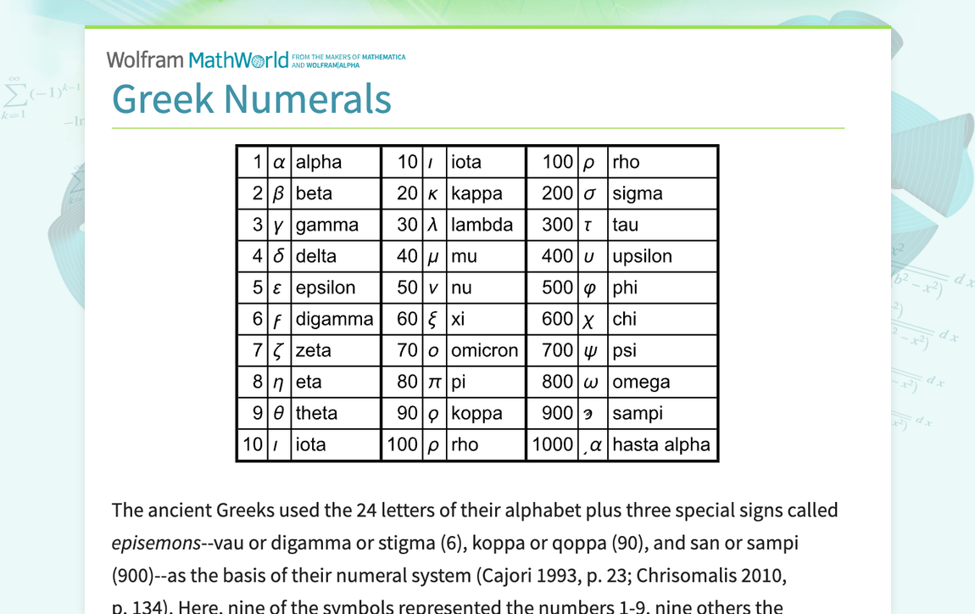
numerals

Slide 21
numerals
Number adverbs
With the exception of ἅπαξ once, δίς twice, and τρίς thrice, greek normally adds –κις to a cardinal number to make numeral adverbs.
For example:
ἅπαξ once
δίς twice
τρίς thrice, three times
τετράκις four times
πεντάκις five times
ἑξάκις six times
δεκάκις ten times

Slide 22
numerals
Exercise 1: supply, in Greek, the answers to the following math problems: e.g.: ἑκκαίδεκα καὶ τέτταρά εἰσιν εἴκοσι = sixteen plus (and) four equals (are) twenty.
A. τρεῖς καὶ ἕξ εἰσι ________________
Β. δέκα καὶ δέκα εἰσὶ ________________
Γ. ἕνδεκα καὶ δώδεκά εἰσι ________________
Δ. τὰ ἑξάκις πέντε ἐστὶ ________________
Ε. τὰ δεκάκις ἑκατόν ἐστι ________________
Στ’ τὰ πεντάκις _______________ ἐστι τετταράκοντα
Ζ. δὶς _______________ ἢ τρὶς _______________ ἢ τετράκις ______________ ἢ ἑξάκις _______________ ἐστὶ τὰ δώδεκα

Slide 23
NUMERALS
A. τρεῖς καὶ ἕξ εἰσι ὀκτώ
Β. δέκα καὶ δέκα εἰσὶ εἴκοσι
Γ. ἕνδεκα καὶ δώδεκά εἰσι τρεῖς καὶ εἴκοσι
Δ. τὰ ἑξάκις πέντε ἐστὶ τριάκοντα
Ε. τὰ δεκάκις ἑκατόν ἐστι χίλια
Στ’ τὰ πεντάκις ὀκτώ ἐστι τετταράκοντα
Ζ. δὶς ἕξ ἢ τρὶς τέτταρες ἢ τετράκις τρεῖς ἢ ἑξάκις δύο ἐστὶ τὰ δώδεκα

Slide 24
Nouns and adjectives
Third-declension nouns:
Third-declension nouns are masculine, feminine or neuter.
Stems, types and gender of third-declension nouns: all third-declension nouns have a stem ending in a consonant or i or y (or semivowels Y or Ϝ).
A number of different subtypes of the third declension are distinguished: the differences between these types largely depend on two factors:
– the (type of) consonant, or ι/υ, in which the stem ends;
– whether or not there is ablaut in the stem.

Slide 25
Nouns and adjectives
Ablaut:
In Greek, as in all Indo-european languages, there are often different grades (variants) of an individual root: the different grades have different vowels. the German term ablaut is normally used for this alternation.
For instance, the following grades of the root meaning ‘father’ are found, depending on the word in which that root is used, and the grammatical case:
πατερ- e.g. in the voc. sg. πάτερ, nom. pl. πατέρες (normal) e-grade
πατηρ- in the nom. sg. πατήρ father lengthened e-grade
πατορ- e.g.inthegen.sg.ἀπατόρος, acc. sg. ἀπατόρα (normal) o-grade
πατωρ- e.g. in the nom. sg. of the adj. ἀπατώρ fatherless lengthened o-grade
πατρ- e.g. in the gen. sg. πατρός, dat. sg. πατρί zero-grade

Slide 26
Nouns and adjectives
It is often impossible to derive the stem of a third-declension noun (and thus the exact pattern of that noun’s declension) from the nominative singular alone: the genitive is required to determine which subtype the noun belongs to. compare, for example:
ὁ ἀγών contest, gen. ἀγῶνος,
stem in ν
but ὁ γέρων old man, gen. γέροντος,
stem in ντ
ἡ ἐλπίς hope, gen. ἐλπίδος,
stem in δ
but ἡ πόλις city, gen. πόλεως,
stem in ι
ἡ κόρυς helmet, gen. κόρυθος,
stem in θ
but ὁ ἰχθῦς fish, gen. ἰχθύος,
stem in υ
but ὁ πῆχυς forearm, gen. πήχεως,
stem in υ, with ablaut
ὁ σωτήρ saviour, gen. σωτῆρος,
stem in ρ
but ὁ πατήρ father, gen. πατρός,
stem in ρ, with ablaut

Slide 27
Nouns and aDjectives
Phonetic details: consonants are sounds produced by the complete or partial interruption of the flow of air by a constriction at some point in the vocal tract: the Greek consonants may be divided into the following categories: stops (labial, velar and dental stops), fricatives, liquids, and nasals (for semivowels).
Stops
Stops (or plosives): sounds produced by the complete interruption of the flow of air. Within this category, three groups may be distinguished, depending on the place of articulation:
– (bi)labial stops: the flow of air is interrupted by pressing the lips (Lat. labia) together;
– dental stops: the flow of air is interrupted by pressing the tongue against the teeth (Lat. dentes);
velar stops: the flow of air is interrupted by pressing the tongue against the roof of the mouth (Lat. velum).

Slide 28
Nouns and adjectives
Phonetic details: the stops may be further divided between:
– voiced stops: the vocal cords vibrate;
– voiceless stops: the vocal cords do not vibrate;
– aspirated (voiceless) stops: the sound is produced together with aspiration (an h-sound).
The following are the nine stops of Greek:
voiced voiceless aspirated (voiceless)
labial stops β [b] π [p] φ [ph]
dental stops δ [d] τ [t] θ [th]
velar stops γ [g] κ [k] χ [kh]

Slide 29
NOUNS AND ADJECTIVES
Notes:
Lengthening: the lengthening of a vowel sound that happens upon the loss of a following consonant.
Contraction: two vowels in hiatus are contracted together into a single long vowel.

Slide 30
NOUNS AND ADJECTIVES
Stems in a labial stop (π, β, φ) or velar stop (κ, γ, χ):
Labial + σ = ψ; velar + σ = ξ:
– in the nom. sg.: γύπ-ς> γύψ; φλέβ-ς > φλέψ; ὄνυχ-ς > ὄνυξ;
– in the dat. pl.: γυπ-σί> γυψί; φλεβ-σί > φλεψί; ὄνυχ-σι > ὄνυξι.
Singular
n αἴξ g αἰγός d αἰγί a αἶγα v αἴξ
Plural
n αἶγες g αἰγῶν d αἰξί a αἶγας v αἶγες
Exercise 2: Can you decline: ἡ φλέψ vein (φλεβ-), ἡ θρίξ hair (θριχ-), ὁ ὄνυξ claw (ὀνυχ-)?

Slide 31
NOUNS AND ADJECTIVES
Stems in a dental stop (τ, δ, θ, except ντ):
Third-declension nouns with a stem ending in a dental stop may be:
– neuter, usually with a stem in μᾰτ: e.g. τὸ πρᾶγμα thing (πραγματ-), τὸ σῶμα body (σωματ-), τὸ ὄνομα name (ὀνοματ-);
– feminine: e.g. ἡ ἐλπίς expectation (ἐλπιδ-), ἡ ἔρις strife (ἐριδ-), ἡ ἐσθής clothing (ἐσθητ-), ἡ κακότης baseness (κακοτητ-), ἡ κόρυς helmet (κορυθ-), ἡ χάρις favour, gratitude (χαριτ-); ἡ Ἄρτεμις Artemis (Ἀρτεμιδ-);
– occasionally masculine: e.g. ὁ πούς foot (ποδ-); common gender: ὁ/ἡ ὄρνις bird
(ὀρνιθ-), ὁ/ἡ παῖς child (παιδ-).

Slide 32
NOUNS AND ADJECTIVES
Stems in a dental stop (τ, δ, θ, except ντ):
dental stops disappear without trace before σ:
– in the nom. sg.: e.g. *ἐλπίδ-ς > ἐλπίς;
– in the dat. pl.: e.g. *ἐλπίδ-σι > ἐλπίσι; *τέρατ-σι > τέρασι.
Singular:
n ἐλπίς g ἐλπίδος d ἐλπίδι a ἐλπίδα v ἐλπί
Plural:
n ἐλπίδες g ἐλπίδων d ἐλπίσι(ν) a ἐλπίδας v ἐλπίδες
Exercise 3: Can you decline: ἡ ἔρις strife (ἐριδ-) and ὁ πούς foot (ποδ-)?

Slide 33
NOUNS AND ADJECTIVES
Stems in ντ:
Third-declension nouns with a stem in ντ are masculine: e.g. ὁ γέρων old man (γεροντ-), ὁ γίγας giant (γιγᾰντ-), ὁ δράκων serpent (δρακοντ-), ὁ λέων lion (λεοντ-), ὁ ὀδούς tooth (ὀδοντ-); ὁ Ξενοφῶν Xenophon (Ξενοφωντ-).
n ἄρχων g ἄρχοντος d ἄρχοντι a ἄρχοντα v ἄρχον
n ἄρχοντες g ἀρχόντων d ἄρχουσι a ἄρχοντας v ἄρχοντες
Exercise 4: Can you decline: ὁ δράκων serpent (δρακοντ-) and ὁ γίγας giant (γιγᾰντ-)?
Stems in ν:
Third-declension nouns with a stem in ν may be:
– masculine: e.g. ὁ ἁγών contest (ἀγων-), ὁ δαίμων spirit (δαιμον-), ὁ δελφίς dolphin (δελφιν-), ὁ ἡγεμών guide (ἡγεμον-), ὁ ποιμήν shepherd (ποιμεν-); ὁ Ἀγαμέμνων Agamemnon (Ἀγαμεμνον-), ὁ Ἕλλην Greek (Ἑλλην-), ὁ Πλάτων Plato (Πλατων-);
– in fewer cases, feminine: e.g. ἡ εἰκών image (εἰκον-), ἡ σταγών drop (σταγον-), ἡ ὠδίς childbirth pain (ὠδιν-); ἡ Σαλαμίς Salamis (Σαλαμιν-).
n ἀγών g ἀγῶνος d ἀγῶνι a ἀγῶνα v ἀγών
n ἀγῶνες g ἀγώνων d ἀγῶσι(ν) a ἀγῶνας v ἀγῶνες
Exercise 5: Can you decline ὁ ποιμήν shepherd (ποιμεν-)?

Slide 34
NOUNS AND ADJECTIVES
Stems in a liquid (λ or ρ):
Third-declension nouns with a stem ending in a liquid are:
– normally masculine: e.g. ὁ ῥήτωρ orator (ῥητορ-), ὁ κρατήρ mixing bowl (κρατηρ-), ὁ σωτήρ saviour (σωτηρ-), ὁ φώρ thief (φωρ-); ὁ Ἕκτωρ Hector (Ἑκτορ-). A few feminine nouns occur: e.g. ἡ κήρ fate (κηρ-), ἡ χείρ hand (χειρ-);
– masculine or feminine are ὁ ἅλς (grain of) salt, ἡ ἅλς sea (ἁλ-); ὁ/ἡ ἀήρ air (ἀερ-); ὁ/ἡ αἰθήρ heaven (αἰθερ-);
– two nouns are neuter: τὸ ἔαρ spring and τὸ πῦρ fire.
The nom. sg. is normally without ending. Several nouns of this type have ablaut in the stem, and then use the lengthened vowel in the nom. sg. : e.g. αἰθήρ (gen. αἰθέρος), ῥήτωρ (gen. ῥήτορος); other nouns have a long vowel throughout the declension: e.g. κρατήρ (gen. κρατῆρος), φώρ (gen. φωρός).
Singular: n ῥήτωρ g. ῥήτορος dat. ῥήτορι a ῥήτορα v — ῥῆτορ Plural: n and v ῥήτορες g ῥητόρων d ῥήτορσι(ν) a ῥήτορας
Exercise 5: Can you decline ὁ κρατήρ mixing bowl (κρατηρ-)?

Slide 35
NOUNS AND ADJECTIVES
Stems in (ε)ρ, with three ablaut grades (type πατήρ, ἀνήρ):
Four nouns ending in -τηρ – ὁ πατήρ father, ἡ μήτηρ mother, ἡ θυγάτηρ daughter, ἡ γαστήρ belly – show three different ablaut variations through their declension:
– lengthened e-grade in the nom. sg.: e.g. πατήρ, μήτηρ;
– e-grade in the acc. and voc. sg.; nom., gen. and acc. pl.: e.g. πατέρα, θυγατέρων, γαστέρας;
– zero-grade in the gen. and dat. sg., and in the dat. pl., e.g. μητρός, θυγατρός; in the resulting combination of the dat. pl., *-τρ-σι, the ρ has expanded to ρᾰ: e.g. πατρ;aσι, γαστρ;aσι.
ὁ ἀνήρ man is similarly declined using three ablaut variations: lengthened grade in the nom. sg. (ἀνήρ), e-grade in the voc. sg. (ἄνερ); however, the zero-grade appears in all the other cases, where the resulting combination νρ has changed to νδρ: e.g. ἀνδρί, ἀνδρῶν. Note the dat. pl. ἀνδράσι.

Slide 36
NOUNS AND ADJECTIVES
Stems in σ (neuter nouns in -ος, names in -ης):
Third-declension nouns with a stem ending in σ may be:
– neuter: nouns ending in -ος, with two ablaut variations in the stem, οσ- (used in nom./acc. sg.) and εσ- (used in all other cases): e.g. τὸ γένος race (γενεσ-), τὸ ἔπος word (ἐπεσ-), τὸ ἔτος year (ἐτεσ-), τὸ κράτος might (κρατεσ-), τὸ τεῖχος wall (τειχεσ-);
– masculine: a number of masculine proper names in -ης, with a stem in εσ-: e.g. ὁ Διογένης Diogenes (Διογενεσ-), ὁ Σωκράτης Socrates (Σωκρατεσ-); also names in -κλῆς, with a stem originally ending in ε(ϝ)εσ-: e.g. ὁ Περικλῆς Pericles (Περικλε(ϝ)εσ-), ὁ Σοφοκλῆς Sophocles (Σοφοκλε(ϝ)εσ-).
The masculine proper names are built on the same stems as some of the neuter nouns: Διογένης (γένος), Σωκράτης (κράτος), Περικλῆς (κλέος fame, <*κλέϝος).
n Σωκράτης g Σωκράτους d Σωκράτει a Σωκράτη or Σωκράτην v = n Σώκρατες
Stems in ι/ε(y) (type πόλις):
Third-declension nouns with a stem ending in ῐ are nearly all feminine: e.g. ἡ πόλις city, ἡ δύναμις power, ἡ ὕβρις brutality. Many such nouns end in -σις : e.g. ἡ ποίησις poetry, ἡ λύσις release, ἡ πρᾶξις act. A few nouns are masculine: e.g. ὁ μάντις seer, ὁ ὄφις serpent.
These nouns show two ablaut variations in the stem:
– (zero-grade) in ι: in nom., acc. and voc. sg.: e.g. πόλι-ς, πόλι-ν, πόλι;
– (e-grade) in εy, the y of which disappeared: in dat. sg. πόλει (<*πόλε(y)-ι), nom. pl. πόλεις (= πόλες <*πόλε(y)-ες, with contraction).
sing. pl.
nom. πόλι-ς πόλεις
acc. πόλι-ν πόλεις
gen. πόλε-ως πόλε-ων
dat. πόλε-ι πόλεσι(ν)
voc. ὦ πόλι πόλεις

Slide 37
NOUNS AND ADJECTIVES
Exercise 6: For the following noun forms, 1) give the proper form of its article(s), and 2) change to its opposite number (singular to plural, plural to singular), if possible.
for example: γένει (answer: τῷ / τοῖς γένεσι):
ἄνδρας, πατέρες, χερσί, τέλους, πῦρ.

Slide 38
Comparison
The comparative (expressing greater degree) and superlative (expressing greatest degree) of adjectives are formed in two different ways:
– most adjectives form comparatives using the suffix -τερος, -τέρᾱ, -τερον; corresponding superlatives are formed using the suffix -τατος, -τάτη, -τατον. e.g. δικαιότερος more just, fairly just, too just, most just (of two); δικαιότατος most just, very just;
– a smaller group of adjectives forms comparatives using the suffix -(ί)ον- (nom. -(ί)ων); corresponding superlatives are formed using the suffix -ιστος, -ίστη, -ιστον. e.g. κακίων worse, fairly bad, too bad, worst (of two), κάκιστος worst, very bad.

Slide 39
comparison
Comparatives in -τερος and superlatives in -τατος
The comparative degree of most adjectives is formed with the suffix -τερος, -τέρᾱ, -τερον, added to the (masculine) stem of the adjective’s positive degree. Such comparatives are declined as first-and-second-declension adjectives, like δίκαιος.
The superlative degree of these adjectives is formed by adding the suffix -τατος, -τάτη, -τατον to the same stem. such superlatives are declined as first-and-second -declension adjectives, like δεινός.

Slide 40
comparison
For adjectives with a masc. in -ος, if the preceding syllable is long (i.e. its vowel is long or followed by two or more consonants), the comparative has the form -ότερος, superlative -ότατος:
positive comparative superlative
δεινός impressive δεινότερος δεινότατος
δίκαιος just δικαιότερος δικαιότατος
ἰσχῡρός strong ἰσχῡρότερος ἰσχῡρότατος
λεπτός fine λεπτότερος λεπτότατος
πικρός painful πικρότερος πικρότατος
If the preceding syllable is short (i.e. its vowel is short) the comparative has the form -ώτερος, superlative -ώτατος:
ἄξῐος worthy ἀξῐώτερος ἀξῐώτατος
ἱκᾰνός suitable, sufficient ἱκᾰνώτερος ἱκᾰνώτατος
νέος young νεώτερος νεώτατος
χαλεπός difficult χαλεπώτερος χαλεπώτατος

Slide 41
comparison
Adjectives with a masc. in -ας (stem in ν) have -άντερος, -άντατος: μέλας dark μελάντερος μελάντατος
Adjectives with a masc. in -υς have -ύτερος/-ύτατος:
βαρύς heavy βαρύτερος βαρύτατος
βραχύς short βραχύτερος βραχύτατος
Adjectives with a masc. in -ης have -έστερος/-έστατος:
ἀληθής true ἀληθέστερος ἀληθέστατος
εὐκλεής famous εὐκλεέστερος εὐκλεέστατος
Adjectives with a masc. in -ων add -έσ- to the stem, giving -ονέστερος/-ονέστατος:
εὐδαίμων fortunate εὐδαιμονέστερος εὐδαιμονέστατος
σώφρων prudent σωφρονέστερος σωφρονέστατος

Slide 42
comparison
Comparatives in -(ί)ων and superlatives in –ιστος
Several frequently occurring adjectives form their comparative degree by adding the suffix -ῑον-/-(y)ον- to the adjective’s stem (this occurs especially with adjectives in -υς), or to an entirely different stem.
The superlative degree of these adjectives is formed by adding the suffix -ιστος, -ίστη, -ιστον to the same stem. such superlatives are declined as first-and-second declension adjectives of three endings, like δεινός, -ή, -όν.

Slide 43
comparison
Comparatives in -(ί)ων and superlatives in –ιστος
The following comparatives and superlatives belong to this type:
positive comparative superlative
ἀγαθός good, strong ἀμείνων ἄριστος (see below)
ἀρείων (poetry only) ἄριστος
βελτίων βέλτιστος
λῴων λῷστος
(κρατύς strong (homer only) κρείττων better κράτιστος best

Slide 44
comparison
Comparatives in -(ί)ων and superlatives in –ιστος
The following comparatives and superlatives belong to this type:
αἰσχρός ugly αἰσχίων αἴσχιστος
ἐχθρός hostile ἐχθίων ἔχθιστος
ἡδύς sweet ἡδίων ἥδιστος
κακός bad, evil κακίων κάκιστος
but also: κακώτερος (poetry only)
χείρων χείριστος
ἥττων worse ἥκιστος worst (usually adv. ἥκιστα)
καλός beautiful καλλίων κάλλιστος
μακρός long (μάσσων, poet.) μήκιστος
but also: μακρότατος
but normally: μακρότερος
μέγας large, great μείζων μέγιστος

Slide 45
comparison
Comparatives in -(ί)ων and superlatives in –ιστος
μικρός small ἐλάττων ἐλάχιστος
μείων —
but also: μικρότερος μικρότατος
ὀλίγος little, few ἐλάττων ἐλάχιστος
μείων ὀλίγιστος
ἥττων less ἥκιστος least (usually adv. ἥκιστα)
πολύς great, many πλέων or πλείων πλεῖστος
ῥᾴδιος easy ῥᾴων ῥᾷστος
ταχύς quick θάττων τάχιστος
Comparatives in -(ί)ων are declined as third-declension adjectives of two endings with a stem in ον-, like σώφρων.

Slide 46
COMPARISON
-(ί)ων, -(ί)ον
μείζων larger, more
masc. and fem. neut.
sg. nom. μείζων μεῖζον
gen. μείζονος μείζονος
dat. μείζονι μείζονι
acc. μείζονα μεῖζον
voc. μείζον = nom.
pl. nom./voc. μείζονες μείζονα
more often μείζους more often μείζω
gen. μειζόνων μειζόνων
dat. μείζοσι(ν) μείζοσι(ν)
acc. μείζονας μείζονα
more often μείζους (= nom.) more often μείζω

Slide 47
comparison
Exercise 7: Pair up comparative forms with positive. Add the superlatives where you can:
ἀγαθός, βέβαιος, δεινός, κακός, καλός, μέγας, μῶρος, πολέμιος, πολύς, φίλος, χρήσιμος
καλλίων, μείζων, φίλτερος, πολεμιώτερος, μωρότερος, δεινότερος, βεβαιότερος, ἀμείνων, χρησιμώτερος, πλείων, κακίων

Slide 48
comparison
Exercise 7: Pair up comparative forms with positive. Add the superlatives where you can:
ἀγαθός = ἀμείνων = ἄριστος
βέβαιος = βεβαιότερος = βεβαιότατος
δεινός = δεινότερος = δεινότατος
κακός = κακίων = κάκιστος
καλός = καλλίων = κάλλιστος
μέγας = μείζων = μέγιστος
μῶρος = μωρότερος = μωρότατος
πολέμιος = πολεμιώτερος = πολεμιώτατος
πολύς = πλείων = πλεῖστος
φίλος = φίλτερος = φίλτατος
χρήσιμος = χρησιμότερος = χρησιμότατος

Slide 49
comparison
Comparison of adverbs:
The comparative and superlative degrees of adverbs are identical to the neuter accusative of the corresponding comparative and superlative adjectives. the acc. neut. singular of the comparative adjective is used for the comparative adverb; the acc. neut. plural of the superlative adjective is used for the superlative adverb.
Thus:
positive comparative superlative
ἀληθῶς ἀληθέστερον more truly ἀληθέστατα most truly
ἀξίως ἀξιώτερον in a more worthy manner
ἀξιώτατα in the most worthy manner
ἁπλῶς ἁπλούστερον more simply ἁπλούστατα most

Slide 50
comparison
Comparison of adverbs:
The same rules apply to superlative adverbs based on ‘irregular’ comparatives and superlatives:
εὖ (ἀγαθῶς) ἄμεινον in a better manner ἄριστα in the best manner
ἡδέως ἥδιον more pleasantly ἥδιστα most pleasantly
μεγάλως, μέγα μεῖζον more greatly μέγιστα most greatly
καλῶς κάλλιον more beautifully κάλλιστα most beautifully
ὀλίγον ἧττον less ἥκιστα least
πολύ πλεῖον more πλεῖστα most
ταχέως, ταχύ θᾶττον more quickly τάχιστα most quickly

Slide 51
comparison
Comparison of adverbs:
In addition to the above forms, comparative adverbs in -τέρως are fairly frequent. e.g.:
δικαιοτέρως more justly (δίκαιος, next to δικαιότερον)
χαλεπωτέρως in a more difficult way (χαλεπός, next to χαλεπώτερον)
σωφρονεστέρως more prudently (σώφρων, next to σωφρονέστερον)
Superlative adverbs in -τάτως occur infrequently, e.g.:
συντομωτάτως in the most summary fashion (σύντομος, next to συντομώτατα)

Slide 52
comparison
Exercise 8: Read aloud and translate:
1) ἀκούοντες τὴν Κύρου ἀρετὴν ἥδιον καὶ προθυμότερον συνεπορεύοντο.
2) ὁ δὲ στρατηγὸς ἔφη αὐτὸς κρείττων ὕδατος.
Vocabulary: ἔφη he, she, it said, ὕδωρ, ὕδατος τό water; pond, ἀρετή, ἀρετῆς, ἡ, goodness, excellence, πρόθυμος, -ος, -ον ready, willing, eager, συμπορεύομαι, come, go, or proceed together

Slide 53
COMPARISON
When they heard of the excellence of cyrus they continued on their way with greater satisfaction and eagerness.
The general said that he is stronger than water.

Slide 54
Philosophical vocabulary
Ε
εἴδος: has a variety of connected meanings, from the way a thing looks (the word is etymologically connected with video), through its shape or form, a species or kind of thing, to the intelligible form of Platonism. As bodily appearance: houtos to eidos pagkalos estin - he is so very beautiful in appearance (Pl. Charm. 154d). As the bodily form itself: antepideiknunai to eidos apoduomenos — to strip and display one’s body in turn (P1. Theaet. 162b). In Aristotle it is sometimes form in a wider sense in contrast to hulé‘ — matter: eti hé hulé esti dunamei hoti elthoi an eis to eidos — also matter is that which potentially might come to be form (Ar. Met. 1050a 15).

Slide 55
Philosophical vocabulary
εἶναι: einai: to be, to exist; to on: that which is, the real;-ousia: being, essence.
ἔλεγχος: elegkhos: usually refutation, sometimes proof, but then normally in an adversative situation: elegkhos esti tou Pittakou rhématos — it is a refutation of the saying of Pittacus (Pl. Prot. 344b); khalepon de se elegxai, 6 Sékrates — it is hard to refute you, Socrates (Pl. Gorg. 470d).
ἐνδελέχεια: to de tés entelekheias onoma legetai men autou tou Aristotelous idion- sémainei to eidos to energeiai’ on — entelekheia is a word that is Aristotle’s own; it means the form that is actualized (Simplicius, Physics 278.6). Usually translated as actuality or perfection: to onoma energeia legetai kata to ergon kai sunteinei pros tén entelekheian — the word energeia isused with reference to the ergon [function] and it itself tends to the actuality (Ar. Met.1050a 22).

Slide 56
Philosophical vocabulary
ἐπιθυμία: the non-rational appetite for pleasure, particularly the simple bodily pleasures, such as eating, drinking and sex, which man shares with other animals; epithumein: to desire; epithumétikon: concerned with appetite. epithumia is distinguished from other types of orexis, such as boulésis, by its non-rationality: to de hoi era'z’te kai peinéi kai dipséi [hé psukhé] kai peri tas allas epithumias eptoétai alogiston te kai epithumétikon, ple‘réseon tinon kai he‘donén hetairon — that with which [the soul] lusts and hungers and thirsts and is concerned with the other appetites is non-rational and appetitive, the companion of certain fillings and pleasures (Pl. Rep. 439d).
ἔθος: ethos: habit, custom; ethizein: to accustom, to habituate. Sometimes an ethos is a mere unthinking habit: hai miméseis, ean ek neén porro diatelesosin, eis ethé te kai phusin kathistantai — mimicry, if it continues for a time from youth onwards, turns into a habit and becomes natural (Pl. Rep. 395d).
εὐδαίμων: comes from eu, well, and daimén, a divinity: eudaimonié ouk yen boskémasin oikei oude en khruséz‘ psukhé oikétérion daimonos — eudaemonia does not reside in cattle or in gold; the soul is the dwelling-place of the divinity (Democritus in Stobaeus, Anthology 2.7.31). Traditionally translated as ‘happy’, but in general use ‘Well of might often do, since it can mean little more than economically prosperous. But usually in general use and always in philosophy it is the adjective denoting the life that is most worth living or the man who lives that life. eudaimonia is the state of such who live that life.

Slide 57
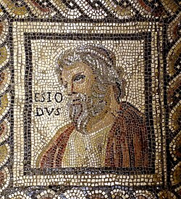
THANK YOU!
Ευχαριστώ!

