Slide 1
Ancient Greek (Intermediate Level)
ATHENS MA IN ANCIENT PHILOSOPHY
NATIONAL AND KAPODISTRIAN UNIVERSITY OF ATHENS / Department of History and Philosophy of Science
In collaboration with:
•UNIVERSITY OF PATRAS / Department of Philosophy
•UNIVERSITY OF CRETE / Department of Philosophy and Social Studies

Slide 2
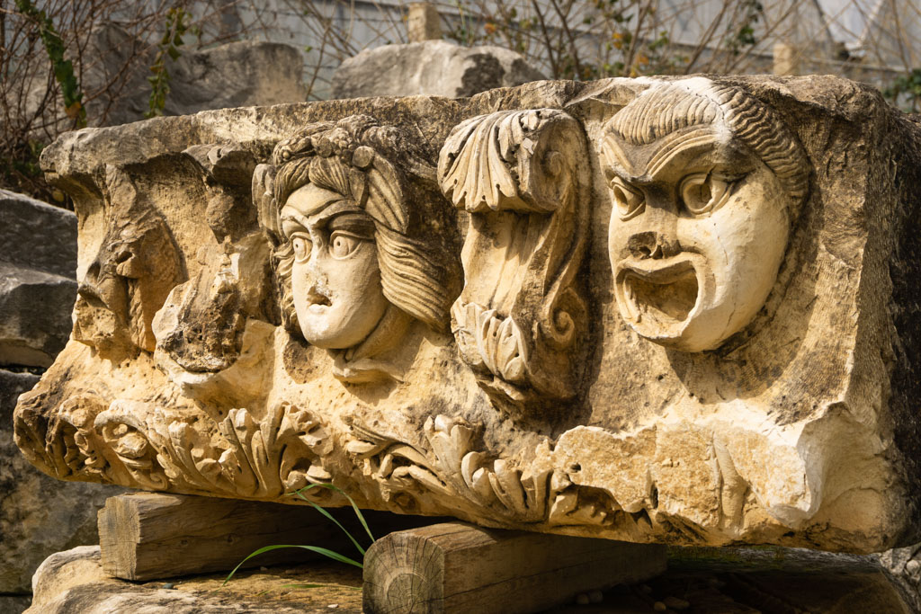
WEEK 3
Adverbs, Prepositions, and Particles

Slide 3
Adverbs
Nearly all adverbs derive from original case-forms of an adjective or noun.
A few adverbs did not originate as case forms of a noun or adjective.
Rare cases: adverbs formed from (the stems of) pronouns (e.g. πότε,
ὁπότε, τότε, τῇδε, ταύτῃ and adverbs formed from numerals (usually in
-άκις, e.g. πολλάκις).

Slide 4
Adverbs
A few of the case endings of adjectives and nouns developed into suffixes specifically used for the formation of adverbs; chief among these is -ως (an old case-ending -ω, with a suffix -ς); this suffix -ως was freely added (i.e. it was productive) to the stems of adjectives to create manner adverbs, e.g. adv. ἡδέως sweetly, with the adj. ἡδύς sweet.
The suffix is added directly to the stem.
Exercise: Form adverbs of manner ending in –ως.
ἄξιος (worthy), ἄλλος (other), καλός (beautiful, fine, noble), ἁπλοῦς (simple), πᾶς (all, whole), ἀληθής (true), ἡδύς (sweet), ἄφρων (senseless), χαρίεις (graceful).

Slide 5
Adverbs
Exercise 1
ἀξίως in a worthy manner (ἄξιος worthy)
ἄλλως otherwise; in vain (ἄλλος other)
καλῶς well, nobly (καλός beautiful, fine, noble)
ἁπλῶς simply (ἁπλοῦς simple)
πάντως wholly, in every way (πᾶς all, whole)
ἀληθῶς truly, really (ἀληθής true)
ἡδέως sweetly, pleasantly (ἡδύς sweet)
ἀφρόνως senselessly (ἄφρων senseless)
χαριέντως gracefully (χαρίεις graceful)

Slide 6
Adverbs
Adverbs Based on Other Case-Forms
Various adverbs derive from other case-forms of adjectives.
– accusative neuter (singular or plural):
μέγα (also μεγάλως) greatly, very, loudly (μέγας great)
μικρόν a little (μικρός small)
ὀλίγον a little (ὀλίγος few, small)
πολλά often (πολύς large, many)
πολύ much, very (πολύς large, many)
ταχύ (also ταχέως) fast, quickly (ταχύς quick)

Slide 7
Adverbs
Adverbs Based on Other Case-Forms
– genitive (neuter):
μικροῦ almost (μικρός small)
ὀλίγου almost (ὀλίγος few, small)
– dative (usually feminine: ὁδῷ may be supplied):
ἰδίᾳ privately (ἴδιος private)
κοινῇ in common, commonly (κοινός communal, shared)
πεζῇ on foot, by land (πεζός on land)

Slide 8
Adverbs
For many adverbs which derive from an original case-form, there is no longer a corresponding adjective or noun in classical Greek: only the adverb remains as an isolated, fossilized form. Some examples are (there are many more):
– Originally accusative:
ἄγαν, λίαν too, excessively, μάτην in vain, εὖ well (adverb with ἀγαθός ‘good’; ἐύς ‘good, brave’occurs in epic), πάλιν back, again
Originally genitive:
ἐξῆς in a row, one after the other
– Originally dative:
εἰκῇ randomly
λάθρᾳ in secret, secretly
– Formed with adverbial -ς (cf. -(ω)ς):
ἅπαξ once
ἅλις sufficiently
μόγις, μόλις with difficulty, hardly, scarcely
εὐθύς (also εὐθύ, εὐθέως) directly, immediately, straight

Slide 9
Adverbs
Other, in some cases obscure derivations (only a few examples are given):
πέλας nearby
μάλα very
πάνυ altogether, completely, very (related to πᾶς)
νῦν now
χθές yesterday

Slide 10
Adverbs
In numerous other cases, another case-form came to be used as adverb: in some instances the derivation was still transparent in classical Greek (as the case-form in question was still used, e.g. adv. πολύ very, greatly, originally acc. sg. neut. πολύ of the adj. πολύς great, many); however, in other cases, the original noun/adjective had gone out of use, and the adverb remained as a fossilized, isolated form.

Slide 11
Adverbs
Less productive, but still widely used, were various endings indicating various local relationships, e.g. -δε/-σε (indicating place to which), -θεν (indicating place from which), etc.
Other Adverbs Indicating Space
With place names and a few other nouns of the first declension (in -η/-α), which have a dative plural in -αις, an older form of the dative plural, in -ᾱσι or -ησι, is still used as a locative (denoting place where):
Ἀθήνησι in Athens
Πλαταιᾶσι in Plataea
There also remain in classical Greek a few fossilized examples of an original locative in -ι.
οἴκοι (at) home
χαμαί on the ground
Πυθοῖ at Delphi

Slide 12
Adverbs
Other Adverbs Indicating Space
Some genitives are also used to indicate place where:
αὐτοῦ here, there, in this very place (αὐτός)
ὁμοῦ in the same place, together, at once, close at hand
An old instrumental ending -ω is used in various adverbs indicating direction, often related to prepositions:
ἄνω above, upwards (ἀνά above)
κάτω below, downwards (κατά below)
ἔξω (to) outside, away (ἐξ (away) from)
πόρρω forward
ὀπίσω backward

Slide 13
Adverbs
Other Adverbs Indicating Space:
Several other suffixes (originally case endings) are used to form spatial modifiers:
– The suffixes -σε and -δε (attached to the accusative) indicate place to which:
πανταχόσε in all directions, ὁμόσε to the same place, Ἀθήναζε (<Ἀθήνασ-δε) to Athens, οἴκαδε (to) home
– The suffix -θεν indicates place from where:
πανταχόθεν from every direction
Ἀθήνηθεν from Athens, οἴκοθεν from home
– The suffix -θι indicates (with certain stems only) place where:
ἄλλοθι elsewhere, ἀμφοτέρωθι on both sides (= in both ways), αὐτόθι (≈ αὐτοῦ) in that very place.

Slide 14
Adverbs
Adverbs Deriving from Prepositions/Prepositional Phrases
Finally, some adverbs derive from a preposition or prepositional phrase:
– Adverbs deriving from a combination of preposition and noun:
ἐκποδών out of the way (ἐκ ποδῶν)
παραχρῆμα immediately (παρὰ χρῆμα)
παράπαν altogether, absolutely (παρὰ πᾶν)
– Many prepositions are used also as adverbs:
μετά thereafter
πρός furthermore, besides

Slide 15
Adverbs
Exercise 2: Read and Translate these Sentences:
A) οἱ δὲ ἐν τῷ πλοίῳ προσεκύνησαν αὐτῷ λέγοντες, Ἀληθῶς θεοῦ υἱὸς εἶ.
B) ὁμοίως καὶ πάντες οἱ μαθηταὶ εἶπαν.
Γ) σωφρόνως καὶ δικαίως καὶ εὐσεβῶς ζήσωμεν ἐν τῷ νῦν αἰῶνι.
Δ) καὶ ἰδοὺ ἔρχομαι ταχύ.
Ε) ὑμεῖς οἱ Φαρισαῖοι τὸ ἔξωθεν τοῦ ποτηρίου καὶ τοῦ πίνακος καθαρίζετε.
Στ’) Eἰς τὸν οἶκόν μου ἐπιστρέψω ὅθεν ἐξῆλθον.
Ζ) πάλιν παραλαμβάνει αὐτὸν ὁ διάβολος εἰς ὄρος ὑψηλὸν λίαν.

Slide 16
Adverbs
Exercise 2: Vocabulary
πλοῖον (τό) = floating vessel: hence, generally, ship, boat; προσκυνῶ = worship;
αἰών (ὁ) = period of existence, age; σώφρων = of sound mind, prudent; δίκαιος = just, right; εὐσεβής = pious, dutiful; ζῶ = I live
ταχύς, εῖα, υ = quick, fast; ἔρχομαι = I come
ποτήριον (το) = cup, drinking vessel; Φαρισαῖος = a Pharisee, a member of the sect or party of the Pharisees; πίναξ (ὁ) = platter; καθαρίζω = I clean
ἐπιστρέφω = I return, ἐξέρχομαι = I go out.
παραλαμβάνω = take along, take by force; διάβολος (ὁ) = the devil; ὄρος (το) = mountain, ὑψηλός, -η, -ον = high

Slide 17
Adverbs
Exercise 2:
A) Those in the boat worshipped him, saying "You are truly the Son of God’’. (Matt. 14:33)
Β) All the disciples said similarly. (Matt. 26:35)
Γ) Let us live sensibly, righteously, and reverently in the present age. (Titus 2:12)
Δ) Behold, I come quickly. (Rev. 22:6)
Ε) You Pharisees clean the outside of the cup and the platter. (Luke 11:39)
Στ’) I will return to my home from whence I came. (Matt. 12:44)
Ζ)Again, the devil takes him (along) to an exceedingly high mountain. (Matt. 4:8)

Slide 18
Prepositions
Greek prepositions can be accompanied by (pro)nominal constituents in the genitive, dative or accusative. Together with this constituent they form a prepositional phrase (e.g. εἰς τὴν πόλιν into the city). These can be used to indicate spatial, temporal or other, more abstract relationships:
(1) τὴν γὰρ ἄνθρωπον ἀποπέμψω ἐκ τῆς οἰκίας. ([Dem.] 59.82)
For I will send the woman away, out of my house. Spatial.
(2) ὑμᾶς δέ, ὦ παῖδες, οὕτως ἐξ ἀρχῆς ἐπαίδευον. (Xen. Cyr. 8.7.10)
And in this way I educated you, my children, from the beginning. Temporal
(3) ταῦτα γάρ οἱ ἐνετέταλτο ἐκ Δαρείου, Θρηίκην καταστρέφεσθαι. (Hdt. 5.2.2)
For this had been ordered to him by Darius, to conquer Thrace. Abstract, the prepositional phrase indicates the source/origin of the order expressed by ἐνετέταλτο.

Slide 19
Prepositions
Distinction is made between
– ‘proper’ prepositions: prepositions that also appear in compound verbs, such as ἐκ (cf. e.g. ἐκβαίνω, ἐξέρχομαι) and ἀπό (cf. e.g. ἀποβαίνω, ἀπαγγέλλω, ἀφίστημι)
– ‘improper’ prepositions: prepositions that are not used in compound verbs, such as χωρίς + gen., ἅμα + dat., ὡς + acc.: these also appear regularly as adverbs without accompanying constituent.
Note: Some prepositions are always accompanied by constituents in a single fixed case (e.g. ἐκ + gen., ἐν + dat., εἰς + acc.), whereas others allow a choice between two or three cases (e.g. διά + gen./acc., παρά + gen./dat./acc.) and differ in meaning accordingly. Improper prepositions are always accompanied by one fixed case.

Slide 20
Prepositions
Prepositions + Accusative Case
ἀμφί around, about
ἀνά up, through
διά because of, through
εἰς/ἐς into
ἐπί against
κατά down, along, according to
μετά after, behind
παρά to, throughout, beside
περί near, around
πρός toward
ὑπέρ above, over, beyond
ὑπό under

Slide 21
Prepositions
Prepositions + Dative Case
ἀμφί around, near
ἀνά upon
ἐν in
ἐπί on, for the purpose of, because of
παρά with, near
περί about
πρός by, in addition to
σύν with (the help of)
ὑπό under

Slide 22
Prepositions
Prepositions + Genitive Case
ἀμφί around, for the sake of
ἀντί opposite, instead of, for the sake of
ἀπό from
διά through
ἐκ from
ἐπί on, at
κατά down, against
μετά with
παρά from
περί about
πρό before, in front of
πρός toward, (swear) by
ὑπέρ over, on behalf of
ὑπό under, by

Slide 23
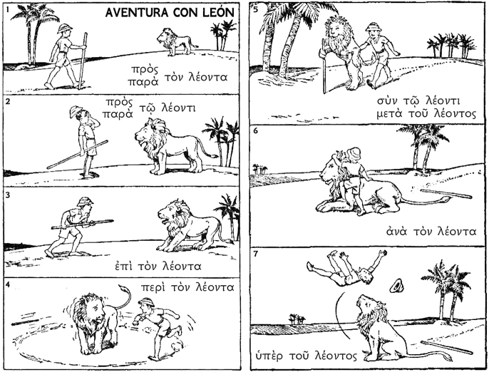
Prepositions

Slide 24
Prepositions
Accents, Elision, and Aspiration
Prepositions – with the exception of εἰς, ἐν, and ἐκ – normally have an ACUTE accent. If the preposition has two syllables, the acute falls on the ULTIMA.
ELISION is common with prepositions; they frequently drop their final vowel before a word beginning with a vowel. In such cases, the preposition has NO ACCENT. There are two important exceptions: περί and πρό. Neither allows for elision.
After a preposition drops its final vowel, if it then ends in a STOP CONSONANT, that consonant becomes ASPIRATED if the following word begins with an aspirated – i.e., marked with a rough breathing – vowel or diphthong.

Slide 25
Prepositions
Examples:
ἀπὸ τῆς ἐλπίδος
from the hope
ἀπ’ ἐλπίδος
from hope
ἀπὸ τοῦ αἵματος
from the blood
ἀφ’ αἵματος
from blood
Exercise 3:
ἐπὶ τοὺς πολεμίους
against the enemies
τὸ ἐπὶ + ἐμἐ = as far as I am concerned
ἐπὶ + ἵππου = on horseback

Slide 26
Prepositions
Prefixes, Elision, and Aspiration
When prefixes are attached to verbs, any final vowel drops out – or ELIDES – if the tense stem to which it is added begins with a vowel. As with prepositions, the prefixes περί and πρό are an exception to this rule, and do not elide. If a prefix drops its final vowel, the remaining consonant becomes ASPIRATED if the tense stem begins with an aspirated vowel or diphthong.
ἀνίστημι (ἀνα + ἵστημι) raise, appoint
ἀποδίδωμι (ἀπο + δίδωμι) give back
ἀφίημι (ἀπο + ἵημι) let go, allow, forgive
ἐπιτίθημι (ἐπι + τίθημι) put on
καθίστημι (κατα + ἵστημι) set down, establish
παραδίδωμι (παρα + δίδωμι) hand over, deliver
πάρειμι (παρα + εἰμί) be present
παρίστημι (παρα + ἵστημι) present
προστίθημι (προς + τίθημι) add to

Slide 27
Prepositions
Exercise 4: Translate the paragraph below, paying attention to how the adverbs and prepositions function.
Paragraph I (from Moby Dick)
It was a humorously perilous business for both of us. πρὶν γὰρ we proceed further, it must be said that the monkey-rope was fast ἐπὶ both ends; fast to Queequeg’s broad canvas belt, and fast to my narrow leather one. So that for better or for worse, we two, εἰς νῦν, were wedded; and should poor Queequeg sink to rise no more, ἔπειτα and usage and honor demanded, that instead of cutting the cord, it should drag me down in his wake. οὕτως, ἔπειτα, an elongated Siamese ligature united us. Queequeg was my own inseparable twin brother; nor could I any way get rid of the dangerous liabilities which the hempen bond entailed.
οὕτως strongly and metaphysically did I conceive of my situation τότε, that μέχρι earnestly watching his motions, I seemed distinctly to perceive that my own individuality was νῦν merged in a joint stock company of two; that my free will had received a mortal wound; καὶ that another’s mistake or misfortune might plunge innocent me εἰς unmerited disaster and death.

Slide 28
Prepositions
Exercise 4:
It was a humorously perilous business for both of us. For, before we proceed further, it must be said that the monkey-rope was fast at both ends; fast to Queequeg’s broad canvas belt, and fast to my narrow leather one. So that for better or for worse, we two, for the time, were wedded; and should poor Queequeg sink to rise no more, then both usage and honor demanded, that instead of cutting the cord, it should drag me down in his wake. So, then, an elongated Siamese ligature united us. Queequeg was my own inseparable twin brother; nor could I any way get rid of the dangerous liabilities which the hempen bond entailed.
So strongly and metaphysically did I conceive of my situation then, that while earnestly watching his motions, I seemed distinctly to perceive that my own individuality was now merged in a joint stock company of two; that my free will had received a mortal wound; and that another’s mistake or misfortune might plunge innocent me into unmerited disaster and death.

Slide 29
Particles
Meanings and Functions; Types of Particle
Particles are usually considered a class separate from adverbs conjunctions and interjections (οἶμοι, ἔα, ἒ ἔ, etc.), even though there is a considerable overlap between these classes. It is indeed almost impossible to draw clear boundaries between particles and adverbs, or between particles and conjunctions.
They are used for rhetorical and stylistic coloring.
The words classed as particles do share some formal characteristics:
– they are short words (mostly one or two syllables) that are never declined, and normally not derived;
– they are either postpositive or prepositive.

Slide 30
Particles
Particles may be subdivided among the following categories:
– connective (or ‘text-structuring’) particles, which function (primarily) to indicate relationships between (the content of) text segments: ἀλλά, αὖ, γάρ, δέ, ἤ, καί, καίτοι, μέν, μέντοι, νυν, οὐδέ/μηδέ, οὔκουν/οὐκοῦν, οὖν, οὔτε/μήτε, τε, τοιγάρ, τοιγαροῦν, τοιγάρτοι and τοίνυν;
– attitudinal (also: ‘modal’ or ‘interactional’) particles, which function (primarily)to indicate a speaker’s attitude towards the content of his/her utterance, or his/her anticipation of the addressee’s attitude towards that content: ἄρα, ἆρα, δή, δήπου, ἦ, μήν, που, and τοι;
– particles of scope, which determine the applicability of an utterance’s content to a particular element: γε, γοῦν, so-called ‘adverbial’ καί, and περ.

Slide 31
Particles
Particle Combinations
Particles very frequently occur in combinations: e.g. ἀλλὰ μήν, μὲν οὖν, καὶ δή, ἦ μήν. It is not always possible to reduce the function of these particle combinations to the sum of their individual parts, as certain (relatively) fixed combinations have acquired specific uses.

Slide 32
Particles
Connective Particles
The vast majority of Greek sentences are ‘connected’ in some way to their surrounding context, in most cases by a connective particle. Different connective particles establish different kinds of coherence relationships between the text segment they stand in and the preceding and/or following context (segments may have more than one connective particle to indicate complex relationships, and there are several common combinations).
Connective particles are used to connect individual sentences, but they can also function to link various clauses within a sentence, various elements within a clause, or (very frequently) to indicate relationships between larger sections of text.
The lack of any particle to connect sentences is relatively rare in Greek texts. It is called asyndeton, and occurs only in certain circumstances.

Slide 33
Particles
List of Connective Particles
ἀλλά = but, rather
αὖ and αὖτε = in turn, again, on the other hand, then, as for, furthermore
γάρ = for, since, then, in fact, indeed
ἤ = or
και = and, also
καίτοι = and yet, although
μέν = but, on the one hand, and
μέντοι = nevertheless, however
νυν = then, so

Slide 34
Particles
List of Connective Particles
οὐδέ/μηδέ and οὔτε/μήτε = and not, but not, nor; neither … nor
οὐκοῦν and οὔκουν = isn’t it the case, then?; not, therefore?;
oὖν = so, then, therefore, well, the point is that
τε = and, as well as
τοιγάρ, τοιγαροῦν, and τοιγάρτοι = therefore, hence, thus, that is why
τοίνυν = well, then, so, now

Slide 35
Particles
Attitudinal Particles
The particles ἄρα, ἆρα, δή, δήπου, ἦ, μήν, τοι and που (also μέντοι, καίτοι and τοίνυν described above) play a role in managing the attitudes and beliefs that speaker and addressee have towards what is said. By using these particles, speakers can signal that their utterance should be interpreted in a specific way, or they can anticipate what the addressee might or should think about it. These particles are by far the hardest to translate, and the ‘definitions’ below are by no means certain.

Slide 36
Particles
List of Attitudinal Particles
ἄρα = apparently, it seems, then, so, in that case
δή = in fact, actually, very, precisely, indeed
ἦ = truly, really, certainly
μήν = I assure you, really, truly, certainly, in fact, know that, let me tell you that
που = perhaps, possibly, somehow, I suppose

Slide 37
Particles
Particles of Scope
The particles γε, γοῦν, καί (negative οὐδέ) and περ are particles that delimit the scope or applicability of a certain statement. A speaker can use these particles to signal that what he/she says is applicable ‘at least in the case of X’, ‘even in the case of X’ or ‘precisely in the case of X’.

Slide 38
Particles
List of Particles of Scope
γε = at least, when it comes to, to be precise
περ = if and only if, precisely if

Slide 39
Particles
Particles in Ancient Greek Discourse: Exploring Particle Use across Genres
https://chs.harvard.edu/chapter/i-7-particle-index/

Slide 40
Particles
Exercise 4: Translate these sentences:
A) ἀμαθής τις εἶ θεός ἢ δίκαιος οὐκ ἔφυς. (Eur. Her. 347)
B) νῦν ὦν ἐπειδὴ οὐκ ὑμεῖς ἤρξατε τούτου τοῦ λόγου, ἀλλ’ ἡμεῖς ἄρξομεν. (Hdt. 9.48.3)
Γ) οἱ μὲν ἡμέτεροι μᾶλλον θαρρήσαντες ἀπίασιν, οἱ δὲ πολέμιοι . . . μᾶλλον φοβήσονται. (Xen. Cyr. 3.3.30)
Δ) Λέγεται ψυχὴ ἡ μὲν νοῦν τε ἔχειν . . . , ἡ δὲ ἄνοιαν . . . καὶ ταῦτα ἀληθῶς λέγεται; Ἀληθῶς μέντοι. (Pl. Phd. 93b–c)
Ε) δῆλον . . . τῆς ἀρετῆς ἐνέργειαν τῆς ψυχῆς ἄριστον εἶναι. ἦν δὲ καὶ ἡ εὐδαιμονία τὸ ἄριστον. ἔστιν ἄρα ἡ εὐδαιμονία ψυχῆς ἀγαθῆς ἐνέργεια. (Arist. Eth. Eud. 1219a28–35)

Slide 41
Particles
Exercise 4: Vocabulary
ἀμᾰθής, -ής –ές = Ignorant, stupid, unwise; φύω (f. φύσω, ao. ἔφυσα, ao.2 ἔφυν, pf. πέφυκα, pqp. ἐπεφύκειν) = be born, germinate, grow;
ἄρχω (ἄρχει; ἄρχε; ἄρχειν: impf. ἆρχε: aor. ἄρξαι: med. ἄρχονται; ἀρχομένου, -μενοι, -μένοις, -μεναι: fut. ἄρξεται dub.: impf. ἄρχετο: aor. ἄρξατο) = rule, begin.
θαρσῶ (participle, aorist, plural, male); ἄπειμι (pres ind act 3rd pl) = to be away or be far from, to go, to depart; μᾶλλον (adv., comp. of μάλα) = more, in a greater degree; φοβέω (fut ind mid 3rd pl) = be afraid, put to flight
ἄνοια (ἡ) = stupidity, lack of reason, madness, folly
δῆλον: adv. = it is clear; ἐνέργεια (ἡ) = energy, activity; ἄριστος, ἀρίστη, ἄριστον = the best (serving as Sup. of ἀγαθός); ἀγαθός, -η, -ον = good, well-born, gentle; εὐδαιμονία (ἡ) = prosperity, happiness; ψυχή (ἡ) = soul.

Slide 42
Particles
Exercise 4:
A) You are an unwise god, or else you are not just.
B) Well then, since you did not start this conversation, we will rather start it.
Γ) Οur men will come back to camp with more courage, whereas the enemy will be more frightened.
Δ) (Socrates:) It is said that one soul possesses sense, another folly . . . And is it true what they say? (Simmias:) Most certainly it is. Simmias confirms the correctness of ἀληθῶς in Socrates’ question.
Ε) It is clear that the activity of excellence is the greatest good of the spirit. And happiness was also the greatest good: so happiness is the activity of a good spirit.

Slide 43
Philosophical Vocabulary
B
βία: force; biaias, forcible; biazein, to force. bia can be used to mean pressure of a non-physical kind in a non-technical context, as when contrasted with hekén: médamés pros bian bouléthéis mallon é hekén legein — not wishing to speak under pressure rather than willingly (Pl. Phaedrus 236d). But in philosophical use it means physical force: anagké gar é biaion einai tén kinésin é kata phusin — the motion must either be forced or natural (Ar. De Caelo 300b 18). In the ethical writings Aristotle gives as examples of akousia biai’ — unintended because of violence — only physical force: biaion hou hé arkhé exéthen — forcible where the source is external (E.N. 1110a 1). bia is one form of anagké; thus biaias anagkés — necessity of a forceful kind (Ar. De Caelo 284a 15).
βίος: life, usually as a social rather than a merely biological phenomenon, which is usually zo‘é‘. Thus Plutarch and Diogenes Laertius wrote Bioi and not Zoai. ton bion apolaustikon -— the life of blabé — bouleuesthai pleasure (Ar. E.N. 1095b '17). Aristotle also speaks of the bios politikos and the theére‘tikos bios. But there is no clear-cut distinction between bios and zéé. bios as life has a paroxytone accent.

Slide 44
Philosophical Vocabulary
Δ
διάνοια: intelligence, mind. Plato and Aristotle use the term sometimes in a general sense: [noséma] kata to séma é kata tén dianoian —- a disease of body or mind (Pl. Laws 916a); ouden paskhontos tou sématos alla mallon tés dianoias — nothing happening in the body but rather in the mind (Ar. E.N. 1117b31). Of thought, including practical thought: dianoia d’auté outhen kinei — thought itself initiates no change (Ar. E.N. 1139a 35); ho entos tés psukhés pros hautén dialogos aneu phone‘s genomenos, tout’auto hémin eponomasthé dianoia — the converse of the soul with itself, without speech, is what we called thought (Pl. Soph. 263e). Sometimes, as in has metaxu ti doxés kai nou tén dianoian ousan, which may mean ‘discursive knowledge is between immediate apprehension and fallible opinion’ (Pl. Rep. 511d), it seems to have a narrower meaning. Also some specific thought or intention of an individual: [skopein] pros tén dianoian tou nomothetou — look to the intention of the lawgiver (Ar. Rhet. 1374b 13). The verb is dianoeisthai.

Slide 45
Philosophical Vocabulary
δόξα, δοξαστός, δοξάζειν: opinion, opinable, to opine. Particularly in the Republic, Plato made a sharp distinction between the intelligible world of forms of which gnésis, knowledge, was possible and the perceptible world of becoming which is only doxastos. This distinction was the basis of neoplatonism: ep’alloi ara tetaktai doxa kai ep’alléi epistémé — opinion has one object and knowledge another (Pl. Rep. 477b); oukoun ei to on gnoston, allo ti an doxaston e to on eié? - surely, if what is is knowable, something other than what is is opinable? (Pl. Rep. 478b); all’hen ge ti doxazei ho doxazon? — but he who opines opines some object? (Pl. Rep. 478b); pan gar to on é aisthéton esti, kai dia touto doxaston, é ontos on, kai dia touto noéton — everything that is is either perceptible and therefore opinable, or true being, and therefore an object of intellect (Proclus, Elements of Theology 123); hoti de allo to doxazein kai allo ti to epistasthai edeixen en téi Theaite‘téi Sékrate‘s ex tou doxan men kai aléthé kai pseudé einai, epistémén de monos aléthé — Socrates showed in the Theaetetus that opining is one thing and knowing another through opinion being both true and false, knowledge only true (Simplicius, Physics 13.10).

Slide 46
Philosophical Vocabulary
δύναμις: generally, power, capacity: phésomen dunameis einai genos ti ton ontén hais dé kai hémeis dunametha ha dunametha — we shall say that powers are a kind of thing by which we are able to do what we are able to do (Pl. Rep. 4770); dunameés d’eis ekeino monon blepé eph’héi te estin kai ho apergazetai — in a power I look only to its scope and to its results (Pl. Rep. 477d). For Aristotle dunamis is one of his arkhai — basic principles. It is potentiality as distinct from entelekheia — actuality: hekaston gar tote legetai hotan entelekheia'i éi, mallon é hotan dunamei — for each thing is called what it is when it is in actuality, rather than when potentially (Ar. Phys. 193b 8). It is also contrasted with energeia: hotan oun eipémen ‘to ginomenon ex ontos gignetai’, ek tou dunamei ontos phamen to energeiai‘ ginesthai 4 when we say ‘what becomes comes from what is’, we say that what actually is comes from what is potentially (Simplicius, Physics 241.3). The varieties of dunamis are discussed by Aristotle in Met. , Book 4, Ch. 12.

Slide 47
Philosophical Vocabulary
Plato, Republic 478b-478e
καὶ ἐπιστήμη, ἄλλη δὲ ἑκατέρα, ὥς φαμεν, ἐκ τούτων δὴ οὐκ ἐγχωρεῖ γνωστὸν καὶ δοξαστὸν ταὐτὸν εἶναι οὐκοῦν εἰ τὸ ὂν γνωστόν, ἄλλο τι ἂν δοξαστὸν ἢ τὸ ὂν εἴη; ἄλλο. ἆρ᾽ οὖν τὸ μὴ ὂν δοξάζει; ἢ ἀδύνατον καὶ δοξάσαι τό γε μὴ ὄν; ἐννόει δέ. οὐχ ὁ δοξάζων ἐπὶ τὶ φέρει τὴν δόξαν; ἢ οἷόν τε αὖ δοξάζειν μέν, δοξάζειν δὲ μηδέν; ἀδύνατον. ἀλλ᾽ ἕν γέ τι δοξάζει ὁ δοξάζων; ναί. ἀλλὰ μὴν μὴ ὄν γε οὐχ ἕν τι ἀλλὰ μηδὲν ὀρθότατ᾽ ἂν προσαγορεύοιτο;
and both opinion and science are faculties, but each different from the other, as we say—these admissions do not leave place for the identity of the knowable and the opinable.” “Then, if that which is is knowable, something other than that which is would be the opinable.” “Something else.” “Does it opine that which is not, or is it impossible even to opine that which is not? Reflect: Does not he who opines bring his opinion to bear upon something or shall we reverse ourselves and say that it is possible to opine, yet opine nothing?” “That is impossible.” “Then he who opines opines some one thing.” “Yes.” “But surely that which is not could not be designated as some one thing, but

Slide 48
Philosophical Vocabulary
πάνυ γε.
μὴ ὄντι μὴν ἄγνοιαν ἐξ ἀνάγκης ἀπέδομεν, ὄντι δὲ γνῶσιν;
ὀρθῶς, ἔφη.
οὐκ ἄρα ὂν οὐδὲ μὴ ὂν δοξάζει;
οὐ γάρ.
οὔτε ἄρα ἄγνοια οὔτε γνῶσις δόξα ἂν εἴη;
οὐκ ἔοικεν.
ἄρ᾽ οὖν ἐκτὸς τούτων ἐστίν, ὑπερβαίνουσα ἢ γνῶσιν σαφηνείᾳ ἢ ἄγνοιαν ἀσαφείᾳ;
οὐδέτερα.
ἀλλ᾽ ἆρα, ἦν δ᾽ ἐγώ, γνώσεως μέν σοι φαίνεται δόξα σκοτωδέστερον, ἀγνοίας δὲ φανότερον;
καὶ πολύ γε, ἔφη.
most rightly as nothing at all. To that which is not we of necessity assigned nescience, and to that which is, knowledge.” “Rightly,” he said. “Then neither that which is nor that which is not is the object of opinion.” “It seems not.” “Then opinion would be neither nescience nor knowledge.” “So it seems.” “Is it then a faculty outside of these, exceeding either knowledge in lucidity or ignorance in obscurity?” “It is neither.” “But do you deem opinion something darker than knowledge but brighter than ignorance?” “Much so,” he said. “And does it lie within the boundaries

Slide 49
Philosophical Vocabulary
ἔντὸς δ᾽ ἀμφοῖν κεῖται;
ναί.
μεταξὺ ἄρα ἂν εἴη τούτοιν δόξα.
κομιδῇ μὲν οὖν.
οὐκοῦν ἔφαμεν ἐν τοῖς πρόσθεν, εἴ τι φανείη οἷον ἅμα ὄν τε καὶ μὴ ὄν, τὸ τοιοῦτον μεταξὺ κεῖσθαι τοῦ εἰλικρινῶς ὄντος τε καὶ τοῦ πάντως μὴ ὄντος, καὶ οὔτε ἐπιστήμην οὔτε ἄγνοιαν ἐπ᾽ αὐτῷ ἔσεσθαι, ἀλλὰ τὸ μεταξὺ αὖ φανὲν ἀγνοίας καὶ ἐπιστήμης;
ὀρθῶς.
νῦν δέ γε πέφανται μεταξὺ τούτοιν ὃ δὴ καλοῦμεν δόξαν;
πέφανται.
of the two?” “Yes.” “Then opinion would be between the two.” “Most assuredly.” “Were we not saying a little while ago1 that if anything should turn up2 such that it both is and is not, that sort of thing would lie between that which purely and absolutely is and that which wholly is not, and that the faculty correlated with it would be neither science or nescience, but that which should appear to hold a place correspondingly between nescience and science.” “Right.” “And now there has turned up between these two the thing that we call opinion.” “There has.”

Slide 50
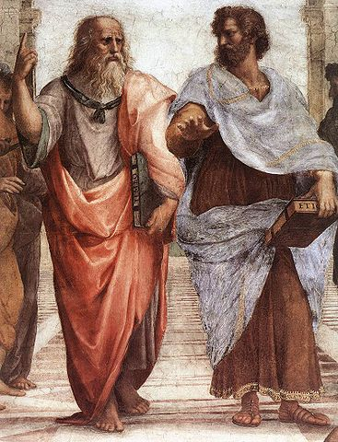
Have a nice evening!
Thank you!

