Slide 1
Ancient Greek (Intermediate Level)
ATHENS MA IN ANCIENT PHILOSOPHY
NATIONAL AND KAPODISTRIAN UNIVERSITY OF ATHENS / Department of History and Philosophy of Science
In collaboration with:
•UNIVERSITY OF PATRAS / Department of Philosophy
•UNIVERSITY OF CRETE / Department of Philosophy and Social Studies

Slide 2
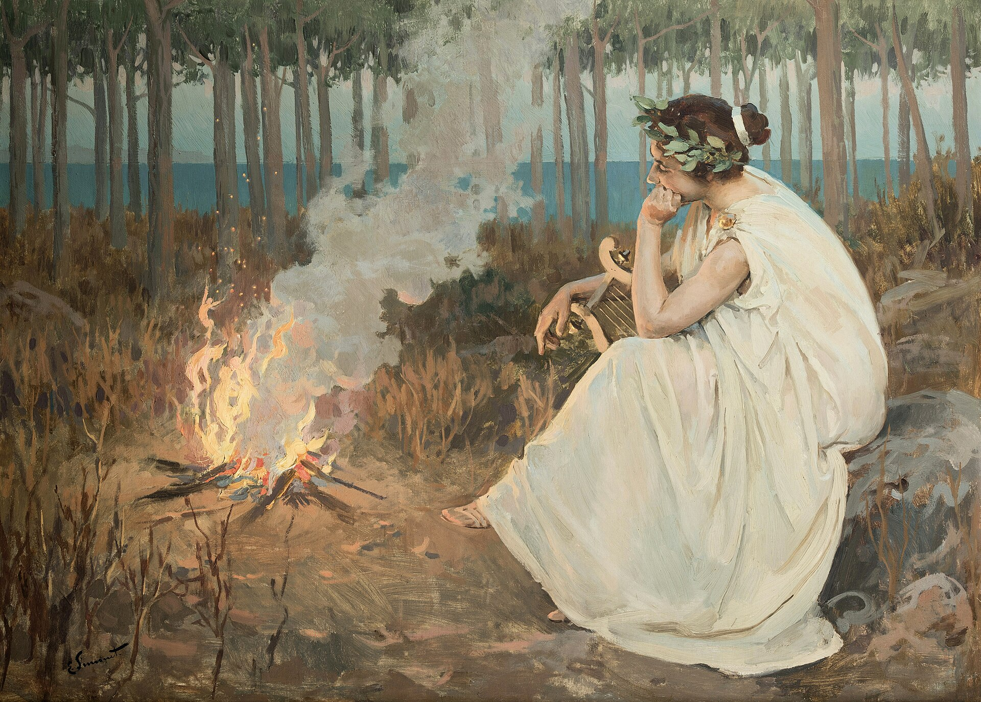
Week 2
Nouns, Pronouns, and Adjectives

Slide 3
Nouns
Nouns name things or people, e.g. potato, telephone, Chloe, honesty, courage. Cf. ‘The dog pursues Charlotte.’.
All nouns are classified according to grammatical gender (masculine, feminine, neuter) and are used in a number (singular, dual, or plural).
They are highly inflected words that change form to show their grammatical gender (masculine, feminine, or neuter), number (singular, dual, or plural), and case (nominative, vocative, accusative, genitive, or dative).
The specific endings a noun takes for these categories are determined by its declension, which is its set of inflectional forms.

Slide 4
Nouns
Gender: Nouns have one of three genders: masculine, feminine, or neuter. Grammatical gender can sometimes align with natural gender (e.g., male persons are masculine), but it is often arbitrary for inanimate objects.
Number: Ancient Greek nouns can be singular, dual (for two of something), or plural.
Case: Nouns decline (change their endings) to indicate their function in a sentence. The five cases are:
Nominative: The subject of a verb.
Vocative: Used when addressing someone directly.
Accusative: The direct object of a verb.
Genitive: Indicates possession or relationship, similar to the "'s" or "of" in English.
Dative: Expresses the indirect object of a verb, or other various functions.

Slide 5
Nouns
How to identify the gender of a noun?
The grammatical gender of a noun is often indicated by the definite article (ὁ, ἡ, τό, meaning "the") that precedes it.
Adjectives that agree in gender with the noun also reveal its gender.
Examples: καλὴ δὲ ἡ ἀκρόπολις, οἱ ναῦται τὸν Ἡγέστρατον διώκουσιν.

Slide 6
Nouns
Nouns are grouped into declensions based on patterns of inflection.
The most common are the first declension (often a-stems), the second declension (o-stems), and the third declension (consonant-stems).
The declension system determines the specific suffixes (endings) added to a noun's stem to form its different cases and numbers.
Roots: A root is the core meaning of a word. New words can be formed from already existing words when we add affixes to them. For instance: the word, "educational", was created by adding the suffixes: "-ion", and "-al", to the word: "educate".
Stems: A stem is the core part of a word, consisting of a root and any derivational affixes (prefixes or suffixes).

Slide 7
Nouns
First Declension: Most nouns of the first declension are feminine. Some nouns of the first declension, however, are MASCULINE, particularly those referring to a specifically male person (ending in –ας or –ης).
Most nouns of the first declension end in –η in the singular. Most of these nouns in this declension are FEMININE and use endings similar to those of the FEMININE DEFINITE ARTICLE.
After –ε, –ι or –ρ. In Attic and Koine Greek, when a first declension noun has a stem ending in –ε, –ι or –ρ, ᾱ appears instead of η in all cases in the singular (e.g. οἰκίᾱ building, house, χώρᾱ land, place).
Masculine nouns: In such instances, two changes occur:
The NOMINATIVE SINGULAR adds –ς.
The GENITIVE SINGULAR uses the masculine –ου ending.
Otherwise, masculine nouns follow the basic rules for all other first declension nouns.

Slide 8
Nouns
FIRST DECLESION, ending in -η:
Singular Plural
Nominative -η -αι
Genitive -ης -ῶν
Dative -ῃ -αις
Accusative -ην -ας

Slide 9
Nouns
 | Singular | Plural
Nominative | ἡ τιμή | αἱ τιμαί
Genitive | τῆς τιμῆς | τῶν τιμῶν
Dative | τῇ τιμῇ | ταῖς τιμαῖς
Accusative | τὴν τιμήν | τὰς τιμάς
Vocative | (ὦ) τιμή | τιμαί

Slide 10
Nouns
 | Singular | Plural
Nominative | ὁ ποιητής | οἱ ποιηταί
Genitive | τοῦ ποιητοῦ | τῶν ποιητῶν
Dative | τῷ ποιητῇ | τοῖς ποιηταῖς
Accusative | τὸν ποιητήν | τοὺς ποιητάς
Vocative | ὦ ποιητά | ποιηταί

Slide 11
Nouns
1st DECLENSION MASCULINE nouns that end in –της are an important exception, forming their vocative singular in –τᾰ.
παραδίδως, ὦ στρατιῶτα, τὴν πατρίδα.
Soldier, you are betraying your country.
στρατιώτης (nom.) → στρατιῶτα (voc.)
παραδίδως, ὦ ποιητά, τὴν πατρίδα.
Poet, you are betraying your country.
ποιητής (nom.) → ποιητά (voc.)

Slide 12
Nouns
FIRST DECLESION, ending in -α:
Singular Plural
Nominative -α -αι
Genitive -ας -ῶν
Dative -ᾳ -αις
Accusative -αν -ας

Slide 13
Nouns
 | Singular | Plural
Nominative | ἡ χώρα | αἱ χῶραι
Genitive | τῆς χώρας | τῶν χωρῶν
Dative | τῇ χώρᾳ | ταῖς χώραις
Accusative | τὴν χώραν | τὰς χώρας
Vocative | (ὦ) χώρα | χῶραι

Slide 14
Nouns: Exercise 1
To decline first declension nouns ending in -η or -ᾱ, first get the stem by removing the genitive singular ending -ης or -ᾱς. What remains is the stem, the base of the word to which the ending is joined.
Can you decline ἡ and μέλιττα?
Can you decline ἡ and ἀρετή?
Can you decline ὁ and πολίτης?

Slide 15
Nouns
Second Declension: Nouns in this declension are mostly MASCULINE and use endings similar to the masculine definite article. The nominative singular, however, adds –ς.
The few FEMININE nouns in this declension use exactly the same endings as the masculine. Only the article marks their feminine gender.
Second declension NEUTER nouns follow the NEUTER LAWS. Namely:
The NOMINATIVE and ACCUSATIVE SINGULAR must be IDENTICAL.
The NOMINATIVE and ACCUSATIVE PLURAL also must be IDENTICAL, and end in a short –α.
Whenever any NEUTER noun is the subject of a verb, the verb is regularly 3rd PERSON SINGULAR, even if the neuter subject is plural!

Slide 16
Nouns
Singular Plural
Nominative -ος -οι
Genitive -ου -ων
Dative -ῳ -οις
Accusative -ον -ους

Slide 17
Nouns
 | Singular | Plural
Nominative | ὁ λόγος | οἱ λόγοι
Genitive | τοῦ λόγου | τῶν λόγων
Dative | τῷ λόγῳ | τοῖς λόγοις
Accusative | τὸν λόγον | τοὺς λόγους
Vocative | ὦ λόγε | λόγοι
 | Singular | Plural
Nominative | ἡ νῆσος | αἱ νῆσοι
Genitive | τῆς νήσου | τῶν νήσων
Dative | τῇ νήσῳ | ταῖς νήσοις
Accusative | τὴν νῆσον | τὰς νήσους
Vocative | ὦ νῆσε | νῆσοι

Slide 18
Nouns
Singular Plural
Nominative -ον -α
Genitive -ου -ων
Dative -ῳ -οις
Accusative -ον -α

Slide 19
Nouns
 | Singular | Plural
Nominative | τὸ ἔργον | τὰ ἔργα
Genitive | τοῦ ἔργου | τῶν ἔργων
Dative | τῷ ἔργῳ | τοῖς ἔργοις
Accusative | τὸ ἔργον | τὰ ἔργα
Vocative | ὦ ἔργον | ἔργα

Slide 20
Nouns: Exercise 2
Can you decline ἡ and ὁδός?
Can you decline ὁ and ἄνθρωπος?

Slide 21
Nouns
Third Declension: All third declension nouns use the same endings, but for some nouns the ending has been disguised by ablaut, contraction, or quantitative metathesis.
1) Subtype 1 Nouns with Stem Ending in ρ- or ερ- (ablaut): e.g. μήτηρ, άνήρ.
2) Subtype 2 Nouns with Stem Ending in σ- (ablaut, contraction, and disappearance of intervocalic sigma, -σ-):
Neuter Nouns Ending in –ος: γένος race
Neuter Nouns Ending in –ας: γῆρας, old age
Feminine and Masculine Nouns Ending in -ης: τριήρης trireme
Proper Nouns Ending in -ης: Σωκράτης Sokrates

Slide 22
Nouns
Third Declension:
3) Subtype 3 Nouns with Stem Ending in ι- (ablaut, contraction, disappearance of intervocalic digamma, -ϝ-, quantitative metathesis): e.g. πόλις
4) Subtype 4 Nouns with Stem Ending in -ηυ or -ηϝ (contraction, disappearance of intervocalic digamma, -ϝ-, quantitative metathesis): e.g. βασιλεύς

Slide 23
Nouns
Singular
N αἴξ ἄρχων ἐλπίς σῶμα φύλαξ χάρις
G αἰγός ἄρχοντος ἐλπίδος σώματος φύλακος χάριτος
D αἰγί ἄρχοντι ἐλπίδι σώματι φύλακι χάριτι
A αἶγα ἄρχοντα ἐλπίδα σῶμα φύλακα χάριν
V αἴξ ἄρχον ἐλπί σῶμα φύλαξ χάρι
Plural
N αἶγες ἄρχοντες ἐλπίδες σώματα φύλακες χάριτες
G αἰγῶν ἀρχόντων ἐλπίδων σωμάτων φυλάκων χαρίτων
D αἰξί (ν) ἄρχουσι (ν) ἐλπίσι (ν) σώμασι (ν) φύλαξι (A αἶγας ἄρχοντας ἐλπίδας σώματα φύλακας χάριτας ν) χάρισι (ν)
V αἶγες ἄρχοντες ἐλπίδες σώματα φύλακες χάριτες

Slide 24
Nouns
Subtype 1: Feminine
Singular
N μήτηρ, G μητρός, D μητρί, A μητέρα, V μῆτερ
Plural
N μητέρες, G μητέρωv, D μητράσι, A μητέρας, V μητέρες
Subtype 1: Masculine
Singular
N ἀvήρ, G ἀvδρός, D ἀvδρί, A ἄvδρα, V ἄvερ
Plural
N ἄvδρες, G ἀvδρῶv, D ἀvδράσι (v), A ἄvδρας, V ἄvδρες

Slide 25
Nouns
Subtype 1: neutral
sing. pl.
nom. πλῆθ-ος πλήθ-η
acc. πλῆθ-ος πλήθ-η
gen. πλήθ-ους πληθ-ῶν
dat. πλήθε-ι πλήθεσι(ν)
voc. πλῆθ-ος πλήθη
Subtype 2: Feminine
sing. pl.
nom. τριήρ-ης τριήρ-εις
acc. τριήρ-η τριήρ-εις
gen. τριήρ-ους τριήρ-ων
dat. τριήρ-ει τριήρεσι(ν)
voc. ὦ τριήρ-η τριήρ-εις

Slide 26
Nouns
Subtype 3: Feminine
ἡ πόλις (3e), city-state
sing. pl.
nom. πόλι-ς πόλεις
acc. πόλι-ν πόλεις
gen. πόλε-ως πόλε-ων
dat. πόλε-ι πόλεσι(ν)
voc. ὦ πόλι πόλεις

Slide 27
Nouns: Exercise 3
Name the GENDER, CASE, and NUMBER (where possible) of the following def. art. + noun combinations:
1. τῇ σκηνῇ 6. τὸ ἆσθμα
2. ἡ δημοκρατία 7. τοῖς δεσπόταις
3. τὸ νεῦρον 8. τῶν σπόγγων
4. τοῦ σκελετοῦ 9. τὰ κρανία
5. τοὺς ὀφθαλμούς 10. τῆς τραγῳδίας

Slide 28
Exercise 4
Write the correct form of ἄνθρωπος or ἔργον for the following def. art. adjective combinations. Check the gender of the def. art. + adj. to determine which noun to put with them. Sometimes you can give two answers:
1. τὸν καλόν – 5. τῷ κακῷ –
2. τῶν κακῶν – 6. τοὺς κακούς –
3. οἱ καλοί – 7. τῷ καλῷ –
4. τοῖς σῶοις – 8. τὸ σῶον –

Slide 29
Exercise 5
ἀγορά, ᾶς, ἡ market-place.
ἡμέρᾱ, ᾱς, ἡ day.
θύρᾱ, ᾱς, ἡ door.
οἰκίᾱ, ᾱς, ἡ house.
στρατιά, ᾶς, ἡ army.
χώρᾱ, ᾱς, ἡ place, land, country.
μακρά adj., long.
μῑκρά adj., small, little.
ἐν prep. with dat., in (a proclitic).
ἦν he (she, it) was.
ἦσαν they were.
ἔχει he (she, it) has.
ἔχουσι they have.
READ ALOUD AND TRANSLATE
1. οἰκίαι μικραί.
2. ἐν ταῖς ἀγοραῖς.
3. ἐν οἰκίᾳ μικρᾷ.
4. ἡ οἰκίᾱ θύραν ἔχει.
5. ἡ ἡμέρα μακρὰ ἦν.
6. στρατιὰς μικρὰς ἔχουσι.
7. αἱ οἰκίαι θύρας ἔχουσι.
8. ἐν τῇ χώρᾳ οἰκίαι ἦσαν.
9. αἱ οἰκίαι μικραὶ ἦσαν.
10. μικραὶ ἦσαν αἱ θύραι τῶν οἰκιῶν.

Slide 30
Adjectives
Adjectives describe or further define nouns (and pronouns). An adjective must agree with its noun in GENDER, NUMBER, and CASE. Like definite articles and pronouns, therefore, adjectives must have forms to represent each possible combination of gender, number and case.
Greek adjectives are formed using the SAME THREE DECLENSIONS.
There are four main declension families:
Three-Ending 1st and 2nd Declension Adjectives (2-1-2)
Two-Ending 2nd Declension Adjectives (2-2)
Two-Ending 3rd Declension Adjectives (3-3)
Three-Ending 1st and 3rd Declension Adjectives (3-1-3)

Slide 31
Adjectives
Three-Ending Adjectives: 1st and 2nd Declension (2-1-2)
Singular:
M F N
Nominative ἀγαθός ἀγαθή ἀγαθόν
Genitive ἀγαθοῦ ἀγαθῆς ἀγαθοῦ
Dative ἀγαθῷ ἀγαθῇ ἀγαθῷ
Accusative ἀγαθόν ἀγαθήν ἀγαθόν

Slide 32
Adjectives
Three-Ending Adjectives: 1st and 2nd Declension (2-1-2)
Plural:
M F N
Nominative ἀγαθοί ἀγαθαί ἀγαθά
Genitive ἀγαθῶν ἀγαθῶν ἀγαθῶν
Dative ἀγαθοῖς ἀγαθαῖς ἀγαθοῖς
Accusative ἀγαθούς ἀγαθάς ἀγαθά

Slide 33
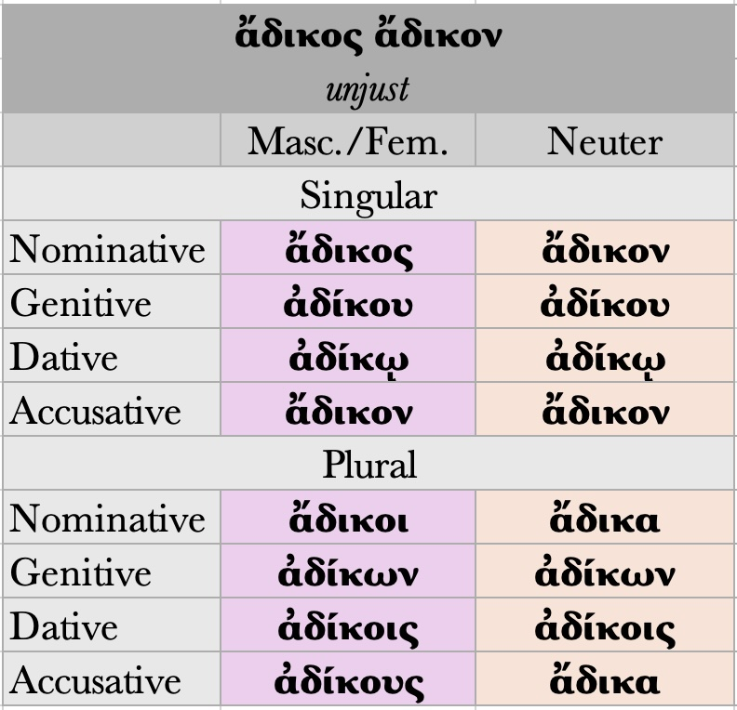
Adjectives
Two-Ending 2nd Declension Adjectives (2-2)
A handful of adjectives, usually compounds, use 2nd DECLENSION endings for ALL GENDERS. For these adjectives:
Both the MASCULINE and FEMININE forms share the SAME ENDINGS as 2nd DECLENSION MASCULINE nouns.
The NEUTER form shares the same endings as 2nd DECLENSION NEUTER nouns.

Slide 34
Adjectives
Two-Ending 3rd Declension Adjectives (3-3)
Another small group of adjectives uses 3rd DECLENSION endings for ALL GENDERS. For these adjectives:
Both the MASCULINE and FEMININE forms share the SAME ENDINGS as 3rd DECLENSION MASCULINE/FEMININE nouns.
The NEUTER form uses the same endings as 3rd DECLENSION NEUTER nouns.
These adjectives tend to fall into one of two groups:
Adjectives ending in –ης –ες.
These adjectives have a stem ending in –εσ.
Adjectives ending in –(ί)ων –(ι)ον.
These adjectives have a stem ending in –(ι)ον.

Slide 35
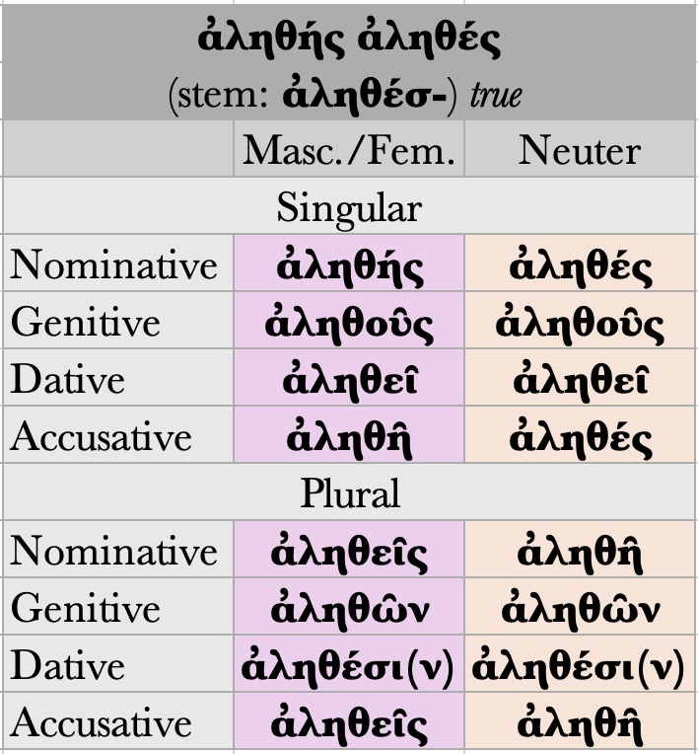
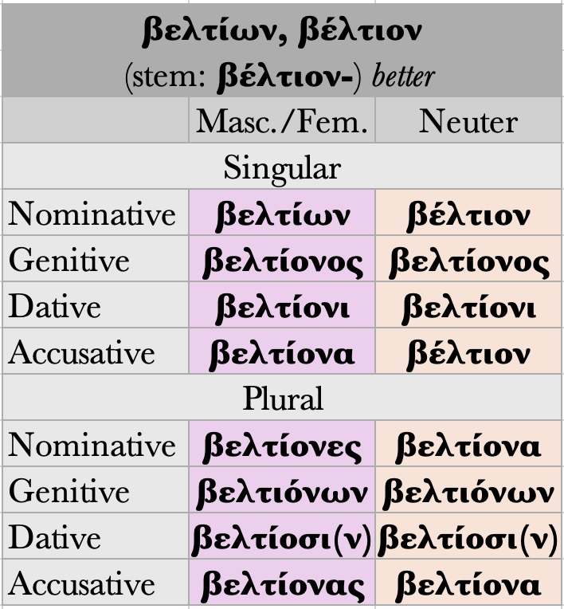
Adjectives (Two-Ending 3rd Declension Adjectives (3-3)

Slide 36
Adjectives
Three-Ending 1st and 3rd Declension Adjectives (3-1-3)
The final group of adjectives uses 3rd DECLENSION endings for MASCULINE and NEUTER, but 1st DECLENSION endings for FEMININE.
These adjectives tend to fall into one of two groups:
Adjectives ending in –ς –σα –ν.
These adjectives have a stem ending in –ντ.
Adjectives ending in –ύς –εῖα –ύ.
These adjectives have a stem ending in –ε.

Slide 37
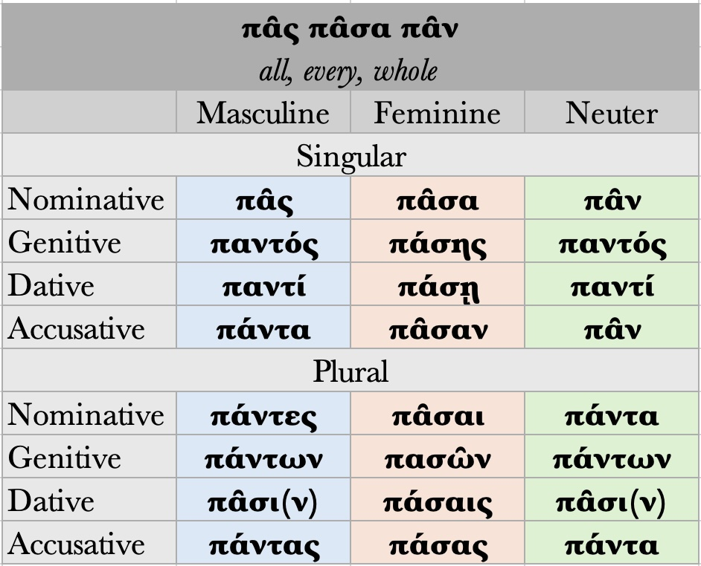
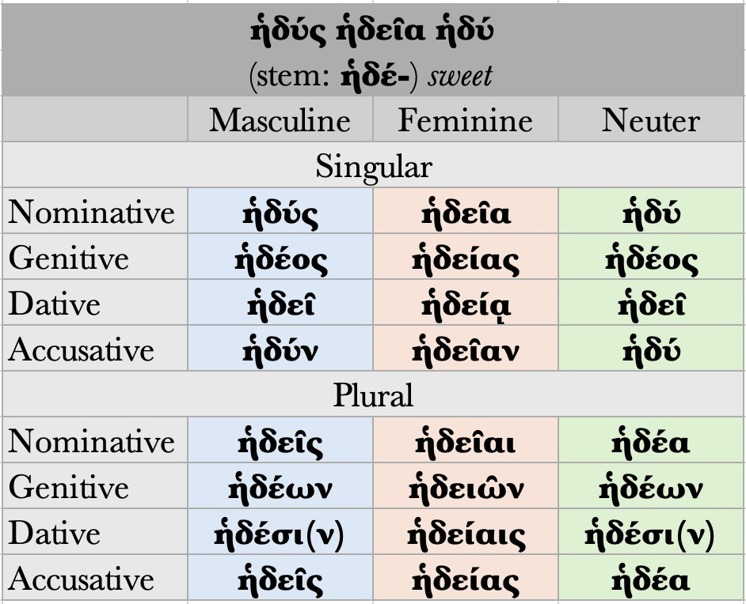
Adjectives: Three-Ending 1st and 3rd Declension Adjectives (3-1-3)

Slide 38
Adjectives
Usage
Depending on its placement, a Greek adjective has three possible functions.
1. Attributive Position
Greek adjectives describe nouns when they are in the attributive position:
ὁ κακὸς βασιλεύς
  the bad king
ὁ βασιλεὺς ὁ κακός
  the bad king
βασιλεὺς ὁ κακός
  the bad king
κακὸς βασιλεύς
  a bad king

Slide 39
Adjectives
Usage
2. Predicate Position
Outside the attributive position, Greek adjectives function as predicates to the noun:
ὁ βασιλεύς κακός.
  The king (is) bad.
αἱ θλίψεις ποιοῦσι τὸν βασιλέα κακόν.
  Troubles make the king bad.

Slide 40
Adjectives
Usage
3. Stand Alone (Substantive)
Greek routinely uses adjectives substantively:
ὁ κακός
  the bad man, the bad person
κακός
  a bad man, a bad person
οἱ κακοί
  the bad men, the bad people
If the definite article is neuter singular – or occasionally neuter plural – the substantive can serve as an abstract noun:
τὸ κακόν
  the bad thing; evil
τὸ ἄδικον
  the unjust thing; injustice
τὸ καλόν
  the beautiful; beauty

Slide 41
Adjectives: Exercise 6
1. Can you decline ὁ and καλός?
2. Can you decline ἡ and κακή?
3. Can you decline τὸ and ἀγαθόν?
4. Can you decline ὁ and ψευδής?
5. Can you decline τὸ and ταχύ?

Slide 42
Adjectives: Exercise 7
2. Write the correct form of καλ-ός -ή -όν for the following nouns (remember you can tell their GENDER, CASE, and NUMBER from their def. art.), e.g. τὸν – ψόφον = τὸν καλὸν ψόφον.
1. ὁ κυβερνήτης
2. τὸ πλοῖον
3. τοῦ ἔργου
4. τὰς Ἀθήνας
5. τοῖς ἀθρώποις
6. τὴν ἀκρόπολιν
7. τὸν Παρθενῶνα
8. ταῖς βοαῖς
9. τῶι πλοίωι
10. τῆι ἀκροπόλει

Slide 43
Pronouns
Usage: they replace nouns.
Most Greek pronouns closely resemble the definite article (e.g. αὐτός).
Categories: personal, demonstrative, possessive, interrogative and indefinite pronouns, relative, reflexive, correlative.

Slide 44
Personal Pronouns
First Person Pronoun (I, we)
Singular Plural
Nominative ἐγώ ἡμεῖς
Genitive ἐμοῦ, μου ἡμῶν
Dative ἐμοί, μοι ἡμῖν
Accusative ἐμέ, με ἡμᾶς

Slide 45
Personal Pronouns
Second Person Pronoun (you)
Singular Plural
Nominative σύ ὑμεῖς
Genitive σοῦ, σου ὑμῶν
Dative σοί, σοι ὑμῖν
Accusative σέ, σε ὑμᾶς

Slide 46
Personal Pronouns
3rd Person Personal Pronoun
It is an intensive pronoun that serves as the third person pronoun in Attic Greek prose.
It is the Greek equivalent he/she/it. Greek uses a single pronoun for all of these, and declines it by gender, number, and case. While the definite article has the stem τ-, this pronoun has the stem αὐτ-. The forms of αὐτός use the same endings with one exception: The masculine nominative singular of the pronoun ends in –ς.
Singular:
M F N
Nominative αὐτός αὐτή αὐτό
Genitive αὐτοῦ αὐτῆς αὐτοῦ
Dative αὐτῷ αὐτῇ αὐτῷ
Accusative αὐτόν αὐτήν αὐτό
Plural:
M F N
Nominative αὐτοί αὐταί αὐτά
Genitive αὐτῶν αὐτῶν αὐτῶν
Dative αὐτοῖς αὐταῖς αὐτοῖς
Accusative αὐτούς αὐτάς αὐτά

Slide 47
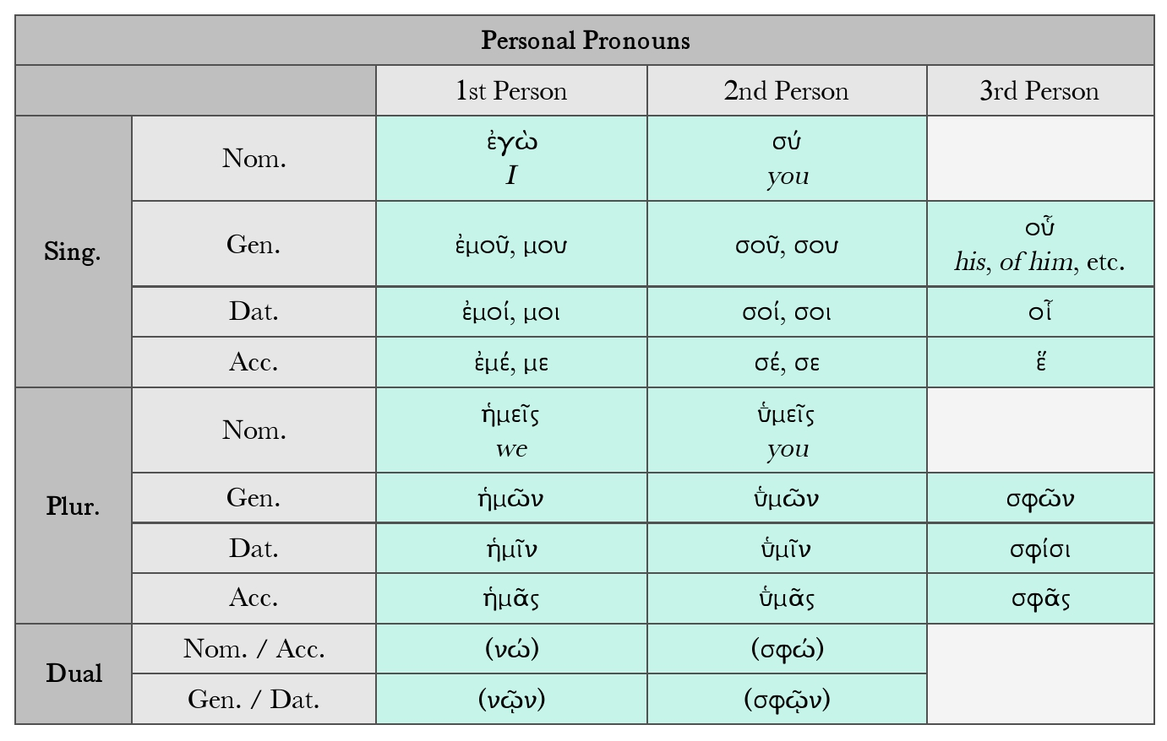
Pronouns

Slide 48
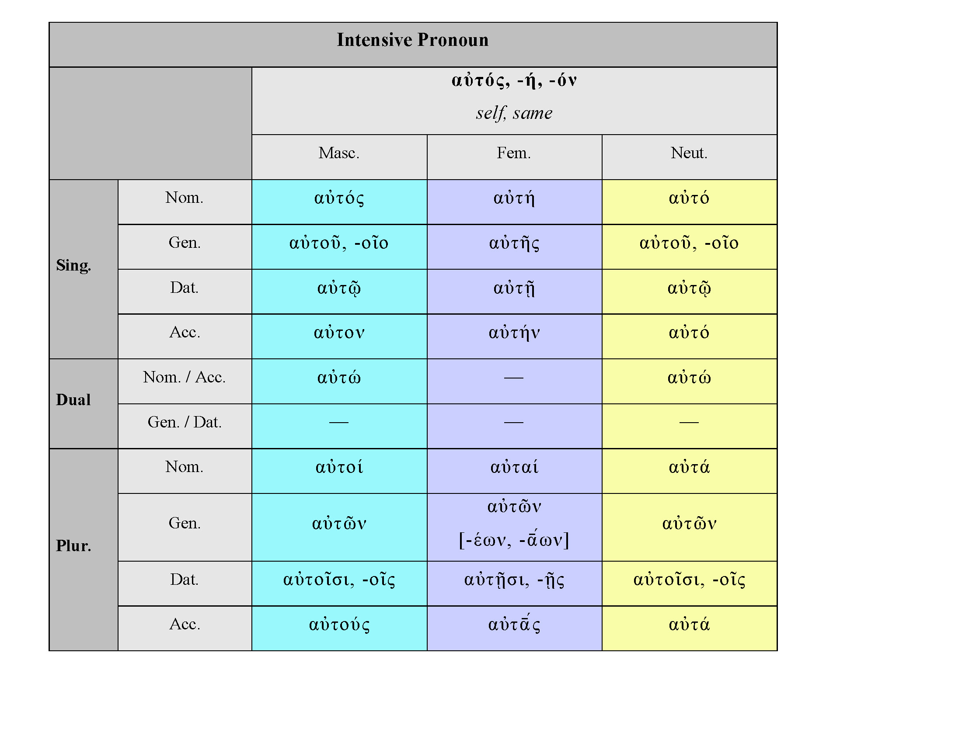
Pronouns
In order to supply the lacking personal pronoun in the third person when used as an object (not as subject), it is necessary to use the so-called anaphoric or intensive pronoun. The word anaphoric means that it refers to something / somebody already mentioned previously. As it cannot be used as a subject, it lacks nominative forms. Its declension is as follows:

Slide 49
Pronouns
Possessive pronouns, formed from the personal pronouns, are
ἐμός, -ή, -όν = my, mine ἡμέτερος, -ᾱ, -ον = our
σός, σή, σόν = thy, thine, your ὑμέτερος, -ᾱ, -ον = your, yours
Also in poetry: ὅς, ἥ, ὅν = his, its, hers and σφέτερος, -ᾱ, -ον = their, theirs
ᾱ̓μός (or ᾱ̔μός), -ή, -όν = our (sometimes my).
σφέτερος occurs in prose in a reflexive sense = their own.

Slide 50
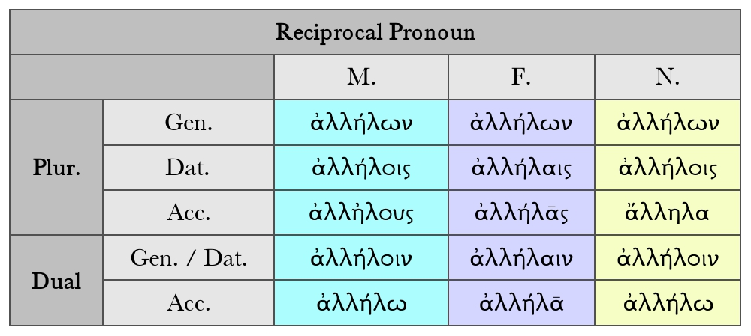
Pronouns
In order to indicate a mutual interaction between two or more people, in Greek it is necessary to use the reciprocal pronoun, which logically has only plural forms and no nominative forms, as this pronoun can not express the subject of a sentence.
Each other.

Slide 51
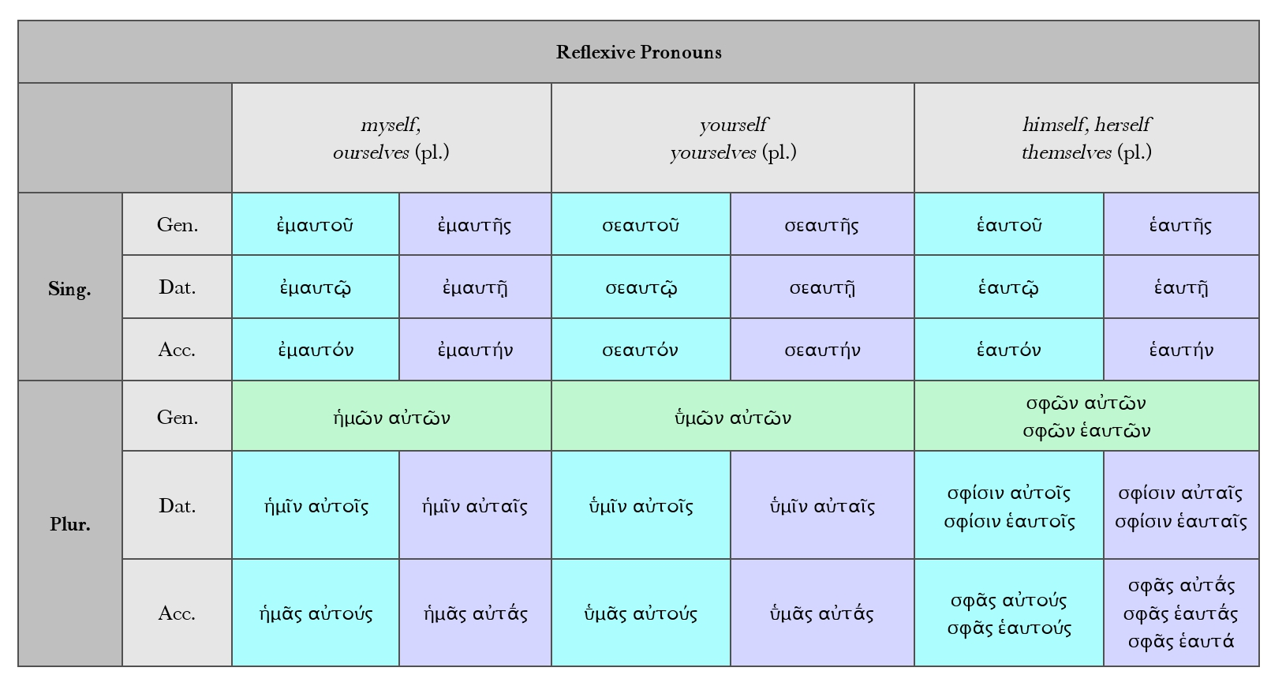
Pronouns
In English the reflexive pronoun self is used in order to say that the object of a sentence is the same as the subject, e.g.: he killed himself, she bought herself a book, etc. Greek reflexive pronouns follow a peculiar inflectional pattern, which features a combination of the basic personal pronouns and αύτός as follows:

Slide 52
Exercise 8
Add the correct form of the noun ἄνθρωπος to the following Greek phrases and specify the CASE and NUMBER of the article, adjective and noun, e.g. ὁ καλός – ἄνθρωπος, nom. s.:
1. τὸν ἡμέτερον – 4. τοῖς ἡμετέροις –
2. τῶν καλῶν – 5. τοῦ καλοῦ –
3. τοὺς ἡμετέρους –

Slide 53
Demonstrative pronouns
Ancient Greek pronouns that refer to nouns, comparing them to external references.
They are used to point things or people out that are near or far from the speaker (the Latin word demonstrare means “to point out”).
The most common of them all: οὗτος αὕτη τοῦτο (this/these).
Like other demonstrative pronouns, οὗτος αὕτη τοῦτο can serve as an ADJECTIVE.
For example:
οἱ Ἀθηναῖοι τοὺς πρέσβεις πρὸς τοὺς Σπαρτιάτας πέμπουσι.
The Athenians are sending ambassadors to the Spartans.
οὗτοι τούτους τοὺς πρέσβεις πρὸς τοὺς Σπαρτιάτας πέμπουσι.
These (men) are sending these ambassadors to the Spartans

Slide 54
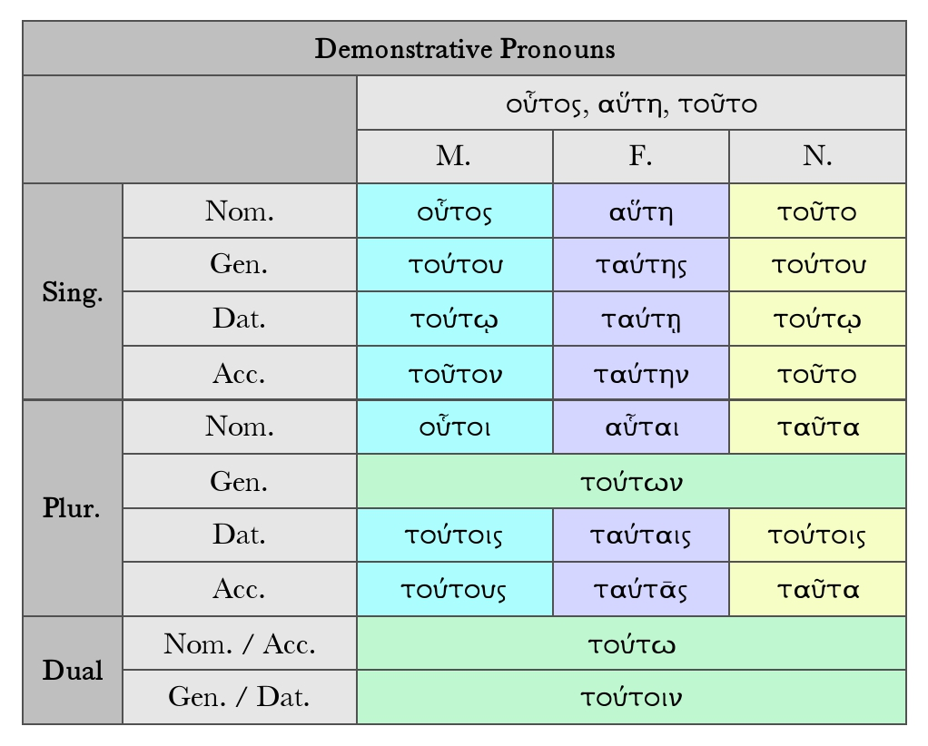
Pronouns

Slide 55
Pronous
The Greek equivalent of that/those, and it is used to point out someone or something far away from the speaker. It can also be used to indicate that the thing or person is well-known. When juxtaposed with the pronoun οὗτος, αὕτη, τοῦτο (introduced below), it can also mean “the former” (as opposed to “the latter”). This pronoun has the stem ἐκειν-. It uses the same endings as the definite articles with one exception: The masculine nominative singular form ends in –ς.
Singular:
M F N
Nominative ἐκεῖνος ἐκείνη ἐκεῖνο
Genitive ἐκείνου ἐκείνης ἐκείνου
Dative ἐκείνῳ ἐκείνῃ ἐκείνῳ
Accusative ἐκεῖνον ἐκείνην ἐκεῖνο
Plural:
M F N
Nominative ἐκεῖνοι ἐκεῖναι ἐκεῖνα
Genitive ἐκείνων ἐκείνων ἐκείνων
Dative ἐκείνοις ἐκείναις ἐκείνοις
Accusative ἐκείνους ἐκείνας ἐκεῖνα

Slide 56
Pronouns
This pronoun can substitute for a noun, or be used as a demonstrative adjective to modify a noun.
οἱ ἄρχοντες διδόασι τὴν ἐλπίδα τοῖς παισίν.
The rulers give hope to the children.
ἐκεῖνοι διδόασι τὴν ἐλπίδα ἐκείνοις τοῖς παισίν.
Those (men) give hope to those children.

Slide 57
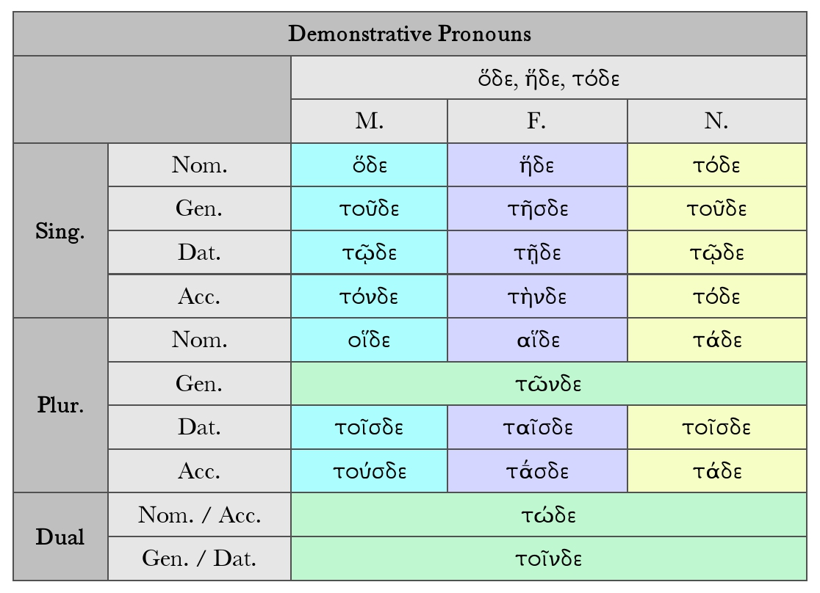
Pronouns
It is the Greek equivalent of this/these. It points out someone or something close to the speaker. To form this pronoun, the suffix –δε is added to the definite article.
This pronoun can substitute for a noun, or be used as a demonstrative adjective to modify a noun.
οἱ ἄρχοντες διδόασι τὴν ἐλπίδα τοῖς παισίν.
The rulers give hope to the children.
οἵδε διδόασι τὴν ἐλπίδα τοῖσδε τοῖς παισίν.
These (men) give hope to these children.

Slide 58
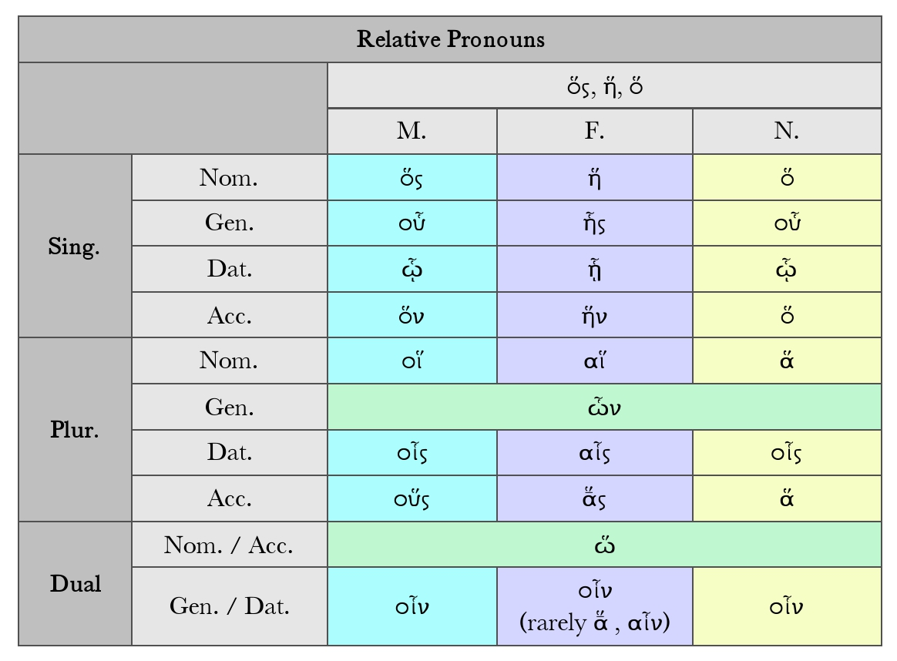
Pronouns
The relative pronouns are ὅς, ἥ, ὅ, who, which, and ὅστις, ἥτις, ὅ τι, whoever, whichever. The latter is called the indefinite relative (who/whose/whom).
Relative pronouns are commonly used to join two sentences or clauses together. Note the following sentences.
οἱ ἄρχοντες διδόασι τὴν ἐλπίδα τοῖς παισίν. οἱ παῖδες ἀποδιδόασι τὰ χρήματα.
The rulers give hope to the children. The children give the money back.
οἱ ἄρχοντες διδόασι τὴν ἐλπίδα τοῖς παισὶν οἳ τὰ χρήματα ἀποδιδόασιν.
The leaders give hope to the children who give the money back.

Slide 59
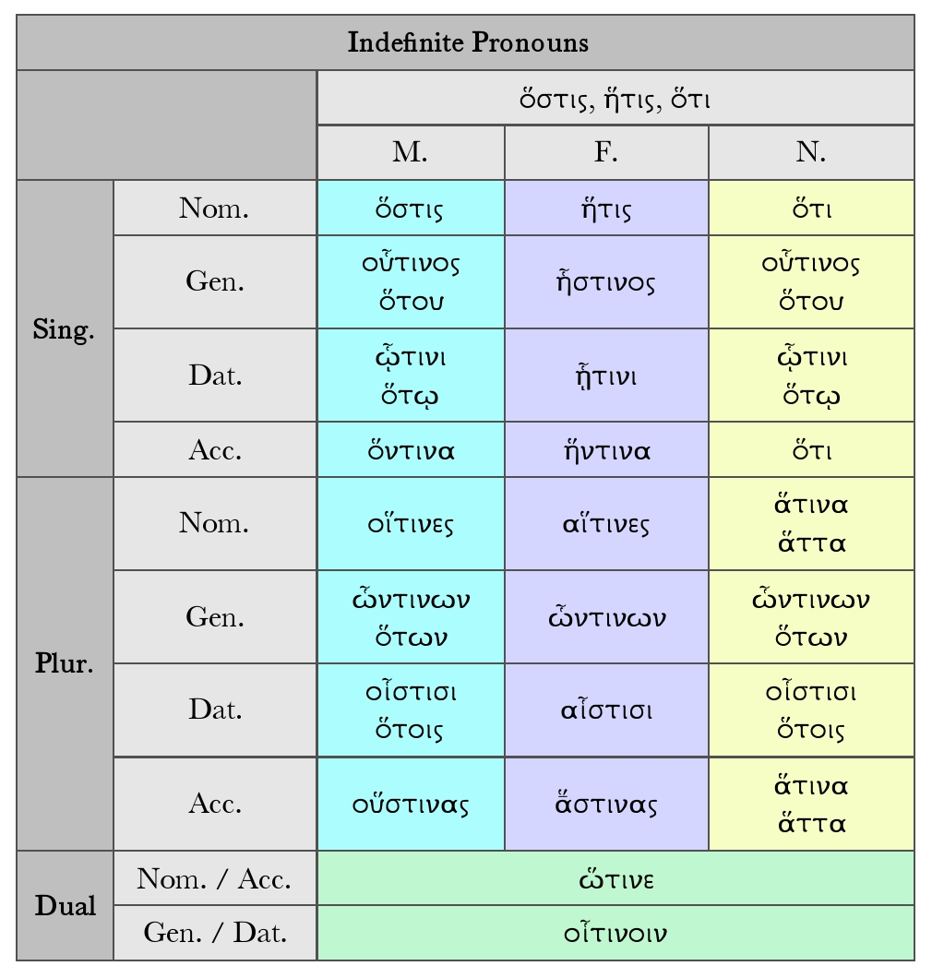
Pronouns
The indefinite relative or pronoun (whoever) is made of the combination of two elements: the relative pronoun and the indefinite pronoun τις , τι. Both halves are declined, each half according to its own declension. Genitive and dative singular masc./neuter and nominative and accusative plural neuter can have alternative forms; moreover the neuter singular form ό τ ι is usually written as two words, in order to avoid confusion with the conjunction ό τ ι.

Slide 60
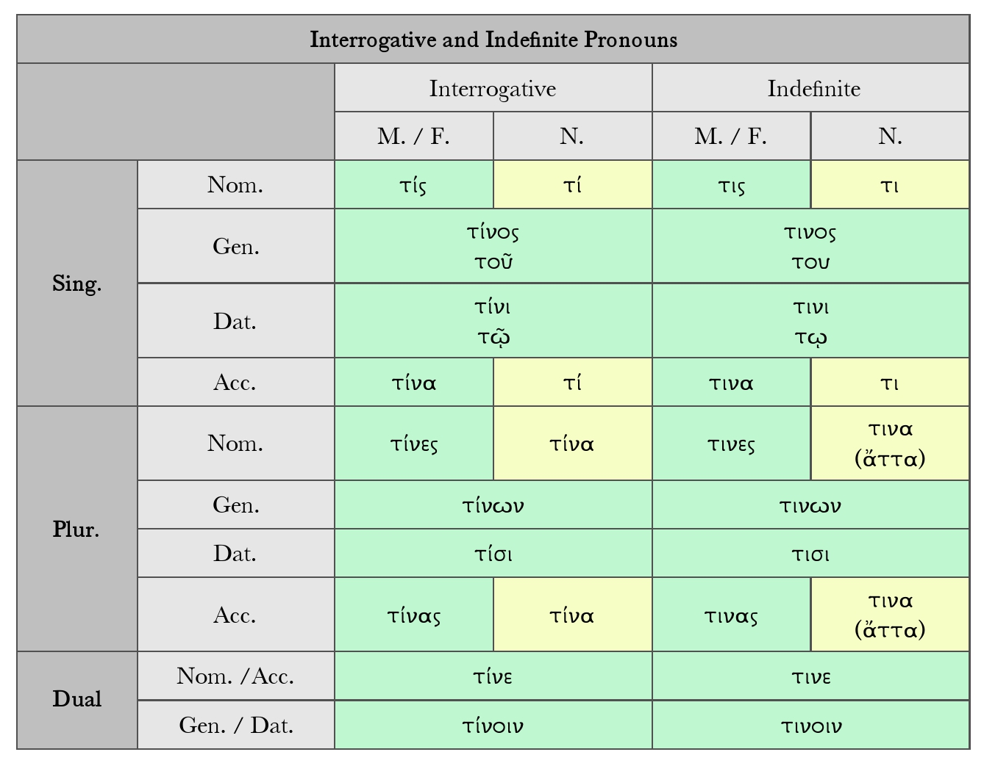
Pronouns
The interrogative pronoun τίς, τί (who? what?) and the indefinite pronoun τις, τι (some one, something, any one, anything) are spelt alike but differ in accent.

Slide 61
Exercise 9
Practice Translating Personal Pronouns and Adjectives. Practice translating this slightly adapted poem of Sappho.
Vocabulary
ἄγω, ἄξω do, drive, lead,
ἀδικέω, ἀδικήσω be unjust, do wrong,
ἀθάνατος, ἀθάνατον immortal, undying
ἄση, ἄσης ἡ distress, nausea; longing, desire,
αὐδή, αὐδῆς ἡ voice, speech; song, αὐτή, αὐτῆς ἡ she, her, hers
Ἀφροδίτη, Ἀφροδίτης ἡ Aphrodite, goddess of love,
ἄψ back,
βούλομαι, βουλήσομαι want, prefer; wish, be willing,
γίγνομαι, γενήσομαι be, be born
δαμνάω tame, conquer, subdue,
δεῖ it is necessary + ‘x’ in gen. or dat. or acc. + inf., δεῖ ἐλθεῖν it is necessary to come

Slide 62
Exercise 10
ἱμείρω long for, yearn for, desire
κάλημμι call
καλός, καλή, καλόν beautiful, good, noble
κελεύω, κελεύσω bid, order, command
κλύω hear, give ear to, attend to
λέγω, λέξω or ἐρέω say, tell, speak
λείπω, λείψω leave
λίσσομαι beg
λύω, λύσω loose, free, destroy
μειδιάω smile
μέριμνα, μερίμνης ἡ care, thought
ὅτι, ὅτινος τό what, whatever

Slide 63
Exercise
δέχομαι, δέξομαι receive; meet; accept
δηὖτε = δὴ αὖτε again
δίδωμι, δώσω give
διώκω, διώξω chase
δόμος, δόμου ὁ house
δῶρον, δώρου τό gift
ἐθέλω (θέλω), ἐθελήσω (θελήσω) wish, be willing
ἔμαι, ἔμων my
ἐμός, ἐμοῦ my
ἔρομαι, ἐρήσομαι ask
ἔρχομαι, ἐλεύσομαι come, go

Slide 64
Exercise
Ζεύς, Διός ὁ Zeus
θέλω, θελήσω wish, be willing
θυμός, θυμοῦ ὁ soul, spirit; passion, heart, will, desire
παῖς, παιδός ἡ ὁ child
πατήρ, πατρός ὁ father
πείθω, πείσω persuade + inf.; (mid. or pass.) listen to, obey + dat. or gen.
πρόσωπον, προσώπου τό face, mask, person
στρουθός, στρουθοῦ ὁ ἡ sparrow
σύμμαχος, συμμάχου ὁ ally
ταχέως quickly, soon

Slide 65
Exercise
τελέω, τελέσω fulfill, accomplish
φεύγω, φεύξομαι flee
φιλέω, φιλήσω love
φιλότης, φιλότητος ἡ friendship, love, affection
χαλεπός, χαλεπή, χαλεπόν difficult, harsh
Ψάπφω, Ψάπφους ἡ Sappho, a famous poet from Lesbos c. 630 B.C.E.

Slide 66
Exercise
1. ἐγὼ λέγω πρὸς σέ. (ἐγὼ λέγω σοί.)
2. ὦ Αφροδίτη, παῖ Δίος, λίσσομαί σε.
3. οὐ σὲ δεῖ ἄσαις μοὶ δαμνάειν θυμόν.
4. σὺ τὰς ἔμας αὔδας κλύεις;
5. πάτρος δὲ δόμον λείπεις καὶ εἰς μὲ ἔρχῃ;

Slide 67
Exercise
6. σὲ κάλοι δέ ἄγουσιν στροῦθοι.
7. σὺ δ᾿, ὦ Αφροδίτη, μειδιάεις ἀθανάτῳ προσώπῳ;
8. ἔρῃ τί δηὖτε κάλημμί σε;
9. ἔρῃ ὅτι μοι μάλιστα θέλω γένεσθαι θυμῷ;
10. ἔρῃ τίνα δηὖτε πείθω ἄψ σε ἄγειν ἐς φιλότητα;
11. τίς σε, ὦ Ψάπφ᾿, ἀδικέει;
12. καὶ γὰρ εἰ φεύγει, κελεύω αὐτὴν ταχέως διώκειν.

Slide 68
Exercise
13. εἰ δὲ δῶρα μὴ δέχεται ἐκ σοῦ, ἀλλὰ ἐγὼ κελεύω αὐτῇ διδόναι σοί.
14. εἰ δὲ μὴ φιλέει, ἐγὼ κελεύω αὐτὴν ταχέως φιλέειν καὶ εἰ μὴ ἐθέλει.
15. ἐμὲ δεῖ χαλεπῶν λύειν ἐκ μερίμνων.
16. ὅτι δέ μοι τελέειν θυμὸς ἱμείρει, βούλομαί σε τελέειν.
17. σὺ δὲ σύμμαχος ἐμὸς εἶ.

Slide 69
Sappho 1 V
ποικιλόθρον᾽ ἀθανάτ Ἀφρόδιτα,
παῖ Δίος δολόπλοκε, λίσσομαί σε·
μή μ᾽ ἄσαισι μηδ᾽ ὀνίαισι δάμνα,
πότνια, θῦμον, 4
ἀλλὰ τυίδ᾽ ἔλθ᾽, αἴ ποτα κἀτέρωτα
τὰς ἔμας αὔδας ἀίοισα πήλοι
ἔκλυες, πάτρος δὲ δόμον λίποισα
χρύσιον ἦλθες 8
Many-minded immortal Aphrodite,
Child of Zeus, plot weaver, I implore you:
Don’t with vexations and frustrations break
My heart, O queen.
Instead, come here, if ever in past times
From far off you heard, and heeded, my calls;
And quitting your father’s golden palace,
You came,

Slide 70
Sappho 1 V
ἄρμ᾽ ὐπασδεύξαισα· κάλοι δέ σ᾽ ἆγον
ὤκεες στροῦθοι περὶ γᾶς μελαίνας
πύκνα δίννεντες πτέρ᾽ ἀπ᾽ ὠράνωἴθε-
ρος διὰ μέσσω· 12
αἶψα δ᾽ ἐξίκοντο, σὺ δ᾽ ὦ μάκαιρα
μειδιαίσαισ᾽ ἀθανάτωι προσώπωι
ἤρε᾽ ὄττι δηὖτε πέπονθα κὤττι
δηὖτε κάλημμι 16
After yoking the chariot. Small birds,
Handsome, swift, bore you across the black earth.
Their fast wings whirred from the upper heavens
down through the middle air.
Quick, their arrival. Then you, blessed one,
A smile on your immortal countenance,
Asked: what is it, this time, that’s happened to me;
Why, this time, do I call;

Slide 71
Sappho 1 V
κὤττι μοι μάλιστα θέλω γένεσθαι
μαινόλαι θύμωι· τίνα δηὖτε πείθω
†. .σάγην† ἐς σὰν φιλότατα; τίς σ᾽ ὦ
Ψάπφ᾽ ἀδικήει; 20
καὶ γὰρ αἰ φεύγει, ταχέως διώξει,
αἰ δὲ δῶρα μὴ δέκετ᾽, ἀλλὰ δώσει,
αἰ δὲ μὴ φίλει, ταχέως φιλήσει
κωὐκ ἐθέλοισα. 24
ἔλθε μοι καὶ νῦν, χαλέπαν δὲ λῦσον
ἐκ μερίμναν, ὄσσα δέ μοι τέλεσσαι
θῦμος ἰμέρρει, τέλεσον, σὺ δ᾽ αὔτα
σύμμαχος ἔσσο. 28
And what does my crazed heart most desire:
“Whom, this time, must I persuade—
Go out, that is, and bring into your love?
O Sappho, who wrongs you?
Even if she’s fleeing, soon she’ll pursue.
If she’s refusing gifts, she’ll give them.
If she’s not in love, soon she’ll be in love—
Even if against her will.”
Come this time too. Release me from hard cares.
Whatever my heart wishes to see done,
Bring about. And you yourself, be my ally
In this fight.

Slide 72
Exercise 11: Apology 17a-18a: Find all the nouns, the adjectives and the pronouns in the genitive case
ὅτι μὲν ὑμεῖς, ὦ ἄνδρες Ἀθηναῖοι, πεπόνθατε ὑπὸ τῶν ἐμῶν κατηγόρων, οὐκ οἶδα· ἐγὼ δ᾽ οὖν καὶ αὐτὸς ὑπ᾽ αὐτῶν ὀλίγου ἐμαυτοῦ ἐπελαθόμην, οὕτω πιθανῶς ἔλεγον. καίτοι ἀληθές γε ὡς ἔπος εἰπεῖν οὐδὲν εἰρήκασιν. μάλιστα δὲ αὐτῶν ἓν ἐθαύμασα τῶν πολλῶν ὧν ἐψεύσαντο, τοῦτο ἐν ᾧ ἔλεγον ὡς χρῆν ὑμᾶς εὐλαβεῖσθαι μὴ ὑπ᾽ ἐμοῦ ἐξαπατηθῆτε ὡς δεινοῦ ὄντος λέγειν. τὸ γὰρ μὴ αἰσχυνθῆναι ὅτι αὐτίκα ὑπ᾽ ἐμοῦ ἐξελεγχθήσονται ἔργῳ, ἐπειδὰν μηδ᾽ ὁπωστιοῦν φαίνωμαι δεινὸς λέγειν, τοῦτό μοι ἔδοξεν αὐτῶν ἀναισχυντότατον εἶναι, εἰ μὴ ἄρα δεινὸν καλοῦσιν οὗτοι λέγειν τὸν τἀληθῆ λέγοντα· εἰ μὲν γὰρ τοῦτο λέγουσιν, ὁμολογοίην ἂν ἔγωγε οὐ κατὰ τούτους εἶναι ῥήτωρ. οὗτοι μὲν οὖν, ὥσπερ ἐγὼ λέγω, ἤ τι ἢ οὐδὲν ἀληθὲς εἰρήκασιν, ὑμεῖς δέ μου ἀκούσεσθε πᾶσαν τὴν ἀλήθειαν—οὐ μέντοι μὰ Δία, ὦ ἄνδρες Ἀθηναῖοι, κεκαλλιεπημένους γε λόγους, ὥσπερ οἱ τούτων,

Slide 73
Exercise: Apology 17a-18a
ῥήμασί τε καὶ ὀνόμασιν οὐδὲ κεκοσμημένους, ἀλλ᾽ ἀκούσεσθε εἰκῇ λεγόμενα τοῖς ἐπιτυχοῦσιν ὀνόμασιν—πιστεύω γὰρ δίκαια εἶναι ἃ λέγω—καὶ μηδεὶς ὑμῶν προσδοκησάτω ἄλλως· οὐδὲ γὰρ ἂν δήπου πρέποι, ὦ ἄνδρες, τῇδε τῇ ἡλικίᾳ ὥσπερ μειρακίῳ πλάττοντι λόγους εἰς ὑμᾶς εἰσιέναι. καὶ μέντοι καὶ πάνυ, ὦ ἄνδρες Ἀθηναῖοι, τοῦτο ὑμῶν δέομαι καὶ παρίεμαι· ἐὰν διὰ τῶν αὐτῶν λόγων ἀκούητέ μου ἀπολογουμένου δι᾽ ὧνπερ εἴωθα λέγειν καὶ ἐν ἀγορᾷ ἐπὶ τῶν τραπεζῶν, ἵνα ὑμῶν πολλοὶ ἀκηκόασι, καὶ ἄλλοθι, μήτε θαυμάζειν μήτε θορυβεῖν τούτου ἕνεκα. ἔχει γὰρ οὑτωσί. νῦν ἐγὼ πρῶτον ἐπὶ δικαστήριον ἀναβέβηκα, ἔτη γεγονὼς ἑβδομήκοντα· ἀτεχνῶς οὖν ξένως ἔχω τῆς ἐνθάδε λέξεως. ὥσπερ οὖν ἄν, εἰ τῷ ὄντι ξένος ἐτύγχανον ὤν, συνεγιγνώσκετε δήπου ἄν μοι εἰ ἐν ἐκείνῃ τῇ φωνῇ τε καὶ τῷ τρόπῳ ἔλεγον ἐν οἷσπερ ἐτεθράμμην, καὶ δὴ καὶ νῦν τοῦτο ὑμῶν δέομαι δίκαιον, ὥς γέ μοι δοκῶ, τὸν μὲν τρόπον τῆς λέξεως ἐᾶν—ἴσως μὲν γὰρ χείρων, ἴσως δὲ βελτίων ἂν εἴη—αὐτὸ δὲ τοῦτο σκοπεῖν καὶ τούτῳ τὸν νοῦν προσέχειν, εἰ δίκαια λέγω ἢ μή· δικαστοῦ μὲν γὰρ αὕτη ἀρετή, ῥήτορος δὲ τἀληθῆ λέγειν.

Slide 74
Exercise: Apology 17a-18a
ὅτι μὲν ὑμεῖς, ὦ ἄνδρες Ἀθηναῖοι, πεπόνθατε ὑπὸ τῶν ἐμῶν κατηγόρων, οὐκ οἶδα· ἐγὼ δ᾽ οὖν καὶ αὐτὸς ὑπ᾽ αὐτῶν ὀλίγου ἐμαυτοῦ ἐπελαθόμην, οὕτω πιθανῶς ἔλεγον. καίτοι ἀληθές γε ὡς ἔπος εἰπεῖν οὐδὲν εἰρήκασιν. μάλιστα δὲ αὐτῶν ἓν ἐθαύμασα τῶν πολλῶν ὧν ἐψεύσαντο, τοῦτο ἐν ᾧ ἔλεγον ὡς χρῆν ὑμᾶς εὐλαβεῖσθαι μὴ ὑπ᾽ ἐμοῦ ἐξαπατηθῆτε ὡς δεινοῦ ὄντος λέγειν. τὸ γὰρ μὴ αἰσχυνθῆναι ὅτι αὐτίκα ὑπ᾽ ἐμοῦ ἐξελεγχθήσονται ἔργῳ, ἐπειδὰν μηδ᾽ ὁπωστιοῦν φαίνωμαι δεινὸς λέγειν, τοῦτό μοι ἔδοξεν αὐτῶν ἀναισχυντότατον εἶναι, εἰ μὴ ἄρα δεινὸν καλοῦσιν οὗτοι λέγειν τὸν τἀληθῆ λέγοντα· εἰ μὲν γὰρ τοῦτο λέγουσιν, ὁμολογοίην ἂν ἔγωγε οὐ κατὰ τούτους εἶναι ῥήτωρ. οὗτοι μὲν οὖν, ὥσπερ ἐγὼ λέγω, ἤ τι ἢ οὐδὲν ἀληθὲς εἰρήκασιν, ὑμεῖς δέ μου ἀκούσεσθε πᾶσαν τὴν ἀλήθειαν—οὐ μέντοι μὰ Δία, ὦ ἄνδρες Ἀθηναῖοι, κεκαλλιεπημένους γε λόγους, ὥσπερ οἱ τούτων,
ῥήμασί τε καὶ ὀνόμασιν οὐδὲ κεκοσμημένους, ἀλλ᾽ ἀκούσεσθε εἰκῇ λεγόμενα τοῖς ἐπιτυχοῦσιν ὀνόμασιν—πιστεύω γὰρ δίκαια εἶναι ἃ λέγω—καὶ μηδεὶς ὑμῶν προσδοκησάτω ἄλλως· οὐδὲ γὰρ ἂν δήπου πρέποι, ὦ ἄνδρες, τῇδε τῇ ἡλικίᾳ ὥσπερ μειρακίῳ πλάττοντι λόγους εἰς ὑμᾶς εἰσιέναι. καὶ μέντοι καὶ πάνυ, ὦ ἄνδρες Ἀθηναῖοι, τοῦτο ὑμῶν δέομαι καὶ παρίεμαι· ἐὰν διὰ τῶν αὐτῶν λόγων ἀκούητέ μου ἀπολογουμένου δι᾽ ὧνπερ εἴωθα λέγειν καὶ ἐν ἀγορᾷ ἐπὶ τῶν τραπεζῶν, ἵνα ὑμῶν πολλοὶ ἀκηκόασι, καὶ ἄλλοθι, μήτε θαυμάζειν μήτε θορυβεῖν τούτου ἕνεκα. ἔχει γὰρ οὑτωσί. νῦν ἐγὼ πρῶτον ἐπὶ δικαστήριον ἀναβέβηκα, ἔτη γεγονὼς ἑβδομήκοντα· ἀτεχνῶς οὖν ξένως ἔχω τῆς ἐνθάδε λέξεως. ὥσπερ οὖν ἄν, εἰ τῷ ὄντι ξένος ἐτύγχανον ὤν, συνεγιγνώσκετε δήπου ἄν μοι εἰ ἐν ἐκείνῃ τῇ φωνῇ τε καὶ τῷ τρόπῳ ἔλεγον ἐν οἷσπερ ἐτεθράμμην, καὶ δὴ καὶ νῦν τοῦτο ὑμῶν δέομαι δίκαιον, ὥς γέ μοι δοκῶ, τὸν μὲν τρόπον τῆς λέξεως ἐᾶν—ἴσως μὲν γὰρ χείρων, ἴσως δὲ βελτίων ἂν εἴη—αὐτὸ δὲ τοῦτο σκοπεῖν καὶ τούτῳ τὸν νοῦν προσέχειν, εἰ δίκαια λέγω ἢ μή· δικαστοῦ μὲν γὰρ αὕτη ἀρετή, ῥήτορος δὲ τἀληθῆ λέγειν.

Slide 75
Translation
How you, O Athenians, have been affected by my accusers, I cannot tell; but I know that they almost
made me forget who I was—so persuasively did they speak; and yet they have hardly uttered a word of
truth. But of the many falsehoods told by them, there was one which quite amazed me;—I mean when
they said that you should be upon your guard and not allow yourselves to be deceived by the force of
my eloquence. To say this, when they were certain to be detected as soon as I opened my lips and
proved myself to be anything but a great speaker, did indeed appear to me most shameless—unless by
the force of eloquence they mean the force of truth; for is such is their meaning, I admit that I am
eloquent. But in how different a way from theirs! Well, as I was saying, they have scarcely spoken the
truth at all; but from me you shall hear the whole truth: not, however, delivered after their manner in a
set oration duly ornamented with words and phrases. No, by heaven! but I shall use the words and
arguments which occur to me at the moment;

Slide 76
Translation
for I am confident in the justice of my cause (Or, I am certain that I am right in taking this course.): at my time of life I ought not to be appearing before you, O men of Athens, in the character of a juvenile orator—let no one expect it of me. And I must beg of you to grant me a favour:—If I defend myself in my accustomed manner, and you hear me using the words which I have been in the habit of using in the agora, at the tables of the money-changers, or anywhere else, I would ask you not to be surprised, and not to interrupt me on this account. For I am more than seventy years of age, and appearing now for the first time in a court of law, I am quite a stranger to the language of the place; and therefore I would have you regard me as if I were really a stranger, whom you would excuse if he spoke in his native tongue, and after the fashion of his country:—Am I making an unfair request of you? Never mind the manner, which may or may not be good; but think only of the truth of my words, and give heed to that: let the speaker speak truly and the judge decide justly.

Slide 77
Greek Philosophical Words: A
ἀγαθός: good. The highest term of commendation whether of what is to be praised (epainetos) or what is to be prized (timios). In general use it can refer to good birth, bravery or other qualities according to context when applied to persons. What is agathos has excellence (areté‘). Sometimes moral: dikaion onta kai andreion kai hosion, agathon andra einai teleés — being just and brave and pious to be a completely good man (Pl. Gorg. 507C). Often with regard to high capacity or achievement in other areas: ton de agathon eu te kai kalés prattein ha an pratté‘i — the good man does what he does well and finely (Gorg. 507C); agathos in argument (Pl. Hip. Min. 367C); agathos runner (Pl. Hip. Min. 373d).
In neuter singular to agathon is the ultimate goal of man, as in E.N.,, Book 1, Ch. 2. In Rep. Books 6 and 7 auto to agathon — the good itself — is the highest principle and the source of being and understanding: touto toinun to tén aléteian parekhon tois gignéskomenois kai téi gignéskonti tén dunamin apodon tén tou agathou idean phathi einai — count that which provides its truth to what is known and gives the faculty of knowing to the knower as the form of the good (Pl. Rep. 508e).

Slide 78
Greek Philosophical Words: A
ἄδικος: adikein, adikia, adikos: in a narrower sense, unjust, unfair: ho t’adikos anisos kai to adikon anison — the unjust man is unfair and injustice is unfairness (Ar. E.N. 1131a 10); in a wider sense, unrighteous, contrary to accepted practice (nomos): ho paranomos adikos — the lawbreaker is unrighteous (Ar. E.N. 1129b 11). The contrary of adikos is dikaios, of adikein, dikaiopragein. Plato
ἄγνοια: agnoein: to be ignorant; agnoia, ignorance. As in English, agnoia can be simple unawareness, as the common man is unaware of the world of forms in Plato, or as Aeschylus was ignorant that it was forbidden to speak of the mysteries (Ar. E.N. 1111a 10); or it can be mistaken opinion, as when the bad man is ignorant of how to behave (Ar. E.N. 1110b 31).

Slide 79
Greek Philosophical Words: A
αἰδῶς: aidôs: shame, bashfulness. Aristotle says it is not a disposition (hexis) but an emotion (pathos) with physical manifestations (Ar. E.N. 1128b 10). He says that it is not an excellence (areté) and befits only the young. Plato also says that it is not always a good thing: estin ara, hos eoiken, aides oak agathon kai agathon — so, as it seems, shame is both not good and good (Pl. Charm. 160e if).
αἰσχρός: aiskhros: applied without any apparent thought of ambiguity both to physical ugliness and to the morally base and shameful. Thus we pity the ugly (aiskhrous), the small and the weak (P1. Prot. 323d). But, also, the life ofthe male prostitute (P1. Gorg. 494e), flattery (Pl. Gorg. 503a) and theft (P1. Gorg. 515e) are aiskhra, and it would have been aiskhron for Achilles not to have avenged Patroclus’ death (Pl. Apol. 28c).

Slide 80
Greek Philosophical Words: A
αἴσθησις: aisthésis: sensation, perception; aisthanesthai: to sense, to perceive; to aisthé‘ton: the object of perception; to aisthétérion: the sense-organ. to aisthanesthai legomen dikhés- to te gar dunamei akouon kai horén akouein kai horan legomen, k’an tukhéi katheudon, kai to édé energoun — we use ‘perceive’ in two ways; for we say that what is capable of hearing and seeing hears and sees, even if it happens to be asleep, as well as the actual perceiver (Ar. De An. 417a 10); katholou de peri pasés aisthe‘seés dei labein hoti men hé aisthésis esti to dektikon ton aisthétén eidén aneu tés hulés — generally concerning all perception it must be understood that perception is the reception of forms without matter (Ar. De An. 424a 17).
αἴτιον: aition: appears to be synonymous with aitia in its second sense. It is traditionally translated ‘cause’, but ‘explanation’ is often more idiomatic. Thus Aristotle’s ‘four causes’ are best understand as four types of explanation: there is the material cause — ex hou gignetai — the hulé‘, the material of which the thing is made; the formal cause — to eidos - that explains what sort of thing it is; the efficient cause — he arkhé tés metabolés — that tells what or who brought the thing about; and the final cause, the telos, the end for which the thing exists. These four causes are systematically listed and explained in Physics, Book 2, Ch. 3. In

Slide 81
Greek Philosophical Words: A
ἀκίνητος: akinétos: unchanging, usually with reference to change of place and thus immovable or motionless: akinéton megalon en peirasi desmon — motionless in the limits of mighty bonds (Parmenides, fr. 8). But ‘motionless’ is often, at best, unidiomatic. Thus to proton kinoun akinéton auto (Ar. Met. 1012b 31), usually translated ‘the prime mover is itself unmoved’ is better translated as ‘the prime source of change is itself unchanging’; ton ta akinéta kinounton — those Who try to change the unchanging (Pl. Theaet. 1813); pan ara é akinéton estin é autokinéton é heterokinéton — everything is either unchanging, self-changing or changed by something else (Proclus, Elements of Theology 14).
ἀκόλαστος: akolastos: in Aristotelian ethics the person who exhibits the fault of excess in relation to the excellence of séphrosuné, which is excellence in respect of the pleasures of the body that involve the sense of touch (haphé) and taste (geusis), notably food, drink and sex; excessive indulgence in pleasures of sound and sight is not included. It is frequently translated ‘self—indulgent’; akolasia is self-indulgence: peri tas toiautas d’hédonas hé akolasia estin h6n kai ta loipa 26a koinonei hautai d’eisin haphé kai geusis — self-indulgence is concerned with such pleasures as other animals share in, and these are touch and taste (Ar. E.N. 1118a 23-5).

Slide 82
Greek Philosophical Words: A
ἀκούσιος: akousios: translated variously as involuntary, unwilling, unintended, contrary to intention. None of these is wholly satisfactory in every context, but in Aristotle’s ethics ‘contrary to intention’ is usually best.
ἀκρασία: akrasia: in Aristotle and later writers, lack of self-control, the condition of being akratés.
ἀληθής: aléthés: true; alétheia: truth; aléthés: truly; alé‘theuein: to tell the truth. In line with its derivation from lanthanein with privative prefix, aléthés has a wider use than the conventional translation ‘true’ would allow. It can have a sense rather like ‘non-deceptive’ and thus be applied topersons and things: aléthés tis — a candid, truthful person (Ar. E.N. 1108a 20).

Slide 83
Greek Philosophical Words: A
ἄλογος: alogos: applies etymologically to that which is without logos. It can mean both irrational — contrary or opposed to reason, or merely non-rational. Thus in general use animals other than man can be called aloga as being (reputedly) incapable of reasoning: ou gar koinon hé proairesis kai t6n alogon, epithumia de kai thumos — animals do not share in rational choice, but do in appetite and anger (Ar. E.N. 1111b 12). In the sense of ‘non-rational’, applied also to parts of the soul (Ar. E.N. 1117b 24) and to the aloga pathé of men (Ar. E.N. 1111b 1).
ἀνάγκη: anagké‘: is necessity of many different sorts; anagkaios: necessary; anagkazein: necessitate.
ἀνάμνησις: anamnésis: recollection, recall; anamimnéskesthai: to recall the forgotten: legétai tis ek léthés eis anamnésin metaballein — someone is said to change from forgetfulness to recollection (Simplicius, Physics 839.23). Especially in Plato, recollection of things known before birth and forgotten, a theory offered as an explanation of discovery of truth by pure thought and thought of the inexperienced like the absolutely just and absolutely equal: to de analambanein auton en hautoi epistémén ouk anamimnéskesthai ‘estin? — is retrieving oneself knowledge in oneself not to recollect? (P1.Meno 85d); hémin hé mathésis ouk allo ti é anamnésis — for us learning is nothing other than remembering (P1. Phaedo 7 2e); cf. Phaedo 92d 6. 22.

Slide 84
Greek Philosophical Words: A
ἀπορία: aporia: literally, absence of a way through; a difficult terrain may be aporos. In general use the noun and the verb aporein refer to not knowing what to do: aporounti autoi erkhetai Prometheus — when [Epimetheus] did not know what to do Prometheus came (Pl. Prot. 321C). This sense isexplained by Aristotle in the Topics at 145b 16 ff. But usually in Aristotle and most later philosophy an aporia is a puzzle arising from the difficulty of reconciling two or more accepted or plausible beliefs. Aristotle believed the solution, or dissolution, of such puzzles to be a main task of philosophy: dei d’hésper epi ton allon, tithentas ta phainomena kai proton diaporésantas houté deiknunai malista men panta ta endoxa peri tauta ta pathé, ei de mé, ta pleista kai kuriotata' ean gar luétai te ta duskheré kai kataleipétai ta endoxa, dedeigmenon an eié hikanés — we must, as elsewhere, state the apparent facts and, having first raised the aporiai, establish preferably all the received opinions about these states, or, if not all, the majority and most important; for if the difficulties are resolved and the received opinions remain, that would be a sufficient proof (Ar. E.N. 1145b 2).
ἀρετή: areté: excellence or goodness of any kind. It is an abstract noun connected with aristos, excellent; the equivalent abstract noun agathotés from agathos is late and rare; areté is commonly translated virtue, a transliteration of the Latin virtus, but neither areté nor virtus means virtue, except in such archaising expressions as ‘the virtues of the internal combustion engine’, where ‘excellences’ would be equivalent: oukoun kai areté dokei soi einai hekastéi hoiper kai ergon ti prostetaktai? - do you not think that everything to which a function is assigned has an excellence? (Pl. Rep. 353b);

Slide 85
Greek Philosophical Words: A
ἄριστος: aristos: is grammatically treated as the irregular superlative of agathos; it means ‘excellent’ or ‘best’ and is applied to whosoever and whatsoever has any areté‘. The supreme goal in life is to ariston, the highest good (Ar. E.N. 1094a 22).
ἀξίωμα: axiéma: an assumption or an axiom. Assumption: houtc‘) gar to te anagkaion estai, kai to axiéma endoxon — thus necessity will be achieved and the assumption ‘will become accepted belief (Ar. An. Pr. 62a 13). Axiom: [arkhé amesos] hén anagké ekhein ton hotioun mathésomenon, axiéma — [an immediate principle] that one must have in order to acquire any knowledge is an axiom (Ar. An. P0. 72a 16); ta d’axiémata aut6n° peri panton gar adunaton apodeixin einai — some of them are self-evident principles; for there cannot be proof about everything (Ar. Met. 997a 8). Euclid’s axioms are called by him koinai ennoiai and his postulates are aitémata. Not in Plato.

Slide 86
Text: Nichomachean Ethics 1095b17-1096a5
τρεῖς γάρ εἰσι μάλιστα οἱ προύχοντες, ὅ τε νῦν εἰρημένος καὶ ὁ πολιτικὸς καὶ τρίτος ὁ θεωρητικός. οἱ μὲν οὖν πολλοὶ παντελῶς ἀνδραποδώδεις φαίνονται βοσκημάτων βίον προαιρούμενοι, τυγχάνουσι δὲ λόγου διὰ τὸ πολλοὺς τῶν ἐν ταῖς ἐξουσίαις ὁμοιοπαθεῖν Σαρδαναπάλλῳ. οἱ δὲ χαρίεντες καὶ πρακτικοὶ τιμήν· τοῦ γὰρ πολιτικοῦ βίου σχεδὸν τοῦτο τέλος. φαίνεται δ᾽ ἐπιπολαιότερον εἶναι τοῦ ζητουμένου·
for there are three specially prominent Lives, the one just mentioned, the Life of Politics, and thirdly, the Life of Contemplation. [3] The generality of mankind then show themselves to be utterly slavish, by preferring what is only a life for cattle; but they get a hearing for their view as reasonable because many persons of high position share the feelings of Sardanapallus. [4] Men of refinement, on the other hand, and men of action think that the Good is honor—for this may be said to be the end of the Life of Politics. But honor after all seems too superficial to be the Good for which we are seeking;

Slide 87
Text: Nichomachean Ethics 1095b17-1096a5
δοκεῖ γὰρ ἐν τοῖς τιμῶσι μᾶλλον εἶναι ἢ ἐν τῷ τιμωμένῳ, τἀγαθὸν δὲ οἰκεῖόν τι καὶ δυσαφαίρετον εἶναι μαντευόμεθα. ἔτι δ᾽ ἐοίκασι τὴν τιμὴν διώκειν ἵνα πιστεύσωσιν ἑαυτοὺς ἀγαθοὺς εἶναι· ζητοῦσι γοῦν ὑπὸ τῶν φρονίμων τιμᾶσθαι, καὶ παρ᾽ οἷς γινώσκονται, καὶ ἐπ᾽ ἀρετῇ· δῆλον οὖν ὅτι κατά γε τούτους ἡ ἀρετὴ κρείττων. τάχα δὲ καὶ μᾶλλον ἄν τις τέλος τοῦ πολιτικοῦ βίου ταύτην ὑπολάβοι. φαίνεται δὲ ἀτελεστέρα καὶ αὕτη· δοκεῖ γὰρ ἐνδέχεσθαι καὶ καθεύδειν ἔχοντα τὴν ἀρετὴν ἢ ἀπρακτεῖν διὰ βίου, καὶ πρὸς τούτοις [1096a] κακοπαθεῖν καὶ ἀτυχεῖν τὰ μέγιστα·
since it appears to depend on those who confer it more than on him upon whom it is conferred, whereas we instinctively feel that the Good must be something proper to its possessor and not easy to be taken away from him. [5] Moreover men's motive in pursuing honor seems to be to assure themselves of their own merit; at least they seek to be honored by men of judgement and by people who know them, that is, they desire to be honored on the ground of virtue. It is clear therefore that in the opinion at all events of men of action, virtue is a greater good than honor; [6] and one might perhaps accordingly suppose that virtue rather than honor is the end of the Political Life. But even virtue proves on examination to be too incomplete to be the End; since it appears possible to possess it while you are asleep, or without putting it into practice throughout the whole of your life; and also for the virtuous man to suffer the greatest misery and misfortune—

Slide 88
Text: Nichomachean Ethics 1095b17-1096a5
τὸν δ᾽ οὕτω ζῶντα οὐδεὶς ἂν εὐδαιμονίσειεν, εἰ μὴ θέσιν διαφυλάττων. καὶ περὶ μὲν τούτων ἅλις· ἱκανῶς γὰρ καὶ ἐν τοῖς ἐγκυκλίοις εἴρηται περὶ αὐτῶν. τρίτος δ᾽ ἐστὶν ὁ θεωρητικός, ὑπὲρ οὗ τὴν ἐπίσκεψιν ἐν τοῖς ἑπομένοις ποιησόμεθα. ὁ δὲ χρηματιστὴς βίαιός τις ἐστίν, καὶ ὁ πλοῦτος δῆλον ὅτι οὐ τὸ ζητούμενον ἀγαθόν· χρήσιμον γὰρ καὶ ἄλλου χάριν. διὸ μᾶλλον τὰ πρότερον λεχθέντα τέλη τις ἂν ὑπολάβοι· δι᾽ αὑτὰ γὰρ ἀγαπᾶται. φαίνεται δ᾽ οὐδ᾽ ἐκεῖνα· καίτοι πολλοὶ λόγοι πρὸς αὐτὰ καταβέβληνται. ταῦτα μὲν οὖν ἀφείσθω.
though no one would pronounce a man living a life of misery to be happy, unless for the sake of maintaining a paradox. But we need not pursue this subject, since it has been sufficiently treated in the ordinary discussions. [7] The third type of life is the Life of Contemplation, which we shall consider in the sequel.
The Life of Money-making is a constrained kind of life, and clearly wealth is not the Good we are in search of, for it is only good as being useful, a means to something else. On this score indeed one might conceive the ends before mentioned to have a better claim, for they are approved for their own sakes. But even they do not really seem to be the Supreme Good; however, many arguments against them have been disseminated, so we may dismiss them.

Slide 89
Your Reading
2nd Week
Nouns, Pronouns, and Adjectives
Palmer, D. 2021. Intermediate Ancient Greek Language. Acton: ANU Press.
JACT. 2007. Reading Greek: Grammar and Exercises (2nd ed.). Cambridge: CUP. – pp. 8-12, 30-32, 46-48, 54-56, 60-62, 70-75, 87, 110, 121.
Beetham, F., Learning Greek with Plato, A Beginner’s Course in Classical Greek, Exeter 2007. – pp. 11-19, 24-29, 46-48.
van Emde Boas, E., Rijksbaron, A., Huitink, L., & de Bakker, M. 2019. The Cambridge Grammar of Classical Greek. Cambridge: CUP. – pp. 36-69, 73-77, 89-100.
3rd Week
Adverbs, Prepositions, and Particles

Slide 90
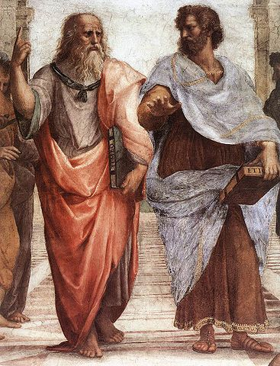
Thank you!
Have a nice evening!

