Slide 2
Το πρόβλημα των πρώτων αρχών
Αριστοτέλης
Στάθης Ψύλλος

Slide 3
Ένα επιχείρημα είναι παραγωγικό όταν με αυτό επιχειρείται να αποδειχθεί ότι το συμπέρασμα έπεται αναγκαστικά από τις προκείμενες.
Με άλλα λόγια, ένα παραγωγικό επιχείρημα στηρίζεται στον ισχυρισμό ότι αν οι προκείμενες του είναι αληθείς, τότε και το συμπέρασμα του είναι επίσης αληθές.

Slide 4
Θα λέμε ότι ένα επιχείρημα είναι παραγωγικά έγκυρο ή λογικά έγκυρο, η απλά έγκυρο αν και μόνο αν είναι αδύνατον όλες οι προκείμενες του να είναι αληθείς και το συμπέρασμα ψευδές.

Slide 5
Η βασική ιδιότητα των λογικά έγκυρων επιχειρημάτων είναι ότι κατά την μετάβαση από τις προκείμενες στο συμπέρασμα διατηρείται η αλήθεια. Αυτό δεν σημαίνει τίποτα άλλο από αυτό που έχουμε ήδη τονίσει: αν οι προκείμενες είναι αληθείς τότε και το συμπέρασμα θα είναι αληθές.
Ωστόσο η θεμελιώδης έννοια της εγκυρότητας δεν συνεπάγεται ότι οι προκείμενες είναι όντως αληθείς.

Slide 6
Το αντίτιμο της εγκυρότητας
Δεν υπάρχει αύξηση του περιεχομένου

Slide 7
Η ιδιότητα της Ορθότητας των επιχειρημάτων: Αν ένα επιχείρημα είναι έγκυρο και όλες του οι προκείμενες είναι αληθείς, τότε το επιχείρημα καλείται ορθό.
ΟΡΘΟ ΕΠΙΧΕΙΡΗΜΑ= ΕΓΚΥΡΟ + ΟΛΕΣ ΟΙ ΠΡΟΚΕΙΜΕΝΕΣ ΑΛΗΘΕΙΣ

Slide 8
Ampliative inference
Inference in which the content of the conclusion of the argument exceeds (and hence amplifies) the content of its premises. A typical case of it is:
‘All observed individuals who have the property A also have the property B; therefore, (probably) All individuals who have the property A also have the property B’.

Slide 9
a1, a2, ..., an are F; therefore All as are F
Or
a1, a2, ..., an are F; therefore an+1 is F
It is non-demonstrative
It is ampliative

Slide 10
Consequently, the rules of ampliative inference do not guarantee that whenever the premises of an argument are true the conclusion will also be true.

Slide 11
Syllogism
a discourse in which certain (specific) things having been supposed, something different from the things supposed results of necessity because these things are so
συλλογισμὸς δέ ἐστι λόγος ἐν ὧι τεθέντων τινῶν ἕτερόν τι τῶν κειμένων ἐξ ἀνάγκης συμβαίνει τῶι ταῦτα εἶναι.

Slide 12
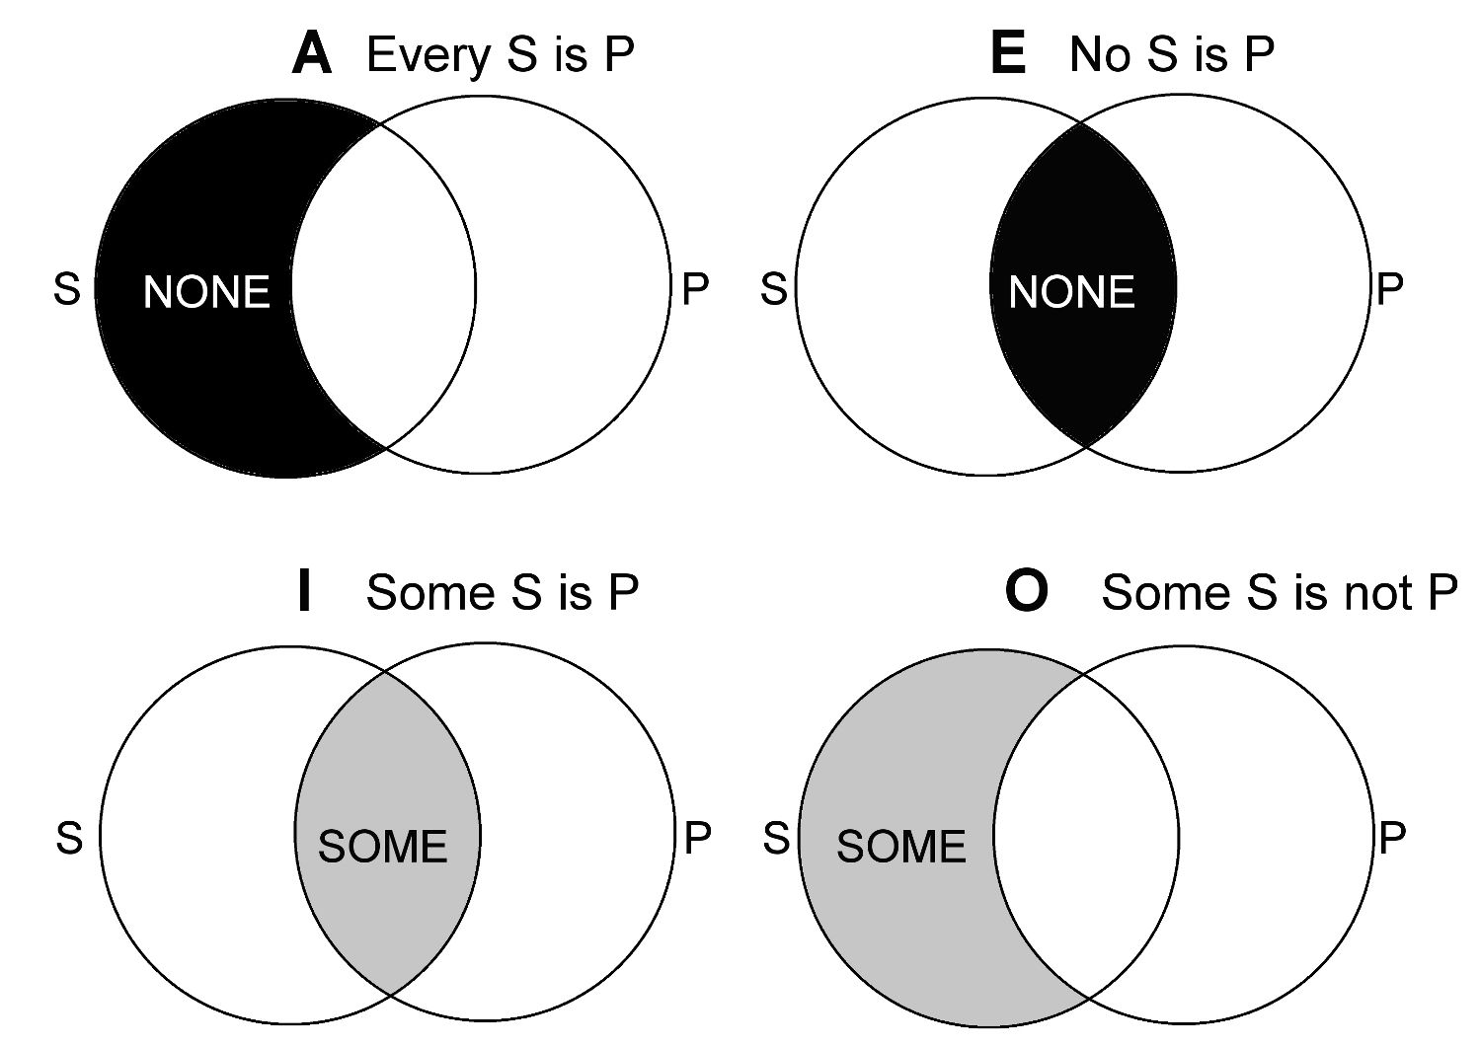

Slide 13
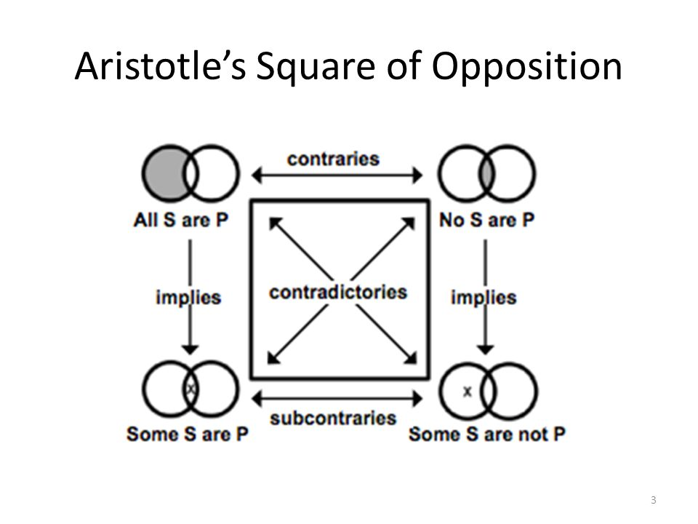

Slide 14
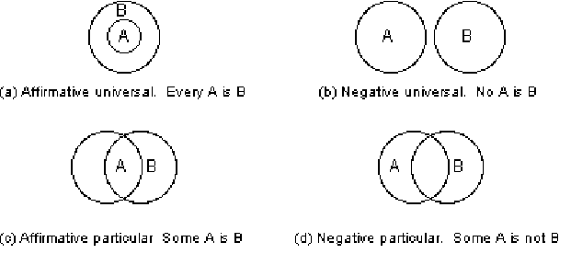

Slide 15
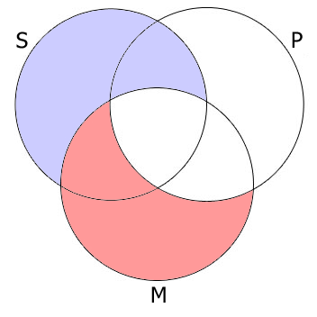
the first, inferring from two universal affirmative propositions a universal affirmative conclusion-
Man is an animal, animal is a substance, man is a substance;
All S are M.
All M are P
Therefore, All S are P.

Slide 16
second, the one inferring from a proposition universally negative toward the major term and one universally affirmative towards the minor, a universally negative conclusion;
All humans are animals
No animal is immortal
Therefore, no human is immortal

Slide 17
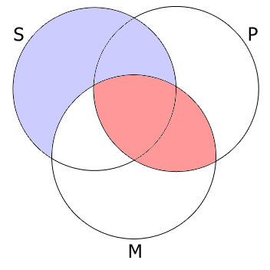
No M are P. All S are M. Therefore, No S are P

Slide 18
the third, one having a particular affirmative conclusion from a universally affirmative major and a particular affirmative minor;
All isosceles triangles have their base angles equal
Some triangles are isosceles
Some triangles have their base angles equal
and last, one inferring from a universally negative and a particular affirmative, a particular negative conclusion;
No painters are sculptors
Some sculptors are artists
Therefore, Some artists are not painters

Slide 19
Episteme: the kind of knowledge that characterises science, is demonstrative and causal knowledge that starts from first principles.
Of these first principles, Aristotle said that they are “true and primitive and immediate and more familiar than and prior to and explanatory of the conclusion” (71b21-23, p.4).

Slide 21
Scientific knowledge is general knowledge; hence it is knowledge of the universals and not knowledge of particulars: a particular object c has property B (or belongs to the kind B) in virtue of the fact that it shares with other particulars attribute A and All As are B.
“Episteme”, then, “is knowledge of the universal” (87b38-39, p.38).

Slide 22
An Aristotelian universal is an one over the many particulars (that is, it is predicated of many particulars), but (unlike Platonic forms) it is not one apart from the many.
It ontologically depends on particulars in that it would not exist if there were no particulars (aka individual substances) (cf. 2b5-7, p.4).

Slide 23
Aristotle stresses repeatedly that the principles of demonstration should be necessary: “Demonstration, therefore, is deduction (syllogism) from what is necessary” (73a24-25). The reason for this is that the object of episteme cannot be otherwise.

Slide 24
1139b19-1139b35 p. 1799
Now what knowledge is, if we are to speak exactly and not follow mere similarities, is plain from what follows. We all suppose that what we know is not capable of being otherwise; of things capable of being otherwise we do not know, when they have passed outside our observation, whether they exist or not. Therefore the object of knowledge is of necessity. Therefore it is eternal; for things that are of necessity in the unqualified sense are all eternal; and things that are eternal are ungenerated and imperishable.

Slide 25
πάντες γὰρ ὑπολαμβάνομεν, ὃ ἐπιστάμεθα, μηδ᾽ ἐνδέχεσθαι ἄλλως ἔχειν: τὰ δ᾽ ἐνδεχόμενα ἄλλως, ὅταν ἔξω τοῦ θεωρεῖν γένηται, λανθάνει εἰ ἔστιν ἢ μή. ἐξ ἀνάγκης ἄρα ἐστὶ τὸ ἐπιστητόν. ἀίδιον ἄρα: τὰ γὰρ ἐξ ἀνάγκης ὄντα ἁπλῶς πάντα ἀίδια, τὰ δ᾽ ἀίδια ἀγένητα καὶ ἄφθαρτα.

Slide 26
Episteme, then, is the kind of causal-explanatory knowledge that starts with non-demonstrable first principles and proceeds by demonstration to account for lesser known phenomena by embedding them in a causal network, thereby unraveling their causes.

Slide 27
To explain this causal account of episteme, Aristotle distinguishes between two accounts of knowing a fact: a causal way and a non-causal way.
The former leads to knowing the reason why something is the case; the latter leads to knowing that something is the case.

Slide 28
Both ways proceed via deductive syllogism, but only the former is episteme because only the former is tied to the knowledge of causes.
The difference between these two types of knowing can be illustrated by contrasting the following two instances of deductive syllogism (cf. 78a28-78b3):

Slide 29
οἷον ὅτι ἐγγὺς οἱ πλάνητες διὰ τοῦ μὴ στίλβειν. ἔστω ἐφ' ᾧ Γ πλάνητες, ἐφ' ᾧ Β τὸ μὴ στίλβειν, ἐφ' ᾧ Α τὸ ἐγγὺς εἶναι. ἀληθὲς δὴ τὸ Β κατὰ τοῦ Γ εἰπεῖν· οἱ γὰρ πλάνητες οὐ στίλβουσιν. ἀλλὰ καὶ τὸ Α κατὰ τοῦ Β· τὸ γὰρ μὴ στίλβον ἐγγύς ἐστι· τοῦτο δ' εἰλήφθω δι' ἐπαγωγῆς ἢ δι' αἰσθήσεως. ἀνάγκη οὖν τὸ Α τῷ Γ ὑπάρχειν, ὥστ' ἀποδέδεικται ὅτι οἱ πλάνητες ἐγγύς εἰσιν. οὗτος οὖν ὁ συλλογισμὸς οὐ τοῦ διότι ἀλλὰ τοῦ ὅτι ἐστίν·
οὐ γὰρ διὰ τὸ μὴ στίλβειν ἐγγύς εἰσιν, ἀλλὰ διὰ τὸ ἐγγὺς εἶναι οὐ στίλβουσιν. ἐγχωρεῖ δὲ καὶ διὰ θατέρου θάτερον δειχθῆναι, καὶ ἔσται τοῦ διότι ἡ ἀπόδειξις, οἷον ἔστω τὸ Γ πλάνητες, ἐφ' ᾧ Β [78b] τὸ ἐγγὺς εἶναι, τὸ Α τὸ μὴ στίλβειν· ὑπάρχει δὴ καὶ τὸ Β τῷ Γ καὶ τὸ Α τῷ Β, ὥστε καὶ τῷ Γ τὸ Α [τὸ μὴ στίλβειν]. καὶ ἔστι τοῦ διότι ὁ συλλογισμός· εἴληπται γὰρ τὸ πρῶτον αἴτιον.

Slide 30
78a30-78a38
E.g. that the planets are near, through their not twinkling: let C be the planets, B not twinkling, A being near. Thus it is true to say B of C; for the planets do not twinkle. But also to say A of B; for what does not twinkle is near (let this be got through induction or through perception). So it is necessary that A belongs to C; so that it has been demonstrated that the planets are near. Now this deduction is not of the reason why but of the fact; for it is not because they do not twinkle that they are near, but because they are near they do not twinkle.
78a39-78b3
But it is also possible for the latter to be proved through the former, and the demonstration will be of the reason why—e.g. let C be the planets, B being near, A not twinkling. Thus B belongs to C and A to B; so that A belongs to C. And the deduction is of the reason why; for the primitive explanation has been assumed.

Slide 31
(P-F): Planets do not twinkle; what does not twinkle is near; therefore, planets are near.
(P-R): Planets are near; what is near does not twinkle; therefore, planets do not twinkle.

Slide 32
The difference between them lies in the “middle term”. In (P-R), but not in (P-R), the middle term states a cause. As Aristotle says: “The middle term is the cause, and in all cases it is the cause that is being sought” (90a5-10, p.42).

Slide 33
(Α): Οι πλανήτες δεν ακτινοβολούν.
Ό,τι δεν ακτινοβολεί είναι κοντά.
Συνεπώς οι πλανήτες είναι κοντά.
(Β): Οι πλανήτες είναι κοντά.
Ό,τι είναι κοντά δεν ακτινοβολεί.
Συνεπώς οι πλανήτες δεν ακτινοβολούν

Slide 34
Ο (Α) αποδεικνύει το γεγονός ότι οι πλανήτες είναι κοντά, αλλά δεν το εξηγεί, επειδή δεν παραθέτει τις αιτίες του. Αντίθετα, ο συλλογισμός (Β) είναι εξηγητικός επειδή δίνει το λόγο (του) γιατί οι πλανήτες δεν ακτινοβολούν: διότι είναι κοντά.

Slide 35
In either case, however, we have a proper syllogism, since the relation between the two extreme terms is proved through the middle, be it the cause or not.
But causal vs non causal explanation

Slide 36
τα εξηγητικά επιχειρήματα -εκτός από το να αποδεικνύουν το γεγονός- θα πρέπει επίσης να εκδηλώνουν μια ασυμμετρία.
Η ασύμμετρη σχέση μεταξύ των αιτιών και των αποτελεσμάτων θα μπορούσε να θεωρηθεί ότι αντανακλάται στην εξηγητική ασυμμετρία μεταξύ των προκειμένων και του συμπεράσματος των εξηγητικών επιχειρημάτων: οι προκείμενες μπορούν να εξηγήσουν το συμπέρασμα αλλά όχι το αντίστροφο.

Slide 37
Η υλική αιτία ενός αγάλματος είναι το υλικό του, η μορφική αιτία του είναι η μορφή ή το σχήμα του, η ποιητική του αιτία είναι ο αγαλματοποιός και η τελική του αιτία είναι ο σκοπός για τον οποίο έγινε το άγαλμα.
Ο Αριστοτέλης είχε την άποψη ότι μία πλήρης αιτιακή εξήγηση πρέπει να αναφέρει και τις τέσσερις αιτίες: η ποιητική αιτία είναι ο ενεργός παράγων που δίνει μορφή (τυπική αιτία) στην ύλη (υλική αιτία) για ένα σκοπό (τελική αιτία)².

Slide 38
So, episteme for Aristotle is based on true, indemonstrable first principles which are general and necessary.
Demonstration, Aristotle says, is a deduction (syllogism) “which depends on necessities” (74b15-16). How are these principles known?

Slide 39
Induction in Aristotle
(PostAn B.19) the problem of first principles

Slide 40
There are two possible answers to the question that Aristotle wants to block rightaway.

Slide 41
The first is that the knowledge of first principles is demonstrative; that is that first principles are known on the basis of prior demonstration (e.g., they are derived from other known propositions). This kind of answer is a non-starter, as it would lead to an infinite regress.
If principle P is demonstrable, then there is another principle P’ from which it follows. But if P’ is demonstrable too, there is yet another principle P’’ from which P’ follows and so on ad infinitum.

Slide 42
The other answer is that the knowledge of first principles is in us.
There are two options here.
The states we are in when we know first principles are in us “without being noticed” (99b25-26). Or the relevant states are acquired. If they were in us but unnoticed, we would possess pieces of knowledge more exact than demonstrative knowledge without noticing them, which is “absurd”.

Slide 43
. But suppose we acquired these states of knowledge (which are the foundations of all demonstrative knowledge). How could we come to know them except by relying on pre-existing knowledge?
Aristotle concludes that it is impossible “both for us to have them and for them to come about in us when we are ignorant and have no such state at all” (99b30-32).

Slide 44
If these two options are blocked, what remains?
The third option is that the knowledge of first principles is from experience.

Slide 45
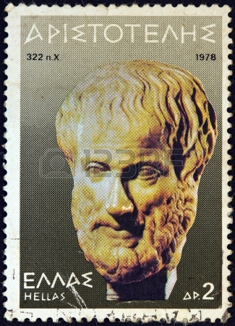
Aristotle
First Principles
Deduction
Induction
Less fundamental Principles
Experience

Slide 46
Now induction is of first principles and of the universal and deduction proceeds from universals. There are therefore principles from which deduction proceeds, which are not reached by deduction; it is therefore by induction that they are acquired. Knowledge, then, is a state of capacity to demonstrate, and has the other limiting characteristics which we specify in the Analytics; for it is when a man believes in a certain way and the principles are known to him that he has knowledge, since if they are not better known to him than the conclusion, he will have his knowledge only incidentally.
ἣ μὲν γὰρ δι' ἐπαγωγῆς, ἣ δὲ συλλογισμῷ. ἡ μὲν δὴ ἐπαγωγὴ ἀρχή ἐστι καὶ τοῦ καθόλου, ὁ δὲ συλλογισμὸς ἐκ τῶν καθόλου. εἰσὶν [30] ἄρα ἀρχαὶ ἐξ ὧν ὁ συλλογισμός, ὧν οὐκ ἔστι συλλογισμός· ἐπαγωγὴ ἄρα. ἡ μὲν ἄρα ἐπιστήμη ἐστὶν ἕξις ἀποδεικτική, καὶ ὅσα ἄλλα προσδιοριζόμεθα ἐν τοῖς ἀναλυτικοῖς· ὅταν γάρ πως πιστεύῃ καὶ γνώριμοι αὐτῷ ὦσιν αἱ ἀρχαί, ἐπίσταται· εἰ γὰρ μὴ μᾶλλον τοῦ συμπεράσματος, [35] κατὰ συμβεβηκὸς ἕξει τὴν ἐπιστήμην. περὶ μὲν οὖν ἐπιστήμης διωρίσθω τὸν τρόπον τοῦτον.

Slide 47
Knowing is either by means of deduction (demonstration) or induction.
Deduction proceeds from universals, whereas induction proceeds from particulars.
It is impossible to view (theorisai) universals except through induction.
Knowledge involves universals.
Hence, there is no knowledge without induction.
But, there cannot be induction without sense perception (since induction proceeds from particulars and particulars are apprehended via the senses).
Hence, there is no knowledge without perception.

Slide 48
Τι είναι η επαγωγή;

Slide 49
105a10-105a19 induction is a passage from particulars to universals, e.g. the argument that supposing the skilled pilot is the most effective, and likewise the skilled charioteer, then in general the skilled man is the best at his particular task.
Ἐπαγωγὴ δὲ ἡ ἀπὸ τῶν καθ´ ἕκαστα ἐπὶ τὸ καθόλου ἔφοδος· οἷον εἰ ἔστι κυβερνήτης ὁ ἐπιστάμενος κράτιστος, [105a15] καὶ ἡνίοχος, καὶ ὅλως ἐστὶν ὁ ἐπιστάμενος περὶ ἕκαστον ἄριστος.

Slide 50
the skilled pilot is the best (most effective) pilot;
and the skilled charioteer is the best (most effective) charioteer
then, in general, the skilled person is the best (most effective) at their particular task.

Slide 51
Aa is Ba
Ab is Bb
Then (in general), Ax is Bx.
I use ‘x’ just to stress that the conclusion that holds ‘in general’ is a general proposition: of anyone who is A it is asserted that they are B.
In modern parlance: for all persons (of type) x, if x is A, then x is B—or as Aristotle would put it: B belongs to A. The two universals (being skilled at F; being best at F) are such that they are connected.

Slide 53
100a3-100a9 p. 165
So from perception there comes memory, as we call it, and from memory (when it occurs often in connection with the same thing), experience; for memories that are many in number from a single experience. And from experience, or from the whole universal that has come to rest in the soul (the one apart from the many, whatever is one and the same in all those things), there comes a principle of skill and of understanding—of skill if it deals with how things come about, of understanding if it deals with what is the case.
Ἐκ μὲν οὖν αἰσθήσεως γίνεται μνήμη, ὥσπερ λέγομεν, ἐκ δὲ μνήμης πολλάκις τοῦ αὐτοῦ γινομένης ἐμπειρία· αἱ γὰρ πολλαὶ μνῆμαι τῷ ἀριθμῷ ἐμπειρία μία ἐστίν. ἐκ δ' ἐμπειρίας ἢ ἐκ παντὸς ἠρεμήσαντος τοῦ καθόλου ἐν τῇ ψυχῇ, τοῦ ἑνὸς παρὰ τὰ πολλά, ὃ ἂν ἐν ἅπασιν ἓν ἐνῇ ἐκείνοις τὸ αὐτό, τέχνης ἀρχὴ καὶ ἐπιστήμης, ἐὰν μὲν περὶ γένεσιν, τέχνης, ἐὰν δὲ περὶ τὸ ὄν, ἐπιστήμης.

Slide 54
The five stages are:
(1) perception;
(2) memory;
(3) experience;
(4) reaching the level of universals (the universal coming to rest in the soul);
(5) the knowledge of first principles.

Slide 55
100a10-100a14 p. 166
Thus the states neither belong in us in a determinate form, nor come about from other states that are more cognitive; but they come about from perception—as in a battle when a rout occurs, if one man makes a stand another does and then another, until a position of strength is reached. And the soul is such as to be capable of undergoing this.
οὔτε δὴ ἐνυπάρχουσιν ἀφωρισμέναι αἱ ἕξεις, οὔτ' ἀπ' ἄλλων ἕξεων γίνονται γνωστικωτέρων, ἀλλ' ἀπὸ αἰσθήσεως, οἷον ἐν μάχῃ τροπῆς γενομένης ἑνὸς στάντος ἕτερος ἔστη, εἶθ' ἕτερος, ἕως ἐπὶ ἀρχὴν ἦλθεν. ἡ δὲ ψυχὴ ὑπάρχει τοιαύτη οὖσα οἵα δύνασθαι πάσχειν τοῦτο. ὃ δ' ἐλέχθη μὲν πάλαι, οὐ σαφῶς δὲ ἐλέχθη, πάλιν εἴπωμεν.

Slide 57
From the states (hexeis) of intellect (διάνοια) by which we grasp truth, some admit falsehood (opinion and calculation) while others are always true.
The latter are episteme and nous.
No kind other than nous is more precise than episteme.
The principles of demonstrations are more known (than the conclusions)
All episteme involves reason (λόγος)
It follows that there will not be episteme of the principles.
And since it is not possible for anything to be truer than episteme, except nous
It follows that there will be nous of the principles.

Slide 58
There is a tendency among commentators to take nous to be a faculty by virtue of which the mind (intellect) immediately and intuitively grasps the first principles. It’s actually fairly standard to translate nous as “intuition” or “rational insight”.
Given that Aristotle insists that first principles are arrived at (and known) by induction, the thought is that induction requires, and is impotent without, supplementation by rational insight or intuitive knowledge.

Slide 59
Hence, it is thought that the knowledge of first principles is based on a two-tier process, the first tier of which is experience (stages 1 to 3 above) and the second tier is rational insight or intuition (stages 4 and 5 above).
Alternatively, it may be thought that induction is “intuitive” or “noetic”.

Slide 60
there is no need to think of Aristotle as introducing either a non-inductive, that is intuitive, stage in the knowledge of first principles or that he takes it that induction is noetic or intuitive simpliciter.

Slide 61
‘nous’
Nous is to induction what episteme is to deduction. First principles become known via induction, and the “state which gets to know them” is nous: “it is by induction that we get to know the first principles, since this is the way perception instils universals” (100b3-4). But nous (in the technical sense of the world) is one thing, and episteme is another.

Slide 62
A two-tier account of scientific knowledge
Hence, Aristotle puts forward a two-tier account of scientific knowledge:
once the first principles are in place, demonstration rules;
but the first principles themselves are known via induction.
Induction is non-demonstrative; it yields non-demonstrative knowledge of truths

Slide 63
“Now induction is of first principles and of the universal and deduction proceeds from universals. There are therefore principles from which deduction proceeds, which are not reached by deduction; it is therefore by induction that they are acquired”.
ἣ μὲν γὰρ δι' ἐπαγωγῆς, ἣ δὲ συλλογισμῷ. ἡ μὲν δὴ ἐπαγωγὴ ἀρχή ἐστι καὶ τοῦ καθόλου, ὁ δὲ συλλογισμὸς ἐκ τῶν καθόλου. εἰσὶν [30] ἄρα ἀρχαὶ ἐξ ὧν ὁ συλλογισμός, ὧν οὐκ ἔστι συλλογισμός· ἐπαγωγὴ ἄρα.

Slide 64
first principles are known,
induction is not in any way inferior to deduction when it comes to knowledge; it just leads to a different kind of (non-demonstrative) knowledge, captured by the technical word ‘nous’.

Slide 65
Induction is required to arrive at indemonstrable first principles
Induction proceeds from particulars to the universals
Induction leads to principles that are necessary and universal (and known to be true)—the principles of Demonstration
Induction does not require complete enumeration
Induction delivers its goods, since we do have knowledge.

Slide 66
A standard objection
How many times are enough for the generalisation of a form All As are B to be accepted? (Galen ME 6; 94-95)
The typical dogmatist argument was this.
One instance of an A being B is not enough for the claim that All As are B.
Suppose that n instances are enough.
Suppose further that you have seen n-1 instances and you are about to see the nth.
Then, in moving from the n-1th instance to the nth, one instance is enough for the general claim All As are B.
This is a contradiction!

Slide 67
Induction: reliance on experience of similarity of instances, which however need not be exhaustive and complete.
It yields general and necessary truths based on experience.
Ampliative reasoning—how can this be?

Slide 68
Sextus

Slide 69
The basic dilemma
Induction is either imperfect and ‘infirm’ or perfect (incomplete) and impossible
We arrive, by induction, at the universal by surveying particulars.
Some particulars? We cannot exclude possible exceptions among the non-surveyed
All particulars? Impossible to survey them all
In either case, induction totters.

