Slide 1
Πιθανότητες και Επικύρωση

Slide 2
H αρχή της επαγωγής κατά Russell
if A has been found very often accompanied or followed by B, and no instance is known of A not being accompanied or followed by B, then it is probable that on the next occasion on which A is observed it will be accompanied or followed by B’.

Slide 3
Τι είναι οι πιθανότητες;

Slide 4
Bayes’s Theorem

Slide 5
Laplace on probability and induction
“Probability is relative, in part to this ignorance, in part to our knowledge. We know that of three or a greater number of events a single one ought to occur; but nothing induces us to believe that one of them will occur rather than the others. In this state of indecision, it is impossible for us to announce their occurrence with certainty. It is, however, probable that one of these events, chosen at will, will not occur because we see several cases equally possible which exclude its occurrence, while only a single one favors it.” (1814: 6)
First Principle.—The first of these principles is the definition itself of probability, which, as has been seen, is the ratio of the number of favorable cases to that of all the cases possible. (1814: 11)
The Rule of Succession: “… an event having occurred successively any number of times, the probability that it will happen again the next time is equal to this number increased by unity divided by the same number, increased by two units.” (1814: 19)
$$\frac{N+1}{N+2}$$

Slide 6
Probabilities as Frequencies
Ellis, Venn, von Mises, Reichenbach
Probability theory deals with repetitive events - ‘same event that repeats itself again and again’ - and the mass phenomena - ‘a great number of uniform elements … [occurring] at the same time’ (1928: 11).
Probability is defined in terms of a collective: “a sequence of uniform events or processes which differ by certain observable attributes, say colors, numbers or anything else” (1928:12).
Law of Stability of Statistical Frequencies: the relative frequencies of certain attributes become more and more stable as the number of observations is increased. (von Mises 1928: 12)
Principle of Randomness: … if we calculate the relative frequency of some attribute not in the original sequence, but in a partial set, selected according to some fixed rule, then we require that the relative frequency so calculated should tend to the same limit as it does in the original set… (von Mises 1957: 29)

Slide 7
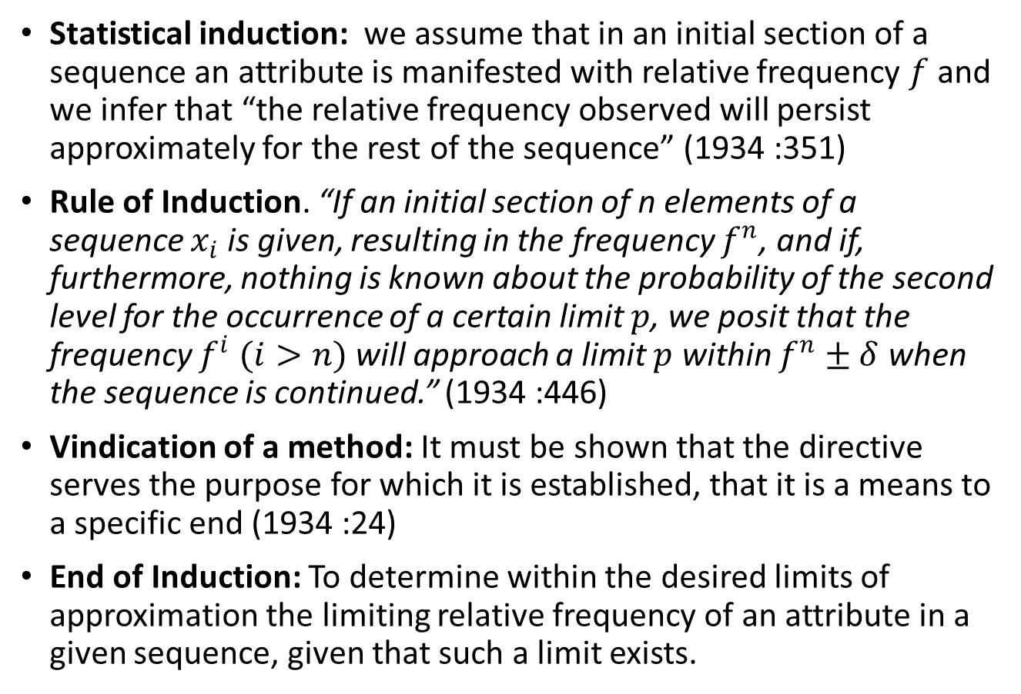
Reichenbach on Induction
Statistical induction: we assume that in an initial section of a sequence an attribute is manifested with relative frequency $f$ and we infer that “the relative frequency observed will persist approximately for the rest of the sequence” (1934 :351)
Rule of Induction. “If an initial section of n elements of a sequence $x_{i}$ is given, resulting in the frequency $f^{n}$, and if, furthermore, nothing is known about the probability of the second level for the occurrence of a certain limit $p$, we posit that the frequency $f^{i} (i>n)$ will approach a limit $p$ within $f^{n}±δ$ when the sequence is continued.” (1934 :446)
Vindication of a method: It must be shown that the directive serves the purpose for which it is established, that it is a means to a specific end (1934 :24)
End of Induction: To determine within the desired limits of approximation the limiting relative frequency of an attribute in a given sequence, given that such a limit exists.

Slide 8
Reichenbach on Induction
Thesis θ. The rule of induction is justified as an instrument of positing because it is a method of which we know that if it is possible to make statements about the future we shall find them by means of this method. (1934 :475)
 | Sequence has a limit | Sequence has no limit
induction is used | Success | Failure
induction is not used | Success or Failure | Failure

Slide 9
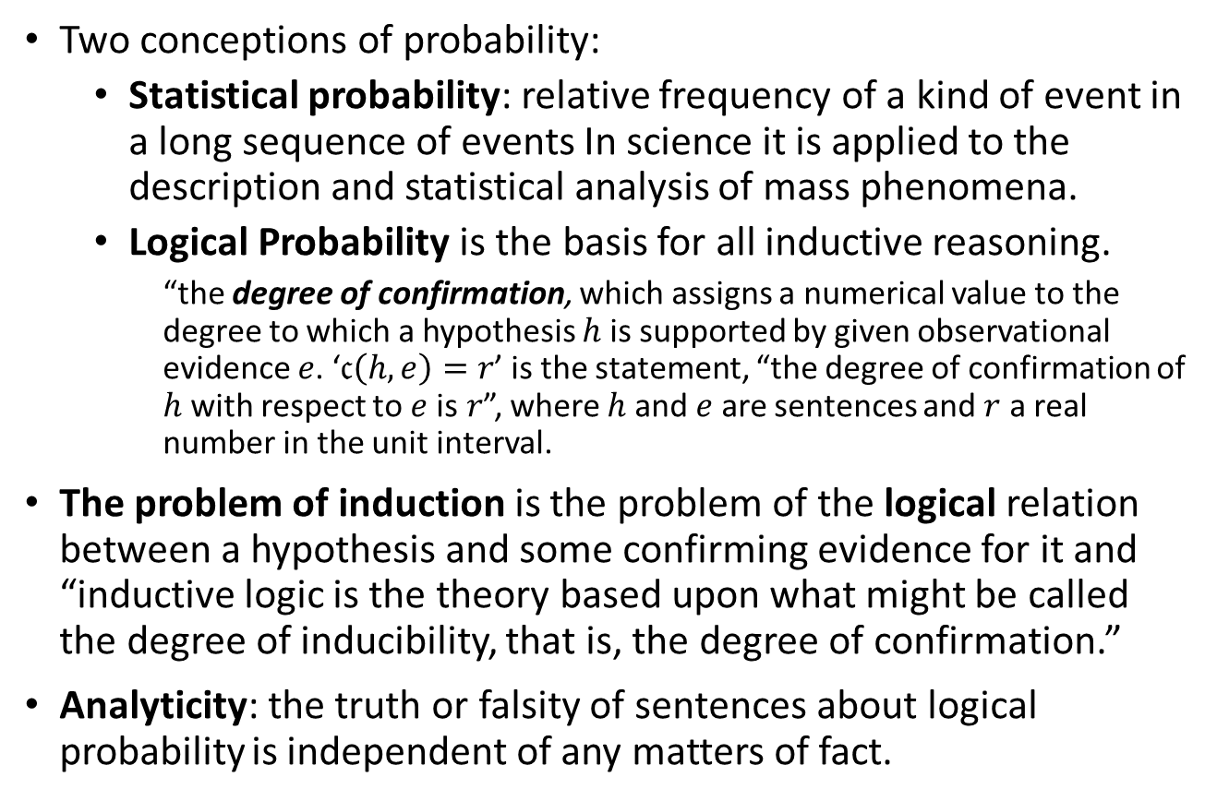
Carnap’s Inductive Logic
Two conceptions of probability:
Statistical probability: relative frequency of a kind of event in a long sequence of events In science it is applied to the description and statistical analysis of mass phenomena.
Logical Probability is the basis for all inductive reasoning.
“the degree of confirmation, which assigns a numerical value to the degree to which a hypothesis $h$ is supported by given observational evidence $e$. ‘$𝔠\left(h,e\right)=r$’ is the statement, “the degree of confirmation of $h$ with respect to $e$ is$r$”, where $h$ and $e$ are sentences and $r$ a real number in the unit interval.
The problem of induction is the problem of the logical relation between a hypothesis and some confirming evidence for it and “inductive logic is the theory based upon what might be called the degree of inducibility, that is, the degree of confirmation.”
Analyticity: the truth or falsity of sentences about logical probability is independent of any matters of fact.

Slide 10
State Description = a class of sentences which describe completely a possible state of the domain of individuals of L (i.e., a possible complete state of affairs) with respect to all the attributes (i.e., properties and relations). It consists of the conjunction of either i or -i but not both of them, of each atomic sentence i in the system L.
Example
Imagine a language with three individual constants and one predicate F. The 8 state
descriptions are:
D1. Fa1 & Fa2 & Fa3
D2. Fa1 & Fa2 & -Fa3
D3. Fa1 & -Fa2 & Fa3
D4. Fa1 & -Fa2 & -Fa3
D5. -Fa1 & Fa2 & Fa3
D6. -Fa1 & Fa2 & -Fa3
D7. -Fa1 & -Fa2 & Fa3
D8. -F a1 & -Fa2 & -Fa3

Slide 11
Range of a sentence = the class of those state descriptions in which the sentence holds true.
Example: the range of Fa1 is the set {D1, D2, D3, D4}
The range of Fa1∨ Fa2 is the set {D1, D2, D3, D4, D5, D6}
The range of Fa1& Fa3 is {D1, D2}

Slide 12
Structure Description corresponding to a class of state descriptions = the disjunction of all the isomorphic state descriptions. Two isomorphic state descriptions have the same structure. Simply put, a structure description is the disjunction of all state descriptions with the same number of unnegated predicates.

Slide 13
In the example above there are 4 structure-descriptions:
D1, D8, (D2∨D3∨D5), (D4∨D6∨D7)
In practice, this means that state descriptions that differ only in the names of individuals involved in them have the same structure. In words, these four structure descriptions state:
‘Everything is F’;
‘Everything is –F’
‘Two Fs, one –F’
‘One F, two –Fs’

Slide 14
The c-function is defined as follows: c(h/e) = m(e&h)/m(e).
m(e) designates a measure assigned to the range of evidence e, i.e., the class of those state descriptions in which e holds.
m(e&h) stands for a measure assigned to the intersection of the ranges R(h) and R(e), viz., R(h&e). In inductive logic, a part of R(e) is contained in R(h).
The degree of confirmation function aims to calculate the degree to which R(e) is contained in R(h); in other words, it aims to calculate the degree that the evidence e (partially) entails the hypothesis h.

Slide 15
The c+-function
How it is constructed? According to Carnap, it might be taken to be plausible to assign equal prior probabilities to the set of state descriptions in a language L. Hence, if B is the set of them, and b one of them, m+(b)=1/@, where @ is the number of them.
c+(h/e)= m+(e&h)/m+(e) = (1/2n+1)/ 2/2n+1=1/2=m+(h)
BUT
The evidence adds nothing to the probability of the hypothesis h. Its degree of confirmation c+ remains the same, no matter whether one hundred or fifty or even zero observations of individuals being F have preceded. Therefore c+ is a strongly counter- inductive function.

Slide 16
The c*-function
c*(h/e)= r+1/n+2
This result amounts to the Laplace’s rule of succession. If r=n, then c*(h/e)=1.
This rule is strongly inductive, since it tends to unity when r tends to n.
Its main justification comes from the assignment of equal probabilities structure descriptions.

Slide 17
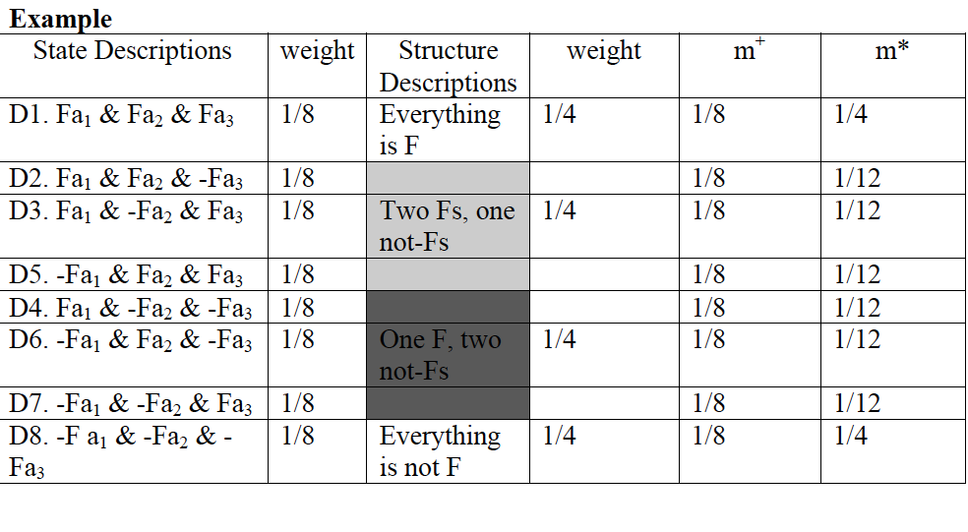

Slide 18
Bayesianism
Probability is the degree of belief of an individual at a given time.
“[t]he subjectivists … maintain that a probability evaluation, being but a measure of someone's beliefs, is not susceptible of being proved or disproved by the facts …” (de Finetti, 1972:21).
To measure beliefs as bases for actions is “to propose a bet and see what are the lowest odds which… [the agent] will accept.” (1926: 172) In a similar vein, de Finetti (1931) characterized probability “the psychological sensation of an individual” and also suggested to use bets to measure degrees of belief.

Slide 19
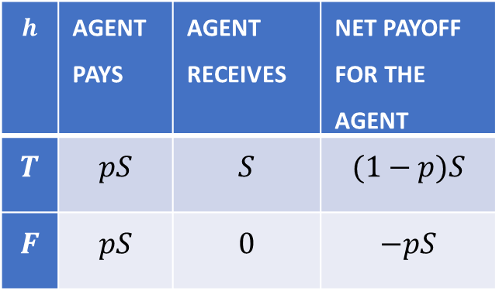
Betting on beliefs
A bet on a hypothesis h, with betting quotient p, at stake S, bet(h,p,S), is defined by the following conditions: (a) if hypothesis h is true, the punter wins (1-p)S; (b) ) if hypothesis h is false, the punter loses pS, where p is any real number in the unit interval and S any sum of money.
Now, we may define the degree of belief of an individual X in a hypothesis h as the price $p which is (i) the highest price X is willing to buy a bet that returns $1 if h is true, and $0 if h is false, and, (ii) the lowest price, X is willing to sell that same bet.
A betting situation with guaranteed loss independently of the truth or the falsity of that belief. Such an unwelcome bet or set of bets which “will with certainty result in a loss” (de Finetti, 1974: 87) for the agent is called Dutch book.
$$h$$ | Agent pays | Agent receives | Net payoff for the agent
$$T$$ | $$pS$$ | $$S$$ | $$(1−p)S$$
$$F$$ | $$pS$$ | $$0$$ | $$−pS$$

Slide 20
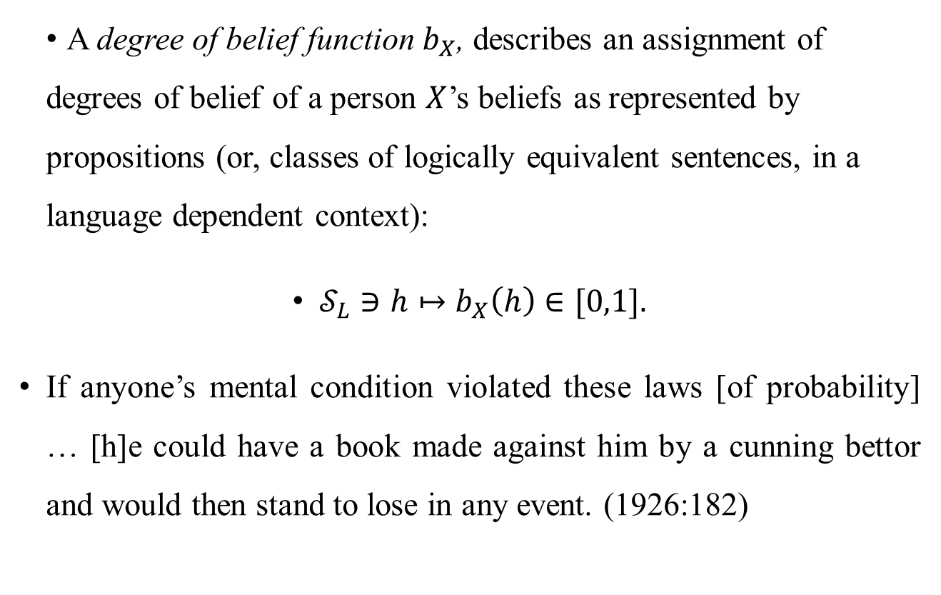
Coherence
A degree of belief function $b_{X}$, describes an assignment of degrees of belief of a person $X$’s beliefs as represented by propositions (or, classes of logically equivalent sentences, in a language dependent context):
$𝒮_{L}∋h↦b_{X}\left(h\right)∈[0,1].$
If anyone’s mental condition violated these laws [of probability] … [h]e could have a book made against him by a cunning bettor and would then stand to lose in any event. (1926:182)

Slide 21
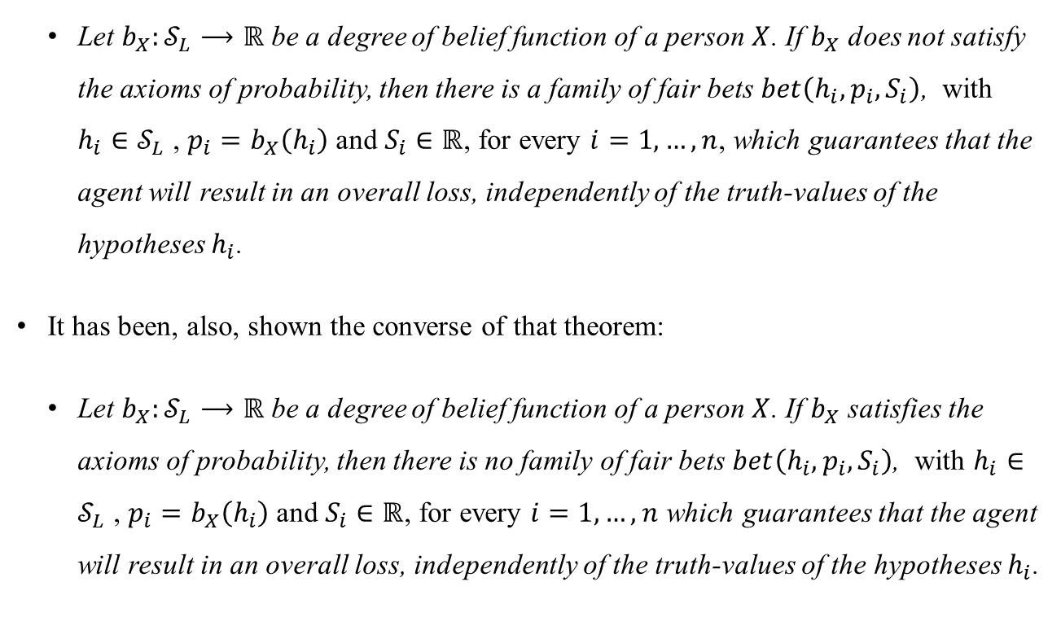
Ramsey – de Finetti or Dutch-Book theorem
Let $b_{X}:𝒮_{L}⟶ℝ$ be a degree of belief function of a person $X$. If $b_{X}$ does not satisfy the axioms of probability, then there is a family of fair bets $bet\left(h_{i},p_{i},S_{i}\right)$, with $h_{i}∈𝒮_{L}$ , $p_{i}=b_{X}\left(h_{i}\right)$ and $S_{i}∈ℝ$, for every $i=1,…,n$, which guarantees that the agent will result in an overall loss, independently of the truth-values of the hypotheses $h_{i}$.
It has been, also, shown the converse of that theorem:
Let $b_{X}:𝒮_{L}⟶ℝ$ be a degree of belief function of a person $X$. If $b_{X}$ satisfies the axioms of probability, then there is no family of fair bets $bet\left(h_{i},p_{i},S_{i}\right)$, with $h_{i}∈𝒮_{L}$ , $p_{i}=b_{X}\left(h_{i}\right)$ and $S_{i}∈ℝ$, for every $i=1,…,n$ which guarantees that the agent will result in an overall loss, independently of the truth-values of the hypotheses $h_{i}$.

Slide 22
Illustration of the R-dF thm
The degree of belief $p$ of an individual $X$ in a hypothesis $h$ is confined within the unit interval.
Assume, first, that $p<0$ and consider the agent selling a bet to the bookie that pays $\$1$ if $h$ is true, and $\$0$ if $h$ is false, for $\$p$. Independently of the truth-value of $h$, this bet is a loss for the agent: the agent has a net gain of $\$\left(−1+p\right)<0$ in case $h$ is true and $\$p<0$ in case $h$ is false.
In a similar vein, if $p>1$, an agent buying a bet from the bookie that pays $\$1$ if $h$ is true, and $\$0$ if $h$ is false, for $\$p$, gains $\$\left(1−p\right)<0$ if $h$ is true, and $\$−p<0$ if $h$ is false, and the bet is, again, a loss for the agent. Hence, if an agent assigns to any of their beliefs degrees that are either negative or greater than 1, they are exposed to a betting situation with guaranteed loss independently of the truth or the falsity of that belief.

Slide 23
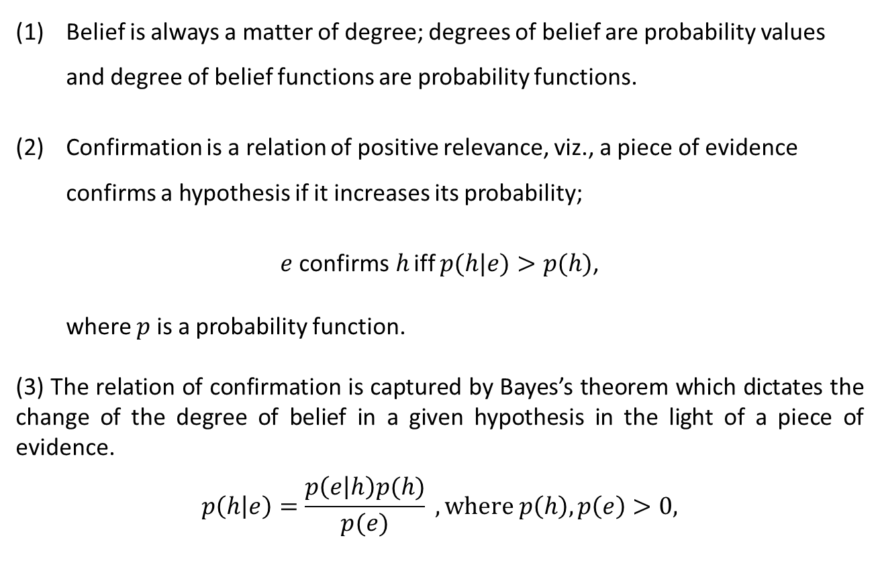
Bayesian theories of confirmation
Belief is always a matter of degree; degrees of belief are probability values and degree of belief functions are probability functions.
Confirmation is a relation of positive relevance, viz., a piece of evidence confirms a hypothesis if it increases its probability;
$e$ confirms$h$ iff $p(h|e)>p(h)$,
where $p$ is a probability function.
(3) The relation of confirmation is captured by Bayes’s theorem which dictates the change of the degree of belief in a given hypothesis in the light of a piece of evidence.
$$p\left(h | e\right)=\frac{p\left(e | h\right)p(h)}{p(e)} , where p\left(h\right),p\left(e\right)>0,$$

Slide 24
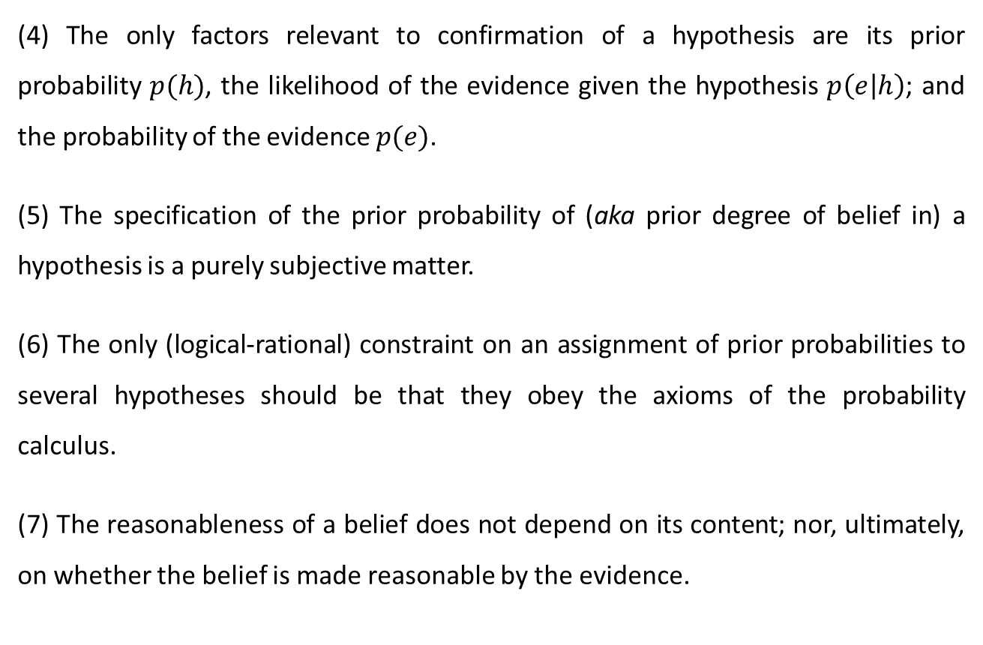
Bayesian theories of confirmation
(4) The only factors relevant to confirmation of a hypothesis are its prior probability $p(h)$, the likelihood of the evidence given the hypothesis $p\left(e | h\right)$; and the probability of the evidence $p(e)$.
(5) The specification of the prior probability of (aka prior degree of belief in) a hypothesis is a purely subjective matter.
(6) The only (logical-rational) constraint on an assignment of prior probabilities to several hypotheses should be that they obey the axioms of the probability calculus.
(7) The reasonableness of a belief does not depend on its content; nor, ultimately, on whether the belief is made reasonable by the evidence.

Slide 25
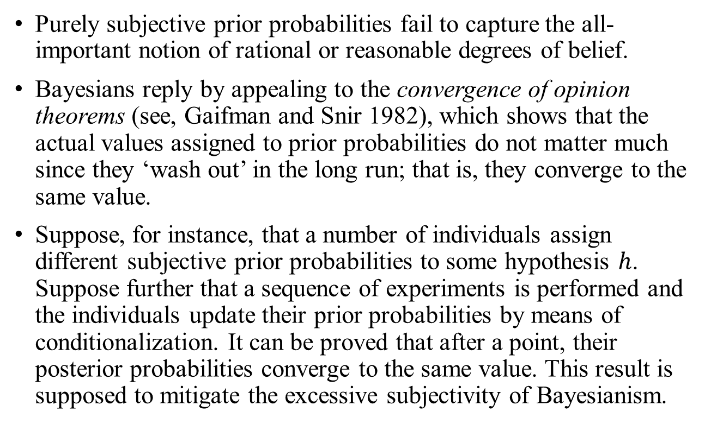
Too subjective?
Purely subjective prior probabilities fail to capture the all-important notion of rational or reasonable degrees of belief.
Bayesians reply by appealing to the convergence of opinion theorems (see, Gaifman and Snir 1982), which shows that the actual values assigned to prior probabilities do not matter much since they ‘wash out’ in the long run; that is, they converge to the same value.
Suppose, for instance, that a number of individuals assign different subjective prior probabilities to some hypothesis $h$. Suppose further that a sequence of experiments is performed and the individuals update their prior probabilities by means of conditionalization. It can be proved that after a point, their posterior probabilities converge to the same value. This result is supposed to mitigate the excessive subjectivity of Bayesianism.

