Slide 1
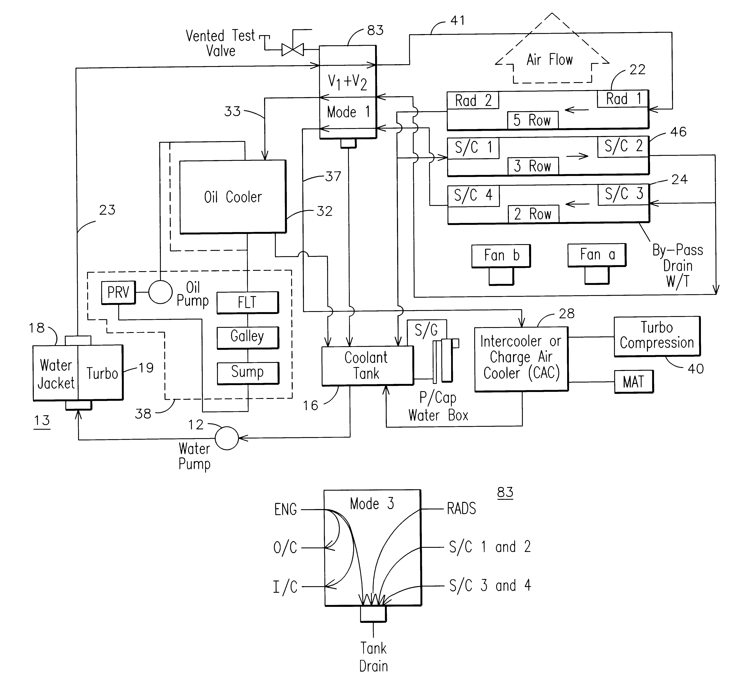
Flow control

Slide 2
Conditionals (& the 2 brothers problem)

Slide 3
Conditionals
if condition
do this stuff
end
if condition
do this stuff
else
do this stuff
end
if condition
do this stuff
elseif condition
do this stuff
else
do this stuff
end

Slide 4
Conditionals
if condition
do this stuff
end
condition should evaluate to logical true or false. examples:
x > 5
y == 5
x<3 & y>=7
strcmp(subject,’S01’)

Slide 5
Flow Control (IF statement)
d=10
d=10;
if d<5
'less than 5'
else
'not less than 5'
end
True?
no
Skip to here
output?
end

Slide 6
Flow Control (IF statement)
The if statement evaluates a logical expression and executes a group of statements when the expression is TRUE. The optional elseif and else keywords provide for the execution of alternate groups of statements. An end keyword, terminates the last group of statements
Example: for different values of A
If (A > B) % Test for condition A > B
disp('A is greater than B'); % disp writes string argument to screen
elseif (A < B) % Test for condition A < B
disp('A is less than B');
elseif (A == B) % Note that == means test for equality
disp('A and B are equal');
else
disp('Rather unexpected situation.... ')
end
The if statement evaluates a logical expression and executes a group of statements when the expression is TRUE. The optional elseif and else keywords provide for the execution of alternate groups of statements. An end keyword, terminates the last group of statements
Example: for different values of A
If (A > B) % Test for condition A > B
disp('A is greater than B'); % disp writes string argument to screen
elseif (A < B) % Test for condition A < B
disp('A is less than B');
elseif (A == B) % Note that == means test for equality
disp('A and B are equal');
else
disp('Rather unexpected situation.... ')
end

Slide 7
function isItBigger(x,y)
% will decide if x is bigger than y
if x > y
fprintf('Yes, x is bigger than y.\n');
else
fprintf('No, x is not bigger than y.\n');
end
>> isItBigger(3,4)
No, x is not bigger than y.
>> isItBigger(8,4)
Yes, x is bigger than y.
function isItNine(x)
% will decide if x is equal to 9
if x = 9
fprintf(’It is nine!\n');
else
fprintf('No, its not nine.\n');
end
function isItNine(x)
% will decide if x is equal to 9
if x == 9
fprintf(’It is nine!\n');
else
fprintf('No, its not nine.\n');
end

Slide 8
Nested conditionals
function fruit = pickAFruit(color,size)
% choose a fruit based on color and size
% color is a string, and size is a double representing weight in grams
if strcmp(color,’red’)
if size < 10
fruit = ‘apple’;
else
fruit = ‘watermelon’;
end
elseif strcmp(color,’yellow’)
fruit = ‘banana’;
else
fruit = ‘unknown’;
end

Slide 9
Switch and Case Statements
The switch statement executes one of a group of case statements, based on whether the value of a variable (logicals included) is the same in both. Only the first match is executed. If no match is found, otherwise is executed.
% In this example, need first to specify a positive integer value for n
switch (rem(n,2)) % use help “rem”
case 0
disp('n is even');
case 1
disp('n is odd')
otherwise
error('This seems hard to believe')
end

Slide 10
Useful videos
https://www.youtube.com/watch?v=rzm_FyZ9SmA (Selection (Branching) in MATLAB - 12min)
https://www.youtube.com/watch?v=rEarTHsM5dY (If-Statement cont'd – 8min)
https://www.youtube.com/watch?v=vJpeMFfwpTM (Nested If-statements – 2min)

