Slide 1
What is Matlab?
“MATLAB® is a high-level language and interactive environment for numerical computation, visualization, and programming. Using MATLAB, you can analyze data, develop algorithms, and create models and applications. The language, tools, and built-in math functions enable you to explore multiple approaches and reach a solution faster than with spreadsheets or traditional programming languages, such as C/C++ or Java™.
You can use MATLAB for a range of applications, including signal processing and communications, image and video processing, control systems, test and measurement, computational finance, and computational biology. More than a million engineers and scientists in industry and academia use MATLAB, the language of technical computing.
The basic data element is the “array”, usually referred to as a vector or matrix

Slide 2
learn how to program because…
Increase your freedom
Increase your scientific value
Enjoyment
Exercise your logical mind

Slide 3
PROGRAMMING == PROBLEM SOLVING
the concept of an ALGORITHM

Slide 4
The process of programming
Programming is not a linear process
Lots of trial and error
Problem solving, detective work, deductive reasoning
Debugging may take longer than initial writing. Enjoy it!

Slide 5
Coding philosophy
There are many different ways to make things work.
The simplest way is usually the most desirable, but:
Top priority is that your script does what you want it to do.
Good coding practices are important
Assume you will remember nothing next time you look at your code
Assume someone else will be using your code
Assume your script will at some point move to another computer

Slide 6
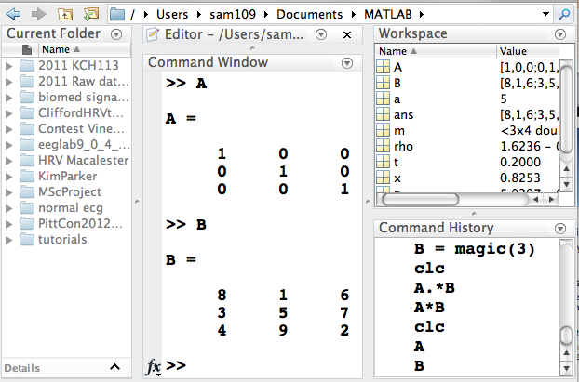
Navigating the Matlab Desktop
Command Window
Where you type the commands into Matlab
Command History
Contains a record of all commands entered in the Command Window
Current Folder Browser
All the contents of the Current Folder where you can save your work
Workspace Browser
Where your data and variables are stored in current Matlab session

Slide 7
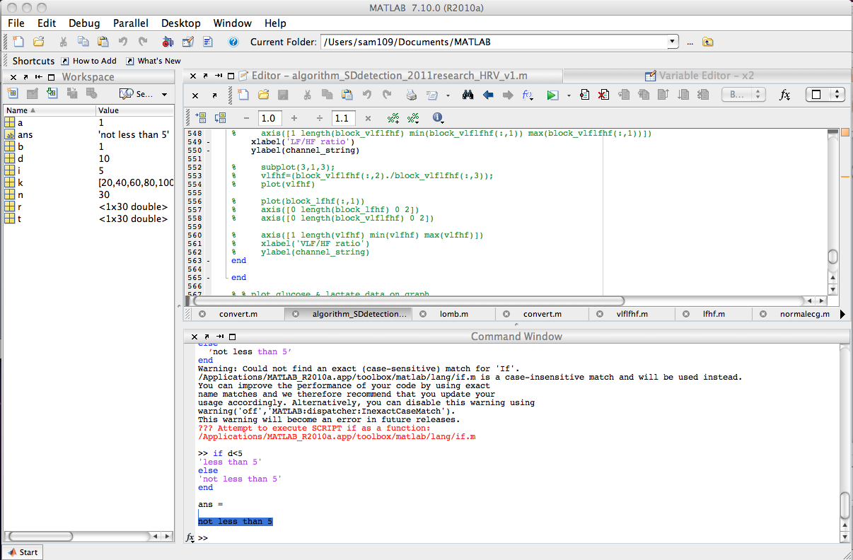
Desktop Layout

Slide 8
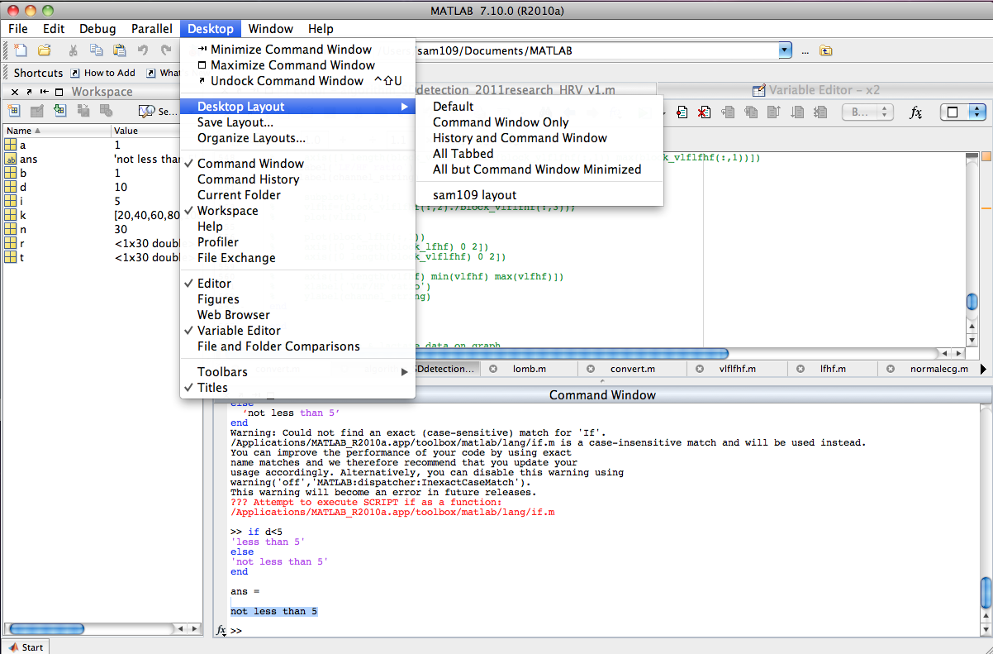
Desktop Layout

Slide 9
The file browser
Moving around through the folder hierarchy
Command line tools for navigation
pwd where are we? cd change directory ls list directory contents . current directory .. parent directory
mkdir make new directory
delete delete file
rmdir delete directory

Slide 10
The workspace and variable editor
settings variables: x = 3
clearing variables: clear x clear all
saving & loading variables: save data load data.mat

Slide 11
Getting help
help function
doc function
lookfor function
>> help sin
sin Sine of argument in radians.
sin(X) is the sine of the elements of X.
See also asin, sind.
Reference page in Help browser
doc sin

Slide 12
Scripts
Anything you type into the workspace can also be run from a script
“.m” files are just saved lists of matlab commands
functions

Slide 13
The Editor
Comments
Syntax highlighting
Code folding

Slide 14
Variable types
Numbers
double: floating point number like 3.24
integer: no decimal places 345

Slide 15
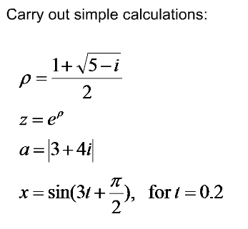
Basic calculations in Matlab
Matlab is a powerful graphical calculator
Functions?
Square root
Exponential
Absolute value
Trigonometry

Slide 16
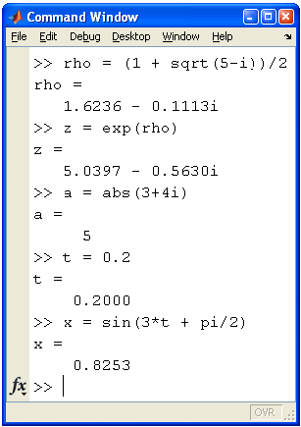
Basic calculations in Matlab

Slide 17
Basic calculations in Matlab
each result is stored in its own variable in the workspace and can be used later in the same session
at any time you can clear (some or all) your variables
if no specific variable name is assigned to the result, the default is ‘ans’

Slide 18
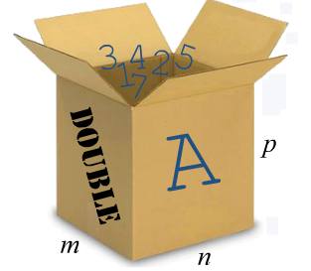
Basic calculations in Matlab
Variables are data containers
All variables are arrays
Scalar (1x1)
Vectors (row or column)
Matrices (m x n)
Default data type is double
double = 8 bytes
16 digits of precision

Slide 19
Basic calculations in Matlab
Creating Variables
salary = 900
Variable name
Assign operator
value
Variables are case sensitive
ie. thisvar and Thisvar and THISVAR are all different
whos = gives a list of the variables in the workspace
Matlab uses the first 31 characters of a variable name only

Slide 20
Basic calculations in Matlab: Variables
Once variables or graphics are created, they remain stored in memory if not explicitly cleared or overwritten.
This is a common source of errors, since old variables may be mixed with new ones.
Clear variables:
clear all % deletes all variables, compiled functions, etc…
clc % clears the Command Window
close all % close all figures

Slide 21
Basic calculations in Matlab: Variables
Syntax errors

Slide 22
Vectors and matrices
Vectors are like lists a = [1,2,3,4,5]
Matrices are like lists of lists a = [ 1,3,5,7; 2,4,6,8 ]
Matrices can have many dimensions

Slide 23
Creating Vectors
Vectors are one dimensional arrays
(either column or row vectors)
m = 1 2 3 4
5 6 7 8
9 10 11 12
Row vector
Column
vector

Slide 24
Creating vectors
>> a = [1 2 3 4 5]
a =
1 2 3 4 5
>> a = [1,2,3,4,5]
a =
1 2 3 4 5
>> a = [1:5]
a =
1 2 3 4 5
>> x = [ 1 2 3 ]; y = [ 4 5 6 ];
>> z = [ x y ]
z =
1 2 3 4 5 6
>> z = [x ; y]; % this is a matrix

Slide 25
Creating Vectors
Also:
>> x = x’ transpose
Example:
>> x=[1:3:13]
>> x = x’
For output not to appear on screen but be stored in the workspace use semicolon:
>> x=[1:3:13];
Can be used to give multiple commands
>> a = 1; b = 2; c = 3;
x = a : dx : b
first number last number
Interval
(default is 1)

Slide 26
Creating vectors
Data can be created in a linear sequence using built in Matlab functions
linspace(x1, x2, N)
This function generates N points linearly between X1 and X2.
For example:
>> a = linspace(1,19,10)
a = 1 3 5 7 9 11 13 15 17 19
If N is not defined it defaults to 100

Slide 27
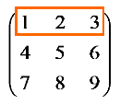
Creating Matrices
Matrices are two dimensional arrays
A couple common ways to create matrices:
Use square brackets when creating arrays

Slide 28
Creating matrices
>> a = [1 2 3; 4 5 6]
a =
1 2 3
4 5 6
>> a = [1 2 3; 4 5 6; 7 8 9]
a =
1 2 3
4 5 6
7 8 9

Slide 29
Creating matrices
>> ones(3)
ans =
1 1 1
1 1 1
1 1 1
>> ones(2,3)
ans =
1 1 1
1 1 1
>> zeros(3,4)
ans =
0 0 0 0
0 0 0 0
0 0 0 0
(rows,columns)

Slide 30
Creating matrices
>> rand(3)
ans =
0.8147 0.9134 0.2785
0.9058 0.6324 0.5469
0.1270 0.0975 0.9575
>> nan(4)
ans =
NaN NaN NaN NaN
NaN NaN NaN NaN
NaN NaN NaN NaN
NaN NaN NaN NaN
NaN = “Not a Number”

Slide 31
Describing matrices
size() will tell you the dimensions of a matrix
length() will tell you the length of a vector

Slide 32
Creating Matrices
Other ways to enter matrices:
Loaded from external data files (check save & load)
Generated using built-in functions
Created with defined functions in M-files

Slide 33
Accessing elements
>> a = [0:4]
a =
0 1 2 3 4
>> a(2)
ans =
1
>> b = [1 2 3;4 5 6;7 8 9]
b =
1 2 3
4 5 6
7 8 9
>> b(2,3)
ans =
6
Also try:
x = [1:0.1:10]

Slide 34
Accessing elements
>> b(1:3,1)
ans =
1
4
7
>> b(1:end,1)
ans =
1
4
7
>> b(1,:)
ans =
1 2 3
>> numel(b)

Slide 35
Accessing elements
>> a = [1:.5:5];
>> a([1 2 4])
ans =
1.0000 1.5000 2.5000
>> indices = [5 6 7];
>> a(indices)
ans =
3.0000 3.5000 4.0000
>> a([5 6 7])
ans =
3.0000 3.5000 4.0000
equivalent

Slide 36
Accessing elements
>> odds = [1:2:100];
>> odds([26:50, 1:25])
ans =
Columns 1 through 14
51 53 55 57 59 61 63 65 67 69 71 73 75 77
Columns 15 through 28
79 81 83 85 87 89 91 93 95 97 99 1 3 5
Columns 29 through 42
7 9 11 13 15 17 19 21 23 25 27 29 31 33
Columns 43 through 50
35 37 39 41 43 45 47 49

Slide 37
Accessing elements
>> [26:50,1:25]
ans =
Columns 1 through 14
26 27 28 29 30 31 32 33 34 35 36 37 38 39
Columns 15 through 28
40 41 42 43 44 45 46 47 48 49 50 1 2 3
Columns 29 through 42
4 5 6 7 8 9 10 11 12 13 14 15 16 17
Columns 43 through 50
18 19 20 21 22 23 24 25

Slide 38
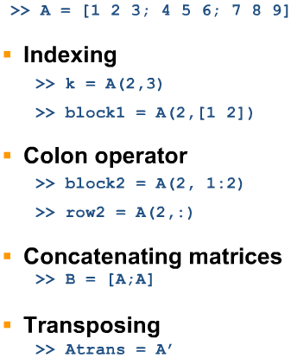
Manipulating arrays

Slide 39
Concatenation & Deleting
Concatenation is the process of joining small matrices to make bigger ones. For example:
B = [A A+32; A+48 A+16]
To set a single element to zero:
A(3,2) = 0 % Note how to address elements!
To delete the third column of B use:
B(:,3) = [ ]
help cat

Slide 40
Vector math
Adding a constant to each element in a vector
Adding two vectors
>> a = [1 2 3]
a =
1 2 3
>> a + 1
ans =
2 3 4
>> b = [5 1 5]
b =
5 1 5
>> a + b
ans =
6 3 8

Slide 41
Vector multiplication
The * sign refers to matrix multiplication:
>> a = [1 2 3]
a =
1 2 3
>> b = [2 2 4]
b =
2 2 4
>> a * b
Error using *
Inner matrix dimensions must agree.
>> b = b'
b =
2
2
4
>> a * b
ans =
18

Slide 42
Vector multiplication
The .* sign refers to element-wise multiplication:
>> a = [1 2 3]
a =
1 2 3
>> b = [2 2 4]
b =
2 2 4
>> a .* b
ans =
2 4 12
>> a * 4
ans =
4 8 12
>> a .* 4
ans =
4 8 12

Slide 43
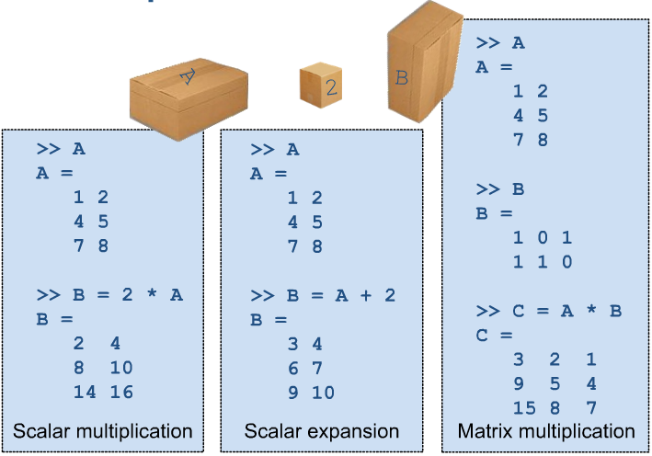
Computing with arrays: Matrix operations
For multiplication, Matlab assumes variables are matrices.
Therefore size limitations apply, ie. inner dimensions must agree
source: The MathWorks Inc

Slide 44
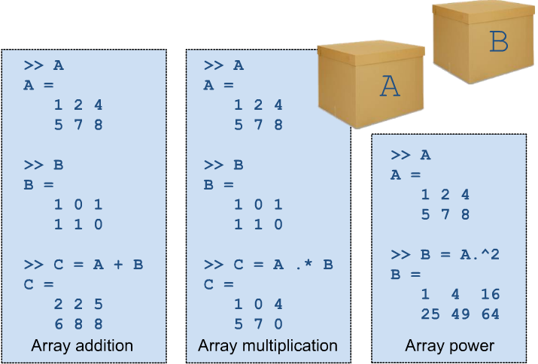
Computing with arrays: Array (or Element) operations
Place a dot(.) before multiplication or powers to perform element-wise operations.
In these cases, matrices must have exact same dimensions.
source: The MathWorks Inc

Slide 45
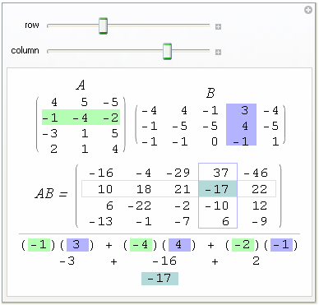

Slide 46
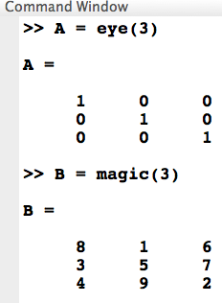
Q&A: Match the expected outcome to the operators used.
? ?
>> A .* B
>> A * B
source: The MathWorks Inc

Slide 47
Multivariate Data
Consider a data set with three variables: Heart rate, Weight and Hours of exercise per week for five observations. The resulting array might look like
D = [ 72 134 3.2;
81 201 3.5;
69 156 7.1;
82 148 2.4;
75 170 1.2 ]
source: HKA & AB slides
Notes:
47

Slide 48
Multivariate Data
Calculate mean and standard deviation for D
mu = mean(D), sigma = std(D)
mu = 75.8 161.8 3.48
sigma = 5.6303 25.499 2.2107
For a list of the data analysis functions available in MATLAB:
>> help datafun
If you have access to the Statistics Toolbox:
>> help stats
source: HKA & AB slides
Notes:
48

Slide 49
Useful videos
https://www.youtube.com/watch?v=VheLmG7rh9w&feature=youtu.be (MATLAB environment 23min)
https://www.youtube.com/watch?v=ZEOubc5i_n8 (MATLAB as a calculator 14min)
https://www.youtube.com/watch?v=Aco4yDvse0I (Syntax and Semantics 5min)
https://www.youtube.com/watch?v=_wxLhQy__6o (the MATLAB help system 8min)
https://www.youtube.com/watch?v=3T4reHaJtXE (Introduction to Matrices and Operators 11min)
https://www.youtube.com/watch?v=i1z3Z0LlPSg (The Colon Operator 8min)
https://www.youtube.com/watch?v=H_DIbljMpZs (Accessing Parts of a Matrix 21min)
https://www.youtube.com/watch?v=EZY53PMmlZA (Combining and Transforming Matrices 10min)

