Slide 3
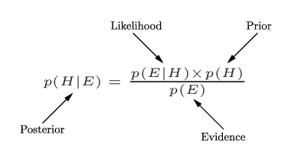
Bayes’ Law/Theorem

Slide 5
<= Wrong!!!

