Slide 1
THE COLOUR CONSTANCY BEHIND THE FLUX
https://www.youtube.com/watch?v=LyOJ8vHsq5I
https://physoc.onlinelibrary.wiley.com/doi/epdf/10.1113/EP089760

Slide 2
Φιλοσοφικό ερώτημα
Ηow do surfaces and objects maintain their (colour) identity in spite of the widely differing contexts in which we view them?
Παραδοσιακές θεωρίες: Οι παραδοσιακές θεωρίες χρωματικής όρασης (τριχρωματική και αντίθετη θεωρία χρώματος) αφορούν περισσότερο τη γενική όραση και όχι συγκεκριμένες για τη σταθερότητα του χρώματος.

Slide 3
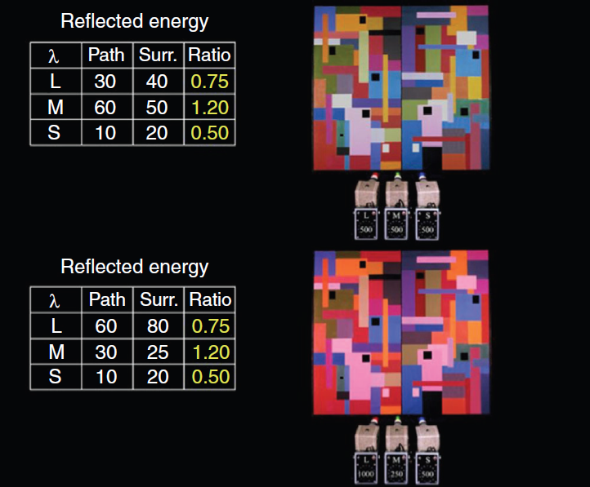
H αντίληψη του χρώματος παραμένει σταθερή παρά τις αλλαγές στη σύνθεση του μήκους κύματος του φωτός
FIGURE 5 The Land retinex experiment. For details see text and Land (1974). During the experiment normal subjects view, successively, different coloured patches of a complex multi-coloured scene (right) illuminated by three projectors, one passing long-wave, anothermiddle-wave and the third short-wave light. Each patch, when looked at (that is, viewed), is made to reflect the identical triplet of energies (see tables to the left). When subjects view different patches successively, each is reported to maintain its colour category despite reflecting the identical wavelength composition of light as patches of another colour,when viewed, reflect. Under these conditions, the ratio of light reflected from the viewed patch and from its surrounds always remains the same (in yellow in the tables). In this figure, the tables to the left give the reflected energies of light of different wavebands reflected from the green rectangle in the lower left (marked with a black spot) for two different viewings. Despite the profound changes in wavelength-energy composition of the light reflected from that rectangle in the two conditions, it is categorized as green, even though its hue changes. Notice that the ratio of light of any waveband reflected from the patch and from its surrounds remains constant throughout (for further details, see text

Slide 4
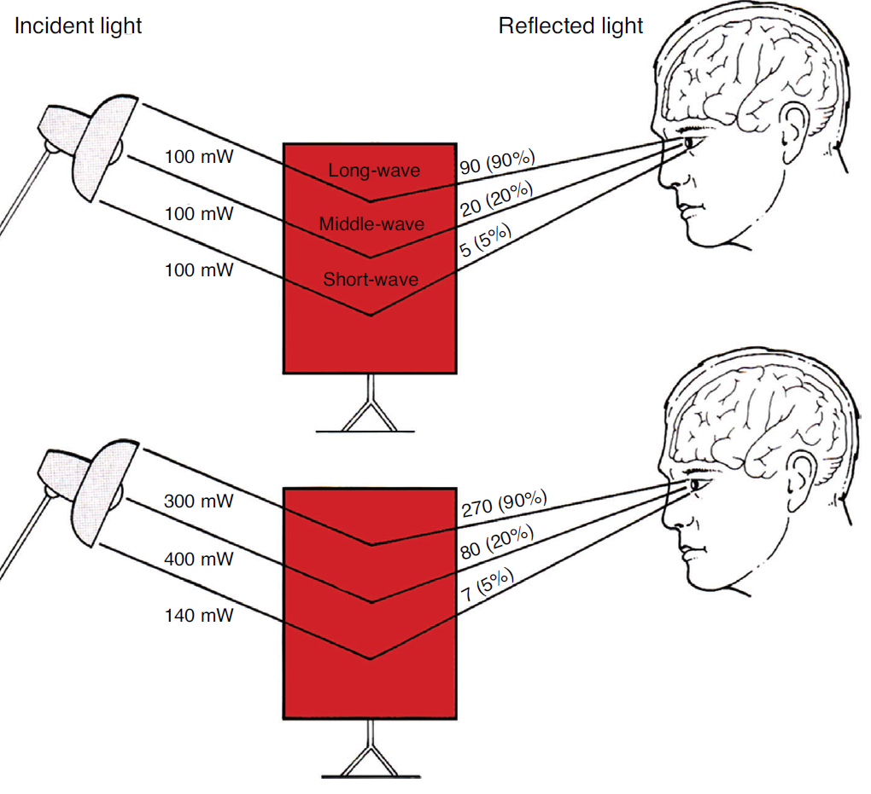
Σταθερή αναλογία φωτός ως προς τη σύνθεση μήκους κύματος-ενέργειας
FIGURE 9 Diagram to illustrate the roots of constant colour categorization in colour vision, namely the reflectance of surfaces. In this figure a human observer views a red patch; in the upper part, the light incident on the patch consists of 100 milliwatts (mW) of each long-, middle- and short-wave light. The surface has a high reflectance for long-wave light, in that it reflects 90% of the long-wave light incident on it; it has a relatively low reflectance for middle- and short-wave light, and reflects 20% and 5%of the amounts of these two wavebands incident on it. Thus the amount of long-, middle- and short-wave light reaching the observers is 90, 20 and 5 milliwatts, respectively. In the lower part, the illuminant has changed so that it is now emitting 300, 400 and 140mWof long-, middle- and short-wave light. Even though the light reaching the eyes of the observer differs from the previous setting, the reflectance of surfaces remains the same and the surface still reflects the same percentage of light as a function of what is incident on it. The reflectance of surrounding surfaces is also constant, and hence the ratio of light in terms of wavelength-energy composition between the viewed patch and its surrounds also remains constant. (From S. Zeki, A Vision of the Brain, Blackwell Scientific, 1993)

Slide 5
The reaction in V1
FIGURE 10 The reaction of a V1 cell with a narrow action spectrum peaking in the long end of the spectrum (see inset above) to different patches of a Mondrian display, when each patch was scaled to occupy the receptive field of the cell but was not isolated from its surrounds. When put in the cell’s receptive field, each patch was made to reflect the identical triplet of energies, namely 60, 30 and 10mWsr−1 m−2 of long-, middle-, and short-wave light, respectively. (From S. Zeki, Neuroscience 1983; 9: 741–765)

Slide 6
The reaction in V4
FIGURE 11 The reaction of a spectrally selective cells in V4 (action spectrum in the inset above) to different patches of a Mondrian display. Each patch was scaled to fit the cell’s receptive field but was not otherwise isolated from the rest of theMondrian display. Each patch, when placed in the cell’s receptive field, was made to reflect 60, 30 and 10mWsr−1 m−2 of long-, middle-, and short-wave light, respectively. (From S. Zeki, Neuroscience 1983; 9: 741–765)

