Slide 1
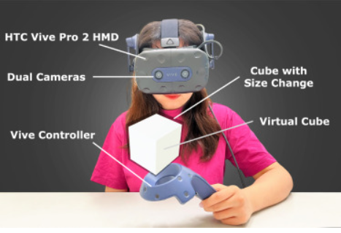
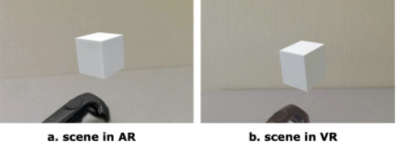
Differences in JND between AR and VR
Ονοματεπώνυμο: Έλενα Μαραγκού
The perception of size in virtual objects in Augmented Reality and Virtual Reality is important the effectiveness of manipulating and interacting with virtual content depends on accuracy of size perception
Does human visual perceptual sensitivity for size differ between AR and VR environments?
Where is there more sensitivity to size changes: in VR or in video see-through AR?
Are size differences easier perceived in VR or in AR?

Slide 2
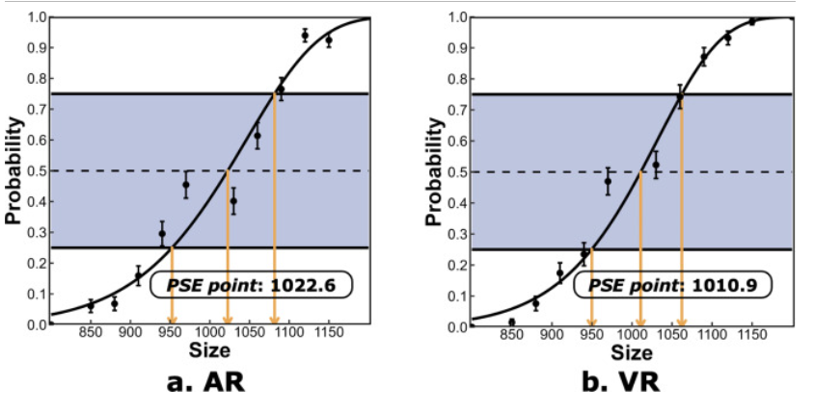
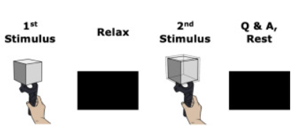
Reference cube: 1000 cm3 PSE(VR): 1.1% PSE(AR): 2.3%

Slide 3
More sensitivity to size discrimination in VR environments
Due to the smaller PSE values, the virtual object was more often perceived as larger in the VR condition than in the AR condition. Participants were more likely to report the perceived size of the virtual object as larger than of the reference object, with probability of over 50% in the VR condition when presented with two virtual cubes of equal size in AR and VR environment.
The size differences of virtual cubes in the VR environment are easier to perceive than in the AR environment
For size changes in AR users are more sensitive to decreases rather than increases
The noticeable size change of virtual objects in VR/ AR should be larger than 1062.2 cm³ in VR and 1081.6 cm³ in AR, respectively, where participants yielded a 75% probability of virtual size discrimination performance.
If designers aim to enable users to perceive a significant size change in both VR and AR conditions, for virtual objects with sizes ranging from 949.8 cm³ to 1081.16 cm³, they should increase the size change by over 1.7% compared to the reference virtual object.
What happens when the size is 1020cm³?
https://www.sciencedirect.com/science/article/pii/S0097849323002388

