Slide 1
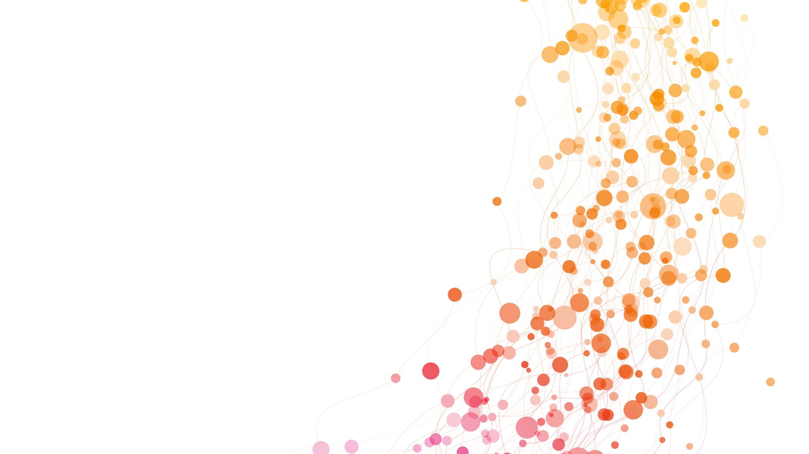
Decoding Perception: The Role of Responsive Bias
Confirmation bias is our tendency to assign more value to—and try to obtain—information and ideas that match those we already believe, thereby confirming our existing stance or suspicions
Framing effect: The psychological bias behind leading questions
Anchoring bias: This cognitive bias occurs when we find something to refer our decisions and/or reasoning back to—the anchor. The anchor is usually the first piece of information we receive, as it forms our understanding of the topic

Slide 2
Confirmation Bias, Black Swan effect
Rare, Unpredictable Events: The Black Swan refers to highly improbable events that are beyond the realm of normal expectations and have significant consequences.
Overlooked by Confirmation Bias: Our tendency to seek information that confirms our existing beliefs can lead us to overlook or underestimate the significance of Black Swan events, as they do not fit into our preconceived notions of what is likely to occur.

