Slide 1
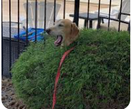
Precision, Multisensory Integration and Bayesian brain
Ονοματεπώνυμο: Έλενα Μαραγκού
The brain is Bayesian!
Balance between prior knowledge and incoming evidence based on how reliable or “precise” these different sources of information are
Weight to that which is most reliable
Multisensory Integration Problem
The capacity of combining information coming from different sensory modalities to get a more accurate representation of environment and body.
e.g.: in daylight visual cues are more accurate than auditory cues
in night the brain should rely more on auditory cues
“multisensory cues come with different degrees of reliability, and the reliability of a given cue can change in different context”
“If sight says right and sound says left, we should dive in straight ahead.”
Is this always optimal, even when some signals are more reliable than others?

Slide 2
Each sensory modality uses a different format to encode the same properties of the environment or body
Simple averaging is suboptimal
e.g.: change in eye position or body posture => different responses to neural responses for the position of an object (receptive fields). The brain must take into account the movements of the body in the space and elaborate computations are required to interpret neural responses
Our perceptual systems combine different signal according to their reliability or uncertainty.
Low noise -> high precision & higher weight to those channels that are more precise
Ventriloquist’s dummy: more weight to what we see
Eventually, we move off to the right, as our brains place more trust in the more accurate visual information

Slide 3
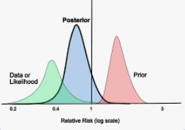
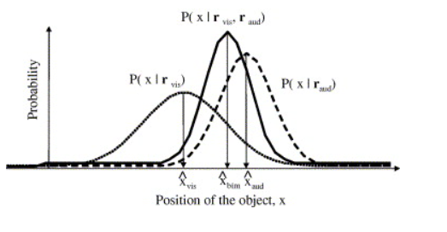
Optimal Combination of Sensory inputs with Varying Reliabilities
Bayesian framework:
P(x|r_{vis}P(x|r_{aud}), P(x|r_{vis},r_{aud}) :
posterior probability
[of object after taking into account the sensory input, r and prior P(x)]
x: position of an object that can be seen and heard at the same time
r_{vis}: neural responses in the visual cortex
r_{aud}: neural responses in the auditory
:values that maximize the distribution (MAP)
If the auditory input is more reliable than visual input (<σ²) then the bimodal estimate of position should be closer to the auditory estimate and vice versa

Slide 4
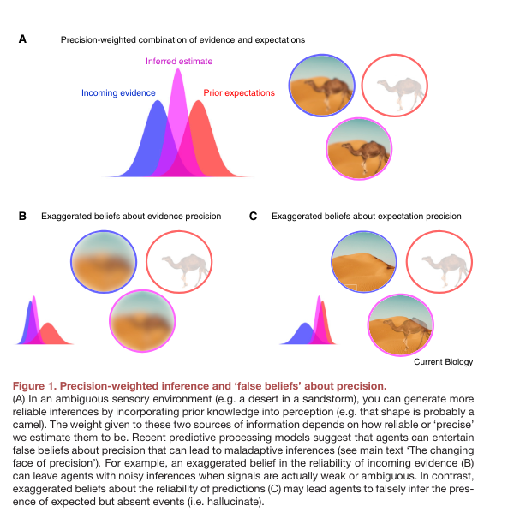
Precision and Prediction
We tend to combine bottom up sensory signals with top down expectations (e.g.: camel and polar bear in the dessert)
But how sure are we about our predictions and how much about the evidence?
To what degree does the present resembles the past?
Update our predictions and our top-down predictions become less precise
More weight to bottom-up signals
https://www.cell.com/current-biology/pdf/S0960-9822(21)01034-4.pdf
https://www.sciencedirect.com/science/article/pii/S0928425704000841

