Slide 1
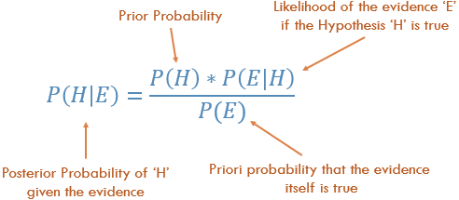

Slide 2
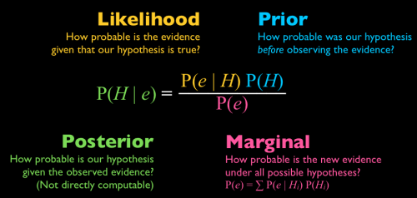

Slide 3
Probability vs. Likelihood
The number that is the probability of some observed outcomes given a set of parameter values is regarded as the likelihood of the set of parameter values (hypothesis) given the observed outcomes (evidence)
The likelihood is about the stimulus/parameter/hypothesis – what are the likely stimuli that could give rise to this data (e.g. activation)?
Likelihood is also referred to as inverse probability, as well as unormalised probability (likelihoods need not add to 1 – thief example)
Probability attaches to possible results whereas likelihood attaches to hypotheses about how these data came around
Sometimes people wright P(D/H)=L(H/D)

Slide 4
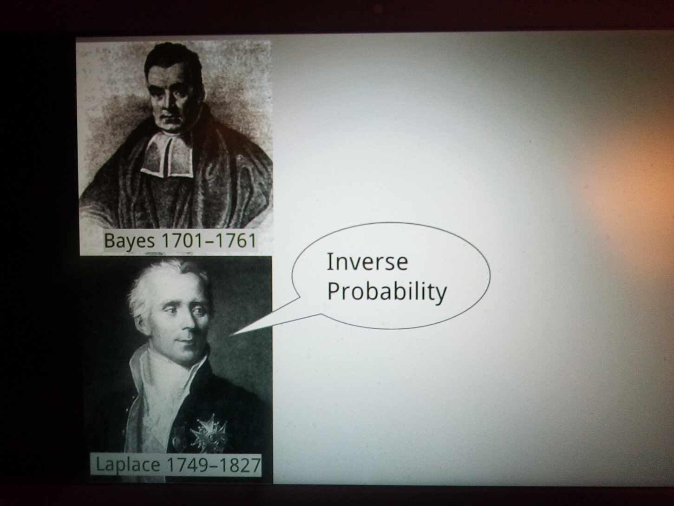

Slide 5
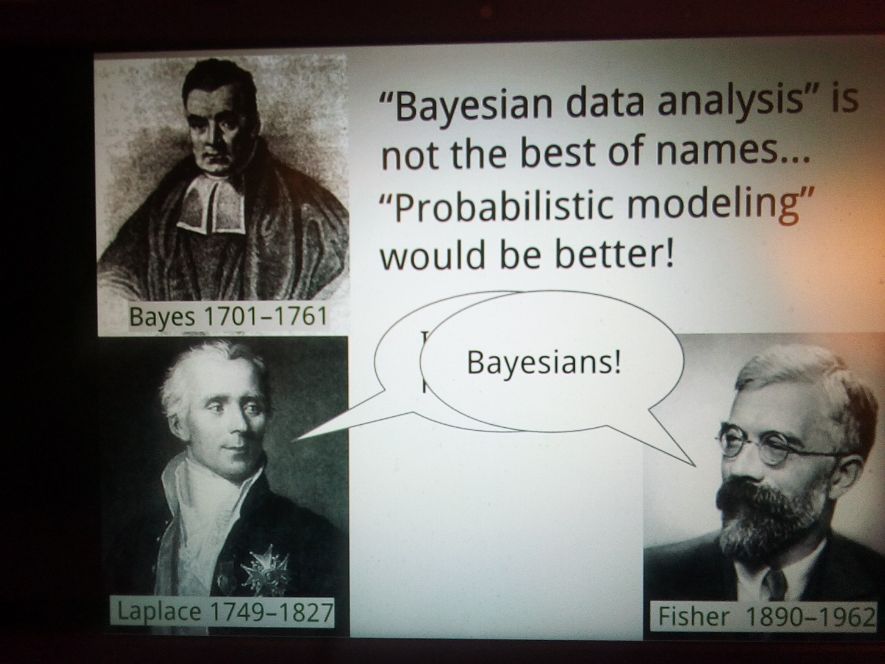

Slide 6
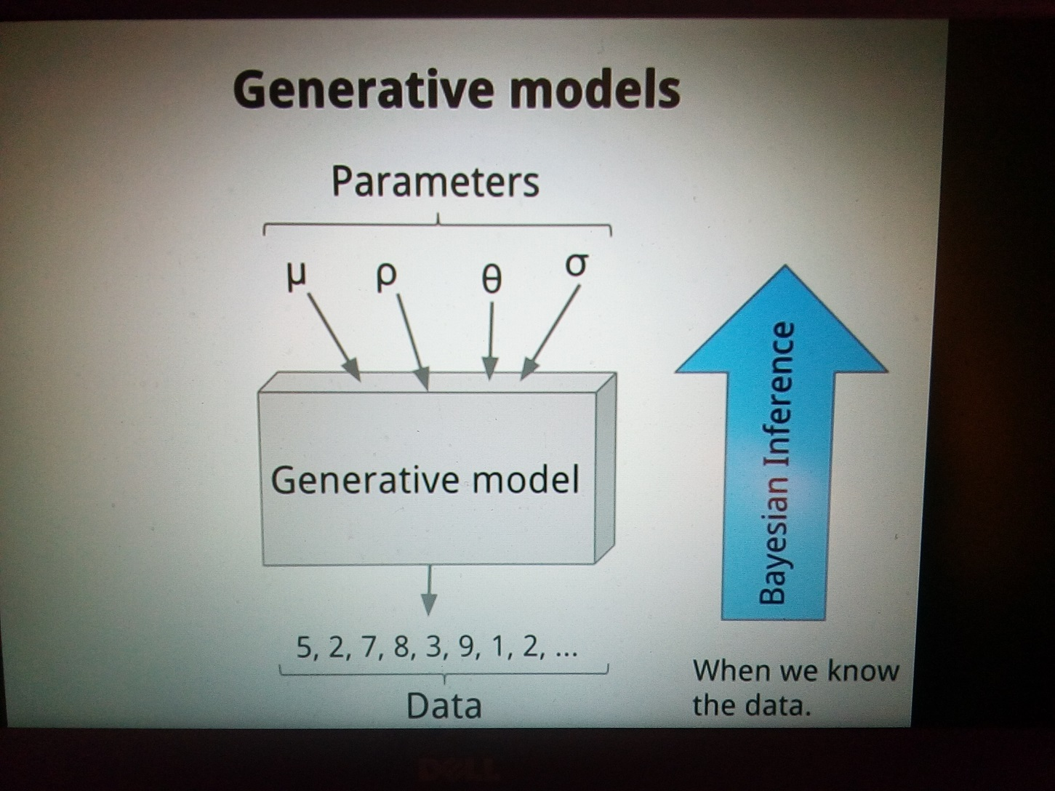

Slide 7
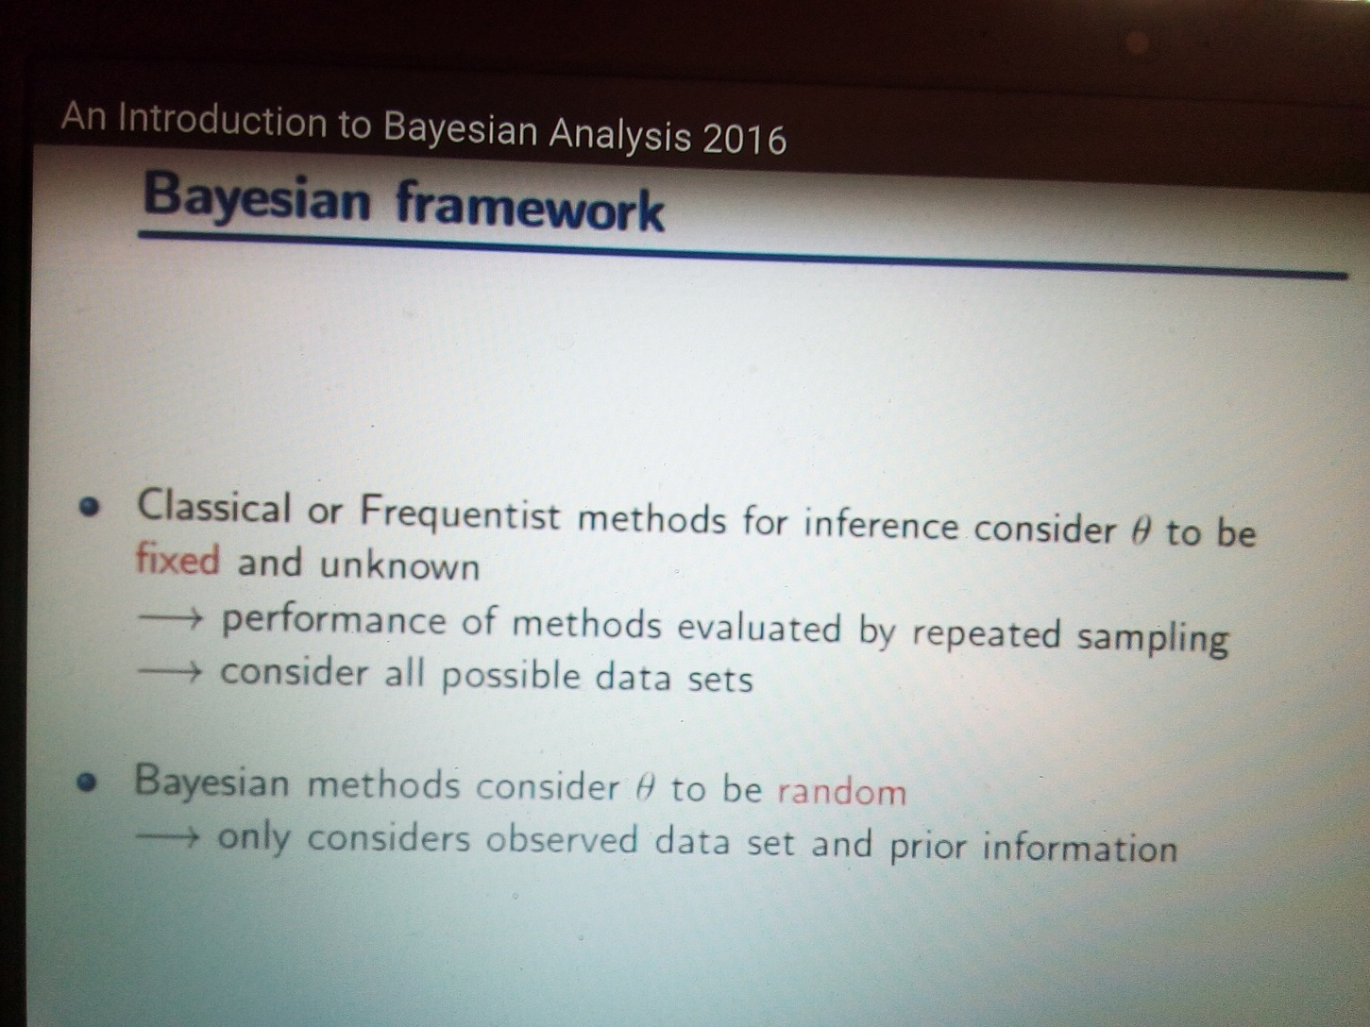

Slide 8
Bayes law makes sense & we use it to make (probabilistic) inferences of what is going on
Gestalt Psychology
Other examples from visual/sensory perception
The problem of forgetting priors
The problem of strong priors (Freud?)
The rare disease problem (test is 90% correct, disease is 1/100) (9/108)
The Monty Hall Example (2/3 win if change)
The cookie problem (30v/10c & 20v/20c: take 1, it is v, P it is from box1?) (3/5)
m&m (‘95 change G 10->20 & Y 20->14. ’94 & ’96 bags, P that Y is from ‘94?) (20/27)
Elvis Presley (P dead twin brother was identical? 1/125 fraternal, 1/300 identical) (5/11)
https://www.youtube.com/watch?v=0KrpZMNEDOY

