Slide 1

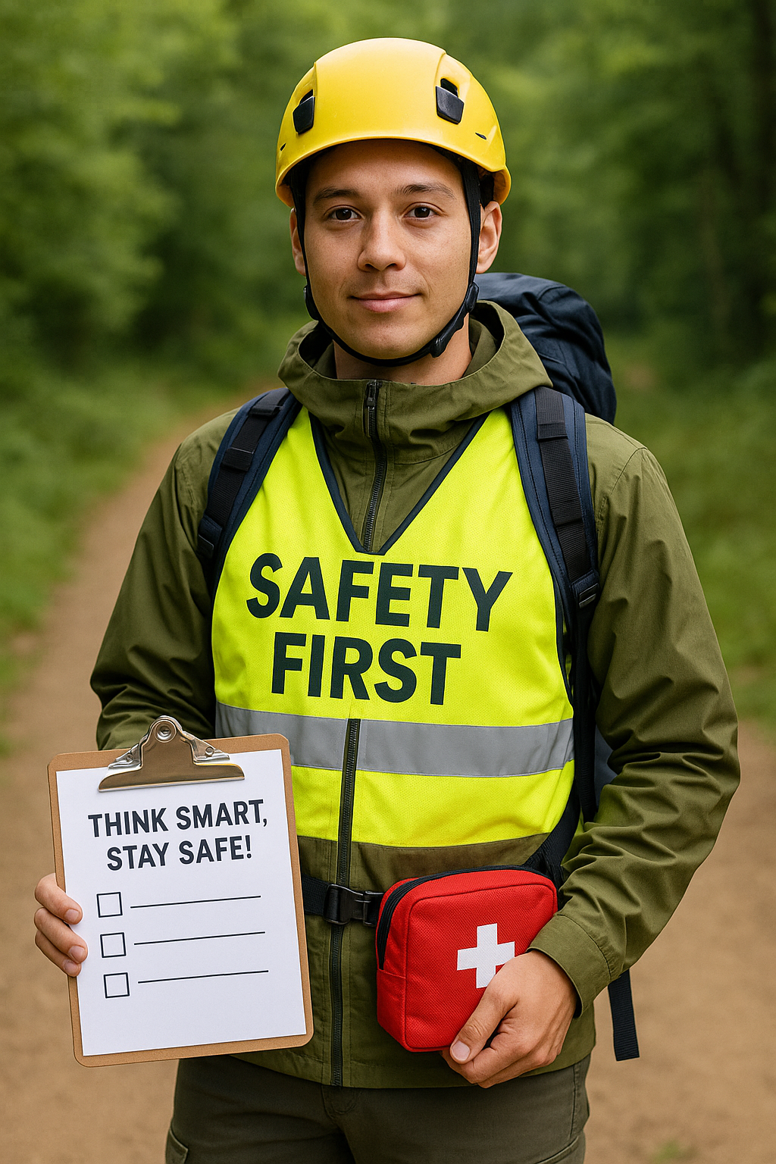
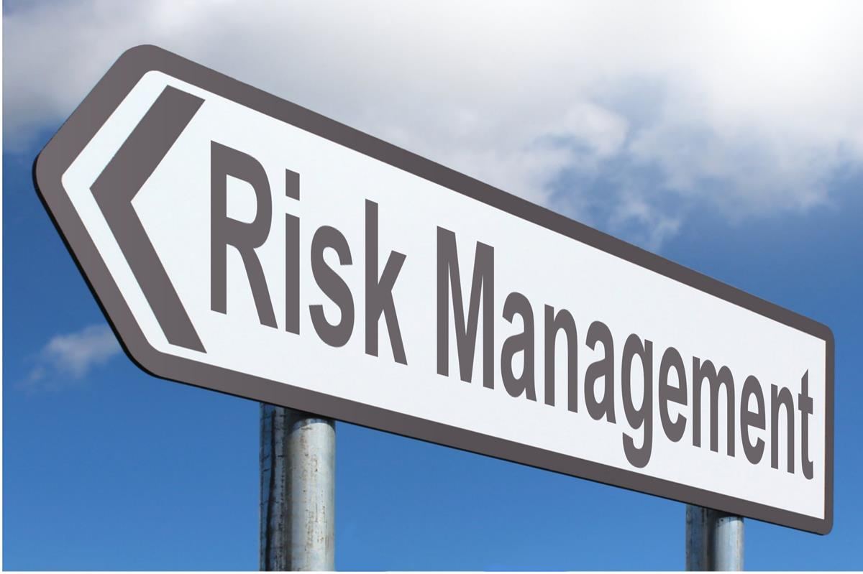









Section 3: Safety
This work is licensed under the Creative Commons Attribution 4.0 International License. http://creativecommons.org/licenses/by/4.0/

Slide 2



Section 3: Safety
Follow the link https://app.animaker.com/animo/QCn2BBQil5pAQ2mh/
or
Scan the QR code and learn more about the content of this section

Slide 3

Section 3: Safety
Teacher´s competences develop through section 3:
Identify the safety elements in OAE: mental, physical and social.
Understand the terminology associated with risk management in OAE/SEL, as well as the different levels of safety.
Know the three big hazards (traffic, weather and terrain), identify the consequences and propose actions to manage the risk.

Slide 4
Section 3: Safety
Content
Safety and Risk terminology in OAE.
PE teacher risk management.
Levels of safety.
How to start with risk management.

Slide 5
Section 3: Safety
Safety and Risk terminology in OAE
PE teachers manage substantial risks in their daily work with pupils.
Minor injuries (scratches, bruises) are often unavoidable.
Ensuring a safe learning environment requires addressing:
  Physical hazards.
  Mental hazards.
  Social hazards.

Slide 6
Section 3: Safety
PE teacher risk management: Balancing Safety and Challenge
Excessive fear (of activities or others) can hinder learning.
However, no challenge = no learning.
Outdoor and Adventure Education (OAE) inherently includes hazards.
A skilled teacher:
  Facilitates learning with acceptable risk levels.
  Uses hazards as motivation and learning tools.

Slide 7
Section 3: Safety
PE teacher risk management: Key Concepts
Hazard: A potential source of harm (e.g., terrain, weather, equipment).
Consequence = refers to the potential harm to individuals’ health and safety, such us twisted ankle, open wound or getting panic.
Risk: The likelihood and severity of harm occurring.
Safety: Maintaining an acceptable level of risk.

Slide 8
Section 3: Safety
PE teacher risk management: Risk Management Questions
What are the three major hazards? (Traffic, Weather, Terrain).
What precautions can be taken to prevent or minimize risks?
Are risks at an acceptable level?

Slide 9
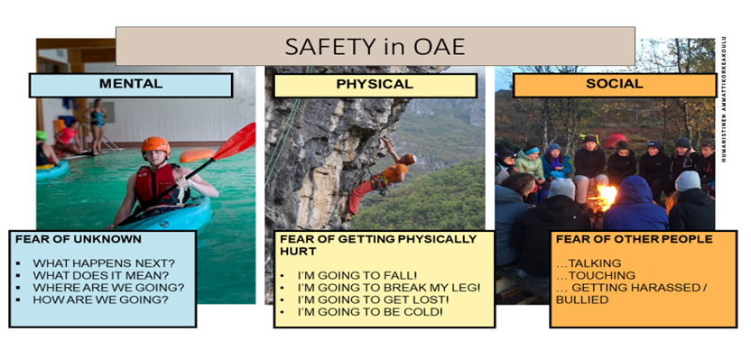
PE teacher risk management
Section 3: Safety
MENTAL
PHYSICAL
SOCIAL
FEAR OF UNKNOWN
WHAT HAPPENS NEXT?
WHERE ARE WE GOING?
HOW ARE WE GOING?
FEAR OF GETTING PHYSICALLY HURT
I AM GOING TO FALL!
I AM GOING TO BREAK MY LEG!
I AM GOING TO GET LOST!
I AM GOING TO BE COLD!
FEAR OF OTHER PEOPLE
… TALKING
… TOUCHING
… GETTING HARASSED/ BULLIED

Slide 10
Levels of safety
Section 3: Safety
DANGER!! PANIC!!
GROWTH
FLEXIBILITY
The stress level gets stronger when moving out of the comfort zone
COMFORT
adapted from Luckner & Nadler (1997)

Slide 11
Section 3: Safety
How to start with risk management: Ask these questions from yourself.
Is there a possibility that Traffic, Weather or Terrain will create a hazard?
Traffic – other people and cars, crossing roads.
Weather – cold/warm/wind/rain.
Terrain – water/slipperiness/iciness/forest/obstacles/elevation difference.
People – bullying or pupil medical history or tiredness or lack of physical condition.
What are the possible consequences?

Slide 12
Section 3: Safety
3. How can you manage risk?
Preventative actions – weather: advice pupils/students to take warm clothing and send message to parents to remind this.
Actions to minimize risks – traffic: use professional driver for transportation, instruct safest road to learning environment.
Precaution is something has happened – terrain: Have you First Aid kit in your backpack.

Slide 13
How to adapt possible risks
Activity: | Orienteering exercises | Place: | Forested area, with trails, 3 km from school
HAZARD | CONSEQUENCES | RISK MANAGEMENT
Traffic
Crossing roads | Hit by a car | Advice safe road Bike with your pupils/use prof. driver Go through how to call 112
Weather
Rainy cold weather | Getting cold | Advice to take warm, waterproof clothing Have a shelter in starting place Have extra clothing and bottle of hot water in thermos with you
Terrain
Big forest | Getting lost | Frame orienteering area and teach how to use map Ask to work in pairs Ask each pupil to take phones and map application
People
Mixed groups | Getting bullied | Plan groups well in advance Give possibility to change group Get ready to debrief

Slide 14
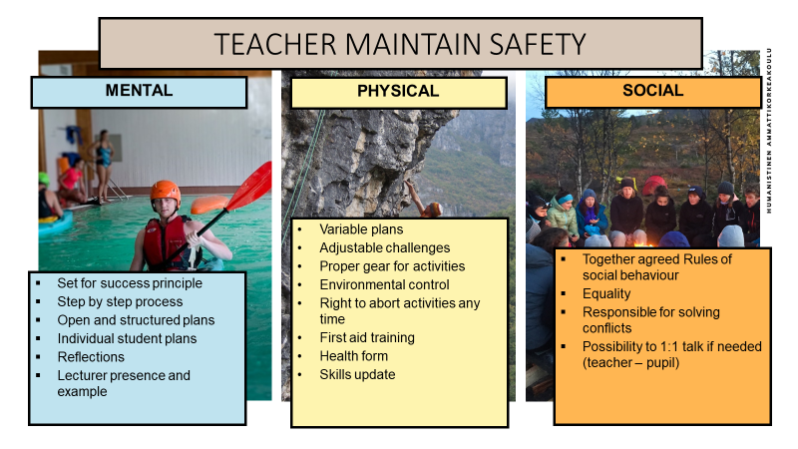
Teacher maintain safety
Section 3: Safety
MENTAL
PHYSICAL
SOCIAL
Variable plans
Adjustable challenges
Proper gear for actities
Environmental control
Right to abort activities ny time
First aid training
Health form
Skills update
Together agreed rules of social behavior
Equality
Responsibility for solving conflicts
Possibility to 1:1 talk if needed (teacher – pupil)
Set for success principle
Step by step process
Open and structred plans
Individual student plans
Reflections
Lecturer presence and example

