Slide 1


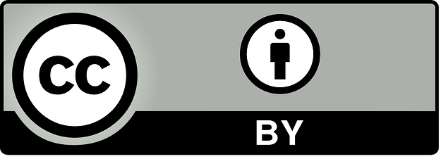







Section 1: Introduction theoretical approach OAE and SEL
This work is licensed under the Creative Commons Attribution 4.0 International License. http://creativecommons.org/licenses/by/4.0/

Slide 2
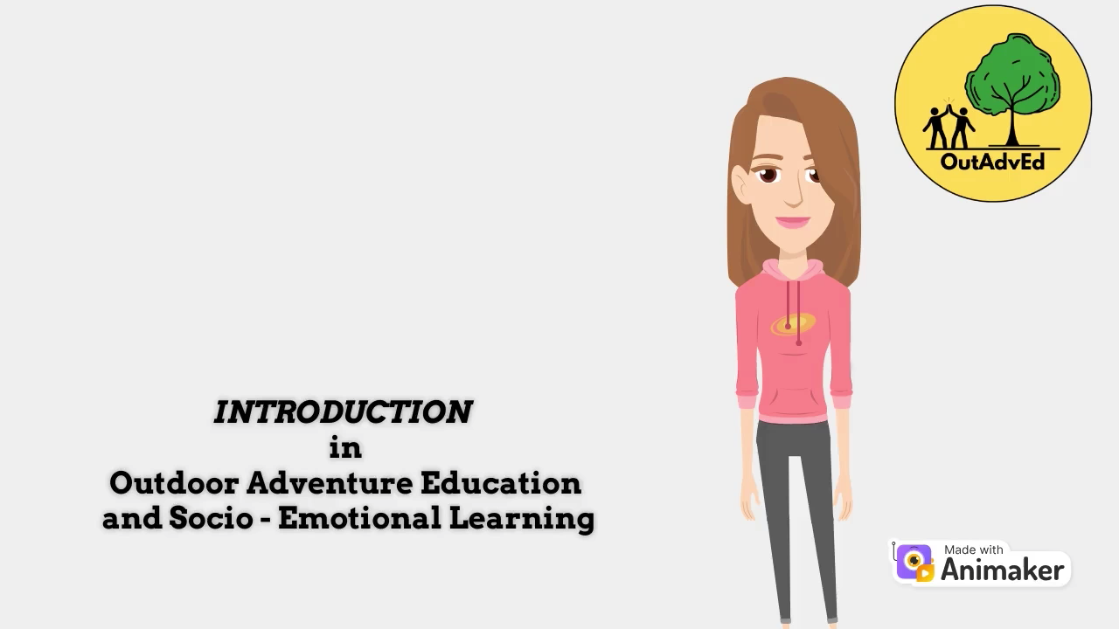


Section 1: Introduction theoretical approach OAE and SEL

Slide 3

Section 1: Introduction
Follow the link https://app.animaker.com/animo/lrr4NrvanozijwBw or
Scan the QR code and find more about the content of this section

Slide 4
Section 1: Introduction theoretical approach OAE and SEL
Introduction
This first section introduces the theoretical foundations of Outdoor Adventure Education (OAE) and Social Emotional Learning (SEL), emphasizing their integration in the physical education curriculum. It highlights how outdoor activities like hiking and ropes courses promote personal growth, skill development, and character building. The holistic approach combines adventure-based challenges with SEL to develop knowledge, social, and emotional skills.

Slide 5
Section 1: Introduction theoretical approach OAE and SEL
Teacher´s competences develop through section 1
Knowledge about OAE.
Knowledge about SEL.
Understand how OAE and SEL link by PE Curriculum.
Understand the learning environment possibilities.

Slide 6
Section 1: Introduction theoretical approach OAE and SEL
Content
Theoretical approach about OAE, SEL, PE curriculum, learning environment.

Slide 7
Module 1: Introduction theoretical approach OAE and SEL
What is Outdoor Adventure Education?
Specialized form of experiential learning that takes place mostly in outdoor settings and focuses on promoting personal, social, and environmental development through adventurous activities and challenges.
Personal growth through an adventure which is grounded in the four non-negotiable features of being mainly outdoors, experiential learning, challenge by choice, and managed risk.

Slide 8
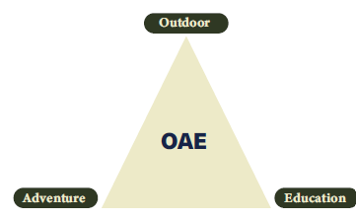
Section 1: Introduction theoretical approach OAE and SEL
Holistic aproach of OAE
The combination of these components allows participants to acquire knowledge, skills and expertise through participating in adventure activities in an outdoor setting, and to be involved in SEL.

Slide 9
Section 1: Introduction theoretical approach OAE and SEL
What is Social Emotional Learning?
Umbrella term to represent a wide array of non-academic skills that individuals need in order to set goals, manage behaviour, build relationships, and process and remember information.
These skills and competencies develop across our lives and are essential to success in school, work, home, and community.
Generally speaking, this set of skills can be organized into three interrelated areas: cognitive, social, and emotional. Importantly, these skills and competencies develop and are in dynamic interaction with attitudes, beliefs, and mindsets as well as character and values, all of which are fundamentally tied to characteristics of settings.

Slide 10
Section 1: Introduction theoretical approach OAE and SEL
The combination of these components enables participants to acquire
knowledge, skills, and expertise through engaging in diverse adventure activities
while being involved in SEL.
OAE content as part of the physical education curriculum serves as a pathway in which facilitating, experiencing, and reflecting play a pivotal.

Slide 11
Section 1: Introduction theoretical approach OAE and SEL
OAE:
Hiking, rock climbing, camping, canoeing, sailing,
kayaking, orienteering, ropes courses, and wilderness expeditions as well as new and emerging activities such as slack-lining, paddle boarding and parkour etc.
To provide opportunities for individuals to step outside their comfort zones, develop soft/meta skills and competences such as resilience, problem-solving skills, build self-confidence, and cultivate a deeper appreciation for nature.

Slide 12
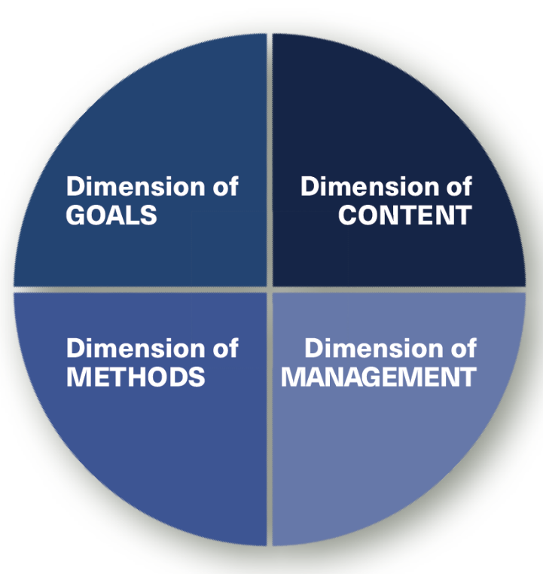
Section 1: Introduction theoretical approach OAE and SEL
Designing a curriculum involves a systematic and thoughtful approach to ensure that the curriculum meets the desired learning outcomes.
For this purpose, we proceed according to the curriculum dimensions, starting with the dimension of goals. Nevertheless, it is important to realize that all dimensions are interrelated and form one common (four-dimensional).

