Slide 1
RESPIRATORY SYSTEM
LUNGS AND PLEURA
Prof. Mara PIAGKOU

Slide 2
Overview of Pleura and Lungs
1. Lungs: Structure & Function
Main organs of respiration, located in pleural cavities on each side of the mediastinum.
Right lung: 3 lobes (superior, middle, inferior); divided by oblique and horizontal fissures.
Left lung: 2 lobes (superior and inferior); separated by an oblique fissure.
Apex: Extends above the first rib, just behind the clavicle.
Base: Rests on the diaphragm.
Surfaces: Costal (lateral) and mediastinal (medial).
Borders: Anterior, posterior, and inferior.

Slide 3
Pleura: Serous Membrane
Two layers forming a double membrane around each lung:
Visceral pleura: Covers lung surface.
Parietal pleura: Lines the inner surface of the thoracic cavity.
Subdivided into:
Costal pleura: Inner surface of rib cage
Diaphragmatic pleura: Over diaphragm
Mediastinal pleura: Faces mediastinum (heart, esophagus, etc.)
Cervical pleura: Extends into the neck (under suprapleural membrane)
Pleural cavity: Potential space between layers, filled with pleural fluid to reduce friction during breathing.

Slide 4
Pleural Recesses
Potential spaces where the lungs do not fully occupy the pleural cavity (important in full inspiration or fluid accumulation):
Costodiaphragmatic recess: Most clinically significant, lowest point in the cavity—common site for fluid collection.
Costomediastinal recess: Found near the cardiac notch, assists in lung expansion (especially left lung).

Slide 5
Bronchopulmonary Segments
Each lung lobe is subdivided into bronchopulmonary segments—functionally and anatomically distinct.
Each segment:
Has its own tertiary (segmental) bronchus and pulmonary artery branch
Is drained by intersegmental pulmonary veins
Can be surgically removed without affecting other segments

Slide 6
Bronchioles
Tertiary bronchi → smaller branches → terminal bronchioles (no cartilage, smooth muscle walls)
Regulated by autonomic nervous system:
Sympathetic (epinephrine) → bronchodilation
Parasympathetic → bronchoconstriction

Slide 7
Hilum of the Lung
Site on the mediastinal surface where structures enter/exit:
Bronchi, pulmonary arteries/veins, nerves, and lymphatics
Inferior to hilum: pulmonary ligament (pleural fold allowing movement of lung structures)

Slide 8
Lower respiratory tract
Larynx
Tracheobronchial tree
Lungs
Notes:
The lower respiratory tract or lower airway is derived from the developing foregut and consists of the trachea, bronchi (primary, secondary and tertiary), bronchioles (including terminal and respiratory), and lungs (including alveoli).^{[8]} It also sometimes includes the larynx.
The lower respiratory tract is also called the respiratory tree or tracheobronchial tree, to describe the branching structure of airways supplying air to the lungs, and includes the trachea, bronchi and bronchioles.^{[9]}
trachea
main bronchus (diameter approximately 1 – 1.4 cm in adults)^{[10]}
lobar bronchus (diameter approximately 1 cm)
segmental bronchus (diameter 4.5 to 13 mm)^{[10]}
subsegmental bronchus (diameter 1 to 6 mm)^{[10]}
conducting bronchiole
terminal bronchiole
respiratory bronchiole
alveolar duct

Slide 9
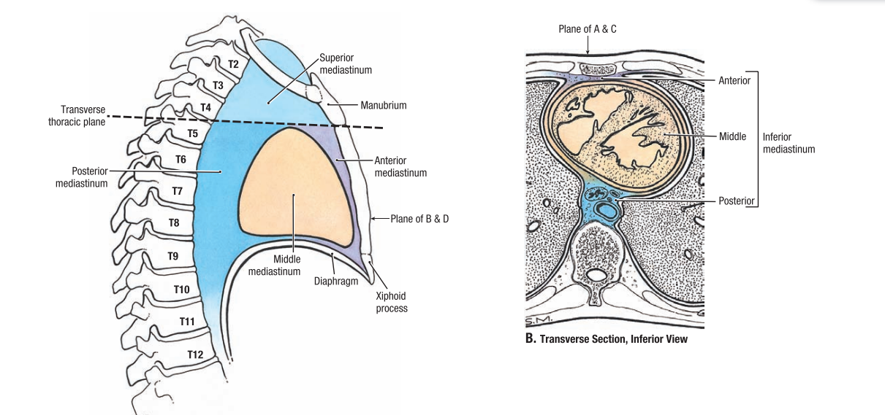
The mediastinum is the central compartment of the thoracic cavity, located between the two pleural cavities (lungs).
Extends from:
Superiorly: Thoracic inlet
Inferiorly: Diaphragm
Anteriorly: Sternum
Posteriorly: Thoracic vertebrae
Contents
Heart & pericardium
Great vessels (aorta, vena cavae)
Trachea
Esophagus
Thoracic duct
Thymus (or its remnants)
Nerves:
Vagus (CN X)
Phrenic
Cardiac plexus
Lymph nodes

Slide 10
MEDIASTINUM
central compartment of the thoracic cavity.
Surrounded by loose connective tissue,
contains vital organs and structures within the thorax, namely the heart and its vessels, the esophagus, the trachea, the vagus, phrenic and cardiac nerves, the thoracic duct, the thymus and the lymph nodes of the central chest.
Notes:
is the central compartment of the thoracic cavity. Surrounded by loose connective tissue, it is a region that contains vital organs and structures within the thorax, namely the heart and its vessels, the esophagus, the trachea, the vagus, phrenic and cardiac nerves, the thoracic duct, the thymus and the lymph nodes of the central chest.

Slide 11
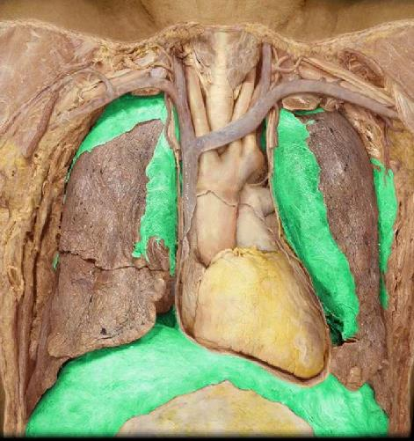
contains vital organs and structures within the thorax, namely the heart and its vessels, the esophagus, the trachea, the vagus, phrenic and cardiac nerves, the thoracic duct, the thymus and the lymph nodes of the central chest.
Clinical Notes
Mediastinal masses or lymphadenopathy may compress airways, esophagus, or major vessels.
Mediastinitis (infection) can spread rapidly due to loose connective tissue.

Slide 12
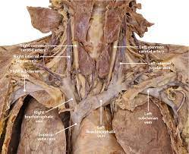
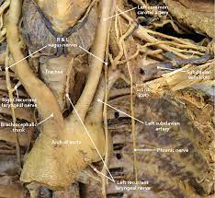
Mediastimum
Wide space at the midline
Sternum, TV, thoracic inlet and outlet

Slide 13
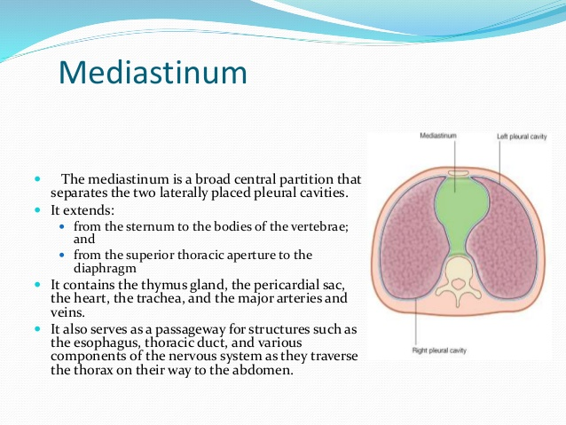

Slide 14
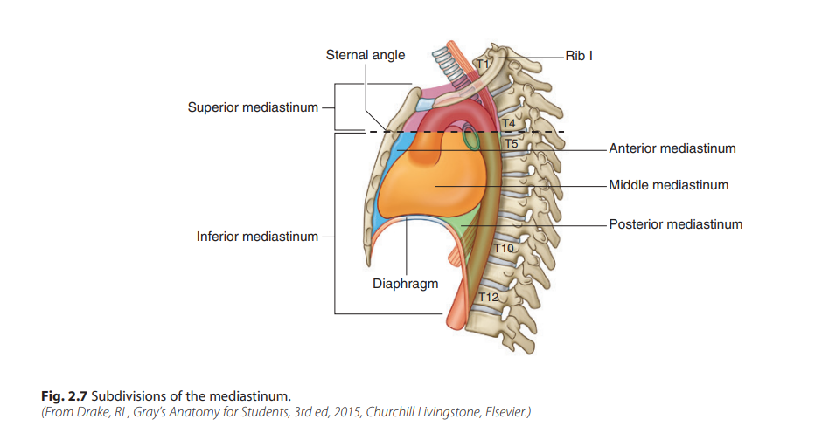
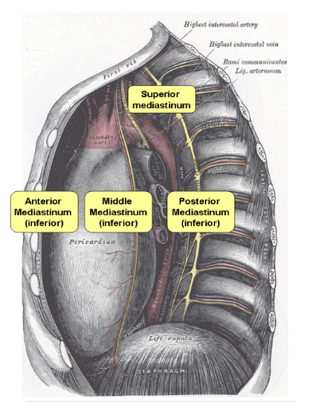
Thorax cavity
Mediastinum divisions

Slide 15
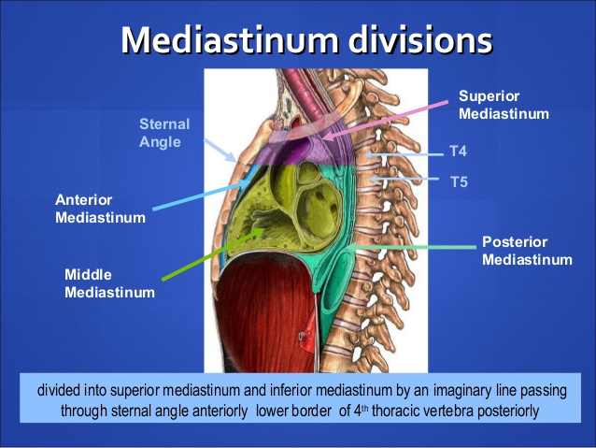

Slide 16
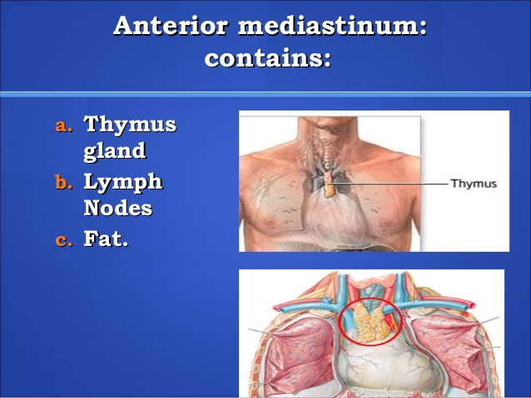
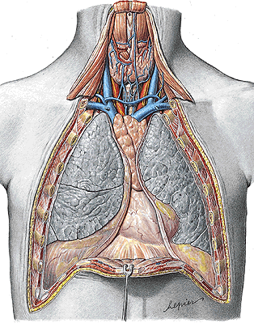
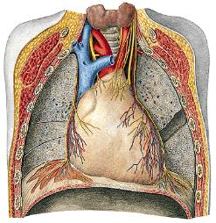

Slide 17
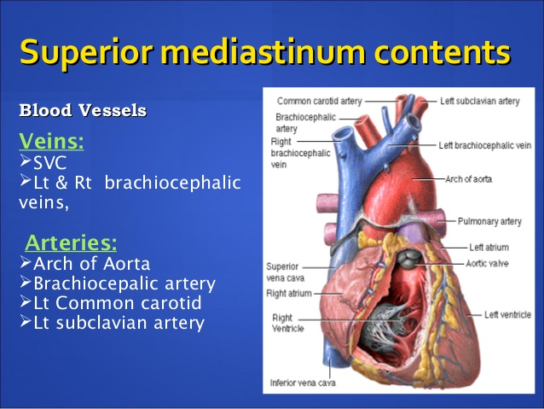
Superior Mediastinum
Above sternal angle (T4-T5) to thoracic inlet
Contents:
Aortic arch + its branches
Brachiocephalic veins & SVC
Trachea
Esophagus
Thoracic duct
Thymus
Vagus, phrenic, and left recurrent laryngeal nerves

Slide 18
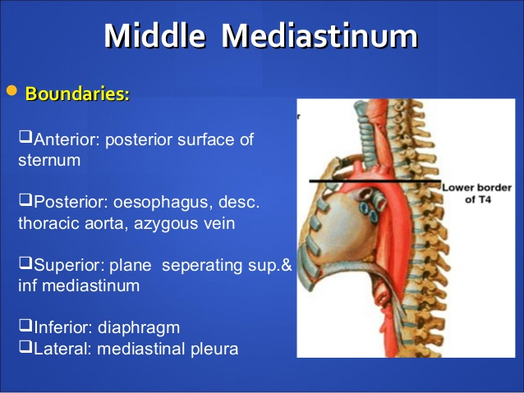

Slide 19
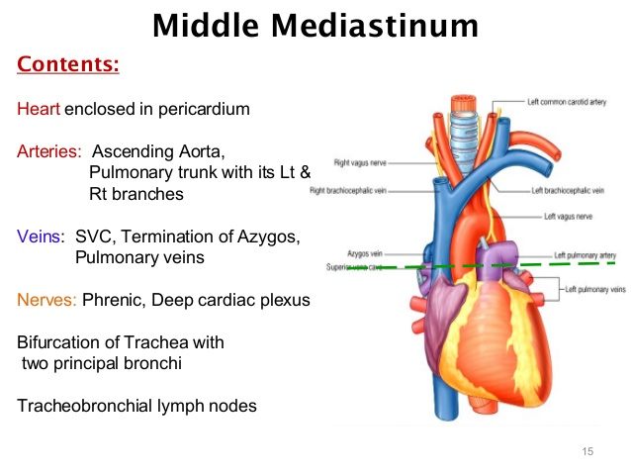

Slide 20
Inferior mediastinum
Subdivision | Location & Contents
Anterior | Between sternum & pericardium– Fat, lymph nodes, remnants of thymus
Middle | Contains the heart in pericardium– Great vessels, phrenic nerves, pericardial sac
Posterior | Behind pericardium, in front of spine– Esophagus, descending thoracic aorta, azygos system, thoracic duct, vagus nerves

Slide 21
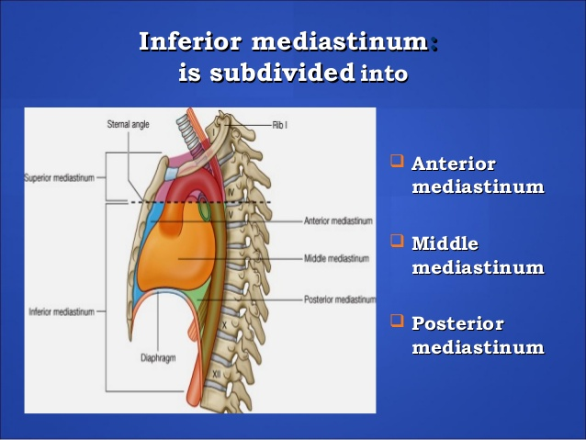

Subdivision | Location & Contents
Anterior | Between sternum & pericardium– Fat, lymph nodes, remnants of thymus
Middle | Contains the heart in pericardium– Great vessels, phrenic nerves, pericardial sac
Posterior | Behind pericardium, in front of spine– Esophagus, descending thoracic aorta, azygos system, thoracic duct, vagus nerves

Slide 22
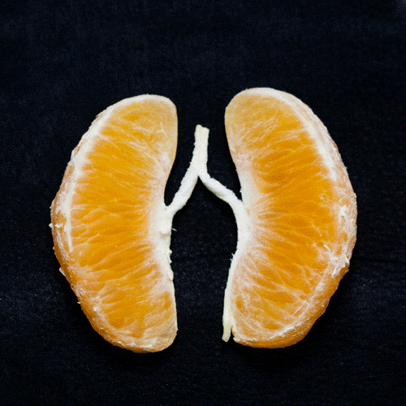
The lungs

Slide 23
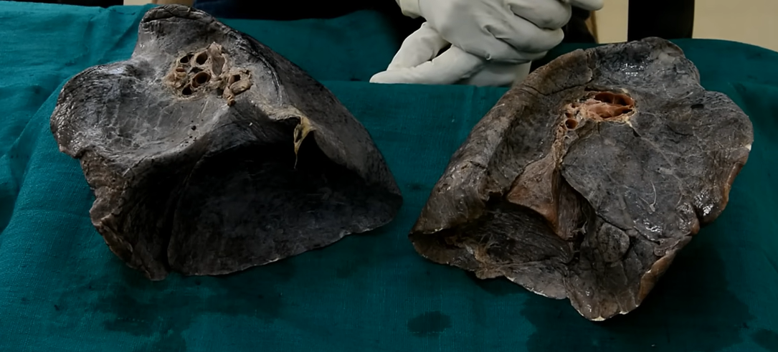

Slide 24
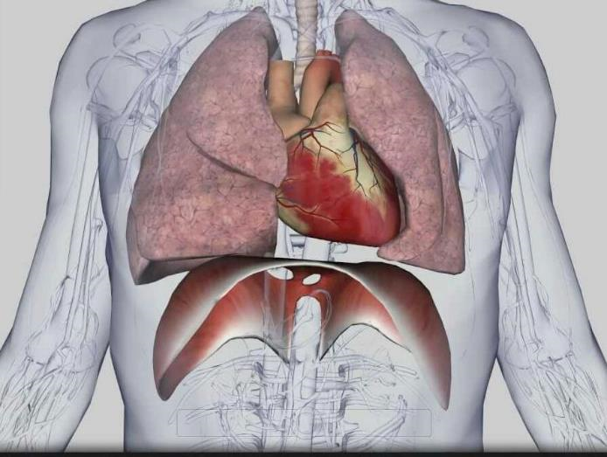
The lungs
in the thoracic cavity, are protected by the rib cage.
At their base is a sheet of skeletal muscle called the diaphragm, that separates the lungs from the stomach and intestines.
The diaphragm is the main muscle of respiration involved in breathing and is controlled by the sympathetic nervous system.
Notes:
.
The lungs which are located in the thoracic cavity, are protected from physical damage by the rib cage. At the base of the lungs is a sheet of skeletal muscle called the diaphragm. The diaphragm separates the lungs from the stomach and intestines. The diaphragm is also the main muscle of respiration involved in breathing, and is controlled by the sympathetic nervous system.
The lungs are encased in a serous membrane that folds in on itself to form the pleurae – a two-layered protective barrier. The inner visceral pleura covers the surface of the lungs, and the outer parietal pleura is attached to the inner surface of the thoracic cavity. The pleurae enclose a cavity called the pleural cavity that contains pleural fluid. This fluid is used to decrease the amount of friction that lungs experience during breathing.

Slide 25
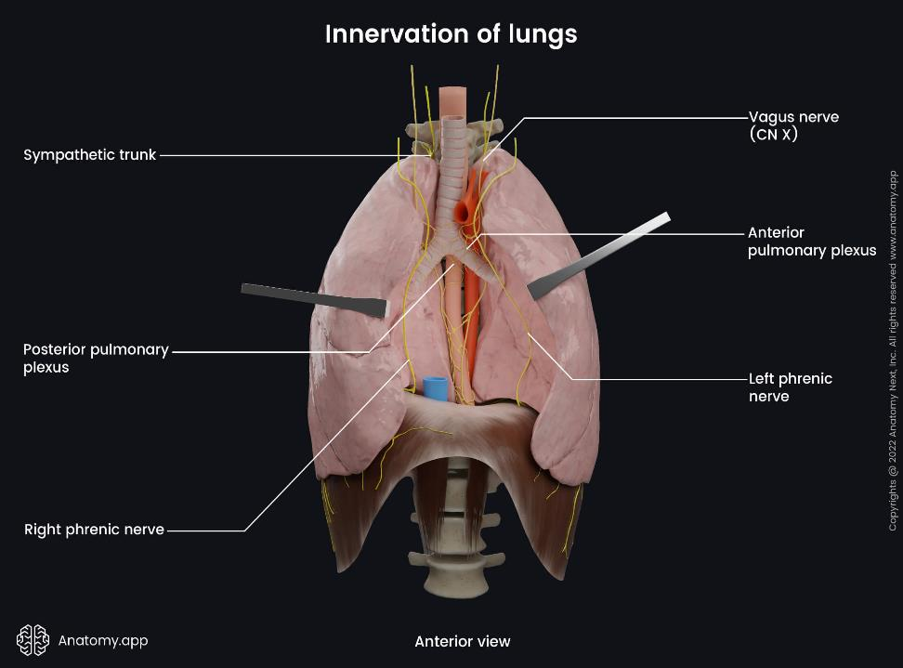

Slide 26
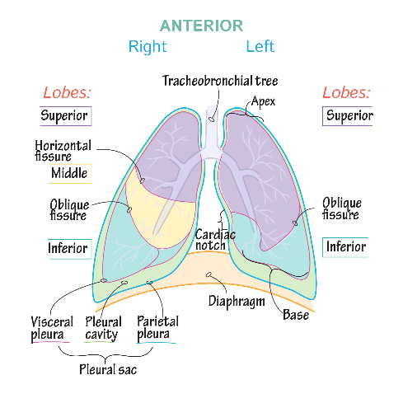
The lungs are encased in a serous membrane that folds to form the pleurae –
a two-layered protective barrier.
inner visceral pleura covers the surface of the lungs,
outer parietal pleura is attached to the inner surface of the thoracic cavity.
enclose a cavity called the pleural cavity that contains pleural fluid, used to decrease the amount of friction that the lungs experience during breathing.
Notes:
.
The lungs which are located in the thoracic cavity, are protected from physical damage by the rib cage. At the base of the lungs is a sheet of skeletal muscle called the diaphragm. The diaphragm separates the lungs from the stomach and intestines. The diaphragm is also the main muscle of respiration involved in breathing, and is controlled by the sympathetic nervous system.
The lungs are encased in a serous membrane that folds in on itself to form the pleurae – a two-layered protective barrier. The inner visceral pleura covers the surface of the lungs, and the outer parietal pleura is attached to the inner surface of the thoracic cavity. The pleurae enclose a cavity called the pleural cavity that contains pleural fluid. This fluid is used to decrease the amount of friction that lungs experience during breathing.

Slide 27
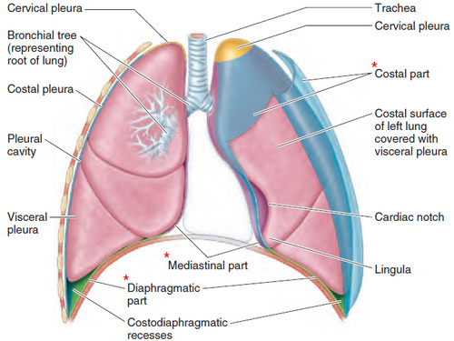

Slide 28
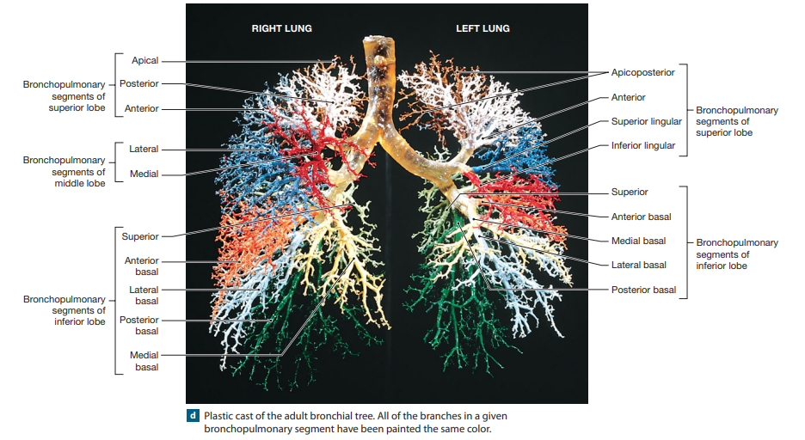
Bronchopulmonary Segments
Each lobe of the lung can be divided into smaller units
Each segment consists of the lung tissue associated with a single tertiary bronchus.
have names that correspond to those of the associated tertiary bronchi

Slide 29
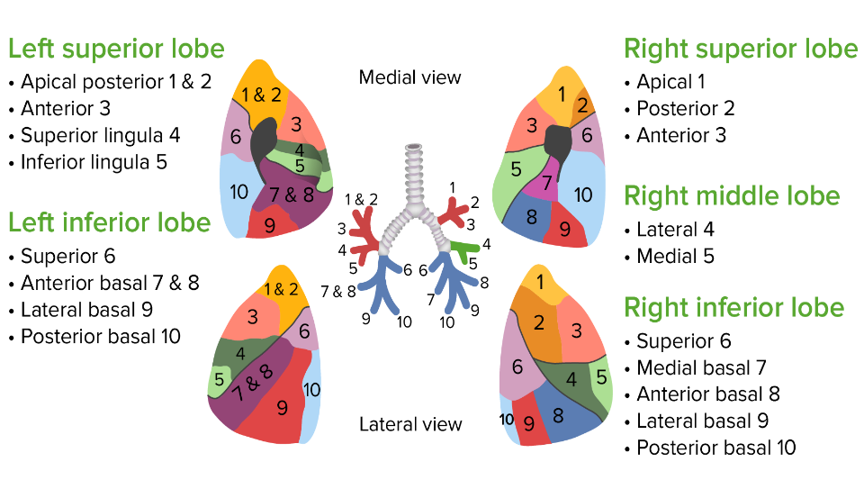

Slide 30
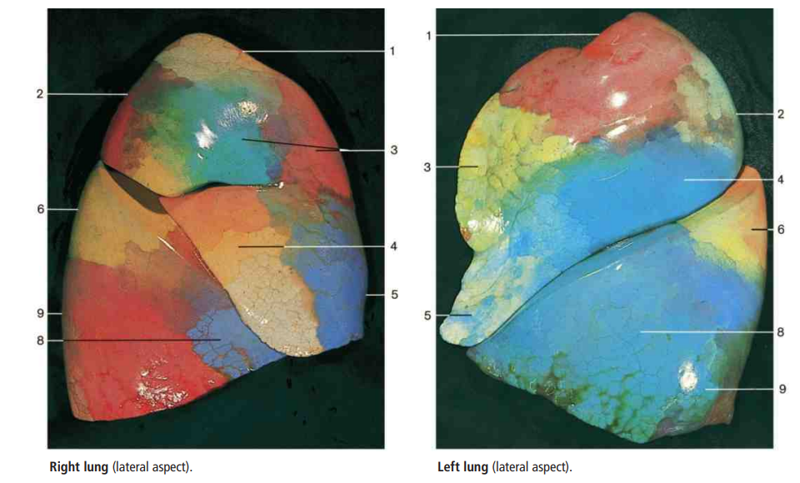
The bronchopulmonary segment
are morphologically and functionally separate, independent respiratory units of the lung tissue.
Each segment is surrounded by connective tissue that is continuous with the visceral pleura.
is not a complete vascular unit, but segmentation is the result of a specific architecture of the lung vasculature.

Slide 31
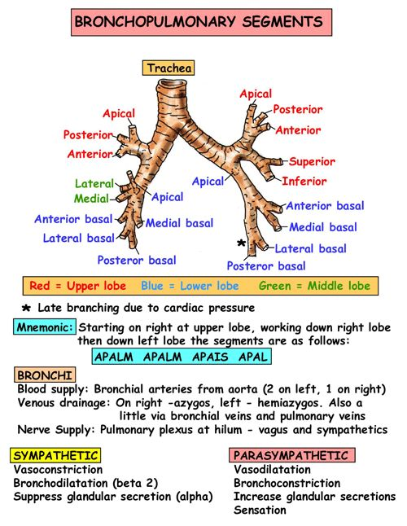
The bronchopulmonary segments
The segmental bronchi are centrally located in each segment and are closely accompanied by branches of the pulmonary arteries, whereas the tributaries of the pulmonary veins run between the segments.
The veins serve two adjacent segments that drain for the most part into more than one vein.

Slide 32
Bronchioles
Each tertiary bronchus branches several times within the bronchopulmonary segment, ultimately giving rise to 6500 smaller terminal bronchioles.
Terminal bronchioles luminal diameter- 0.3–0.5 mm.
The walls are continuous and lack cartilaginous support, are dominated by smooth muscle tissue
The autonomic nervous system regulates the activity in the smooth muscle layer of the terminal bronchioles and thereby controls the diameter.
Sympathetic activation and the release of epinephrine by the suprarenal medullae cause enlargement of the airways, or bronchodilation.
Parasympathetic stimulation leads to bronchoconstriction. These changes alter the resistance to airflow toward or away from the respiratory exchange surfaces.

Slide 33
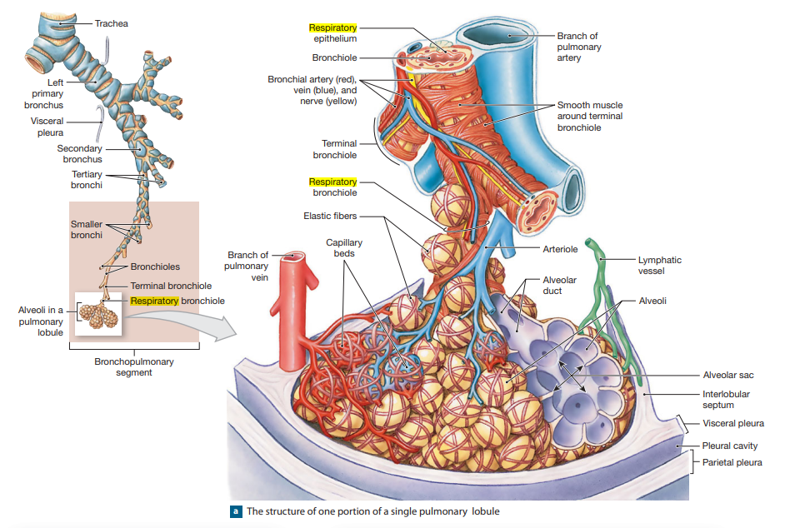
Notes:
Each tertiary bronchus branches several times within the bronchopulmonary segment, ultimately giving rise to 6500 smaller terminal bronchioles.
Terminal bronchioles luminal diameter- 0.3–0.5 mm.
The walls are continuous and lack cartilaginous support, are dominated by smooth muscle tissue
The autonomic nervous system regulates the activity in the smooth muscle layer of the terminal bronchioles and thereby controls the diameter.
Sympathetic activation and the release of epinephrine by the suprarenal medullae cause enlargement of the airways, or bronchodilation.
Parasympathetic stimulation leads to bronchoconstriction. These changes alter the resistance to airflow toward or away from the respiratory exchange surfaces.

Slide 34
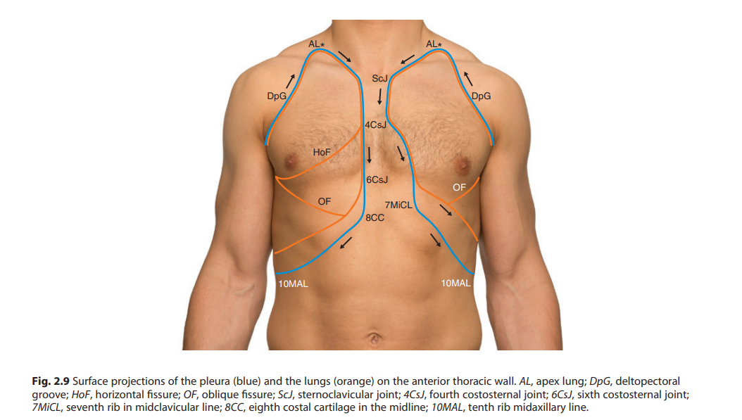
The pleura

Slide 35
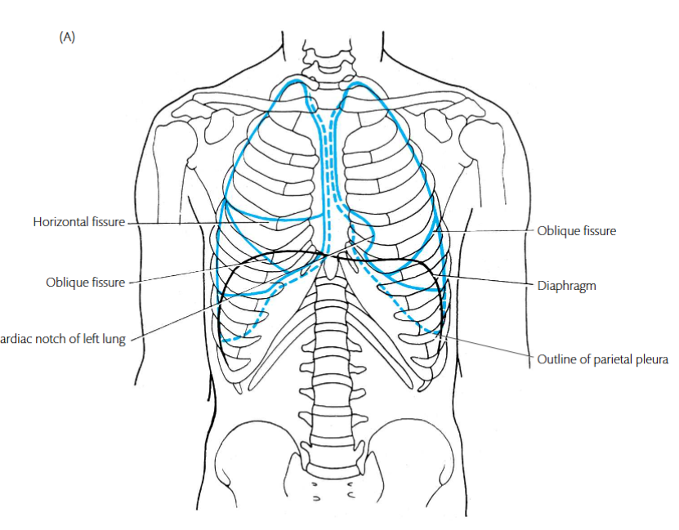

Slide 36
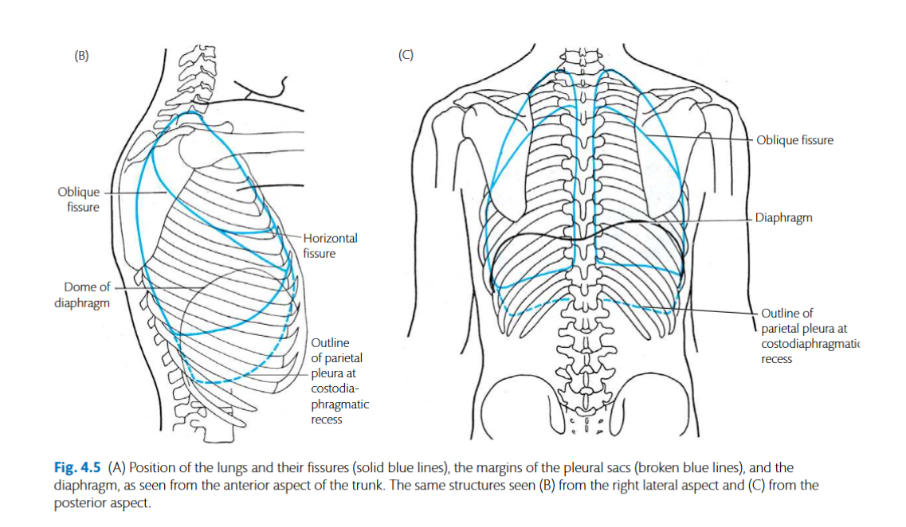

Slide 37
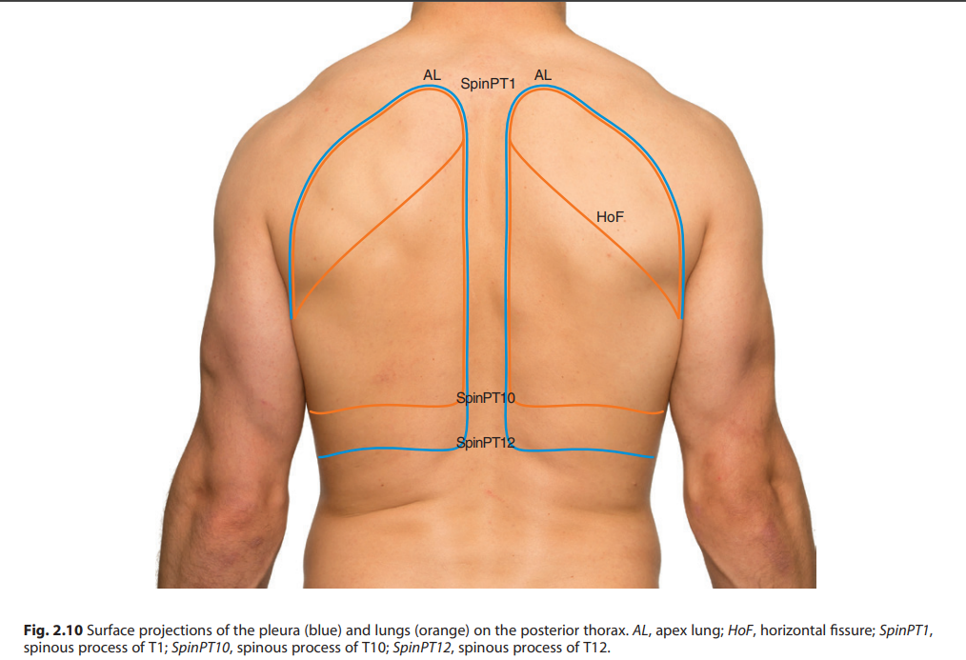
The pleura

Slide 38
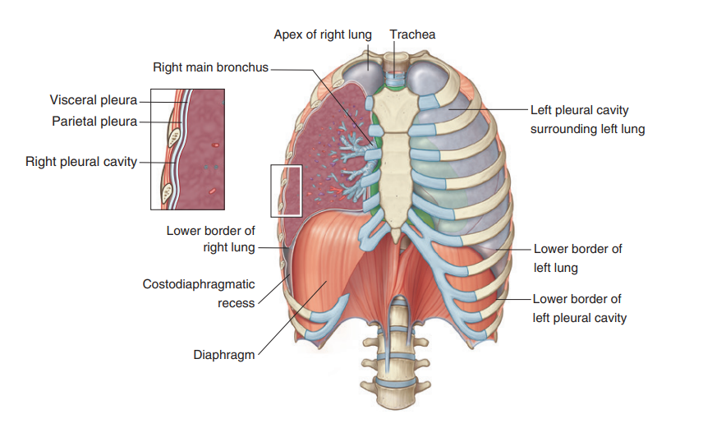
The pleura division
Pleura divisions (pulmonary and parietal)

Slide 39
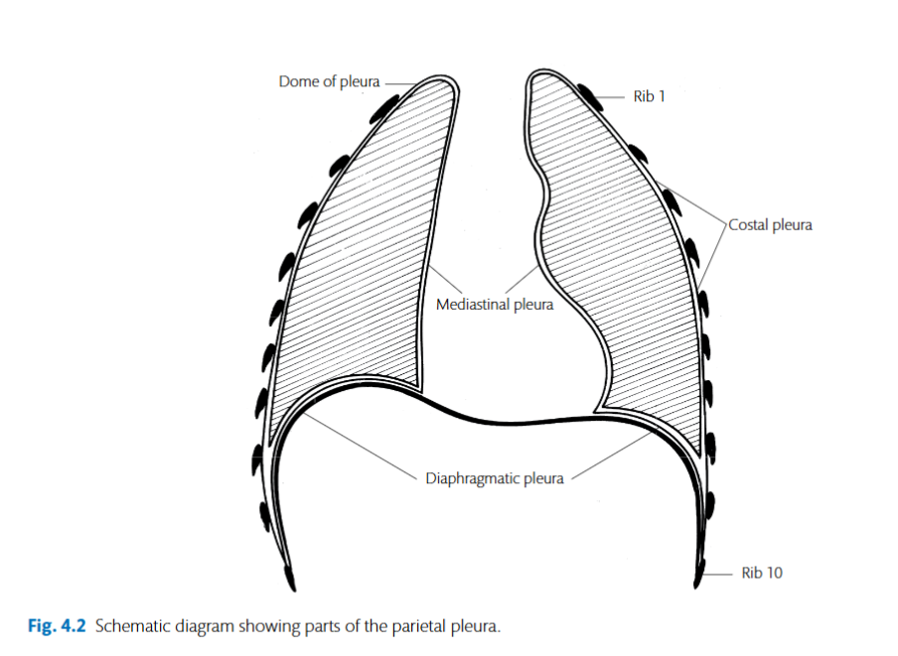
The portion of pleura that covers the mediastinum is called mediastinal (fibrous pericardium, oesophagus, thoracic aorta and its main branches).
The diaphragmatic portion covers the upper surface of the diaphragm.
The costal portion covers the inside of the rib cage. Some authors also designate a cervical portion (covering the underside of the suprapleural membrane).

Slide 40
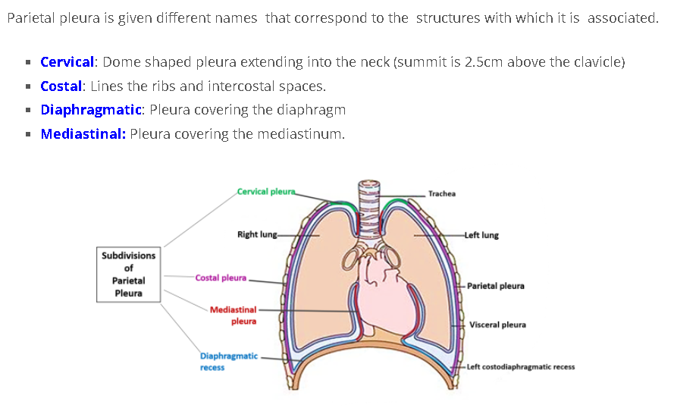
Parietal pleura division

Slide 41
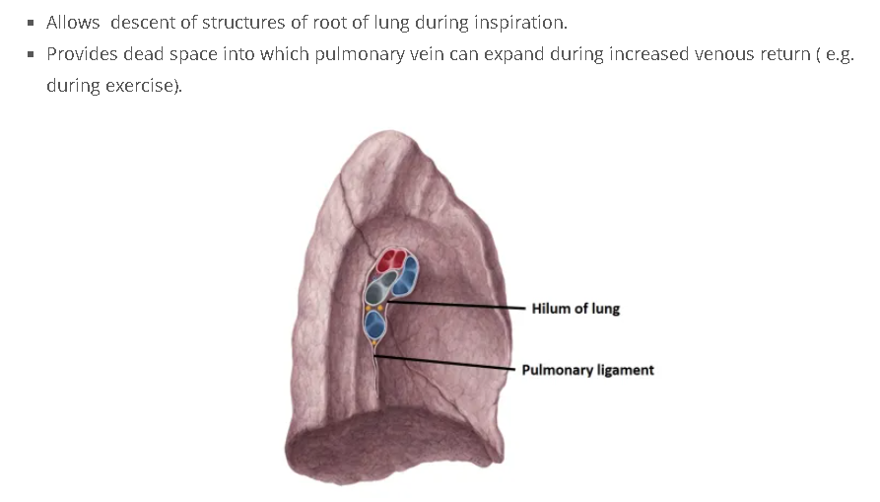
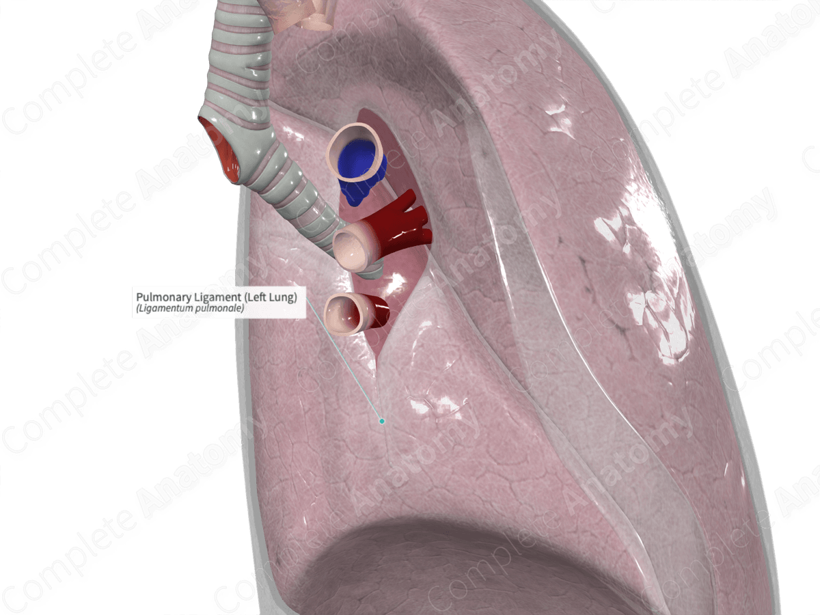
Visceral pleura and pulmonary ligament

Slide 42
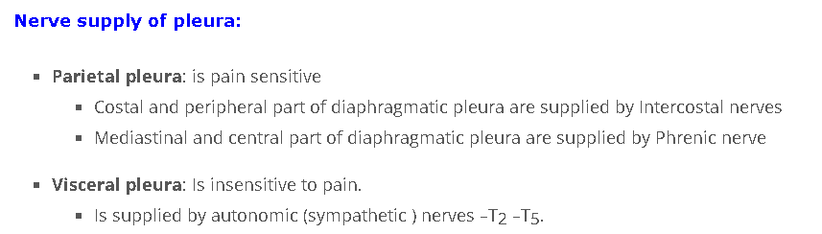
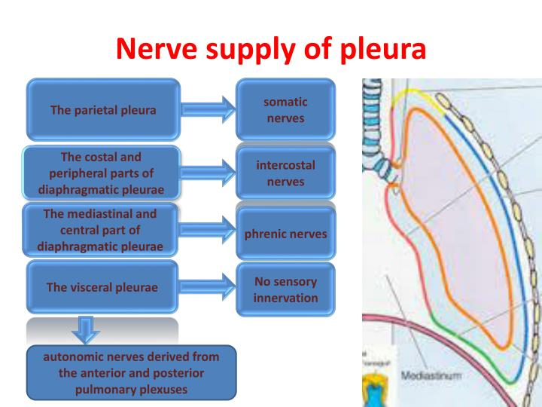

Slide 43
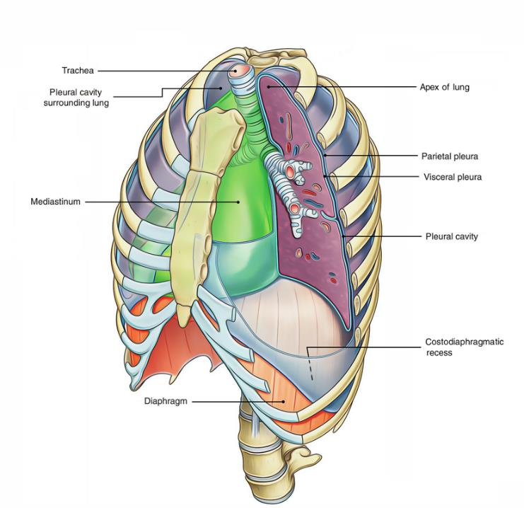
Pleural recesses
are empty parts of the pleural cavity, occupied by the lung only in full inspiration.
They lie where different parts of the parietal pleura meet at an acute angle and are in apposition to each other

Slide 44
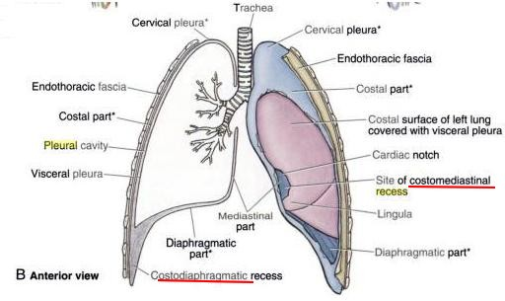
Pleural recesses
Anterior and inferior regions of pleural cavities are normally not occupied by the lungs.
In these regions the two layers of parietal pleura are opposed to each other resulting in presence of potential spaces called pleural recesses .
These recesses allow expansion of lungs during inspiration.
The two recesses of the pleura are:
Right and laeft costomediastinal recesses
Right and left costodiaphragmatic recesses

Slide 45
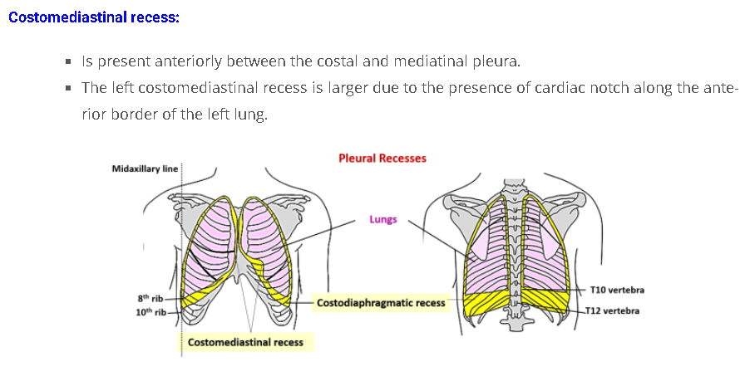
Costodiaphragmatic recesss
Is the largest and clinically most important recess.
Is present between the costal and diaphragmatic parts of parietal pleura.
Is C- shaped and present between the inferior margins of the lungs and the inferior margin of the pleural cavities.
Is the most dependent part of the pleural cavity and therefore the fluid of pleural effusions first collect here.

Slide 47
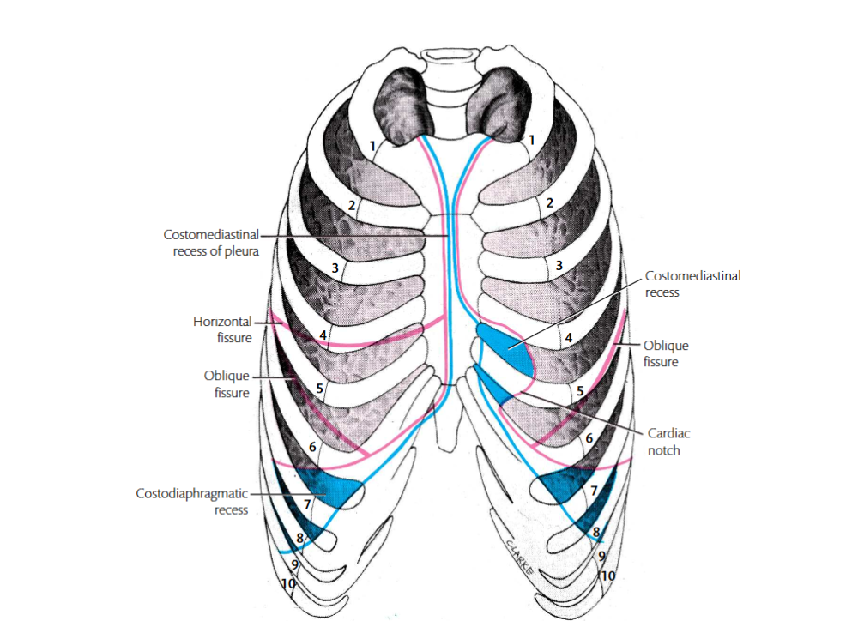
The costomediastinal recess is a potential space at the border of the mediastinal pleura and the costal pleura. It assists lung expansion during deep inspiration, and the costodiaphragmatic recess has a greater volume. The lung expands into the costomediastinal recess even during shallow inspiration. The costomediastinal recess is most obvious in the cardiac notch of the left lung.

Slide 48
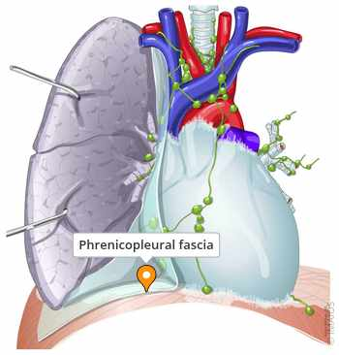
Where the costal and diaphragmatic parts of the pleura meet, they are bound down to the costal cartilages and diaphragm by a narrow thickening of the endothoracic fascia—the phrenicopleural fascia

Slide 49
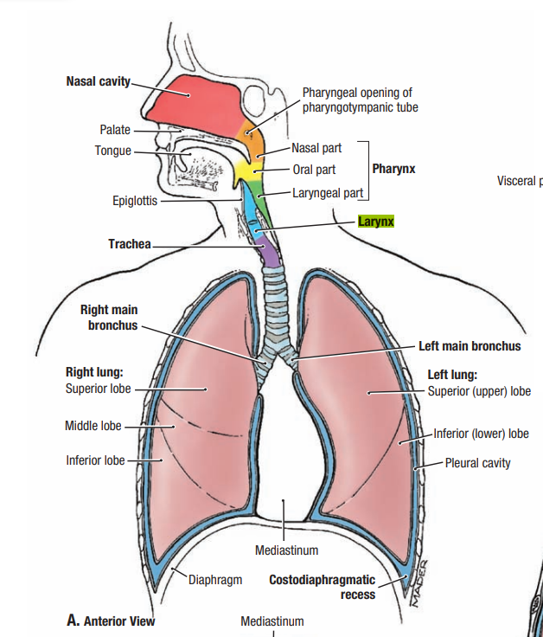
The lungs
the principal organs of respiration.
located within the pleural cavities
The right lung has 3 lobes: the superior, middle, and inferior, which are divided by oblique and horizontal fissures.
The left lung has only 2 lobes: the superior and inferior, which are separated by an oblique fissure.

Slide 50
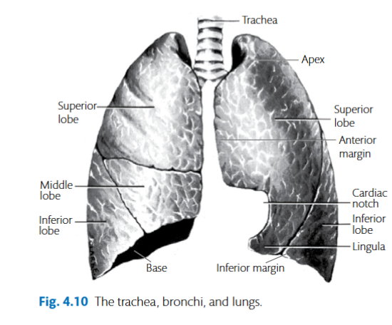

Slide 51
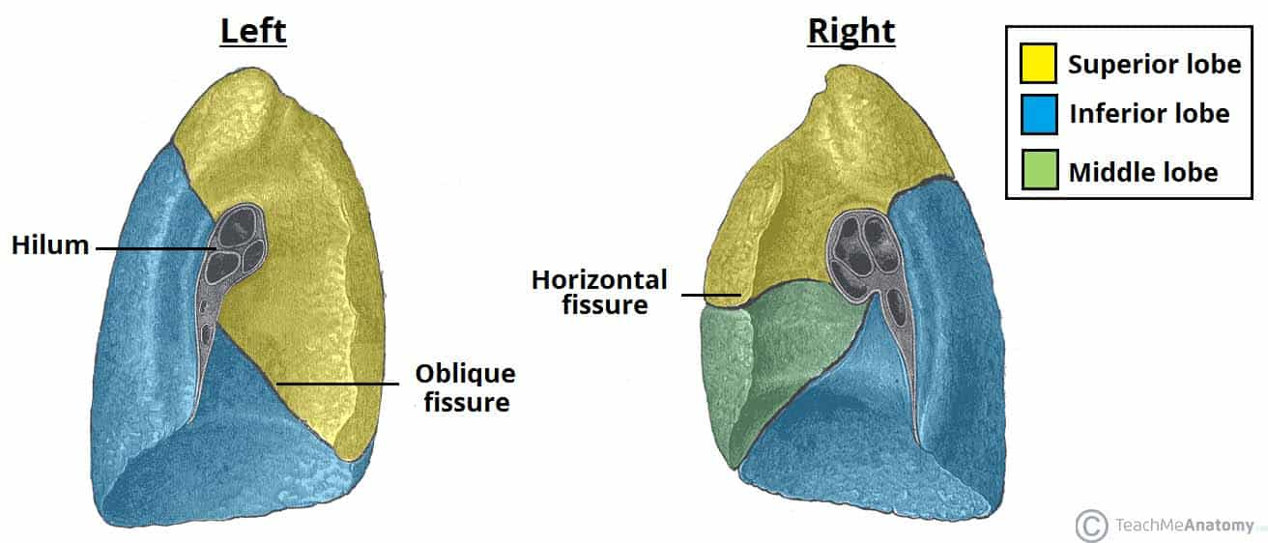

Slide 52
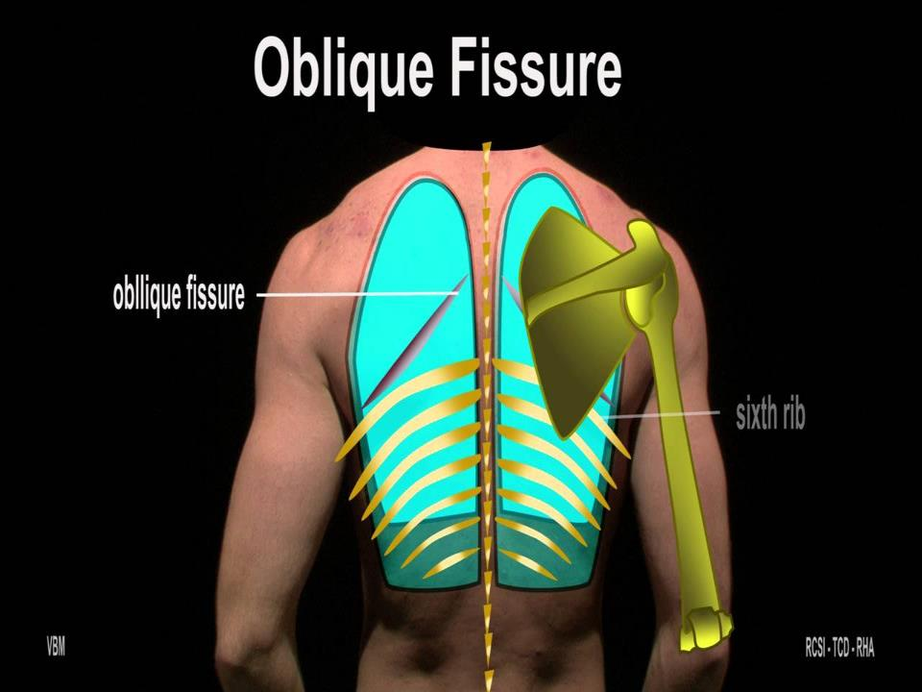

Slide 53
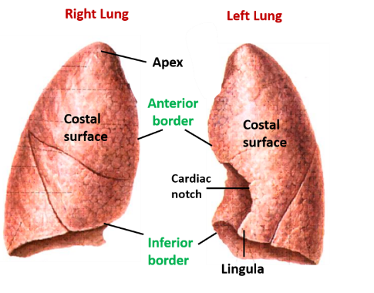
The apex of the lungs
Both lungs have a superior border, known as the apex, that sits just above the clavicle in the midclavicular line.

Slide 54
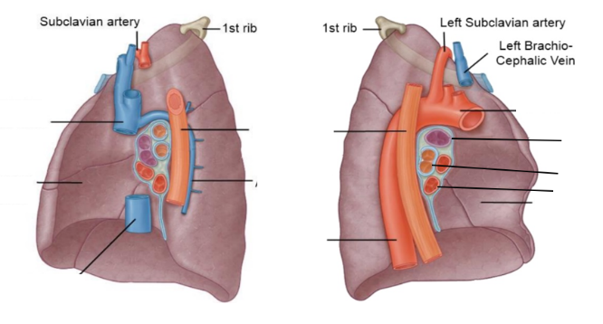
Apex of the lung
extends into the root of the neck, 3–5 cm above the anterior part of the first rib and 1–2 cm above the medial third of the clavicle.
The subclavian artery and vein cross the anterior surface of this part and may groove it
These vessels are separated from the lung by the pleura and the suprapleural membrane.

Slide 55
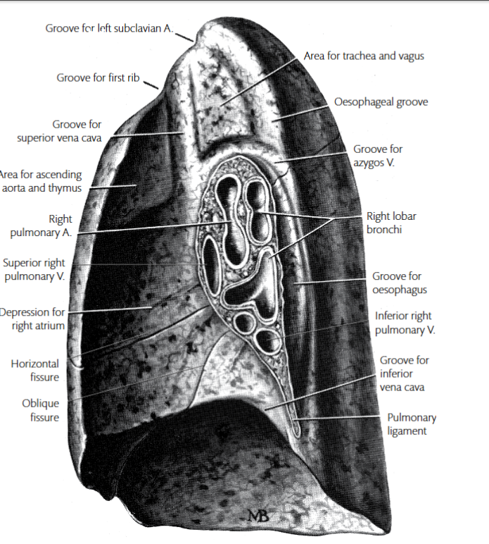
On the right lung, the impressions of the heart, right brachiocephalic vein, superior vena cava, inferior vena cava, azygos vein, trachea, and oesophagus are seen.

Slide 56
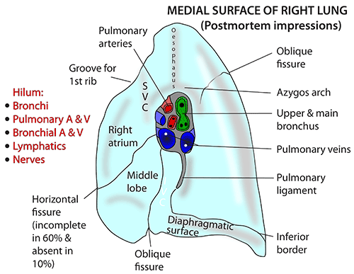

Slide 57

On the mediastinal surface of the left lung
the impressions of the heart, arch of the aorta, descending aorta, left common carotid and left subclavian arteries, and esophagus

Slide 58


Slide 59




Slide 60




Slide 61


Slide 62




Descriptive anatomy……
Apex
Basal surface
2 surfaces (medial-lateral)
3 borders (anterior-posterior-inferior)

Slide 63


Slide 64

apex of the lung

Slide 65

relationships of the apex of the lungs

Slide 66

2) Basal view

Slide 67


3) Lateral surface

Slide 68


3) Medial-mediastinal surface

Slide 69


Slide 70


hilum of the lung

Slide 71


hilum of the lungs

Slide 72


Hilum and ...

Slide 73


Slide 74


Pulmonary ligament
General Features
Hilum of the lung: Entry/exit point for bronchi, pulmonary vessels, nerves, and lymphatics.
Pulmonary ligament: Pleural fold below the hilum; stabilizes lung root.
Contains grooves/impressions from nearby thoracic structures.

Slide 75



Slide 77


Lobes of the lungs

Slide 78

Fissure

Slide 79
Left Lung – Medial Surface
Key impressions and relations:
Heart (left ventricle — deeper cardiac impression)
Aortic arch
Descending thoracic aorta
Left subclavian artery
Left common carotid artery
Esophagus
Hilum arrangement (top to bottom):
Pulmonary artery
Bronchus
Pulmonary veins

Slide 80
Right Lung – Medial Surface
Key impressions and relations:
Heart (right atrium)
Superior vena cava (SVC)
Inferior vena cava (IVC)
Azygos vein
Trachea
Esophagus
Right brachiocephalic vein
Hilum arrangement (top to bottom):
Bronchus (eparterial)
Pulmonary artery
Pulmonary veins (anterior & inferior)

