Slide 1
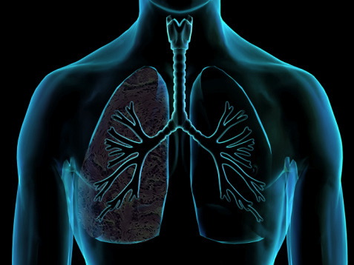
RESPIRATORY SYSTEM-LARYNX
PROFESSOR
M. PIAGKOU

Slide 2
Functions of the respiratory system (RS)
gas exchange between air and circulating blood
Moving air to and from the exchange surfaces of the lungs
Protecting respiratory surfaces from dehydration, temperature changes, and other environmental variations
Defending the RS and other tissues from invasion by pathogenic microorganisms
Producing sounds involved in speaking, singing, or nonverbal communication
Assisting in the regulation of blood volume, blood pressure, and the control of body fluid Ph

Slide 3
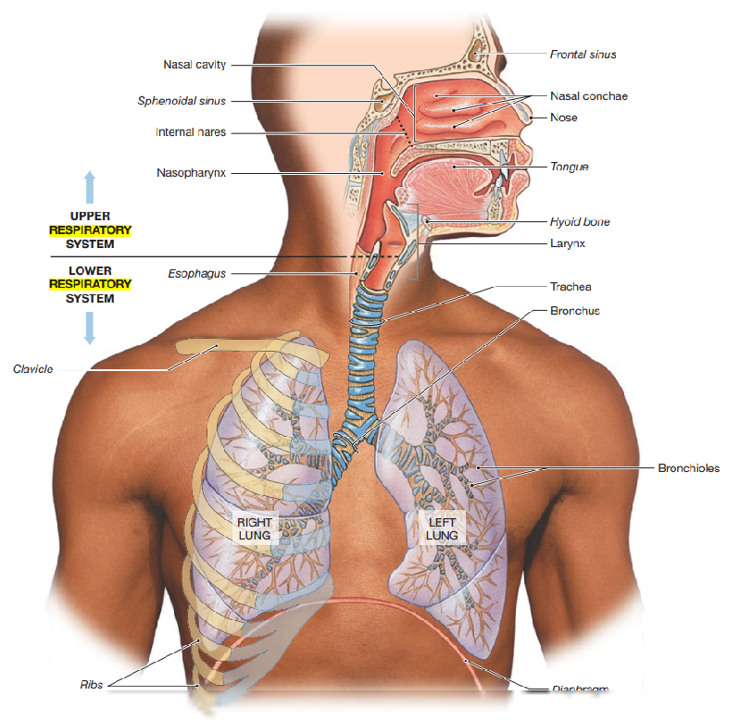

Slide 4
1. Upper Respiratory Tract:
Nose & Nasal Cavity: Filters, warms, and humidifies incoming air.
Larynx (Voice Box): Contains the vocal cords and protects the lower airway during swallowing.
2. Lower Respiratory Tract:
Trachea: A rigid tube that connects the larynx to the bronchi.
Bronchi: Trachea divides into the right and left bronchi, leading to each lung.
Bronchioles: Smaller branches of the bronchi within the lungs.
Alveoli: Tiny air sacs where gas exchange occurs. Oxygen enters the blood, and carbon dioxide is expelled.
3. Lungs:
The right lung has 3 lobes, and the left lung has 2 lobes (to accommodate the heart).
Surrounded by the pleura, a double-layered membrane that reduces friction during breathing.

Slide 5
1. Definition & Location
Also called the voice box
Located in the anterior neck, from C3 to C6
Lies between the pharynx (above) and the trachea (below)

Slide 6
Functions
Voice production (phonation)
Air passage to the lungs
Airway protection during swallowing (via the epiglottis)
Regulates pressure (e.g., Valsalva maneuver)
Cough reflex

Slide 7
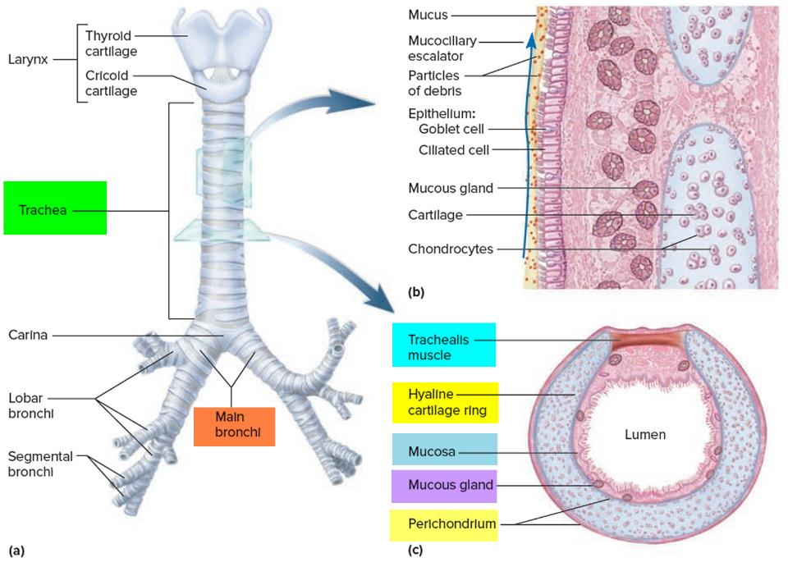

Slide 8
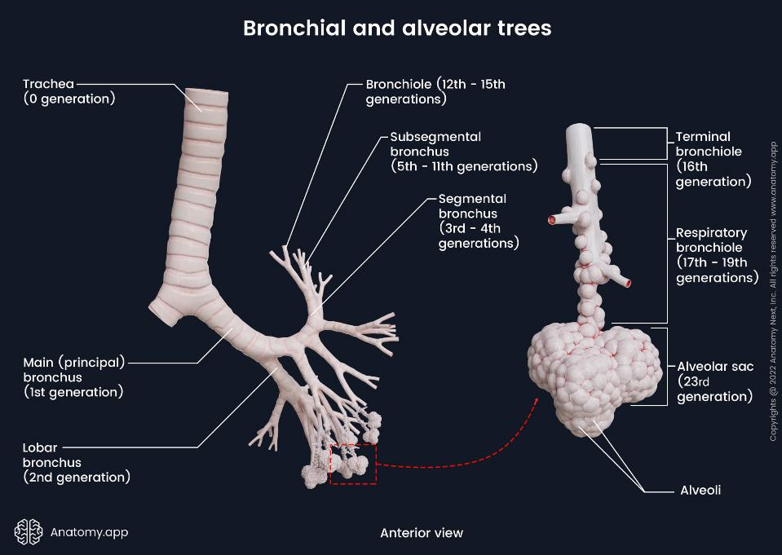
Alveoli: Tiny air sacs where gas exchange occurs. Oxygen enters the blood, and carbon dioxide is expelled

Slide 9
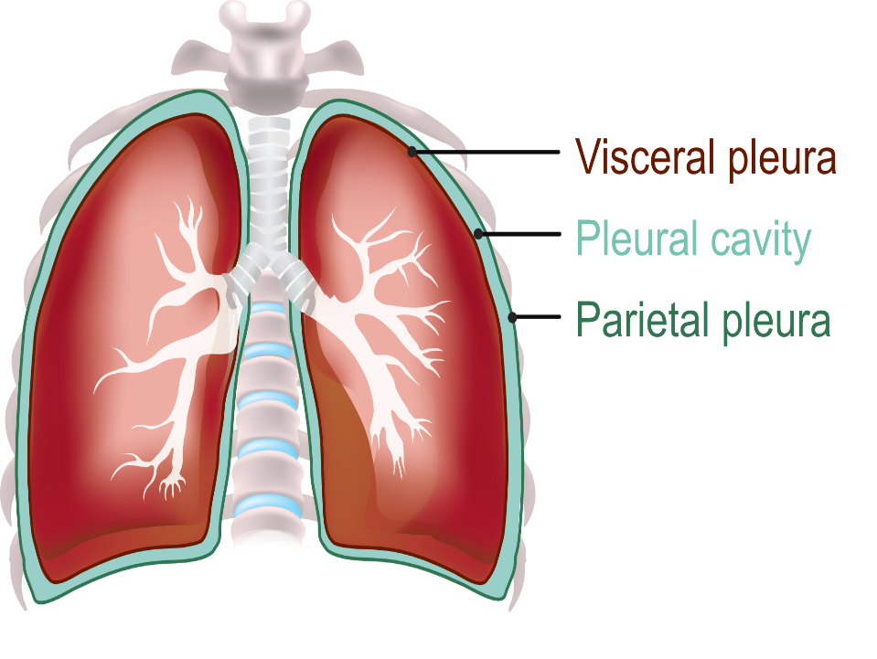

Slide 10
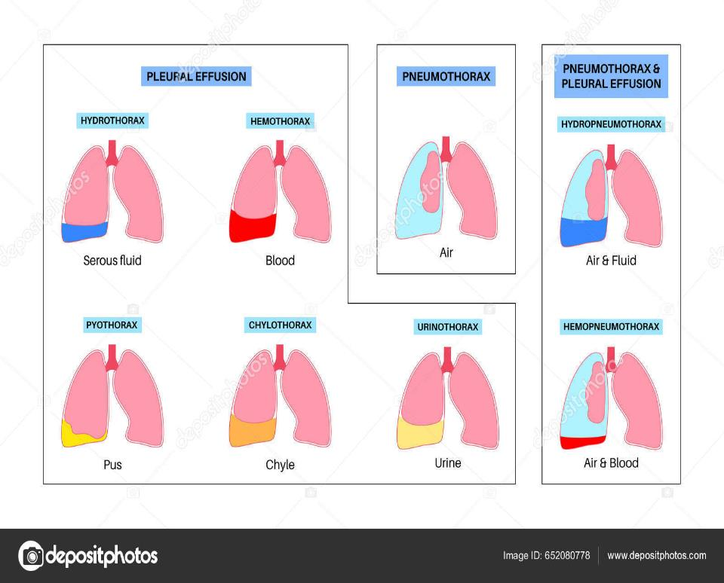

Slide 11
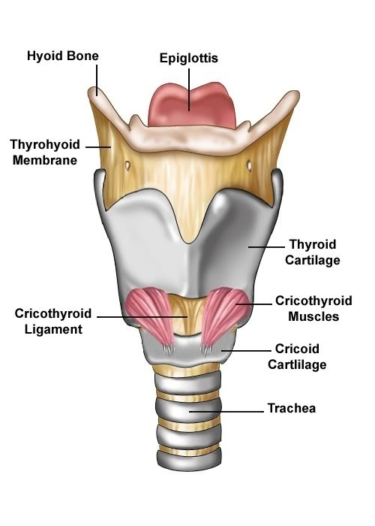
The larynx
the voice box, is a crucial structure located in the neck.
key roles in breathing, producing sound, and protecting the airway during swallowing.

Slide 12
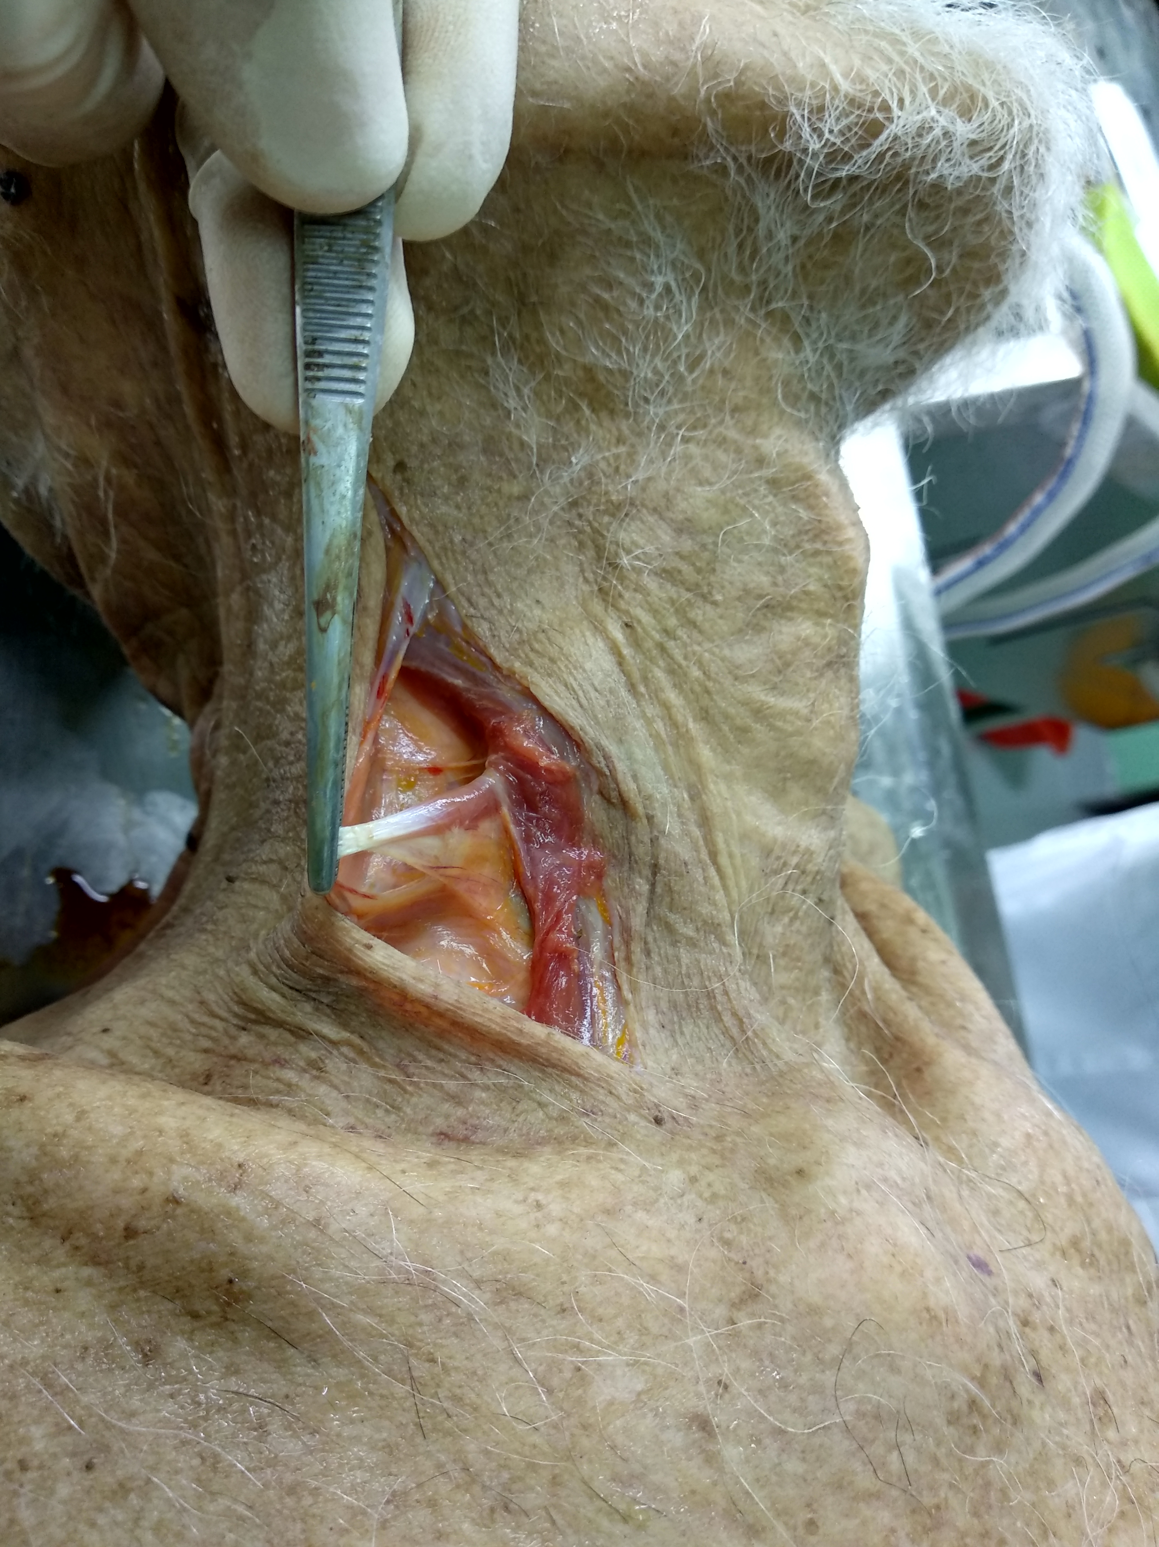
Location:
in the anterior neck, between the pharynx (above) and the trachea (below).
It spans from the C3 to C6 vertebral levels

Slide 13
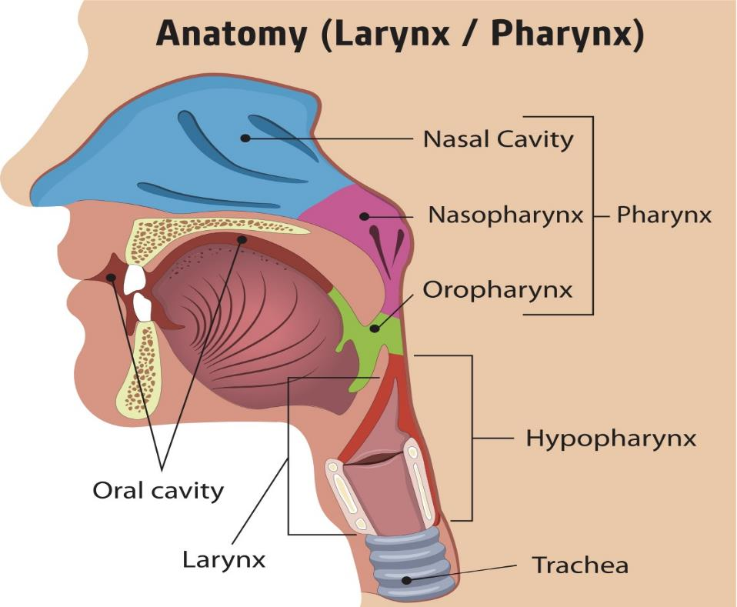

Slide 14
Cartilages of the Larynx
Total: 9 cartilages
Unpaired (3):
  Thyroid: Largest, forms Adam’s apple
  Cricoid: Only complete ring, below thyroid
  Epiglottis: Leaf-like; folds to protect airway
Paired (3 sets):
  Arytenoid: Controls vocal cords
  Corniculate: On top of arytenoids; structural support
  Cuneiform: Within aryepiglottic fold; maintains laryngeal inlet

Slide 15
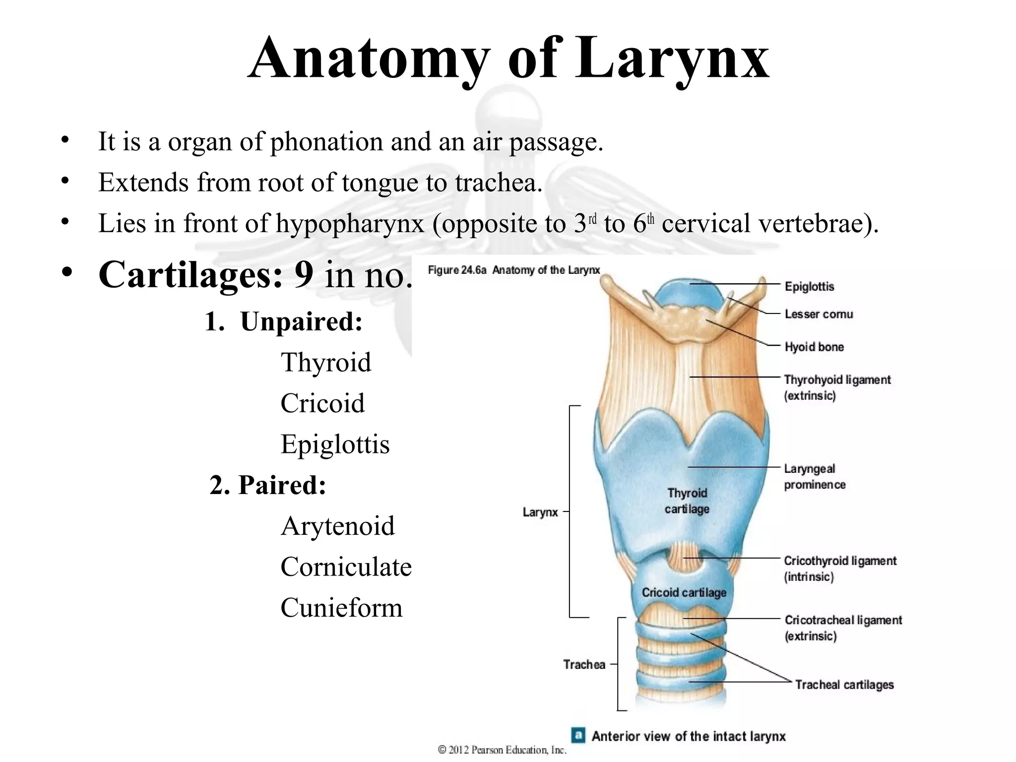

Slide 16
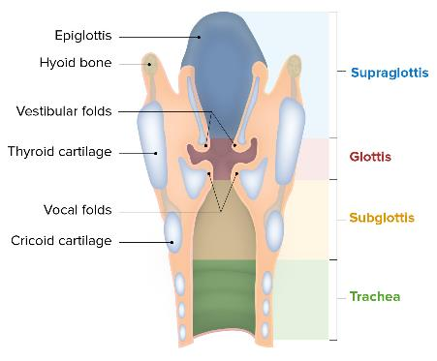
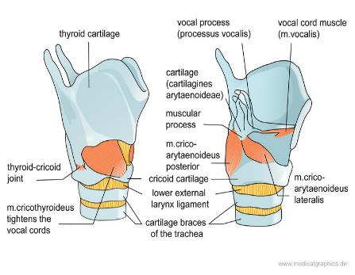
Cartilages
Provide structure and support.
Thyroid: The largest cartilage; forms the Adam's apple.
Cricoid: The only complete ring of cartilage; located below the thyroid cartilage.
Epiglottis: A leaf-shaped cartilage that prevents food from entering the airway during swallowing.
Arytenoids (pair): Essential for vocal cord movement.
Corniculate and cuneiform (paired): Provide additional support.

Slide 17
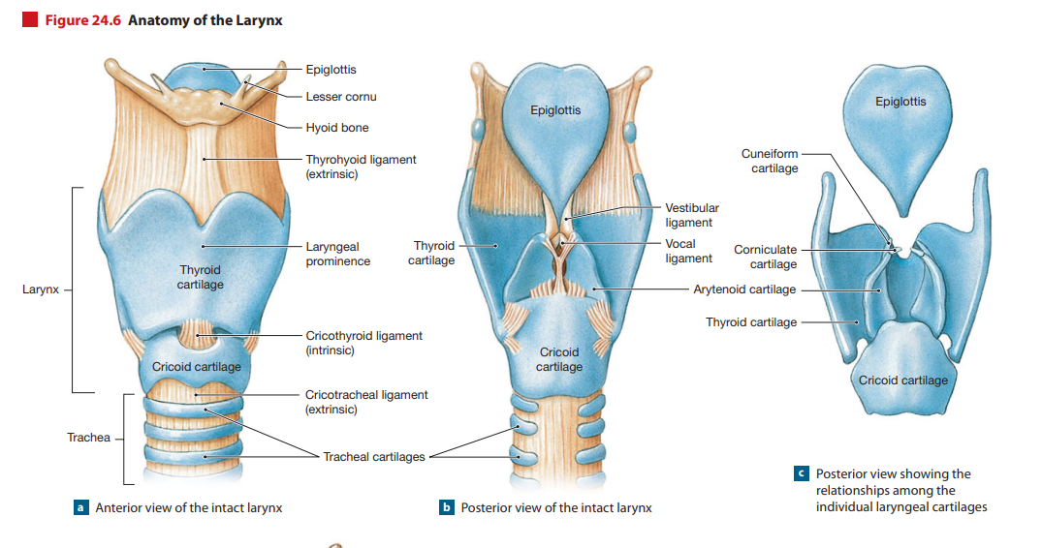

Slide 18
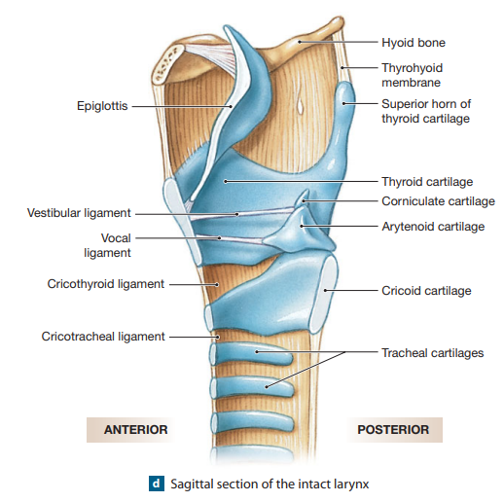

Slide 19
Muscles of the larynx
Control sound production and airway protection.
Intrinsic muscles: Adjust the tension of the vocal cords and open/close the glottis (e.g., cricothyroid, thyroarytenoid).
Extrinsic muscles: Help in elevating or depressing the larynx (e.g., infrahyoid and suprahyoid muscles).

Slide 20
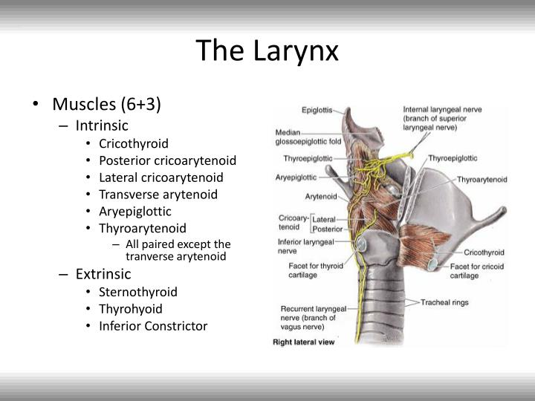

Slide 21
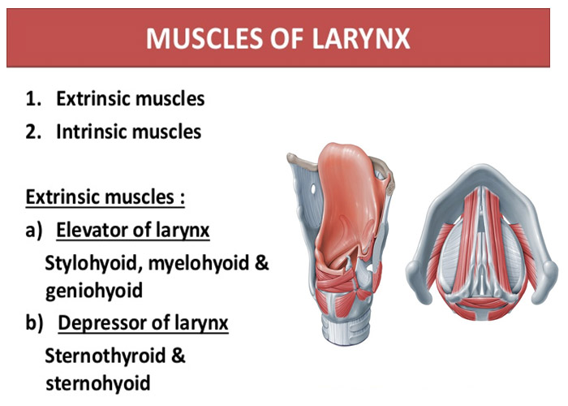

Slide 22
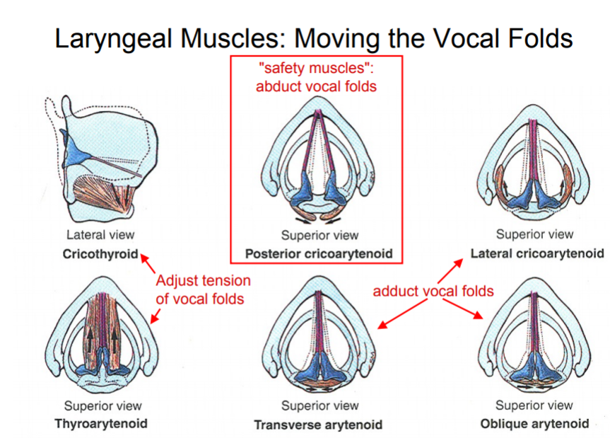

Slide 23
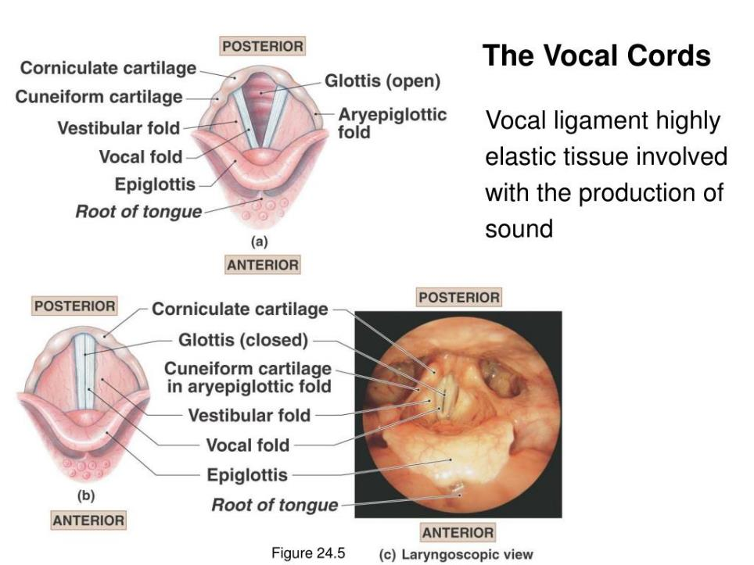

Slide 24
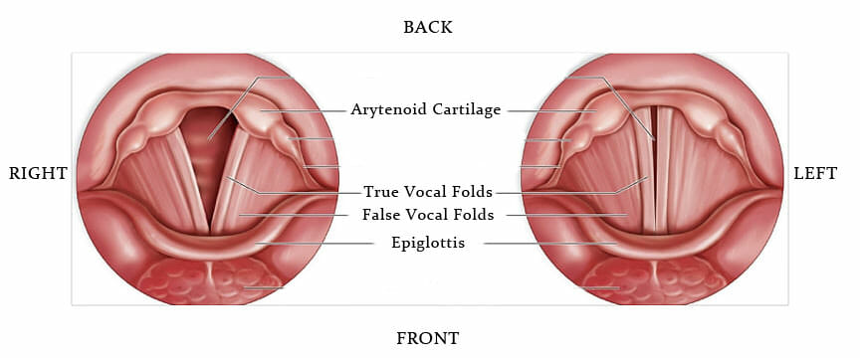
Vocal Cords (Folds)
True: Involved in sound production.
False (vestibular folds): Do not produce sound; help protect the airway.

Slide 25
Vocal Cords
Glottis = Opening between true vocal cords
Rima glottidis = Space that changes shape with vocal cord movement
Type | Function
True (vocal folds) | Sound production (elastic)
False (vestibular folds) | No sound; airway protection

Slide 26
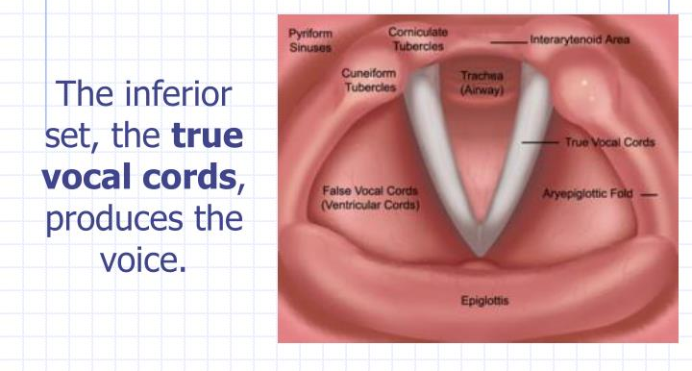
Vocal Cords (Folds)
True: Involved in sound production.
False (vestibular folds): Do not produce sound; help protect the airway.

Slide 27
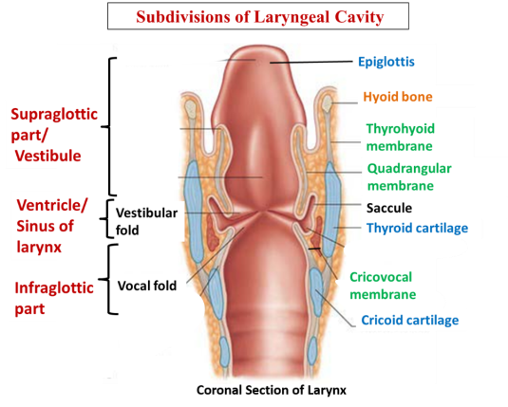
Laryngeal Cavity
Supraglottic: Above the vocal cords.
Glottic: Contains the vocal cords.
Subglottic: Below the vocal cords, leading to the trachea.

Slide 28
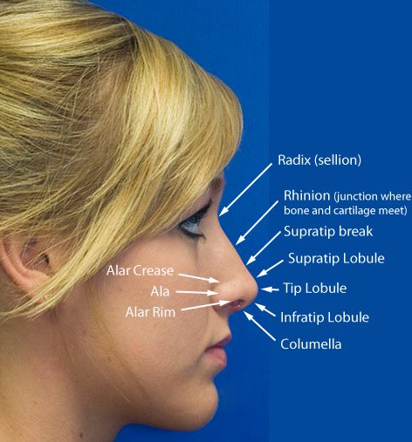
The nose
is a complex structure involved in breathing, smelling, and filtering air.
It consists of external and internal structures, each playing a crucial role in the respiratory and olfactory systems

Slide 29
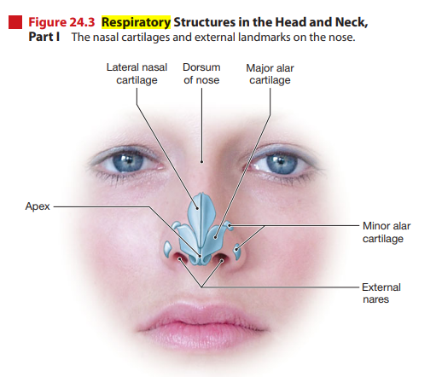

Slide 30
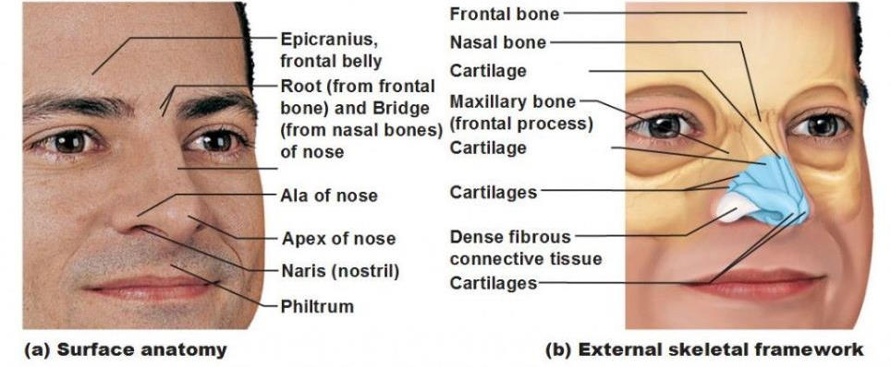
External Nose
Nasal Bridge: The bony upper part of the nose.
Nostrils (Nares): The two external openings through which air enters.
Alae: The fleshy, outer parts of the nostrils.
Nasal Septum: Divides the nostrils into left and right; made of bone and cartilage.

Slide 31
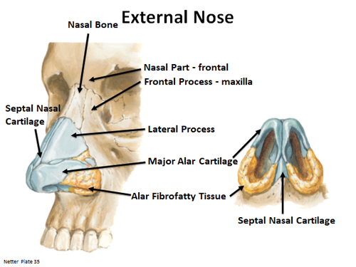
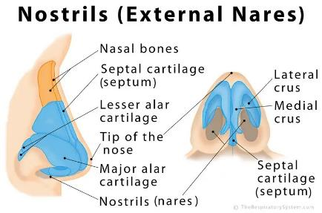
Nasal Bone: Provides structure and forms the bridge of the nose.
Cartilage: Gives shape and flexibility, including:
Lateral cartilage: Supports the sides of the nose.
Alar cartilage: Shapes the nostrils.
Septal cartilage: Forms the anterior part of the nasal septum.
Nostrils (Nares): Openings through which air enters the nasal cavity.

Slide 32
Internal Nose (Nasal Cavity)
a hollow space behind the nose, extending to the pharynx. It is divided into:
A. Nasal Septum:
Composed of the vomer bone, perpendicular plate of the ethmoid bone, and septal cartilage.
B. Nasal Conchae (Turbinates):
Three bony projections on the lateral walls:
  Superior Concha
  Middle Concha
  Inferior Concha
These structures increase the surface area of the nasal cavity, enhancing air filtration and humidification.
C. Nasal Meatuses:
Passageways beneath each concha (superior, middle, inferior).
They drain sinuses and direct airflow.
D. Mucous Membrane:
The nasal cavity is lined with a mucous membrane and cilia:
  Cilia: Tiny hair-like structures that trap particles and move mucus towards the throat.
  Mucus: Helps moisten air and trap pathogens.

Slide 33
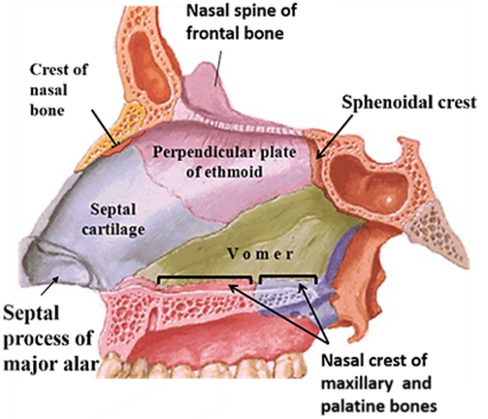

Slide 34
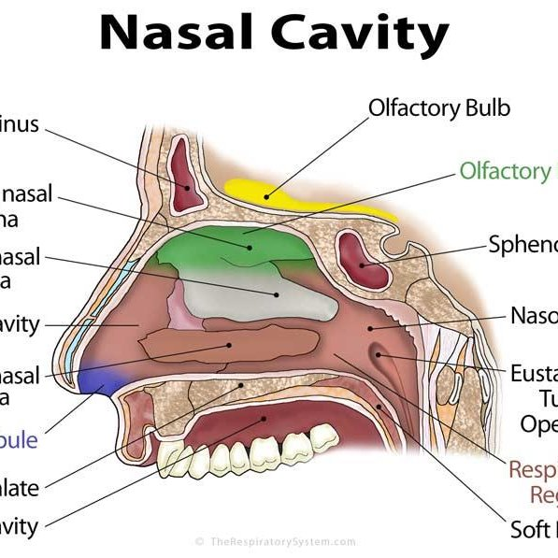

Slide 35
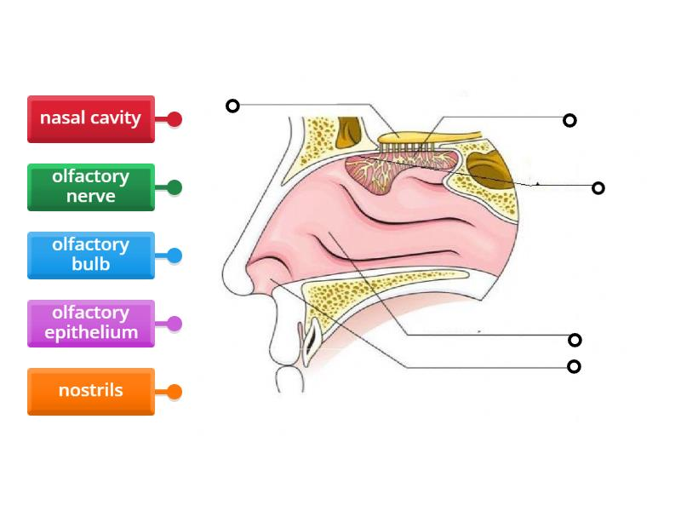

Slide 36
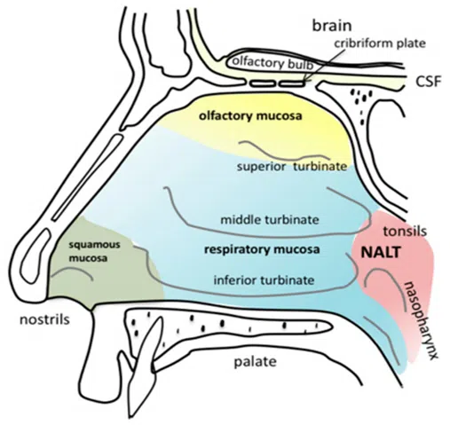

Slide 37
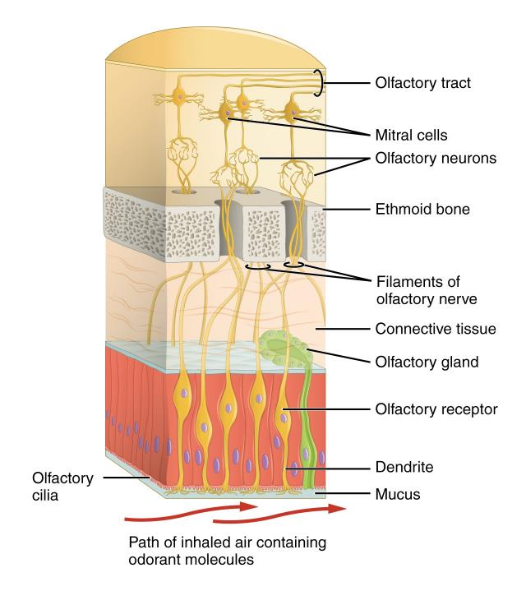
Olfactory Region
Located in the upper nasal cavity.
Contains olfactory receptors for the sense of smell.
Signals are sent to the olfactory bulb in the brain.
Contains olfactory receptors for smell detection.

Slide 38
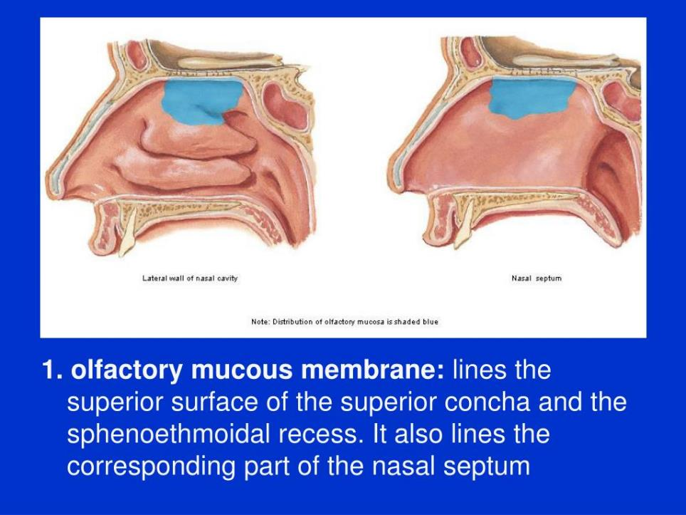

Slide 39
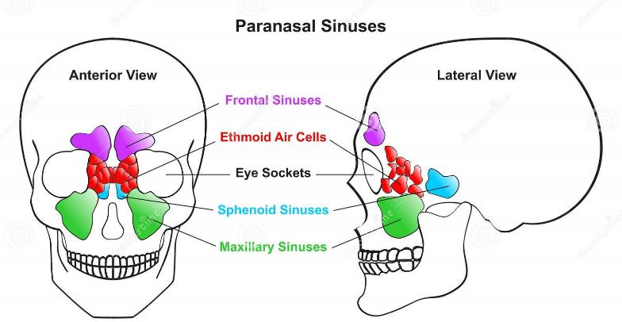
Paranasal Sinuses
Air-filled spaces in the skull that connect to the nasal cavity.
Include frontal, maxillary, ethmoid, and sphenoid sinuses.
Functions: Lighten the skull, Contribute to voice resonance, Produce mucus.

Slide 40
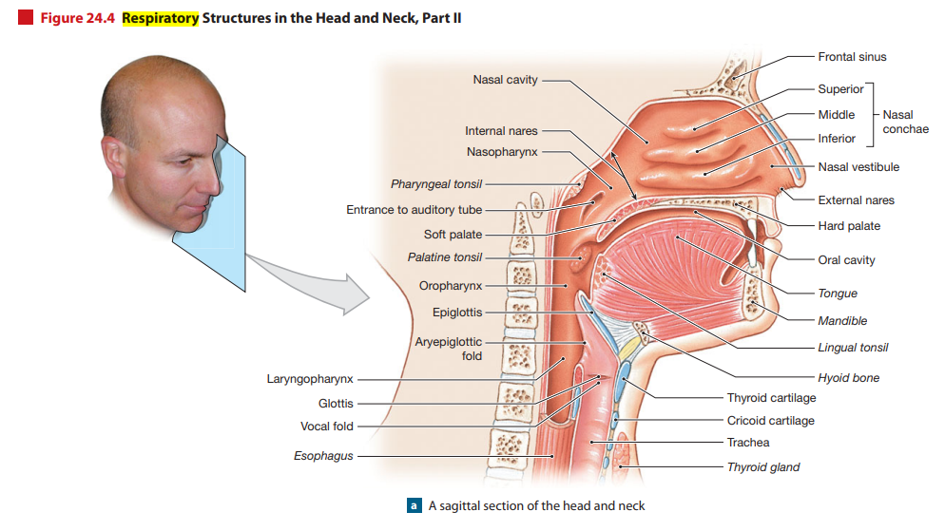

Slide 41
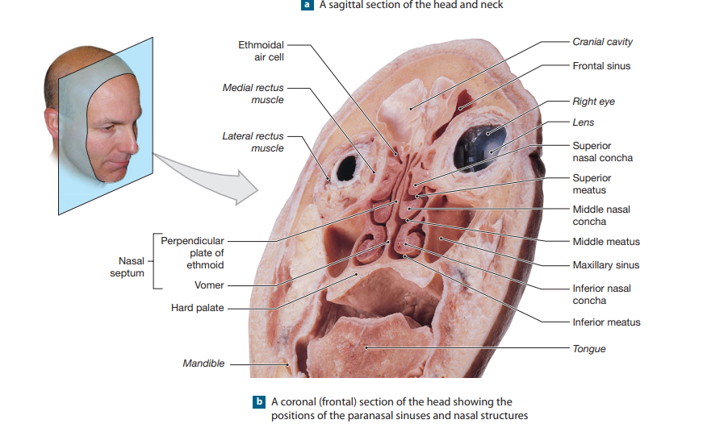

Slide 42
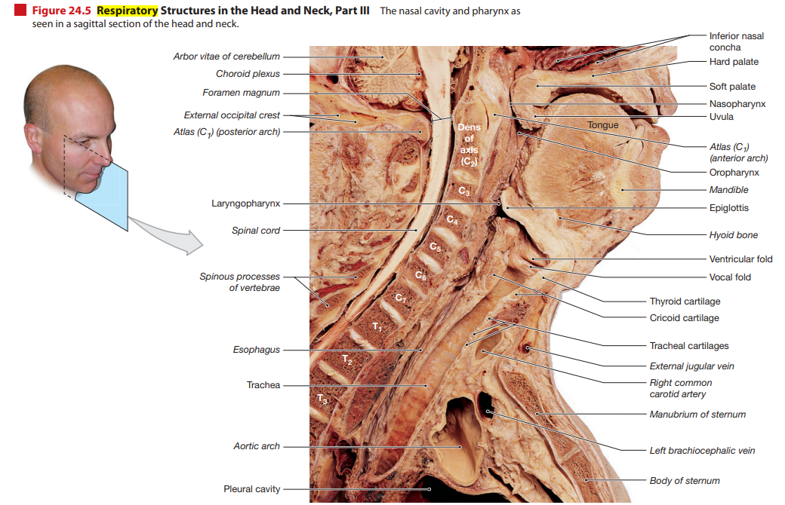

Slide 43
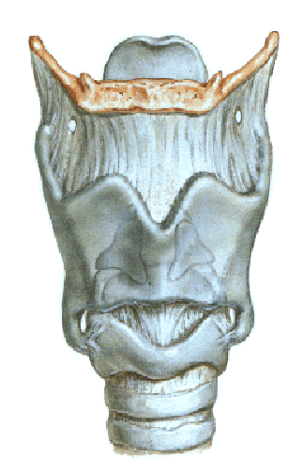
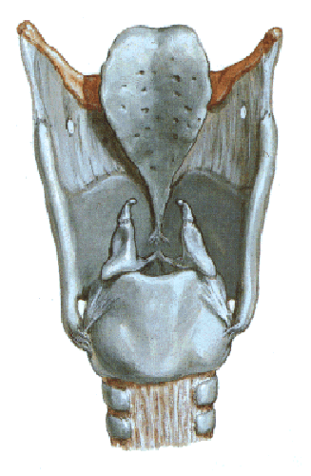
LARYNX CONSTRUCTION
SINGLE
1) Thyroid
2) Cricoid
3) Epiglottis
BIFID
1) Arytaenoid
2) Corniculate
3) Cuneiform

Slide 44
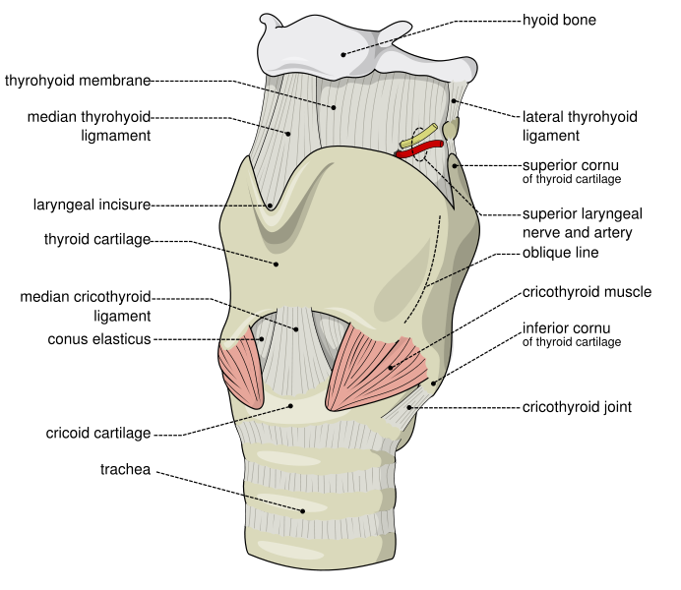
Thyroid cartilage
the largest cartilage of the larynx
critical role in protecting the vocal cords and aiding in sound production.
most prominent in males, Adam's apple
Anatomy: resembles a shield or butterfly with two broad, flat plates called laminae.
Two plates meet at the laryngeal prominence, commonly known as the Adam's apple.
Superior and Inferior Horns:
Superior horns: Attach to the hyoid bone via the thyrohyoid membrane.
Inferior horns: Connect to the cricoid cartilage, allowing movement during speech.

Slide 45
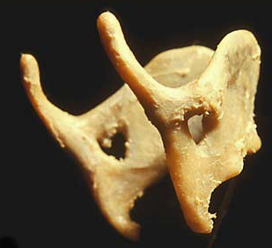
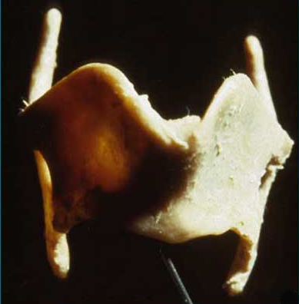
Thyroid cartilage

Slide 46
Location: Positioned in the anterior neck, at the level of C4 to C5 vertebrae.
Forms the front wall of the larynx and part of its sidewalls
Functions:Protecting the Vocal Cords:
Vocal cords sit just behind the thyroid cartilage, and it acts as a shield.
Supporting the Larynx: Provides an attachment point for muscles and ligaments involved in speech and swallowing.
Facilitating Sound Production: Through its connection with the cricoid cartilage, it helps adjust the tension of the vocal cords, influencing pitch and tone.

Slide 47
Muscles
Intrinsic muscles: Move vocal cords, control pitch & airway opening
  E.g., cricothyroid, posterior cricoarytenoid (opens cords)
Extrinsic muscles: Move the larynx as a whole (e.g., swallowing)
  E.g., suprahyoid, infrahyoid

Slide 48
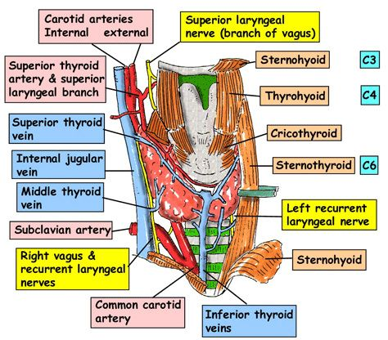
Extrinsic Muscles: the sternothyroid and thyrohyoid muscles, which help move the larynx during swallowing. Intrinsic Muscles: the cricothyroid muscle, which tenses the vocal cords to adjust pitch.

Slide 49
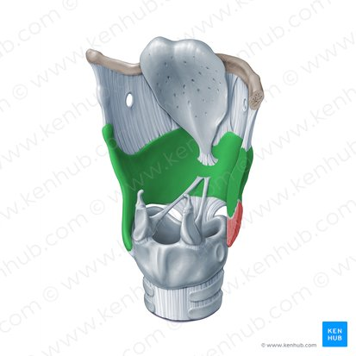
Thyroid cartilage
the largest
two smooth laminae of which the two lower thirds fuse in the midline, while the most superior third remains unfused and creates the laryngeal notch (Adam’s apple) due to the laryngeal prominence
The cartilaginous superior and inferior horns are created by the projections of the posterior superior and inferior borders of the cartilage.
The thyrohyoid membrane connects the superior aspect of the cartilage to the hyoid bone.
Notes:
Thyroid cartilage
the largest of the laryngeal cartilages
is made of two smooth laminae of which the two lower thirds fuse in the midline, while the most superior third remains unfused and creates the laryngeal notch.
makes the well-known Adam’s apple due to the laryngeal prominence that is made because of the fused laminae.
The cartilaginous superior and inferior horns are created by the projections of the posterior superior and inferior borders of the cartilage respectively.
The thyrohyoid membrane connects the entire superior aspect of the cartilage to the hyoid bone.

Slide 50
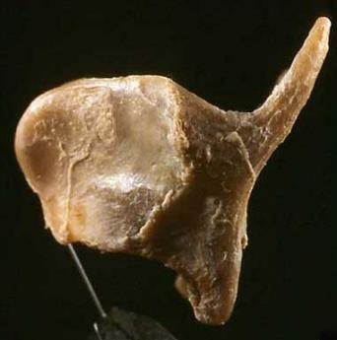
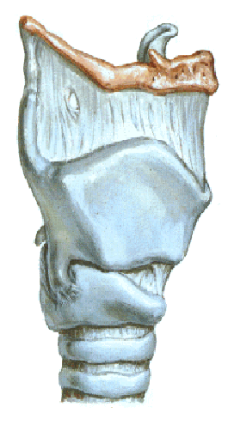
Thyroid cartilage

Slide 51
The cricoid cartilage
a ring-shaped cartilage
maintaining the airway's patency, facilitating sound production, and serving as an important landmark
Shape: resembles a signet ring, with a broad lamina (posteriorly) and a narrow arch (anteriorly).
Location: below the thyroid cartilage and above the trachea, at the C6 vertebra.
Anterior Arch: Provides support to the front of the larynx.
Posterior Lamina: A wider section that offers an attachment point for muscles

Slide 52
The cricoid cartilage
a ring-shaped cartilage
maintaining the airway's patency, facilitating sound production, and serving as an important landmark
Shape: resembles a signet ring, with a broad lamina (posteriorly) and a narrow arch (anteriorly).
Location: below the thyroid cartilage and above the trachea, at the C6 vertebra.
Anterior Arch: Provides support to the front of the larynx.
Posterior Lamina: A wider section that offers an attachment point for muscles
Connections:Above: Connected to the thyroid cartilage via the cricothyroid membrane.
Below: Continues with the first tracheal ring
Laterally: Articulates with the inferior horns of the thyroid cartilage at the cricothyroid joints.
Posteriorly: Supports the arytenoid cartilages, which are crucial for vocal cord movement.

Slide 53
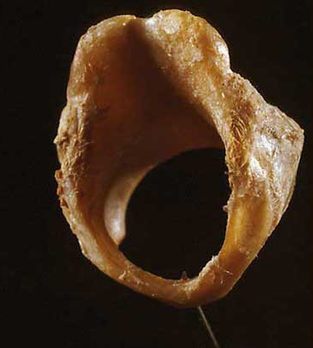
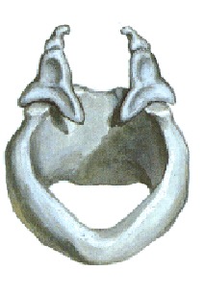
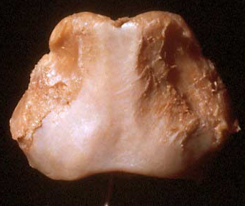
Cricoid cartilage
Basal cartilage of the larynx
Lower cartilage of the larynx
It constitutes the posterior and small part of the anterior wall of the larynx
Όψη από πάνω
Όψη από πίσω

Slide 54
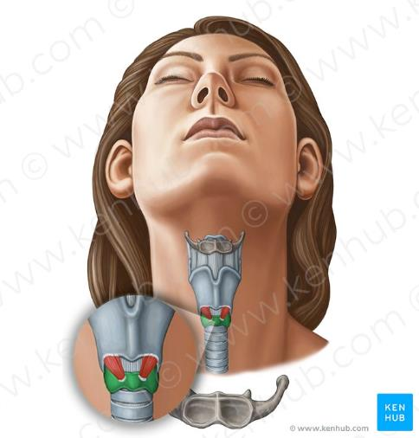
a complete circle of cartilage
is attached superiorly via the median cricothyroid ligament to the inferior aspect of the thyroid cartilage.

Slide 55
The cricoid cartilage
Muscle Attachments:
Intrinsic Muscles:Cricothyroid Muscle: Stretches and tenses the vocal cords, influencing pitch.
Posterior Cricoarytenoid: The only muscle that abducts (opens) the vocal cords, critical for breathing.
Lateral Cricoarytenoid : Adducts (closes) the vocal cords, important for phonation.

Slide 56
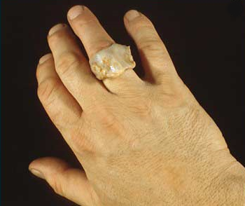
This cartilage is shaped like a signet ring, with the signet-shaped lamina facing posteriorly. It is a complete circle of cartilage
Notes:
A cricoid cartilage on your finger doesn’t look like a signat ring at all-it looks like a cricoid cartilage on your finger

Slide 57
The cricoid cartilage
Functions:
Maintains Airway Patency: The only complete ring of cartilage in the respiratory tract, providing structural stability.
Supports Vocal Cord Movement: Through articulations with the arytenoid cartilages.
Facilitates Sound Production: By adjusting the tension of the vocal cords.
Protects the Airway: During swallowing, the cricoid cartilage helps close the laryngeal inlet.

Slide 58
The cricoid cartilage
Cricothyrotomy: An emergency procedure where an incision is made through the cricothyroid membrane to establish an airway.
Intubation: The cricoid pressure (Sellick maneuver) may be applied to prevent aspiration during anesthesia.
Subglottic Stenosis: Narrowing of the area below the vocal cords, which can involve the cricoid cartilage.

Slide 59



Arytaenoid cartilages
Superior border of the cricoid cartilage
Part of the posterior wall of the larynx
The most important functionally
Κάτω όψη
Πρόσθια
–έξω όψη

Slide 60
Arytenoid cartilages
pyramidal in shape
Articulate with the lateral superoposterior aspects of the lamina of cricoid cartilage
3 processes: an apex, a vocal process, and a muscular process.
The apex is the most superior process that bears an articular facet for corniculate cartilage and is attached to the aryepiglottic fold.
The vocal process projects anteriorly and is the posterior attachment of the vocal cord.
the muscular process which sits laterally, holds the posterior and lateral insertions of the transverse arytenoid, posterior and lateral cricoarytenoid muscles.

Slide 61
Arytenoid cartilages
are the only major paired cartilages
the corniculate and cuneiform cartilages are seen to be minor cartilages.
pyramidal in shape and have three faces.
Articulate with the lateral superoposterior aspects of the lamina of cricoid cartilage
3 processes: an apex, a vocal process, and a muscular process.
The apex is the most superior process that bears an articular facet for corniculate cartilage and is attached to the aryepiglottic fold.
The vocal process projects anteriorly and is the posterior attachment of the vocal cord.
the muscular process which sits laterally, holds the posterior and lateral insertions of the transverse arytenoid, posterior and lateral cricoarytenoid muscles.

Slide 62



Slide 63
Corniculate cartilages
minor paired elastic cartilages
as nodules in the posterior aryepiglottic folds which attach the arytenoid cartilages to the lateral margin of the epiglottis.
The corniculate cartilages attach themselves to the apex of the arytenoid cartilages where the aryepiglottic fold inserts and that is how the nodule shape in the fold is made.

Slide 64
Cuneiform cartilages
minor paired elastic cartilages
The cuneiform cartilages are small and club-shaped. They do not directly attach themselves to any other cartilages but are suspended within the posterior part of the aryepiglottic fold.

Slide 65
It is situated between the hyoid bone and the dorsal part of the tongue anteriorly and the laryngeal inlet posteriorly, while the superior tip is left standing free.
The base of the epiglottis is, however, fastened to the thyroid laminae in the midline via the thyroepiglottic ligament.
Several membranes run bilaterally between the arytenoid cartilages and the epiglottic cartilages and are quadrangular in shape, so their free corners along with the covering mucosa produce the aryepiglottic fold.

Slide 66
Epiglottis or epiglottic cartilage
elastic cartilage which looks like a leaf
When oral contents are swallowed, it functions by closing over the laryngeal inlet (rima glottidis) or simply the glottis.

Slide 67
Ligaments & Membranes
Type | Key Structures & Functions
Extrinsic | Thyrohyoid membrane, cricotracheal ligament
Intrinsic | Cricothyroid ligament, vocal ligament, quadrangular membrane

Slide 68
Nerve Supply
Motor:
  Recurrent laryngeal nerve (CN X): All intrinsic muscles (except cricothyroid)
  External branch of superior laryngeal nerve: Cricothyroid
Sensory:
  Above vocal cords: Internal branch of superior laryngeal nerve
  Below vocal cords: Recurrent laryngeal nerve

Slide 69
Laryngeal Ligaments
A series of intrinsic ligaments binds all nine cartilages together to form the larynx
Extrinsic ligaments attach the thyroid cartilage to the hyoid bone and the cricoid cartilage to the trachea. The vestibular ligaments and the vocal ligaments extend between the thyroid cartilage and the arytenoids. Folds of laryngeal epithelium that project into the glottis cover the vestibular and vocal ligaments. The vestibular ligaments lie within the superior pair of folds, known as the vestibular folds
The vestibular folds, which are relatively inelastic, help prevent foreign objects from entering the glottis and provide protection for the more delicate vocal folds. The vocal folds are highly elastic, because the vocal ligament is a band of elastic tissue. The vocal folds are involved with the production of sounds, and for this reason they are known as the true vocal cords. Because the vestibular folds play no part in sound production, they are often called the false vocal cords

Slide 70
Sound Production
Air passing through the glottis vibrates the vocal folds and produces sound waves. The pitch of the sound produced depends on the diameter, length, and tension in the vocal folds. The diameter and length are directly related to the size of the larynx. The tension is controlled by the contraction of voluntary muscles that change the relative positions of the thyroid and arytenoid cartilages. When the distance increases, the vocal folds tense and the pitch rises; when the distance decreases, the vocal folds relax and the pitch falls. Children have slender, short vocal folds, and their voices tend to be high pitched. At puberty the larynx of a male enlarges considerably more than that of a female. The true vocal cords of an adult male are thicker and longer, and they produce lower tones than those of an adult female. The entire larynx is involved in sound production because its walls vibrate, creating a composite sound. Amplification and echoing of the sound occurs within the pharynx, the oral cavity, the nasal cavity, and the paranasal sinuses. The final production of distinct sounds depends on voluntary movements of the tongue, lips, and cheeks

Slide 71


Slide 72
The Bronchopulmonary Segments
Each lobe of the lung can be divided into smaller units
Each segment consists of the lung tissue associated with a single tertiary bronchus.
have names that correspond to those of the associated tertiary bronchi

Slide 73


Notes:
Air is breathed in through the nose to the nasal cavity, where a layer of nasal mucosa acts as a filter and traps pollutants and other harmful substances found in the air. Next, air moves into the pharynx, a passage that contains the intersection between the oesophagus and the larynx. The opening of the larynx has a special flap of cartilage, the epiglottis, that opens to allow air to pass through but closes to prevent food from moving into the airway.
From the larynx, air moves into the trachea and down to the intersection known as the carina that branches to form the right and left primary (main) bronchi. Each of these bronchi branches into a secondary (lobar) bronchus that branches into tertiary (segmental) bronchi, that branch into smaller airways called bronchioles that eventually connect with tiny specialized structures called alveoli that function in gas exchange

Slide 74

Respiratory tract
upper
lower
Notes:
Το αναπνευστικό σύστημα απαρτίζεται από όλα εκείνα τα όργανα που συμμετέχουν στη λειτουργία της αναπνοής, δηλαδή στην είσοδο και έξοδο αέρα και την ανταλλαγή του οξυγόνου και διοξειδίου του άνθρακα μεταξύ του αέρα και του αίματος.

Slide 75

Lower respiratory tract
Larynx
Tracheobronchial tree
Lungs
Notes:
The lower respiratory tract or lower airway is derived from the developing foregut and consists of the trachea, bronchi (primary, secondary and tertiary), bronchioles (including terminal and respiratory), and lungs (including alveoli).^{[8]} It also sometimes includes the larynx.
The lower respiratory tract is also called the respiratory tree or tracheobronchial tree, to describe the branching structure of airways supplying air to the lungs, and includes the trachea, bronchi and bronchioles.^{[9]}
trachea
main bronchus (diameter approximately 1 – 1.4 cm in adults)^{[10]}
lobar bronchus (diameter approximately 1 cm)
segmental bronchus (diameter 4.5 to 13 mm)^{[10]}
subsegmental bronchus (diameter 1 to 6 mm)^{[10]}
conducting bronchiole
terminal bronchiole
respiratory bronchiole
alveolar duct

Slide 76


Larynx

Slide 77
Summary
Skeleton of the cartilages of the larynx
9 cartilages
3 of them are paired and bilaterally symmetrical
3 remain unpaired and specifically placed for accurate function.
The main cartilages of the larynx are:
the thyroid cartilage
the epiglottic cartilage
the cricoid cartilage
the arytenoid cartilages and
the corniculate and cuneiform cartilages

Slide 78


Larynx
Increased oxygen requirements for movement and breathing
Protection of the lower respiratory tract (cough)
Participation in ingestion
Airway organ
Clamp that:
a) controls the entrance of the lower airway and protects the lungs (prevents aspiration, cough-mucus)
b) increases intraabdominal pressure
(c) participates in ingestion
Vocal organ
(relationship between position of the larynx and function)

Slide 79







Level of larynx
Position and tone of voice (singer stand)
Position and swallowing
Position and breastfeeding (pups, mammals)
Location and tracheotomy

Slide 80


Location of larynx
Limits
Upper: to upper body surface C3
Bottom: to lower body surface 6
In the female 0.5-1 vertebra higher
(Extension-head flexion, speech, swallowing,
cough, the voice of acute and deep tones)

Slide 81


LARYNX VOLUME
Size and stature. Increase in sagittal diameter in men during puberty – castrated men
Length: 44 or 70mm (36)
Transverse diameter:43 mm (41)
Sagittal diameter:36 mm (26)
LARYNGEAL PROMINENCE

Slide 82

location of the larynx
Sagittal section
Notes:
The larynx is the most superior part of the respiratory tract in the neck and the voice box of the human body.
It surrounds and protects the vocal chords, as well as the entrance to the trachea, preventing food particles or fluids from entering the lungs.
The cartilages of the larynx make up its skeleton. Of the nine cartilages all together, three of them are paired and bilaterally symmetrical, while three remain unpaired and specifically placed for accurate function
the respiratory tract surrounds and protects the vocal cords, as well as the entrance to the trachea, preventing food particles or fluids from entering the lungs.
The cartilages of the larynx make up its skeleton. Of the nine cartilages, three of them are paired and bilaterally symmetrical, while three remain unpaired and specifically placed for accurate function.

Slide 83
Larynx-functions
Speech production
  the voice box
  Vibrations of these vocal folds allow humans to speak and sing
  Changes in the vibration speed and tension of the vocal folds vary the pitch
Air passage in the respiratory system
  The larynx helps provide smooth passage of air from the nasal cavity to the lungs
  Air enters through the nose and mouth when a person inhales, and travels through the pharynx, larynx, and bronchi
Channeling food into the digestive system
  The larynx helps prevent choking when eating and drinking
  When food is swallowed, a small flap called the epiglottis covers the opening of the larynx to keep food and drink from entering the airways
Notes:
Speech production
Also called the voice box, the larynx is comprised of two pairs of vocal folds (mucous membrane structures)
Vibrations of these vocal folds allow humans to speak and sing
Changes in the vibration speed and tension of the vocal folds vary the pitch
Air passage in the respiratory system
The larynx helps provide smooth passage of air from the nasal cavity to the lungs
Air enters through the nose and mouth when a person inhales, and travels through the pharynx, larynx, and bronchi
When a person is breathing normally, the vocal cords are relaxed and partly open
If the body needs more oxygen, the vocal cords open more widely during inhalation
If sensors in the larynx detect foreign particles that could damage the airways, a cough reflex is stimulated
Channeling food into the digestive system
The larynx helps prevent choking when eating and drinking
When food is swallowed, a small flap called the epiglottis covers the opening of the larynx to keep food and drink from entering the airways

Slide 84




LARYNX CONSTRUCTION
1) Cartilage-Ligaments/Joints
2) Muscles
3) Cavity-Mucosa
4) Vessels and nerves

Slide 85
LARYNX CONSTRUCTION
Cricoid
Thyroid
Epiglottis
Α. CARTILAGINOUS
SKELETON
Β. LIGAMENTS
Γ. MUSCLES
- VESSELS AND NERVES
Arytaenoid (2)
Corniculate (2) Cuneiform (2)
Notes:
The larynx is a complex band of cartilage, ligament, and muscle as well as a mucous membrane. A hollow structure, it’s formed of three large sections of cartilage that are unpaired—the thyroid, cricoid, and epiglottis—as well as six smaller cartilages. Here’s a quick breakdown of the large cartilages:¹

Slide 86


Slide 87


Slide 88

laryngeal cavity
Notes:
Όλο αυτό το δομικό υπόστρωμα που περιγράψαμε εσωτερικά , κατά την κοιλότητα που δημιουργείται επαλείφεται με βλεννοφόνο και έτσι σχηματίζεται η λαρυγγική κοιλότητα
Στην οπίσθια άποψη έχει γίνει διατομή . Μορφή κλεψύδρας.
Άνω στόμιο : επιγλωττίδα άνω χείλος, αρυταινοεπιγλωττιδική πτυχή, βλεννογόνος μεταξύ των κερατοειδών χόνδρων: μεσαρυταινοειδής εντομή.
Δίο πτυχές που προεξέχουν στο εσωτερικό , τη στενεύουν και τη διαιρούν σε τρία μεγάλα διαμερίσματα:
Πρόδομος
Μεσαίο τμήμα
Υπογλωττικός χώρος
Στο μεσαίο τμήμα από το διάκενο προβάλλει ο βλεννογόνος προς τα έξω: λαρυγγική κοιλία.: αδένες που παράγουν βλέννα για τη λίπανση των φωνητικών πτυχών.

Slide 89

Τραχεία
Συνέχεια του λάρυγγα
Α6-Θ4/5
Ινοχόνδρινος σωλήνας
16-20 ημικρίκια
Μεσοκρίκιοι σύνδεσμοι
Notes:
Στο επίπεδο Α6 που ο φάρυγγας συνέχεται στον οισοφάγο, ο λάρυγγας συνέχεται στην τραχεία.
Πορεύεται επιφανειακά στον τράχηλο μπροστά από τον οισοφάγο και εισέρχεται στο ανώτερο μεσοθωράκιο
Εισέρχεται στο ανώτερο μεσοθωράκιο και στο επίπεδο της στερνικής γωνίας διχάζεται στο δεξιό και αριστερό βρόγχο

Slide 90


Slide 91


Slide 92

Notes:
ΜΕΣΟΛΟΒΙΕΣ ΣΧΙΣΜΕΣ

Slide 93


