Slide 1
Skin-Breast
Structure and Function, Embryology, Axilla, and Related Muscles
IOANNIS DIMOVELIS
M.D.,M.Sc.,Ph.D.,FEBOPRAS
PLASTIC AND RECONSTRUCTIVE SURGEON

Slide 2
Introduction
The mammary gland is a modified sweat gland present in the superficial fascia of the pectoral region. The mammary gland is found in both sexes.
However, it remains rudimentary in male but becomes well-developed in female at puberty.
On rare occasions the breasts of male become enlarged, this condition is called gynecomastia.
In female, it forms an accessory sex organ of female reproductive system and provides milk to the newborn. The anatomy of breast is of great surgical importance, and therefore, needs to be studied in detail.

Slide 3
INTRODUCTION
The breasts are paired structures located on the anterior thoracic wall, in the pectoral region. They are present in both males and females, yet are more prominent in females following puberty.
In females, the breasts contain the mammary glands – an accessory gland of the female reproductive system. The mammary glands are the key structures involved in lactation.

Slide 4
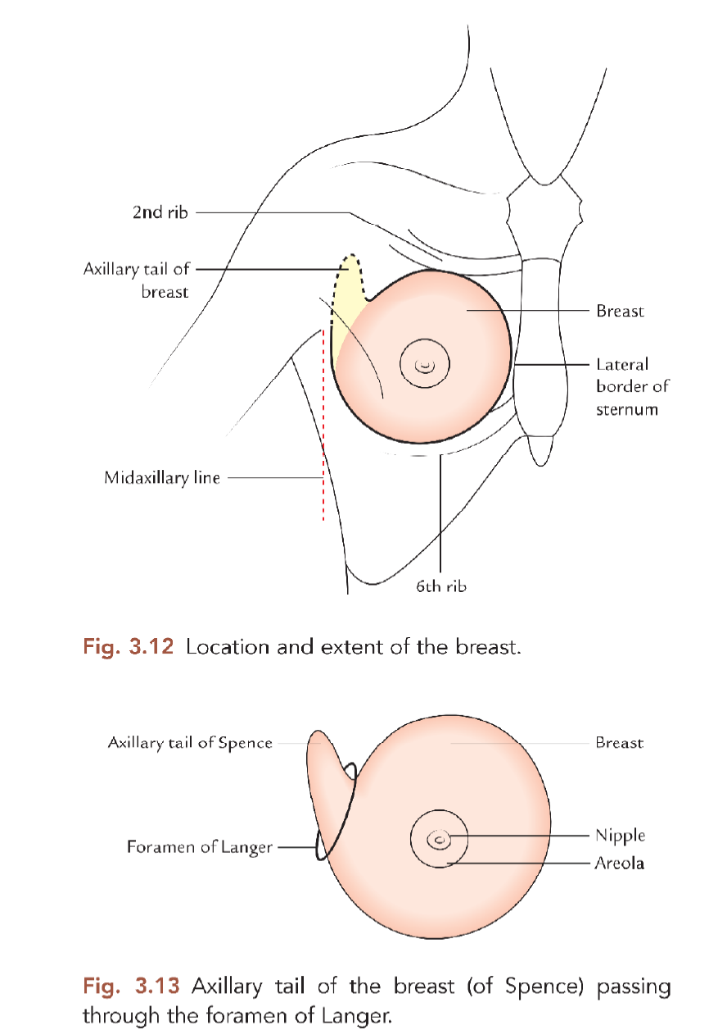
Location
The breast is located in the superficial fascia of the pectoral region.
A small extension from its superolateral part (axillary tail of Spence) however pierces the deep fascia and extends into the axilla.
The aperture in the deep fascia through which axillary tail passes into the axilla is called foramen of Langer.
The axillary tail is the site of high percentage of breast tumor.

Slide 5
Shape and extent
It has a shape of hemispherical bulge
It extends:
Vertically from 2nd rib to 6th rib.
Horizontally, from lateral border of the sternum to the midaxillary line.

Slide 6
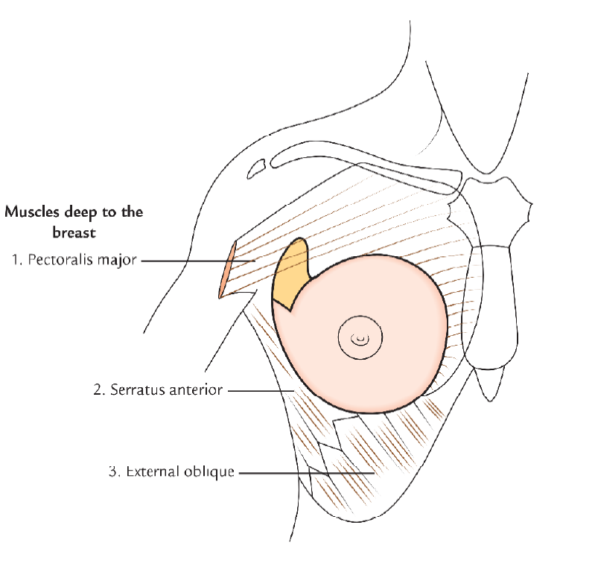
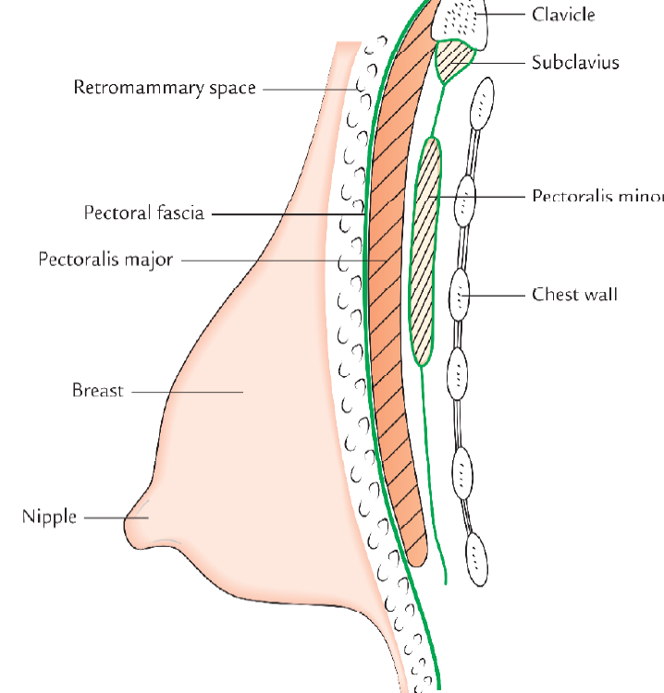
Relations
The deep aspect of the breast is related to the following structures superficially to deep
Pectoral fascia, the deep fascia covering the anterior aspect of pectoralis major
Three muscles:Pectoralis major,serratus anterior and external oblique

Slide 7
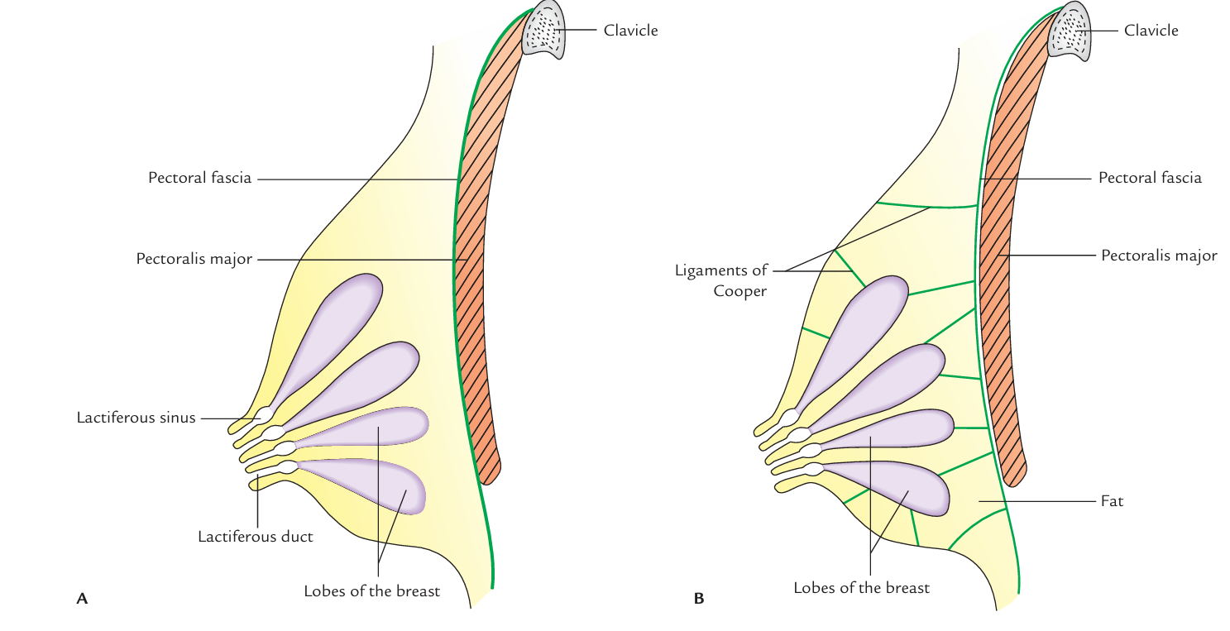
STRUCTURE
It consists of the following structures
Skin
Stroma
Breast parechyma

Slide 8
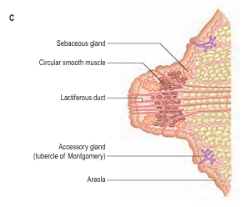
Skin
It is the covering for the breast and presents the following features:
Nipple: It is a conical projection below the center of the breast, usually at the level of the 4th intercostal space. It contains smooth muscle fibres, which can make the nipple stiff and erect or flatten it.
Being extensively innervated by sensory nerve endings, the nipple is the most sensitive part of the breast to tactile stimulation and become erect during sexual arousal.

Slide 9
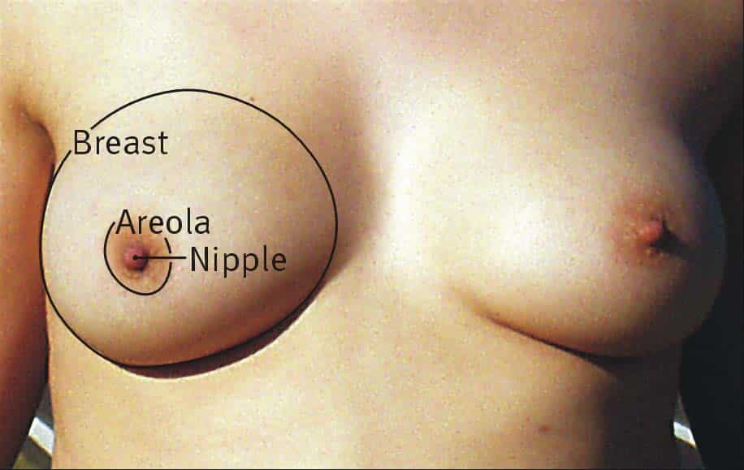
Skin
Areola: It is the circular area of pigmented skin surrounding the base of the nipple. It contains large number of modified sebaceous glands, particularly at its outer margin.
They produce oily secretion, which lubricates the nipple and areola, and thus prevents them from drying and cracking.
The color of the areola and the nipple varies with the race
During pregnancy the areola becomes darker and enlarged.

Slide 10
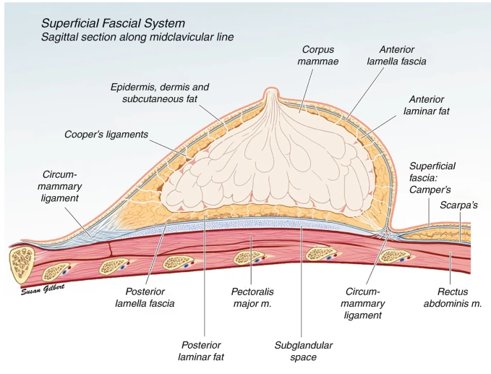
STROMA
The stroma of breast consists of connective tissue and fat. It forms the supporting framework of the breast.
The connective tissue condenses to form fibrous strands/ septa, called suspensory ligaments of Cooper. The suspensory ligaments of Cooper are arranged in a radial fashion. They connect the dermis of the overlying skin to the ducts of the breast and pectoral fascia. The ligaments of the Cooper maintain the protuberance of the breast.
Their atrophy due to ageing makes the breast pendulous in old age.
The fat forms most of the bulk of the breast. It is distributed all over the breast except beneath the areola and the nipple.

Slide 11
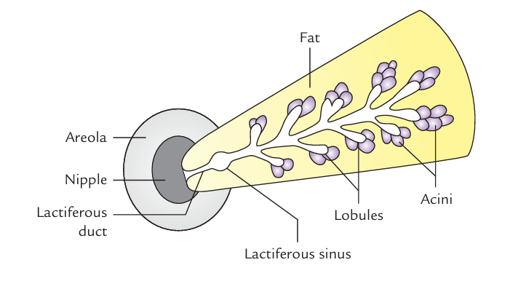
BREAST PARENCHYMA
The parenchyma/glandular tissue of the breast secrete milk to feed the newborn baby.
It consists of about 15–20 lobes arranged in a radial fashion like the spokes of a wheel and converge towards the nipple. Each lobe is divided into lobules, which consist a cluster of acini
Each lobe is drained by a laciferous duct. The ducts from different lobes converge towards the nipple and open at its submit.
Near the termination, each duct expands into a laciferous sinuses which serves as a milk reservoir during lactation

Slide 12
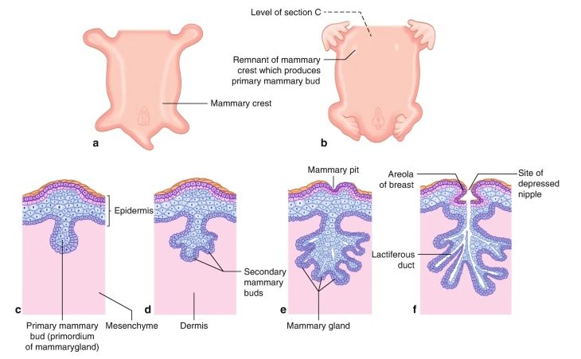
Breast Embryology
Breast development begins prenatally, around 4–6 weeks of gestation
During this time, mammary progenitor cells of ectodermal origin form the mammary crest, which is a paired line that gently curves from the axilla to the inguinal region bilaterally
Most of the mammary crest atrophies to leave paired primary breast buds at the fourth intercostal space
These ectodermal cells subsequently invaginate into the underlying mesoderm and begin to form the network that will eventually become the lactiferous acini and ducts , or the gland itself .
The mesenchymal cells will eventually form into adipocytes, fibroblasts, and smooth muscle cells to become the future stroma surrounding the breast gland .

Slide 13
By the end of the first trimester, the mammary bud is largely formed. During the second trimester, secondary branching patterns off the initial mammary bud continue to invaginate into the underlying mesenchyme to form a more complex network of mammary ducts This continues into the third trimester until birth. By birth, the breast gland contains around 15–20 lobes, each with their own lactiferous duct drainage system that converges on the nipple
After birth and during the first 2 years of life, both male and female infants will have transient breast enlargement and some will secrete milk from the rudimentary breast gland All of these changes are dependent on fluctuating hormone levels in the newborn, in large part mediated by estradiol. By 2 years of age, however, the breast gland becomes quiescent until puberty
Breast development is the first sign of puberty in the female and is dependent not only on estrogen but also on growth hormone and insulin-like growth factor-1 . On average, the mature breast forms between 8 and 13 years of age and is considered pathological if no breast development occurs by 14 years.

Slide 14
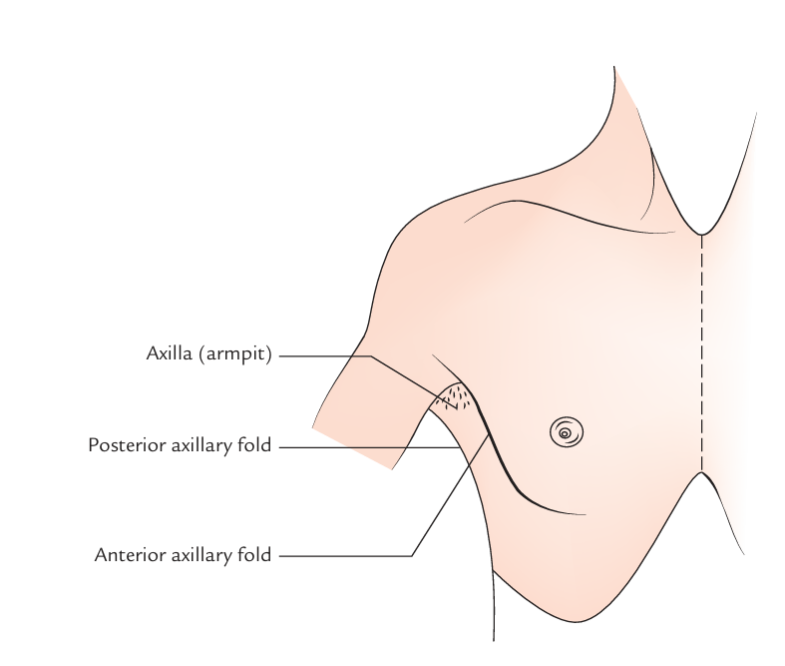
Axilla
The axilla or armpit is a fat-filled pyramid-shaped space, between the upper part of the arm and the side of the chest wall
It contains the brachial plexus, axillary vessels, and lymph nodes.
It also acts as a funnel shaped tunnel for neurovascular structures to pass from the root of the neck to the upper limb and vice versa.
Groups of lymph nodes within it drain the upper limb and the breast. The study of axilla is clinically important because axillary lymph nodes are often enlarged and hence routinely palpated during physical examination of the patient.

Slide 15
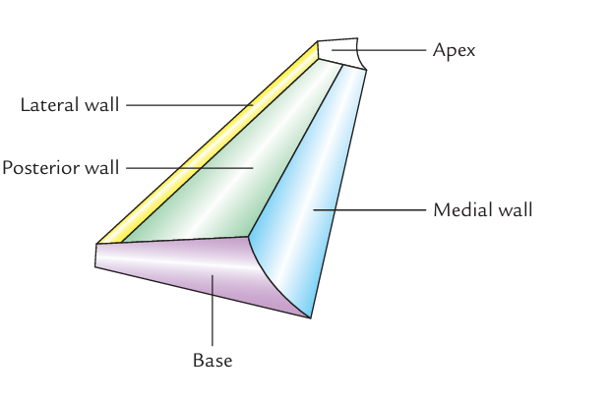
Boundaries
The axilla resembles a truncated four-sided pyramid and presents an apex, a base and four walls (anterior, posterior, medial, and lateral)

Slide 16
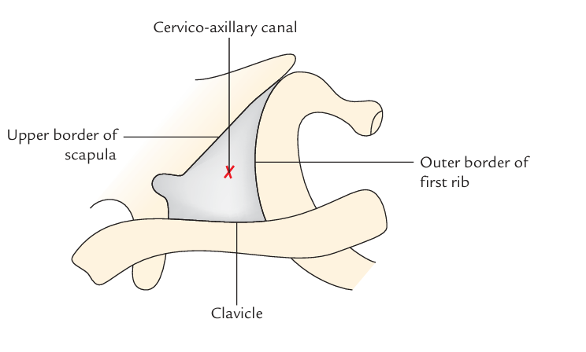
Apex
Apex/cervico-axillary canal: It is a passageway between the neck and axilla.
It is directed upwards and medially into the root of the neck and corresponds to the triangular space bounded in front by the clavicle, behind by the upper border of the scapula and medially by the outer border of the first rib .
The axillary artery and brachial plexus enter the axilla from neck through this gap, hence it is also termed cervico-axillary canal. The axillary vein enters the neck from the axilla into the neck through this canal

Slide 17
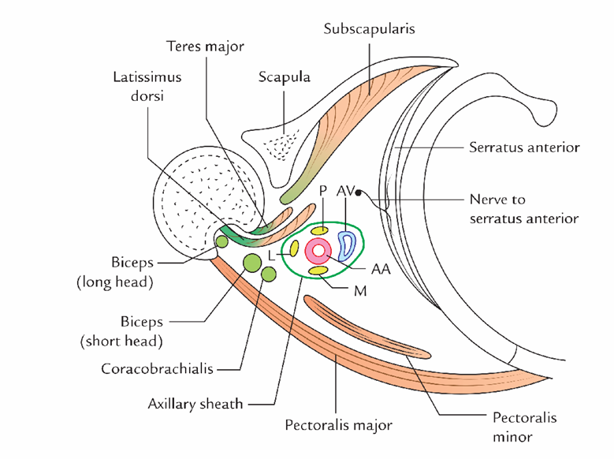
Base/Floor
It is at the lower end of the axilla and directed downwards. It is formed by the axillary fascia. The base corresponds to the hollow bounded in front by the anterior axillary fold, formed by the lower border of the pectoralis major muscle,
Behind by the posterior axillary fold formed by the tendon of latissimus dorsi and teres major muscles, and medially by the lateral aspect of the chest wall.

Slide 18
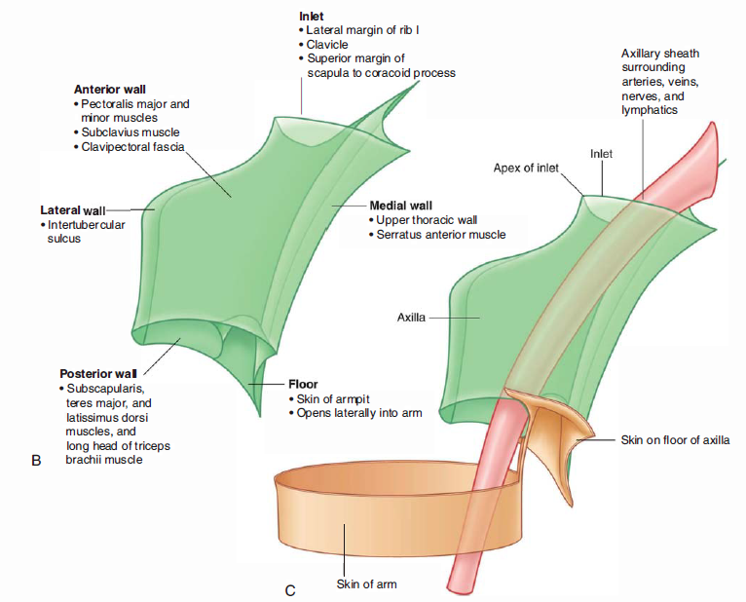
Walls of the Axilla
Anterior wall: It is formed by the pectoralis major, subclavius, and pectoralis minor muscles.
Posterior wall: formed by the subscapularis muscle above and latissimus dorsi and teres major muscles below.
Medial wall: It is formed by the upper four or five ribs, and corresponding intercostal spaces covered by the serratus anterior muscle.
Lateral wall: It is formed by tendon of biceps brachii the bicipital groove of humerus coracobrachialis and short head of biceps brachii. The lateral wall is extremely narrow because anterior and posterior walls of the axilla converge at this site

Slide 19
Anterior Wall
The anterior wall of the axilla is formed by the
lateral part the pectoralis major muscle,
the underlying pectoralis minor
the underlying subclavius muscles, and
the clavipectoral fascia

Slide 20
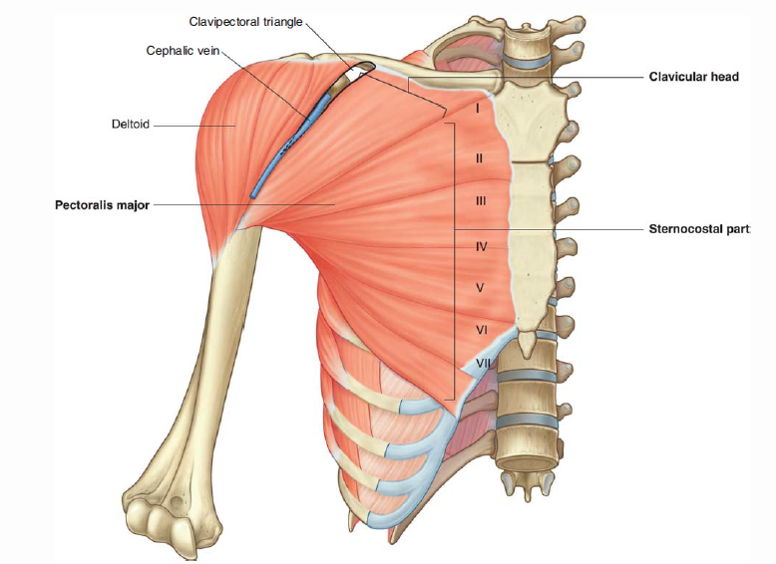
Pectoralis Major
The largest and most superficial muscle of the anterior wall . Its inferior margin underlies the anterior axillary fold, which marks the anteroinferior border of the axilla.
The muscle has two heads: The clavicular head from the medial half of the clavicle. The sternocostal head from the medial part the anterior thoracic wall-often, fibers from this head continue inferiorly and medially to attach to the anterior abdominal wall, forming an additional abdominal part of the muscle.
The muscle inserts into the lateral lip of the intertubercular sulcus of the humerus.
Acting together, the two heads of the pectoralis major flex, adduct, and medially rotate the arm at the glenohumeral joint.
The clavicular head flexes the arm from an extended position, whereas the sternocostal head extends the arm from a flexed position, particularly against resistance.
Innervated by the lateral and medial pectoral nerves(brachial plexus)

Slide 21
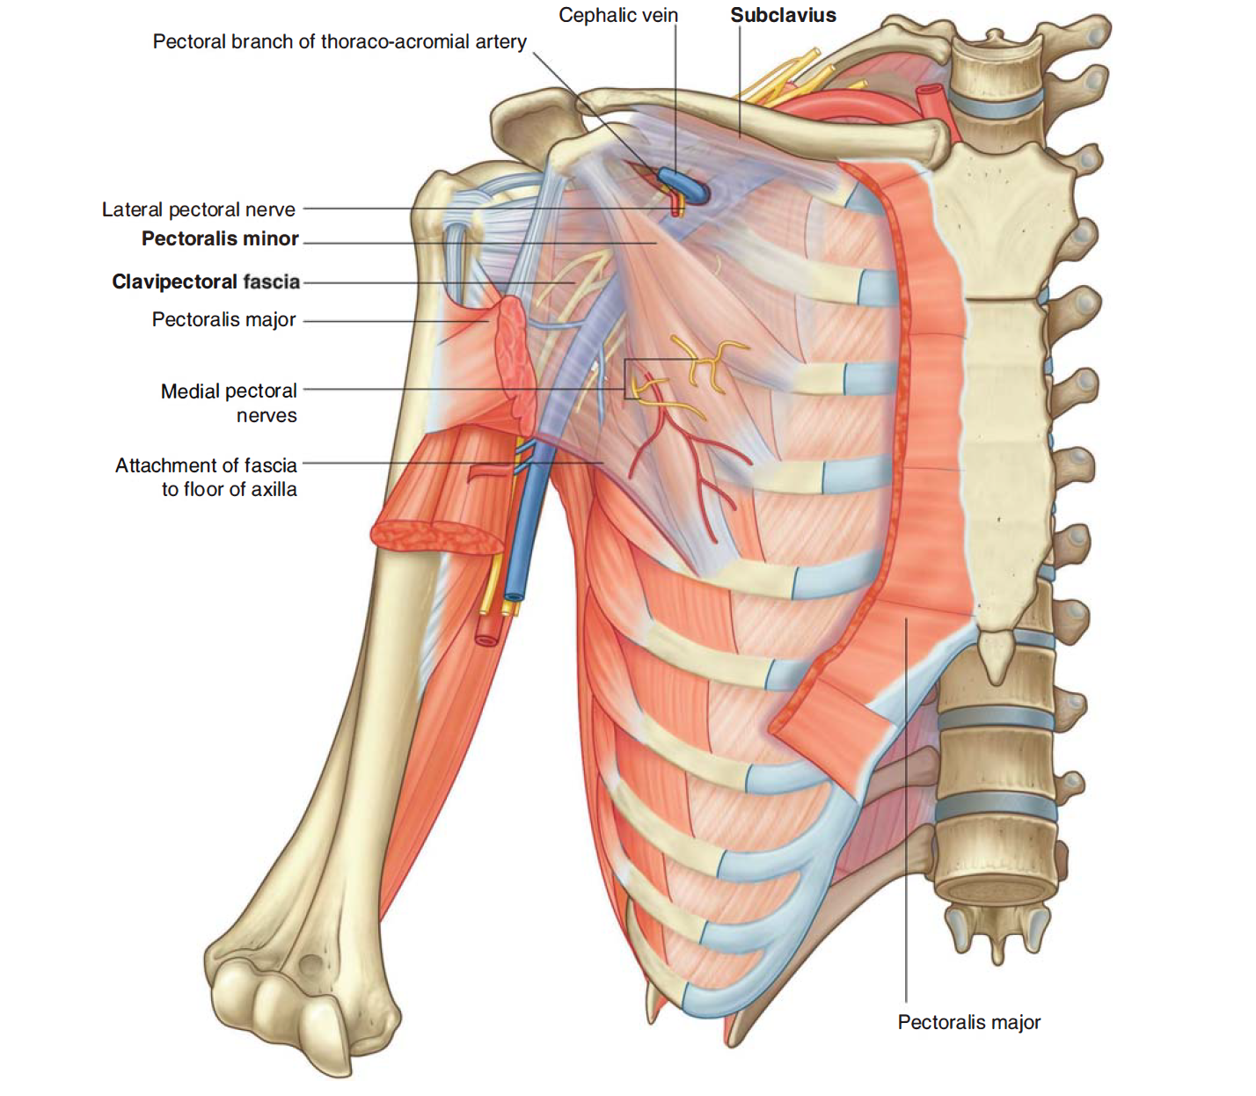
Subclavius Muscle
Small muscle that lies deep to the pectoralis major muscle and passes between the clavicle and rib I .
It originates medially, as tendon, from rib I at the junction between the rib and its costal cartilage.
It passes laterally and superiorly to insert via muscular attachment into an elongate shallow groove on the inferior surface of the middle third of the clavicle.
The function of the subclavius is not entirely clear, but it may act to pull the shoulder down by depressing the pulling the clavicle medially.
The subclavius muscle is innervated by a small branch from the superior trunk of the brachial plexus.

Slide 22
Pectoralis Minor Muscle
The pectoralis minor muscle is a small triangular-shaped muscle that lies deep to the pectoralis major muscle and passes from the thoracic wall to the coracoid process of the scapula.
It originates as three muscular slips from the anterior surfaces and upper margins of ribs III to V and from the fascia overlying muscles of the related intercostal spaces.
The muscle fibers pass superiorly and laterally to insert into the medial and upper aspects of the coracoid process.
The pectoralis minor muscle protracts the scapula (by pulling the scapula anteriorly on the thoracic wall) and depresses the lateral angle of the scapula.
Innervation: medial pectoral nerve (brachial plexus)

Slide 23
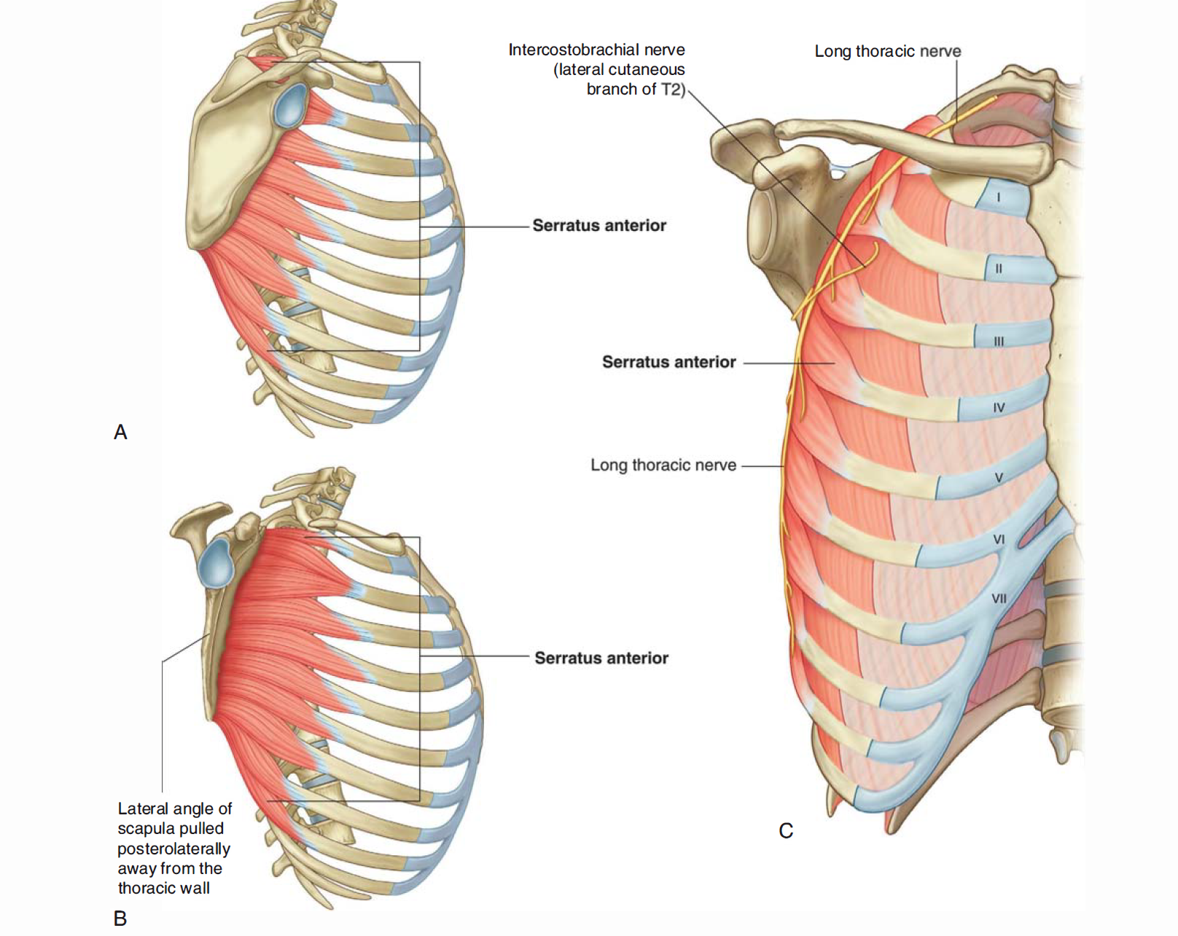
Medial Wall
It consists of the:
  upper thoracic wall (the ribs and related intercostal tissues)
  serratus anterior muscle
The only major structure that passes directly through the medial wall and into the axilla is the intercostobrachial nerve (lateral cutaneous branch of the second intercostal nerve)
It communicates with the medial cutaneous nerve of the arm (brachial plexus) in the axilla and supplies skin on the upper posteromedial side of the arm(T2 dermatome part).

Slide 24
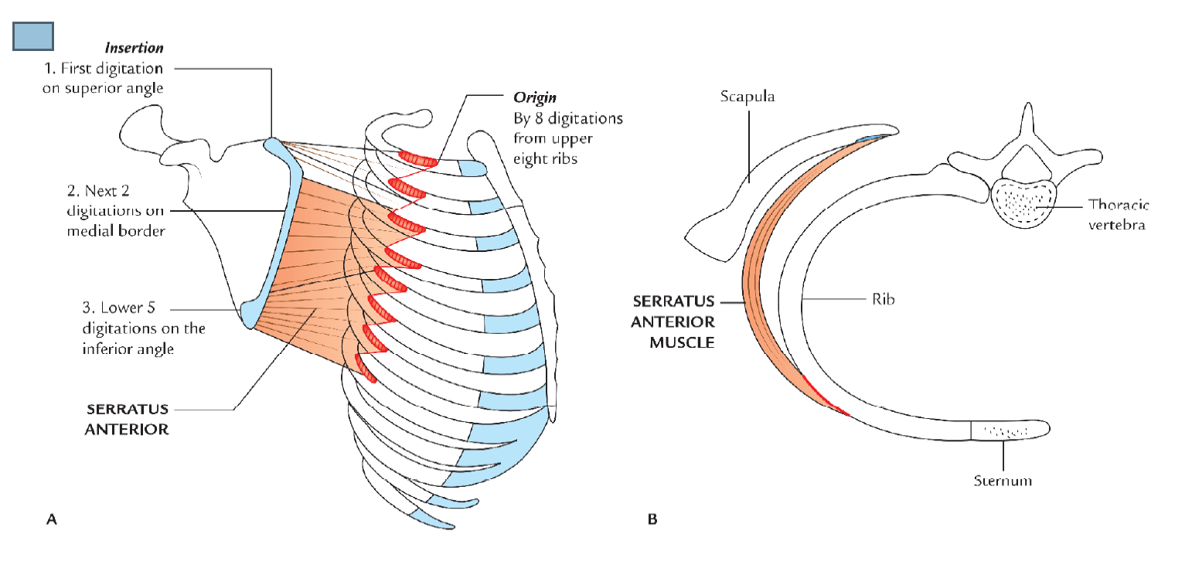
Serratus anterior
It originates as a number of muscular slips from the lateral surfaces of ribs I to IX and the intervening deep fascia overlying the related intercostal spaces
The muscle forms a flattened sheet, which passes posteriorly around the thoracic wall to insert primarily on the costal surface of the medial border of the scapula.
It anterior pulls the scapula forward over the thoracic wall and facilitates scapular rotation. It also keeps the costal surface of the scapula closely opposed to the thoracic wall.
Innervated by the long thoracic nerve(brachial plexus) which passes through the axilla along the medial wall and passes vertically down the serratus anterior muscle on its external surface, just deep to skin and superficial fascia.

Slide 25
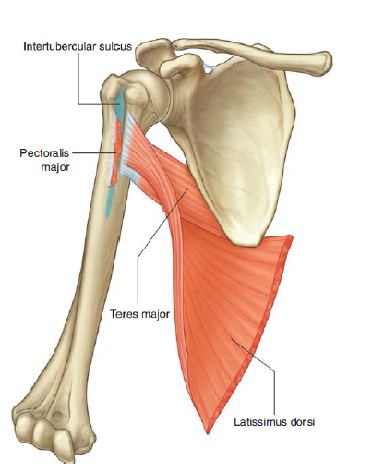
Lateral Wall
The lateral wall of the axilla is narrow and formed entirely by the intertubercular sulcus of the humerus .
The pectoralis major muscle of the anterior wall attaches to the lateral lip of the intertubercular sulcus.
The latissimus dorsi and teres major muscles of the posterior wall attach to the floor and medial lip of the intertubercular sulcus, respectively.

Slide 26
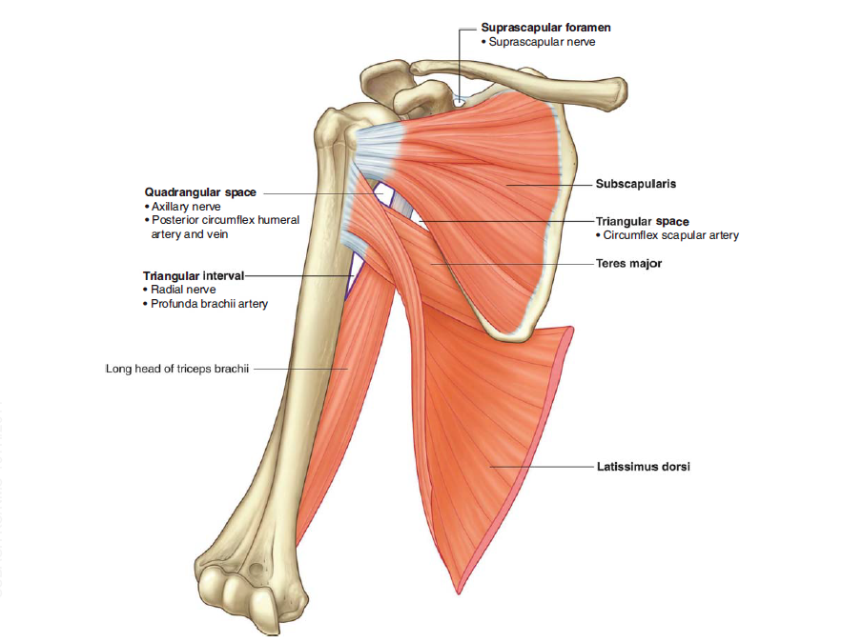
Posterior Wall
The posterior wall of the axilla is complex
Its bony framework is formed by the costal surface of the scapula.
Muscles of the wall are:
the subscapularis muscle
the distal parts of the latissimus dorsi and teres major muscles
and the proximal part of the long head of the triceps brachii
Gaps between the muscles of the posterior wall form apertures through which structures pass between axilla, posterior scapular region, and posterior compart- ment of the arm.

Slide 27
Subscapularis
The subscapularis muscle forms the largest component of the posterior wall of the axilla.
It originates from, and fills, the subscapular fossa and inserts on the lesser tubercle of the humerus
The tendon crosses immediately anterior to the joint capsule of the glenohumeral joint.
Together with three muscles of the posterior scapular region (the supraspinatus, infraspinatus, and teres minor muscles), the subscapularis is a member of the rotator cuff muscle group, which stabilize the glenohumeral joint.
The subscapularis is innervated by branches of the brachial plexus (the superior and inferior subscapular nerves), which originate in the axilla.

Slide 28
Teres major and latissimus dorsi
The inferolateral aspect of the posterior wall of the axilla is formed by the terminal part of the teres major muscle and the tendon of the latissimus dorsi muscle
These two structures lie under the posterior axillary fold. which marks the posteroinferior border of the axilla.
The flat tendon of the latissimus dorsi muscle curves around the inferior margin of the teres major muscle on the posterior wall to insert into the floor of the intertubercular sulcus of the humerus, anterior to and slightly above the most distal attachment of the teres major muscle to the medial lip of the intertubercular sulcus.
Τherefore the inferior margin of the teres major muscle defines the inferior limit of the axilla laterally.
The axillary artery becomes the brachial artery of the arm as it crosses the inferior margin of the teres major muscle. Long head of the triceps brachii
The long head of the triceps brachii muscle passes vertically through the posterior wall of the axilla, and, together with surrounding muscles and adjacent bones, results in the formation of three apertures through which major structures pass through the posterior wall: the quadrangular space, the triangular space, and the triangular interval

Slide 29
The long head of the triceps brachii muscle passes vertically through the posterior wall of the axilla, and, together with surrounding muscles and adjacent bones, results in the formation of three apertures through which major structures pass through the posterior wall: the quadrangular space, the triangular space, and the triangular interval.

Slide 30
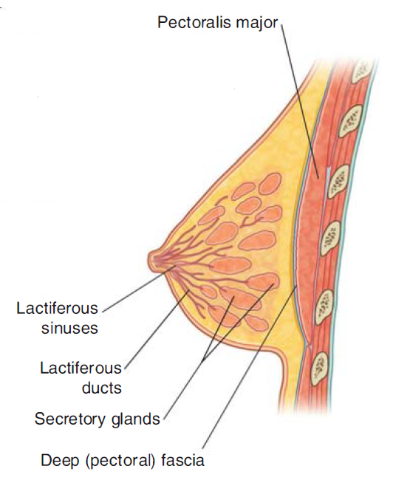
Fascial Systems
PECTORAL FASCIA
It is the deep fascia covering the anterior aspect of the pectoralis major muscle. It is thin and anchored firmly to the muscle by numerous fasciculi.
It extends:
Superiorly, it is attached to the clavicle.
Inferiorly, it is continuous with the fascia of anterior abdominal wall.
Superolaterally, it passes over the deltopectoral groove to become continuous with the fascia covering the deltoid muscle.
Inferolaterally, it curves round the inferolateral border of the pectoralis major to become continuous with the axillary fascia. The axillary fascia is a dense fibrous sheet that extends across the base of the axilla.

Slide 31
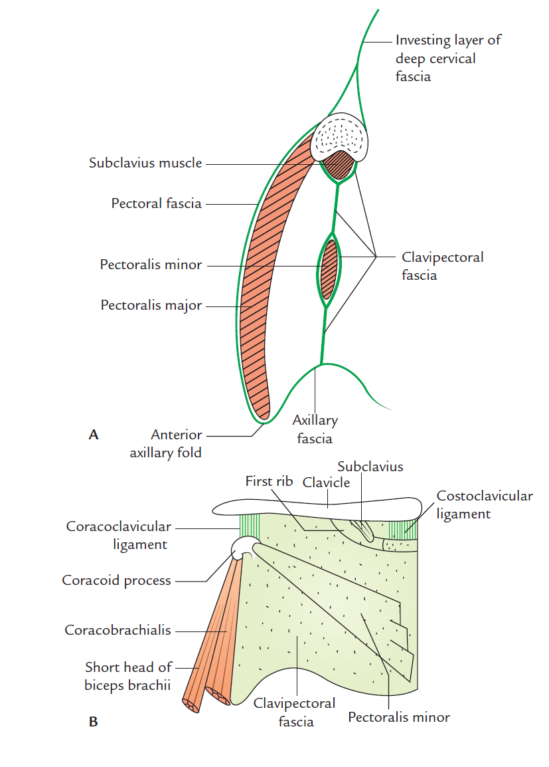
Clavipectoral Fascia
The clavipectoral fascia is a strong fascial sheet deep to the clavicular head of the pectoralis major muscle, filling the space between the clavicle and the pectoralis minor muscle. The clavipectoral fascia is a thick sheet of connective tissue that connects the clavicle to the floor of the axilla muscles and spans the gap between them.
It encloses the subclavius and pectoralis minor Structures travel between the axilla and the anterior wall of the axilla by passing through the clavipectoral fascia either between the pectoralis minor and subclavius muscles or inferior to the pectoralis minor muscle.

Slide 32
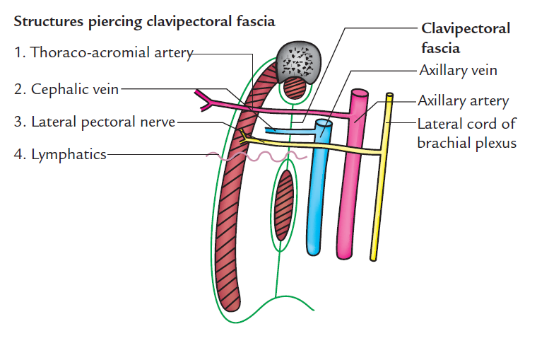
Clavipectoral Fascia
Important structures that pass between the subclavius and pectoralis minor muscles include the cephalic vein, the thoraco acromial artery, and the lateral pectoral nerve.
The lateral thoracic artery leaves the axilla by passing through the fascia inferior to the pectoralis minor muscle. The medial pectoral nerve leaves the axilla by penetrating directly through the pectoralis minor muscle to supply this muscle and to reach the pectoralis major muscle.
Occasionally, branches of the medial pectoral nerve pass around the lower margin of the pectoralis minor to reach and innervate the overlying pectoralis major muscle.

Slide 33
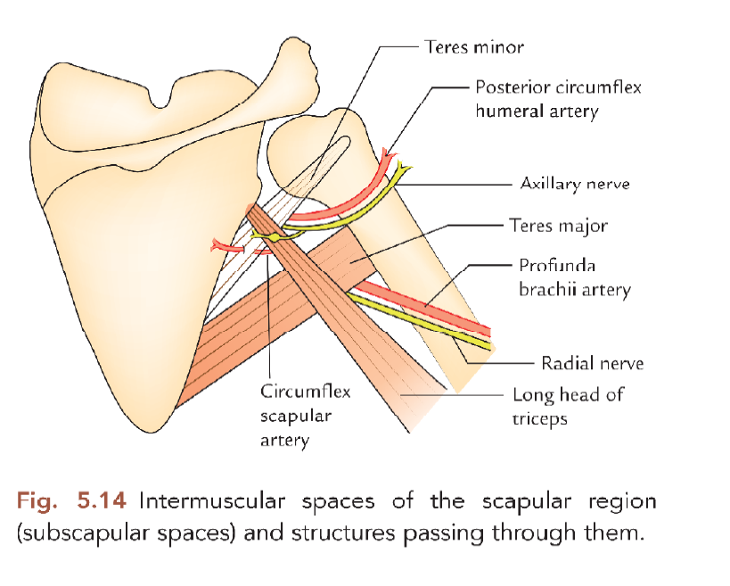
Quadrangular Space
The quadrangular space provides a passageway for nerves and vessels passing between the axilla and the more posterior scapular and deltoid regions When viewed from anteriorly, its boundaries are formed by:
the inferior margin of the subscapularis muscle,
the surgical neck of the humerus,
the superior margin of the teres major muscle, and
the lateral margin of the long head of the triceps brachii muscle.
Passing through the quadrangular space are the axillary nerve and the posterior circumflex humeral artery and vein.

Slide 34
Triangular Space
The triangular space is an area of communication between the axilla and the posterior scapular region
When viewed from anteriorly, it is formed by:
the medial margin of the long head of the triceps brachii muscle
the superior margin of the teres major muscle
the inferior margin of the subscapularis muscle.
The circumflex scapular artery and vein pass into this space.

Slide 35
Triangular interval
This triangular interval is formed by
the lateral margin of the long head of the triceps brachii muscle,
the shaft of the humerus, and
the inferior margin of the teres major muscle
The radial nerve passes out of the axilla traveling through this interval to reach the posterior compartment of the arm. Profunda brachii artery transverses the triangular interval as well

Slide 36
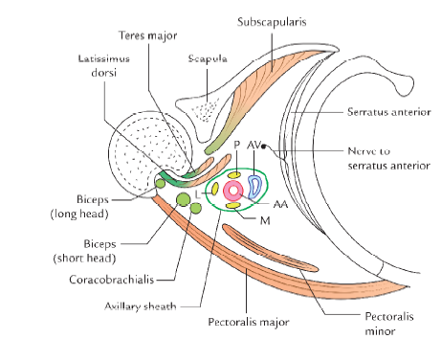
Contents of the Axilla
Axillary artery
Axillary vein and its tributaries.
Cords of brachial plexus.
Axillary lymph nodes.
Fibrofatty tissue. Axillary tail of breast.
Long thoracic and intercostobrachial nerves N.B.
Proximal part of coracobrachialis and biceprs brachi muscle

Slide 37
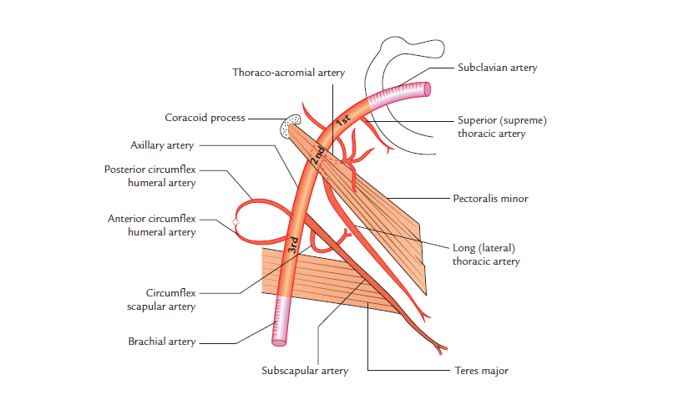
Axillary Artery
The axillary artery is the main artery of the upper limb. begins at the outer border of the first rib as the continuation of subclavian artery and ends by becoming brachial artery at the lower border of teres major.
In axilla, it runs from its apex to the base along the lateral wall nearer to the anterior wall than the posterior wall.
During its course through axilla, it is crossed on superficial aspect by the pectoralis minor muscle, which divides it into three parts.
The axillary vein is medial to the artery and the cords of brachial plexus are arranged around the second part of the artery (i.e., part deep to the pectoralis minor); the lateral cord being lateral, the medial cord medial, and posterior cord behind. Parts
The axillary artery is divided into the following three parts by the pectoralis minor:
First part, superior (or proximal) to the muscle.
Second part, posterior (or deep) to the muscle.
Third part inferior (or distal) to the muscle
Relations The axillary vein lies medial to the axillary artery throughout its course, but the relationship of cords of brachial plexus and their branches are different for each of the three parts of the artery.
The axillary artery gives six branches: one branch from first part, two branches from the second part, and three branches from the third part. Most of these branches go to and supply

Slide 38
Biceps brachii
The biceps brachii muscle originates as two heads
The short head originates from the apex of the coracoid process of the scapula and passes vertically through the axilla and into the arm where it joins the long head.
The long head originates as a tendon from the supraglenoid tubercle of the scapula, passes over the head of the humerus deep to the joint capsule of the glenohumeral joint, and enters the intertubercular sulcus where it is held in position by a ligament, the transverse humeral ligament. The tendon passes through the axilla in the intertubercular sulcus and forms a muscle belly in the proximal part of the arm.
The long and short heads of the muscle join in distal regions of the arm and primarily insert as a single tendon into the radial tuberosity in the forearm.
The biceps brachii muscle is primarily a powerful flexor of the forearm at the elbow joint and a powerful supinator in the forearm. Because both heads originate from the scapula, the muscle also acts as an accessory flexor of the arm at the glenohumeral joint. In addition, the long head prevents superior movement of the humerus on the glenoid cavity.
The biceps brachii muscle is innervated by the musculocutaneous nerve.

Slide 39
Coracobrachialis
The coracobrachialis muscle, together with the short head of the biceps brachii muscle, originates from the apex of the coracoid process
It passes vertically through the axilla to insert on a small linear roughening on the medial aspect of the humerus, approximately midshaft.
The coracobrachialis muscle flexes the arm at the glenohumeral joint.
In the axilla, the medial surface of the coracobrachialis muscle is pierced by the musculocutaneous nerve, which innervates and then passes through the muscle to enter the arm.

Slide 40
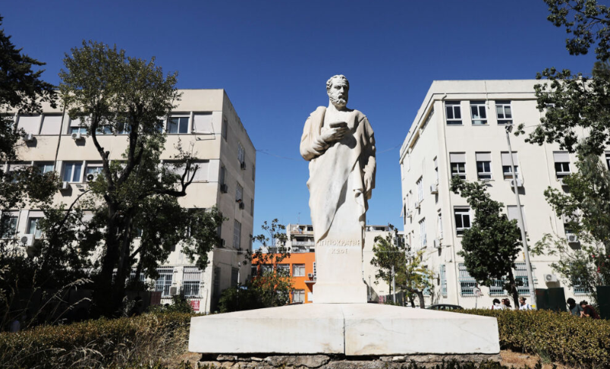
THANK YOU

