Slide 1


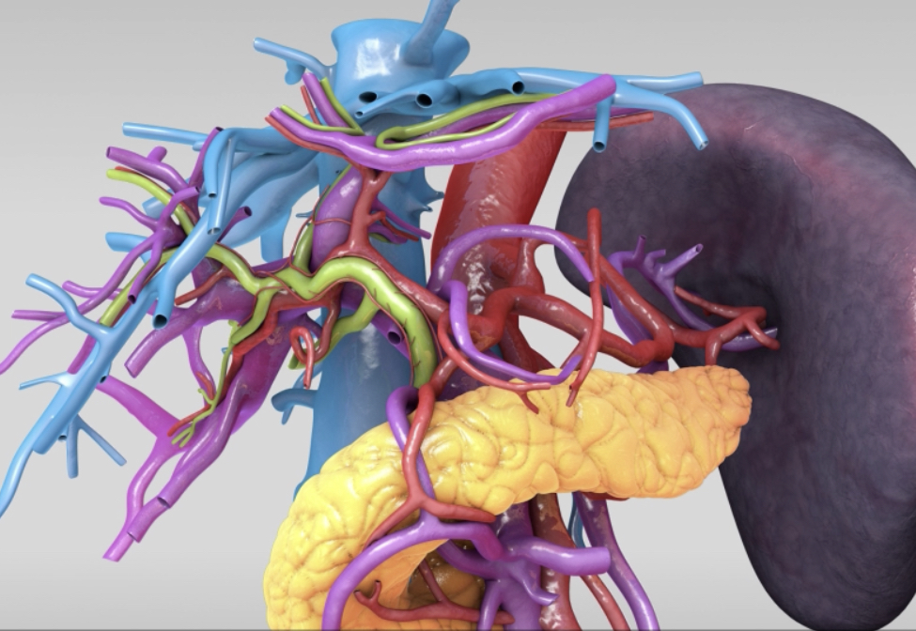

Anatomy of the
Jejunum and Ileum
Athanasios Tampakis, MD, Dr med, PhD, Post Doc
General Surgeon
Lecturer and Attending Surgeon,
University Hospital of Basel, Switzerland

Slide 2
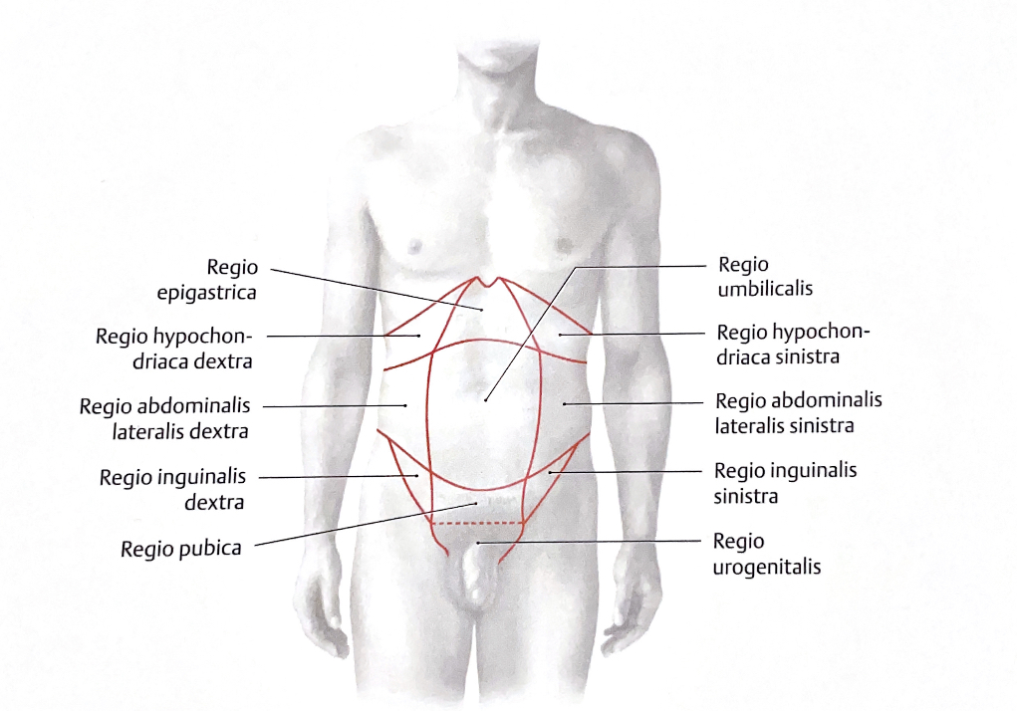
Topography of the Abdomen
Prometheus LernAtlas der Anatomie

Slide 3
Topography of the Abdomen
Peritoneum
Prometheus LernAtlas der Anatomie

Slide 4
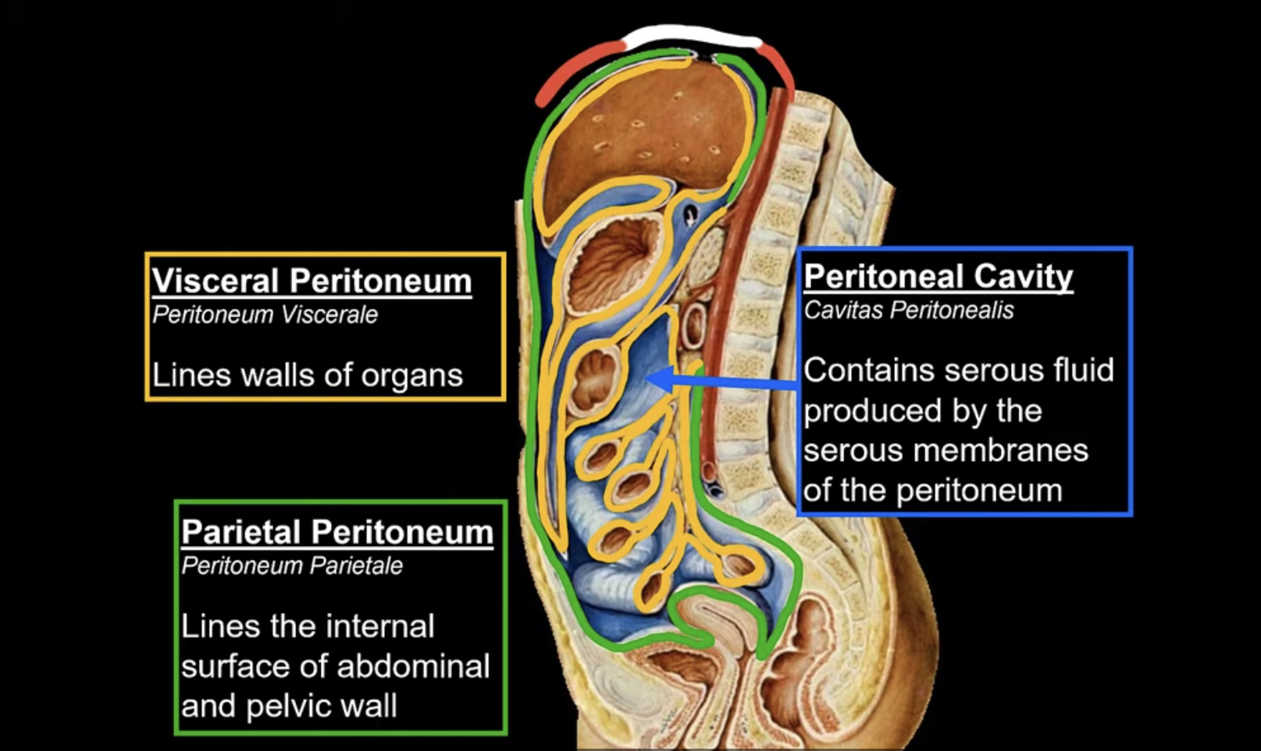
Peritoneum
www.youtube.com Taim Talks med

Slide 5
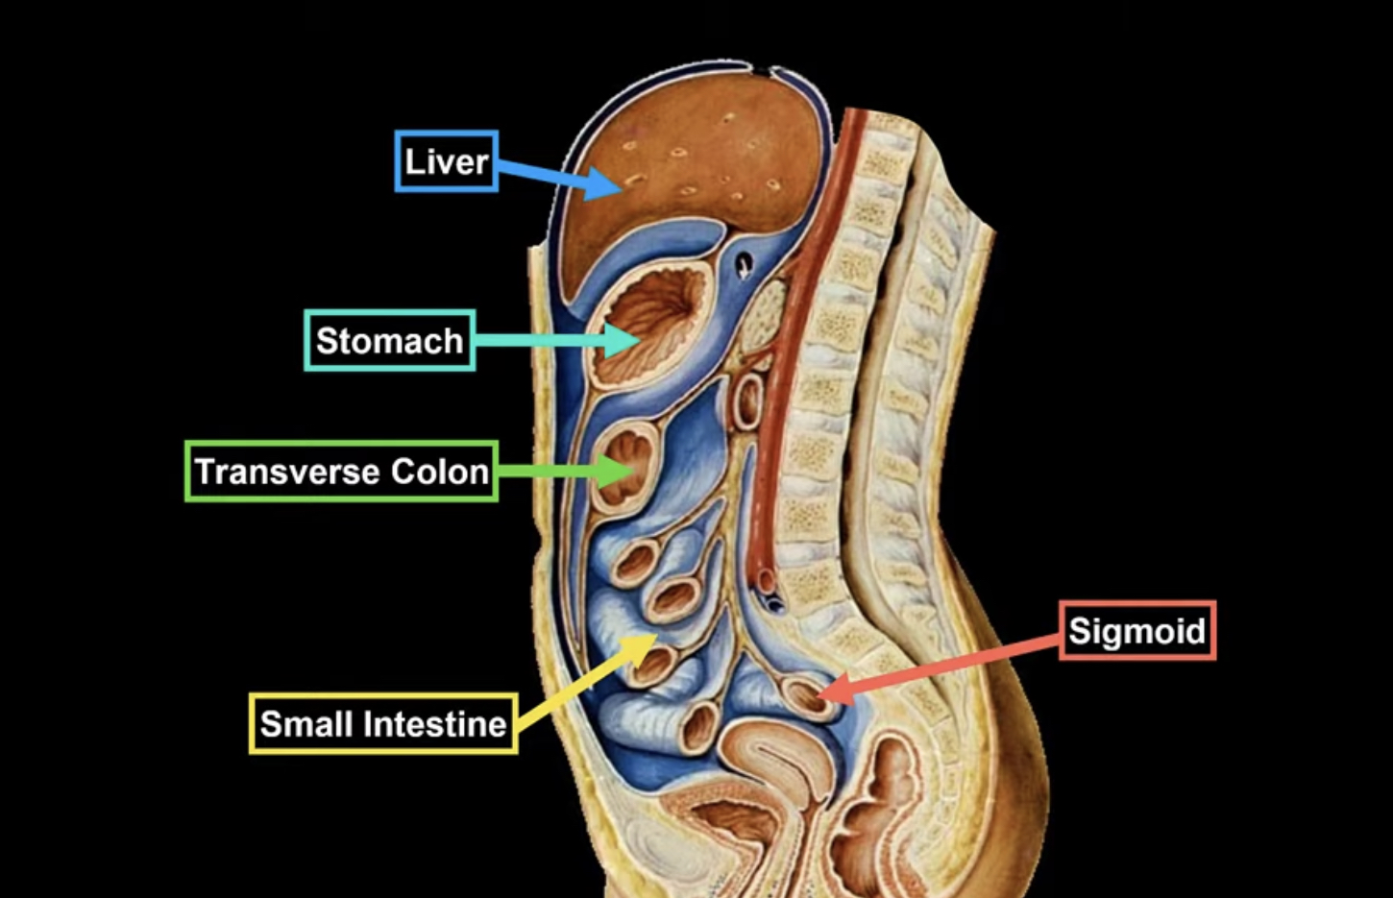
Peritoneum
www.youtube.com Taim Talks med

Slide 6
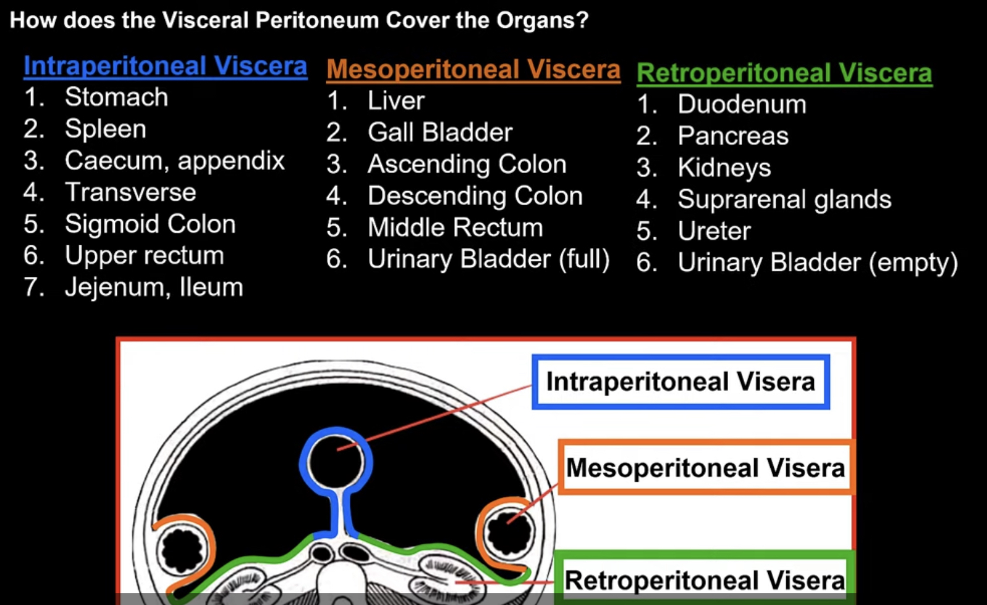
Peritoneum
www.youtube.com Taim Talks med

Slide 7
Small Intestine

Slide 8
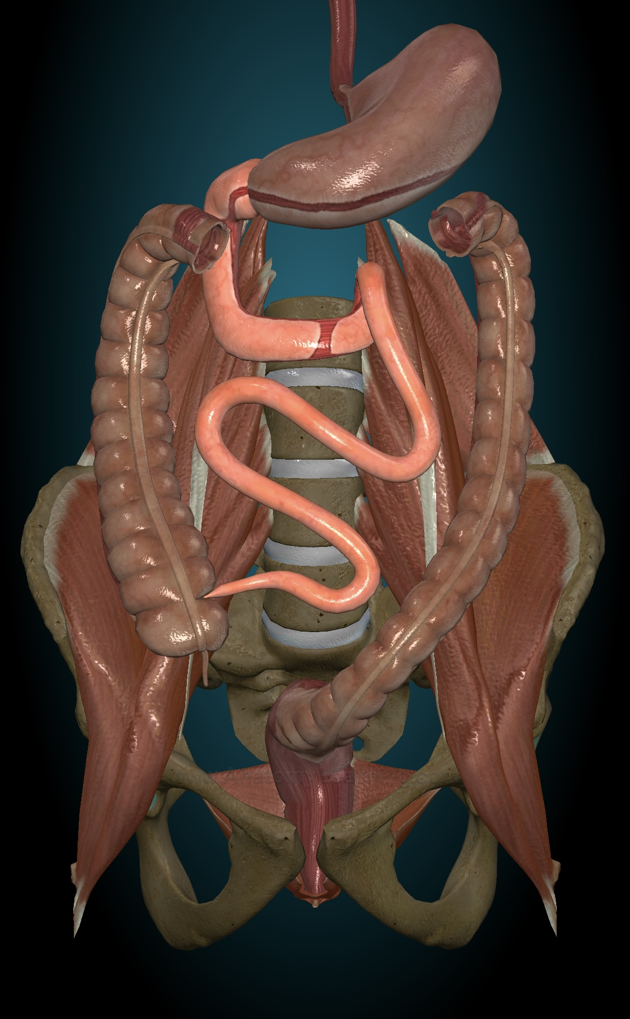
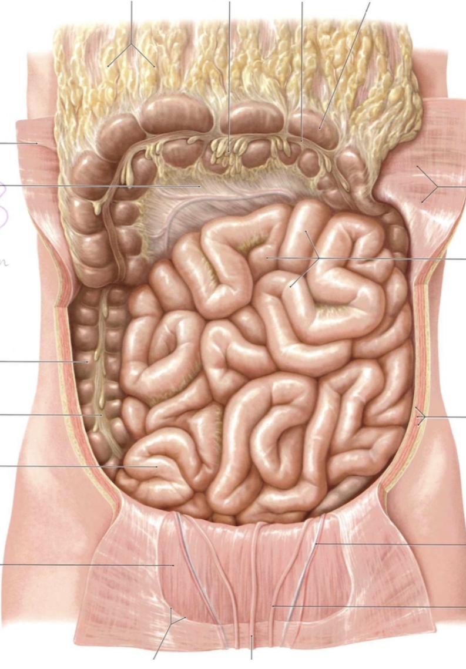
Small intestine
Topography
Starts after pylorus of the stomach
Up to ileocecal valve
Parts
Duodenum
Jejunum
Ileum
Prometheus LernAtlas der Anatomie
Anatomy Learning
Sabiston, Textbook of Surgery, 20th Edition, 2016

Slide 9
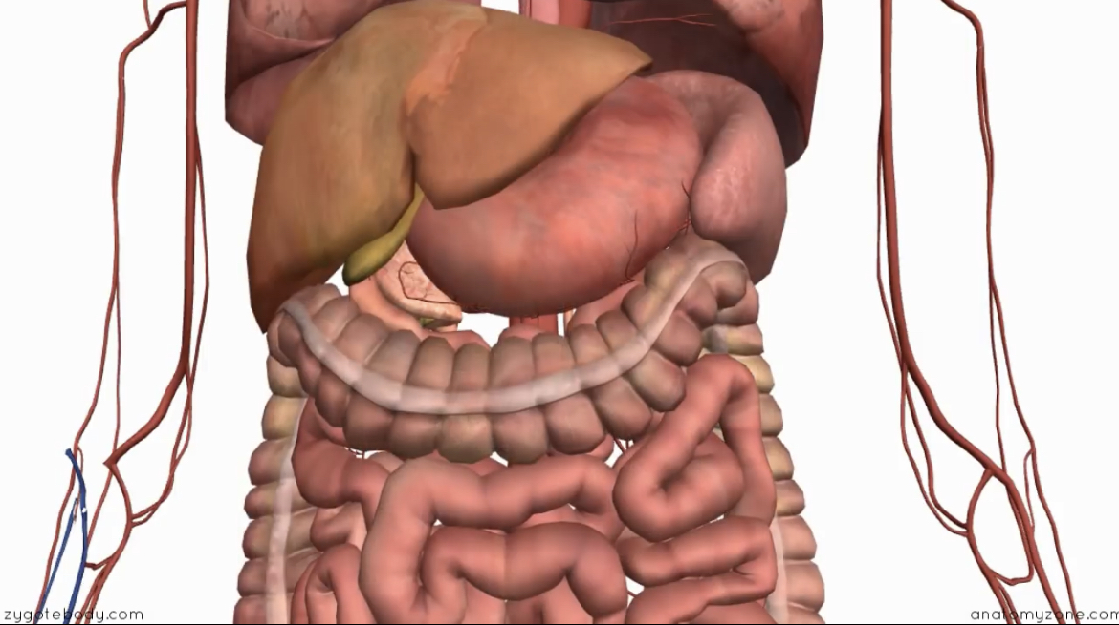
Small intestine
No clear anatomic border between jeunum and ileum
15 to 18 small intestine loops
Anatomy Learning
Alice Roberts The Complete Human Body, 2nd Edition, 2016

Slide 10
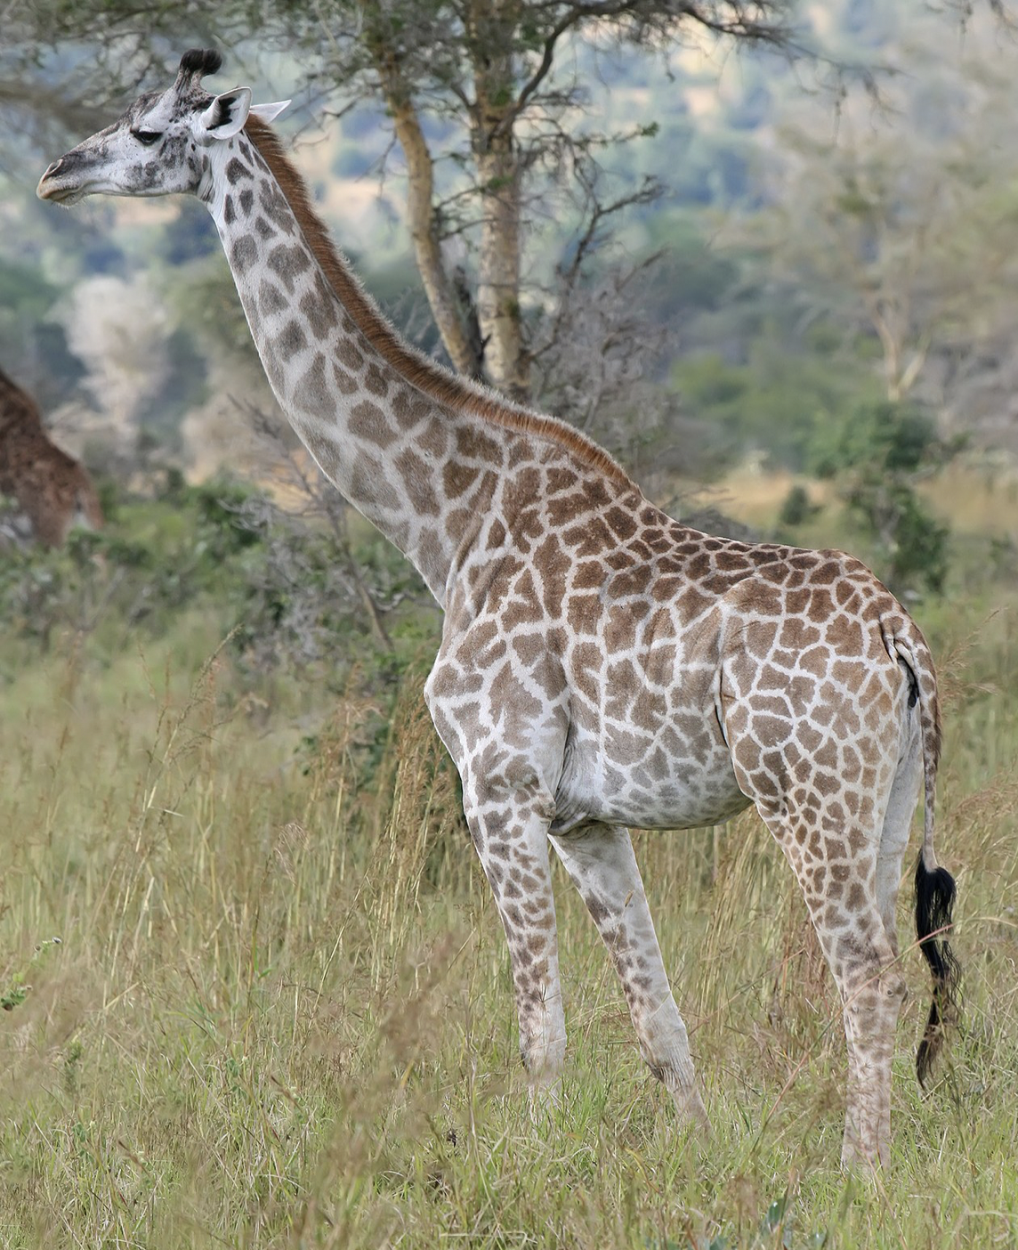
Small Intestine
Responsible for 90% of digestion
Up to 6m length
Prometheus LernAtlas der Anatomie
Anatomy Learning
Sabiston, Textbook of Surgery, 20th Edition, 2016

Slide 11
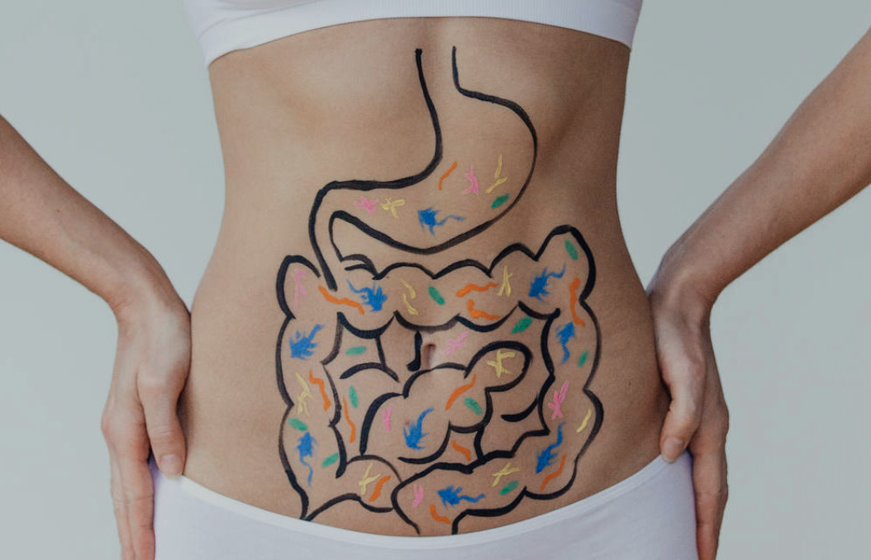
Small Intestine
Starts digesting
Slow Down
Contract
Relax
Prometheus LernAtlas der Anatomie
Anatomy Learning
Sabiston, Textbook of Surgery, 20th Edition, 2016

Slide 12
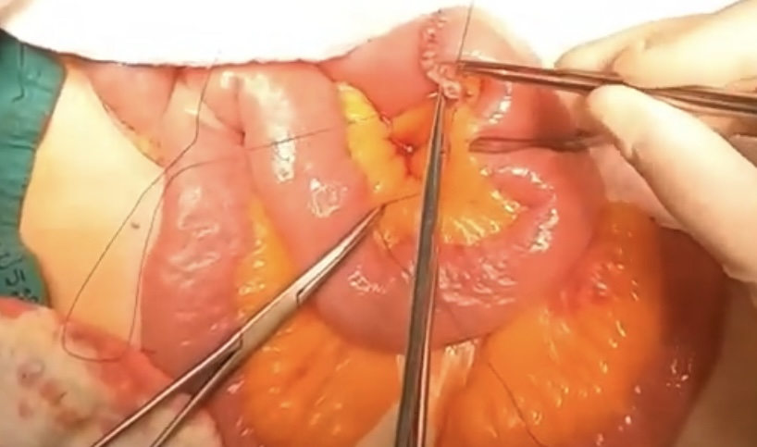
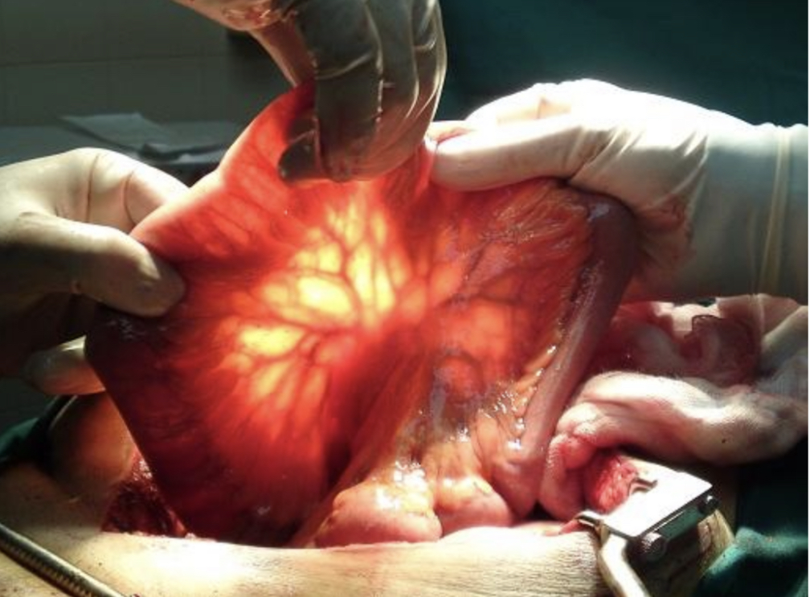
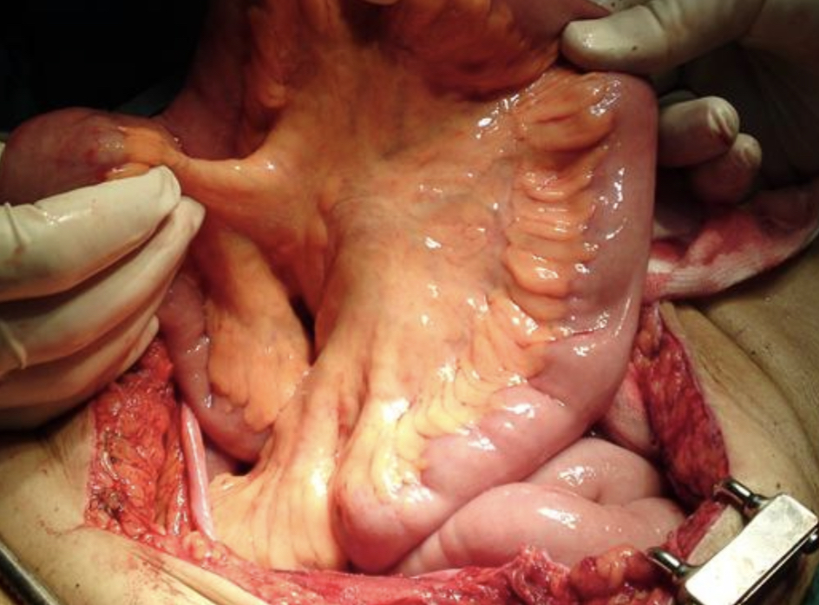
Small intestine
Intestinal loops
Verges
Mesenteric
Antimesenteric
The general Surgeon
Keith L. Moore, Clinically Oriented Anatomy, 8th Edition, 2017

Slide 13
Small Bowel
Location
Lower abdomen
Supported by
Abdominal wall tone
Adjacent abdominal organs
Difference between atmospheric and intra-abdominal pressure
Mesentery
Prometheus LernAtlas der Anatomie
Keith L. Moore, Clinically Oriented Anatomy, 8th Edition, 2017

Slide 14
Mesentery

Slide 15
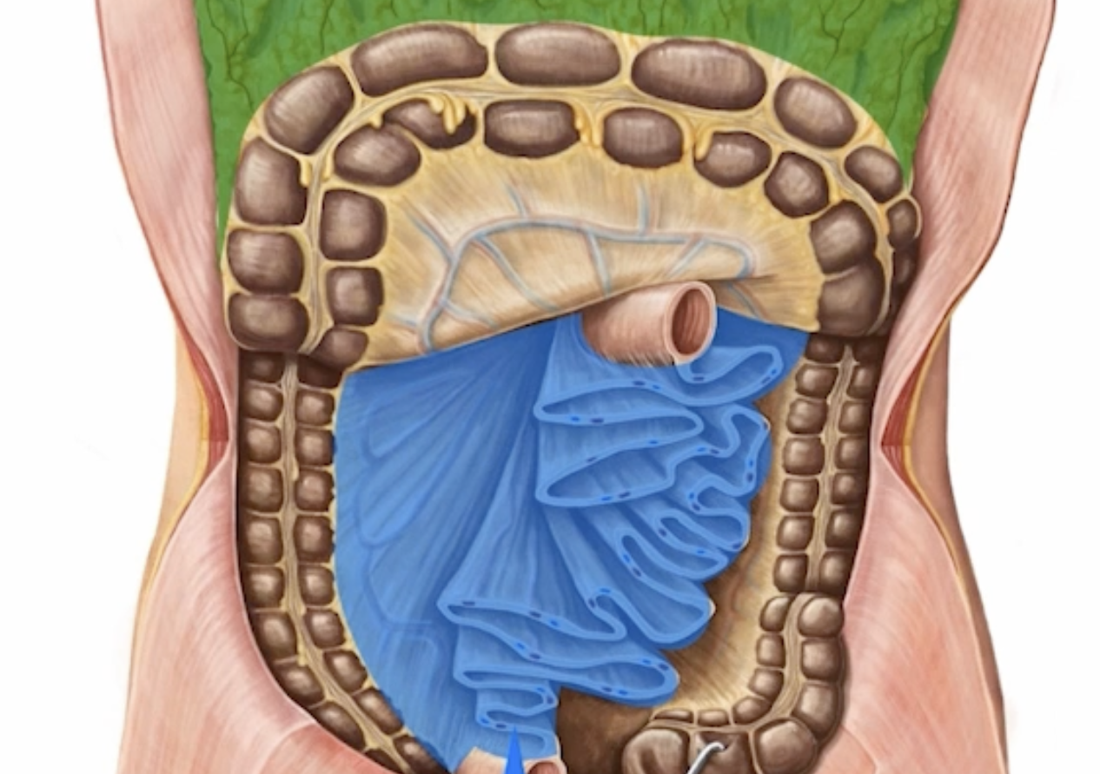
Mesentery
Mesenteries
peritoneal folds
contain viscera
anchor them to the posterior abdominal wall
Largest mesentery: the mesentery proper or mesentery of the small bowel
Attached at the junction between duodenum and jejunum
Travels downwards until the ileocecal junction
Contains blood vessels, nerves and lymphatics
Prometheus LernAtlas der Anatomie, Kenhub anatomy
Keith L. Moore, Clinically Oriented Anatomy, 8th Edition, 2017

Slide 16
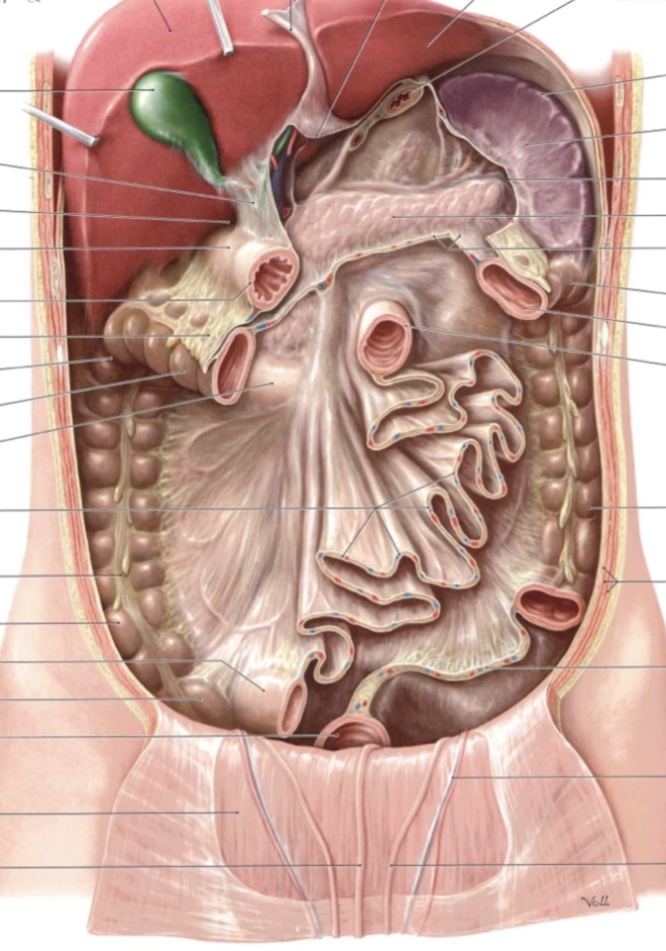
Mesentery
Mesentery
Peritoneal fold
Adhseion to the posterior abdominal wall
Includes vessels, lymph nodes and lymphatics, nerves
Prometheus LernAtlas der Anatomie
Keith L. Moore, Clinically Oriented Anatomy, 8th Edition, 2017

Slide 17
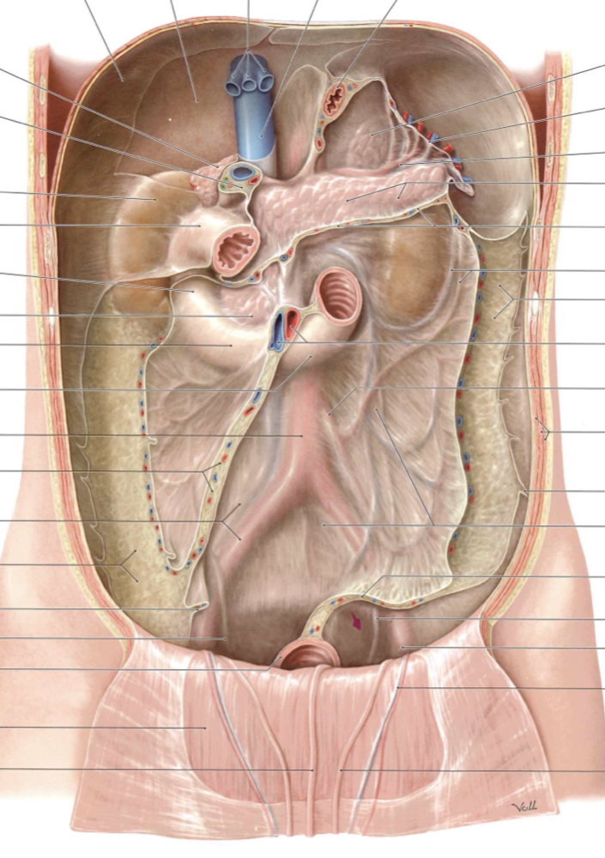
Mesentery
Mesentery
Verges
1. Posterior→root of mesentery
15-20 cm
1st – 2nd lumbar vertebra until the right sacroiliac joint
Intersects the third part of duodenum
Inferiorly→lies anterior to aorta, vena cava and intersects with psoas muscle, right ureter and right spermatic vessels
2. Anterior which follows the intestinal loops
https://www.youtube.com/watch?v=xMo6f6ewqW0
Prometheus LernAtlas der Anatomie
Keith L. Moore, Clinically Oriented Anatomy, 8th Edition, 2017

Slide 18
Histology

Slide 19
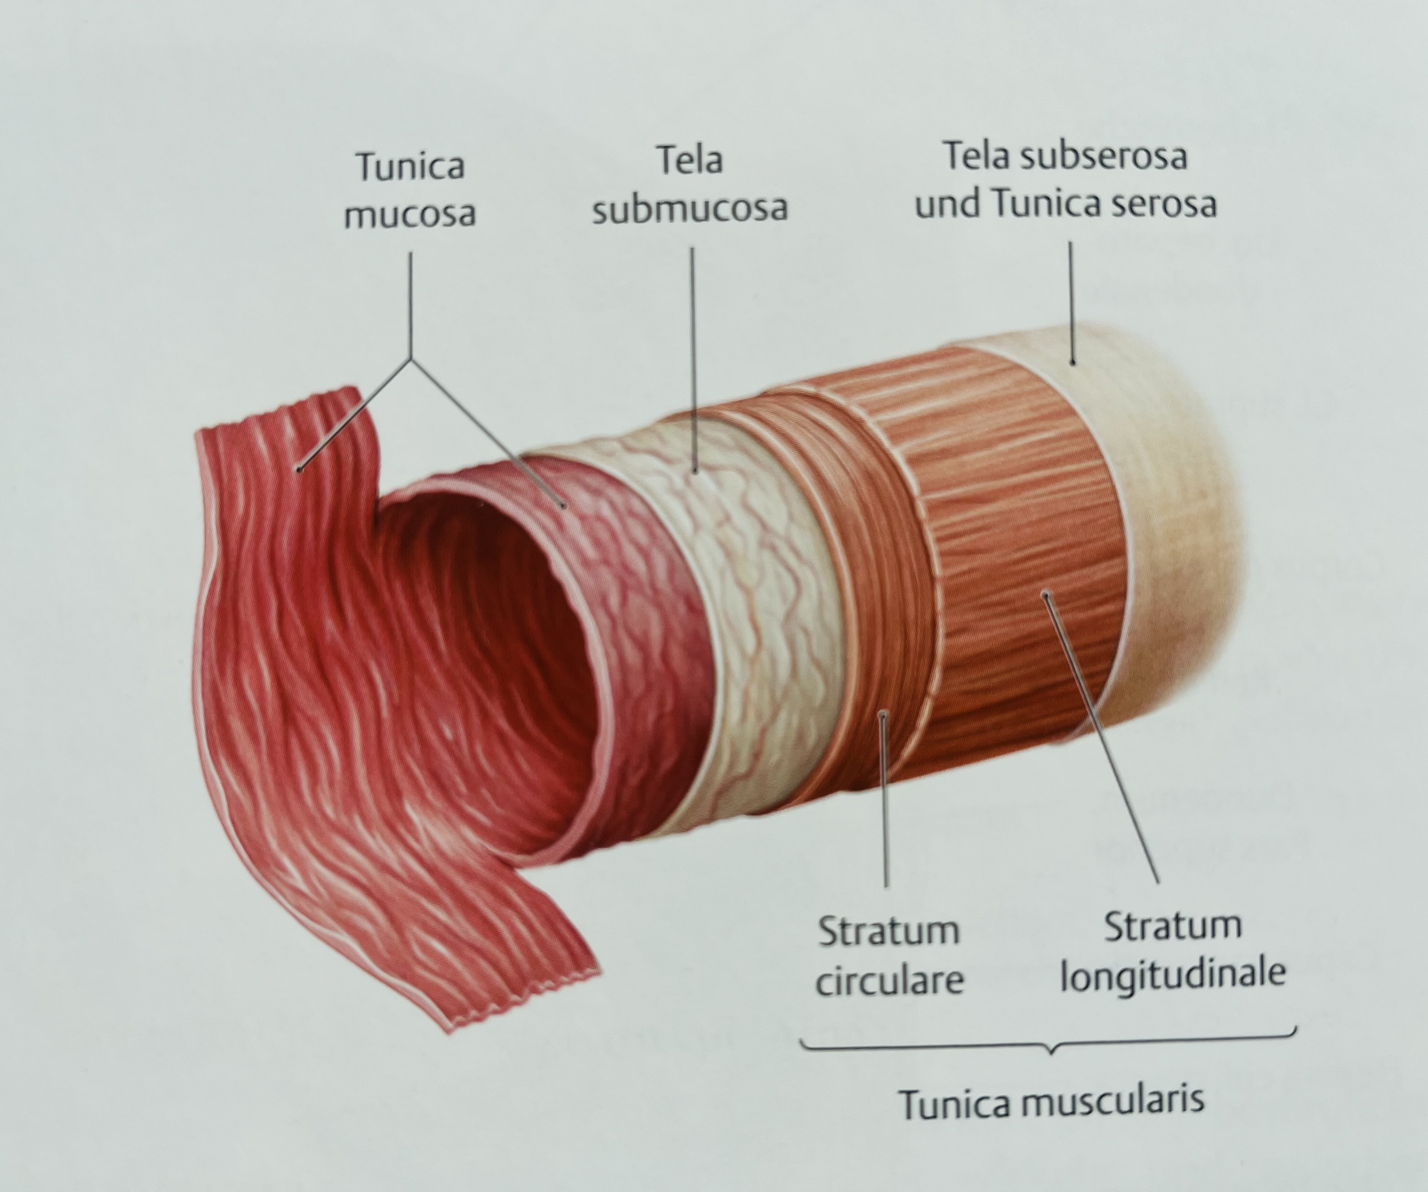
Histology
4 layers
Tunica mucosa
Submucosa
Tunica muscularis
Tunica serosa
Prometheus LernAtlas der Anatomie
Keith L. Moore, Clinically Oriented Anatomy, 8th Edition, 2017

Slide 20
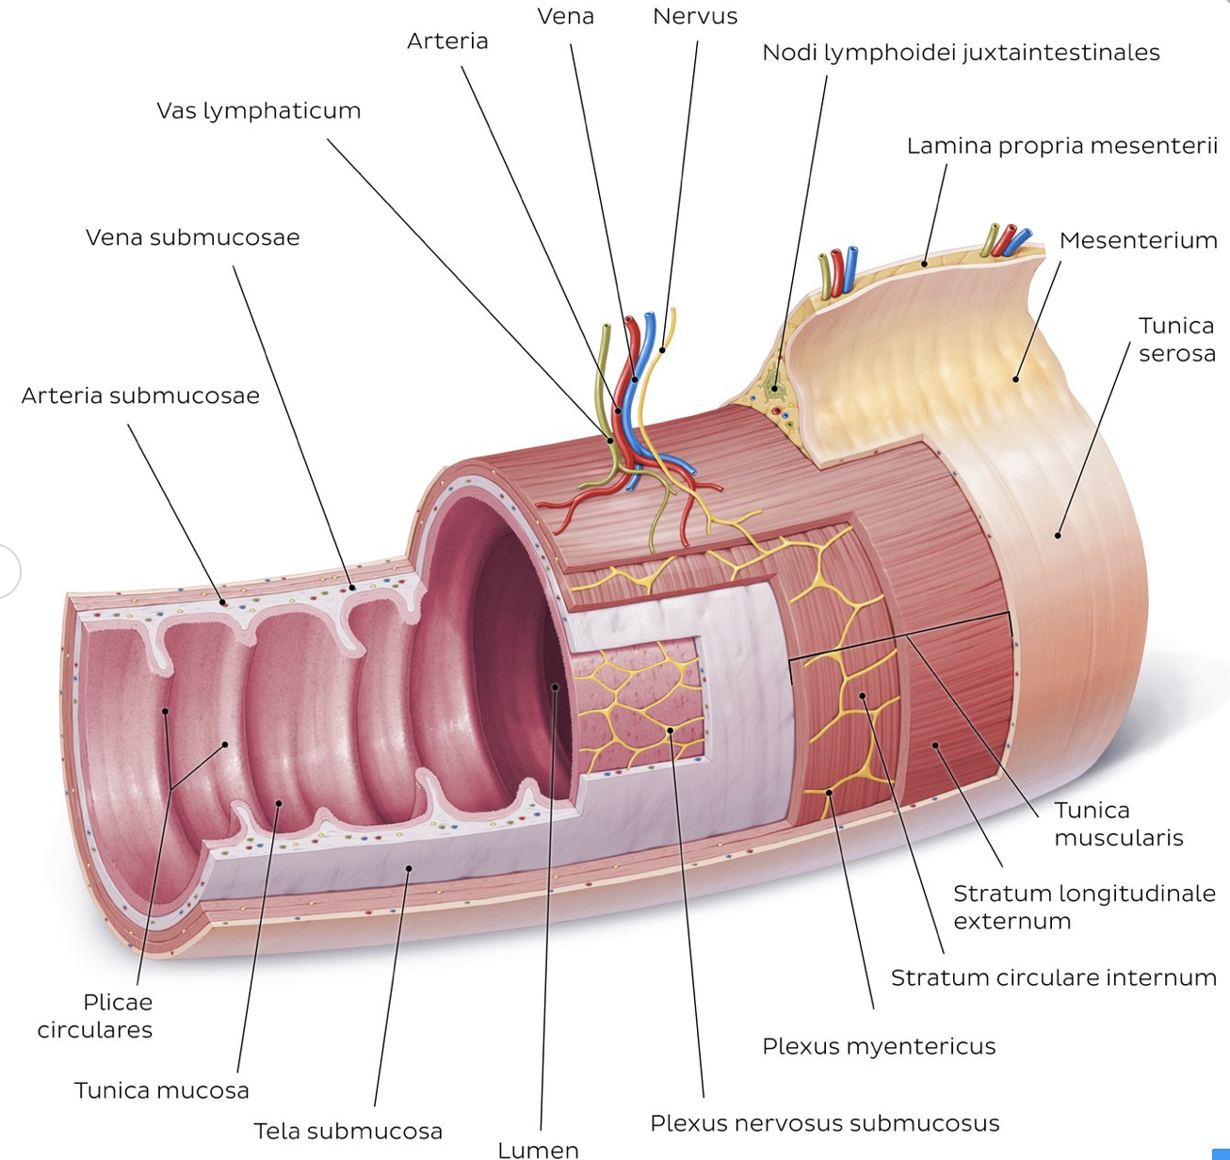
Histology
4 layers
Tunica mucosa
  Lamina propria
  Muscularis mucosa
Submucosa
  Glands, blood and lymphatic vessels, Meissner plexus
Tunica muscularis
  Inner circular
  Outer longitudinal
  Menteric plexus (Auerbach)
Tunica serosa
Plicae circulares (folds of Kerchkring): large valvular flaps projecting into the lumen of small intestine
Prometheus LernAtlas der Anatomie
Keith L. Moore, Clinically Oriented Anatomy, 8th Edition, 2017

Slide 21
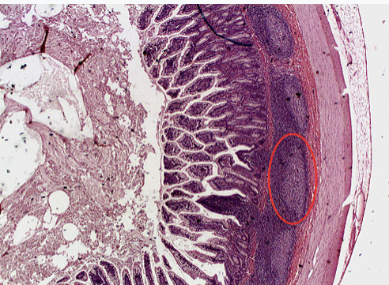
Histology
Payer`s patches
Group of lymphoid follicles in the mucus membrane that line small intestine
Important part of gut associated lymphoid tissue
Prometheus LernAtlas der Anatomie
Keith L. Moore, Clinically Oriented Anatomy, 8th Edition, 2017

Slide 22
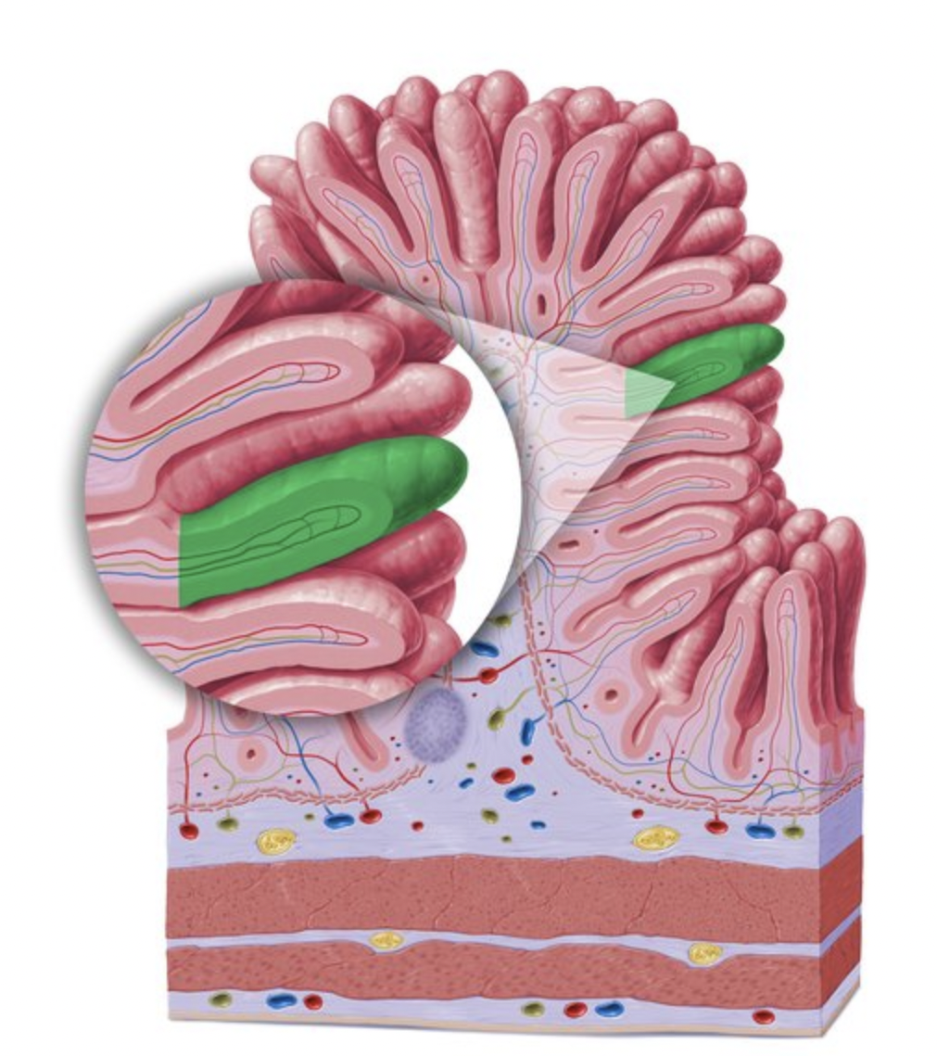
Histology
Jejunum
Intestinal villus
a unique structural and functional unit for the luminal sensing, digestion, absorption, secretion, and immune defense in the small intestine
Prometheus LernAtlas der Anatomie
Keith L. Moore, Clinically Oriented Anatomy, 8th Edition, 2017

Slide 23
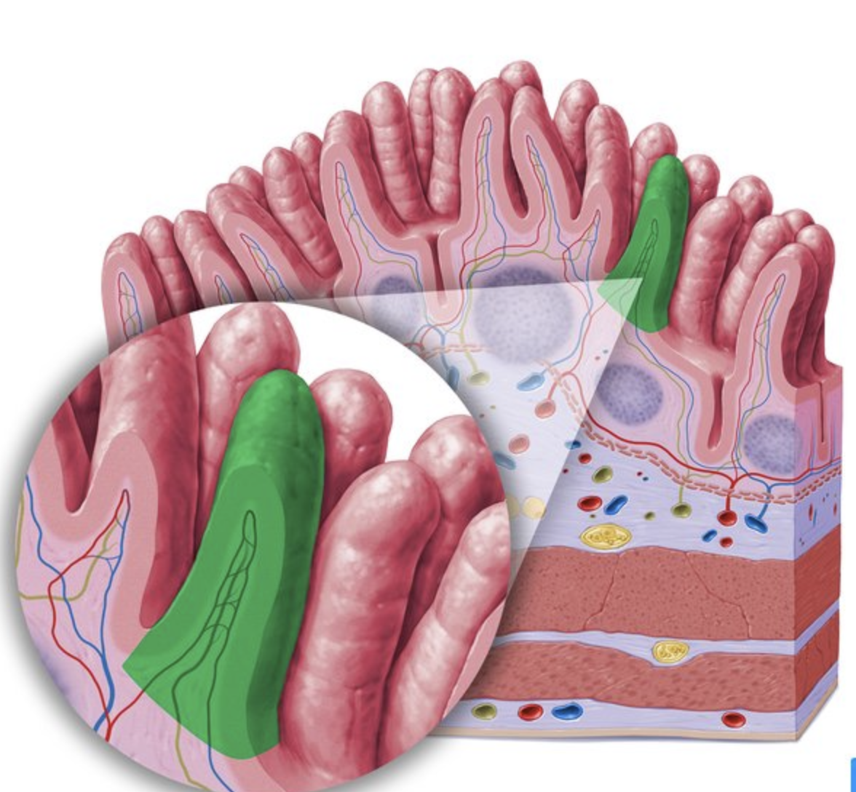
Histology
Ileum
Intestinal villus
Prometheus LernAtlas der Anatomie
Keith L. Moore, Clinically Oriented Anatomy, 8th Edition, 2017

Slide 24
Jejunum and Ileum

Slide 25
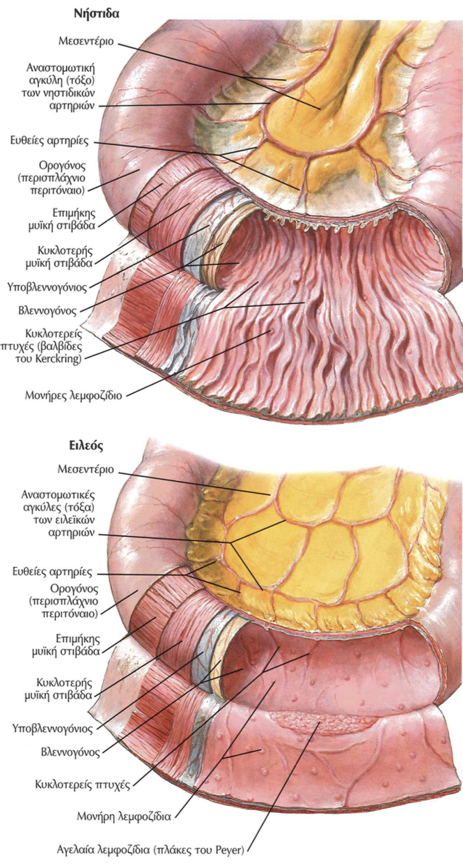
Jejunum
Jejunum
Regio umbilicalis and left iliac fossa
Upper 2/5 of the small intestine
Large width of intestinal loops
High and dense circular folds
Extended vascularity
Minimum number of Payer^s patch
Netter`s Surgical Anatomy and Approaches, 2020
Alice Roberts The Complete Human Body, 2nd Edition, 2016

Slide 26
Ileum
Ileum
Hypogastrium, right iliac fossa and small pelvis
Lower 3/5 of small intestine
Small width, thin wall
Low and sparse circular folds
Less vascularised than jejunum
Larger number of Payer`s patch
Netter`s Surgical Anatomy and Approaches, 2020
Alice Roberts The Complete Human Body, 2nd Edition, 2016

Slide 27
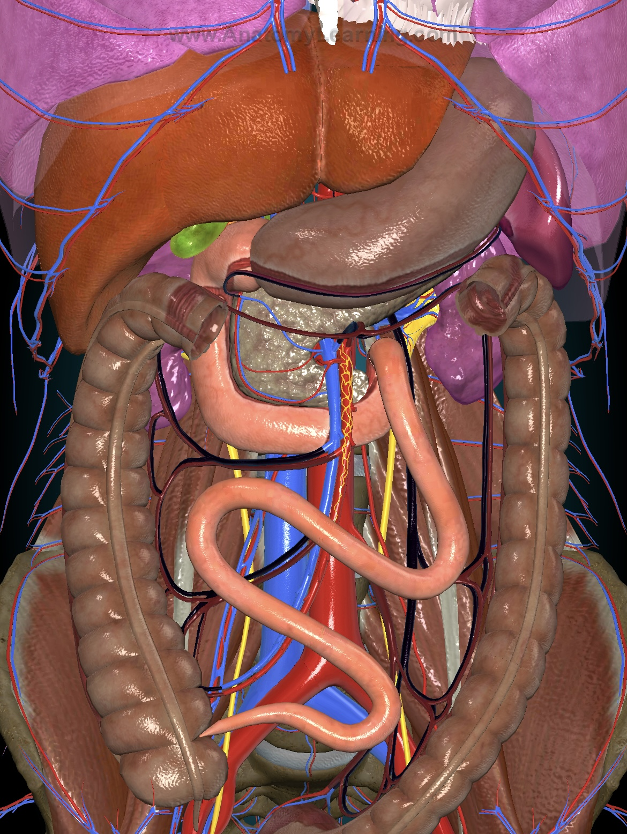
Small intestine/anatomic relationships
Posteriorly
Posterior abdominal wall
Duodenum
Kidneys
Ureters
Aorta
Vena Cava
Anatomy Learning
Susan Standring Dsc, Gray´s Anatomy, The Anatomical Basis of Clinical practice, 2015

Slide 28
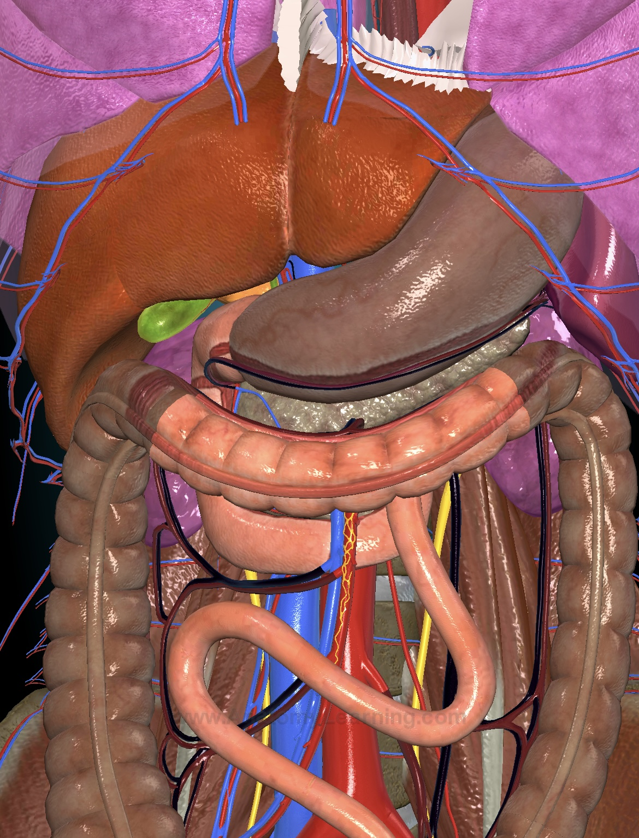
Small intestine/anatomic relationships
Superiorly
Transverse Colon and Mesocolon
Anatomy Learning
Susan Standring Dsc, Gray´s Anatomy, The Anatomical Basis of Clinical practice, 2015

Slide 29
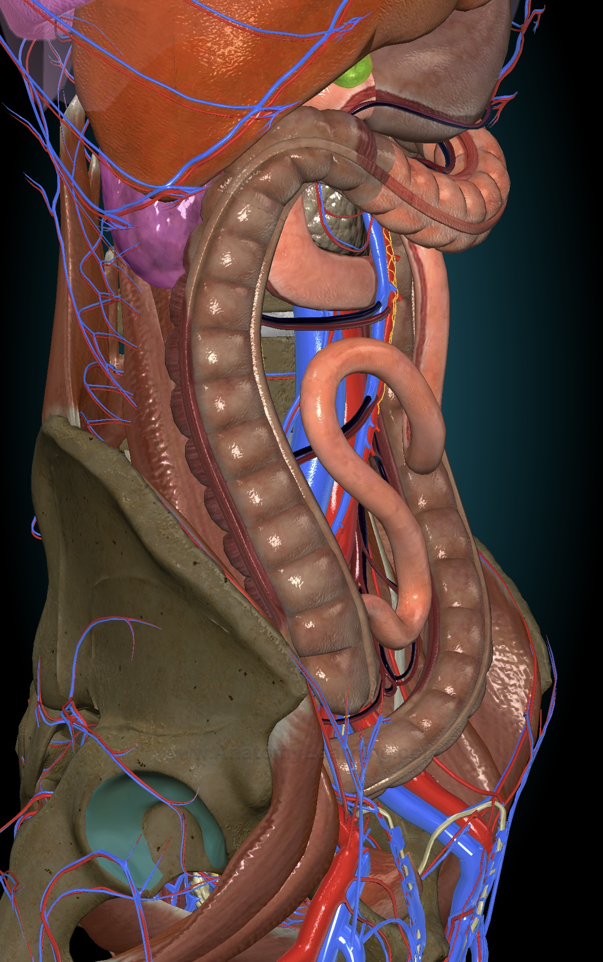
Small intestine/anatomic relationships
Right
Cecum
Ascending Colon
Anatomy Learning
Susan Standring Dsc, Gray´s Anatomy, The Anatomical Basis of Clinical practice, 2015

Slide 30
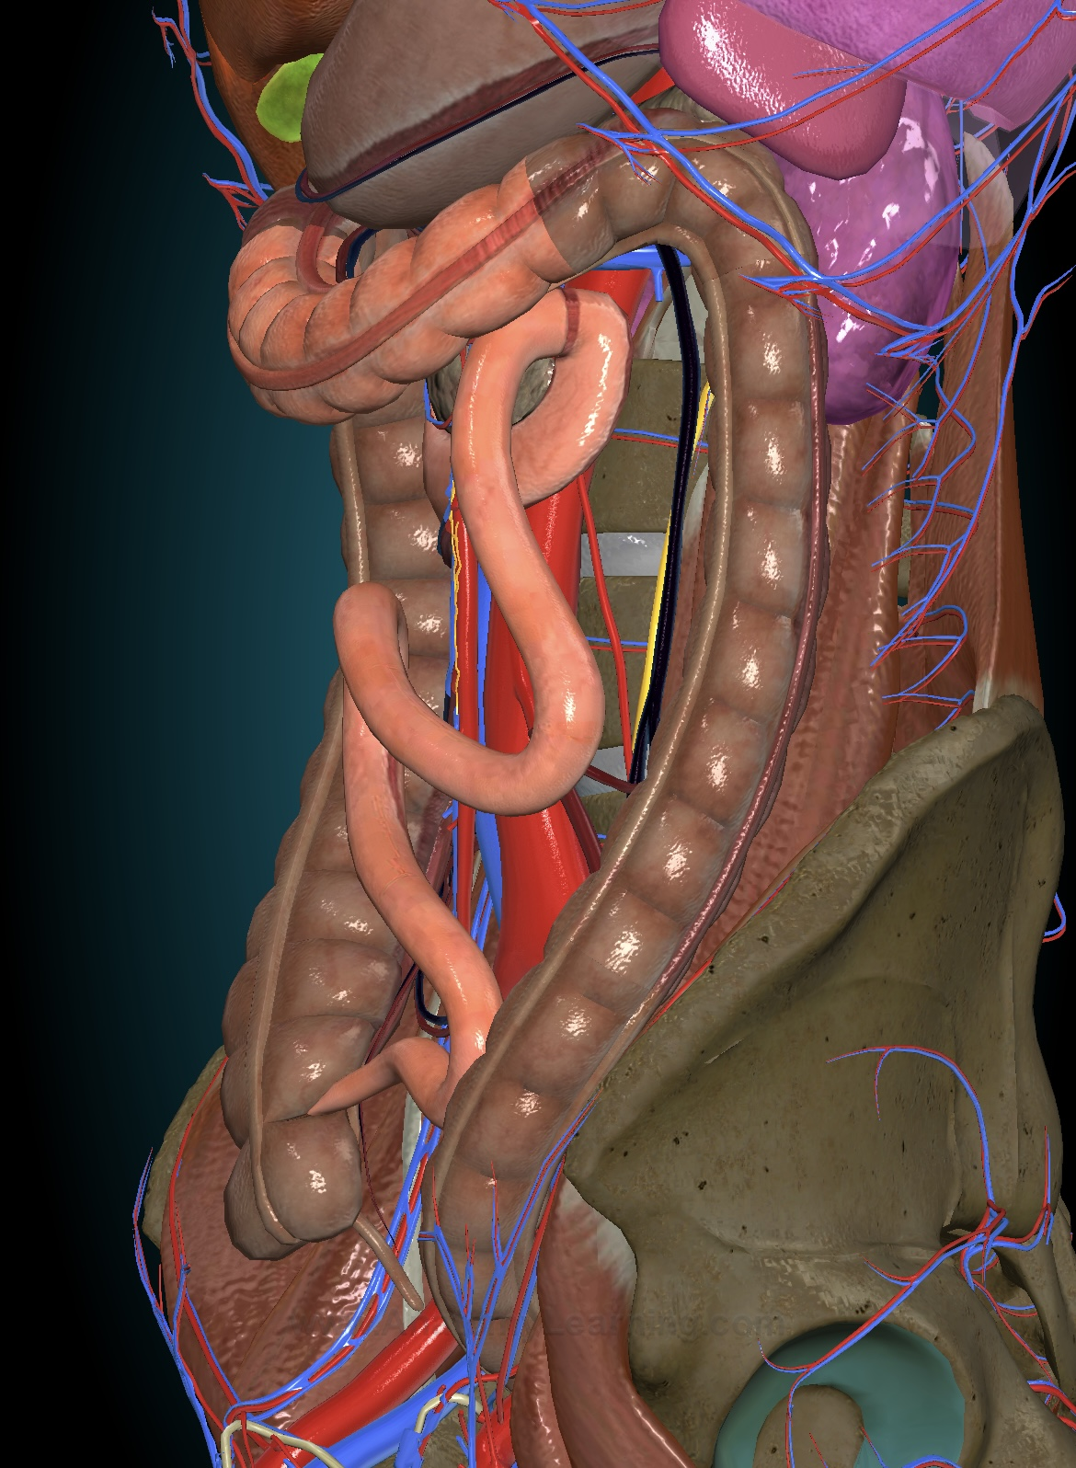
Small intestine/anatomic relationships
Left
Descending Colon
Anatomy Learning
Susan Standring Dsc, Gray´s Anatomy, The Anatomical Basis of Clinical practice, 2015

Slide 31
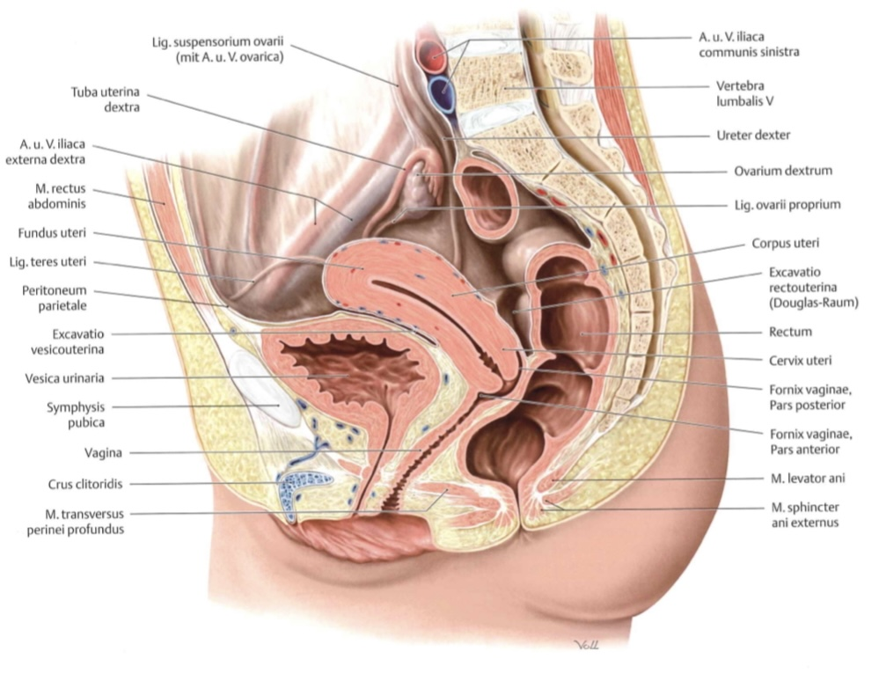
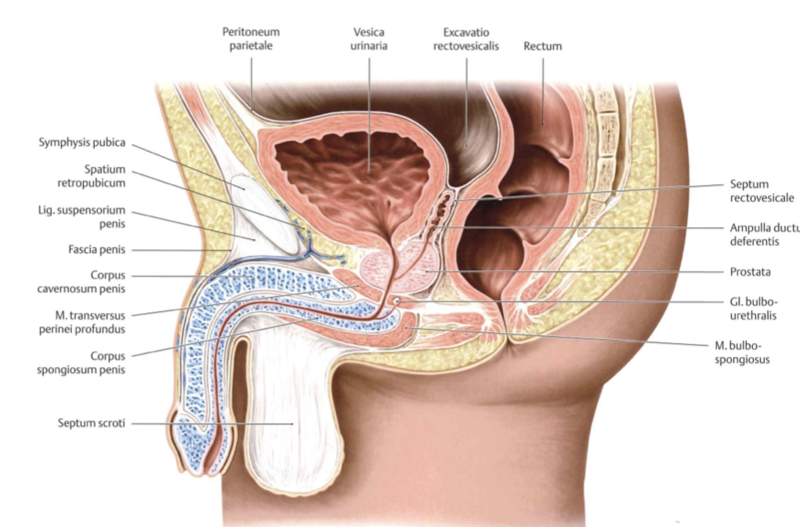
Small intestine/anatomic relationships
Inferiorly
Into the small pelvis
Women: between uterus and rectum→rectouterine pouch
Men: Between bladder and rectum (rectovesical pouch)
Prometheus LernAtlas der Anatomie
Susan Standring Dsc, Gray´s Anatomy, The Anatomical Basis of Clinical practice, 2015

Slide 32
Vessels

Slide 33
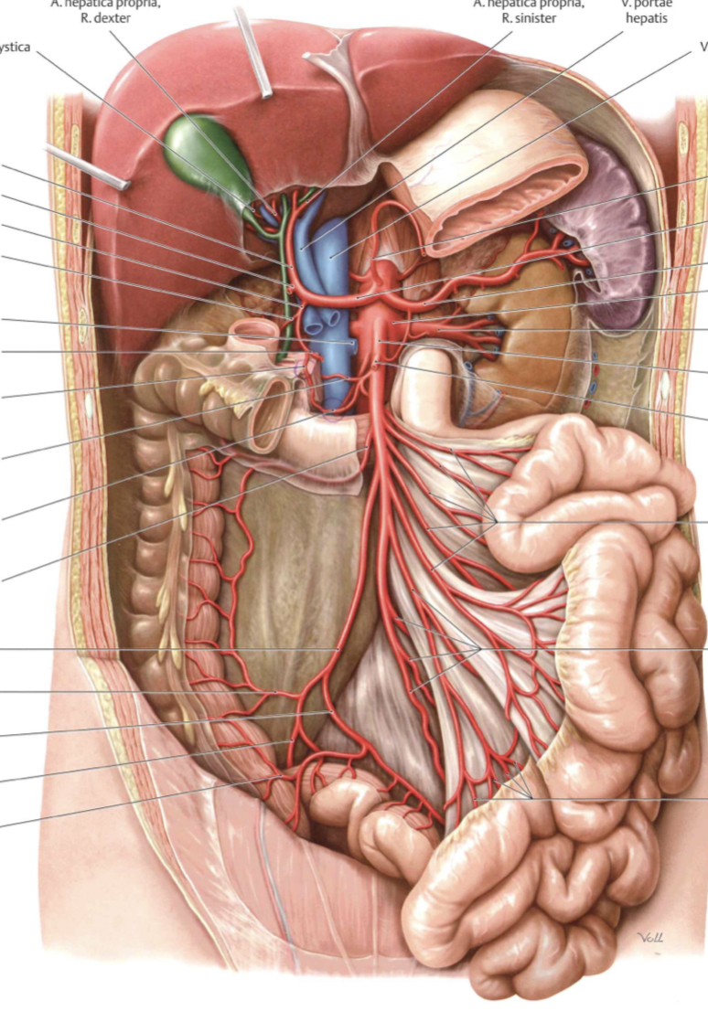
Small intestine/Arteries
Arteries
12/18 jejunal and ileal arteries
Ileocolic arteries
Prometheus LernAtlas der Anatomie
E.Christopher Ellison, Zollinger´s Atlas of Surgical Operations, 2021

Slide 34
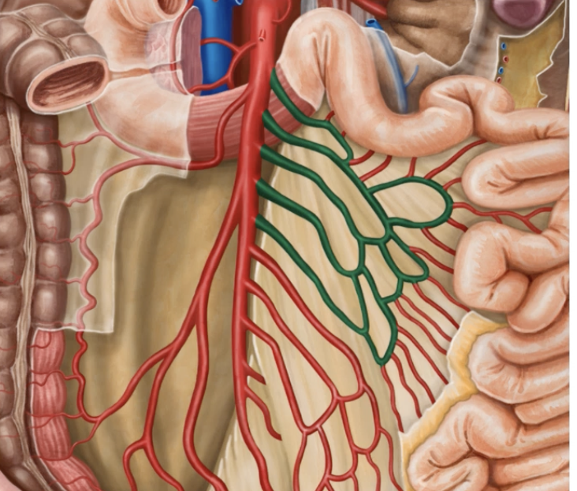
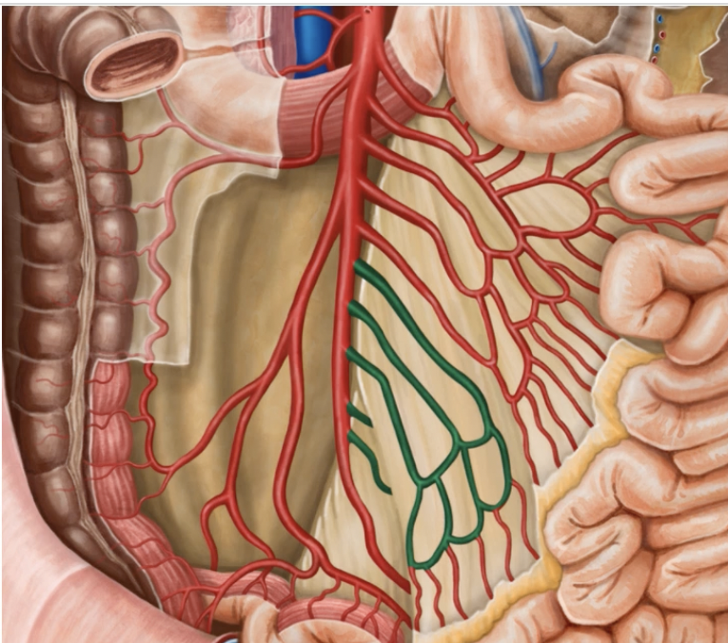
Small intestine/Arteries
Form series of loops of arches→arcades
Prometheus LernAtlas der Anatomie
E.Christopher Ellison, Zollinger´s Atlas of Surgical Operations, 2021

Slide 35
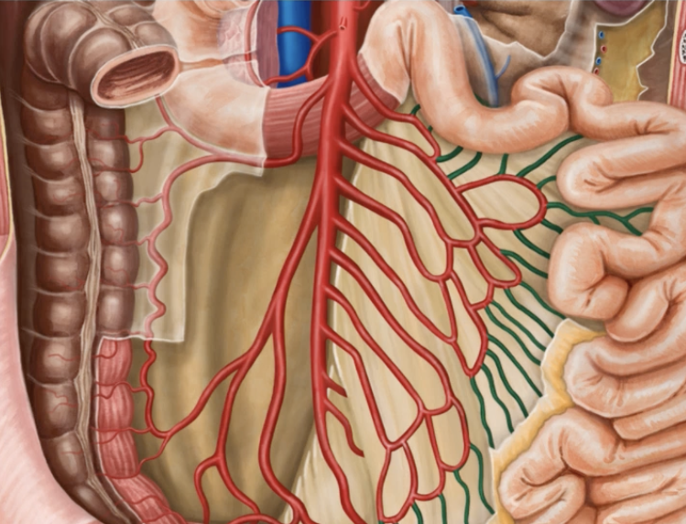
Small intestine/Arteries
Form the arcades come the straight arteries or vasa recta
Prometheus LernAtlas der Anatomie
E.Christopher Ellison, Zollinger´s Atlas of Surgical Operations, 2021

Slide 36
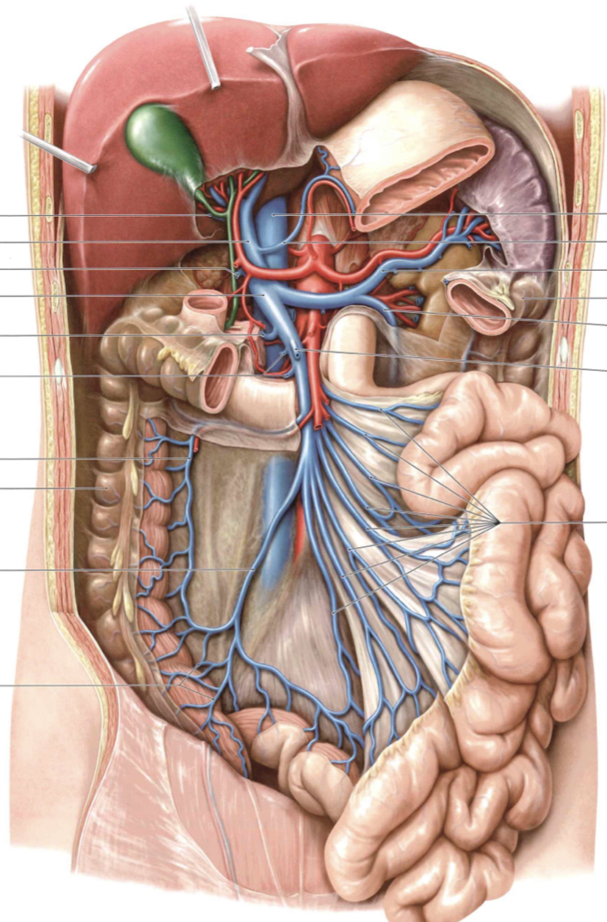
Small intestine/Veins
Veins
Jejunal and ileal veins
Ileocolic vein
Drain to superior mesenteric vein and from there to portal vein
Prometheus LernAtlas der Anatomie
E.Christopher Ellison, Zollinger´s Atlas of Surgical Operations, 2021

Slide 37
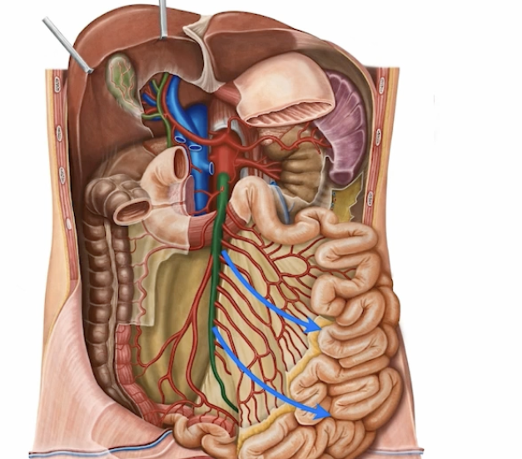
Mesenteric ischemia
Occurs when the blood flow to the small intestines is restricted
Can cause necrosis of the intestine
Two types
Acute
chronic
Prometheus LernAtlas der Anatomie
E.Christopher Ellison, Zollinger´s Atlas of Surgical Operations, 2021

Slide 38
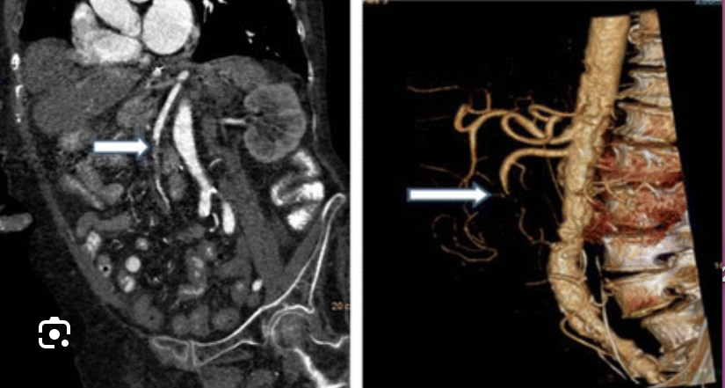
Acute mesenteric ischemia
Etiology
  Embolic
  thrombosis
Prometheus LernAtlas der Anatomie
E.Christopher Ellison, Zollinger´s Atlas of Surgical Operations, 2021

Slide 39
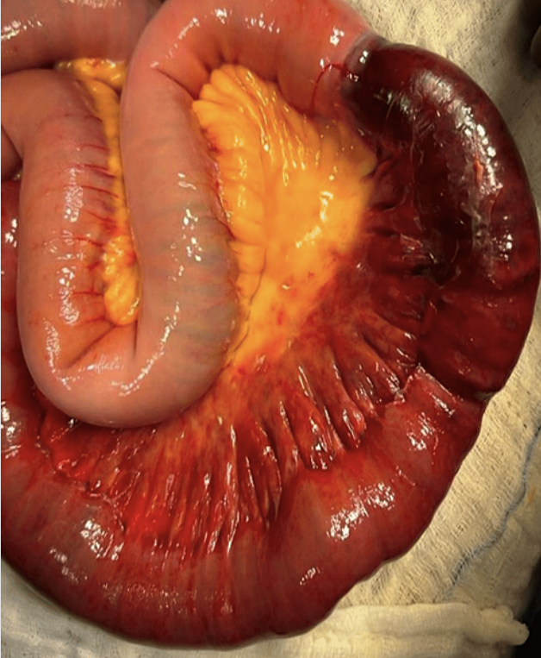
Acute mesenteric ischemia
Super Emergency in visceral surgery
Excision of necrotic bowel
Revascularisation
Prometheus LernAtlas der Anatomie
E.Christopher Ellison, Zollinger´s Atlas of Surgical Operations, 2021

Slide 40
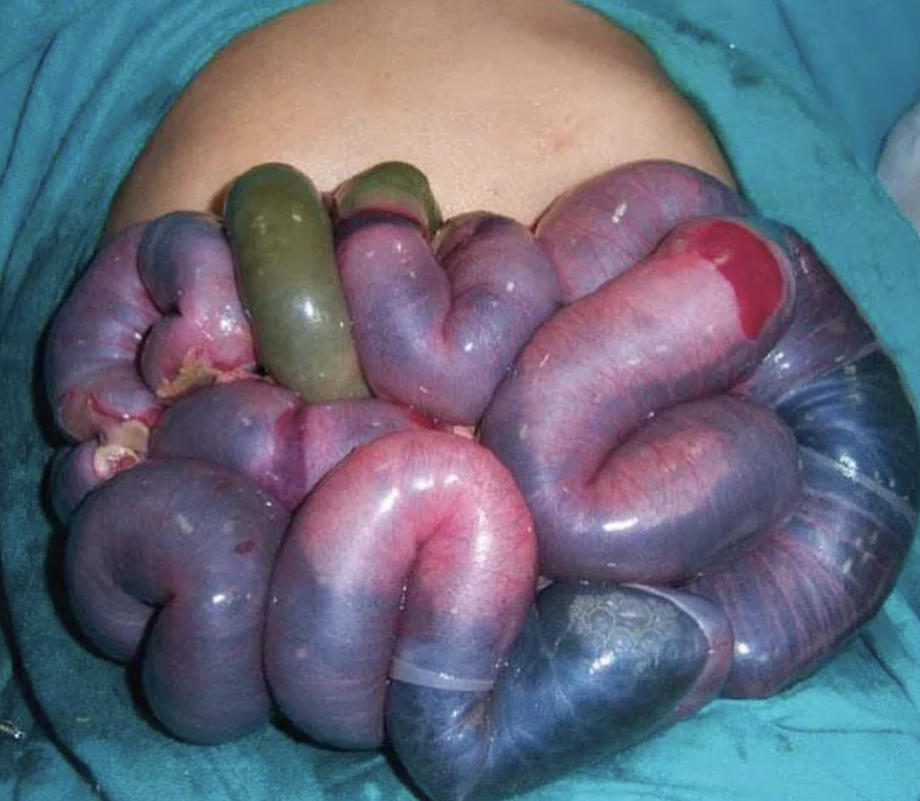
Acute mesenteric ischemia
Super Emergency in visceral surgery
Prometheus LernAtlas der Anatomie
E.Christopher Ellison, Zollinger´s Atlas of Surgical Operations, 2021

Slide 41
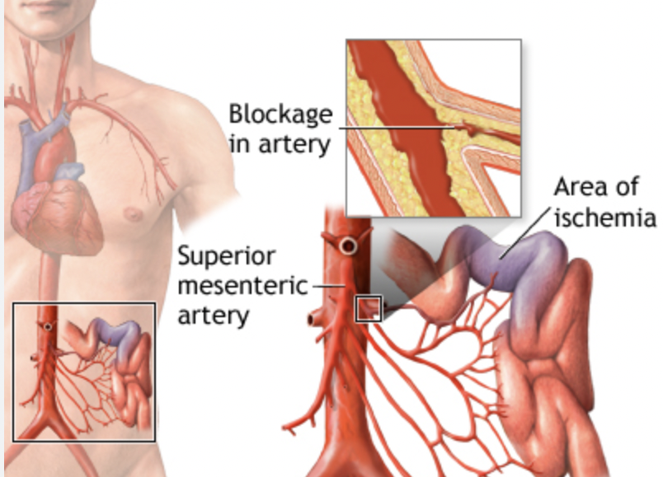
Chronic mesenteric ischemia
Usually the result of atherosclerosis
Options
  Surgery
  Stents
Prometheus LernAtlas der Anatomie
E.Christopher Ellison, Zollinger´s Atlas of Surgical Operations, 2021

Slide 42
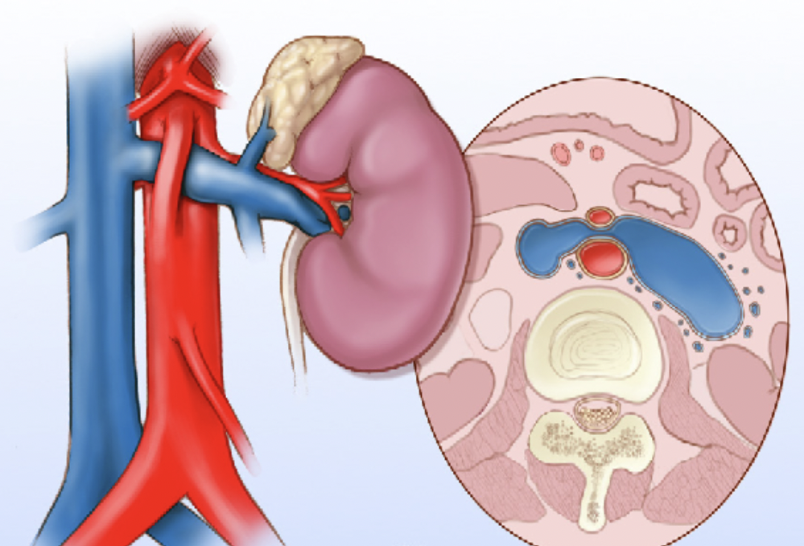
Nutcracker Syndrome
Rare vein compression disorder
Compression of the left renal vein from the abdominal aorta and the superior mesenteric artery
Flank pain, hematuria
Prometheus LernAtlas der Anatomie
E.Christopher Ellison, Zollinger´s Atlas of Surgical Operations, 2021

Slide 43
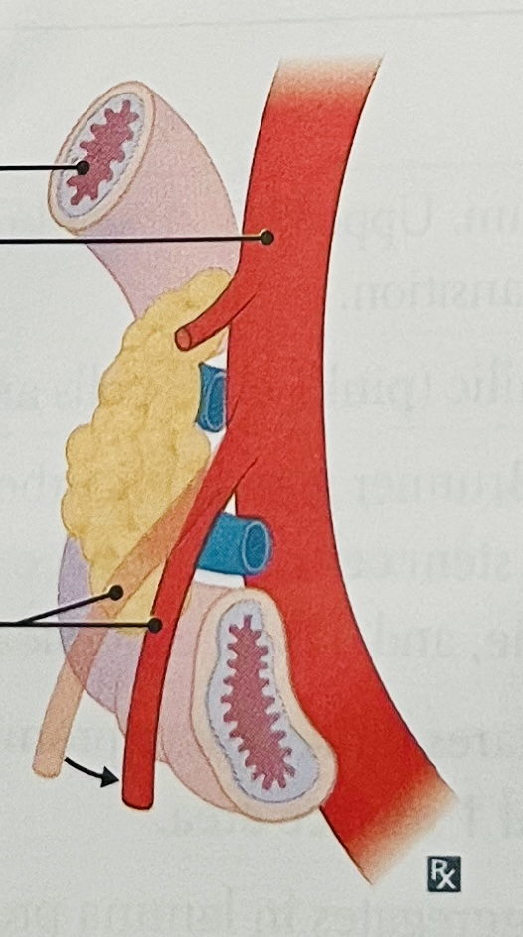
Superior Mesenteric Artery Syndrome
Compression of the Pars III of the Duodenum
Compression from the abdominal aorta and the superior mesenteric artery
Postprandial pain
In conditions with diminished mesenteric fat
Prometheus LernAtlas der Anatomie
E.Christopher Ellison, Zollinger´s Atlas of Surgical Operations, 2021

Slide 44
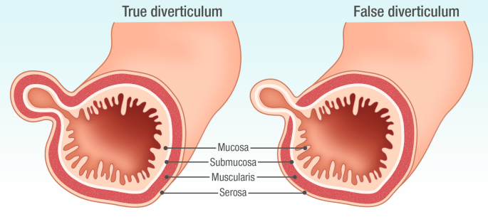
Meckel`s Diverticulum
True Diverticulum: all gut wall layers outpouch
False Diverticulum: only mucosa and submucosa outpouch. Occur especially where vasa recta perforate muscularis externa
Prometheus LernAtlas der Anatomie
E.Christopher Ellison, Zollinger´s Atlas of Surgical Operations, 2021

Slide 45
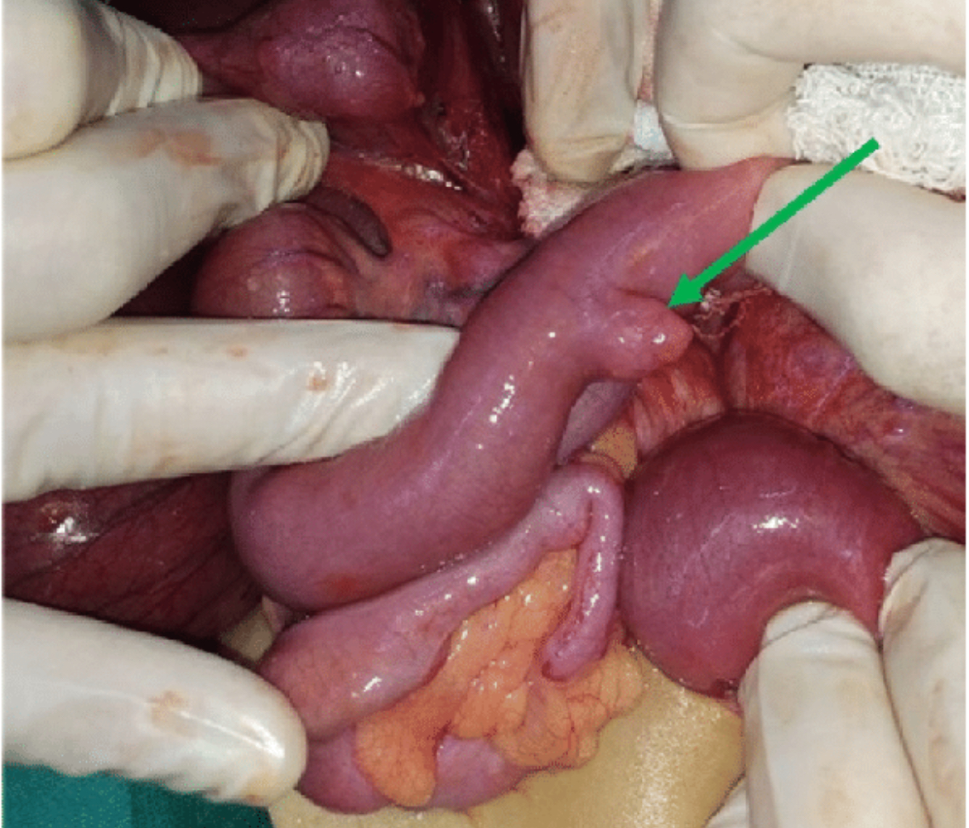
Meckel`s Diverticulum
True diverticulum
Protrusion of ileum or jejunum
Often 30cm-50cm from the ileocecal valve
Relic of the omphaloenteric duct
(regression 6th embryonic week)
Incidence: 2%-4% of infants
Asymptomatic but can cause GI bleeding and intestinal obstruction
Prometheus LernAtlas der Anatomie
E.Christopher Ellison, Zollinger´s Atlas of Surgical Operations, 2021

Slide 46
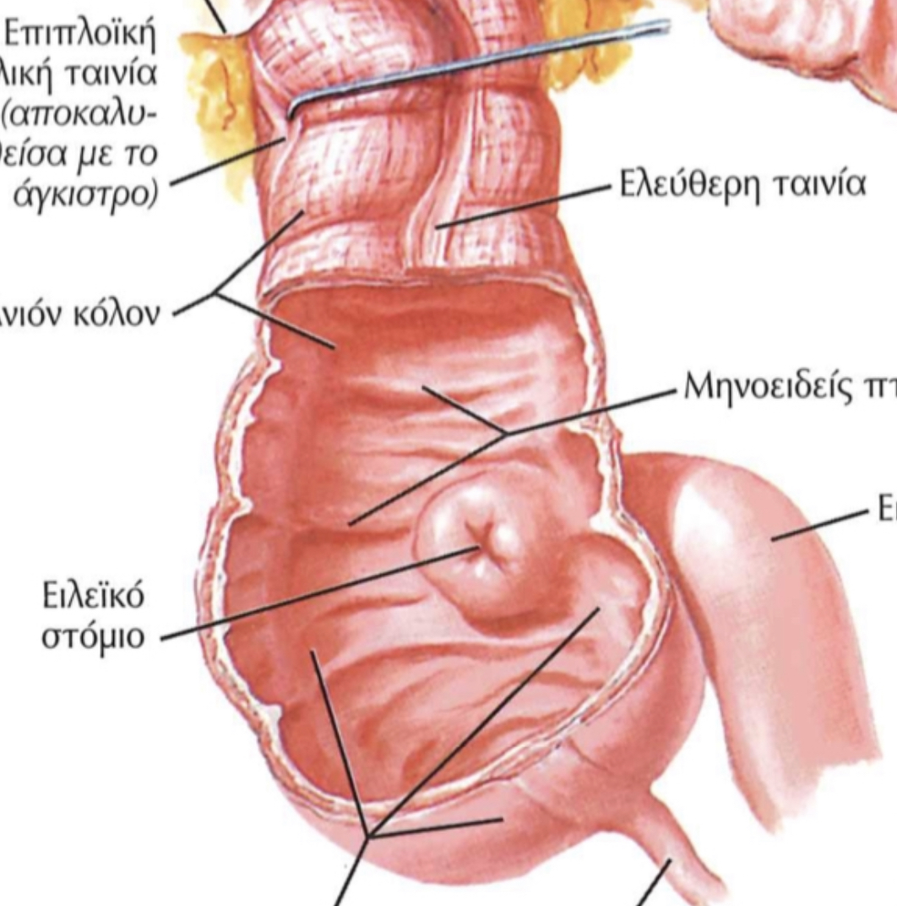
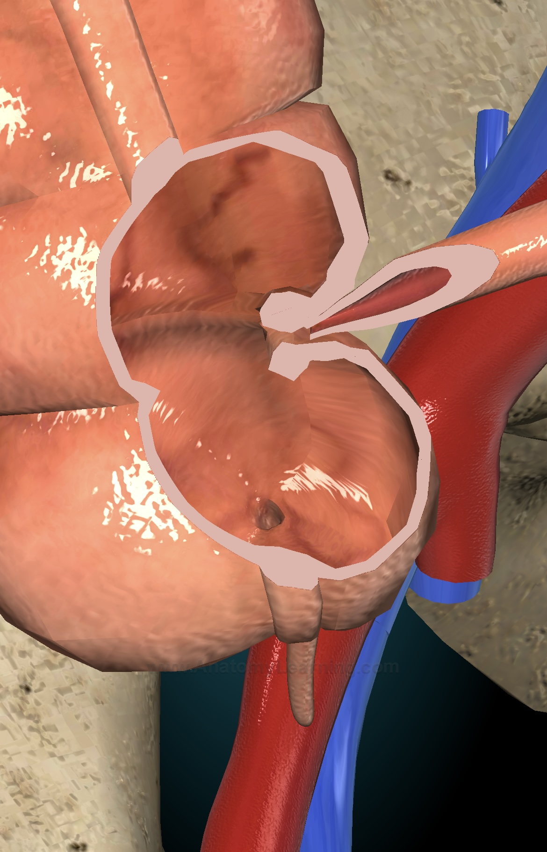
Ileocolic valve
Sphincter muscle valve that seperates small from large intestine
Role to limit the reflux of colonic contents into the ileum
Histology: thickening of the muscularis mucosa and the muscularis externa
Anatomy Learning
Netter`s Surgical Anatomy and Approaches, 2020
Keith L. Moore, Clinically Oriented Anatomy, 8th Edition, 2017

Slide 47
Innervation of the small intestine

Slide 48
Small Intestine
Innervation of the small intestine
Receives signals from
Extrinsic sources
Brain/spinal cord
Intrinsic Sources
Within small intestine
Prometheus LernAtlas der Anatomie
Anatomy Learning
Sabiston, Textbook of Surgery, 20th Edition, 2016

Slide 49
Small Intestine
Innervation of the small intestine
Functions of the gastrointestinal tract
Motility
Secretomotor function of glands in the GI tract
Regulation of blood flow
Immunomodulation
Prometheus LernAtlas der Anatomie
Anatomy Learning
Sabiston, Textbook of Surgery, 20th Edition, 2016

Slide 50
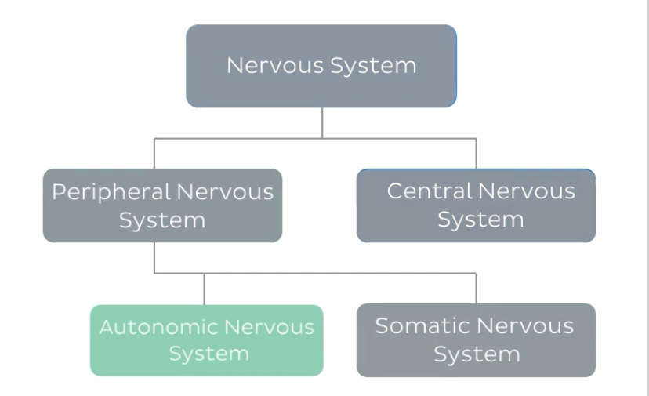
Small Intestine
Extrinsic Innervation
Prometheus LernAtlas der Anatomie
Anatomy Learning
Sabiston, Textbook of Surgery, 20th Edition, 2016
Notes:
tResponsible for controlling bodily functions which are not consiously directed such as brrathing

Slide 51
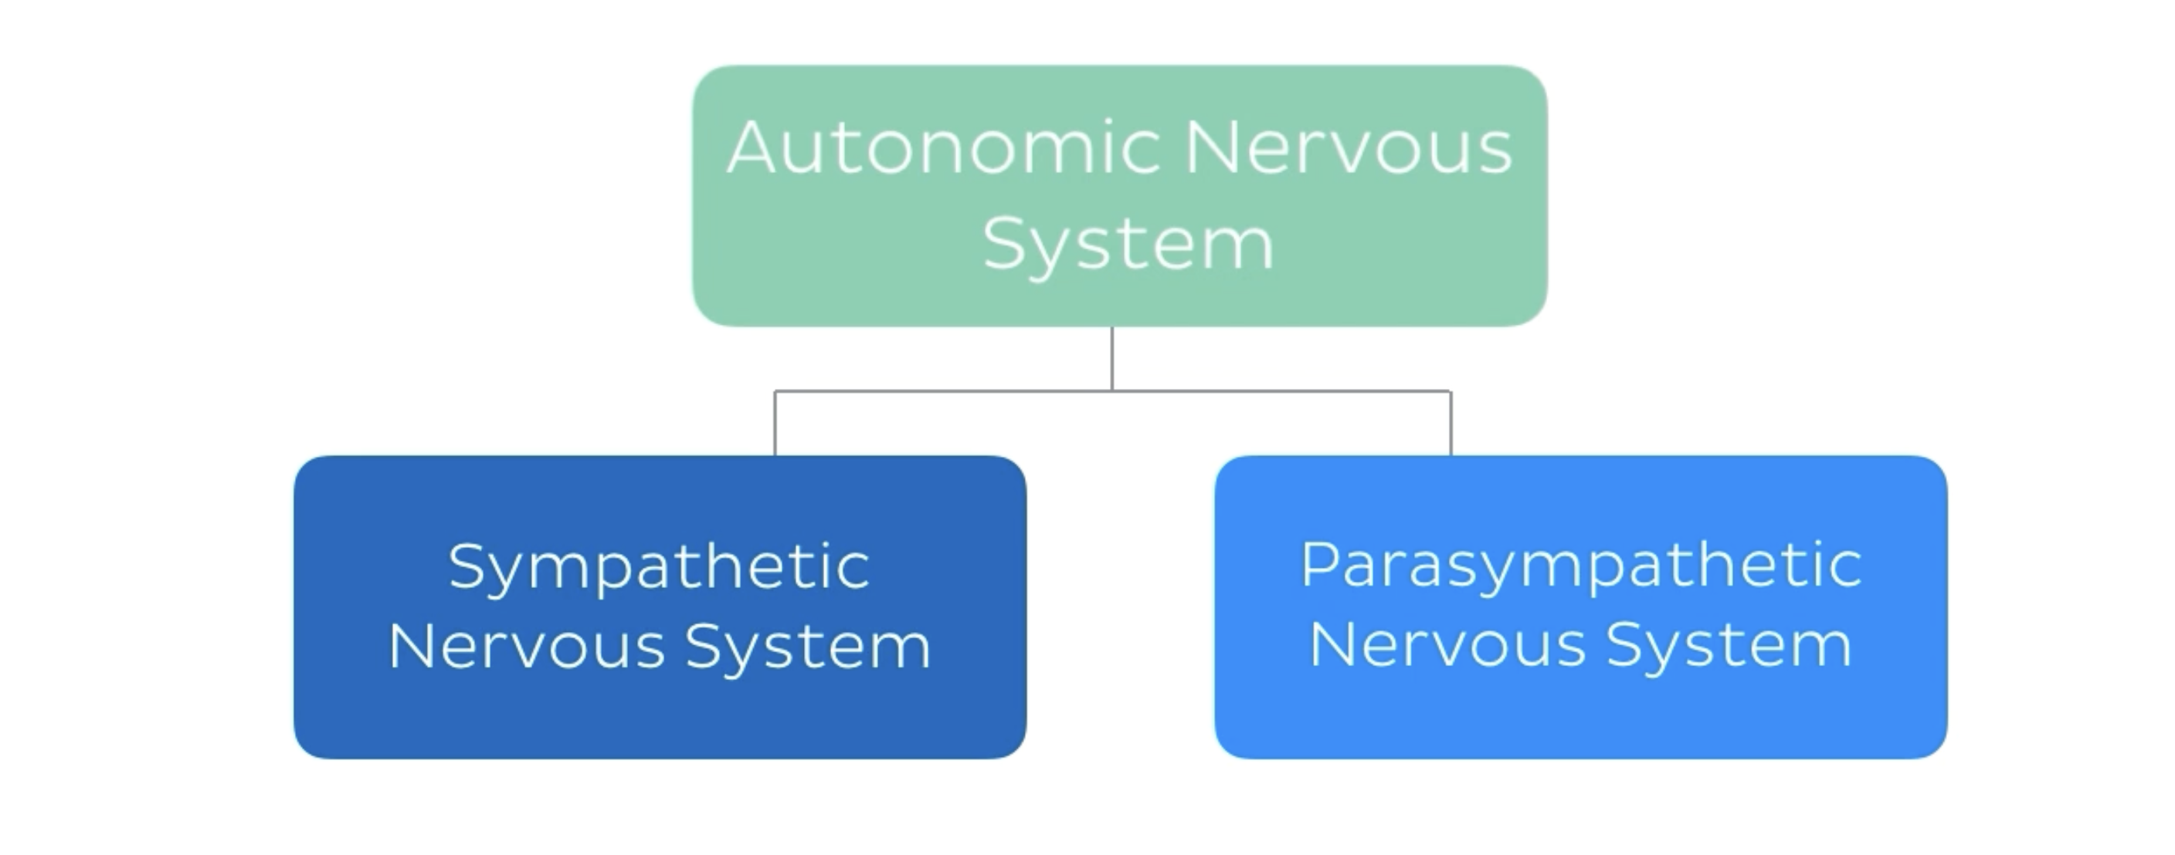
Small Intestine
Autonomic nervous system
Prometheus LernAtlas der Anatomie
Anatomy Learning
Sabiston, Textbook of Surgery, 20th Edition, 2016
Notes:
tResponsible for controlling bodily functions which are not consiously directed such as brrathing

Slide 52
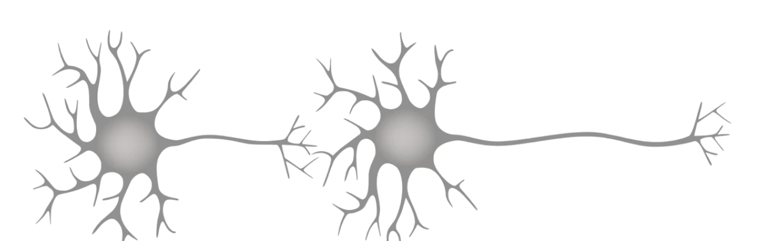
Small Intestine
Sympathetic Nervous System
Consists of two neuron chain
Preganglionic neuron (shorter), arises from the thoracolumbar spinal cord and their axons travel to ganglion
Postganglionic neuron (longer), begins from the ganlgion to supply the target structure
Prometheus LernAtlas der Anatomie
Anatomy Learning
Sabiston, Textbook of Surgery, 20th Edition, 2016
Notes:
tResponsible for controlling bodily functions which are not consiously directed such as brrathing

Slide 53
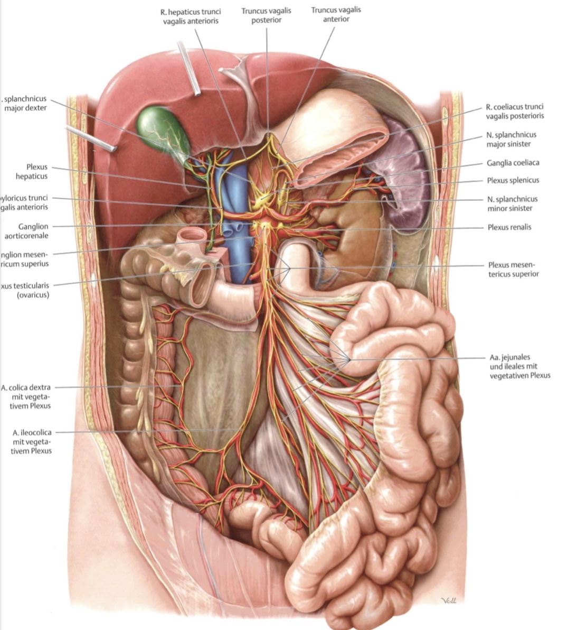
Small Intestine
Sympathetic Nervous System
Prevertebral ganglia
Location: anterior to the abdominal aorta
Prometheus LernAtlas der Anatomie
Anatomy Learning
Sabiston, Textbook of Surgery, 20th Edition, 2016
Notes:
tResponsible for controlling bodily functions which are not consiously directed such as brrathing

Slide 54
Small Intestine
Sympathetic Nervous System
Inhibits digestion
Slows down motility and gastrointestinal secretion
Causes contraction of gastrointestinal sphincters and blood vessels
Prometheus LernAtlas der Anatomie
Anatomy Learning
Sabiston, Textbook of Surgery, 20th Edition, 2016
Notes:
tResponsible for controlling bodily functions which are not consiously directed such as brrathing

Slide 55
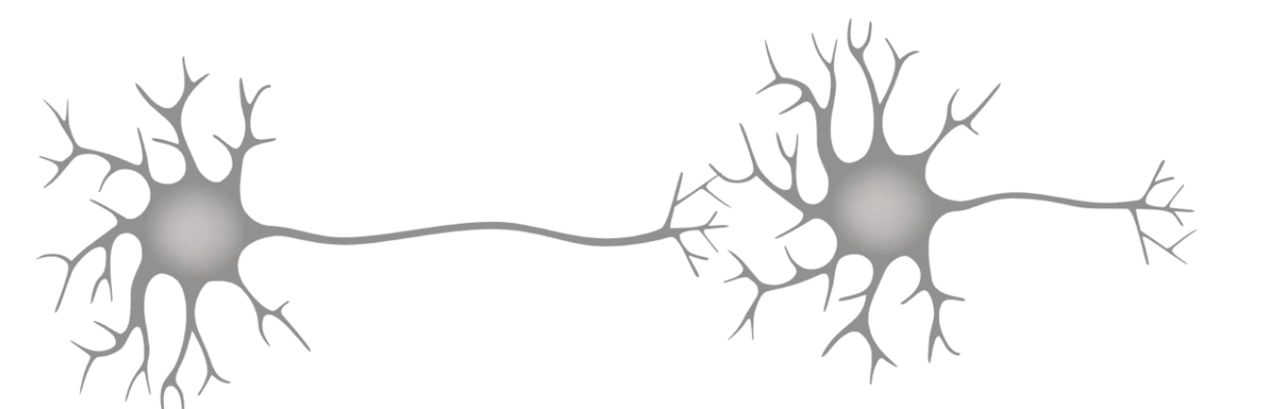
Small Intestine
Parasympathetic Nervous System
Consists of two neuron chain
Preganglionic neuron (longer), arises from the craniosacral spine cord and their axons travel to ganglia
Postganglionic neuron (shorter), begins from the ganlgion to supply the target structure
Prometheus LernAtlas der Anatomie
Anatomy Learning
Sabiston, Textbook of Surgery, 20th Edition, 2016
Notes:
tResponsible for controlling bodily functions which are not consiously directed such as brrathing

Slide 56
Small Intestine
Parasympathetic Nervous System
Opposite of sympathetic nervous system
Stimulates digestion
Increases gastrointestinal secretion and motor activity
Prometheus LernAtlas der Anatomie
Anatomy Learning
Sabiston, Textbook of Surgery, 20th Edition, 2016
Notes:
tResponsible for controlling bodily functions which are not consiously directed such as brrathing

Slide 57
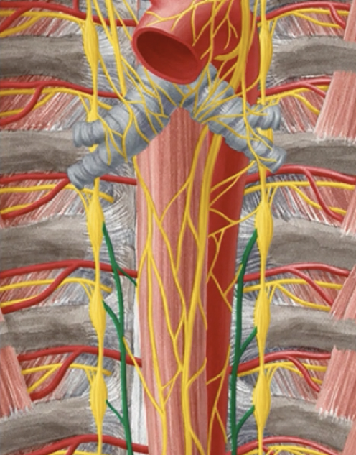
Small Intestine
Extrinsic innervation Sympathetic nervous system
Preganglionic sympathetic fibers arising from the
thoracolumbar spinal cord
travel as the greater and lesser thoracic splanchnic nerves to
the celiac, aorticorenal and superior mesenteric ganglia
Prometheus LernAtlas der Anatomie
Anatomy Learning
Sabiston, Textbook of Surgery, 20th Edition, 2016
Notes:
tResponsible for controlling bodily functions which are not consiously directed such as brrathing

Slide 58

Small Intestine
Extrinsic innervation Sympathetic nervous system
Nervous splanchnicus major (T5-9/T10)
Make their way into abdomen by piercing the ipsilateral crus of the diaphragm and synapse to the celiac ganglia (prevertebral ganglia)
Prometheus LernAtlas der Anatomie
Anatomy Learning
Sabiston, Textbook of Surgery, 20th Edition, 2016
Notes:
tResponsible for controlling bodily functions which are not consiously directed such as brrathing

Slide 59

Small Intestine
Extrinsic innervation Sympathetic nervous system
Nervous splanchnicus minor (T10-11)
Arise inferior to the great splachnic nerves and travel lateral to them also piercing the ipsilateral crus of the diaphragm and delivers axons to the celiac ganglia (prevertebral ganglia) and aorticorenal ganglia
Prometheus LernAtlas der Anatomie
Anatomy Learning
Sabiston, Textbook of Surgery, 20th Edition, 2016
Notes:
tResponsible for controlling bodily functions which are not consiously directed such as brrathing

Slide 60

Small Intestine
Extrinsic innervation Sympathetic nervous system
Nervous splanchnicus imus (T11-12)
delivers axons to the celiac ganglia (prevertebral ganglia) and aorticorenal ganglia and mostly innervates kidney
Prometheus LernAtlas der Anatomie
Anatomy Learning
Sabiston, Textbook of Surgery, 20th Edition, 2016
Notes:
tResponsible for controlling bodily functions which are not consiously directed such as brrathing

Slide 61

Small Intestine
Celiac Plexus
Complex network of intersecting nerves
Houses sympathetic and
parasympathetic neurons
Level T12/L1
Connect the celiac
with the aorticorenal ganglia
Supplies stomach, liver, pancreas,
Gallbladder, spleen, kidneys
Prometheus LernAtlas der Anatomie
Anatomy Learning
Sabiston, Textbook of Surgery, 20th Edition, 2016
Notes:
tResponsible for controlling bodily functions which are not consiously directed such as brrathing

Slide 62


Small Intestine
Superior Mesenteric Plexus
Inferior continuation of the celiac plexus
Accompanies the superior mesenteric artery
At the origin of SMA its ganglion
Gives off secondary plecuses
(inf Duod-Asc.Colon)
Prometheus LernAtlas der Anatomie
Anatomy Learning
Sabiston, Textbook of Surgery, 20th Edition, 2016
Notes:
tResponsible for controlling bodily functions which are not consiously directed such as brrathing

Slide 63

Small Intestine
Extrinsic innervation Parasympathetic nervous system
Nervus vagus
Originate from the brainstem
Make their way down through neck and thoracic cavity
Lateral to esophagus
Turning anteriorly and posteriorly before crossing diaphragm to form
  Anterior vagal trunk
  Posterior vagal trunk
Prometheus LernAtlas der Anatomie
Anatomy Learning
Sabiston, Textbook of Surgery, 20th Edition, 2016
Notes:
tResponsible for controlling bodily functions which are not consiously directed such as brrathing

Slide 64

Small Intestine
Extrinsic innervation Parasympathetic nervous system
Anterior vagal trunk (fibers mostly from the left but right vagus as well) for stomach and duodenum
Prometheus LernAtlas der Anatomie
Anatomy Learning
Sabiston, Textbook of Surgery, 20th Edition, 2016
Notes:
tResponsible for controlling bodily functions which are not consiously directed such as brrathing

Slide 65

Small Intestine
Extrinsic innervation Parasympathetic nervous system
Posterior vagal trunk (fibers mostly from the right vagus)
Prometheus LernAtlas der Anatomie
Anatomy Learning
Sabiston, Textbook of Surgery, 20th Edition, 2016
Notes:
tResponsible for controlling bodily functions which are not consiously directed such as brrathing

Slide 66
Small Intestine
Intrinsic innervation or enteric nervous system
Myenteric plexus
Submucosal Plexus
Prometheus LernAtlas der Anatomie
Anatomy Learning
Sabiston, Textbook of Surgery, 20th Edition, 2016
Notes:
tResponsible for controlling bodily functions which are not consiously directed such as brrathing

Slide 67

Small Intestine
Intrinsic innervation
Controls
Tone of smooth muscle
Speed and intensity of muscle contractions
Prometheus LernAtlas der Anatomie
Anatomy Learning
Sabiston, Textbook of Surgery, 20th Edition, 2016
Notes:
tResponsible for controlling bodily functions which are not consiously directed such as brrathing

Slide 68

Small Intestine
Intrinsic innervation
Controls
Intestinal secretion of enzymes
Absorption of food
Blood flow
It is a ``little brain``as it operates independently of the brain and spinal cord
Prometheus LernAtlas der Anatomie
Anatomy Learning
Sabiston, Textbook of Surgery, 20th Edition, 2016
Notes:
tResponsible for controlling bodily functions which are not consiously directed such as brrathing

Slide 69

Small Intestine-Innervation-Synopsis
Notes:
tResponsible for controlling bodily functions which are not consiously directed such as brrathing

Slide 70

Small Intestine-Innervation-Synopsis
Notes:
tResponsible for controlling bodily functions which are not consiously directed such as brrathing

Slide 71

Small Intestine-Innervation-Synopsis
Notes:
tResponsible for controlling bodily functions which are not consiously directed such as brrathing

Slide 72
      Lymph nodes of the small intestine
Notes:
tResponsible for controlling bodily functions which are not consiously directed such as brrathing

Slide 73
Small Intestine
Lymphatic Anatomy
Afferent Lymph nodes (lymph inwards)
Efferent Lymph nodes (lymph outwards)
Prometheus LernAtlas der Anatomie
Anatomy Learning
Sabiston, Textbook of Surgery, 20th Edition, 2016
Notes:
tResponsible for controlling bodily functions which are not consiously directed such as brrathing

Slide 74

Small Intestine
Ileocolic Lymph nodes
Lymph drainage from termial ileum, cecum, ascending colon
Prometheus LernAtlas der Anatomie
Anatomy Learning
Sabiston, Textbook of Surgery, 20th Edition, 2016
Notes:
tResponsible for controlling bodily functions which are not consiously directed such as brrathing

Slide 75


Small Intestine
Juxtaintestinal Lymph nodes
Close to the arcades and vasa recta of jejunal/ileal arteries
Notes:
tResponsible for controlling bodily functions which are not consiously directed such as brrathing

Slide 76

Small Intestine
Intermediate mesenteric Lymph nodes
Lie within the mesentery
Prometheus LernAtlas der Anatomie
Anatomy Learning
Sabiston, Textbook of Surgery, 20th Edition, 2016
Notes:
tResponsible for controlling bodily functions which are not consiously directed such as brrathing

Slide 77

Small Intestine
Superior mesenteric Lymph nodes
Lymph drainage of the reported lymph nodes
Prometheus LernAtlas der Anatomie
Anatomy Learning
Sabiston, Textbook of Surgery, 20th Edition, 2016
Notes:
tResponsible for controlling bodily functions which are not consiously directed such as brrathing

Slide 78
Small Intestine
Celiac Lymph nodes
Might receive lymph from the superior mesenteric lymph nodes
Prometheus LernAtlas der Anatomie
Anatomy Learning
Sabiston, Textbook of Surgery, 20th Edition, 2016
Notes:
tResponsible for controlling bodily functions which are not consiously directed such as brrathing

Slide 79

Small Intestine
Cisterna chyli
Formed by the union of the left lumbar trunk and the intestinal trunk
Drains lymph from abdomen, lower limbs and pelvic organs
Prometheus LernAtlas der Anatomie
Anatomy Learning
Sabiston, Textbook of Surgery, 20th Edition, 2016
Notes:
tResponsible for controlling bodily functions which are not consiously directed such as brrathing

Slide 80

Small Intestine
Cisterna chyli
Sac-like expansion of the thoracic duct
right of the abdominal aorta
pierces diaphragm with the aorta at the level of T12
continues to the posterior mediastinum before drainining into the left venous angle
(internal jug. and subcl.)
Prometheus LernAtlas der Anatomie
Anatomy Learning
Sabiston, Textbook of Surgery, 20th Edition, 2016
Notes:
tResponsible for controlling bodily functions which are not consiously directed such as brrathing

