Slide 1



Upper Extremity #2
Elbow – Forearm – Wrist – Hand
Dr Georgios D. Tsikouris, MD, MSc, PhD
Orthopaedic Surgeon,
MSc in Sports Medicine (Univ. of Nottingham, UK) and in Surgical Anatomy (NKUA)
P.G. Dip. In Musculoskeletal Ultrasound, Univ. of Bournemouth, UK
PG Dip. In Aviation Medicine (HAF GH, GR)

Slide 2
Bones
Ulna
Radius
Wrist bones
Metacarpals
Phalanges
Joints
Elbow
PRU Joint
DRU Joint
Wrist
MCP
PIP &DIP
Vessels
Radial artery
Ulnar artery
Veins and lymph vessels
Muscles
Flexors of the forearm
Extensors of the forearm
Thenar & hypothenar
Lubricals
Interosseous
Nerves
Ulnar
Radial
Median & branches

Slide 3
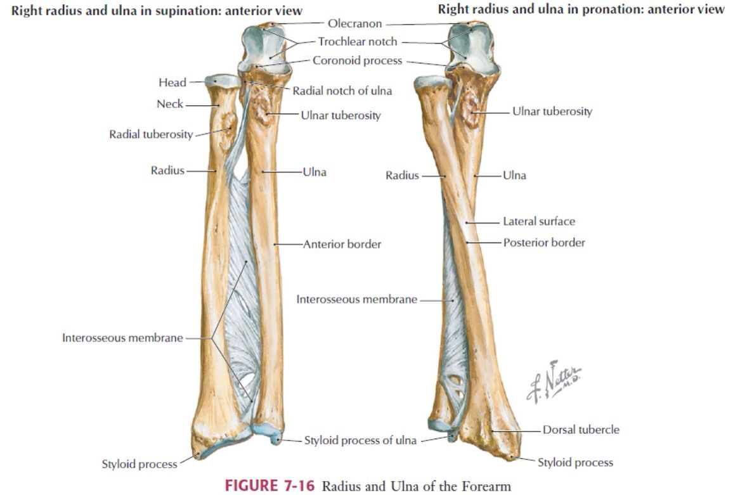
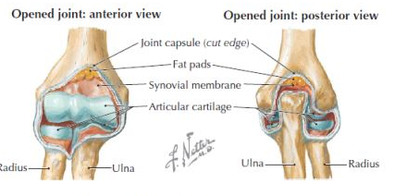
Bones

Slide 4
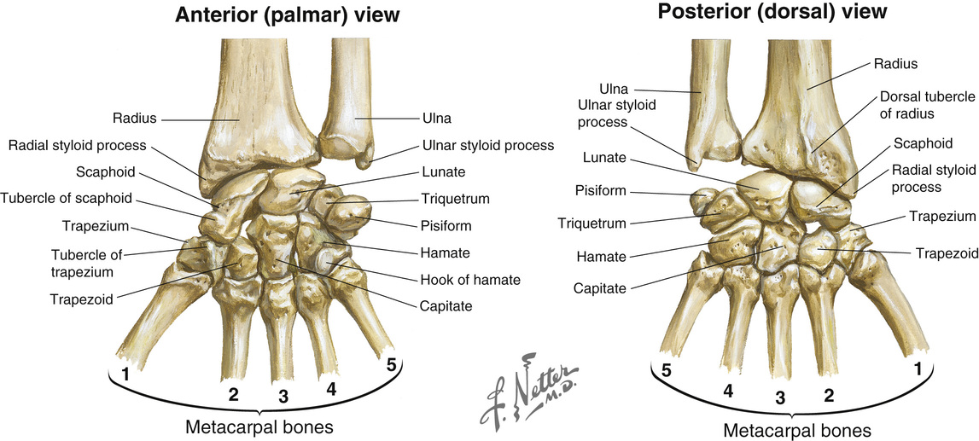

Slide 5
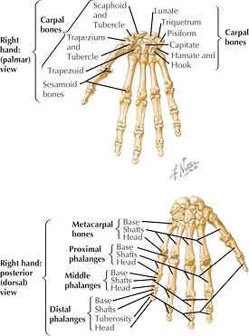
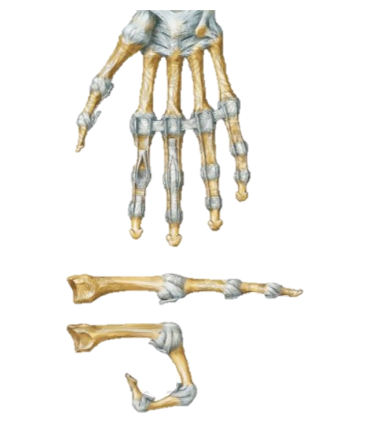

Slide 6
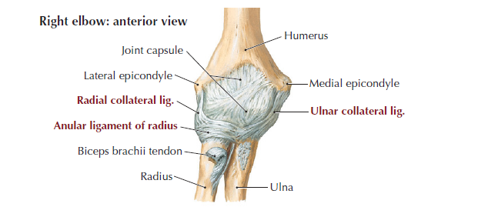
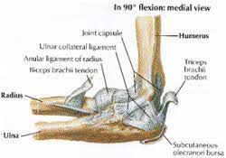
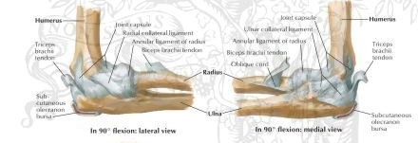
Joints
The elbow

Slide 7
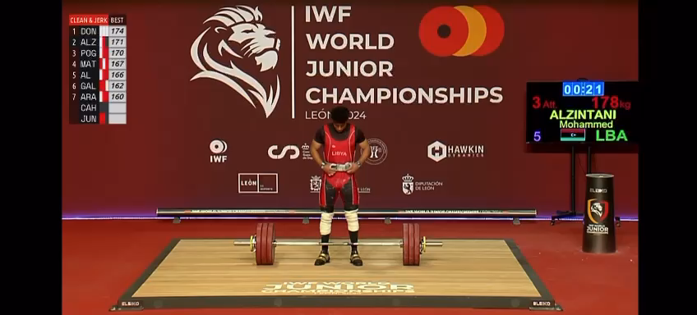

Slide 8
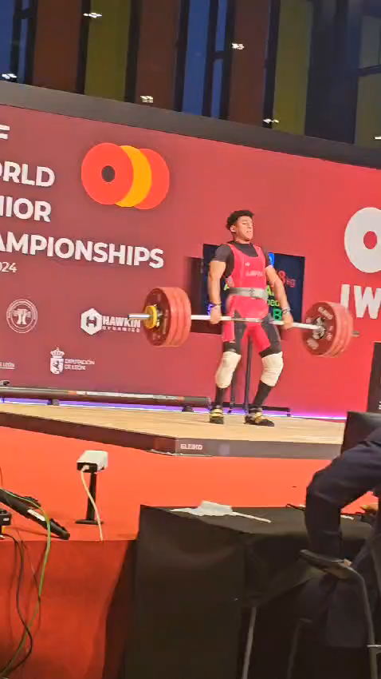

Slide 9
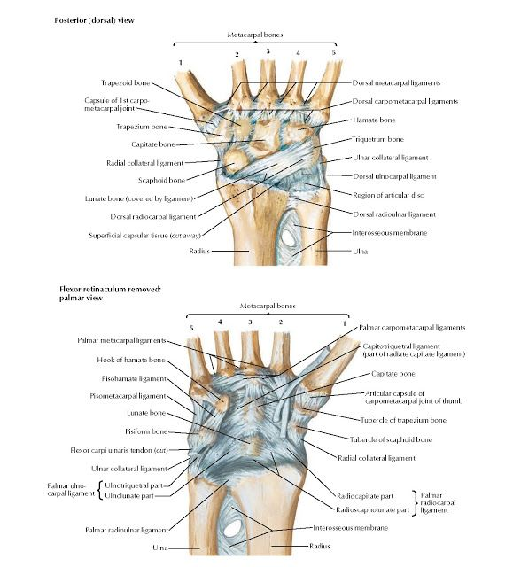
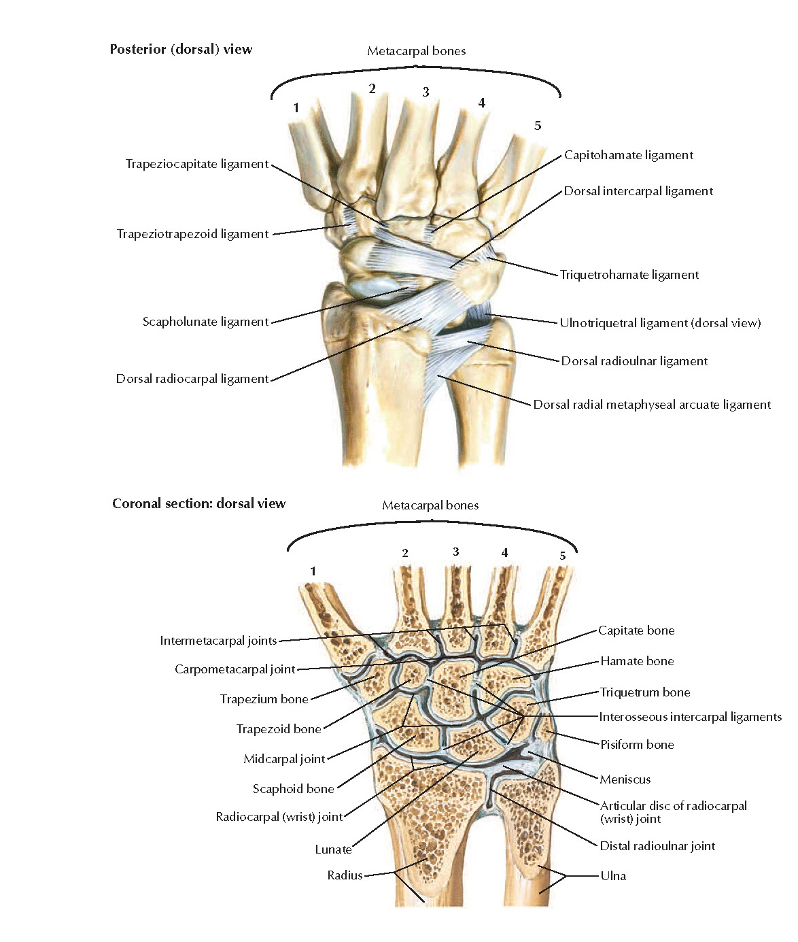
The wrist

Slide 10
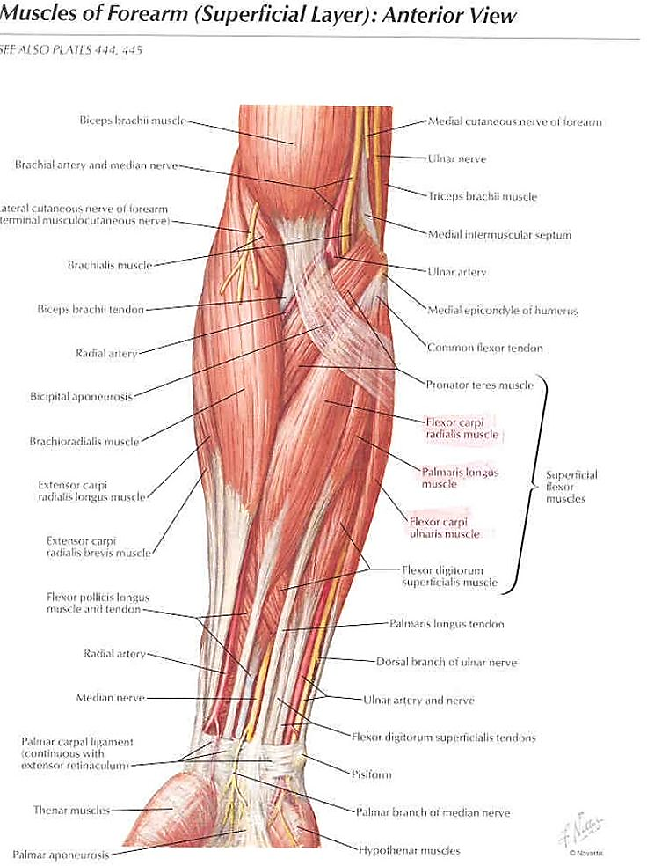
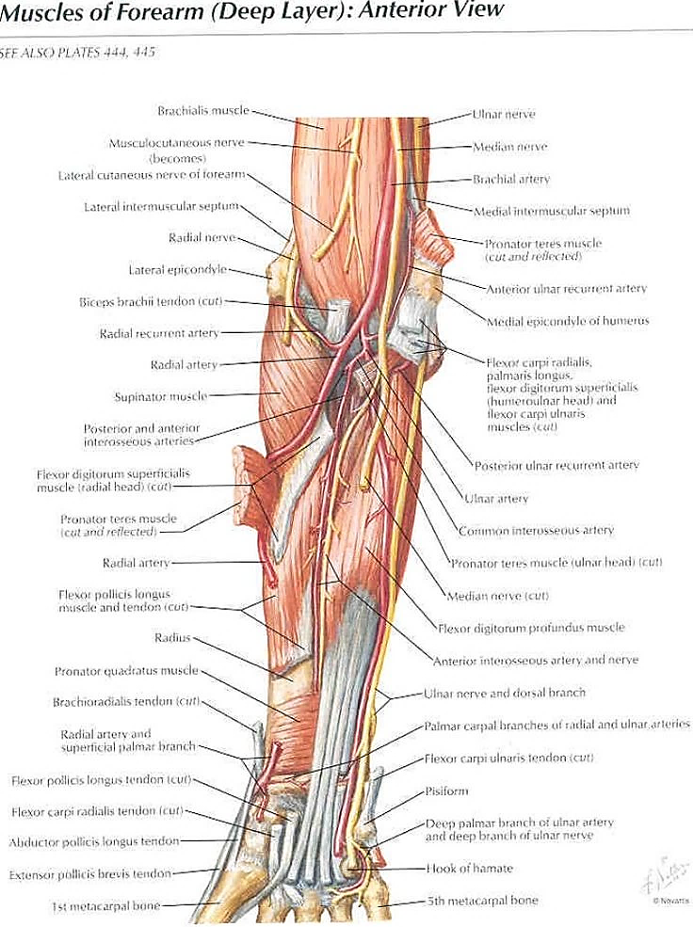
Flexor Muscles of the forearm

Slide 11
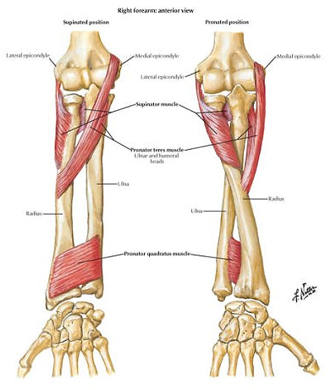
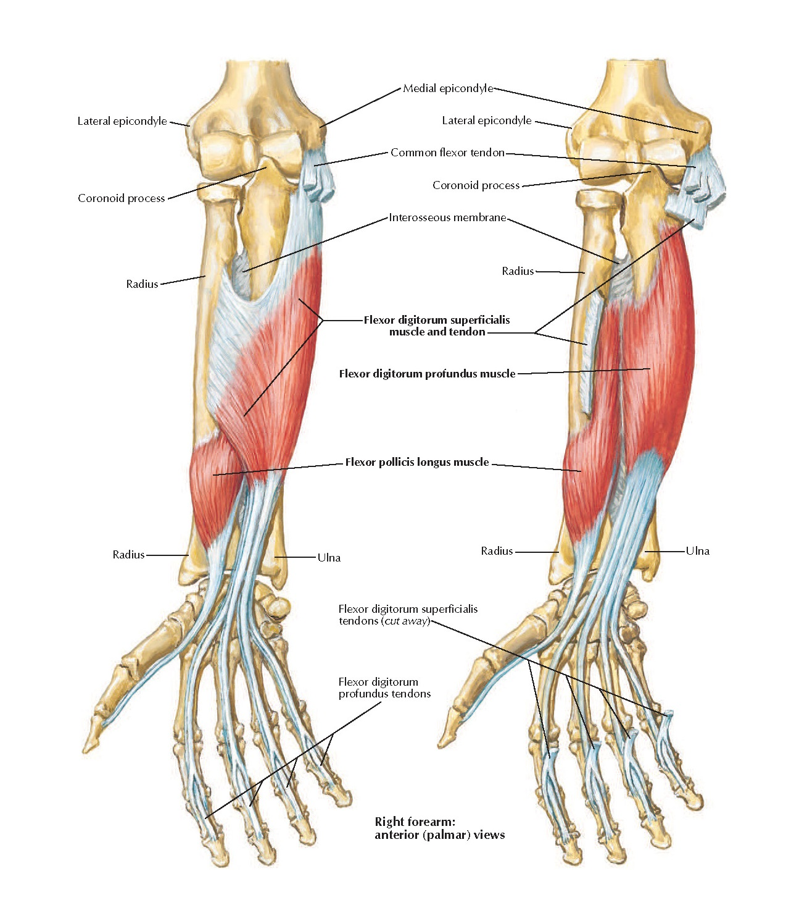

Slide 12
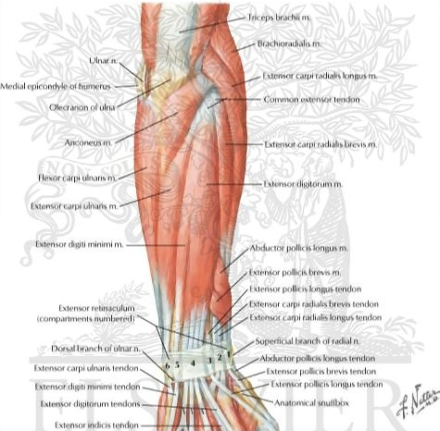
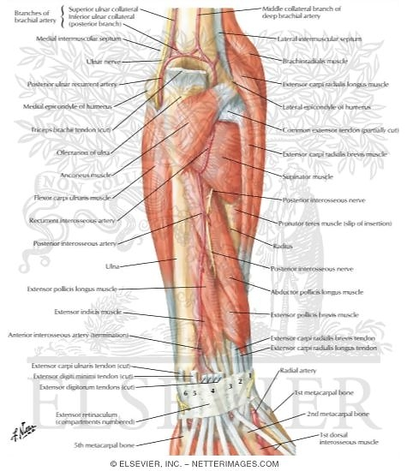
Extensor muscles of the forearm

Slide 13
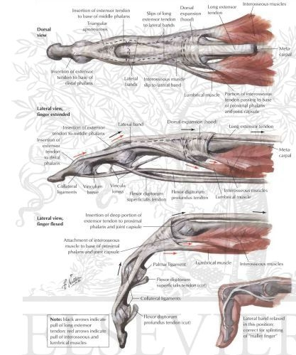
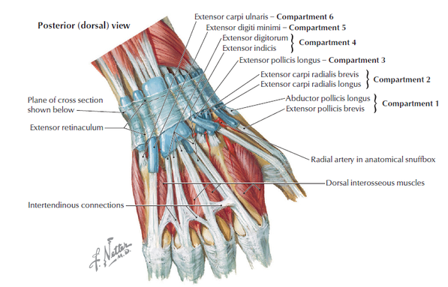
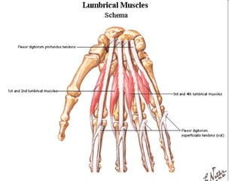

Slide 14
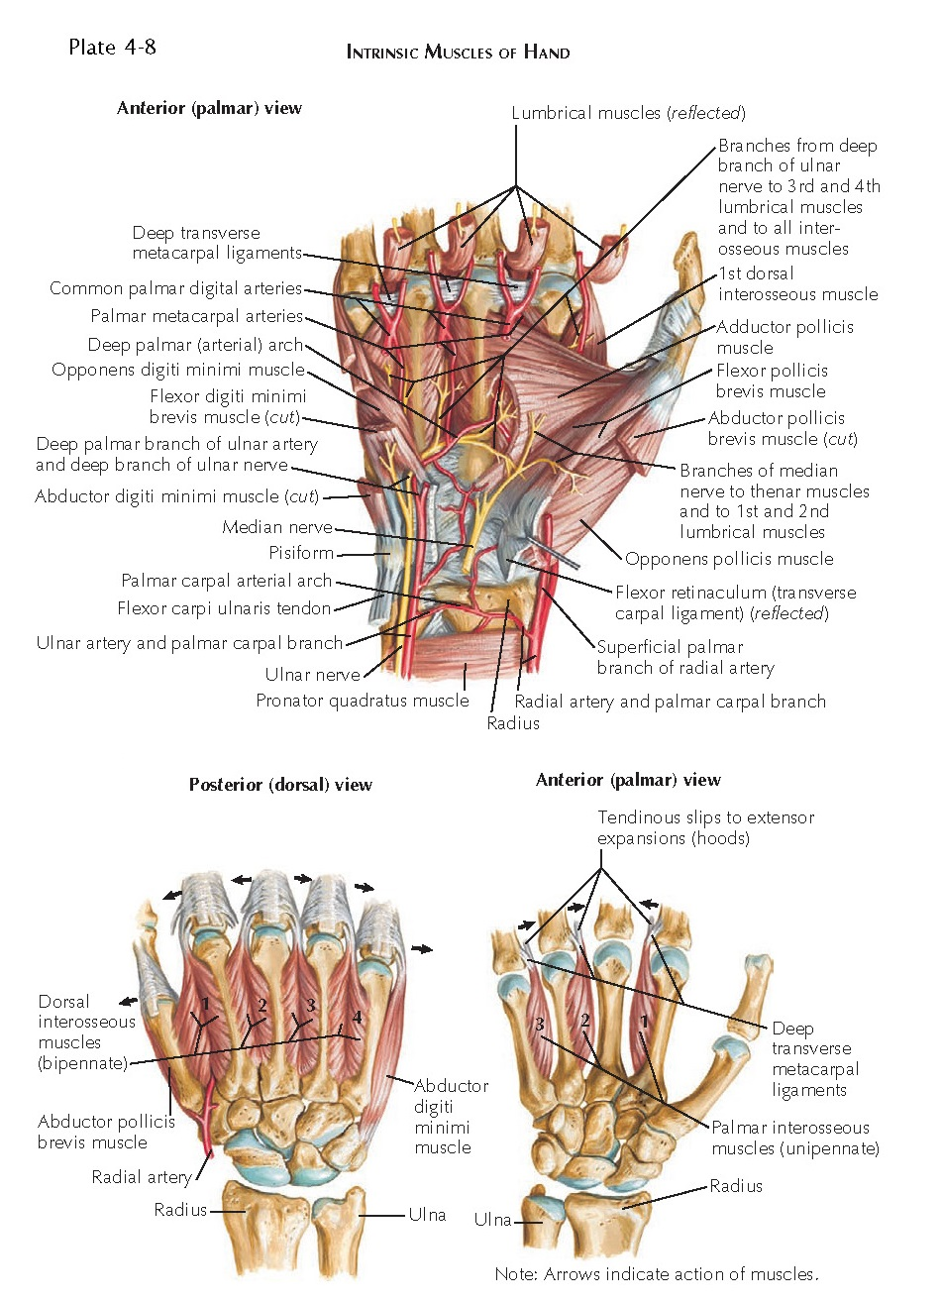
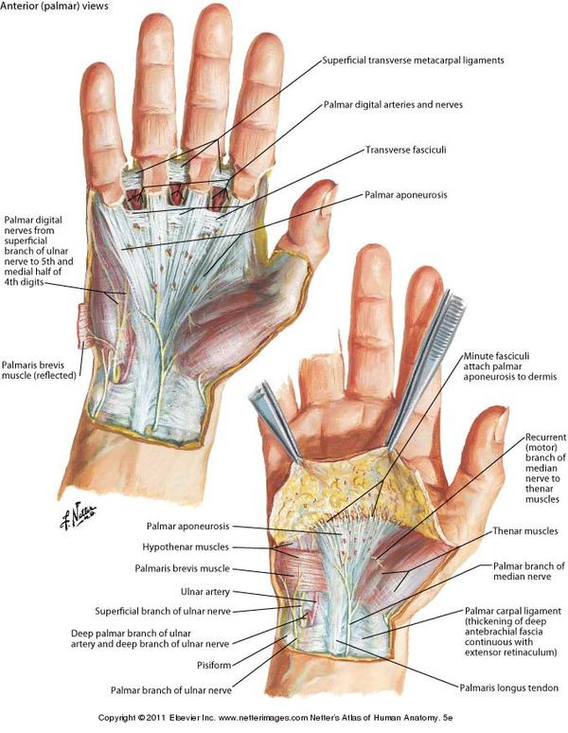

Slide 15
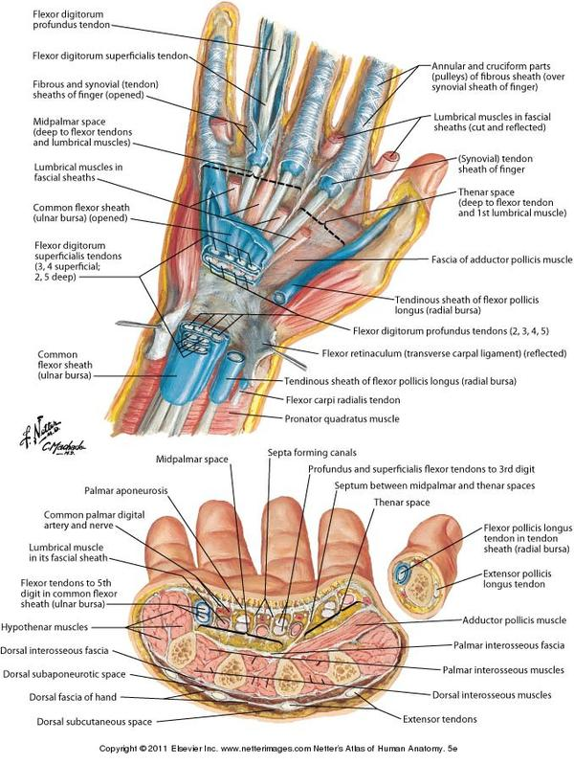
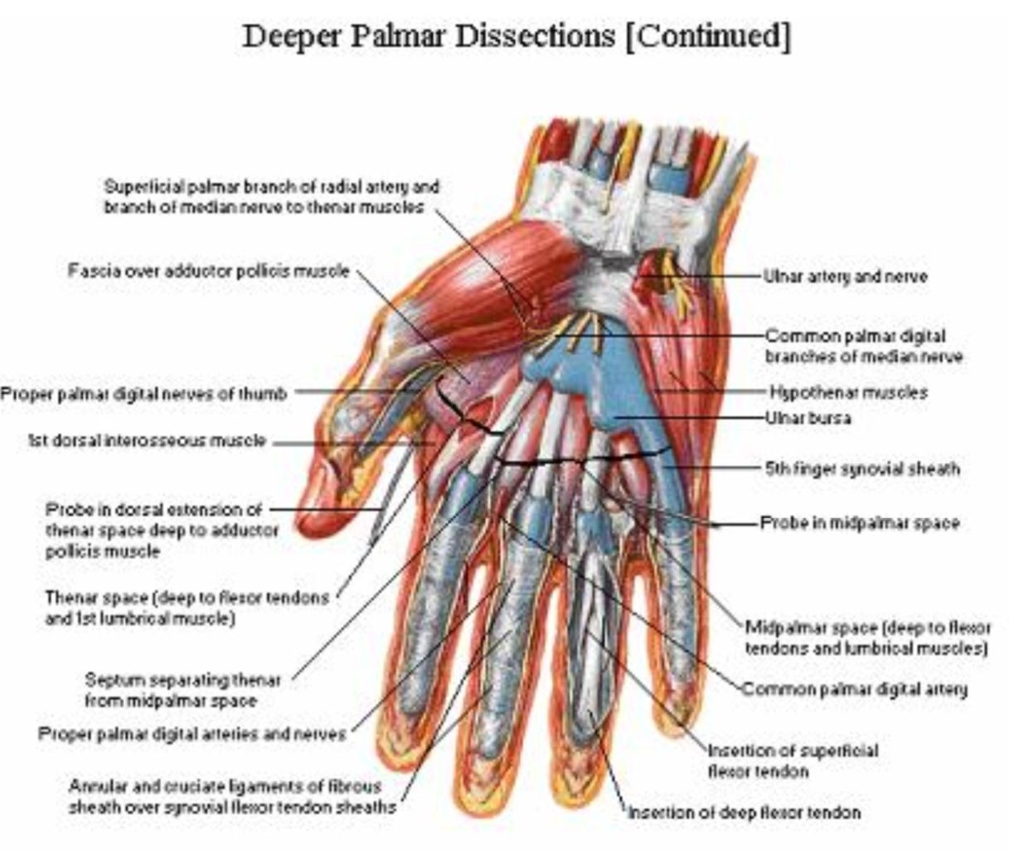
The carpal tunnel

Slide 16
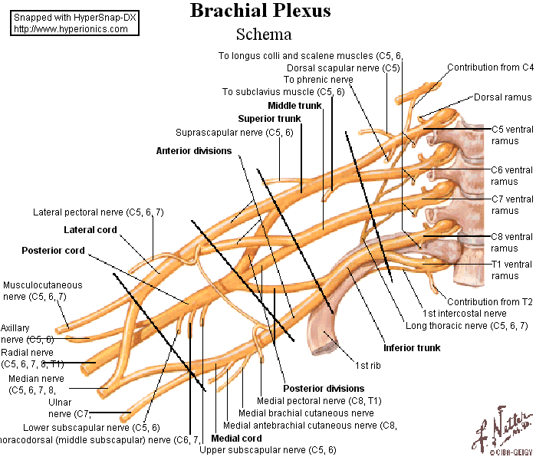
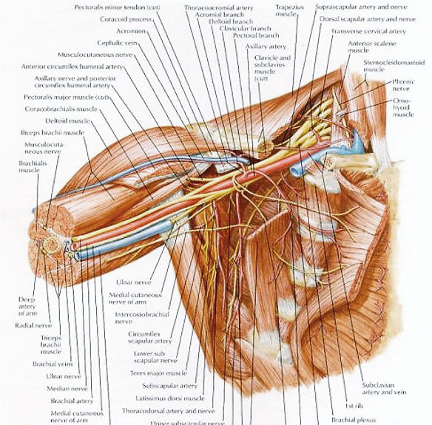
Brachial plexus

Slide 17
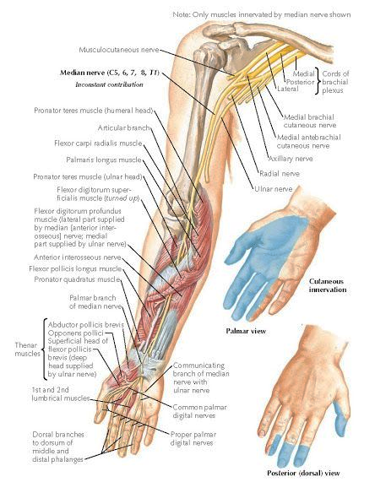
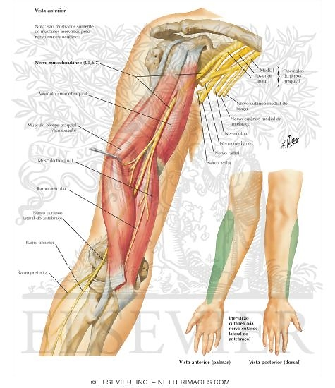

Slide 18
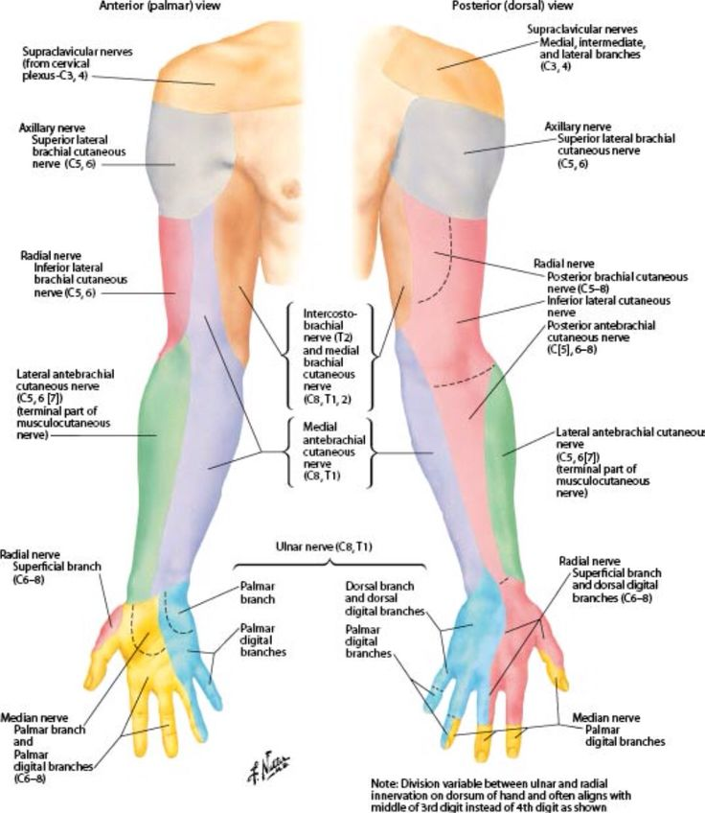
Sensory innervation of the upper extremity

Slide 19
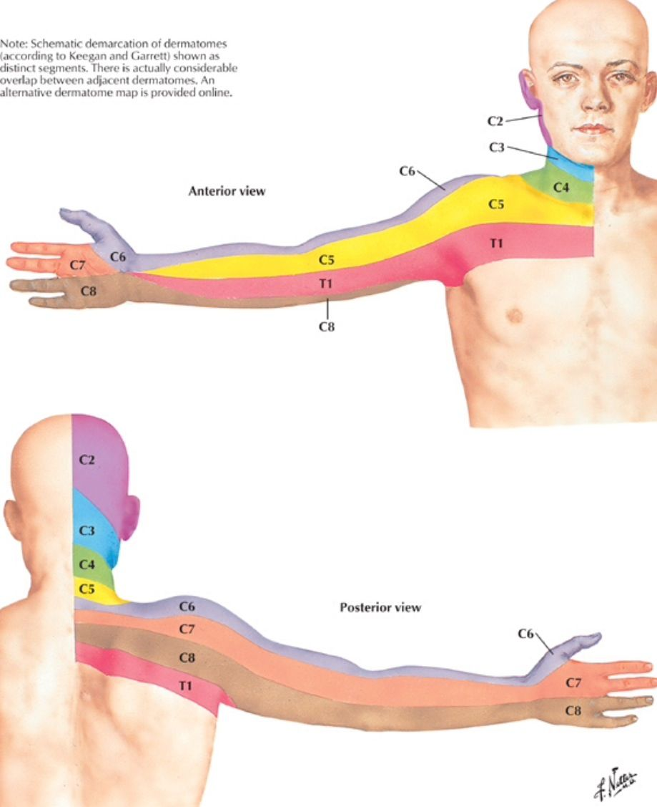

Slide 20
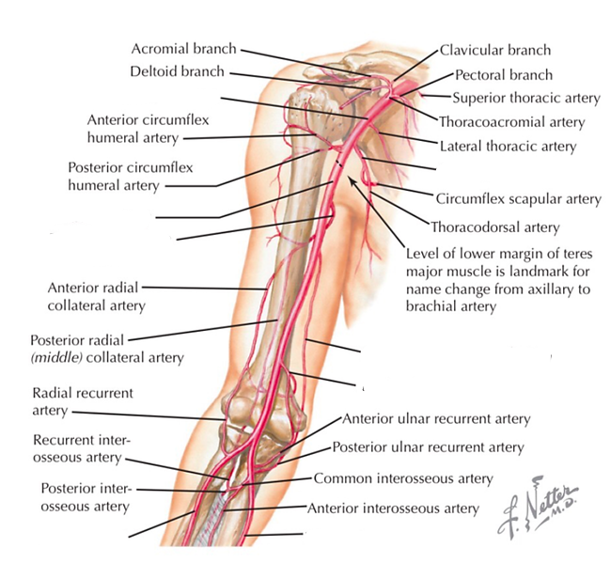
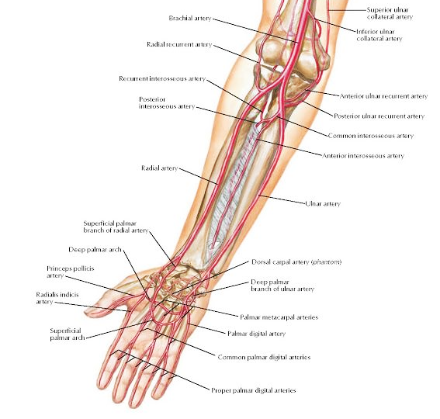
vessels

Slide 21
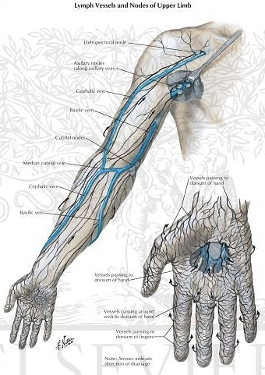

Slide 22
To sum it up
What are the ligaments of the elbow joint?
What are the names of the carpal bones?
What structures pass through the carpal tunnel?
What is the origin of the pronator terres?
What innervates the median nerve in the hand?
Which are the muscles of the thenar eminence?
What are the main branches of the radial artery?
Which nerve innervates the extensor muscles of the forearm?

Slide 23
T h a n k y o u !!!

