Slide 1
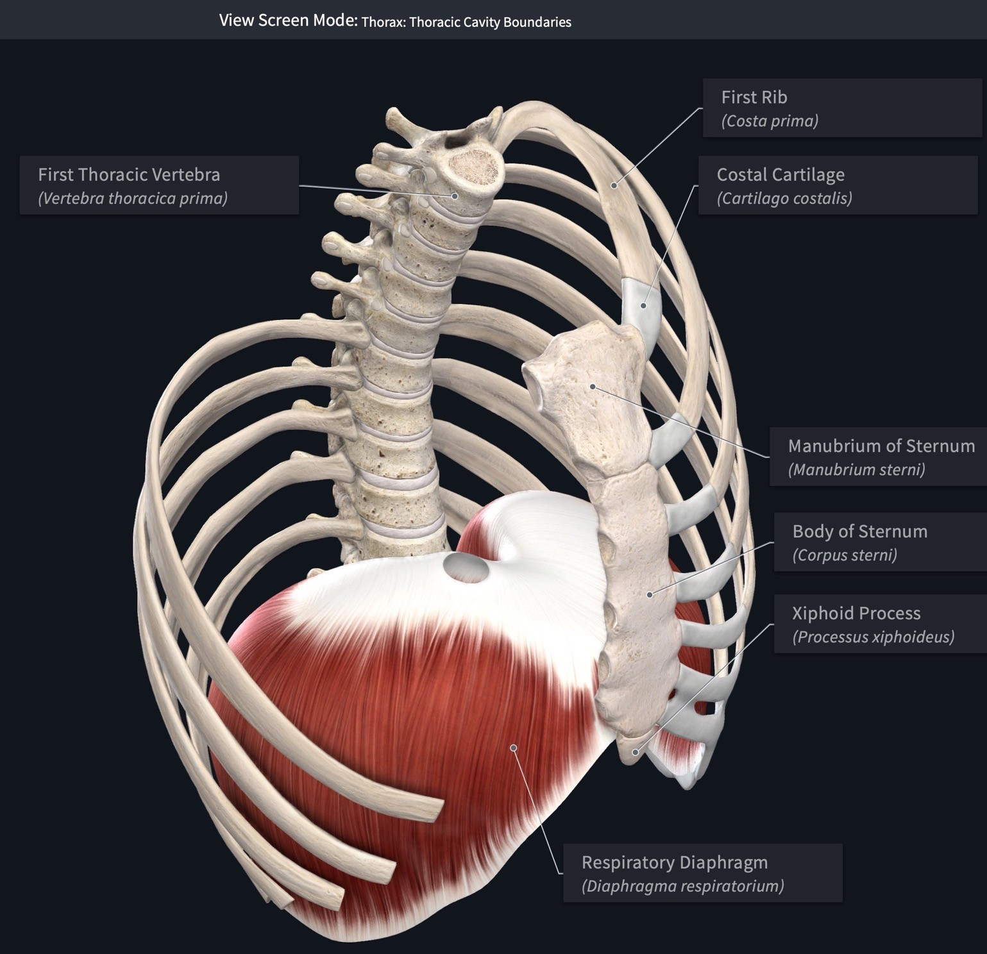
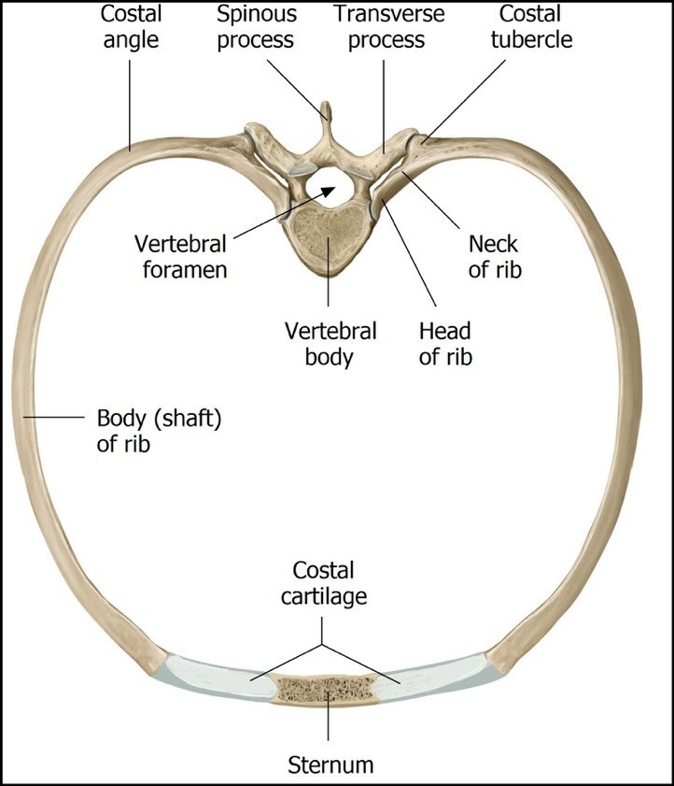
Thorax & Thoracic Cavity: Introduction
The thorax refers to the region of the body between the neck and the abdomen. The thoracic cavity is an irregularly shaped cylinder enclosed by the musculoskeletal walls of the thorax and the diaphragm.
Anteriorly, the thoracic wall consists of the sternum.
Posteriorly, it consists of the 12 thoracic vertebrae and their intervening intervertebral discs.
Laterally, it consists of the ribs, each rib’s associated costal cartilages, and muscles that span the space between adjacent ribs/costal cartilages.
Inferiorly, the diaphragm forms the physical boundary between the thoracic cavity and the abdominal cavity.
https://3d4medic.al/enFsQOFf

Slide 2
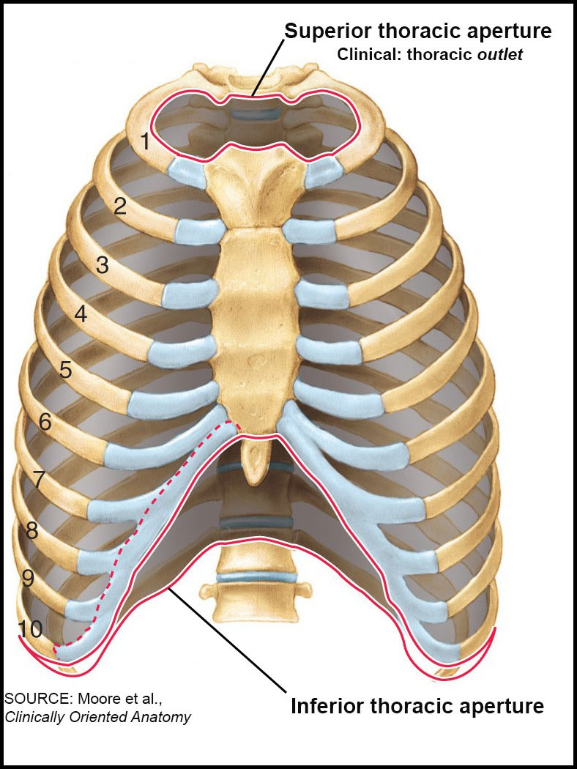
Thoracic Cavity Apertures
The thoracic cavity contains a small opening on its superior end called the superior thoracic aperture and a relatively large opening on the inferior end called
the inferior thoracic aperture.
Ribs
The superior thoracic aperture is the opening through which structures pass to enter and exit the neck and upper extremities. Clinicians refer to the superior thoracic aperture as the thoracic outlet. The following structures form the boundaries of the superior thoracic aperture (thoracic outlet).
Costal Cartilage
Manubrium
anteriorly: the superior surface of the manubrium
posteriorly: internal margins of the T1 vertebra
laterally: the first pair of ribs
Body of Sternum
The inferior thoracic aperture is the large, irregularly shaped inferior opening of the thoracic cavity.
The anterolateral border of the inferior thoracic aperture is a continuous arch of cartilage referred to as the costal arch (margin). It is formed by the cartilages of ribs 7-10 attaching to each side of the sternum.
The diaphragm encloses the inferior thoracic aperture forming a physical boundary between the thoracic and abdominal cavities. For structures to pass between the two cavities, they must either pass posterior to the diaphragm or pass through various diaphragmatic apertures.
Costal Arch

Slide 3
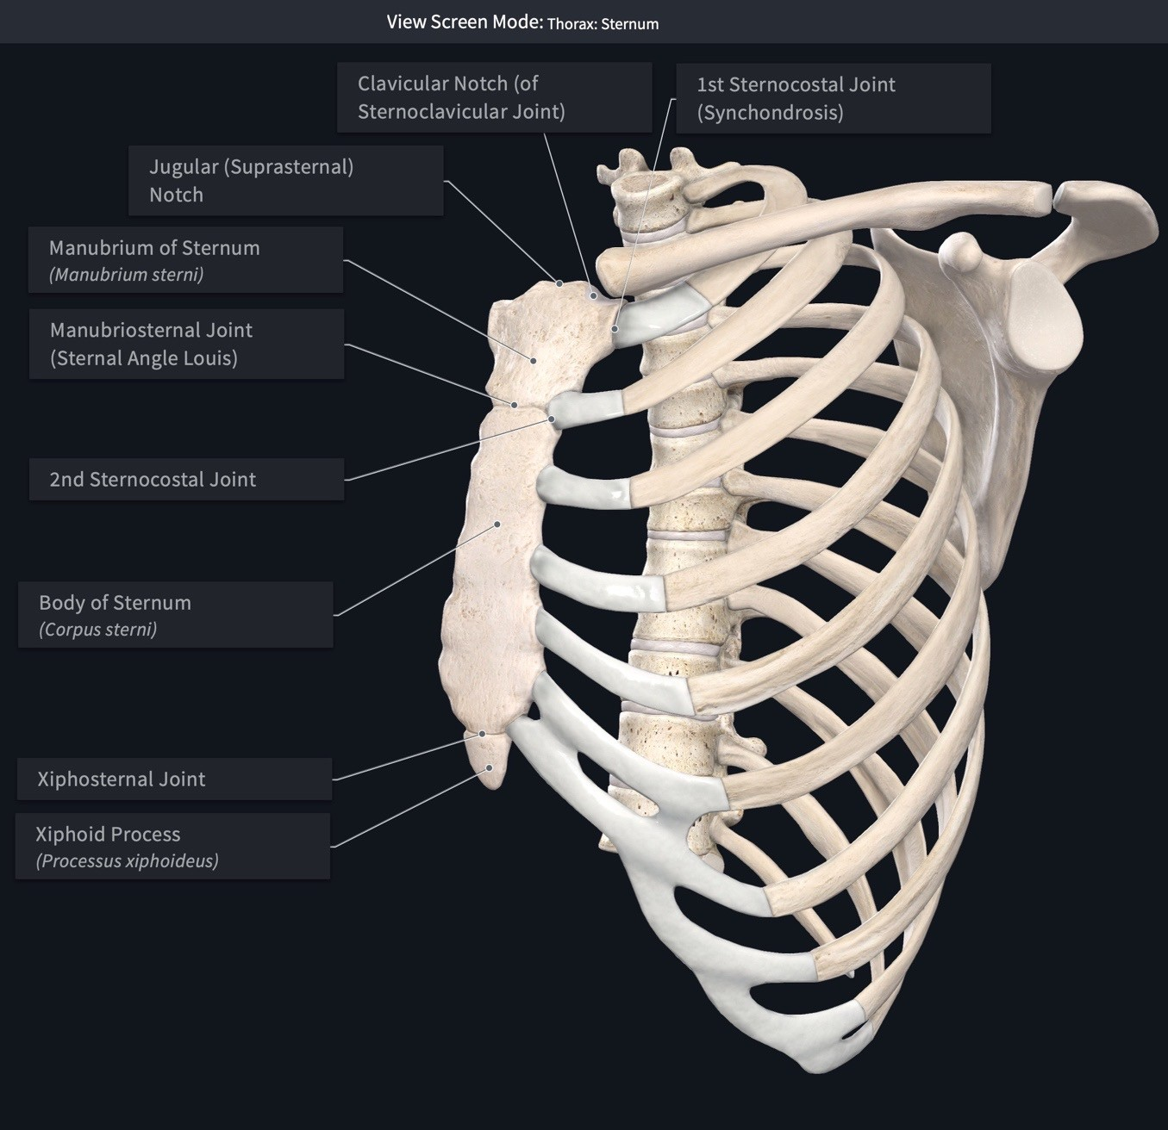
Osseous Thorax: Sternum
The sternum is a flat bone consisting of three parts.
Manubrium
  The superior edge of the manubrium contains an easily palpated notch called the jugular (suprasternal) notch.
  It forms several articulations.
https://3d4medic.al/VFNQekPB
It articulates with the clavicle at the clavicular notch forming the
sternoclavicular joint.
It articulates with the costal cartilage of the first rib forming the first sternocostal joint. This sternocostal joint is unique when compared to the other sternocostal joints because it is a synchondrosis and not a synovial joint.
It articulates with the superior portion of the costal cartilage of the second rib.
It articulates with the body of the sternum at the manubriosternal joint (sternal angle of Louis). This is an important palpable landmark that is presented on the next slide.
Body of sternum
  The body of the sternum forms the bulk of the sternum.
  Articulations
    It articulates with the 2nd-7th costal cartilages (sternocostal joints).
    It articulates with the Xiphoid process at the xiphosternal junction.
Xiphoid process
  The xiphoid process is the smallest part of the sternum. In youth it consists entirely of hyaline cartilage but is gradually replaced with a core of bone during adulthood.

Slide 4
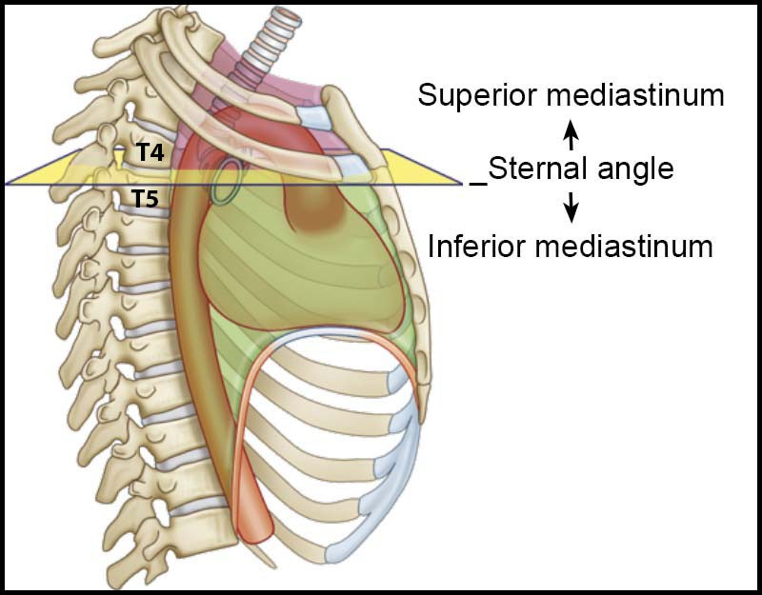
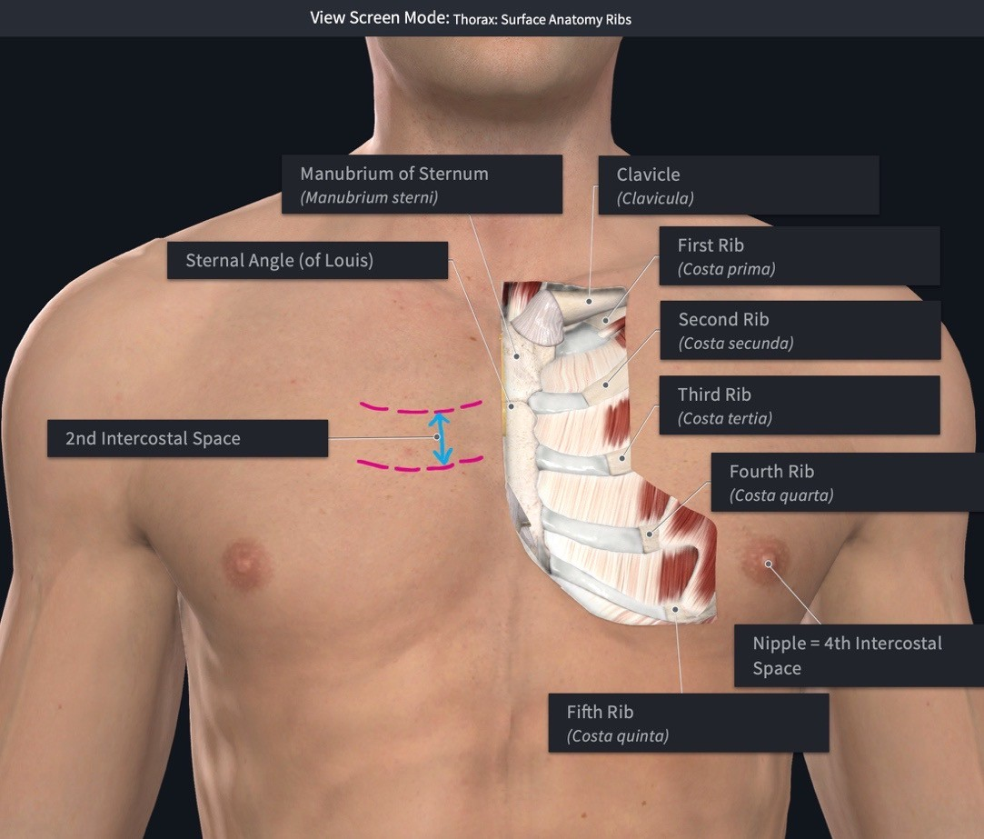
Osseous Thorax: Sternal Angle and Transverse Thoracic Plane
At the manubriosternal joint, the manubrium and sternum lie in different planes, which creates an easily palpated bony protrusion. This clinically important palpable landmark is referred to as the sternal angle (of Louis).
A transverse plane through the sternal angle commonly intersects the T4/T5 intervertebral disc. This transverse plane (transverse thoracic plane) is a landmark for several anatomical divisions.
  It divides the mediastinum into a superior mediastinum and an inferior mediastinum. Details regarding the mediastinum occur on a later slide.
  It is at the level of the tracheal bifurcation.
  It marks the location where the aortic arch begins and ends.
On either side the sternal angle, the cartilages of the second ribs articulate with the sternum. Using the sternal angle as a palpation landmark, moving your fingers laterally in either direction about 1 inch will cause your fingers to be resting on the bone/cartilage of the 2nd rib. This simple method of palpating the second ribs can be used as your starting point to palpate the 2nd intercostal space when auscultating the heart, other ribs, and intercostal spaces.
Transverse Thoracic Plane
https://3d4medic.al/DJLz5vyP

Slide 5
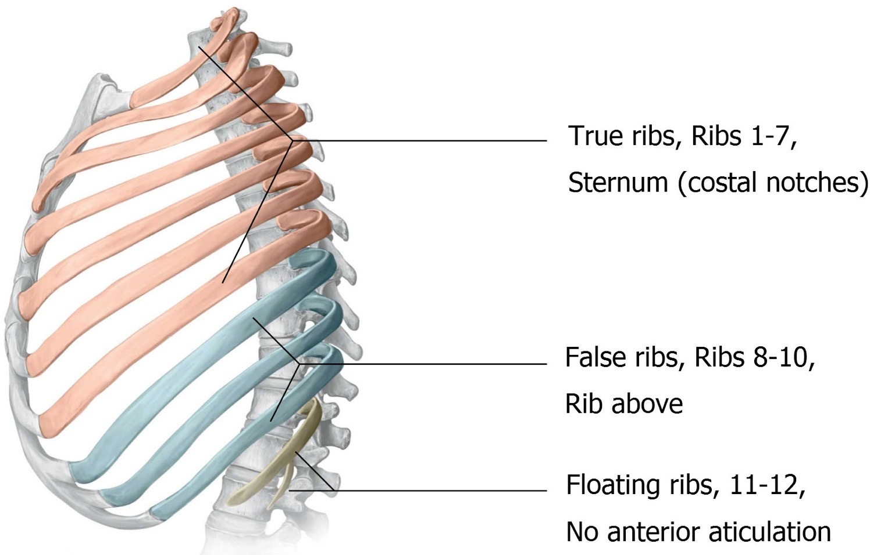
Osseous Thorax: Ribs
The thorax consists of 12 ribs on each side, which can be organized into the following groups.
The true ribs (ribs 1-7) attach directly to the sternum via their costal cartilages.
The false ribs (ribs 8-10) attach indirectly to the sternum via the costal cartilage of the superior rib.
The floating ribs (ribs 11-12) do not attach to the sternum.
Ribs can also be described as typical or atypical. For our purposes, we will describe the details of a typical rib (next slide).
Ribs 3-9 are the typical ribs, which means they are anatomically similar to each other.
Ribs 1,2, and 10-12 are atypical ribs, which means they have anatomical features that differ from the typical ribs.
Typical Ribs: Ribs 3-9

Slide 6
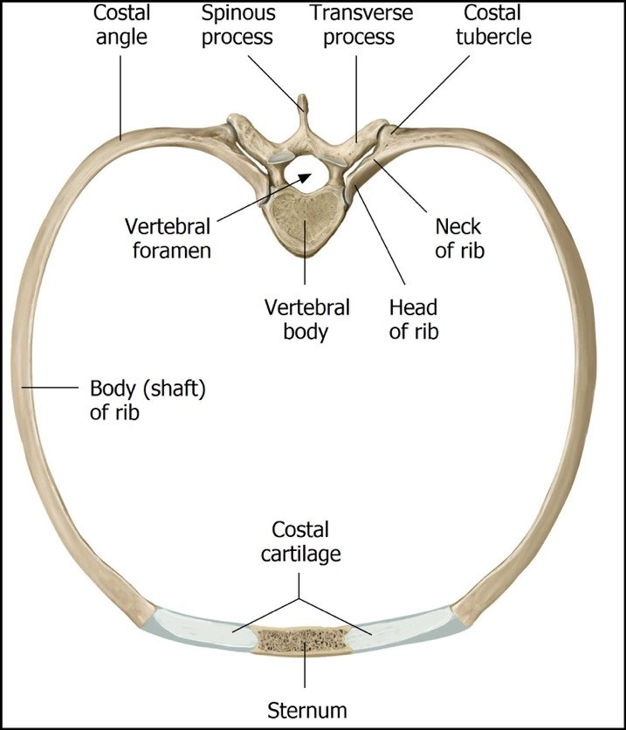
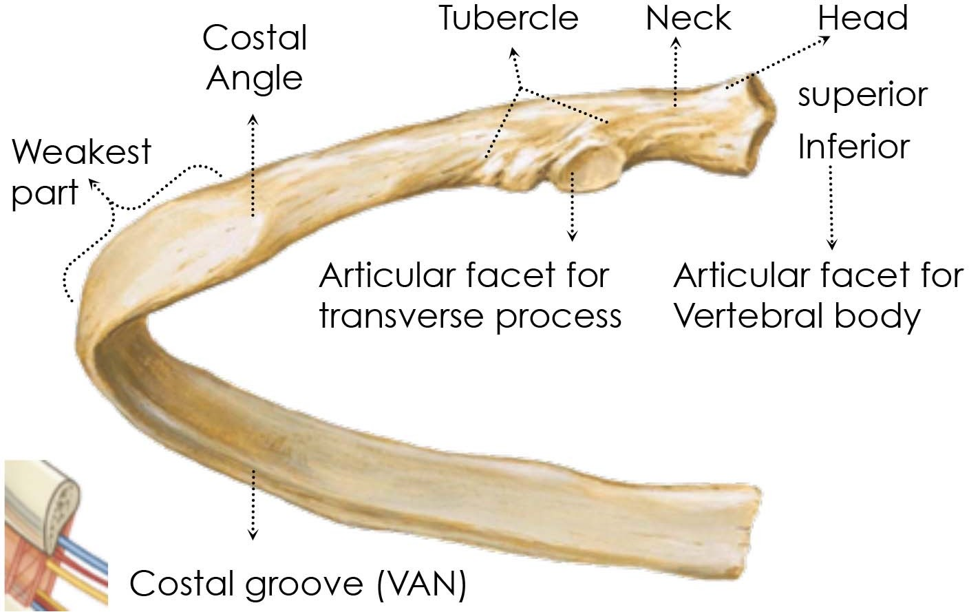
Osseous Thorax: Ribs
Each typical rib (3rd-9th) consist of the following parts.
The head is the wedge-shaped end of the rib that articulates with at least one vertebral body.
  Note: All ribs (typical and atypical) have a head.
  The heads of typical ribs contain two facets that articulate with two adjacent vertebral bodies and the intervening intervertebral disk.
    The inferior facet articulates with the thoracic vertebrae of the same numbered level. (The inferior facet of the 3rd rib articulates with T3.)
    The superior facet articulates with the thoracic vertebrae above the vertebrae with the same number. (The superior facet of the 3rd rib articulates with T2.)
  NOTE: The atypical ribs (except rib 2) only articulate with one vertebral body.
The rib neck is a short and flat region of the bone that connects the head to the tubercle.
The rib (costal) tubercle is a bony protuberance located at the junction of the neck and the rib body. The tubercle contains a facet that articulates with a corresponding facet on a transverse process of the associated vertebra. (Rib 3 articulates with the transverse process of T3). The tubercles are most prominent in the upper ribs.
The body, also known as the shaft of the rib, is thin, curved, and forms the longest part of the rib.
  The costal angle is the point of maximal curvature of a rib and is the most lateral location where the deep back muscles attach to the ribs.
  The costal groove is located on the inferior side of the body along the rib's inner
surface. The groove contains the intercostal neurovascular bundle consisting of an intercostal nerve and posterior intercostal artery and vein.

Slide 7
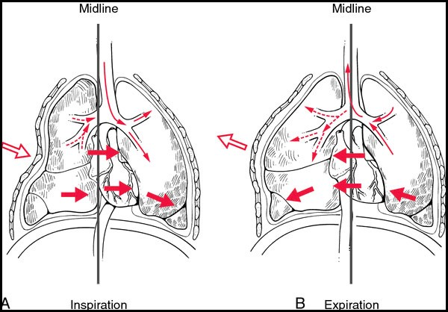
Osseous Thorax: Ribs
Figure 1
CLINICAL ANATOMY: Rib Fractures
The weakest part of a rib is just anterior to the costal angle (Figure 1). Rib fractures commonly result from direct impact or indirectly from crush injuries. The middle ribs are most commonly injured.
CLINICAL ANATOMY: Flail chest refers to the paradoxical movement of a portion of the thoracic wall that accompanies fractures of multiple ribs. Fracturing 3 consecutive ribs in 2 places on each rib, results in flail chest (Figure 2).
The flail segment of chest wall moves inward on inspiration and outward on expiration.
Flail chest is extremely painful and impairs ventilation because the “flail” segment of
the chest wall is unable to contribute to ventilation and lung expansion.
Figure 2

Slide 8
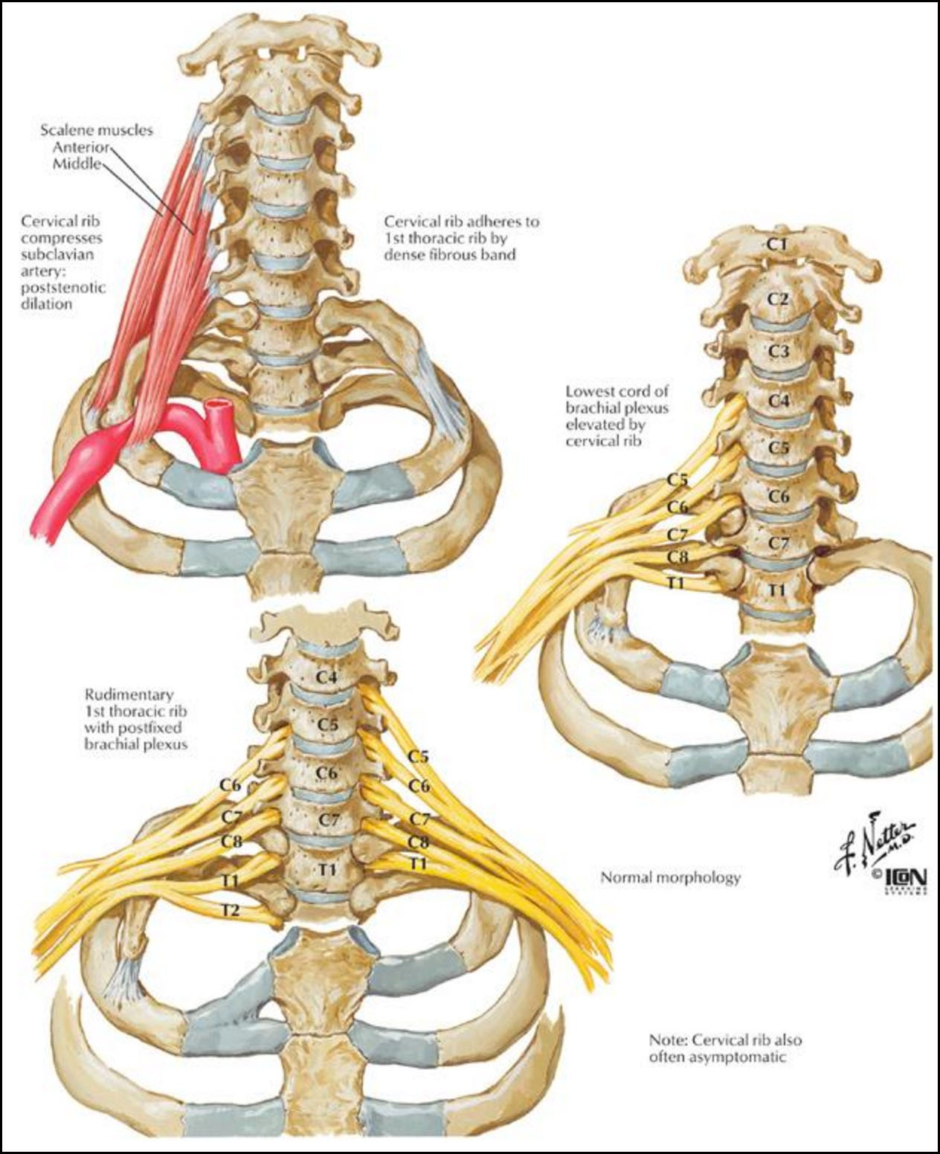
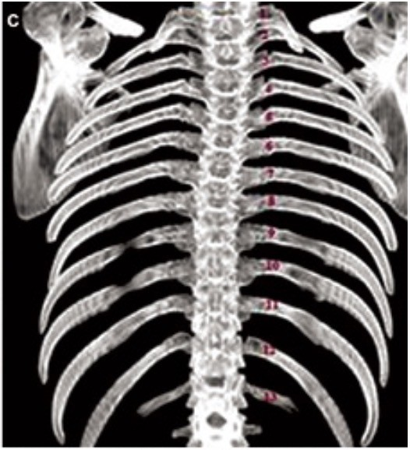
Supernumerary Ribs
CLINICAL ANATOMY: Occasionally supernumerary ribs occur.
A cervical rib is an accessory (extra) rib, typically associated with the 7th cervical vertebra. They have an incidence of <1% and are occasionally associated with thoracic outlet syndrome in which the brachial plexus and/or subclavian artery/vein are compressed, which leads to pain and numbness in the shoulder and upper limb (Figure 1).
Lumbar ribs are less common but can be problematic when using ribs as a landmark to identify vertebral levels in radiographs (Figure 2).
Figure 1
Figure 2

Slide 9
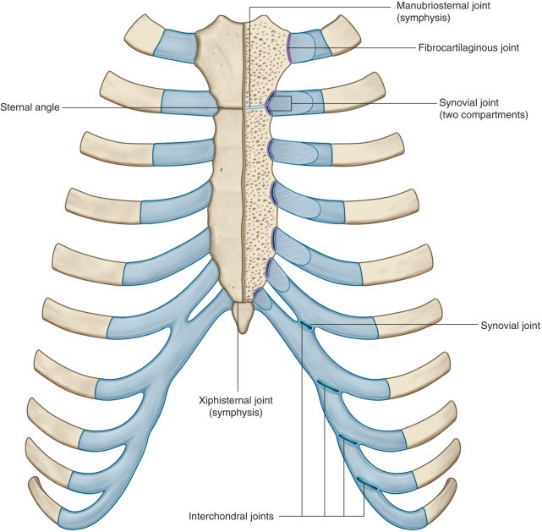
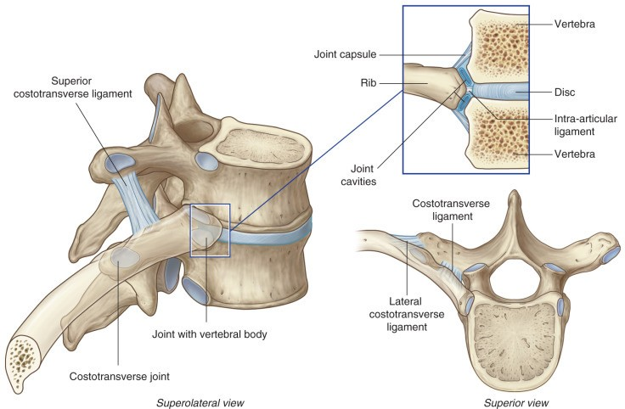
Osseous Thorax: Rib Joints
Costovertebral joints are synovial joints between the ribs and the vertebrae. They can be divided into joints at the rib head and the tubercle (Figure 1).
Rib Heads
  Typical Ribs (and rib 2) articulate with two vertebral bodies
    Inferior facets of the rib head articulate with the superior costal demifacets on the vertebra with the same number as the rib.
    Superior articular facets of the rib head articulate with inferior costal demifacets on the vertebra superior to the vertebra with the same number as the rib.
  Atypical ribs (except rib 2) articulate with only one vertebral body.
Rib Tubercles: Costotransverse joints are synovial joints between the rib tubercles and the transverse processes. (All ribs except 11 and 12 form a costotransverse joint.)
Sternocostal joints are joints between the costal cartilages of the ribs and the sternum (Figure 2).
The sternocostal joint of rib 1 is a synchondrosis (fibrocartilaginous).
The sternocostal joints of ribs 2-7 are synovial joints.
Figure 2
Figure 1
T6
T7
Rib 7

Slide 10
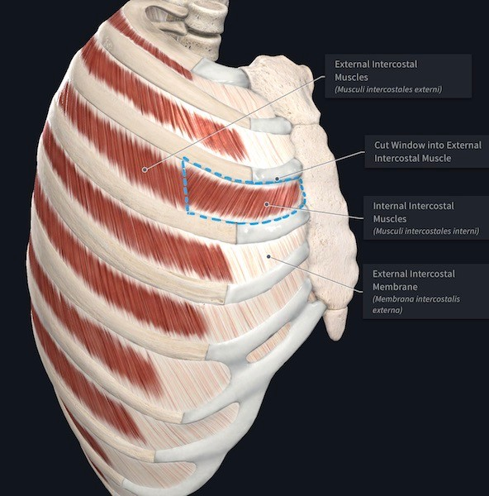
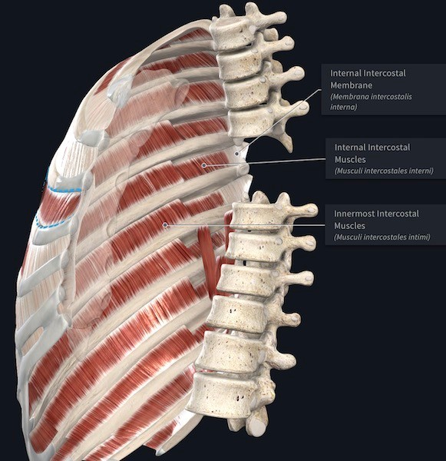
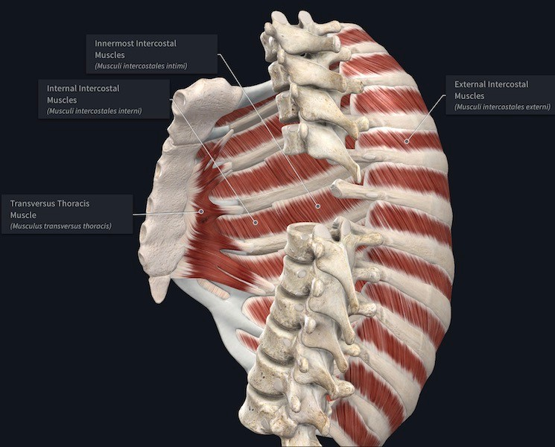
Muscular Thorax: Intercostal Muscles
Muscle | Superior Attachment | Inferior Attachment | Innervation | Main Action(s)
External Intercostal | Inferior border ribs | Superior border ribs | Intercostal nerves (T1-T11) | Elevate ribs in forced inspiration
Internal Intercostal | Inferior border ribs | Superior border ribs | Intercostal nerves (T1-T11) | Interosseous part: depresses all ribs (forced expiration) Interchondral part: elevates cartilage of ribs (forced inspiration)
Innermost Intercostal | Inferior border ribs | Superior border ribs | Intercostal nerves (T1-T11) | Depress rib in forced expiration
Transversus thoracis | Posterior surface of the inferior sternum | Internal surface of costal cartilages 2-6 | Intercostal nerves (T1-T11) | Weakly depresses ribs in force expiration
https://3d4medic.al/UfdLfsUB
https://3d4medic.al/omUeuAAE
https://3d4medic.al/qM0yPybM

Slide 11
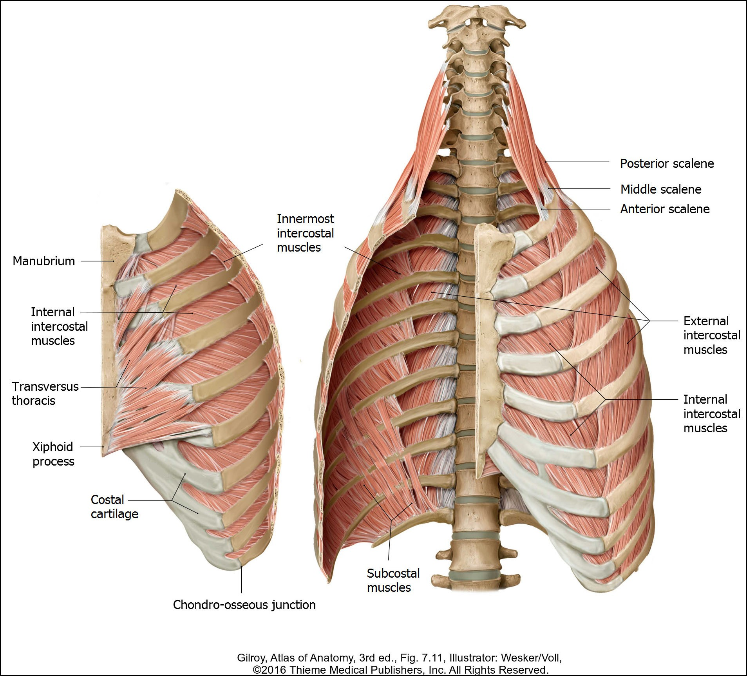
Muscular Thorax: Intercostal Muscles (Continued)
External intercostal muscles:
Fiber orientation: Inferior and anterior from superior rib (“hand in pocket” orientation)
They are continuous inferiorly with the external abdominal muscles.
They span the distance from the rib tubercles to the costochondral joints.
  Anteriorly beyond the costochondral joints, the external intercostal muscles are replaced by a connective tissue membrane, through which the internal intercostal muscle fibers can be seen.
Internal intercostal muscles
Fiber orientation: Inferior and posterior from superior rib (perpendicular to external intercostal muscles)
The internal intercostal muscles span the distance from the sternum to the costal angle of the ribs.
Medial to the costal angles, the internal intercostal muscles are replaced by the internal intercostal membrane.
Innermost Intercostal muscles
Fiber orientation: Inferior and posterior from superior rib (same orientation as internal intercostals)
They are located only along the lateral portion of the thoracic wall, which is roughly the space between the costal angle of the ribs and
the costocartilage junction.

Slide 12
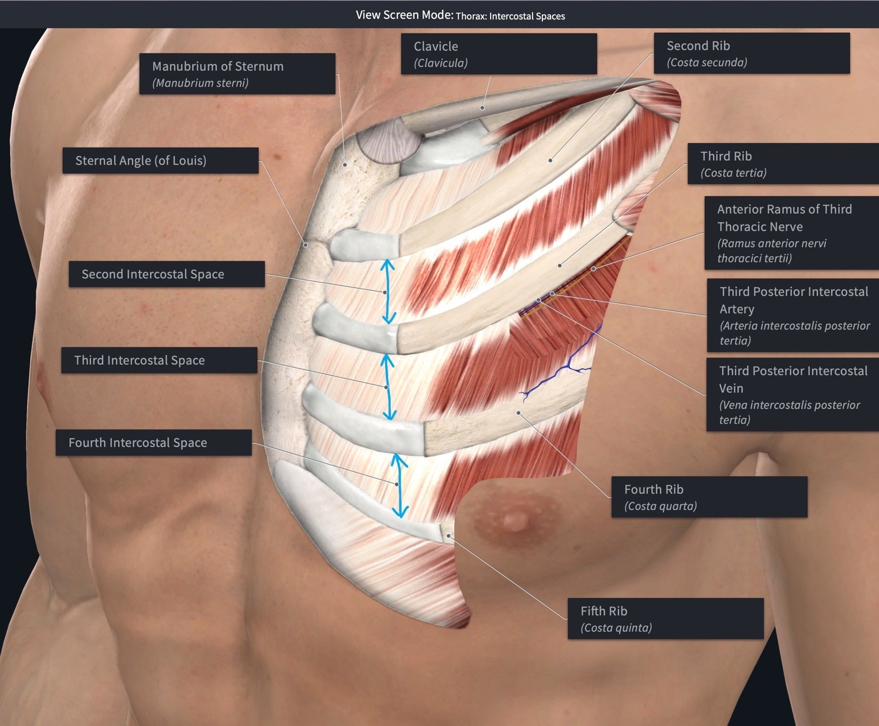
Intercostal Spaces and Intercostal Neurovascular Bundles
On an articulated skeleton, the ribs and their associated cartilages are separated by spaces called intercostal spaces.
https://3d4medic.al/vygmb69W
Each intercostal space contains intercostal muscles and a neurovascular bundle.
The intercostal spaces, and the neurovascular structures located
within the spaces, are named according to the numbered rib forming the superior border of the space.
  The intercostal space between ribs 3 and 4 is the 3rd intercostal space.
  Located in the 3rd intercostal space (inferior to rib 3) is the
3rd intercostal nerve, artery, and vein.
Note that the space inferior to the 12th rib is referred to as
the subcostal space containing the subcostal artery, vein, and nerve
(anterior ramus of spinal nerve T12).

Slide 13
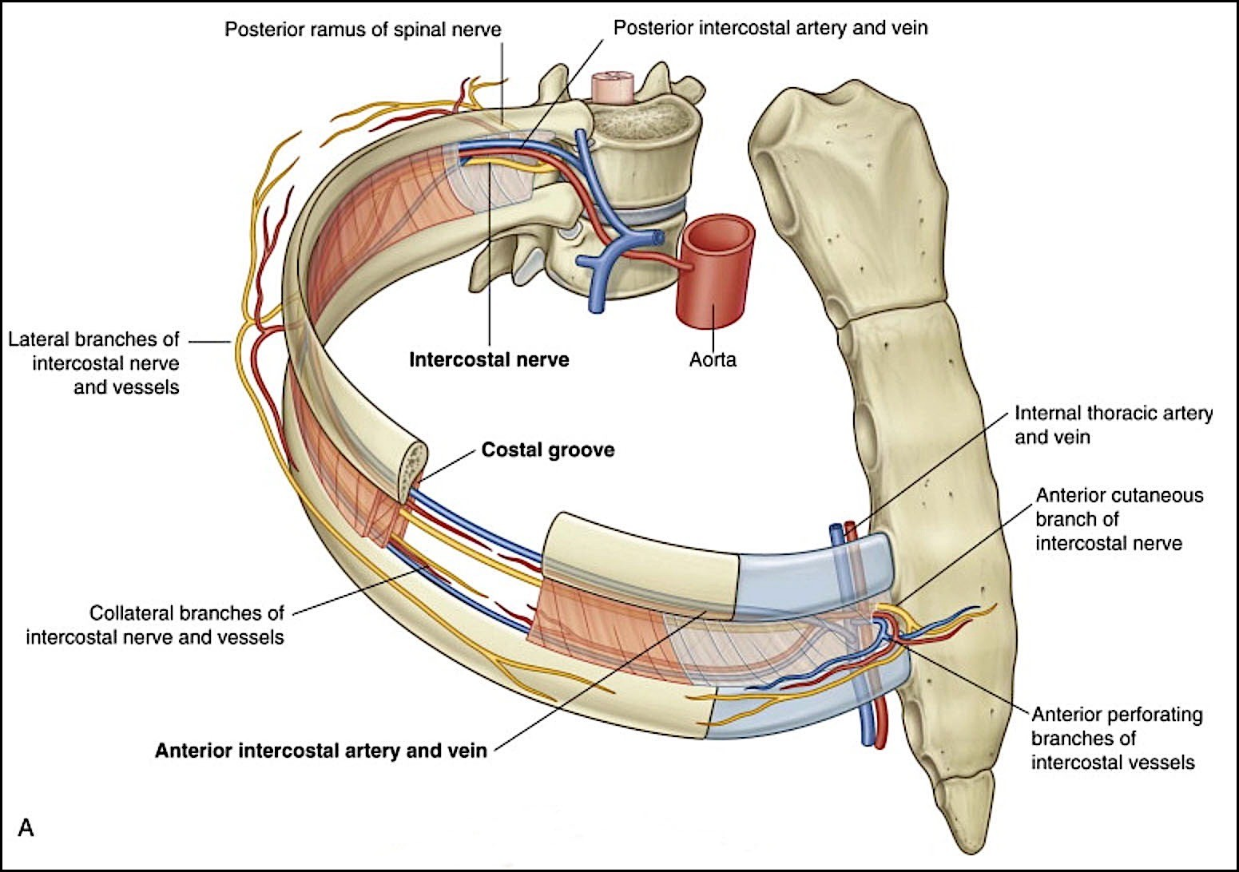
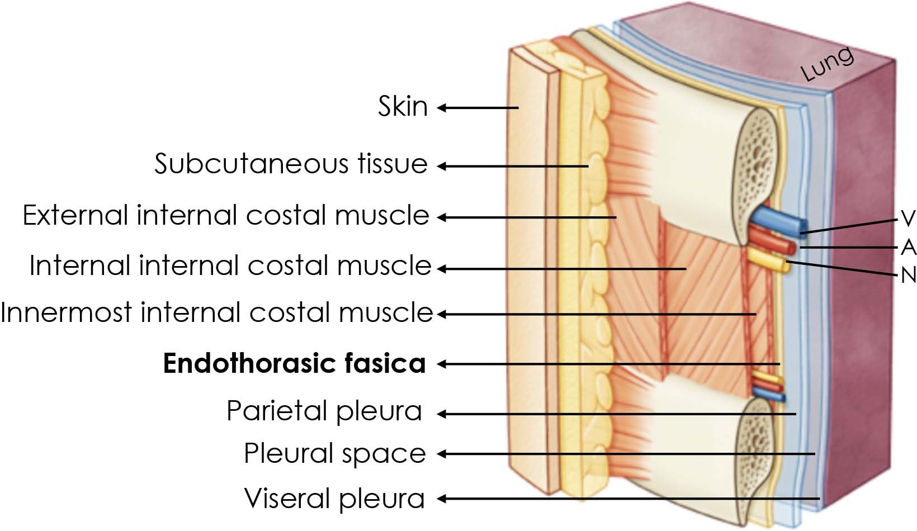
Intercostal Neurovascular Bundle
Figure 1
The neurovascular bundle within each intercostal space consists of the structures listed below from superior to inferior: (VAN).
Vein
Artery
Nerve
Near the angle of the rib, the intercostal neurovascular bundle enters the muscular portion of the thoracic wall by passing between the internal and innermost intercostal muscles (Figure 1). It courses in an anterior direction between the innermost and internal intercostal muscles following the costal groove (Figure 2). Collateral branches of the artery, vein, and nerve to descend within the intercostal space to course along
the superior border of the inferior rib.
Within each intercostal space, posterior intercostal arteries anastomose with branches of anterior intercostal arteries (Figure 1).
  Most of the posterior intercostal arteries are branches of the thoracic aorta.
(The exception is the first 2 arteries.)
  Anterior intercostal arteries are branches of the internal thoracic (mammary) artery.
The intercostal nerves located in the T1-T11 intercostal spaces are the ventral rami of the T1-T11 spinal nerves. The ventral ramus of the T12 spinal nerve does not travel within an intercostal space, but instead, passes inferior to rib 12, which is why it is called the subcostal nerve.
Figure2

Slide 14
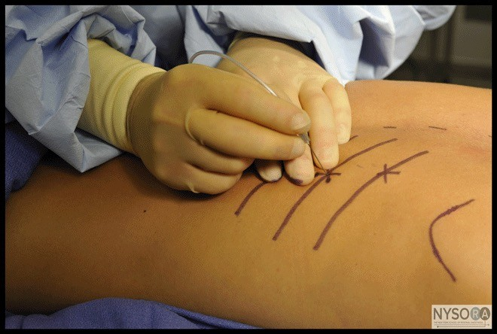
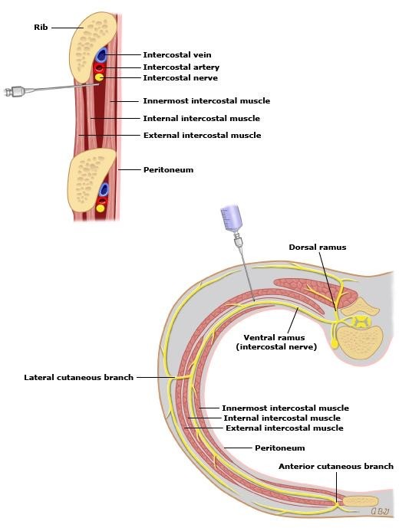
Intercostal Nerve Block
CLINICAL ANATOMY: An intercostal nerve block is an injection of a local anesthetic and/or corticosteroid around the intercostal nerve coursing in the costal groove to manage pain involving the chest wall and the upper abdominal wall. An intercostal nerve block can be used to treat acute herpes zoster, cancer pain, rib fractures, and post-thoracotomy pain. In addition, it can also be used as an anesthetic prior to the placement of percutaneous thoracostomy and nephrotomy tubes.

Slide 15
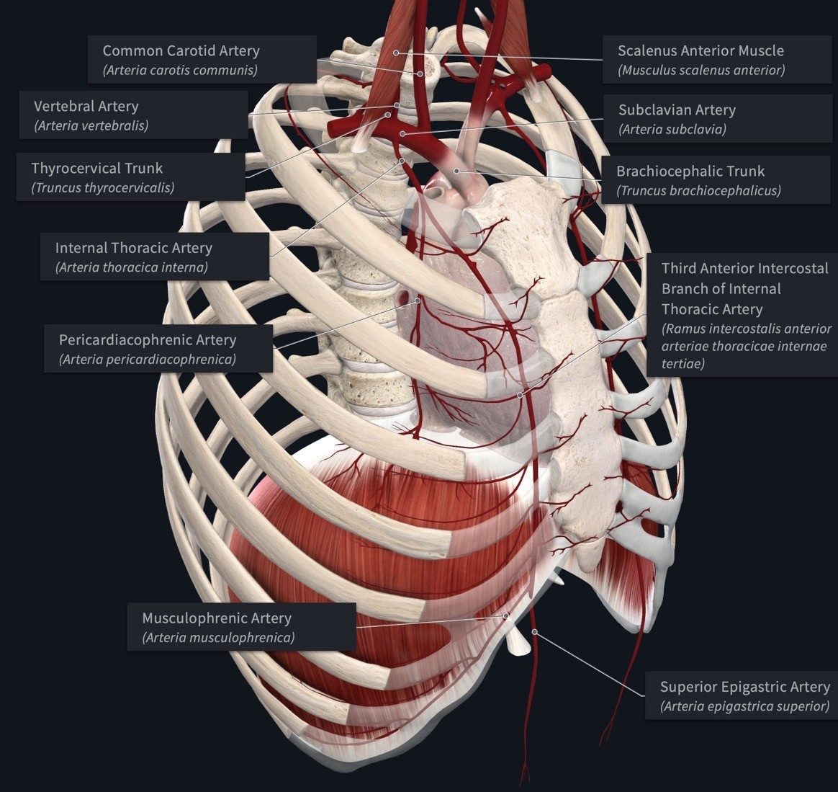
Internal Thoracic (Mammary) Artery
Recall that three arteries branch the first part of the subclavian artery (portion of the artery medial to the anterior scalene muscle) .
Vertebral artery
Internal thoracic (mammary) artery
Thyrocervical trunk
After branching from the first part of the subclavian, the right and left internal thoracic arteries pass in an inferior direction into the thoracic cavity by coursing posterior to the subclavian vein and first rib. They continue on a vertical course through the thoracic cavity along the sides of the sternum. Along their path they form the following branches.
The pericardiaphrenic artery branches from the internal thoracic to course inferiorly between the pericardium and the pleura on a path alongside the phrenic nerve. It supplies the the pericardium proximally and a small portion of the diaphragm distally.
Anterior intercostal arteries branch from the internal thoracic arteries as they cross the first 6 intercostal spaces. Anterior intercostal arteries transport blood to the anterior portion of the intercostal spaces to supply the intercostal muscles. In addition, branches pass through the intercostal muscles to supply the pectoral muscles, breast, and skin. Intercostal spaces 1- 6 are supplied by branches directly from the internal thoracic artery.
At the level of the 6th intercostal space, the internal thoracic artery forms the following terminal branches.
  Musculophrenic a.
The musculophrenic artery continues inferiorly to cross the 7th-9th intercostal spaces, which it supplies by anterior intercostal arteries that branch from it.
The musculophrenic artery continues distally to contribute blood supply the anterolateral diaphragm.
https://3d4medic.al/enFsQOFf
Superior epigastric a.
  The superior epigastric artery descends to the anterior abdominal wall to anastomose with the inferior epigastric artery (remember this from GI). The anastomosis between the two vessels occurs in the location between the posterior rectus sheath and the rectus abdominis muscle.

Slide 16
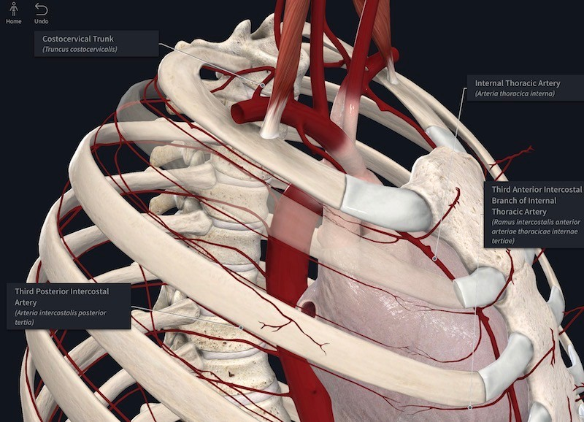
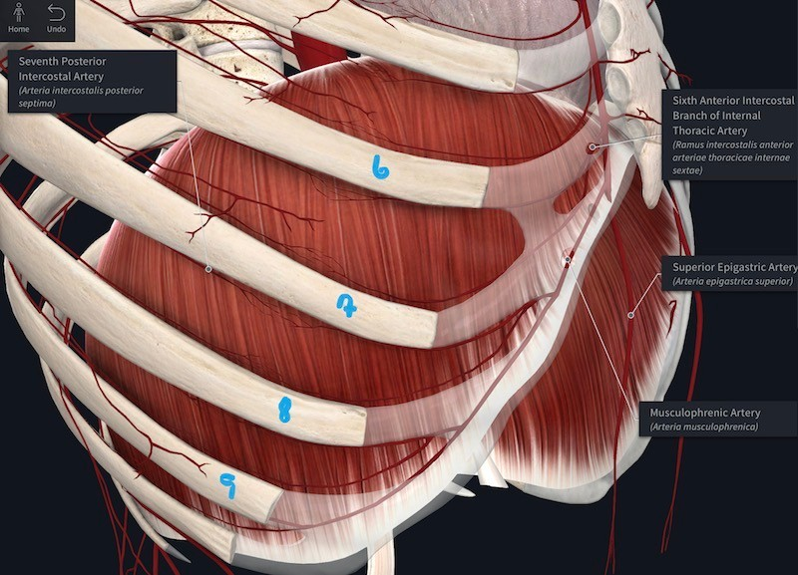
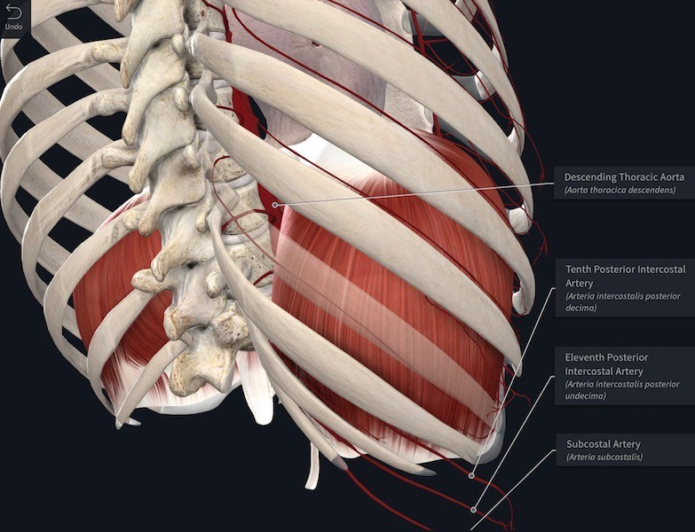
Summary of of Intercostal Vessels
The blood supply to intercostal spaces varies by level.
Intercostal spaces 1-6 (Figure 1)
  Anterior intercostal arteries directly branching from the internal thoracic artery
  Posterior intercostal arteries
    Posterior intercostal arteries 1 and 2 branch from the costocervical trunk, which branches from the second part of the subclavian artery (region of subclavian posterior to the anterior scalene muscle).
    Posterior intercostal arteries 3-6 are branches from the thoracic aorta.
Intercostal spaces 7-9 (Figure 2)
  Anterior intercostal arteries branching from the musculophrenic artery
  Posterior intercostal arteries branching from the thoracic aorta
Intercostal spaces 10 and 11 (Figure 3)
Posterior intercostal arteries ONLY that branch from the thoracic aorta.
Figure 2
Figure 1
Figure 3
https://3d4medic.al/qnmqbbgC
https://3d4medic.al/gvCZQvk9
https://3d4medic.al/JBo6urJG

Slide 17
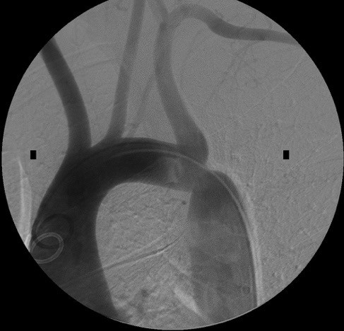

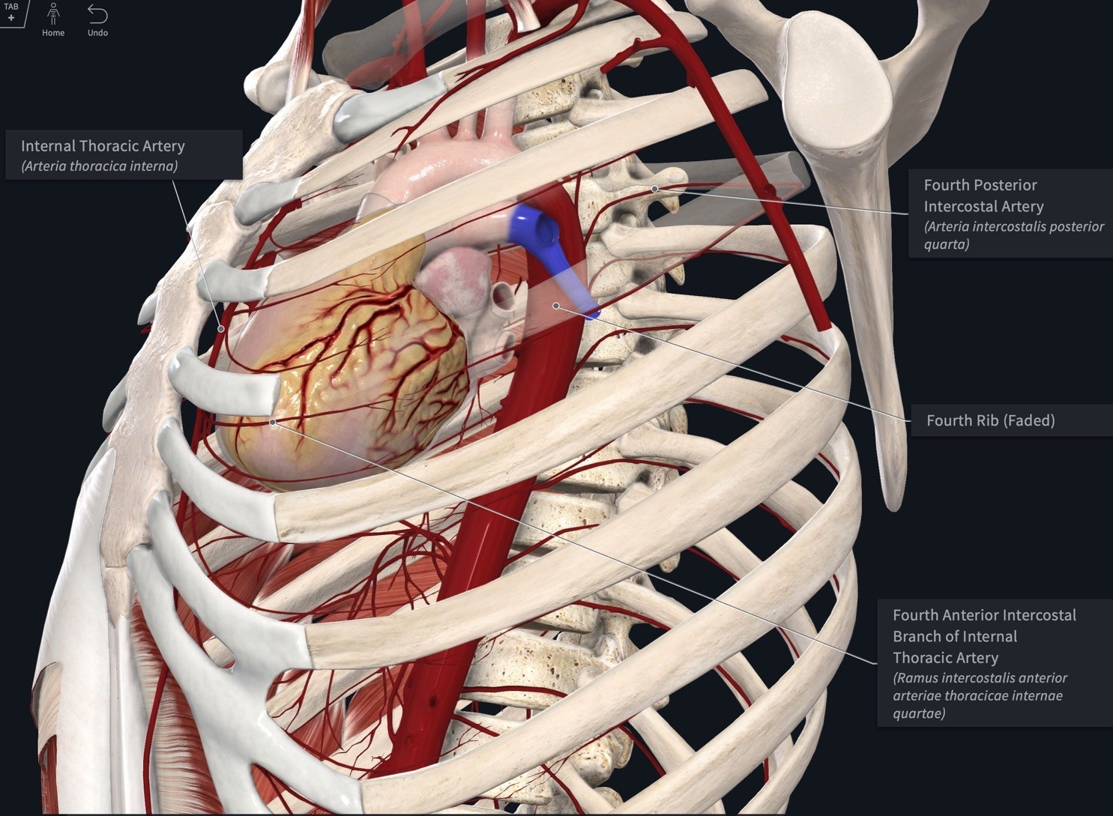
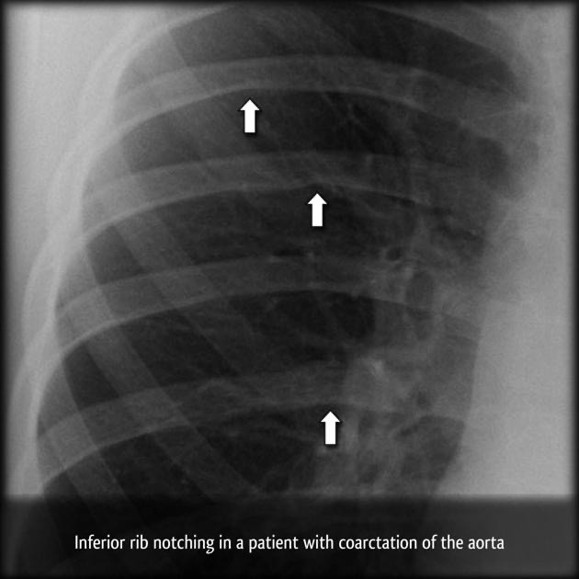
Collateral Circulation Through Internal Thoracic Artery
CLNICAL ANATOMY: The internal thoracic artery has branches that anastomose with branches of the aorta. Blood flowing through this collateral circulation can be important when blood flow through the aorta is reduced, such as occurs in congenital coarctation of the aorta and in acquired aortic stenosis. To bypass the area blocked, blood can take the following alternative pathways:
Subclavian a → internal thoracic a → superior epigastric a → inferior epigastric a- → external iliac artery
Subclavian a → anterior intercostal a → anastomosis → posterior intercostal a → aorta
In the case of extra blood flow occurring within the intercostal arteries, the intercostal vessels can hypertrophy and cause anatomical changes in the ribs, which can be seen as “rib notching” on CXR (see bottom right image).
Coarctation of Aorta
https://3d4medic.al/5Bv15kRk

Slide 18
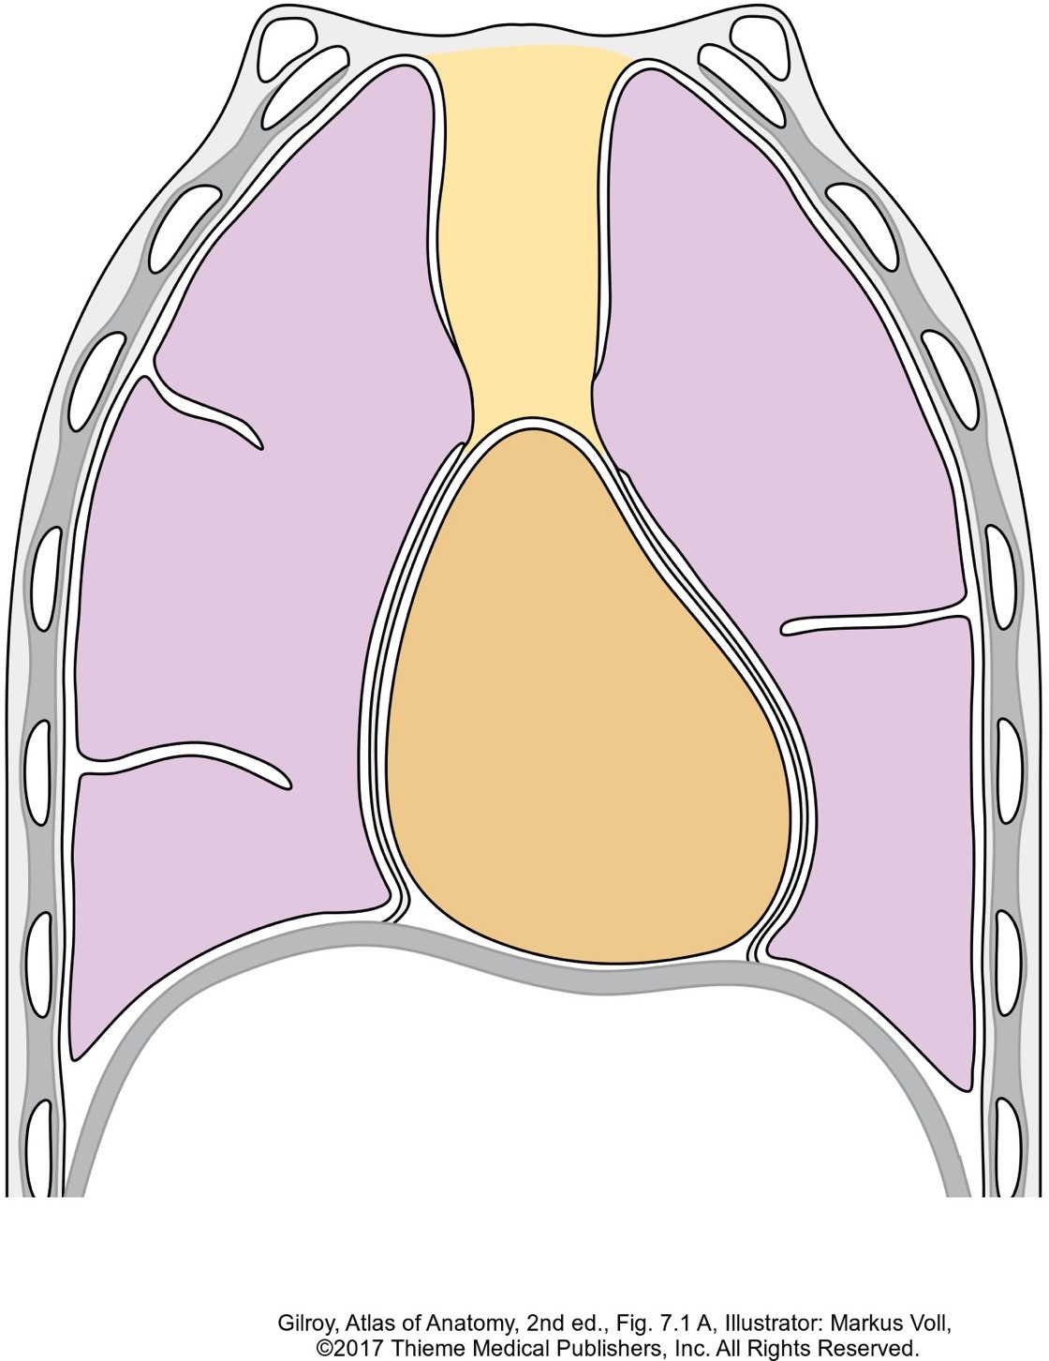
Thoracic Cavity Subdivisions
The thoracic cavity contains three subdivisions:
Mediastinum
Mediastinum
The mediastinum is the central compartment of the thoracic cavity containing the heart, great vessels, trachea, esophagus, thymus, and lymph nodes. It extends from
the superior thoracic aperture to the diaphragm and can further be divided into different regions, which will be explained in a later slide.
The mediastinum completely separates the thoracic cavity into two pulmonary cavities located on either side of it.
Two pulmonary cavities: The pulmonary cavities are large spaces on either side of the mediastinum. Each pulmonary cavity is lined by parietal pleura and contains the following structures/spaces.
  a lung
  visceral pleura of the lung
  pleural cavity (The pleural cavity is the space located between the visceral pleura lining the surface of the lung and the parietal pleura lining the pulmonary cavity.)
Pulmonary Cavity
Visceral Pleura Pleural Cavity Parietal Pleura
Heart covered by pericardium

Slide 19
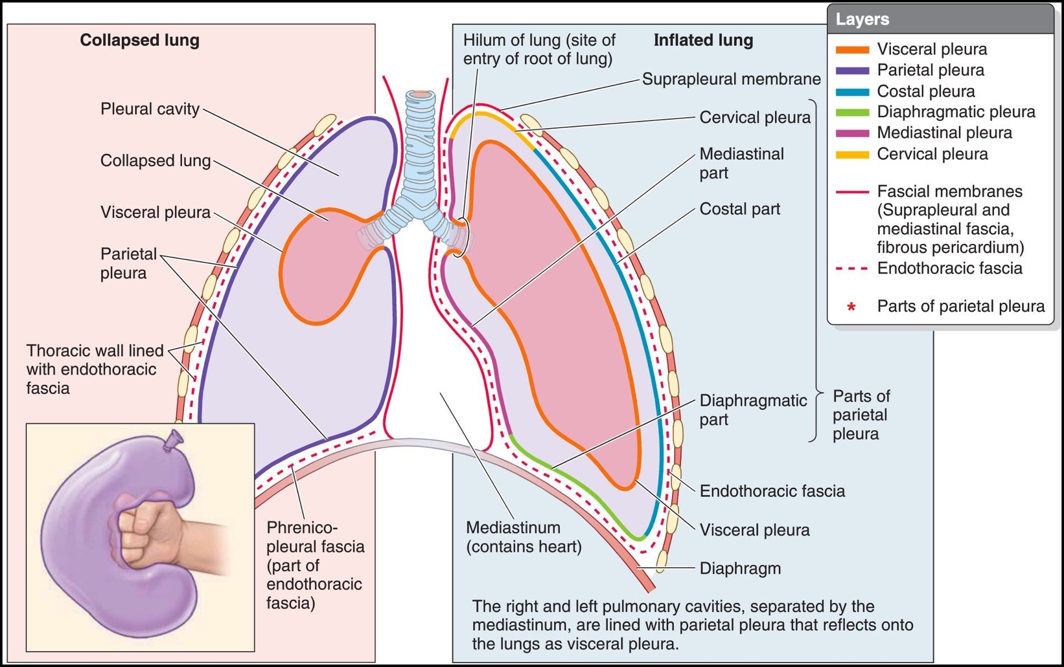
Pleura and Endothoracic Fascia
Parietal pleura is a thin epithelium/connective tissue layer that lines the pulmonary cavity and and forms the outer limits of the pleural cavity. The parietal pleura is subdivided and named according to the structures it covers. The specific regions of the parietal pleura are listed below.
The costal pleura lines the sternum, ribs, costal cartilages, intercostal muscles, and lateral sides of thoracic vertebral bodies. Sandwiched between the costal pleura and the musculoskeletal thoracic wall is an areolar connective tissue layer called endothoracic fascia.
The diaphragmatic pleura lines the diaphragm.
The mediastinal pleura lines the lateral mediastinum.
The cervical pleura is a dome-shaped portion of the
parietal pleura that extends into the root of the neck through the superior thoracic aperture.
Endothoracic fascia is an areolar connective tissue layer that separates the parietal pleura from ribs and intercostal muscles.
Visceral pleura covers the entire outer surface of the lung including the lung’s surfaces that are separated by fissures. Due to
its adherence and thinness, it cannot be dissected from the lung.
The pleural cavity is a potential space between the parietal pleura and visceral pleura that contains a small amount of serous fluid.
Serous fluid in the cavity functions as a lubricant allowing the visceral and parietal layers to glide against each other during inspiration and expiration. This fluid also creates a cohesive force that keeps the lung surfaces in contact with the thoracic wall. If the cohesive “seal” between the layers is broken, such as occurs with a penetrating wound of the pleural cavity, the lung will collapse (atelectasis).
CLINICAL ANATOMY: Endothoracic Fascia
The endothoracic fascia provides a surgical plane for the separation of the parietal pleura from the thoracic wall. If pleural adhesions are so dense and extensive that separating the parietal and visceral layers from each other might cause significant damage to the lung parenchyma, the parietal pleura can be separated from the endothoracic fascia instead.

Slide 20
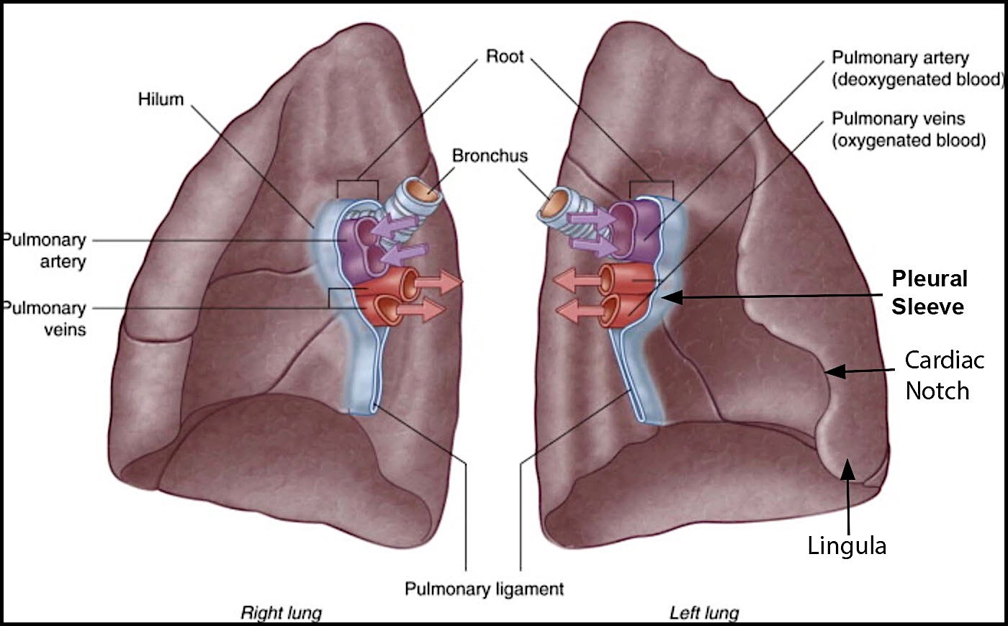
Visceral Pleura
The mediastinal parietal pleura is continuous with visceral pleura in the following locations.
Mediastinal pleura continues in a lateral direction to cover the root of the lung. (The root consists of all the structures that connect the lung to the mediastinum.) The pleura surrounding the root of the lung is referred to as the pleural sleeve.
Projecting inferiorly from the pleural sleeve is a double-layer of pleura called the pulmonary ligament (sometimes called the inferior pulmonary ligament). The
pulmonary ligament is a continuation and junction of the following pleurae: mediastinal pleura, visceral pleura, and the pleural sleeve. This double-layer of pleura connects the mediastinum (anterior to the esophagus), the root, and the lower region of each lung. It allows for vascular expansion of the pulmonary veins and anchors the lower region of each lung.
Pulmonary Ligament

Slide 21
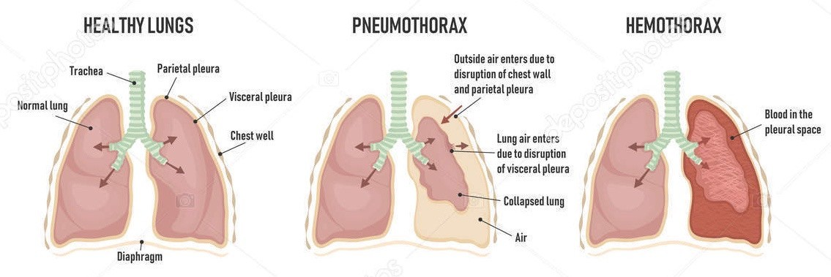
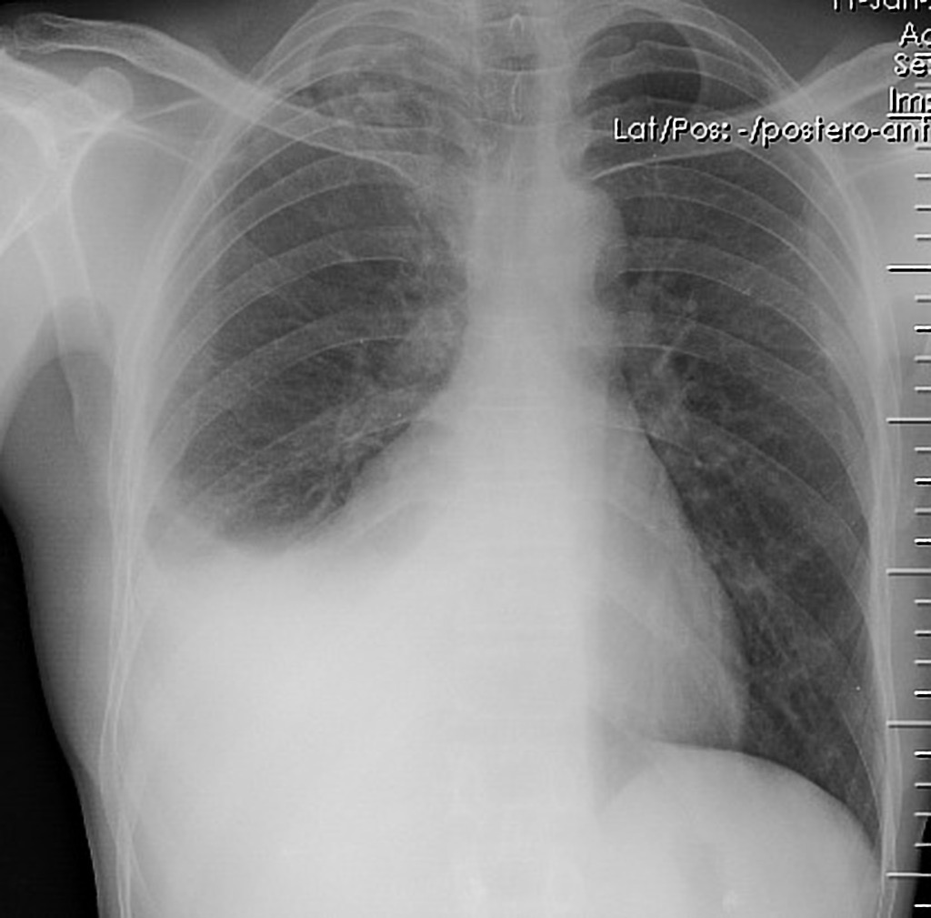
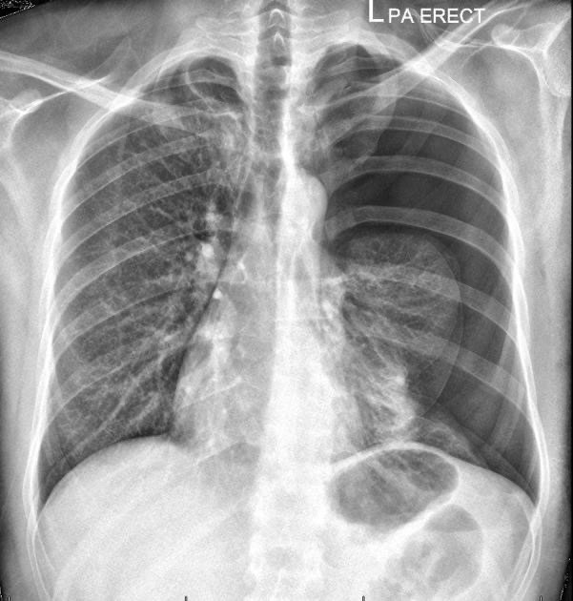

Pneumothorax, Pleural Effusion, Hemothorax
CLINICAL ANATOMY: The surface tension created by the serous fluid within the pleural cavity provides the cohesion necessary to keep the lung surface in contact with the thoracic wall during inspiration and expiration. If the contact between the visceral and parietal layers of pleura is broken (e.g., with a wound that penetrates the pleural membrane), the cohesion that is normally produced by the serous fluid between the visceral and parietal pleural is disrupted. As a result of this lost cohesion, the lung "collapses" (atelectasis) due to its elastic properties.
A pneumothorax is the presence of air in the pleural cavity, which can occur spontaneously, be a complication of underlying lung disease, result from trauma, or be an unwanted consequence of a medical procedure.
Pleural effusion is the presence of excessive fluid in the pleural cavity. As fluid accumulates, the cohesion between the pleural membranes is broken during inspiration, preventing expansion of the lung.
A hemothorax occurs when blood enters the pleural cavity, which usually is the result of trauma or a ruptured blood vessel.
Note that fluid (hemothorax or pleural effusions)
appears white/gray whereas air (pneumothorax) appears black on CXR.
Air in Pleural Cavity = Pneumothorax
New Info
Lung
Pleural Effusion
Case courtesy of Dr Vivek Pai, Radiopaedia.org, rID: 27112
Case courtesy of Dr Muhanad Jaff, Radiopaedia.org, rID: 24722

Slide 22
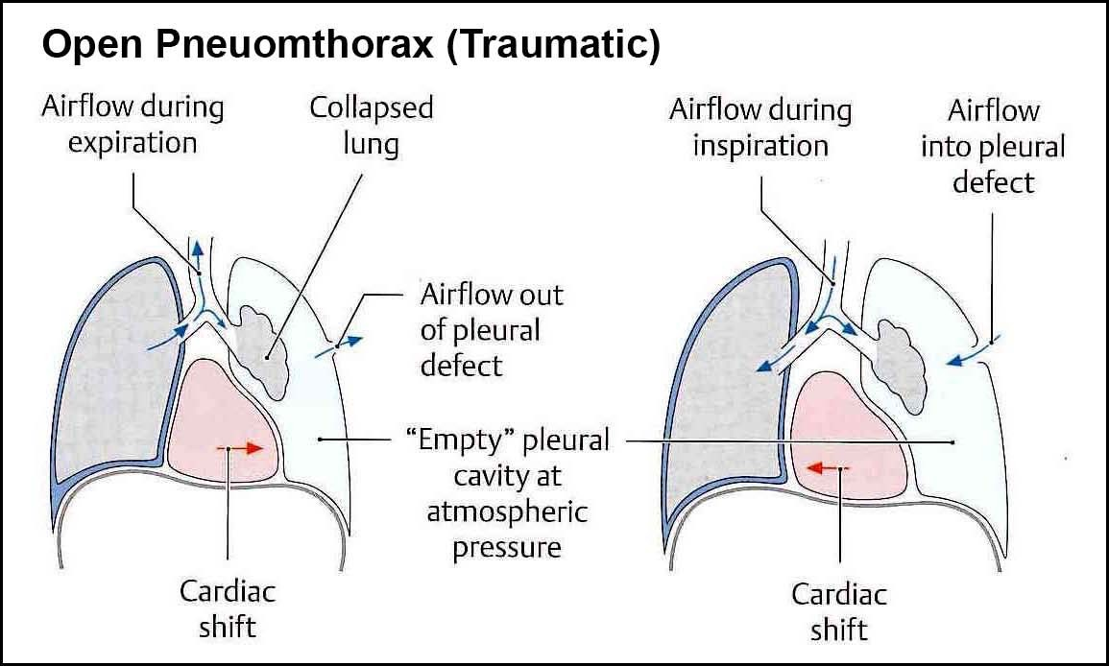
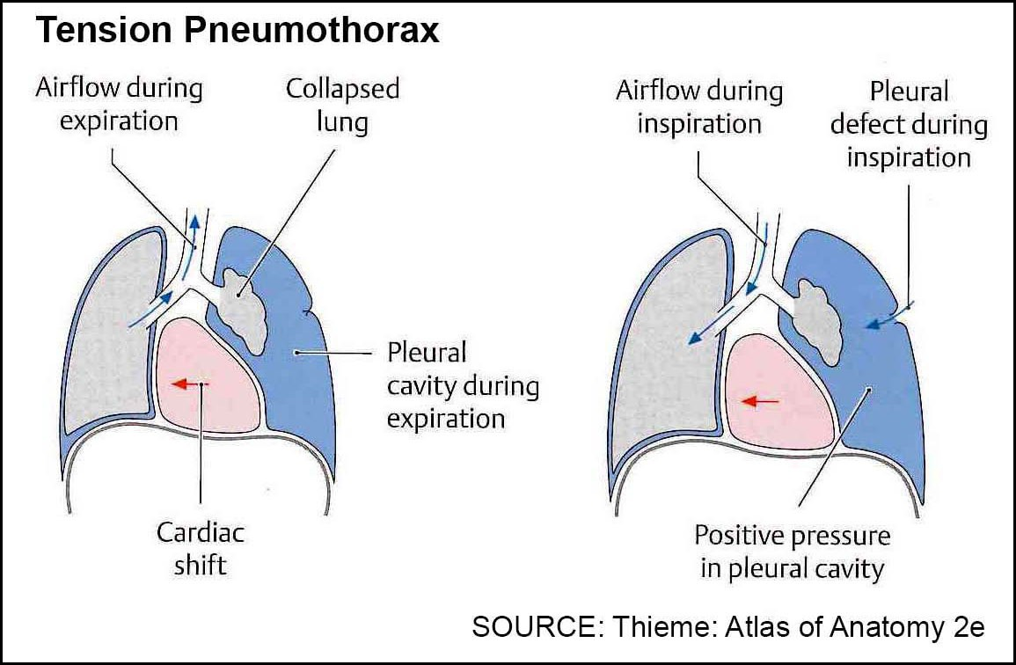
Types of Pneumothorax
A pneumothorax can result from different causes.
Primary spontaneous pneumothorax is thought to be due to rupture of subpleural apical blebs or bullae. It is NOT associated with underlying lung disease.
Secondary pneumothorax occurs in patients as a complication of underlying lung disease (emphysema, tuberculosis, and pneumoconiosis).
Traumatic pneumothorax occurs as a result of traumatic injury (stab wound).
Iatrogenic pneumothorax occurs as a result of diagnostic or therapeutic interventions (subclavian central line placement).
A pneumothorax can further be categorized as either an open pneumothorax or a tension pneumothorax.
In an open pneumothorax (Figure 1), air freely enters and exits the pleural cavity on the side with the disrupted pleura during inspiration without becoming trapped. In the affected pleural cavity, negative pressure created by downward movement of the diaphragm during inspiration causes the mediastinum to shift toward the unaffected side. During expiration, the mediastinum returns back towards the midline, creating a movement known as “mediastinal flutter”.
In a tension pneumothorax (Figure 2), the pleural defect acts like a one-way valve that can cover the defect in the pleural cavity. Because of this, a small amount of air enters the pleural cavity with each inspiration that doesn’t escape during expiration. This air trapped within the pleural space gradually pushes the mediastinum toward the unaffected side (mediastinal shift). This can obstruct venous return to the heart causing hemodynamic instability. This potentially lethal situation requires urgent thoracic decompression by insertion of an intercostal tube to reduce the pressure on the side of the ruptured pleura to prevent cardiac
arrest.
Figure 1 Figure 2

Slide 23
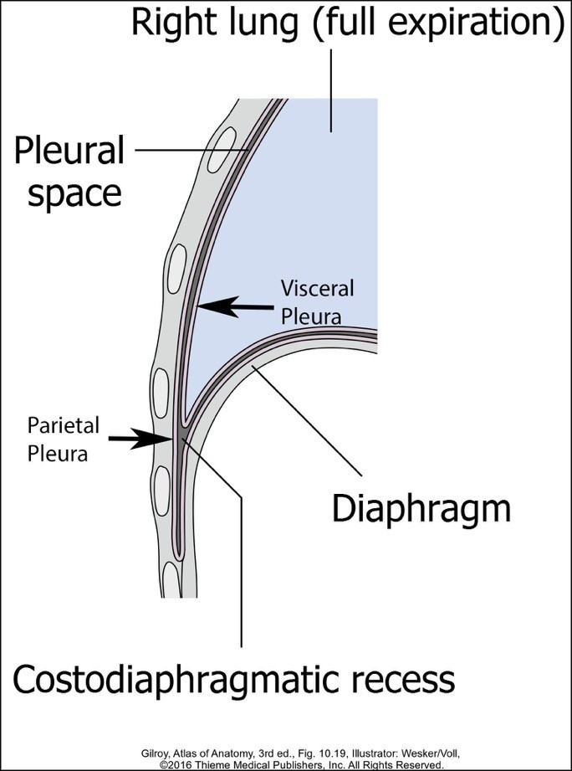
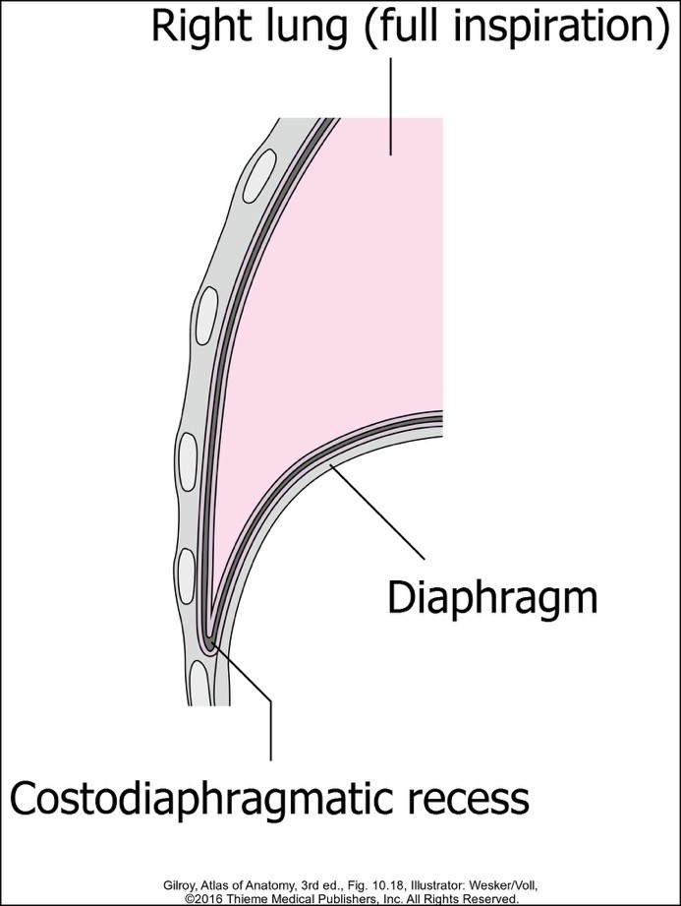
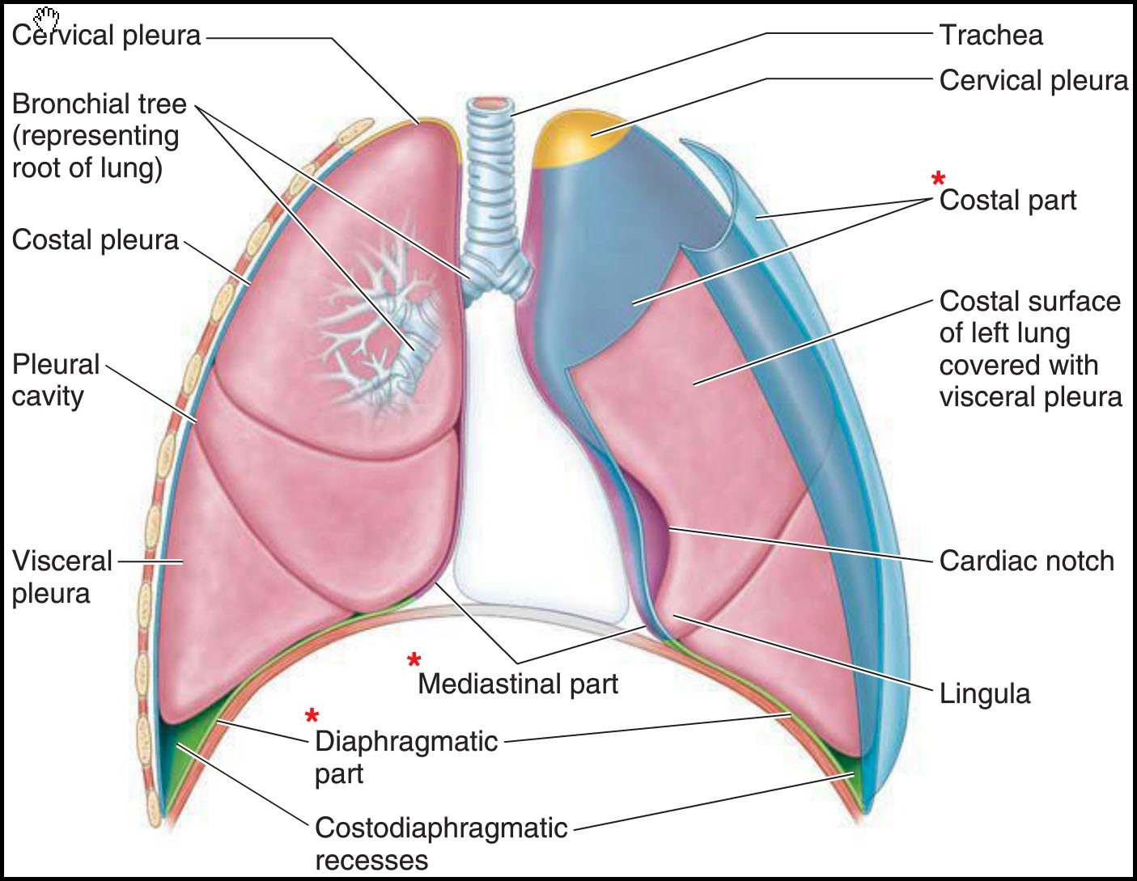
Pleural Recesses
Pleural recesses are spaces of the pleural cavity where the parietal pleura is in contact with itself and not the lung’s visceral pleura (Figure 2). The lung moves into these spaces during inspiration (Figure 3) and retreats from the spaces during expiration (Figure 2). This expansion of the lung causes the lung to move inferiorly about two rib levels during inspiration (Figure 3).
The costodiaphragmatic recess is located where the costal pleura reflects onto the diaphragm. The costodiaphragmatic recess is considered a potential space because it has the potential to collect fluid (pleural effusion) or microorganisms (empyema), which can be identified radiologically (next slide).
The smaller, costomediastinal recesses are located posterior to the sternum where the costal parietal pleura contacts the mediastinal parietal pleura. The left recess is larger because of the cardiac notch on the left lung. Due to the removal of the anterior thoracic wall, the costomediastinal recesses are not typically
identifiable in the formaldehyde preserved cadaver. Like the diaphragmatic recesses, the lungs will move into these spaces during inspiration and retreat from them during expiration.
Figure 2 Figure 3
Figure 1
Lung
Lung

Slide 24
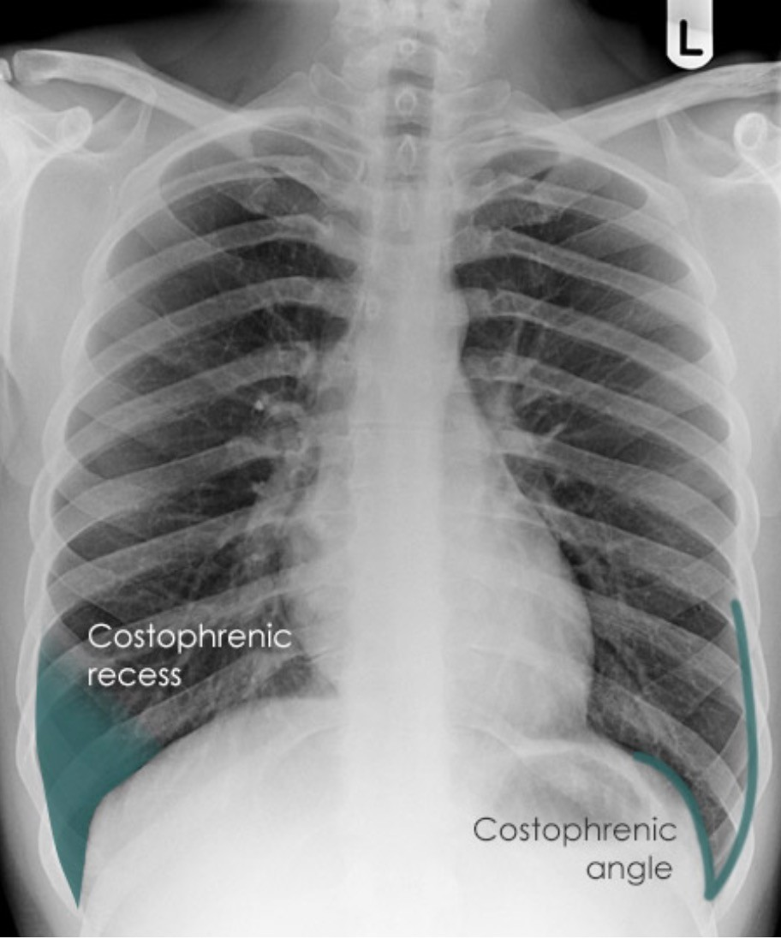
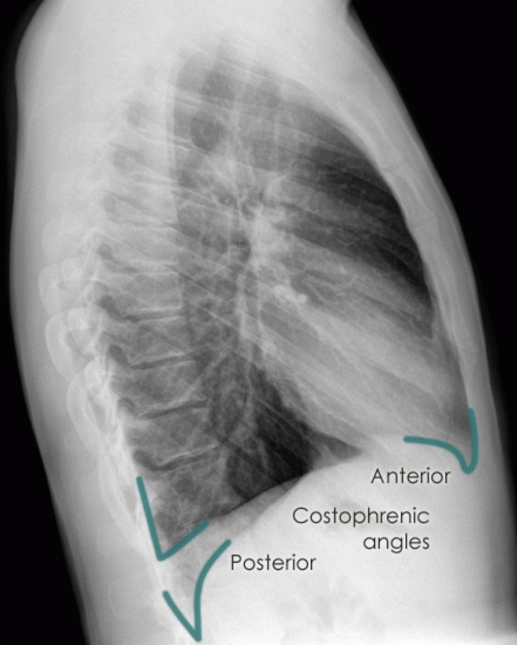
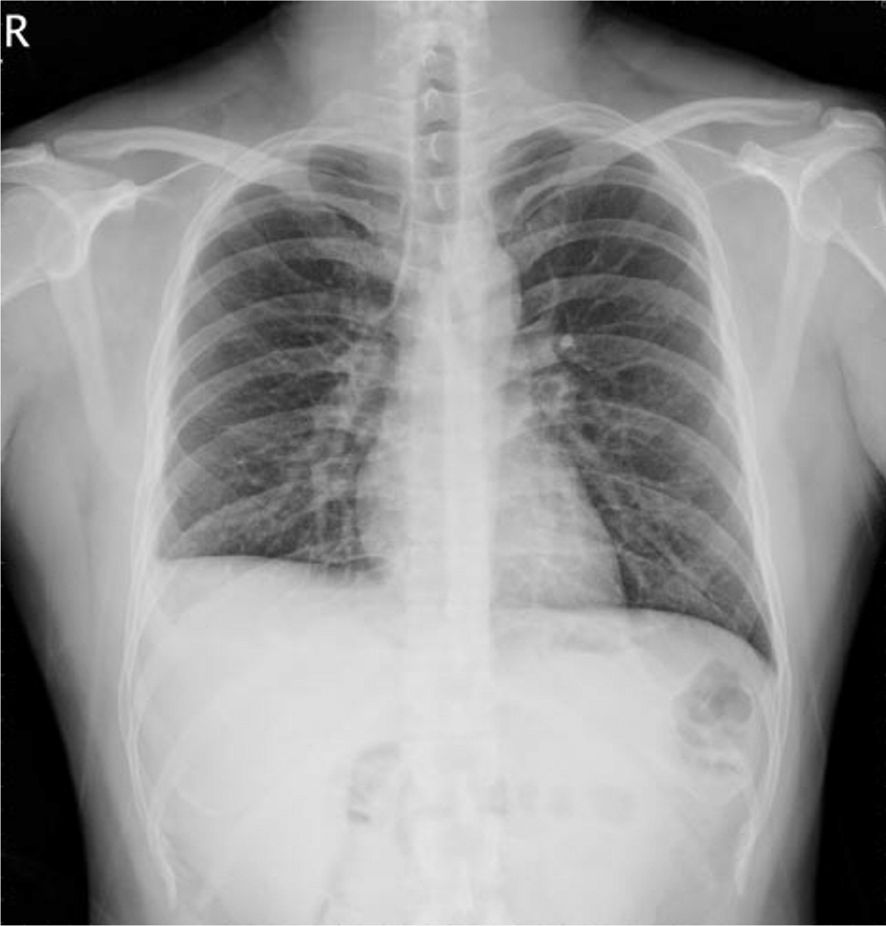
Costodiaphragmatic Recess and Costophrenic Angle
CLINICAL ANATOMY: The costodiaphragmatic recess is a potential site of fluid accumulation in a vertical patient. The costodiaphragmatic recesses are described as costophrenic angles when visualized on PA and lateral CXR. A costophrenic angle containing fluid is a finding often described as “blunting,” which may indicate a pleural effusion. However, it is important to note that “blunting” isn’t exclusive to pleural effusion and can result from pleural diseases or other underlying lung disease.
PA CXR
Lateral CXR
*
Note the ”blunting” in the right costophrenic angle indicated by the *.

Slide 25
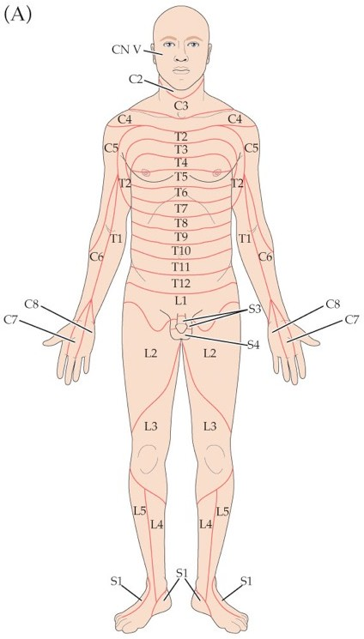
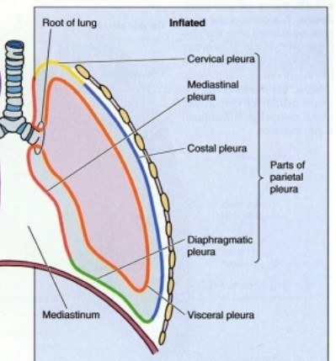
Pleurisy and Referred Pain
CLINICAL ANATOMY: Pleuritis (Pleurisy) is an inflammation of the pleura that causes sharp, stabbing pain, especially upon exertion. Pleurisy often results from viral or bacterial infections, but may also result from traumatic injury, tumors, complications of lung diseases such as pneumonia, TB, lung abscesses, influenza, SLE, or pulmonary embolism. Pleurisy can be divided into two types: wet and dry. Dry pleurisy results when the fluid content in the pleural cavity is not increased. Dry pleurisy more commonly causes sharp pain during the entire time the pleural membranes are inflamed. Dry pleurisy can be heard in the stethoscope as a pleural rub as a result of the inflamed layers rubbing against each other.
Phrenic Nerve: Dermatomes = C 3, 4, and 5
Intercostal Nerves Dermatomes= T1-T12
Pain associated with wet pleurisy usually subsides during the height of the inflammatory process when the pleural layers are separated by exudate and is less before and after exudate accumulation.
The visceral pleura isn't innervated, so no pain is involved with inflammation of ONLY that layer.
The parietal pleura is innervated by intercostal nerves and the phrenic nerve (C3, 4, and 5), so pain can be "felt" along the thoracic wall and the root of the neck
  Costal Pleura: Thoracic wall and peripheral diaphragmatic pleura (intercostal nerves)
  Mediastinal pleura/central (most of) diaphragm: Dermatomes corresponding to C3, 4, and 5 because transmitting nerve is the phrenic nerve.

Slide 26
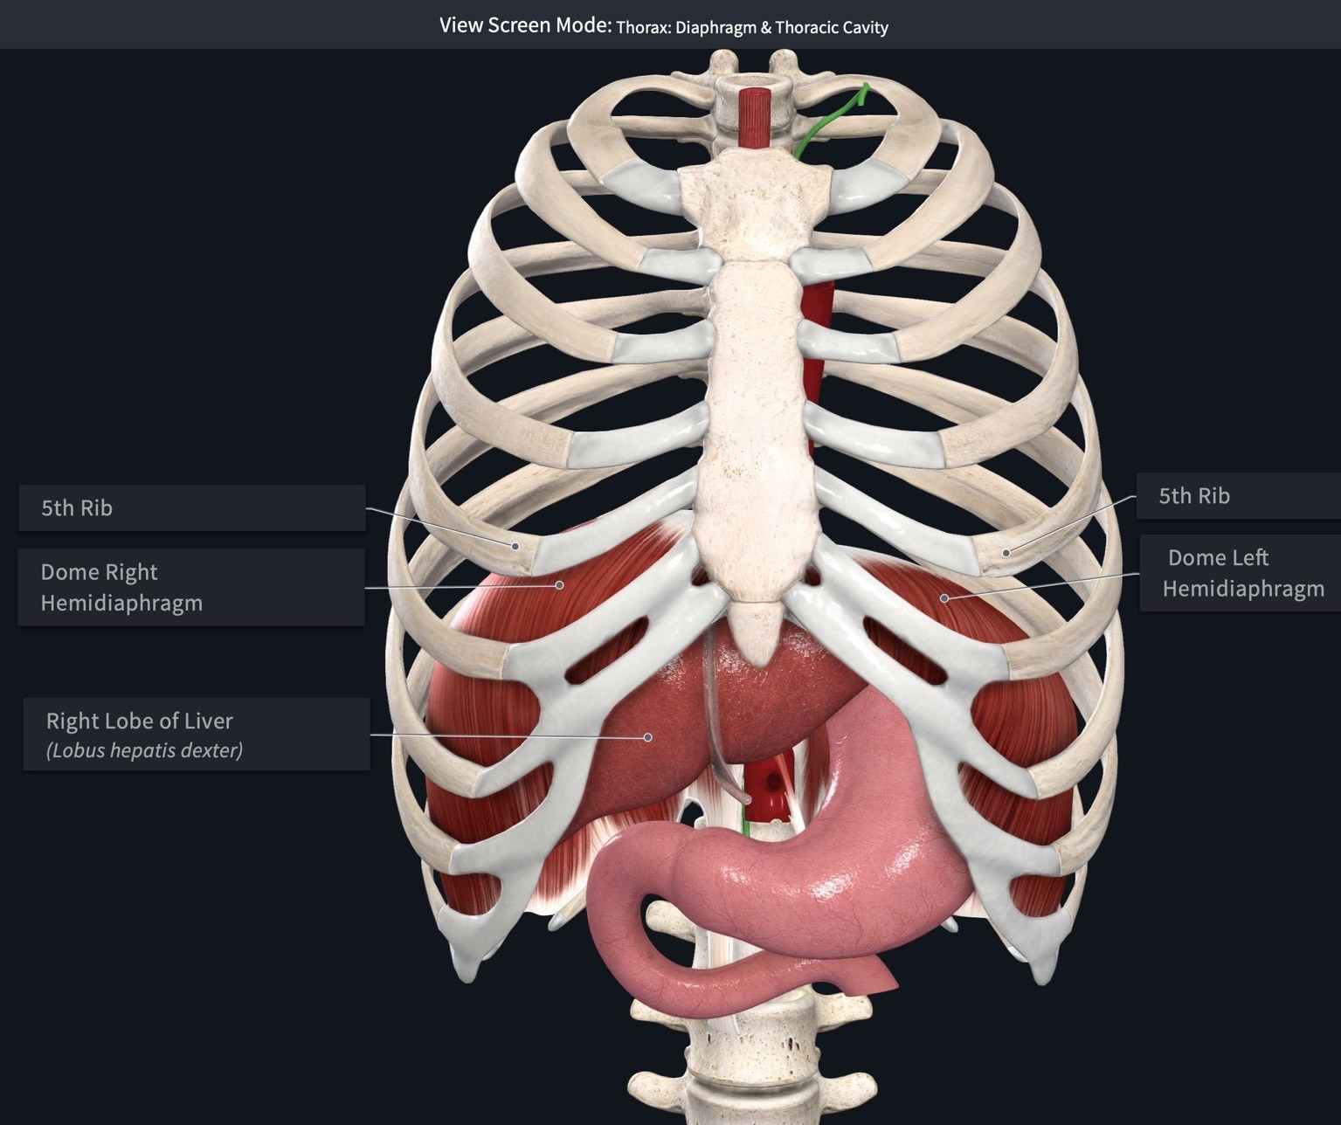
Diaphragm Introduction
The diaphragm is a double-domed musculotendinous structure that forms a physical boundary between the thoracic cavity and
the abdominal cavity at the inferior thoracic aperture. Clinically, the diaphragm is often described as consisting of two halves (right and left hemidiaphragm) that are separated by an imaginary midsagittal plane. Each hemidiaphragm is dome-shaped where it projects superiorly toward the thorax. The level of the domes is altered during respiration, postural changes, and degree of abdominal viscera distention
https://3d4medic.al/fGzhXu26
The dome of the right hemidiaphragm projects superiorly slightly more than the left due to the large right lobe of the liver pushing it superiorly. At complete normal expiration in a standing person, the dome of the right hemidiaphragm is approximately at the position of the 5th rib anteriorly.
The dome of the left hemidiaphragm is at the level of the inferior
border of the 5th rib at the midclavicular line.
Note: The level of the fifth rib at the midclavicular line corresponds with the T8 vertebral level.

Slide 27
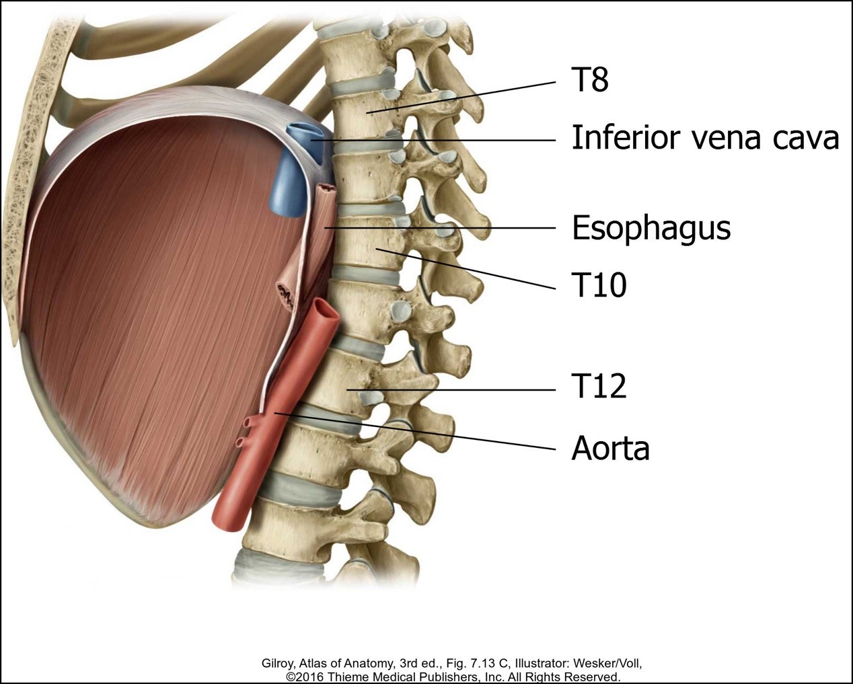
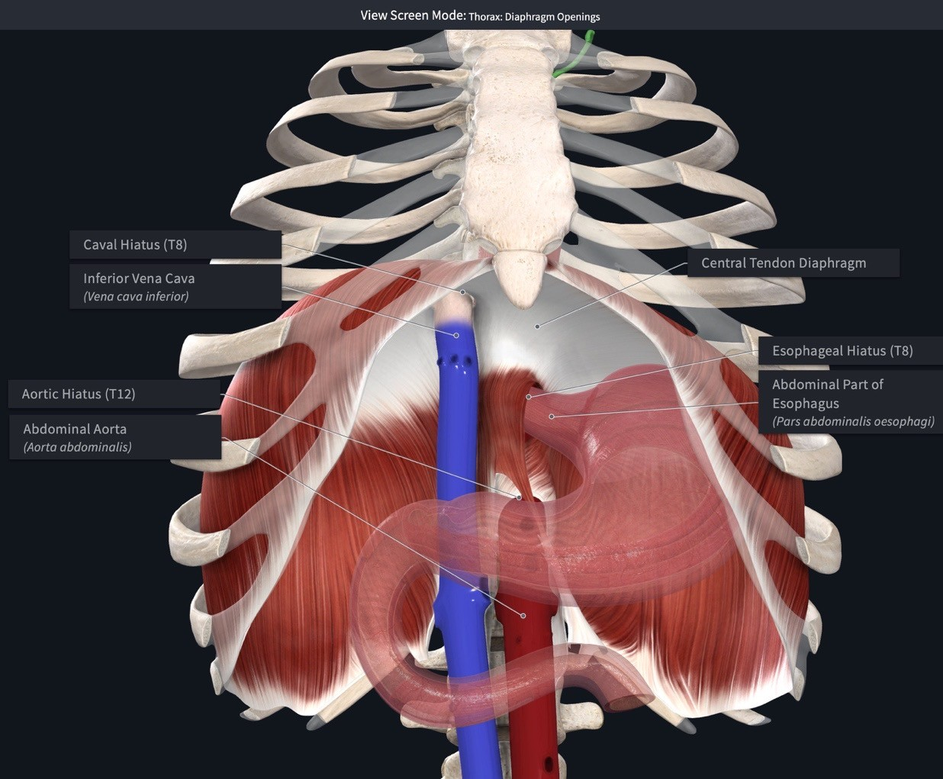
Diaphragm Apertures
The diaphragm’s muscle fibers converge centrally at a thin, but strong aponeurosis called the central tendon of the diaphragm. The surface of the central tendon facing the thorax is continuous with, and inseparable from, the fibrous pericardium.
Structures must pass through the diaphragm to course between the abdomen and thorax.
The inferior vena cava passes through the caval opening at vertebral level T8 (vena cava consists of 8 letters).
The esophagus and vagal trunks pass through the esophageal hiatus at vertebral level T10 (British spelling of oesophagus consists 10 letters).
The aorta, thoracic duct, and azygos/hemiazygos veins pass through the aortic hiatus at vertebral level T12 (aortic hiatus consists of 12 letters).
https://3d4medic.al/Mo7vYdQs

Slide 28
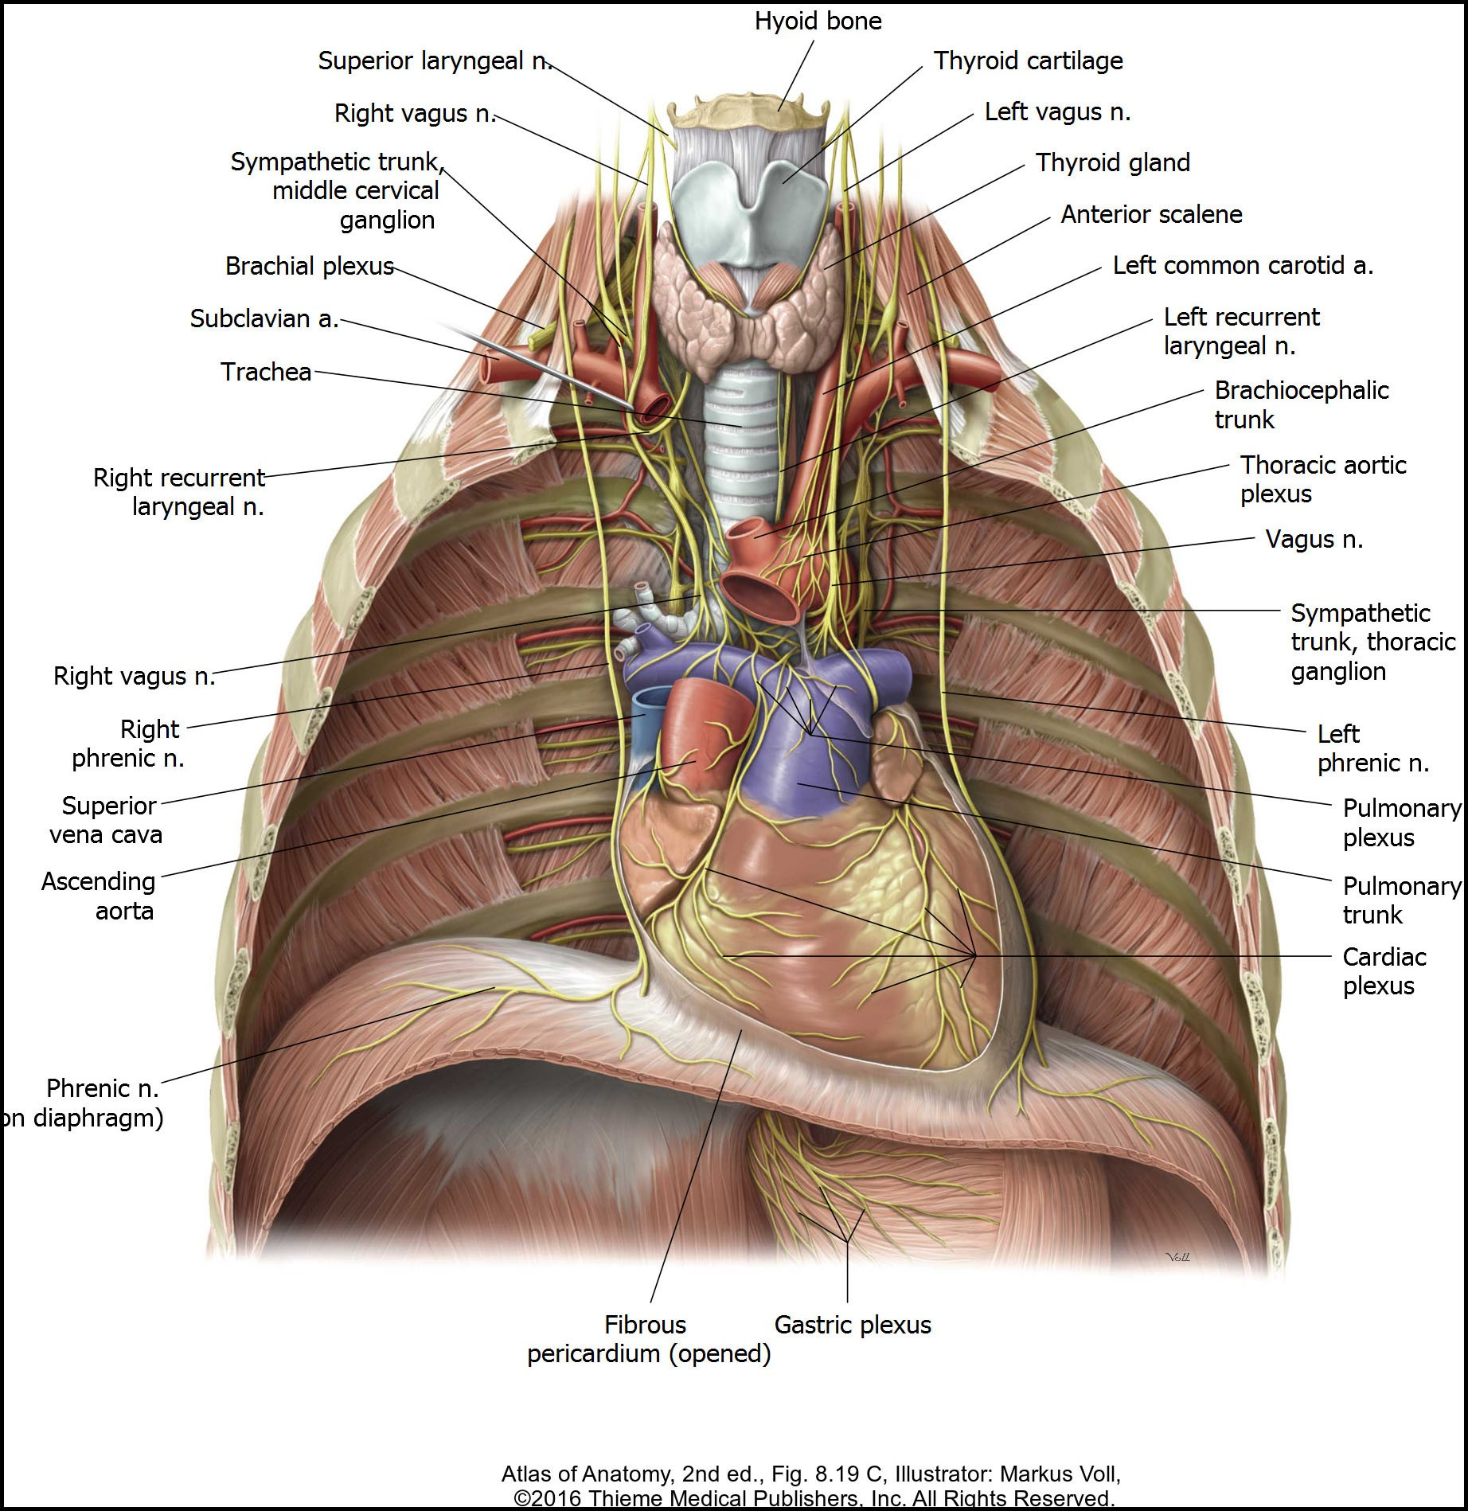
Diaphragm Motor Innervation
Motor innervation of the diaphragm
The anterior rami of the C3-C5 spinal cord levels contribute axons to form the right and left phrenic nerves. (The following mnemonic can help remember the spinal cord levels that innervate the diaphragm: C3, 4, and 5 keep the diaphragm alive.)
Phrenic nerve path
  courses through the neck anterior to the anterior scalene muscle
  enters the thoracic cavity by passing through the
superior thoracic aperture.
  passes through the thorax anterior to the root of the lung between the fibrous pericardium and the parietal pleura
  enters the diaphragm at its superior surface

Slide 29

Diaphragm Movements
Movements of a normal diaphragm during ventilation are as follows:
The diaphragm descends during inspiration, which increases thoracic cavity volume.
The diaphragm ascends during expiration, which decreases thoracic cavity volume.
CLINICAL ANATOMY: Paralysis of one half of the diaphragm due to injury of one phrenic nerve does not affect the other half of this large, dome- shaped muscle. Paralysis results in paradoxical diaphragm
movements. Movements of the diaphragm during hemiparalysis resulting from injury to one phrenic nerve are as follows.
During inspiration, the paralyzed side (dome) is pushed superiorly. This
results from the normal side descending during inspiration, which increases abdominal cavity pressure. The increase in intra-abdominal pressure pushes the abdominal viscera toward the thorax.
During expiration, the paralyzed dome is pushed inferiorly. This results
from the normal side ascending during expiration, which increases intra- thoracic pressure. The increase in intra-thoracic pressure causes the diaphragm to be pushed inferiorly toward the abdomen.

Slide 30

Diaphragm Sensory Innervation
The sensory innervation of the diaphragm is different for the central portion as compared to the peripheral portion.
Afferent neurons from the central region are contained within the phrenic nerves and enter the C3-C5 spinal cord levels.
Afferent neurons from the peripheral region are contained within the intercostal nerves (T5-T-11) and subcostal nerves (T12).
CLINICAL ANATOMY: Referred diaphragmatic pain (Figure 5.4) Due to dual sensory innervation of the diaphragm, pain can be referred to two different areas.
Irritation of the diaphragmatic pleura (thorax side of diaphragm) or diaphragmatic peritoneum (abdominal side of diaphragm) typically results in shoulder pain, which corresponds to dermatome levels C3-C5.
Irritation to the periphery of the diaphragm results in pain referred to the skin covering the costal margin on the anterolateral abdominal wall, which corresponds with dermatomes of the lower intercostal nerves.

Slide 31

Lung Surfaces
The surface of the lung is anatomically divided into different regions based upon the structures that each lung surface faces.
https://3d4medic.al/ziJVfZWw
The costal surface is the entire surface of the lung that faces the ribs.
The medial or mediastinal surface is the surface of the
lung that faces the mediastinum, which is medial to each lung.
The diaphragmatic surface is the concave surface of the lung that faces the diaphragm. This surface is also known as the base of the lung.
The apex of each lung is the tapered superior region that projects superiorly beyond the level of the clavicle into the base of the neck.

Slide 32



Root of the Lung
The root of the lung consists of the structures connecting the lung to the mediastinum.
The structures forming the root pass through a space called the hilum to enter/exit the lung. The following structures
compose the root and pass through the hilum.
Main (primary) bronchi
Pulmonary arteries
Pulmonary veins
The anatomical relationship of the phrenic nerve and vagus nerves relative to the root of the lung is listed below.
The phrenic nerve passes anterior to the root of the lung.
The vagus nerve passes posterior to the root of the lung.
Root
Root

Slide 33

Lung Lobes and Fissures
The lung is separated into lobes by deep grooves called fissures. The right and left lungs differ in the number of lobes and fissures.
https://3d4medic.al/C4Du45Px
The right lung consists of a superior (upper) lobe, middle lobe, and an inferior (lower) lobe.
  The horizontal (minor) fissure is only present on the right lung and separates the superior and middle lobes.
  The oblique fissure (major) separates the inferior lobe from both the middle and
superior lobes.
The left lung consists of a superior (upper) lobe and an inferior (lower) lobe, which are separated by fissures.
  The oblique (major) fissure separates the
superior lobe from the inferior lobe.
On the anterior surface of the left lung's superior lobe, a visible notch called the cardiac notch is present to accommodate the space occupied by the apex of the heart.
The lingula is a tongue-shaped structure that forms the
inferior border of the cardiac notch. The lingula is the left lung's homologue of the right lung's middle lobe.

Slide 34


Contact Impressions on Mediastinal Lung Surface (Right)
Several contact impressions are located on the mediastinal surface of each lung. While these impressions are artifacts that can only be viewed in an embalmed cadaver, they nevertheless illustrate the close anatomical relationships of mediastinal structures to the lung.
Right lung
Cardiac impression
Esophageal impression
Arch of azygos impression
Superior vena cava impression

Slide 35


Contact Impressions on Mediastinal Lung Surface (Left)
Left lung
Cardiac impression
Aortic arch impression
Thoracic aorta impression

Slide 36

Surface Anatomy Correlates of Lung Lobes and Fissures
In a male or a prepubescent female, the nipple is slightly lateral to the 4th intercostal space at the midclavicular line.
At the end of normal EXPIRATION, the location of the lungs, lobes, and fissures can be estimated using the thoracic cavity’s visible and palpable osseous features.
The apex of the lung is approximately 2-4 cm superior to the medial third of the clavicle.
The 6th rib in the midclavicular line (vertical line though the midpoint of the clavicle) represents the inferior level of the lung anteriorly.
The 8th rib in the midaxillary line (vertical line through the midpoint of the axilla) represents the inferior level of the lung laterally.
The 10th rib at the scapular line (vertical line through the inferior angle of scapula.) represents the level of the lung posteriorly.
A line connecting the T3 spinous process to the 6th rib anteriorly represents the oblique fissure.
The location where the oblique fissure crosses the 5th rib at the midaxillary line corresponds to the junction of the oblique and horizontal fissures. From th location of this junction, the horizontal fissure continues anteriorly along the 4th rib.

Slide 37


Lung Auscultation
The lobes of the lungs are often auscultated and percussed using a pattern like the one shown. In addition, the apex of each lung is typically evaluated in the root of the neck.
Note that posterior thorax isn’t usually percussed over the scapula because the bone and its surrounding muscles alter the percussion sounds. Note that
the inferior angle of the scapula overlies the 7th rib and may project inferiorly into the 7th intercostal space.

