Slide 1



Back AND RELATED MUSCLES,GLUTEAL REGION AND PERINEUM
IOANNIS DIMOVELIS MD,msc,phd,febopras
Plastic surgeon

Slide 2
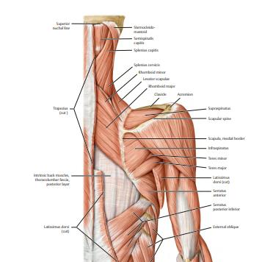
Muscles of the back
Introduction
Superficial & intermediate: Extrinsic muscles
Superficial: Related to upper limb
Intermediate: Related to thorax & ribs
Deep muscles: Intrinsic muscles
Related to movement of the back

Slide 3
Groups of back muscles
SUPERFICIAL(5) | INTERMEDIATE(2) | DEEP(3)
Trapezius, Latissimus dorsi, Levator scapulae Rhomboid Major Rhomboid Minor | Serratus Posterior Superior Serratus Posterior Inferior | Splenius muscles Erector Spinae muscles Tranversospinalis muscles

Slide 4
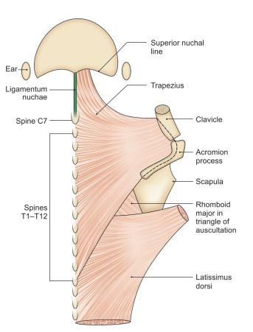
TRAPEZIUS muscle
Origin (3)
.Medial superior nuchal line
Ligament nuchae
Spinous processes C7-T12
Insertion (3)
Lateral clavicle
.Acromion
Spine of scapula
Innervation:Accessory nerve
Action :Elevate, adduct & depresses scapula

Slide 5
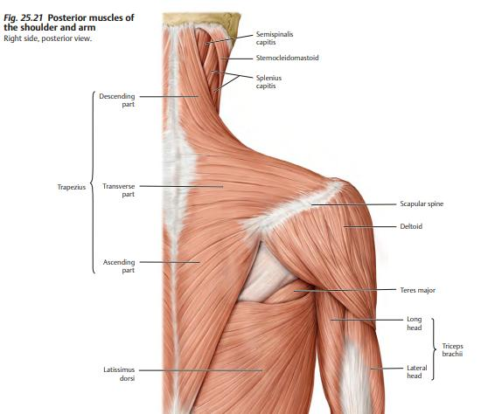
TRAPEZIUS
Flat, triangular muscle
Most superficial back muscle
Covers posterior neck & superior half of the trunk
Assists in suspending upper limp (via scapula)
Fibers are divided into 3 parts
Superior (descending) fibers→1. elevate + Scapula 2.Rotate+ extend neck
Middle fibers →adduct (retract) scapula
Inferior (ascending) fibers →1.depress scapula & lower shoulder 2. Assist upper fibers rotate scapula

Slide 6
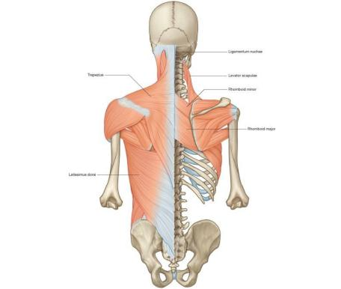
Latissimus dorsi
Origin
Spinous processes of T6-T12
thoracolumbar fascia,
iliac crest,
inferior 3 ribs.
Insertion
Intertubercular sulcus of the humerus
Innervation
Thoracodorsal nerve
Action→Adducts, medially rotates & extends humerus

Slide 7
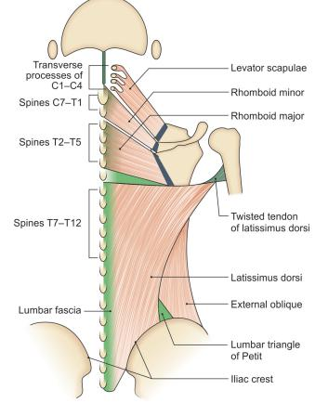
Latissimus dorsi
Large, flat triangular muscle
Covers lower back
Forms posterior axillary fold

Slide 8
Levator Scapulae MUSCLE
Small strap-like muscle. It begins in the neck, and descends to attach to the scapula.
Origin:Transverse processes of the C1-C4 vertebrae
Insertion:Medial border of the scapula.
Innervation: Dorsal scapular nerve.
Actions: Elevates the scapula.
Strap – like muscle: Covered by trapezius & latissimus dorsi
Acting unilaterally→rotates neck
Acting bilaterally→extends neck

Slide 9
RHOMBOIDS
2 rhomboid muscles→ Major and minor.
The rhomboid minor is situated superiorly to the major.
Deep to trapezius,oftenly united
Rhomboid Major
Origin→spinous processes of T2-T5 vertebrae.
Insertion→ medial border of the scapula, between spine and inferior angle.
Innervation: Dorsal scapular nerve.
Actions: Retracts and rotates the scapula.

Slide 10
rhomboids
Rhomboid Minor
Origin: Spinous processes of C7-T1 vertebrae.
Insertion: Medial border of the scapula, at the level of the spine
Innervation: Dorsal scapular nerve.
Actions: Retracts and rotates the scapula.

Slide 11
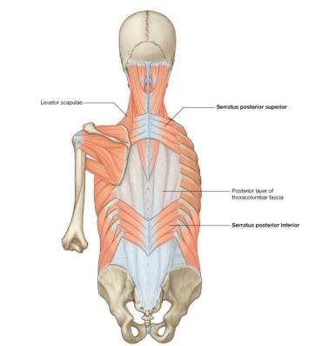
Intermediate Group
The intermediate group contains two muscles:
the serratus posterior superior and
serratus posterior inferior.
These muscles run from the vertebral column to the ribcage, and assist with elevating and depressing the ribs. They are thought to have a slight respiratory function.

Slide 12
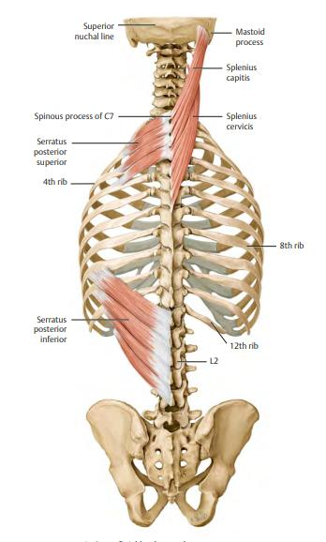
Serratus Posterior Superior
The serratus posterior superior is a thin, rectangular shaped muscle. It lies deep to the rhomboid muscles on the upper back.
Origin: lower part of the ligamentum nuchae, and the cervical and thoracic spines (usually C7 – T3).
Insertion: The fibres pass in an inferolateral direction, attaching to ribs 2-5.
Actions: Elevates ribs 2-5.
Innervation: Intercostal nerves.

Slide 13
Serratus Posterior Inferior
The serratus posterior inferior is broad and strong. It lies underneath the latissimus dorsi.
Origin: Thoracic and lumbar spines (usually T11 – L3).
Insertion:The fibres pass in a superolateral direction, attaching to ribs 9-12.
Actions: Depresses ribs 9-12.
Innervation: Intercostal nerves

Slide 14
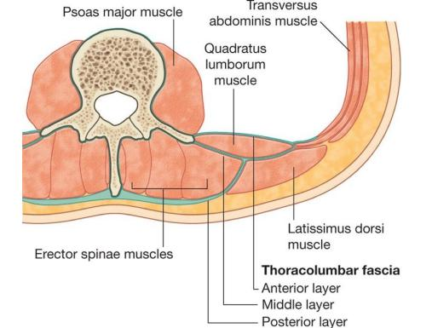
Deep muscles
The deep muscles develop embryologically in the back, and are thus described as intrinsic muscles. The superficial and intermediate muscles do not develop in the back, and are classified as extrinsic muscles.
Well-developed, and collectively extend from the sacrum to the base of the skull. They are associated with the movements of the vertebral column, and the control of posture.
The muscles themselves are covered by deep fascia, which plays a key role in their organisation.
Anatomically, the deep back muscles can be divided into three layers; superficial, intermediate and deep.

Slide 15
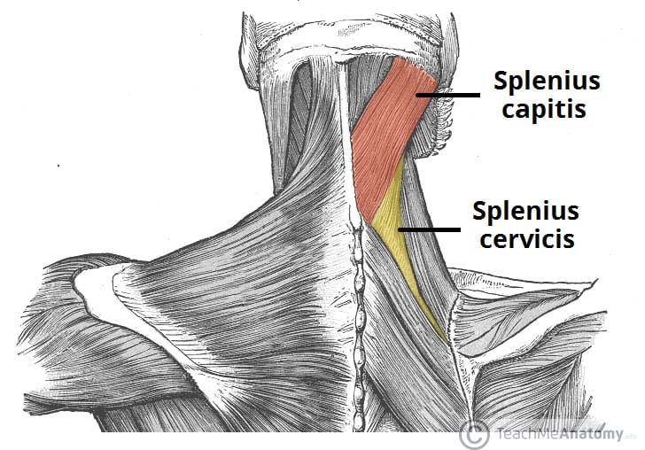
SUPERFICIAL GROUP
The superficial muscles are also known as the spinotransversales. There are two muscles in this group
splenius capitis and
splenius cervicis.
Associated with movements of the head and neck.
They are located on the posterolateral aspect of the neck, covering the deeper neck muscles.

Slide 16
SUPERFICIAL GROUP
Splenius Capitis
Attachments: Originates from the lower aspect of the ligamentum nuchae, and the spinous processes of C7 – T3/4 vertebrae. The fibres attach to the mastoid process and the occipital bone of the skull.
Innervation: Posterior rami of spinal nerves C3 and C4.
Actions: Rotate head to the same side.

Slide 17
SUPERFICIAL GROUP
Splenius Cervicis
Attachments: Originates from the spinous processes of T3 – T6 vertebrae. The fibres attach to the transverse processes of C1-3/4.
Innervation: Posterior rami of the lower cervical spinal nerves.
Actions: Rotate head to the same side.
The two splenius muscles can also act together to extend the head and neck.

Slide 18
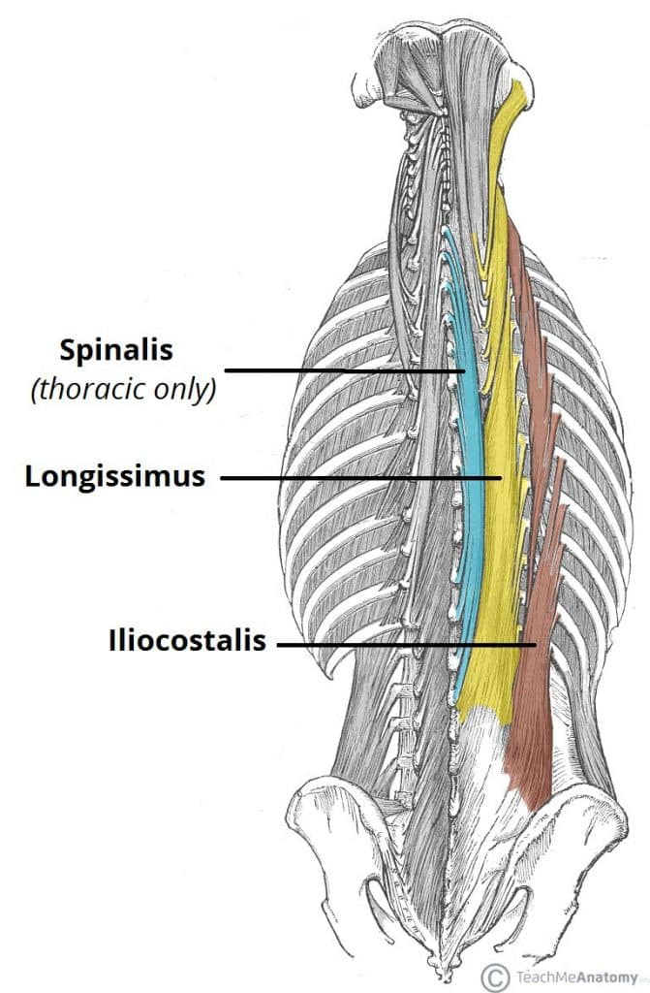
Intermediate
There are 3 intermediate intrinsic back muscles – the iliocostalis, longissimus and spinalis. Together these muscles form a column, known as the erector spinae.
The erector spinae is situated posterolaterally to spinal column, between the vertebral spinous processes and the costal angle of the ribs.
All three muscles can be subdivided by their superior attachments (into lumborum, thoracic, cervicis and capitis).
They also all have a common tendinous origin, which arises from:
Lower thoracic and lumbar vertebrae
Sacrum 3
Posterior aspect of iliac crest.
Sacroiliac and supraspinous ligaments.

Slide 19
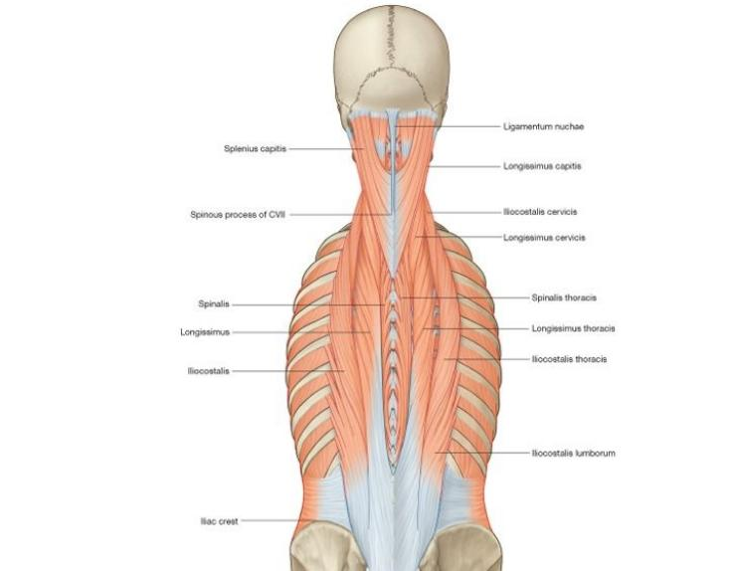
Intermediate
Iliocostalis
The iliocostalis muscle is located laterally within the erector spinae. It is associated with the ribs, and can be divided into three parts – lumborum, thoracis, and cervicis.
Origin: common tendinous origin,
Insertion: Costal angle of the ribs and the cervical transverse processes.
Innervation: Posterior rami of the spinal nerves.
Actions: Acts unilaterally to laterally flex the vertebral column. Acts bilaterally to extend the vertebral column and head.

Slide 20
Intermediate
Longissimus
The longissimus muscle is situated between the iliocostalis and spinalis. It is the largest of the three columns. It can be divided into three parts – thoracic, cervicis and capitis.
Origin: common tendinous origin
Insertion:Lower ribs, the transverse processes of C2 – T12, and the mastoid process of the skull.
Innervation: Posterior rami of the spinal nerves.
Actions: Acts unilaterally to laterally flex the vertebral column. Acts bilaterally to extend the vertebral column and head.

Slide 21
Intermediate
Spinalis
The spinalis muscle is located medially within the erector spinae. It is the smallest of the three muscle columns. It can be divided into the thoracic, cervicis and capitis (although the cervicis part is absent in some individuals).
Origin: common tendinous origin,
Insertion: spinous processes of C2, T1-T8 and the occipital bone of the skull.
Innervation: Posterior rami of the spinal nerves.
Actions: Acts unilaterally to laterally flex the vertebral column. Acts bilaterally to extend the vertebral column and head

Slide 22
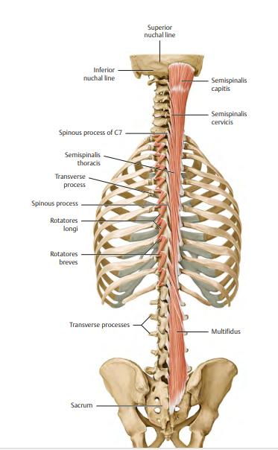
deep
The deep intrinsic muscles are located underneath the erector spinae, and are known collectively as the transversospinales.
They are a group of short muscles, associated with the transverse and spinous processes of the vertebral column.
There are three major muscles in this group – the
Semispinalis
multifidus
rotatores

Slide 23
SEMISPINALIS MUSCLE
The semispinalis is the most superficial of the deep intrinsic muscles. Much like the intermediate muscles, it can be divided by its superior attachments into thoracic, cervicis and capitis.
Origin: transverse processes of C4-T10.
Insertion: The fibres ascend 4-6 vertebral segments, attaching to the spinous processes of C2-T4, and to the occipital bone of the skull.
Innervation: Posterior rami of the spinal nerves.
Actions: Extends and contralaterally rotates the head and vertebral column.

Slide 24
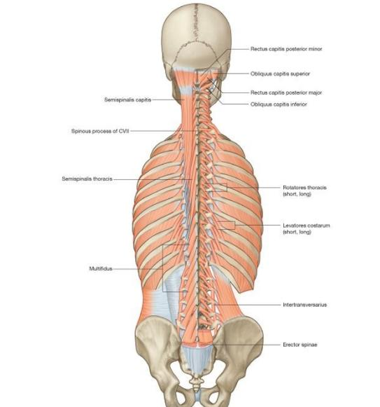
Multifidus
The multifidus is located underneath the semispinalis muscle. It is most developed in the lumbar area.
Origin: Has a broad origin – arises from the sacrum, posterior iliac spine, common tendinous origin of the erector spinae, mamillary processes of lumbar vertebrae, transverse processes of T1-T3 and articular processes of C4-C7.
Insertion: The fibres ascend 2-4 vertebral segments, attaching to the vertebral spinous processes.
Innervation: Posterior rami of the spinal nerves.
Actions: Stabilises the vertebral column.

Slide 25
Rotatores
The rotatores are the deepest muscles of the transversospinales group. They are most prominent in the thoracic region.
Attachments: Originates from the vertebral transverse processes. The fibres ascend and attach to the lamina and spinous processes of the vertebrae above.
Actions: Contributes to extension and rotation of the vertebral column. Also stabilises the vertebrae and had a proprioceptive function.
Innervation: Posterior rami of the spinal nerves

Slide 26
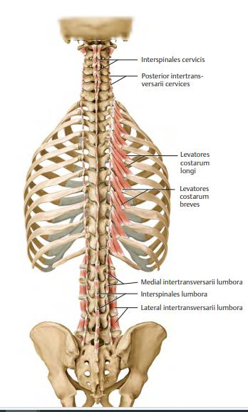
Minor deep
Minor Deep Intrinsic Muscles:
Interspinales – Spans between adjacent spinous processes. Acts to stabilise the vertebral column.
Intertranversarii – Spans between adjacent transverse processes. Acts to stabilise the vertebral column.
Levatores costarum – Originates from the transverse processes of C7-T11, and attaches to the rib immediately below. Acts to elevate the ribs

Slide 27
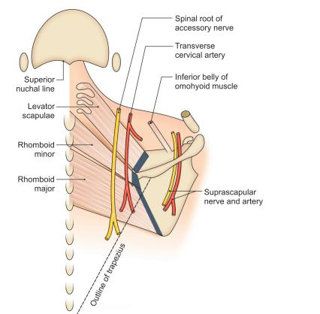
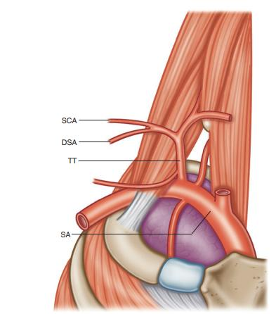
Vessels and nerves of the area
Vessels
Suprascapular artery and vein (branch of thyrocervical trunk)
Superficial branch of the transverse cervical artery (superficial cervical) and accompanying veins
3 Deep branch of transverse cervical (dorsal scapular) and accompanying veins

Slide 28
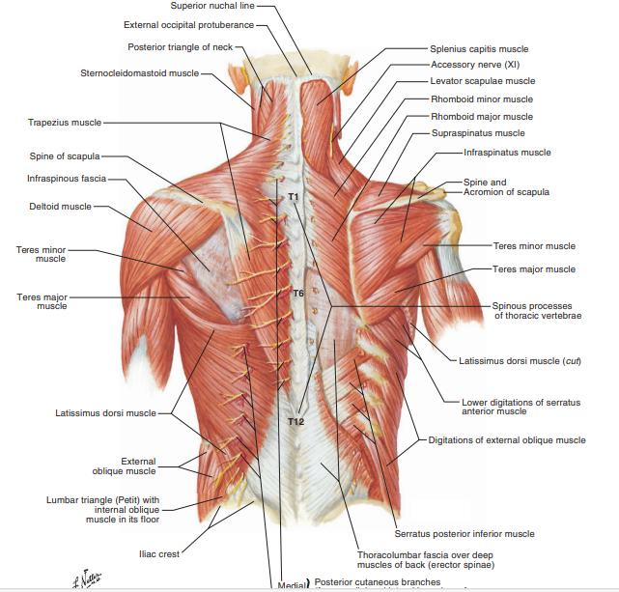
NERVES
Nerves
Spinal root of accessory nerve
Suprascapular nerve
C3, C4 nerves
Posterior primary rami of C2–C6 and T1–T12 pierce the muscle to become cutaneous nerves.

Slide 29
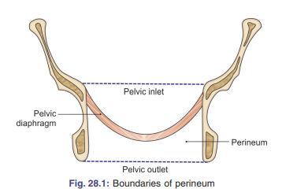
PERINEUM
The perineum is an anatomical region in the pelvis. It is located between the thighs, and represents the most inferior part of the pelvic outlet. The perineum is separated from the pelvic cavity superiorly by the pelvic floor.
This region contains structures that support the urogenital and gastrointestinal systems – and it therefore plays an important role in functions as such micturition, defecation, sexual intercourse and childbirth.

Slide 30
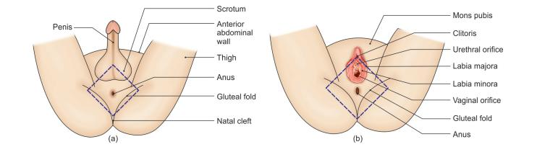
BORDERS OF PERINEUM
In clinical practice, the term “perineum” is frequently used to describe the area between the external genitalia and the anus. However, in anatomical terms, the perineum is a diamond-shaped structure.
There are two main ways in which the boundaries of the perineum can be described. The anatomical borders refer to its exact bony margins, whilst the surface borders describe the surface anatomy of the perineum.

Slide 31
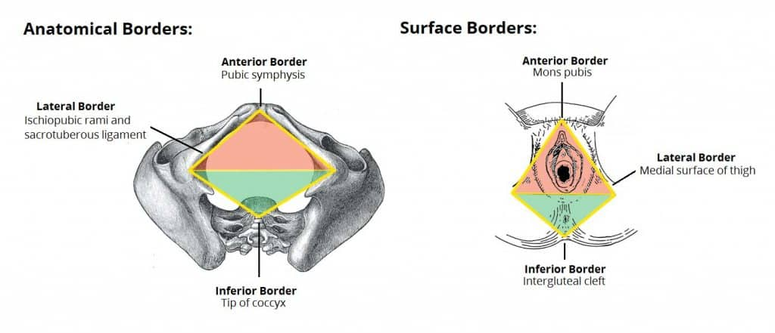
Surface Borders
The surface boundaries are best shown when the lower limbs are abducted, and a diamond shape is depicted:
Anterior – mons pubis in females, base of the penis in males.
Laterally – medial surfaces of the thighs.
Posterior – superior end of the intergluteal cleft.

Slide 32
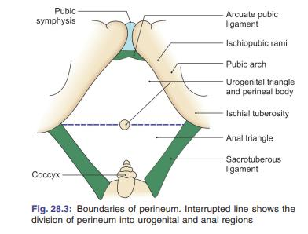
ANATOMICAL BORDERS
The anatomical borders of the perineum are:
Anterior – pubic symphysis.
Posterior – tip of the cocyx.
Laterally – inferior pubic rami and inferior ischial rami, and the sacrotuberous ligament.
Roof – pelvic floor.
Base – skin and fascia.
The perineum can be subdivided by a theoretical line drawn transversely between the ischial tuberosities. This split forms the anterior urogenital triangle and the posterior anal triangle.

Slide 33
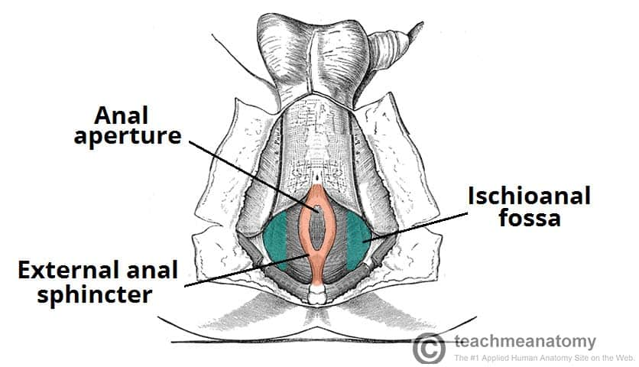
Anal Triangle
The anal triangle is the posterior half of the perineum. It is bounded by the coccyx, sacrotuberous ligaments, and a theoretical line between the ischial tuberosities.
The main contents of the anal triangle are:
Anal aperture – the opening of the anus.
External anal sphincter muscle – voluntary muscle responsible for opening and closing the anus.
Ischioanal fossae (x2) – spaces located laterally to the anus.
.

Slide 34
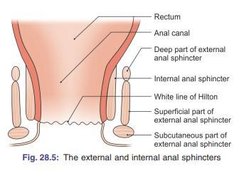
EXTERNAL Anal sphincHter
Surrounds the whole length of the anal canal.
Supplied by the inferior rectal branch of pudendal nerve and by the and by branches directly from the anterior ramus of S4.
It is under voluntary control and keeps the anus and anal canal closed.
Consists of three parts-deep, superficial, and subcutaneous-arranged sequentially along the canal from superior to inferior
The deep part is a thick ring-shaped muscle that circles the upper part of the anal canal and blends with the fibers of the levator ani muscle.
The superficial part also surrounds the anal canal, but is anchored anteriorly to the perineal body and posteriorly to the coccyx and anococcygeal ligament.
The subcutaneous part is a horizontally flattened disc of muscle that surrounds the anal aperture just beneath the skin.

Slide 35
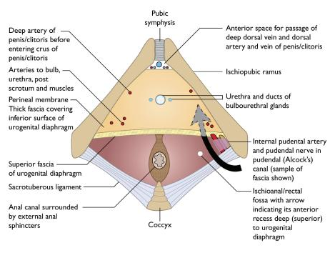
CONTENTS OF ANAL TRIANGLE
The anal aperture is located centrally in the triangle with the ischioanal fossae either side. These fossae contain fat and connective tissue, which allow for expansion of the anal canal during defecation. They extend from the skin of the anal region (inferiorly) to the pelvic diaphragm (superiorly).
Another important anatomical structure within the anal triangle is the pudendal nerve, which supplies the whole perineum with somatic fibres

Slide 36
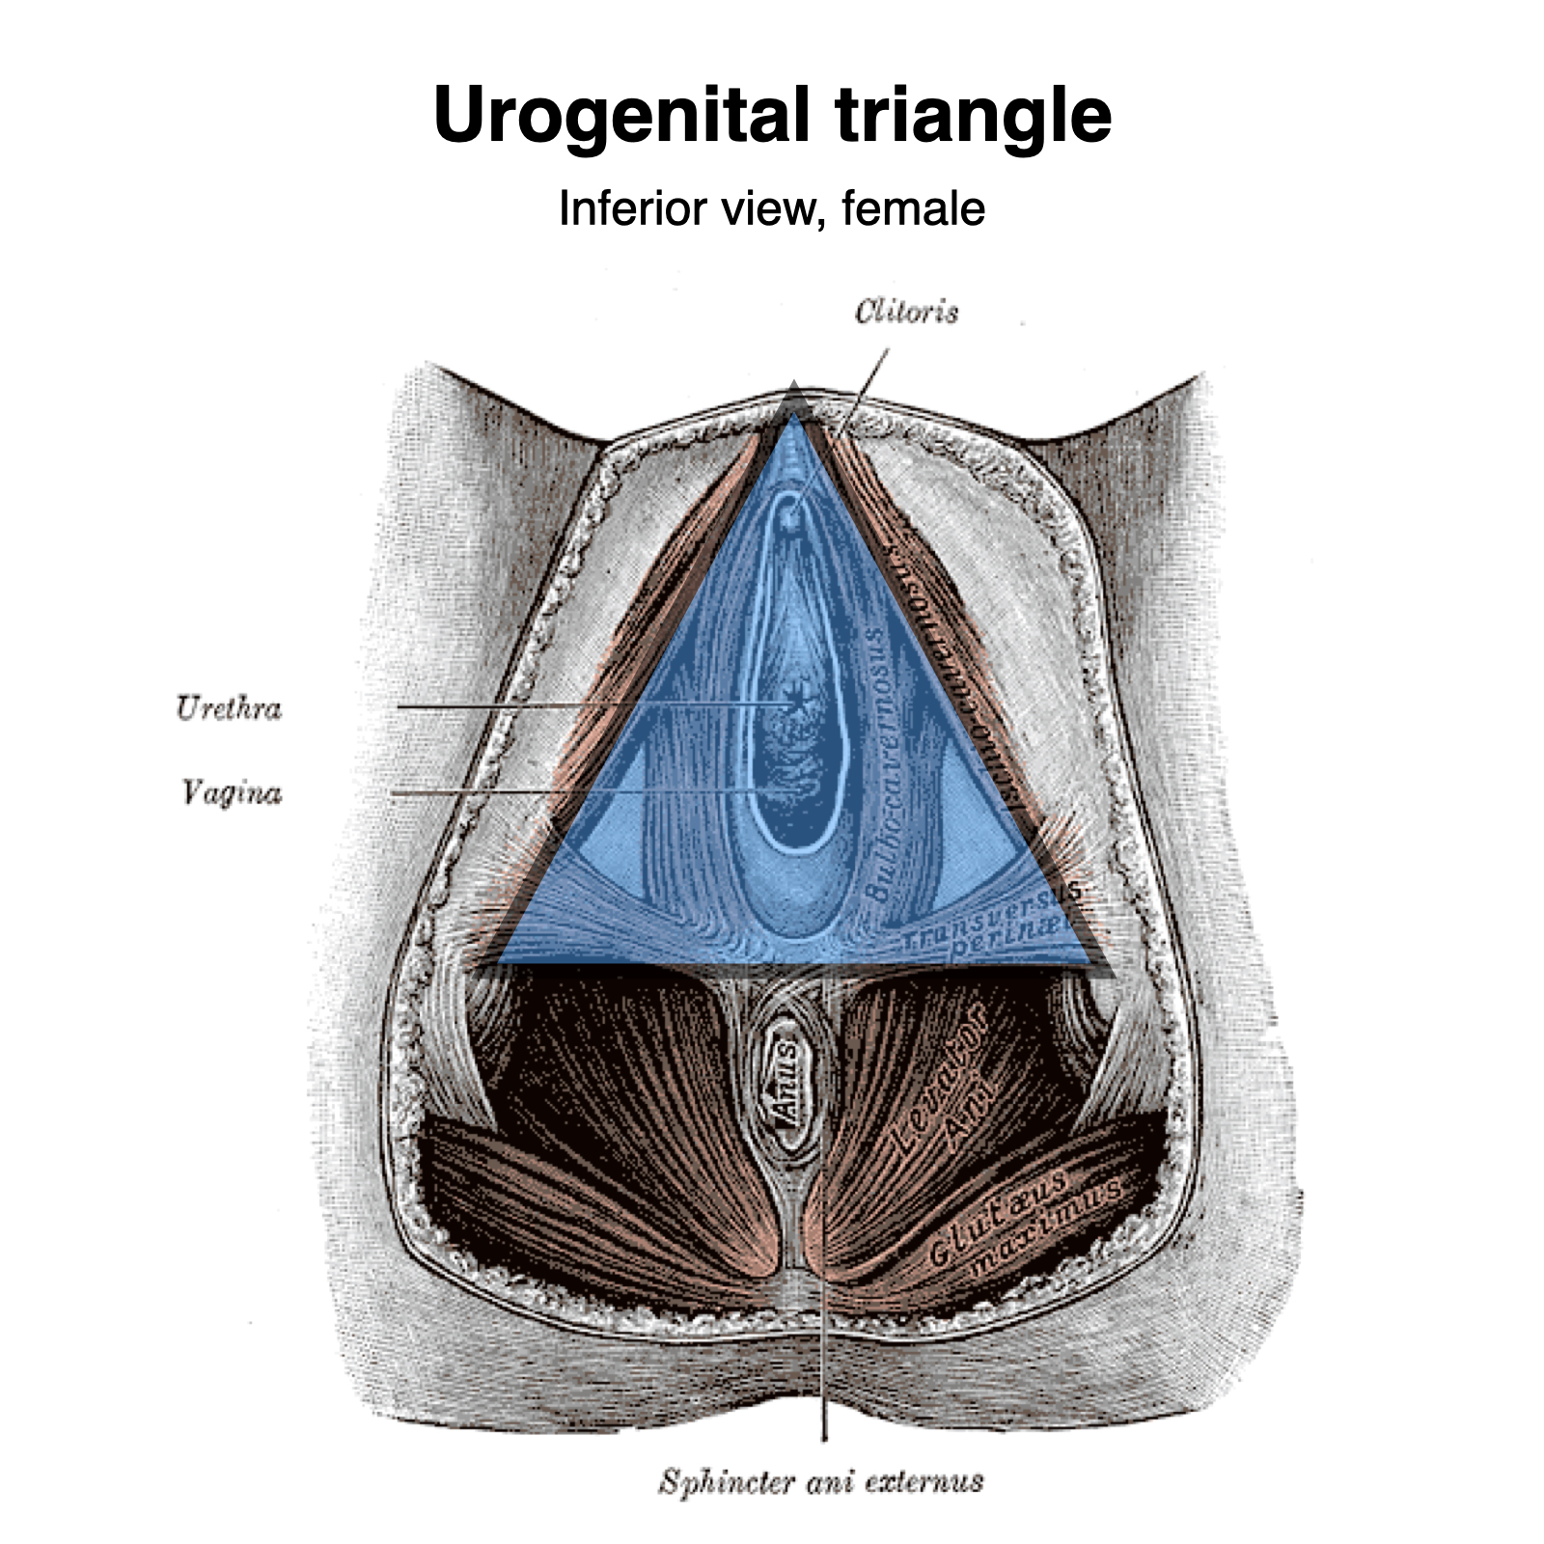
Urogenital Triangle
The urogenital triangle is the anterior half of the perineum. It is bounded by the pubic symphysis, ischiopubic rami, and a theorectical line between the two ischial tuberosities. The triangle is associated with the structures of the urogenital system – the external genitalia and urethra.
Structurally, the urogenital triangle is complex, with a number of fascial layers and pouches. Unlike the anal triangle, the urogenital triangle has an additional layer of strong deep fascia; the perineal membrane. This membrane has pouches on its superior and inferior surfaces.

Slide 37
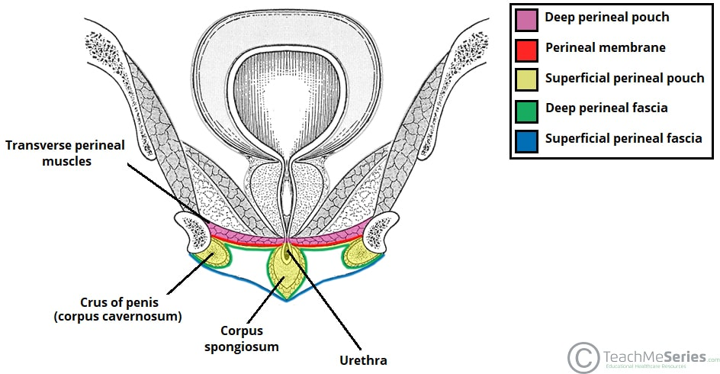
Urogenital triangle
The layers of the urogenital triangle (deep to superficial):
Deep perineal pouch – a potential space between the deep fascia of the pelvic floor (superiorly) and the perineal membrane (inferiorly). It contains part of the urethra, external urethral sphincter, and the vagina in the female. In males, it also contains the bulbourethral glands and the deep transverse perineal muscles.
Perineal membrane – a layer of tough fascia, which is perforated by the urethra (and the vagina in the female). The role of the membrane is to provide attachment for the muscles of the external genitalia.

Slide 38
Superficial perineal pouch – a potential space between the perineal membrane (superiorly) and the superficial perineal fascia (inferiorly). It contains the erectile tissues that form the penis and clitoris, and three muscles – the ischiocavernosus, bulbospongiosus and superficial transverse perineal muscles. The greater vestibular glands (Bartholin’s glands) are also located in the superficial perineal pouch. The pouch is bounded posteriorly to the perineal body.

Slide 39
Perineal fascia – a continuity of the abdominal fascia that has two components:
Deep fascia: covers the superficial perineal muscles and protruding structures (e.g. penis & clitoris).
Superficial fascia is composed of a further two layers of fascia:1.Superficial layer – continuous with Camper’s fascia of the anterior abdominal wall and 2.Deep layer (Colles’ fascia) – continuous with Scarpa’s fascia of the anterior abdominal wall
Skin – The urethral and vaginal orifices open out onto the skin.

Slide 40
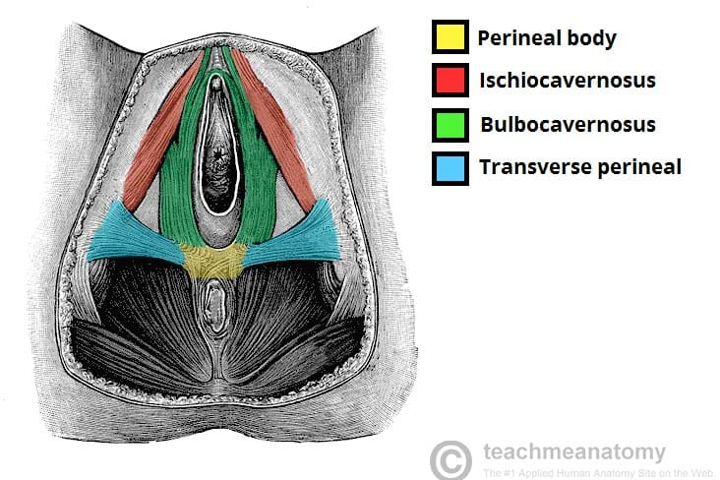
The Perineal Body
The perineal body is an irregular fibromuscular mass. It is located at the junction of the urogenital and anal triangles – the central point of the perineum. This structure contains skeletal muscle, smooth muscle and collagenous and elastic fibres.
Anatomically, the perineal body lies just deep to the skin. It acts as a point of attachment for muscle fibres from the pelvic floor and the perineum itself:
Levator ani (part of the pelvic floor).
Bulbospongiosus muscle.
Superficial and deep transverse perineal muscles.
External anal sphincter muscle.
External urethral sphincter muscle fibres.
In women, it acts as a tear resistant body between the vagina and the external anal sphincter, supporting the posterior part of the vaginal wall against prolapse. In the male, it lies between the bulb of penis and the anus.

Slide 41
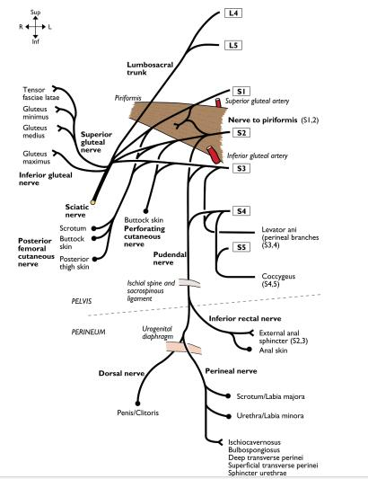
NEUROVASCULAR SUPPLY
Th major neurovascular supply to the perineum is from the pudendal nerve (S2 to S4) and the internal pudendal artery.

Slide 42
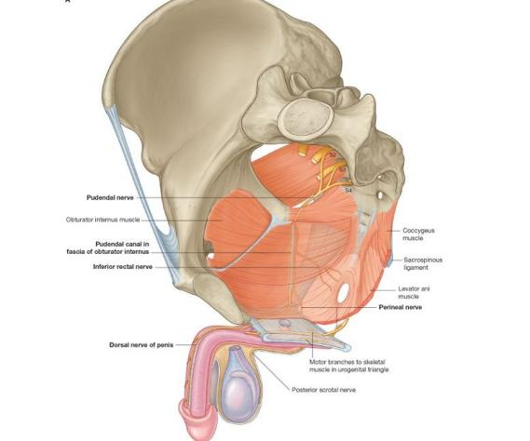
Pudendal nerve
The major somatic nerve of the perineum is the pudendal nerve(S2-S4).
Oringinates from sacral plexus S4. It leaves the pelvic cavity through the greater sciatic foramen inferior to the piriformis muscle, passes around the sacrospinous ligament, and then enters the anal triangle of the perineum by passing medially through the lesser sciatic foramen.

Slide 43
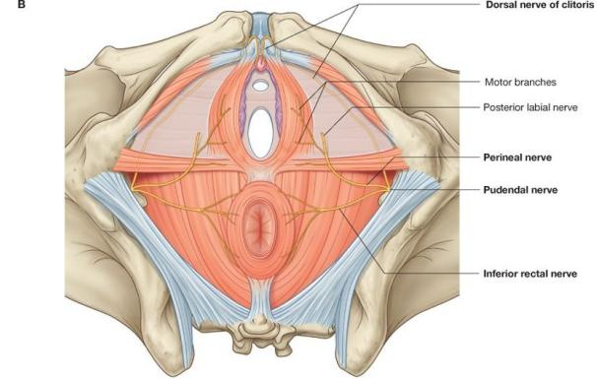
As it enters to the perineum, it travels along the lateral wall of the ischioanal fossa in the pudendal canal, which is a tubular compartment formed in the fascia that covers the obturator internus muscle.
This pudendal canal also contains the internal pudendal artery and accompanying veins.
The pudendal nerve has three major terminal branches-the inferior rectal and perineal nerves, and the dorsal nerve of penis or clitoris-which are accompanied by branches of the internal pudendal artery

Slide 44
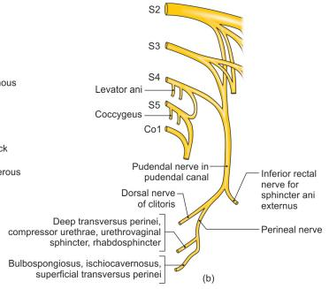
Pudendal nerve
The inferior rectal nerve which innervates the external anal sphincter and related regions of the levator ani muscles and also general sensory for the skin of the anal triangle.
The perineal nerve passes gives rise to motor and cutaneous branches. The motor branches supply skeletal muscles in the superficial and deep perineal pouches. The largest of the sensory branches is the posterior scrotal nerve in men and the posterior labial nerve in women.
The dorsal nerve of penis and clitoris gives branches to the penis and clitoris

Slide 45
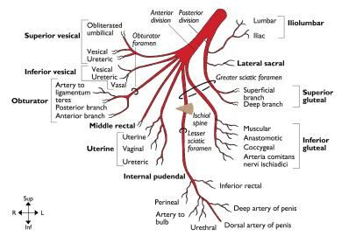
Vessels of the area
The internal pudendal artery originates as a branch of the anterior trunk of the internal iliac artery in the pelvis
Along with the pudendal nerve, it leaves the pelvis through the greater sciatic foramen inferior to the piriformis muscle. It passes around the ischial spine, where the artery lies lateral to the nerve, enters the perineum by coursing through the lesser sciatic foramen, and accompanies the pudendal nerve in the pudendal canal on the lateral wall of the ischio-anal fossa.

Slide 46
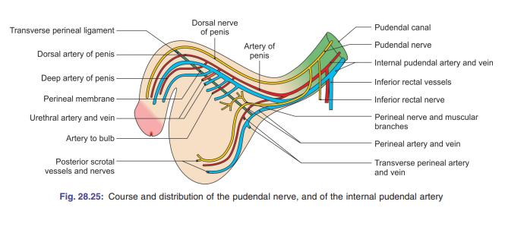
The branches of the internal pudendal artery are similar to those of the pudendal nerve in the perineum and include the inferior rectal and perineal arteries, and branches to the erectile tissues of the penis and clitoris

Slide 47
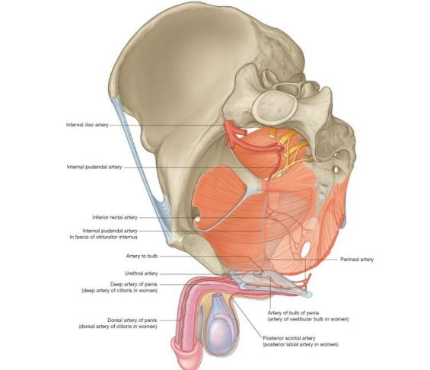
Other arteries of the area
Perineal artery
External pudendal arteries
Testicular and cremasteric arteries

Slide 48
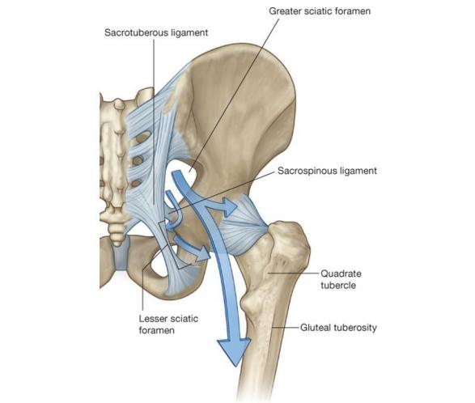
GLUTEAL AREA
The gluteal region is an anatomical area located posteriorly to the pelvic girdle, at the proximal end of the femur. The muscles in this region move the lower limb at the hip joint.
The gluteal region communicates anteromedially with the pelvic cavity and perineum through the greater and lesser sciatic foramina, respectively. Inferiorly, it is continuous with the posterior thigh.

Slide 49
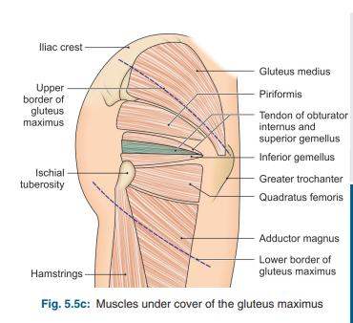
The muscles of the gluteal region can be broadly divided into two groups:
Superficial abductors and extenders – group of large muscles that abduct and extend the femur. Includes the gluteus maximus, gluteus medius, gluteus minimus and tensor fascia lata.
Deep lateral rotators – group of smaller muscles that mainly act to laterally rotate the femur. Includes the quadratus femoris, piriformis, gemellus superior, gemellus inferior and obturator internus.
The arterial supply to these muscles is mostly via the superior and inferior gluteal arteries – branches of the internal iliac artery. Venous drainage follows the arterial supply.

Slide 50
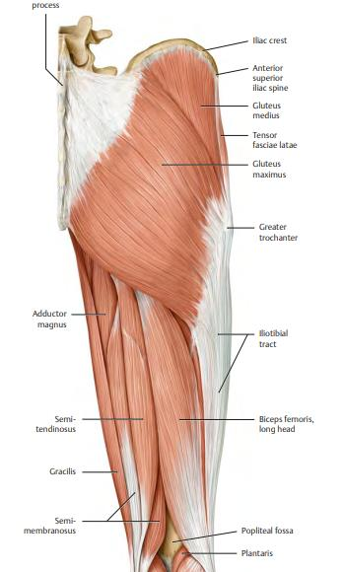
Superficial muscles
The Superficial Muscles
The superficial muscles in the gluteal region consist of the three glutei and the tensor fascia lata. They mainly act to abduct and extend the lower limb at the hip joint.
Gluteus Maximus
The gluteus maximus is the largest of the gluteal muscles. It is also the most superficial, producing the shape of the buttocks.
Attachments: Originates from the gluteal (posterior) surface of the ilium, sacrum and coccyx. The fibres slope across the buttock at a 45 degree angle and insert onto the iliotibial tract and gluteal tuberosity of the femur.
Actions: It is the main extensor of the thigh, and assists with lateral rotation. However, it is only used when force is required, such as running or climbing.
Innervation: Inferior gluteal nerve.

Slide 51
Superficial muscles
Gluteus Medius
The gluteus medius muscle is fan-shaped and lies between to the gluteus maximus and the minimus. It is similar in shape and function to the gluteus minimus.
Attachments: Originates from the gluteal surface of the ilium and inserts into the lateral surface of the greater trochanter.
Actions: Abduction and medial rotation of the lower limb. It stabilises the pelvis during locomotion, preventing ‘dropping’ of the pelvis on the contralateral side.
Innervation: Superior gluteal nerve.

Slide 52
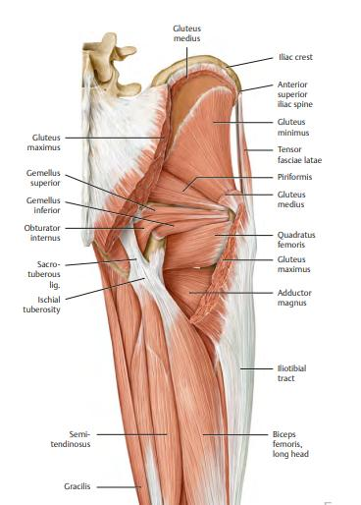
Superficial muscles
Gluteus Minimus
The gluteus minimus is the deepest and smallest of the superficial gluteal muscles. It is similar in shape and function to the gluteus medius.
Attachments: Originates from the ilium and converges to form a tendon, inserting to the anterior side of the greater trochanter.
Actions: Abduction and medial rotation of the lower limb. It stabilises the pelvis during locomotion, preventing ‘dropping’ of the pelvis on the contralateral side.
Innervation: Superior gluteal nerve.

Slide 53
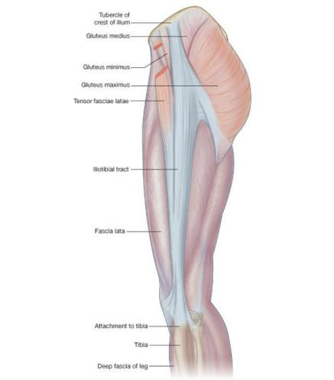
Superficial muscles
Tensor Fascia Lata
Tensor fasciae lata is a small superficial muscle which lies towards the anterior edge of the iliac crest. It functions to tighten the fascia lata, and so abducts and medially rotates the lower limb.
Attachments: Originates from the anterior iliac crest, attaching to the anterior superior iliac spine (ASIS). It inserts into the iliotibial tract, which itself attaches to the lateral condyle of the tibia.
Actions: Assists the gluteus medius and minimus in abduction and medial rotation of the lower limb. It also plays a supportive role in the gait cycle.
Innervation: Superior gluteal nerve.

Slide 54
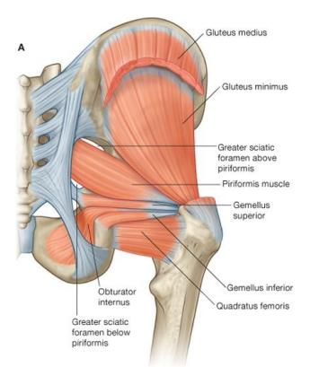
Deep muscles
The deep gluteal muscles are a set of smaller muscles, located underneath the gluteus minimus. The general action of these muscles is to laterally rotate the lower limb. They also stabilise the hip joint by ‘pulling’ the femoral head into the acetabulum of the pelvis.

Slide 55
Deep muscles
Piriformis
The piriformis muscle is a key landmark in the gluteal region. It is the most superior of the deep muscles.
Attachments: Originates from the anterior surface of the sacrum. The fibres travel inferiorly and laterally through the greater sciatic foramen to insert onto the greater trochanter of the femur.
Actions: Lateral rotation and abduction.
Innervation: Nerve to piriformis.

Slide 56
Deep muscles
Obturator Internus
The obturator internus forms the lateral walls of the pelvic cavity. In some texts, the obturator internus and the gemelli muscles are considered as one muscle – the triceps coxae.
Attachments: Originates from the pubis and ischium at the obturator foramen. It travels through the lesser sciatic foramen, and attaches to the greater trochanter of the femur.
Actions: Lateral rotation and abduction.
Innervation: Nerve to obturator internus.

Slide 57
Deep muscles
The Gemelli – Superior and Inferior
The gemelli are two narrow and triangular muscles. They are separated by the obturator internus tendon.
Attachments: The superior gemellus muscle originates from the ischial spine, the inferior from the ischial tuberosity. They both attach to the greater trochanter of the femur.
Actions: Lateral rotation and abduction.
Innervation: The superior gemellus muscle is innervated by the nerve to obturator internus, the inferior gemellus is innervated by the nerve to quadratus femoris.

Slide 58
Deep muscles
Quadratus Femoris
The quadratus femoris is a flat, square-shaped muscle. It is the most inferior of the deep gluteal muscles, located below the gemelli and obturator internus.
Attachments: Originates from the lateral aspect of the ischial tuberosity and attaches to the quadrate tuberosity on the intertrochanteric crest.
Actions: Lateral rotation.
Innervation: Nerve to quadratus femoris.

Slide 59
NERVES OF GLUTEAL REGION
Seven nerves enter the gluteal region from the pelvis through the greater sciatic foramen
the superior gluteal nerve
sciatic nerve
nerve to the quadratus femoris
nerve to the obturator internus
posterior cutaneous nerve of the thigh,
pudendal nerve
inferior gluteal nerve.
An additional nerve, the perforating cutaneous nerve, enters the gluteal region by passing directly through the sacrotuberous ligament.

Slide 60
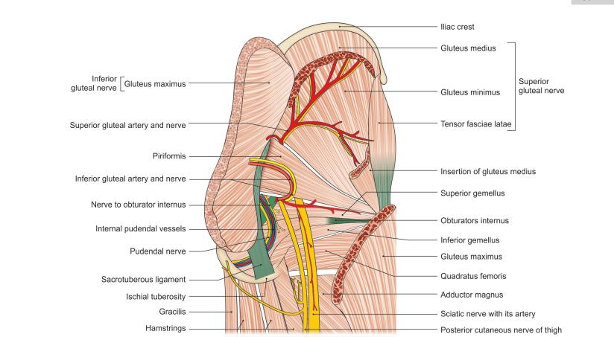
GLUTEAL NERVES
SUPERIOR GLUTEAL NERVE (L4, 5, S1)
Branch of the lumbosacral plexus. It enters the gluteal region through the greater sciatic foramen, above the piriformis, runs forwards between the gluteus medius and minimus, and supplies three muscles, the gluteus medius, the gluteus minimus and the tensor fasciae latae
INFERIOR GLUTEAL NERVE (L5, S1, 2)
Inferior gluteal nerve is also a branch of the sacral plexus.
It enters the gluteal region through the greater sciatic foramen below the piriformis, and ends by supplying the gluteus maximus only.

Slide 61
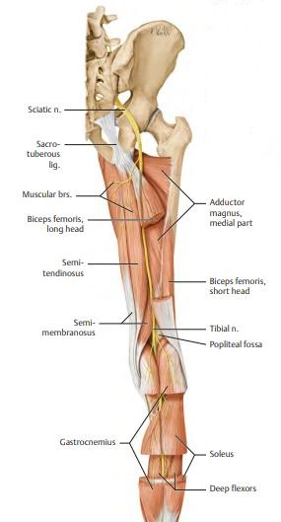
SCIATIC NERVE
Sciatic nerve(L4-S3)
Thickest nerve in the body.
It is the main continuation of the sacral plexus.
Enters the gluteal region through the greater sciatic foramen below the piriformis, runs downwards between the greater trochanter and the ischial tuberosity
At the lower margin of the quadratus femoris muscle, the sciatic nerve enters the posterior thigh. It does not give any branches in the gluteal region

Slide 62
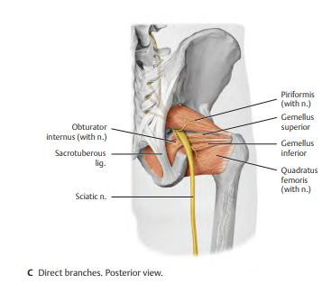
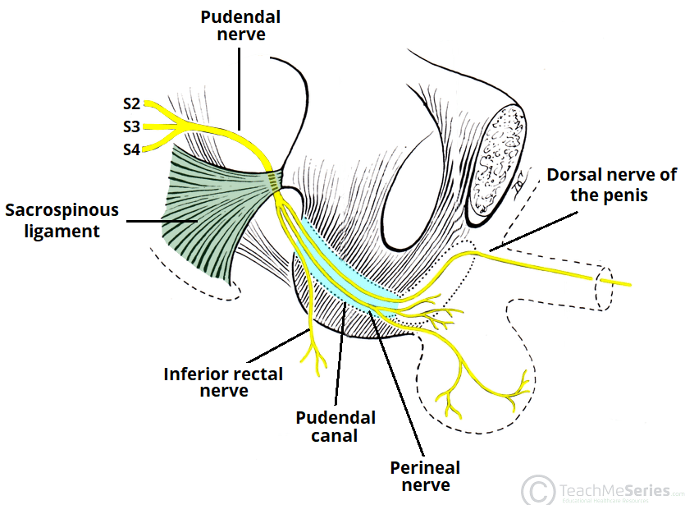
OTHER NERVES
NERVE TO QUADRATUS FEMORIS (L4, 5, S1)
Enters the gluteal region through the greater sciatic foramen below the piriformis, and runs downwards deep to the sciatic nerve, the obturator internus and the gemelli. It supplies the quadratus femoris, the gemellus inferior and the hip joint
PUDENDAL NERVE (S2, 3, 4)
Only a small part of this nerve is seen in the gluteal region.
Enters this region through the greater sciatic foramen. It then crosses the apex or lateral end of the sacrospinous ligament, medial to the internal pudendal vessels. It leaves the gluteal region by passing into the lesser sciatic foramen through which it enters the ischioanal fossa It does not supply any structure in the gluteal region.

Slide 63
OTHER NERVES
NERVE TO THE OBTURATOR INTERNUS (L5, S1, 2)
It enters the gluteal region through the greater sciatic foramen and crosses the ischial spine, lateral to the internal pudendal vessels, to re-enter the pelvis. It supplies both the obturator internus and the gemellus superior muscles
PERFORATING CUTANEOUS NERVE (S2, 3)
It pierces the lower part of the sacrotuberous ligament, winds round the lower border of the gluteus maximus, and supplies the skin of the posteroinferior quadrant of the gluteal region

Slide 64
ARTERIES
Arteries Two arteries enter the gluteal region from the pelvic cavity through the greater sciatic foramen, the inferior gluteal artery and the superior gluteal artery .They supply structures in the gluteal region and posterior thigh and have important collateral anastomoses with branches of the femoral artery.

Slide 65
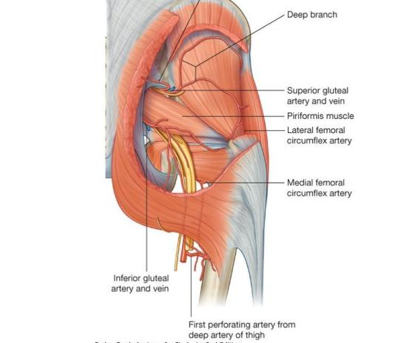
GLUTEAL ARTERIES
Two arteries enter the gluteal region from the pelvic cavity through the greater sciatic foramen, the inferior gluteal artery and the superior gluteal artery.
They supply structures in the gluteal region and posterior thigh and have important collateral anastomoses with branches of the femoral artery.

Slide 66
GLUTEAL ARTERIES
Inferior gluteal artery
Originates from the anterior trunk of the internal iliac artery in the pelvic cavity. It leaves the pelvic cavity with the inferior gluteal nerve through the greater sciatic foramen inferior to the piriformis.
Supplies adjacent muscles and descends through the gluteal region and into the posterior thigh where it supplies adjacent structures and anastomoses with perforating branches of the femoral artery. It also supplies a branch to the sciatic nerve.

Slide 67
GLUTEAL ARTERIES
Superior gluteal artery
Originates from the posterior trunk of the internal iliac artery in the pelvic cavity. It leaves the pelvic cavity with the superior gluteal nerve through the greater sciatic foramen above the piriformis muscle
In the gluteal region, it divides into a superficial branch and a deep branch: the superficial branch passes onto the deep surface of the gluteus maximus muscle; the deep branch passes between the gluteus medius and minimus muscles.

