Slide 1
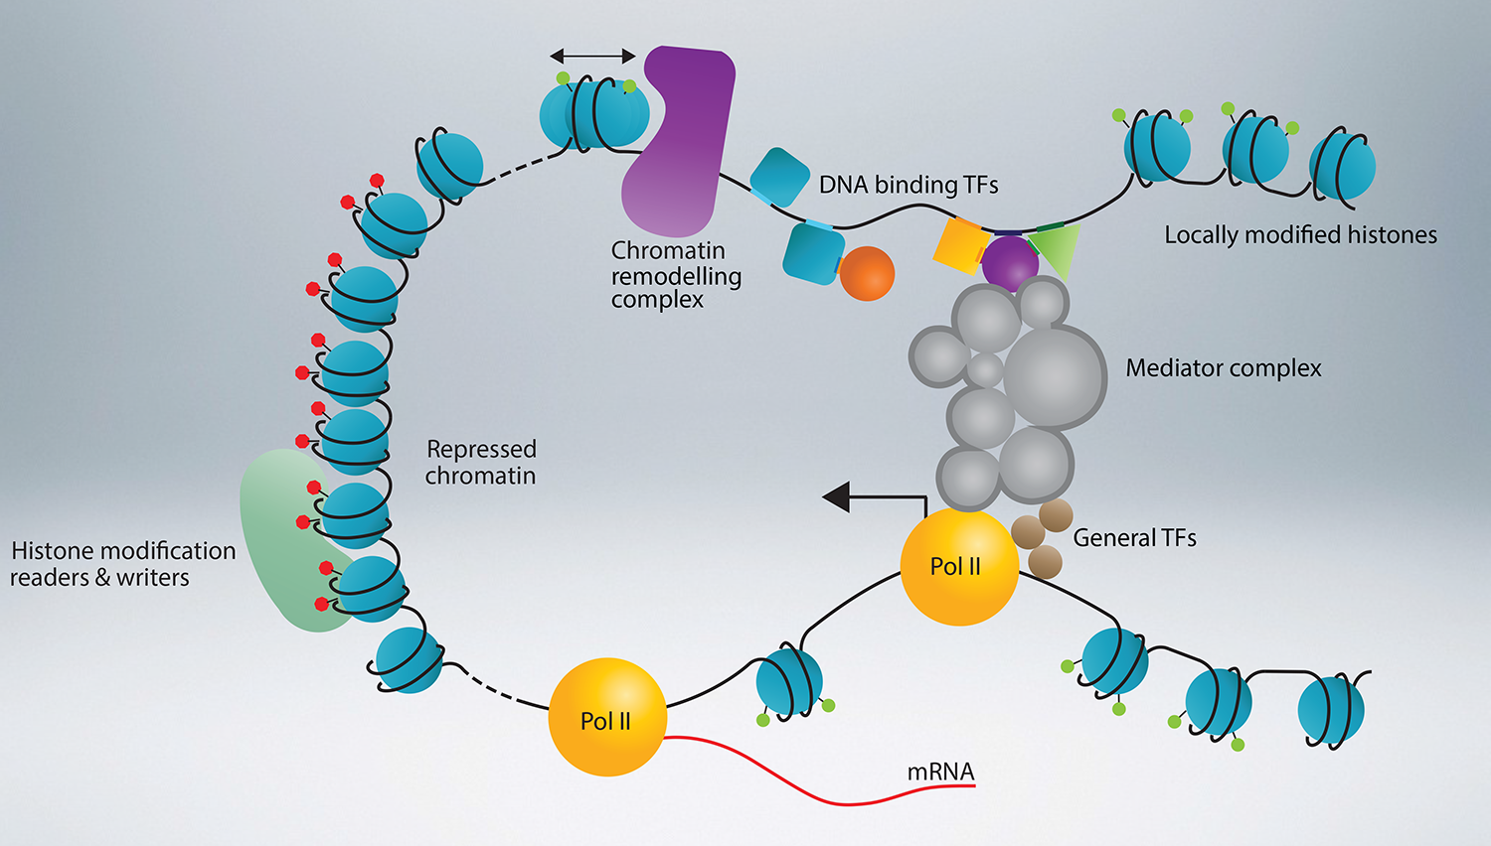
Basic principles of transcriptional regulation in eukaryotic cells
Kostas Papavassiliou MD, PhD
Harvard University
October 2023

Slide 2
Eukaryotic gene

Slide 3
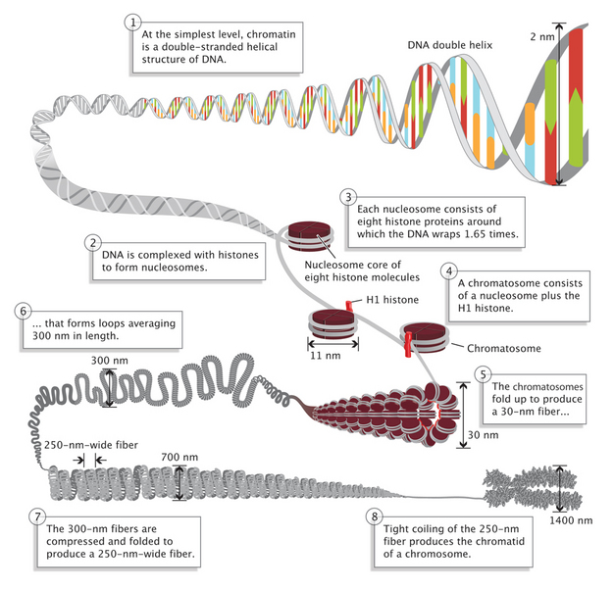
Eukaryotic genome complexity

Slide 4
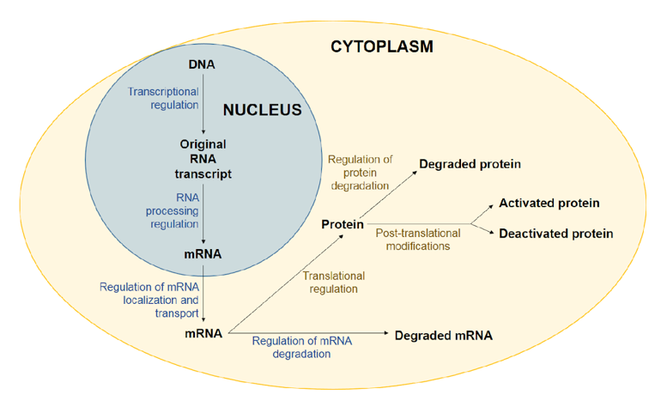
Levels of regulation of gene expression

Slide 5
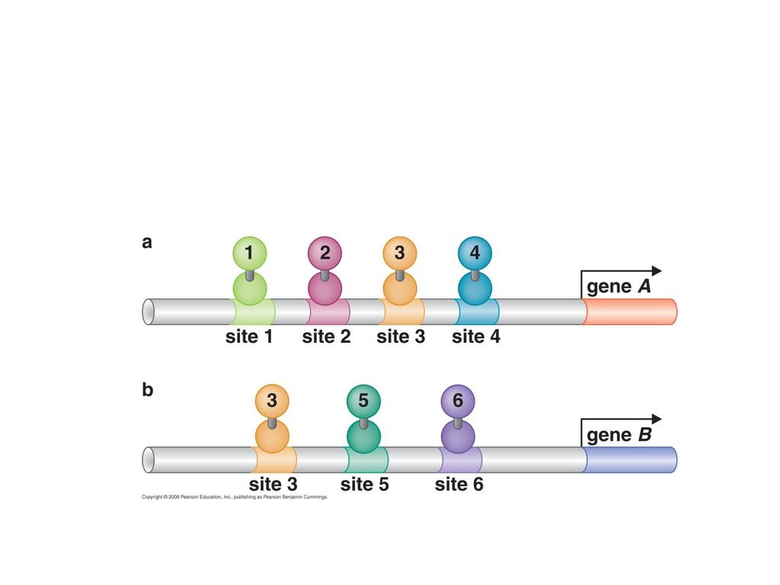
Gene regulation & Combinatorial control

Slide 6
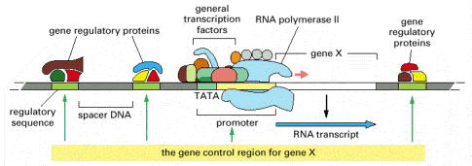
Initiation of transcription
Transcription is regulated by:
General transcription factors (TFs) which recruit and allow
RNA pol Ιl binding at the promoter sequence
Specific TFs which bind at a distance from the promoter at regulatory sequences (enhancers)

Slide 7
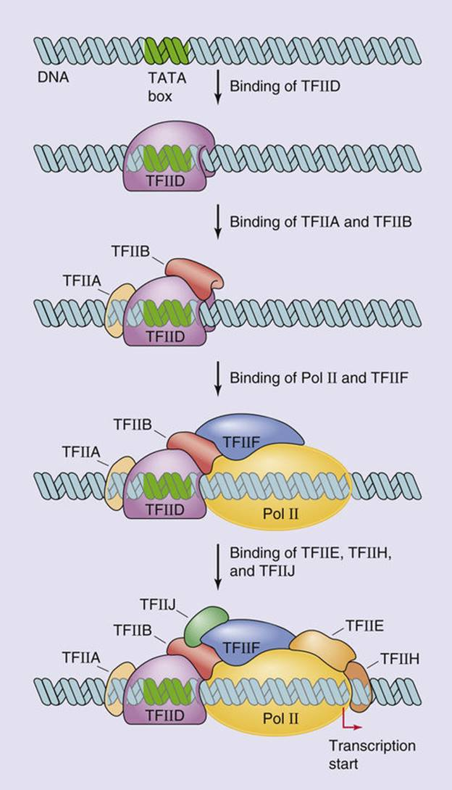
General transcription factors

Slide 8
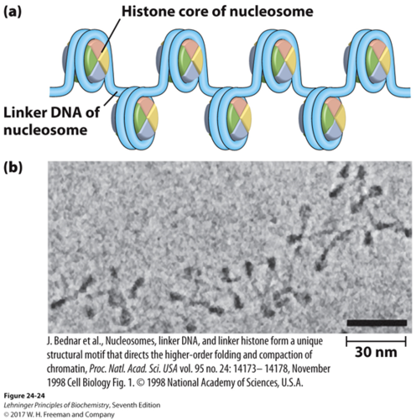
Chromatin

Slide 9
Acetylation

Slide 10
CBP (CREB-Binding Protein) / p300
Function controlled by concentration
Participate in vital cellular processes
Transcriptional coactivators
Acetyltransferase activity
Karamouzis MV et al. Cell Res 2007

Slide 11
CBP (CREB-Binding Protein) / p300
Transactivation
Acetyl-
transferase
Transactivation
NH2-
-COOH
66%
93%
86%
86%
66%
82%
CBP
RID
CH1
KIX
BD
CH2
CH3
SID
QP
2441 a.a.
p300
RID
CH1
KIX
BD
CH2
CH3
SID
QP
2414 a.a.
Nuclear
Receptors
RXR
STAT2
HIF-1
Ets-1
Mdm2
p53
CREB
c-Jun
Elk-1
C-Myb
BRCA1
SREBP
Tax
p53
Elk-1
MyoD
SRC-1
p53
ACTR
Smad
c-Fos
MyoD
E2F
GATA-1
E1A
p53
p73
pCAF
SV40 large T
pp90 RSK
E1A
STAT1
p73
TBP
TBP
c-Jun
Karamouzis MV et al. Cell Res 2007

Slide 12
Transcriptional regulation
Specialized TFs which bind to enhancers act via a distance
upregulating
downregulating transcription
-
+

Slide 13
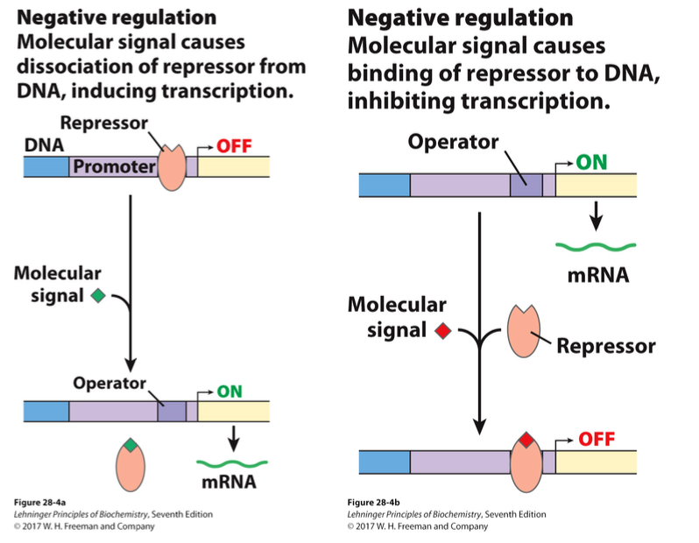
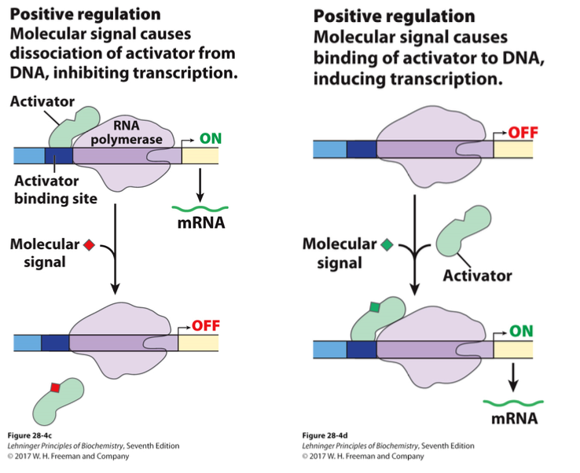
Transcriptional regulation

Slide 14
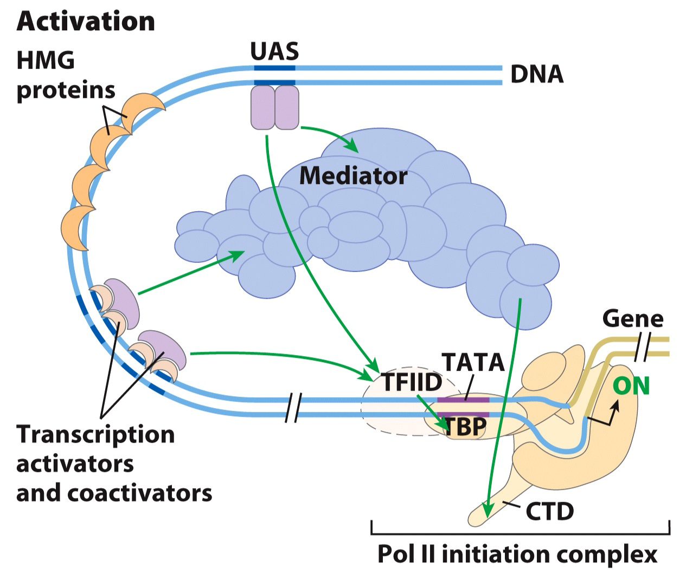
Transcriptional regulation

Slide 15
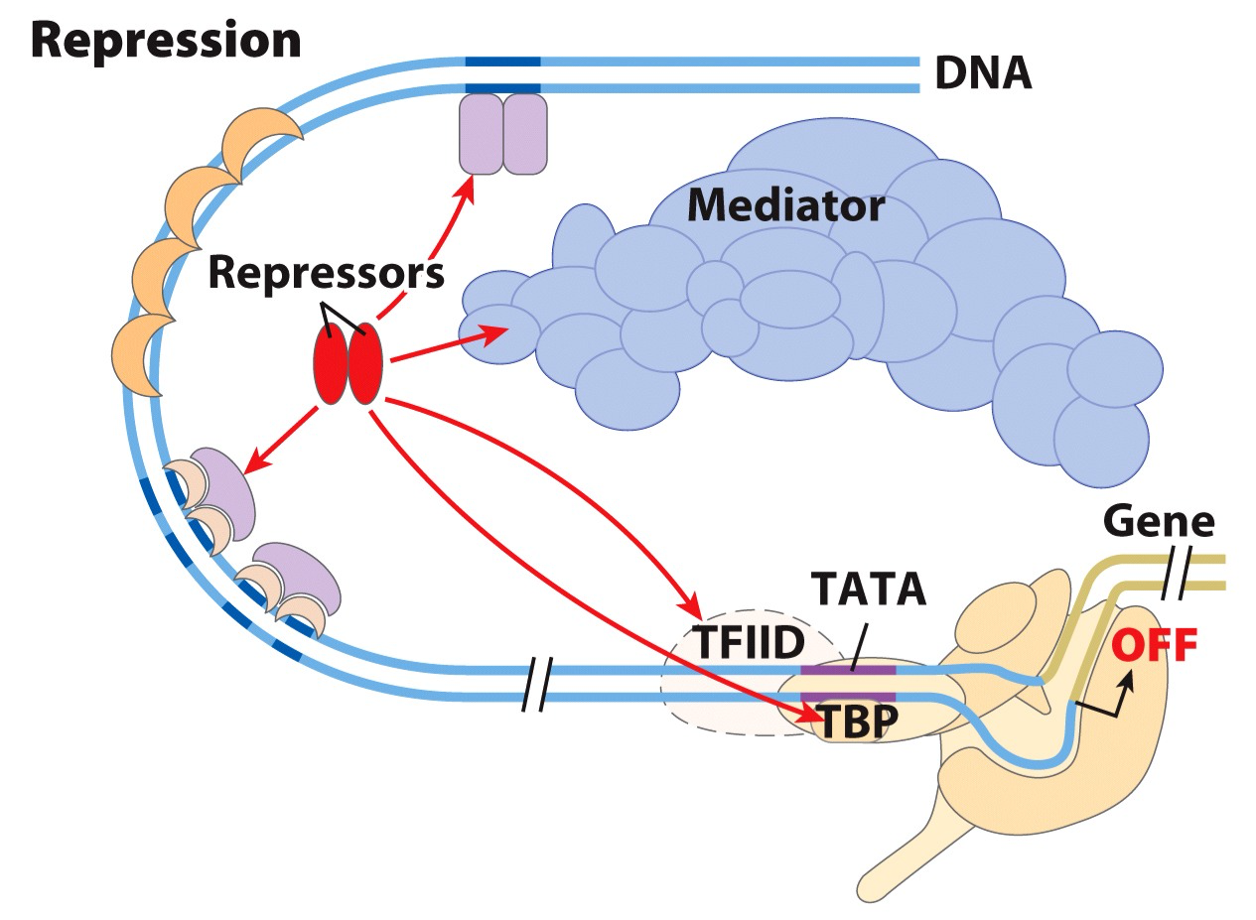
Transcriptional regulation

Slide 16
Prerequisites for successful RNA pol II binding at promoter
Transcriptional activators (specialized TFs)
Architectural regulators
Chromatin remodeling complexes
Co-activators
Basal TFs

Slide 17
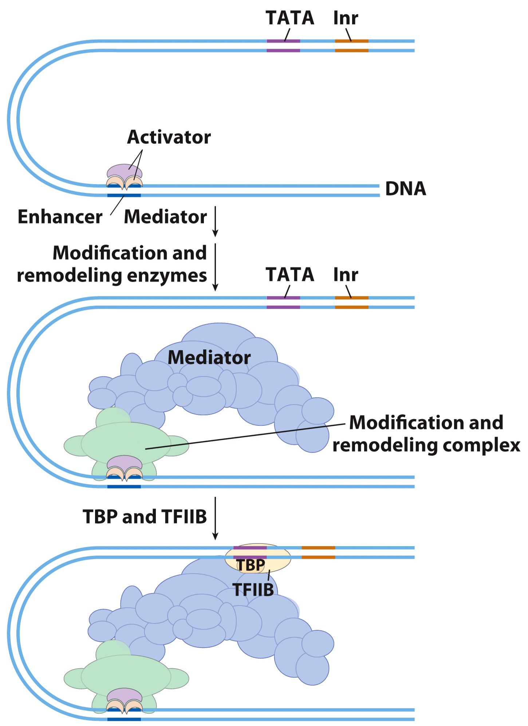
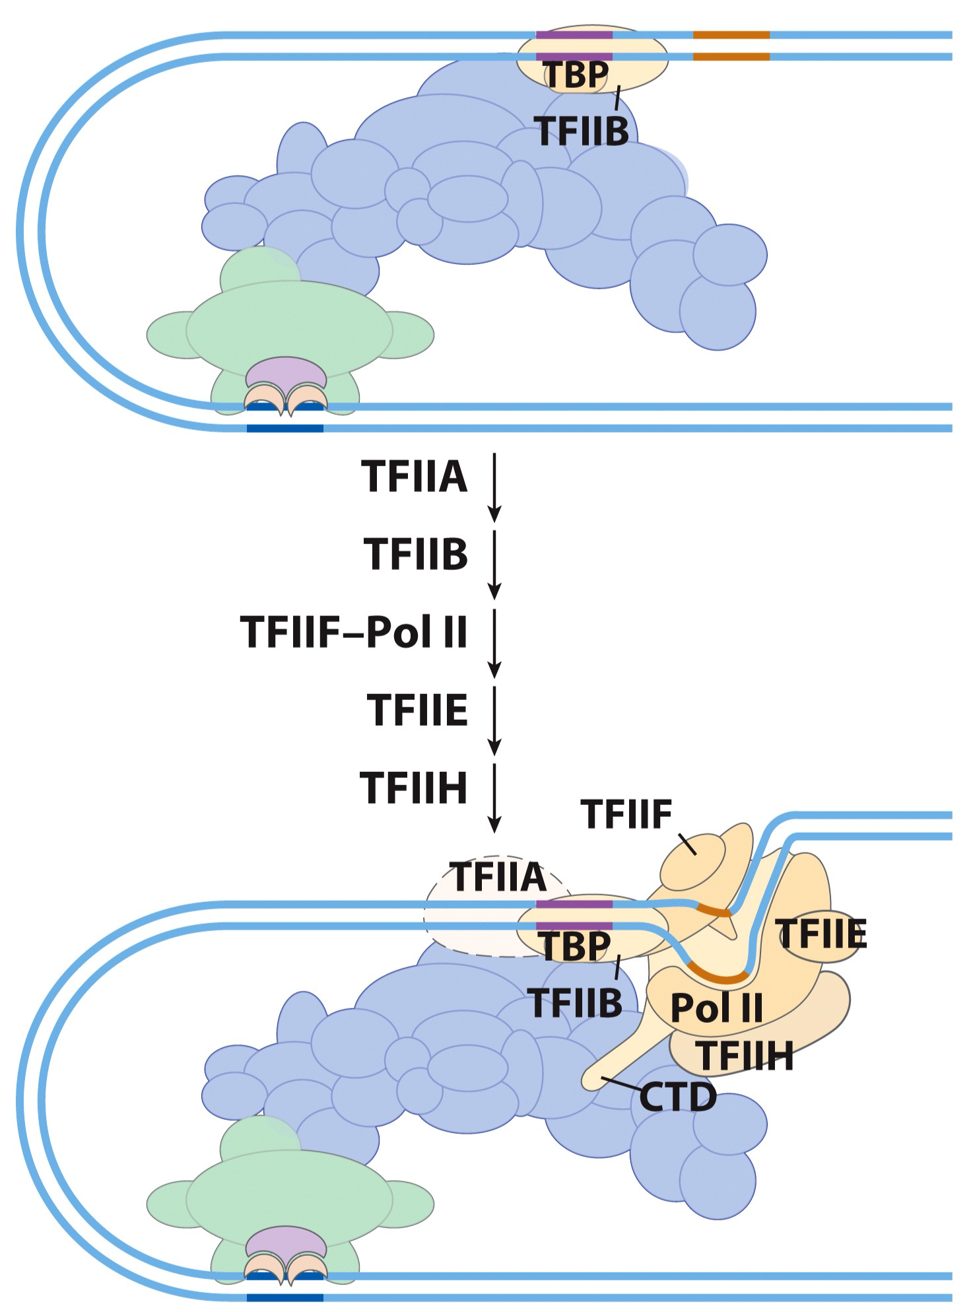
Transcriptional activation

Slide 18
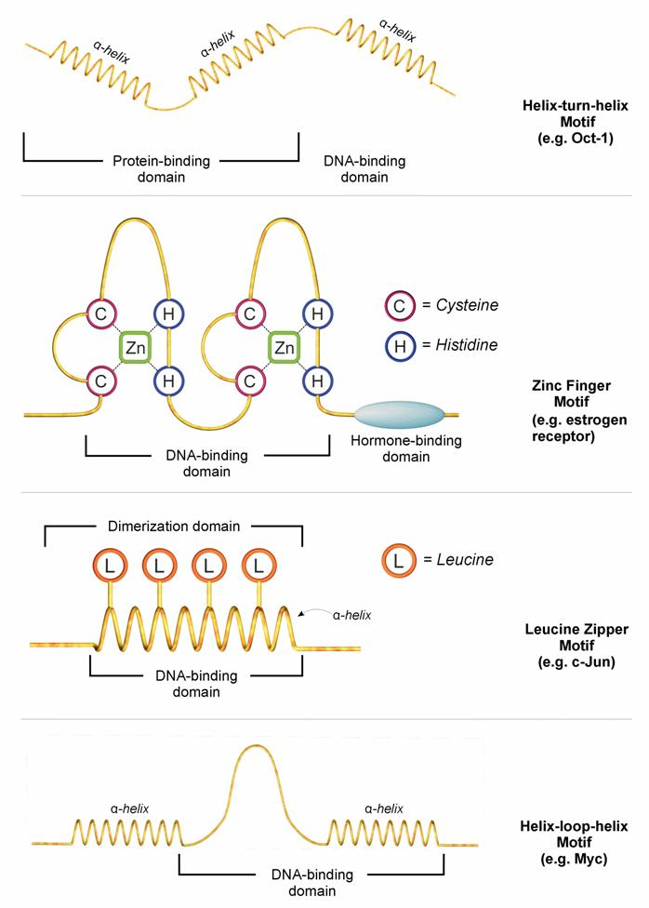
Specialized TFs
Karamouzis M V, Gorgoulis VG
& Papavassiliou AG. Clin Cancer Res 2002;8:949
Notes:
Modes of action of GSTFs (TF) and possible ways in which rationally designed small molecule drugs could influence their function. An NR is taken as an example. In 1, the putative drug may interfere with the nuclear translocation of the TF, precluding its physical contact with DNA/BTA, hence, overall activity. In 2, most TFs need to form dimers/oligomers to be active. The putative drug may prevent the dimerization/oligomerization process, thereby impairing TF activity, although nuclear localization may be accomplished. In 3, after dimerization, TFs bind to promoter/enhancer regions to modulate transcription of respective genes. Drugs designed to hinder DNA binding may result in inhibition of the transcription process. In 4, other potential drugs may interfere selectively with the interplay of TFs with the BTA (pol II and BTFs), leaving DNA binding intact. In 5, a variety of coregulators/mediators, with positive or negative action, has a pertinent role in the activity of several TFs. These “bridging” molecules seem to contribute critically to the DNA-binding and/or transeffecting potential of selective TFs in different cell types, leading to different transcriptional specificities and roles. Revealing the molecular identity of these mediators and their precise mode of action in the TF-DNA-BTA complex may provide unique TF biosurfaces for small molecule drug targeting. Finally, in 6, TF degradation may also be subject to small molecule drug targeting. Enhancing oncogenic TF degradation could minimize its deleterious effects.

Slide 19
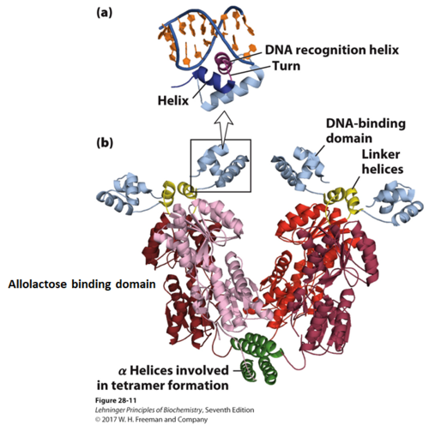
Specialized TFs

Slide 20
Specialized TFs
Karamouzis M V, Gorgoulis VG
& Papavassiliou AG. Clin Cancer Res 2002;8:949
Notes:
Modes of action of GSTFs (TF) and possible ways in which rationally designed small molecule drugs could influence their function. An NR is taken as an example. In 1, the putative drug may interfere with the nuclear translocation of the TF, precluding its physical contact with DNA/BTA, hence, overall activity. In 2, most TFs need to form dimers/oligomers to be active. The putative drug may prevent the dimerization/oligomerization process, thereby impairing TF activity, although nuclear localization may be accomplished. In 3, after dimerization, TFs bind to promoter/enhancer regions to modulate transcription of respective genes. Drugs designed to hinder DNA binding may result in inhibition of the transcription process. In 4, other potential drugs may interfere selectively with the interplay of TFs with the BTA (pol II and BTFs), leaving DNA binding intact. In 5, a variety of coregulators/mediators, with positive or negative action, has a pertinent role in the activity of several TFs. These “bridging” molecules seem to contribute critically to the DNA-binding and/or transeffecting potential of selective TFs in different cell types, leading to different transcriptional specificities and roles. Revealing the molecular identity of these mediators and their precise mode of action in the TF-DNA-BTA complex may provide unique TF biosurfaces for small molecule drug targeting. Finally, in 6, TF degradation may also be subject to small molecule drug targeting. Enhancing oncogenic TF degradation could minimize its deleterious effects.

Slide 21
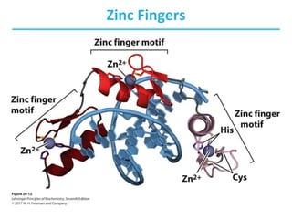
Specialized TFs

Slide 22
Specialized TFs
Karamouzis M V, Gorgoulis VG
& Papavassiliou AG. Clin Cancer Res 2002;8:949
Notes:
Modes of action of GSTFs (TF) and possible ways in which rationally designed small molecule drugs could influence their function. An NR is taken as an example. In 1, the putative drug may interfere with the nuclear translocation of the TF, precluding its physical contact with DNA/BTA, hence, overall activity. In 2, most TFs need to form dimers/oligomers to be active. The putative drug may prevent the dimerization/oligomerization process, thereby impairing TF activity, although nuclear localization may be accomplished. In 3, after dimerization, TFs bind to promoter/enhancer regions to modulate transcription of respective genes. Drugs designed to hinder DNA binding may result in inhibition of the transcription process. In 4, other potential drugs may interfere selectively with the interplay of TFs with the BTA (pol II and BTFs), leaving DNA binding intact. In 5, a variety of coregulators/mediators, with positive or negative action, has a pertinent role in the activity of several TFs. These “bridging” molecules seem to contribute critically to the DNA-binding and/or transeffecting potential of selective TFs in different cell types, leading to different transcriptional specificities and roles. Revealing the molecular identity of these mediators and their precise mode of action in the TF-DNA-BTA complex may provide unique TF biosurfaces for small molecule drug targeting. Finally, in 6, TF degradation may also be subject to small molecule drug targeting. Enhancing oncogenic TF degradation could minimize its deleterious effects.

Slide 23
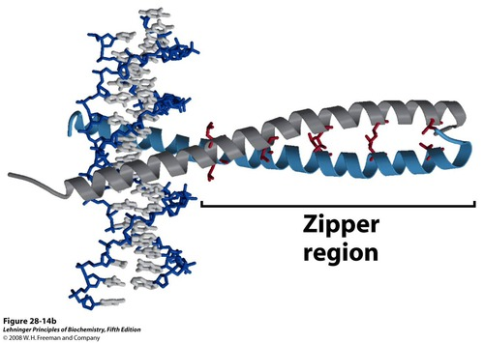
Specialized TFs

Slide 24
Specialized TFs
Karamouzis M V, Gorgoulis VG
& Papavassiliou AG. Clin Cancer Res 2002;8:949
Notes:
Modes of action of GSTFs (TF) and possible ways in which rationally designed small molecule drugs could influence their function. An NR is taken as an example. In 1, the putative drug may interfere with the nuclear translocation of the TF, precluding its physical contact with DNA/BTA, hence, overall activity. In 2, most TFs need to form dimers/oligomers to be active. The putative drug may prevent the dimerization/oligomerization process, thereby impairing TF activity, although nuclear localization may be accomplished. In 3, after dimerization, TFs bind to promoter/enhancer regions to modulate transcription of respective genes. Drugs designed to hinder DNA binding may result in inhibition of the transcription process. In 4, other potential drugs may interfere selectively with the interplay of TFs with the BTA (pol II and BTFs), leaving DNA binding intact. In 5, a variety of coregulators/mediators, with positive or negative action, has a pertinent role in the activity of several TFs. These “bridging” molecules seem to contribute critically to the DNA-binding and/or transeffecting potential of selective TFs in different cell types, leading to different transcriptional specificities and roles. Revealing the molecular identity of these mediators and their precise mode of action in the TF-DNA-BTA complex may provide unique TF biosurfaces for small molecule drug targeting. Finally, in 6, TF degradation may also be subject to small molecule drug targeting. Enhancing oncogenic TF degradation could minimize its deleterious effects.

Slide 25
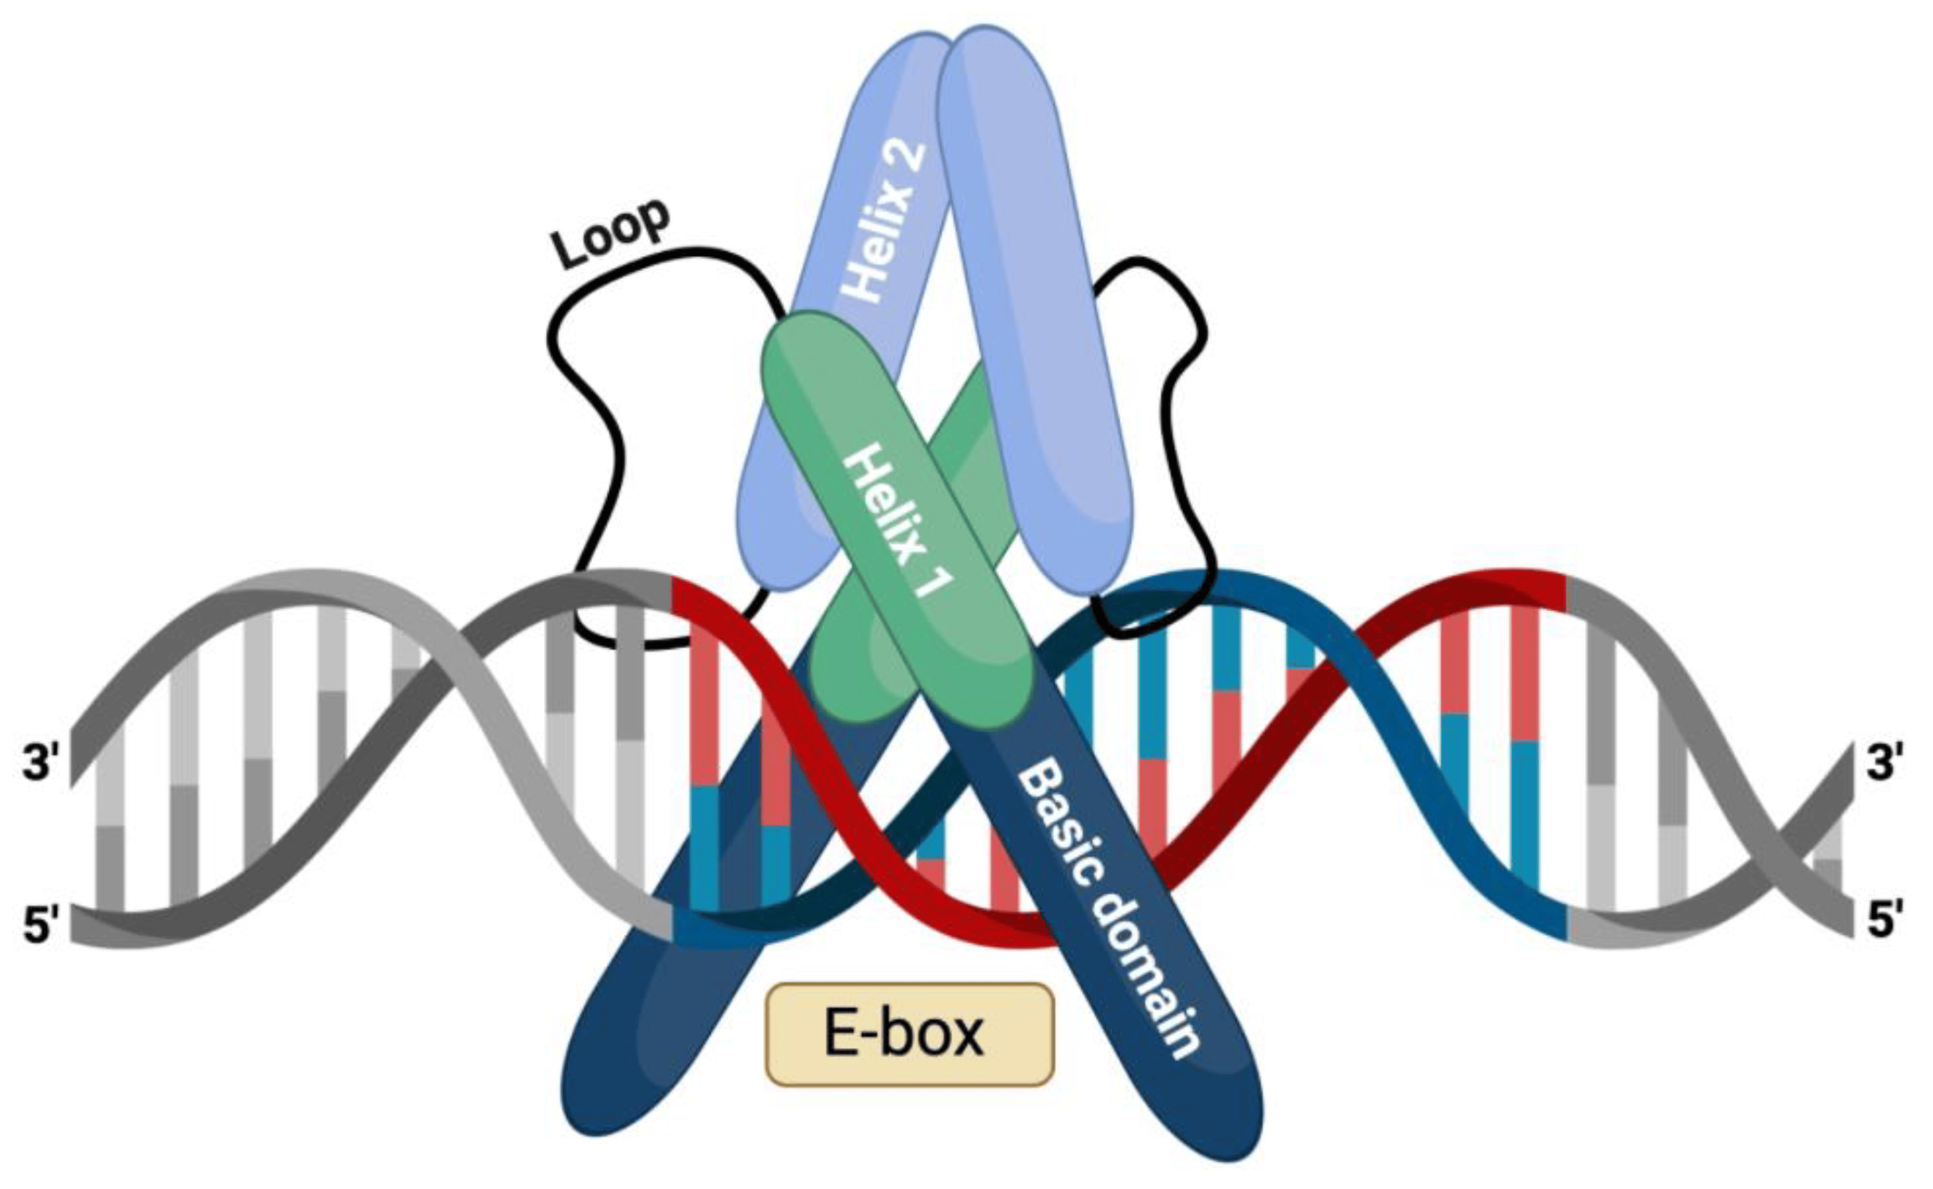
Specialized TFs

Slide 26
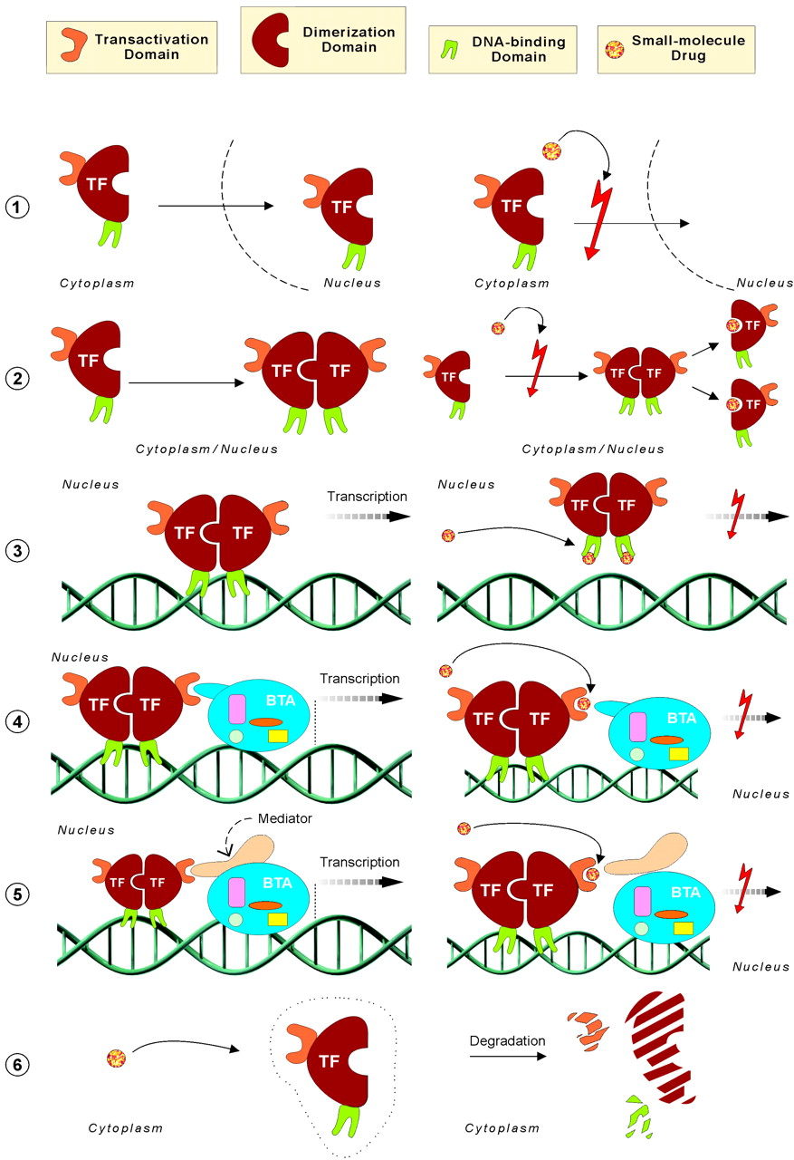
TF drug targeting
Karamouzis M V, Gorgoulis VG
& Papavassiliou AG. Clin Cancer Res 2002;8:949
Notes:
Modes of action of GSTFs (TF) and possible ways in which rationally designed small molecule drugs could influence their function. An NR is taken as an example. In 1, the putative drug may interfere with the nuclear translocation of the TF, precluding its physical contact with DNA/BTA, hence, overall activity. In 2, most TFs need to form dimers/oligomers to be active. The putative drug may prevent the dimerization/oligomerization process, thereby impairing TF activity, although nuclear localization may be accomplished. In 3, after dimerization, TFs bind to promoter/enhancer regions to modulate transcription of respective genes. Drugs designed to hinder DNA binding may result in inhibition of the transcription process. In 4, other potential drugs may interfere selectively with the interplay of TFs with the BTA (pol II and BTFs), leaving DNA binding intact. In 5, a variety of coregulators/mediators, with positive or negative action, has a pertinent role in the activity of several TFs. These “bridging” molecules seem to contribute critically to the DNA-binding and/or transeffecting potential of selective TFs in different cell types, leading to different transcriptional specificities and roles. Revealing the molecular identity of these mediators and their precise mode of action in the TF-DNA-BTA complex may provide unique TF biosurfaces for small molecule drug targeting. Finally, in 6, TF degradation may also be subject to small molecule drug targeting. Enhancing oncogenic TF degradation could minimize its deleterious effects.

