Slide 1

Carcinogenesis
Signal Transduction
Michalis V. Karamouzis MD, PhD
Medical Oncologist
Professor
Medical School
National and Kapodistrian University of Athens
October 2023

Slide 2

Cancer Cell Basic Features
Self-sufficiency of proliferation signals
Un-responsiveness in anti-proliferative signals
Apoptosis
Neo-angiogenesis
Invasion & Metastasis
Uncontrolled cellular proliferation
Hanahan & Weinberg, Cell 2011;144:646
Notes:
Through these “hallmarks” or features of cancer cells, tumors are able to proliferate with limitless replicative potential, enabling tumors to grow, invade, and metastasize.
Adapted from Hanahan and Weinberg. Cell. 2000;100:58.

Slide 3
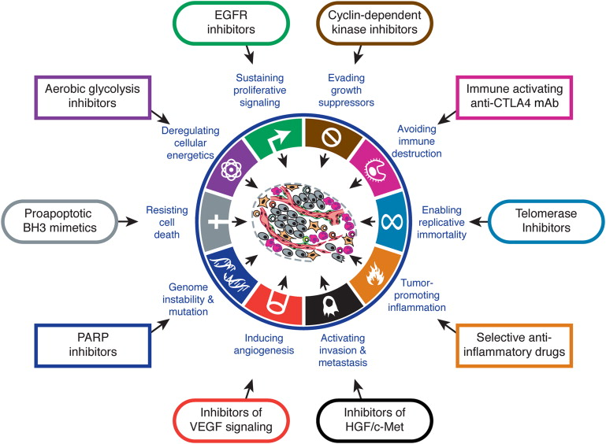
Cancer Cell Basic Features
Hanahan & Weinberg, Cell 2011;144:646

Slide 4
Normal-appearing
epithelium
Pre-malignant
lesions
Invasive
carcinoma
Metastatic
carcinoma
Apoptosis
Angiogenesis
Differentiation
EMT
Proliferation
ECM
Invasion
Signal transduction
to the nucelus
Membrane /
Cytoplasm
Nucleus
Co-factors
TFs
BTM
Target gene transcription
DNA
Targeted agents
Chemotherapy /
Radiotherapy
Context-dependent TF targeting
Targeted agents
Future TF-directed strategies
Current TF-directed strategies
Karamouzis & Papavassiliou. Mol Med 2011;17:1133

Slide 5
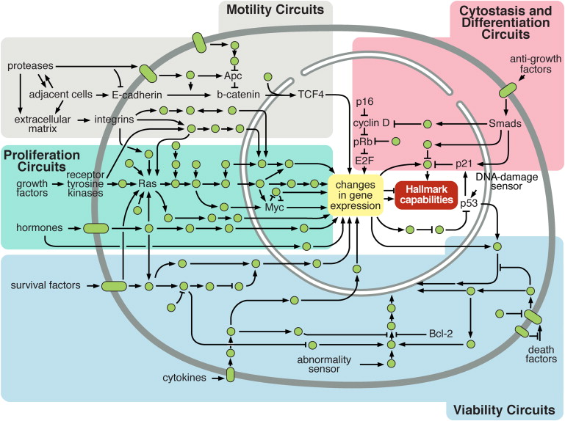
Cancer Cell Basic Features
Hanahan & Weinberg, Cell 2011;144:646

Slide 6
Signal Transduction

Slide 7
Signal Transduction

Slide 8
Signal Transduction
Receptor tyrosine kinases. Growth factor receptors that initiate signals through Tyr kinase activity
include those for insulin (INSR), vascular epidermal growth factor (VEGFR), platelet-derived growth factor (PDGFR),
epidermal growth factor (EGFR), high-affinity nerve growth factor (TrkA), and fibroblast growth factor (FGFR). All these
receptors have a Tyr kinase domain on the cytoplasmic side of the plasma membrane (blue). The extracellular domain is
unique to each type of receptor, reflecting the different growth-factor specificities. These extracellular domains are
typically combinations of structural motifs such as cysteine- or leucine-rich segments and segments containing one of
several motifs common to immunoglobulins (Ig). Many other receptors of this type are encoded in the human genome, each
with a different extracellular domain and ligand specificity.

Slide 9
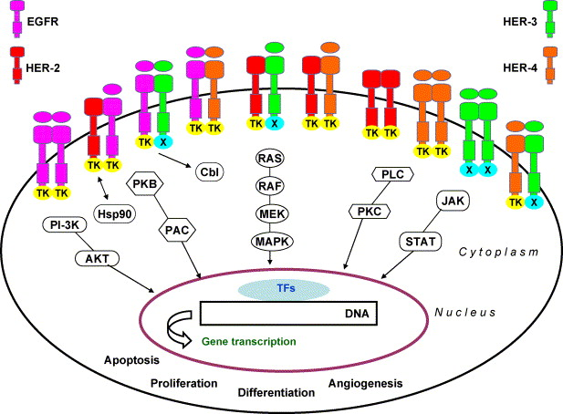
ERΒB Receptor Family
Karamouzis MV et al. Int J Biochem Cell Biol 2007;39:851

Slide 10
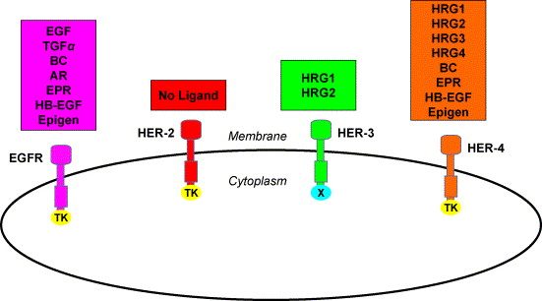
ERΒB Receptor Family
ΤΚ: Tyrosine Kinase Activity
AR: Amphiregulin; BC: Betacellulin; EPR: Epiregulin; HB-EGF: Heparin-binding EGF-like
ligand; HRG: Heregulin
Karamouzis MV et al. Int J Biochem Cell Biol 2007;39:851

Slide 11
ERΒB Receptor Family
Karamouzis MV et al. Int J Biochem Cell Biol 2007;39:851

Slide 12
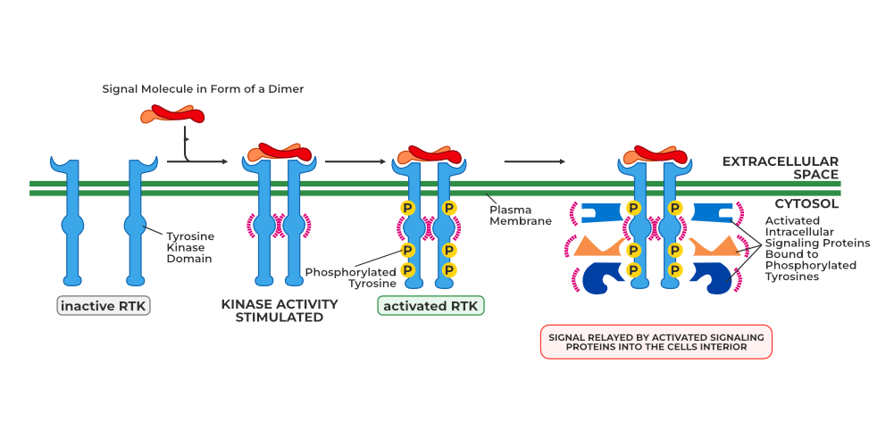
Signal Transduction with Growth Factors

Slide 13
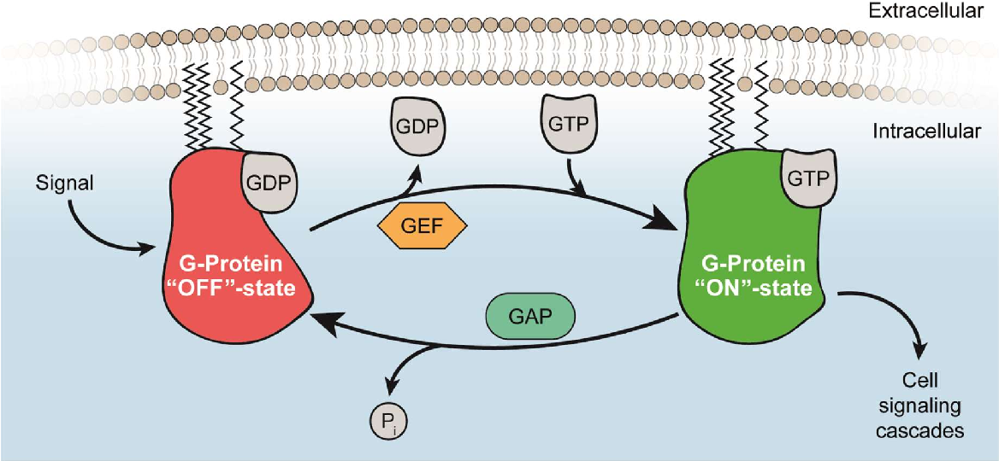
Signal Transduction with Growth Factors

Slide 14
Signal Transduction with Growth Factors
Some binding modules of signaling proteins. Each protein is represented by a line (with the amino
terminus to the left); symbols indicate the location of conserved binding domains (with specificities as listed in the key;
abbreviations are explained in the text); green boxes indicate catalytic activities. The name of each protein is given at its
carboxyl-terminal end. These signaling proteins interact with phosphorylated proteins or phospholipids in many permutations and combinations to form integrated signaling complexes.

Slide 15
Signal Transduction with Growth Factors
A scaffold protein from yeast that organizes and regulates a protein kinase cascade. (a) The
scaffold protein KSR has binding sites for all three of the kinases in the Raf-MEK-Erk cascade. With the binding of all
three in appropriate orientations, interactions among the proteins are rapid and efficient. When Erk has been activated
(left), it phosphorylates the binding site for Raf (right), forcing a conformational change that displaces Raf and thereby
prevents the phosphorylation of MEK. The result of this feedback regulation is that MEK phosphorylation is temporary. (b) In yeast cells with mutant KSR lacking the phosphorylation sites (red curve), no feedback occurs, producing a different time course of signaling.

Slide 16
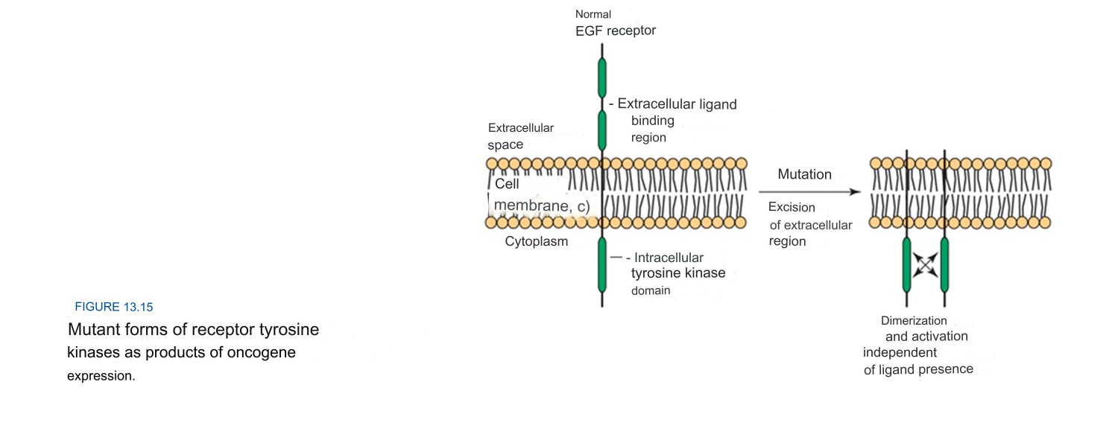
ERΒB Receptor Family

Slide 17
EGFR expression in various tumors
Tumor Type | Frequency of EGFR Expression, %
Lung | 40-80
Head and neck | 80-100
Esophageal | 43-89
Breast | 14-91
Colorectal | 25-77
Pancreatic | 30-50
Bladder | 31-48
Prostate | 65
Cervical/uterus | 90
Ovarian | 35-70
Renal cell | 50-90

Slide 18
EGFR Activation Process
Πρόσδεμα
P
P
P
P
Degradation or
reexpression
P
P
P
P
Cell-cycle progression
P
P
Survival
P
P
Proliferation
Notes:
Signal transduction through the ErbB receptors proceeds through an ordered, multistep process.¹
The first step requires expression of the receptor on the cell surface as well as expression of the appropriate ligand, either by the same cell or by a neighboring cell.
When both ligand and receptor are in close proximity, binding can occur.
Interaction of ligand with the receptor causes receptor pairing, or dimerization. This interaction can occur between 2 of the same receptor (homodimerization) or between 2 different ErbB family members (heterodimerization).
Receptor dimerization leads to activation of the intrinsic tyrosine kinase activity of the receptors, which results in transphosphorylation of the cytoplasmic tails, creating docking sites for downstream signaling molecules.
5. The interaction of downstream signaling molecules with the receptor tails leads to the formation of a signaling complex. This triggers additional phosphorylation events and sets off a signaling cascade that activates downstream pathways including MAPK/ERK and PI3K/Akt, producing outcomes such as cell-cycle progression, proliferation, and survival.
6. Activation of the ErbB receptors also triggers receptor internalization in a process that involves endocytosis in clathrin-coated pits.
7. Internalized receptors are either degraded within endosomal compartments, or recycled and returned to the cell surface. Sorting is based primarily on dimer composition. Homo- or heterodimers containing ErbB-1 are generally targeted for degradation, those containing ErbB3 are recycled, and those containing ErbB2 experience slower rates of endocytosis and increased recycling to the cell surface.
1. Yarden Y, Sliwkowski MX. Untangling the ErbB signalling network. Nat Rev Mol Cell Biol 2001; 2:127-37.

Slide 19
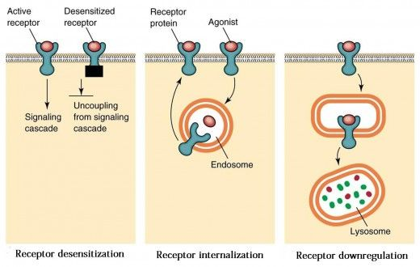
Signal Transduction with Growth Factors

Slide 20
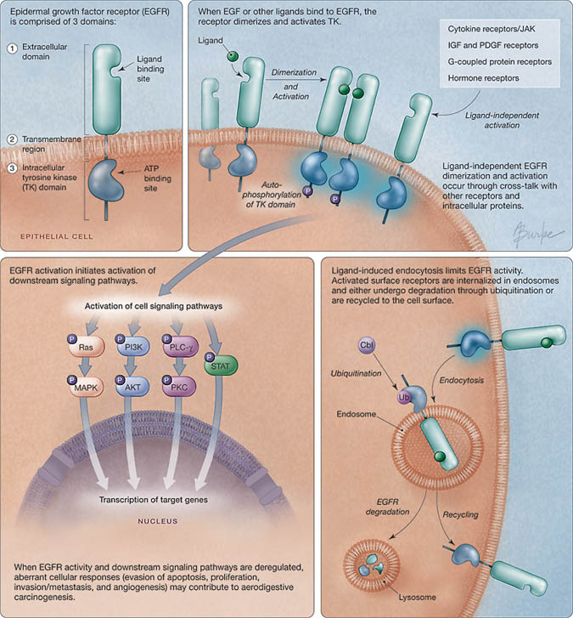
EGFR activation, processing signalling and trafficking
Karamouzis, Grandis
& Argiris
JAMA 2007;298:70

Slide 21
Complexity Levels of EGFR action by cell / tissue
Specifity by tissue and/or cell?
Expression / Μutations
Type of Ligand
MESSAGE
TRANSDUCTION
TO THE
NUCLEUS
Type of Dimer
Dimer Re-distribution
Activated Pathways
Cross-talk with other pathways

Slide 22
Therapeutic Strategies against EGFR
MA AGAINST EXTRACELLULAR DOMAIN
    IMC-225 (Cetuximab)
    ABX-EGF (Panitumumab)
    EMD 72000, h-R3, κ.α.
TOXIC LIGANDS / IMMUNOCONJUGATES
ΤΚ INHIBITORS OF THE INTRACELLULAR DOMAIN
NUCLEIC ACID-BASED GENE SILENCING MOLECULES
    Antisense oligonucleotides (ΑΟΝ)
    Riboenzymes
    siRNAs
https://www.youtube.com/watch?v=amEbIIwO1EM

Slide 23
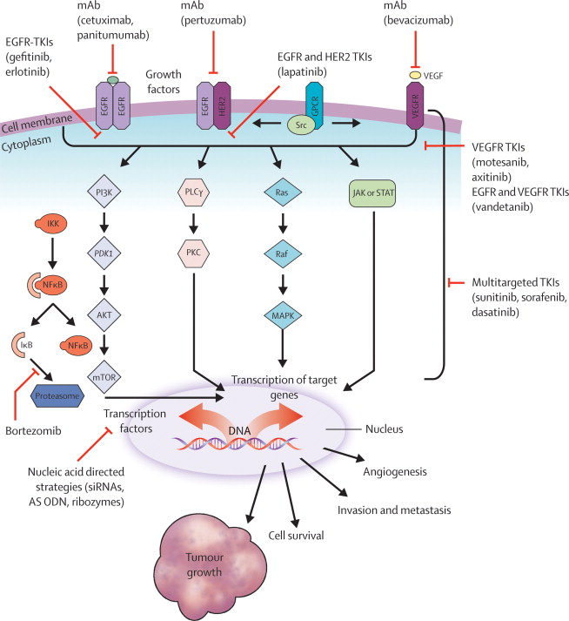
Molecular signalling pathways and novel targeted agents
Karamouzis, Argiris,
Raben & Ferris
Lancet 2008;371:1695

Slide 24
EGFR Inhibitors Actions
Cellular Cycle arrest in G1 phase
Apoptosis induction (modulation of the levels of pro- and anti-apoptotic proteins)
Negatively affect neo-angiogenesis (de-regulation of the expression of VEGF and other molecules)
Impact DNA damage repair mechanisms

Slide 25
ERΒB Receptor Family
Karamouzis MV et al. Int J Biochem Cell Biol 2007;39:851

Slide 26
ERΒB Receptor Family
Almost 15-20% of breast carcinomas over-express HER-2 protein
Normal (1x)
~ 25,000-50,000 HER-2 receptors
HER-2 over-expression (10-100x)
Up to ~ 2,000,000
HER-2 receptors
Un-controlled cellular proliferation
Notes:
The HER2 subtype of breast cancer, defined by amplification of the HER2 gene, represents 20% to 25% of breast cancers, and this number is relatively consistent worldwide. When the HER2 gene is amplified, the number of HER2 receptors expressed in the cell increases. As shown in the upper left-hand corner of this slide, a normal cell or a breast cancer cell without the HER2 alteration typically expresses 20,000-50,000 receptors per cell-surface membrane. However, as shown in the center of this slide, HER2 amplification in a tumor cell results in a commensurate overexpression of the receptor and the expression of 2 million or more HER2 receptors per cell in some patients. In general, there is a 2 log increase in the number of receptors displayed on tumor cells when the HER2 alteration is present, which has several phenotypic consequences. Compared with a HER2-normal cell, a HER2-overexpressing cell:
Has a significantly increased growth rate (as shown in the bottom right-hand corner of this slide)
Has a significantly increased ability to form tumors in experimental mice
Displays an increased ability to form metastatic deposits in animal models owing to an increase in cellular motility
Begins to secrete high levels of vascular endothelial growth factor (VEGF) to support metastatic growth
When making therapeutic decisions, it is important to keep in mind that HER2-overexpressing cells are frequently estrogen receptor and progesterone receptor positive, like in the case patient’s tumor. Although estrogen receptor– and progesterone receptor–positive breast cancers are likely responsive to hormonal therapy, response rates decrease significantly with hormonal therapy alone when the HER2 alteration is present.
1. Rowinsky. Annu Rev Med. 2004;55:433.
2. Slamon et al. Science. 1987;235:177.
3. Pegram et al. Cancer Treat Res. 2000;103:57.

Slide 27
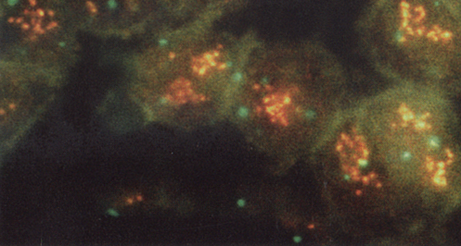
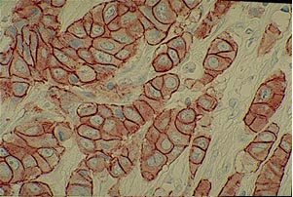
ERΒB Receptor Family
HER2 gene
amplification
FISH
Patients’ Medium Survival
HER-2 positive 3 years
HER-2 normal 6–7 years
HER2-positive protein overexpression
IHC
Slamon D, et al. Science 1987; 235:177–182;
Pauletti, G et al. J Clin Oncol 2000; 18:3651–3664.
Notes:
Seminal discovery

Slide 28
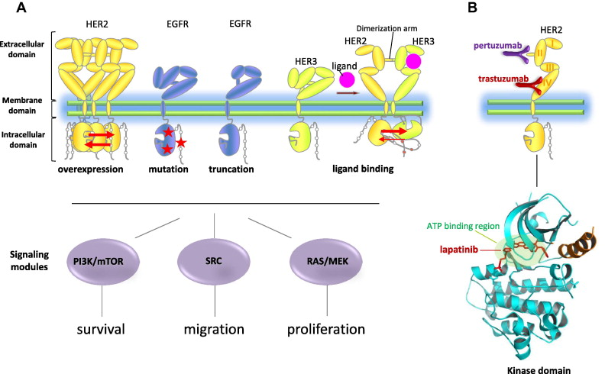
Therapeutic Strategies against HER-2 receptor
Ocana et al. Cancer Treat Rev 2013;39:68

Slide 29
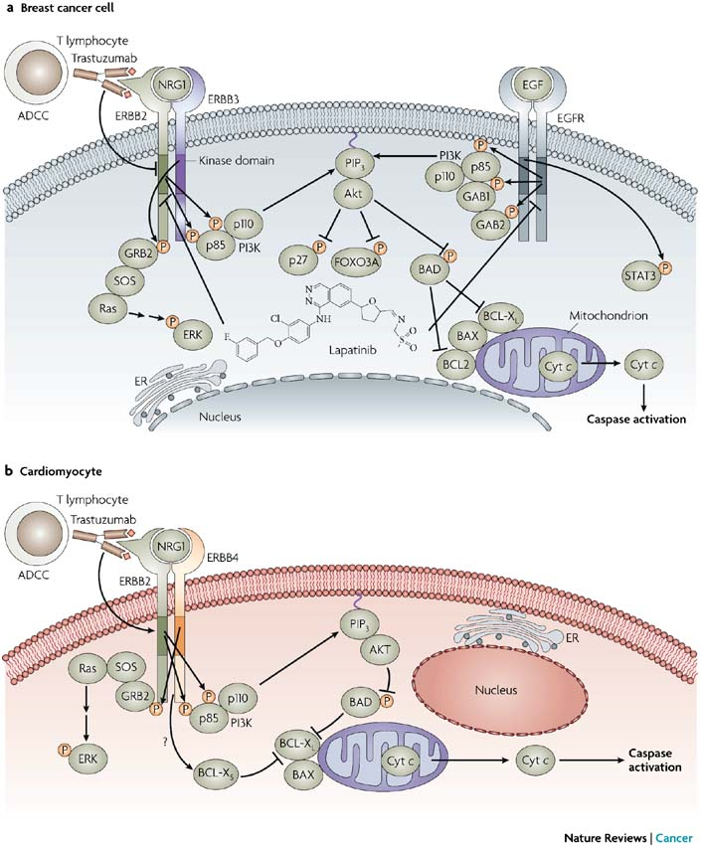
Trastuzumab
Mechanism of Action & Toxicity
Force T et al. Nat Rev Cancer 2007;7:332

Slide 30














Therapeutic Strategies against HER-2 receptor
_{Homodimers}
_{Heterodimers}
_{HER1:HER1}
_{HER2:HER2}
_{HER3:HER3}
_{HER4:HER4}
_{HER1:HER2}
_{HER1:HER3}
_{HER1:HER4}
_{HER2:HER3}
_{HER2:HER4}
_{HER3:HER4}
+
+
+
+
+
+
+
+
+
+
+
+
+
+
+
+
+
+
Most common and most potent oncogenic dimer in
HER2-positive breast cancer
Signalling activity

Slide 31
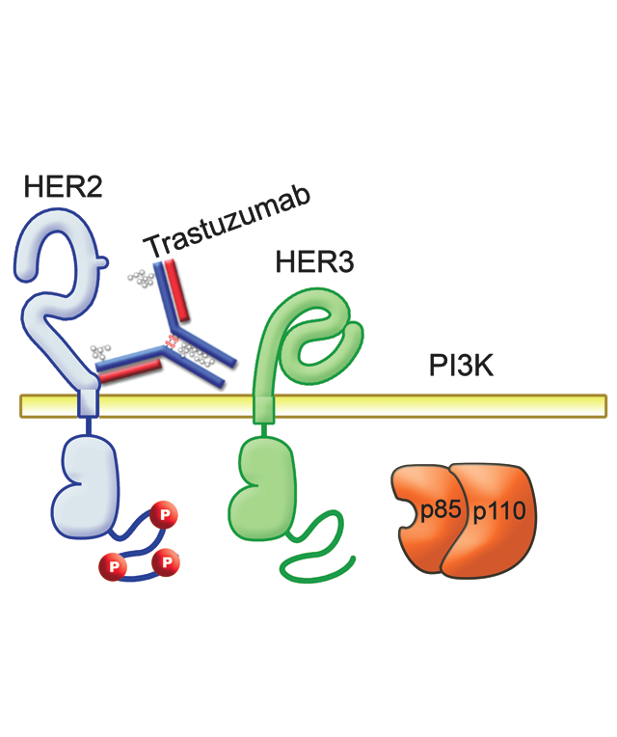
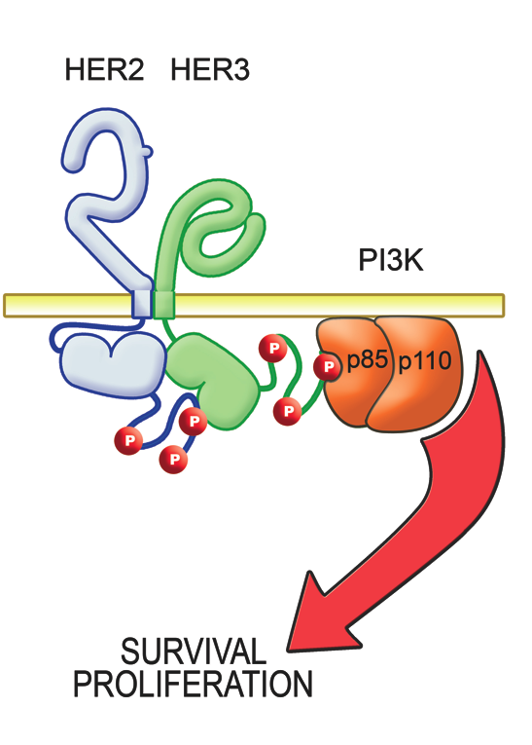
Trastuzumab disrupts ligand-independent
HER2-HER3-PI3K complex
Therapeutic Strategies against HER-2 receptor

Slide 32
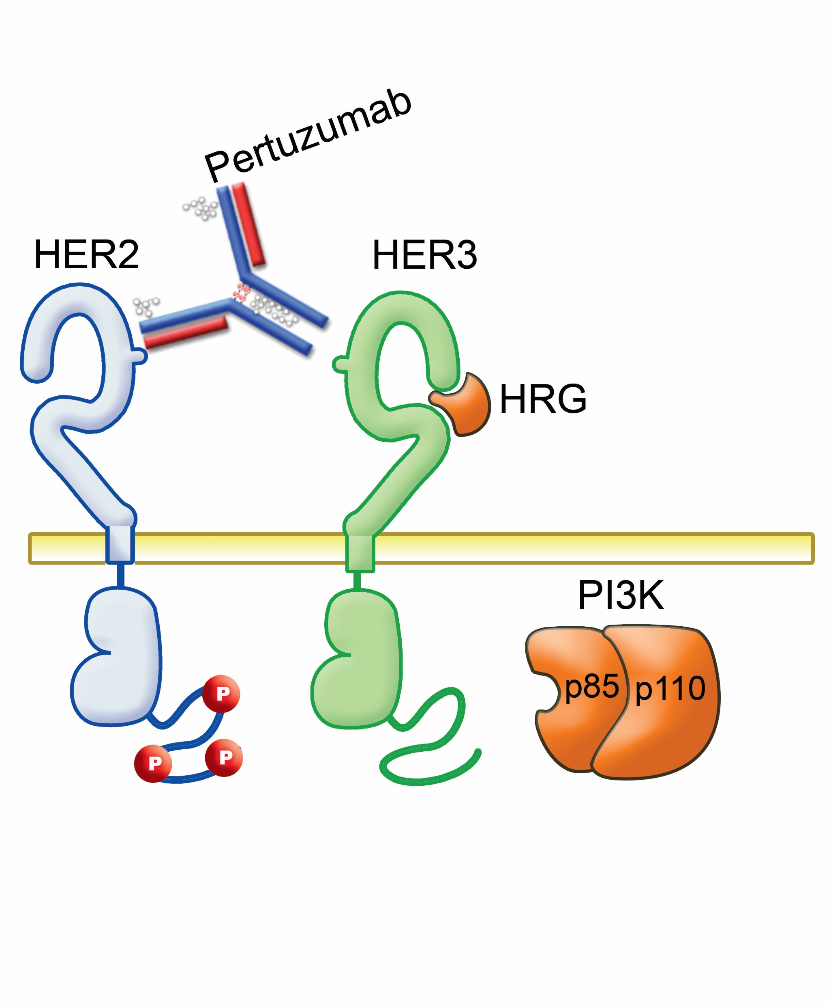
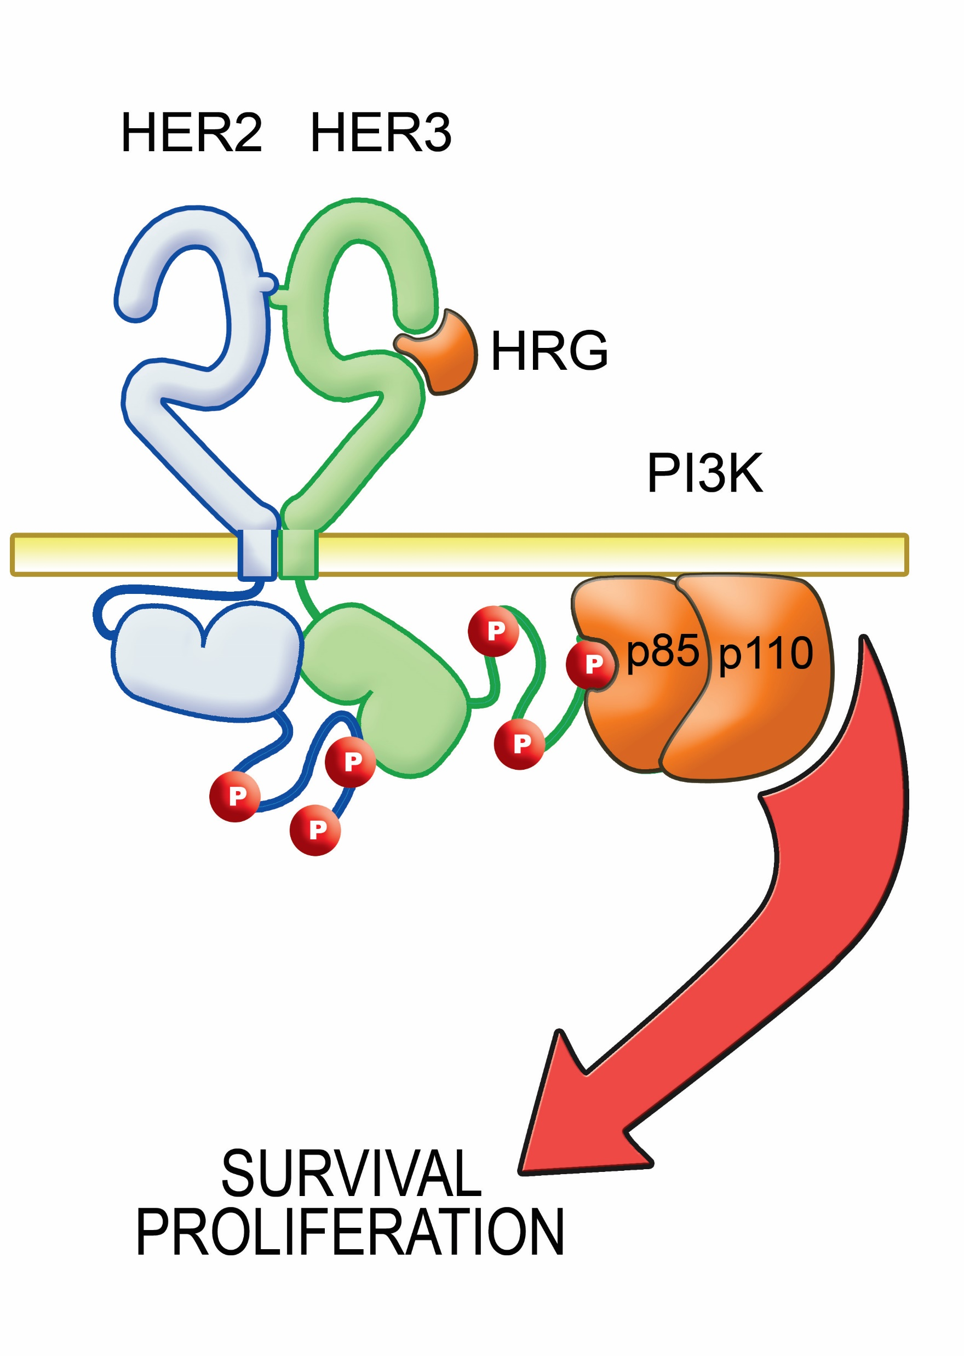
Pertuzumab prevents ligand-induced
HER2-HER3 dimerization
Therapeutic Strategies against HER-2 receptor

Slide 33
Therapeutic Strategies against HER-2 receptor
Overexpression:
Arising from gene amplification, which results in constitutive activation of HER2 (ligand independent)
Antagonized by trastuzumab
Co-receptor:
  For other HER family members especially HER3
  (ligand dependent)
  Antagonized by pertuzumab

Slide 34

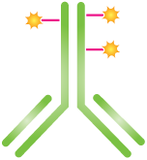

T-DM1: the first-in-class HER2-targeted antibody-drug conjugate
  Target expression: HER2
Monoclonal antibody: trastuzumab
  Cytotoxic agent: DM1
Highly potent chemotherapy
(maytansine derivative)
T-DM1
  Linker
Systemically stable
Breaks down in target cancer cell

Slide 35
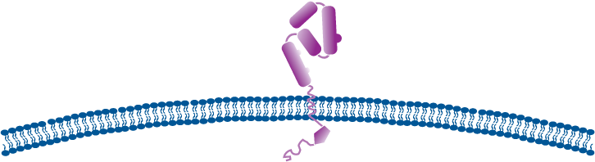
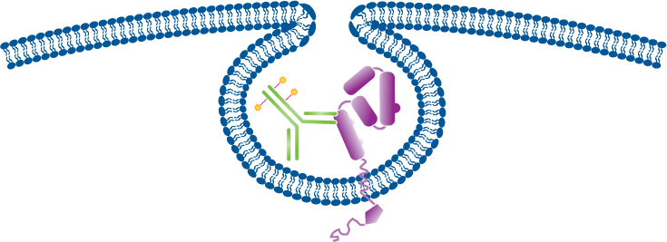
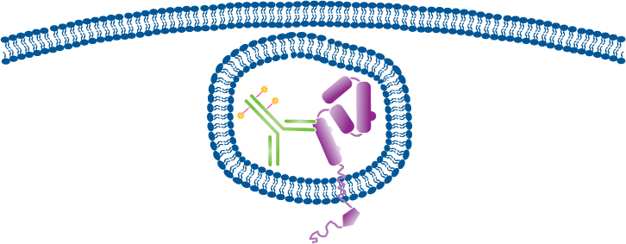
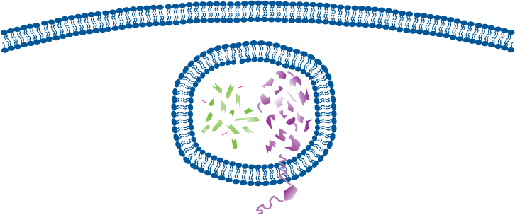
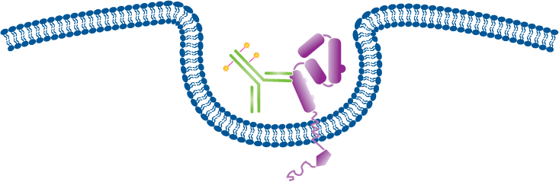
T-DM1 selectively delivers a highly toxic payload to HER2-positive tumor cells
T-DM1 binds to the HER2 protein on cancer cells
Receptor-T-DM1 complex is internalized into HER2-positive cancer cell
Potent antimicrotubule agent is released once inside the HER2-positive
tumor cell
Trastuzumab-like activity by binding to HER-2
Targeted intracellular delivery of a potent anti-microtubule agent, DM1

Slide 36
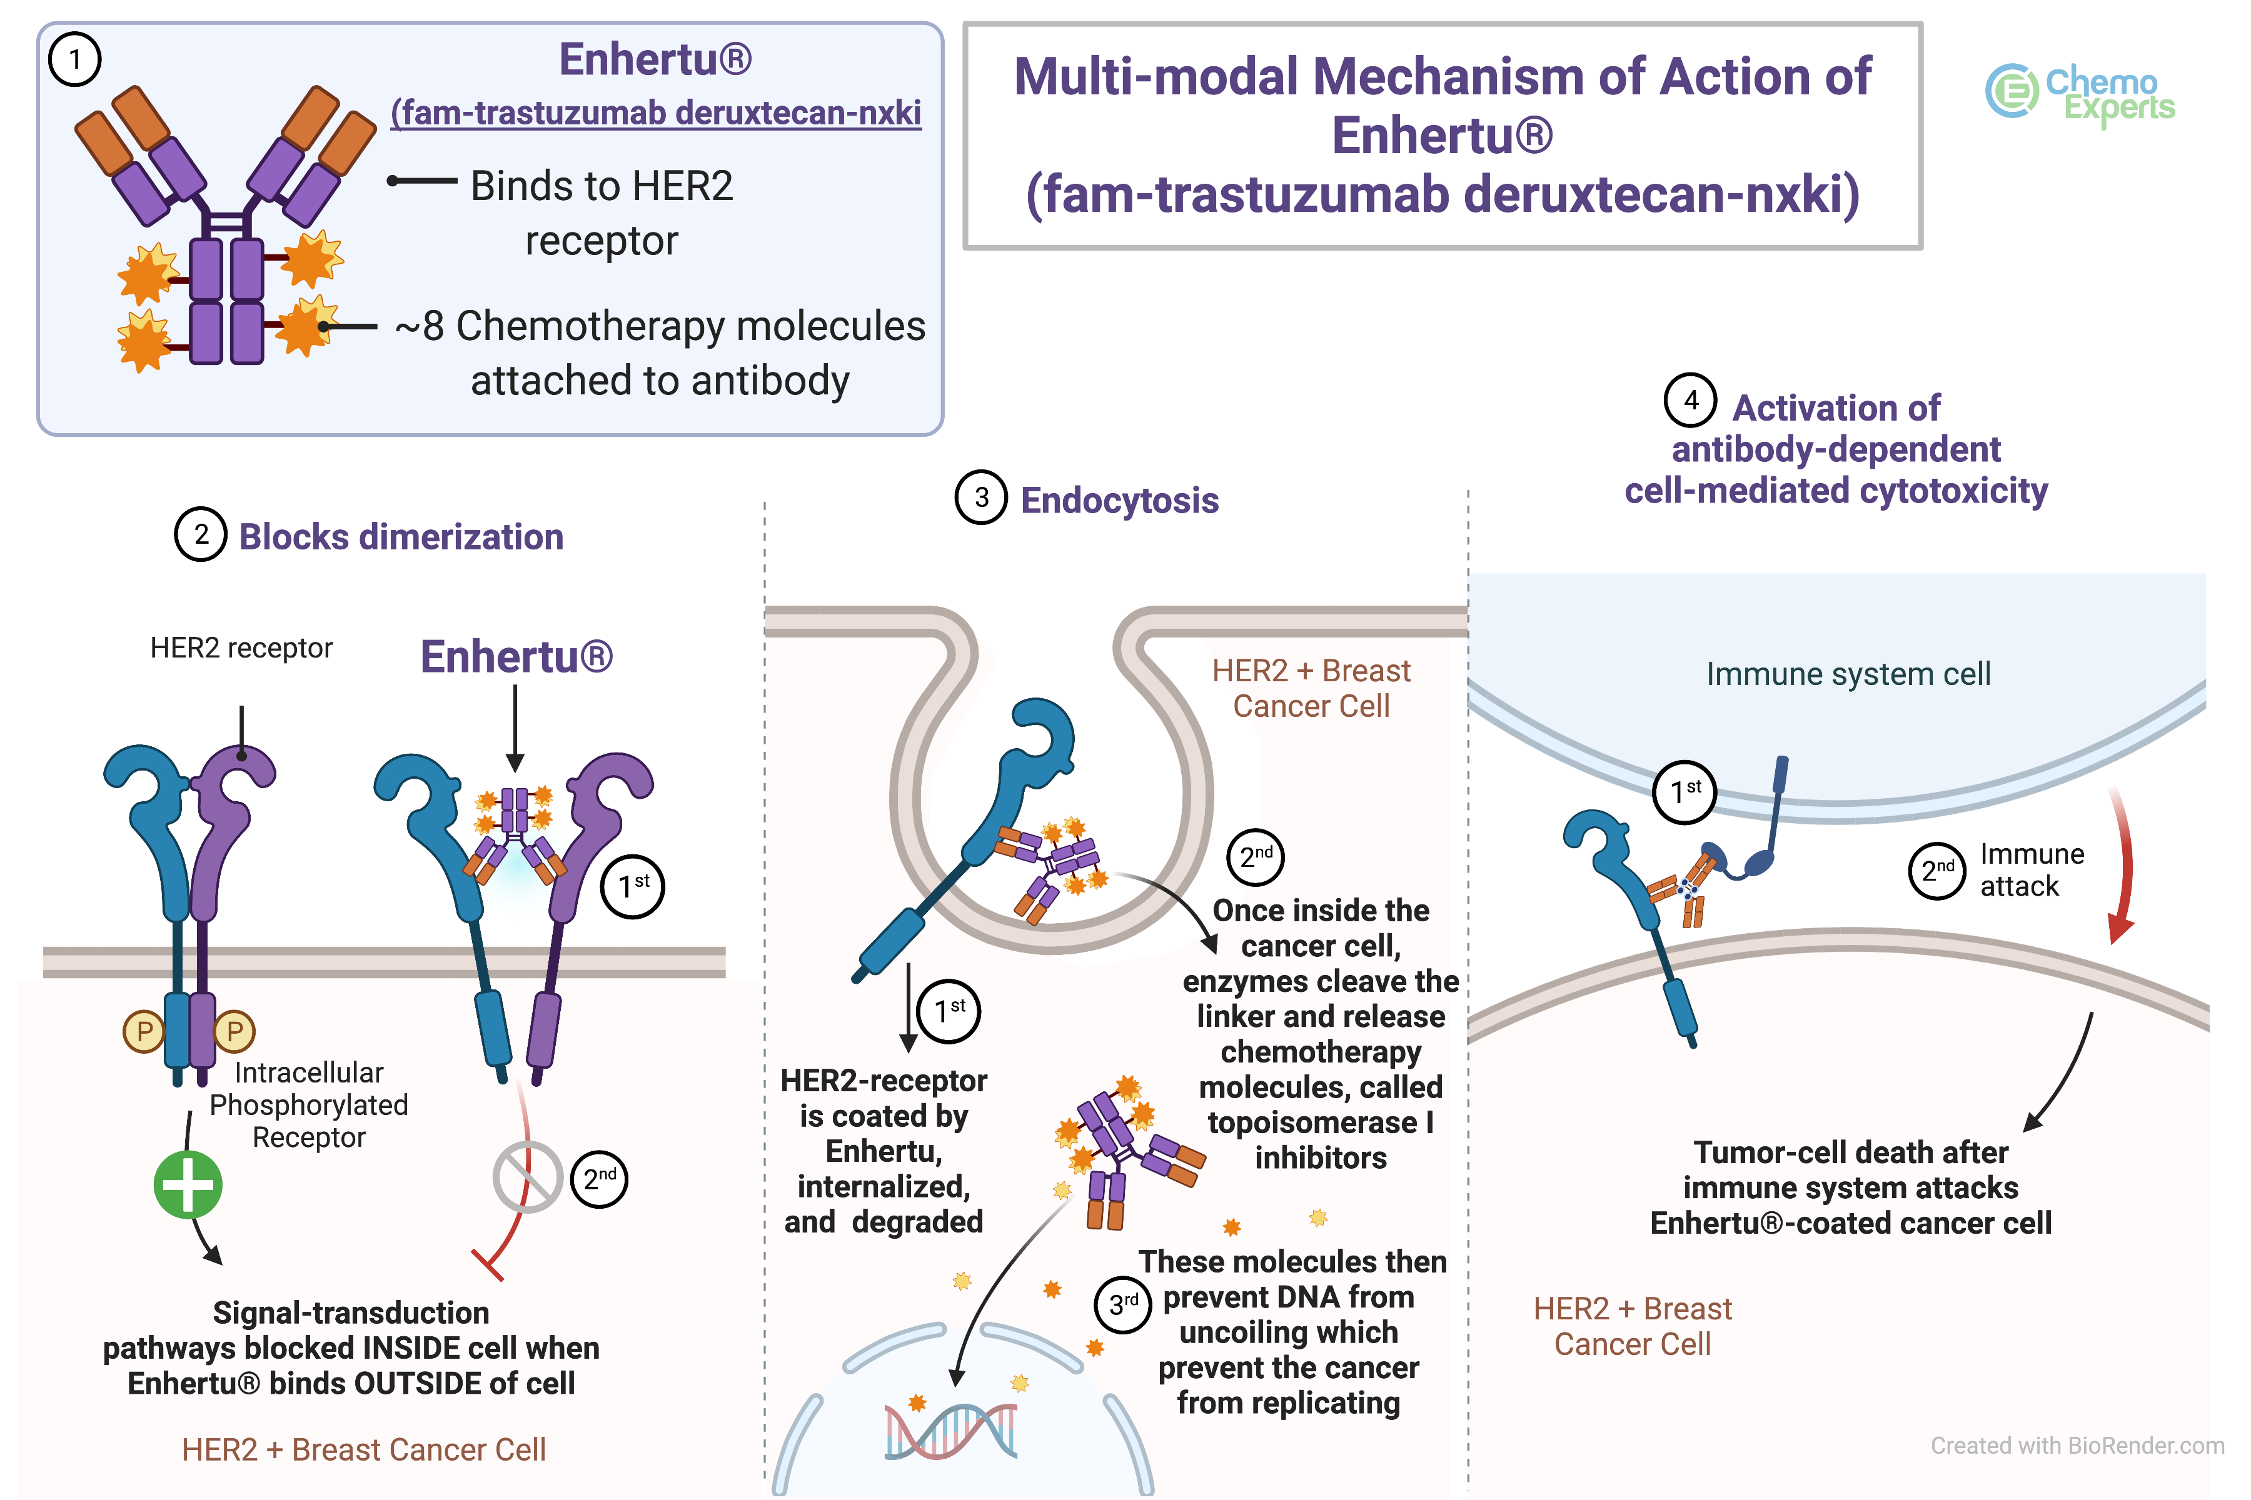
https://www.youtube.com/watch?v=L75VvIsqASs

Slide 37
Cancer Cell Basic Features
https://www.youtube.com/watch?v=jq5cqBeL73M
https://www.youtube.com/watch?v=TflpuEF07YE
Self-sufficiency of proliferation signals
Un-responsiveness in anti-proliferative signals
Apoptosis
Neo-angiogenesis
Invasion & Metastasis
Uncontrolled cellular proliferation
Hanahan & Weinberg, Cell 2011;144:646
Notes:
Through these “hallmarks” or features of cancer cells, tumors are able to proliferate with limitless replicative potential, enabling tumors to grow, invade, and metastasize.
Adapted from Hanahan and Weinberg. Cell. 2000;100:58.

Slide 38
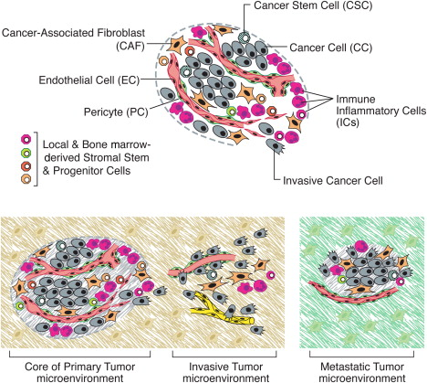
Cancer Cell Basic Features
Hanahan & Weinberg, Cell 2011;144:646

Slide 39
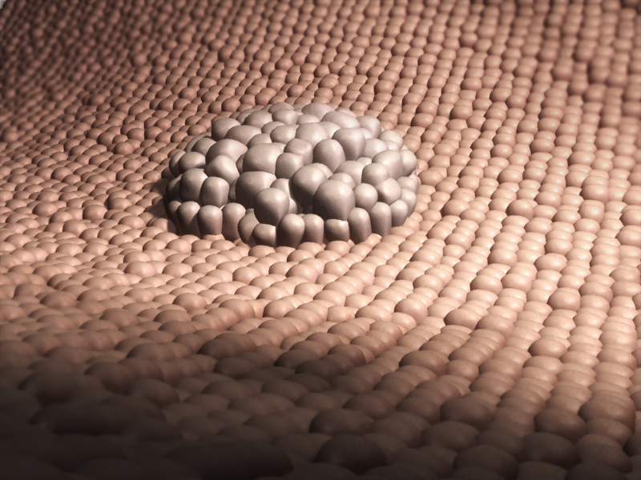
Tumor Αngiogenesis
Avascular phase: small lesions up to 1-2mm
Vascular phase: initiation of angiogenesis
1-2 mm³

Slide 40
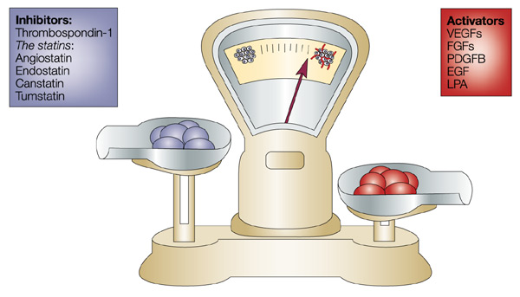
Tumor angiogenesis
“The angiogenic switch”
Avascular
Phase
Vascular
Phase
Bergers & Benjamin. Nat Rev Cancer 2003;3:401

Slide 41
Targeting tumor angiogenesis
VEGF / VEGFR in Carcinogenesis
VEGF is implicated in
  Proliferation of endothelial cells
  Migration of endothelial cells
  Expression of proteases of endothelial cells
  Adhesion of endothelial cells
  Creation of vasculature
  Vessel maturation / Pericytes migration
Also act as
  Survival Factor of neo-vessels
  Factor affecting vascular permeability

Slide 42
Tumor Αngiogenesis
Endothelial Cells
Represent ~1Kg of tissue
Estimated Surface ~1000m²
Most are suppressed – 1/10.000 are used in menstrual cycle
Normal conditions of neo-angiogenesis induction
Trauma
Menstrual Cycle
Placenta formation – Pregnancy

Slide 43
Sprouting Αngiogenesis
1. Secretion of
angiogenic
factors
Tumor
4. Appearance
of new tumor
vasculature
2. Proteolytic
destruction
of ECM
3. Endothelial
cell proliferation
and migration
Sprouting capillary
ECM, extracellular matrix
Notes:
The process of angiogenesis is complex, relying on a cascade of biochemical signals to initiate and progress vascular development.
Sequential steps occur in the process of neovascularization:
Release of specific angiogenic molecules triggers the degradation of the basement membrane by proteases.
This allows endothelial cell migration into the interstitial space, and capillary sprouting.
Endothelial cell proliferation then occurs at the migrating tip.
This is followed by lumen formation, the generation of a new basement membrane with the recruitment of pericytes, formation of anastomoses, and finally blood flow.

Slide 44
The VEGF / VEGF-R family
VEGF Family
VEGF-A
VEGF-B
VEGF-C
VEGF-D
VEGF-E
Placenta Growth Factor 1 (PGF1)
Placenta Growth Factor 2 (PGF2)

Slide 45
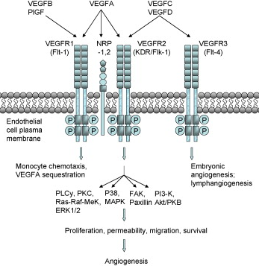
The VEGF / VEGF-R family (cont.)
VEGF-Receptors
VEGF-R2 is conjugated
with smaller proteins
than VEGF
(110-165 a.a.)
VEGF-R1 has greater
affinity
for VEGF than
VEGF-R2
VEGF-R1 has weaker
TK activity than
VEGF-R2 after VEGF
activation
Increased expression
of proteases that contribute
to ECM degradation and
cell migration
VEGF is released by
tumor and stroma cells
Ho & Kuo Int J Biochem Cell Biol 2007;39:1349

Slide 46
Targeting tumor angiogenesis
VEGF / VEGFR in Carcinogenesis
VEGF is implicated in
  Proliferation of endothelial cells
  Migration of endothelial cells
  Expression of proteases of endothelial cells
  Adhesion of endothelial cells
  Creation of vasculature
  Vessel maturation / Pericytes migration
Also act as
  Survival Factor of neo-vessels
  Factor affecting vascular permeability
https://www.youtube.com/watch?v=Ep_nCSEDeAE

