Slide 1
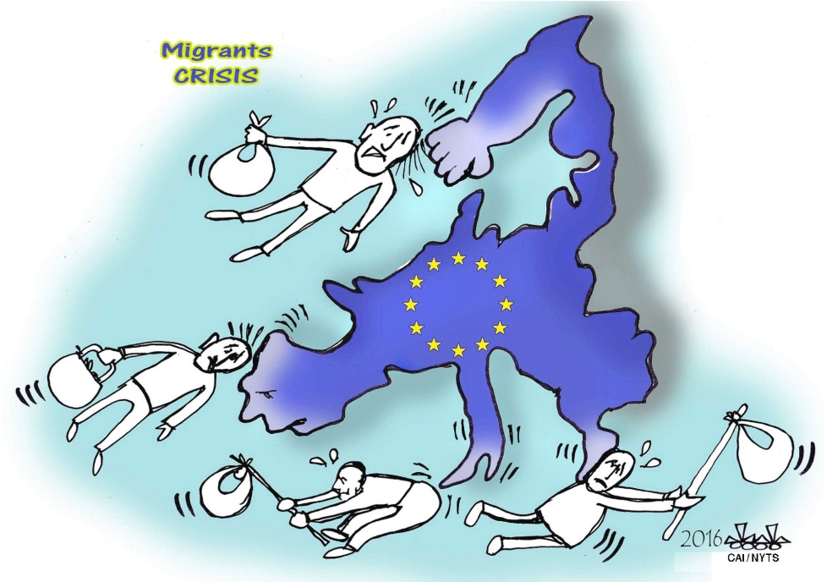
Refugee / Migration Flows Old and New Media
Migration and populist rhetoric
Professor emerita Roy Panagiotopoulou
Department of Communication and Media Studies
National and Kapodistrian University of Athens
rpanag@media.uoa.gr

Slide 2
Structure of presentation
Populism (definitions, characteristics)
EU and the rise of populist parties
Populism and Media coverage of migration policies

Slide 3

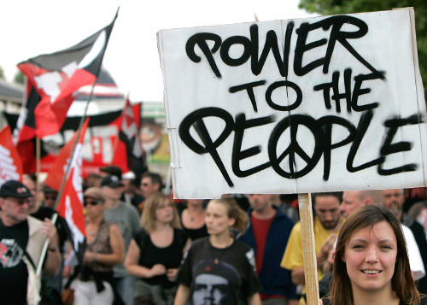
Populism

Slide 4
Populism again!
Populism is dynamically and unexpectedly back on the agenda of political studies in general and political communication, especially regarding the impact of new communication forms such as internet and social media. Disinformation – misinformation are also powerful weapons on the populist agenda.
The rise of populism in Western Europe is considered mainly as a reaction to the failure of traditional parties to respond adequately in the eyes of the voters to a series of phenomena such as (Albertazzi and McDonnell 2008):
  Economic and cultural globalization
  Speed and direction of European integration
  Immigration
  Decline of ideologies and class politics
  Elite corruption, etc.

Slide 5
Political malaise
It is also the product of a much-cited, but rarely defined, ‘political malaise’, manifested in:
steadily falling turnouts across Western Europe,
declining party memberships,
ever-greater numbers of citizens citing a lack of interest
distrust in politics and politicians.
fostered by the media.
Social and political malaise − a common precondition for the growth of anti-political sentiments − shows that both political and media factors form a unique alliance, whose catalyst may be found in the country’s political culture at a given time.

Slide 6
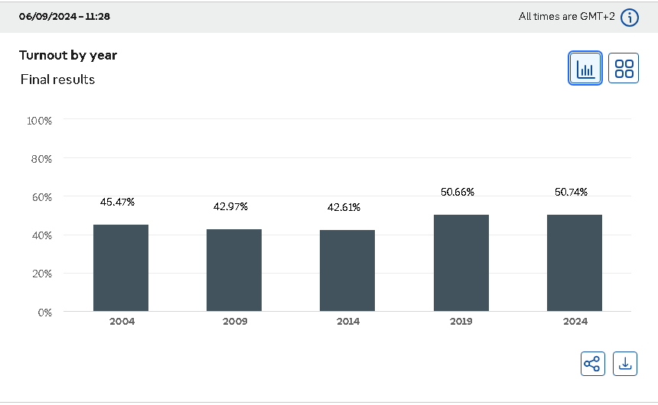
Turnout European Parliament Elections
Source: https://results.elections.europa.eu/en/turnout/

Slide 7
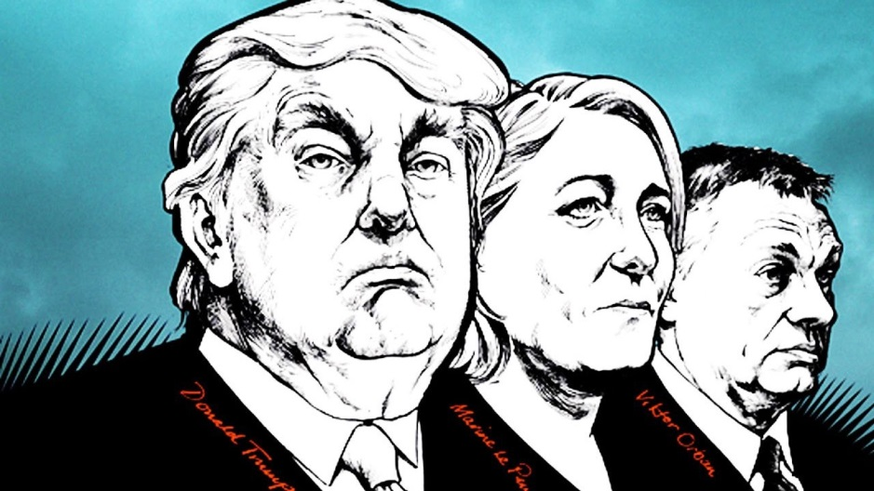
Irrelevant politics, incapable politicians
An anti-political climate is said to have grown throughout Western European societies in which people perceive politics as:
more convoluted,
distant and
irrelevant to people’s lives.
Politicians are criticised as:
more incapable,
impotent,
self-serving and
similar to one another than in the past.

Slide 8
Media do play a role in disseminating political malaise
This malaise is certainly not provoked by the media, but the media do play a role in disseminating it, either by simply keeping it on a country’s public agenda, or by spreading political mistrust and a mood of fatalistic disengagement − all elements that can be easily and promptly exploited by populist politicians (Mazzoleni 2008).
The classical distinction between mainstream and tabloid news media and recently social media is of great value in the analysis, as it has been argued that these types of news outlets adopt different approaches in their treatment of populism (Mazzoleni, 2003: 15−16). In most countries, the established news media are the mouthpieces of the ruling classes.

Slide 9
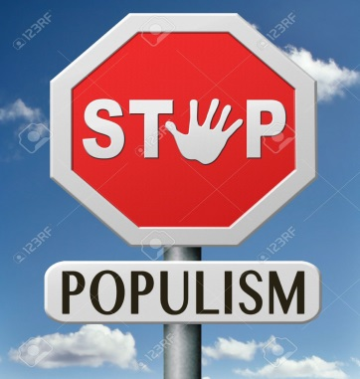
Populism: ‘Spectre haunting the world’ or ‘spirit of the time’
Ionescu and Gellner (1969:1) perceived populism as a ‘spectre haunting the world’ implicating something obscure, unnatural, and terrifying. Populism, at least in Western Europe, was initially understood as a pathological form of democracy (Betz, 1994).
However, Mudde (2004:542) proposed a shift of perception by arguing that populism was not a political disease, but had become ‘mainstream in the politics of Western democracies’. It takes the notion of a populist ‘Zeitgeist’.

Slide 10
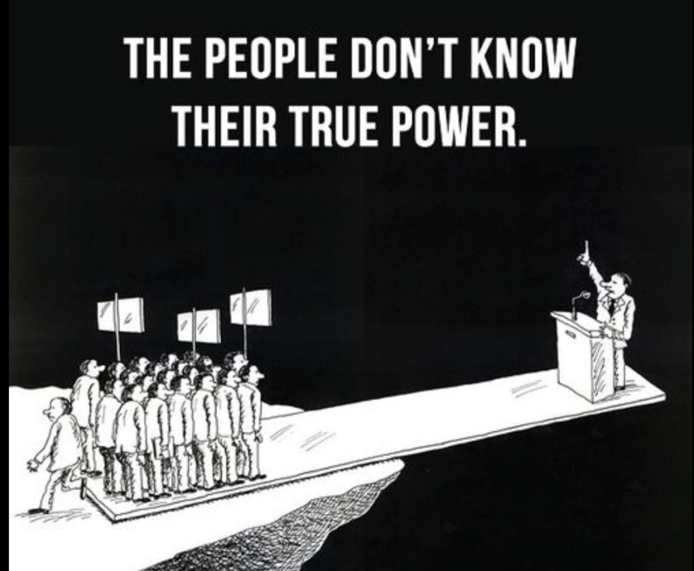
Populism ideology : We vs dangerous others
Cas Mudde (2004: 543) defines populism as “ideology which pits a virtuous and homogeneous people against a set of elites and dangerous ‘others’ who are together depicted as depriving (or attempting to deprive) the sovereign people of their rights, values, prosperity, identity and voice”.

Slide 11
Populism: theoretical approaches I
Perspective | Main characteristics | Key theorists
Populism as an ideology | Populism is an ideology that considers society split into two homogeneous groups: the pure people vs. the corrupt elite. However, it is a thin ideology because it lacks political consistency and attaches itself to thick ideologies like liberalism or socialism. | Cas Mudde Christóbal Kaltwasser Margaret Canovan
Populism as a style | Populism is a style of political representation that includes the discursive content of what politicians say, as well as the performative elements that accompany discourse, for example: rhetorical devices, gestures, staging, attire, accents, and mannerisms. Populists appeal to ‘the people’, talk or act in unconventional ways, and conjure a sense of crisis through political performances. | Benjamin Moffitt Simon Tormey Michael Bossetta Yannis Stavrakakis

Slide 12
Populism: theoretical approaches II
Perspective | Main characteristics | Key theorists
Populism as a movement | Populism is an undemocratic movement that primarily exists on the right side of the political spectrum. It is characterized as anti-pluralist in the sense that its proponents see themselves as the only representatives of the ‘true’ people and excludes those who do not belong to this category. Populism should be fought with liberal democratic means. | Jan-Werner Müller Robert Jansen
Populism as a logic | Populism is a logic of articulation that unifies political identities in equivalential chains against a common adversary. The adversary is often known as ‘the elite’ or ‘the establishment’, but this is not a given. Populism is not a distinct trait of particular movements or parties, but an integral part of all political projects. As such, the end of populism coincides with the end of politics. | Ernesto Laclau Chantal Mouffe David Howarth

Slide 13
Contested times, contested definitions
The main reason why there is no universal definition of populism is the fact that it manifests itself differently depending on the contextual conditions.
However, some social and political phenomena of neoliberal policies implemented in the EU have become increasingly unpopular, triggering popular mobilizations that, in turn, are denounced as populist.
The European crisis seems to intensify both the renewed appeal for empowering the ‘people’ and the complexity of the various language games around the terms “the people” and “populism.” (Stavrakakis 2014: 505).

Slide 14
4 reasons of the rise of populist parties in Europe
Ruth Wodak (2014) spoke about four distinctive reasons that would explain their rise in different countries:
"Parties [that] gain support via an ambivalent relationship with fascist and Nazi pasts" (e.g., in Austria, Hungary, Italy, Romania, and France),
parties that "focus primarily on a perceived threat from Islam" (e.g., in the Netherlands, Denmark, Poland, Sweden, and Switzerland),
parties that "restrict their propaganda to a perceived threat to their national identities from ethnic minorities" (e.g., in Hungary, Greece, Italy, and the United Kingdom) and
parties that "endorse a fundamentalist Christian conservative-reactionary agenda" (e.g., in Poland, Romania and Bulgaria).”

Slide 15

Populist parties are not exclusively extreme right parties
In recent years, the dominant tendency in scholarly literature has been to identify and analyse the rise of populism in Western Europe as a phenomenon exclusively of the Right (Betz 1994) stressing on issues, such as immigration and taxation, which populists have sought to capitalize on.
However, populism is not exclusively connected with the Right. In fact, the claim that the people (however defined) are the only legitimate sovereign and have been deprived of power can sit quite easily with leftist ideologies.
Taguieff (2002: 84), consider populism as being highly compatible ‘not only with any political ideology (Left or Right, reactionary or progressive, reformist or revolutionary) and any economic programme (from state-planned to neoliberal), but also with diverse social bases and diverse types of regime.

Slide 16

Who is ‘the people’?
‘The people’ refers to the totality of a given political community, to the citizenry as a unitary political body (e.g. constitutional references to “We, the people”), and, at the same time, designates “the poor, the disinherited, and the excluded”; the marginalized from political participation, excluded from the enjoyment of political rights and socioeconomic rewards and public life. Simply put, ‘the people’ is simultaneously part and whole (Stavrakakis 2014).
Political battles between the 'us and them' of populist politics involve struggles to determine the divides that constitute populist identities, and set up new political frontiers.

Slide 17
Us vs them: Regarding migrant integration
For right-wing populists, immigration is not simply a question of economic competition but it constitutes a threat against the presumed (constructed) identity of the people and their traditional values.
Again, the principle of “othering”, of constructing and highlighting an antagonism of “us versus them”, is uniformly applied by right-wing populists, but the definition of “the other” varies pursuant to nationally specific conditions (Greven 2016).
The more Western democracies turn to despotic, oligarchic forms of governance, the more is populism likely to ﬁgure as a suitable vehicle for a sought after re-democratization.

Slide 18
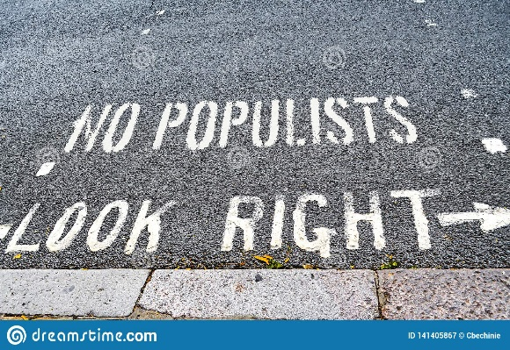
Anxieties, threats and fears surround the ‘common people’
Socio-political challenges raise concern regarding the migration flows. Populist rhetoric is based on social inequalities and uncertainties in many domains of life. Thus populist media attract specific audiences and adapt their narratives to specific contents such as enhancing all kind of fears.
Fear of:
Losing one’s job
‘Strangers’ (i.e. migrants internal or international)
Losing national autonomy, or identity
Losing old traditions and values
Climate change and pollution
Disappointment or even disgust with mainstream politics and parties
Anger about growing gap between rich and poor
Disgust for lack of transparency in political decisions and corruption.

Slide 19

Representation of migrants
Community is a place where ‘it is crystal-clear who is “one of us” and who is not, there is no muddle and no cause for confusion’ (Bauman, 2001: 12).
By contrast, the enemies of the people − the elites and ‘others’ like immigrants– are neither homogeneous nor virtuous. Rather, they are accused of conspiring together against the people, who are depicted as being under siege from above by the elites and from below by a range of dangerous others.
Recently, immigrants make the most salient ‘enemy’ with few possibilities to tolerate their presence in some host countries, not to mention their social integration.

Slide 20
Facebook fueled anti-refugee attacks in Germany
According to an article in NYT (21.8.2018) a study in Altena (a small country town of 3000 inhabitants) with a frequent Facebook use gave the following findings:
Altena exemplifies a phenomenon long suspected by researchers who study Facebook: that the platform makes communities more prone to racial violence.
Social media scramble users’ perceptions of outsiders, of reality, even of right and wrong.
Some posts appeared to come from outsiders, joined by a handful of locals. Over time, their anger proved infectious, dominating the local public opinion.
The algorithm used by Facebook is built around a core mission: promote content that will maximize user engagement. Posts that tap into negative, primal emotions like anger or fear, perform best and so proliferate. That is how anti-refugee sentiment — which combines fear of social change with us-versus-them rallying cries, two powerful forces on the algorithm — can seem unusually common on Facebook, even in pro-refugee communities.
Even if only a minority of users express vehement anti-refugee views, once they dominate the newsfeed, this can have consequences for everyone else.
People instinctively conform to their community’s social norms, which are normally a brake on bad behavior.
(https://www.nytimes.com/2018/08/21/world/europe/facebook-refugee-attacks-germany.html)

Slide 21
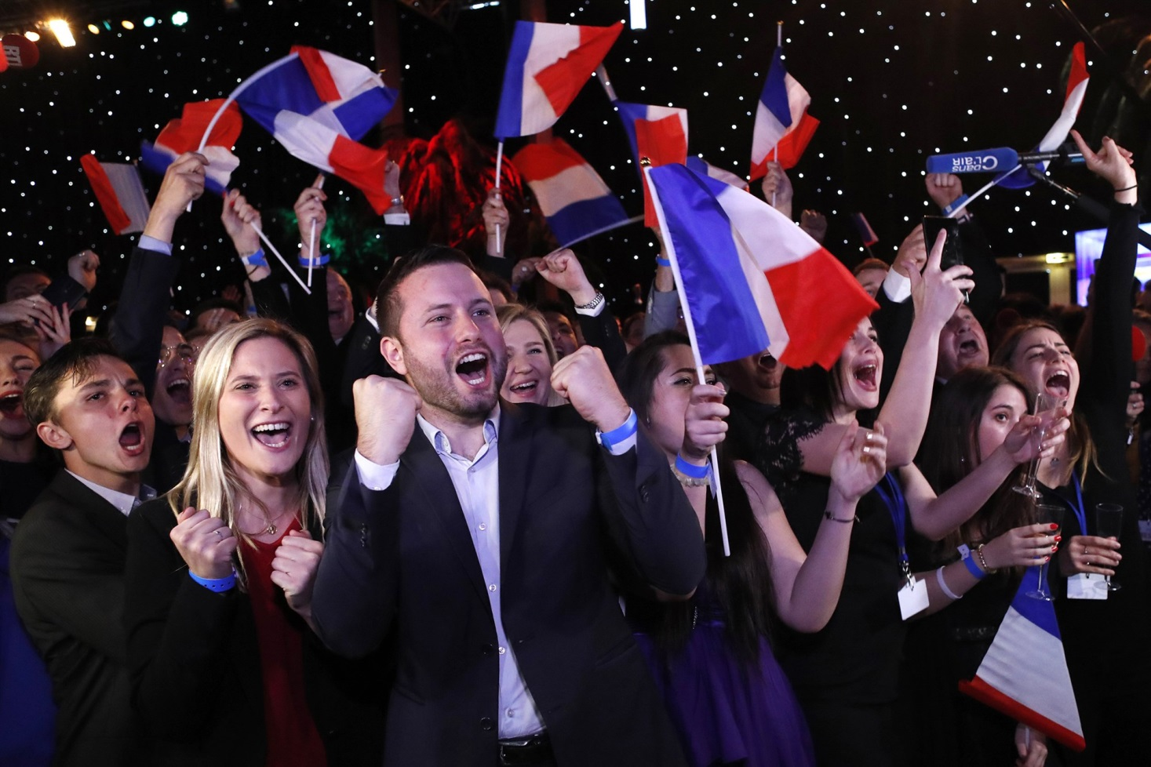
EU and the rise of populist parties
Supporters of France's far-right National Rally party celebrate in Paris on May 26 2019

Slide 22
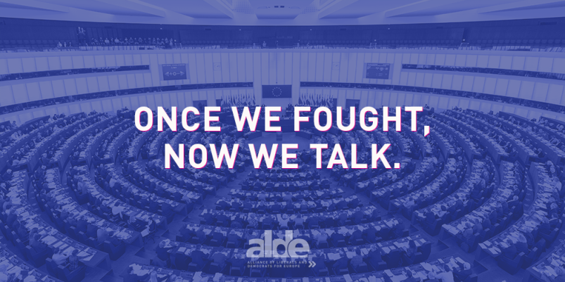
The rise of extreme-right parties
Right-wing extremism and Euroscepticism are not new terms in post-war European history.
The recent escalation of the migration crisis has become a very serious and sinister driving force for far right wing parties.
After WWII extreme right parties witnessed a significant decline in their popularity in Europe. They started to evolve into the contemporary political power in the end of the 1980s as anti-globalist, anti-immigrant movements.
Far right parties did well in the European Parliament (EP) elections in 2014, 2019 and 2024.
The trend to vote far right parties among the European Union (EU) countries is constantly increasing.

Slide 23
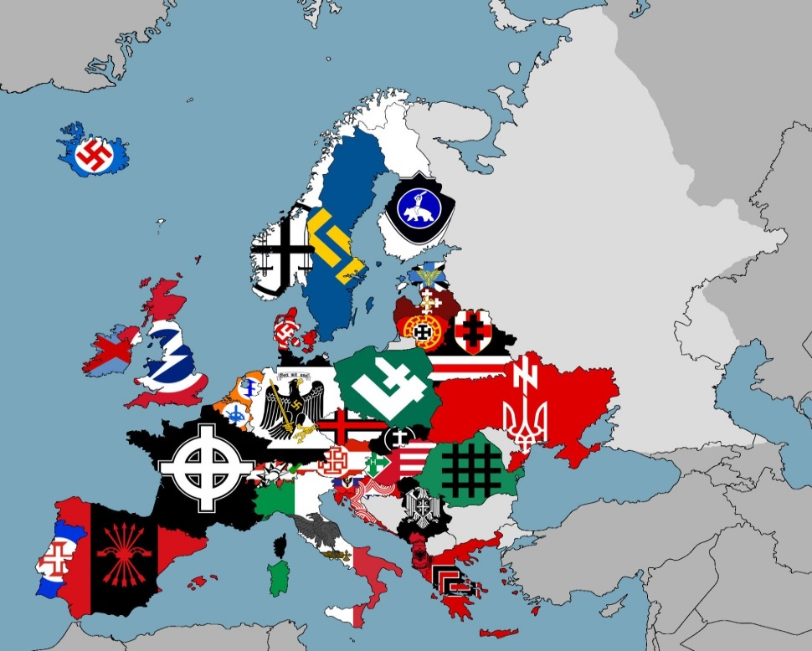
Increase of far right parties in EU for first time
Right-wing extremists or populists turned out to be the strongest party in EP elections 2014 and received the highest share of voters in their respective countries:
  Front National (FN) in France,
  United Kingdom Independence Party (UKIP) in Great Britain
  Danish People’s Party (Dansk Folkeparti - DF) in Denmark.
Unexpected growth for those parties (right but also left) which call for withdrawal from the EU. About one quarter of the MEPs belong to Eurosceptic parties of the far right and left political spectrum.

Slide 24
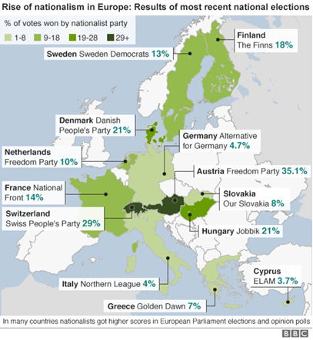
2016
Source: BBC, Guide to nationalist parties challenging Europe. 23 May 2016, http://www.bbc.com/news/world-europe-36130006

Slide 25
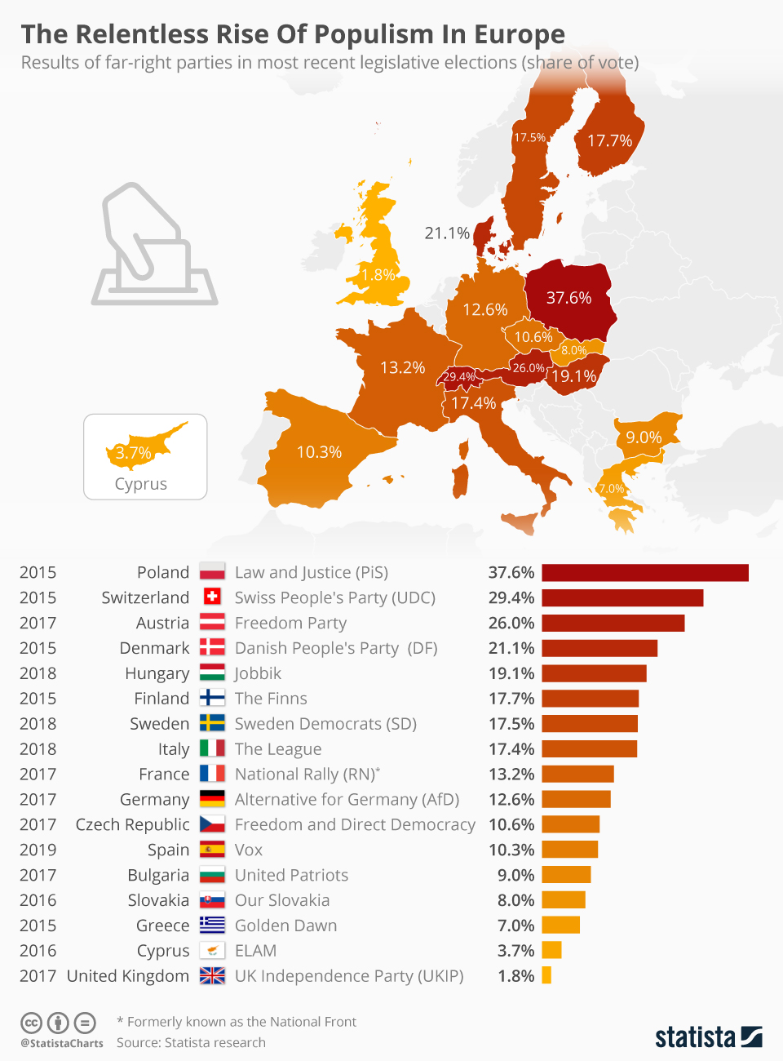
Voters share for far right populist parties in Europe 2015-2019
Source: https://www.statista.com/chart/17860/results-of-far-right-parties-in-the-most-recent-legislave-elections/

Slide 26
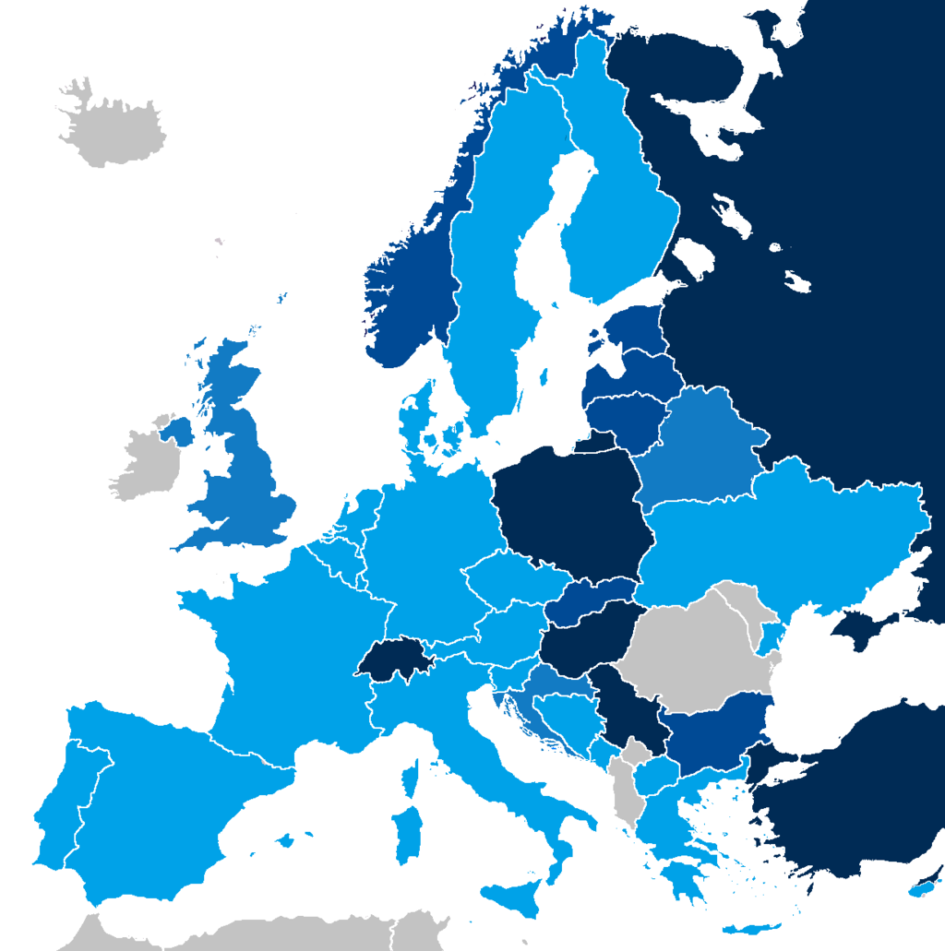
European national parliaments with representatives from right-wing populist parties in November 2019:
Right-wing populists appoint prime minister
Right-wing populists providing external support for government
Right-wing populists involved in the government
Right-wing populists represented in the parliament.
Source: https://en.wikipedia.org/wiki/List_of_active_nationalist_parties_in_Europe

Slide 27
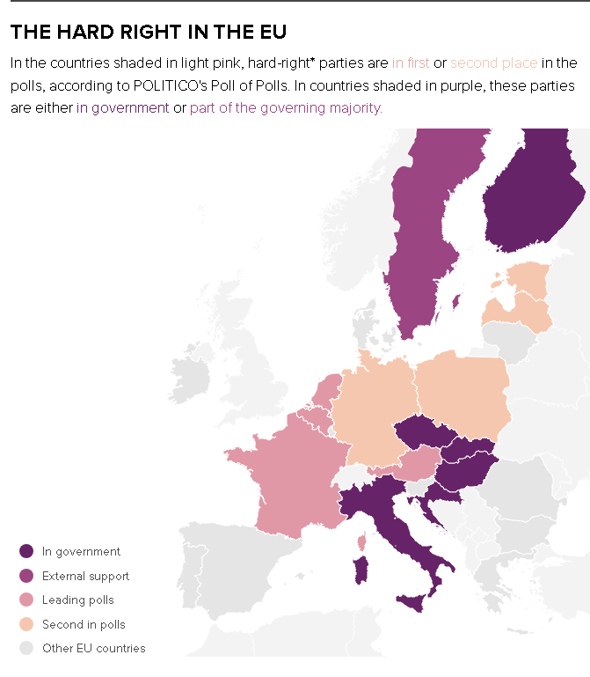
Right wing parties in the EU before EP elections 2024
Source: POLITICO research Polling data as of May 23, 2024. https://www.politico.eu/article/mapped-europe-far-right-government-power-politics-eu-italy-finalnd-hungary-parties-elections-polling/

Slide 28
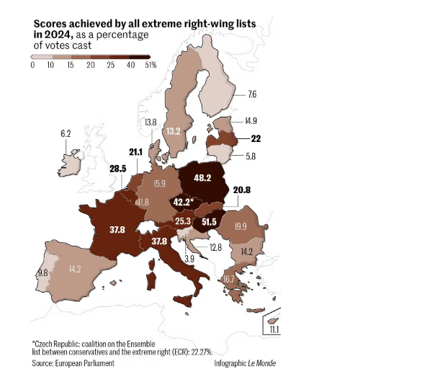
EP elections 2024, score of far right political parties
Source: https://www.lemonde.fr/en/international/article/2024/06/13/european-elections-the-far-right-gained-ground-in-eu-founding-countries_6674740_4.html

Slide 29
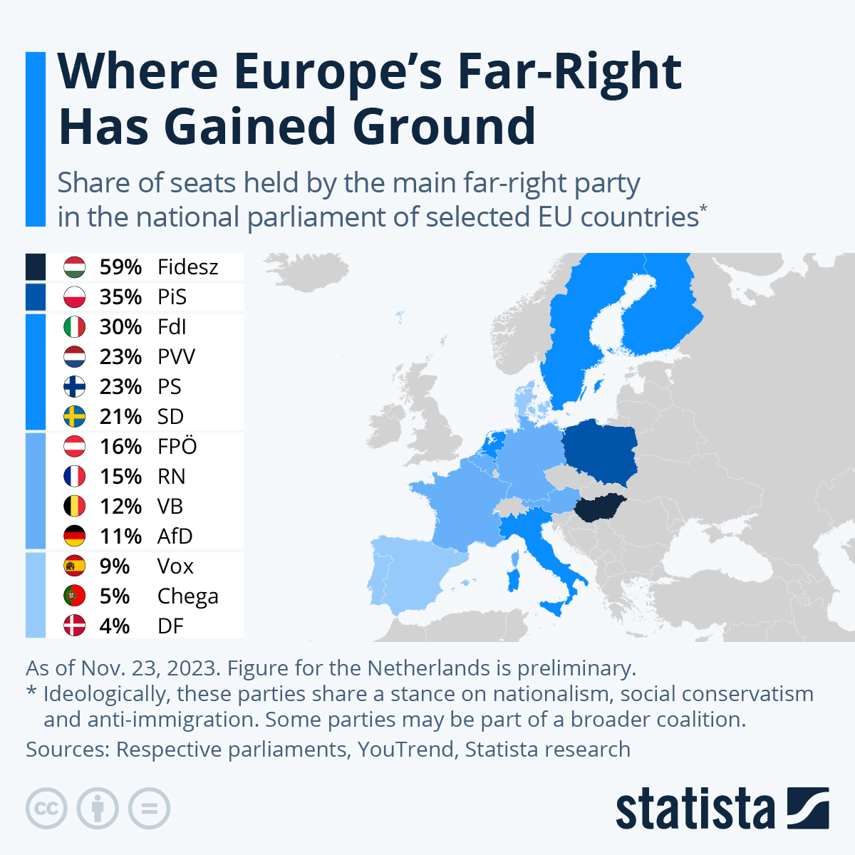
Source: https://www.statista.com/topics/3291/right-wing-populism-in-the-european-union/#topicOverview

Slide 30
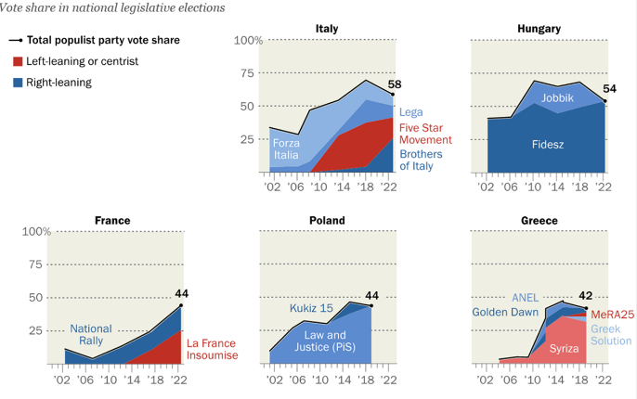
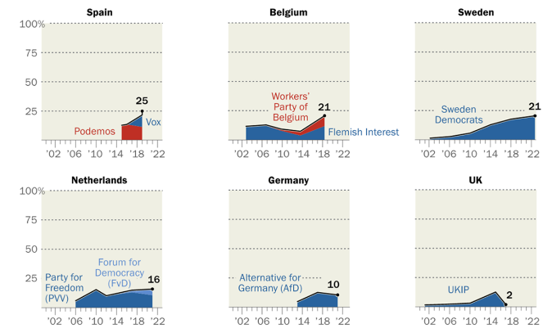
Populist Parties have increased their vote shares in many recent European elections during 2000-2022

Slide 31
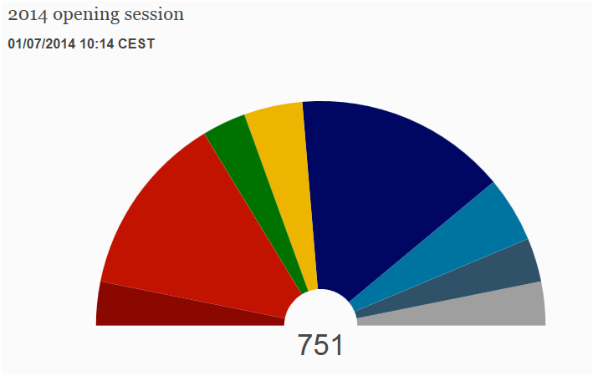
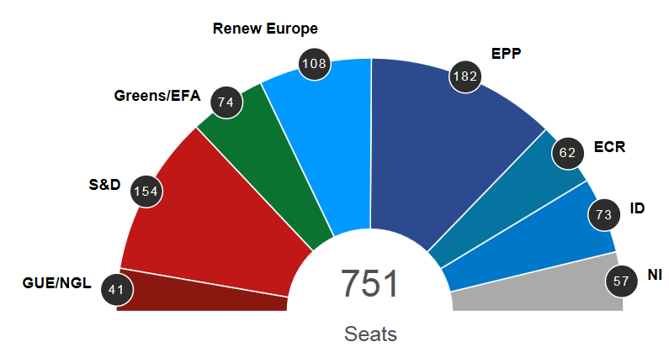
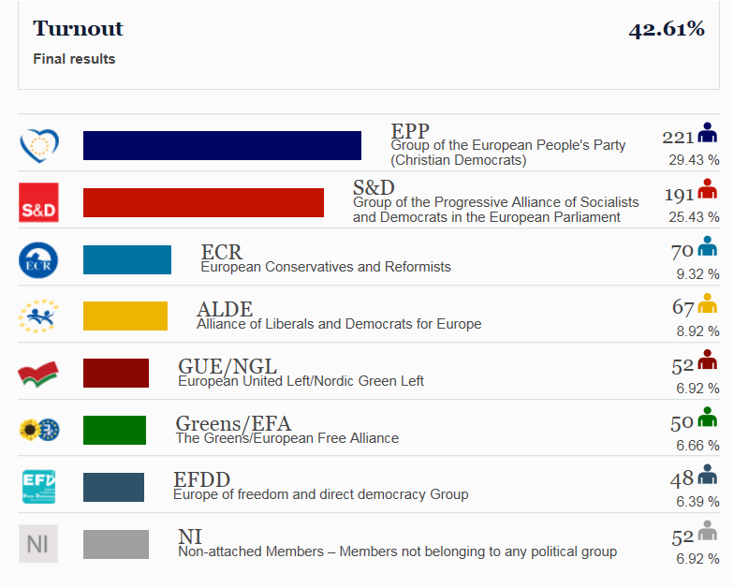
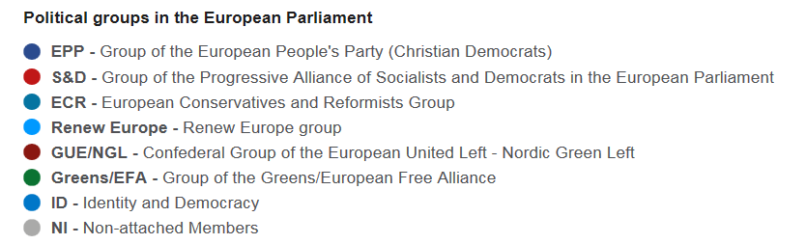
EU Parliament elections results
2014
2019

Slide 32
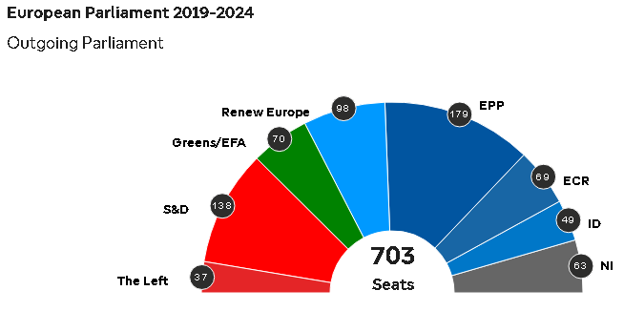
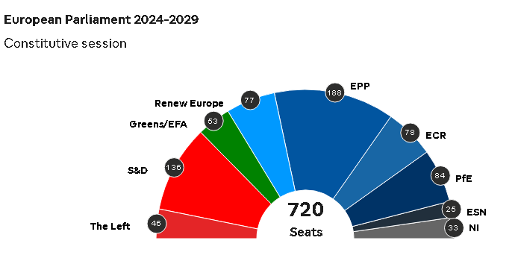
European Parliament seats distribution 2019-2024 and 2024-2029

Slide 33
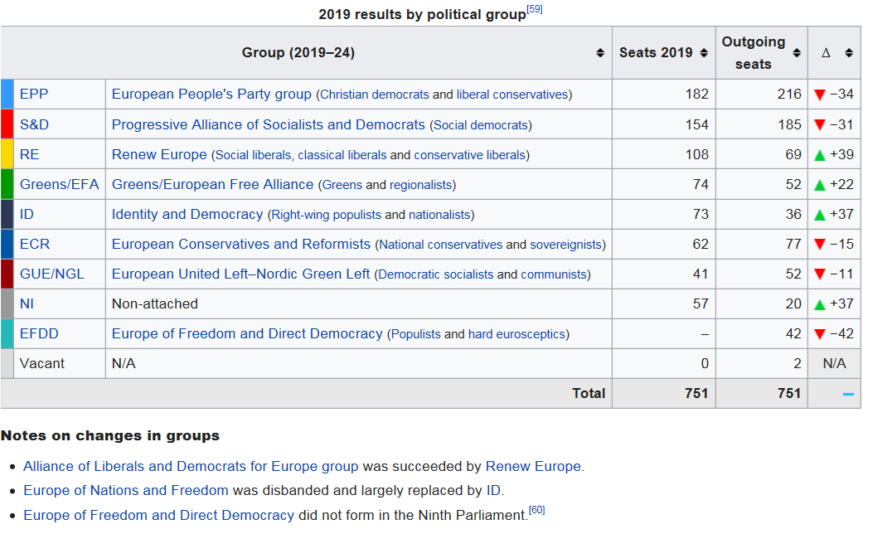
EP seats distribution 2019

Slide 34
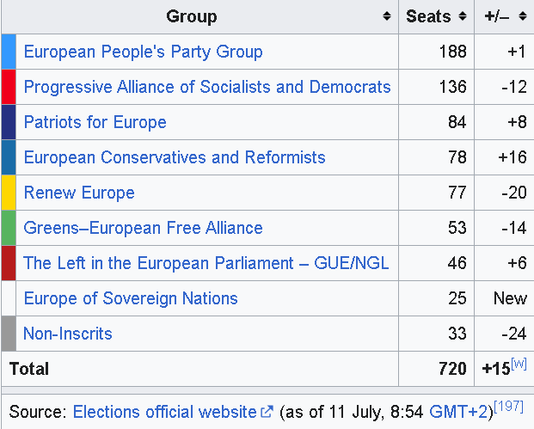
EP seats distribution 2024 by political group
Source: https://en.wikipedia.org/wiki/2024_European_Parliament_election

Slide 35
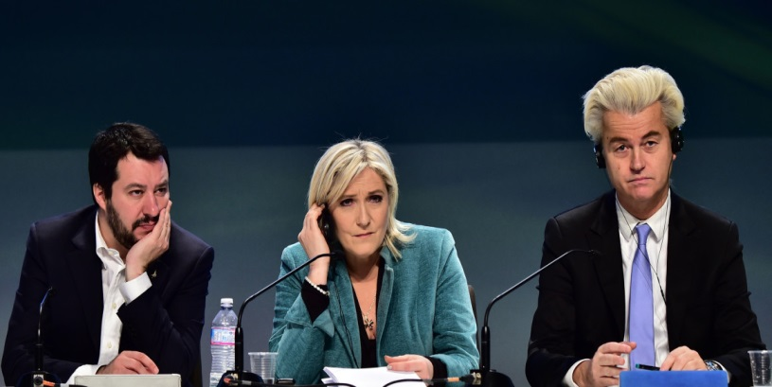
Shrinking of traditional center parties, increasing of right and left parties 2019
Far-right populists had some wins in 2019, but it wasn't quite the dramatic, widespread surge seen in recent elections at the national and local level across the continent.
What is clear is that the mainstream parties from the center-left and center-right hemorrhaged votes, with much of their support going to a fragmented collection of environmentalists and pro-European Union liberals.
The 2019 EP election results represented a seismic rejection of the traditional ruling parties across the continent. "We are facing a shrinking center of the European Union parliament" (Manfred Weber, European Peoples Party).

Slide 36
Shrinking of Green and Left parties, increasing of far right parties 2024
Germany’s AfD will enter the Parliament for the first time with 15 seats, and Hungary’s Fidesz has gained 10 seats. These two national parties, together with ECR and ID, hold 156 seats (21.7%) – more than the S&D group.
The ability of far right parties to exert real influence in the Parliament will be impacted by how united they can be. They are not in alignment on key issues such as support for Ukraine, and fiscal responsibilities.
As the number of Eurosceptic leaders and parties increase at national level, the positions that member states take at the Council may change.
Hostility towards immigration into the EU is perhaps the sole policy issue the various far right factions agree on.
Far right parties have used immigration to exploit people’s genuine grievances about healthcare, housing and the cost of living. This has made the debate around immigration particularly sensitive in member states. Since then, centrist parties have tried to adopt far right narratives on immigration at both national and EU level, hoping to retain voters who might otherwise consider defecting to far right parties.

Slide 37
Far right populists appear as a durable political force
Right-wing populists fell short of expectations in Austria, the Netherlands and Denmark, while Germany's AfD party made only slight gains (2024). There were clear victories for the far right parties in Poland, Hungary and Italy.
France led the rightward lurch with such a crushing victory for the far-right National Rally (31.4%) that liberal President Emmanuel Macron dissolved France’s parliament and called an early election.
In Germany, the center-right is cruising to a comfortable victory, with the far-right Alternative for Germany (AfD) (15.9%)coming second and beating Chancellor Olaf Scholz’s Socialists into third place (14%).
That said, while the gains might not have been as dramatic as some forecast, the election arguably cemented far-right populism as a European force that isn't going away soon. Such parties are often anti-migrant, anti-Muslim and anti-EU, or at least wish to radically reshape the bloc from within.

Slide 38
Eurozone’s deep aversion to populism
From the standpoint of the Eurozone’s economic, political and intellectual elites, Europe and populism are viewed as the two extremes of a radical antithesis.
Elites, who define the issues, have lost touch with the people, but also with reality too. They are unaware that, in order to function properly, both the economy and democracy require a broad distribution of wealth and income. They also think that the people’s say on their own future is superfluous. And when they pose demands, their demands are conveniently denounced as populism.
European elites opt to demonize populism, shaping their political future in the articulation of an extreme anti-populist agenda. However, they often use populist strategies to demonstrate their discontent or opposition either to national political decisions (e.g. Greek Referendum of 5.7.2015) or to broader socio-economic phenomena (e.g. ‘refugee crisis’ March 2015 – March 2016).

Slide 39

EU’s inability to overcome ‘burden-sharing’
Migration and asylum only became part of EU affairs as a result of the Tampere European Summit in 1999. The summit signaled a diplomatic move from low to high politics that – as the EU’s ongoing difficulties in agreeing and enforcing a common response to unabated migrant arrivals show – is not reflected in the reality of current immigration policy or crisis management.
The EU’s inability to overcome its member states’ aversion to ‘burden-sharing’ and redistributing asylum seekers across its territory has been taken to indicate the exhaustion of the European integration project itself.

Slide 40
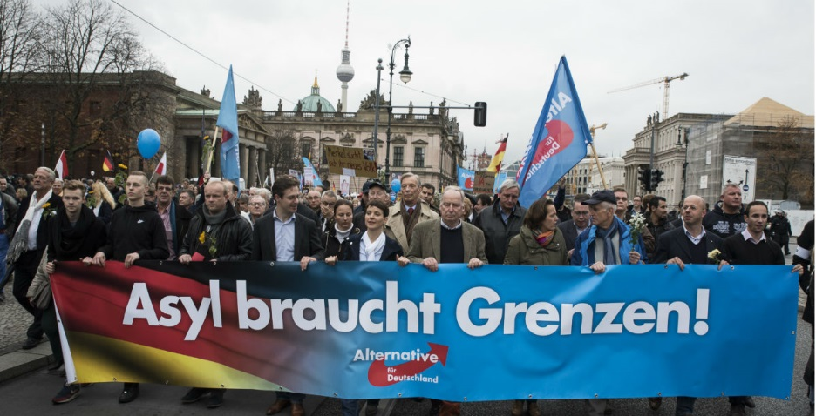
No comprehensive European immigration policy
Hence, the comprehensive European immigration policy seems to be failing to gather all member states around common decisions. Besides, the reactions of some countries to its implementation completely jeopardise the sentiment and goal of unity and solidarity between EU members.

Slide 41
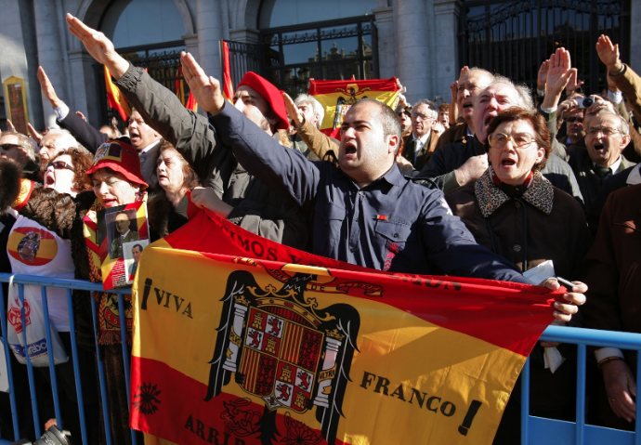
Characteristics of far right voters and parties programs
People from lower social strata and social categories suﬀering from disintegration are more likely to vote for a radical right-wing party.
Five clusters of socio-economic characteristics (Billiet and De Witte, 1995; Mudde, 2007):
  Anti-immigrant attitudes
  Favorable in-group attitudes
  Authoritarian attitudes
  Political dissatisfaction
  Euroscepticism

Slide 42
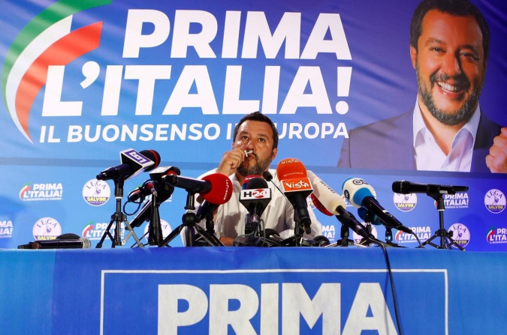
Far right parties are against EU integration
The opening of the borders through the Schengen Agreement, the EU enlargement and globalization have increased competition on lower levels of the labor market and the threat of cheap labor force offered by immigrants increase political distrust and discontent of the citizens.
Migration and asylum policy in the radical right’s rhetoric as well as euroscepticism are strongly associated with perceived ethnic threats.
Radical-right parties have a nativist ideology that combines xenophobia and nationalism which leads to Euroscepticism because it is inherently against the idea of supranational authority that overrides the will of the people.

Slide 43

Political crisis, social inequalities, disillusions
In the course of the profound financial crisis, political systems have also plunged into serious crisis. The ruling elites have proved incapable of dealing with the collapse of traditional bourgeois civil society and its economic dynamic. The priority to safeguard the interests of the financial capital and banking system, no matter of the citizens living conditions, has further enhanced nationalistic feelings.
Profound disillusion, growing insecurity, and the feeling that politics is no longer able to deliver solutions affect the whole traditional political spectrum. Social inequalities between poor and rich countries and individuals constantly increase and demonstrate the size of the chasm which is deepening within a ‘unified’ Europe.
Widespread criticism of the system is not spontaneously generating progressive options. A North –South axis is emerging which influence political behavior. Central and North EU –wealthy- countries tend to turn to far right, while the South EU –poor- countries turn to the left. This tendency is shifting after 2020.

Slide 44
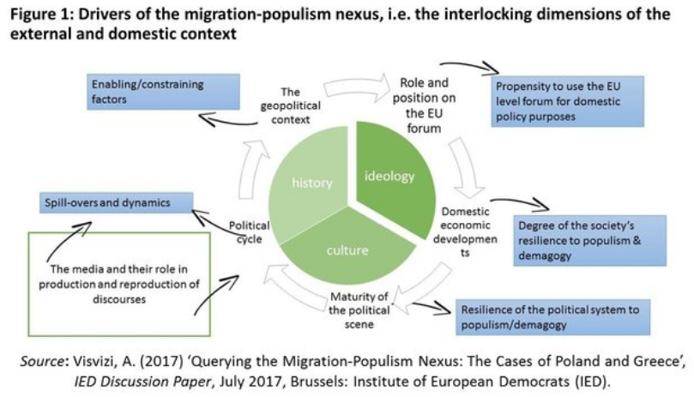
Migration – populism nexus

Slide 45
Populism as an ideology
The EU is caught in the crossfire between
  nationalists and internationalists,
  populists and liberals,
in the political battle across Europe.
The Eurozone and migration crises have dramatically accelerated preexisting trends of polarization and fragmentation. Some long-established parties are disappearing. Anti-establishment movements have been gaining support in many countries.
Populism as an ideology that considers society to be ultimately separated into two homogeneous and antagonistic groups – ‘the pure people’ versus the ‘corrupt elite’, and which argues that politics should be an expression of the volonté générale (general will, J.J. Rousseau) of the people and not of some bureaucrats in Brussels.

Slide 46

Migration crisis the biggest challenge for the EU member states
Migration crisis has placed the unity, cooperation and harmony of the EU under scrutiny from its outset and has tested the union’s moral ground to the limits.
No common European policy toward migration could be followed since 2015. Euroscepticism is constantly rising rather fast, but not as fast and dramatically as feared by democratic parties.

Slide 47
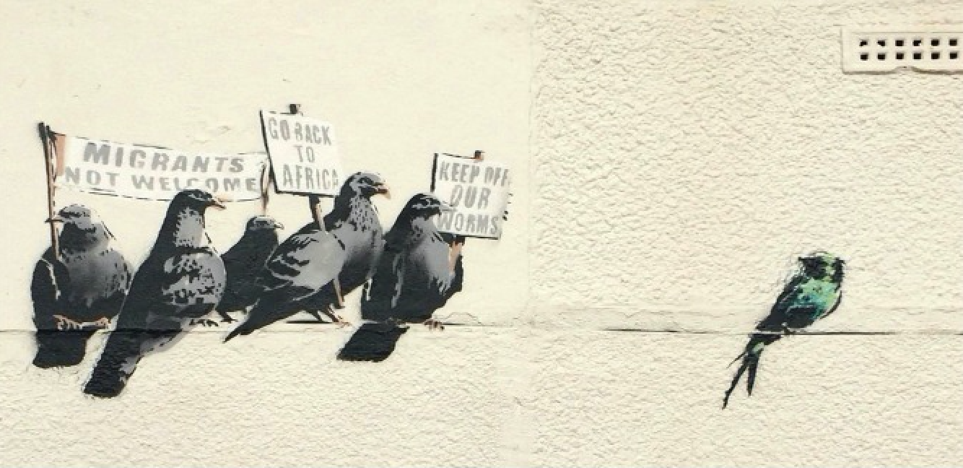
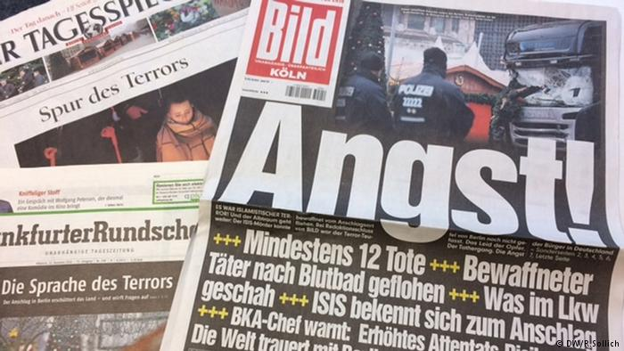
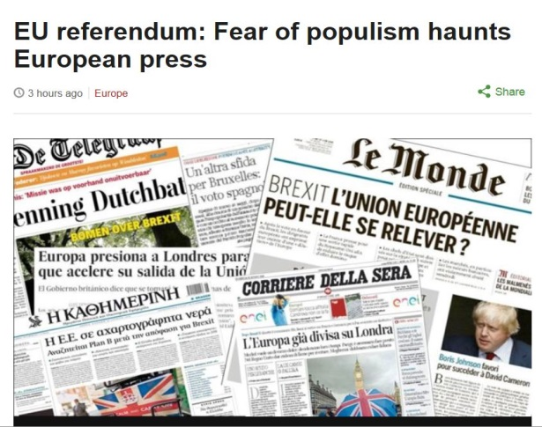
Populism and Media coverage of migration policies

Slide 48
Role of the media in representing immigration
Although some cast ‘the media’ as a singular entity, they are in fact a complex set of institutions, with tremendous internal variation. For our purposes, we view the media as a range of communication sources that transfer information from producers to consumers; increasingly, with internet-based and social media, consumers are also producers engaged in more direct exchanges than in traditional newspapers, magazines, TV and radio.
Role of the media regarding migration:
They provide a source of information about groups or issues related to migration and diversity
They convey or construct particular representations of minorities and immigrants, including negative depictions
They act as a space for the participation of migrants and minorities in a public sphere where they can advance their interests and identities

Slide 49
Populism and migration the perfect mixture for media coverage
In general, right-wing populist parties profit from the mechanisms of modern media (even though they make it a point to consider them as part of the “corrupt” establishment), because their strategies of political communication resonate with the needs of the media in terms of market demands and the news cycle.

Slide 50
Populism and media relation has a contagious quality
Some scholars believe that communication through the Internet can restructure political power in a populist direction and promote unmediated communication between politicians and citizens.
It is true that right and left-wing populist receive a lot of free media attention because of the sometimes provocative, emotional and simplified nature of their political communication.
Populism is threatening because it has a contagious quality – the appearance and rise of a populist party will predictably push a country’s other parties in a populist direction – and because populism can lead to the consolidation of illiberal polities (mostly right-wing populism) (Pappas 2017 www.democraticaudit.com).

Slide 51
Populism: is media attractive
Populist are frequently more personal and sensationalistic in nature. In this way, social media provide the populists with the freedom to uncontested articulate their ideology and spread their messages.
While the mass media adhere to professional norms and news values, social media serve as direct linkage to the people and allow the populists to circumvent the journalistic gatekeepers.

Slide 52
Journalism and media coverage of migration
A similarity in media coverage of refugees around the world is that “journalism is under pressure from a weakening media economy; political bias and opportunism that drives the news agenda” (Ethical Journalism Network, 2015).
There is adaptive challenge for the whole industry to change from 24-hour sensationalist and negative news towards more solution and positive coverage, not only regarding the issue of refugees, but everyday issues as well.
Media should re-take its power in helping public understand the facts, causes and solutions regarding the refugee crisis. Human side of the refugees’ crisis should not be excluded from the reporting on refugees if we seek to create a more profound understanding of the situation.

Slide 53
Media coverage of migration and far right populism
As migration flows grew bigger and more countries were affected, citizens got anxious and became aware of the consequences.
The shift in public awareness of the impact of migration crisis to the national economies and the EU led to a consolidation of an EU public sphere. Ongoing negative information about Eurozone hazards has encouraged individuals to gradually engage in systematic evidence-based opinion formation.
Newspapers and online media were flooded with articles describing and analyzing this unprecedented phenomenon, the respective politics and, peoples’ opinions and stances.

Slide 54
The media politics of everyday fear
For populist media there is a ‘culture of fear’ in western societies in relation to health, the environment, migration, technology and personal security.
Within refugee –migration ‘crisis’ discourse, immigrants, especially those categorized as ‘non-whites’ or ‘Muslims’, are not labelled as being racially inferior. Nonetheless, their cultures and values are commonly represented in media discourse as ‘alien’ and a threat to native people, and western, core values or democracy itself.

Slide 55
Is there a common ‘European’ narrative in the press?
Various comparative researches among different EU member states concluded that there is significant variation among national press “challeng[ing] assertions of an emerging single coherent European mode of framing immigration.” (Caviedes 2015: 911).
Against the aspiration of a common policy on migration, the result demonstrate divergent narratives across countries… separate, nationally tailored solutions appear (ibid. 912, see also Berry, Garcia-Blanco & Moore 2016:7).
“One size” reporting does not fit all. Effective media advocacy requires nationally targeted, tailored campaigning.
Thus, exclusion seems for the right and far right parties the only solution to defend oneself and the nation.

Slide 56
Media are incapable to understand and mediate the new phase
Media represent a key domain for Europe to encounter refugees. As the refugee - migration ‘crisis’ is entering a new phase, that of refugees becoming immigrants and that of their integration to the host societies, media continue to face significant challenges to understand the responsibilities and consequences of the new residents (Chouliaraki, Georgiou, Zaborowski 2017).

Slide 57
Bibliography
Albertazzi D. and Duncan McDonnell (eds.) (2008), Twenty-First Century Populism: The Spectre of Western European Democracy, Palgrave Macmillan, New York.
Baumann Zygmund (2001) The Individualized Society, Cambridge Polity Press.
Berry M., Garcia-Blanco I., Moore K. (2016), Press Coverage of the Refugee and Migrant Crisis in the EU: A Content
Analysis of Five European Countries, Report prepared for the United Nations High Commission for Refugees
(December 2015).
Billiet J., De Witte H. (1995), Attitudinal Dispositions to Vote for a ’New’ Extreme Right-Wing Party: The Case of Vlaams Blok, European Journal of Political Research, 27, 181-202.
Caviedes A. (2015), An Emerging ‘European’ News Portrayal of Immigration?, Journal for Ethnic and Migration Studies, 41, 897-917.
Greven T, (2016), The Rise of Right-wing Populism in Europe and the United States A Comparative Perspective, Friedrich Ebert Stiftung,
Mazzoleni G. (2003), The Media and Neo-populism: A Contemporary Comparative Analysis, Greenwood Publishing Group, California.
Mazzoleni G. (2008), Populism and the Media, in: Albertazzi D. and Duncan McDonnell (eds.), Twenty-First Century Populism: The Spectre of Western European Democracy, Palgrave Macmillan, New York, pp. 49-66.
Betz G. Right- wing Populism in Western Europe, MacMillan, London.
Mudde, Cas. 2004. The populist Zeitgeist. Government and Opposition, 39 (4): 541–563.
Mudde, Cas. 2007. Populist radical right parties in Europe. Cambridge: Cambridge University Press.
Stavrakakis, Yannis, and Giorgos Katsambekis. 2014. “Left-Wing Populism in the European Periphery: The Case of SYRIZA.” Journal of Political Ideologies 19 (2): 119–142.
Visvizi A.(2017), Querying the Migration-Populism Nexus: Poland and Greece in Focus, V4 EUROPE – “Pieces of populism in Europe and how to overcome the challenge”, Budapest – Hungary, Discussion Paper.
Wodak, Ruth (4 March 2014). "Right wing populist parties on the rise". Cyprus Mail.

Slide 58
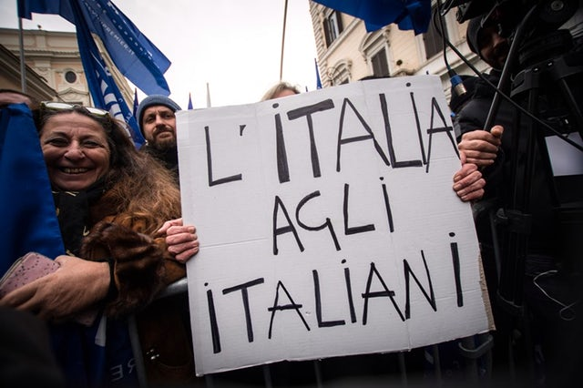
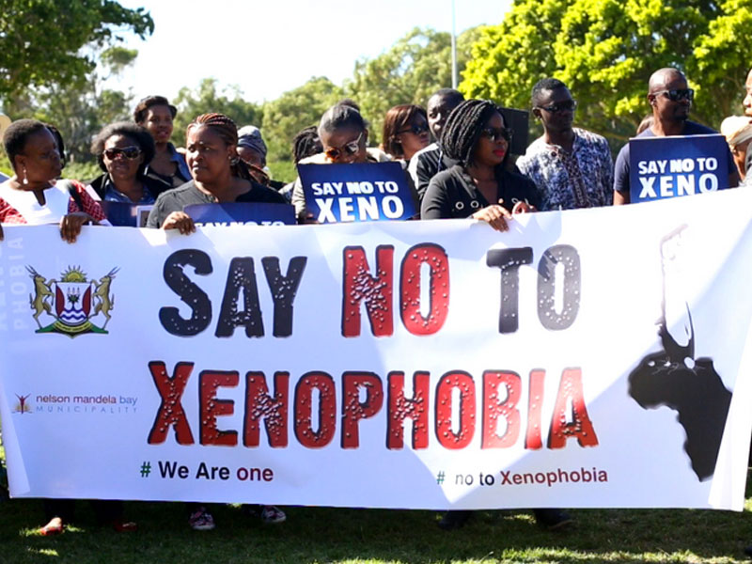
Thank you

