Slide 1
Refugee / Migration Flows Old and New Media
The European media discourse on immigration
Professor emerita Roy Panagiotopoulou
Department of Communication and Media Studies
National and Kapodistrian University of Athens
rpanag@media.uoa.gr

Slide 2
Content of this presentation
Development of common migration policy
EU immigration policy based on solidarity?
EU solidarity and cohesion at stake?
The rise of extreme-right parties in the EU and immigration issues

Slide 3
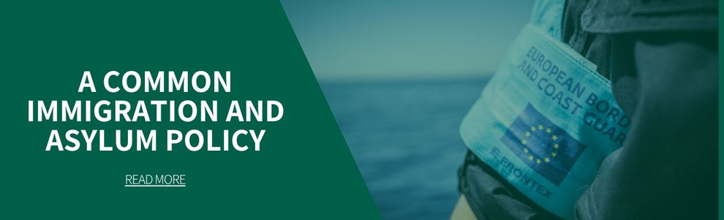
Development of common migration policy in the EU

Slide 4
Brief timeline of European migration regulations I
1950 – 1960: Although it is difficult to generalize about different policies and countries, it can be argued that immigrants were primarily an extra workforce in most western European countries. They offered cheap and flexible workforce that did not exist in the domestic market. France, Germany, Belgium and the Netherlands used a permissive or even promotional migration policy.
1960 -1970: immigration became increasingly a subject of public concern. There was a shift from a permissive immigration policy to a control-oriented, restrictive policy. However, the understanding of immigrants itself did not radically changed, they were still categorized as guest workers (Gastarbeiter). The restrictive policies were motivated by changes in the labor market and by a desire to protect the social and economic rights of the domestic workforce.
1974: A first attempt towards a common migration policy was the adoption of the action programme in favor of migrant workers and their families. The interest in regulating questions of migration was connected to EC enlargement to the UK, Ireland and Denmark.

Slide 5
Brief timeline of European migration regulations II
Since the mid-1980s, immigration has been increasingly politicized through the question of asylum, or through the (con)fusion of immigration and asylum. Asylum has been politicized as an alternative route for economic immigration in the EU. This politicization also explains why asylum has been so easily connected to illegal immigration.
Migration became an important issue in intergovernmental fora in Europe such as Trevi, (Ad Hoc Group on Immigration) and the Schengen group. These fora shaped the development of migration policy within the EU.
1992: The Treaty on European Union introduced a Third Pillar on Justice and Home Affairs in which migration was an explicit subject of intergovernmental regulation within the EU.

Slide 6
Dublin Convention – Refugee policy
1997: Dublin Convention, came into force on September 1997 for the first twelve signatories. The Dublin Convention is a piece of European law that has two main aims: to establish a common framework for determining which country in the European Union decides an asylum seeker’s application and to ensure that only one member state should process each asylum application. Common regulations on migration in western Europe have emphasized the need for restrictions of population flows. The Dublin Convention limits the ability of states to pass the buck in the case of application for asylum. It sets out criteria – for example, place of application and family links – determining the state that must process the asylum application. In a way the convention improves the situation for the asylum-seeker.

Slide 7
Dublin Regulation I – Refugee policy
2003: The Dublin II Regulation was replacing the Dublin Convention in all EU member states except Denmark. It determines which EU Member state is responsible for the examination of applications from asylum seekers seeking international protection within the EU under the Geneva Convention and the EU Qualification Directive. It is the cornerstone of the Dublin System, which consists of the Dublin Regulation and the EURODAC Regulation, which establishes a Europe-wide fingerprinting database for unauthorized entrants to the EU.
The vast majority of “illegal” immigrants or asylum seekers enter Europe through countries like Greece, Malta, Italy and Spain. Some of them are too small (Malta), or economically too weak at the moment (Greece) to deal with the sheer numbers of immigrants on their own. However, Central and North EU countries make it very difficult for countries on the borders of Europe to deal with the problem, plus they criticize them for any failure or mishandling.

Slide 8
Dublin Regulation III – Refugee policy
The Dublin III Regulation (No. 604/2013) was approved in June 2013, replacing the Dublin II Regulation, and applies to all member states except Denmark.
Under the Dublin Regulation, an asylum seeker has to apply for asylum in the first EU country he/she enters, and, if he/she cross borders to another country after being fingerprinted, he/she can be returned to the former.
During the 2015 European refugee and migrant crisis, Hungary became overburdened by asylum applications to the point that it stopped on 23 June 2015 receiving back its applicants who later crossed the borders to other EU countries and were detained there.
On 24 August 2015, Germany decided to make use of the "sovereignty clause" to voluntarily assume responsibility for processing Syrian asylum applications for which it is not otherwise responsible under the criteria of the Regulation.

Slide 9
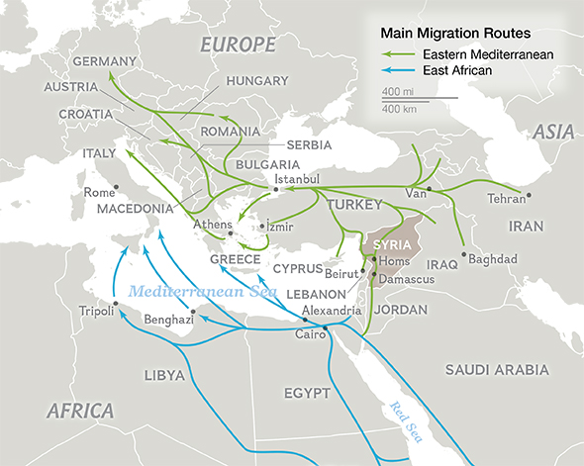
Eastern Mediterranean Route
Source: http://news.nationalgeographic.com/2015/09/150919-data-points-refugees-migrants-maps-human-migrations-syria-world/

Slide 10
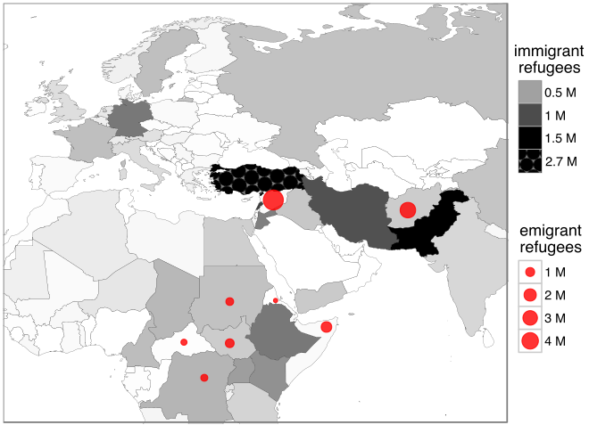
Refugees and asylum seekers at the end of 2015

Slide 11
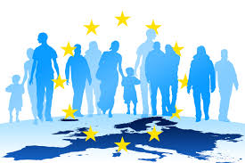
EU immigration policy based on solidarity?

Slide 12
EU SOLIDARITY CLAUSE
The Solidarity clause, introduced by Article 222 of the Treaty on the Functioning of the European Union (TFEU), provides the option for the EU countries:
to act jointly;
to prevent the terrorist threat in the territory of an EU country;
to provide assistance to another EU country which is the victim of a natural or man-made disaster.
The clause was implemented as anticipated following the terrorist attacks in Madrid in March 2004.
In 2014, the EU adopted a decision laying down the rules and procedures for the operation of the solidarity clause. It ensures that all the parties concerned at national and at EU levels work together to respond quickly, effectively and consistently in the event of terrorist attacks or natural or man-made disasters.
The European Union Solidarity Fund is an instrument financing operations in the field of civil protection first created in 2002. Under revised rules adopted in 2014, working procedures have been simplified and eligibility criteria clarified and extended to cover drought.

Slide 13
EU migration policy based on solidarity?
On 2 September 2015, the Czech Republic decided not to offer asylum to Syrian refugees who have already applied for asylum in other EU countries and who reach the country to either have their application processed in the Czech Republic (i.e. get asylum there) or to continue their journey elsewhere.
Apart from Czech Republic other member states such as Hungary, Slovakia and Poland (Visegrad group) officially stated their opposition to any possible revision or enlargement of the Dublin Regulation, specifically referring to the eventual introduction of new mandatory or permanent quotas for solidarity measures.

Slide 14
EU migration policy based on solidarity?
Objectives of a common immigration policy
A forward-looking and comprehensive European immigration policy, based on solidarity, is a key objective for the European Union. Immigration policy is intended to establish a balanced approach to dealing with both regular and irregular migration.
From 2015 onwards solidarity and common dealing with the migration policy – refugee crisis was over!
Lack of common decisions and therefore a common policy characterize the entire EU migration policy up to now.

Slide 15
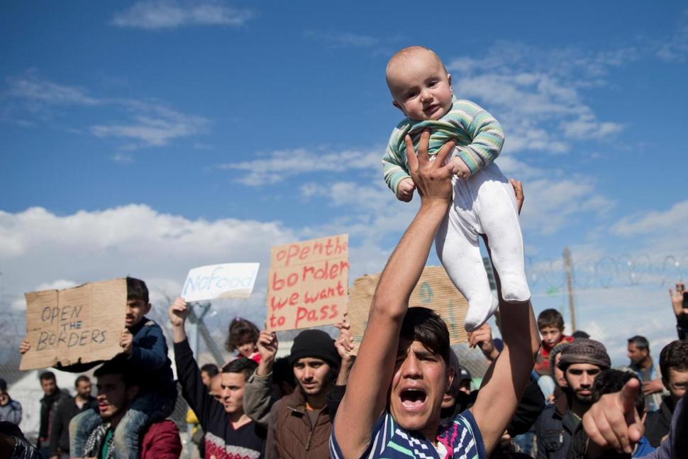
Closing boarders to Europe
After closing the boarders in Hungary, Austria, Czech Republic and Germany in September 2015, the Schengen agreement of free circulation of people was overrode until the end of this year.
After reducing the flow to a trickle of a few hundred Syrians and Afghans a day, Norther Macedonia fully sealed its border with Greece on 9.3.2016, shutting down the Balkan trail used by more than a million people. Northern Macedonia said the lockdown was a response to action by Slovenia, Croatia and Serbia further up the route. Hungary on 8.3.2016 extended a “state of emergency” to the whole country and said it was ready to deploy troops.
Due to these measures refugees were trapped in the northern boarder of Greece (Idomeni) refusing at the beginning to accept the new situation. The majority of migrants wants to settle somewhere in central or northern Europe.

Slide 16
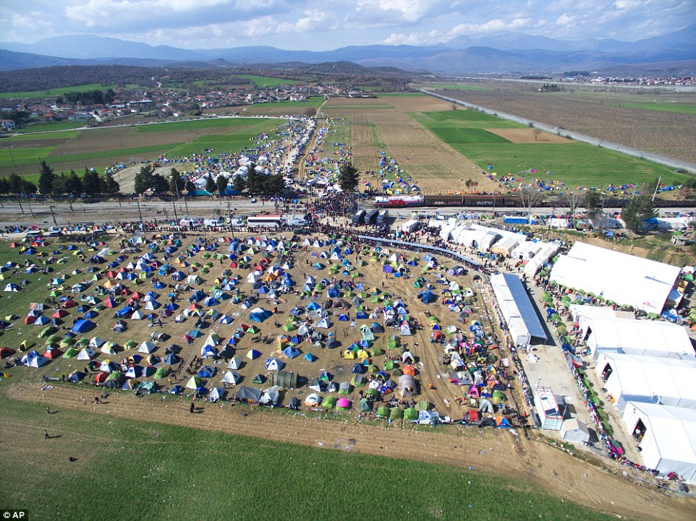
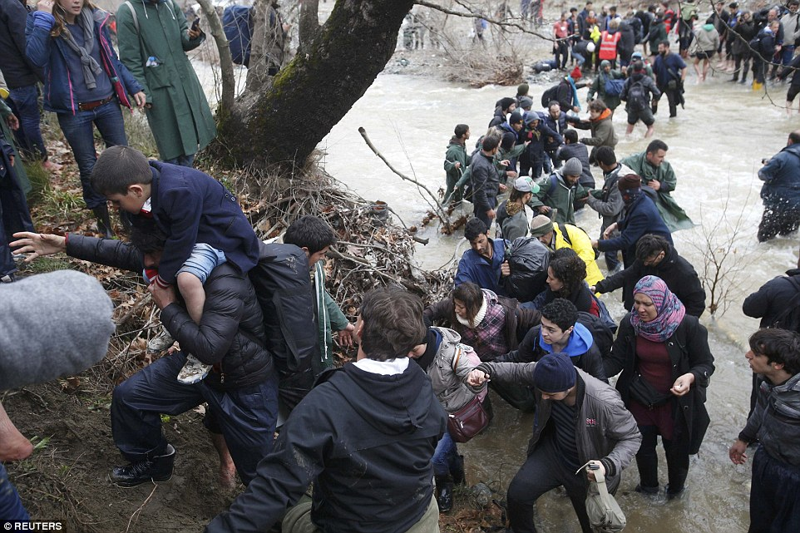
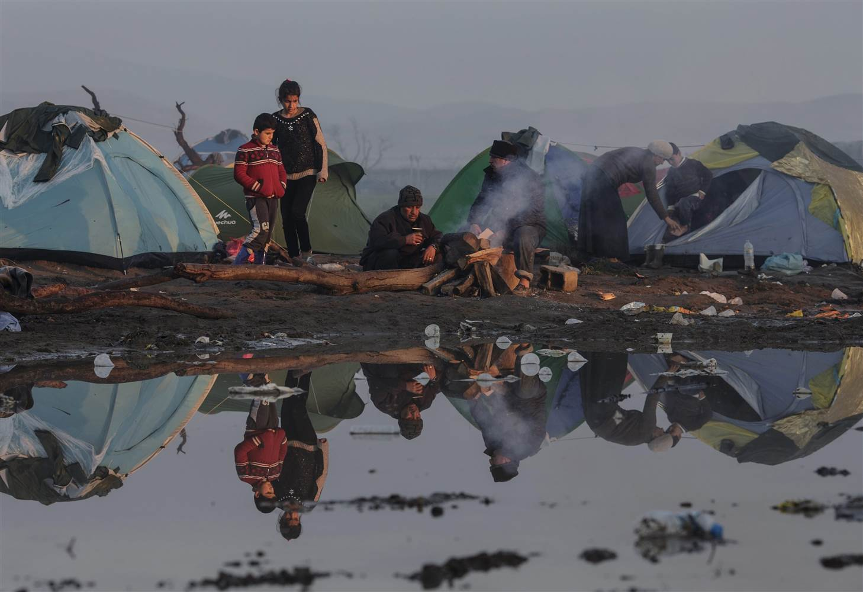
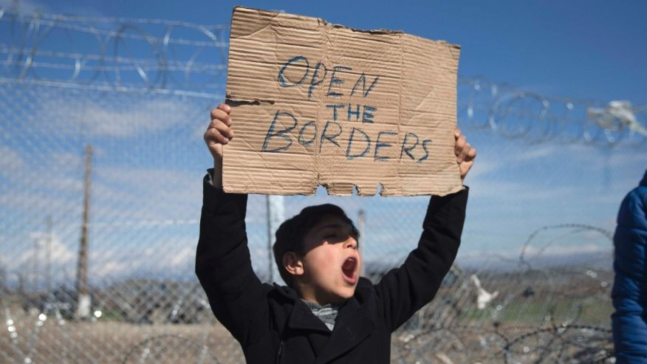
Open the boarders! Deadly desperate…
15.3.2016 Idomeni, trying to cross the boarder illegally

Slide 17
The EU –Turkey agreement nine months later (The Guardian 8.12.2016)
After the EU-Turkey Statement was signed on the 18 March, 2016 and the borders with Northern Macedonia were closed, the bulk of the migration flows were diverted to the Central Mediterranean route.
From a total of 160,000 refugees to be relocated according the EU-Turkey Statement, up to 5.12.2016 only 8,162 have been relocated. This is about 5% of the total refugee population. This is 6.212 refugees come from Greece and 1.950 from Italy.
From the Visegrad group Hungary and Poland haven’t accepted any refugee, Slovakia 9 and Czech Republic 12!
At the same time 748 migrants have been send back from Greece to Turkey.
From the promised 3 billion Euros only 677 mio. have been given to Turkey as support for the migration flow in the first two years of the Statement.
Deep disagreement and national political priorities still prevail. Up to now the EU countries have not succeed to set up a common migration policy that is accepted and followed by all member states.

Slide 18
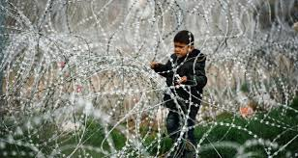
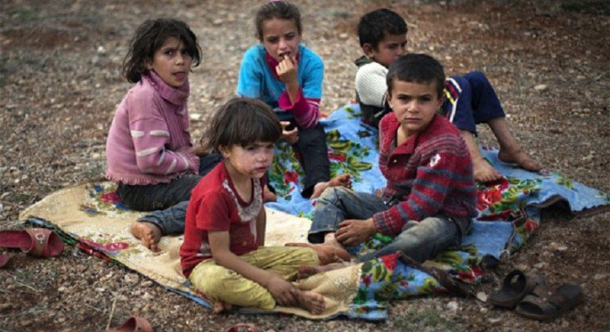
Unaccompanied minors
According to UNICEF, 37% of people arriving in Greece since January 2016 ware children. With new arrivals detained on the islands since the EU’s Statement with Turkey, there ware about 6,000 children living in camp facilities (Save the Children 14.11.2016).
At least 600 children have died trying to cross the Mediterranean so far in 2016 (Save the Children 3.10.2016).
The majority of the children seeking asylum (75%) ware 15-17 years old, while 19% ware 10-14 years old. Regarding country of origin, 51% originated from Afghanistan, 33% from Syria and 13% from Iraq (total 690 unaccompanied children) (2.8.2016 http://greece.greekreporter.com/2016/08/02/hundreds-of-unaccompanied-children-among-asylum-seekers-in-greece/).
This is a family reunion strategy followed by immigrants who have not the status of refugee.

Slide 19
Lost in Europe: Migrant and refugee children missing in Europe (2021)
Between 2018-2020, 18,292 children in migration went missing in Europe.
The countries with the largest numbers of missing children were Italy (5,775), Belgium (2,642), and Greece (2,118).
The situation is partly a consequence of the migration policies. In some countries, migrant minors need to go through very bureaucratic processes to prove their age when applying for asylum. This can result in trying their luck elsewhere, as they move to another country. First country is losing track of them. There are also criminal cases (work exploitation, trafficking, porn, etc.).
Since 2018, at least 440 underage refugees and migrants have died on their way to Europe (open source database compiled by UNITED, https://lostineurope.eu/file/no-numbers-file).

Slide 20
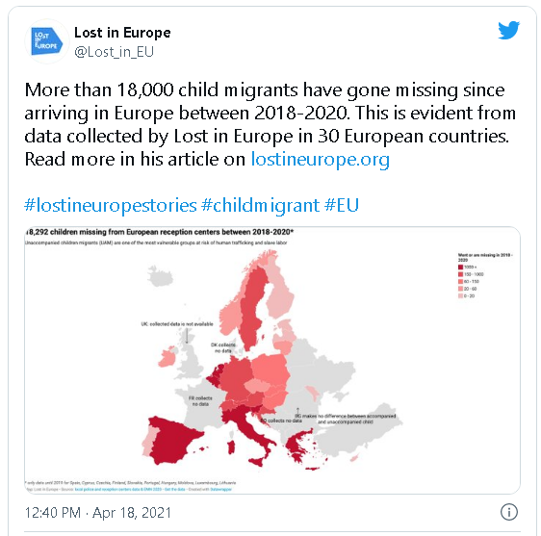
Source: https://missingchildreneurope.eu/over-18-000-missing-children-in-migration/

Slide 21
EU: Development of common migration policy
The development of a common migration policy in the EU is embedded in wider social, political and economic processes that in the majority of cases articulate an endangered society. Integration of migrants into the societies of the member states faces a wide range of challenges and political legitimacy such as:
economic and financial globalization,
rise of poverty,
deterioration of living conditions mostly in cities,
revival of racist and xenophobic parties and movements,
estrangement of the electorate from the traditional political parties and elites,
rise of multiculturalism, etc.

Slide 22
Fortress Europe. Open or closed borders?
Although in 2018 migration crisis was almost over, the problem of migrant settlement remains acute and causes political tensions.
End of June 2018, a severe crisis among the governing party coalition in Germany has sawn how splitting this issue may be. CDU and CSU heads split over “secondary” migrants.
Ms. Merkel (CDU) has staked her legacy on upholding the European Union and maintain open borders among member states. She has also emphasized German leadership on accepting migrants and refugees.
Mr. Seehofer, leader of CSU and Minister of Interior, underpinned that Bavaria, located on the border with Austria, receives a disproportionate number of secondary migrants.(although new arrivals have dropped off).
Ms. Merkel announced a compromise deal. Germany would set up closed camps along the Austrian border to house secondary migrants while their status was reviewed. The plan would work through bilateral deals between Germany and other European countries — rather than through big, multilateral agreements, which is how the union is supposed to work. That would further chip away at the union.
Closing Europe’s internal borders would put enormous pressure on the countries where migrants and refugees typically arrive first. Italy’s new populist government threatened to leave the Union altogether.

Slide 23
EU common measures on COVID-19 pandemic concerning immigration
Although COVID-19 pandemic affected all EU member states, there were only few measures applying to all countries to bring the virus under control, keep systems operation and to mitigate the impacts on migrants and citizens. Each member state has decided for its own system of citizen and migrant protection (e.g. border closures, quarantines, lockdowns, vaccination, travel restrictions, residence permits, restrictions on in-person immigration related services and introduction of sanitary measures).
Mainstream supports available to the unemployed were also applicable to migrants during this period and special health care measures and facilities were initiated (medical care, vaccination). Especially COVID-19 related healthcare was available for all migrants but not all EU countries adopted the same level of service provision. UNHCR undertook a great part of emergency healthcare and essential treatment for refugees / migrants.
Source: European Commission (2021), The impact of COVID-19 in the migration area in EU and OECD countries EMN OECD UMBRELLA INFORM, file:///D:/My%20Documents/NEW_OLD%20WINDOWS%202013/Pandemic%20Koronoios%202020/00-eu-emn-covid19-umbrella-inform-en.pdf

Slide 24
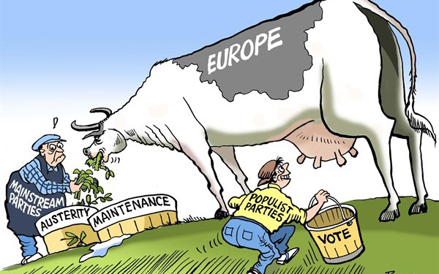
EU solidarity and cohesion at stake?

Slide 25
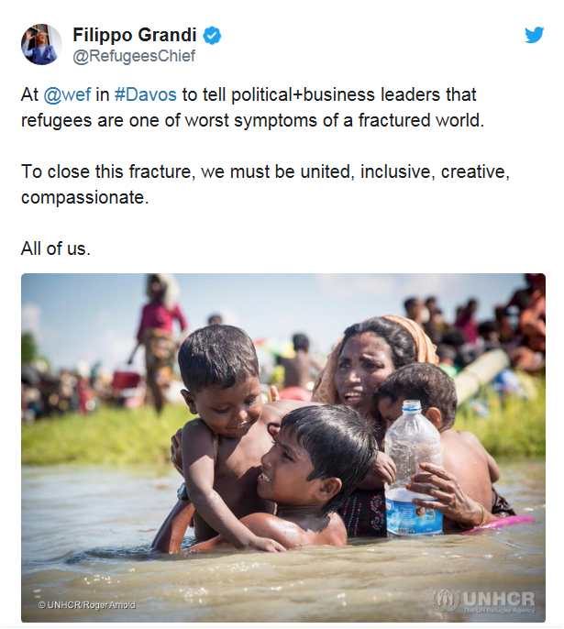

UNHCR chief Filippo Grandi: EU won’t solve migration crisis without restoring solidarity

Slide 26
Solidarity is the glue that keeps our Union together
On 14 September 2016 the president of the European Commission Jean-Claude Junker delivered his State of the Union speech before the European Parliament. He stated that solidarity is the glue that keeps our Union together. Regarding Europe’s response to the dramatic increase in the number of migrants coming to Europe since Spring 2015, he argued:
  “And when it comes to managing the refugee crisis, we have started to see solidarity. I am convinced much more solidarity is needed. But I also know that solidarity must be given voluntarily. It must come from the heart. It cannot be forced.” (European Commission, 2016a, p.16).

Slide 27
Attempts to develop a relocation scheme accepted by all EU member states
Following highly debated controversies on the role that the Union needs to play in regards to several accidents in the Mediterranean Sea, the European Commission established its first relocation scheme in May 2015.
However, still facing a huge number of asylum applications, the European Union decided, in September 2015, to set up new refugee quotas. The plan of relocating 120,000 people located in Italy, Greece and Hungary has been quite controversial amongst EU member states.

Slide 28
Attempts to develop a relocation scheme accepted by all EU member states
More specifically, in May 2015 the Council issued a proposal for the relocation of 40,000 asylum seekers. In September of the same year, a new proposal was presented, which provided for the relocation of 106,000 asylum seekers from Greece and Italy, plus 54,000 from an unspecified country, mainly from Hungary, the total number amounting to 160,000 persons.
The countries of the Visegrad Group (Poland, Hungary, Slovakia, Czech Republic, V4) are showing clear opposition to this relocation system.
Ultimately, relocations were limited only to Syrian nationals.

Slide 29
Solidarity discourse in the refugee crisis
The solidarity discourse in the refugee crisis was predominantly on political solidarity and served as common ground for the public debate among party actors.
The demand for an institutional reform of the Common European Asylum System (CEAS) combined with the aim of protecting the Schengen Agreement created unique solidarity discourses that largely focused on political means to solidarity. Nonetheless, at the end of 2015, security and demarcation issues became more visible and challenged the predominant solidarity framing of the German media discourse.
Then, setting up fences at national borders and the renationalization of border control and border surveillance fundamentally questioned a solidarity solution to the refugee crisis.

Slide 30
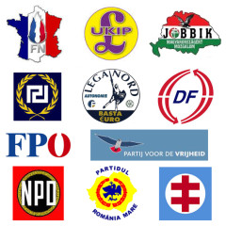
The rise of extreme-right parties in the EU and immigration issues

Slide 31
The rise of extreme-right parties
Right-wing extremism and Euroscepticism are not new terms in post-war European history. The recent escalation of the refugee ‘crisis’ has become a very serious and sinister driving force for far right wing parties.
After WWII extreme right parties witnessed a significant decline in their popularity in Europe. They started to evolve into the contemporary political power in the end of the 1980s as anti-globalist, anti-immigrant movements.
Far right parties did well in the European Parliament (EP) elections in 2014, 2019 and 2024.
The trend to vote far right parties among the European Union (EU) countries is constantly increasing.

Slide 32
A right wing party shift in 2014 EP elections
In Europe, the results of the 2014 European Parliament elections were largely interpreted as a populist backlash, giving rise to the success of Eurosceptic parties.
Right-wing parties such as the French National Front (FN), the United Kingdom Independence Party (UKIP), and the Danish People’s Party, received the highest share of voters in their respective countries. At the same election left wing parties like SYRIZA in Greece and Podemos in Spain have gained considerable support.

Slide 33
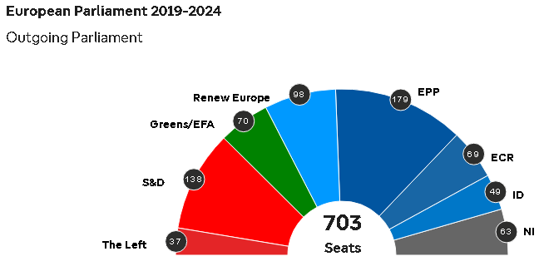
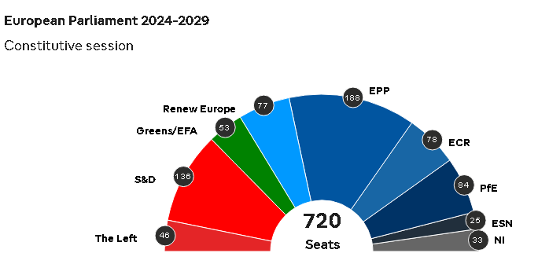
European Parliament seats distribution 2019-2024 and 2024-2029

Slide 34
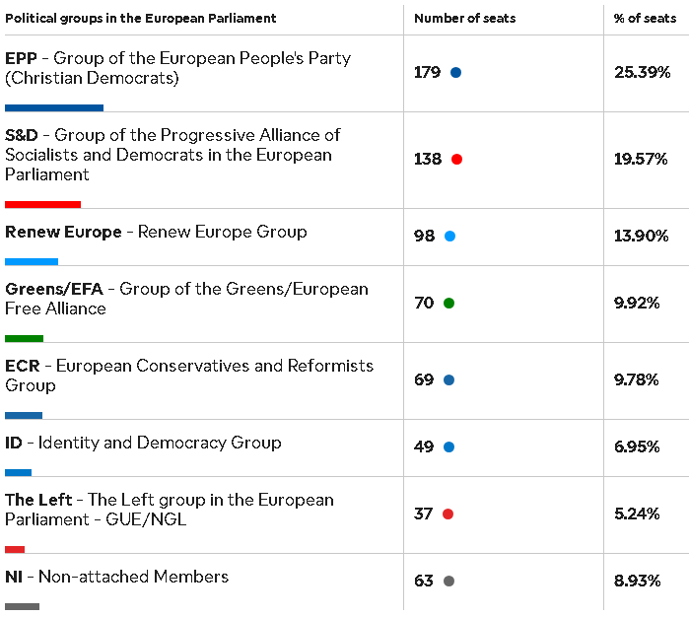
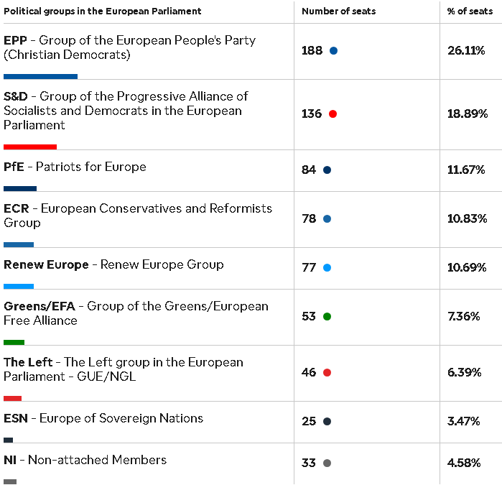
European Parliament seats distribution 2019-2024 and 2024-2029
EP seats distribution 2019-2024 (and in %)
EP seats distribution 2024-2029 (and in %)

Slide 35
Eurozone’s deep aversion to populism
From the standpoint of the Eurozone’s economic, political and intellectual elites, Europe and populism are viewed as the two extremes of a radical antithesis.
Elites, who define the issues, have lost touch with the people, but also with reality too. They are unaware that, in order to function properly, both the economy and democracy require a broad distribution of wealth and income. They also think that the people’s say on their own future is superfluous. And when they pose demands, their demands are conveniently denounced as populism.
European elites opt to demonize populism, shaping their political future in the articulation of an extreme anti-populist agenda. However, they often use populist strategies to demonstrate their discontent or opposition either to national political decisions (e.g. Greek Referendum of 5.7.2015) or to broader socio-economic phenomena (e.g. migration ‘crisis’ March 2015 – March 2016).

Slide 36
EU a community of shared values?
However, the EU itself also claims to be a community of shared values, as expressed in the 2001 Laeken Declaration, the 2007 Berlin Declaration, the 2011 GAMM framework, the Copenhagen criteria for accession and the conditionality it imposes on trade agreements with third countries. It is this community of value on whose behalf then EU Commission President José Manuel Barroso accepted the Nobel peace prize in 2012 and to which Angela Merkel doggedly refers. Phrases like ‘Europe’s disgrace’ and ‘shame’ to describe the terrible humanitarian situation in Idomeni, Lesvos, Chios and elsewhere along the EU’s borders explicitly refer to these putative shared values. These are values that member states now only honour but not follow.

Slide 37
EU’s inability to overcome ‘burden-sharing’
Migration and asylum only became part of EU affairs as a result of the Tampere European Summit in 1999. The summit signaled a diplomatic move from low to high politics that – as the EU’s ongoing difficulties in agreeing and enforcing a common response to unabated migrant arrivals show – is not reflected in the reality of current immigration policy or crisis management.
The EU’s inability to overcome its member states’ aversion to ‘burden-sharing’ and redistributing asylum seekers across its territory has been taken to indicate the exhaustion of the European integration project itself.

Slide 38
No comprehensive European immigration policy
Hence, the comprehensive European immigration policy seems to be failing to gather all member states around common decisions. Besides, the reactions of some countries to its implementation completely jeopardise the sentiment and goal of unity and solidarity between EU members.

Slide 39
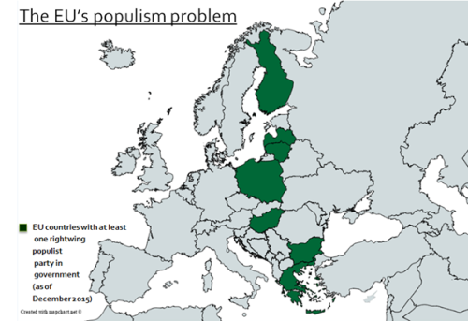
EU countries with at least one right-wing populist party in government 2015
Source: Tamás Boros, 15.3.2016, http://www.progressives-zentrum.org/populism-and-migration-challenges-for-the-left/

Slide 40
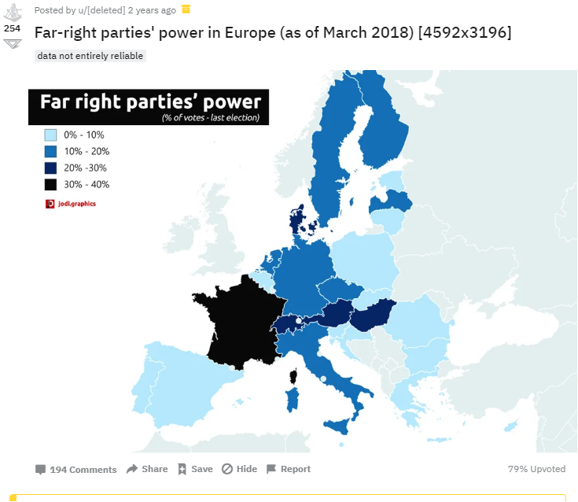
Source: https://www.reddit.com/r/MapPorn/comments/870ybl/farright_parties_power_in_europe_as_of_march_2018/

Slide 41
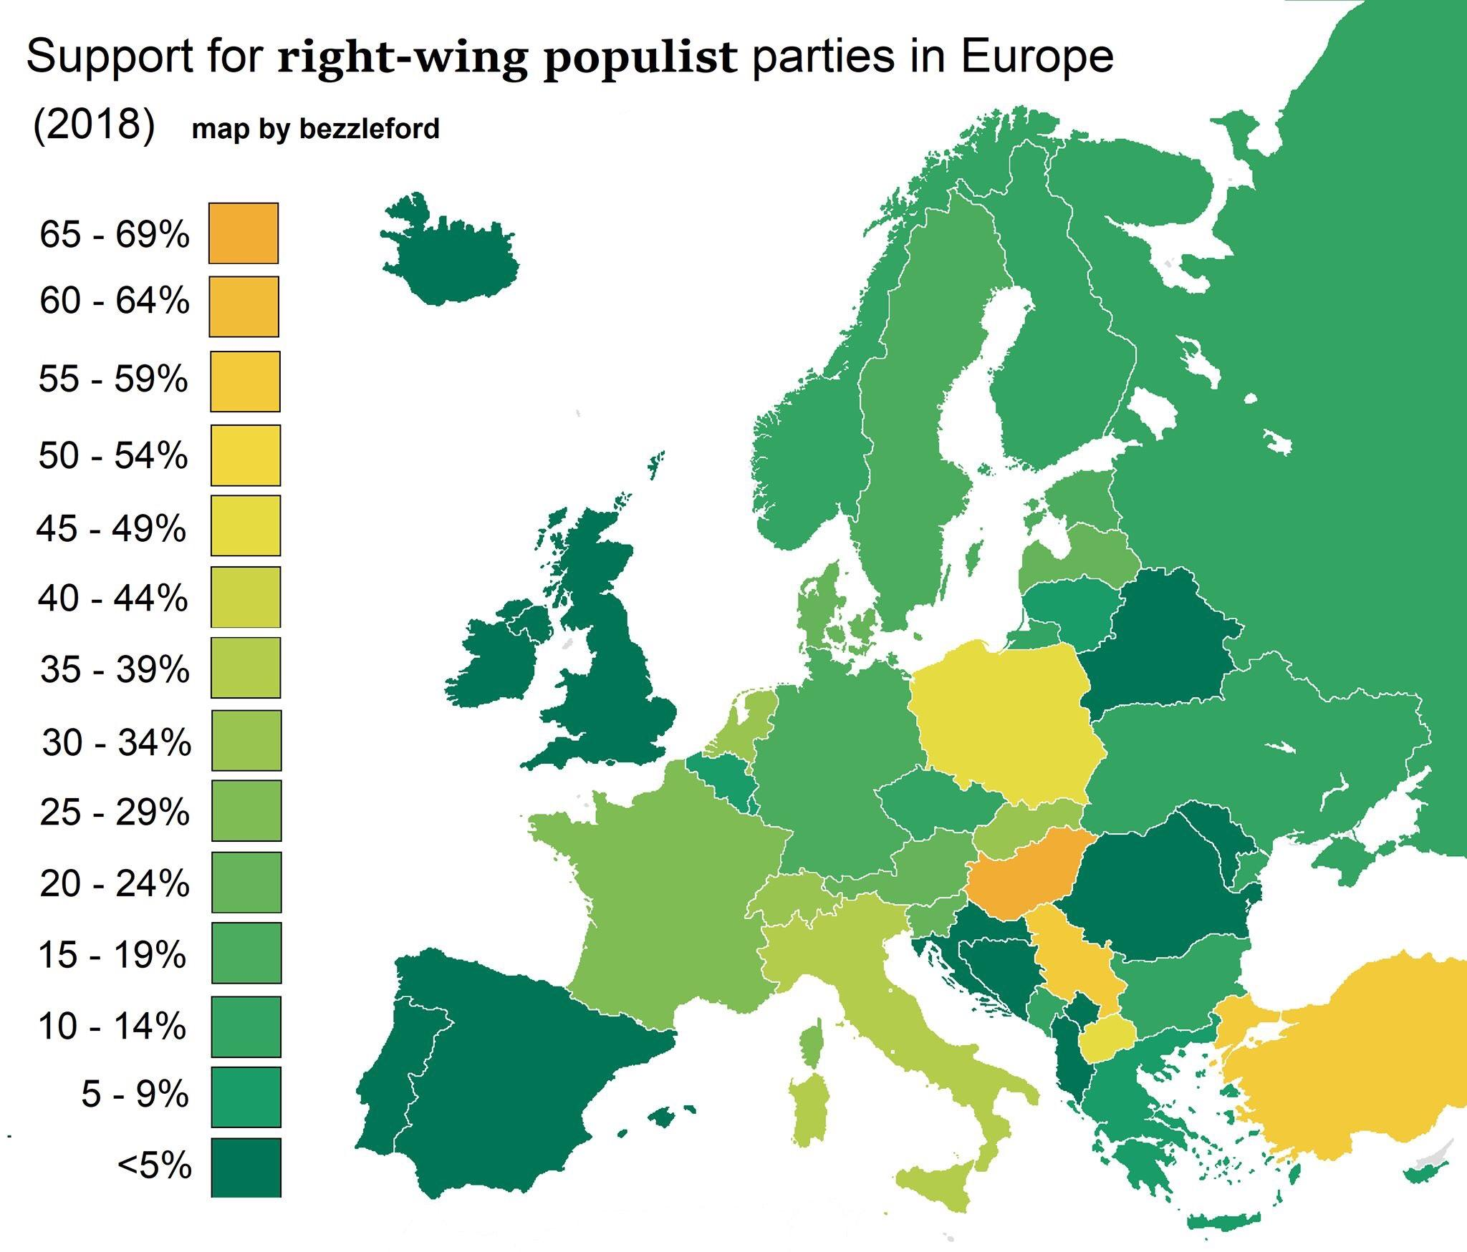
Source: https://www.reddit.com/r/europe/comments/9jou5h/support_for_rightwing_populist_parties_in_europe/

Slide 42
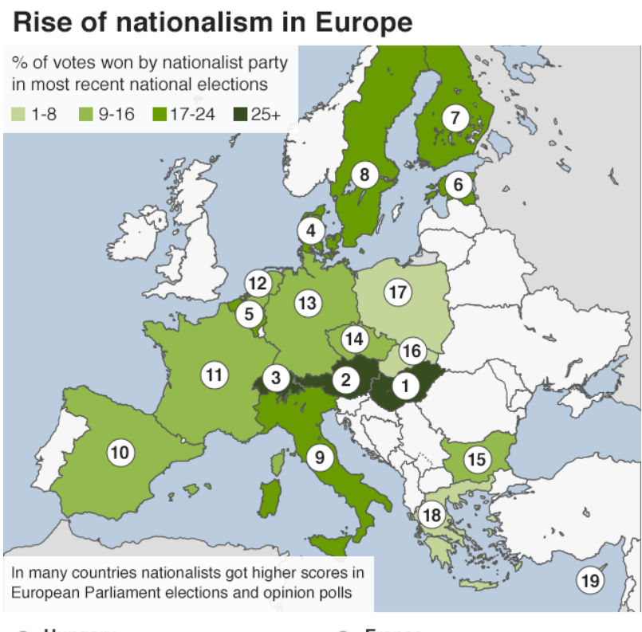
2019
Source: https://www.bbc.com/news/world-europe-36130006

Slide 43
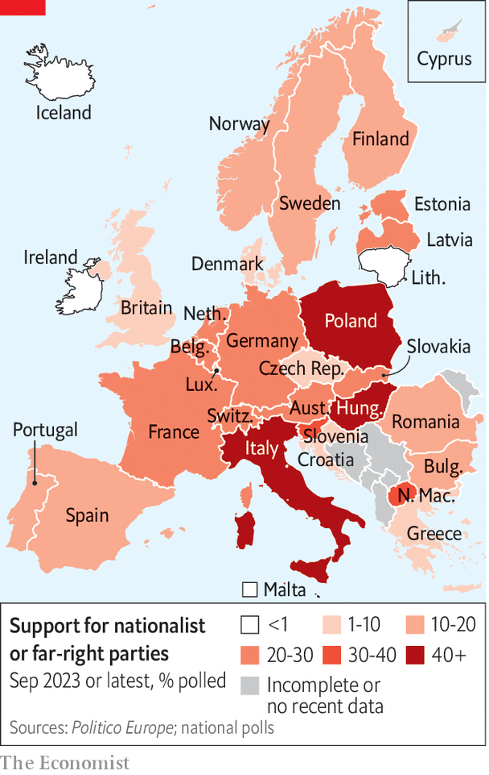
Rise of Natio-nalism in Europe 2023

Slide 44
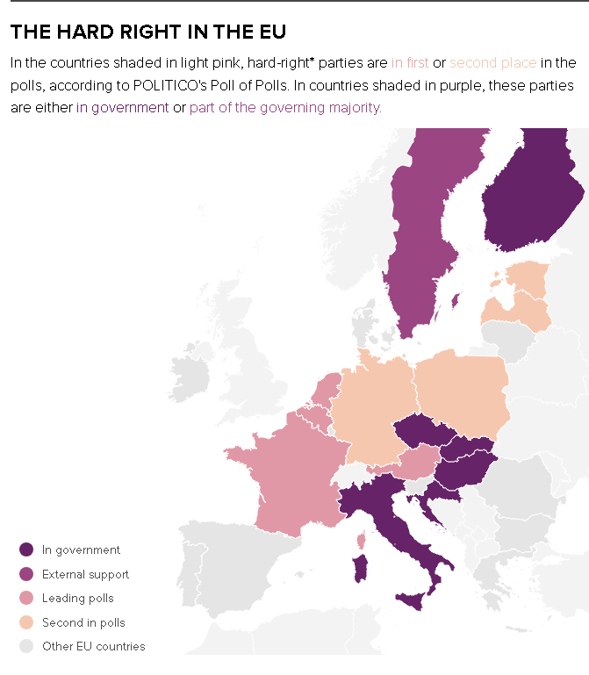
Right wing parties in the EU before EP elections 2024
Source: POLITICO research Polling data as of May 23, 2024. https://www.politico.eu/article/mapped-europe-far-right-government-power-politics-eu-italy-finalnd-hungary-parties-elections-polling/

Slide 45
Populism as ideology regarding EU politics
The EU is caught in the crossfire between
  nationalists and internationalists,
  populists and liberals,
in the political battle across the future of Europe.
The Eurozone and migration ‘crises’ have dramatically accelerated preexisting trends of polarization and fragmentation. Some long-established parties are disappearing. Anti-establishment movements and far right political parties have been gaining support in many countries.

Slide 46
Clear division of member states on immigration policy and its implications
The division of member states on immigration policy is leading to significant consequences, in a time when the Union is already facing huge difficulties, notably with Brexit, various crises and the democratic deficit.
The migration crisis and the reactions of some member states might be revealing a deeper issue related to xenophobia and islamophobia. Eventually, the European Union needs to take concrete actions in order to overcome this wave of non-toleration, as it goes against the values and core essence of the Union, and call into question the coexistence of different cultures across Europe.

Slide 47
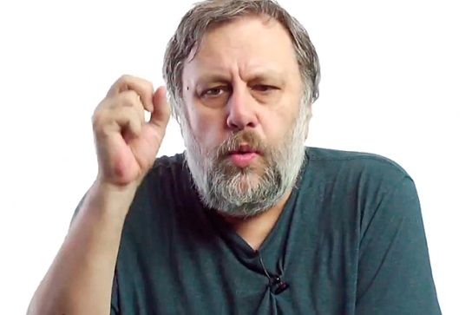
The weakness of a Europe: identity and cohesion
Slavoj Žižek (2016), underpin that the paranoid talk about the immigrant threat is still an ideological pathology. It tells more about us, Europeans, than about immigrants.
The true question is not “are immigrants a real threat to Europe?”, but “what does this obsession with the immigrant threat tell us about the weakness of Europe?”
(https://www.newstatesman.com/politics/uk/2016/02/slavoj-zizek-what-our-fear-refugees-says-about-europe)

Slide 48
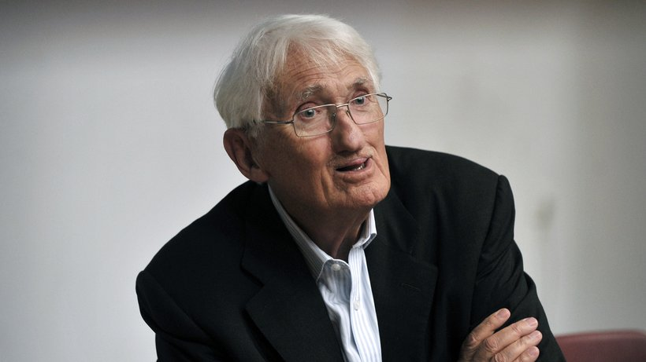
Are we still good Europeans?
Jürgen Habermas (speech, German-French Media Prize 6.7.2018, https://www.zeit.de/kultur/2018-07/european-union-germany-challenges-loyalty-solidarity/komplettansicht):
… Merkel demanded joint political action on asylum policy …, and in this context called for the "loyalty" of the EU partners. Generally, it is the boss who expects loyalty from her employees, while joint political action generally requires solidarity rather than loyalty. Depending on the constellation of interests, it is sometimes the one, sometimes the other, who must subordinate their own interests to those of the whole. …In such cases, joint political action means that one party takes the interests of others into consideration and takes on its share of responsibility for the jointly approved political resolution.

Slide 49
Simply retreating behind national borders is not an adequate response to the challenges of our time!
Right-wing populism may feed off anti-migrant prejudice and the fears of modernization rampant in the middle class, but symptoms are not the illness itself. The underlying cause of political regression is the palpable disappointment that the EU in its current state is more than merely lacking the necessary political efficacy to counteract the trends of growing social inequality within and between its member states. …. In its current condition, the Union can only accelerate this dangerous destabilization.
Today, national populations are overwhelmed by the politically uncontrollable functional imperatives of a global capitalism that is being driven by unregulated financial markets. The frightened retreat behind national borders cannot be the correct response to that challenge.

Slide 50
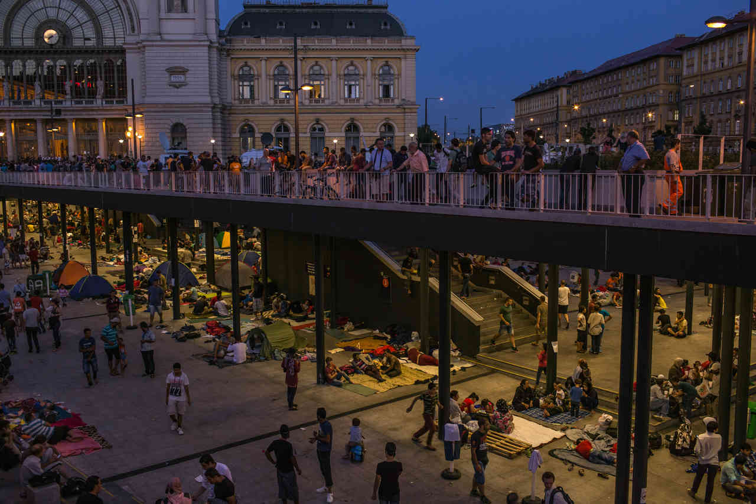
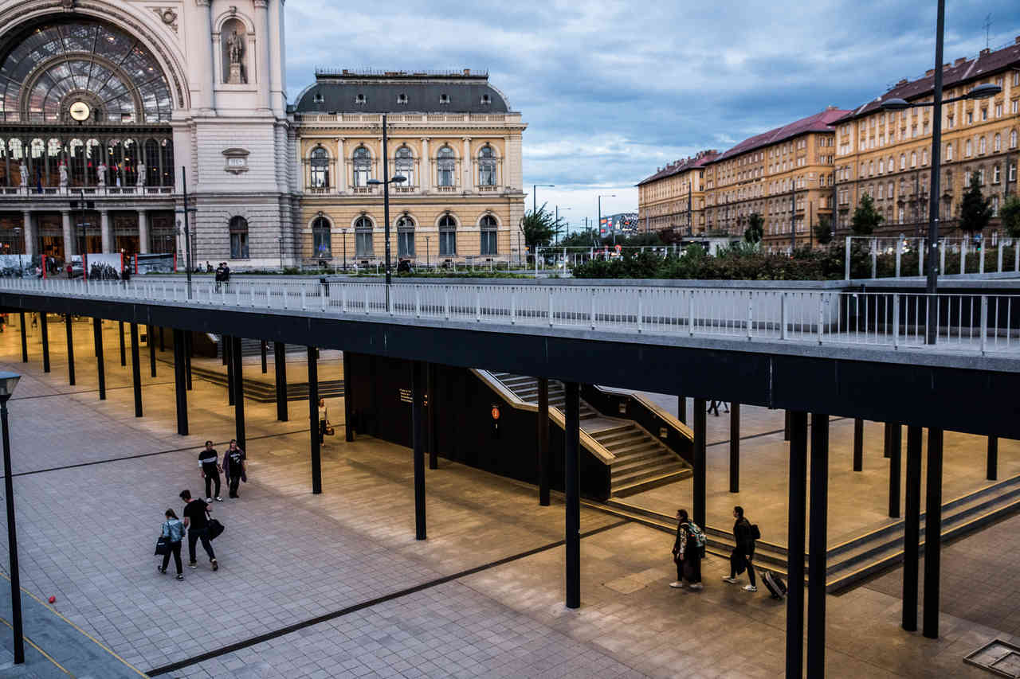
Former refugees now migrants
Refugee families camped in central Budapest, Hungary, in 2015. The same location in June 2018.

