Slide 1




Polycrisis Handbook Workshop
PolyCIVIS Communication and Dissemination Work Package
Dakar 2025
1st Workshop
Notes:
20’ for introductions and the social contract

Slide 2
Who we are…

Slide 3

What is this workshop about?

Slide 4



Polycrisis Handbook
Encouraging the design of Polycrisis Handbook on participatory teaching methods
Understanding the challenges and opportunities of providing participatory teaching on polycrisis
Discover the best participatory teaching methods around the concept of polycrisis

Slide 5
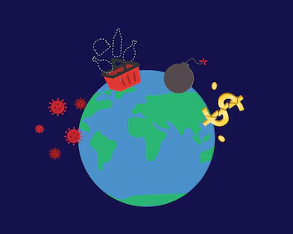
Workshop Outcomes – Toward the Polycrisis Handbook
Deepened Understanding:
Clear insights to guide design decisions for the Polycrisis Handbook structure, format, and content, aligned with the needs and preferences of HE students and tutors across Africa and Europe.
Stronger Team Engagement:
Strengthened collaboration among HE students and tutors from diverse universities and disciplines within the PolyCIVIS network — fostering ongoing online work and participation in future workshops.
Collaborative Synthesis Pathway:
Established a roadmap to integrate outcomes from local workshops in Sfax and Athens with the Dakar workshop, supporting the co-creation of the Polycrisis Handbook.

Slide 6

What is your role in this workshop?

Slide 7

30’ of fame

Slide 8
Our social contract
4 hr workshop
15 minutes break/per hour
Brainstorming activities
Bilingual (English – French)
Notes
Photos – Consent
Respect others’ opinions
Active listening
Positive feedback
Any other thoughts…

Slide 9

Opening Pandora's Box
Notes:
20’ myth/ questions/ brainstorming
Presenting the myth and the connection to Polycrisis

Slide 10

If the Polycrisis is our modern-day Pandora’s Box...
Notes:
Opening Questions
Could Pandora foresee the polycrisis? Foreseen
Could she understand it and manage it? Understanding
Did she have polysolutions? Managing - Polysolutions
Had Pandora been taught about the polycrisis? Today’s workshop

Slide 11
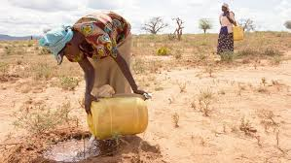
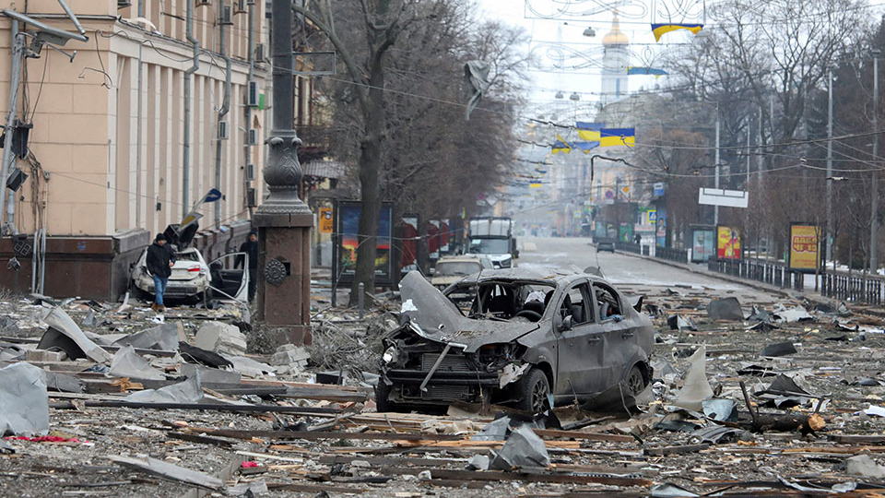
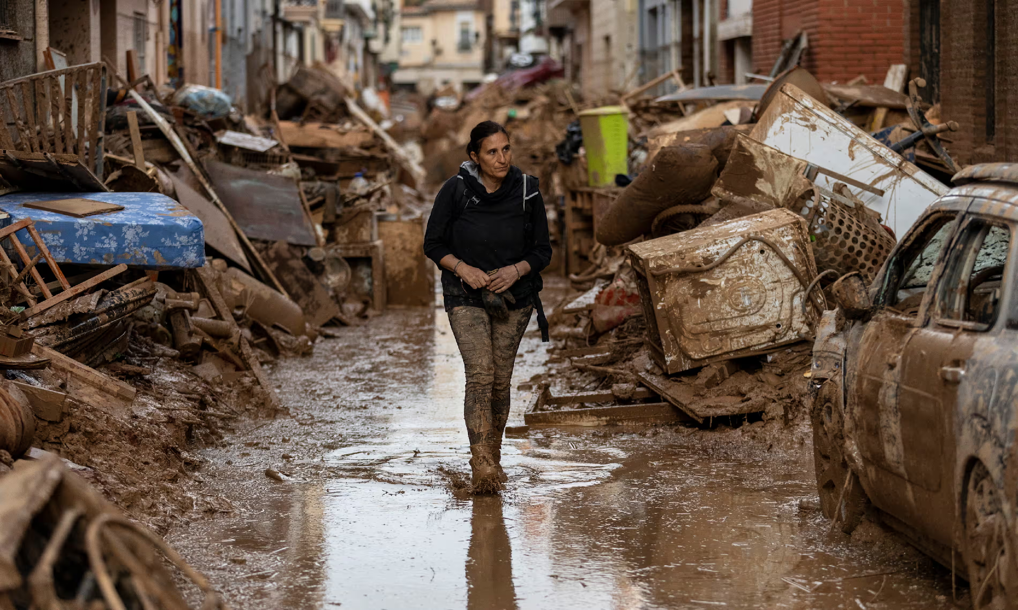
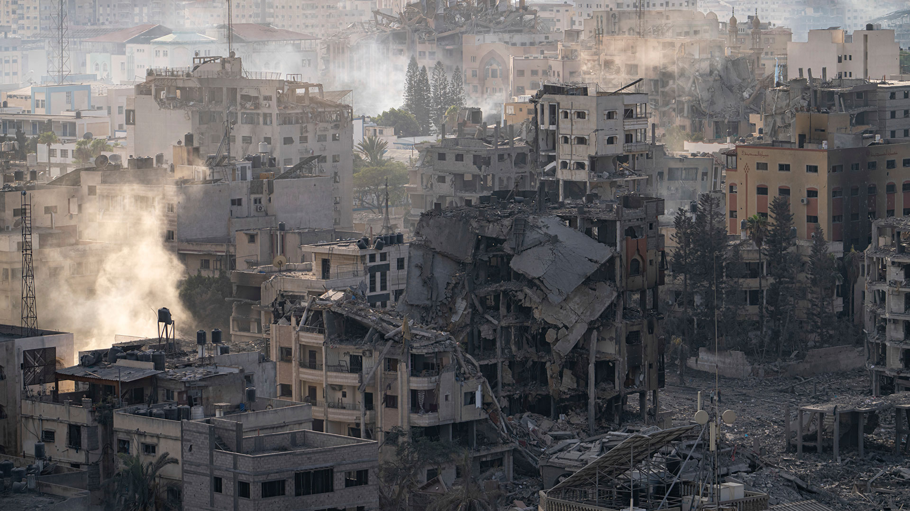
Notes:
20’ crises connections
Discussing about examples of crises around the world - participants should mention the first example that came to their mind - one minute activity

Slide 12

"Crisis Connections"
Notes:
Participants share a recent crisis that affected their community/study, mapping interconnections with other crises – visualization of interconnected crises in a whiteboard through sticky notes

Slide 13
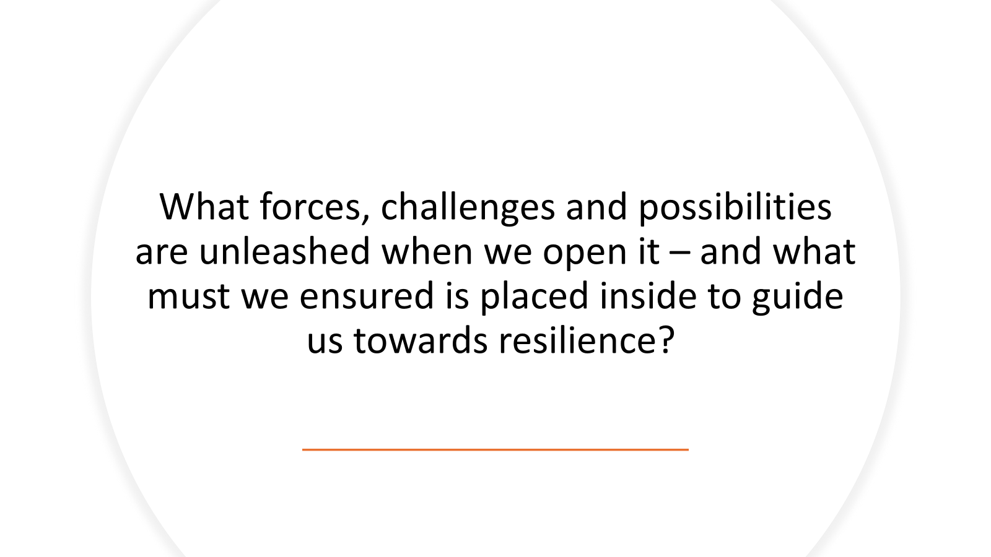
Notes:
Brainstorming activity (all participants can write something on a post it and add it at a specific section on the wall)

Slide 14

“Do you think polycrisis is a concept that is/can be taught and how?
Notes:
Brainstorming activity – separate the participants into two groups for debate

Slide 15

Notes:
15’

Slide 16
Understanding PolyCrisis Handbook’s Purpose & Scope
Notes:
30’ activity

Slide 17

A digital resource (open access e-book) designed for higher education communities across Europe and Africa, supporting joint training and collaborative responses to the polycrisis.
Interactive and Engaging: Incorporates cross-platform, rich-media formats to foster deeper participation and learning.
Provide educators with practical tools, strategies, and insights to ensure a relevant, engaging, and collaborative learning approach to polycrisis
Core Components:
Foundational references and key concepts
A common definition of the polycrisis
Participatory and inclusive teaching tools
Flexible, reproducible instructional formats tailored for diverse audiences

Slide 18
What are the key elements/contents/ formats that make a handbook engaging, practical, and impactful for both educators and students?”
Notes:
Brainstorming activity (2 groups) Switch roles between students and professors if it is possible (20 minutes activity)

Slide 19
Discussing participatory teaching methods
Notes:
30’

Slide 20
1. “What makes a teaching experience truly engaging and participatory?”
2. “How can we effectively teach Polycrisis to foster deeper understanding and proactive solutions?“
3. “How could the teaching procedures be made more participatory?”
Notes:
We separate the participants into three tables to work on these three questions… Collect all the questions and write them in big flip charts

Slide 21


Slide 22

Co-Designing participatory teaching methods for Polycrisis
Notes:
40’ Break the participants into three groups…Based on the information/data collected from the exercise “Crisis connected” each group selects a teaching method and develops a short description of the method and to be used in polycrisis education. Afterwards, groups should provide steps for implementation in a classroom/ training setting.

Slide 23


Slide 24


Slide 25
Month | Activity
April 2025 | Implementation of workshop in Dakar Initiate 1st Phase of online survey
September 2025 | Implementation of workshop in Sfax Initiate 2nd Phase of online survey
December 2025 | Implementation of workshop in Greece
May 2026 | Deliver the final version of D.5.1 PolyCrisis Handbook

Slide 26


Slide 27



Workshop report – feedback
Participation on the survey (educators/ students)
Follow PolyCivis activities

Slide 28


Slide 29
RECOMMENDED READINGS AND RESOURCES
"Transformational Education in Poly-crisis" - a paper addressing the challenges facing education systems in the context of multiple crises, such as the COVID-19 pandemic and other societal, economic, and environmental challenges | Publications Office of the European Union
Polycrisis exploration workshop, European Commission - Workshop tool to facilitate strategic conversations about current and future risks, disasters, and polycrisis.
Africa Facing Polycrisis, UNCTAD Economic Development in Africa Report 2024

Slide 30


