Slide 1

The social construction of
Children and childhood

Slide 2
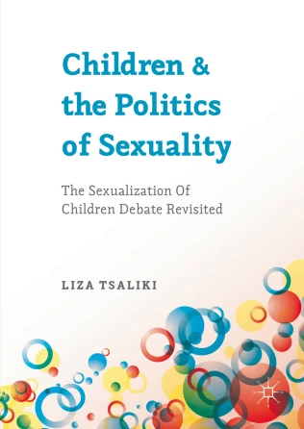
Children, sexuality, popular culture

Slide 3
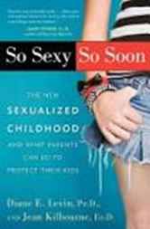
Moral panics about children
So Sexy So Soon: The New Sexualized Childhood, and What Parents Can Do to Protect Their Kids
By Diane E. Levin and Jean Kilbourne · 2008

Slide 4
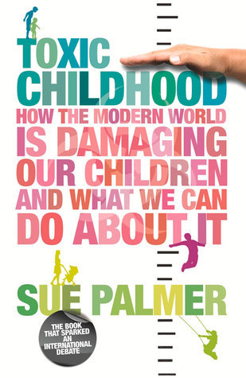
Moral panics about children
Sue Palmer 2007; 2015
https://www.mothersathomematter.com/articles/toxicchildhood

Slide 5

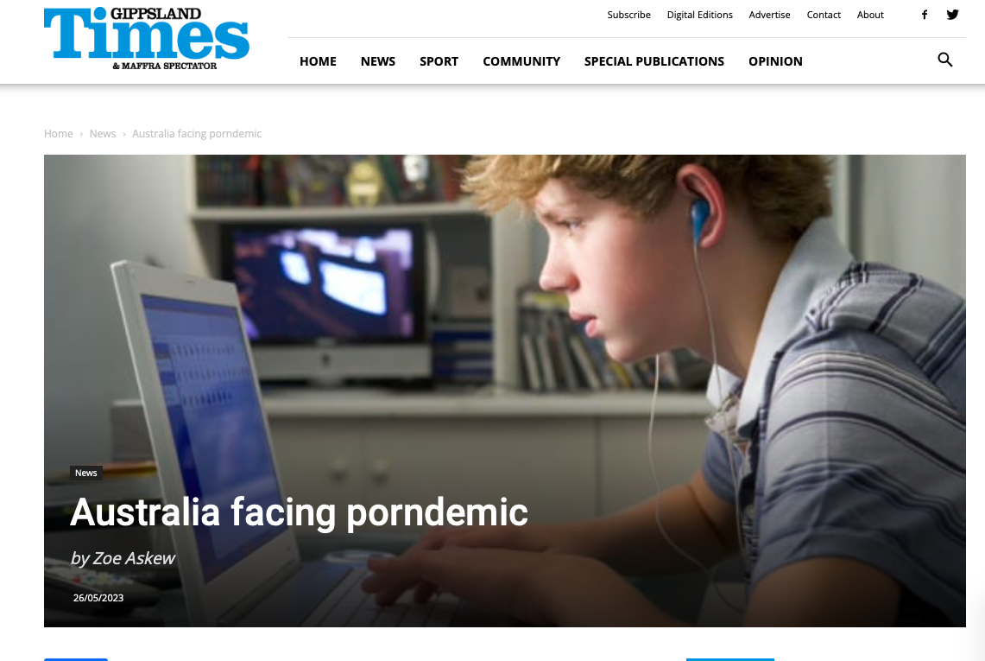

The public discourse: young people and the ‘porndemic’- the effects argument

Slide 6
Moral panics about children
Usually tied to childhood and children’s relation with the media and popular culture
  => children’s media consumption consistently under scrutiny since the 19th c.
    (at the time, concern mostly about boys;
    Think about the social construction of women-and girls- as pertinent to domesticity)

Slide 7
Moral panics about children
What various ‘discourses of anxiety’ show:
  Confluence of childhood and sexuality -> infringes upon child’s ability to ‘just be’ a kid =>
  Which shows that the domain of childhood CANNOT include sexuality =>
  Any young person experiencing sexuality =outside of domain of childhood =>
  There is a prevailing cultural ambivalence about childhood sexuality and what this entails
    (usually including any notion of sexual knowledge as well =>
    Which further complicates the discussion about sex-ed)

Slide 8
Moral panics about children
Foucault’s work (The History of Sexuality, 1984) shows ->
How discourses of protection and social reform legitimated social intervention through the government of childhood sexuality
  (in terms of discipline, surveillance, scientific management)
  Philippe Aries (1962): conceptualization of child as distinct from adults = 18th c

Slide 9
Moral panics about children
Good example of such moral panics:
  The social construction of the sexual child in the age of modernity.
  Two distinct discourses:
    A. 18th c. discourse of ‘sensationism’:
      Drawing from Enlightenment/John Locke’s ‘wild children’
    B. 19th c. ‘masturbation phobia’

Slide 10
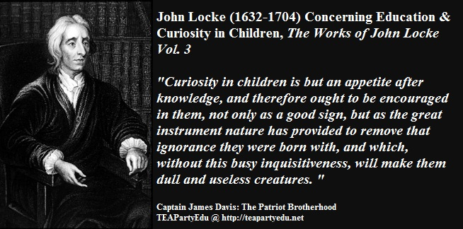
18th c. discourse of ‘sensationism
Children, with proper education and training =>
Will tame the inner savage and monitor balance between senses, body, reason
=> education was possible and desirable
And the child-to-be-educated = essentially ‘good’

Slide 11
18th c. discourse of ‘sensationism
Such optimism was tempered by fears of negative impact of civilization
  The ‘adult-in-training- must be protected from ‘bad influences’
  In the Anglophone world = this was translated as the result of urbanization, industrialization (reflected in epidemic disease, demographic imbalance and social unrest)
  How to deal with all that?

Slide 12
18th c. discourse of ‘sensationism
  How to deal with all that?
    -> deployment of scientific methods to modern pathological social phenomena => this leads to:
    Increase in medical knowledge and empowerment of the medical profession
  John Locke’s ‘wild children’:
    Children need adult guidance since they lack moral guidelines

Slide 13
19th c. ‘masturbation phobia’
As Foucault says,
Modernity was characterized by urgency to manage populations
  Masturbation was the way to articulate the secular problematization of the sexual body,
  With the parallel establishment of the medical profession (which would determine ‘normality’)

Slide 14
19th c. ‘masturbation phobia’
The child seen as equally susceptible to masturbation as adults
  Masturbatory insanity; masturbation as disease, vice, compulsion (1830s-1840s)
    Avoid tight clothing, excessive heat, feather beds, too much meat
  Seen as a threat for child’s moral health – role of the medical expert

Slide 15
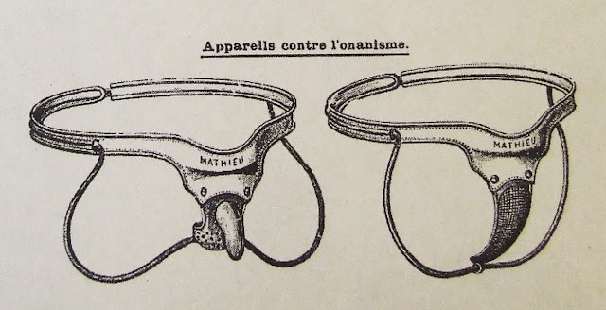
19th c. self-pollution, self-abuse, or onanism
The Victorians: The ‘solitary vice’ was being discussed in medical texts and religious treatises.

Slide 16
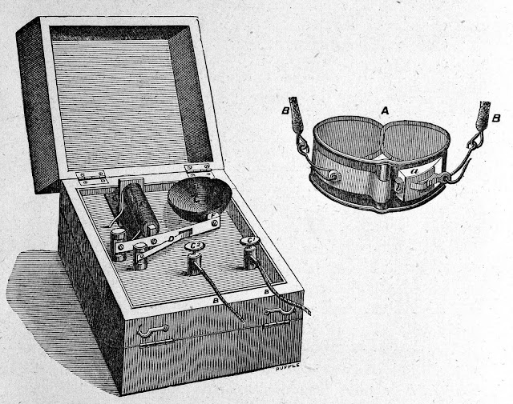
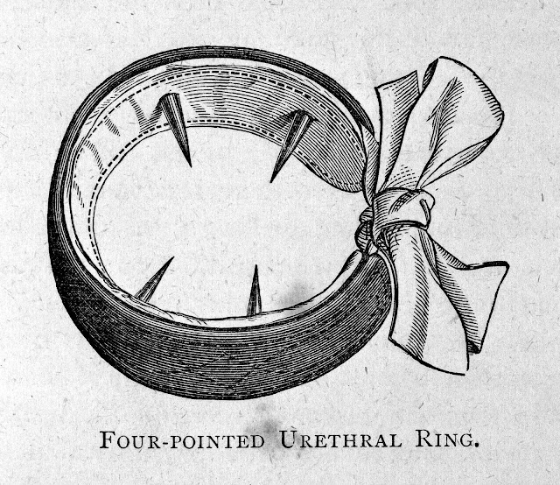
The Four Pointed Urethral Ring, 1887 and The Electric Alarum for Treatment of Masturbation, 1887

Slide 17
The ‘social purity’ movement – turn of 20th c.
It advocated the end of sexual ignorance for children
  In order to counter and redeem damage of solitary masturbation
  So, child = sexual now,
  and child-rearing advice and sexual training = correctives
  Innocence = inherent in children, YET -> a virtue to be taught => Parental instruction = important,
  If not => corruption and vice -> e.g. the new urban culture
    (hotbed for moral pollution)/ Temperance movement

Slide 18
The child in pre-modern times
Middle Ages- 1600s: children valued for their role in inheritance, but
Losing a child = not the emotional tragedy it is today
Appropriate sexuality: sex tied to reproduction within marriage
  Royal families -> married children 12-13ys; the rest, much later

Slide 19
The child in pre-modern times
  Up to 17th c., children not sheltered from sexual acts
  (‘privacy’/common habits in households; sexual references in songs, jokes, stories; sexual humour in fairy tales)
  Early 17th c.: sexual references start to be expurgated,
  as childhood ‘innocence’ = sexual ignorance

Slide 20
The child in pre-modern times
  Childhood innocence reinforced with severe physical punishment
  End of 16th c. England: rise of mercantilism =>individualistic values-> families start closing in around their children/family privacy

Slide 21
The child in pre-modern times
  Changes in children’s attire – now different from adults’
    (initially applied to upper class and middle class boys under 7,
    Gradually included girls and older children).
  This differentiation spread to games, rhymes and stories,
  And education (age –grading for children of aristocracy and rising bourgeoisie)
  Lower-class children continued to share lives of adults

Slide 22
The child in pre-modern times
  In pre-modern America (1630s):
  Relationship between children and adults, shaped by a Puritan (Calvinist) ideology:
  human relations ordained by God;
  the baptized male = closer to the top;
  the child = near the bottom
  Central to Puritan view:
  Calvinist notion of ‘original sin’

Slide 23
The child in pre-modern times
  one of the most influential colonial texts in 17th-18th c. America = a school text, the New England Primer:
  reminder that the child = sinner.
  The Primer taught children their right place in the world
  (Puritan adult approach to children:
  children are sinners who need terror and trauma
  before they can live happy and well-adjusted lives.
  in order to please God, children have to be broken
  at the hands of the father/school master) =>
  Pedagogies of submission (i.e. corporal punishment ->
  link between sin and physical punishment)

Slide 24
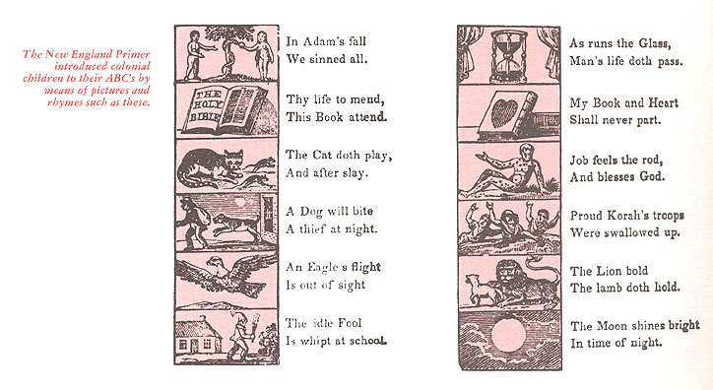

Slide 25
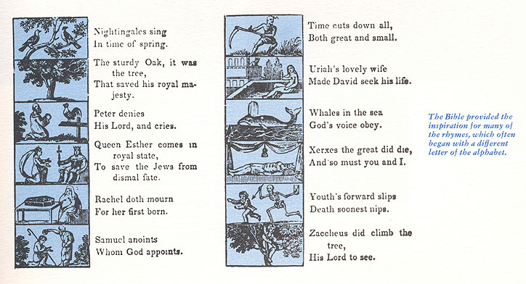

Slide 26
Children and Victorian imperialism
Parental Duties in the Promotion of Early Piety (1834 ) Reverend Jacob Abbot:
  I would also remark, that parents cannot take a single step to advantage in
  endeavoring to train up their children to piety, without first obtaining their
  unlimited, unqualified, entire submission to their authority. The very first
  lesson to be taught the child is to submit, to obey. There are various
  methods of obtaining this ascendancy. In some way or other it must be
  done. Your children must be habituated to do what you command, and to
  refrain from what you forbid; not because they can see the reason for it, but
  because you command or forbid: submission, not to your reason, but to
  your authority [remains vital]…. Be it remembered, insubordination is the
  essence of irreligion. I repeat it—insubordination is the essence of
  irreligion

Slide 27
Children and Victorian imperialism
Ellice Hopkins, On the Early Training of Girls and Boys: An Appeal to Working Women (London: Hatchards, 1882), p. 343
“Teach them to obey you, and children will be happy”… “That one great lesson of all life, ‘to submit’”

Slide 28
Children and Victorian imperialism
Child rearing technologies (middle/upper class) – facilitating mother-child separation (= civilized):
  nursery
  Baby bottle
  Rubber nipple
  Crib
  Nanny
  Child obedience started at the home -> church -> completed at (public) school (the English gentleman)

Slide 29
Children and Victorian imperialism
In Victorian England: the child perceived in a state of original sin =>
  Becoming a true Englishman = a process of ‘reform’ (corporal punishment);
  The child = savage,
  The adult = civilized
  1870s Britain:
    children banned from productive labour;
    Compulsory comprehensive education
    New theories of child development were brought by the new science of psychology

Slide 30
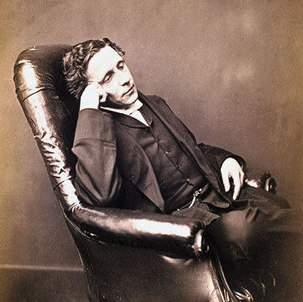
Children and Victorian imperialism
Charles Dodgson-Lewis Carroll and
Alice Liddle

Slide 31
Victorian sensibilities
Photographs of nude children sometimes appeared on postcards or birthday cards, and nude portraits—skillfully done—were praised as art studies.
Victorians saw childhood as a state of grace; even nude photographs of children were considered pictures of innocence itself.

Slide 32
Victorian sensibilities
In discussing the possibility of photographing one 8-year-old girl unclothed, Dodgson wrote to her mother: “It is a chance not to be lost, to get a few good attitudes of Annie’s lovely form and face, as by next year she may (though I much hope won’t) fancy herself too old to be a ‘daughter of Eve.’ ”

Slide 33
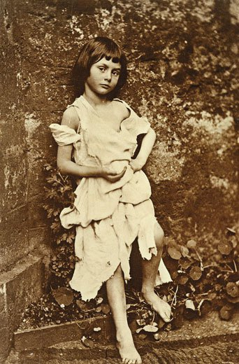
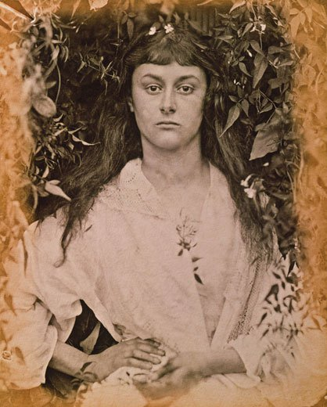
Victorian sensibilities- Alice Liddell

Slide 34
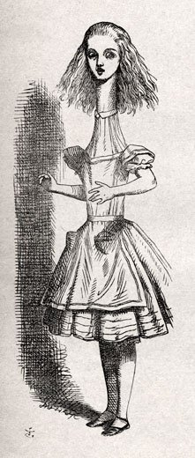
Phallic imagery in Alice in Wonderland

Slide 35
The Brothers Grimm and Black Pedagogy
In Kinder-und Hausmärchen (Children’s and Household Tales) in 1812 the Brothers Grimm
  hoped to lead the reader to an ideological and emotional identification with an idea of a past Germany
  through the production—and reproduction—of the ancient German folklore.
The Brothers Grimm operated from the assumption that the stories of das Volk provided access to the real, the pure, and the truly German.

Slide 36
The Brothers Grimm and Black Pedagogy
In the Kingdom of Westphalia – the Brothers were seen as part of the illiterate Volk due to their Hessian ethnicity;
In their willingness to create a tradition of folk wisdom - the Brothers Grimm collected stories from family
friends, read previously published stories, and then
presenting a construction of the oral tradition and an image of das Volk as if it were collected from the peasants themselves
the Hessian Volk as they were constructed by the Brothers
Grimm in Children’s and Household Tales
might be understood as repositories of the Germanic tradition
Ideological indoctrination of the child through fairytales

Slide 37
The Brothers Grimm and Black Pedagogy
Child-rearing pedagogies bent on the domination and subjugation of the child =
direct appropriation of the Judeo-Christian child-rearing model as
it was understood and adapted from the Bible, especially the Old Testament.
For the Brothers Grimm this tradition, like the Puritans in America, drew on the Protestant Christianity of Calvinism,
a theology defined by the doctrine of “original sin”

Slide 38
The Brothers Grimm and Black Pedagogy
According to the Reform Calvinist perspective of the Brothers Grimm,
cleanliness, orderliness, and above all, obedience were traits that, when
adhered to passionately, would have “salvific” results for the depraved child.
From the point of view of the dominant culture, the ideal child raised in this
way is—or should be—tractable, obedient. These qualities lead to “success.”

Slide 39
The Brothers Grimm and Black Pedagogy
the black pedagogy in 18th-19th c. Germany offers a way of seeing how
violent child-rearing practices are directly related with the rise of 20th c. fascism
The hierarchy of authority must never be questioned; therefore the child who
wishes to avoid violence, shame, and suffering
learns early and often not to question the dominant social order

Slide 40
The Brothers Grimm and Black Pedagogy
“the first appearance of willfulness.” Dr. Schreber advises that the adult
‘should no longer simply wait for it to pass…but should proceed in a somewhat more positive way: by quickly diverting its attention, by stern words, threatening gestures, rapping on the bed…or if none of this helps, by appropriately mild corporal admonitions repeated persistently at brief intervals until the child quiets down or falls asleep…. This procedure will be necessary only once or at most twice and then you will be master of the child forever. From now on a glance, a word, a single threatening gesture will be sufficient to control the child

Slide 41
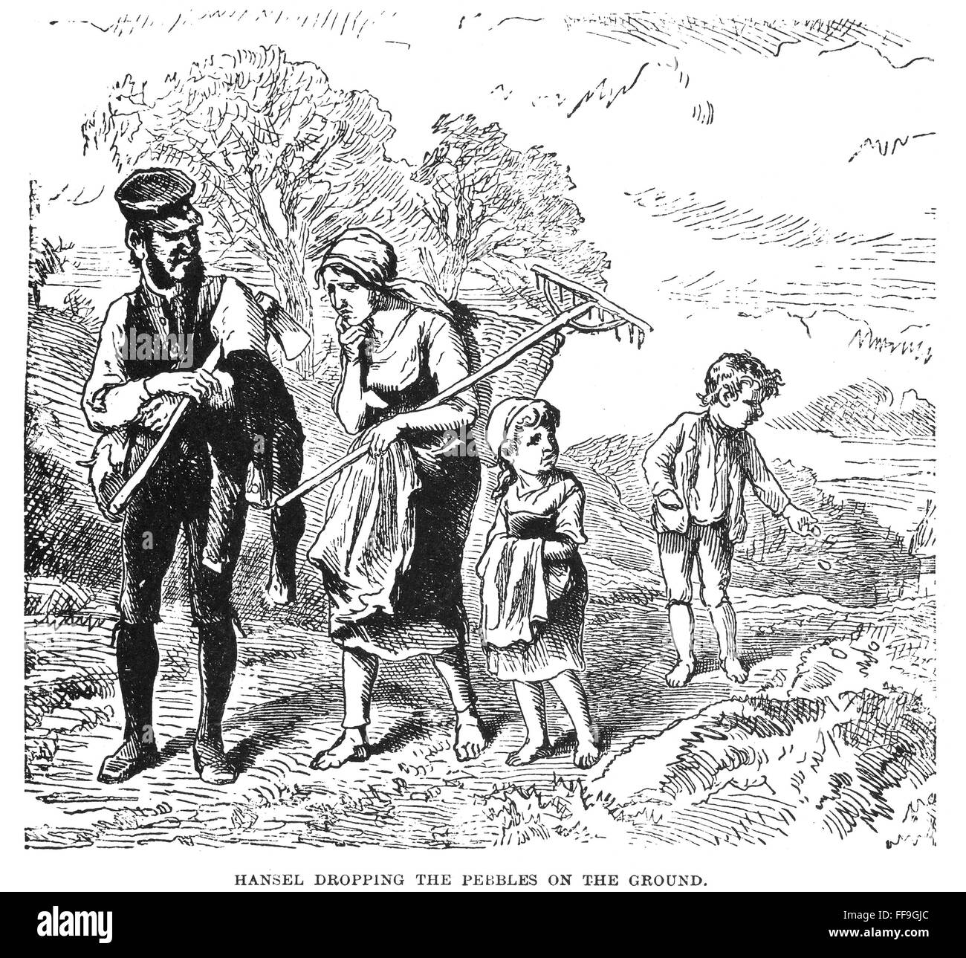
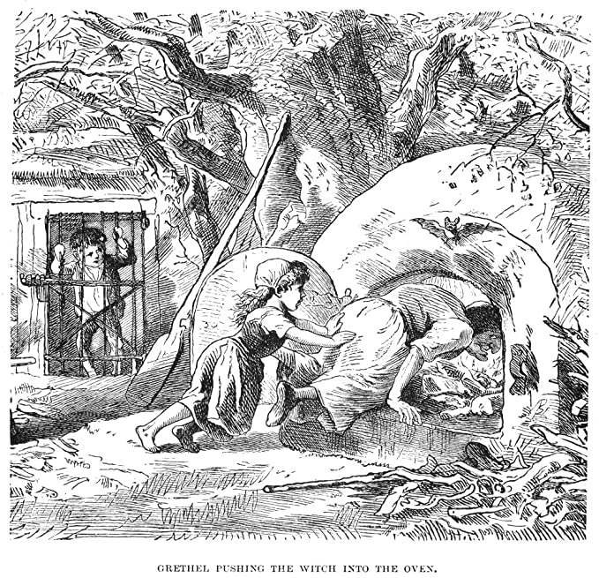
Hansel and Gretel

Slide 42
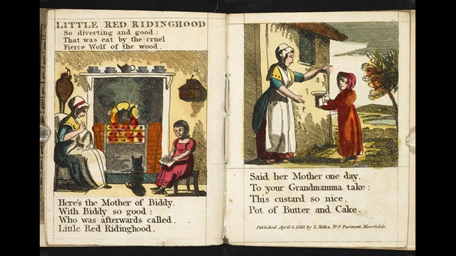
Little Red Riding Hood, 1810
Come, Little Red Cap, take this piece of cake and bottle of wine and bring them to your grandmother. She’s sick and weak, and this will strengthen her. Get an early start, before it becomes hot, and when you’re out in the
woods, be nice and good and don’t stray from the path, otherwise you’ll fall and break the glass, and your grandmother will get nothing. And when you enter her room, don’t forget to say good morning, and don’t go peeping in all the corners.

Slide 43
‘New sociology of childhood’
1980s- Philippe Aries: childhood ceased to be naturalized, and was recognized as a cultural phenomenon
  Role of psychology since 19thc:
    Pathologized children -> promoted notion of children’s incompetence and dependency -> shaped childhood policy-making

Slide 44
‘New sociology of childhood’
    By the time sociology entered academia, childhood had already been psychologized
    1980s-1990s: ‘new sociology of childhood’-> emphasis on its inventiveness; challenged psychological approaches
    Alas, hegemony of ‘pro-effects’ approach => construction of children as ‘being at risk’,
      Especially of all things sexual….

