Slide 1
The porn debate in greece
Porn studies seminar

Slide 2
Overall context
overabundance of research that accounts for either the (usually negative) impact of pornographic content on children and teenagers
  or for its cultivation of sexist and misogynistic stereotypes
contemporary public debate = largely framed by notion of psychological effects that follow consumption of porn, [‘addiction’ discourse /adoption of violent behavior]
preoccupation with violent behaviour = common within radical feminist agenda, where pornography = objectification
  and unrealistic body images and standards of sexual performance

Slide 3
In Greece
  = study of pornography underdeveloped and dominated by hegemonic pro-effects approach regarding its impact on children’s and adolescents’ wellbeing
  Contrary research has shown that social, policy and academic concerns regarding the ‘devastating’ impact of pornographic content on youngsters = seriously overstated =>a media alarmist and sensationalist culture and
  largely Νorth American conceptions and political divisions (which take a more conservative view to legal action and social policy)

Slide 4
Overall context
within the EU Kids Online II project -> media coverage focuses public attention disproportionately on internet risks:
in Greece, pornography = over half of risks covered in the press.
quite often newspapers in Greece confuse pornography which features children with sexual content which is consumed by them.
=> the media agenda serves to concentrate public discussion on children who are ‘at risk’ from the consumption of porn
Greek Google search on ‘pornography in Greece’ -> almost exclusively, about apprehension of networks of child pornography =>
  public debate in Greece conflates ‘pornography’ with child pornography

Slide 5
Overall context
What we see here:
  gradual acceptance in Greece of 19th c. Anglophone constructions of the ‘sexual child’ [and significantly shaped how we make sense of pornographic culture and its assumed effects today]
  => Greek conceptions of ‘pornography controversy’, moulded by Anglosaxon (mainly US-originating, morally conservative, effects-dominated) perspective
  we attempt to make sense of this discussion in Greece, and we offer an explanation of why it has turned out the way it has.

Slide 6
Overall context
        We argue = main reason for the linkage between pornography and children in the public imagination in Greece:
        debate on pornography not shaped by feminist controversies that have saturated other cultural contexts in the West, and has taken a different course.
          concise trajectory of Greek feminism that spans
          from the 1920s, when the Greek Communist Party (then the Socialist Labour Party) and the League for the Rights of Greek Women were both founded, to date
          Greek erotic cinema of mid-seventies, which, we argue, has been also instrumental in shaping of culture of pornography in present-day Greece

Slide 7
A short history of Greek feminism
      From its inception, the communist movement in Greece did not espouse feminism:
        the Communist Party systematically denounced the feminists for luring working women into ‘parliamentary delusions’
        For the communists, gender oppression = a corollary of class oppression.
        => by the end of 1920s, feminism in Greece = ‘bourgeois’
          by depicting feminism as ‘bourgeois’ => the communists relegated the feminist movement to the realm of social conservatism, =>any institutional feminist demands (right to vote) either suppressed or ridiculed.

Slide 8
A short history of Greek feminism
During inter-war years,
The communists sought to reinforce negative stereotype of the feminist as the ‘new woman’, [ridiculous and dangerous/ dubious morals and insatiable sexuality]
In contrast to this stereotype, the Communist Party offered own construction of ‘legitimate’ femininity =
  the woman worker who would find deliverance from the ills of capitalism through class struggle and always through her role as wife, mother and sister of (male) fighter

Slide 9
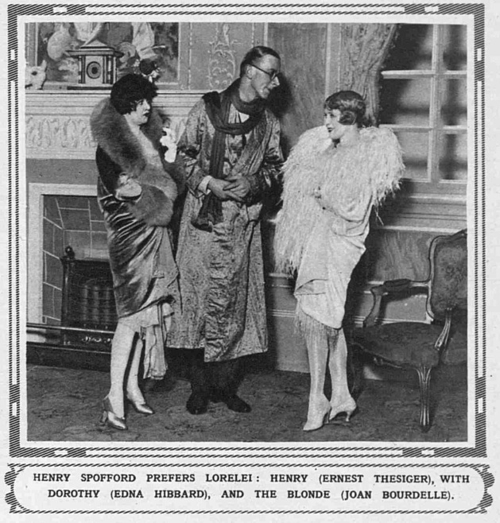
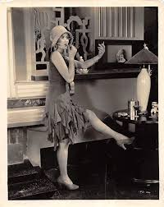
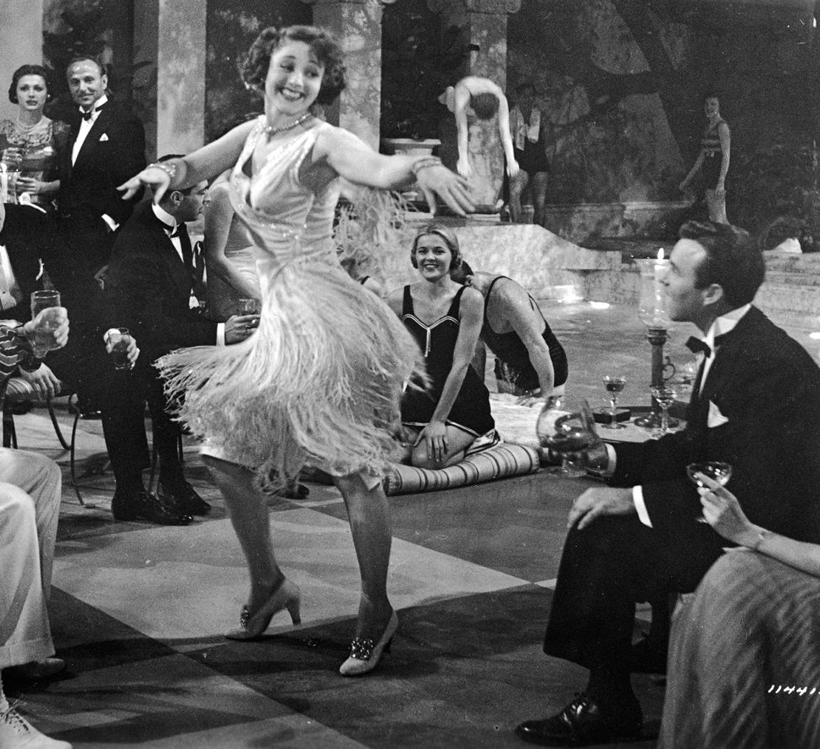
Flapper girls (the ‘new woman’)

Slide 10
A short history of Greek feminism
By 1936, communist women collaborated with feminists to set up wider anti-fascist women’s front
In Greece, => subordination of feminist demands to major left-wing political forces of the time
within the Resistance, political commitment of women = feminine familial obligation, associating motherly care with the survival of the nation.
During Greek civil war (1946–1949)= mass sexual violence used to coerce women on the left; communist women were depicted as ‘the mothers of the nation’ =>
feminism came to be seen as old-fashioned and those women who were active in gender politics did not identify themselves as feminists

Slide 11
A short history of Greek feminism
Following collapse of military dictatorship (1974), the Left experienced a political renaissance
Within this re-empowerment of the Left ->mass women’s movement brought the ‘woman question’ into the mainstream
entry into the European Union (then, the EEC) meant that Greece was obliged to assimilate equality discourse of the West
  However, the more influential, older generation aligned women’s liberation with the Left, and saw women’s organizations mainly as appendages to the parties of the Left:

Slide 12
A short history of Greek feminism
  during the 1980s, a wave of progressive institutional changes in Greece altered de jure status of women.
  women’s movement divided over the issue of ‘autonomy’
  Younger advocates espoused autonomy – independence
  from the conventional political parties – along the lines of Anglo-American feminism.
  Older: women’s lib with the Left (state feminism)

Slide 13
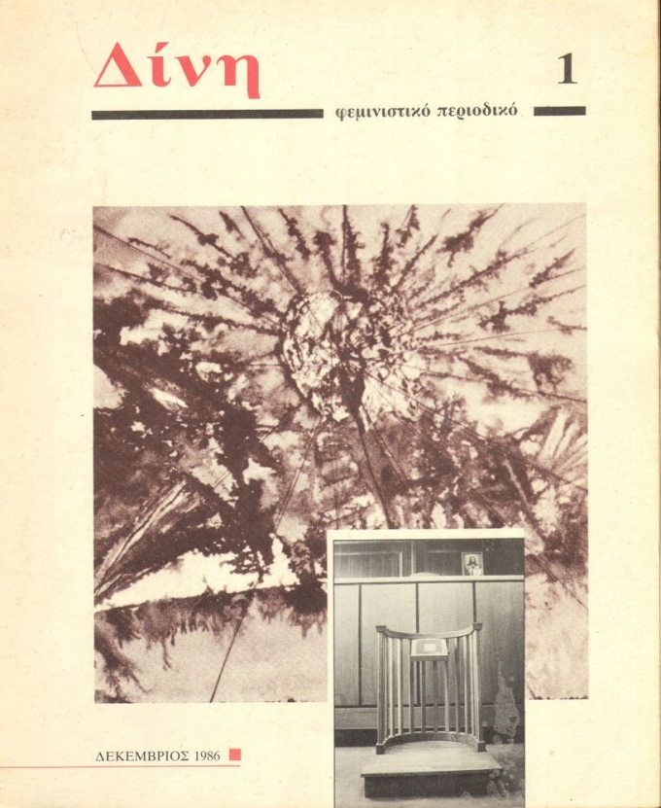

1980s Greek feminism

Slide 14
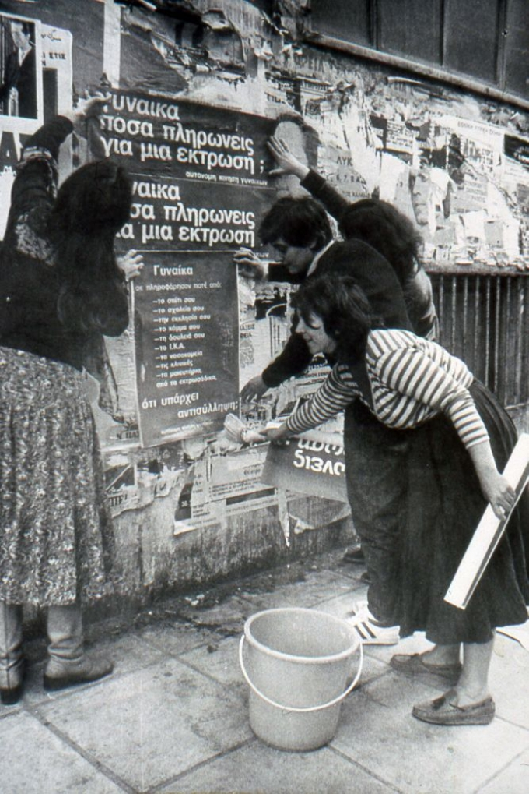
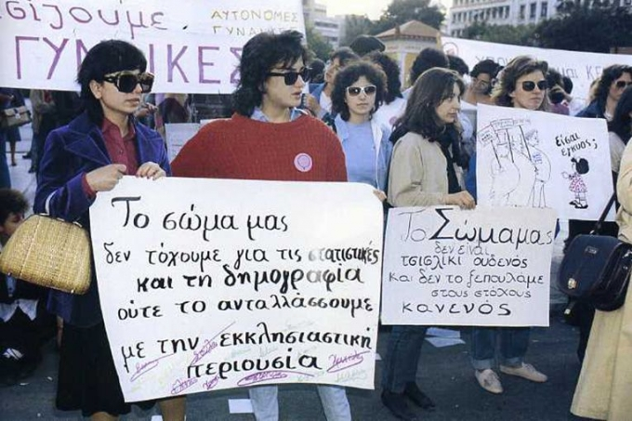
1980s Greek feminism

Slide 15
A short history of Greek feminism
  1974ΚΚΕεσωτερικού = Κίνηση Δημοκρατικών Γυναικών
  1974 επανιδρυση Συνδέσμου για Δικαιώματα Γυναίκας
  1975 Κίνηση για απελευθέρωση γυναίκας (Αυτόνομο κίνημα)
  1976 ΠΑΣΟΚ = ‘Ένωση Γυναικών Ελλάδος
  1976 ΚΚΕ = Ομοσπονδία Γυναικων Ελλάδος
  https://tomov.gr/2017/02/23/%CF%80%CE%BF%CF%8D-%CF%80%CE%AE%CE%B3%CE%B1%CE%BD-%CE%BF%CE%B9-%CE%B5%CE%BB%CE%BB%CE%B7%CE%BD%CE%AF%CE%B4%CE%B5%CF%82-%CF%86%CE%B5%CE%BC%CE%B9%CE%BD%CE%AF%CF%83%CF%84%CF%81%CE%B9%CE%B5%CF%82/

