Slide 1

pornography
In a historical context

Slide 2
Pornography has a history
η πορνογραφία δεν αποτελούσε ξεχωριστή κατηγορία γραπτής ή οπτικής αναπαράστασης πριν από αρχές 19ου αι
μεταξύ 1500-1800 (Ευρώπη πρώιμης νεωτερικότητας), πορνογραφία = εργαλείο κριτικής της θρησκευτικής και πολιτικής εξουσίας
βασικές αρχές της σύγχρονης πορνογραφικής παράδοσης και η λογοκρισία της ξεκινούν από Ιταλία 16ου, Γαλλία 17ου και Αγγλία 18ου αι.

Slide 3
Pornography has a history
Η πορνογραφία της πρώιμης νεωτερικότητας ήταν συνδεδεμένη με
    Ελευθερία έκφρασης και αίρεση (επαναστατικότητα)
    επιστήμη
    φιλοσοφία
    κριτική σε απολυταρχικά καθεστώτα
Σε γενικές γραμμές,
  από Μεσαίωνα μέχρι και τον 17ο αι, ο έλεγχος των έργων (χειρόγραφα ή έντυπα έργα) στην Ευρώπη γινόταν στο όνομα θρησκείας και πολιτικής
  και όχι στο όνομα της σεμνότητας (decency)

Slide 4
Pornography has a history
Walter Kentrick: The Secret Museum
η πορνογραφία ως ρυθμιστική/ελεγκτική κατηγορία επινοήθηκε ως απάντηση στην απειλή της δημοκρατικοποίησης της κουλτούρας

Slide 5
16th c. Italian pornography
πρώτη σύγχρονη πηγή που αναφέρεται από κάθε ειδικό πορνογραφίας = Pietro Aretino, Ιταλός συγγραφέας 16ου αι.
Among Aretino’s many works, the most characteristic are his satirical attacks, often amounting to blackmail, on the powerful.
Despite the support of the Pope and other patrons, Aretino was forced to leave Rome for Venice because of his general notoriety and his 1524 collection of Sonetti lussuriosi (“Lewd Sonnets”)
In his Ragionamenti (1534–36; modern edition, 1914; “Discussions”, or ‘reasonings’), Roman prostitutes reveal to each other the moral failings of many important men of their city

Slide 6
16th c. Italian pornography: Ragionamenti
The Lives Of Nuns, The Lives Of Married Women, The Lives Of Courtesans
Ragionamenti: Published in 1536 it can claim to be the first erotic book to be written in the vulgar tongue of ordinary speech, but there is more to it than just an early example of titillation:
the picture he paints is one of lust and greed with the men coming off far worse than the women. Money ambition and cynical power rule and the conversations between the women are all about how they can survive in such a world. Aretino provides us with a satisfying portrait of the corruption in 16th century society.

Slide 7
16th c. Italian pornography: Ragionamenti
The Lives Of Nuns, The Lives Of Married Women, The Lives Of Courtesans
Ragionamenti: centres around a conversation between two experienced and sharp-tongued women on the topic of women's occupations. At the time there were only three: wife, whore, or nun. Their discussion is an amusing account of the advantages, perils, and pleasures each profession offers.
Not only was the first erotic book in the Christian world to be written in the common vernacular, it was but one of the few to describe the obscenity of commercial love, and is thus a cornerstone of both Italian literature and Counter-Renaissance

Slide 8
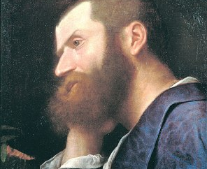
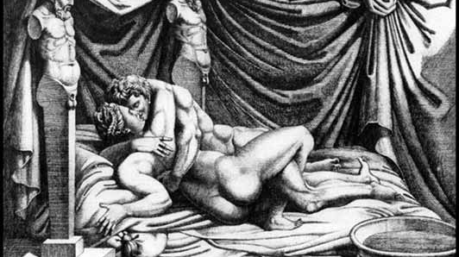
Pietro Aretino: ‘Aretino’s postures’
16 illustrations (initially, drawings by Giulio Romano, which were then reproduced as engravings by Marcantonio Raimondi),upon which Aretino wrote 16 rhythmed sonnets

Slide 9
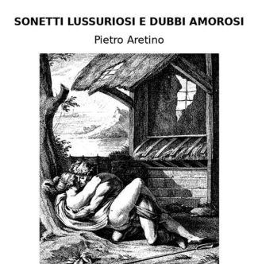
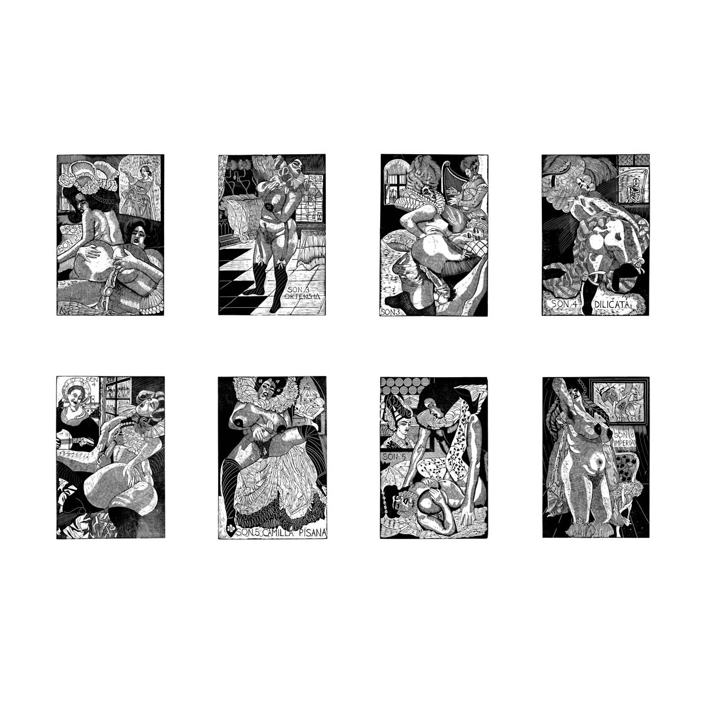
Sonnetti lussuriosi

Slide 10
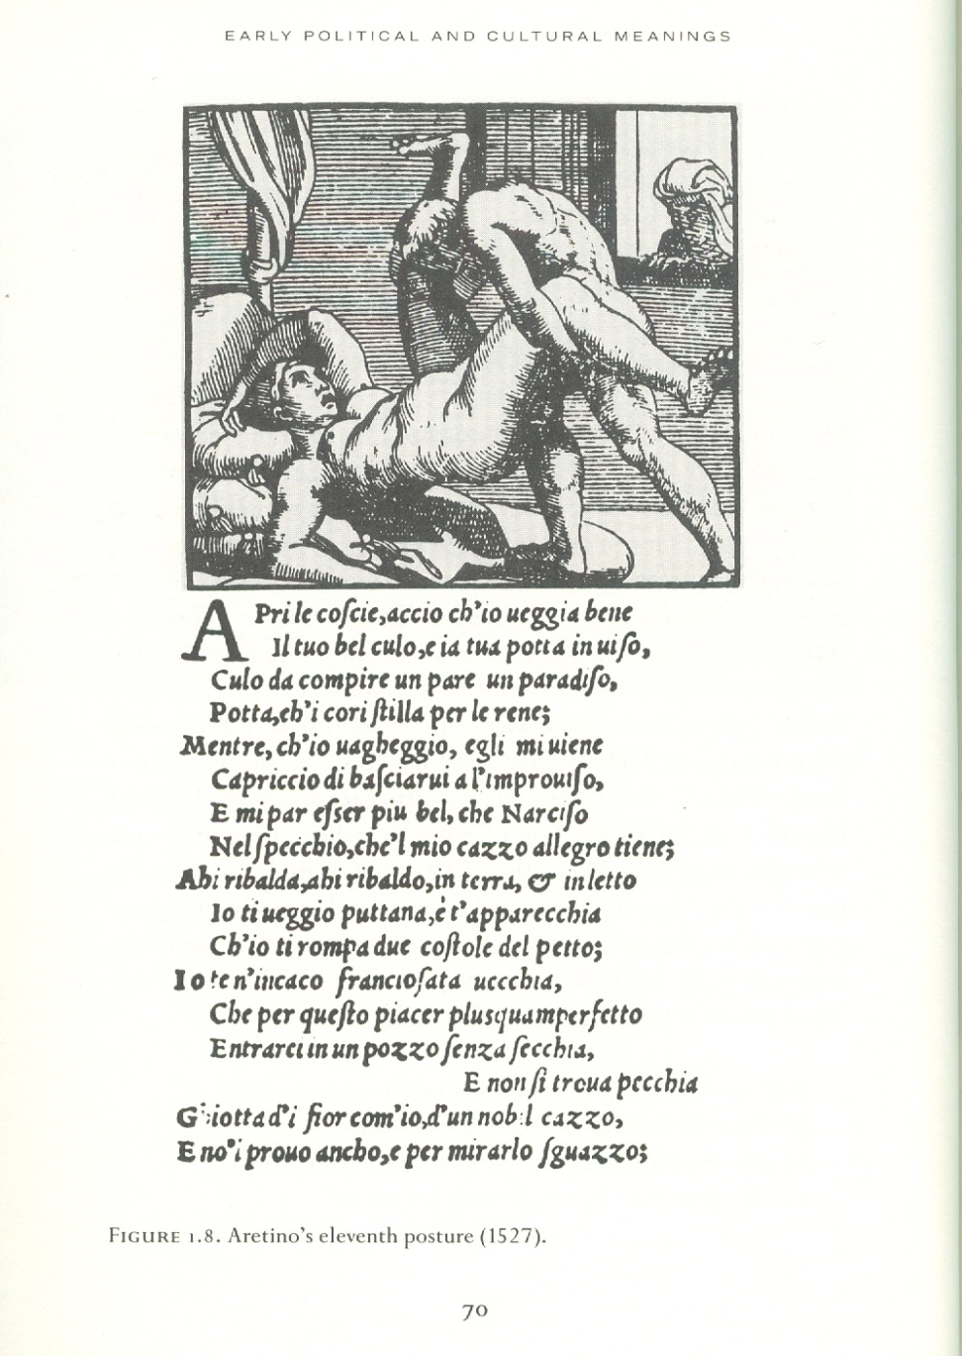
Aretino’s eleventh posture (1527) and his Sonnetti lussuriosi

Slide 11
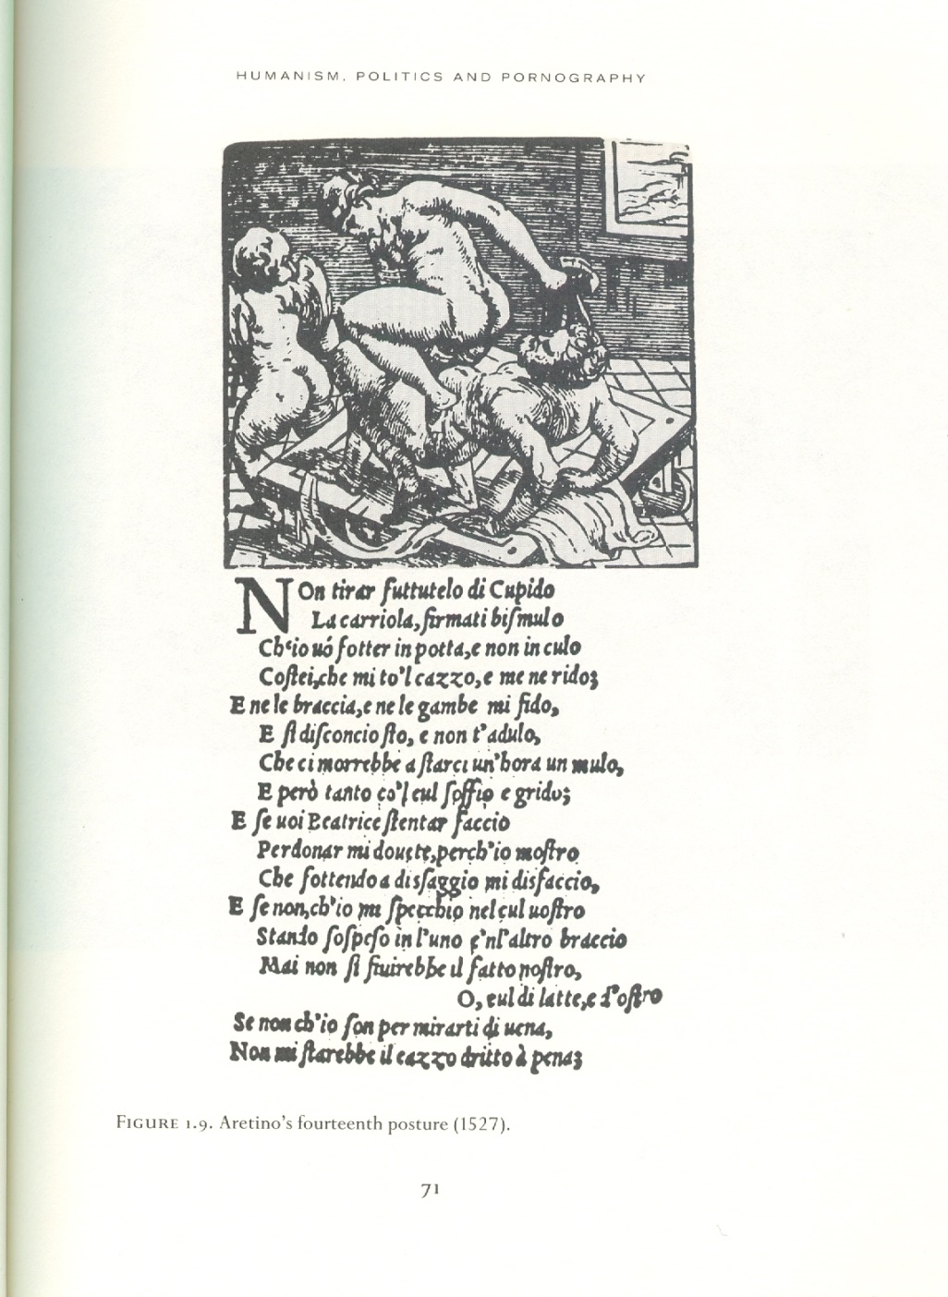
Aretino’s 14th posture (1527)- Sonnetti lussuriosi

Slide 12
Sonnetti lussuriosi
Fuck us, my soul, fuck us soon
because we are all born for fuck;
and if you love the dick, I love it,
and the world will be a dick without this.And if post mortem fucking were honest, I would say: So much fottiam, che ci moiamo; and from there we'll fuck Eve and Adam, who find dying so dishonest. […]
Put a finger in my ass, dear old man,and push your cock inside little by little; he lifts this leg well to make a good game, then leads without making a name for himself.What, for my faith! this is the best morsel than eating greased bread next to the fire;
and if in potta you are sorry, muta luoco, that man is not someone who is not buggiarone. […]

Slide 13
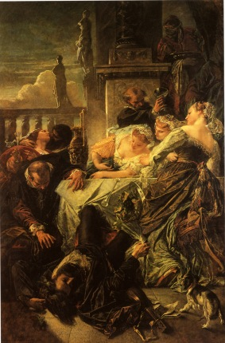
Anselm Feuerbach - The Death of the Poet Pietro Aretino- 1854
Pietro Aretino died in 1556. the anecdote suggests he died of a laughing fit that ended in a broken neck. Most probably, he died of a heart attack.
His work continues to cause controversy. In 2007, Michael Nyman set some of his ‘lust sonnets’ to music. When they were performed in 2008 at Cadagon Hall in Chelsea, the programme was withdrawn on grounds of obscenity (one of the few pieces of classical music with a ‘Parental Advisory, Explicit Content’ disclaimer)

Slide 14
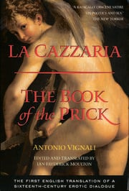
Antonio Vignali (1501-1559
La Cazzaria is the most outspoken erotic text of the Italian Renaissance-a dialogue about politics, sex, and desire. The book is remarkable for its frank discussions of sexuality and explicit homoeroticism-especially when compared to other writings of the period-and for its sophisticated treatment of sexual and political power.

Slide 15
Antonio Vignali (1501-1559
La Cazzaria, Antonio Vignali (1501-1559): Sienna ως μια “phallontocracy”, όπου κυριαρχούσε το κόμμα των τυραννικών και αριστοκρατών Pricks
    ο Vignali περιγράφει την αντιπαράθεση ανάμεσα στις διάφορες φράξιες της Σιέννα (Pricks, Cunts, Balls and Asses).
Η ουσία: η χρήση ερωτικού στοιχείου ως μέσο φιλοσοφικής και πολιτικής έκφρασης από τις ελίτ της Αναγέννησης => δείχνει την ισχυρή σχέση ανάμεσα σε ουμανισμό και πορνογραφική κουλτούρα.
Στην πορνογραφία του 16ου αι., ‘σοδομιστές’ και πόρνες αναπαρίστανται ως προνομιούχοι παρατηρητές και κριτικοί της καθεστηκυίας τάξης, χάρη στη συμμετοχή τους στο ‘3ο φύλο’

Slide 16
Antonio Vignali (1501-1559
La cazarria was by far the bawdiest of many 16th-century Italian treatises on sex, in this case a dialogue between Arsiccio (Vignali himself) and his sexually naïve friend Sodo.
When Vignali wrote La cazzaria, Italy had long been notorious throughout western Europe as a hotbed of sodomy.
“sodomy” was by no means a precise term in the period; it was used to refer to a wide variety of transgressive and nonprocreative sexual activities. In general, though, it referred to sexual activity between men, especially anal sex.
So strong was the popular association of Italy with sodomy that in early modern Germany, the word for “sodomite” = Florenzer.

Slide 17
Συμβολή Aretino και συγχρόνων του
Ο Aretino και οι σύγχρονοί του,
εγκαινίασαν μια νέα λογοτεχνική παράδοση με 2 τρόπους:
μέσα από την τυπογραφία (όπου φτάνουν στο ευρύ κοινό) και
χρησιμοποιώντας πολιτική σάτιρα
τα ερωτικά και άσεμνα συγγράμματα του 16^{ου} αι, προετοίμασαν την ευρύτερη διάδοση πορνογραφίας 17^{ο}, 18^{ο} αι.,
καθορίζοντας τα όρια του πορνογραφικού είδους και τις τεχνικές παρουσίασης του.
η πορνογραφία (voyeuristic, ανατρεπτική, φιλοσοφική), έγινε το αγαπημένο μέσο έκφρασης της αγανάκτησης απέναντι στα κοινωνικά κακώς κείμενα (βγάζοντας και χρήματα ταυτόχρονα!).
όλα αυτά έγιναν δυνατά μέσα από την τυπογραφία, η οποία
δημοσιοποίησε μια τεράστια ερωτική κουλτούρα και την εμπορευματοποίησε.

Slide 18
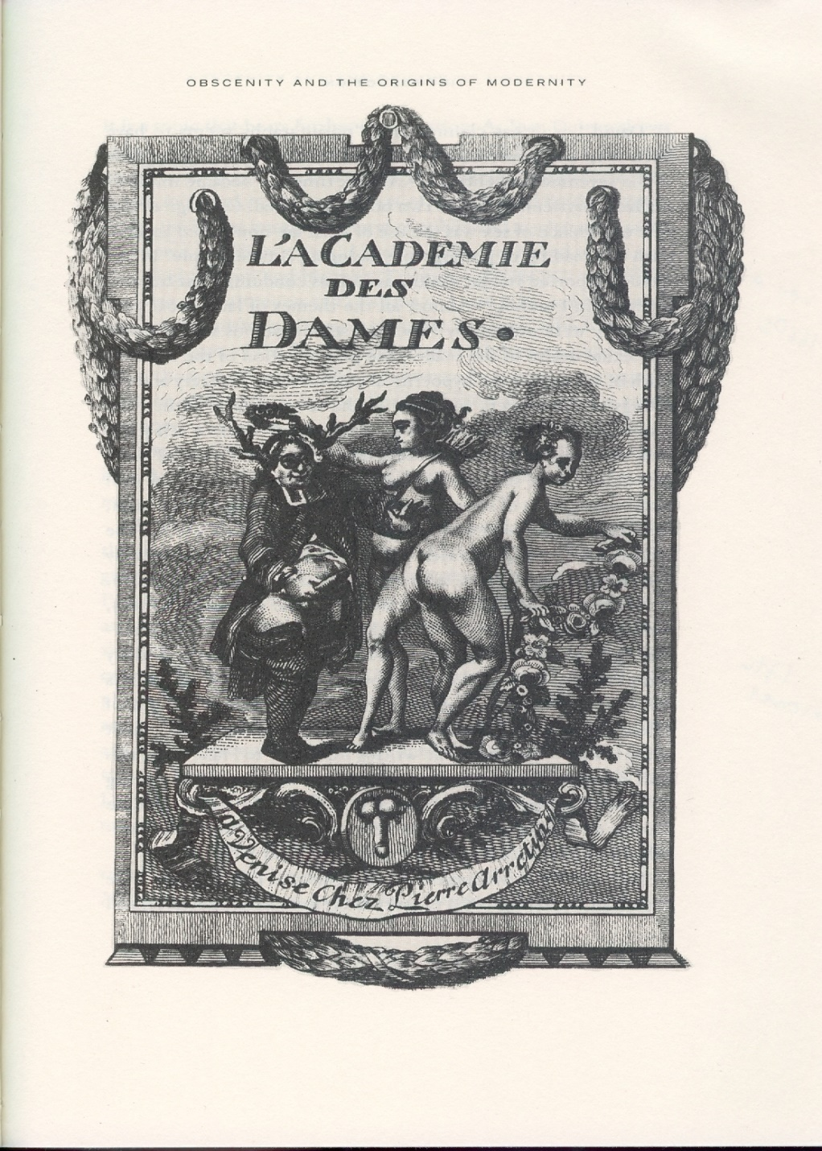
1650s France
Η επόμενη σημαντική στιγμή στην καθιέρωση πορνογραφικής παράδοσης->
  στα λατινικά αρχικά, και κατόπιν σε πολλαπλές μεταφράσεις
Για κάποιους σχολιαστές,
η πορνογραφία ωρίμασε σε σύντομο χρονικό διάστημα στα μέσα 17^{ου}:
το σεξ = πιο intellectual.
στοιχείο της νέας εμπειρίας του σεξ = χρήση sex aids, π.χ. ανάγνωση πορνογραφίας
ενώ στα 1660ς = εισαγωγή ιταλικών dildos και προφυλακτικών στο Λονδίνο
συνειδητή σεξουαλική διέγερση του αναγνώστη
αντιπαράθεση υλικής αλήθειας του σεξ απέναντι στην υποκρισία της κοινωνίας και της εκκλησίας

Slide 19
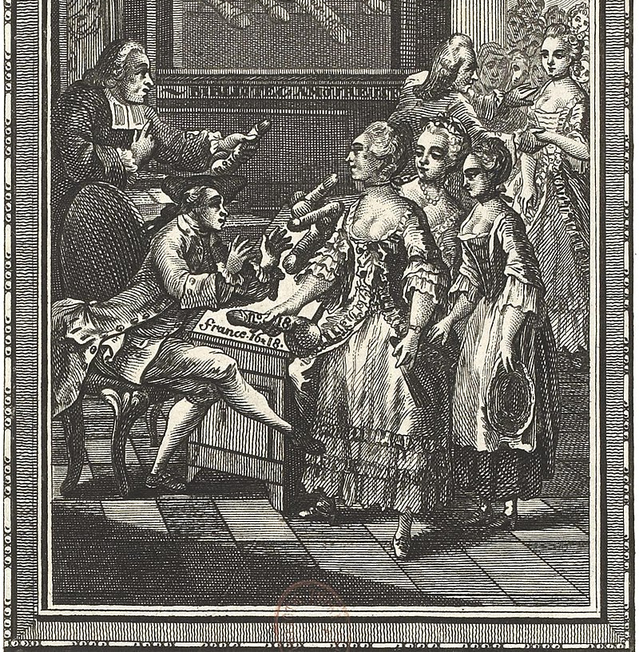
L’ Académie des dames(1660; 1770)
The School of Women, or The Seven Flirtatious Encounters of Aloisia
series of dialogues between Tullia, a 26-year-old Italian woman,, who is charged with the sexual initiation of her young cousin, Ottavia

Slide 20
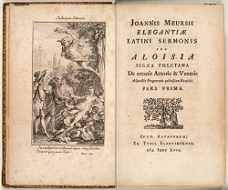
L’ Académie des dames
Tulia: "Your mother asked me to reveal to you the most mysterious secrets of the bridal bed and to teach you what you must be with your husband, which your husband will also be, touching these small things which so strongly inflame men's passion. This night, so that I can teach you above all in a freer language, we will sleep together in my bed, which I would like to be able to say will have been the softest of Venus's lace.

Slide 21
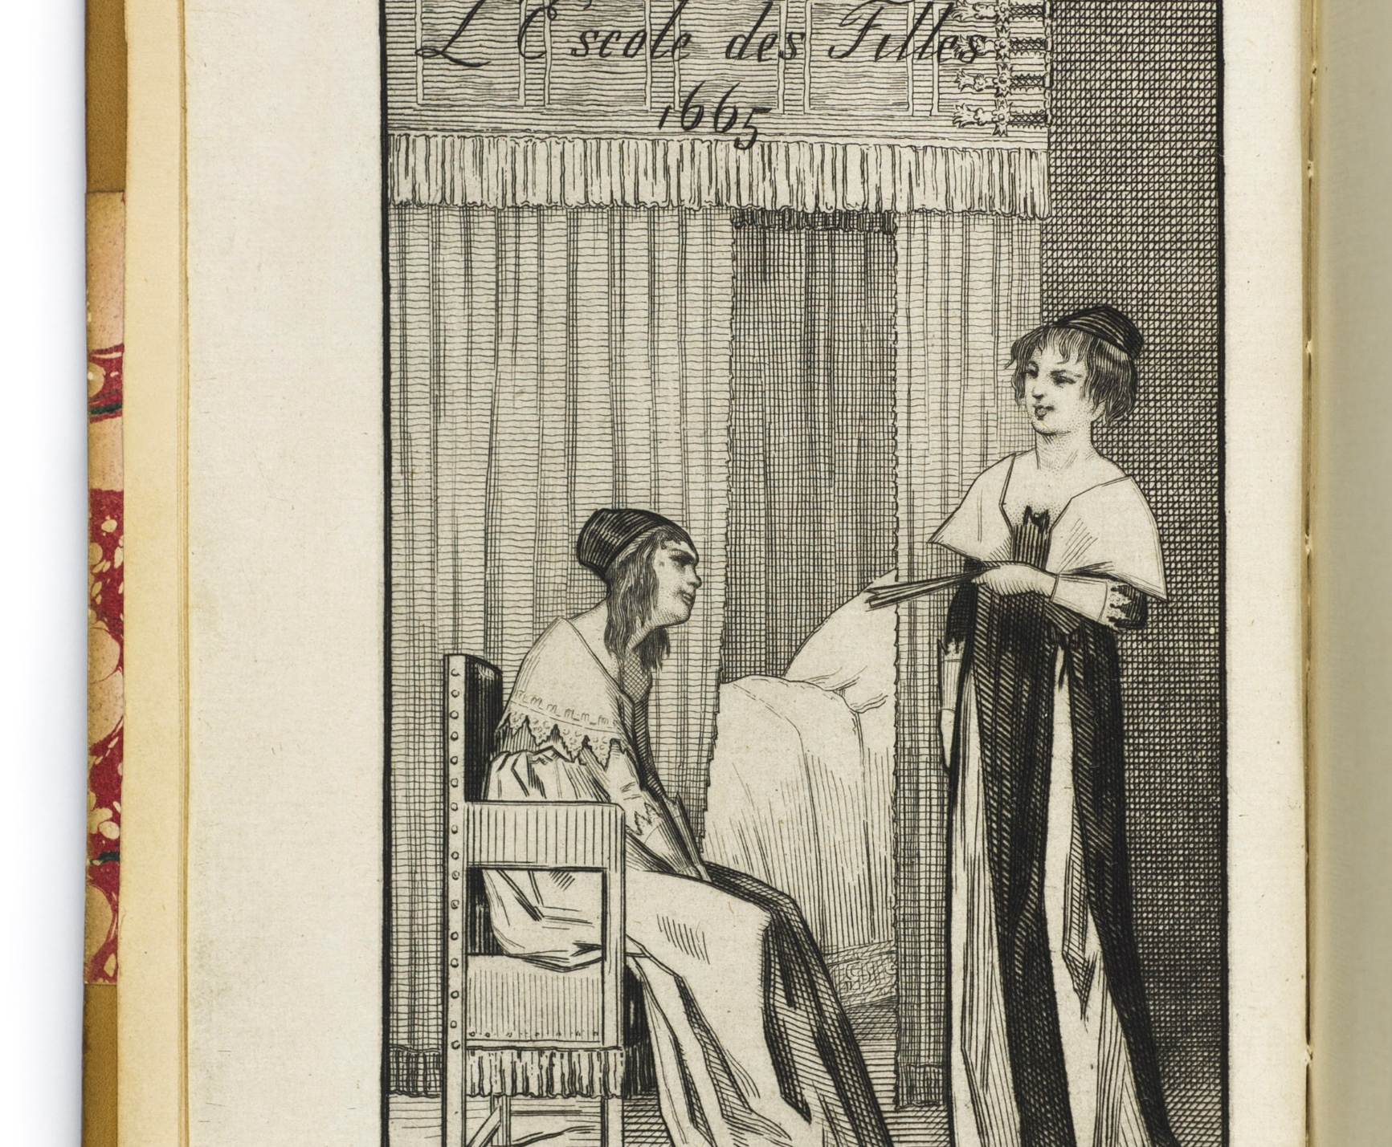
L’ École des filles- 1665 (anonymous)
  Considered the first French libertine novel of the 17th century.
Περιγράφεται, σύμφωνα με τον Rousseau «ως ένα από αυτά τα επικίνδυνα βιβλία τα οποία μια όμορφη γυναίκα του κόσμου βρίσκει να την αναστατώνουν γιατί, όπως λέει η ίδια, μπορεί κανείς να τα διαβάσει μόνο μ’ ένα χέρι».
  The narrative recounts the sexual initiation of the young female character Franchon, through two dialogues with her cousin Susanne and a sexual relationship with the male character Robinet

Slide 22
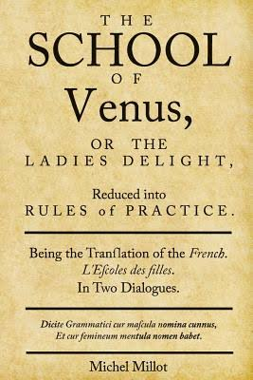
L’ École des filles- 1665 (anonymous)
the first publisher of the book, was put on trial and the book burned in Paris on August 9, 1655.
A first English translation of the novel was clandestinely published in 1680, under the title The School of Venus, or the Ladies Delight, Reduced into Rules of Practice.
The novel was not legally published, in either France or the United States, until the 20th c.

Slide 23
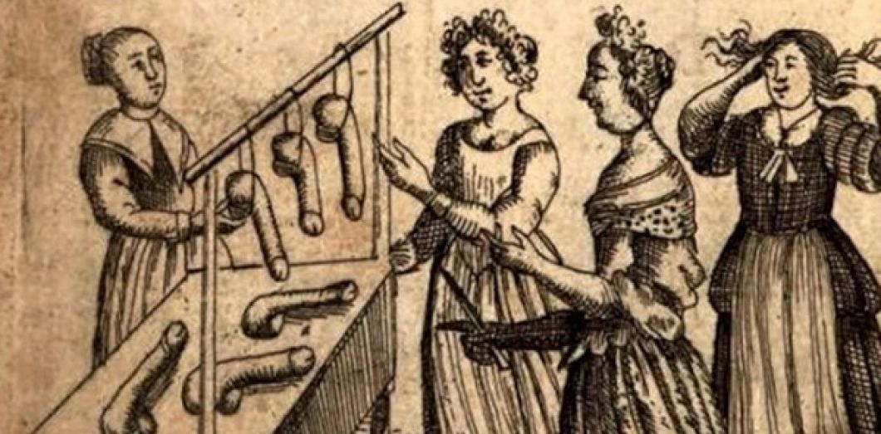
L’ École des filles- 1665 (anonymous)

Slide 24
manuals
Perhaps one of the best places to discuss how the discourses of science and erotica are intertwined -> the medical (sexual) and midwifery manual

Slide 25
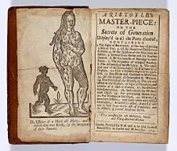
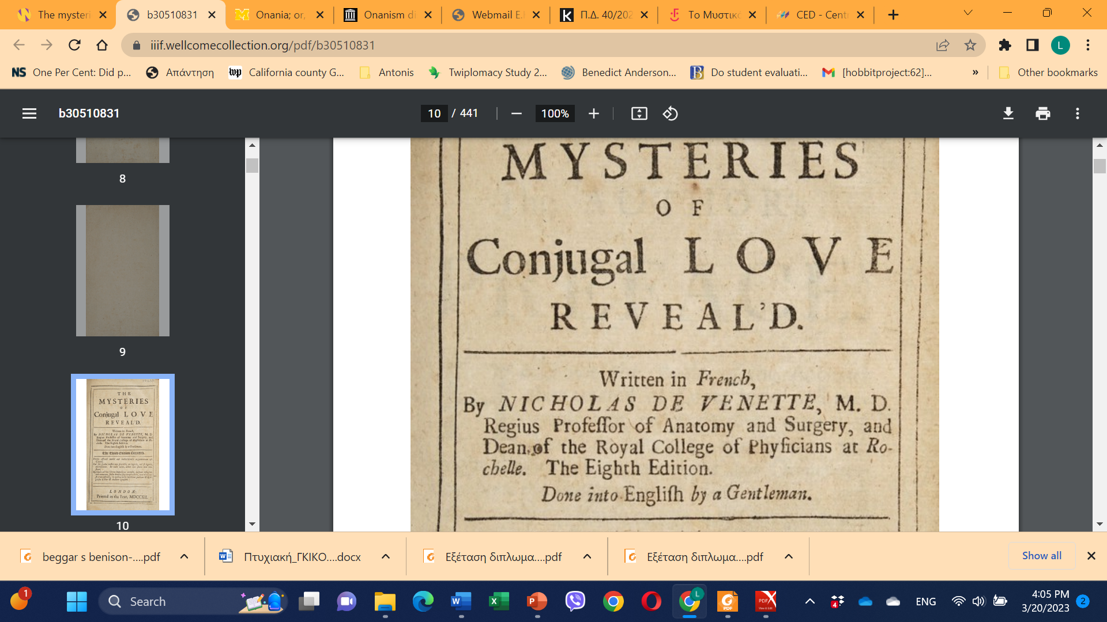
Sex advice manuals and midwifery manuals: Mysteries of Conjugal Love Reveal’d, Nikolas de Venette, 1703; Aristotle’s Masterpiece, 1684-19th c.

Slide 26
The early modern hermaphrodite
Ruth Gilbert (in "Seeing and Knowing: Science, Pornography and Early Modern Hermaphrodites." In At the Borders of the Human: Beasts, Bodies and Natural Philosophy in the Early Modern Period, edited by Erica Fudge, Ruth Gilbert, and Susan Wiseman, 150–70. Basingstoke: Macmillan, 1999), focuses on the early modern hermaphrodite, a figure around which revolved scientific, paramedical and erotic literature
  (and was featured as a case study(1687 in the Philosophical Transactions of the Royal Society, the first and longest running scientific journal in the world, rooted in the "natural history" model of the time).

Slide 27
The early modern hermaphrodite
Why the interest?
Because of the implicit concern about what was seen as excessive female sexuality;
  As sexual knowledge began to disseminate in scientific and pornographic texts, women were represented as susceptible to carnal immoderations
  With the evolution of scientific knowledge (17th c) -> we see the gradual replacement of superstition by empirical truth; a need to ‘See and Know’, following the discovery of the microscope;
  The Scientifc gaze: expands from the geographical world to the inners of the human body

Slide 28
The early modern hermaphrodite
Till the 16th c: discussions of the human/reproductive body -> written in Latin and Greek, and circulated within an elite male culture;
16th-17thc: there works are translated in vernacular versions;
Dilemma: how to represent the human body without exciting the reader
Proliferation of medical knowledge -> accompanied by an understanding of the human body as shameful

Slide 29
The early modern hermaphrodite
Many early modern authors of books about human reproduction: careful to construct their work as Scientia sexualis (a scientific study of the sexed body) and not as Ars erotica (knowledge of sexual pleasure);
In many cases, there were disclaimers of any lewdness that could be read into them (which drew attention to the very interpretation they were trying to avoid)
Also-> rising levels of literacy and emergence of print culture => readership= uncontrollable

Slide 30
The early modern hermaphrodite
Having said this, in early modern medical and erotic works ->
science and pornography drew upon the same material, ad presented in a similar way!!
(so, a great deal of erotic material was disseminated through sensational paramedical lit, which could inform as well as arouse the readers; e..g. Aristotle’s Masterpiece)
The hermaphrodite was an ideal subject of ‘pleasurable titillation’, inextricably linked to depiction of sexual parts (and necessitated a detailed and repeated naming of its parts)

Slide 31
The early modern hermaphrodite
The case of Marguerite Malause (widely discussed in early modern medical, paramedical and pornographic literature):
In December 1686, Monsieur Veay, (French physician), wrote a letter to the Philosophical Transactions about a ‘sensational’ case of hermaphroditism (the account came with the note:
  'this communication is reprinted in the original French, it being judged improper to appear in English'.
S/he was born in Pourdiac, near Toulouse, where s/he lived as a woman until s/he became ill in 1686 and was examined by Veay;

Slide 32
The early modern hermaphrodite
although she appeared to be female, she could only be penetrated to about two finger widths deep.
s/he was found to have a penis ('un membre viril d'une grosseur fort considerable') which could erect to about eight inches. According to Veay both urine and semen, as well as menstrual blood, flowed through this penis.
Ordered by doctors, Marguerite was declared to be predominantly male and ordered to change her/his name to the masculine Arnaud and adopt the clothes and life-style of a man.
Marguerite/Arnaud did not live happily as a man.

Slide 33
The early modern hermaphrodite
eventually left Toulouse and assumed again a female identity;
In 1691 s/he was arrested for transgressing the boundaries of the sex and was ordered to live like a man again;
In 1693 s/he came to Paris where she was examined by the famous physicians Helvetius and Saviard who concluded finally that s/he was in fact a woman.
Marguerite/Arnaud may have participated in presenting her/himself as a spectacle for the view of 'those who were curious’ (for money)
.

Slide 34
The early modern hermaphrodite
The scientific gaze: Saviard represented the hermaphrodite without compassion - he 'examined her in each part with exactitude.’
Marguerite/Arnaud's body was thus fragmented into a series of pieces which were thoroughly objectified by this scientific/pornographic examination.
.

Slide 35
The early modern hermaphrodite
‘I made her urinate before the gathered assembly, upon her claiming that urine did issue from two separate places; and in order to make apparent the contrary, while she urinated I did spread apart the lips of her vulva, by which means I did make the spectators see the urinary meatus from whence the flow did proceed exclusively’
couched in the language and methodology of scientific objectivity, the hermaphrodite was presented as a public experiment

Slide 36
The early modern hermaphrodite: The hermaphrodite as erotic entertainment
Several ads between 1680-1700 about a hermaphrodite woman from Angola in the British Library;
  Information in English, followed by detailed description of genitalia in Latin; the use of Latin encoded sexual knowledge – for the learned
  The proliferation of knowledge about the anatomical details of this Angolan woman, is also a graphic illustration of the eroticisation of the colonial gaze within a scientific context

Slide 37
The early modern hermaphrodite: The hermaphrodite as erotic entertainment
The consumption of erotic novels such as Francois de Chavigny de la Bretonniere's The Gallant Hermaphrodite (1688):
presented as a private pleasure of an emerging, and increasingly female, bourgeois readership.
However, the textual construction of this implied female reader - intimately absorbed by the hermaphrodite's erotic adventures whilst alone (and 'without scandal’) -> also allows the male reader to fantasize the imagined pleasures of this scene.

Slide 38
The early modern hermaphrodite: The hermaphrodite as erotic entertainment
the woman reader is also addressed in Giles Jacob’s Treatise of Hermaphrodites (1718) - https://www.gutenberg.org/ebooks/13569
Disclaimer: ‘My Design in the following sheets is meerly as an innocent Entertainment for all curious Persons, without any Views of inciting Masculine-Females to Amorous Tryals with their own Sex; and I am perswaded there will not be one single HERMAPHRODITE the more in the World, on account of the publishing this TREATISE’
Hermaphrodites were, in other words, created not born. They were defined by their sexuality as well as their sexual anatomy. For Jacob, hermaphrodites were, lustful women whose enlarged clitorises reflected their equally enlarged sexual appetites. (so we are talking here about female sexual desire)
.

Slide 39
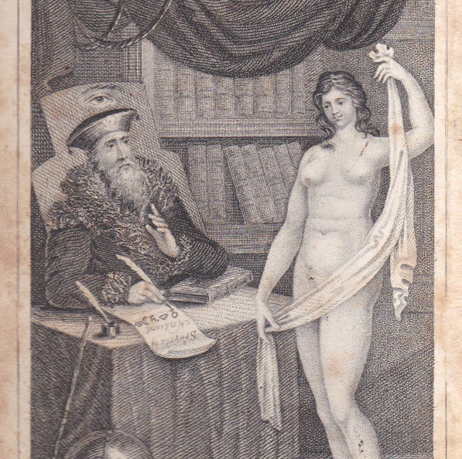
Manuals: Aristotle’s Masterpiece
https://publicdomainreview.org/essay/when-the-birds-and-the-bees-were-not-enough-aristotle-s-masterpiece/
Front cover, 1820s edition of the Masterpiece; by now the naked woman is no longer monstrous and hairy, and she’s lost the black baby

Slide 40
Βασικό ερώτημα:
υπάρχει σύνδεση ανάμεσα στα φιλοσοφικά βιβλία και τη μαζική εξέγερση στη Γαλλία που οδήγησε στη Γαλλική Επανάσταση?
  Ανάδυση πορνογραφίας στη Γαλλία, απαραίτητη για Γαλλική Επανάσταση
Στη Γαλλία, λοιπόν, τη στιγμή που άρχισε να αστυνομεύεται η πολιτική ανυπακοή, άρχισε να αναπτύσσεται και η χρήση της σεξουαλικότητας για ανατροπή επίσημου κρατικού ελέγχου.
Επόμενη έκρηξη στην πορνογραφική παράδοση, 1740ς:
  Histoire de Dom Bourge, portier des Chartreux (1741)
  Le Sopha (1742)
  Les Bijoux indiscrets (Diderot) 1748
  Thérèse philosophe (1748)
  Cleland’s Fanny Hill

Slide 41
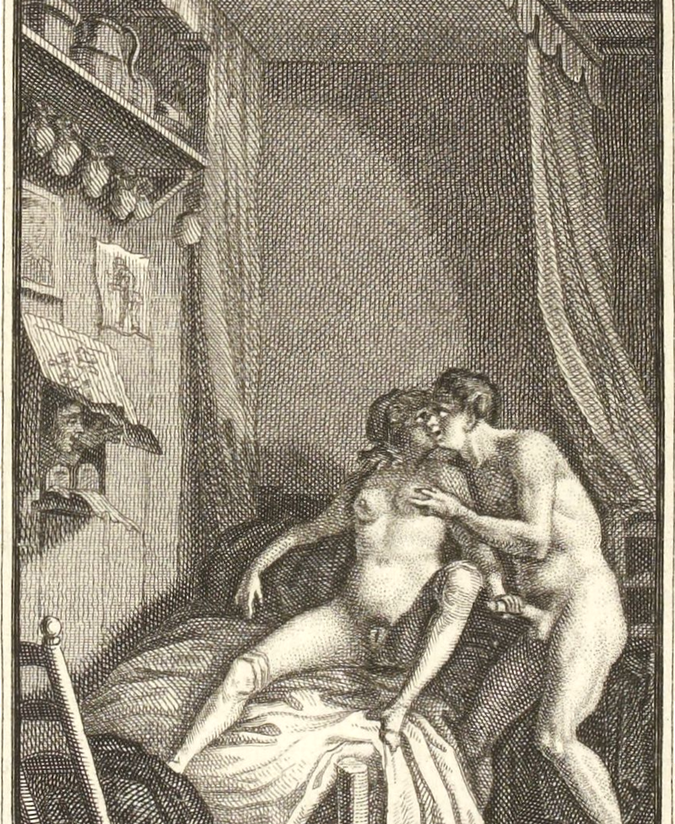
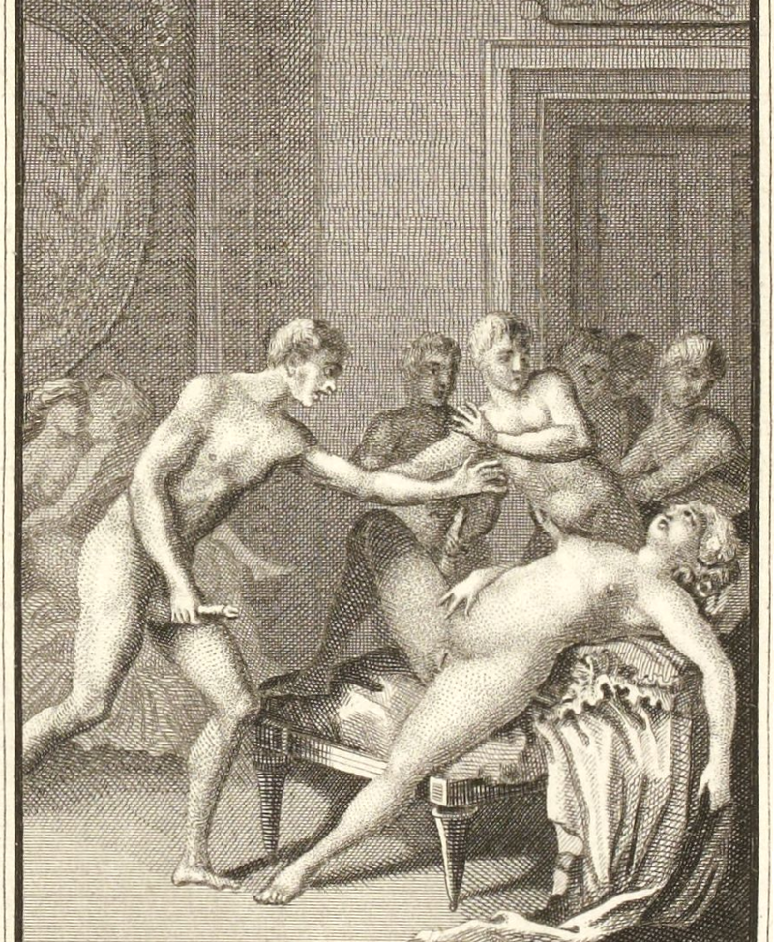
Histoire de Dom Bougre, portier des Chartreux (1741)
Allegedly the anonymous author was Jean-Charles Gervaise de Latouche. Histoire de Dom Bougre = one of the most celebrated French erotic novels of the 18th century, and one of the most frequently reprinted. The name Bougre refers to the French term boulgre meaning bugger.

Slide 42
Histoire de Dom Bougre
first-person perspective of the life story of the monk B… (acronym stands for Bougre, French vulgar expression for pederast); real name = Saturnin
series of taboo breaking practices, offering ruthless criticism of church and society
meets his syphilis sister (alleged) Suzon, in a brothel; spends the night with her despite risk of infection;
Saturnin falls ill and is forcibly castrated to save his life, Suzon dies; Saturnin finds refuge in a Carthusian monastery, where, freed from all passions, he can await death.
He would like the words: Hic situs est Dom Bougre, fututus, futuit (Here lies Dom Bougre, he fucked, and was fucked), to be inscribed on his grave.

Slide 43
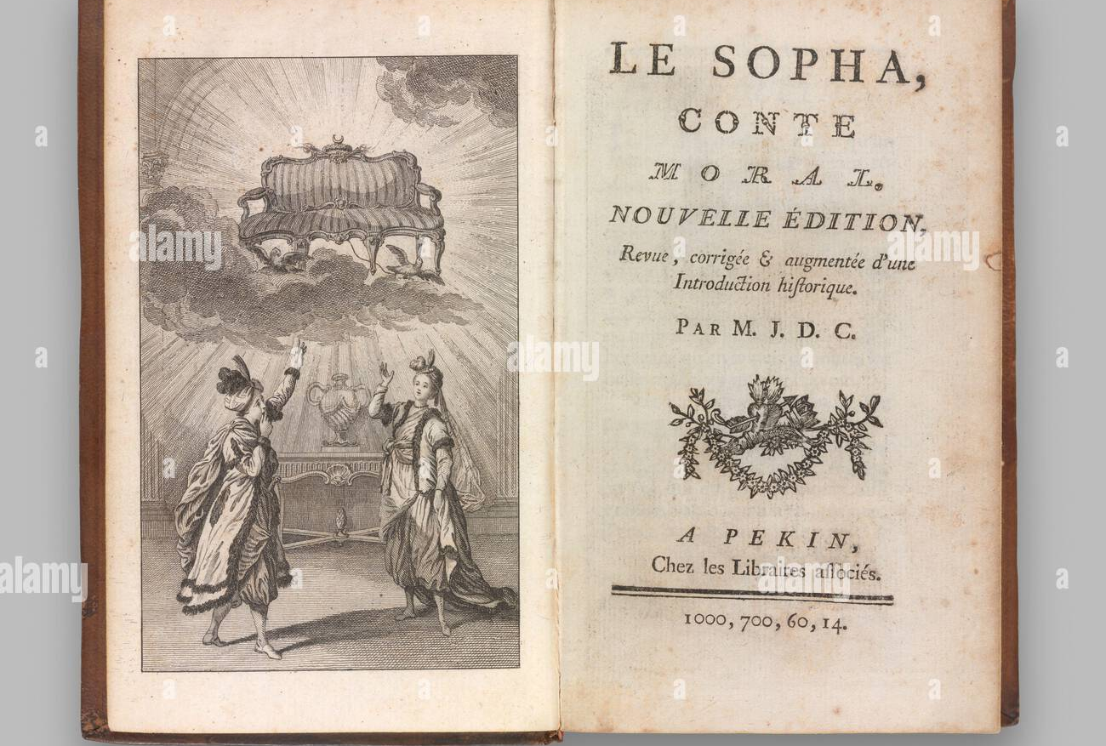
Le Sopha- A Moral Tale (1742)
(by Claude Prosper Jolyot de Crébillon)
The novel is structured as a frame story in an oriental setting, explicitly evocative of the Arabian Nights, in which Amanzéï recounts the adventures of 7 couples, which he witnessed in his sofa form, to the bored sultan Shah Baham.

Slide 44
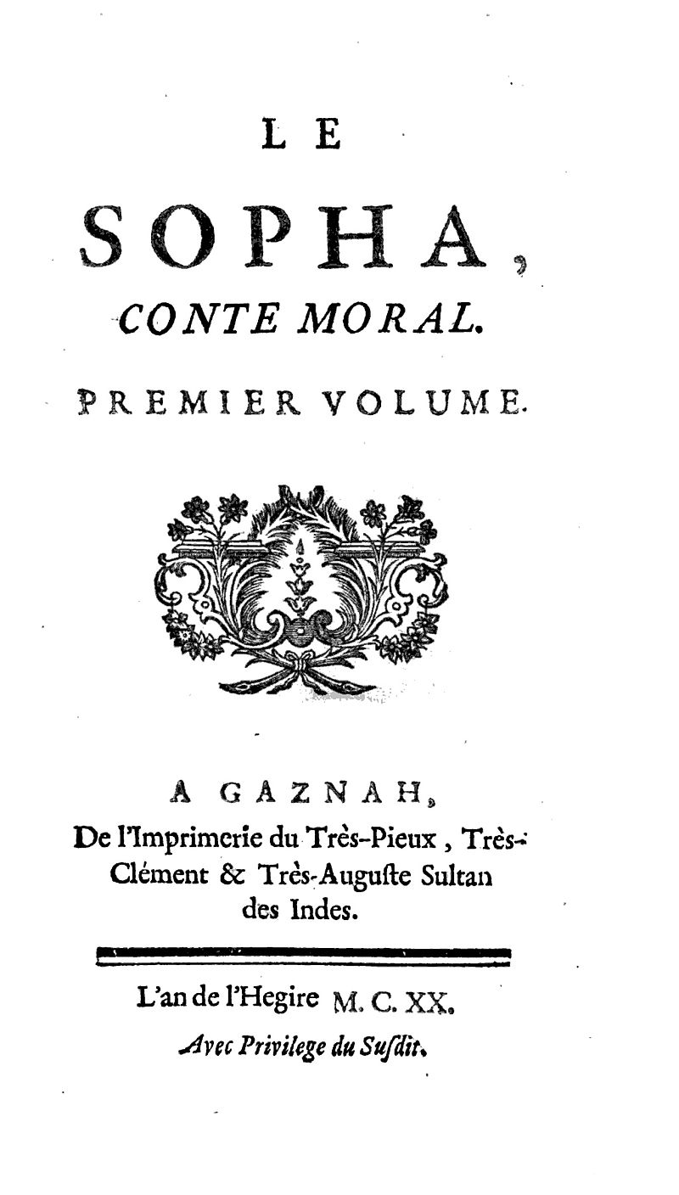
Le Sopha- A Moral Tale (1742)
Many of the characters in the novel are satirical portraits of influential and powerful Parisians of Crébillon's time
some recognize Louis XV in the figure of the ridiculous Shah Baham. Although the book was published anonymously and with a false imprint, Crébillon was discovered to be the author and was exiled to a distance of thirty leagues from Paris on April 7, 1742.

Slide 45
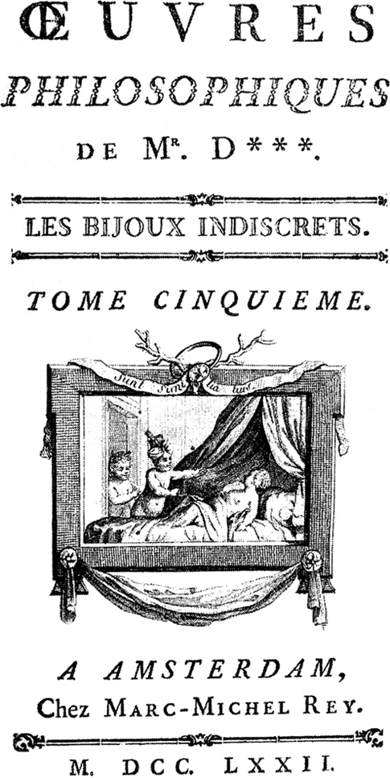
Les Bijoux indiscrets (Diderot) 1748
The Indiscreet Jewels (‘toys’)
Allegory, portraying Louis XV of France as Mangogul, Sultan of Congo, who owns a magic ring that makes women's vaginas ("jewels") talk.
The character of Mirzoza represents Louis XV's mistress Madame de Pompadour, who Diderot pictured in a flattering light, probably to ensure her support for his Encyclopedie

Slide 46
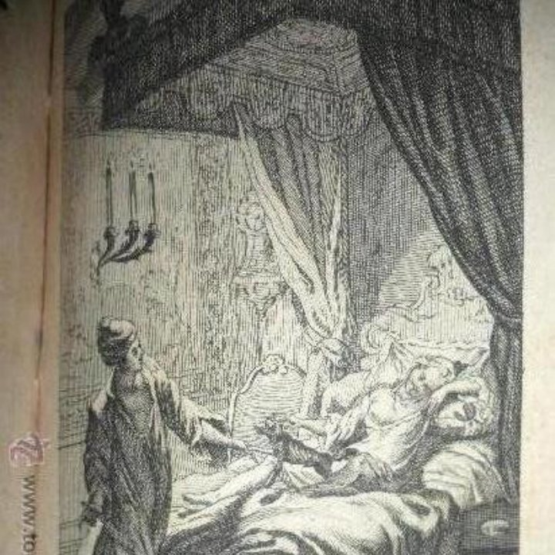
Les Bijoux indiscrets
the magical ring is presented to the Sultan by a genie;
When rubbed and pointed at the vagina of any woman, the vagina begins speaking about its amorous experiences;
the ring also makes its owner invisible when required => a few of the sexual experiences are recounted through direct observation

Slide 47
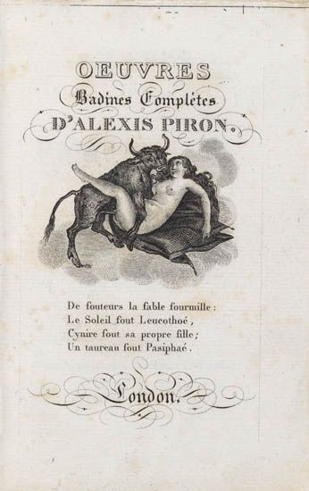
Oeuvres badines et morales de Mr. Cazotte, 1788
A complete edition of his work was published as the Œuvres badines et morales, historiques et philosophiques de Jacques Cazotte;
On the discovery of some of his counter-revolutionary letters in August 1792, Cazotte was arrested; and though he escaped for a time, he was beheaded the following month.

Slide 48
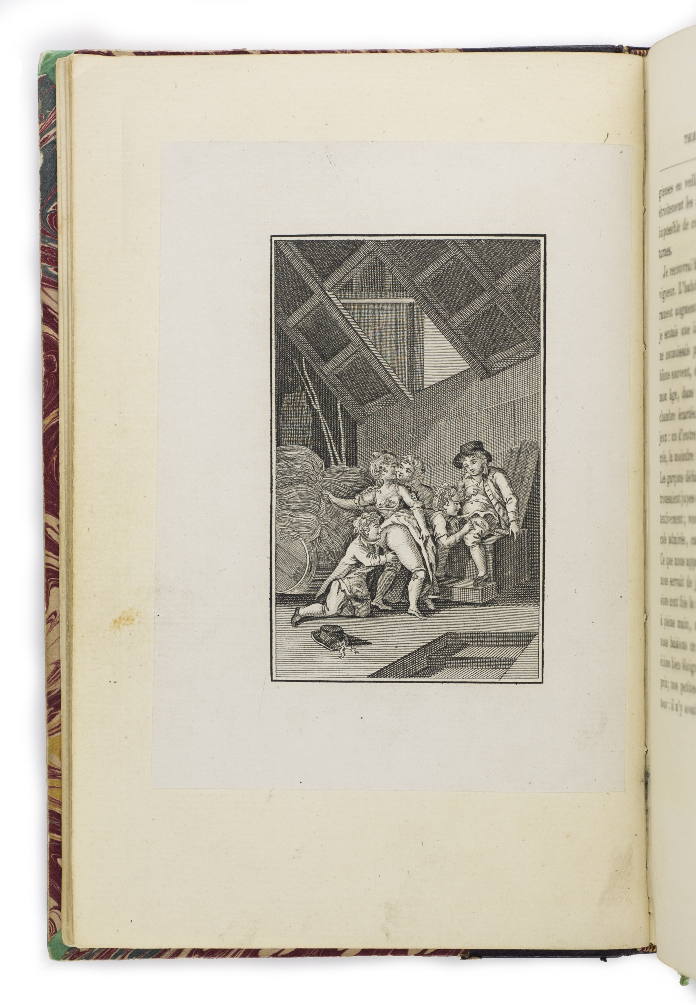
Therese philosophe, 1748
Thérèse philosophe records the tale of a young woman’s sexual education, as she recounts her experiences in explicit detail to her noble lover.
“What, Sir, seriously you want me to write my story?”
She consents to write down the story she has already recounted in person, framing a narrative dedicated to evaluating the power of the written word to excite physical response

Slide 49
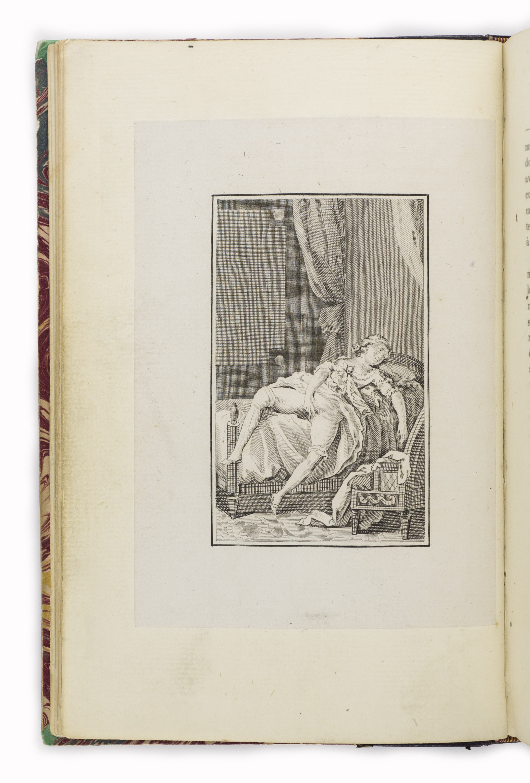
Therese philosophe, 1748
Juxtaposition of: the narrator’s sexual awakening with extended meditations on philosophical materialism, natural law theory, and refutations of established principles of Catholic doctrine

Slide 50
Therese philosophe, 1748
As a child of 7, Thérèse was discovered rubbing “that part that distinguishes us from men” to a pleasurable release. The narrator presents her younger self’s habitual masturbation as evidence of a natural drive so powerful and yet so contrary to contemporary morality that her mother resorted to tying her hands together to stop it.
Even awake, she found ways to gratify her innate sexual curiosity. Nor was she unusual in this behavior, for she recalls childish games with groups of children dropping pants and lifting skirts to examine and kiss other children’s private parts, motivated by curiosity and “simple nature.” .
In this, the law of nature demands the satisfaction of the physical desire for sexual pleasure.

Slide 51
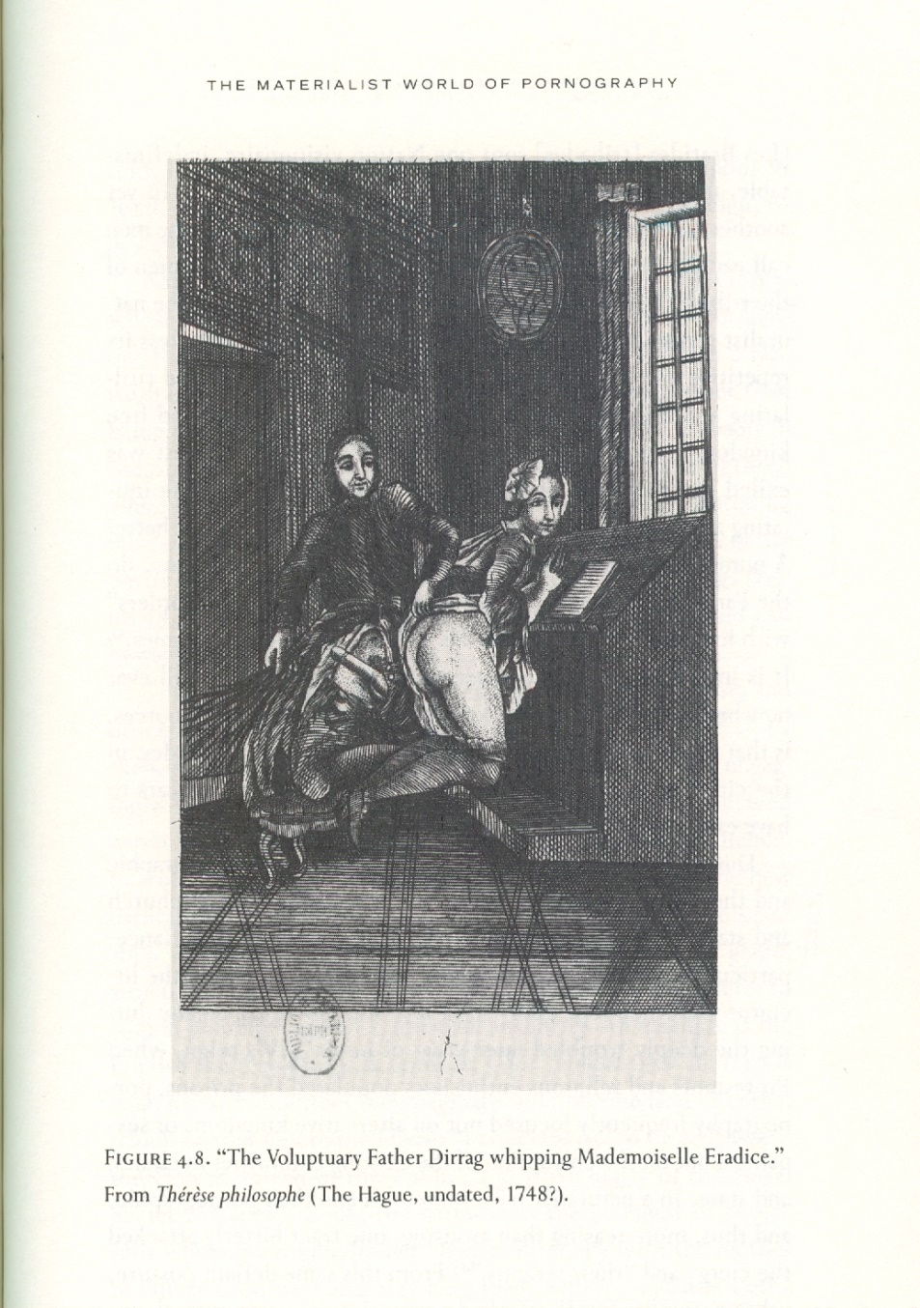
Therese philosophe, 1748
At 11, Thérèse is placed in a convent, where she is taught sexual excitement is not a simple, natural phenomenon but a satanic temptation -to be avoided. She avoids masturbation til she turned 25, when she met the famous Père Dirrag and his young novitiate Eradice. This section contains a roman à clef based on a 1731 cause célèbre and causes Thérèse to question Catholic morality regarding sexuality

Slide 52
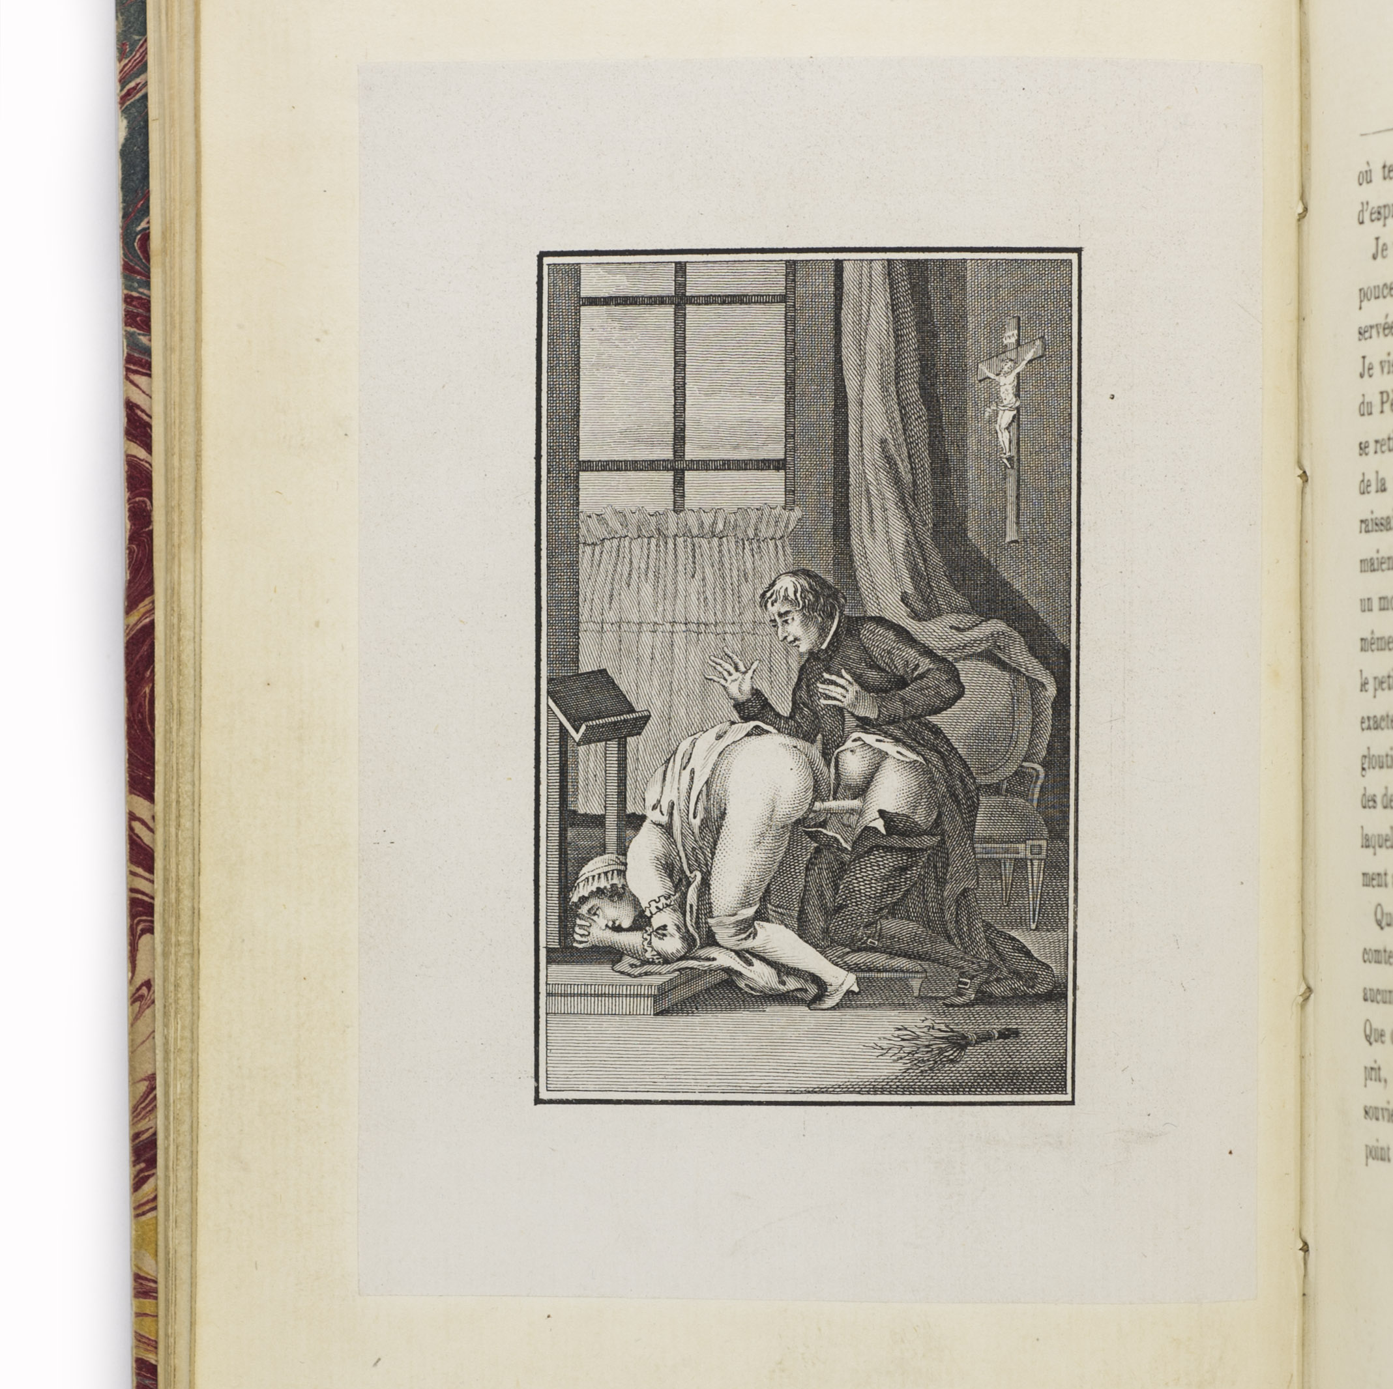
Therese philosophe, 1748
When her health falters, Abbé T., advises: “as natural as those of hunger and thirst; you need not seek them or excite them, but when you feel them, there’s nothing wrong with using your hand, your finger, to care for this part by agitating it as necessary.” (I, 89-90) He forbids her from pushing her finger inside, however, since “this could be a problem one day for the husband that you marry.”
Church mandates against masturbation are ignored here, as the cleric advises Thérèse to follow the “laws of nature” rather than canon law.

Slide 53
Therese philosophe, 1748
Thérèse philosophe showcases the hypocrisy in medical and moral advice regarding female sexuality.
the author sought to transform bodily practices: Indeed, the attentive and curious reader can learn about masturbation, oral sex, and the withdrawal method of birth control from this text.
The novel also initiates its readers into a community attuned to the physical effects of reading sexually explicit literature, mentioning specific texts and noting their impact on key characters.

Slide 54
Therese philosophe, 1748
One evening, Thérèse overhears a conversation between Mme C. and the Abbé T., whose relationship is presented as an ideal philosophical union, in which they explain how they depend on techniques of mutual masturbation and withdrawal to avoid a pregnancy which would threaten their honor and Mme C’s health.

Slide 55
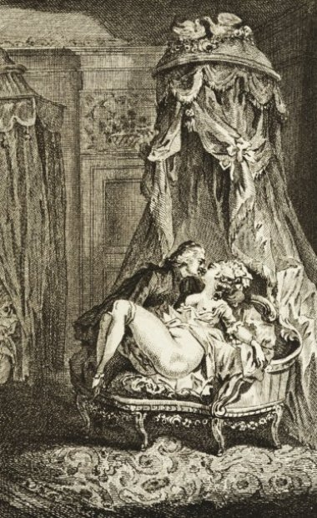
Therese philosophe, 1748
One evening, Mme C. insists that the Abbé not hold back any longer, for “reading your naughty Portier des Chartreux has lit me on fire… I’m dying of desire and I consent to risk everything.” (I, 130) The act of reading constitutes sexual foreplay, arousing Mme C. to the point of requiring embodied intercourse.
However, the abbé refuses to penetrate her saying that he loves her too much to damage her reputation by getting her pregnant.
He obliges her with oral sex instead.

Slide 56
Therese philosophe, 1748
final section: Thérèse has a similar experience of textually inspired desire with the Count. She agrees to live with him as his mistress, but refuses to allow penetration;
He agrees to loan her his collection for a year, provided that she could abstain from masturbating for 15 days;
“on the fifth day, after an hour of reading, I fell into a sort of ecstasy.”
Finally, by Thérèse’s invitation, the Count appears, and provides one final lesson on the withdrawal method, clearly equating romantic love with this way to avoid pregnancy.
Demographers have cited the novel as evidence that the withdrawal method had gained cultural acceptance and played a role in women of all social classes bearing fewer children in 18th c. France

Slide 57
Couple of points about masturbation
Hippocrates, 5th B.C. and Galen, 2th B. C.: necessary for both men and women, to release ‘seed’; masturbation good for health (alleviate women’s tension or blockages);
Middle Ages: Early Church Fathers legacy = onanism as sin (Genesis 38: 4-11); Onan ‘spills his seed on the ground’; a misunderstanding (coitus interruptus). Punishment.
Renaissance: masturbation = mortal sin, like sodomy => capital punishment (more often banishment; Protestants: hamstringing)
17th-18thc.: libertine men formed secret societies (The Beggar’s Benison)- masturbation as bonding mechanism
Rousseau: 1762, Emile ‘the most deadly habit to which a young man can be subject’
Sex advice manuals

Slide 58
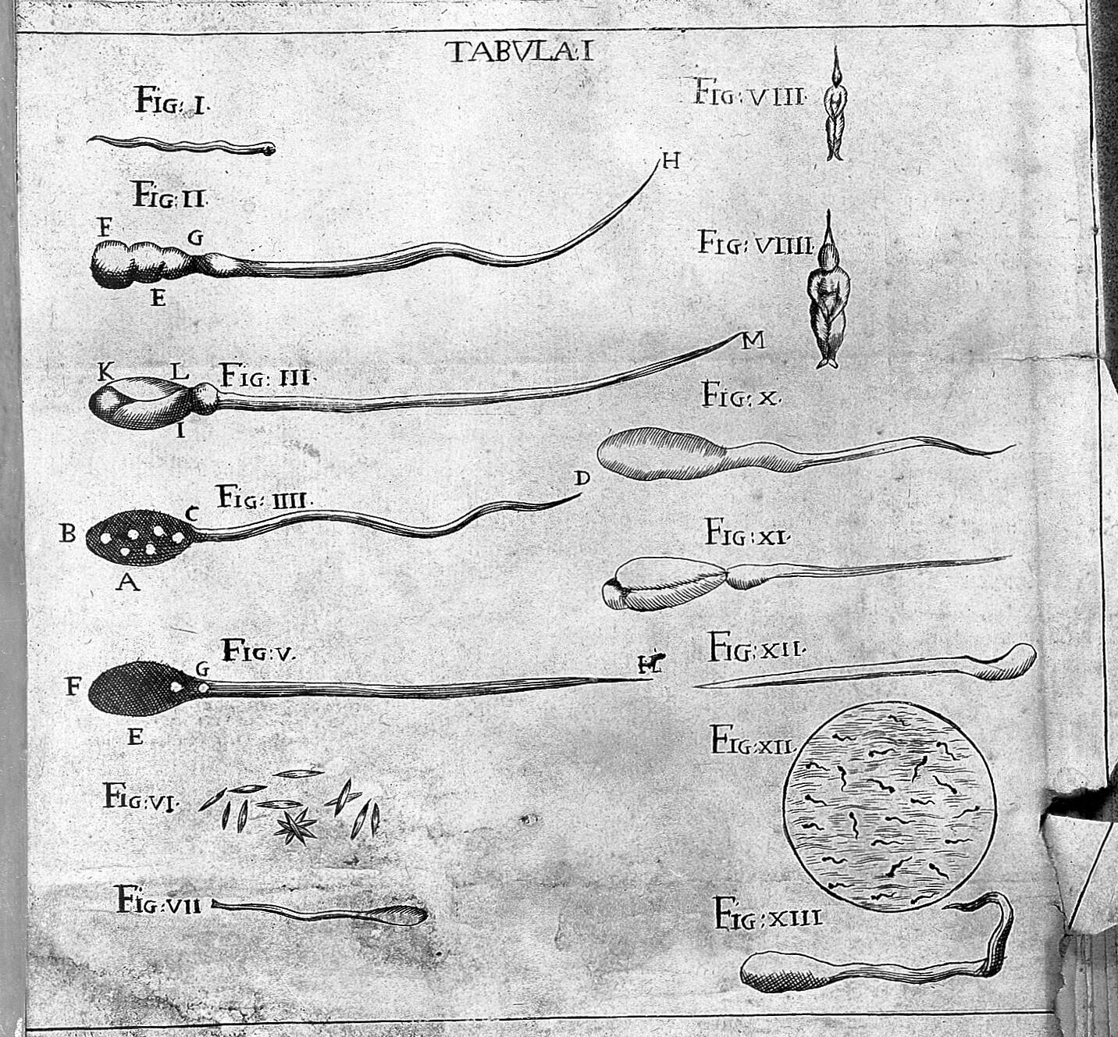
Couple of points about masturbation
Emergence of science of medicine: masturbation connected to physical disability (health risks)
Up until discovery of the microscope, the sperm was thought to carry fully formed humans- homunculi => waste of seed = homicide
With growth of medical knowledge: medics = the new moral authorities about good and bad sex

Slide 59
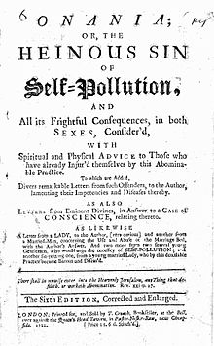
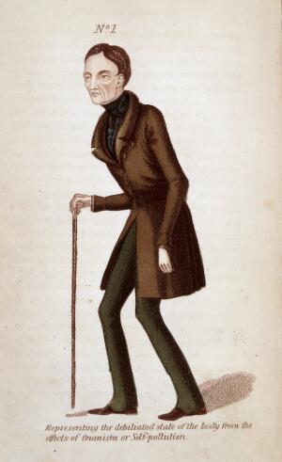
Onanism Display’d (1719) ‘Representing the debilitated state of the body from the effects of onanism or self-pollution.’

Slide 60
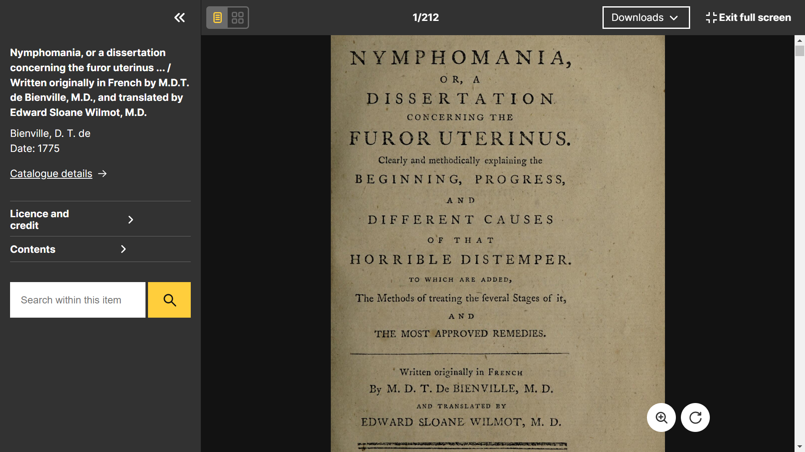
Couple of points about masturbation
French medical text: ‘Nymphomania/Or a Dissertation Concerning the Furor Uterinus’, 1775 by D.T. Bienville
Argument: female desire is unnatural; and …. Women are naturally lascivious, possessing a bestial sexuality- socially disruptive if not contained;
This is typical of mid-18th c. writing: representation of women as both chaste and lovely, and as naturally bestial in their sexuality…

Slide 61
Couple of points about masturbation
Such approaches to female desire: tied up with concerns about increasing luxuriousness of society; (Plato’s Republic/Πολιτεία):
Luxurious indulgence will effeminate the state, its governors becoming enfeebled by luxury => anarchy
Bienville’s argument: consumption of luxurious products (rich food, reading novels) = will aggravate the disease; excessive female desire = a pathology, NOT a natural attribute of femininity
During 17th c.: ‘hysteria’ understood in the medical paradigms of Hippocratus, Aristotle, Galen; ‘furor’ discussed in terms of the ‘one-sex’ model of human anatomy- women as incipient men; cannot concoct blood into semen => health problems; wombs = like wild animals, not to be hampered in sexual union, because will cause diseases

Slide 62
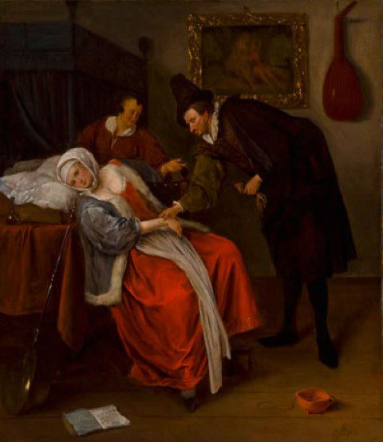
The Doctor’s Visit, 1663
Jan Steen (The wandering womb)
“hysteria,” or “furor uterinus”: the uterus travelled throughout the body, or become inflamed and “suffocated”; epidemic among women from ancient times through the 17th c. when its diagnosis peaked.
Victims suffered apathy, depression, mood swings, perverted appetite, and sleeplessness, abdominal pain, difficult breathing, and fainting. Hungry and bored, the uterus roamed throughout the body looking for food and purpose…
virgins, widows and nuns: especially threatened
Reading (especially Latin), working mathematical problems, wearing male clothing, cutting the hair, delaying marriage and childbirth=> wandering womb. Women instructed to engage in frequent sex (with their husbands), and maintain a state of continuous pregnancy

Slide 63
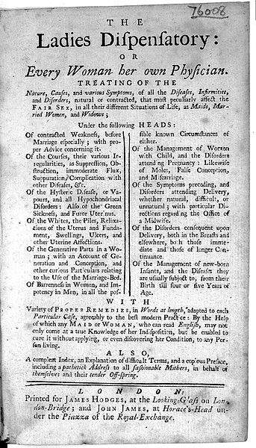
Couple of points about masturbation
Nymphomania = disease caused by ‘high feeding, want of exercise, mixed conversation, indulging vehement desires; too indulgent a life; an overly large clitoris (result of masturbation) (self-help medical text The Ladies Dispensatory 1739).
Recommended treatment:
  avoid all immoderate stimulation and luxury;
  Diet = thin and cooling, not large quantities
  Exercise = moderate
  Keep away from the companion of men.
  Esp the man she loves
  The Ladies Dispensatory: a secular conduct book for women, rather than a medical textbook; was discredited by medics who moved on to a nervous model of ‘hysteria’;
  Still, hysteria was linked with refined tastes => Bienville links nymphomania with pleasure and high living (rich sauces, spiced meats, luxuriously set tables)

Slide 64
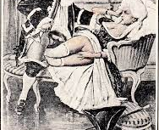
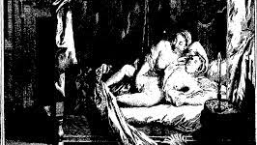
Fanny Hill
Αγγλία: John Cleland’s Memoirs of a woman of pleasure (Fanny Hill) 1748-1749
Μόνο μετά τα 1880ς και μετά (εποχή ανάδυσης των mass politics) έχουμε εθνική πορνογραφία σε κάθε χώρα- κάτι που δηλώνει σχέση μεταξύ πορνογραφίας και δημοκρατικής παράδοσης

Slide 65
1790s
Όλα τα έργα αυτής της εποχής
κάνουν χρήση της φόρμας του μυθιστορήματος,
έχουν απομακρυνθεί από το μοντέλο του Aretino (διάλογος μεταξύ γυναικών).
Μεταξύ 1740-1790ς,
η γαλλική πορνογραφία γίνεται ιδιαίτερα πολιτική:
πορνογραφικά φυλλάδια σατιρίζουν
κλήρο
αυλή
και τον ίδιο το βασιλιά στην περίπτωση του Louis XV.

Slide 66
1790s
  η Γαλλική Επανάσταση έφερε μια άλλη πλημμύρα πορνογραφικών φυλλαδίων (που είχαν σχέση με πολιτικές διαμάχες)
  εδώ είναι και ο de Sade, ο οποίος ασχολήθηκε με όλες θεματικές σύγχρονης πορνογραφίας:
    βιασμό
    αιμομιξία
    σοδπμισμό
    παιδοφιλία
    ακραίες μορφές βασανισμού και φόνου σε σχέση με σεξουαλική διέγερση

Slide 67
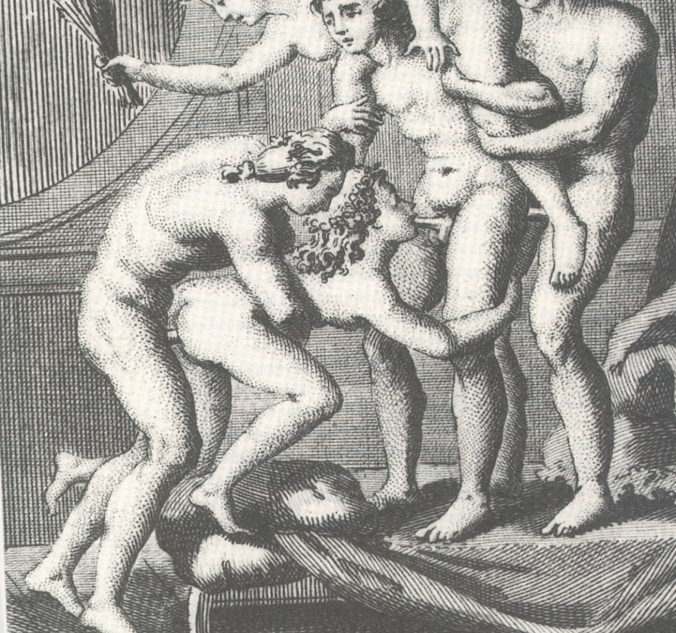
La Philosophie dans le boudoir, 1795- de Sade

Slide 68
η πόρνη ως κοινωνικό βαρόμετρο
ένα από τα βασικά πρόσωπα στην ιστορία πορνογραφίας = η πόρνη
  Από Αναγέννηση, στη Γαλλική Επανάσταση και μετά,
η εταίρα (courtesan) = πανταχού παρούσα στη λογοτεχνία των λιμπερτίνων =>
Αποτελεί εξαιρετικό μέσο για να διαγνώσουμε αλλαγές στην πορνογραφία και άρα αλλαγές στις αξίες και απόψεις της κοινωνίας

Slide 69
η πόρνη ως κοινωνικό βαρόμετρο
Δυο βασικές φιγούρες στη γαλλική παράδοση, - η libertine whore όπως
  η Margot (Margot la ravandeuse, 1750)
  Juliette (Histoire de Juliette, ou Les Prospérités de la vice, de Sade, 1792)
  Και τα δυο έργα διαφέρουν από άλλα που καταπιάνονται με πόρνες,
στο ότι είναι και τα δυο πορνογραφικά= ιστορίες ρητά σεξουαλικές που περιφρονούν τα σύγχρονα ταμπού.

Slide 70
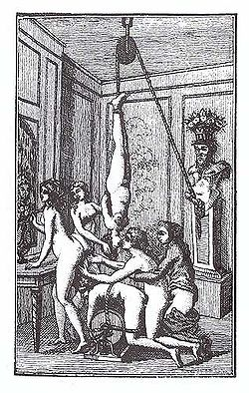
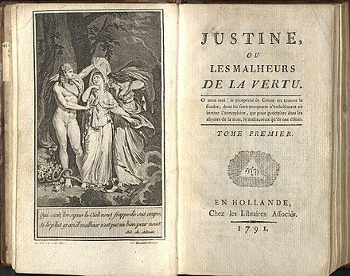
Histoire de Juliette, ou Les Prospérités de la vice, de Sade, 1792

Slide 71
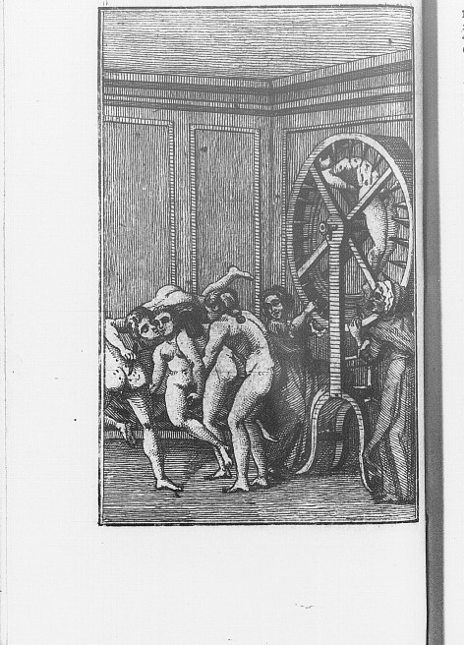
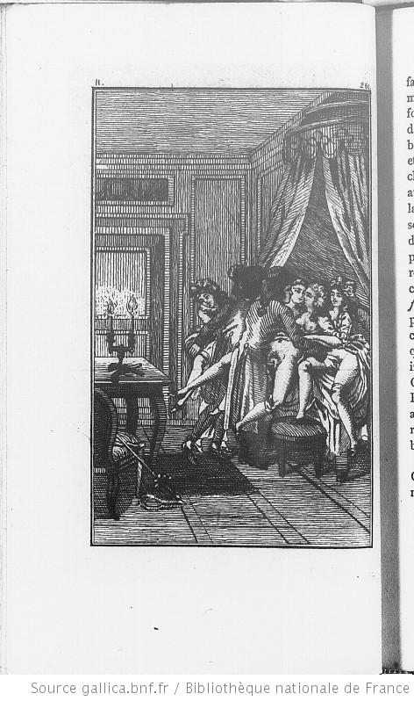
Histoire de Juliette, ou Les Prospérités de la vice, de Sade, 1792

Slide 72
Margot = “libertine whore”
      Ανεξάρτητη, αισθησιακή, δεξιοτέχνης
      Υγιής, με κανονική, υγιή σεξουαλική όρεξη
      Businesswoman, καλλιτέχνης, προσφέρει ‘διαφοροποιημένο’ σεξ σε άνδρες με τα μέσα να πληρώσουν
      Ζει πολυτελώς, ακολουθώντας υλιστική φιλοσοφία (materialist philosophy)
      έξυπνη, ανεξάρτητη, περήφανη
      Δεν είναι άρρωστη, τερατώδης
      Δε θυματοποιείται από τη ζωή ή τους πελάτες
      Μπορεί να έχει εργατικές ρίζες, αλλά τις έχει ξεπεράσει μέσα από παιδεία-καλλιέργεια
      μορφωμένη, δεν υποφέρει από ρομαντική αγάπη, είναι καθαρή, περιφρονεί σεμνοτυφία, τελειώνει τη ζωή της πάμπλουτη

Slide 73
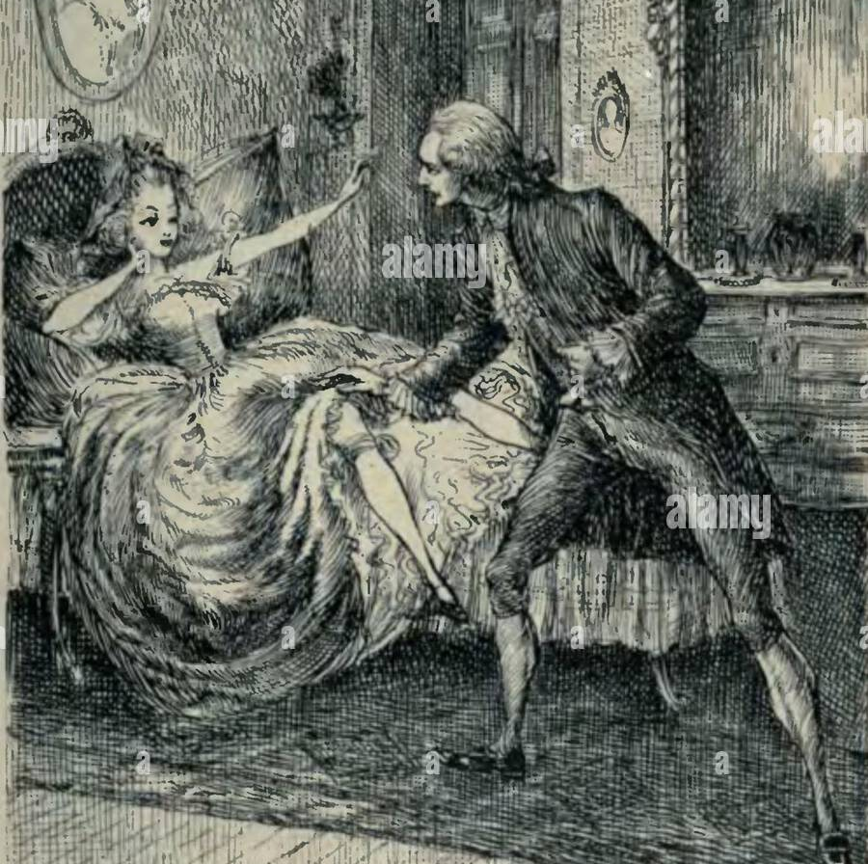
The «virtuous courtesan»
    Στον αντίθετο πόλο: μια πόρνη που εμφανίζεται στη λογοτεχνία 18ου αι, η ενάρετη εταίρα, «virtuous courtesan»
    θύμα χωρίς χαρά στη ζωή
    φτωχή, από εργατική τάξη, κακοποιείται από άνδρες
    άρρωστη στο σώμα, ίσως και στο πνεύμα
    καταδικασμένη να υπομένει σαδισμό ανδρών και κοινωνίας
    π.χ. «πόρνη με τη χρυσή καρδιά» -> Zéphire στο Palais Royal του Restif de la Bretonne
  Δηλαδή, αθωότητα χαρακτήριζε όλες τις γυναίκες, ακόμα και τις ‘διεφθαρμένες’

Slide 74
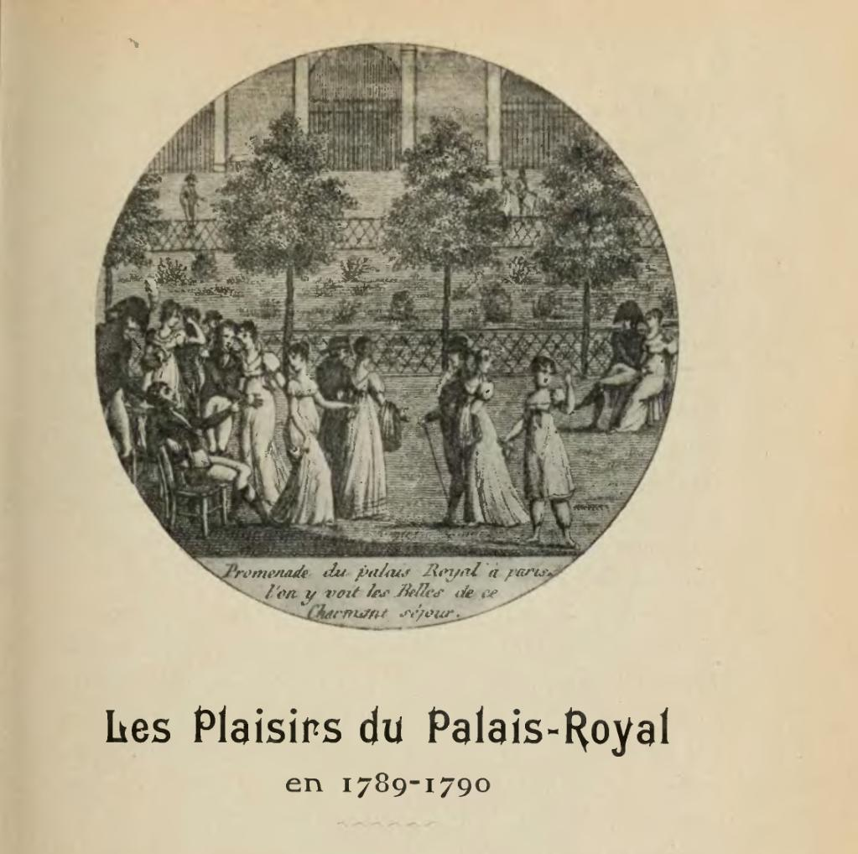
The «virtuous courtesan»
στο Palais Royal (1790), ο Restif de la Bretonne
περιγράφει τις γυναίκες του δρόμου ως
παρθένες, θύματα κακών μανάδων-πατεράδων που τις πούλησαν
παρά τις δυσκολίες, διατήρησαν την αγνότητά τους
=> αναπαράσταση γυναικών ως
σεμνές από τη φύση τους
αθώες σαν παιδιά
ασεξουαλικές
ακόμα και οι πόρνες διατηρούν την αρετή τους (εξαναγκάζονται στην πορνεία, δεν το επιλέγουν)

Slide 75
«λιμπερτίνα πόρνη» (Margot, Fanny, Juliette)
  Καμία σχέση με την Zéphire («πόρνη με τη χρυσή καρδιά») -> , γιατί η λιμπερτίνα πόρνη έχει απορρίψει τις αντιλήψεις του Ρουσώ περί γυναικείας σεμνότητας
  Πλάσματης κουλτούρας του rococo, που αποδέχεται
      Υλιστική φιλοσοφία
      Αισθησιακή ευχαρίστηση
      Κυρίως, τη ‘διαφορετική’ ευχαρίστηση
Δε νοιάζεται για υποτιθέμενη εγγενή γυναικεία σεμνότητα
Ούτε για οικογένεια
Είναι μια δημόσια γυναίκα σε μια εποχή που δεν υπήρχε διαχωρισμός ιδιωτικού/δημόσιου
Δε γνωρίζει συστολές, ντροπή, ενοχή
Αποτελεί μετεξέλιξη προηγούμενων μορφών (Αρετίνο)- μας δίνει πληροφορίες για παριζιάνικη ζωή και μόδα- π.χ. ‘Guide rose’

Slide 76
The ‘libertine whore’
Κοινό στοιχείο:
  ηρωίδα δέχεται χρήματα ή συντήρηση σε αντάλλαγμα για σεξ.
  Περνά χρόνο σε μπορντέλο προτού περάσει στο επόμενο στάδιο, της σπιτωμένης γυναίκας.
  Ηρωίδα περιγράφει σύντομα παιδική-εφηβική ηλικία προτού περάσει στο κυρίως θέμα: την εκπαίδευση της ως ‘fille du monde’.
  Ακολουθεί σειρά σεξουαλικών εμπειριών που οδηγούν -> επιτυχία -> απόσυρση (well deserved)
  Η εξομολόγηση της πόρνης = ιστορία ενός ταξιδιού στην επαγγελματική εξειδίκευση, επιτυχία, οικονομική ευρωστία, καλοζωία
  whore novel: ένας γυναικείος χαρακτήρας μιλά για τον εαυτό της/ First person narrative

Slide 77
The ‘libertine whore’
μην ξεχνάμε: συγγραφείς = άνδρες =>
  γράφουν για ανδρικό κοινό (κυρίως), άρα η libertine whore αντανακλά ανδρική σεξουαλικότητα
Παράλληλα, η “libertine whore´ δεν είναι δυστυχισμένο θύμα που ανέχεται στωικά τον εξευτελισμό και πόνο.
  Αντίθετα με πορνογραφία σήμερα, η libertine whore δεν υποκρίνεται ότι της αρέσει οποιαδήποτε μορφή κακοποίησης
Αυτή που κακοποιείται = ‘ενάρετη εταίρα’, η οποία πρέπει να τιμωρηθεί, εξευτελιστεί ως τίμημα για απώλεια αρετής

Slide 78
The «virtuous courtesan»
Μετά το τέλος Γαλλικής Επανάστασης: πόρνες στο δρόμο, και σχέση τους με αριστοκρατία -> διαφθορά αριστοκρατίας
  Πόρνες σε βρώμικα μπορντέλα και καπηλειά
  Προσιτές ακόμα και στους φτωχούς -> πόρνη =σύμβολο εργατικής τάξης
  Το μέλλον ανήκει πλέον στη ενάρετη εταίρα, την οποία περιμένουν αρρώστιες, εξευτελισμός και θάνατος (ως τίμημα της σεξουαλικής της δραστηριότητας καθώς αυτό υπαγορεύει η ηθική του 19ου σχετικά με σεμνότητα και υποτέλεια γυναικών)

