Slide 1
Contextualizing
Sex-ed

Slide 2
Sex-ed
Uneasy relationship between young ppl (i.e. teens) and sex(ual knowledge)/sex-ed:
  Because of how children/childhood is constructed =>
    Confusion and anxiety about teen’s access to sexual content (online, and offline) =>
    Concern from young ppl themselves; their families; educators; caregivers; policymakers
  Because sexual knowledge assumed to lead -> practice of sex
  Which means: who can teens/children talk to when they want to talk about sex???
  (teens can’t, won’t talk to adults about sex, for fear of censure or punishment) =>
  Impossible to have a grown-up conversation around children/teens and porn

Slide 3
Sex-ed
‘Risk’ = key term in sex-ed;
  Sex = dangerous, it can kill!! (biomedical view of sex)
  Sex as presented for teens = not safe; nothing about ‘healthy’ relationships;
  Nothing about sex as embodied pleasure
  Think of how ‘childhood innocence’ = ignorance about sex
  And how does this affect actual needs for safe sex??
  Safe sex as fun (not in medical terms)

Slide 4
Sex-ed
Concern about ‘effects of pornography’
  So, not only pornography (historically) being constructed as ‘evil’, ‘corruptive’, BUT,
  Practically, young ppl’s voices usually absent from such a debate:
    i.e. we rarely hear from teens who have watched/used porn; we hear the voice of professionals, (so doctors, psychologists) =>
    Catch-22: how can young ppl have a speaking position on the matter, when regulation dictates they should have not encountered ‘adult content’??
    And given that many teens do encounter such content, how can we have an inclusive and meaningful debate, that takes young ppl voices seriously????
    One way: use fiction (‘Sex-Education’, Netflix, 2019-2023, 4 seasons)
    Another: through inclusive, teen-friendly research -> research ethics; consent forms; ethical clearance

Slide 5
Sex-ed
    Sth else to think about:
    Fears about what kind of/how much sexual knowledge teens get => we tend to ignore more pressing issues for teens: user-generated content, thinspiration, pro-suicide ideation, bullying, etc).
    To complicate things further:
    Research around young ppl’s responses to ‘official’ information about sex and sexuality (i.e. in sex-ed classes) = shows that teenagers find them too blunt and unfit for their needs
    So, teens want to discuss the qualitative elements of sexual activity and education, including pleasure and desire:
      sex usually discussed in context of reproduction – and how NOT to get pregnant,
      NOT it’s pleasurable, recreational aspects!! =>
      Sex and sexuality discussed from a fear-based, sex-negative angle (queer sex more so than heterornomative sex).

Slide 6
Sex-ed
    YET, teens today = sexual beings:
    The surrounding culture = sexual content easily accessible;
      Link with post-feminism: sexual agency, sexiness as an imperative!
      BUT
      Any discussion about sex+children = stigmatized and awkward! =>
      Clash of conflicting attitudes, values, behaviours…
      Which leads us to how important is a more comprehensive, teen-friendly, inclusive sex-ed:
      Comprehensive Sex-Education (CSE) needed to help teens navigate such conversations and information;

Slide 7
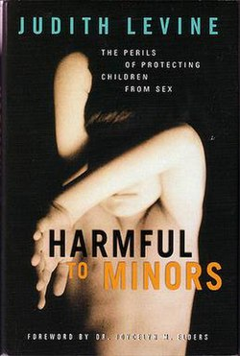
Sex-ed
Harmful to Minors:The Perils of Protecting Children from Sex
2002, Judith Levine
“Sex is a wonderful, crucial part of growing up, and children and teens can enjoy the pleasures of the body and be safe, too. In this important and controversial book, Judith Levine makes this argument and goes further, asserting that America’s attempts to protect children from sex are worse than ineffectual. It is the assumption of danger and the exclusive focus on protection—what Levine terms "the sexual politics of fear"—that are themselves harmful to minors.”

Slide 8
Sex-ed
    CSE is not about STD or reducing pregnancies, Should include:
    Porn literacy;
    Healthy relationships
    Child sex abuse prevention
    Breaking gender stereotypes
    Socio-emotional learning (e.g. managing feelings, self-image, empathy, respect, boundaries etc)
    When offered proficiently, CSE is argued τo be the most potent preventative measure for reducing sexual violence; As well as increasing:
    Teenage wellbeing;
    Supporting a healthy adulthood
    HOWEVER, CSE still remains limited in Australia and US public and private schools
    (think of Trump’s gender directives…)

Slide 9
Sex-ed
    Problems at school:
    No consistency and auditing of what is taught from school to school’
    How to fit in sex-ed in a crowded curriculum?
    Apprehension around delivery of CSE by teachers

Slide 10
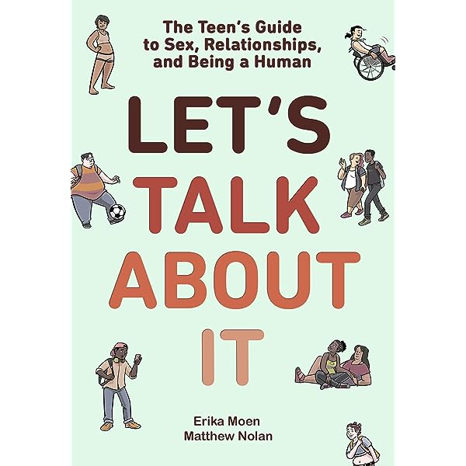
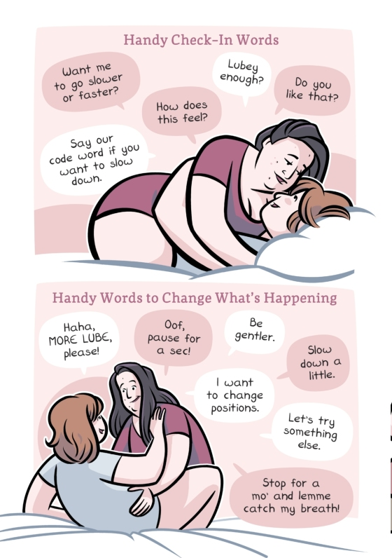

Concerns about what counts as sex ed
Australia

Slide 11
Sex-ed in the US
comprehensive sex education over abstinence-only curriculums
“‘A Sexplanation’ Review: Sex Education Fit for a Classroom” (NYT, 7.6.2022)
an insightful documentary in which the director Alex Liu explores the politics and culture of sex ed in the United States while confronting his own shame around sexuality that stems back to his adolescence:
Shame-based programming doesn’t work; lessons should incorporate discussion about consent and cover L.G.B.T.Q.-inclusive experiences; conversations about pornography can help teenagers decipher between reality and fantasy and gain more realistic ideas about sex and relationships.
On the other side of the debate, Liu interviews Todd Weiler, a Republican member of the Utah State Senate who has lobbied to mandate pornography filters on the internet, and speaks with several anti-abortion campaigners outside the San Francisco Women’s March.

Slide 12
Sex-ed in the US
(“A Private-School Sex Educator Defends Her Methods”, NYT 7.7.2021)
Justine Ang Fonte, sex educator
Columbia Grammar and Preparatory School on the Upper West Side of Manhattan (May 2021), invited her to teach two Zoom sessions, on pornography literacy and consent
A week later: “Students and parents reel after class on ‘porn literacy,’”; and “Dalton parents enraged over ‘masturbation’ videos for first graders.” (The New York Post)

Slide 13
Sex-ed in the US
Multiple sex educators interviewed for the NYT article said there was nothing inappropriate about her classes.All of it was in line with current National Sex Education Standards and the World Health Organization’s International Technical Guidance on Sexuality Education.
material for her first-grade class: The lesson was about private parts being private and included a cartoon in which two characters use anatomically correct names for their genitals and say that sometimes it feels good to touch them. “It’s OK to touch yourself and see how different body parts feel, but it’s best to only do it in private,” the narrator tells viewers.
“I equip them with a way that they can exercise body agency and consent, by knowing exactly what those parts are, what they are called, and how to take care of them,” Ms. Fonte said.
“We think, condom on a banana, and that’s enough, and then we’re confused as to why there’s a consent problem,” Ms. Fonte said. “We’re still teaching the golden rule and we should be teaching the platinum rule: to treat others the way they want to be treated.”

Slide 14
Sex-ed in the US
Though classes on literacy in sexually explicit media are not mainstream, many sex educators support them. [Yet] Parents, policymakers, public officials and health experts have all expressed concern over the unrealistic expectations set by pornography and by the fact that it is a primary source of sex education for many young people
Pornography literacy classes teach students how to critically assess what they see on the screen — for example, how to recognize what is realistic and what is not, how to deconstruct implicit gender roles, and how to identify different types of behavior
‘Pornography Literacy: Why We Need It and How It Can Help Us’, Sophie Dorosin, remake, issue 3, Oct. 2022 [https://remake.wustl.edu/issue3/dorosin-pornography-literacy]

Slide 15
Sex-ed in the US
“Young people need to have the ability to critically examine those messages and to think about their own values and to make decisions about which of those messages they feel are really beneficial and which they want to question,” says one sex educator
“we cannot wait until adulthood to talk with young people about what they and their friends and sexual partners are already seeing, whether in pornography or on TikTok, where videos about choking and a whole range of rough sex behaviors are already prevalent.” says Debby Herbenick, professor at the Indiana University School of Public Health

Slide 16
Sex-ed in the US (in 2022, so before-Trump… )
24 states and the District of Columbia require sex education courses to include information on asserting personal boundaries and refusing unwanted sexual advances; 37 states and D.C. require educators to cover teen dating violence and sexual violence
28 states require that abstinence be stressed in sex education classes, and 6 states require that only negative information be provided on homosexuality, according to the Guttmacher Institute [https://www.guttmacher.org/fact-sheet/american-teens-sexual-and-reproductive-health]
Several states have recently made efforts to increase “parental rights” in sex education classes (e.g. state lawmakers in Arizona tried to prevent students from learning about sexuality, gender identity and H.I.V./AIDS without an opt in from parents).

Slide 17
The Genderbread Person
https://www.itspronouncedmetrosexual.com/2015/03/the-genderbread-person-v3/
Van Wichelen, T., Verhoeven, E., & Hau, P. (2023). The Genderbread Person: mapping the social media debate about inclusive sexuality education. Sex Education, 24(5), 585–601. https://doi.org/10.1080/14681811.2023.2238189

Slide 18
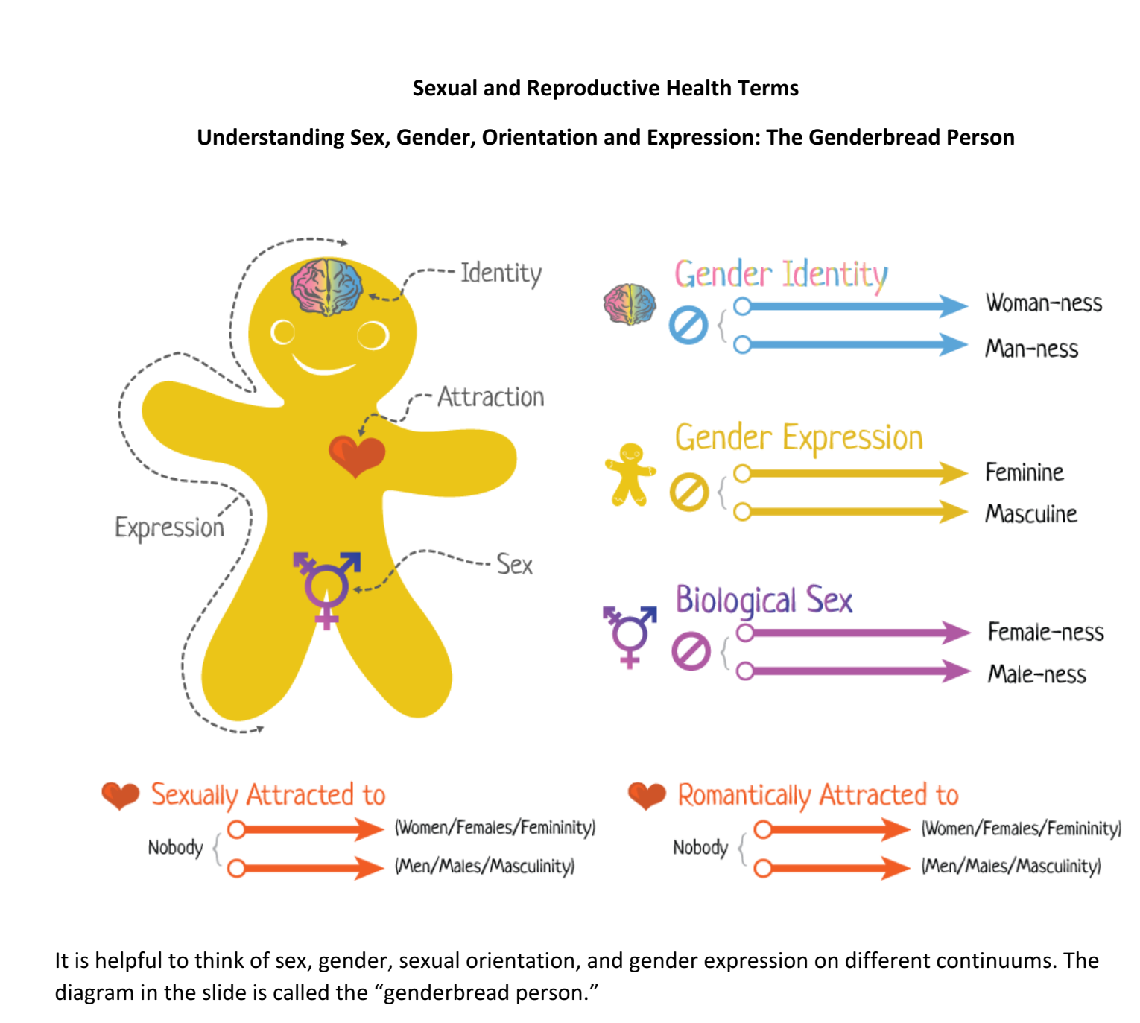

Slide 19
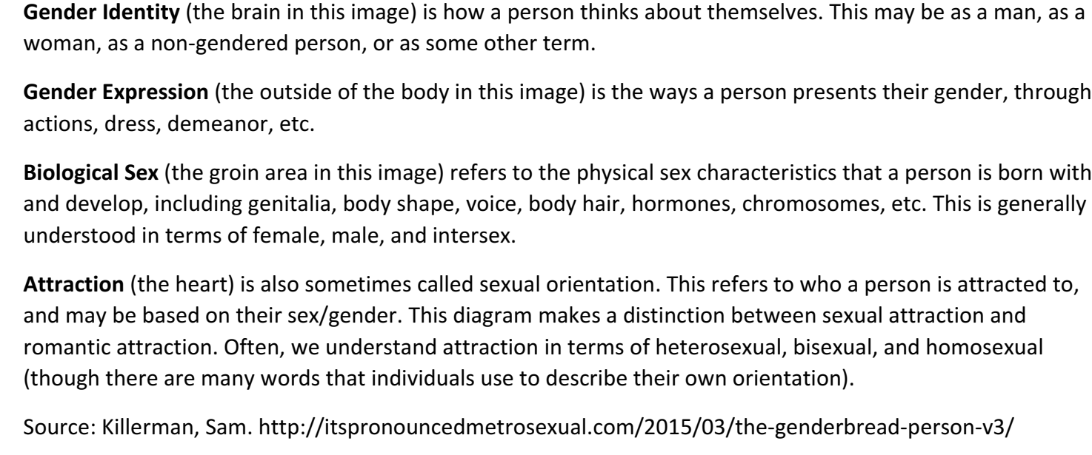
the Genderbread Person

Slide 20
ένα ελληνικό παράδειγμα…
28/1/2022: Σάλος με το βίντεο «Προγεννητική Αγωγή, προετοιμασία για την γονεϊκότητα, Σεξουαλικότητα – Γονιμότητα – Γονεϊκότητα, μια αδιαχώριστη ενότητα» από την Ελληνική Εταιρεία Προγεννητικής Αγωγής.
θεωρία του «αγέννητου παιδιού» (η ζωή του βρέφους αρχίζει με τη σύλληψη)
«Η γυναίκα προορίζεται να σώσει τη σχέση», «οι έγκυες γυναίκες δεν πρέπει να κάνουν παρέα με ελαττωματικούς», «Ο αγ. Πορφύριος και η ευγονική»
η μητέρα εκτός από το αίμα της περνάει στο έμβρυο τις σκέψεις της, την πνευματική τροφή, όλες οι ασθένειες του παιδιού ακόμα κι αν εκδηλώνονται δεκαετίες μετά, έχουν σχέση με την εγκυμοσύνη.
Μετά από τον δημόσιο σάλο, το Ινστιτούτο Εκπαιδευτικής Πολιτικής απέσυρε το βίντεο, μετά από σχετική παρέμβαση και της τότε Υπουργού, Ν. Κεραμέως
https://www.ieidiseis.gr/politiki/169583/aposyrthike-to-anachronistiko-vinteo-gia-ti-sexoyaliki-diapaidagogisi-meta-ton-salo/

Slide 21
ένα ακόμα ελληνικό παράδειγμα…
2-4 Ιουλίου 2021: Σάλος για το διαφημιστικό βίντεο για το «1ο Πανελλήνιο Συνέδριο Γονιμότητας και Αναπαραγωγικής Αυτονομίας: Όρια και Επιλογές»
Κ.Πάντος (Γ.Γ. Ελληνικής Εταιρείας Αναπαραγωγικής Ιατρικής) δήλωσε σε ΜΜΕ ότι το βίντεο είχε λάβει την έγκριση της ΕΡΤ (ανέφερε ότι το παίζει εδώ και 10 ημέρες) ενώ είχε λάβει άδεια από το ΕΣΡ.
συνέχεια ήταν η ΠτΔ Κ.Σακελλαροπούλου να αποσύρει την στήριξη στο συνέδριο αν και αρχικά ήταν υπό την αιγίδα της. Εν συνεχεία και η κυβέρνηση δήλωσε ότι επίσης δεν θα το στηρίξει.
https://www.youtube.com/watch?v=4bJvRXygk8M&ab_channel=Flashgr

Slide 22
Pornography as self-couple-group sex-ed
Many ppl use porn as a form of sex-ed (due to lack of CSE in schools)- Albury 2014; Wright 2018
  Esp for queer and sexually diverse teens, porn offers a source of information and support (Albury 2014) –
  Eric in ‘Sex-ed’ watches gay porn; Lily writes/illustrates a graphic novel to express an aspect of her desire)
  Muslim world
  Teen’s consumption of pornography can present and reflect differing, changing sexual ideals -> deviate from heterosexual, conservative, monogamous norms)
  (e.g. Otis and friends: sexually diverse subjectivities, including pansexual; bisexual; asexual;non binary identities)
  => teens embrace diversity in a way rarely addressed within education system or in info about gender identities

Slide 23
Pornography as self-couple-group sex-ed
So,
think here about rising concern about pornography use on digital devices – esp for young girls (worries about ‘hypersexualized’ imagery, etc)
uncritical reading of pornographic texts may lead to misunderstandings about the pleasure of sexual activities, and…
… inhibit understandings that one person’s pleasure may be sb else’s anathema =>
Need for a critical reading of pornography – instead of banning it!!! (to explain the male gaze, male orgasm, body types, etc)- [porn literacies]

Slide 24
Pornography as self-couple-group sex-ed
=> given the widespread availability of pornography ->
Really important to have intelligent discussions about sex (between adults and teens)
BUT, as already said, young teens are excluded from such discussions on account of their ‘well-being’

Slide 25
Pornography as self-couple-group sex-ed
Let’s go back to benefits of porn education for queer sexualities:
  Pornography can offer information and support not often available in homes and schools (Albury 2014)
  Teens’ consumption of pornography can reflect changing sexual ideals => array of sexual possibilities
  Despite fears of sexualization –’too much, too soon’- teens ARE sexual beings, who want to express themselves sexually and find information about sex => Porn provides an accepting framework that sex is FUN (sth usually removed from school and home info)
  Overall: need to search for what teens say about their porn use, otherwise ‘evidence’ will always reflect adult and researchers fears!!!!

Slide 26
Teen sexuality
…. A universal cause of social anxiety
This anxiety conflates fantasy with reality;
  Children’s fantasies = policed and censored;
  Sharing of sexual fantasies across generations = taboo; unthinkable
  Video-based pornography: associated with teenage boys
      Constructed as more likely to have seen it;
      Less likely to have been disturbed by it (Rovolis and Tsaliki 2012)
      What goes amiss: how many teens distinguish between fantasy (porn) and reality (relationship)

Slide 27
Teen sexuality
-> which means:
A teen’s playfool exploration of sexual fantasy -> has no necessary link with sexual fact
-> which brings us back to the problem:
Parents and gatekeepers being unable to tell between
teen’s fantasies and sexual fact => social anxiety

Slide 28
‘Sex-Education’
The Thoughtful Raunch of Sex Education: Netìix’s new series is a graphic teen dramedy with a difference. (The Atlantic, 9 Jan 2019)
Netflix’s ‘Sex Education’ is the feminist show young viewers need (Women’s Media Centre, 14 Febr 2019)
The first scene of Netflix’s young adult series, Sex Education, depicts a teenage boy faking an orgasm while having sex with his girlfriend. He looks bored and distracted despite his partner’s enthusiasm. After he pretends to finish, his girlfriend insists on seeing the condom, and despite his refusal, she takes it to see for herself. The scene ends with her disappointedly holding up the empty, shriveled latex to the audience.
Every subsequent episode of Sex Education, […], begins with its own equally awkward sex scene, each tailored to the specific sex-related issue that episode will tackle.

Slide 29
‘Sex-Education’
[…] Sex Education normalizes the concept of teens asking questions about their bodies and relationships — like how they can be good sexual and emotional partners for their own benefit as well as the benefit of the people with whom they are having sex.
Sex Education does this by taking on the kind of personal issues that are crucial to healthy sexuality and relationships, but which are rarely discussed in actual sex education classes.
  For example, in the E7 of Season 1, a classmate asks Otis for help: He’s made many grand gestures to ask a girl he likes to the dance, but she continues to say no. “Well, I know it’s hard, but if you’ve asked her and she said no, then I think you’ve got your answer,” Otis kindly tells his client. “No means no.” (Women’s Media Centre, 14 Febr 2019)

Slide 30
‘Sex-Education’
[…]
When a lesbian couple asks Otis for advice, he does research before giving them any, admitting from the beginning that as a straight, cisgender man he doesn’t know how lesbian sex works. This transmits the message to the show’s young audience that they must be aware of both the privileges they have and the privileges their peers do not — in terms of sex and beyond. (Women’s Media Centre, 14 Febr 2019)

Slide 31
‘Sex-Education’
Why Netflix’s Sex Education is so important (13 Feb. 2020- The Johns Hopkins (student) NewsLetter)
As you may know, the Netflix show Sex Education is all the talk these days, and I am one of those disciples who swear by it. Just to clarify, I am not a TV person. I am not even that much of a Netflix kind of gal. What I am, however, is a huge fan of sex education.
As an active member of SARU (our University’s Sexual Assault Resource Unit), I really value educating people about sex, healthy relationships and consent among other things. Therefore, when I do watch TV shows, I often criticize them for portraying unhealthy relationship habits, non-consensual behavior and unrealistic expectations about sex.

Slide 32
‘Sex-Education’
I am so glad Sex Education was created and that it is out there on Netflix for people to watch and enjoy. At the end of the day, Sex Education is a very entertaining show, even if you don’t want to learn anything about sex (still, it is inevitable that you will learn something). The characters are relatable and diverse; the plot and subplots are engaging and raw; and the setting is gorgeous. Who could resist the gorgeous British accents?
[..] Some movies just reinforce all these ideas that people always finish at the same time, that no one uses a condom or that your first time is this magical moment where everything is perfect. Compared to these movies, Sex Education will give you a better understanding of sex when you settle down and watch it (or, in my case, rewatch it). Sex is messy. Relationships are messy. Life is messy. However, with the right people, you don’t mind the mess so much and you can make it work. It can even be rather magical (13 Feb. 2020- The Johns Hopkins (student) NewsLetter)

Slide 33
‘Sex-Education’
'It answered my weird questions': what do teens really think of Netflix's Sex Education? The Guardian, 22 Jan 2020)
A wave of sex-positive teen shows are tackling taboos from abortion to anal douching – and teaching young viewers what their schools won’t
Besides Netflix’s Big Mouth, a cartoon series about how puberty upends the lives of a bunch of 13-year-olds, the biggest hit is the appropriately named Sex Education, the warm, ribald and hugely entertaining drama about a teenage boy giving sex therapy to his classmates which tackles the (t)horny issues schools are failing to teach. Given that a 2017 report by the Terrence Higgins Trust found half of young people rated their schools’ relationships and sex education (RSE) as either poor or terrible, the popularity of these shows is hardly surprising. But what do teens really think of them? Is TV providing better advice than most schools?
Laurie Nunn: ‘what did I want to know about sex when I was 16’?

Slide 34
‘Sex-Education’
Something to Talk About: Sex Education on Netflix, (Power to Decide, 18 Jan 2019)
If you’ve ever wondered whether sexual content on TV glamorizes—or even encourages —young people to have sex, the following might surprise you. As sexual content in pop culture became more explicit and more prevalent over the last twenty-some years, teen pregnancy and birth rates dropped by more than half. In fact, popular media is one key factor credited with helping to drive this public health miracle. Not by showing less sex; but by normalizing open conversations about sex, portraying birth control as a regular part of sex, and spotlighting how characters feel about their decisions to have sex (or not).
[…] the show is a heartfelt testament to honesty, respect, and trust as the keys to satisfying relationships at any age. It’s an ode to the power of open conversations

Slide 35
‘Sex-Education’
Another reason Sex Education is a great conversation-starter: we’ve all been there. Maybe not in these exact situations, but the doubts, heartbreak, thrills, and panic these characters experience are deeply relatable at all ages. Fact: 7 in 10 young people 12-24 say they have learned something useful about sex, love, or relationships from TV shows/popular media; 2 out of 3 say that when there are teen/unplanned pregnancy stories in popular media that they can relate to, it makes them think more about their own risk; and more than half have had a helpful conversation with their parents about sex because of something they saw in popular media. TV shows rank 3rd, after friends and parents, as the source where teen girls say they’ve learned the most about romantic relationships. (Something to Talk About: Sex Education on Netflix, (Power to Decide, 18 Jan 2019)

Slide 36
‘Sex-Education’
Each episode of Sex Education is packed with beyond-the-basics sex questions that everyone—adults and young people alike—thinks about, but few people have the guts to ask. If you have a young person in your life, this show will make you more motivated than ever to be clear that you’re trustworthy (but not intrusive!); to start talking with them now; and to point them to good information about sex, relationships, and birth control. For those who worry that these conversations will encourage sex, research shows that the opposite is true: providing accurate, comprehensive sex education doesn’t hasten sex, it helps young people have safer sex when they’re ready. If there’s one takeaway from the show’s mix of sweetness and spice, it’s this: Talking is power. (Something to Talk About: Sex Education on Netflix, (Power to Decide, 18 Jan 2019)

Slide 37
‘Sex-Education’
Sex Education’s creator, Laurie Nunn, explained (about S3), “I really wanted to explore how dangerous I think shame can be when it is weaponized. And I think so many people have had experiences at school which make them feel ashamed about their own sexuality or their own identity or the way that they express themselves. And I think sadly, you know, even in 2021, this is still really rife.” (Let’s Talk About Sex (Education), Power to Decide, 21 October 2021)

Slide 38
POWER TO DECIDE
TV Shows to Get the Conversation Started
https://powertodecide.org/news/tv-shows-get-conversation-started
Sharing Your Sex Ed Story Can Have a Real Impact
https://powertodecide.org/news/sharing-your-sex-ed-story-can-have-real-impact
TikTok's Sex Tips Aren't An Education, Experts Warn
https://www.huffingtonpost.co.uk/entry/tiktok-sex-ed-accuracy_uk_63fdea72e4b08b1402dff37a

Slide 39
‘Sex-Education’
What is Sex Education About on Netflix | Therapists Review, (The BetterYou Institute)
[…] Sex education is not just about teaching kids what to do or where babies come from. It can also prevent sexual harassment and date rape by giving kids the right knowledge at the right time, so they know when someone crosses a line with them or touches them inappropriately.
The more we educate our children now, the safer they will be as adults later on in life because they will have the tools necessary to make good decisions for themselves without being manipulated into doing something they don’t want to do.
How to use the information in this article
For health educators…
The show points out the faults of regular sexual health curriculums. Instead, the show suggests:
  Incorporating lessons about sex that are not based solely on heterosexual couples
  Teach about the realities of sex and individual differences such as sexuality, readiness for sex, and issues with having sex.
https://thebetteryouinstitute.com/2021/07/27/what-is-sex-education-about-netflix/

Slide 40
‘Sex-Education’
For parents…
Use your best judgment about whether your child should watch the show
  Due to the mature scenes (e.g., sexual assault, nudity, sexual intercourse) in the series, the series is recommended for audiences aged 18 and older. That being said, use your best judgment based on the information I provide to determine if your children should watch the show. [….]
Should my child watch this show?
This is a decision that you (and the other parent, if applicable) should make on your own. The show is given the rating of TV Mature, which means that it is better suited for adults because of the graphic sex scenes, mature themes, and nudity. So while governing bodies do not suggest it as appropriate for children aged 17 and younger, it could be helpful for parents and their children to watch it to help children with their sexuality and sex.

Slide 41
‘Sex-Education’
For teens/adolescents…
Expose yourself to mature and graphic scenes presented in the show based on reality rather than unrealistic pornographic scenes.
Hold awareness that some of the scenes may trigger you. Have a safe person you can talk to and process your thoughts and feelings with.
If you learn something that you don’t completely understand from the show, speak with a parent, guardian, or doctor to understand better that some of the actors’ experiences may look and feel similar to your own but can also be different.
Spectrum of sexuality

Slide 42
‘Sex-Education’
Inadequate sex education
Schools typically teach about sex education from the white, heterosexual lens, which is important, but all other types of sex are neglected. Not only could teachers and education board leaders learn from this lack of important sex education, but parents could help their children learn about certain sex education that they are missing in school. An example of how sex education can be helpful is how it is depicted in the show: Anwar, one of the gay characters in the show, does not know much about gay sex because it is not taught. Otis teaches him how to douche before he is about to have sex. Thus, allowing for safer sex. See a ‘how to’ for anal douching here.
Anal douching safety tips
By San Francisco AIDS Foundation

Slide 43
‘Sex-Education’- sex-ed
‘Own your narrative’: [you need to own your narrative, not let it control you] = you need to construct your personal sense of self]
Young ppl faced with double standards and double binds; (e.g. sexting in Victoria for under 18s = ‘child exploitation material’; teens convicted for pornography and placed for life in Sex Offenders Register) => activity legal for adults, but criminal for under 18s… =>
Popular culture fills the gaps in formal education

Slide 44
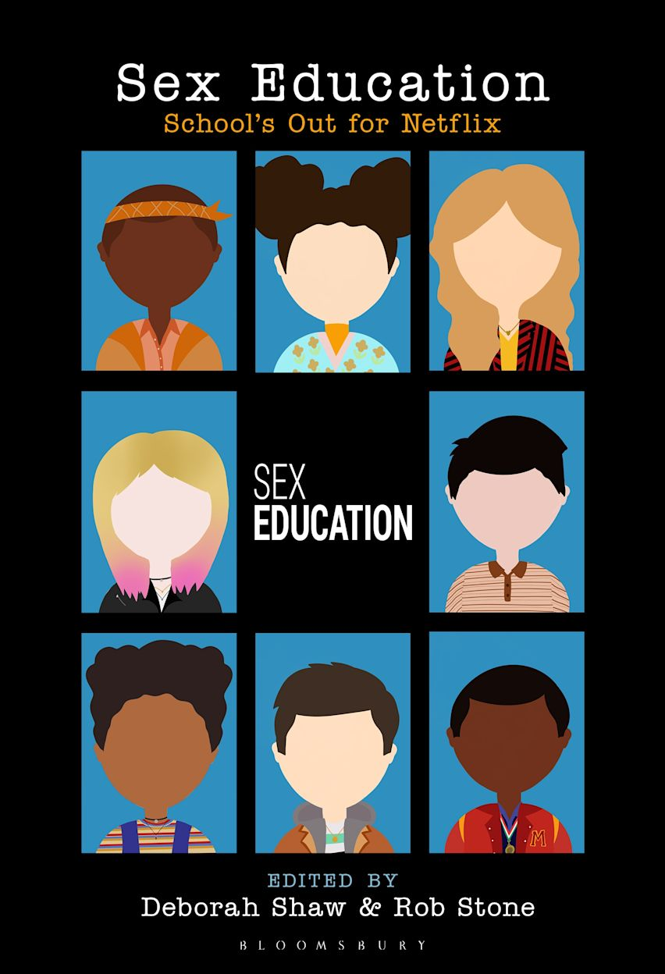
Recent work on ‘Sex Education’
Deborah Shaw (Anthology Editor) , Rob Stone (Anthology Editor), Bloomsbury (2025)
https://www.bloomsbury.com/uk/sex-education-9798765107317/#

Slide 45
Recent work on ‘Sex Education’
Derzioti, O. (2024). Destigmatizing kinks: alien erotica in Netflix’s sex education. Journal of Gender Studies, 1–7. https://doi.org/10.1080/09589236.2024.2349912
Allen, L. (2024). Young people and sexual pleasure in Netflix’s Sex Education. Sex Education, 1–15. https://doi.org/10.1080/14681811.2024.2381194
Allen, L. (2023). What Can the Netflix Series Sex Education Teach School-Based Sexuality Education? American Journal of Sexuality Education, 19(4), 398–416. https://doi.org/10.1080/15546128.2023.2282505
Dudek, D., Woodley, G., & Green, L. (2021). ‘Own your narrative’: teenagers as producers and consumers of porn in Netflix’s Sex Education. Information, Communication & Society, 25(4), 502–515. https://doi.org/10.1080/1369118X.2021.1988130

Slide 46
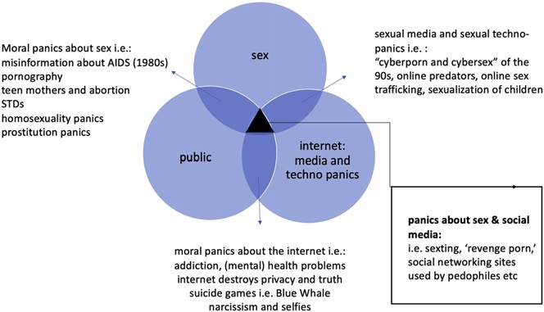
The ‘trifecta of anxieties’
Tiidenberg, K., & Van Der Nagel, E. (2020)

Slide 47
What do these concerns reflect?
Such concerns do not operate in a social and cultural vacuum- they reflect
  broader anxieties about gender relations and power structures (Smith, 2007 for a critique on sex wars)
  Anxieties about how much access to power children have when accessing or quickly adapting to ever-expanding networking technologies and cultures (Lumby, 1997)
  adult fears about technology eroding future generational and societal values and structures (Buckingham, 2000/2013)
  anxieties about how much technology -specifically online- is shaping public and private spheres
  about how big tech is trying to control people’s lives
  about ‘excessive’, ‘problematic’, ‘unregulated’ cultural consumption as a symptom of a more general moral and ethical decline (Miller, 2006)

Slide 48
What do discourses of anxiety do?
‘Constant visibility of the risk discourse’, reproduces neoliberal cultures of responsibilization (Tsaliki & Chronaki, 2020)
Parenting (and related ‘expert’ guidance) take the form of systematic scrutinization of childhood and childhood sexuality
Children expected to learn how to broker risk information; to become ‘resilient’ and literate reputation managers in public (and private) space (Tsaliki, 2016)
A wider ‘turn to character’ may also include pedagogies of sexual shame, to regulate children’s social encounters online (Sanderson, 2015)
A long-standing concept of ‘child protection’ across cultures and time, from the 19th , through the 20th and during the 21st centuries (Egan & Hawkes, 2010)

