Slide 1

Visual politics:
The pornography of pain

Slide 2
The pornography of pain
A new humanitarian sensibility emerges in early 18th c. England., shaped by John Locke’s philosophy.
This culture of sensibility broadened the arena of humanitarian feeling,
extending compassion to
animals and to previously despised types of persons including slaves, criminals, and the insane and
generating a critique of forms of cruelty that had once gone unquestioned.

Slide 3
The pornography of pain
All this = part of a broader "reformation of manners“ reshaping English social (and especially male) behavior,
at the heart of which was a
sympathetic concern for the pain and suffering of other sentient beings
=> compassion and a reluctance to inflict pain became identified as distinctively civilized, while cruelty was labeled as savage or barbarous

Slide 4
The pornography of pain
This new humanitarian sensibility revolutionized the meaning of pain in Anglo-American culture.
In Orthodox Christianity: pain = not only God's punishment for sin (English term derived from the Latin poena, punishment) but also a redemptive opportunity to transcend the flesh by imitating the suffering of Christ
Whereas preanesthetic cultures responded to pain as sth inescapable, ->
the 18th c. cult of sensibility redefined pain as unacceptable and indeed eradicable => pain as sth revulsive

Slide 5
The pornography of pain
From this emergent revulsion from pain -> the pornography of pain.
The pornography of pain represented pain as obscenely titillating precisely because the humanitarian
sensibility deemed it unacceptable, a taboo.

Slide 6
Intellectual origins of humanitarian sensibility
Humanitarian sensibility comes from late 17th c- early 18th c. Latitudinarians.
Contrary to English Puritanism and to the secular Calvinism of Thomas Hobbes, the Latitudinarians argued that
human nature is instinctively sympathetic, naturally inclined to virtuous actions.

Slide 7
Intellectual origins of humanitarian sensibility
,
18th c. moral philosophers treated sympathy as a sentiment stirred primarily through sight
(Influenced by John Locke's understanding of the primacy of vision among the senses)

Slide 8
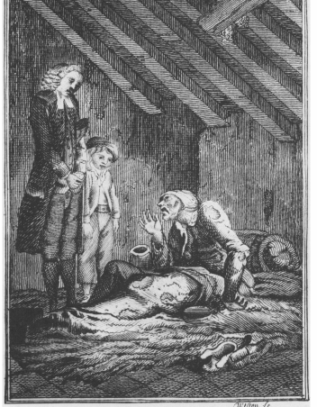
The curate and little Charles extend virtuous sympathy to an impoverished inebriate dying of consumption.
In Elements of Morality for the Use of Children, by Rev. C. G. Salzmann (1796)

Slide 9
Intellectual origins of humanitarian sensibility
For Adam Smith (University of Glasgow), who developed the ‘principle of spectatorial sympathy’:
The man of virtue feels sympathy by first seeing the sufferings of another, either in reality or in his mind’s eye, and then exercising his imagination in an effort to enter into those sufferings
The concept of spectatorial sympathy shaped the 18th c. literature of sensibility (a substantial body of English novels, plays, poems, art) -> teaching virtue by softening the heart

Slide 10
Intellectual origins of humanitarian sensibility
Sentimental art offered pitiful suffering -(scenes of poverty, imprisonment, slavery, the aftermath of war, tormented animals, women in distress) -all aimed at
Arousing readers' spectatorial sympathy and thus enhancing (and demonstrating) their virtue

Slide 11
Intellectual origins of humanitarian sensibility
Yet… gradually….
sentimental sympathy was said to be a "dear delicious pain," "a sort of pleasing Anguish”…
and by the end of 18th c. ->
serious doubts about the virtue of its exercise. (e.g. avid readers of sentimental fiction fell under suspicion of moral passivity and hypocrisy)
- and concern about its alleged sadism

Slide 12
Intellectual origins of humanitarian sensibility
e.g. Samuel Richardson's early sentimental masterpieces, Pamela (1740-41) and
Clarissa (1747-48), were heavy with sexual victimization, psychological torture,
and a sadistic voyeurism that would eventually appeal to the marquis de Sade, who reveled in the prolonged torment and rape of Clarissa and based his novel Justine
(1791) on the perils of Pamela.

Slide 13
Intellectual origins of humanitarian sensibility
Sentimental fiction was characterized by an aggressive kind of voyeurism in which the spectator identified not just with the
sufferings of the virtuous victim but with the cruelty of her or his tormentor =>
Pleasure mixed with pain, and pain with pleasure

Slide 14
How to explain the pleasures of spectatorial sympathy?
late 17th-early 18th c.: many English people were distanced from suffering as a result of:
- increasing production of food;
- relative price stability and rising real wages;
- disappearance of the plague;
- end to civil wars;
- dramatic increase in English wealth;
- growing accessibility of consumer luxuries to the expanding middle classes

Slide 15
How to explain the pleasures of spectatorial sympathy?
As the aptly named Spectator observed in 1712,
"when we read of torments, wounds, deaths and the like dismal accidents, our pleasure does not flow so properly from the grief which such melancholy description gives us, as from the secret comparison which we make between ourselves and the person who suffers. Such representations teach us to set a just value upon our own condition, and make us prize our good fortune, which exempts us from the like calamities.“
As Edmund Burke (1757) explained, even though immediate pain or danger are "simply terrible ... at certain distances, and with certain modifications, they may be, and they are delightful."

Slide 16
Suffering in medicine
The increasing middle-class sensitivity to pain contributed to the late 18th c. intensification of medical efforts to discover an effective form of anesthesia.
Traditionally, Western medicine saw pain as inevitable (in tandem with orthodox Christianity);
and discouraged efforts to stop pain (on the grounds that suffering = vital part of body’s natural healing process)

Slide 17
Suffering in medicine
in the 18th c, physicians and surgeons grew more sensitive to the pain they inflicted on patients;
The medical establishment began a systematic search for a painless surgical technique
(e.g. refrigeration techniques, nerve compression, hypnosis, subcutaneous injection of morphine, controlled asphyxia, and drastic bleeding to the point of syncope just before operating)
While in early 18th c., "anesthesia" referred to a defective lack of feeling; -> by end of the c., = "positive medical relieving of feeling, a blessing rather than a defect”

Slide 18
The exploration of pain in Gothic fiction
The most obvious example of a new literary genre geared to the exploration of the horror of pain = Gothic fiction.
(one of the most popular genres in England and the US by end of 18th c.)
Gothic fiction: a predilection for scenes of torture-sometimes set in an Inquisition context- for sexual violation and murder, in a way that aroused maximum revulsion and disgust.
Its treatment of torture closely linked pain with beauty and cruelty with sexual desire, (which helps explain de Sade's admiration for Matthew Lewis's famous novel The Monk (1796)).

Slide 19
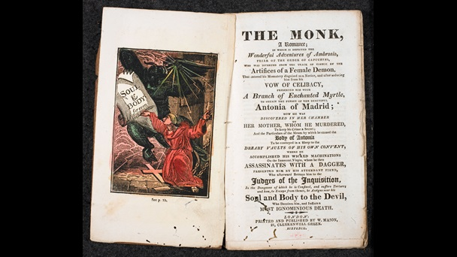
exploration of pain in Gothic fiction
twin themes: erotic obsession and the corrupting influence of power. At heart, it remains a morality tale about one man’s fall from grace through greed, pride and lust.
poet Samuel Taylor Coleridge attacked the book arguing that its scenes of lust and depravity were likely to corrupt readers. For him, The Monk was a novel ‘which if a parent saw in the hands of a son or daughter he might reasonably turn pale’.

Slide 20
other forms of literary expression of pain: nonfictional accounts of murder in America…
Late 18th-early 19th.c., new genres=
trial reports, criminal biographies and autobiographies,
journalistic accounts of crimes, and detection narratives.
The popular account of murder became increasingly ‘visual’, offering detailed verbal descriptions and sometimes illustrations of the crime.
Readers were expressly invited to envision the murder in question, to reconstruct it imaginatively in their mind's
eye, to watch the violence unfold.
attention directed to the carnage of the scene, wounds inflicted, sufferings of the victim, state of the corpse, in language calculated to evoke readers' horror.

Slide 21
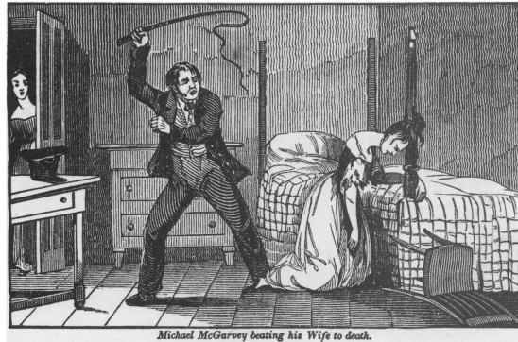
Sensationalistic violence: Michael McGarvey, Philadelphia carter, flogs his wife to death with a leather whip, having tied her to the bedpost by her hair (1828)

Slide 22
other forms of literary expression of pain: nonfictional accounts of murder in England…
.
Gothic fiction and the popular accounts of murder = a broader literary trend in the late 18th- early 19th c. = "sensationalism“
According to the Oxford English Dictionary:
1779 = earliest usage of term "sensation" as "an excited or violent feeling" or "the production of violent emotion as an aim in works of literature or art“
in 1801, William Wordsworth (English Romantic poet) characterized it as a "craving for extraordinary incident" and "a degrading thirst after outrageous stimulation."
Causes of sensationalism for Wordsworth: urbanization and modern information technology

Slide 23
other forms of sensationalist expression of pain
.
The American penny press;
captivity narratives; dime novels;
the popular "mysteries of the city" genre;
historical works on the Inquisition -
all were sensationalistic in nature and appealed to a popular voyeuristic taste for scenarios of suffering.
"Reader," wrote James Brice in Secrets of the
Mount-Pleasant State Prison (1839), "if you could but once witness a state prison flogging. The victim is stripped naked and beaten with a cruel instrument of torture called a cat, from his neck to his heels, until as raw as a piece of beef.”
- The trope of redemptive suffering (in the American prison)

Slide 24
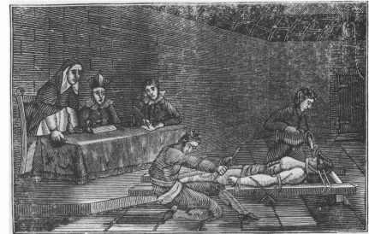
the "torture of the rack, also called that of water and ropes" to a prisoner in the presence of ecclesiastical spectators. Rev. Cyrus Mason, A History of the Holy Catholic Inquisition,
1835

Slide 25
other forms of literary expression of pain: pornography
Traditional English erotica had been dominated by bawdy, an innocent and unself-conscious kind of sexual writing,
especially attentive to themes of cuckoldry and scatology.
in the second half of 17th.c, English booksellers and printers began to produce a more modern kind of sexual writing, designed to arouse lust and encourage creation of sexual fantasies

Slide 26
other forms of literary expression of pain: pornography
If we define pornography as "the written or visual presentation in a realistic form of any genital or sexual behaviour with a deliberate violation of existing and widely accepted moral and social taboos.“ (Peter Wagner, Eros Revived: Erotica of the Enlightenment in England and America, London, 1988: 7),
then
It wasn’t until the 18^{th c.} that these taboos included the infliction of pain

Slide 27
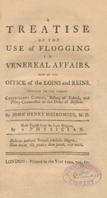
flagellation pornography
sexual flagellation interested few readers and authors before the 18th c.
1718, Edmund Curll published an English translation of a Latin medical work, A Treatise of the Use of Flogging in Venereal Affairs.
1730s: the respectable Gentleman 's Magazine was including some essays and letters on the art of flogging

Slide 28

flagellation pornography
1748-49: John Cleland’s Fanny Hill, or Memoirs of a Woman of Pleasure: scene of mutual flagellation between Fanny and Mr. Barvile.
flagellation mania significantly increases in late 18th c. -just at the time the marquis de Sade produces his own works.

Slide 29
The English vice
the 19th c. = "the English vice“ becomes the central convention of English pornography.
In such works as The Rodiad (c. 1820) and The Merry Order of St. Bridget (1868) = various combinations of sexes and (often ambiguous, due to cross-dressing and role-playing) genders
participated in the flagellation mania

Slide 30
The English vice
THE RODIAD- by GEORGE COLEMAN. 1820.
“ The Schoolmaster’s joy is to flog.” —
“ Schools without birch,” and “ All
corrections cruel, Beyond ten lines
by heart, and water gruel ; ”
“ All moral force.” A nice look out
in truth, For us, the Teachers of
ingenious youth;
Who, when we must not mark our discipline, In bright red letters on their hinder skin,
And once have lost command of their posteriors, Will soon be taught who are the true superiors.

Slide 31
The English vice
I ’m a schoolmaster of the good old school, — One to whose ear no sound such music seems
-As when a bold big boy for mercy screams Mercy, which with my will he will not get
Till his low breeches with his blood be wet, — One who enjoys more than any farce The writhings of a flagellated;
When the sharp ends of long fresh-budded rods, Wrap round the thighs and twinge the burning cods ; Or the more spicy play of waxy whips, Dissects the buttocks and tatoos the hips.
For want of better sport, I hold with glee

Slide 32
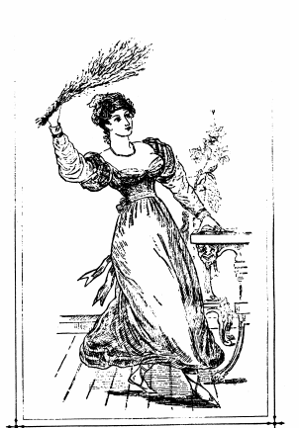
The English vice
a lady flagellant flourishes her birch in the frontis illustration of
The Romance of Chastisement; or, Revelations of the School and Bedroom: By an Expert (1876)

Slide 33
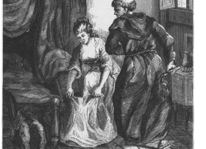
The English vice
‘St Edmund, Bishop of Canterbury, was tormented by a very beautiful young woman: summoning her to his study, he administered such a flagellation that her body was covered with weals’. W.M. Cooper, Flagellation and the Flagellants: A History of the Rod in All Countries from the Earliest Period to the Present Time (1877).

Slide 34
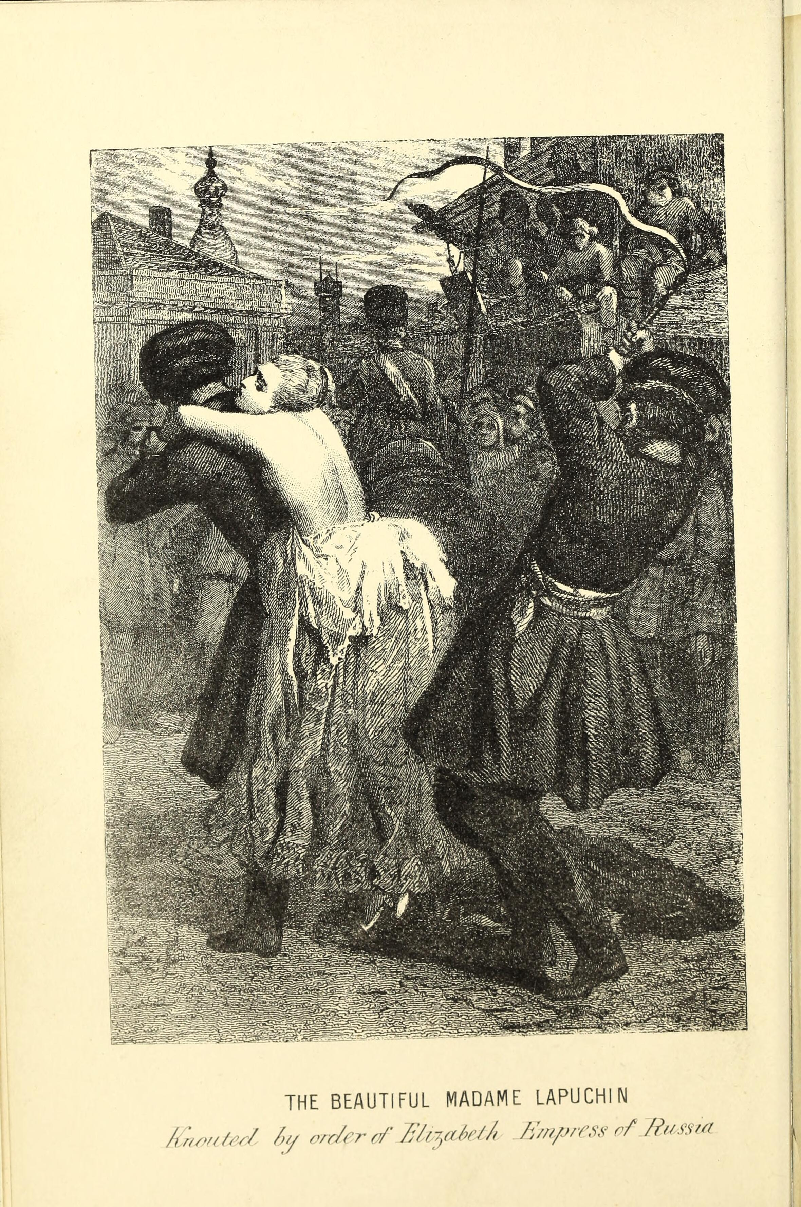
Flagellation and the Flagellants: A History of the Rod in All Countries from the Earliest Period to the Present Time (1877).
- stories of the knout in Russia

Slide 35
The English vice
So, by the early 19th c. ->
the spectacle of suffering-
(which had first emerged from moral philosophy, -> found its full articulation in sentimental literature and art, then-> assumed increasingly sadistic forms in popular sensationalism)
became the dominant convention of sexual pornography
Why??

Slide 36
The English vice
From a broader and more historical perspective, the key to both these pornographic expressions =
Changing attitudes toward pain in late 18- early 19th c.
If pornography is best defined = the representation of sexual behavior with a deliberate violation of moral and social taboos, =>
growing violence of pornography in late 18th and 19th c. is attributable to the new shock value of pain within a culture redefining it as forbidden and therefore obscene.

Slide 37
Pornography of pain
During this period= heightened awareness of the close relationship between the revulsion and the excitement aroused by pain.
Throughout the 18th c., humanitarian reform had played a major causal role in the cultural reconstruction of pain, (identifying a range of formerly unquestioned social practices as unacceptable cruelties and demanding that virtuous people put a stop to such practices).
The emergent pornography of pain became a troubling moral dilemma within the literature of humanitarian reform

Slide 38
Humanitarian reform
Anglo-American humanitarian reformers became deeply concerned about pain and opposed to its willful infliction in a wide range of social practices:
- Among the earliest beneficiaries of the new vogue for compassion = animals, => call for an end to animal abuse, including blood sports
(e.g. cock fighting and cock throwing, bull and bear baiting, and stag hunting)

Slide 39
Humanitarian reform
public infliction of pain or death on the bodies of criminal offenders = was gradually replaced by the penitentiary system.
brutal treatment of the insane was challenged by a new generation of asylum keepers who replaced the physical coercions and medical procedures of traditional "terrific" mental healing with "moral treatment" (based on the humanitarian conviction that the insane were not immune to physical suffering)

Slide 40
Humanitarian reform
violent punitive practices of the armed services (English reformers focused on the army, Americans on the navy) came under growing criticism: flogging was "a disreputable, cowardly, unmanly, unfeeling, brutal, inhuman and bloody mode of punishment” (1834)
Corporal punishment of children challenged by liberal Lockeans and Romantics.
War, dueling, prize fighting, even "football" (a term covering a wide range of games in which serious wounds, broken bones, and occasional deaths occurred) were all objects of reform concern

Slide 41
The literature of humanitarian reform
The literature of humanitarian reform targeted illicit cruelty by offering graphic treatments of its practice.
A wide range of victims (British soldiers, American sailors, schoolboys, convicts, the insane, and African slaves) were endlessly flogged

Slide 42
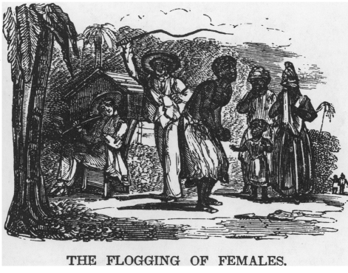
The literature of humanitarian reform
The humanitarian spectacle of pain: a white man flogs a half-naked slave woman. The African-American spectators show the proper response of sentimental sympathy and distress at her suffering; the single white spectator shows callous indifference to, if not barbaric pleasure in, her exposure and pain.
The Anti-Slavery Record I, no. 10 (October 1835)

Slide 43
The literature of humanitarian reform
Within these representations, the victims' extreme pain was an important focal point:
"While under the lash, the bleeding [slave] victim writhes in agony, convulsed with torture." [American Slavery as It Is: Testimony of a Thousand Witnesses [Theodore Dwight Weld, comp.] (New York, 1839)]
British soldiers who were flogged reported that "the sensation experienced at each lash was as though the talons of a hawk were tearing the flesh off their bones.“ [Henry C. Wright, Defensive War Proved to Be a Denial of Christianity and of the Government of God: With Illustrative Facts and Anecdotes (London, 1846)]

Slide 44
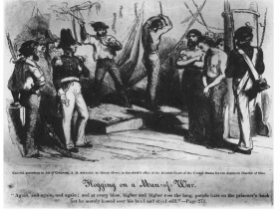
The literature of humanitarian reform
A naval flogging.
Henry Howe: Life and Death on the Ocean… with Thrilling Relations of Experiences and of Sufferings (1855)

Slide 45
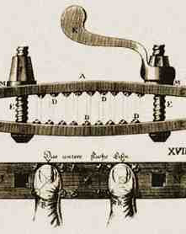
The literature of humanitarian reform
Beyond flagellation, reformers often selected cases of unusual cruelty to illustrate the evils of the institution in question:
English opponents of the slave trade, for example, cited use of thumbscrews, roasting in an iron coffin, and burning alive to depict the torments of enslaved Africans
Theodore Dwight Weld's American Slavery as It Is (1839) clearly demonstrates slavery’s focus on torture:
A is for Arbitrary power, cruelty of,
B is for Branding with hot iron; C is for Chopping of slaves piecemeal,
D is for Dislocation of bones; E is for Ear-cropping.

Slide 46
The literature of humanitarian reform
Arguments against such (corporal) punishments:
Because of their ill effects on their victims
(who were said to be debased and hardened by corporal punishment, with destroyed self-respect and made more recklessly vicious than ever)
And the pernicious influence of corporal punishment on the practitioner
(hardening and debasing them as well as the victim, transforming them into a tyrant or worse)

Slide 47
The literature of humanitarian reform
But the broadest area of concern among humanitarian reformers =
effects of corporal punishments on spectators.
Benjamin Rush, "An Enquiry into the Effects of Public Punishments upon Criminals, and upon Society" (1787):
When the suffering cannot be alleviated – e.g. in cases of public execution – sympathy is weakened, and spectators trained to contemplate misery without emotion or sympathy. =>
Watching frequent slave flogging =>made spectators heartless and insensitive.
=> It aroused a positive taste for cruelty

Slide 48
The literature of humanitarian reform
One contributor to American Slavery as It Is (1839) offered a horrific picture of this escalating love in creole women who ordered the flogging of their slaves:
"Their sensibility changed to fury must needs feed itself for a while on the hideous spectacle; they must, as if to revive themselves, hear the piercing shrieks, and see the flow of fresh blood; there are some of them who, in their frantic rage, pinch and bite their victims.“
=> "taste" for cruelty in its spectators was viewed as a "progressive vice," a "craving" or "hunger" that grew more powerful as it was fed

Slide 49
Was suffering, as represented in humanitarian reform literature,
"pornographic"?
well, reform literature did eroticize pain, constructing it as sexual in nature.
The eroticization of suffering in humanitarian reform sometimes took the form of overtly sexual references:
to the "indecent" nudity and sexual abuse of idiot or insane women, to the sexual coercion and rape of slave women, to the rape of war victims, and to the genital mutilation and torture of both male and female slaves.
Their treatment of scenarios of suffering, if not narrowly
pornographic in nature, assumed that the spectacle of pain was a source of illicit excitement, prurience, and obscenity

Slide 50
Could the reformers’ sensibilities have been blunted by witnessing all this cruelty?
To respond to this, reformers reported about their own emotional status as proof of how their sensibilities remained intact

Slide 51
The moral dilemma of humanitarian reform:
Reformers were caught in a contradiction of their own making
To arouse popular opposition to the evil practices they sought to eradicate,-> they had to display those practices in all their horror.
But, by their own line of argument,
viewing the spectacle of suffering could inflict terrible moral damage on the
spectator, turning them into a "savage" with an "atrocious passion" for cruelty.
so, humanitarian reform was a major cultural vehicle for the growing unacceptability of pain; it was also, inescapably, an expression and
a demonstration of the new obscenity of pain

Slide 52
The moral dilemma of humanitarian reform
The reformers' purpose = not to exploit
the obscenity of pain but to expose it (in order to redefine a wide range of
previously accepted social practices as cruel and unacceptable).
So, reason for close descriptions of horror, revulsion, and disgust in the
face of suffering = to instruct readers in the appropriate response to pain

Slide 53
Humanitarian reform
Humanitarian reform led -> production of a new cultural linkage of violence and sex.
Toward the end of the 19th c., Richard von Krafft-Ebing formally introduced the terms "sadism" and "masochism" into the psychopathological lexicon ->
This way the sex-pain connection was psychopathologized
By the turn of the 20th c., psychopathologists and humanitarians agreed: the linking of sex with pain was a by-product of diseased and perverted minds

Slide 54
Pornography of pain
yet,
The pornography of pain played a significant role in directing some humanitarian activity toward the privatization (NOT eradication) of pain practices
=> the spectacle of pain is kept out of sight of the ‘civilized’ classes (e.g. 19th c. privatization of execution)
This new social distance from the sight of punishment-> enhanced the pornography of pain (as seen in the sensationalist literature of the asylum expose)

Slide 55
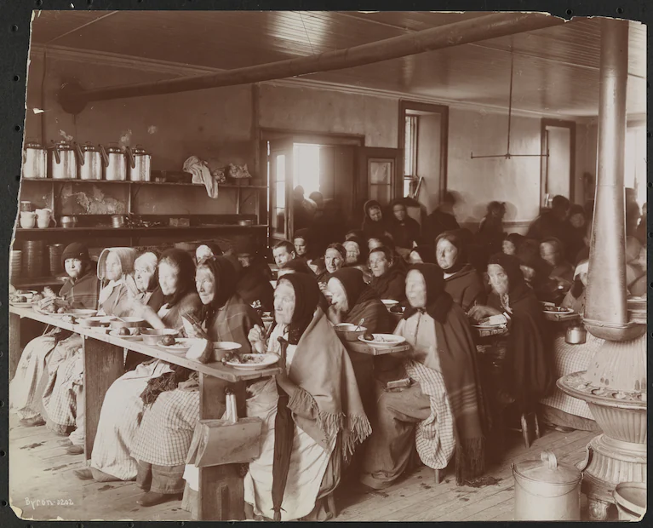
Nellie Bly, undercover investigative journalism- 1887- Blackwell’s Island, now Roosevelt Island
“Take a perfectly sane and healthy woman shut her up and make her sit from 6 a.m. to 8 p.m. on straight-back benches, do not allow her to talk or move during these hours . . . give her bad food and harsh treatment, and see how long it will take to make her insane..,” Bly wrote.
Among the sane ones, … many were immigrants who didn’t understand English and [were] mistakenly committed to the island. Others were just poor and thought they were going to a poorhouse, she wrote. … horrible stories of neglect and cruelty.

Slide 56
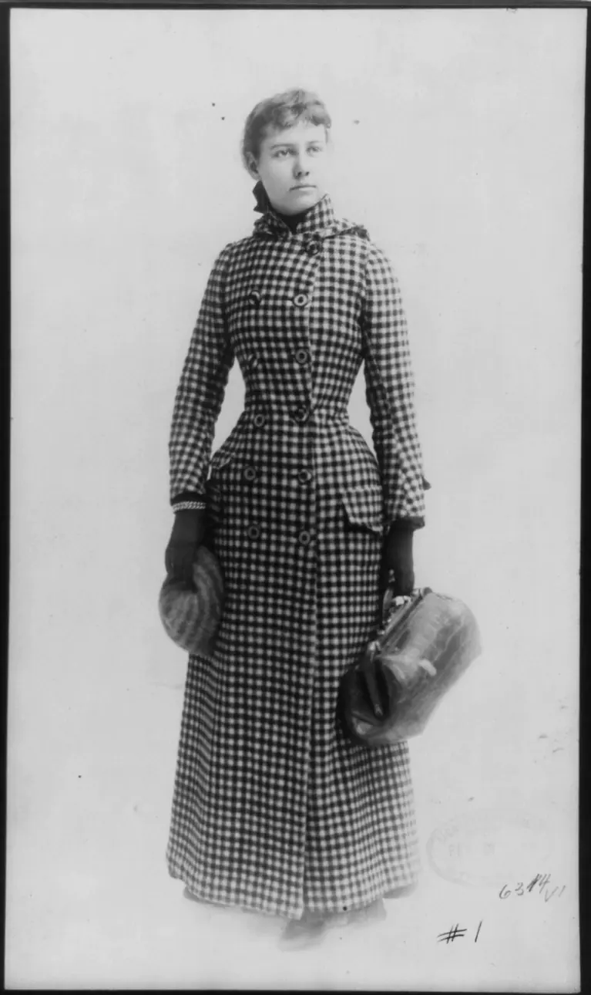
Nellie Bly in 1890-
Oct. 9, 1887, the New York World, 2-part series; released as a book two months later, called “Ten Days in a Mad-House.”
(The Washington Post, 28 July 2019)

Slide 57
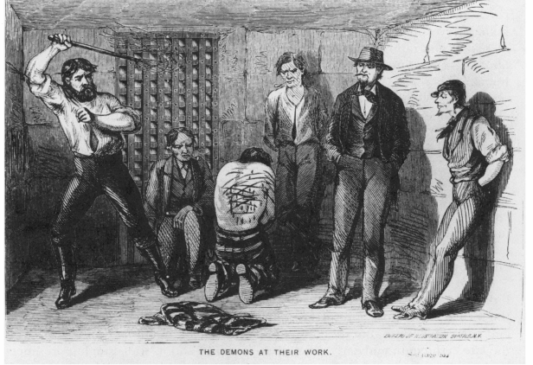
The obscenity of privatized pain:
An Illustrated History and Description of State Prison Life, By One Who Has Been There, Toledo 1871
"Here! step up to this window that looks into the 'black room,’ or room where the whipping is done. There, surrounded by half a dozen fiends in human shape; naked and upon his knees, is the poor [prisoner]. A powerful brute stands over him, grinning like a fiend incarnate. In his brawny hand he holds that merciless instrument of torture, the cat-o'-nine tails; rising upon his toes, he brings the hard-twisted, bullet-tipped thongs down upon the poor victim's bare back, each blow counting nine lashes, eating into the tender flesh, and drawing forth the shrieks of pain we heard."

Slide 58
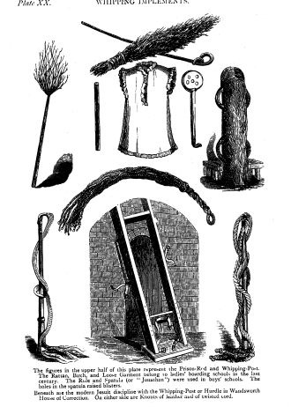
"Whipping Implements" (judicial and schoolroom), from William M. Cooper (pseud)
[James Bertram Glass], Flagellation and the Flagellants (1877)

Slide 59
Pornography of pain
Historically, just as the spectacle of punishment was coming under humanitarian attack, an imaginative literature appeared that established a new cultural linkage between pain and sexual obscenity or taboo.
The humanitarian sensibility fostered an imaginative cultural underground of the illicit and forbidden, accessible through the expanding
cultural practice of solitary reading, at the center of which was a flogging scene

Slide 60
Pornography of pain
In this way, The dominant convention of literary pornography in early 19th c. = pornography of pain
(which means that despite growing middle class concern about infliction of pain in public spaces ->
Sexual flagellation narratives become more popular
WHY??
-> a way to transgress boundaries and taboos or romantic love: as middle-class ideals of romantic love within companioned marriage develops in late 18th- early 19th c. -> popularity of pornography of pain increases

Slide 61
A different kind of visual politics (of pain)???
Think about how ‘spectatorial sympathy’ might apply today…
…through public art
Keep in mind: cultural codes and conventions regarding nudity and sexual behaviour -> NOT universal, but CONTEXT-SPECIFIC

Slide 62
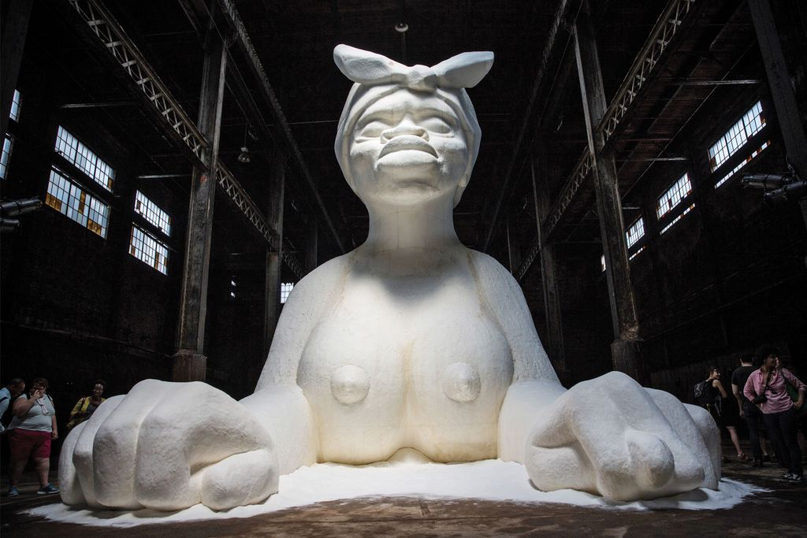
“A Subtlety or the Marvelous Sugar Baby, an Homage to the unpaid and overworked Artisans who have refined our Sweet tastes from the cane fields to the Kitchens of the New World on the Occasion of the demolition of the Domino Sugar Refining Plant.”
Kara Walker, 2014, Brooklyn https://www.youtube.com/watch?v=W2sedoeOiB8&ab_channel=CreativeTime

Slide 63
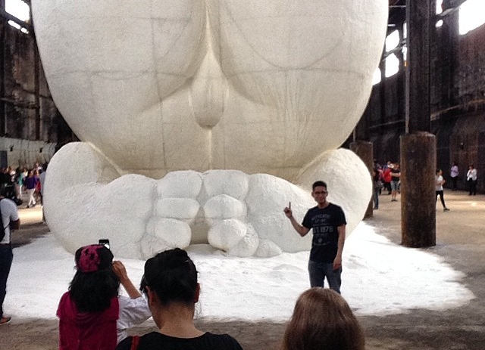

A Subtlety’s selfies

Slide 64

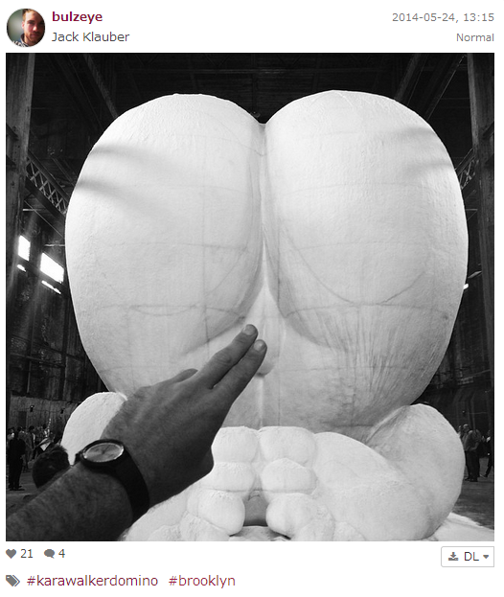
A Subtlety’s selfies

