Slide 1
A watchdog without teeth? The normative role of mass media to curb corruption Christopher Starke University of Münster Department of Communication

Slide 2
Agenda
A few words about Münster
What is corruption?
How can mass media curb corruption?
What about the internet?

Slide 3
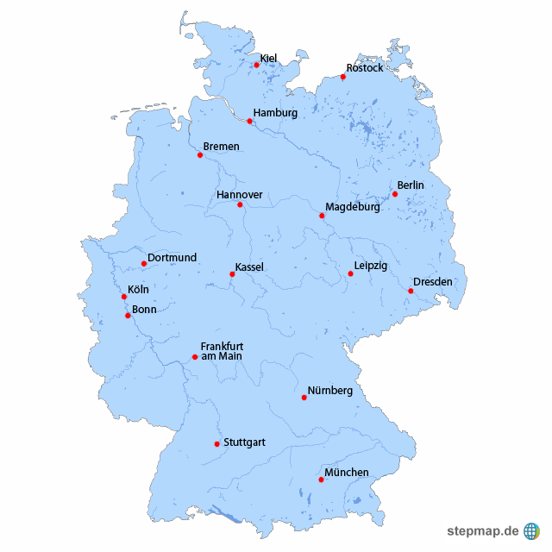
ca. 300.000 inhabitants
ca. 55.000 students
ca. 500.000 bicycles

Slide 4
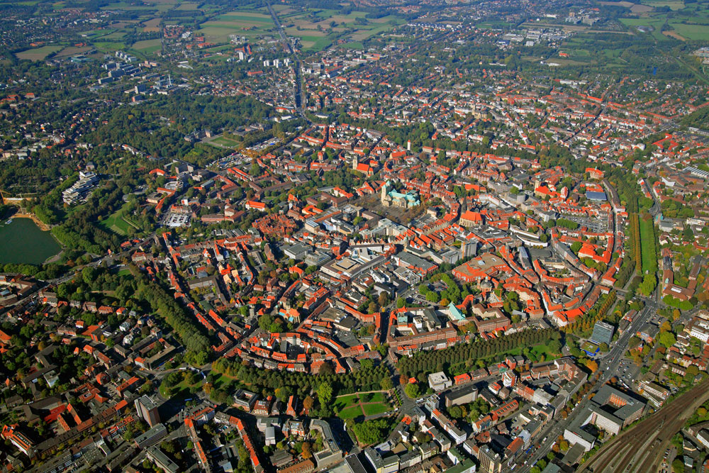

Slide 5
What is corruption?

Slide 6
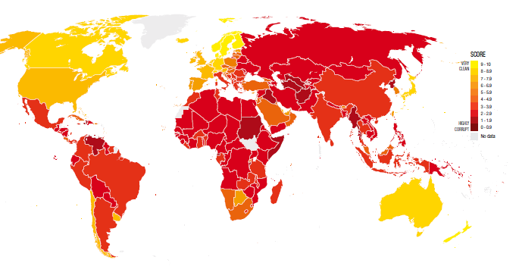
Levels of Corruption
Notes:
Possible Questions relevant to Media & Communication research
How does Media Freedom affect corruption on a global scale?
How do journalists use the words corruption?
How does interpersonal communication affect corrupt behavior?

Slide 7
Definitions
„Korruption ist die Einflussnahme einer Person auf den Inhaber besonderer Entscheidungs-befugnisse über die Interessen eines Dritten mittels einverständ-licher Gewährung von Vorteilen für den Machtinhaber oder einem Dritten, auf die der Machtinhaber keinen Anspruch hat“.
Niehaus, 2012: 63
position of power
corrupt actor represents a third party
„voluntariness“
actor is not entitled for those benefits
Does corruption need a victim?

Slide 8
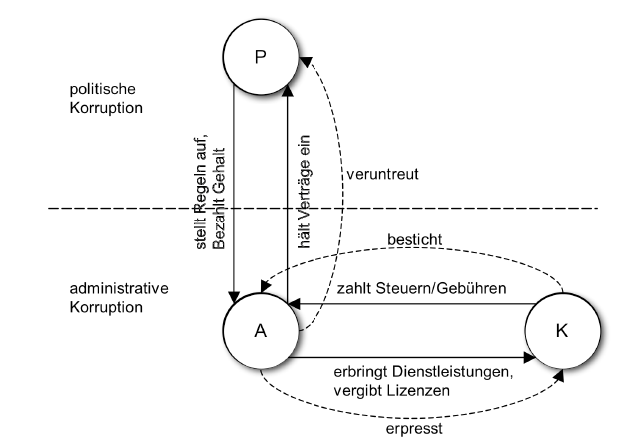
Principal-Agent-Theory

Slide 9
Definitions
„Korruption ist die Einflussnahme einer Person auf den Inhaber besonderer Entscheidungs-befugnisse über die Interessen eines Dritten mittels einverständ-licher Gewährung von Vorteilen für den Machtinhaber oder einem Dritten, auf die der Machtinhaber keinen Anspruch hat“.
Niehaus, 2012
„abuse of entrusted power for private gains“.
Transparency International

Slide 10
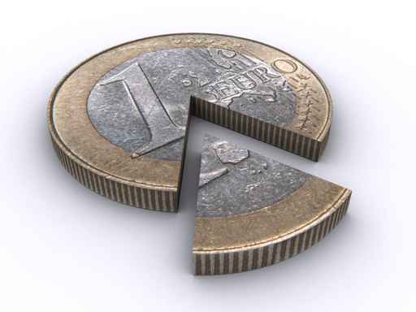
Definitionen
„Korruption ist die
Monopoly + Discretion – Accountability = Corruption
Klitgaart, 1988

Slide 11
Deterrence-Theory (Becker & Stigler, 1974)
high magnitude of external rewards
low probability of detection
low severity of punishment
→ Rational-Choice Paradigm

Slide 12
Different forms of corruption
individual vs. interpersonal corruption
one time vs. repetitive corruption
extortive vs. collusive corruption
administrative vs. political corruption
petty vs. grand vs. systemic corruption
Suphachalasai, 2005; Brunetti & Weder, 2003

Slide 13
Anti-Corruption Efforts
Frequency of interaction between Agent and Client (trust) → rotating responsibilities
4-eyes-principal / privacy
Face-to-Face → written communication
„Naming & Shaming“ (Dr. Antanas Mockus) → reputation
the power of reciprocity („never accept free candy“)

Slide 14
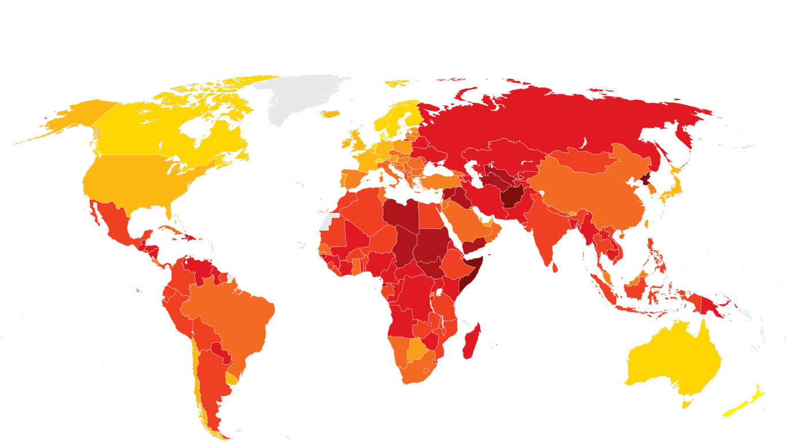

Slide 15
How can mass media curb corruption?

Slide 16
Political functions of mass media
Information
complete
objective
understandable
Sozialization
education to become a politically mature, critical and active citizen
Political Watchdog
„fourth estate“
Monitoring compliance with democratic norms, values and rules

Slide 17
Democratic checks and balances
Separation of powers
Legislative
Exekutive
Judiciary
Media

Slide 18
„tangible effects“ (Stapenhurst, 2000)
Investigative journalism → exposing corruption → public pressure → resignation
“Naming & Shaming”
Media coverage can prompt official public prosecution (gather evidence)
„Naming, Shaming & Jailing“ (z.B. Anas Aremeyaw Anas)
Problem: political alienation, low political participation
Strengthening the legitimacy of official anti-corruption bodies by educating the public
Reformation of official anti-corruption bodies by exposing flaws in the system
Prevention of future corruption by enhancing the probality of getting caught
Agenda-Setting-Effect

Slide 19
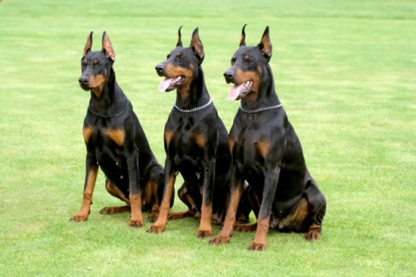
Types of journalism
Watchdog-Journalism
?
Lapdog-Journalism
?
Junkyard-Dog-Journalism
?

Slide 20
What about the Internet?

Slide 21
The Internet is “a cost-effective and convenient means to promote openness and transparency and to reduce corruption“
(Bertot et al., 2010: 264).

Slide 22
The role of the internet to reduce corruption
More difficult to control and censor than traditional media (e.g. Social Media, Proxy-Server) → enable public access to political information
Enable access to foreign media (e.g. BBC World News, France24, Deutsche Welle, CNN)
Enables whistleblowers to publish anonymously → protection against self-censorship
Changes the speed to spread information (e.g. amateur videos via Social Media)
Citizen journalism & Watchdog-Blogs

Slide 23
E-Government
“public sector use of the Internet and other digital devices to deliver services, information, and democracy itself” (West, 2005: 1)
Government to Citizen (G2C): forms, tax declaration, E-Voting
“E-government offers a partial solution to the multifaceted problem of corruption. It reduces discretion, thereby curbing some opportunities for arbitrary action. It increases chances of exposure by maintaining detailed data on transactions, making it possible to track and link the corrupt with their wrongful acts. By making rules simpler and more transparent, e-government emboldens citizens and businesses to question unreasonable procedures and their arbitrary application.”
(Bhatnagar 2003: 30)

Slide 24
Empirical Results
Anderson (2009)
E-Government and Internet access have a negative impact on corruption
Khahaeli & Stockemer (2013)
Internet use increases transparency and accountability
Goel et al. (2012)
Awareness of corruption on the internet reduces corruption

Slide 26
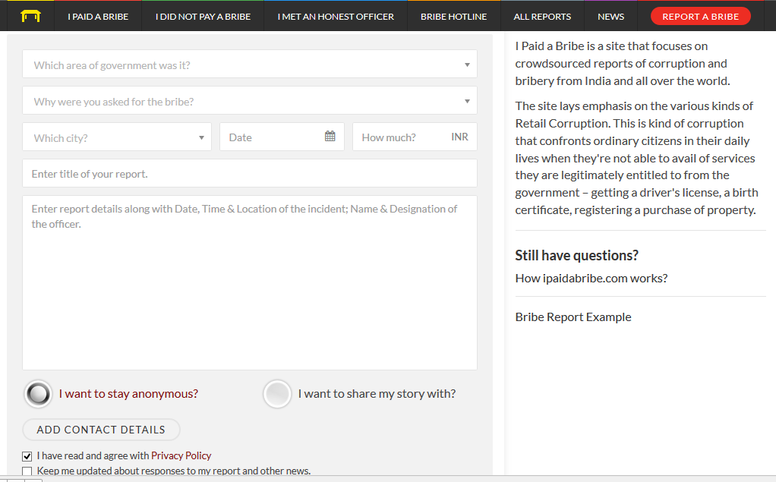

Slide 27
“Forums, chatrooms and blogs […] [allow] enough room for a sufficiently wide range of subjects that people can let off steam about government corruption or incompetence, thus giving people more things to do with their frustrations before considering taking their gripes to the streets.“
(MacKinnon, 2007: 33)

Slide 28
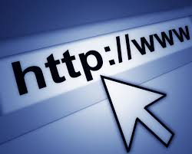
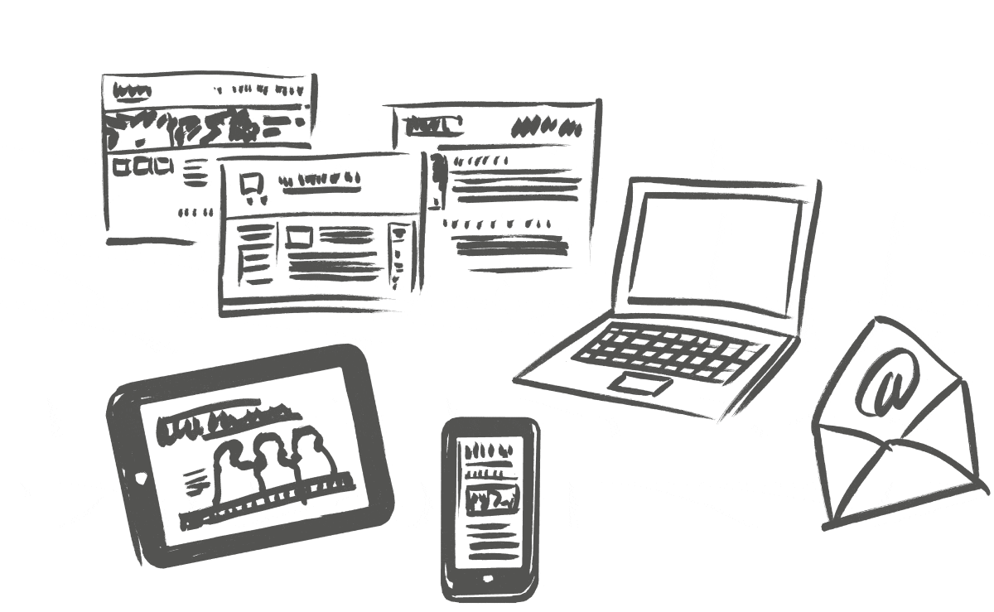
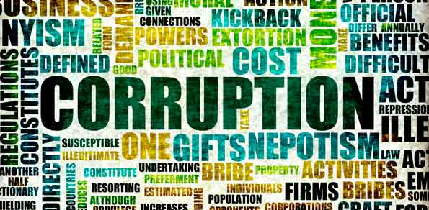
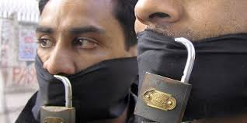
X

Slide 29
Thank you for your attention!!!

