Slide 1
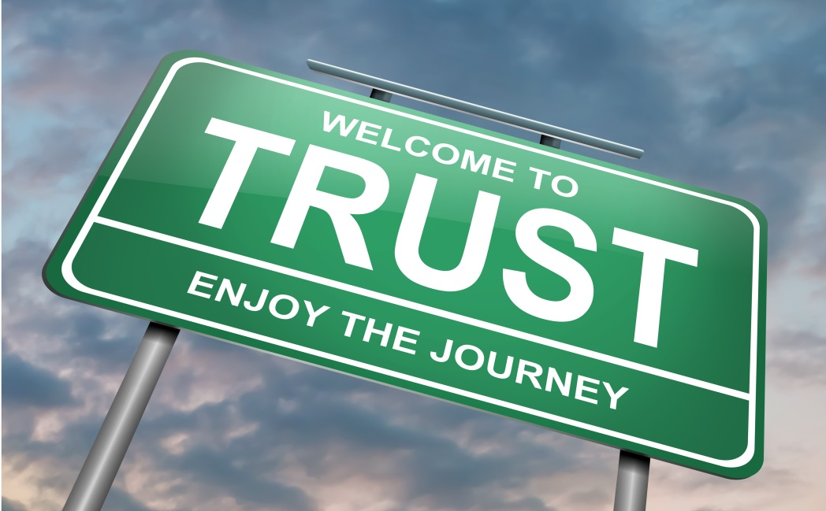
In politics we trust? The link between media use and political trust Christopher Starke University of Münster Department of Communication

Slide 2
Agenda
What is trust?
What is political trust?
Media-Malaise-Hypothesis, Virtuous-Circle-Hypothesis, Spiral of Cynicism
Empirical research

Slide 3
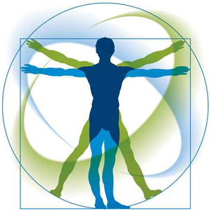
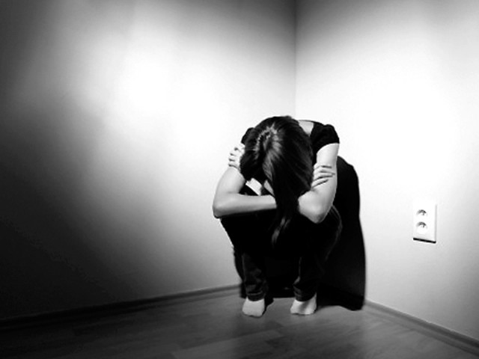
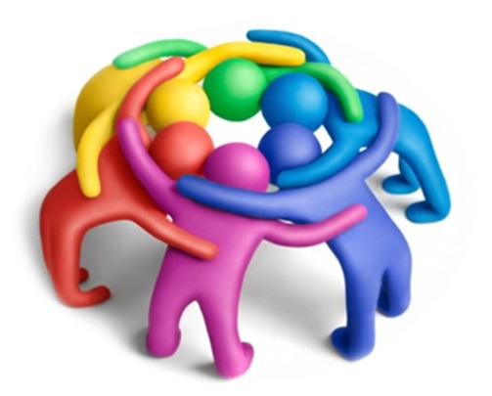
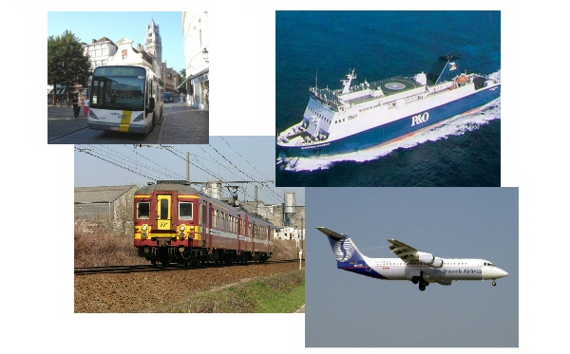
„trust is a cornerstone of human life“

Slide 4
Elements of a trust relation
At least to social actors (trustor & trustee)
Trust enables social action in the face of uncertainty. It allows people to make decisions even though they lack information about the effective consequences of their actions (Coleman, 1994)
Contigency (knowing that both the trustor and the trustee have different options) → risk
trust reduces complexity within social systems (e.g. the political system, the economic system) because it increases the ability for social action by eliminating options.

Slide 5
Elements of a trust relation
‘trust is only demanded where there is ignorance’ (Giddens, 1990)
trust alludes to future actions and is based on knowledge about past actions
trust in people vs. trust in abstract systems (Luhmann, 1979; Seligman, 1997). Trust in people ‘is built upon mutuality of response and involvement […]. Trust in abstract systems provides for the security of day-to-day reliability, but by its very nature cannot supply either the mutuality or intimacy which personal trust relations offer’ (Giddens, 1990: 114).

Slide 6
Trust & Risk
 | Trustor has contigency | Trustor does not have contigency
Trustee has contigency | Trust | Danger for the trustor
Trustee does not have contigency | (Danger for the trustee) | Familiarity

Slide 7
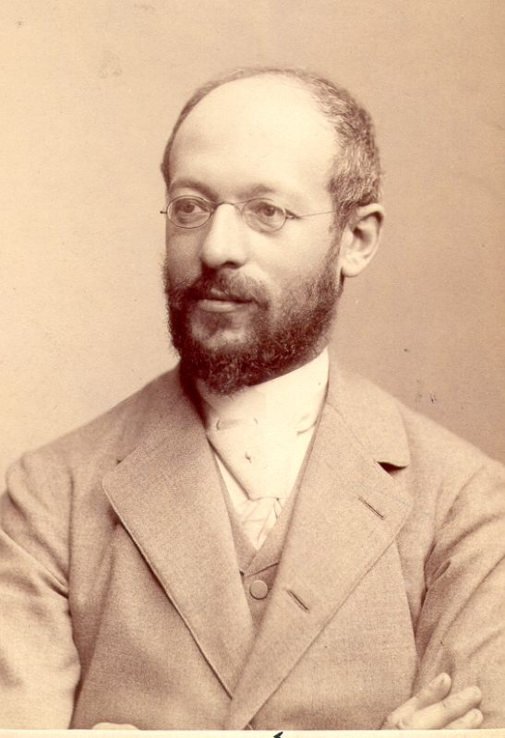
Georg Simmel (1858 – 1918)
intermediate between knowledge and ignorance
If one is in possession of full knowledge, one would not need to trust (but rather to calculate); in the absence of any knowledge, one would not be able to trust
Trust is a mechanism to compensate for lack of knowledge / ignorance

Slide 8
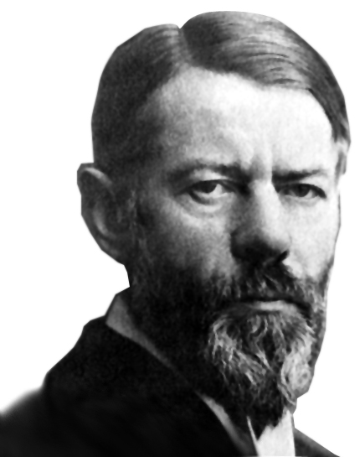
Max Weber (1864 – 1920)
„As-if-actions“
Trust replace a lack of knowledge (similar to Simmel)
contigency
Trust in systems (in this case technology)
Trust vs. Familarity
Risk

Slide 9
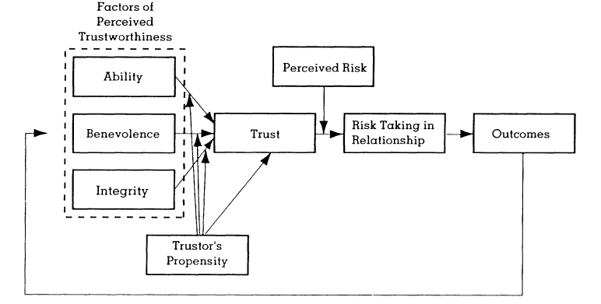
Model of Trust (Davis, Meyer & Schoorman, 1995)

Slide 10
Vertrauen als rationale Entscheidung
Trust as a bet
as rational actors, individuals trust if the chance of profit (if the trustee justifies the given trust) exeeds the chance of loss (if the trustor does not justify the given trust)

Slide 11
Prisoners Dilemma
 | Cooperation | Defection
Cooperation | A & B reach their goals (1 years in prison) | A benefits (0 years in prison), B loses (3 years in prison)
Defection | B benefits (0 years in prison), A loses (3 years in prison) | A & B do not reach their goals (2 years in prison

Slide 12
Prisoners Dilemma
 | Cooperation | Defection
Cooperation | A & B reach their goals (1 years in prison) | A benefits (0 years in prison), B loses (3 years in prison)
Defection | B benefits (0 years in prison), A loses (3 years in prison) | A & B do not reach their goals (2 years in prison

Slide 13
Political Trust

Slide 14
Notes:
Folgen von Vietnam
Watergate & Nixons Rücktritt
Ökonomische Krisen
Golf-Krieg führt zu Steigerung (kurz)
Lewinsky-Affäre
9/11
Kontroverse über Irak-Krieg
Hurricane-Katrina
Finanzkrise

Slide 15
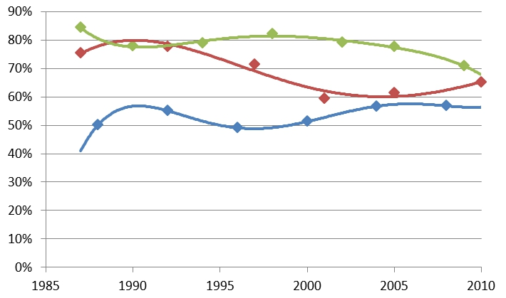
Notes:
Grün – D
Rot – GB
Blau - USA

Slide 16
Danger of decreasing trust in politics
lower levels of voter turnout in elections (Grönlund and Setälä, 2007; Shaffer, 1981)
lower levels of institutionalized political participation (Hooghe and Marien, 2012)
decreased willingness to pay taxes and to lower levels of compliance with laws (Marien and Hooghe, 2011)
increased voting for extreme right and populist parties (Billiet and De Witte, 1995; Pauwels, 2010).

Slide 17
Theory by Hetherington (2005)
Political decision-makers are legitimized in elections
They have to make decisions based on responsiveness
If political trust decreases, citizens tend to support political decisions which benefits them
Thus „left“, „liberal“ policies lose support (redistributive policies)
Decreasing political trust leads to rather conservative policies

Slide 18
Object of political trust
Politicians
Political Parties
Political Institutions
Parlament
Government
The political system
Democracy

Slide 19
Distinction in political science
Polity:
Political structures (government, political parties etc.)
Rule of law
Policy:
Content of political decision making
Political problem solving & designing societal conditions
Politics:
Political processes (e.g. elections, lobbying)

Slide 20
Measuring political trust
American National Election Studies (ANES)
“How much of the time you think you can trust the government in Washington to do what is right?”
“Would you say the government is run by a few big interests looking out for themselves or that it is run for the benefit of all the people?”
“Do you think that people in government waste a lot of the money we pay in taxes?”
“Do you feel that almost all of the people running the government are smart people?”
“Do you think that quite a few of the people running the government are a little crooked?”
Dutch Citizens’ Outlooks Barometer (COB)
“How much do you trust …”
Politicians
Parliament
Government
European Social Survey & World Value Survey
‘‘Please tell me on a scale of 1–5 how much you personally trust each of the following institutions.’’
Parliament | The judiciary / courts
Political parties | The police
Government | Politicians in general

Slide 21
Measuring political trust
Incumbent-Based Trust (Craig et al., 1990)
do what is right & is run by a few big interests
Most government officials try to serve the public interest, even if it is against their personal interests,
When government leaders make statements to the American people on television or in the newspapers, they are usually telling the truth.
Unless we keep a close watch on them, many of our elected leaders will look out for special interests rather than for all the people.
Those we elected to public office usually try to keep the promises they have made during the election.
Most of the people running our government are well-qualified to handle the problems that we are facing in this country.
Quite a few of the people running our government are not as honest as the voters have a right to expect.
Most public officials can be trusted to do what is right without our having to constantly cheek on them
Regime-based Trust (Craig et al., 1990)
“Whatever its faults may be, the American form of government is still the best for us.”
“There is not much about our form of government to be proud of.”
“It may be necessary to make some major changes in our government in order to solve the problems facing our country.”
“I would rather live under our system of government than any other that I can think of.”

Slide 22
Definition of trust in politics
“Political trust as one’s expectations in the ability of the political system to provide favourable outcomes”

Slide 23
Suggestion to measure political trust
“How sure are you that German politics is able to…” (1 = “not at all sure“ to 5 = “very sure”)
…guarantee future energy supply?
…guarantee peace for the country?
…protect the natural environment against destruction?
…provide for a well-functioning educational system?
…ensure economic wealth in Germany?”

Slide 24
Suggestion to measure political trust
r1
r2
r3
r4
r5
.52
.47
.41
.43
.57
guarantee energy supply
save peace for the country
ensure economic wealth
provide educational system
protect natural environment
.72
.69
.64
.65
.75
Political Trust
ML-Estimation; Chi-square= 10.245 (df = 5 p=.069); RMSEA= .046; CFI =.993

Slide 25
Media Effects

Slide 26
Possible Relationships
T
dV
iV
T
T
T
iV
dV
iV
dV
Moderation
Mediation

Slide 27
3 possible models of Media effects on political trust
Media-Malaise-Hypothesis
(Robinson 1976)
The news media tends to emphasize negative aspects of politics (e.g. conflict, violence)
Exposure to the media’s negativity and lack of substance leads to growing public mistrust in politics and enhances cynicism
Virtuous-Circle-Hypothesis
(Norris 2000)
higher levels of political interest and trust will foster exposure to a variety of news media sources
Attention to political news will further increase political interest and trust.
The disinterested and distrusting will probably simply not pay attention to the news media.
Spiral of Cynicism-Hypothesis
(Capella & Jamieson 1997)
Media mainly report on politics strategically (e.g. in election campaigns)
Strategic news coverage fosters mistrust and cynicism
Cynicism reduces political participation (e.g. voter turnout)

Slide 28
Empirical results
strategic campaigns within the news media (Cappella & Jamieson 1997; Valentino et al. 2001) and entertaining news formats (Guggenheim et al. 2011; Tsfati et al. 2009) reduce political trust .
entertaining formats lead to growing public mistrust in politics, whereas reliable news formats show hardly any significant negative effects (Holtz-Bacha 1990)
Uncivility (Mutz & Reeves 2005), political orientation (Avery 2009) moderate the negative effect on trust in politics
newspaper exposure affects trust more positively than exposure to television (Putnam 200; Milner 2002) (Aarts et al., 2011) do not find that effect)
Aarts et al. (2011), Norris (2000) find support for the virtuous circle hypothesis

Slide 29
Social media and Impression formation of politicians
Hightened social presence because of possibilities for interacting
(Lee & Shin 2012)
Imagined intimacy leads to more positive evaluations of politicians
(Bente et al. 2008, Lee & Oh 2012, Crawford 2009)
Positive effects of following a politician on facebook on candidate evaluations
(Dimitrova & Bystrom 2013, Hwang 2013)
Even passive reception („background listening“ Crawford 2009: 528) has positive effects on impression formation of politicians
(Tanis & Postmes 2003, Donath 2008)

Slide 30
Measurement model of political trust
Political Trust
Ability to decide
Ability to execute
Ability to solve problems
Political trust
Confidence in Outcome
Expectations in Outcome
Reasons
System characteristics (structures & processes)
Evaluations of politicians
Sources
Personal experiences
Interpersonal communication
Media

Slide 31
Hypotheses
evaluative beliefs in political personnel
social media use for political information
H1: The indirect impact of social media use for political information on people’s trust in politics is mediated by people’s evaluative beliefs in politicians.
trust in politics

Slide 32
Hypotheses
evaluative beliefs in political personnel
evaluative beliefs in political structures & processes
social media use for political information
trust in politics
H2: The indirect effect of evaluative beliefs in politicians on political trust is further mediated by people’s evaluative beliefs in the political system.

Slide 33
Method
Respondents are selected from a nationwide Online-Access-Panel (Global Market Insight)
a final sample of 500 German adults (18+) was used for statistical analysis
All survey questions and scale constructions were pre-tested in paper and pencil surveys with three different student samples (total N = 246) and one telephone-survey (N = 221)
Structural Equation Modelling (SEM) was used to test relationships between variables

Slide 34
Results
R²= .05
R²= .49
evaluative beliefs in political personnel
evaluative beliefs in political structures & processes
.70***
.22***
.28***
.49***
R²= .51
social media use for political information
trust in politics
ML-Estimation, Chi-square = 3.807 (df=2, p=.149), RMSEA = .043, CFI = .997

Slide 35
Results
R²= .05
R²= .49
evaluative beliefs in political personnel
evaluative beliefs in political structures & processes
.70***
.22***
.28***
.49***
R²= .51
social media use for political information
trust in politics
ML-Estimation, Chi-square = 3.807 (df=2, p=.149), RMSEA = .043, CFI = .997

Slide 36
Results
R²= .05
R²= .49
evaluative beliefs in political personnel
evaluative beliefs in political structures & processes
.70***
.22***
.28***
.49***
R²= .51
social media use for political information
trust in politics
ML-Estimation, Chi-square = 3.807 (df=2, p=.149), RMSEA = .043, CFI = .997

Slide 37
Thank you for your attention!!!

