Slide 1
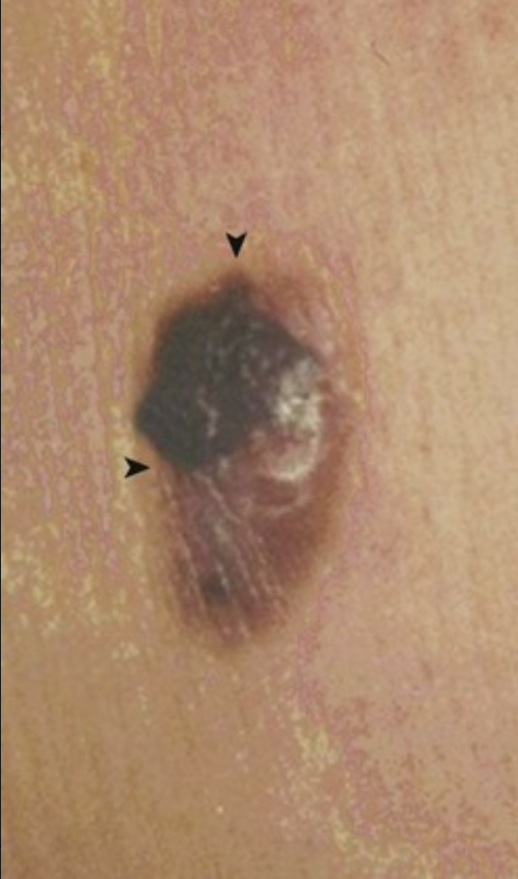
A 62-year-old man has noted the enlargement of the right upper back skin lesion shown over the past 5 months.
What features suggest that this is malignant?
What is a biopsy specimen likely to show?
What is the major risk factor?
What is the prognosis?
Rapid increase in size, irregular borders (▾), and irregular pigmentation (▸) suggest that this is a malignant melanoma.
Microscopic features include hyperchromatic and pleomorphic polygonal and spindle cells, often with cytoplasmic melanin granules.
Prolonged exposure to ultraviolet light, particularly UVB, induces pyrimidine dimers and increases the risk for melanoma.
Prognosis depends on the size and particularly on the depth of invasion. Lesions less than 0.75 mm deep have a good prognosis (>95% 5-year survival); lesions more than 1.5 mm deep have a poor prognosis (<50% 5-year survival).

Slide 2
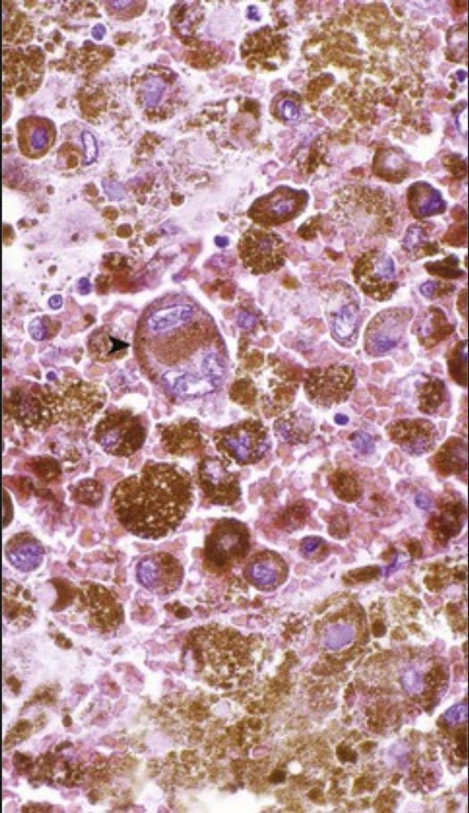
A 44-year-old woman has noted an enlarging brown and black skin nodule on her left upper arm that bleeds easily with even minor trauma. On examination, the lesion has irregular borders and surface ulceration. A biopsy specimen has the microscopic appearance shown (Fontana-Masson stain).
What is the diagnosis?
What molecular alterations are likely present?
How is this lesion most likely to spread?
The large pleomorphic polygonal cells (▸) have abundant brown melanin within their cytoplasm; this is consistent with a malignant melanoma.
The p16/INK4A gene that encodes for CDNK2 is frequently deleted, particularly when there is a family history of melanoma. Mutations that involve the CDK4 and BRAF genes may also occur.
When the melanoma begins a vertical growth phase, metastases are more likely to occur.
Of all malignancies, melanomas have the greatest potential to metastasize to many different sites (e.g., brain, heart, spleen), although the initial metastases are often to regional lymph nodes.

Slide 3
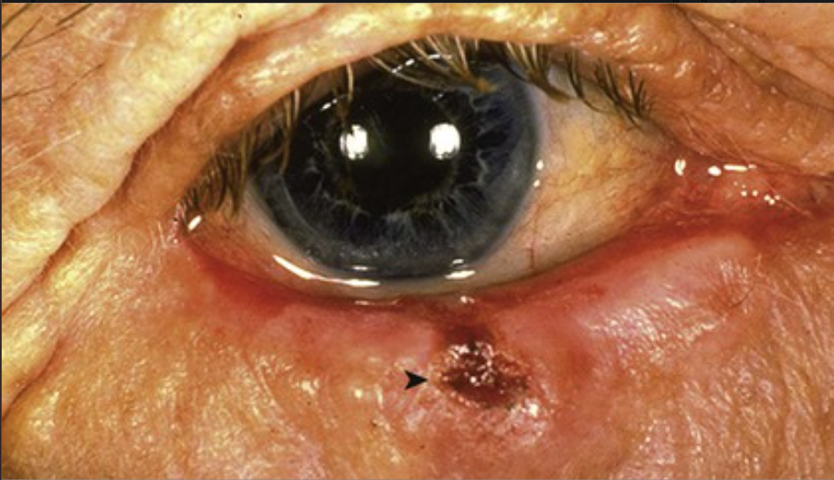
A 78-year-old man enjoys sport fishing, and he spends many hours outdoors. He has noted that the lesion shown has been slowly enlarging for the past 4 years.
What is the diagnosis?
What is the major risk factor for this lesion, and what is the molecular mechanism for its growth?
How is this treated?
This lower eyelid nodular skin lesion with central ulceration (▴) is typical of basal cell carcinoma.
Sun exposure is the major risk factor. Ultraviolet light, mainly UVB, induces pyrimidine dimer formation in DNA. Nucleotide excision repair pathways are overwhelmed by ongoing UVB damage.
Treatment requires complete surgical excision. The careful assessment of the margins (typically with frozen section examination at the time of surgery) can limit the amount of tissue removed in critical areas such as the eyelid, where function must be maintained.

Slide 4
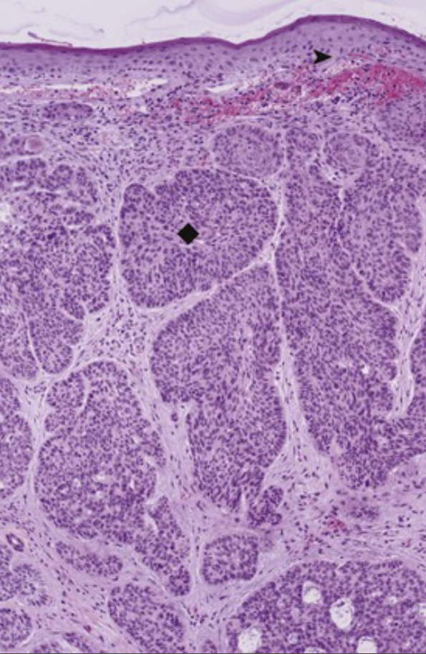
A 69-year-old woman has a 6-year history of a slowly enlarging pearly pink papule on the helix of her left ear. The lesion is excised; its microscopic appearance is shown.
What normal skin cells do these tumor cells mimic?
What could happen if this lesion was not removed?
Name the predisposing inherited disorders of DNA repair genes and the PTCH gene.
The dark-blue cells in nests (♦) dropping into the dermis mimic the normal basal cells (▸) of the epidermis.
Basal cell carcinoma remains localized for a long time, but it slowly invades adjacent tissue. Extensive local invasion may make complete excision difficult. These tumors rarely metastasize. Xeroderma pigmentosum, which is an autosomal-recessive condition, arises from mutation in one of several genes (XPa through XPg) that direct DNA nucleotide excision repair (NER) pathways. The autosomal-dominant nevoid basal cell nevus syndrome (Gorlin syndrome) involves germline mutation of the PTCH gene, which normally inactivates the SMO transmembrane protein that upregulates transcription factors.

Slide 5
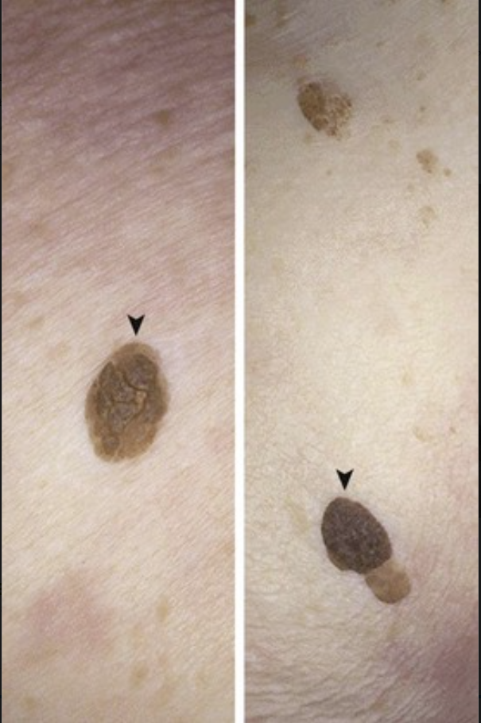
A 77-year-old woman has had minimal sun exposure to her trunk, where the lesions shown are found. Similar lesions appear on her head and neck. They have slowly increased in size over the past 14 years.
Are these lesions benign or malignant?
What might you see on inspection with a magnifying lens?
What could happen with excoriation?
What would the appearance of many lesions suggest in a patient with an underlying malignancy?
These seborrheic keratoses (▾) have smooth, regular borders and uniform pigment distribution, which are benign characteristics. They appear coinlike, as though they were “stuck on” the surface.
There are often porelike ostia that are filled with keratin.
Excoriation or scratching can produce local hemorrhage and increase the risk for secondary infection.
The paraneoplastic syndrome (Leser-Trélat sign) results from excessive transforming growth factor-α production by neoplastic cells, which drives the explosive appearance of seborrheic keratoses.

Slide 6
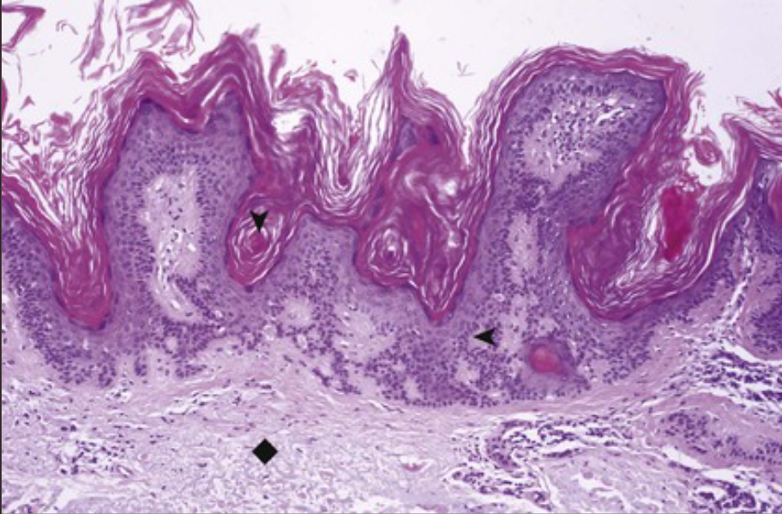
A 62-year-old man has 12 slowly enlarging, sharply demarcated, uniformly dark-brown skin lesions that range from 0.3 to 1 cm and that appear on his face, trunk, and upper arms. The microscopic appearance of the lesions is shown.
Describe the findings.
What is the most likely risk factor?
What additional change seen here in the dermis is associated with sun exposure?
This seborrheic keratosis has an exophytic growth pattern of sheets of basal-like cells (▸) with pronounced keratin production that invaginates and produces keratin-filled horn cysts (▾).
These lesions accompany aging. They are less common in individuals with more darkly pigmented skin.
The dermis shows homogeneous blue-gray elastic fibers (elastosis) that are characteristic of actinic (sun) damage (♦).

Slide 7
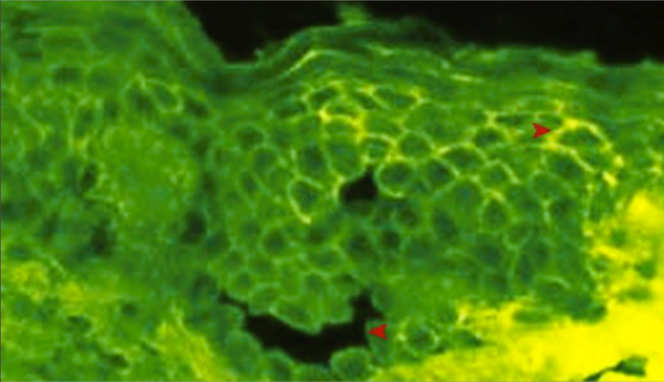
A 55-year-old man with painful oral mucosal erosions from ruptured bullae develops flaccid skin blisters filled with clear fluid on his scalp, axilla, and inguinal regions over the following 3 months. The immunofluorescent staining pattern for IgG of one biopsy specimen from a lesion is shown.
What is your diagnosis?
What does the autoantibody in this disease recognize?
How do the blisters form?
This patient has pemphigus vulgaris. There is a lacelike (“reticular”) pattern (▴) of immunofluorescent staining around the individual keratinocytes.
The autoantibody recognizes desmoglein-3, a component of the desmosomes that hold keratinocytes together in the stratum spinosum.
Bound antibody on the surface of keratinocytes activates them to release a urokinase-like plasminogen activator (serine protease) that degrades desmosome junctions. This leads to acantholysis (▾) as the epidermal cells lose adhesion. The blister that forms is usually above the basal layer of cells.

Slide 8
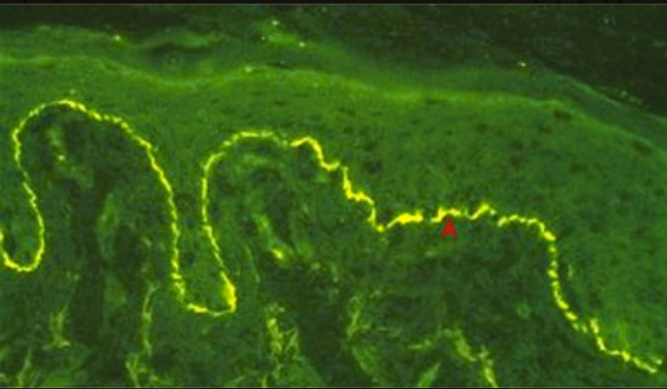
A 65-year-old woman has had skin blisters for 2 years. Recurrent crops of tense bullae 3 cm or less in diameter appear on her abdomen, groin, thighs, and forearms. They always spontaneously regress, and they heal without scarring. The immunofluorescent microscopic appearance of one such lesion that has been stained for IgG (or C3) is shown.
What is your diagnosis?
What immune mechanism is involved?
How do the bullae form?
This patient has bullous pemphigoid. There is linear staining (◂) at the dermal-epidermal junction for IgG and complement.
IgG autoantibodies are directed against hemidesmosome proteins at the dermal-epidermal junction (e.g., BPAg2 [type XVII collagen], a transmembranous protein with a collagenous extracellular domain).
Immune-mediated basement membrane damage (via complement activation and through the activity of Fc receptor–bearing inflammatory cells) leads to hemidesmosome degradation and subepidermal separation.

Slide 9
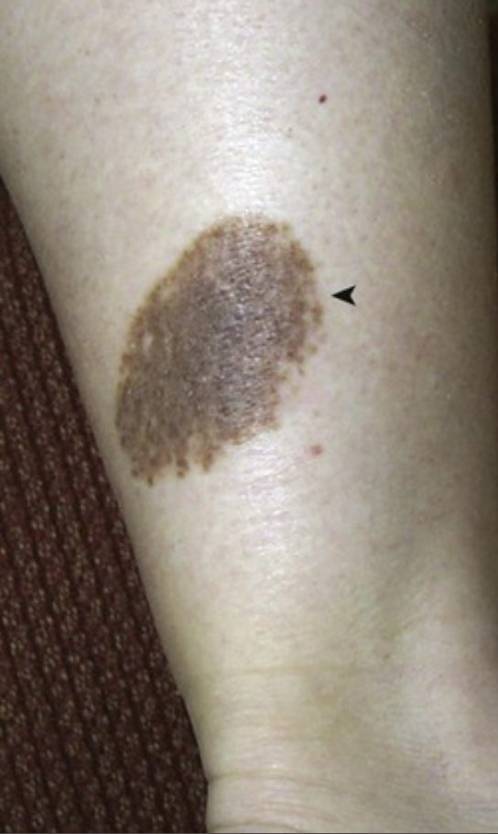
A 51-year-old woman has had the calf lesion shown here, without any change in its appearance, for as long as she can remember.
What is your diagnosis?
What is this lesion called if it is present from birth?
What similar pink-red lesion is found in children?
What condition should be considered in the setting of hundreds of such lesions?
This pigmented lesion with sharp borders (◂) is a nevus. Most common nevi are less than 6 mm in diameter.
Congenital nevus.
Spitz nevus.
Dysplastic nevi, which are also called BK moles (these are the first letters of the surnames of the two families first described as having such lesions). These nevi are larger than most acquired nevi; they have a tendency to occur in non–sun-exposed areas, and they carry a risk of developing into malignant melanoma.

Slide 10
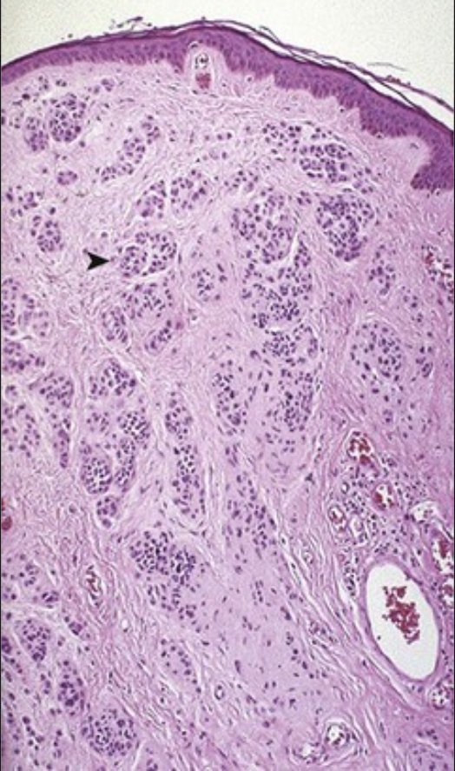
A 35-year-old woman has 17 pale tan to dark-brown lesions on her torso and her upper extremities. They range from macules to small papules that are 2 to 6 mm in diameter. They have smooth borders and uniform pigmentation. The microscopic appearance of one lesion is shown.
What is your diagnosis?
What is the cell of origin?
Is there a risk for malignancy?
How do these lesions mature?
These are common, benign, melanocytic nevi.
Melanocytes are normally interspersed in the epidermis with keratinocytes. A nevus typically contains round, transformed melanocytes that proliferate in nests (▸).
There is no risk for malignancy. Melanocytic nevi are not precursors to melanoma, although they must be distinguished from melanoma.
Common nevi tend to undergo maturation. Melanocytic cells are initially found at the dermal-epidermal junction (junctional nevus), but they later extend into the dermis (compound nevus), and they are eventually found entirely within the dermis (intradermal nevus).

Slide 11
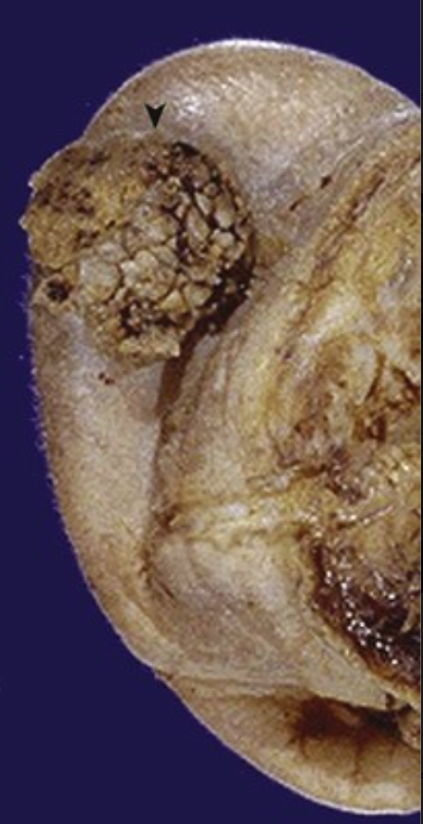
A 66-year-old man with a 5-year history of a slowly enlarging nonpigmented nodule on his ear pinna now states that it bleeds easily when scratched. A wide excision is performed and is shown.
What is your diagnosis?
What are the risk factors?
This raised, rough, nodular lesion (▾) is a squamous cell carcinoma. Note the extent of excision (ear removal); this is an extremely invasive malignancy with a propensity for local recurrence or metastasis if not adequately excised. Melanoma and basal cell carcinoma are other malignancies that can manifest as nodular lesions.
Sun exposure is the most likely risk factor. Individuals who are immunocompromised (e.g., transplant recipients) are also at risk.

Slide 12
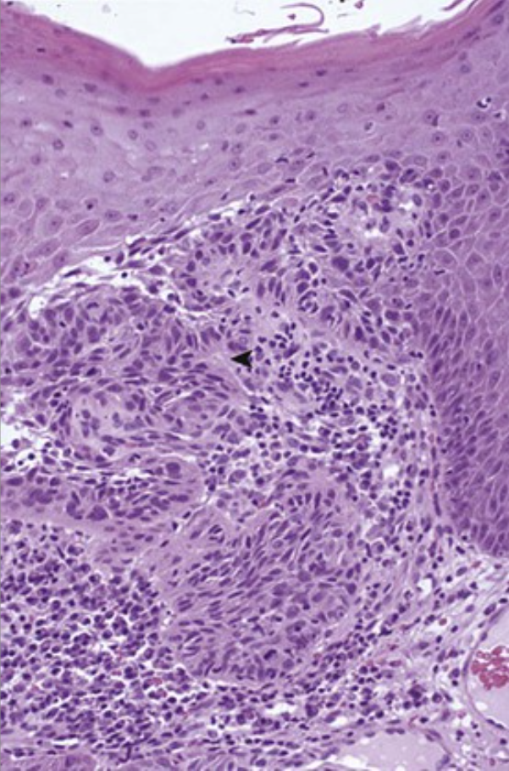
A 52-year-old woman with a 3-year history of a 2-cm, slowly enlarging, irregular, ulcerated, nodular lesion on her upper eyelid presents for resection. The microscopic appearance of the lesion is shown.
What is your diagnosis?
What form of environmental radiant energy induces this lesion?
What pathways normally prevent this neoplastic event?
What genetic condition predisposes affected individuals to having multiple such lesions?
Large, pink, polygonal cells of squamous cell carcinoma infiltrate (◂) into the dermis.
Ultraviolet (UV) light from sun exposure is responsible for this condition. UVB rays are the most carcinogenic.
UV light induces pyrimidine dimer formation in DNA; this is a process that is ordinarily efficiently repaired by nucleotide excision and base pair reinsertion. UV light induces p53 protein, which arrests the cell cycle until repair can be effected. However, recurring sun exposure eventually results in errors that are not corrected before cell division occurs. In addition, UV light depresses the immune surveillance function of epidermal dendritic (Langerhans) cells.
Xeroderma pigmentosum is an autosomal-recessive condition that involves mutations in DNA excision repair genes.

Slide 13
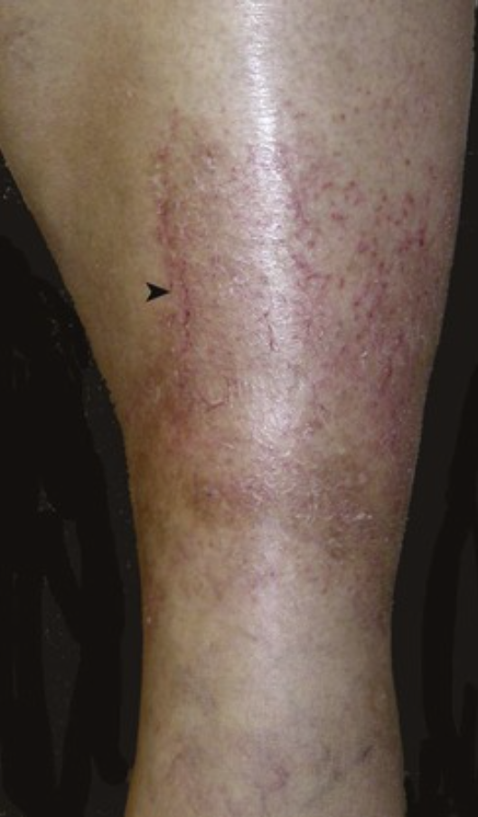
A 30-year-old woman with the recent onset of the red, oozing area shown reports that, by week's end, the area has evolved to raised, scaling plaques.
What is your diagnosis?
What could cause this lesion?
What is a potential complication?
Eczema is a general term for the acute appearance of red, oozing, and crusted lesions (▸) that, in time, become scaling plaques.
Taking a patient history can help to identify potential causes, including contact dermatitis, atopic dermatitis, insect bite, drug reaction, chemical exposure, and photosensitivity.
Bacterial superinfection can occur as a result of the compromise of the otherwise intact epidermal barrier.

Slide 14
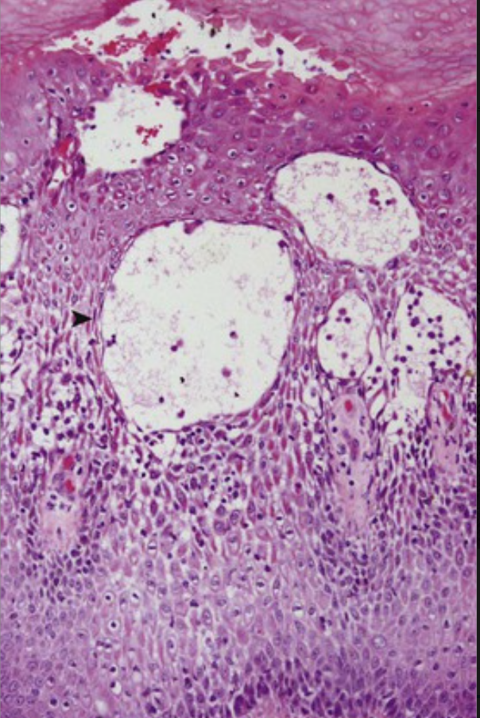
A 25-year-old woman who has been prescribed carbamazepine for a seizure disorder develops a papulovesicular skin rash with the microscopic appearance shown.
What is the general term for this histologic appearance?
Describe the microscopic changes.
What inflammatory cell types play a role in the pathogenesis of this condition?
This is acute eczematous dermatitis.
The epidermis has extensive edema with spongiosis and spongiotic vesicles (▸) filled with fluid.
Epidermal Langerhans cells present antigen to CD4+ helper T lymphocytes, which become activated and secrete cytokines (type IV hypersensitivity). Some CD4+ cells become memory cells so that antigen re-exposure results in a more rapid and exuberant inflammatory response. Perivascular T cells secrete inflammatory mediators that act on endothelial cells to promote increased permeability and inflammatory cell egress (e.g., an exudate).

Slide 15
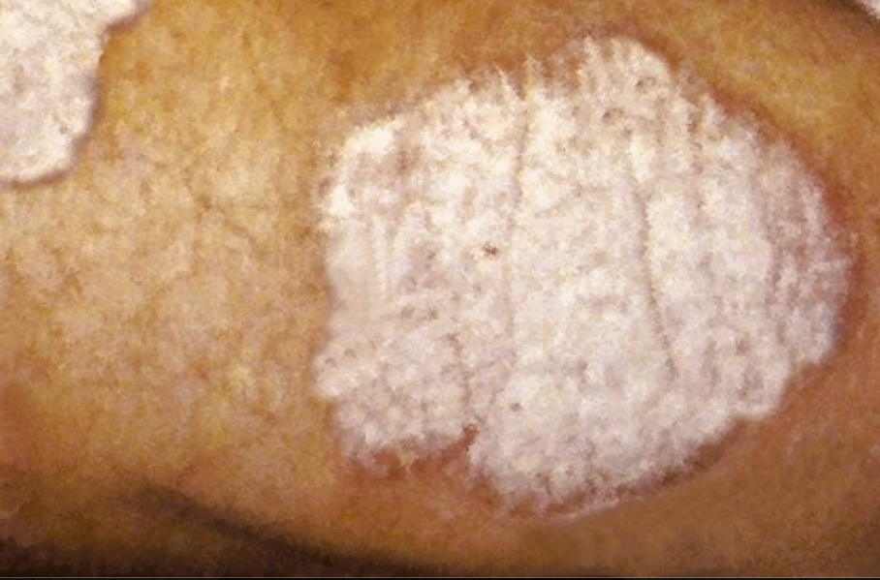
A 20-year-old man has symmetrically distributed lesions similar to those shown over his elbows, knees, and scalp. These are fine, dry, silvery-white scales, and the skin underneath is red and glossy. Scratching makes these lesions more likely to appear.
What is your diagnosis?
What are the risk factors for this condition?
What can happen to this patient's fingernails?
What joint disease may be associated with this?
This is plaque psoriasis.
In addition to skin trauma (Koebner phenomenon), emotional stress, cigarette smoking, alcohol consumption, and drugs such as nonsteroidal anti-inflammatory drugs increase the risk for an outbreak.
Nail psoriasis occurs in one third of patients with this condition; it consists of yellow-brown discoloration with pitting and separation of the nail plate (onycholysis).
Psoriatic arthritis involves the distal interphalangeal joints of the hands and feet being affected with inflammation similar to that of rheumatoid arthritis.

Slide 16
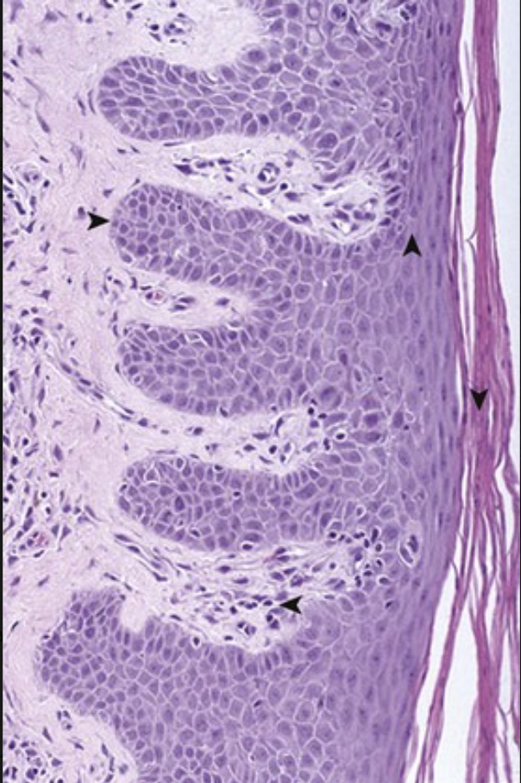
A 58-year-old woman with 1- to 3-cm, pruritic, elevated, plaquelike areas of scaling skin over her genital region and her buttocks as well as under her breasts and her arms has a biopsy specimen with the microscopic appearance shown.
What is your diagnosis?
What is the pathogenesis?
What drugs can be used to treat this disease?
This is psoriasis with acanthosis, with thinning of the stratum granulosum (▴), parakeratotic scale (▾), downward elongation of the rete ridges (▸), and dilated vessels (◂) in the dermal papillae.
This is probably a TH1 immune response driven by an autoimmune interaction of Langerhans cells and CD4+ cells, with the activation of CD8+ cells and the release of cytokines such as tumor necrosis factor (TNF).
Topical corticosteroids, psoralens with phototherapy, and systemic immunosuppressants such as methotrexate are used to treat this condition.

Slide 17
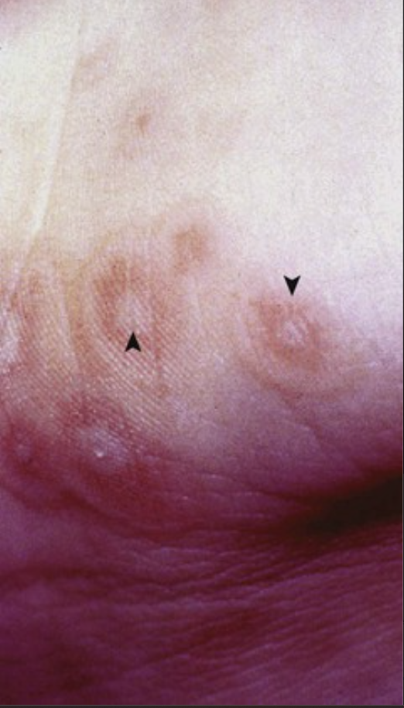
A 35-year-old man who is being treated with a cephalosporin for an upper respiratory tract infection develops the lesions shown over the extensor surfaces of his extremities as well as his palms, neck, and face. They subside in 3 weeks.
What is your diagnosis? What is the immunologic basis for this condition?
What can precede the development of this lesion?
This is erythema multiforme with the classic targetoid lesions exhibiting a central pale vesicle (▴) surrounded by a zone of erythema (▾). Macules, papules, vesicles, and bullae can also occur with this “multiform” condition.
Erythema multiforme is a delayed-type hypersensitivity reaction, typically against an agent that haptenates self-proteins and elicits an inflammatory response.
Preceding infections include herpes simplex virus, Mycoplasma, and many bacteria and fungi. Drugs such as antibiotics, anticonvulsants, antipyretics, and antituberculosis agents have been implicated. An underlying carcinoma or lymphoma may be present, or this may also occur with a collagen vascular disease such as systemic lupus erythematosus.

Slide 18
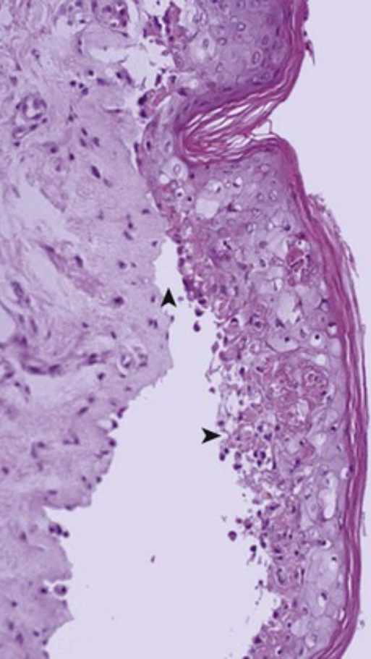
A 47-year-old woman begins treatment with a sulfonamide for a fever and sore throat, and she develops symmetric erythematous skin lesions on her face and torso 2 days later. These progress to flaccid bullae that slough. The microscopic appearance of a biopsy specimen of a lesion is shown.
What is your diagnosis?
What similar condition has mucosal involvement?
How serious is this condition?
This is toxic epidermal necrolysis (TEN). Note the necrosis (▸) of the epidermal keratinocytes and the separation of the epidermis at the dermal-epidermal junction (▴). This is the most severe variant of erythema multiforme, and it is usually associated with prior drug therapy.
Stevens-Johnson syndrome (SJS) has mucosal involvement that typically affects the oral cavity, the conjunctiva, the urethra, and the genital and perianal regions.
The mortality rate with SJS can be 5%, and the mortality rate with TEN can be 40%.

Slide 19
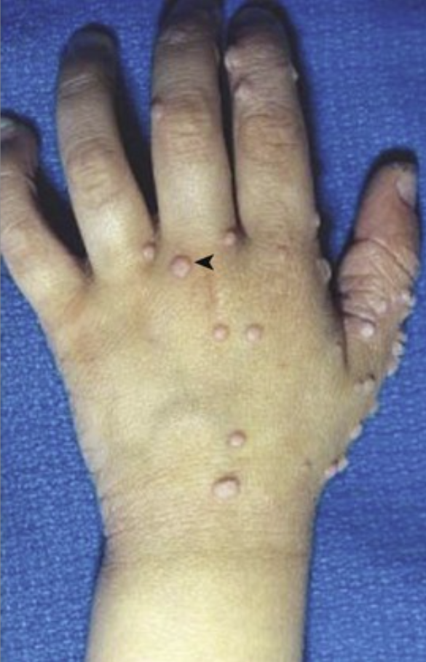
A 16-year-old boy has a 5-year history of the lesions shown. He reports that they subsequently regressed over the course of a year. There is no associated pain, swelling, itching, or redness.
What is your diagnosis?
What are similar lesions on the palms or soles called?
What grossly similar lesion may appear in the genital region?
Why did these lesions spontaneously regress?
These rough-surfaced tan lesions (◂) are common warts, or verruca vulgaris.
Verruca plantaris occurs on the soles; verruca palmaris occurs on the palms.
Condylomata acuminata (venereal warts) occur in the genital region.
Regression is associated with the development of cytotoxic T cells that are capable of eradicating infected cells. Circulating neutralizing antibodies may also participate by preventing viral spread.

Slide 20
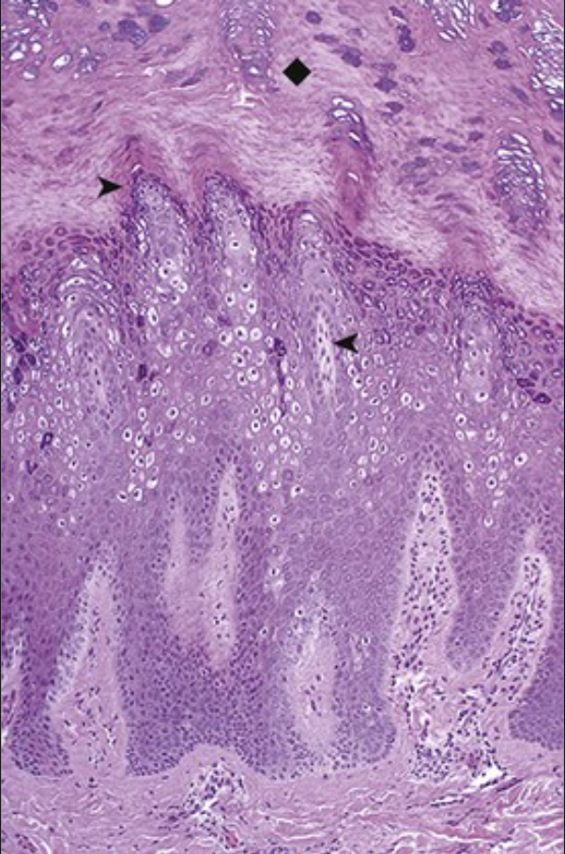
A 10-year-old girl with a 0.6-cm, dark tan, roughened papule on the dorsum of her left hand has it resected. The microscopic appearance is shown.
What is your diagnosis?
What is the pathogenesis?
This verruca vulgaris has papillomatous epidermal hyperplasia (▸) with marked overlying hyperkeratosis (♦). The viral cytopathic effect is marked by koilocytotic change (cytoplasmic vacuolization [◂]) in the keratinocytes.
Human papillomavirus (HPV) infection causes these lesions by driving keratinocyte proliferation. There are many subtypes, a few of which are also linked to dysplasia and carcinoma, including subtypes 16 and 18 in cervical carcinoma. Venereal warts are most often associated with subtypes 6 and 11.

