Slide 1
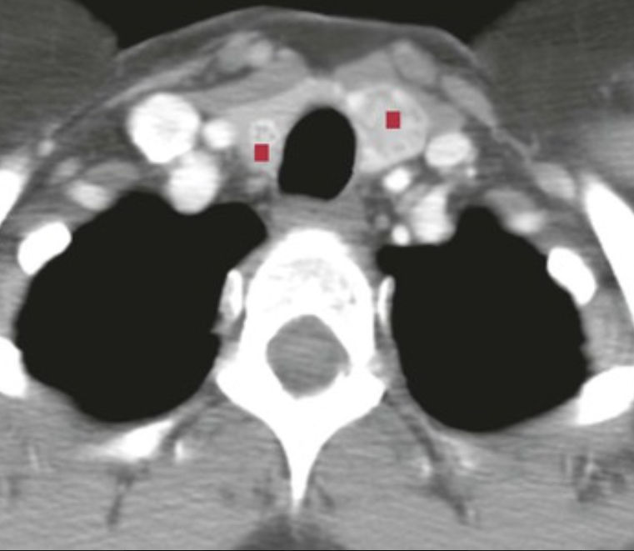
A 37-year-old man with an enlarging mass in his left thyroid lobe has increased serum calcitonin levels. His neck CT scan is shown. His brother and mother have similar lesions.
What is the likely diagnosis?
What gene mutation is likely?
What syndrome might he have?
His increased serum calcitonin level and family history point to medullary thyroid carcinoma. About 25% of such tumors are familial, and most of these occur as multiple masses (▪), as in this man.
Affected individuals likely have a RET gene missense mutation coding for a receptor protein tyrosine kinase.
This could be either multiple endocrine neoplasia (MEN) type IIA (Sipple syndrome i.e., thyroid cancer and noncancerous tumors of the parathyroid glands and adrenal glands) or MEN IIB i.e., medullary thyroid cancer, noncancerous tumors of the adrenal gland, and noncancerous tumors on the lips, on the tongue and in the digestive tract; marfanoid habitus or mucocutaneous ganglioneuromas. MEN 2B does not cause problems with the parathyroid glands; parathyroid hyperplasia is not part of MEN IIB.

Slide 2
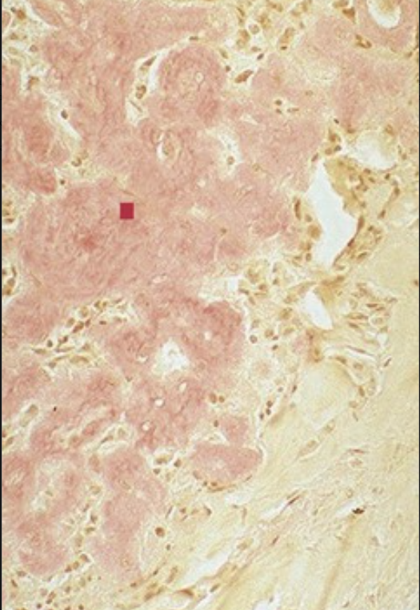
A 40-year-old woman has a neck mass that is causing dysphagia, respiratory difficulty, and hoarseness from recurrent laryngeal nerve compression. She has increased 24-hour urine catecholamine levels, and her serum calcium level is 12.8 mg/dL (nl 8.5 to 10.3 mg/dL), with a normal phosphorus level. The microscopic appearance of a thyroid biopsy specimen stained with Congo red is shown.
Explain this microscopic appearance.
Explain the laboratory findings.
Note the amyloid (▪) deposition, which is almost certainly from calcitonin produced by neoplastic cells arising in a medullary carcinoma derived from parafollicular C cells. The serum calcitonin level is often elevated with this condition. Other paraneoplastic syndromes may also occur (e.g., cortisol and Cushing syndrome; serotonin and carcinoid syndrome; parathyroid hormone and hypercalcemia).
Elevated urinary catecholamine levels suggest pheochromocytoma and elevated serum calcium parathyroid hyperplasia, which likely represent multiple endocrine neoplasia type IIA (Sipple syndrome).

Slide 3
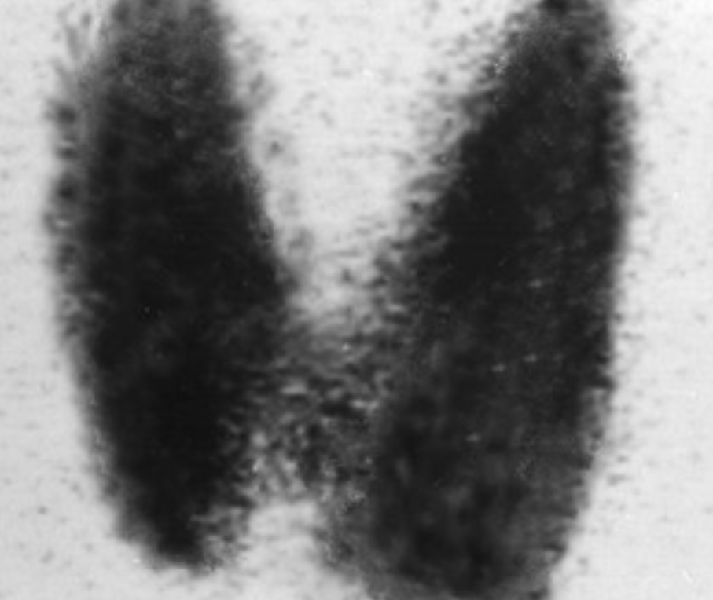
A 37-year-old woman has tachycardia and heat intolerance, with a 5-kg weight loss occurring over the course of 4 months. On examination, there is diffuse thyroid enlargement. Her thyroid scintigraphy scan is shown.
What is the diagnosis? What life-threatening complication could she develop?
What ocular finding might she have?
There is diffusely increased uptake in the thyroid, which is typical for Graves disease. With this condition, the thyroid is usually two to three times the normal size.
Thyroid storm can rarely complicate Graves disease; this involves malignant hyperthermia and heart failure.
Thyroid ophthalmopathy can involve a combination of proptosis and lid lag as a result of the increased sympathetic stimulation of the levator palpebrae superioris muscle and the periorbital deposition of hydrophilic mucopolysaccharides and fibrosis.

Slide 4
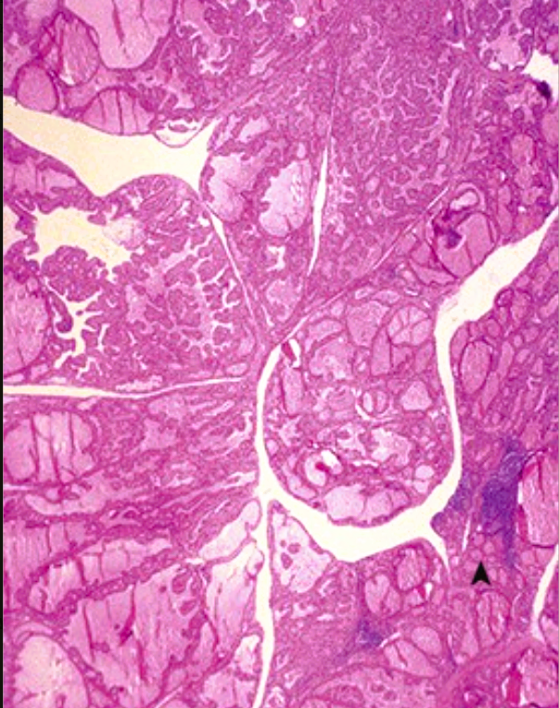
A 40-year-old woman has tremulousness, palpitations, and congestive heart failure. Her serum thyroid-stimulating hormone (TSH) level is 0.1 mIU/L (nl 0.5 to 4.7 mIU/L), and her thyroxine level is 16 µg/dL (nl 4.5 to 12.5 µg/dL). A biopsy specimen of her thyroid is shown.
Describe this microscopic appearance. Explain the laboratory findings.
Suggest possible pharmacologic therapies and
their mechanisms of action.
What would you suspect if the TSH level was 8 mIU/L?
There is diffuse papillary hyperplasia of the thyroid epithelium and lymphoid aggregates (▴), which are typical for Graves disease.
Increased thyroid hormone production in patients with Graves disease elevates the serum thyroxine level, with feedback inhibition of pituitary TSH production.
Propylthiouracil and methimazole inhibit thyroid peroxidase, thereby inhibiting iodide oxidation and blocking its addition to the thyroglobulin protein.
An elevated TSH level with an elevated serum thyroxine level would suggest the presence of a TSH-secreting pituitary adenoma.

Slide 5
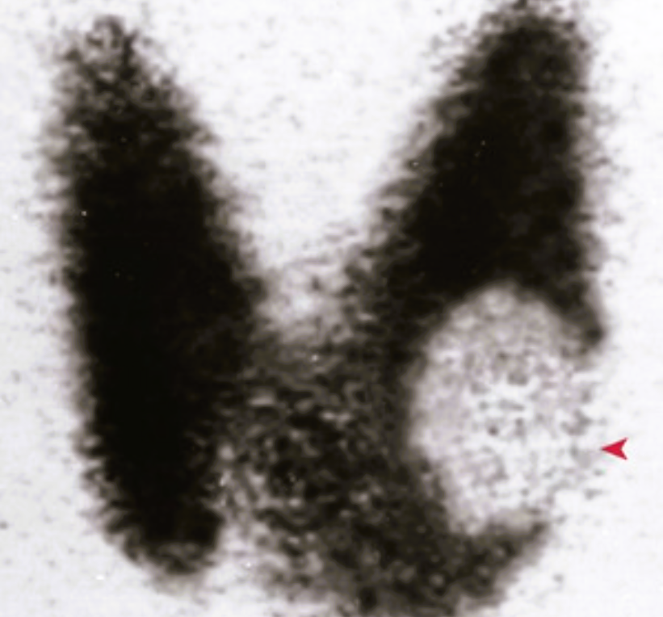
A 44-year-old woman with a palpable left thyroid nodule has a serum TSH level of 3 mIU/L (nl 0.5 to 4.7 mIU/L) and a thyroxine level of 9 µg/dL (nl 4.5 to 12.5 µg/dL). Her thyroid scintigraphy is shown.
Explain the appearance of this lesion.
What microscopic finding do you expect to find?
This “cold” nodule (◂) is making less colloid and taking up less iodine than the surrounding thyroid.
Most solitary nodules in the thyroid are benign tumors, cysts, or inflammatory lesions (benign lesions outnumber malignant neoplasms by 10 : 1), but a cold nodule has a greater likelihood of being malignant. Without the invasion of the capsule or the vasculature, this lesion is likely to be a (benign) follicular adenoma.

Slide 6
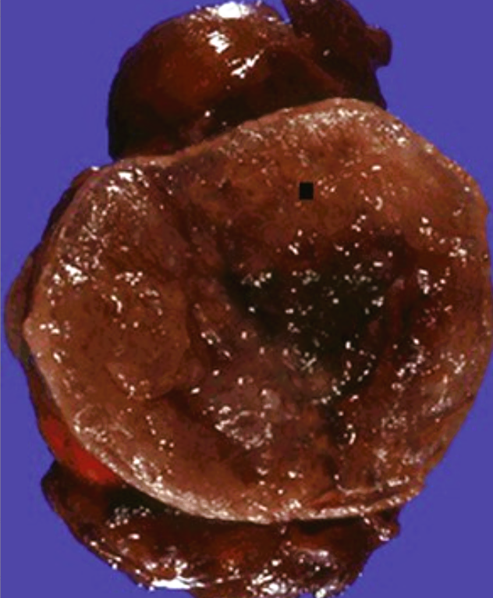
A 47-year-old woman with a 6-month history of palpitations, diarrhea, polyphagia, tremulousness, anxiety, and insomnia has borderline hypertension at 150/85 mm Hg. Her serum thyroid-stimulating hormone (TSH) level is 0.2 mIU/L (nl 0.5 to 4.7 mIU/L), her thyroxine (T4) level is 6 µg/dL (nl 4.5 to 12.5 µg/dL), and her triiodothyronine (T3) level is 380 ng/dL (nl 60 to 181 ng/dL). The gross appearance of her resected thyroid is shown.
What is the likely diagnosis? Explain the laboratory findings. Explain the patient's signs and symptoms. Name the thyroid lesions that produce similar findings.
There is a discrete nodule (▪) of red-brown thyroid that is consistent with a benign adenoma.
The T3 level is increased, whereas the TSH level is low; the T4 level is normal. This is consistent with a “toxic” adenoma that is secreting excess T3.
Thyroxine (T4) is responsible for metabolism, mood, and body temperature, among other things. Triiodothyronine (T3), too, is made in the thyroid gland, and it can also be made in other tissues within the body by converting T4 (in a process called deiodination) into T3. This hormone is at the center of digestive and metabolic function, and it also oversees bone health.
T4 is found in the body in 2 forms: free T4 and bound T4. Free T4 travels into body tissues that use T4. Bound T4 attaches to proteins that prevent it from entering these tissues. More than 99% of T4 is bound. Because T4 is converted into another thyroid hormone called T3 (triiodothyronine), free T4 is the more important hormone to measure. Any changes show up in T4 first.
The patient's findings are consistent with hyperthyroidism.
Graves disease, toxic multinodular goiter, and hyperfunctioning thyroid carcinoma can also produce hyperthyroidism.

Slide 7
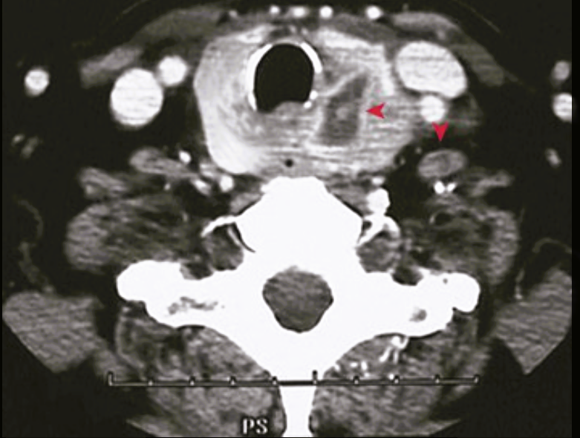
A 46-year-old woman with left thyroid lobe enlargement and a large nontender left anterior cervical lymph node has normal TSH and thyroxine levels. Her neck CT is shown.
What is the likely diagnosis?
Are gene mutations present?
What is the prognosis?
The left lobe shows a cystic mass (▾) with an associated enlarged lymph node (▸). The nodal lesion is probably a metastasis, so this is a malignant thyroid tumor, most likely papillary carcinoma (75% to 85% of malignant thyroid tumors are papillary carcinomas, 10% to 20% are follicular carcinomas, 5% are medullary, and <5% are anaplastic).
Gene mutations are almost certainly present. Gene mutations in papillary carcinomas include RET and NTRK1 (tyrosine kinase receptors), BRAF, and RAS.
Despite metastasis, the prognosis remains good, with a 10-year survival rate of more than 95%.

Slide 8
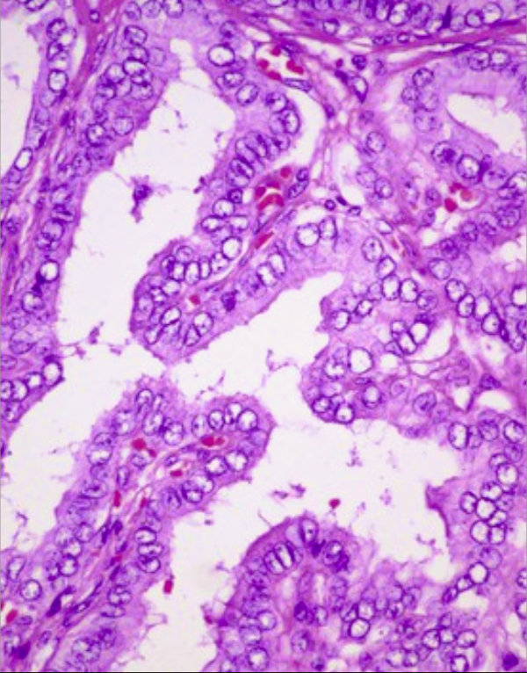
A 49-year-old woman has a 9-month history of right neck discomfort. Scintigraphy shows a “cold” right thyroid lobe nodule. Her TSH and thyroxine levels are normal. The microscopic appearance of her resected thyroid mass is shown. What is your diagnosis? Explain the laboratory findings. What is a risk factor for this disease?
The true papillary pattern and the empty-appearing nuclei are typical for papillary carcinoma of the thyroid. Additional features include psammoma bodies and, at higher magnification, nuclei with a ground-glass appearance.
Although this tumor is clearly not making thyroid hormone, there must be a sufficient amount of remaining normal thyroid gland to maintain a euthyroid state.
Exposure to ionizing radiation, particularly during the first two decades of life, is a risk for thyroid carcinoma. There are also medullary thyroid carcinomas associated with MEN type II syndromes and resulting from RET mutations.

Slide 9
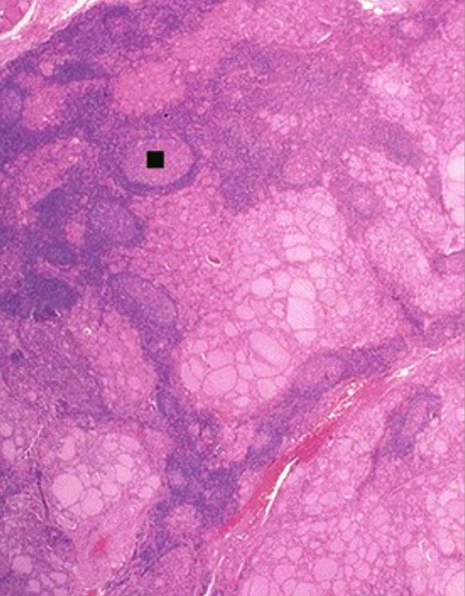
A 52-year-old woman with a 1-year history of fatigue, apathy, and cold intolerance has a painless and diffusely enlarged thyroid. Her twin sister previously had similar symptoms. The microscopic appearance of a representative thyroid biopsy specimen is shown. What is the diagnosis? What is the pathogenesis? What serologic tests help with the making of the diagnosis? What will her thyroid function be in 10 years?
This patient has Hashimoto thyroiditis, with dense lymphocytic infiltrate that includes many lymphoid follicles with germinal centers (▪).
This has an autoimmune pathogenesis. CD8+ cells target thyroid epithelium via FAS–FAS ligand interactions; CD4+ cells elaborate cytokines such as interferon-γ and activate macrophages, whereas B cells synthesize various antithyroid autoantibodies.
Antithyroid peroxidase and antithyroglobulin autoantibodies are often present.
There is evolution into thyroid atrophy with hypothyroidism.

Slide 10
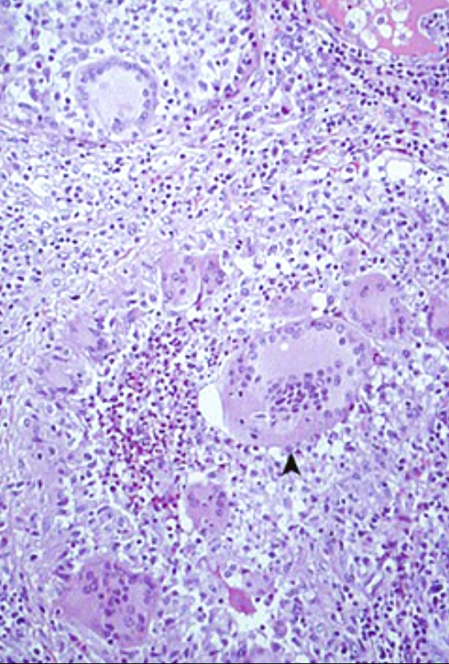
A 49-year-old woman has a 1-month history of heat intolerance, tremulousness, and tachycardia after an upper respiratory tract infection. A painful and diffusely enlarged thyroid is palpated. Her serum TSH level is 0.3 mIU/L (nl 0.5 to 4.7 mIU/L), and her thyroxine level is 13.4 µg/dL (nl 4.5 to 12.5 µg/dL). The microscopic appearance of a thyroid biopsy specimen is shown. Her symptoms resolve, and her laboratory tests normalize 2 months later.
What is the diagnosis? Explain the laboratory findings. What is the pathogenesis of this disease?
Thyroiditis with granulomatous inflammation and giant cells (▴) is present; this is consistent with de Quervain thyroiditis.
There is transient hyperthyroidism from the disruption of thyroid follicles and the release of hormone. Typically, after the resolution of the inflammation, completely normal thyroid function returns.
Subacute granulomatous thyroiditis is attributed to a postviral inflammatory disorder.

Slide 11
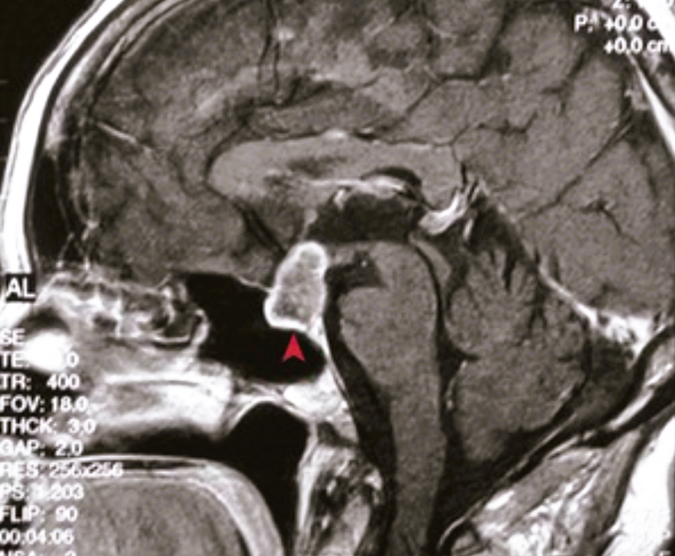
A 15-year-old boy has a 5-month history of worsening headaches. He is short for his age, and he appears to be prepubertal. His brain MRI is shown.
What is the diagnosis?
Name the lesion's embryologic origin.
Explain this patient's clinical appearance.
There is a suprasellar focally calcified cystic mass (▴) just posterior and superior to the sphenoid sinus and extending into the sella, which is consistent with craniopharyngioma.
Craniopharyngiomas are squamous epithelial tumors derived from Rathke pouch remnants.
The neoplasm encroaches on normal adenohypophysis; this leads to the decreased production of both growth hormone and follicle-stimulating hormone/luteinizing hormone.

Slide 12
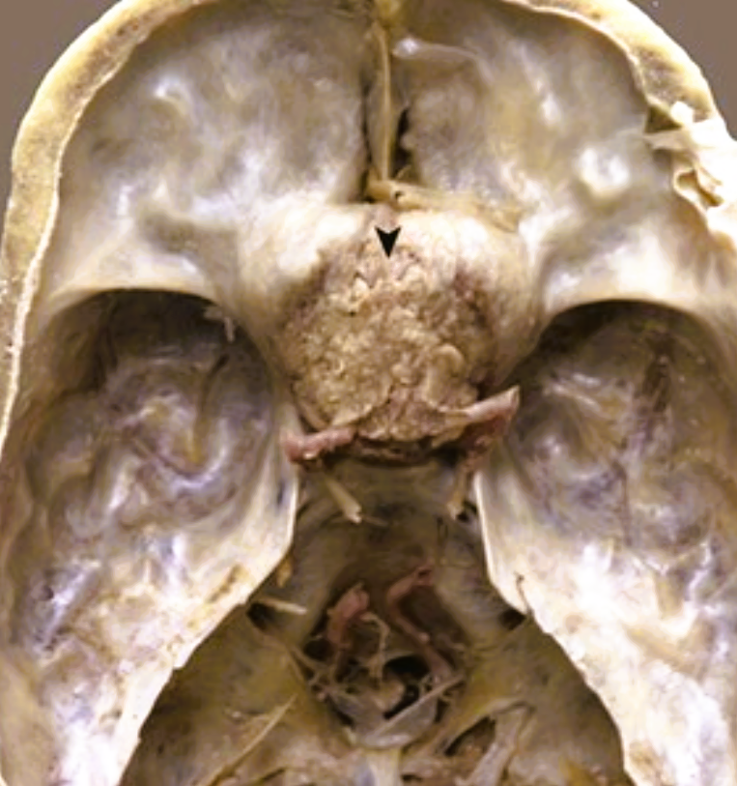
A 58-year-old woman has a 7-month history of worsening headaches, constant thirst, and visual problems that she describes as “tunnel vision.” Her serum sodium level is 155 mmol/L (nl 135 to 146 mmol/L), and her chloride level is 118 mmol/L (nl 95 to 108 mmol/L), with normal potassium and CO2 levels. On examination, she has bitemporal hemianopsia. If she had come to autopsy, the causative lesion would have appeared as shown. What could this be? Explain the laboratory findings. Explain her visual symptoms. What is the prognosis?
This mass (▸) in the region of the sella could be either a craniopharyngioma or a pituitary adenoma.
This patient has diabetes insipidus with hypernatremia caused by a loss of antidiuretic hormone secretion from the disruption of the hypothalamus tracts to the posterior pituitary.
The bitemporal hemianopsia results from the compression of the optic chiasm by the mass; this affects the visual tracts from the medial retina, which perceive the lateral visual fields.
If it is less than 5 cm in size and noninvasive, a craniopharyngioma has a good prognosis. Pituitary adenomas are slow growing and generally noninvasive, and they have excellent prognoses.

Slide 13
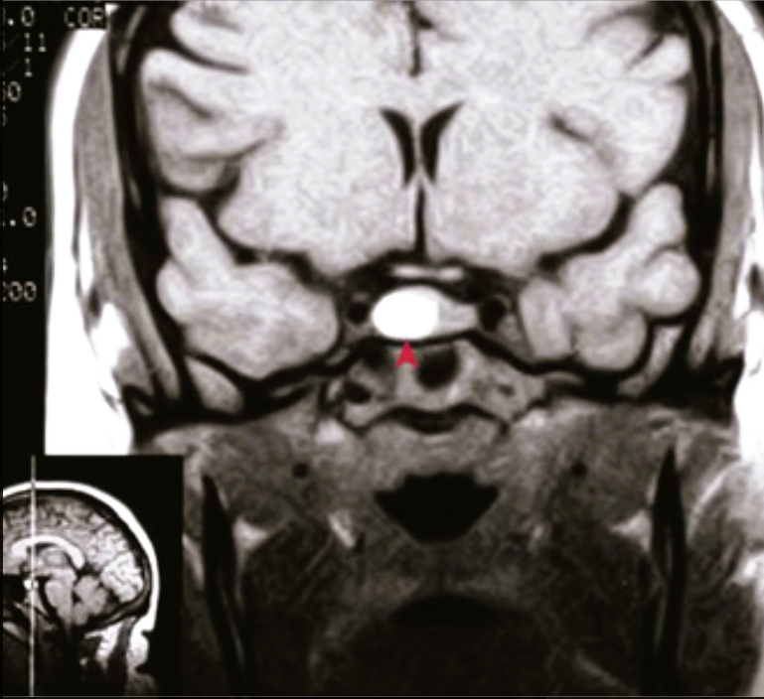
A 35-year-old man has noted a change in his appearance, with coarse facial features and gloves that no longer fit. He also has polyarthritis with joint deformity. His brain MRI is shown.
What is the diagnosis?
What laboratory finding is likely?
Explain this patient's appearance.
What would a child with this lesion have?
This mass (◂) in the pituitary is enhancing; it is a microadenoma.
An elevation in growth hormone (GH) is likely, and this stimulates the hepatic production of insulin-like growth factor I (IGF-I). This patient may have secondary diabetes mellitus, with abnormal glucose tolerance.
He has acromegaly as a result of the growth of soft tissues as well as hyperostosis with appositional bone enlargement.
A child with a GH-secreting adenoma would have gigantism.

Slide 14
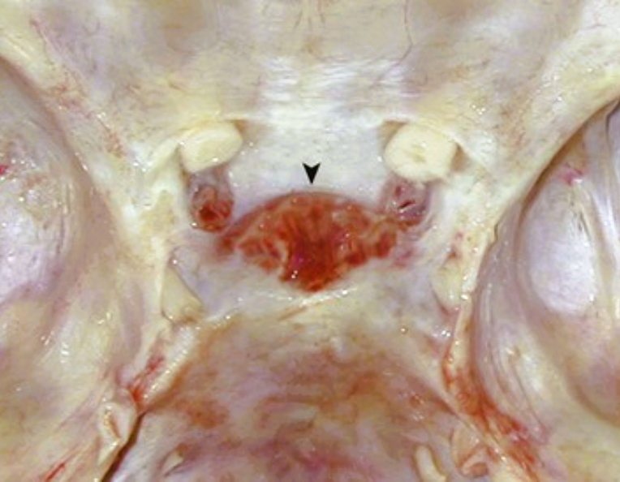
A 23-year-old primigravida has placental abruption at term. She is unable to lactate postpartum, and she has amenorrhea, lethargy, hyperkalemia, and hypotension. The causative lesion is shown within the sella turcica.
What is her diagnosis?
What laboratory findings could she have?
Why did this occur?
Does she have sufficient ADH?
This patient has Sheehan syndrome as a result of postpartum pituitary necrosis.
Adenohypophyseal hormones such as prolactin, FSH/LH, TSH, and ACTH are decreased, which leads to panhypopituitarism.
During pregnancy, hyperplasia of the adenohypophysis makes its portal blood supply tenuous. When this patient had blood loss as a result of the abruption, there was ischemic necrosis and hemorrhage (▸), as shown grossly.
Yes. The neurohypophysis has an arterial supply that is less likely to be compromised.

Slide 15
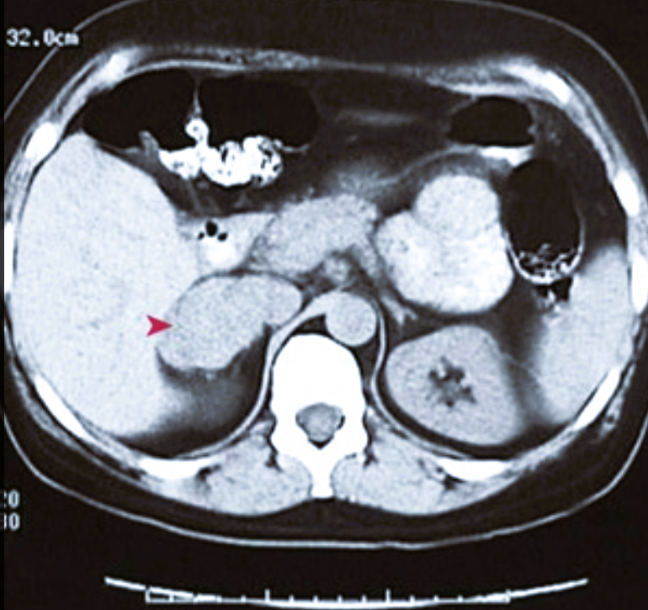
A 31-year-old man with intermittent headache, tachycardia, tremor, and anxiety also periodically becomes hypertensive. His abdominal CT scan is shown.
What is the diagnosis?
What laboratory findings are likely?
Explain the symptoms.
Name the associated inherited disorders.
The right adrenal mass (▴) and the symptoms are highly suggestive of a pheochromocytoma. Ten percent of pheochromocytomas are malignant, 10% are bilateral, 10% are extra-adrenal, and 10% arise as part of a familial syndrome.
Elevations in urinary catecholamines, metanephrines, and vanillylmandelic acid as well as serum norepinephrine, epinephrine, and dopamine levels can occur.
Catecholamines have a sympathomimetic effect with increased blood pressure, heart rate, and tremulousness.
Pheochromocytomas can be present in multiple endocrine neoplasia (MEN) IIA and IIB and in von Hippel–Lindau syndrome.

Slide 16
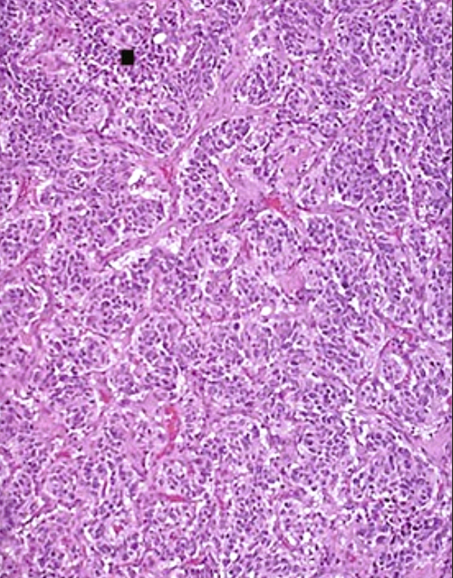
A 50-year-old man with dysphagia has a left lateral neck mass and absent activity of left cranial nerves IX, X, and XI. A left parapharyngeal space mass is resected, and the microscopic appearance is shown.
What is the diagnosis? What are the likely laboratory findings? What is the physiologic function of this structure?
These nests (▪) of round blue cells in this location indicate that this is a paraganglioma, which likely arose in the carotid body.
Paragangliomas are unlikely to secrete significant amounts of hormone, even though they are of neuroendocrine origin. Nevertheless, some can secrete catecholamines, which are similar to adrenal pheochromocytomas.
The carotid body is putatively a chemoreceptor for oxygen and carbon dioxide to stimulate brainstem respiratory centers.

Slide 17
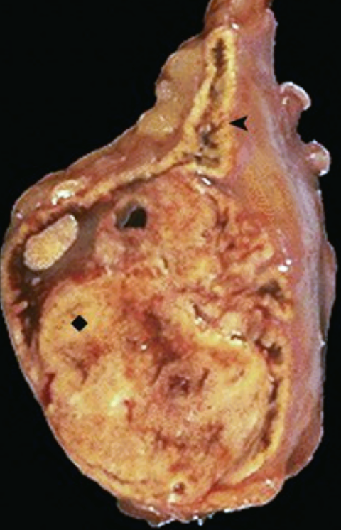
A 60-year-old man with poorly controlled hypertension has an incidental adrenal lesion found during a CT scan that was performed to assess abdominal trauma. The resected lesion is shown.
What is the diagnosis if he also has hypokalemia?
What is the diagnosis if he has glucose intolerance, plethora, and osteoporosis? What if there are no other associated findings?
This adrenal gland contains a golden yellow mass (♦) with an appearance that is similar to adrenal cortex (◂); this is an adenoma. If the adenoma secretes aldosterone, sodium retention and potassium excretion occur, thereby leading to hypertension and hypokalemia (Conn syndrome).
If the adenoma secretes cortisol, Cushing syndrome results.
Nonfunctioning adrenal adenomas can typically be left alone; when they are less than 2 cm in size, they are virtually always benign. Such an incidentaloma can be found on abdominal CT scans that are performed for other reasons.

Slide 18
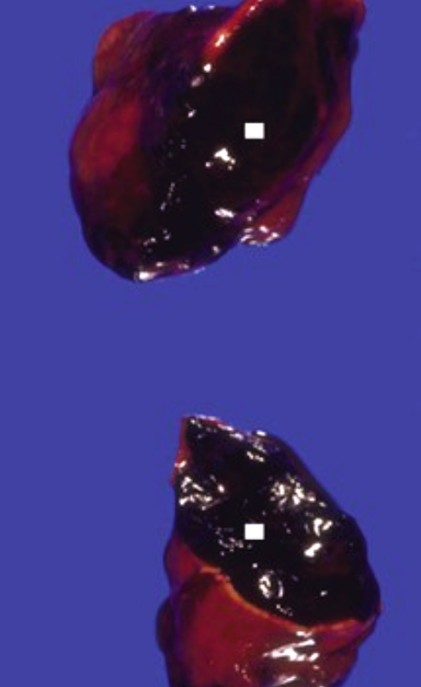
A 22-year-old woman presents with pharyngitis and a severe headache, and she develops hypotension and palpable purpura within 12 hours. Schistocytes are present on her peripheral blood smear, her platelet levels are low, and her coagulation parameters are all prolonged. Despite the prompt administration of antibiotics and pressor support, she dies. The appearance of her adrenals at autopsy is shown.
What diagnosis is suggested by the appearance of these adrenals?
What did her blood culture likely grow?
There is extensive hemorrhage (▪) within enlarged adrenal glands. This is Waterhouse-Friderichsen syndrome, with bilateral adrenal hemorrhage and necrosis leading to acute adrenal insufficiency. It typically occurs in the setting of disseminated intravascular coagulopathy as a result of infectious causes, and it results in intractable hypotension.
Most cases are caused by infection with Neisseria meningitidis (meningococcus), although Pseudomonas, Haemophilus, Streptococcus pneumoniae, and Staphylococcus aureus can also be causative.

Slide 19
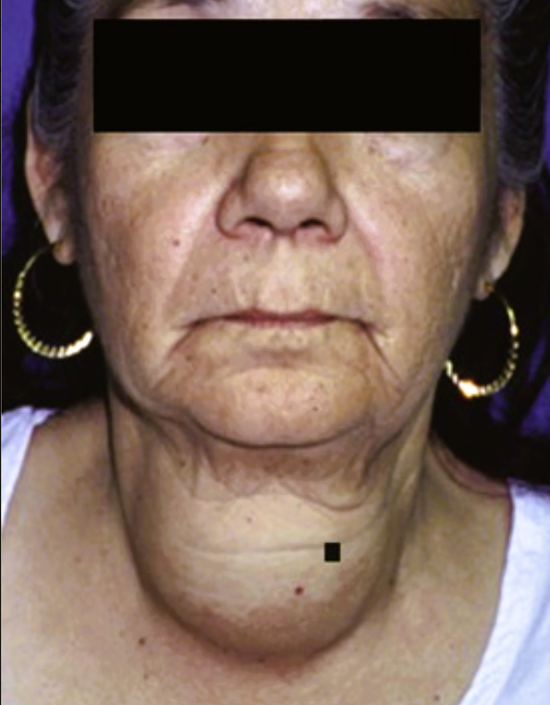
This 66-year-old woman with a 10-year history of a progressively enlarging neck mass finally sought medical attention. Her TSH level is 4 mIU/L (nl 0.5 to 4.7 mIU/L), and her thyroxine level is 7.8 µg/dL (nl 4.5 to 12.5 µg/dL).
What is the most likely diagnosis? What nutritional deficiency can cause this finding?
What would accompany such a lesion in a child? What complication may occur from this lesion?
This is a multinodular goiter (▪) that is probably the result of an intrinsic variation in the responses of follicular epithelial cells to TSH. Most patients are euthyroid.
In parts of the world where iodine is deficient in the diet and where patients have insufficient thyroid hormone production, this is known as endemic goiter.
A child with a goiter likely has an inherited biosynthetic defect and would probably present with cretinism.
Occasionally, in a nontoxic multinodular goiter, an isolated de novo mutation in the TSH-signaling pathway can cause an autonomously functioning nodule (“hot” nodule) and result in a toxic goiter (with runaway thyroid hormone production).

Slide 20
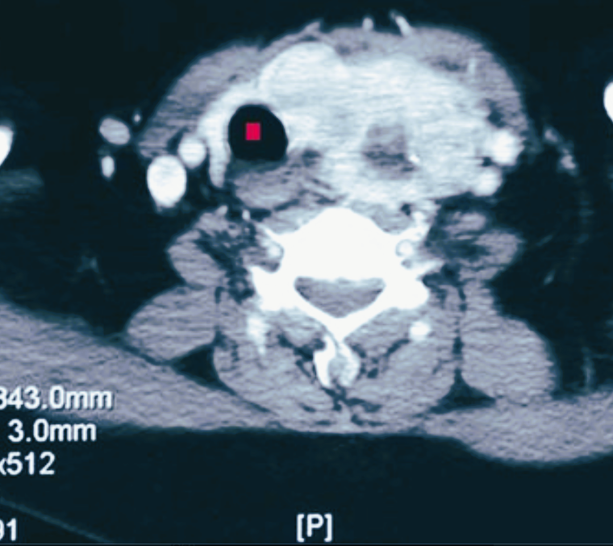
A 53-year-old woman with neck discomfort, dysphagia, and upper respiratory tract wheezing has the CT scan shown.
What is the diagnosis? How can diet be related
to this lesion?
Could this become malignant?
There is an irregular mass displacing the trachea (▪) to the right and compressing the esophagus posteriorly. This is likely a nodular goiter.
Cruciferous vegetables such as Brussels sprouts, cabbage, cauliflower, turnips, and cassava contain goitrogenic compounds (e.g., glucosinolates) that interfere with normal thyroid hormone synthesis. Typical levels of consumption usually have minimal effect.
No. Malignancies do not arise within a goiter. An asymmetric nodular goiter like this one could grossly and radiographically mimic thyroid carcinoma.

Slide 21
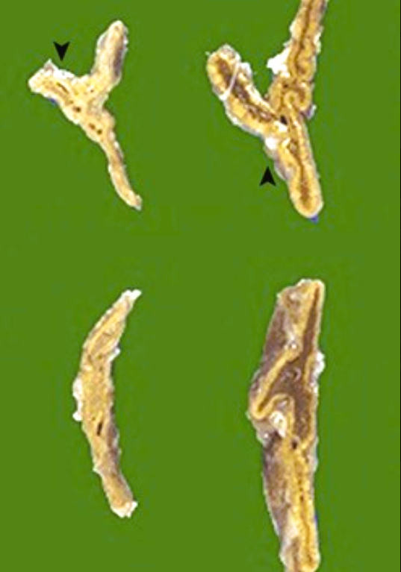
A 54-year-old woman with a 6-month history of fatigue, anorexia, weight loss, skin hyperpigmentation, and diarrhea develops hypotension and lapses into a coma after a minor upper respiratory tract infection. At autopsy, her adrenals are small (▾) as compared with normal adrenals (▴). What is a possible diagnosis? What laboratory findings would you have expected when this patient was alive? What is the most likely cause?
The clinical history and these atrophic adrenals are characteristic of primary chronic adrenal insufficiency, which is also known as Addison disease.
Inadequate amounts of mineralocorticoids (mainly aldosterone) and glucocorticoids result in hyponatremia, hyperkalemia, and hypoglycemia.
Most cases of Addison disease are autoimmune. Tuberculosis, AIDS, and metastatic cancer round out the top four causes; lesser causes include hemochromatosis, amyloidosis, sarcoidosis, and lymphoma.

Slide 22
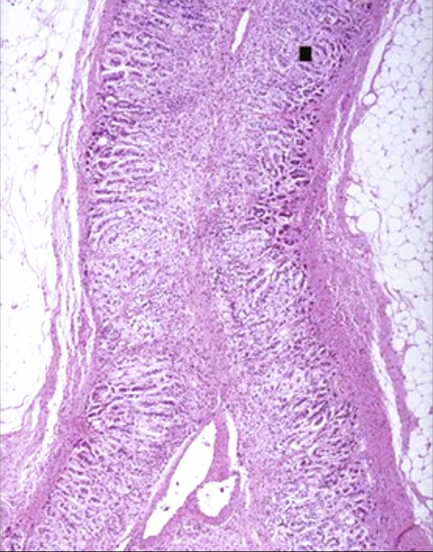
A 49-year-old woman with chronic mucocutaneous candidiasis and ectodermal dystrophy with skin, tooth enamel, and fingernail abnormalities also has pernicious anemia. Had we checked at this point, her adrenals would have appeared as shown.
What is your diagnosis?
What hormones are produced in the adrenals?
What gene mutation may she have?
There is marked atrophy of the adrenal cortex (▪), which is consistent with chronic adrenal insufficiency.
The adrenal cortex produces aldosterone (zona glomerulosa), sex steroids (zona fasciculata and zona reticularis), and glucocorticoids (all layers). Catecholamines (norepinephrine and epinephrine) come from adrenal medulla.
The autoimmune regulator (AIRE) gene can be mutated with autoimmune polyendocrine syndrome type I. The autoimmune destruction of adrenal cortex and other target organs is mediated by self-reactive T lymphocytes.

Slide 23
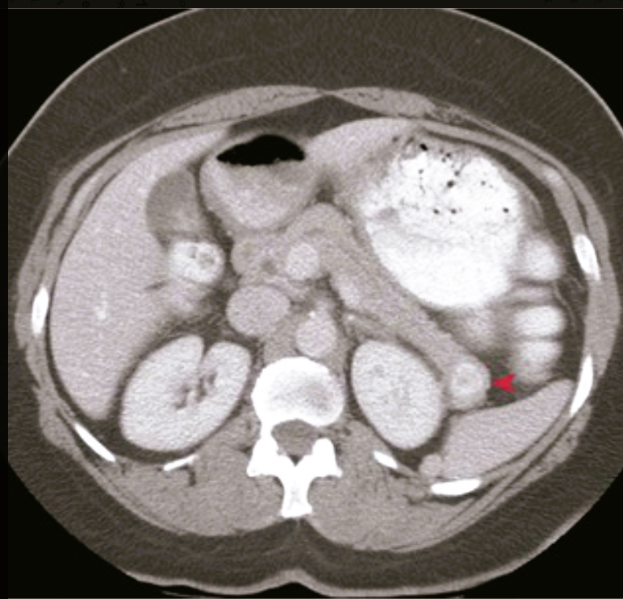
A 26-year-old woman with epigastric pain and hematemesis has an upper gastrointestinal endoscopy that reveals multiple antral and duodenal bulb ulcers. Her abdominal CT scan is shown.
What is the most likely diagnosis? What laboratory finding do you expect?
What other lesion could cause this? What syndrome would she have if hypercalcemia, hyperprolactinemia, and Cushing syndrome were also present?
There is a small, discrete mass (▾) of the pancreatic tail that is consistent with an islet cell “adenoma-NET”; in this case, this is likely a gastrinoma that is resulting in Zollinger-Ellison syndrome. At the time of diagnosis, more than half of such tumors are locally invasive or have metastasized.
An elevated serum gastrin level.
Gastrin-producing neuroendocrine cells in other sites can form adenomas-NETs in peripancreatic tissue, in the wall of the duodenum, or in ectopic pancreatic rests such as within a Meckel diverticulum.
Multiple endocrine neoplasia type I (MEN-I). A mutant MEN1 gene leads to pituitary adenomas, islet cell neoplasms, and parathyroid hyperplasia or adenomas.

Slide 24
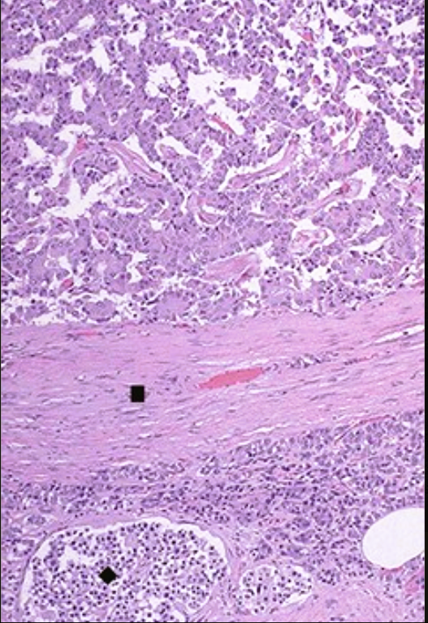
A 39-year-old man with a 1-year history of syncopal episodes has a pancreatic lesion that is resected; the microscopic appearance is shown.
What is the diagnosis? What laboratory findings would he have?
How could you distinguish this from a factitious case?
There is an islet cell “adenoma-NET” surrounded by a fibrous capsule (▪), with normal pancreas below, including a single normal islet of Langerhans (♦); hypoglycemia in this patient would be the probable cause of the syncope.
His plasma insulin level is increased, and his serum glucose level is decreased.
The factitious administration of insulin would also produce hypoglycemia, but the plasma C-peptide level would not be elevated.

Slide 25
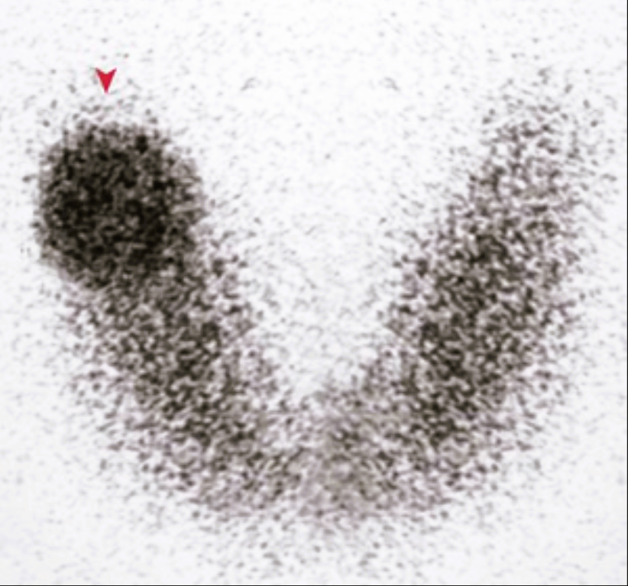
A 45-year-old woman has become increasingly anxious during the past year. On examination, she has right thyroid lobe enlargement. Her serum TSH level is 0.5 mU/L (nl 0.5 to 4.7 mU/L), and her thyroxine level is 12 µg/dL (nl 4.5 to 12.5 µg/dL). Her thyroid scintigraphic scan is shown.
Explain the appearance of this lesion.
What is this lesion most likely to be?
What signaling pathway likely has a gain of function mutation in this lesion?
The scan shows a “hot” nodule (▾), because it is taking up more iodine than the surrounding thyroid tissue.
This is a follicular adenoma; the rest of the thyroid is not enlarged, so it is not likely to be a toxic multinodular goiter.
An activating somatic mutation in the TSH receptor signaling pathway has increased the production of cyclic adenosine monophosphate to drive follicular epithelial proliferation.

Slide 26
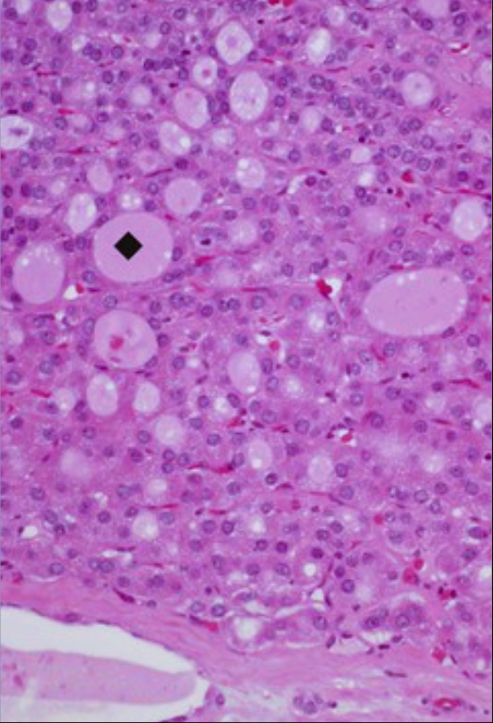
A 47-year-old woman notes a nodule in her right neck that has slowly enlarged for the last 4 years. Her serum TSH level is 3.3 mU/L (nl 0.5 to 4.7 mU/L), and her thyroxine level is 7 µg/dL (nl 4.5 to 12.5 µg/dL). An ultrasound shows a 3-cm right thyroid lobe solid mass with distinct borders. The microscopic appearance of this lesion is shown.
Describe this microscopic appearance and diagnosis.
Explain the laboratory findings.
How would you explain the appearance of a lung nodule in this patient 10 years later? What mutations could be present in the cells of such a lesion?
There are uniformly sized epithelial cells forming smaller-than-normal thyroid follicles (♦). This appearance is consistent with a follicular adenoma. The eosinophilic cytoplasm is described as having an oxyphil, or Hürthle cell, change.
The normal TSH and thyroxine levels suggest that this nodule is not functioning to release excessive thyroid hormone.
About 10% of thyroid adenomas with a follicular pattern that appear “cold” on scan eventually prove to be malignant. About half of follicular carcinomas have an RAS oncogene mutation; about a third have a PAX8-PPARγ1 fusion gene.

Slide 27
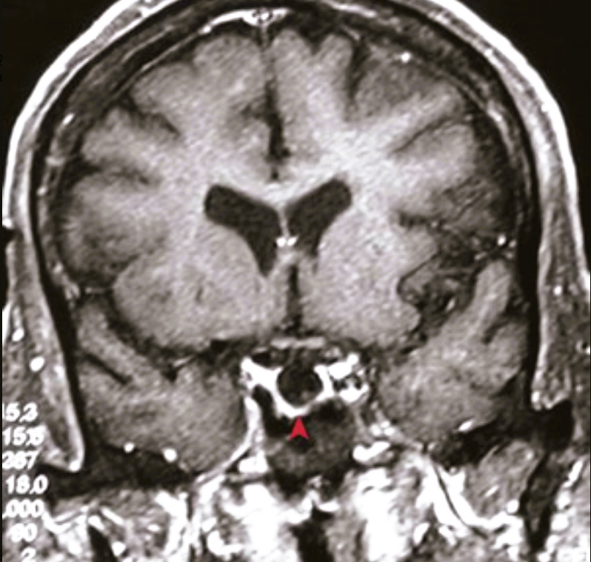
An obese 35-year-old woman (G6, P6) develops amenorrhea, lethargy, cold intolerance, weakness, and diffuse skin pigmentation. An MRI of her head is shown.
What is your diagnosis?
What laboratory findings are likely?
How might this have occurred?
The lack of tissue within the unexpanded sella turcica (▴) is consistent with empty sella syndrome.
This patient has panhypopituitarism with hypothyroidism (low TSH), adrenal insufficiency (Addison disease, low ACTH), and amenorrhea (lack of FSH/LH).
A defect in the diaphragma sella allows for arachnoid herniation with compression atrophy of the pituitary. Postpartum pituitary necrosis (Sheehan syndrome) also leads to anterior pituitary loss.

Slide 28
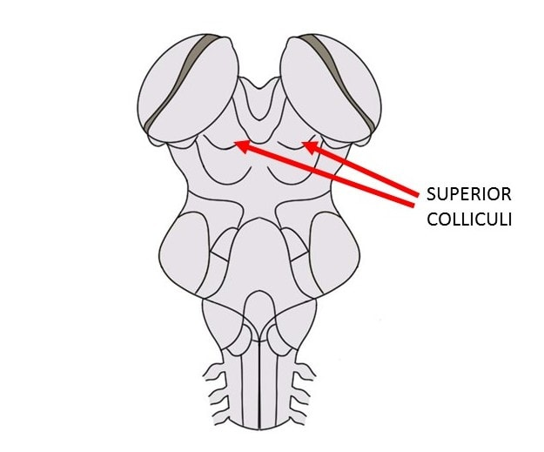
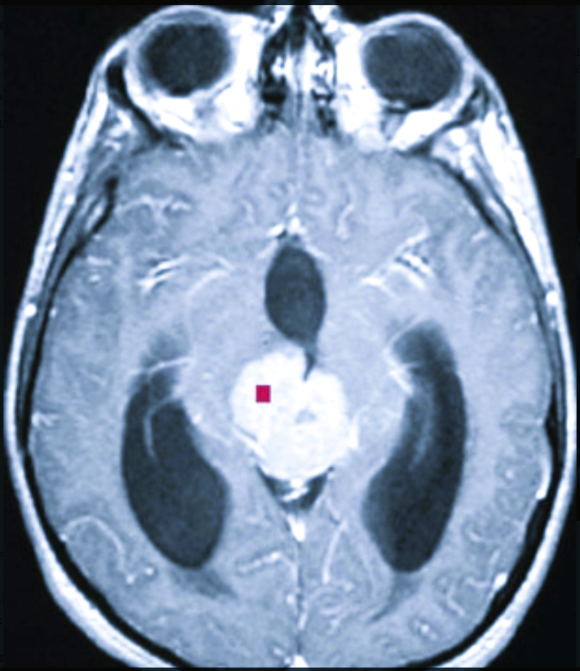
A 13-year-old boy with headache, nausea, vertical gaze palsy, and increased thirst has a serum sodium level of 158 mmol/L (nl 135 to 146 mmol/L), with a urine sodium level of 10 mmol/L (this is low, given his serum sodium value). His plasma osmolarity is 320 mOsm/mL (nl 278 to 305 mOsm/mL), and his urine osmolarity is 40 mOsm/mL (nl 50 to 1200 mOsm/mL). His brain MRI is shown.
What is your diagnosis?
Explain this patient's signs and symptoms.
There is a mass (▪) arising in the region of the pineal gland; possibilities include germinoma and pineocytoma.
The mass compresses the aqueduct of Sylvius, thereby causing obstructive hydrocephalus with third and lateral ventricular enlargement. Compression of the superior colliculi causes the upward gaze palsy. The mass also compresses the pituitary, which interferes with the posterior pituitary production of antidiuretic hormone (ADH) and leads to diabetes insipidus, with hypernatremia resulting from a loss of free water reabsorption in the renal collecting ducts.

Slide 29
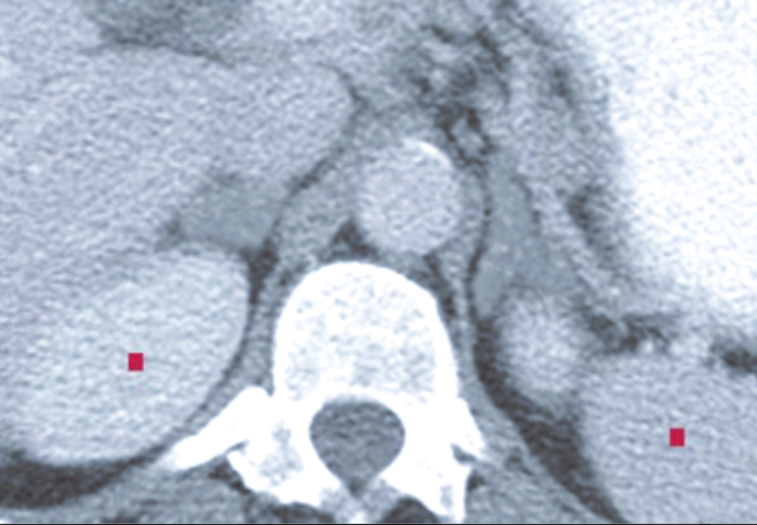
A 9-year-old girl with ambiguous genitalia and coarse pubic hair has the abdominal CT scan shown. Serum sodium and potassium levels are normal, and the patient is normotensive.
What is the diagnosis?
Explain the biochemistry.
The bilaterally enlarged adrenal glands (▪) are adjacent to the diaphragmatic crura. On the basis of the patient's clinical history, this is congenital adrenal hyperplasia (CAH) with adrenogenital syndrome but without salt wasting.
This patient has a partial 21-hydroxylase deficiency. The enzyme normally converts progesterone to 11-deoxycorticosterone in the pathway to aldosterone and 17-hydroxyprogesterone to 11-deoxycortisol in the pathway to cortisol. Partial deficiency in the enzyme leads to low but physiologically adequate levels of mineralocorticoids but inadequate cortisol levels. The result is elevated pituitary ACTH production and increased adrenal steroidogenesis into the only remaining pathway, which yields elevated adrenal production of the sex steroids and precocious puberty with the potential for virilization.

Slide 30
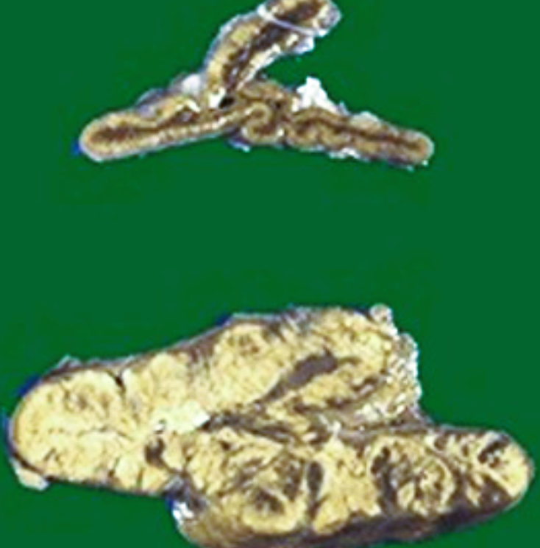
A 10-year-old girl has increased serum testosterone, decreased aldosterone, and increased ACTH levels. Her testosterone decreases after she is given low-dose dexamethasone (a potent glucocorticoid with very little if any, mineralocorticoid activity). Her adrenal would appear as shown (bottom) as compared with a normal organ (top).
What gene abnormality is likely present?
Explain the laboratory findings.
How might this be treated?
In this form of congenital adrenal hyperplasia (CAH), the functional CYP21B gene on chromosome 6 is typically recombined with (and replaced by) an adjacent nonfunctional pseudogene CYP21A.
The lack of adrenal 21-hydroxylase activity and the subsequent deficient mineralocorticoid production leads to salt wasting and hypotension with hyperkalemia; deficient cortisol production leads to an elevated ACTH level that drives adrenal hyperplasia with the overproduction of sex steroids.
Exogenous glucocorticoids replace the cortisol requirement and suppress the ACTH overproduction; mineralocorticoids must also be given to patients with the salt-wasting form of CAH.

