Slide 1
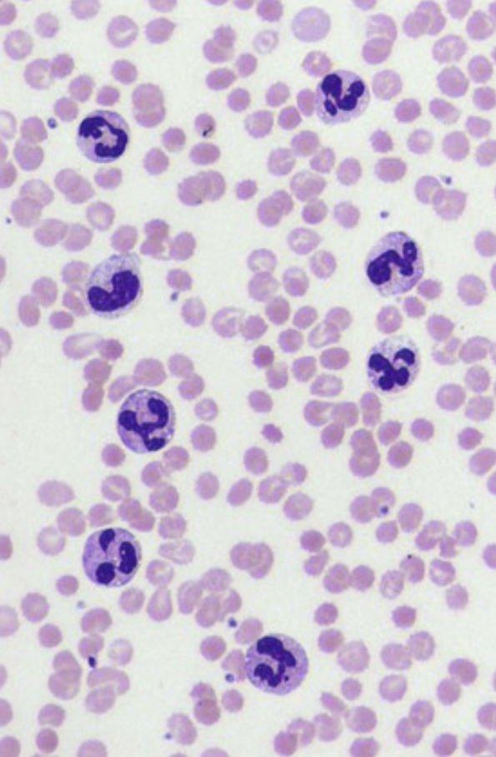
A 61-year-old woman with fever, rigors, and tachycardia has a blood culture that is positive for Enterobacter cloacae. Her peripheral blood smear is shown.
What leukocytes are present in this smear?
What is her total WBC count likely to be?
What precursor population in her marrow is increased?
What cytokines drive this process?
Segmented neutrophils and a band neutrophil can be seen.
The WBC count is increased, with leukocytosis and specifically neutrophilia as a consequence of her sepsis.
The myeloid population undergoes hyperplasia in response to the infection.
Inflammatory cytokines such as tumor necrosis factor and interleukin-1 stimulate bone marrow stromal cells to produce growth factors, such as granulocyte-macrophage colony-stimulating factor (GM-CSF), which drive myeloid proliferation.

Slide 2
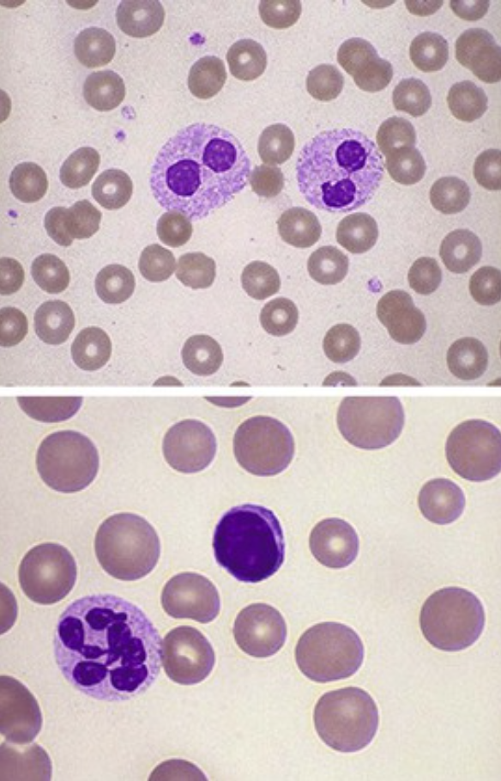
A 25-year-old man has a normal total WBC count, but the “band count” is reportedly increased. His peripheral blood smear is shown in the upper frame.
What is the diagnosis for this man?
50-year-old woman has anemia and atrophic gastritis. Her peripheral blood smear is shown in the lower frame.
What is the diagnosis for this woman?
These are bilobed neutrophils (not band neutrophils), which are characteristic for Pelger-Huet anomaly, an autosomal-dominant disorder caused by mutations in the lamin B receptor. Homozygotes lack any nuclear lobation and can have mild to moderate neutrophil dysfunction. Pseudo-pelgeroid changes are seen with myeloid leukemia and myelodysplastic syndromes.
The hypersegmented neutrophil is characteristic for megaloblastic change. This is probably a result of vitamin B12 deficiency given the patient's likely lack of intrinsic factor as a result of the loss of gastric parietal cells.

Slide 3
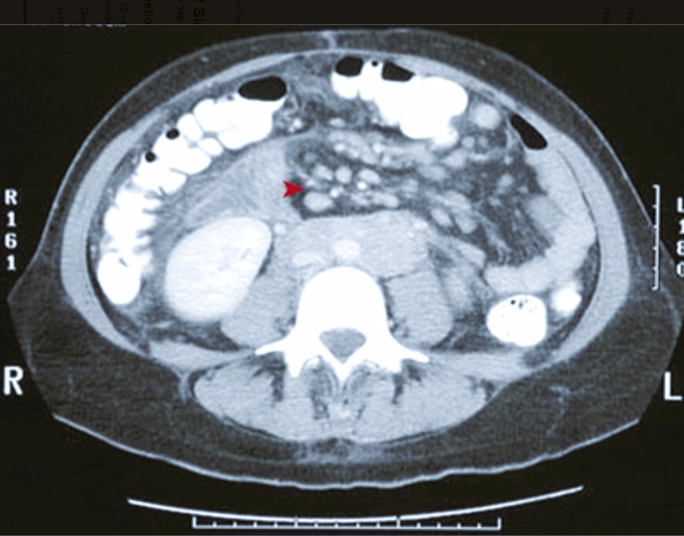
A 24-year-old man with a 4-day history of abdominal pain, fever, diarrhea, and anorexia has the abdominal CT scan shown. His stool cultures are positive for Yersinia enterocolitica.
What structures are enlarged (▴)? What would you expect on a biopsy specimen?
What would this patient's WBC count show? What happens in the enlarged structures?
What is the route of infection?
The enlarged mesenteric lymph nodes represent a reactive lymphadenitis.
The nodes exhibit large, expanded follicles with prominent germinal centers.
The patient likely has lymphocytosis (i.e., an increased lymphocyte count).
Affinity maturation occurs within germinal centers; B cells that produce more specific antibody are progressively selected and expanded.
Y. enterocolitica is spread by the fecal-oral route.

Slide 4
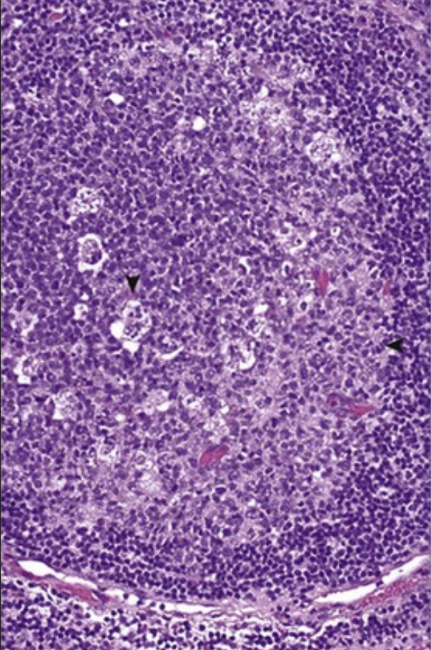
A 10-year-old boy with a week-long history of right groin pain is found to have enlarged tender lymph nodes. A biopsy specimen of one of these is obtained and shown here. The pain and enlargement spontaneously subside over the next few weeks.
Describe the appearance.
Is this benign or malignant?
How is antigen delivered to this node?
The large follicle has a pale germinal center (◂) with enlarged, activated lymphoid cells of all shapes and sizes (polyclonal response). There are also numerous macrophages (▾) that contain apoptotic bodies.
This is a benign, reactive lymphadenitis. Malignant lymphoid proliferations are typically painless and monoclonal, with effacement of their architecture.
Antigen-presenting cells include macrophages and dendritic cells (and, to a lesser extent, B cells); they can arrive via lymphatics from peripheral sites, or they can reach the node hematogenously.

Slide 5
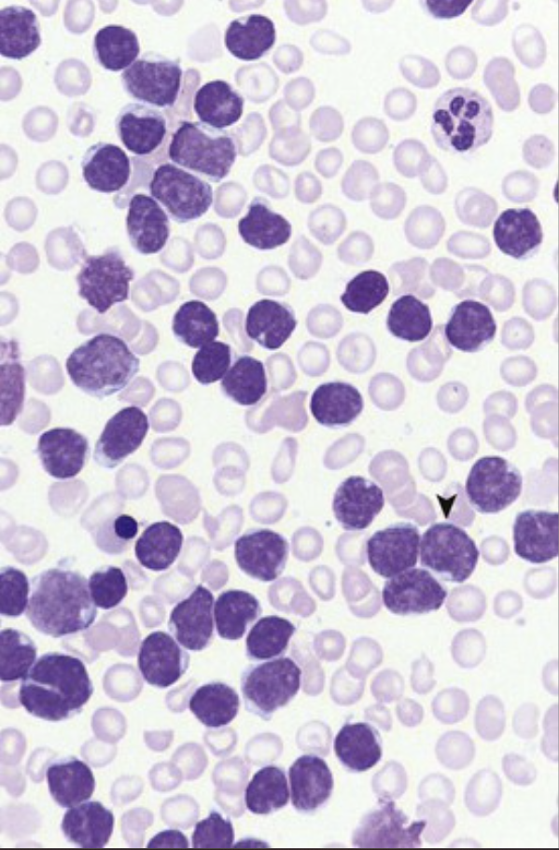
A 9-year-old boy with fatigue, epistaxis, and easy bruisability develops pneumonia. On examination, he also has extremity bone pain, mild splenomegaly, and generalized nontender lymphadenopathy. His peripheral blood smear is shown.
What form of leukemia does he have?
Explain his clinical findings.
What enzyme is expressed in these cells?
These cells (▾) are blasts that have minimal agranular cytoplasm with enlarged nuclei that have small nucleoli; this is consistent with acute lymphoblastic leukemia (ALL). Blasts comprise more than 25% of the marrow cellularity in ALL. Blasts typically appear in large numbers in the peripheral blood; in the rarer cases of “aleukemic” leukemia, they do not.
Leukemic cells fill the marrow and displace and suppress the normal hematopoietic elements, thereby leading to pancytopenia; the result is anemia with fatigue, thrombocytopenia with bleeding, and decreased myelopoiesis leading to bacterial infections.
Terminal deoxynucleotidyl transferase (TdT) is expressed only in pre-B and pre-T lymphoblasts.

Slide 6
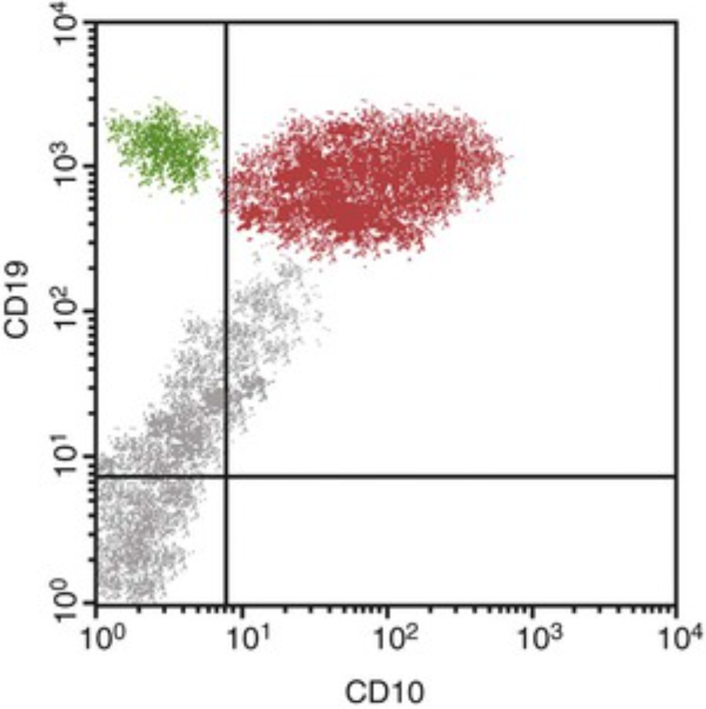
A 6-year-old girl has a 1-month history of fatigue, headache, and vomiting. Her hemoglobin level is 8 g/dL (nl 12 to 15.6 g/dL), her platelet count is 56,400/µL (nl 130,000 to 400,000/µL), and her total WBC count is 18,270/µL (nl 3800 to 10,800/µL). Flow cytometry of a marrow aspirate exhibits the pattern shown. What is the diagnosis? What is the prognosis with chemotherapy?
The red population of WBCs marks for CD19 (a B-cell marker) and CD10 (a pre–B cell marker), which is consistent with acute pre–B cell lymphoblastic leukemia. There is a smaller green population of normal B cells with remaining normal marrow cells, which are highlighted here in gray.
This patient's prognosis is good.
Worse prognostic factors include an age of onset of less than 2 years or onset during adolescence or adulthood, a higher WBC count, and presence of the t(9;22) “Philadelphia chromosome” translocation.

Slide 7
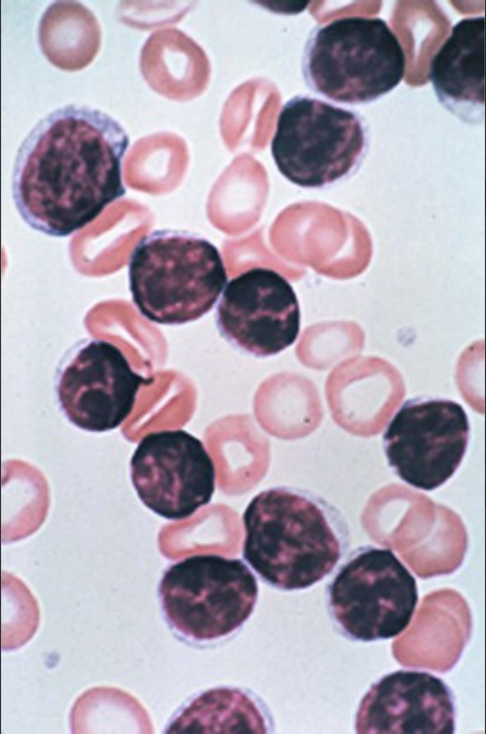
A 68-year-old man with a 1-year history of progressive fatigue has an enlarged spleen and nontender cervical adenopathy. His hematocrit level is 26.8% (nl 41% to 50%) with normal indices, his platelet count is within normal limits, and his WBC count is 36,500/µL (nl 3800 to 10,800/µL). His peripheral smear is shown.
What is the predominant cell type shown here?
What are complications of his disease?
This patient has chronic lymphocytic leukemia (CLL) with many small mature lymphocytes. CLL is often accompanied by a tissue phase known as small lymphocytic lymphoma, which involves the same abnormal lymphocytes infiltrating the spleen, liver, and lymph nodes.
Tumor progression is heralded by a prolymphocytic transformation with worsening cytopenias (15% to 30% of patients) or a Richter transformation to a diffuse large B-cell lymphoma (10% of patients).

Slide 8
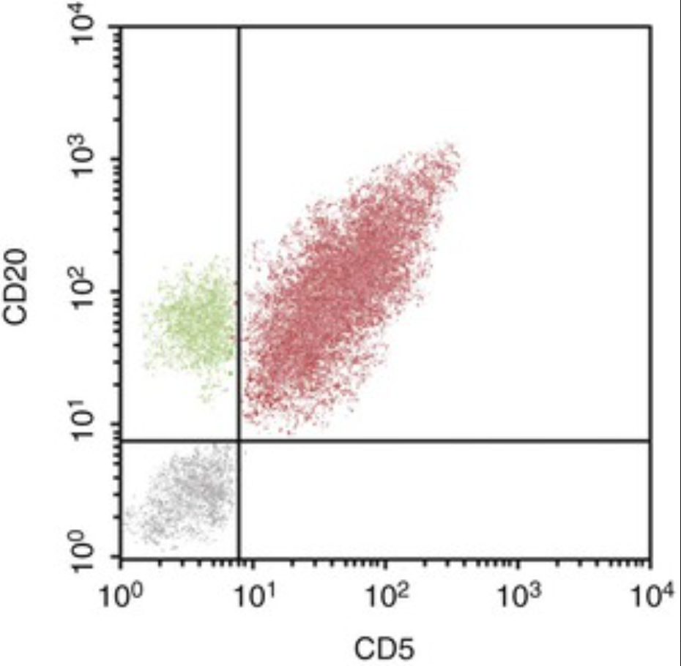
A 66-year-old man has anemia, hepatomegaly, and splenomegaly. His serum haptoglobin level is decreased, and his direct Coombs test is positive. Flow cytometry of his peripheral blood lymphocytes is shown.
What diagnosis is suggested by flow cytometry?
What complication is suggested by the positive Coombs test?
Chronic lymphocytic leukemia (CLL) or small lymphocytic lymphoma is suggested. The large population in red marks for CD20 (a pan B-cell marker) and CD5 (normally a T-cell marker, but it is present on a small population of B cells); a few normal CD20-positive B cells (green) are LAO present. The abnormal leukemic cells also express CD19 and CD23 as well as low levels of surface immunoglobulin.
Approximately 10% to 15% of patients with CLL develop autoimmune hemolytic anemia with a positive Coombs test. Serum haptoglobin is depleted as erythrocytes hemolyze and release their hemoglobin.

Slide 9
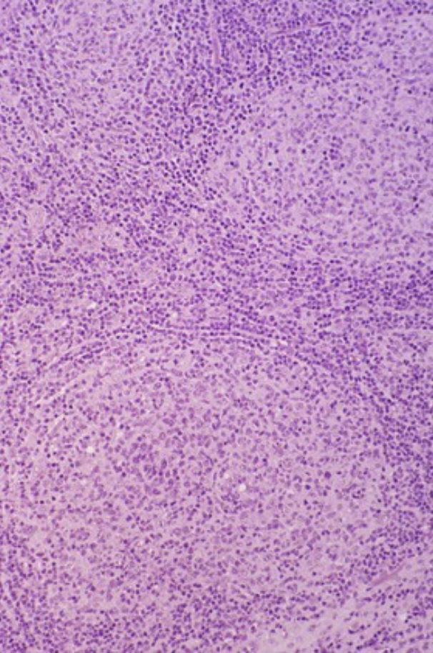
A 51-year-old woman has diffuse nontender lymphadenopathy. The microscopic appearance of a lymph node biopsy specimen is shown.
What is the diagnosis?
Transformation to what disease may occur?
What is the prognosis?
This is a follicular lymphoma, which is the most common form of non-Hodgkin lymphoma (about 45% of cases). Note the nodular expansion of the relatively monomorphous tumor cells.
Approximately 30% to 50% of these cases transform into diffuse large B-cell lymphoma.
Low-grade lymphomas tend to be indolent, but they cannot be cured. The median length of survival is 7 to 9 years.

Slide 10
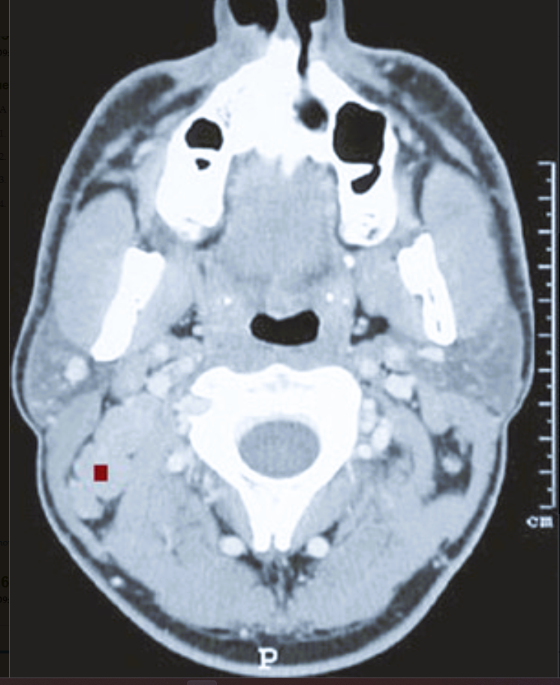
A 44-year-old man has had painless lumps in his upper posterior neck for the past year. His head CT scan is shown.
What is enlarged in this CT scan?
What is the diagnosis if a biopsy specimen shows Reed-Sternberg cells?
What is the diagnosis if cells mark with CD10, CD19, and CD20? How does a t(14;18) translocation affect cellular proliferation?
What is the diagnosis if cells mark with CD5, CD19, CD20, and CD23?
There is right posterior cervical lymphadenopathy (■).
Hodgkin lymphoma
Follicular lymphoma. Ninety percent of patients with this condition have a t(14;18) translocation that juxtaposes the IgH locus on chromosome 14 with the BCL2 locus on chromosome 18. This results in the overexpression of BCL-2, which is an antiapoptotic protein that promotes follicular lymphoma cell survival.
Small lymphocytic lymphoma/chronic lymphocytic leukemia

Slide 11
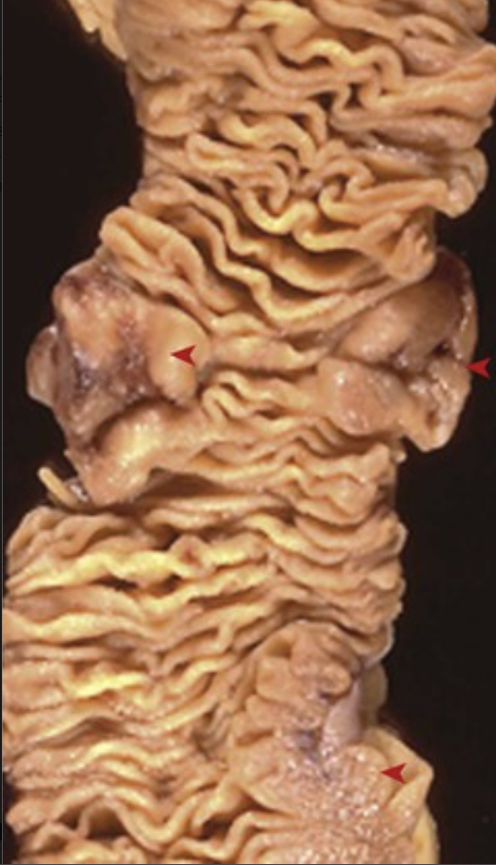
A 38-year-old man with severe abdominal distention and air-fluid levels on a KUB radiograph undergoes emergent partial bowel resection to relieve the obstruction. There are three bulky lesions (◄) in this section of bowel; cells from these masses mark with CD19, CD20, CD10, EBV, and BCL6. A karyotype shows t(8;14). His CD4+ lymphocyte count is 100/mm3 (nl 490 to 1740/mm3).
What is your diagnosis?
Where do similar lesions in the African endemic form of this disease typically occur?
Is the peripheral blood usually involved?
The cells mark as Burkitt lymphoma, which is likely driven by an underlying Epstein-Barr virus (EBV) infection and immortalization. The low CD4+ count suggests HIV infection with AIDS as a predisposing event that facilitates the EBV-mediated B-cell expansion.
The mandible is usually involved.
No. Most Burkitt lymphomas occur at extranodal sites (witness the bowel involvement here), and the cells do not usually circulate or involve the bone marrow.

Slide 12
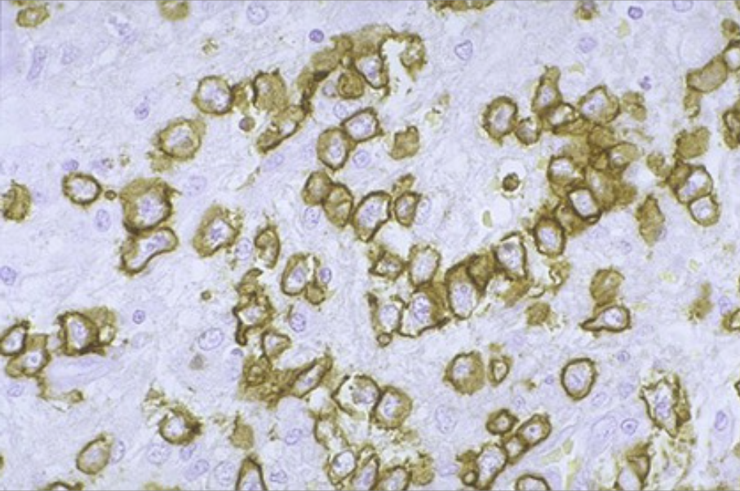
A 59-year-old man with a 3-month history of dysphagia has a head CT scan that reveals enlargement of the lymphoid tissues in the Waldeyer ring. The biopsy specimen shown yields cells that immunostain for CD20 and BCL6. He is treated with intensive chemotherapy, and he remains in remission after 5 years.
What form of non-Hodgkin lymphoma is present?
What is the genetic mechanism underlying the transformation of many of these tumors?
The large B cells and immunophenotype are consistent with diffuse large B-cell lymphoma (DLBCL).
BCL-6 is a transcription factor required for normal germinal center formation; it is normally downregulated when B cells exit the germinal center. BCL-6 overexpression occurs in patients with DLBCL as a result of either promoter sequence mutations or BCL6 translocations; both may occur via the normal events involved in somatic B-cell hypermutation.

Slide 13
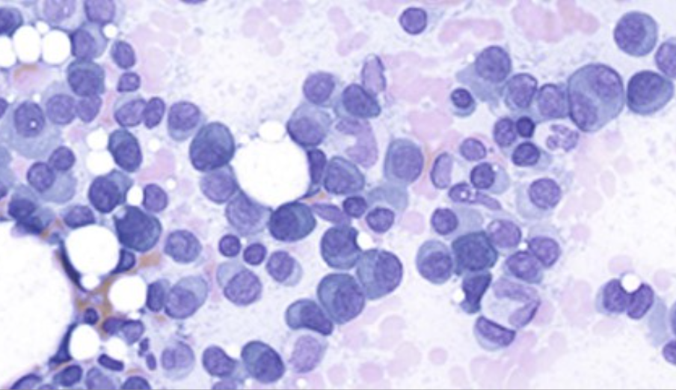
A 66-year-old woman with polyuria and fatigue has had two bouts of pneumococcal pneumonia during the past year. A pathologic femoral fracture prompts a workup that reveals multiple bony lytic lesions, an elevated creatinine level, and nephrotic-range proteinuria. Her bone marrow biopsy specimen is shown.
What is the diagnosis?
What is the cause of her fracture?
Why does she have proteinuria?
This specimen contains more than 30% plasma cells, which is consistent with multiple myeloma. The defective production of normal immunoglobulins results in recurrent bacterial infections. Hypercalcemia from bone resorption and anemia from marrow replacement may be responsible for this patient's fatigue.
Multiple myeloma cells secrete factors such as the receptor activator of the NF-κβ ligand (RANKL), which acts as an osteoclast activating factor and leads to bone resorption. This in turn leads to hypercalcemia and the bony lytic lesions that cause pathologic fractures.
Excess light chains produced by the myeloma cells (also called Bence Jones proteins) are toxic to the renal tubular epithelium; more than 6 g/dL may be present in the urine.

Slide 14
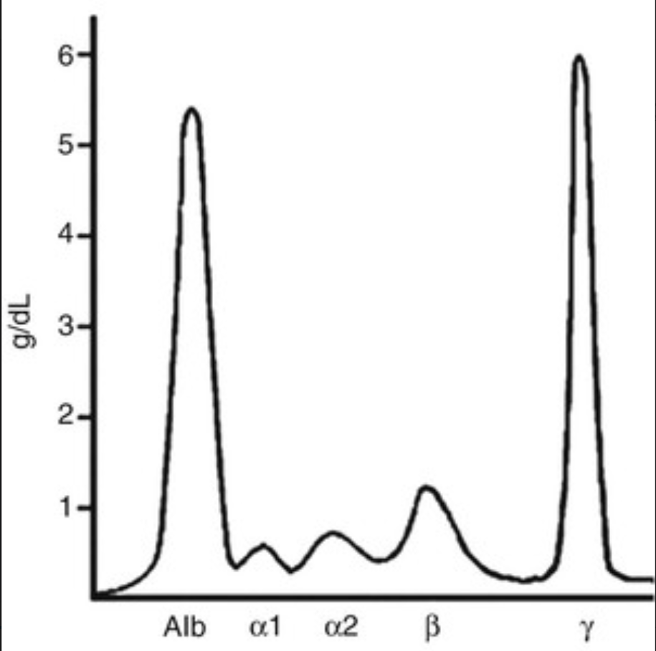
A 71-year-old woman has lower back pain, and a radiograph shows a T12 compression fracture. There is a bilateral loss of sensation over the medial palmar aspect of her hands that involves the fifth and fourth fingers. Her serum calcium level is 12.8 mg/dL (nl 8.5 to 10.3 mg/dL), her total protein level is 9.6 g/dL (nl 6 to 8.5 g/dL), and her albumin level is 4.2 g/dL (nl 3.5 to 5 g/dL). Her serum protein electrophoresis (SPEP) is shown. What does this SPEP show? Explain this patient's signs and symptoms. How can this malignancy be treated?
There is a large “M” spike of immunoglobulin, which is typical for multiple myeloma.
The immunoglobulin light chains (Bence Jones proteins) can deposit as AL chain amyloidosis, which causes carpal tunnel syndrome.
Bisphosphonates inhibit osteoclast activity. Bortezomib, a proteasome inhibitor, blocks pro-apoptotic factor degradation. Thalidomide inhibits angiogenesis and stromal cell growth while modulating the production of cytokines such as tumor necrosis factor and interleukin-6, which contribute to myeloma cell survival.

Slide 15
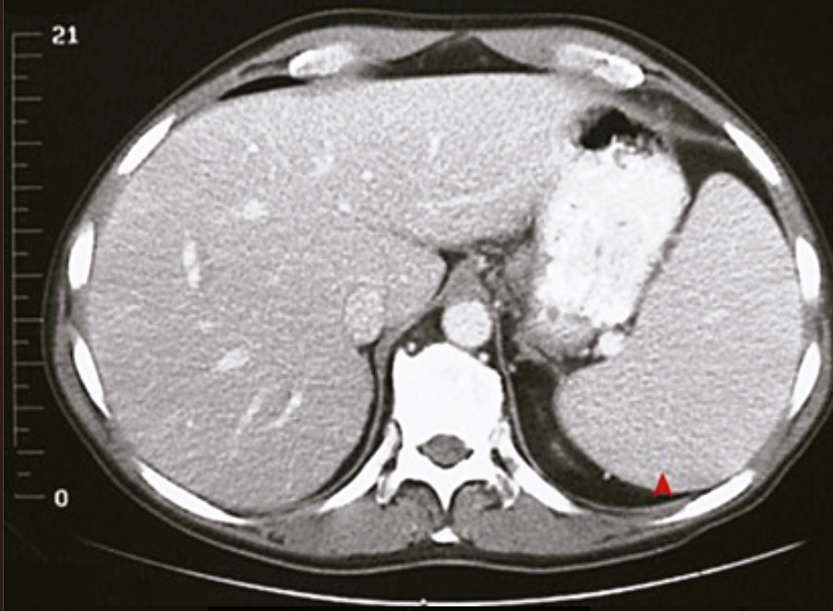
A 40-year-old man with a 6-month history of left upper quadrant abdominal discomfort has mild pancytopenia. His abdominal CT scan is shown.
Why does he have pancytopenia?
What are the causes of splenomegaly?
What would you suspect if this patient's marrow is fibrotic?
Could the splenomegaly be due to cirrhosis?
This patient has splenomegaly (◂). Hypersplenism as a result of the sequestration of circulating cells causes pancytopenia.
Causes include cirrhosis of any cause, including primary hepatic and cardiogenic; obstruction of the portal or splenic veins (e.g., thrombosis in the setting of local inflammation) or extrinsic compression (e.g., by tumor); various infections; myeloproliferative disorders; storage diseases; and amyloidosis.
Myelofibrosis as part of a myeloproliferative disorder would be suspected. The resulting extramedullary hematopoiesis would cause splenomegaly.
No. This patient's liver is uniform and does not show cirrhosis.

Slide 16
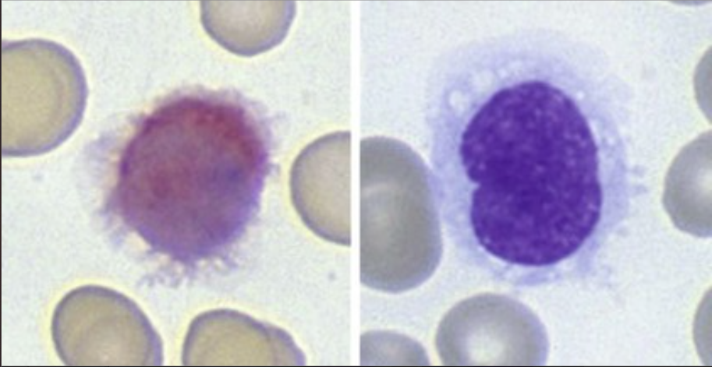
A 41-year-old man with a 5-month history of fatigue develops a persistent fever. He has marked splenomegaly but no lymphadenopathy, and he is pancytopenic. His peripheral blood smear is shown (bottom: tartrate-resistant acid phosphatase stain).
What is your diagnosis?
What is the immunophenotype of these cells?
What could this patient's fever represent?
What is his prognosis?
The hairlike projections from these leukocytes are typical for hairy cell leukemia (HCL).
B cells expressing CD19, CD20, and surface immunoglobulin as well as typical monocyte antigens CD11c and CD25 are present. These also classically have tartrate-resistant acid phosphatase activity, as shown.
The reduction in normal leukocytes (particularly monocytes) with HCL predisposes affected individuals to infection, particularly atypical mycobacterial infections.
With chemotherapy, most patients develop long-lasting remission.

Slide 17
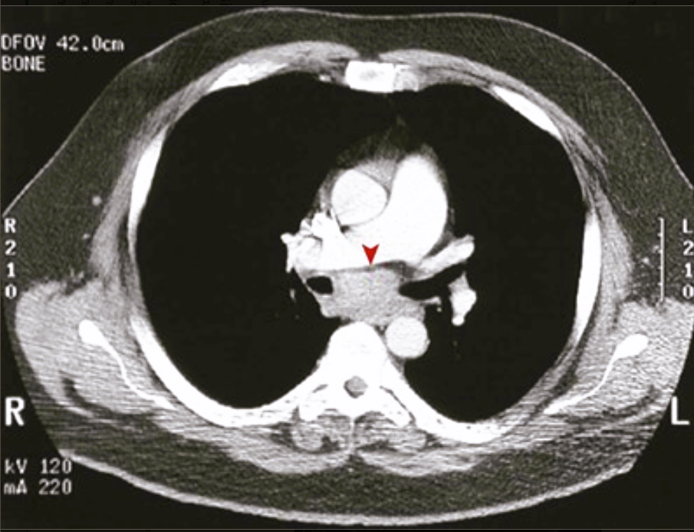
A 30-year-old man with a 2-month history of dyspnea describes intermittent chest pain with alcohol consumption. Biopsy of the lesion shown on the chest CT scan reveals bands of fibrosis and lacunar cells marking for CD15 and CD30.
What is your diagnosis?
What is the stage of this patient's disease?
What is the prognosis?
In the subcarinal region between the right and left main bronchi is a mass (▸) of enlarged lymph nodes. The chest pain symptoms are a curious paraneoplastic finding of Hodgkin lymphoma (HL). The pathology description suggests HL, nodular sclerosis type.
If this is the only region involved, then the patient has stage I disease. If another lymph node region or contiguous spread to adjacent tissue is involved, then the patient has stage II disease.
The prognosis of patients with HL, nodular sclerosis type, is excellent.

Slide 18
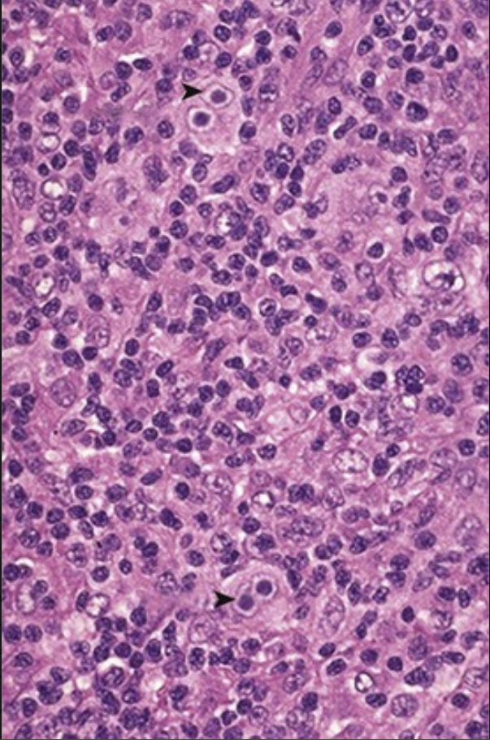
A 57-year-old man with a 3-month history of night sweats and weight loss has palpable nontender cervical and axillary lymph nodes with splenomegaly. Although a PPD test was positive in the past, it is now negative. His bone marrow biopsy specimen is shown.
What is your diagnosis?
What viral genome is present in these cells?
What is the stage of this disease?
What immunologic phenomenon explains the negative PPD test?
There are numerous Reed-Sternberg (R-S) cells (▸), which are diagnostic for Hodgkin lymphoma (HL). Also present is a background of lymphocytes and macrophages, with several mononuclear variants that are typical for the mixed cellularity type of HL.
The R-S cells and their variants mark for Epstein-Barr virus.
Marrow involvement makes this stage IV disease; the patient's other symptoms indicate stage IV-B disease.
The patient has cutaneous anergy as a result of depressed cell-mediated immunity.

Slide 19
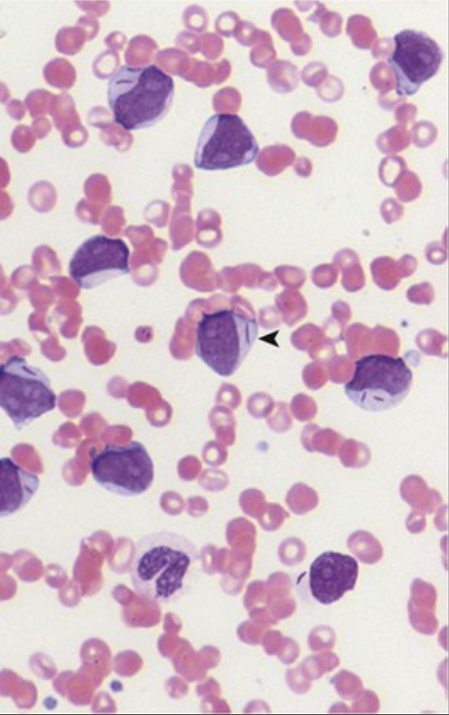
A 41-year-old man with fatigue and fevers develops cutaneous petechiae and epistaxis. His hemoglobin level is 6.7 g/dL (nl 13.8 to 17.2 g/dL), his platelet count is 9800/mm3 (nl 130,000 to 400,000/mm3), and his WBC count is 168,400/mm3 (nl 3800 to 10,800/mm3). His peripheral smear is shown.
What form of leukemia does he have?
Explain his clinical findings.
What is the prognosis?
The WBCs have enlarged nuclei, multiple nucleoli, and elongated condensations of abnormal azurophilic granules known as Auer rods (◂), which are consistent with the M2 form of acute myelogenous leukemia (AML).
The replacement of this patient's marrow with immature myeloid forms leads to pancytopenia; anemia explains the fatigue, and thrombocytopenia accounts for the bleeding problems. The abnormal WBCs do not function properly for the fighting of infections.
Although remission may be achieved, relapses are common, and few patients with AML are cured.

Slide 20
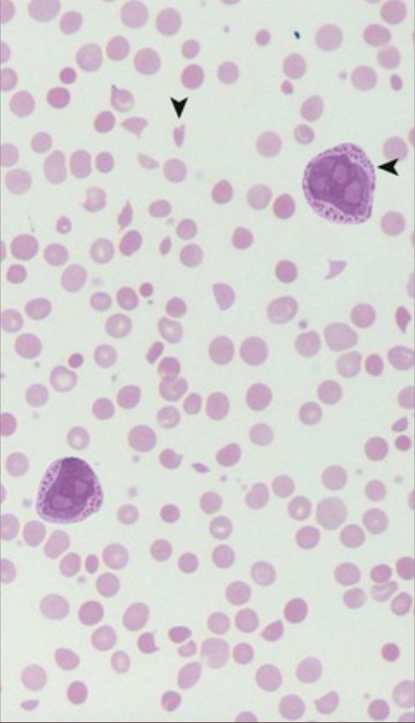
A 37-year-old woman has fatigue, purpura, and prolonged menstrual periods. Her hemoglobin level is 7 g/dL (nl 12 to 15.6 g/dL), her platelet count is 11,100/mm3 (nl 130,000 to 400,000/mm3), and her WBC count is 77,910/mm3 (nl 3800 to 10,800/mm3). Her prothrombin time, partial thromboplastin time, and D-dimer all are markedly increased. Her peripheral blood smear is shown.
What type of leukemia does she have?
What cytogenetic alteration is present?
What therapy is effective for the induction of remission?
The large immature myeloblasts with nucleoli and many cytoplasmic red granules (◂) are typical for promyelocytic leukemia, which is the M3 variant of acute myelogenous leukemia. The release of granules' procoagulant tissue factor leads to disseminated intravascular coagulation, with schistocytes (▾) and elevated D-dimer.
A t(15:17) translocation produces a fusion protein that stops differentiation at the promyelocyte stage.
All-transretinoic acid (ATRA) induces a transient remission in most cases by overcoming the differentiation blockade.

Slide 21
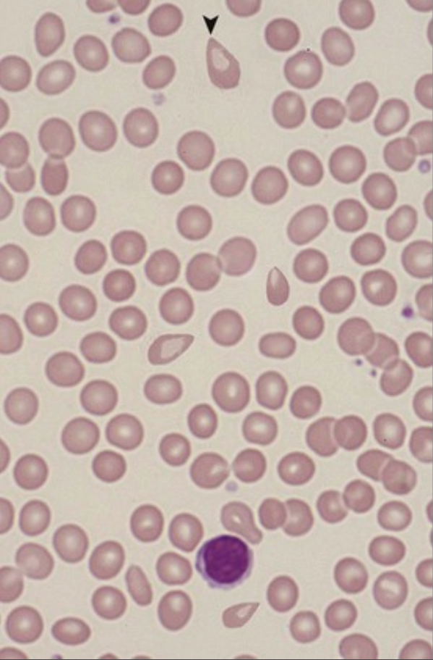
A 40-year-old woman who has had worsening fatigue for 1 year now presents with pneumonia. She has cutaneous petechiae and splenomegaly. Her hemoglobin level is 6 g/dL (nl 12 to 15.6 g/dL), her platelet count is 15,000/mm3 (nl 130,000 to 400,000/mm3), and her WBC count is 1000/mm3 (nl 3800 to 10,800/mm3). Her peripheral blood smear is shown.
What abnormal RBC form is present?
Why is her spleen enlarged?
What is the pathophysiology of this disorder?
Teardrop-shaped RBCs (dacryocytes) (▾) are seen in myelofibrosis, which in this case represents a primary chronic myeloproliferative disorder.
When the marrow space is filled with tumor or fibrosis, hematopoietic stem cells go elsewhere (extramedullary hematopoiesis)—particularly the spleen—and cause prominent splenomegaly.
Neoplastic megakaryocytes release fibrosing cytokines, such as platelet-derived growth factor and transforming growth factor-β, which induce non-neoplastic fibroblasts in the marrow. In 5% to 20% of cases, transformation into acute myelogenous leukemia occurs.

Slide 22
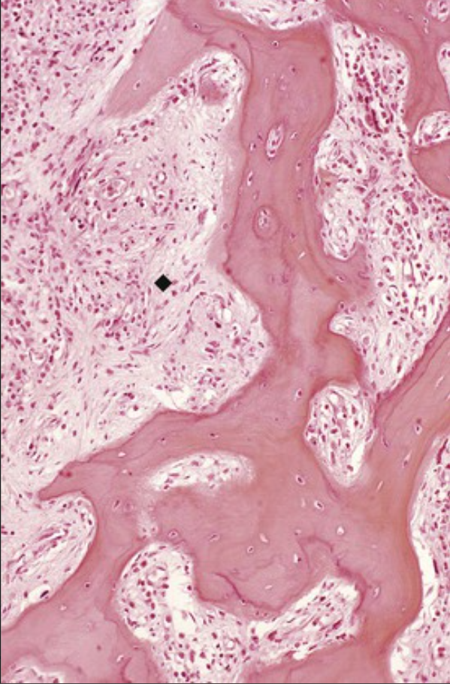
A 60-year-old man who previously underwent chemotherapy for chronic myelogenous leukemia (CML) now has pancytopenia, splenomegaly, and uric acid renal calculi. His blood smear shows leukoerythroblastosis. His bone marrow biopsy specimen is shown.
What is the diagnosis?
What is leukoerythroblastosis?
Explain his uric acid calculi.
This is secondary myelofibrosis (♦) resulting from neoplastic megakaryocytes arising in the context of the patient's CML.
Leukoerythroblastosis is the presence of immature RBC and WBC forms in the peripheral blood; it occurs with marrow-ablative processes, such as fibrosis or tumor.
Although myelofibrosis leads to extramedullary hematopoiesis, it tends to be ineffective, with high cell turnover that results in increased purines that get metabolized into uric acid.

Slide 23
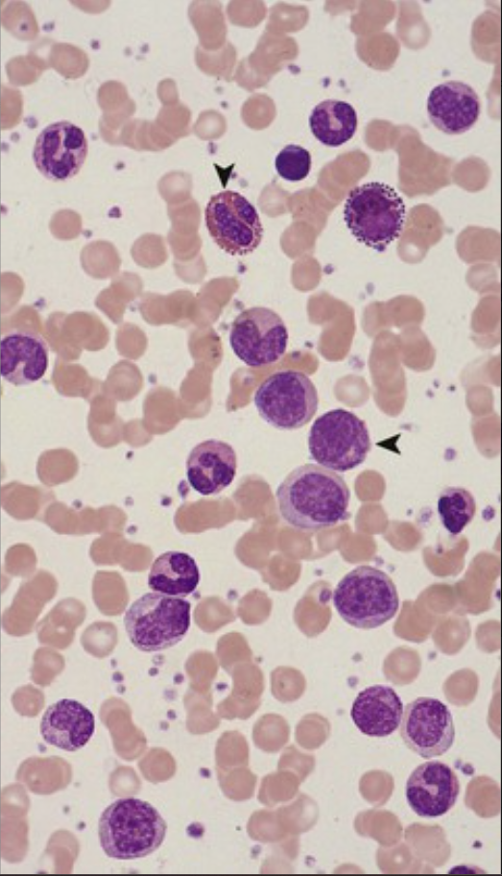
A 45-year-old man with an 8-month history of fatigue and weight loss has marked splenomegaly. His hemoglobin level is 9 g/dL (nl 13.8 to 17.2 g/dL), his platelet count is 550,000/mm3 (nl 130,000 to 400,000/mm3), and his WBC count is 250,000/mm3 (nl 3800 to 10,800/mm3). His peripheral blood smear is shown.
What form of leukemia does he likely have?
What cytogenetic alteration is typically present?
What therapy is useful for treatment?
This patient has chronic myelogenous leukemia (CML), which is one form of chronic myeloproliferative disorder. The WBC count is markedly elevated but with few blasts, and there are many immature myeloid cells (◂), basophils, and eosinophils (▾).
More than 90% of CML has the distinctive t(9;22) “Philadelphia chromosome” translocation. This forms a BCR-ABL fusion gene that results in a constitutively active tyrosine kinase that inhibits apoptosis and drives stem cell proliferation.
Imatinib (a selective tyrosine kinase inhibitor) induces remission in more than 90% of patients. The tumor cells frequently develop kinase mutations that no longer bind the drug.

Slide 24
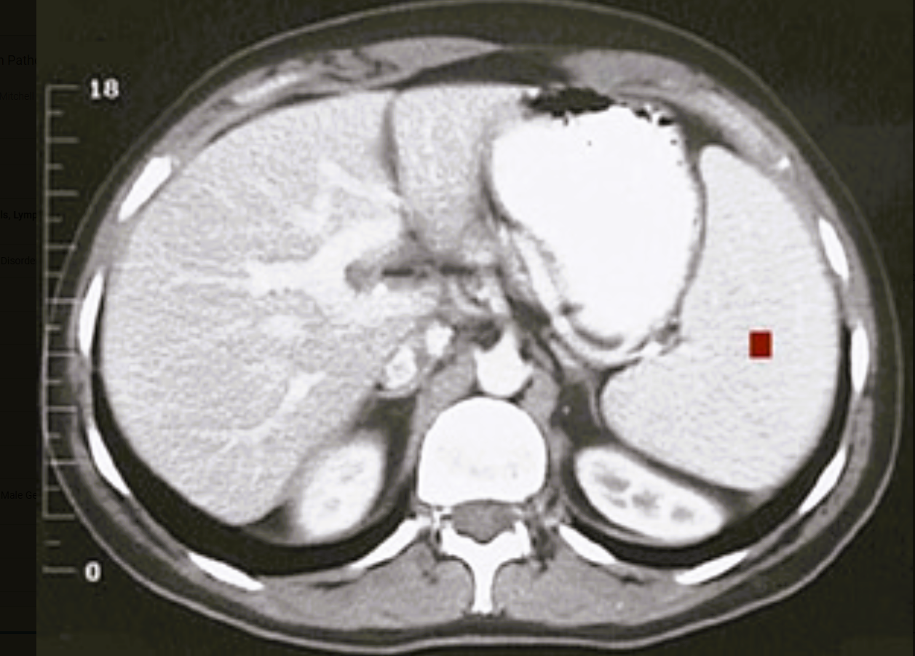
A 50-year-old woman has purpura, headaches, and abdominal fullness. Her hemoglobin level is 20 g/dL (nl 12 to 15.6 g/dL), her platelet count is 800,000/mm3 (nl 130,000 to 400,000/mm3), and her WBC count is 31,000/mm3 (nl 3800 to 10,800/mm3). Her abdominal CT scan is shown.
What is the diagnosis?
Explain the CT finding.
What complications may occur?
This patient has a chronic myeloproliferative disorder, most likely polycythemia vera. Treatment typically involves long-term phlebotomy, with a median survival of 10 years.
The neoplastic pleuripotent stem cells infiltrate many organs, particularly the spleen, which results in splenomegaly (■).
The markedly elevated peripheral counts can lead to abnormal blood flow; with platelet dysfunction, there is a significant risk of either thrombotic or hemorrhagic complications. Polycythemia vera tends to evolve to a burnt-out phase with myelofibrosis, but it can also proceed to acute myelogenous leukemia.

