Slide 1
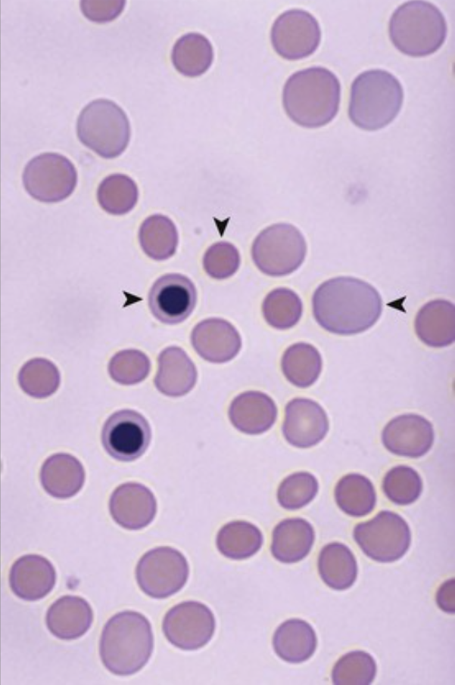
A 33-year-old woman with a 4-month history of worsening fatigue has a hemoglobin level of 7 g/dL (nl 12 to 15.6 g/dL) and a hematocrit level of 22% (nl 35% to 46%); her MCV is 98 fL (nl 78 to 102 fL), and her WBC and platelet counts are normal. Her serum haptoglobin level is 0.3 mg/dL (nl 43 to 212 mg/dL), and her antinuclear antibody (ANA) test is positive. Her peripheral blood smear is shown.
What is the diagnosis?
What are the direct and indirect Coombs tests?
What does the positive ANA result mean?
Nucleated RBCs (▸), polychromasia (◂), and microspherocytes (▾) are features of hemolytic anemia that are consistent with the markedly low haptoglobin level. Antibody bound to RBCs can lead to intravascular hemolysis as a result of complement-mediated rupture; splenic macrophages in the cords of Billroth also take “bites” out of antibody-coated RBCs, thus reducing their size.
The direct Coombs test detects antibody bound to RBCs; the indirect Coombs test detects anti-RBC antibody in a patient's serum.
A positive ANA test suggests an underlying autoimmune disease, such as systemic lupus erythematosus.

Slide 2
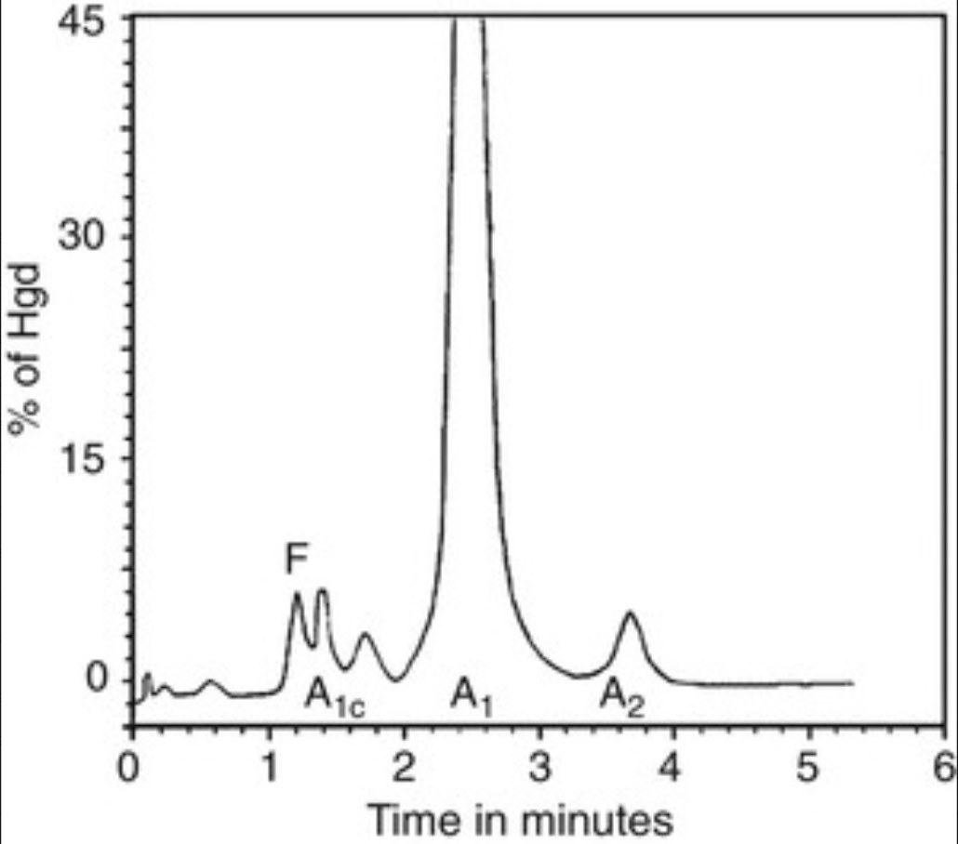
A 27-year-old man has had fatigue with exertion for years. His hemoglobin level is 9 g/dL (nl 13.8 to 17.2 g/dL), his hematocrit level is 26% (nl 41% to 50%), and his MCV is 68 fL (nl 78 to 102 fL); his WBC and platelet counts are normal. His serum ferritin level is 720 ng/mL (nl 18 to 350 ng/mL). His hemoglobin electrophoresis is shown; the hemoglobin A2 (α2Aδ2) value is about 5% of the total hemoglobin (nl ≤2.5%), and the hemoglobin F value is also increased.
What disease explains this presentation? Explain the hemoglobin electrophoretic pattern. Is this patient iron deficient?
β-Thalassemia minor results from deficient β-chain synthesis caused by gene point mutations and unimpaired α-chain production, with ineffective erythropoiesis and hypochromic microcytic RBCs.
Hemoglobin A2 and fetal hemoglobin increase in the absence of an adequate number of β chains to complex with the α chains.
No. Ineffective erythropoiesis leads to increased iron absorption and increased iron stores, which are reflected by the markedly increased serum ferritin level.

Slide 3
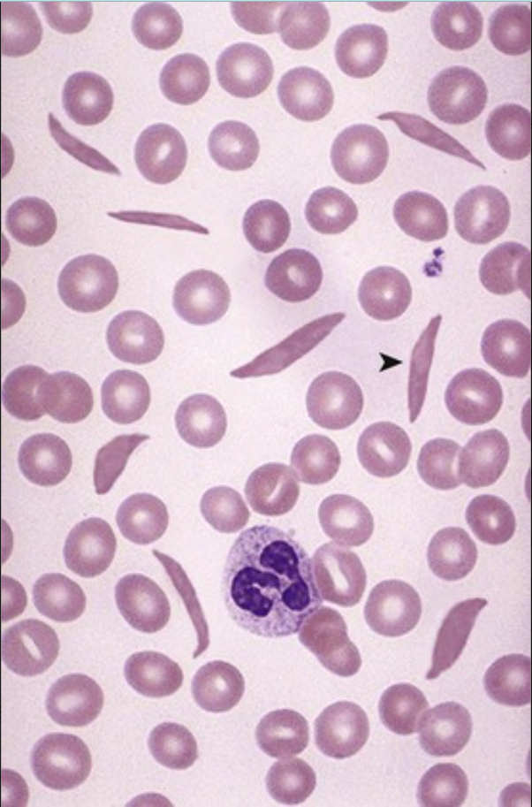
After developing mild dehydration after a diarrheal illness, a 9-year-old Bengalese girl develops sudden and severe extremity pain. She has a moderately enlarged spleen. Her hemoglobin level is 6.6 g/dL (nl 12 to 15.6 g/dL). Her peripheral blood smear is shown.
What is the diagnosis? What would hemoglobin electrophoresis show?
Why did she develop extremity pain?
What biliary tract complication can occur?
Sickled RBCs (▸) with sickle cell anemia contain more than 90% hemoglobin S (α2βs2), some hemoglobin F (α2Aγ2) and hemoglobin A2 (α2Aδ2), but no hemoglobin A1 (α2Aβ2A).
Sickle cell crises can occur with reduced oxygen tension, infection, dehydration, or temperature change, but often no precipitating event can be found. Vaso-occlusive crises result when “sticky” sickled cells clog capillaries and cause tissue ischemia.
Chronic hemolysis leads to pigmented biliary stones.

Slide 4
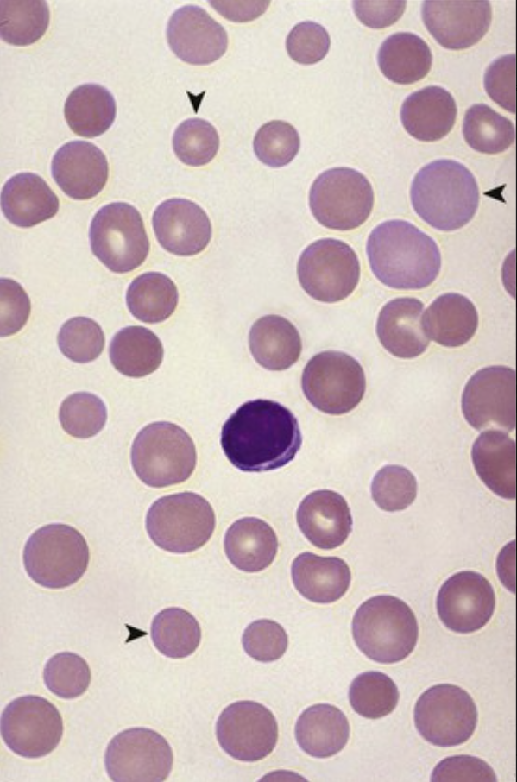
A 30-year-old man from Stockholm had neonatal jaundice, and he has had a lifelong history of fatigue. His spleen is enlarged. His hemoglobin level is 11 g/dL (nl 13.8 to 17.2 g/dL), his hematocrit level is 31% (nl 41% to 50%), and his MCV is 74 fL (nl 78 to 102 fL). His peripheral blood smear is shown.
What hemoglobinopathy is likely present?
What gene mutations could this patient have?
What is the inheritance pattern?
What infection could precipitate an aplastic crisis?
There is microcytosis (many RBCs are smaller [▾] than the lymphocyte nucleus) and spherocytosis, including a loss of RBC central pallor (▸). Mild hemolytic anemia leads to compensatory reticulocytosis (◂).
Hereditary spherocytosis results from RBC membrane or cytoskeletal protein defects (e.g., ankyrin and spectrin mutations).
Autosomal dominant
Parvovirus infection could lead to temporary erythropoietic shutdown.

Slide 5
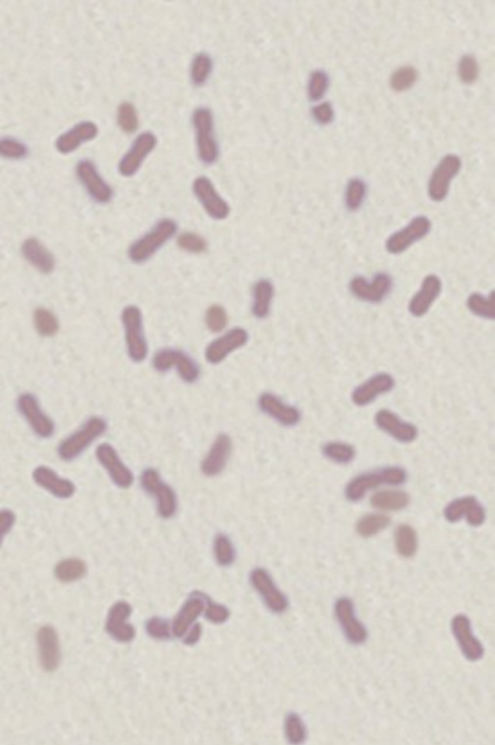
A 13-year-old boy with sickle cell anemia and a lifelong history of sickle crises develops a high fever with hypotension. A positive blood culture grows the organisms that are shown here with Gram staining.
What are these organisms?
Why did the patient become septic?
The Gram stain shows short, slightly curved gram-negative rods that are consistent with Haemophilus influenzae. Sepsis with H. influenzae and sepsis with Streptococcus pneumoniae are the most common causes of death in children with sickle cell disease. For unclear reasons, patients with sickle cell disease are also prone to Salmonella infections, typically either osteomyelitis or cholecystitis.
By late childhood, multiple autoinfarctions of the spleen have led to markedly reduced spleen size (autosplenectomy) so that the splenic immune function, which is particularly useful for encapsulated bacteria, is diminished.

Slide 6
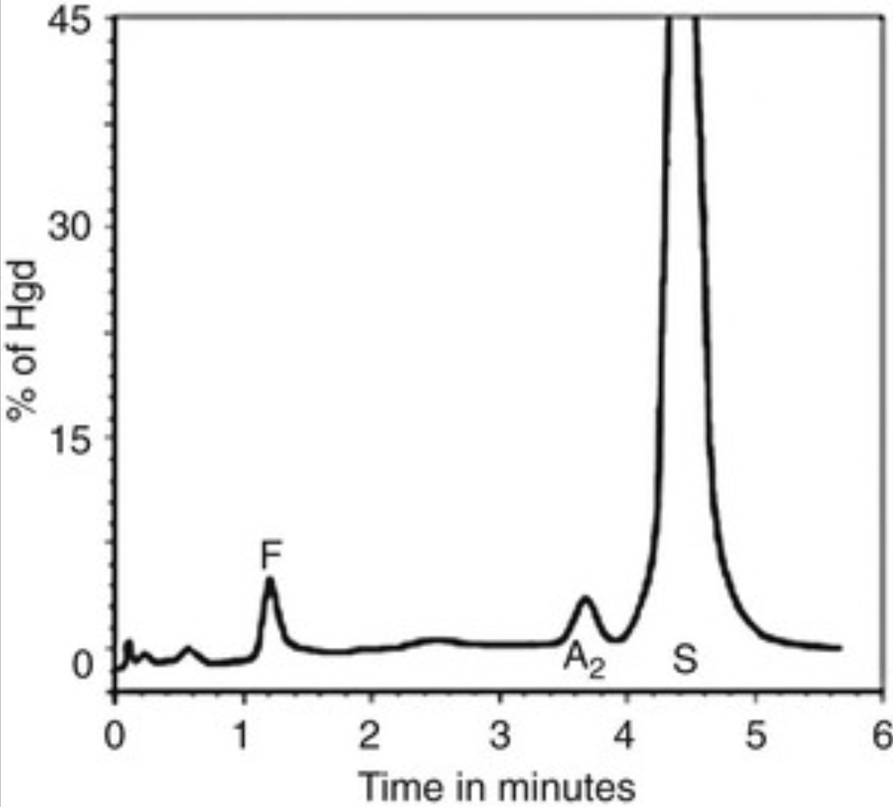
A 24-year-old African-American man has a lifelong history of fatigue. His abdominal CT scan shows no apparent spleen. His hemoglobin level is 8 g/dL (nl 13.8 to 17.2 g/dL), his hematocrit level is 22.4% (nl 41% to 50%), and his MCV is 72 fL (nl 78 to 102 fL). A urinalysis shows hematuria. His hemoglobin electrophoresis is shown.
What is the diagnosis? Explain the pathophysiology of this disease. Why is pain so common?
This patient has sickle cell anemia. The hemoglobin electrophoresis shows a large hemoglobin S peak, with smaller hemoglobin A2 and hemoglobin F fractions.
A single nucleotide mutation results in a valine-for-glutamic acid substitution at the sixth position in the hemoglobin β chain. When an individual is homozygous for this mutation, the resulting hemoglobin tetramers are more hydrophobic when they are deoxygenated, which results in aggregation and polymerization into long needle-like fibers that distort (“sickle”) the RBC.
Sickling makes the affected RBCs prone to plugging small capillaries, which leads to tissue hypoxia and the painful crises. Chest, abdominal, and back pain are common, and there is also risk for cerebrovascular accident (“stroke”) involving the brain.

Slide 7
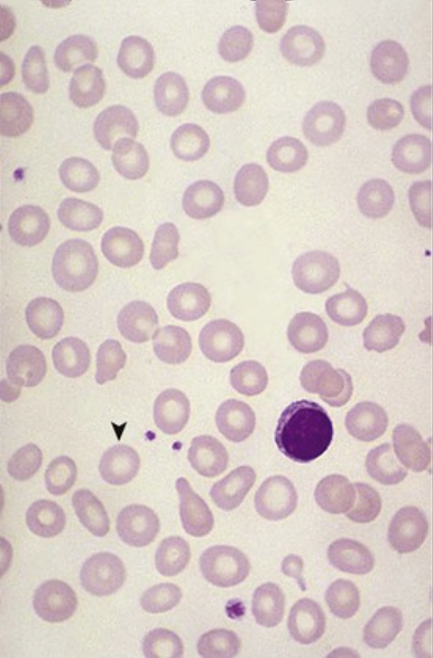
A 54-year-old woman with an 8-month history of fatigue and exercise intolerance develops a painful, inflamed tongue and difficulty swallowing. Her hemoglobin level is 8.2 g/dL (nl 12 to 15.6 g/dL), her hematocrit level is 23.8% (nl 35% to 46%), and her MCV is 73 fL (nl 78 to 102 fL). Her peripheral blood smear is shown.
What nutritional deficiency does she likely have?
What other laboratory test findings do you expect?
Why does she have difficulty swallowing?
This patient has iron deficiency anemia. Note the hypochromic (large central pallor) microcytic RBCs (▾). In an adult with iron deficiency, one should always suspect blood loss.
This patient's serum iron and serum ferritin levels should be low: her total iron binding capacity is increased, mainly because her transferrin saturation (normal ≥33%) is also low.
Glossitis, esophageal webs (which can impede swallowing), and microcytic hypochromic anemia constitute the triad of Plummer-Vinson syndrome.

Slide 8
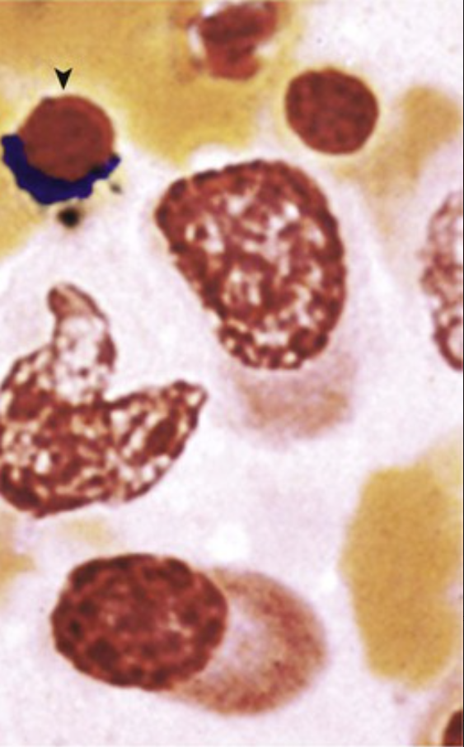
A 56-year-old woman with a long history of rheumatoid arthritis has a chronic, low-grade, microcytic, hypochromic anemia. Her serum iron and transferrin levels are low, but her serum ferritin level is elevated. A bone marrow biopsy specimen stained with Prussian blue for iron is shown.
What is the likely diagnosis?
Why is this patient's serum ferritin level high but her serum iron level low?
What is the mechanism for the anemia?
Anemia of chronic disease has a low serum iron level and abundant stored iron, typically in phagocytes. Note the ringed sideroblast (▾); bone marrow macrophages should also be substantially iron replete.
The serum ferritin level reflects intracellular stores of iron, which are elevated. Free iron is ineffectively released from these intracellular stores.
Chronic inflammatory states lead to increased liver synthesis of hepcidin, which reduces the expression of ferroportin necessary for the release of intracellular iron stores.

Slide 9
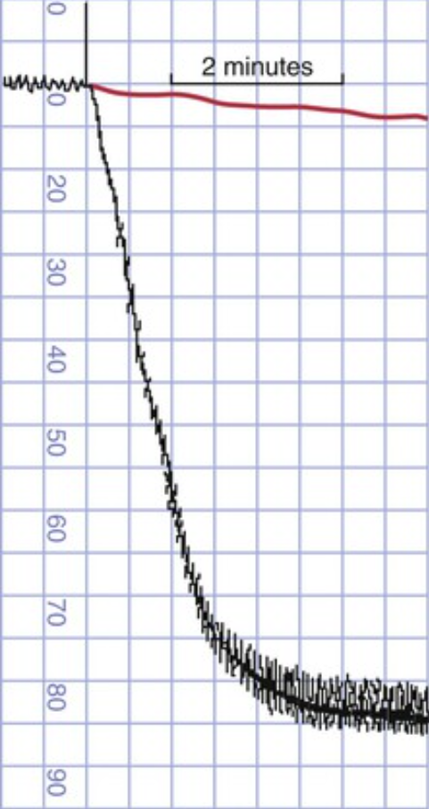
A 17-year-old girl has had heavy menstrual periods since menarche; she also has gingival bleeding and cutaneous purpura with minimal trauma. She has abnormal platelet aggregation in the presence of ristocetin (her curve is shown in red as compared with the black control), although her platelets aggregate normally to ADP, collagen, and epinephrine.
What is your diagnosis?
What is the mechanism for her abnormal bleeding?
What is the inheritance pattern?
Name a (rare) disorder with the same assay but that involves abnormally large platelets.
Ristocetin causes von Willebrand factor (vWF) to bind to platelet glycoprotein Ib receptors, and it induces platelet aggregation. A defective ristocetin aggregation assay most commonly indicates von Willebrand disease (vWD). vWD has variable severity, depending on the mutation present, and it affects 1% of the population.
vWD is caused by decreased or mutated vWF. Bleeding occurs because there is abnormal platelet adhesion via the glycoprotein Ib receptors, and a primary hemostatic plug fails to form. Because factor VIII also binds to vWF, defective synthesis—if severe—can also prolong the partial thromboplastin time (PTT).
vWD is most commonly an autosomal-dominant disorder.
Autosomal-recessive Bernard-Soulier syndrome results from defective or deficient glycoprotein Ib receptors.

Slide 10
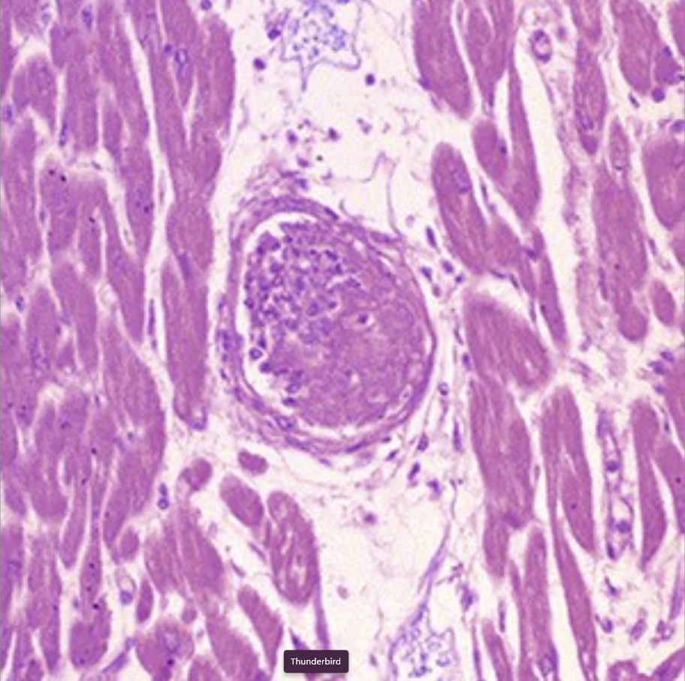
A 44-year-old woman develops fever, headaches, and confusion. She is anemic and thrombocytopenic, with a serum creatinine level of 5 mg/dL (nl ≤1.2 mg/dL) elevated D-dimer and schistocytes on a peripheral blood smear. She develops ventricular fibrillation and dies. A myocardial arteriole from her autopsy is shown.
What is your diagnosis?
What is the mechanism for this disorder?
What related disorder can accompany gastroenteritis?
This patient had thrombotic thrombocytopenic purpura (TTP). The arteriole contains a hyaline thrombus that is composed of aggregated platelets.
A deficiency of metalloproteinase ADAMTS13 prevents the processing of large von Willebrand factor multimers into smaller subunits, which leads to abnormal platelet aggregation and thromboses.
Hemolytic-uremic syndrome caused by Shiga-like toxin that damages endothelium is classically associated with infection caused by Escherichia coli strain O157:H7.

Slide 11
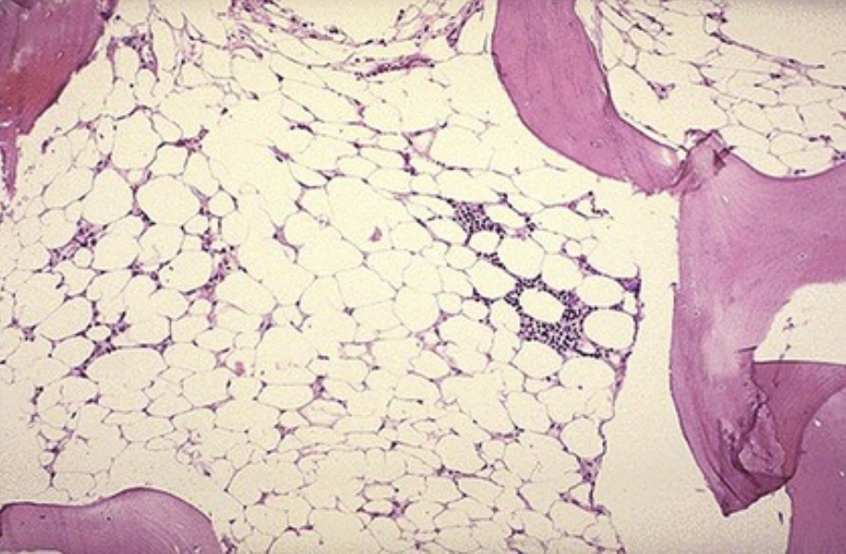
A 29-year-old woman with a 3-month history of easy bruising and fatigue develops pneumonia with septicemia. Her work-up involves an iliac crest bone marrow biopsy; the specimen is shown.
What appearance should her marrow have?
What is your diagnosis?
Explain her symptoms.
At this age, the bone marrow should contain at least 50% hematopoietic cells; in this case, it is composed mainly of adipocytes. However, the bone is normal.
This patient has aplastic anemia. Despite the name of this condition, all major hematopoietic cell lines are reduced.
Thrombocytopenia results in easy bruising; reduced myelopoiesis leads to neutropenia with a risk for infection, and reduced erythropoiesis causes anemia with fatigue.

Slide 12
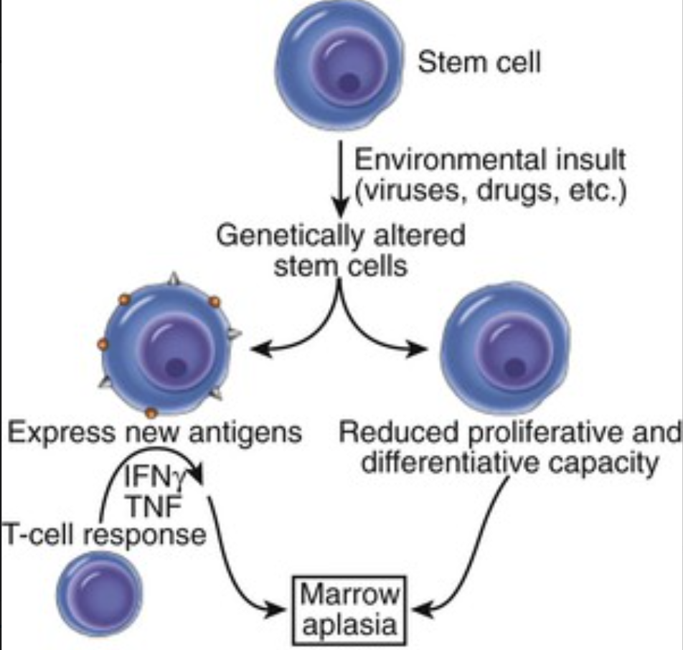
A 48-year-old man with malaise, fever, and chills is found to have tachycardia and occult blood in his stools. He is also profoundly anemic, neutropenic, and thrombocytopenic, although his absolute lymphocyte count is roughly normal. A bone marrow biopsy specimen shows only fat and lymphocyte aggregates. A diagram of the possible pathogenic pathways is shown.
Aside from an acquired intrinsic mutation of the stem cell, what could be the pathogenesis of these findings?
What drugs can cause this? What infections might cause this?
Pancytopenia is caused by a marked reduction in erythroid, myeloid, and megakaryocytic cell lines. Aplastic anemia can result from a stem cell defect in the marrow, from a toxin, or from immunologically mediated marrow suppression (e.g., after infection).
Chemotherapeutic agents (e.g., vincristine, mercaptopurine) can cause this condition, and it may also result from idiosyncratic responses to small doses of antibiotics or other drugs (e.g., streptomycin, trimethoprim-sulfamethoxazole, chlorpromazine).
Infections that can cause this condition include viral hepatitis (i.e., non-A, non-B, non-C, and non-G), Epstein-Barr virus, cytomegalovirus, varicella-zoster virus, and parvovirus.

Slide 13
A 30-year-old woman presents with a 2-day history of dysuria, fever, and flank pain; she is hypotensive and tachycardic. A blood culture grows the organisms shown with Gram staining.
What is suggested by the history and the Gram stain?
What is the mechanism of this patient's fever and tachycardia?
The large gram-negative bacilli are typical of Enterobacteriaceae such as Escherichia coli with urinary tract infection. The fever and flank pain with hypotension and positive blood culture suggest acute pyelonephritis with septicemia.
Gram-negative bacterial cell walls contain lipopolysaccharide with a lipid A moiety that interacts with CD14 and Toll-like receptor 4 on leukocytes and macrophages to release tumor necrosis factor.

Slide 14
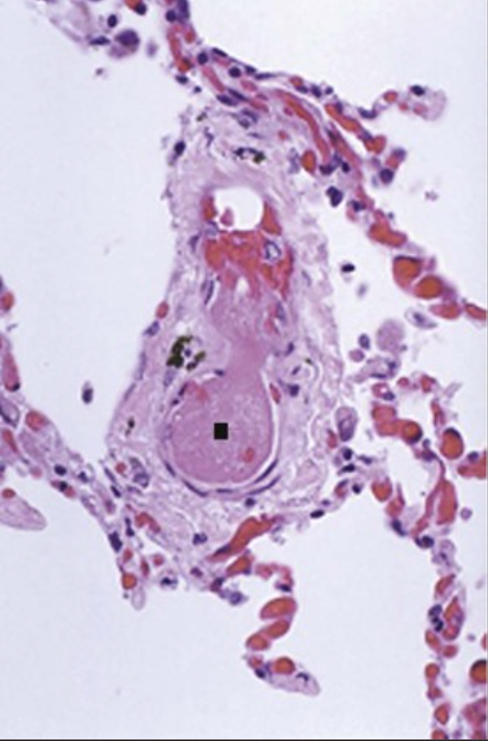
A 79-year-old man with Klebsiella pneumoniae sepsis has a hematocrit level of 35.5% (nl 41% to 50%), a platelet count of 87,600/mm3 (nl 130,000 to 400,000/mm3), and a WBC count of 15,130/mm3 (nl 3800 to 10,800/mm3). His prothrombin time is 23 seconds (nl 10 to 12.5 seconds), his partial thromboplastin time is 57 seconds (nl 20 to 36 seconds), and D-dimer value is 8 µg/mL (nl ≤0.25 µg/mL). His peripheral blood smear shows schistocytes. His lung is shown.
What is the diagnosis? What is suggested by the laboratory data?
The lungs show microvascular thrombosis (■). This patient has disseminated intravascular coagulation (DIC) as a result of gram-negative sepsis. In patients with DIC, small fibrin thrombi can form in the microcirculation; this leads to tissue ischemia and RBC fragmentation (schistocytes). Components of gram-positive bacteria and fungi can elicit similar effects.
Lipopolysaccharide-mediated cytokine production induces monocytes and endothelial cells to release tissue factor, which initiates the widespread activation of the coagulation cascade. This consumption coagulopathy leads to these findings.

Slide 15
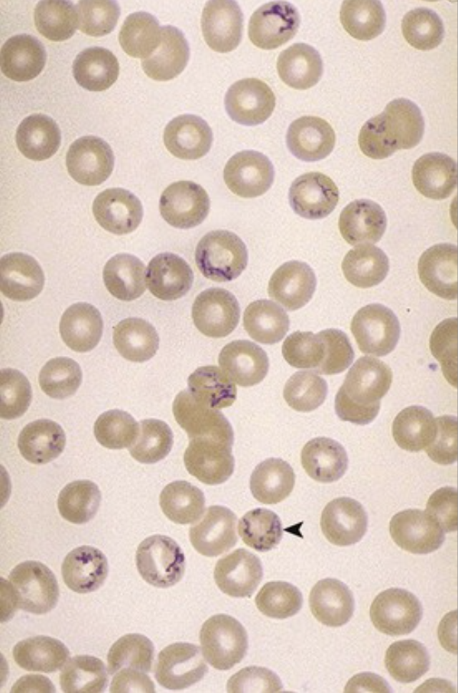
A week after intravenous cephalosporin treatment for pneumonia, a 93-year-old man has a hemoglobin level of 7.3 g/dL (nl 13.8 to 17.2 g/dL), a hematocrit level of 22.4% (nl 41% to 50%), normal RBC indices, and normal platelet and WBC counts. His Coombs test is positive at 37° C. His peripheral blood smear with methylene blue supravital stain is shown.
What are the RBCs with irregular bluish strands?
What does a positive Coombs test mean?
What caused this problem?
These reticulocytes (◂) are immature forms of RBCs that can be prematurely released into the peripheral blood in certain settings. Reticulocytosis is a bone marrow response to anemia; it is prominent after blood loss in a healthy person and in those with hemolytic anemias.
A positive Coombs test is consistent with immunohemolytic anemia, and it indicates the presence of antibodies directed at the patient's own RBCs. These can be antibodies against either intrinsic RBC antigens or bound molecules (haptens).
This is a drug-induced warm antibody hemolytic anemia. Cephalosporins and penicillins can bind to RBC surface proteins and act as hapten targets to host antibodies.

Slide 16
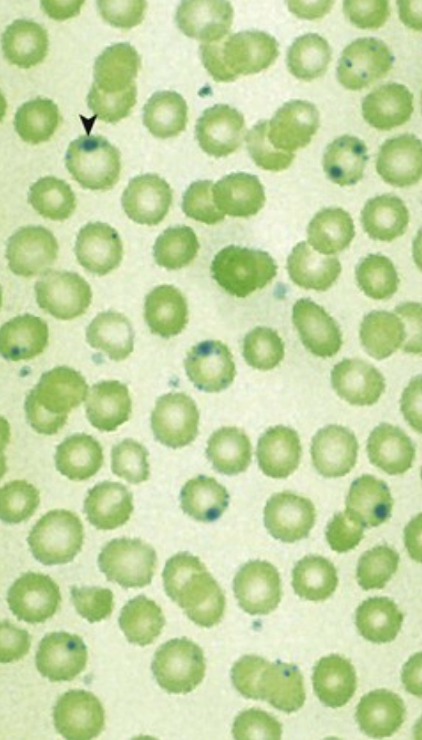
A 24-year-old man takes a nitrofurantoin drug for a urinary tract infection. Three days later, he develops dark brown urine. His hemoglobin level is 8.6 g/dL (nl 13.8 to 17.2 g/dL), with normal platelet and WBC counts. His Coombs test is negative. His peripheral blood smear with Heinz body stain is abnormal, as shown.
What inherited enzyme deficiency does this patient have?
Why did he develop hemoglobinuria after drug therapy?
The Heinz bodies (▾) are denatured globin chains from oxidant injury caused by reduced glucose-6-phosphate dehydrogenase (G6PD) activity in the RBCs. G6PD deficiency is an X-linked recessive disorder.
In the setting of G6PD deficiency, drugs with oxidant activity (e.g., nitrofurantoin, sulfa drugs, antimalarials, aspirin, phenacetin) can cause erythrocyte hemolysis.

