Slide 1
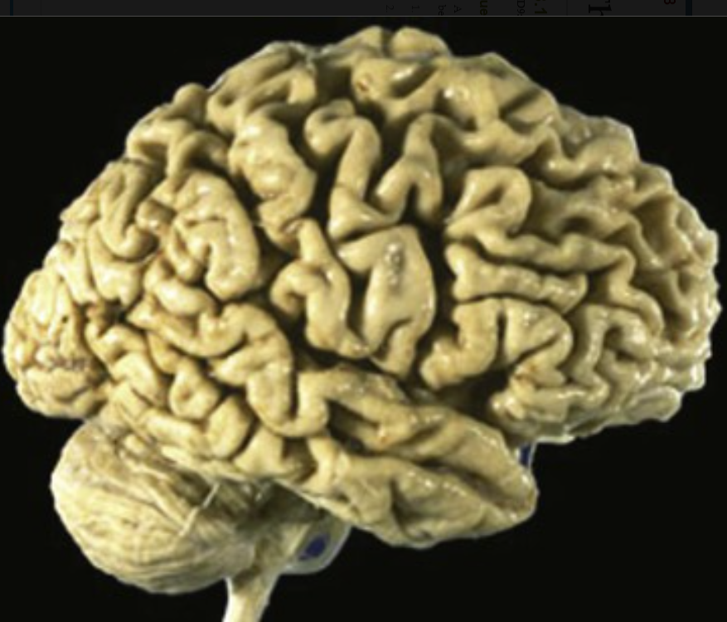
A 77-year-old man with a 3-year history of progressive withdrawal and apathy is found on formal examination to have severe short-term memory loss. He is not oriented to place or time. Before further work-up can be performed, he commits suicide. The medical examiner finds the brain to be as shown.
What is the diagnosis?
What are the possible gene mutations associated
with this pathology?
The marked cortical atrophy with the relative sparing of the occipital lobe is consistent with Alzheimer disease (AD).
Mutations in the APP gene (chromosome 21) increase the production of Aβ and are found in familial AD. Trisomy 21 (Down syndrome) is also associated with increased Aβ production. The E4 allele of apolipoprotein E (chromosome 19) increases Aβ and the risk for late-onset AD. Early-onset AD is associated with mutations in the presenilin 1 gene (chromosome 14) and the presenilin 2 gene (chromosome 1), which are involved in Aβ processing.

Slide 2
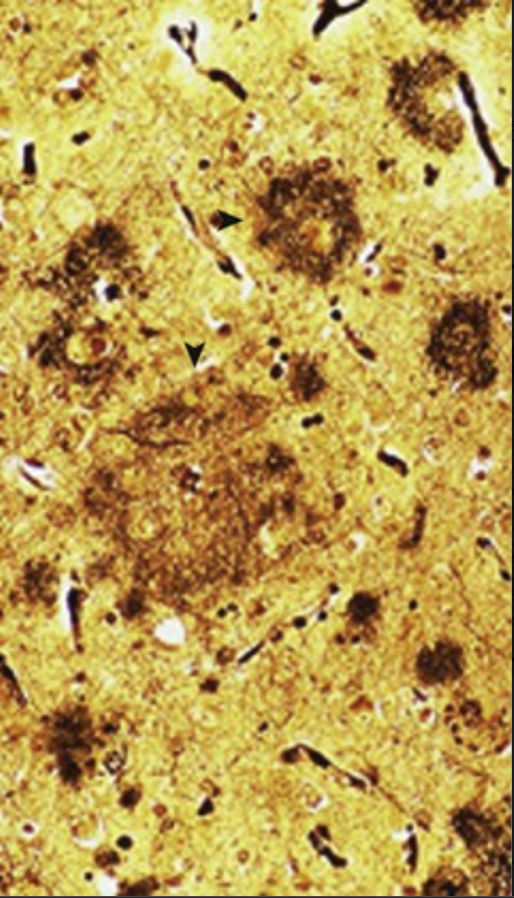
An 81-year-old woman has become progressively dependent on her daughter for routine activities of daily living for the past 5 years. She has no focal neurologic signs, but she cannot remember three objects after 5 minutes, and she cannot count backward from 100 by 7s. She is frequently depressed. She falls and sustains a hip fracture; subsequently, she dies of a pulmonary embolism. At autopsy, her neocortex exhibits the changes shown on silver stain. What is your diagnosis? What mood disorder is suggested by her history?
This patient has Alzheimer disease. Diagnostic neuritic plaques (▴) (as a result of hyperphosphorylated tau protein) and numerous diffuse plaques (▸) (masses of amyloid beta-protein [Aβ] derived from amyloid precursor protein [APP]) are present.
This patient's findings suggest a major depressive disorder, but the onset was more insidious, and the loss of mental function was more severe.

Slide 3
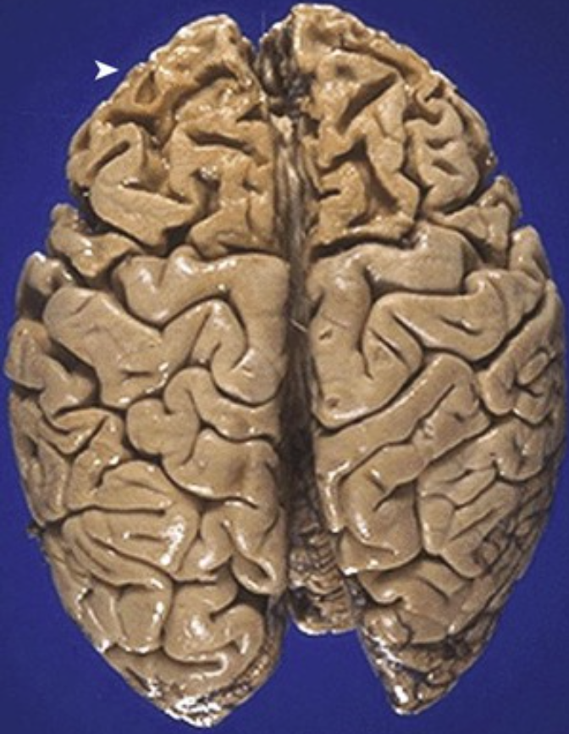
A 63-year-old woman with a 3-year history of difficulty with activities of daily living becomes increasingly irritable and irresponsible, and she eventually develops speech difficulties. She dies of an aspiration pneumonia. Her brain at autopsy is shown.
What is your diagnosis? Why did aspiration occur?
What neurodegenerative condition would involve a vertical gaze palsy and truncal rigidity?
The marked atrophy is primarily in a frontal lobe distribution (▸). The gross and clinical findings suggest a frontotemporal dementia such as Pick disease.
Any condition that reduces or alters consciousness, including any condition that reduces the gag reflex, increases the risk of aspiration pneumonia.
Progressive supranuclear palsy with neuronal loss in the globus pallidus, colliculi, and periaqueductal gray is present. In contrast with Pick disease, mutations in tau proteins have not been identified with this type of condition.

Slide 4
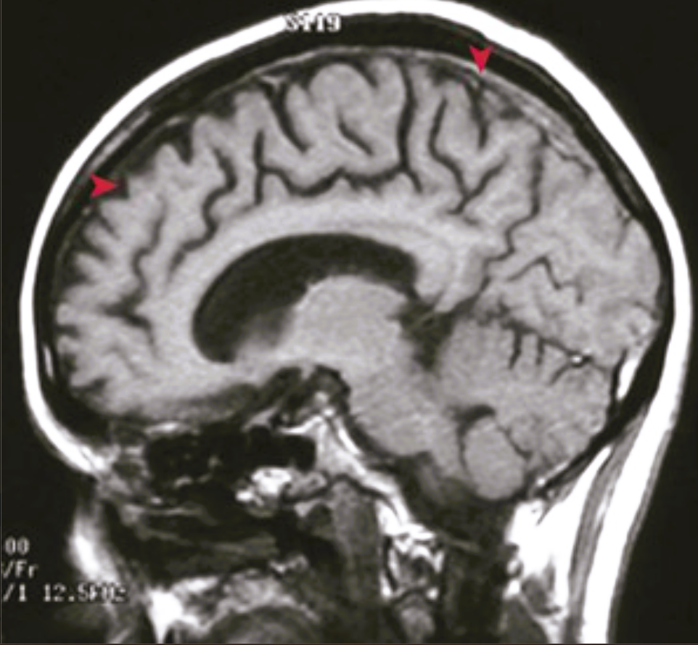
A 73-year-old woman has a 2-year history of behavioral changes, worsening confusion, and speech pathology. Although she can name three objects after 5 minutes, she cannot draw a clock. Her MRI is shown.
What is your diagnosis?
What paired helical filaments are present in round cytoplasmic inclusions in patients with this disorder?
A characteristic but nondiagnostic radiographic feature of dementias is cortical atrophy, which is shown here as prominently involving the frontal (▸) and parietal (▴) regions. The clinical history and severity of the atrophy suggest a form of frontotemporal lobar degeneration known as Pick disease.
Tau filaments accumulate within Pick bodies; the latter are round to oval inclusions found in residual neurons.

Slide 5
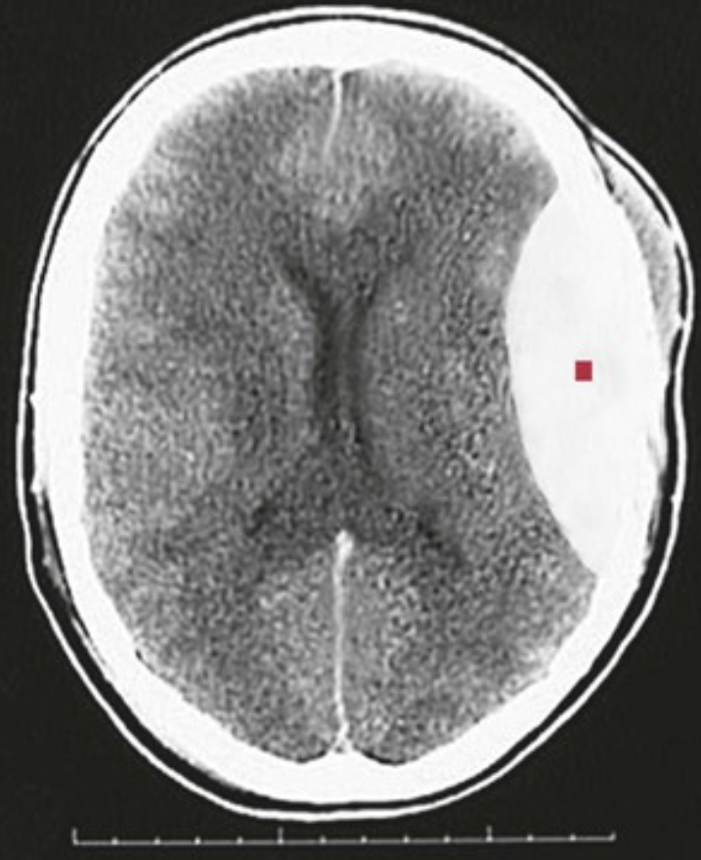
A 16-year-old boy who was demonstrating motorcycle stunts while not wearing a helmet falls and strikes the left side of his head on the pavement. Within minutes, he develops a severe headache, vomits, and has a seizure. His head CT scan is shown.
What is your diagnosis? What is the mechanism for this pathology?
The large, lens-shaped (▪) epidural collection of blood on the left is bounded by parietal bone suture lines.
The middle meningeal artery can be torn in association with a skull trauma, with or without fracture. Arterial bleeding under pressure leads to the rapid onset of symptoms.

Slide 6
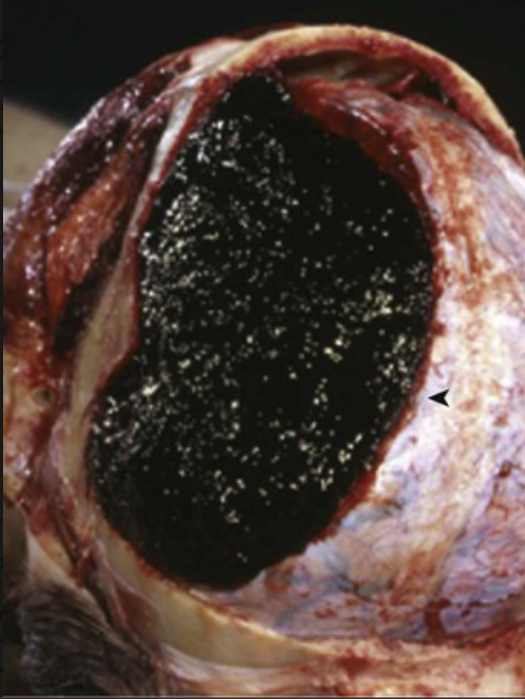
A 65-year-old man falls off a ladder and strikes the left side of his head. He initially loses consciousness, but he then remains alert (albeit with a bad headache) for 2 hours, when he again becomes unconscious. At that time, his pulse is 55 beats/min, his respiratory rate is 10 breaths/min, and his blood pressure is 160/100 mm Hg. He develops papilledema on the right, and then he dies. His brain is shown in situ at autopsy.
Where is this hematoma located? Explain this patient's clinical course.
What could cause his death?
There is a large, dark, reddish-black, left-sided epidural hematoma (◂).
The patient had a “lucid” interval after his initial concussion. Less than 20% of patients with epidural hematoma exhibit a “lucid” interval after injury.
Unless the blood is expeditiously evacuated, the expanding hematoma within the closed intracranial cavity can cause herniation.

Slide 7
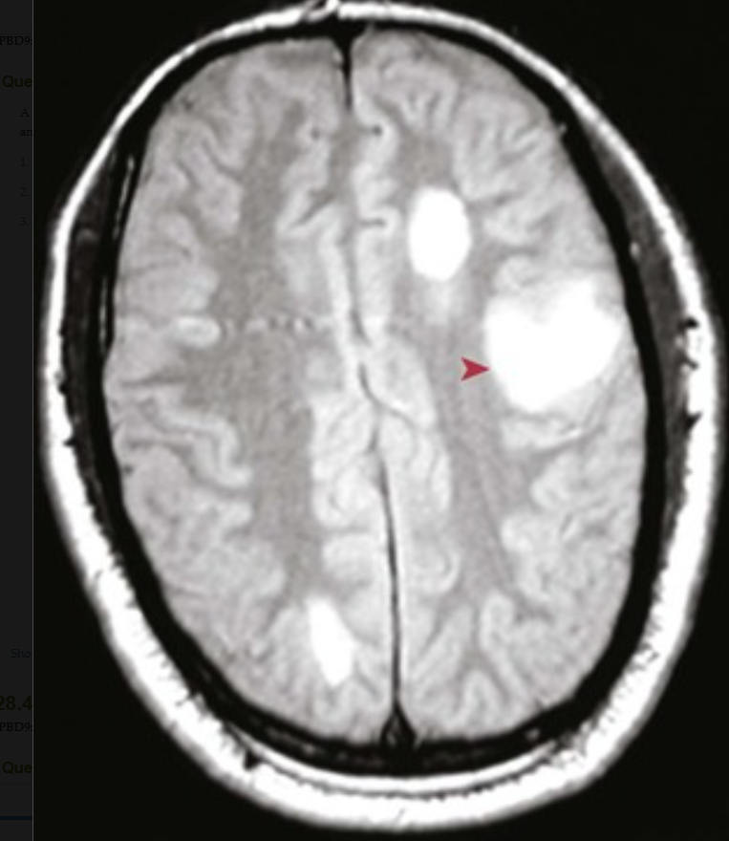
A 27-year-old woman who presented with transient visual difficulty 1 year ago has since developed fatigue, difficulty concentrating, dizziness, right arm paresthesias, difficulty with urination, loss of bowel control, and dysarthria. Her brain MRI is shown.
What is your diagnosis?
Explain the pathophysiology.
What is the prognosis?
Note the bright areas (▸) within the white matter. These are typical of the demyelinating lesions of multiple sclerosis.
The patient's visual changes may be due to optic neuritis. Her newer symptoms are attributable to transverse myelitis (bladder and bowel dysfunction). Motor tract involvement can cause weakness or spasticity. Cerebellar findings (ataxia), intranuclear ophthalmoplegia, and sensory paresthesias are also common.
Most patients have a relapsing-remitting course with acute exacerbations followed by partial to full remissions; one third of patients have complete recovery within 2 months of onset.

Slide 8
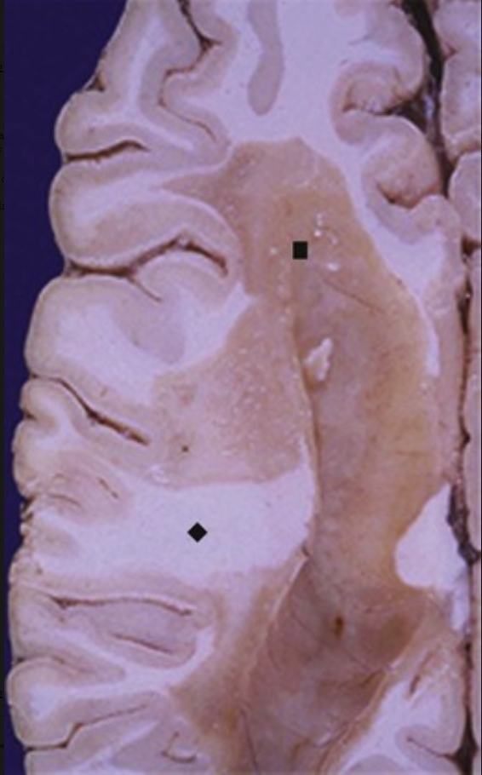
A 22-year-old man with ataxia, diplopia on lateral gaze, and flashes of light on eye movement has a cerebrospinal fluid (CSF) protein level of 69 mg/dL (nl 20 to 45 mg/dL), with 14 WBCs/mm3 (all mononuclear) and an increased CSF IgG level with oligoclonal bands. His glucose level is normal. Gross brain lesions typical for his disease are shown.
What is your diagnosis?
What do the laboratory findings represent?
This is multiple sclerosis (MS). Plaques of demyelination (▪) appear as pale tan to gray areas as compared with normal white matter (♦). This is putatively an autoimmune disorder that involves cellular immunity directed against the oligodendroglial cells responsible for synthesizing myelin.
The CSF findings are typical for MS. The oligoclonal antibodies reflect increased B-cell proliferation, but these immunoglobulins are directed against multiple epitopes rather than myelin or other oligodendroglial antigens.

Slide 9
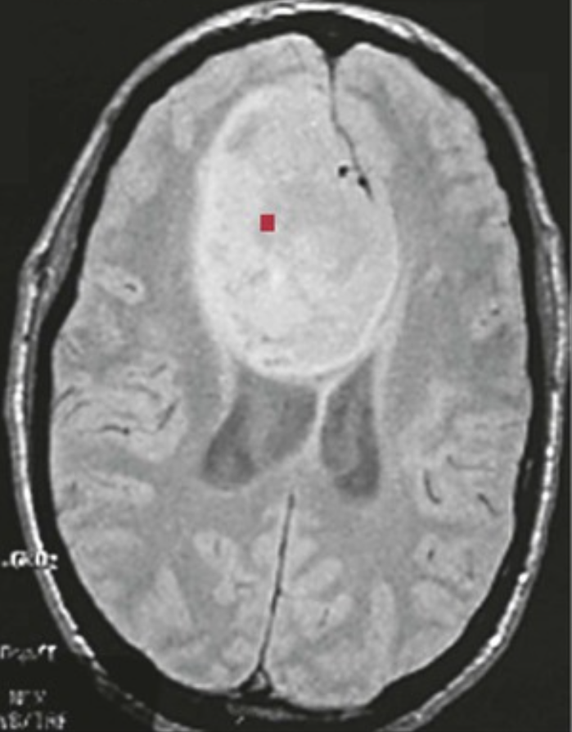
A 47-year-old man with a 3-month history of worsening headaches has a seizure. His initial MRI is shown, after which he undergoes surgical debulking followed by radiation and chemotherapy.
What is your diagnosis?
What is the prognosis?
This is almost certainly a glioblastoma. The large right cerebral mass (▪) infiltrates across the midline and impinges on the cerebral ventricles. Glioblastoma is the most aggressive of the gliomas; it can infiltrate widely and seed through the CSF.
Because it is difficult to eradicate such large neoplasms surgically, most patients survive less than 1 year.

Slide 10
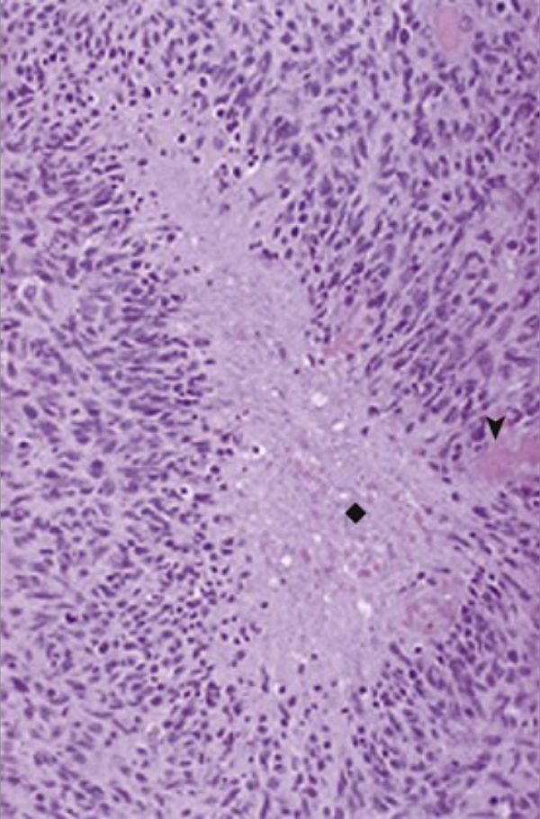
A 53-year-old woman has a grand mal seizure. Her CSF values reveal a total protein value of 117 mg/dL (nl 20 to 45 mg/dL), normal glucose levels, and 3 WBCs/µL (all mononuclear; upper limit of normal), with no organisms seen with Gram staining. A large right cerebral mass is resected and has the microscopic appearance shown.
What is your diagnosis?
What genetic alterations can be present?
Explain the CSF findings.
This patient has a glioblastoma. This is a highly cellular neoplasm with vascular proliferation (▴) and densely packed malignant cells arranged around areas of necrosis (♦) (pseudopalisading).
Glioblastomas can arise from low-grade astrocytomas that acquire inactivating mutations of p53, the overexpression of PDGF-A, or both. Primary glioblastomas tend to have mutations in PTEN, p16 deletion, and MDM2 overexpression.
The high CSF protein and normal glucose levels in this case are consistent with neoplasia. The few mononuclear cells may be reactive.

Slide 11
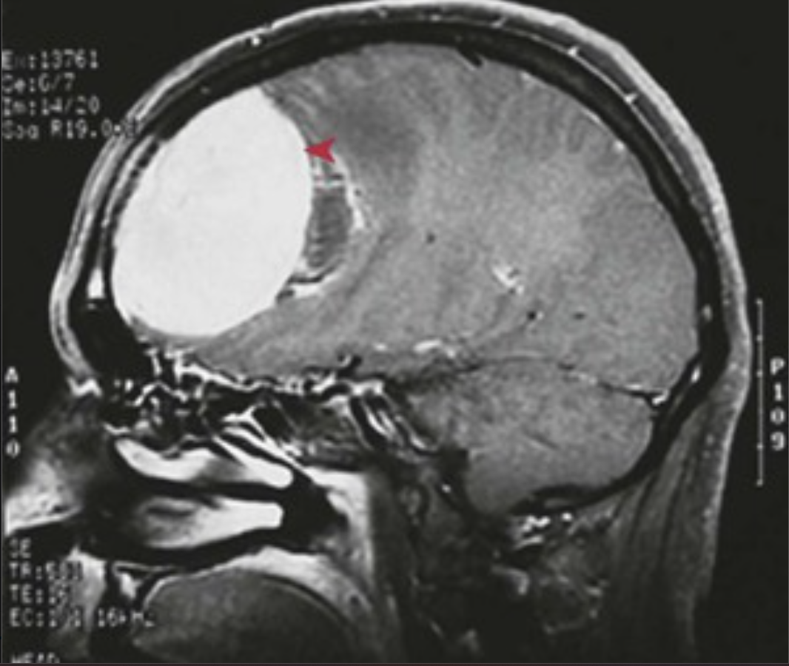
A 38-year-old woman has a 1-year history of increasingly frequent headaches that crescendo with her menstrual cycle. The headaches are now worsening with her recent pregnancy. Her MRI is shown.
What is your diagnosis?
Explain the effect of pregnancy.
There is a circumscribed mass (◂) in the parasagittal region that is impinging on the frontal lobe; this is consistent with meningioma.
Meningiomas often express progesterone receptors, so their growth is stimulated during menstrual cycles or pregnancy. Most are benign lesions; approximately 10% are atypical (having more aggressive growth) or frankly malignant.

Slide 12
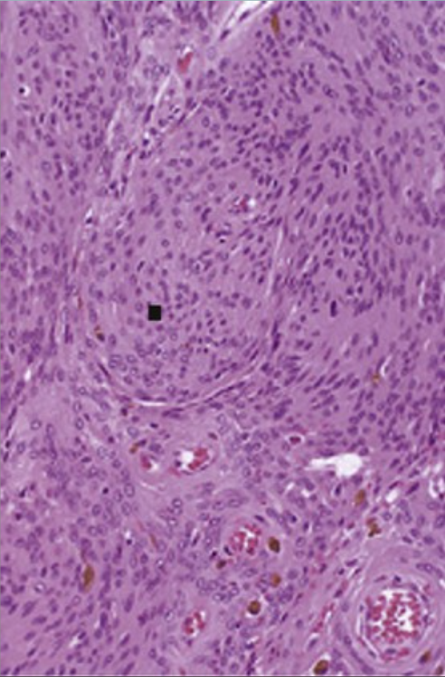
A 45-year-old woman with a 6-month history of worsening headaches develops new unilateral anosmia. She has also developed obsessive anxiety about her health and her children, and she is calling the school that they attend several times per day. A left subfrontal 5-cm mass is resected and has the microscopic appearance shown.
What is your diagnosis?
If she had other similar lesions and an acoustic neuroma, what syndrome would you suspect?
What is her behavioral disorder?
This meningioma is composed of whorled nests (▪) of cells with abundant pink cytoplasm (psammoma bodies may also be seen in this kind of neoplasm). Common locations are subfrontal and parasagittal.
Neurofibromatosis type 2 would be suspected. The most common genetic abnormality in meningiomas is the deletion of 22q12, where the NF2 gene is located.
This patient has an anxiety disorder as a result of a general medical condition.

Slide 13
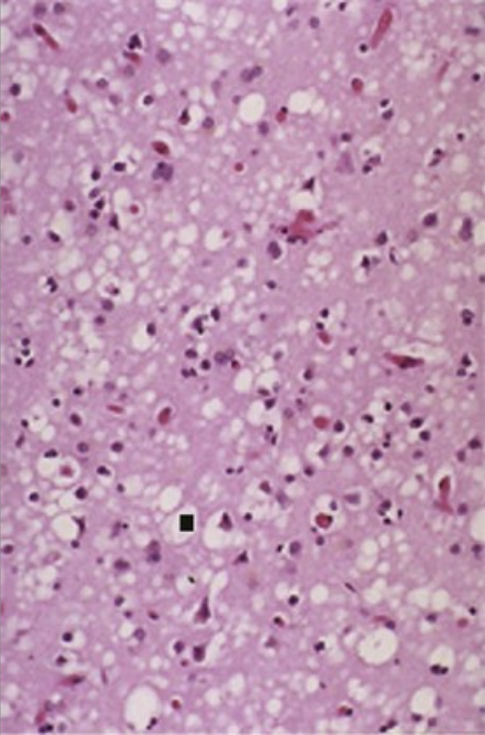
A 63-year-old man has had a rapidly progressive decline in mental function over the past 5 weeks. He has clumsiness when walking or eating. Neurologic examination shows impairment of his attention span, verbal and nonverbal memory, spatial skills, and judgment. The microscopic appearance of his neocortex is shown.
What is the diagnosis? What is the pathophysiology of this disease?
This is spongiform encephalopathy with numerous clear vacuolar spaces (▪) in the neocortex, which is consistent with Creutzfeldt-Jakob disease.
Creutzfeldt-Jakob disease is a prion disease. Prion protein (PrP) coded by the PRNP gene is present in many cells of the body, but it is expressed at the highest levels in neocortical neurons. Exposure to an abnormal variant PrP known as PrPSC (or PrPres for its proteinase resistance), similar to an infectious disease, results in a conformational change of normal PrP that can accumulate in the CNS of affected individuals. The accumulated abnormal protein drives the loss of neuronal cell function, vacuolization, and death, thereby leading to the extensive and rapid destruction of the brain.

Slide 14
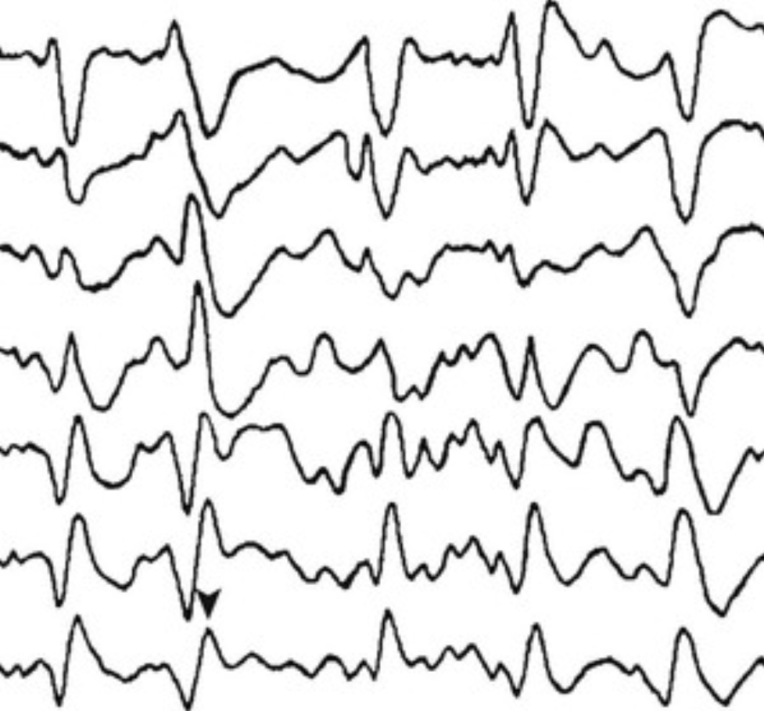
A 66-year-old previously healthy man has dementia that has been worsening for the past 3 months. He is no longer able to perform any activities of daily living, and he exhibits myoclonic jerks of his entire body whenever anyone touches him. His EEG is shown.
Describe this EEG. How common is this disease?
His EEG shows high-voltage slow (1 to 2 Hz) and sharp wave complexes (▴) on an increasingly slow and low-voltage background.
Sporadic Creutzfeldt-Jakob disease has an incidence of 1 in 1 million, with a mean age at onset of 62 years and survival of less than 1 year. The rarer variant Creutzfeldt-Jakob disease is presumed to be related to bovine spongiform encephalopathy, which has a mean age at onset of 28 years and a longer course.

Slide 15
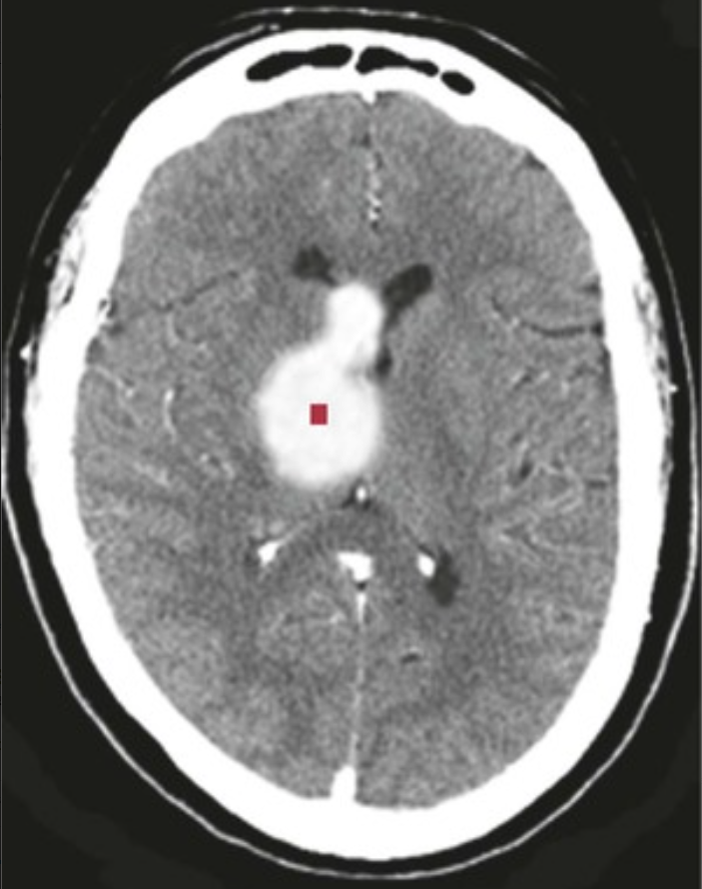
A 77-year-old man with medical history significant only for poorly controlled hypertension develops a sudden and severe headache followed by obtundation. His head CT scan is shown.
What is your diagnosis? Explain the pathophysiology. What is the prognosis?
The bright attenuation is in the right basal ganglia (▪); this is consistent with hypertensive hemorrhage.
With chronic hypertension, smaller penetrating cerebral arteries undergo hyaline arteriosclerosis and subintimal fibroblast proliferation, ultimately leading to wall weakening; focal Charcot-Bouchard microaneurysms can also occur. Severe hypertension can also result in frank arteriolar necrosis. All of these changes make the vessels prone to rupture and bleeding.
The prognosis for hemorrhages in the basal ganglia, thalamus, and brainstem is poor. The surgical evacuation of cerebellar lesions can result in a better outcome.

Slide 16
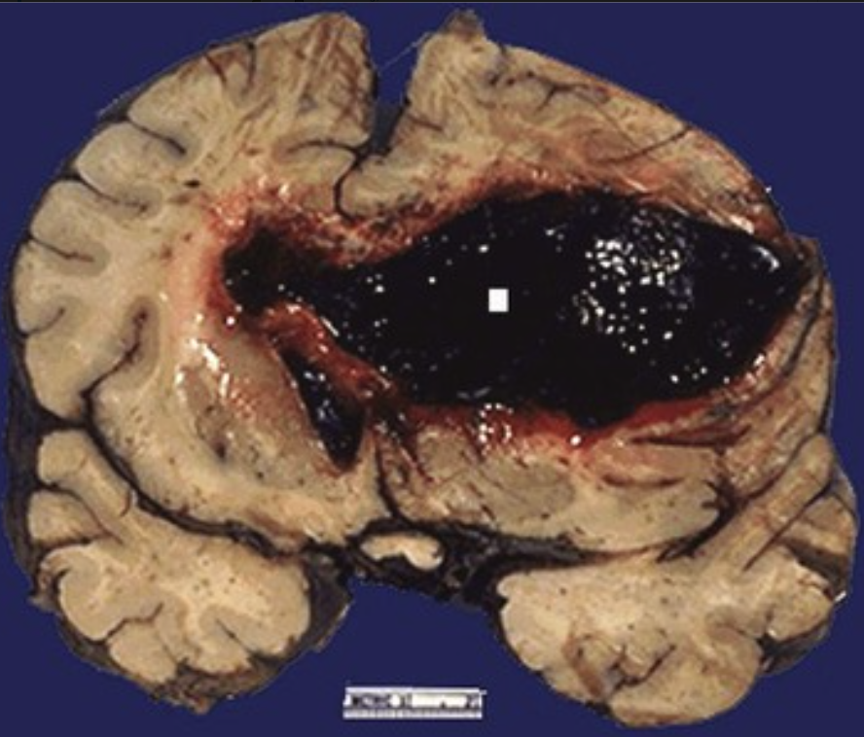
A 55-year-old man with lifelong hypertension has a sudden loss of consciousness. His CSF has normal protein and glucose levels, but it also has 860 RBCs/mm3 (normally there are none). He develops bilateral “blown” pupils and becomes unresponsive, dying within 1 hour. The gross appearance of his brain at autopsy is shown.
Give the likely cause of his condition. What are possible complications of hypertension-associated hemorrhage?
In the United States, 20% of strokes are intracerebral hemorrhages; most of these result from hypertension, and most occur in the basal ganglia and the thalamus (▪). Intracerebral hemorrhage accounts for approximately 15% of mortality in patients with chronic hypertension.
Complications include edema, ischemia, and infarction. A large hemorrhage can cause obstructive hydrocephalus by compressing the foramen of Monro, the third ventricle, or the aqueduct of Sylvius. The extension of hemorrhage into the ventricles can cause hydrocephalus.

Slide 17
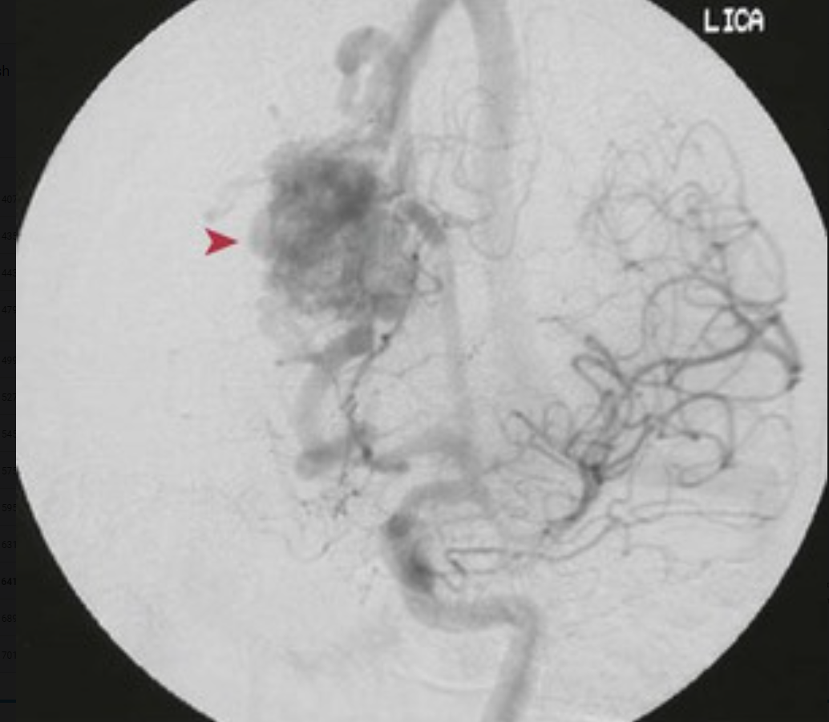
A 24-year-old man with no significant medical history has a sudden, new-onset grand mal seizure. During a subsequent work-up, he is normotensive. The angiogram of his left internal carotid artery is shown.
What is your diagnosis?
Explain the pathophysiology of this disease.
There is a focal area that consists of irregular vascular channels (▸), which is consistent with a vascular malformation. The most common site of this condition is the territory of the middle cerebral artery. Men are affected twice as frequently as women.
The abnormal vasculature associated with this malformation has a tendency to bleed within the brain or to extend into the subarachnoid space.

Slide 18
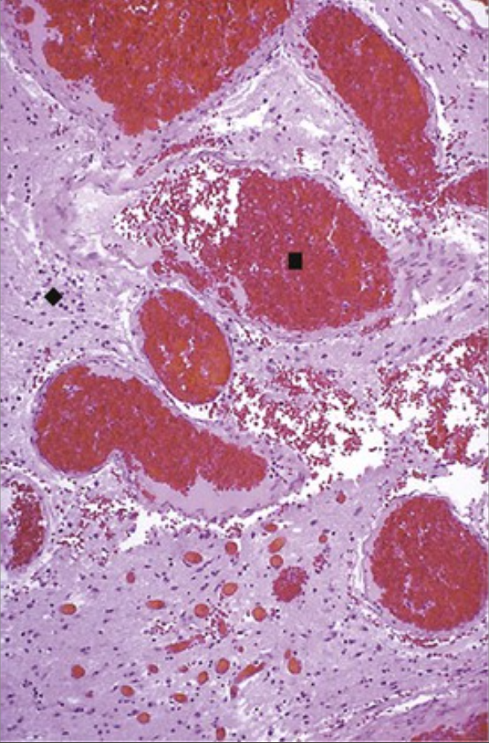
A 17-year-old boy with a 7-month history of headaches has CSF with normal protein and glucose levels but with 775 RBCs/mm3 (normally there are none). A head CT scan shows left superior subarachnoid hemorrhage that extends from an underlying left cerebral hemispheric lesion. He is treated via the endovascular injection of acrylic material to thrombose the lesion. A representative microscopic appearance of what his brain lesion could look like is shown.
What is your diagnosis? What is the likely cause of this condition?
There is a focus of abnormal ectatic venous channels (▪) with intervening gliotic tissue (♦); this is consistent with an arteriovenous malformation. Other vascular malformations include cavernous hemangiomas, which lack intervening nervous tissue, and capillary telangiectasias, which have ectatic thin-walled vessels with interspersed neural tissue.
This vascular malformation results in hemorrhage into the brain parenchyma, which causes a seizure disorder, or into the subarachnoid space, which leads to erythrocytes in the CSF.

Slide 19
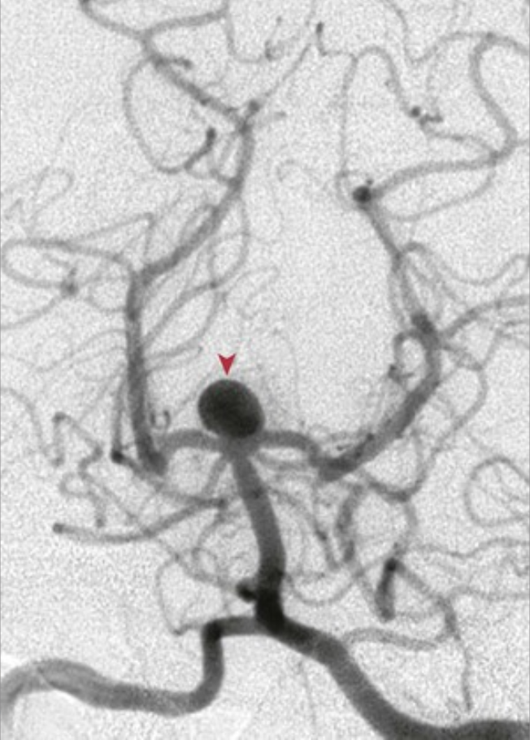
A 47-year-old previously healthy woman with a sudden severe headache has the vertebral artery angiogram shown.
What is your diagnosis? How does this lesion form?
How common is this disease?
Note a large saccular (berry) aneurysm (▴) at the branching of the basilar artery into the posterior cerebral arteries.
The cause of this condition is unknown, and most occur sporadically. Although these are considered congenital, most are not present at birth; rather, they develop with time as a result of focal vascular wall weakness. Adult polycystic kidney disease, Ehlers-Danlos syndrome, Marfan syndrome, neurofibromatosis, aortic coarctation, and fibromuscular dysplasia are associated conditions.
Berry aneurysms (ruptured or not) are found in 2% of autopsies.

Slide 20
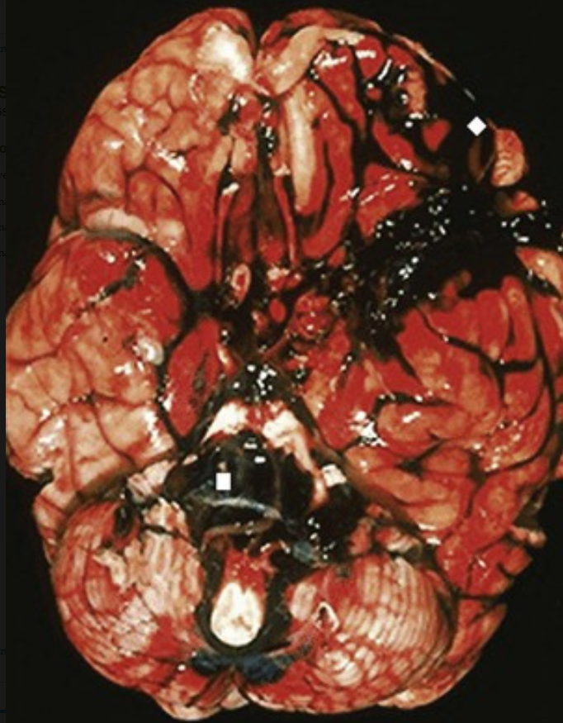
A 48-year-old woman experiences the “worst headache” of her life before suddenly losing consciousness and dying. The gross appearance of her brain at autopsy is shown. What is shown here? What likely happened? What might you think about if the clinical history also included adult-onset renal failure?
There is extensive subarachnoid hemorrhage (▪), particularly at the base of the brain in the vicinity of the circle of Willis and tracking up over the left convexity (♦).
It is likely that bleeding has occurred as a result of the rupture of a saccular (berry) aneurysm. Most of these occur in the circle of Willis and bleed at a rate of about 1.3% per year. Aneurysms that are 10 mm or larger in size have a 50% annual risk of bleeding.
Patients with autosomal-dominant polycystic kidney disease (ADPKD) have a greatly increased risk for berry aneurysms.

Slide 21
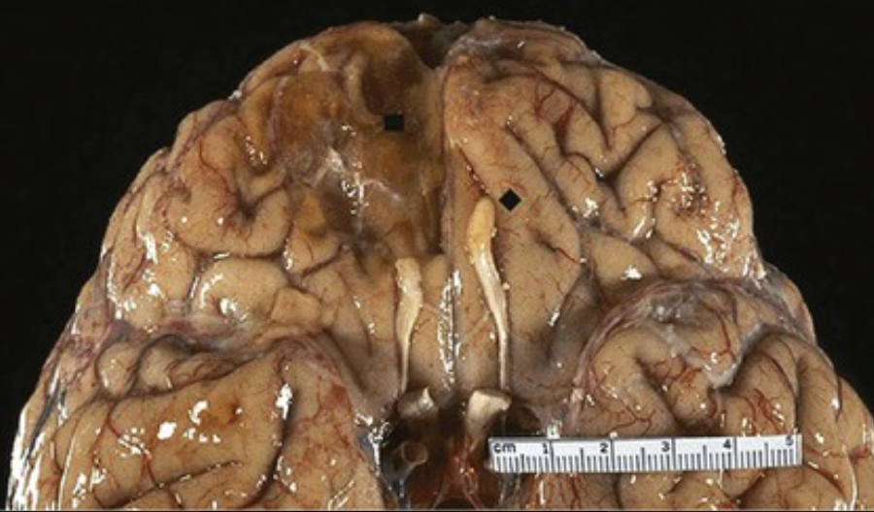
A 63-year-old woman slips on a loose area rug and falls, striking the back of her head; she does not lose consciousness. She has no subsequent neurologic problems other than right-sided anosmia. Many years later, she dies of unrelated causes; her brain at autopsy is shown.
What is your diagnosis?
How could her fall have led to this result?
The depressed right subfrontal lobe area with brown discoloration (▪) represents a remote contusion. The right olfactory bulb (compare with the left bulb [♦]) is absent from the trauma.
When the patient fell backward, her moving skull struck the floor and transmitted the force anteriorly (contrecoup injury).

Slide 22
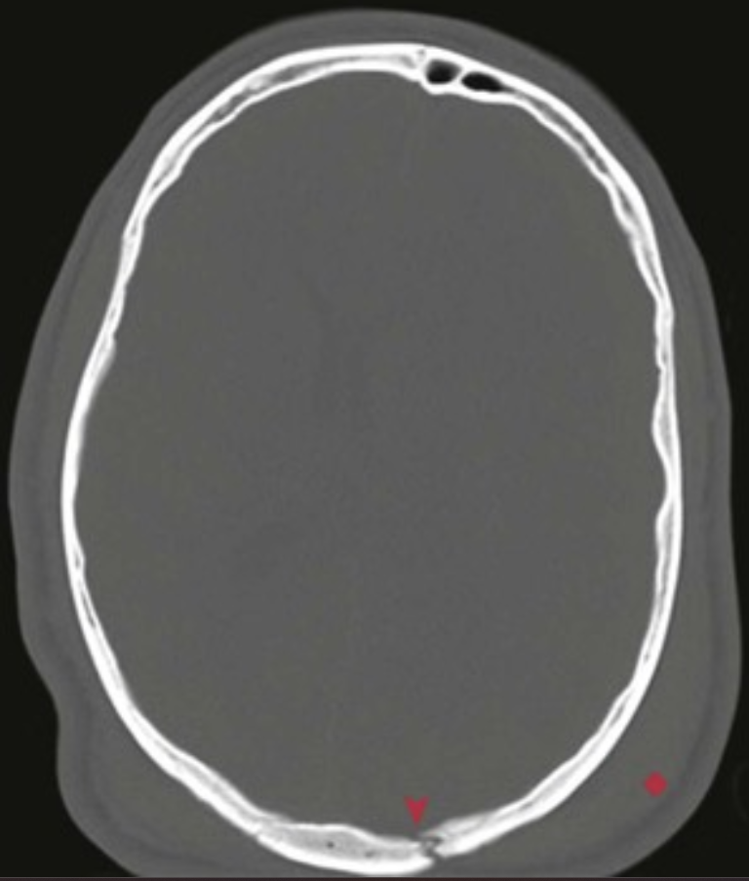
A 92-year-old man slips in the bathtub and falls. He develops a worsening headache. A head CT scan is performed and shown here; the bone window setting is shown, which makes all soft-tissue density appear gray.
What is your diagnosis?
In which direction did he fall?
What complication can develop on the opposite side of his head?
If he develops mental status changes 3 weeks later, what complication should be suspected?
Note a posterior occipital skull fracture (▴) with soft-tissue swelling (♦) at the occiput as a result of blunt force trauma. He fell backward.
The moving skull striking an object transmits the force to the opposite side, which results in a contrecoup injury such as subfrontal or temporal tip contusions. The contusions can also bleed into the subarachnoid space.
Falls in older individuals who have cerebral atrophy are more prone to the tearing of cerebral veins and subsequent subdural hematoma from the venous bleeding.

Slide 23
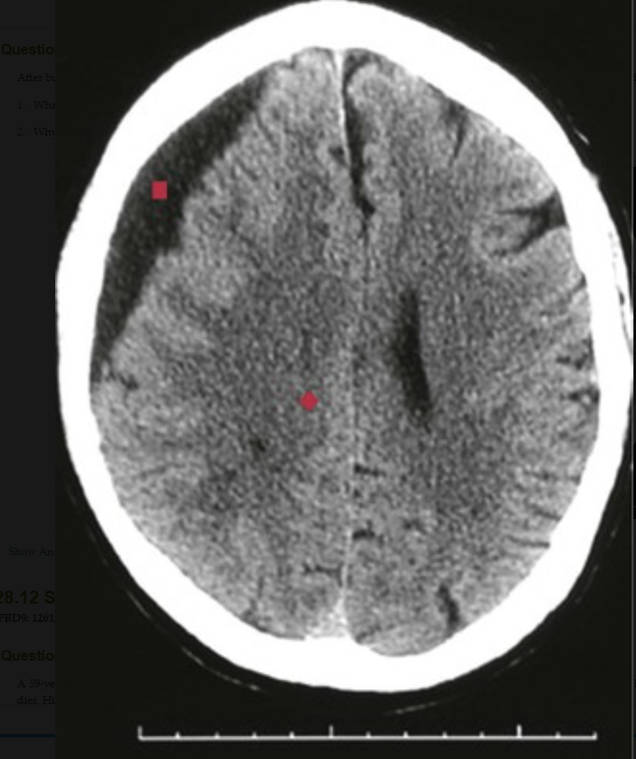
After bumping her head against a cabinet door 1 month earlier, an 82-year-old woman has become more irritable and confused, with new-onset headaches. Her head CT scan is shown. What is your diagnosis? Why is there a 1-month delay in symptom onset?
This is a chronic subdural hematoma. There is fluid collection (▪) beneath the dura on the right, with compression of the underlying cerebral hemisphere and left shift to efface (♦) the lateral ventricles on the right. The hemorrhage crosses the cranial sutures, so this cannot be an epidural hematoma.
After trauma—especially when there is some cerebral atrophy and the vessels are less well tethered—there can be slight tearing and slow blood collection; symptoms can develop over the course of days to weeks.

Slide 24
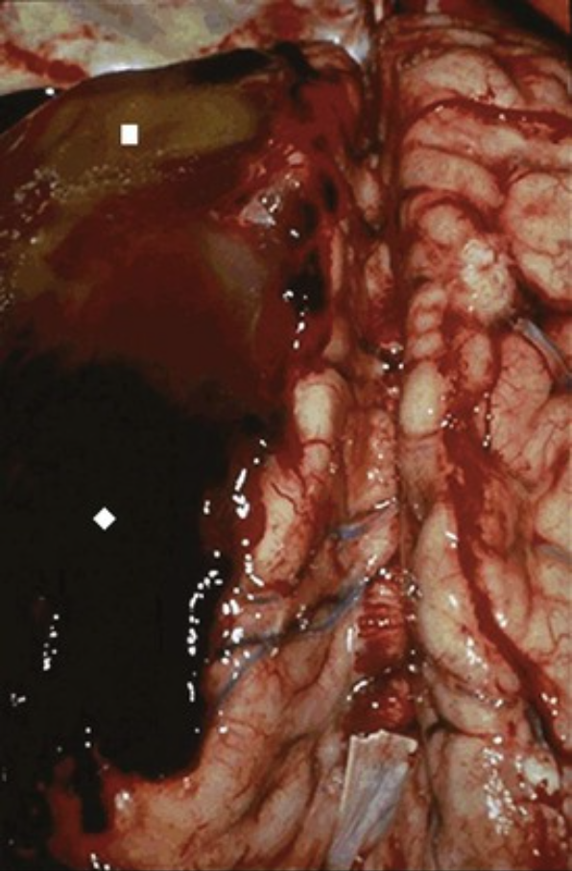
A 59-year-old man falls outside of his favorite tavern (where he has fallen more than once before on his wobbly way home). Despite a headache and confusion, he violently refuses any assistance. He collapses and dies. His brain is shown at autopsy.
Describe the findings shown.
How does this condition develop?
Why might he develop a cranial nerve III palsy?
What lesion could develop in his midbrain?
Blood has collected beneath the dura and over the left cerebral hemisphere. The pale tan to green region (▪) suggests prior injury and resolution, whereas the dark red region (♦) suggests more recent hemorrhage.
This subdural hematoma likely represents bleeding from traumatized and torn cerebral veins.
Blood collecting in the cranial cavity increases pressure and leads to medial temporal lobe herniation against the third nerve near the midbrain.
Duret hemorrhages can develop in the midbrain and pons as a result of medial temporal lobe herniation.

Slide 25
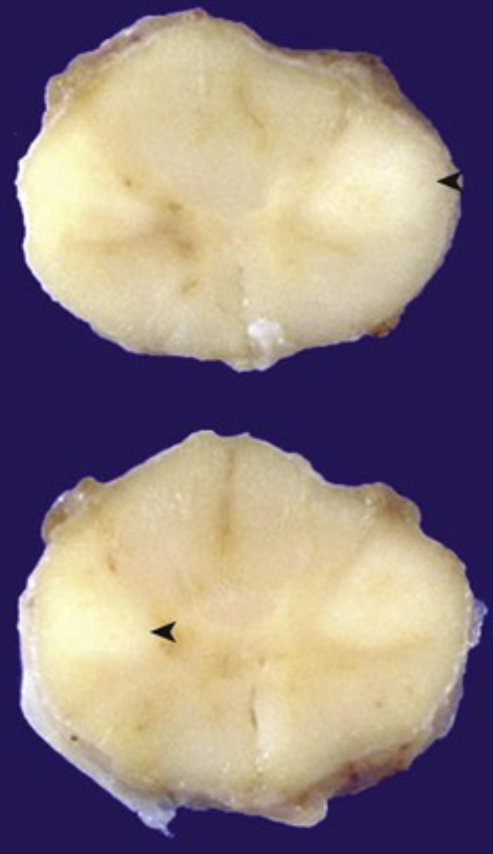
A 51-year-old man with a 1-year history of increasing hand and forearm weakness and clumsiness develops dysarthria and dysphagia. He dies as a result of an acute aspiration event. Two levels of his spinal cord are shown, with the corticospinal tracts (◂) being lighter in appearance.
What is your diagnosis? What is the pathologic mechanism for these findings?
What is the course of this disease?
This patient had amyotrophic lateral sclerosis (ALS).
There is a loss of upper motor neurons in the motor cortex and the cranial nerve nuclei and a loss of anterior horn cells in the spinal cord. The result is progressive motor weakness.
The neuronal loss is inexorable, with death within 2 years occurring in most cases. Death may occur more quickly if bulbar signs are present, as they are in this man.

Slide 26
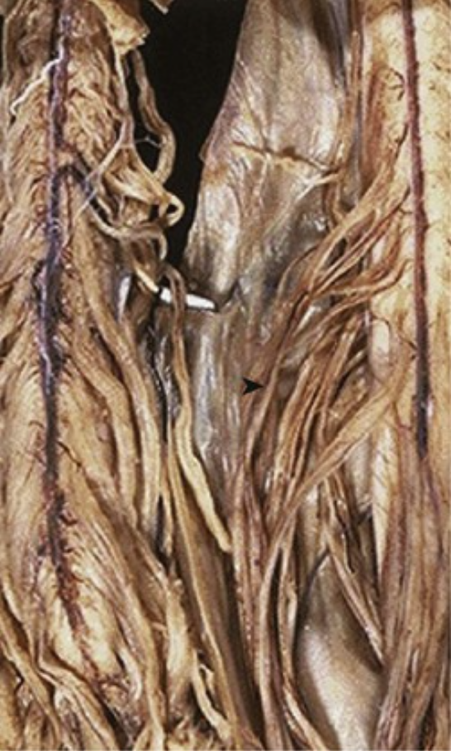
A 48-year-old woman who is too weak to climb a flight of stairs reports bilateral leg spasticity. On examination, her thigh and leg muscles are atrophic, and a biopsy specimen shows muscle fiber group atrophy. Her spinal cord would appear as shown on the right (▸); a normal cord is shown on the left.
What is your diagnosis? What would microscopy of the spinal cord show?
A famous person—for whom this disease is named—was never given his diagnosis by his neurologist, even after his consecutive game streak of 2130 was broken by this disease. What is his name? What other high-profile individual has this disease (and has continued his work despite it)?
This is amyotrophic lateral sclerosis (ALS). The ventral nerve roots (▸) in the patient are quite thin as compared with normal.
A loss of anterior horn cells would be present in the cord.
The diagnosis of ALS was initially withheld from baseball player Lou Gehrig in 1939, which is an example of “paternalism” in medicine. He died 2 years later. Astrophysicist Stephen Hawking also has ALS, but he has survived for more than three decades with it.

Slide 27
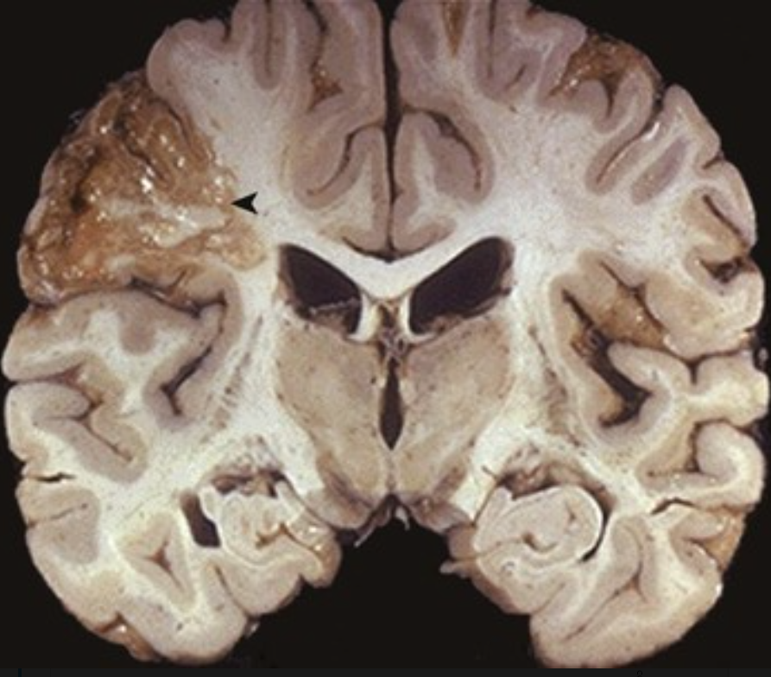
A 66-year-old woman with rheumatic heart disease develops sudden left lower leg paralysis. This is followed in short order by a loss of consciousness and death. Her brain is shown at autopsy.
What is your diagnosis?
What is the pathologic mechanism?
What microscopic process is present?
Had this patient lived, would function be recovered?
The area of reddish, glistening parietal lobe is a cerebral infarct (▴).
This stroke can be ischemic, secondary to cerebral artery thrombosis, or can result from embolus of a cardiac mural thrombus (e.g., in a patient with a dilated left atrium caused by rheumatic mitral valve stenosis).
There is liquefactive necrosis. As macrophages clear the debris, the lesion becomes cystic.
Some function can be recovered as the brain “rewires” itself, but such plasticity declines with aging.

Slide 28
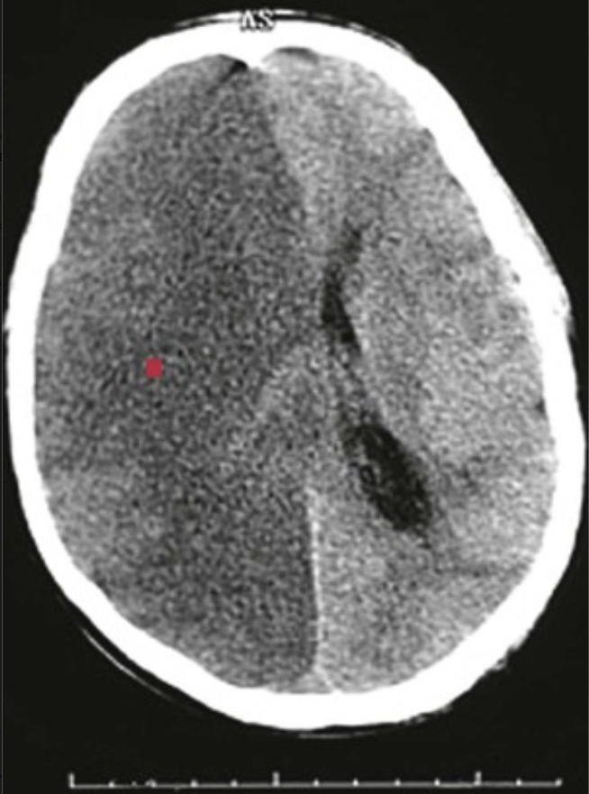
A 58-year-old man with diabetes mellitus has a sudden loss of consciousness and remains in a persistent vegetative state. His CT scan is shown.
What is your diagnosis? How could diabetes mellitus contribute to this?
A loss of distinction between the gray and white matter along with signal attenuation consistent with edema (▪) is the result of a massive stroke: a CNS infarction.
Patients with diabetes mellitus can have advanced atherosclerosis involving the cerebral arteries, which leads to occlusion with ischemia, or they may have thromboembolism with infarction caused by unstable plaque. Coronary artery atherosclerosis can lead to myocardial infarction that is complicated by ventricular mural thrombosis; subsequent embolization causes infarction that can become hemorrhagic as the embolus fragments and the blood flow is restored into necrotic tissue.

Slide 29
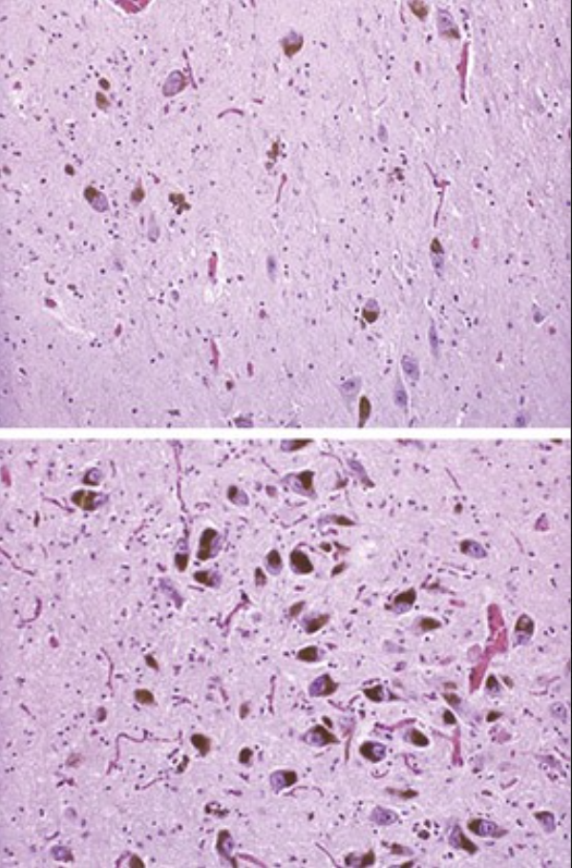
A 44-year-old man has a 2-year history of increasing difficulty initiating movement. At rest, he has a hand tremor that ceases when he is making a purposeful motion. His midbrain (and specifically his substantia nigra) would appear as shown in the upper panel as compared with normal midbrain as shown in the lower panel.
What is your diagnosis? What pharmacologic therapy can be used?
What gene alterations may be present?
This patient has Parkinson disease (PD) with a loss of pigmented neurons in the substantia nigra.
L-dopa (L-dihydroxyphenylalanine) is the immediate precursor to dopamine, and it has the advantage of passing across the blood-brain barrier. It transiently increases local CNS dopamine levels.
Such an early onset suggests a familial form of PD. There may be Parkin mutations in the α-synuclein gene; Parkin mutations tend not to form Lewy bodies. Sporadic PD in older individuals is not typically associated with such mutations.

Slide 30
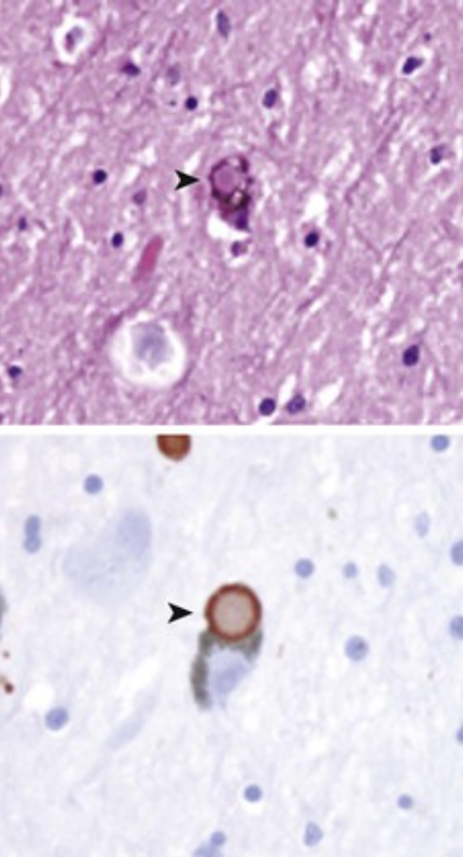
A 69-year-old woman with recent progressive decline in carrying out activities of daily living frequently sits motionless and staring into space; she also has frank visual hallucinations. She has difficulty initiating movement, and she exhibits muscular rigidity and resting tremor of her left hand. Her neocortex is shown (immunohistochemical staining for α-synuclein is shown in the lower panel).
What is your diagnosis? What is her movement disorder?
Pink Lewy bodies (▸) in the substantia nigra and the neocortex are seen in dementia with Lewy bodies (DLB). These are composed of aggregated α-synuclein (admixed with other proteins), an abundant lipid-binding protein that is associated with the synapses.
Parkinson-like features are often present in patients with DLB. Varying levels of attention, greater visuospatial impairment, and hallucinations are more characteristic for DLB than other dementias. Otherwise, DLB often seems similar to Alzheimer disease.

Slide 31
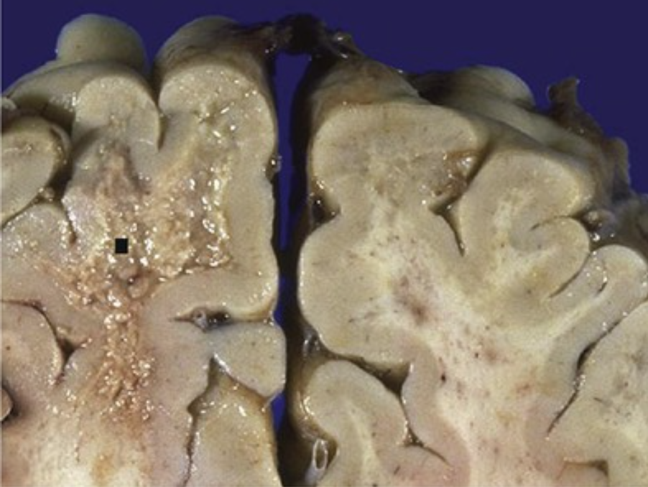
A 39-year-old man with AIDS and a CD4+ lymphocyte count of 80/mm3 (nl 490 to 1740/mm3) has a 1-month history of headaches with right arm weakness, speech difficulties, cognitive changes, and a gait disorder. He dies of Pneumocystis pneumonia. His brain is shown at autopsy. What is your diagnosis? What is the likely cause?
This is progressive multifocal leukoencephalopathy. Note the granularity (▪) that primarily involves the white matter.
This is likely the result of JC polyomavirus, an opportunistic infection that preferentially causes a lytic infection of oligodendrocytes, which leads to CNS demyelination. Pneumocystis jiroveci infection is typically seen in immunocompromised hosts.

Slide 32
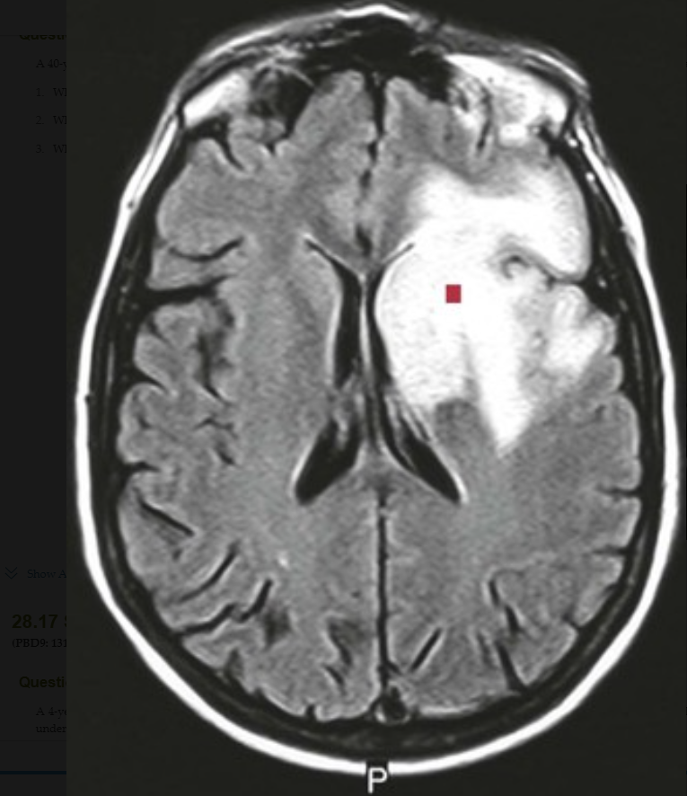
A 40-year-old woman who underwent chemotherapy for breast cancer develops visual disturbances with diplopia, cognitive changes, and new-onset seizures. Her brain MRI is shown. What is your diagnosis? What would you expect to see microscopically? What is the pathophysiology of this disease?
The hyperintense area (▪) that involves the white matter in the left frontoparietal region spares the gray matter. This is typical of progressive multifocal leukoencephalopathy.
Microscopic features would include demyelination, with enlarged nuclei of oligodendrocytes, scattered microglial cells, and bizarre astrocytes.
Immunosuppression with a loss of cell-mediated immunity allows for the reactivation of prior JC polyomavirus infection, which is evident serologically in about 90% of normal young adults.

Slide 33
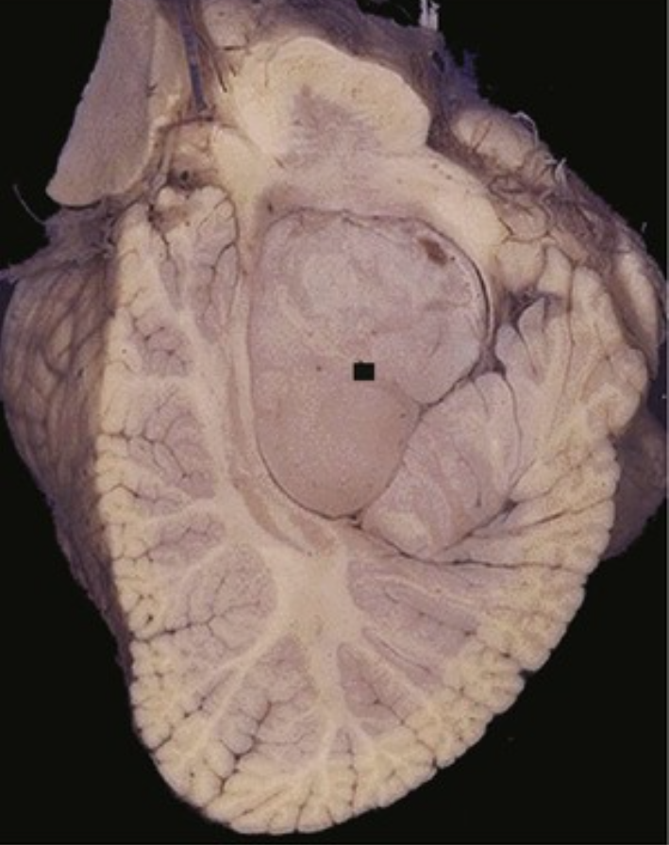
A 4-year-old child with a 2-month history of unremitting headaches, lethargy, nausea, and vomiting has an MRI showing marked ventricular enlargement above the fourth ventricle. Before any intervention can be undertaken, the child has an unwitnessed aspiration event and dies. His posterior fossa contents are shown.
From where is this mass likely arising?
What is the diagnosis?
Explain the symptoms.
What underlying syndrome may be present?
This circumscribed mass (▪) is within the fourth ventricle, and it is arising from the ependymal cells that line the ventricle.
This is an ependymoma. This location in the fourth ventricle is common when the tumor arises during the first two decades of life.
This patient has obstructive hydrocephalus.
This patient likely has neurofibromatosis type 2; mutations in the NF2 gene on chromosome 22 seem to be associated only with cord ependymomas.

Slide 34
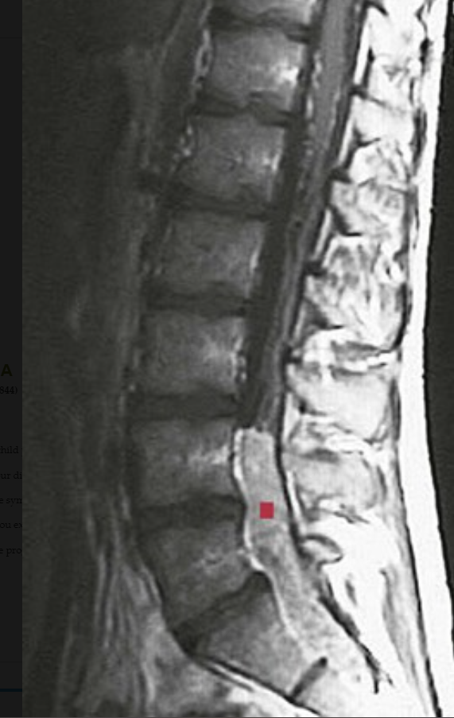
A 28-year-old woman with a 3-month history of worsening low back pain and leg weakness has objective muscle atrophy and fasciculations, with sensory loss in the perianal region. Her spine MRI is shown.
Where is this lesion located?
What is your diagnosis?
What do you expect to see microscopically?
What could be seen in the CSF?
Name an associated gene mutation.
There is an enhancing, lobulated mass (▪) in the region of L4–S2.
This is likely an ependymoma.
Most ependymomas in the cauda equina region have a myxopapillary pattern microscopically.
Ependymomas can seed into the CSF.
Spinal ependymomas often involve an NF2 gene mutation.

Slide 35
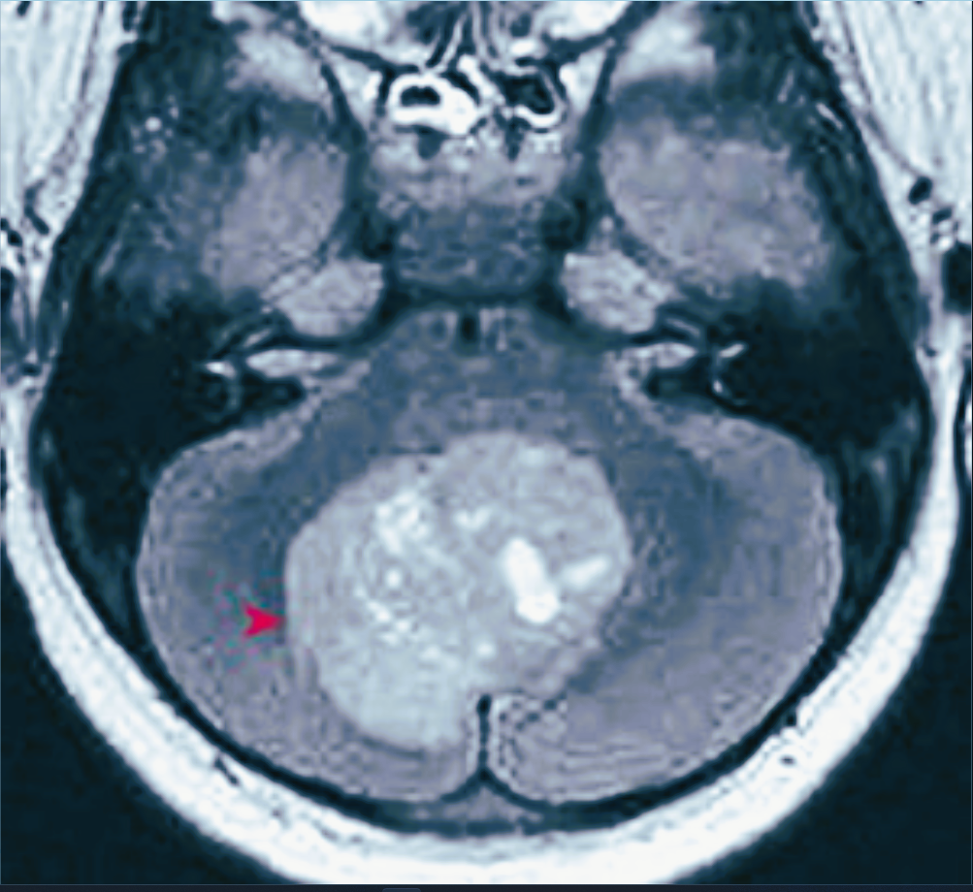
A 5-year-old child presents with a wide-based gait and truncal ataxia. MRI reveals third and lateral ventricular enlargement, along with the lesion shown.
What is your diagnosis? Explain the symptoms. What do you expect to see microscopically? What is the prognosis?
This is a medulloblastoma; the circumscribed but irregular mass (▸) is within the midline of the cerebellum, above the fourth ventricle. Medulloblastomas account for 20% of childhood brain tumors.
The patient has obstructive hydrocephalus; tumor cells can also seed into the CSF.
This is one of the “small round blue cell” tumors of childhood. The highly cellular mass has poorly differentiated cells, which sometimes form Homer-Wright rosettes.
The tumor is highly malignant but also highly radiosensitive. With complete surgical resection and radiotherapy, 5-year survival approaches 75%.

Slide 36
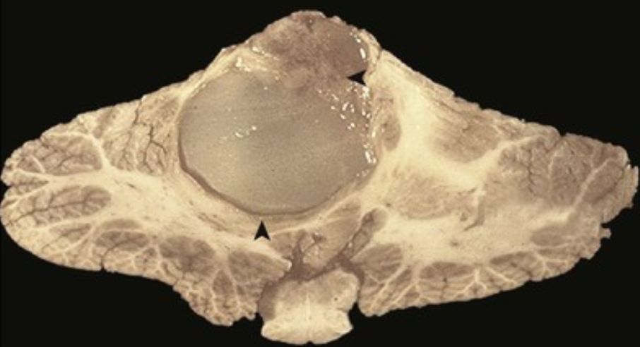
A 7-year-old girl develops worsening headache, nausea, vomiting, and a gait abnormality. Her brain would appear as shown.
What is your diagnosis?
What do you expect to see microscopically?
What is the prognosis?
Biotherapy that targets what signaling pathway may be useful?
This is a pilocytic astrocytoma. The cerebellar mass (◂) is well circumscribed and mostly cystic, with a mural nodule (▴) that contains most of the tumor cells.
Tumor cells are bipolar, with long, thin, glial fibrillary acidic protein (GFAP)–positive processes. Rosenthal fibers (long, thick, eosinophilic structures that are typical of sites with reactive gliosis) are also characteristically present.
Most of these tumors are slow growing, noninfiltrative, and amenable to surgical resection, with a good prognosis.
Inhibiting the BRAF signaling pathway may be useful, particularly for lesions in unresectable locations.

Slide 37
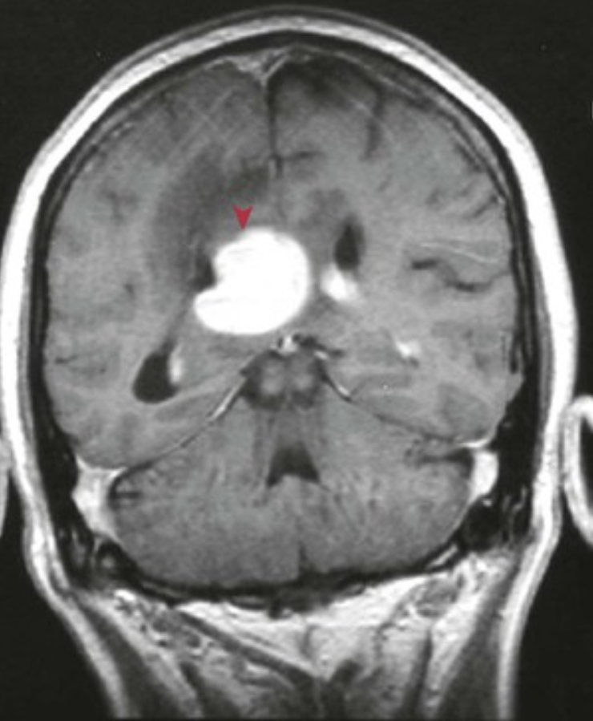
A 41-year-old man with AIDS and a CD4+ count of 66/mm3 (nl 490 to 1740/mm3) has a 6-week history of lethargy and confusion. He develops a severe headache and then has a seizure. A stereotaxic biopsy specimen of the mass shown on MRI reveals large cells with scant cytoplasm expressing CD20.
What is your diagnosis? What viral genome is likely present?
Based on the location and the history, this is likely to be a primary non-Hodgkin lymphoma; most are large B-cell lymphomas. The enhancing periventricular mass (▴) has adjacent darker regions that are consistent with edema.
Virtually all primary CNS lymphomas (with or without AIDS) are associated with Epstein-Barr virus (EBV) infection.

Slide 38
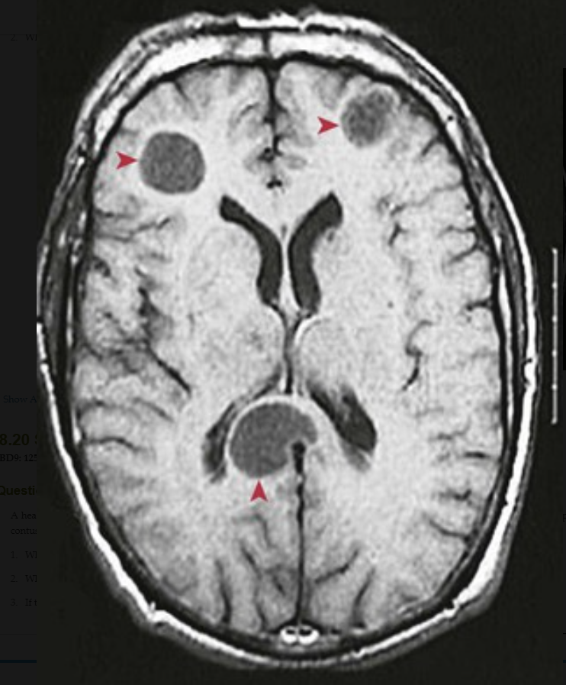
A 67-year-old male smoker becomes irritable and emotionally labile, with headaches and nausea. His brain MRI is shown, and a stereotaxic biopsy specimen of a left frontal mass shows small dark cells with scant cytoplasm that stains for neuroendocrine markers. What is your diagnosis? What are the probable sources of these lesions?
Multiple masses with neuroendocrine markers suggest metastases from a lung primary small-cell carcinoma. The anterior masses (▸) are near the cerebral gray-white junction; the posterior mass (▴) impinges on the corpus callosum.
Half of brain metastases originate from a lung primary. Other primary tumors (near the top of a long list) that metastasize to the CNS include breast and kidney carcinomas as well as melanoma (which is often widely metastatic).

Slide 39
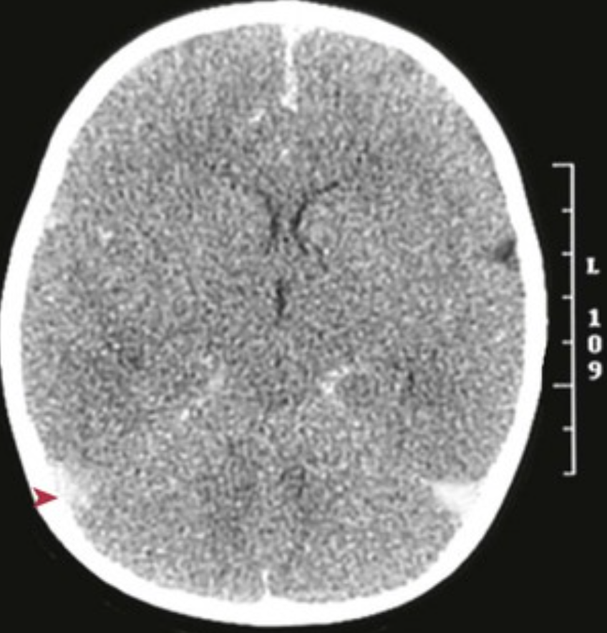
A healthy infant left with a caregiver is unresponsive when the parents return; the caregiver asserts, “I only accidentally dropped the baby.” On physical examination, there are retinal hemorrhages and soft-tissue contusions on both arms. The infant's head CT scan is shown. What are the CT findings? What is likely to have happened? If the infant dies, what is the manner of death?
There is diffuse low attenuation that is characteristic of diffuse cerebral edema. The bright areas (▸) represent hemorrhage in the subarachnoid space. The lateral ventricles are effaced.
These findings result from the violent shaking seen with “shaken baby syndrome”; there can be extensive intracranial damage with subarachnoid and subdural bleeding as well as cerebral damage and edema.
The manner of death would be homicide.

Slide 40
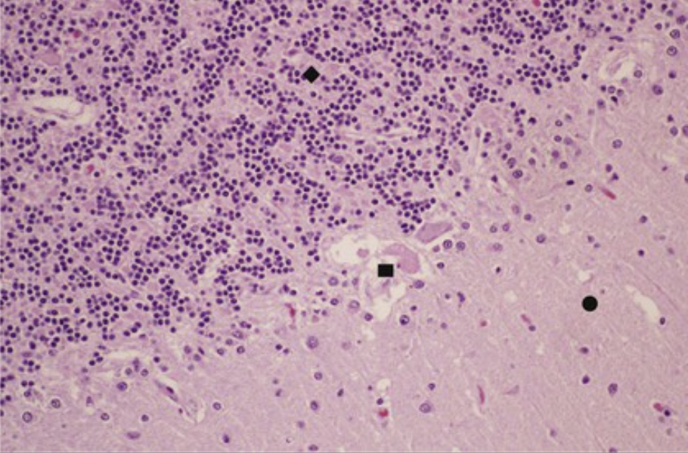
A 70-year-old man with ischemic heart disease has a sudden cardiac arrest; 10 minutes elapse before a cardiac rhythm can be reestablished. He does not regain consciousness. His EEG is isoelectric, and he is allowed to die quietly. The microscopic appearance of his cerebellum is shown.
What major cell in this tissue has been injured?
How did this happen?
Is this “brain death”?
The Purkinje cells (▪) between the granular (♦) and molecular (•) layers are necrotic. Neurons are the CNS cells that are most vulnerable to injury.
The patient had global cerebral ischemia as a consequence of his cardiac arrest, with markedly reduced cardiac output. About 15% of the resting cardiac output and about 20% of the total oxygen consumption go to support the CNS.
Widespread neuronal death leads to “brain death,” with a loss of EEG activity, a loss of spontaneous respiration, a loss of reflexes, and absent cerebral perfusion.

Slide 41
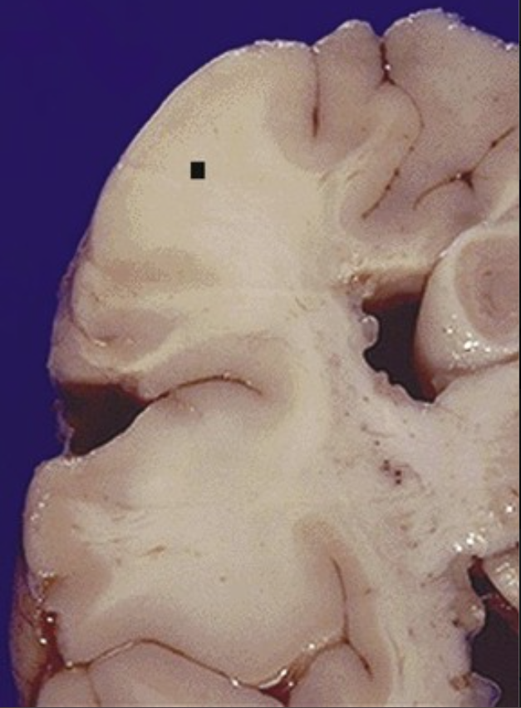
13-year-old girl has a history of seizures. She has cutaneous shagreen patches, a subungual fibroma, and retinal glial hamartomas. A characteristic CNS lesion for this syndrome is shown.
What is your diagnosis? What is the genetic basis for this syndrome? What lesion may this patient have in her heart?
What renal lesions might she develop?
This is a cortical “tuber” or hamartoma (▪) found in a patient with tuberous sclerosis.
The most commonly mutated gene is TSC2, which encodes for the tuberin protein; this protein may have GTPase-activating activity. The less common TSC1 gene mutation affects the protein hamartin, which does not have a known function. Together, both proteins are suggested to regulate cellular proliferation.
Cardiac rhabdomyoma
Renal angiomyolipomas

Slide 42
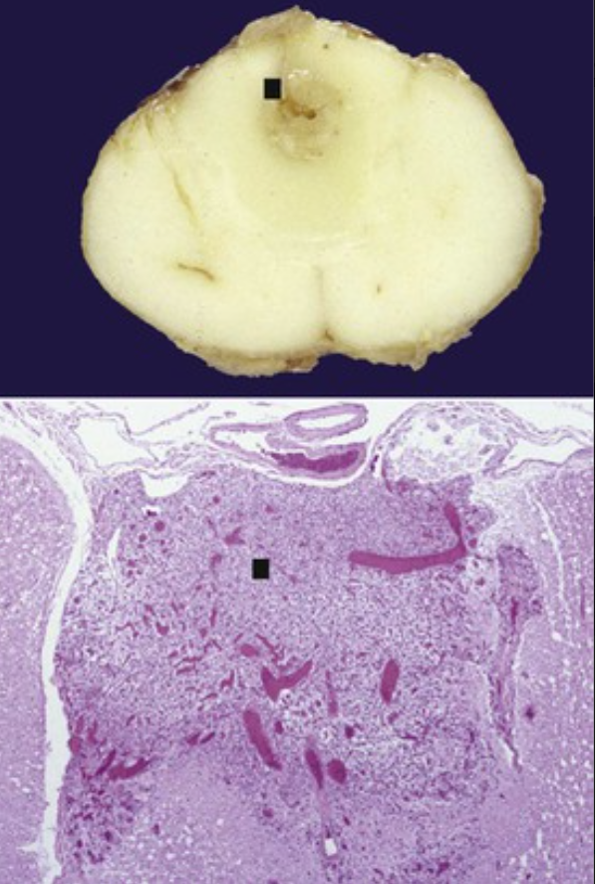
A 20-year-old man is plethoric, with a hemoglobin level of 21 g/dL (nl 13.8 to 17.2 g/dL). He is hypertensive, and he has elevated urinary catecholamine levels. An abdominal CT scan reveals adrenal and renal masses with hepatic cysts. MRI reveals cerebellar and cervical spinal cord lesions. The gross and microscopic appearances of a characteristic spinal cord lesion from a similar patient are shown. What gene has mutated? What is the cord lesion? What are the patient's adrenal and renal lesions likely to be?
The von Hippel–Lindau (VHL) gene acts as a tumor suppressor. It regulates the expression of vascular endothelial growth factor (VEGF) through hypoxia-inducible factor-1.
VHL syndrome is associated with several neoplasms; capillary hemangioblastomas (▪) are common in the CNS. These hemangioblastomas can also secrete erythropoietin and cause polycythemia (hence the patient's florid facies and elevated hematocrit level).
Pheochromocytoma and renal cell carcinoma.

Slide 43
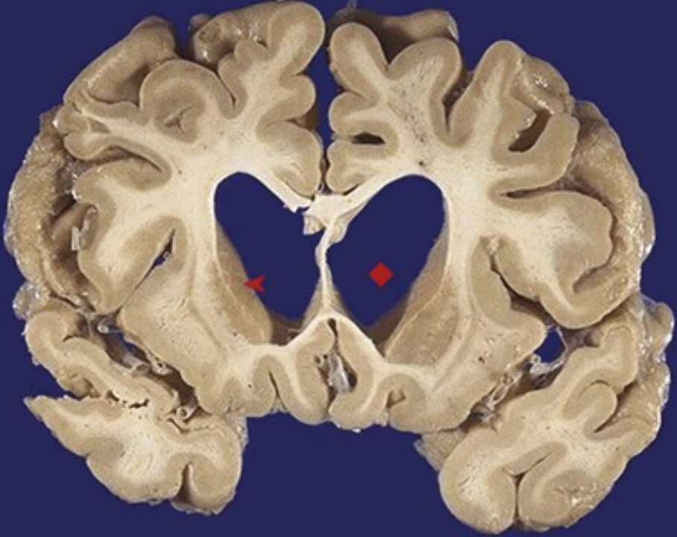
A 44-year-old man with a 1-year history of worsening jerky, hyperkinetic (choreoathetoid) movements of all limbs subsequently develops bradykinesia and rigidity. After another 8 years, he dies of pneumonia. The gross appearance of his brain is shown.
What is your diagnosis? What is the genetic mechanism for this disease? Why might individuals with the abnormal gene not manifest the disease?
The corpus striatum is most affected by Huntington disease (HD). Note the marked caudate nucleus atrophy (▴) with hydrocephalus ex vacuo (♦).
This is an example of a trinucleotide repeat disorder. Increased repeats of CAG in the huntingtin gene coding sequence lead to increased numbers of linked glutamines. These presumably lead to protein misfolding, aggregation, and toxic intranuclear inclusions.
Normal HD genes have 6 to 35 repeats. Although 36 to 38 repeats may not lead to disease, 39 or more usually do. Repeats tend to expand in successive generations (“anticipation”).

Slide 44
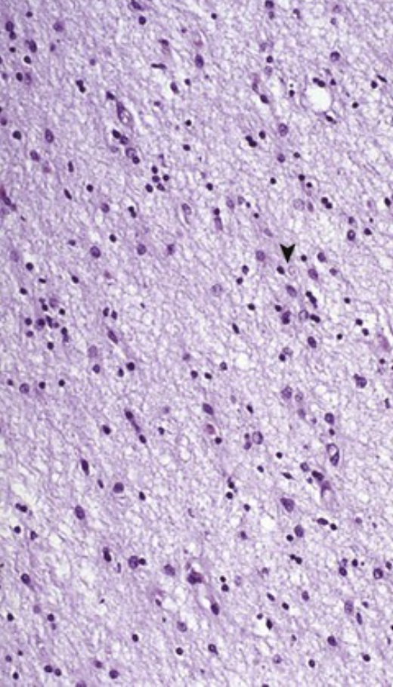
A 49-year-old woman with a 10-year history of a choreoathetoid movement disorder develops depression and memory loss that progress to profound dementia. She dies of aspiration pneumonia. The microscopic appearance of her caudate nucleus is shown.
What is your diagnosis?
What inheritance pattern does this disease have?
Why was her father affected at an older age?
Note the loss of neurons and the gliosis (▴), which are typical for Huntington disease.
There is an autosomal-dominant pattern of inheritance. Spontaneous new mutations are uncommon.
The expansion of CAG tandem repeats occurs during spermatogenesis, so fathers can pass expanded numbers of repeats to offspring, who manifest more severe disease at an earlier age (“anticipation”).

Slide 45
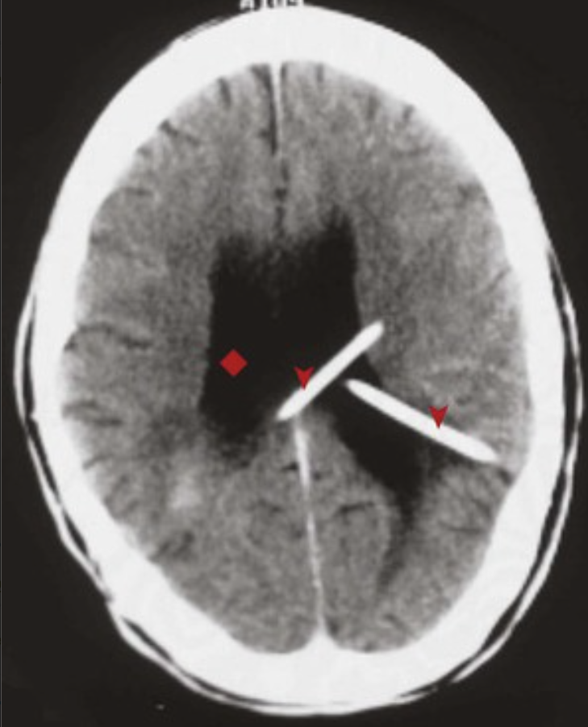
A 24-year-old man with a 1-week history of headache, vomiting, and blurry vision is found to have papilledema. His head CT scan after treatment is shown. The CT scan revealed a tumor at the base of the brain.
What is your diagnosis? How was this treated?
Describe the normal flow of CSF.
The lateral ventricles are enlarged (♦), and the history is consistent with acute hydrocephalus.
Two ventriculostomy shunts (▴) were placed to relieve the increased pressure acutely.
About 0.5 L of CSF per day is produced in choroid plexuses. This fluid circulates from lateral ventricles to the third ventricle, down the aqueduct of Sylvius, into the fourth ventricle, and out the foramina of Luschka and Magendie into the subarachnoid space. The CSF is then reabsorbed in arachnoid granulations at the vertex.

Slide 46
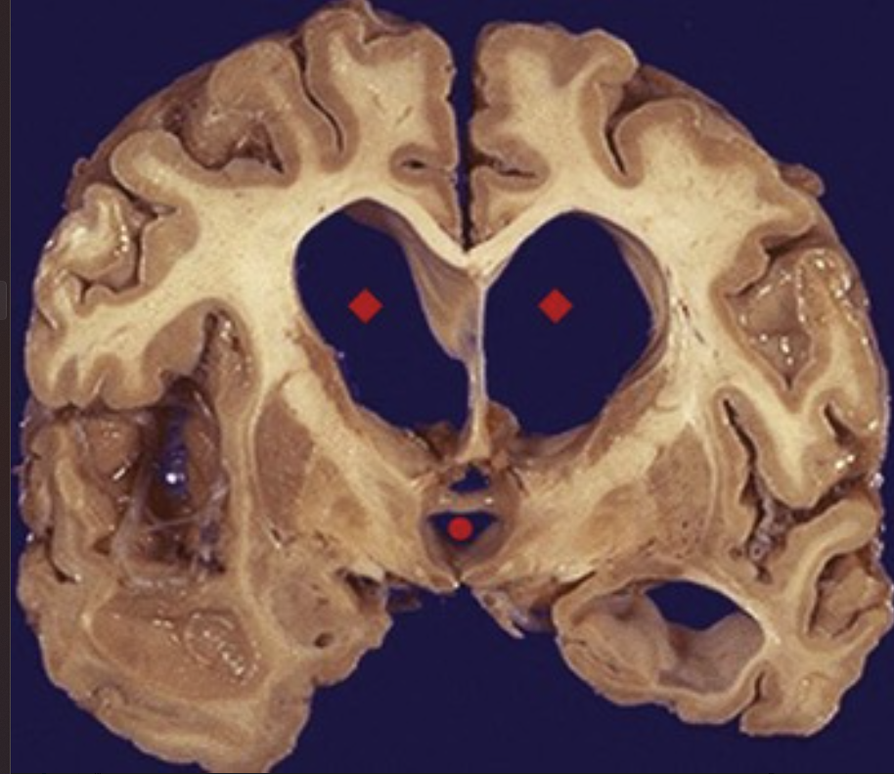
A 77-year-old woman who has had progressive dementia and incontinence for 1 year is found on examination to have gait apraxia. Papilledema is not present. The representative gross appearance of her brain is shown.
What is your diagnosis?
What could block the flow of CSF?
Why might CSF pressure be increased in the absence of a blockage to flow?
The findings point to normal-pressure hydrocephalus. Note the enlarged lateral ventricles (♦) and third ventricle (•) shown.
A neoplasm or an organization of hemorrhage or infection at the base of the brain can block CSF outflow from the foramina. Obstruction leads to noncommunicating hydrocephalus.
The obliteration of arachnoid granulations can occur after meningitis, thereby interfering with CSF reabsorption. A choroid plexus papilloma will occasionally produce excess CSF.

Slide 47
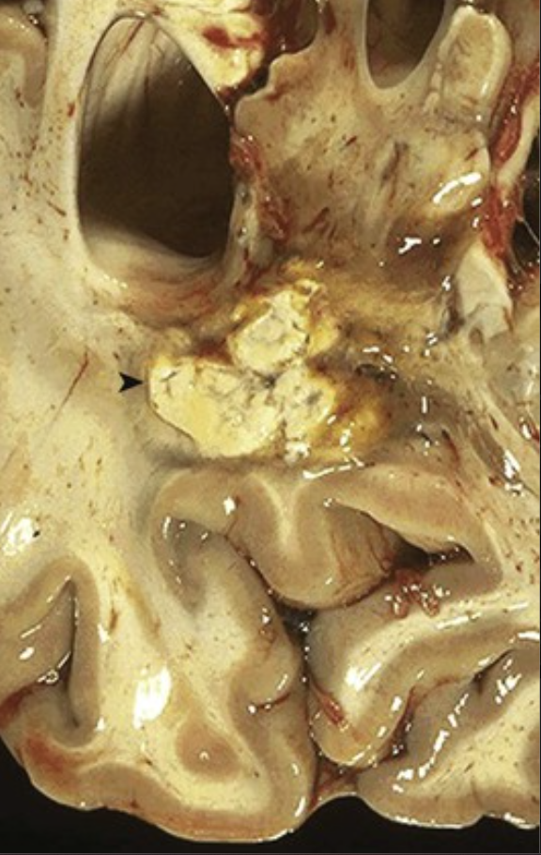
A 32-year-old HIV-positive man with newly diagnosed Kaposi sarcoma has a 3-day history of headache and confusion followed by seizures and hemiparesis. A CT scan of his brain shows multiple ring-enhancing lesions. The corresponding gross appearance of his brain is shown.
What is your general diagnosis?
Why does it cause “ring enhancement” on CT?
Suggest likely infectious causes in this patient.
Suggest other causes in this patient.
Abscess
Organization with increased vascularity at the margins of abscesses (▸) yield the “ring enhancement” seen with imaging.
CNS infections in patients with AIDS that yield this picture include toxoplasmosis and fungal diseases (e.g., cryptococcosis). Other causes of brain abscesses include nocardiosis and bacterial infections.
In this patient, ring-enhancing lesions could also include lymphoma (Epstein-Barr virus–driven) and progressive multifocal leukoencephalopathy (JC virus); Kaposi sarcoma in the brain is rare.

Slide 48
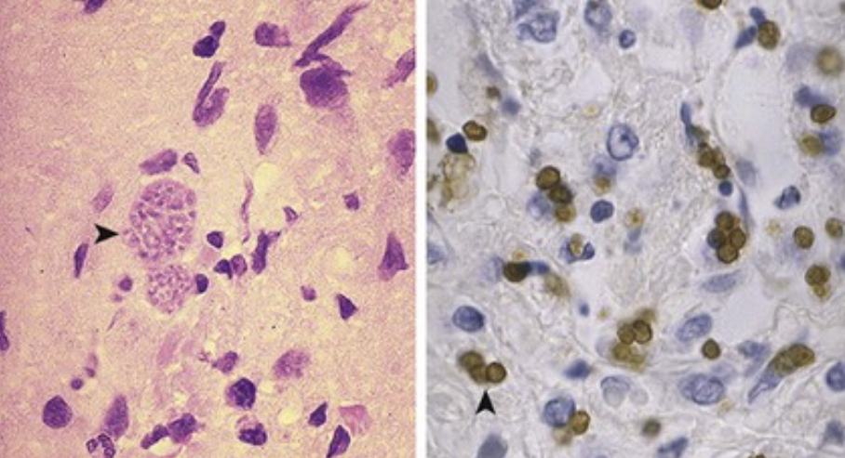
A 40-year-old woman with progressive weakness and ataxia for 10 days becomes lethargic and then comatose. MRI of her brain shows multiple areas of abnormal signal intensity with rim enhancement. The microscopic appearance of a stereotaxic biopsy specimen is shown (top, H&E; bottom, immunostain).
What is your diagnosis?
What complication could occur if she were pregnant?
Describe the life cycle of this organism.
This patient has Toxoplasma gondii as evidenced by pseudocysts filled with bradyzoites (▴). Tachyzoites (▸) are identified with immunostaining.
Congenital toxoplasmosis causes periventricular leukomalacia with necrosis and calcification.
Cats (definitive host) ingest bradyzoites that transform into gametocytes; these fuse to form zygotes, which sporulate and divide to form sporozoites within an oocyst that is finally shed. Ingested oocysts in humans release sporozoites that infect enterocytes, which rupture to release tachyzoites. These infect adjacent cells or are disseminated via the lymphatics and the bloodstream; they can infect a variety of cell types, including neurons and cardiac myocytes.

