Slide 1
Επιθηλιακά Νεοπλάσματα Μικροσκοπικό Εργαστήριο
Δέσποινα Μυωτέρη
Παθολογοανατόμος
Αρεταίειο Νοσοκομείο

Slide 2
Normal cells and Epithelia

Slide 3
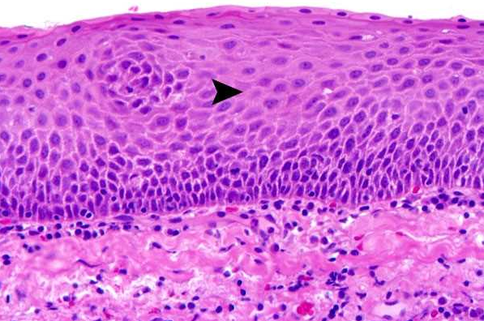
SQUAMOUS EPITHELIUM- Stratified squamous epithelium of cervix is shown composed of flattened cells one on the top of other and joined by intercellular bridges. The cells at the bottom-third are the most recent ones while the cells at the top are the oldest

Slide 4
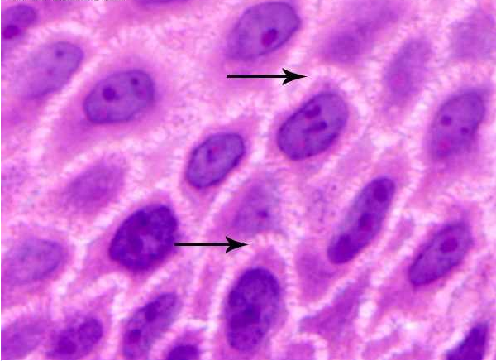
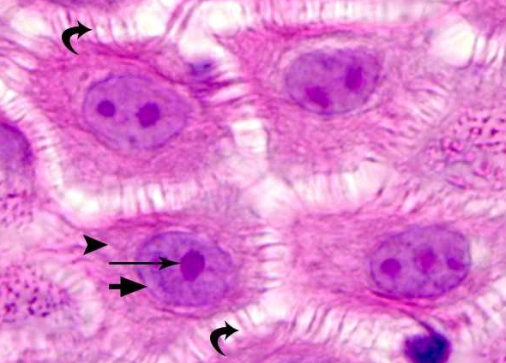
SQUAMOUS EPITHELIUM - Squamous cells are joined to each other by cell junctions called intercellular bridges (arrows), which represent a hallmark of squamous differentiation.
NORMAL CELLS, SQUAMOUS TYPE- Each cell contains a nucleus in the center bounded by a cell membrane (thick arrow). The nucleus contains nucleolus (long think arrow). Some cells contain two or three nucleoli. The cytoplasm is shown with an arrowhead containing various cytoskeletal components.

Slide 5
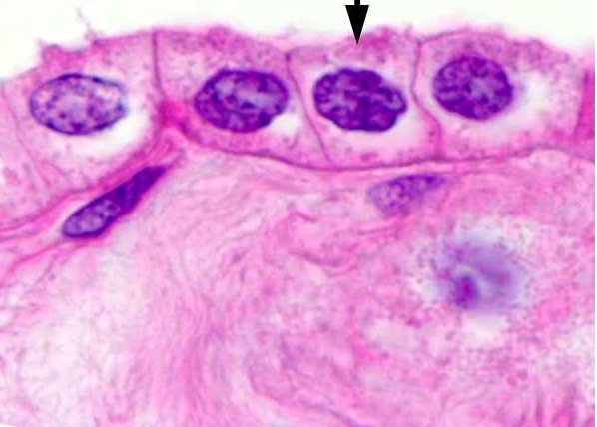
CUBOIDAL EPITHELIUM - In a cuboidal epithelium the lining cells are neither flat nor tall but more of less square shaped. Many tissues are lined by cuboidal epithelium, including ducts of many secretory glands

Slide 6
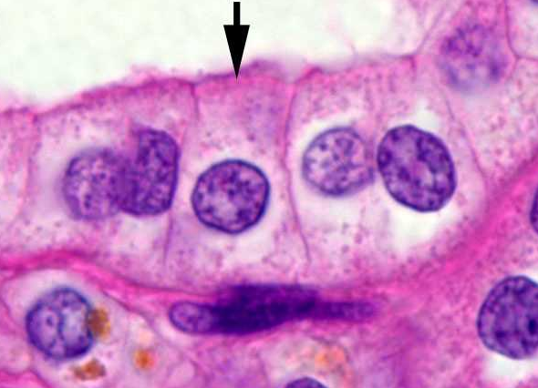
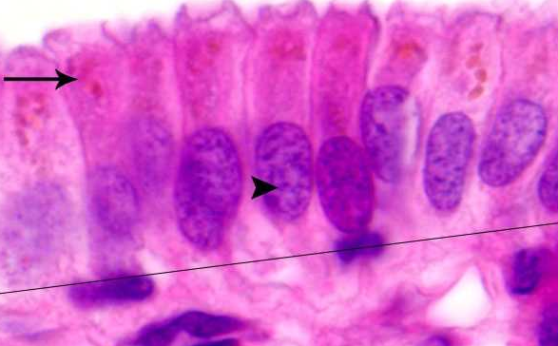
LOW COLUMNAR EPITHELIUM - In columnar epithelium the height is more than the width of the cell
HIGH COLUMNAR EPITHELIUM- This photomicrograph shows a high columnar epithelium of gallbladder with nuclei (arrowhead) present near the base of cells and bile pigment at the apical portion (long arrow on the left)

Slide 7
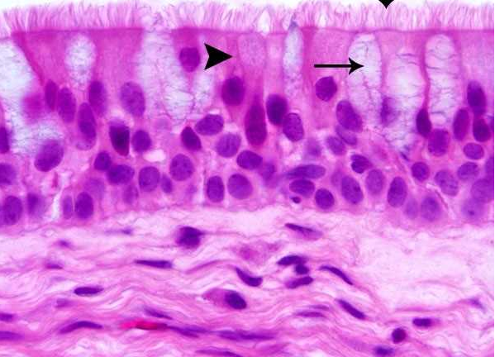
RESPIRATORY (CILIATED COLUMNAR) EPITHELIUM - The upper respiratory tract is lined by ciliated pseudo-stratified columnar epithelium. The columnar cells nuclei are not located in an exact position creating an impression of stratification but in fact no true stratification is present. The columnar cells are punctuated by mucus-producing goblet cells (thin arrow)

Slide 8
TRANSITIONAL EPITHELIUM (UROTHELIUM)- Transitional epithelium lines the urinary tract from renal pelvis down to the urethra. The cells can take a flattened to columnar shape depending on the horizontal stretch of the epithelium

Slide 10
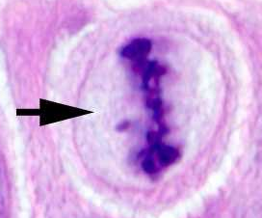
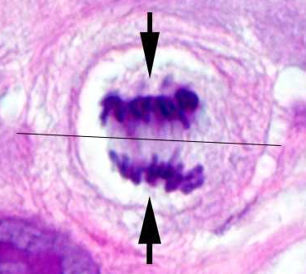
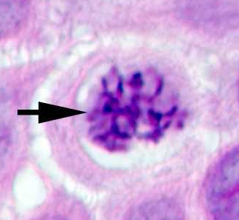
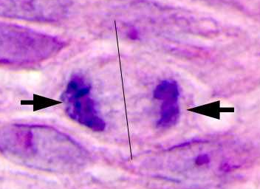
Normal Mitoses
NORMAL MITOSIS, METAPHASE
NORMAL MITOSIS, ANAPHASE
NORMAL MITOSIS, PROPHASE
NORMAL MITOSIS, TELOPHASE

Slide 11
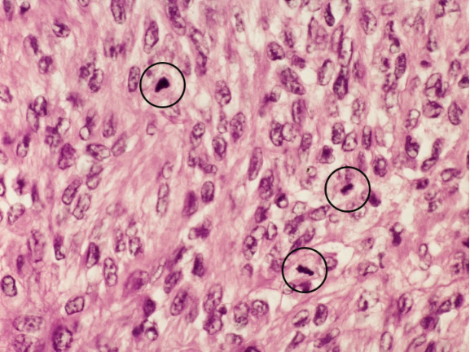

Slide 13
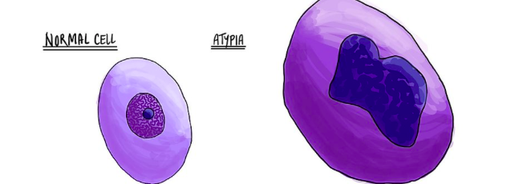
What does cytologic atypia mean?
Atypia is a word used to describe cells that look abnormal either in shape, colour, or size compared to normal, healthy cells in the same location (atypical cells)

Slide 14
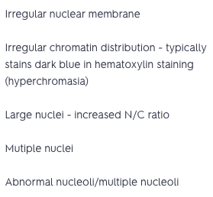
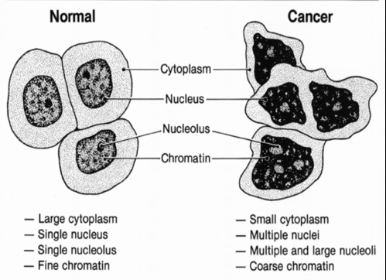
What are the characteristic features of neoplastic cells?

Slide 15
What does hyperchromasia mean?
The word hyperchromasia describes a nucleus that looks darker than normal when examined under the microscope. Another word for hyperchromasia is hyperchromatic.

Slide 16
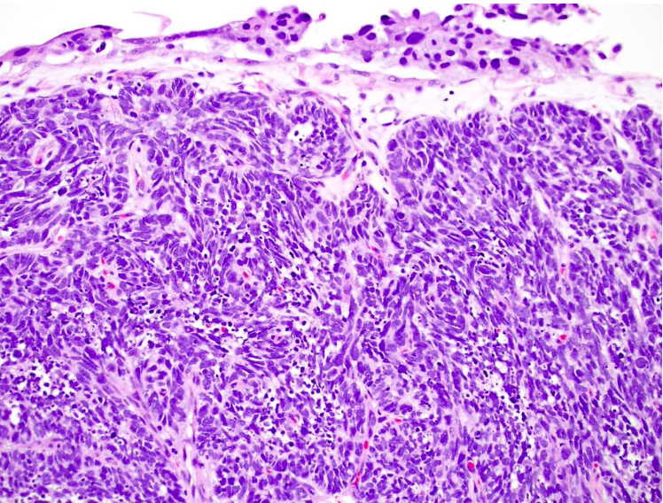
Small cell neuroendocrine carcinoma of the urinary bladder: minimal cytoplasm, nuclear molding, indistinct nucleoli

Slide 17
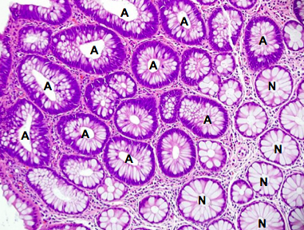
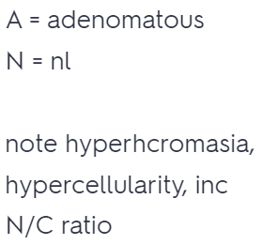

Slide 18
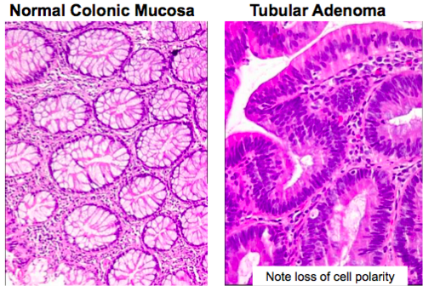

Slide 19
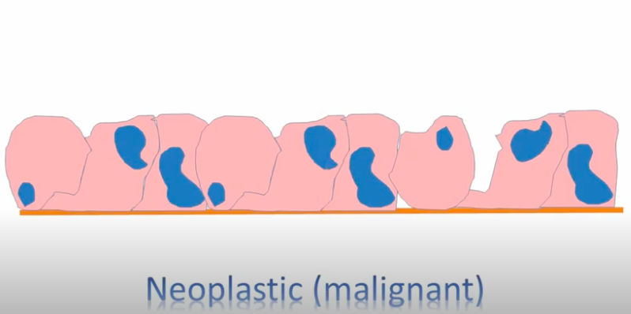
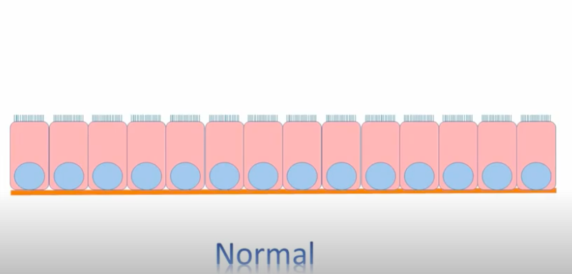
What is pleomorphism?
Variation in size and shape of cells and/or nuclei
Occuring in various distinct forms

Slide 20
What is pleomorphism?
Pleomorphism is often a feature of high grade, poorly differentiated, malignant tumours
- e.g. pleomorphic liposarcoma
But
Benign tumours may exhibit pleomorphism
- e.g. pleomorphic lipoma

Slide 21
Pleomorphic lipoma with myxoid change and multiple floret cells.

Slide 22
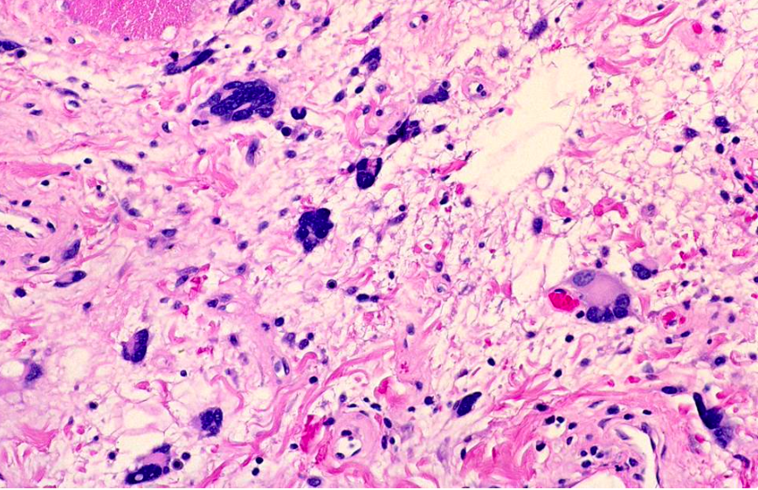
Pleomorphic lipoma with multiple floret cells, some with bizarre features
Infiltrative growth, necrosis, atypical spindle cells, pleomorphic lipoblasts and significant mitotic activity usually absent

Slide 23
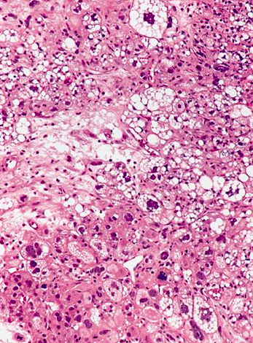
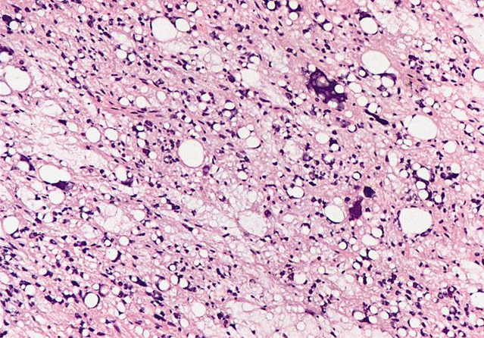
Pleomorphic liposaroma
Vacuolated lipoblasts
Myxoid stroma with markedly pleomorphic cells

Slide 25
Here are three abnormal mitoses. Mitoses by themselves are not indicators of malignancy. However, abnormal mitoses are highly indicative of malignancy. The marked pleomorphism and hyperchromatism of surrounding cells also favors malignancy.

Slide 26
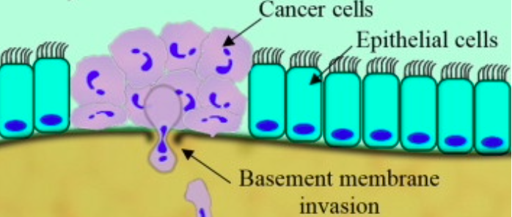
Atypical cellular features
Pleomorphism
↑ Nucleus/Cytoplasm
Hyperchromasia
Disordered organization
Invasion of basement membrane
Cancer
$$=$$
$$=$$
Dysplasia

Slide 32
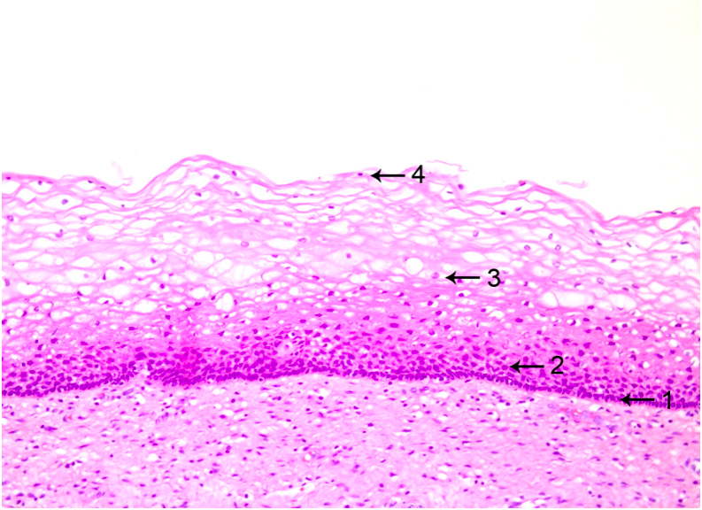
Ectocervix
Stratified nonkeratinizing squamous epithelium
Basal cells: deepest layer; dense nuclear chromatin, uniform oval nuclei oriented perpendicular to basement membrane, scant cytoplasm
Parabasal cells: located just above the basal cell layer; slightly more cytoplasm than basal cells; may be multiple cell layers thick
Intermediate cells: abundant cytoplasm which may be pink or clear due to glycogen accumulation
Superficial cells: small, round nuclei; abundant pink or clear cytoplasm; cells flatten and are oriented parallel to basement membrane
Hormone responsive
Superficial cells predominate in early cycle due to estrogen
Intermediate cells predominate in late cycle due to progestins
Loss of intermediate and superficial cells (atrophy) occurs postmenopause

Slide 33
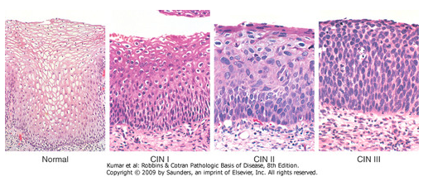
Low-grade SIL
High-grade SIL
Diagnosis of squamous intraepithelial lesions (dysplasia) is based on:
Nuclear / cytoplasmic (N/C) ratio
Nuclear atypia: variation in nuclear size and shape (“raisinoid”), hyperchromasia and coarse chromatin granules
Notes:
Σταφιδοειδής
χοντροκομμένος

Slide 34
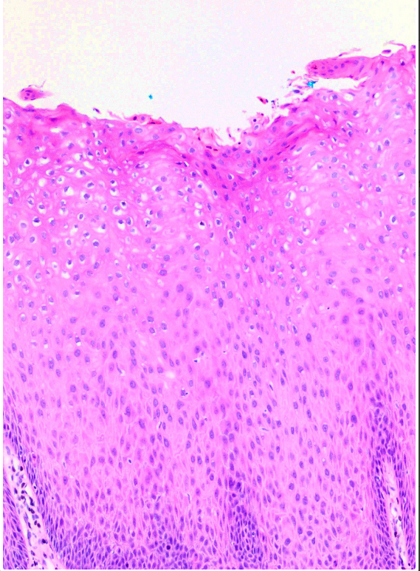
LGSIL(CIN I)
The changes involve only the lower 1/3 of the epithelium
Or there are koilocytic changes in the upper epithelium (maturation seen)

Slide 35
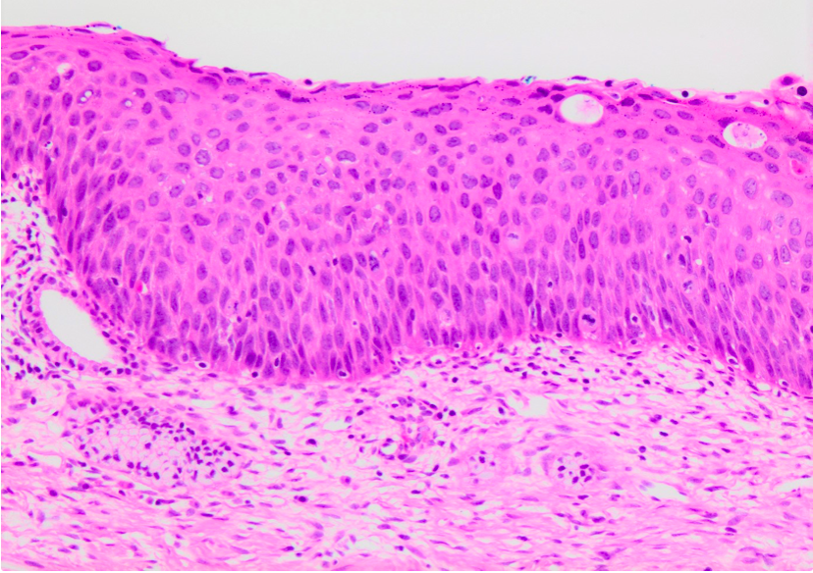
HSIL (CIN II)
Diffuse nuclear enlargement, hyperchomasia and membrane irregularities with persistent cytoplasmic maturation at the upper third of the epithelium.
Increased mitotic activity in the lower and middle thirds (200x).

Slide 36
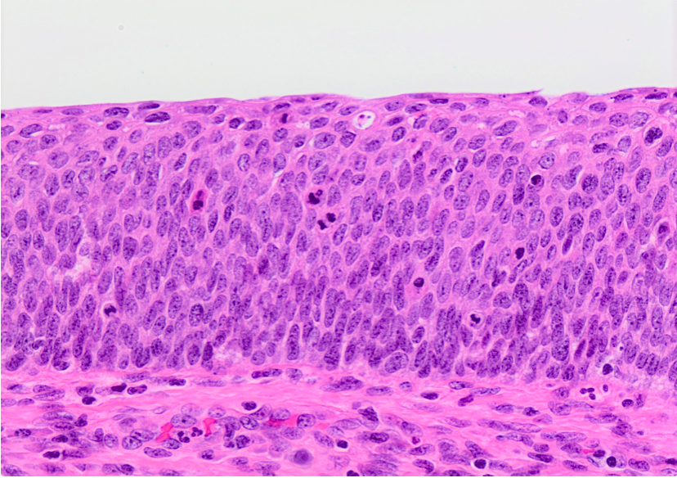
HSIL (CIN III)
full thickness, no maturation difference across layers

Slide 37
Neoplasia [G. neos, new + G. plasis, a molding]
The pathologic process that results in the formation and growth of a neoplasm
“Abnormal growth that continues”

Slide 38
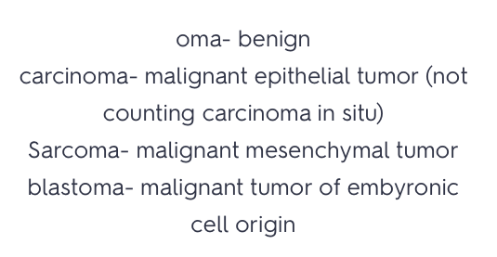
Neoplasms

Slide 39
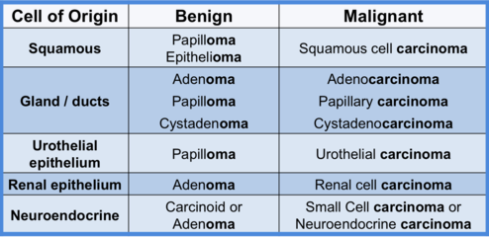
Histogenesis of epithelial tumours
Where did the tumour originate from?
85% of all neoplasms are of epithelial origin

Slide 40
Growth patterns of epithelial tumors
Polyps represent a growth pattern of neoplastic cells that protrudes ABOVE the epithelial surface. Think of mushrooms…

Slide 41
Growth patterns of epithelial tumors
Polyps represent a growth pattern of neoplastic cells that protrudes ABOVE the epithelial surface. Think of mushrooms…
Papillary growth has a finger or frond like arrangement of cells around a central core of fibrous and vascular tissue.

Slide 42
Two types of polyp growth
sessile- broad base
predunculated- stalky base

Slide 43
Growth patterns of epithelial tumors
Polyps represent a growth pattern of neoplastic cells that protrudes ABOVE the epithelial surface. Think of mushrooms…
Papillary growth has a finger or frond like arrangement of cells around a central core of fibrous and vascular tissue
Cyst: fuild filled sac, like a water ballon that is lined by epithelial cells (gland/ducts give rise to cysts)

Slide 44
Question
Benign tumors arising from glandular epithelium are called what?
And what are their malignant tumors called?

Slide 45
Question
Benign tumors arising from glandular epithelium are called what?
- Adenomas
And what are their malignant tumors called?
- Adenocarcinomas

Slide 46
Tubular adenomas have at least 75% tubular component. By definition, all tubular adenomas show epithelial dysplasia. There is hypercellularity and glandular crowding.

Slide 47
The nuclei are enlarged and hyperchromatic with prominent nucleoli. There is increased mitotic activity. Atypical mitoses may be seen

Slide 48
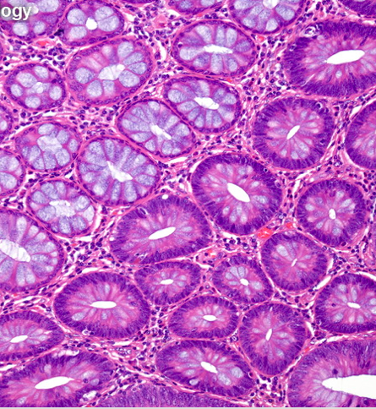
Low-grade dysplasia: The nuclei are slightly enlarged, elongated, and hyperchromatic but are still uniform and maintain their polarity. There is nuclear overcrowding and pseudostratification. Nucleoli are not prominent. Mature goblet cells are reduced in number

Slide 50
Features of high-grade dysplasia are: nuclear enlargement, pleomorphism, nuclear hyperchromasia, loss of polarity, enlarged nucleoli, and further loss of goblet cell mucin. There is considerable hypercellularity, glandular crowding and increased mitotic activity. Atypical mitoses may be present.

Slide 51
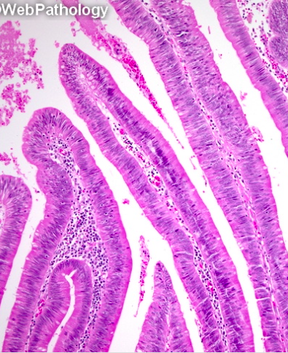
Finger-like processes covering most of the surface of this villous adenoma

Slide 52
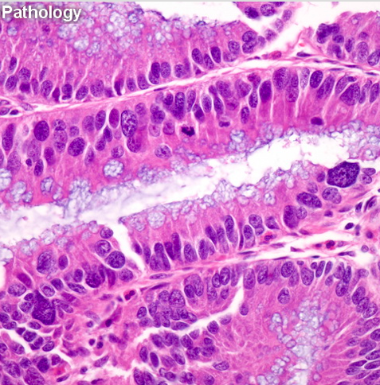
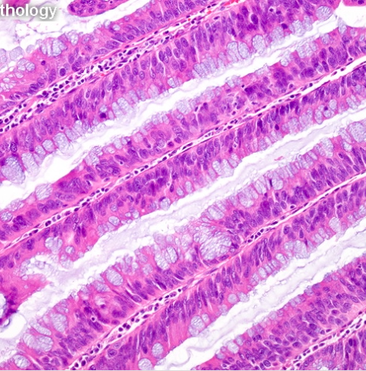

Slide 53
Villous adenoma with high-grade dysplasia
Villous adenoma with low-grade dysplasia

Slide 54
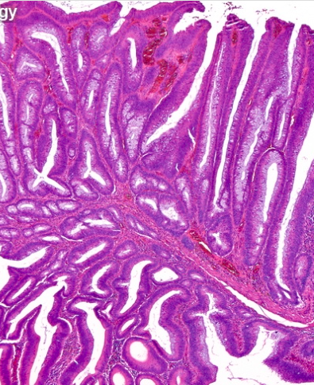
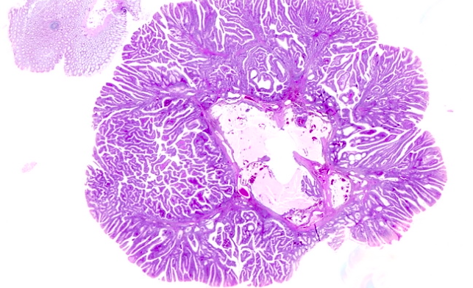
Tubulovillous adenoma showing an admixture of tubular and villous components

Slide 56
Patterns of adenocarcinomas
Six basic patterns: -glandular-acinar (donuts/crushed donuts) -nests -sheets of cells -trabecular -papillary -signet ring

Slide 57
Keratinized vs. non keratinized stratified squamous epithelium
Where are they located?

Slide 58
Keratinized vs. non keratinized stratified squamous epithelium
Where are they located?
-keratinized: found in the skin -non- found in the oral cavity, including the tongue, lips, cornea, true vocal cords, esophagus; vagina; ectocervix, and anus

Slide 59
Where does squamous metaplasia occur?
Squamous cell tumors arise from where?
Are squamous papilloma benign or malignant?

Slide 60
Where does squamous metaplasia occur?
-Upper and lower respiratory tract, endocervix, and urinary bladder
Squamous cell tumors arise from where?
- Squamous cell tumors arise from squamous epithelium or squamous metaplastic epithelium
Are squamous papilloma benign or malignant?
-Squamous papilloma: BENIGN, exophytic (grows outward toward the surface) papillary growths from stratified squamous epithelium

Slide 61
Squamous papilloma of the oral cavity is usually pedunculated.

Slide 62
It is composed of numerous finger-like papillary projections lined by keratinized stratified squamous epithelium with fibrovascular connective tissue cores.

Slide 63
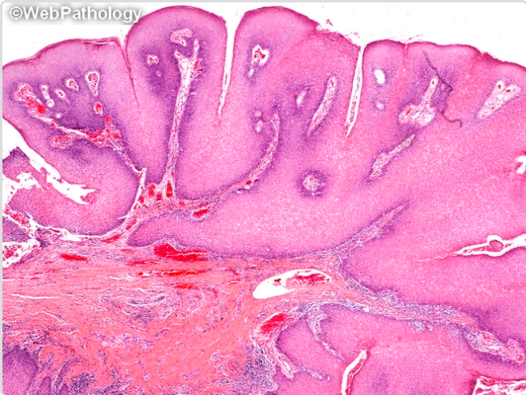
The squamous epithelium shows normal maturation pattern to the surface. Some cases show basilar hyperplasia and increased mitotic activity.

Slide 64
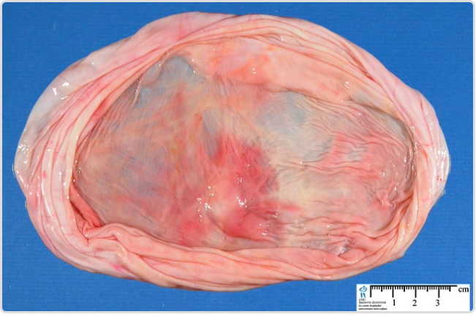
Benign serous ovarian tumor (serous cystadenoma) comprises approximately 60% of all serous ovarian tumors. It is most frequently encountered in the 4th and 5th decades of life.

Slide 65
Serous cystadenomas are lined by ciliated pseudostratified cuboidal or columnar epithelium (resembling that lining the fallopian tube)

Slide 66
The cilia can be clearly seen in this high magnification view.

Slide 67
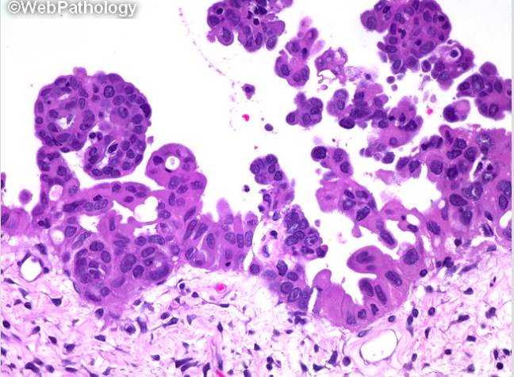
High power view of a papillary serous carcinoma of the ovary showing irregularly branching papillae lined by highly atypical nuclei.

Slide 68
A focus of microinvasion in a high-grade serous carcinoma of the ovary.

Slide 69
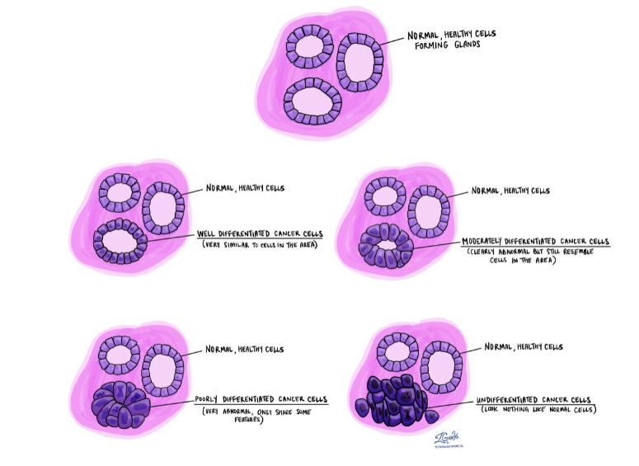
Differentiation
Well differentiated – very similar to the surrounding normal cells
Moderately differentiated –clearly abnormal looking but still share some features with normal cells
Poorly differentiated –look very abnormal.
Undifferentiated – completely different from normal cells anywhere in the body.

Slide 70
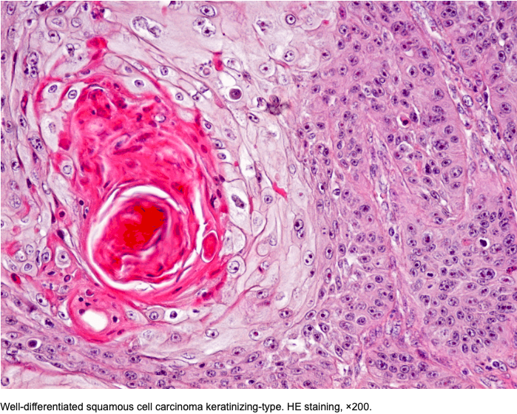

Slide 73
Differentiation and grade
For some types of cancer, the differentiation of the tumour is used to determine the grade. For example, each level of differentiation may equal a grade as shown below:
Well differentiated = Grade 1.
Moderately differentiated = Grade 2.
Poorly differentiated = Grade 3.
Undifferentiated = Grade 4.
Grade is another word used to describe the difference between cancer cells and the normal, healthy cells they have replaced
Grade is usually described using numbers to represent different levels

Slide 74
Low and high grade cancer cells
Or some levels of differentiation may be grouped together to make a grade
Well differentiated and moderately differentiated = Low grade
Poorly differentiated and undifferentiated = High grade

Slide 76
